Slide 1
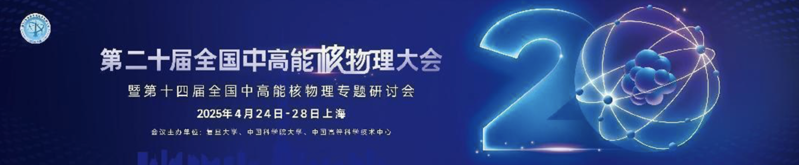






Nuclear Clustering and Non-Equilibrium Dynamics in Small- System Collisions
Xinli Zhao (赵新丽)
In Collaboration with:
Guoliang Ma (马国亮), Chao Zhang (张潮), You Zhou, Ziwei Lin

Slide 2
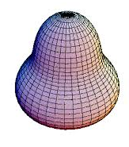
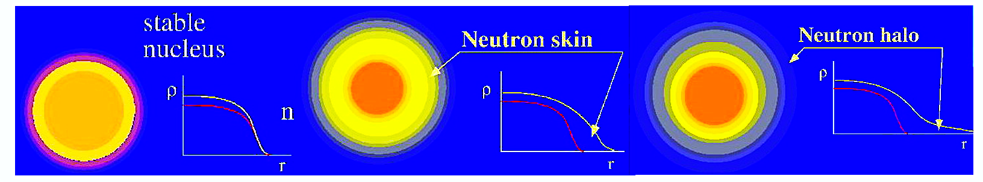
Deformed and Odd-shaped Atomic Nuclei
Deformations
Odd-shaped

Slide 3
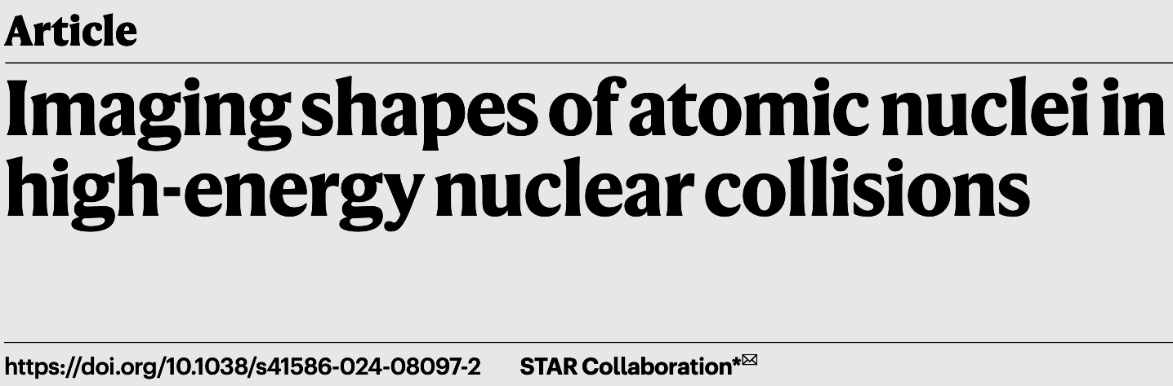
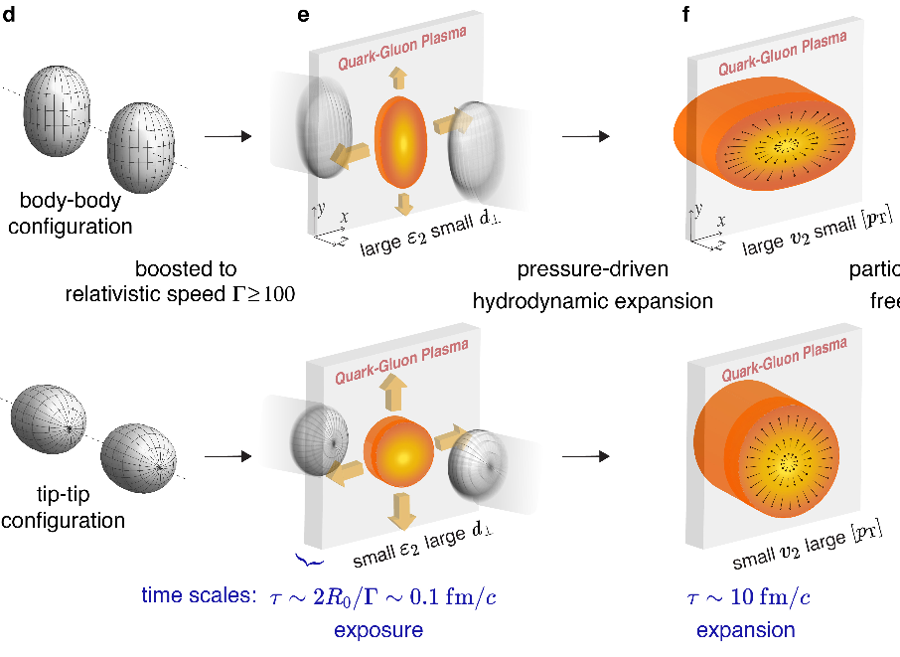
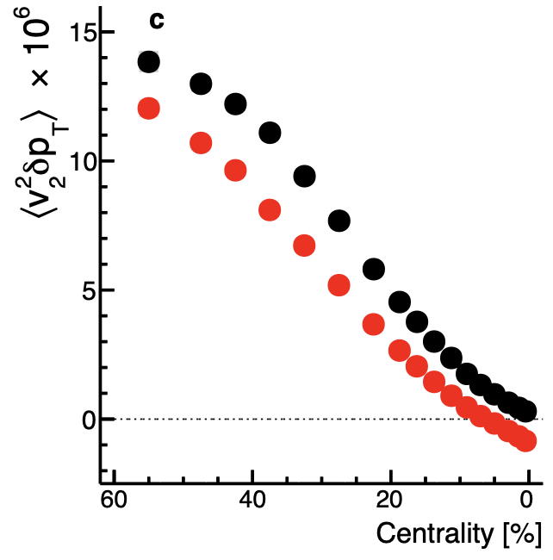
Deformed and Odd-shaped Atomic Nuclei
Deformations
Odd-shaped
张春健，25日14:30
C.J. Zhang, J.Y. Jia, et al., Nature 635, 67 (2024)

Slide 4
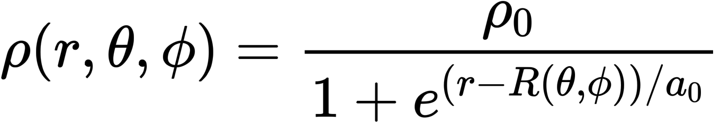
Deformed and Odd-shaped Atomic Nuclei
Deformations
Odd-shaped
张春健，25日14:30
Quadrupole
Octupole
Hexadecapole
C.J. Zhang, J.Y. Jia, et al., Nature 635, 67 (2024)
The study of nuclear structure in high-energy heavy ion collisions uniquely reveals how nuclear properties affect collision dynamics and QGP formation.

Slide 5
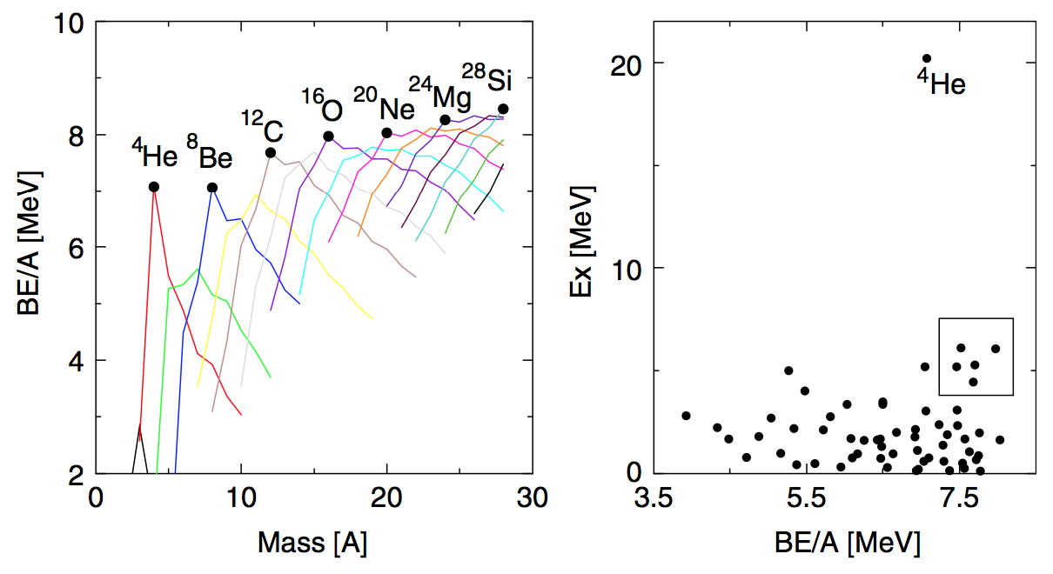
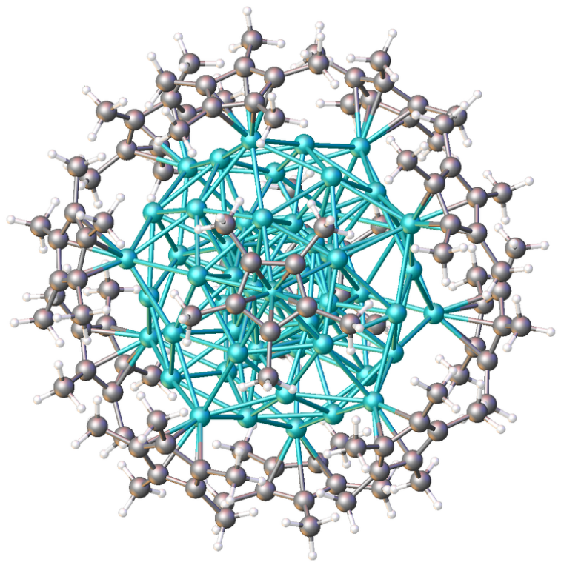
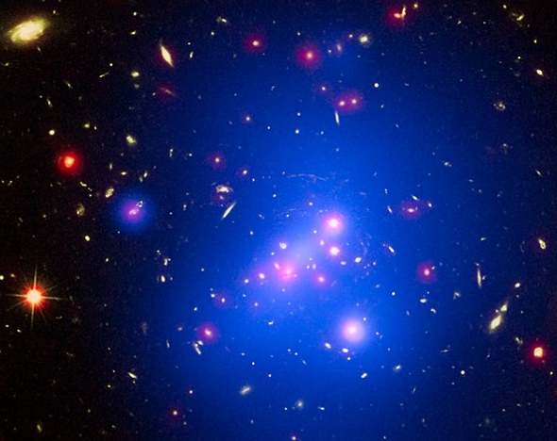
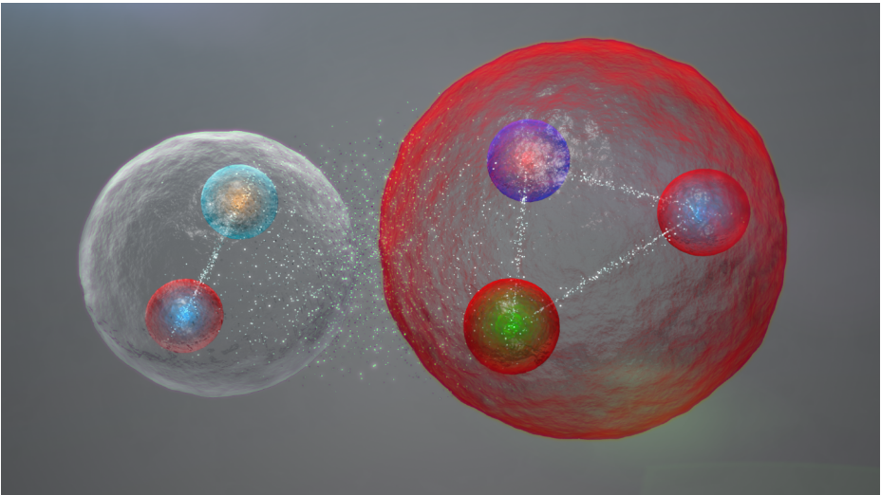
Cluster Structures
5-quark cluster Multi-atom cluster Galaxy cluster

Slide 6
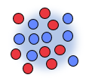
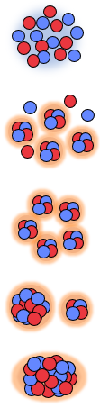
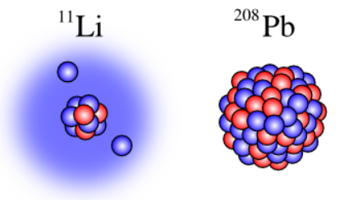



Cluster Structures
5-quark cluster Multi-atom cluster Galaxy cluster
During the nuclear excitation, phase transitions occur then form nuclear clusters.
Nucleosynthesis
in astrophysics
12
fm
¹²C ($0_{2}^{+}$)
Nuclear excitation
$3α$Bose-Einstein condensate
Halo type for $11Li$
Clusters play an extremely important role at all levels of matter.
Understanding and describing cluster structure are an important scientific problem.

Slide 7
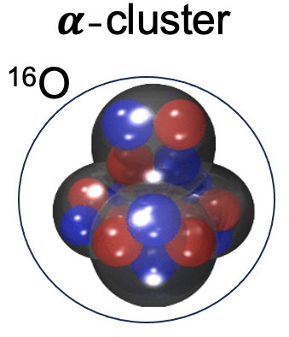
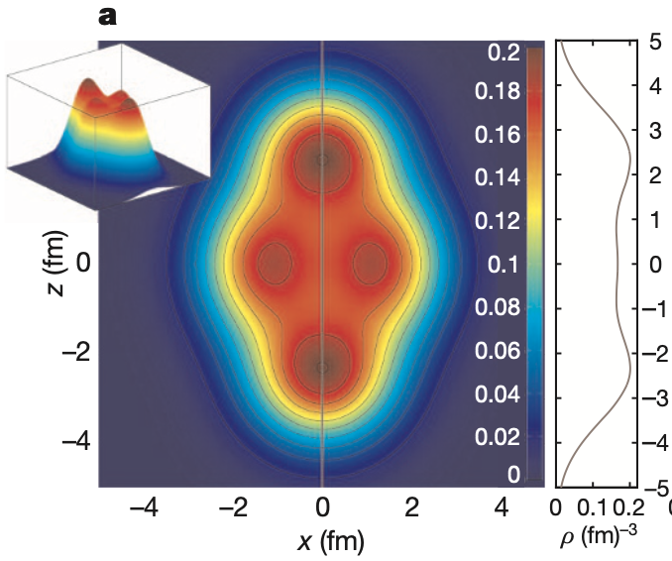
Cluster Structures
5-quark cluster Multi-atom cluster Galaxy cluster
During the nuclear excitation, phase transitions occur then form nuclear clusters.
Nucleosynthesis
in astrophysics
nucleonic clustering
12
fm
¹²C ($0_{2}^{+}$)
Nuclear excitation
$3α$Bose-Einstein condensate
Halo type for $11Li$
Clusters play an extremely important role at all levels of matter.
Understanding and describing cluster structure are an important scientific problem.
J.P. Ebran et al. Nature487, 341(2012)

Slide 8
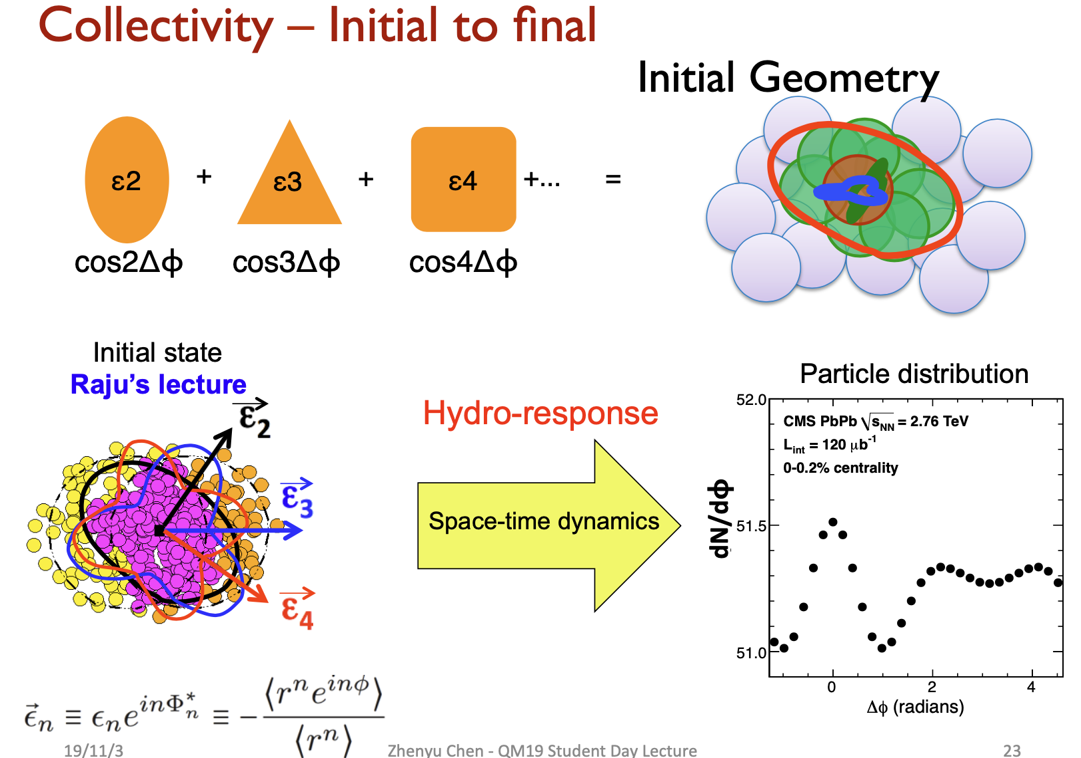
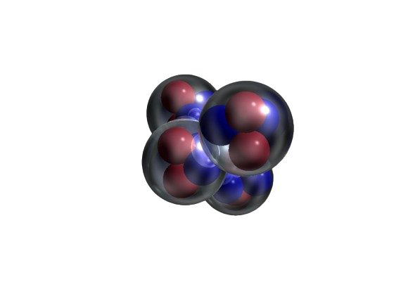
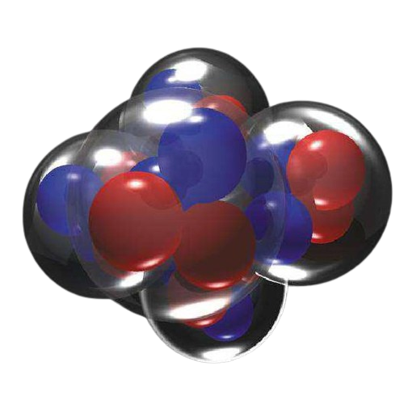
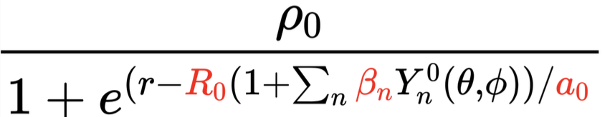
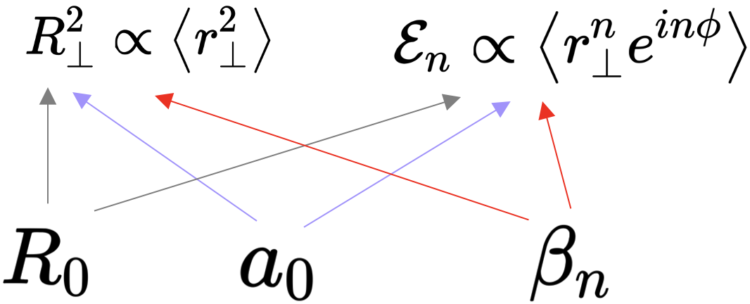
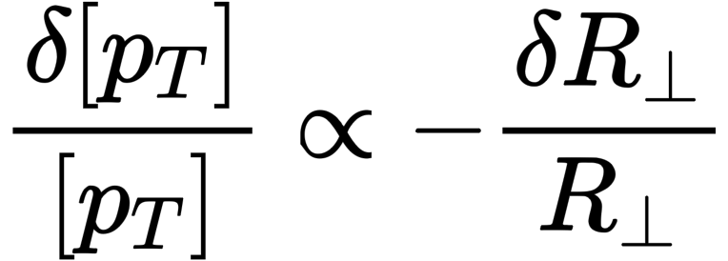
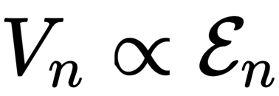
Collective Flow & Nuclear Structure
imaging
=
Initial size Initial shape
Approximate linear response:
From J.Y. Jia’s talk
Image the shape and radial profile of nuclei using the hydrodynamic response.

Slide 9
Collective Flow & Nuclear Structure
徐浩洁，26日16:10
徐 骏，26日17:40
imaging
=
Initial size Initial shape
Approximate linear response:
From J.Y. Jia’s talk
Image the shape and radial profile of nuclei using the hydrodynamic response.

Slide 10
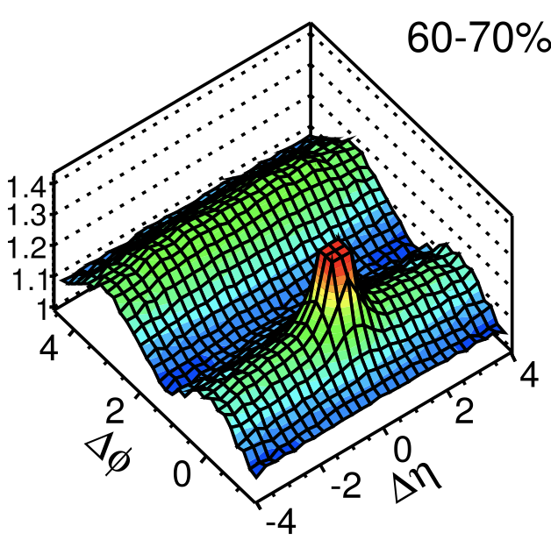
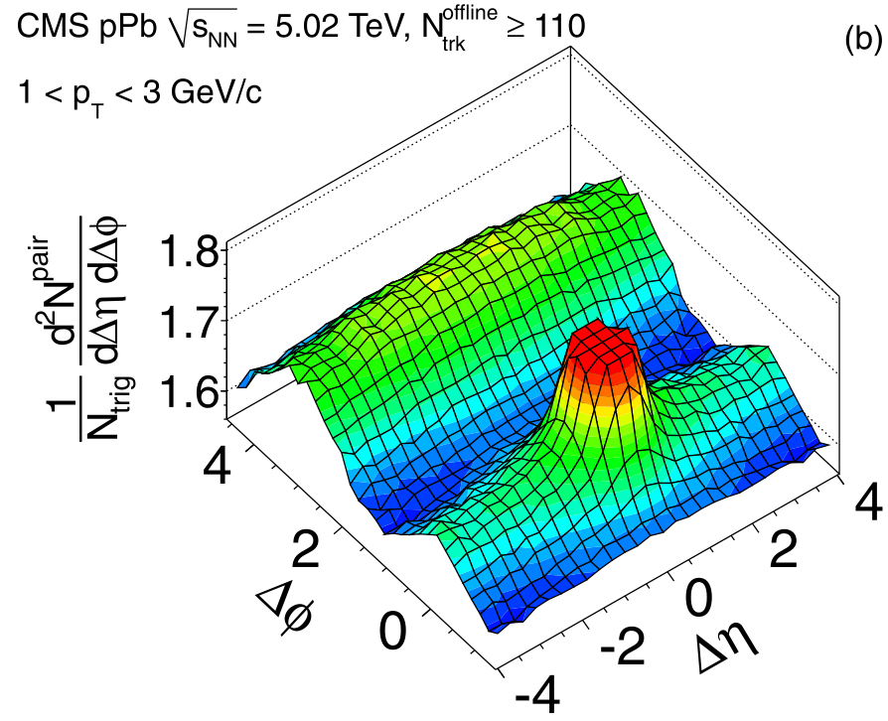
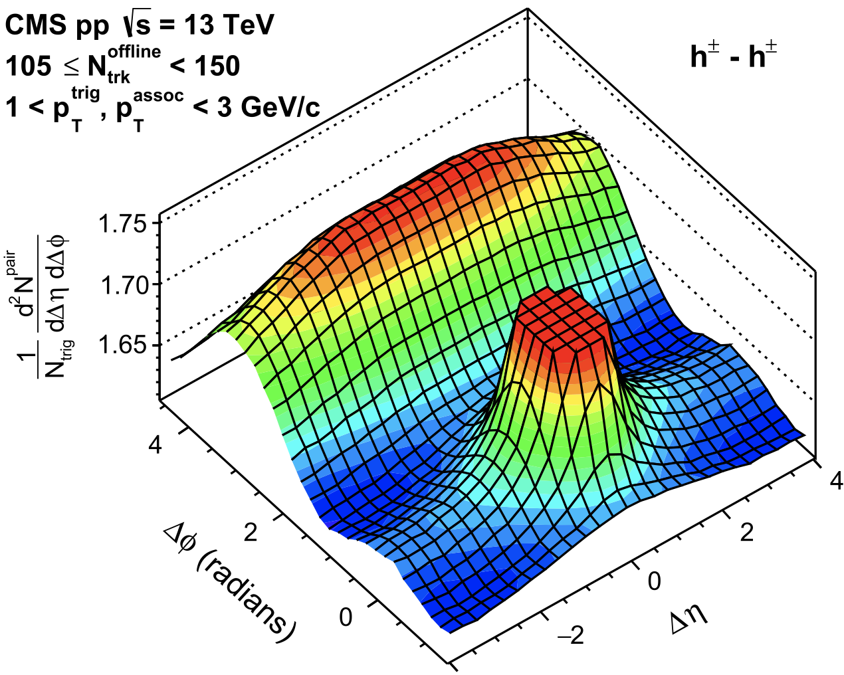



Motivation of Transport Models for Small Systems
$$Pb+Pb$$
$$p+Pb$$
$$p+p$$
Near side ridges are indication of collectivity in small systems.
Are they real signals from collectivity?
Is a parton matter formed in small systems?
Is the matter far off equilibrium or close to equilibrium?
CMS, 2.76 TeV
CMS, EPJC (2012) 72:2012
CMS, PLB 718 (2013) 795–814
CMS, PLB 765 (2017) 193–220
Large systems
Small systems

Slide 11
Motivation of Transport Models for Small Systems
$$Pb+Pb$$
$$p+Pb$$
$$p+p$$
Near side ridges are indication of collectivity in small systems.
Are they real signals from collectivity?
Is a parton matter formed in small systems?
Is the matter far off equilibrium or close to equilibrium?
CMS, 2.76 TeV
For large systems
Transport models are similar to hydrodynamics and work very well.
2) For finite/small systems
Non-equilibrium effects are expected to be important.
e.g. Parton escape mechanism: interaction-induced response from kinetic theory to the anisotropic spatial geometry.
CMS, EPJC (2012) 72:2012
CMS, PLB 718 (2013) 795–814
CMS, PLB 765 (2017) 193–220
Large systems
Small systems
Pb+Pb
U+U
Au+Au
Xe+Xe
O+O
Ne+Ne
Ca+Ca
…
p+A
d+A
He+A
…
To study the properties of parton matter in small systems, transport models are crucial as they address non-equilibrium dynamics.

Slide 12
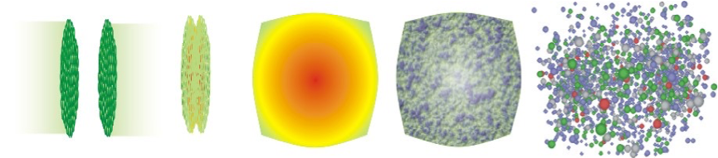
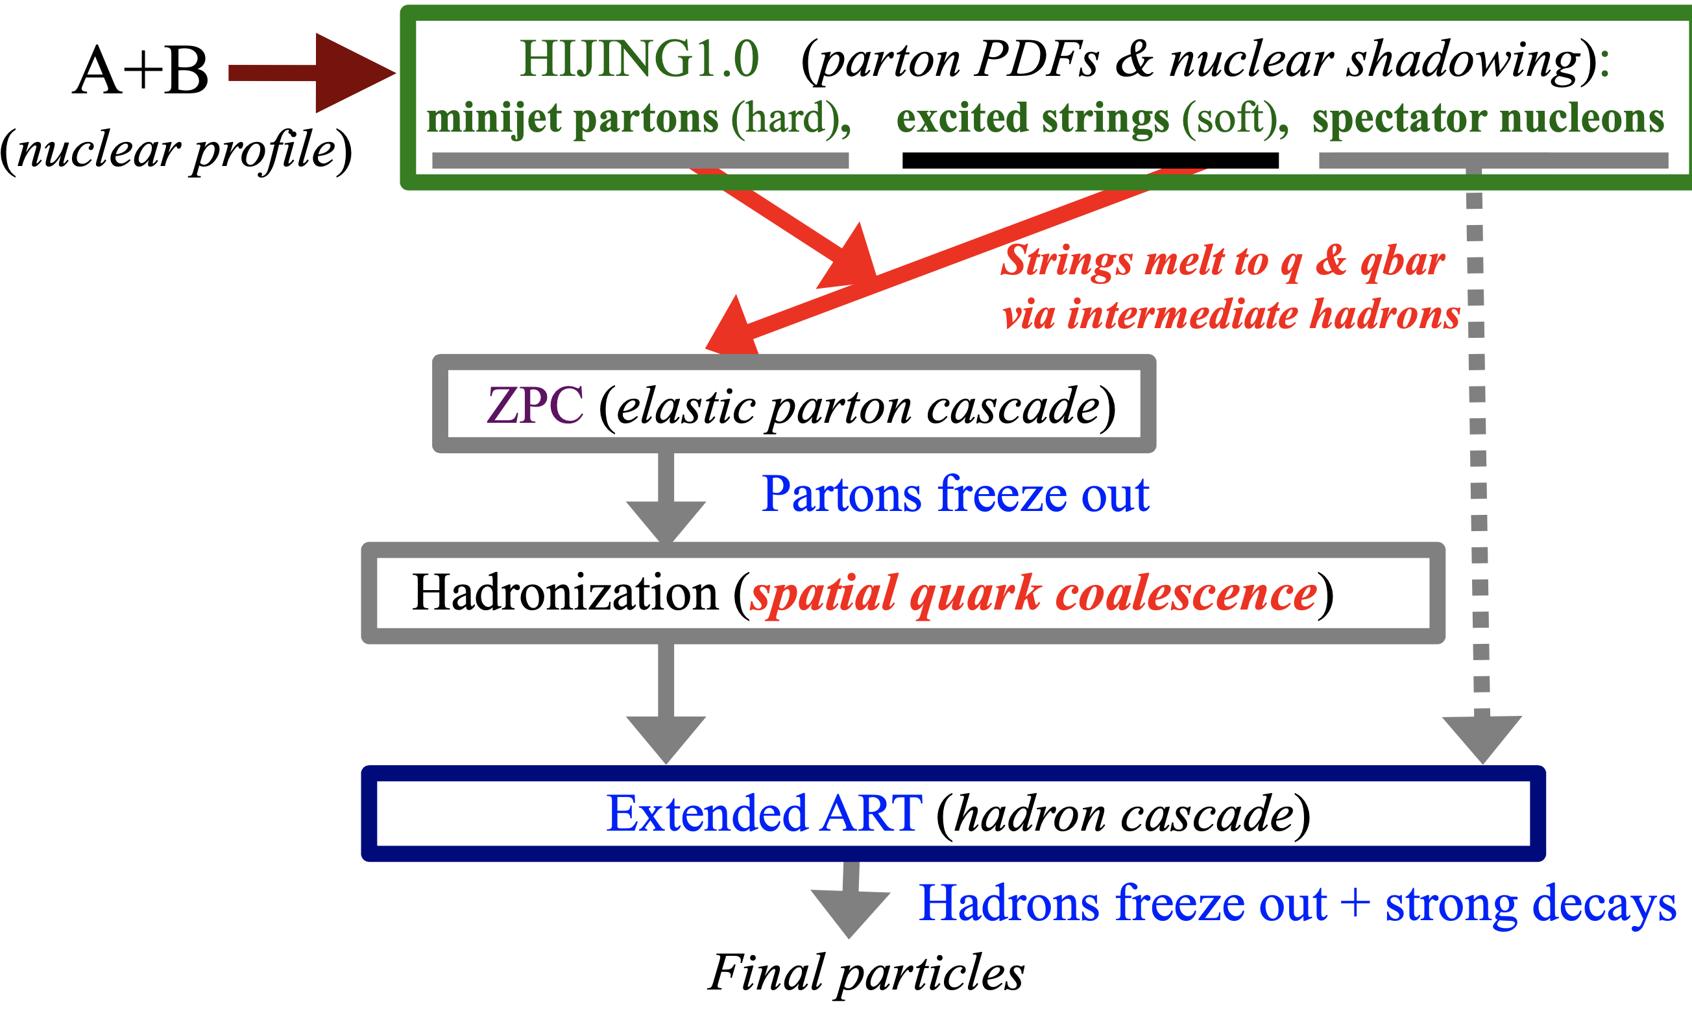
String Melting Version of A Multi-Phase Transport (AMPT) Model
A transport model for non-equilibrium.
AMPT is designed to be a self-contained kinetic description of nuclear collisions.
Evolves the system from initial state to final observables.
Automatically includes 3D productions of all flavours & conserved charges.
Automatically includes non-equilibrium initial state & dynamics/evolution.
Generate parton
space-time
Z.W. Lin, Phys. Rev. C 72 (2005) 064901.

Slide 13
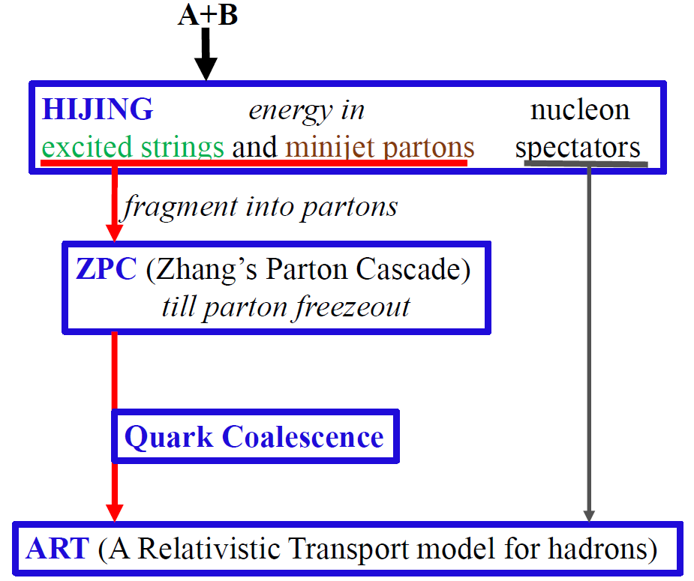


Nuclear Structure for ¹⁶O in AMPT
1) New quark coalescence model
2) Improved heavy quark productions
3) Modern PDFs, nuclear shadowing
and Local nuclear scaling
parton cross section $σ$
Final particle spectra

Slide 14
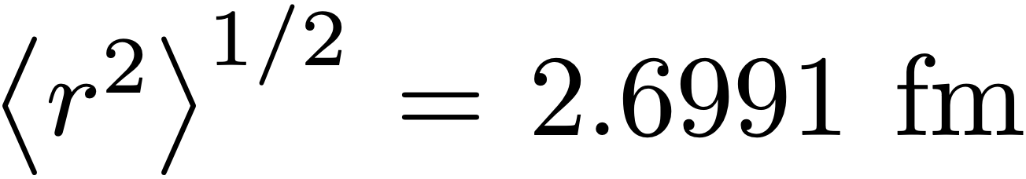
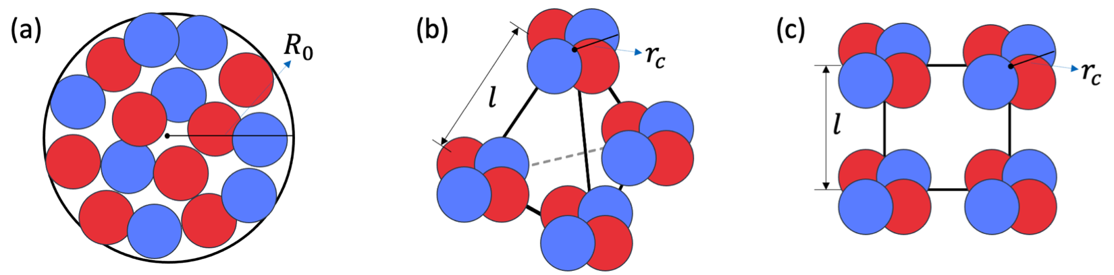
Nuclear Structure for ¹⁶O in AMPT
Constraint:
1) New quark coalescence model
2) Improved heavy quark productions
3) Modern PDFs, nuclear shadowing
and Local nuclear scaling
1. Woods-Saxon
2. Tetrahedron
3. Square
4. ab initio method (NLEFT)
N. Summerfield, B.-N. Lu, C. Plumberg, D. Lee,
J. Noronha-Hostler, and A. Timmins, Phys. Rev. C
104, L041901 (2021), 2103.03345.
parton cross section $σ$
Final particle spectra

Slide 15
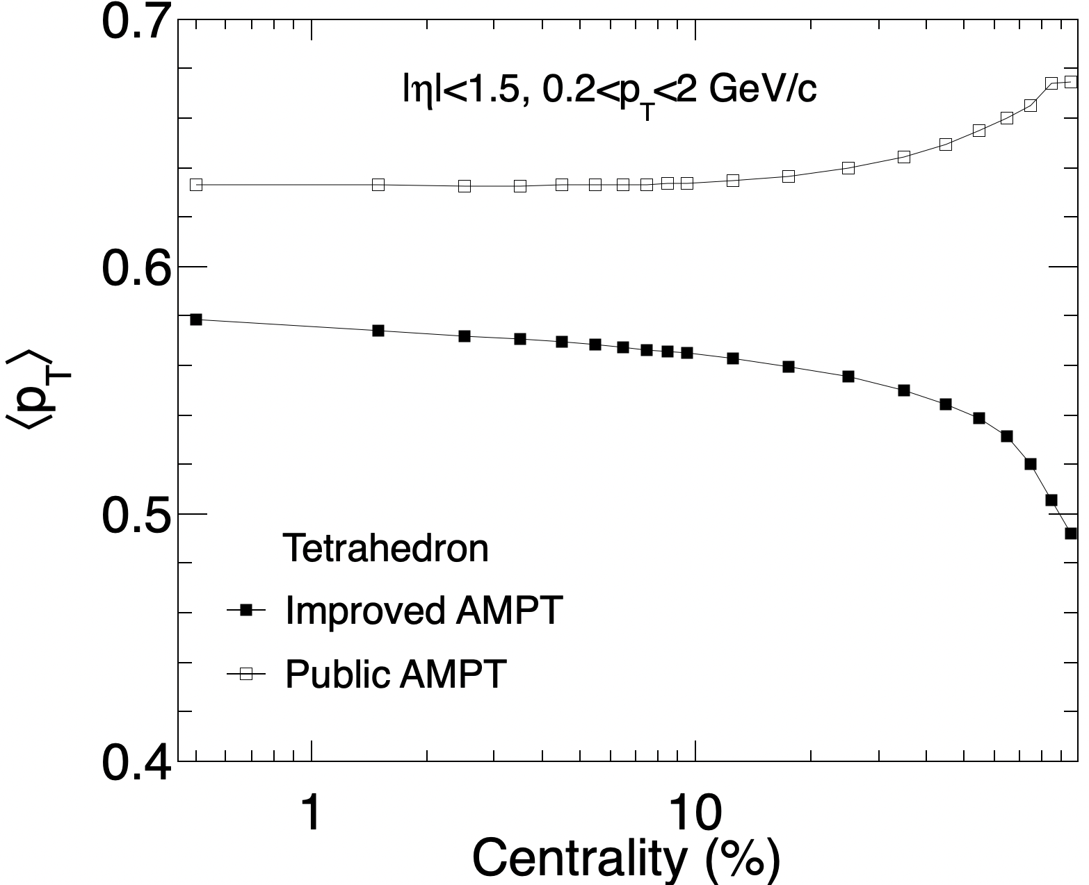
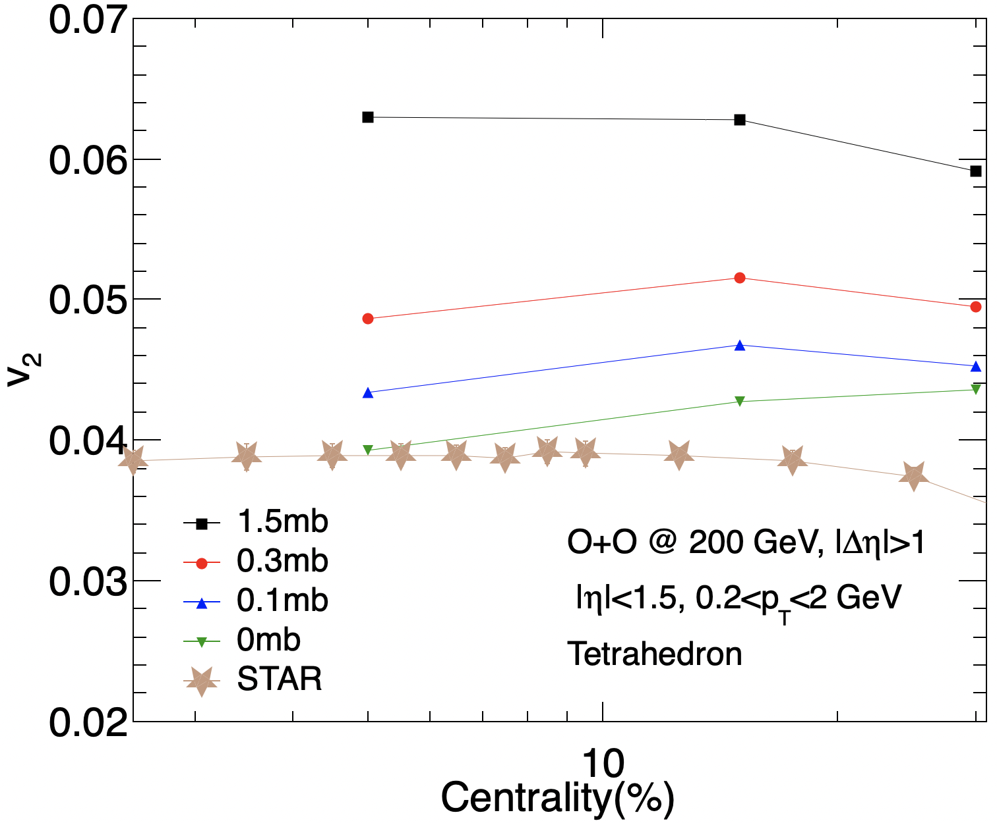
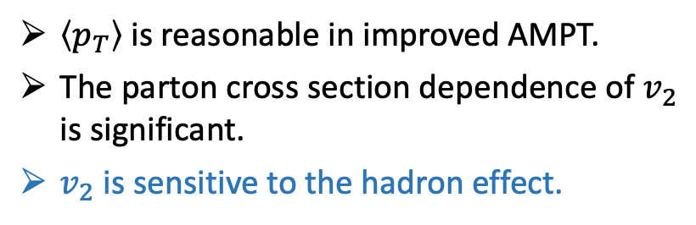
Hadron Effect on $v_{2}$ for ¹⁶O+ ¹⁶O in Improved AMPT
$\left\langle p_{T}\right\rangle$is reasonable in improved AMPT.
The parton cross section dependence of $v_{2}$ is significant.
$v_{2}$ is sensitive to the hadron effect.

Slide 16
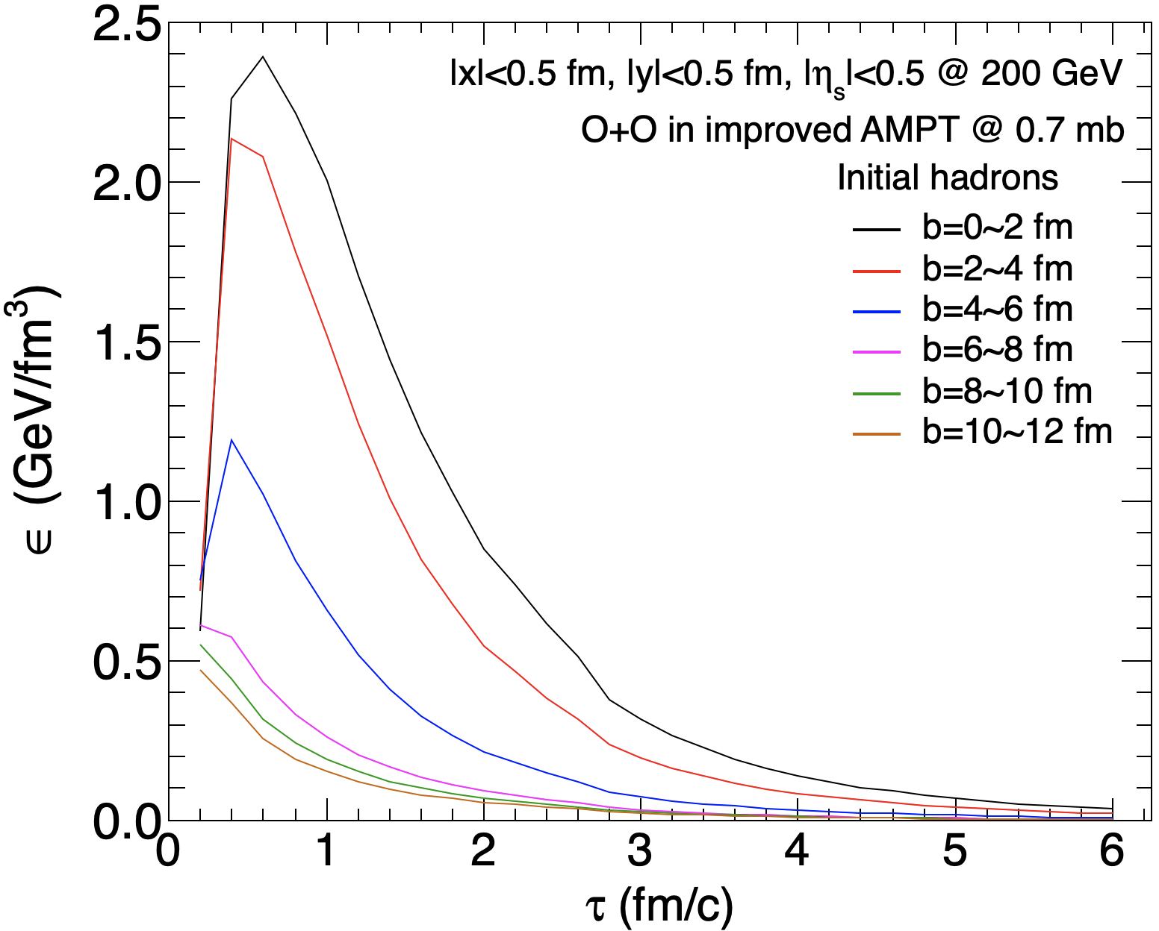
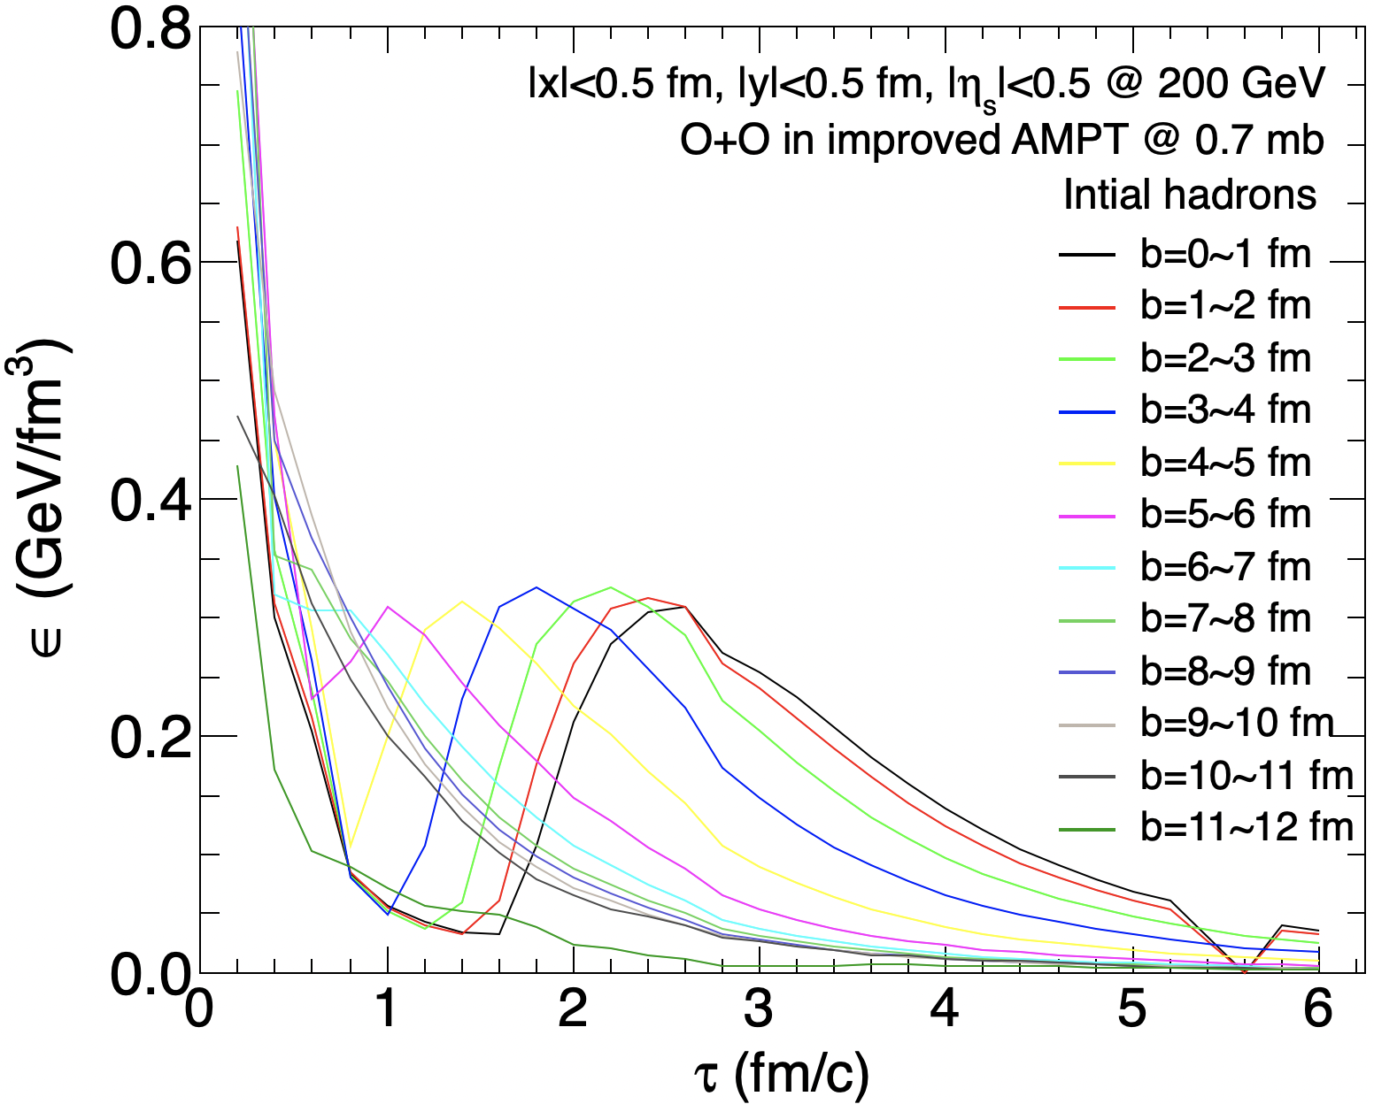
Hadron Effect on $v_{2}$ for ¹⁶O+ ¹⁶O in Improved AMPT
$\left\langle p_{T}\right\rangle$is reasonable in improved AMPT.
The parton cross section dependence of $v_{2}$ is significant.
$v_{2}$ is sensitive to the hadron effect.
Correct the energy density of initial hadrons.

Slide 17
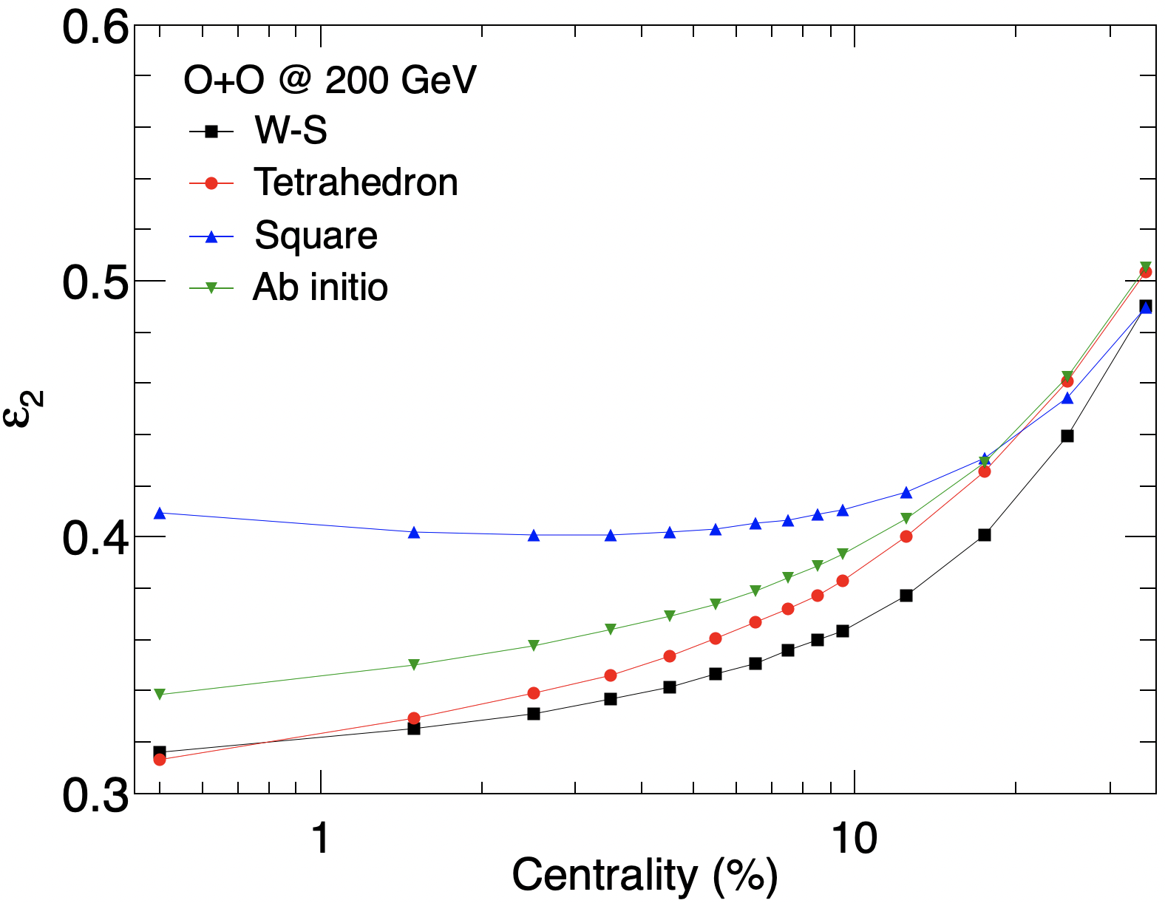
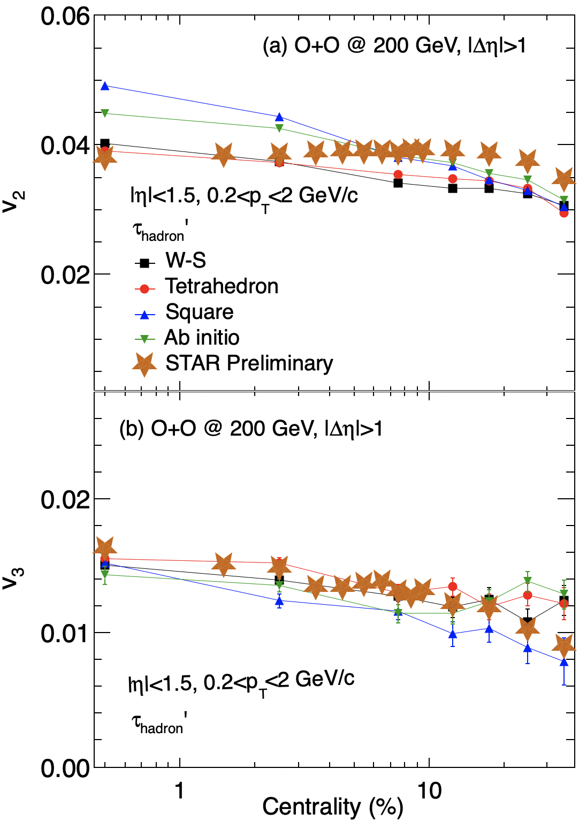
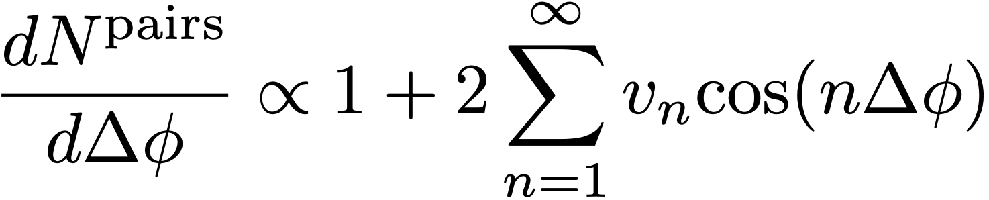
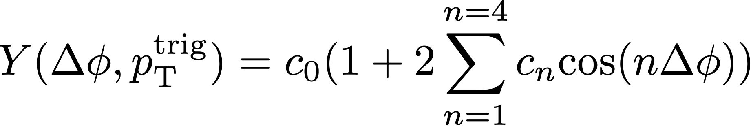
$v_{2}$ & $v_{3}$ Results for ¹⁶O+ ¹⁶O in Improved AMPT
The non-flow subtraction methods
Preliminary

Slide 18
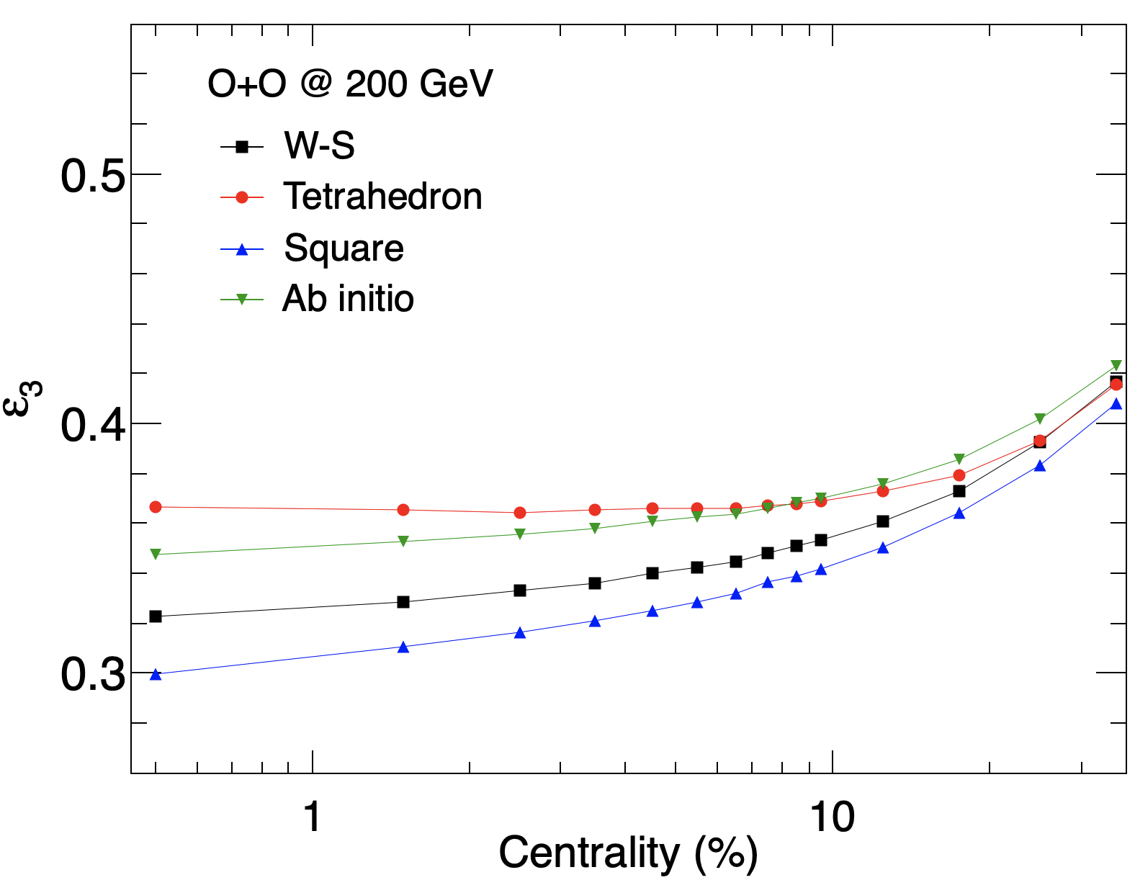
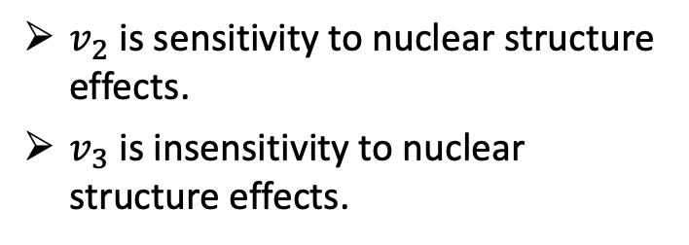
$v_{2}$ & $v_{3}$ Results for ¹⁶O+ ¹⁶O in Improved AMPT
The non-flow subtraction methods
Preliminary
$v_{2}$ is sensitivity to nuclear structure effects.
$v_{3}$ is insensitivity to nuclear structure effects.
Preliminary

Slide 19
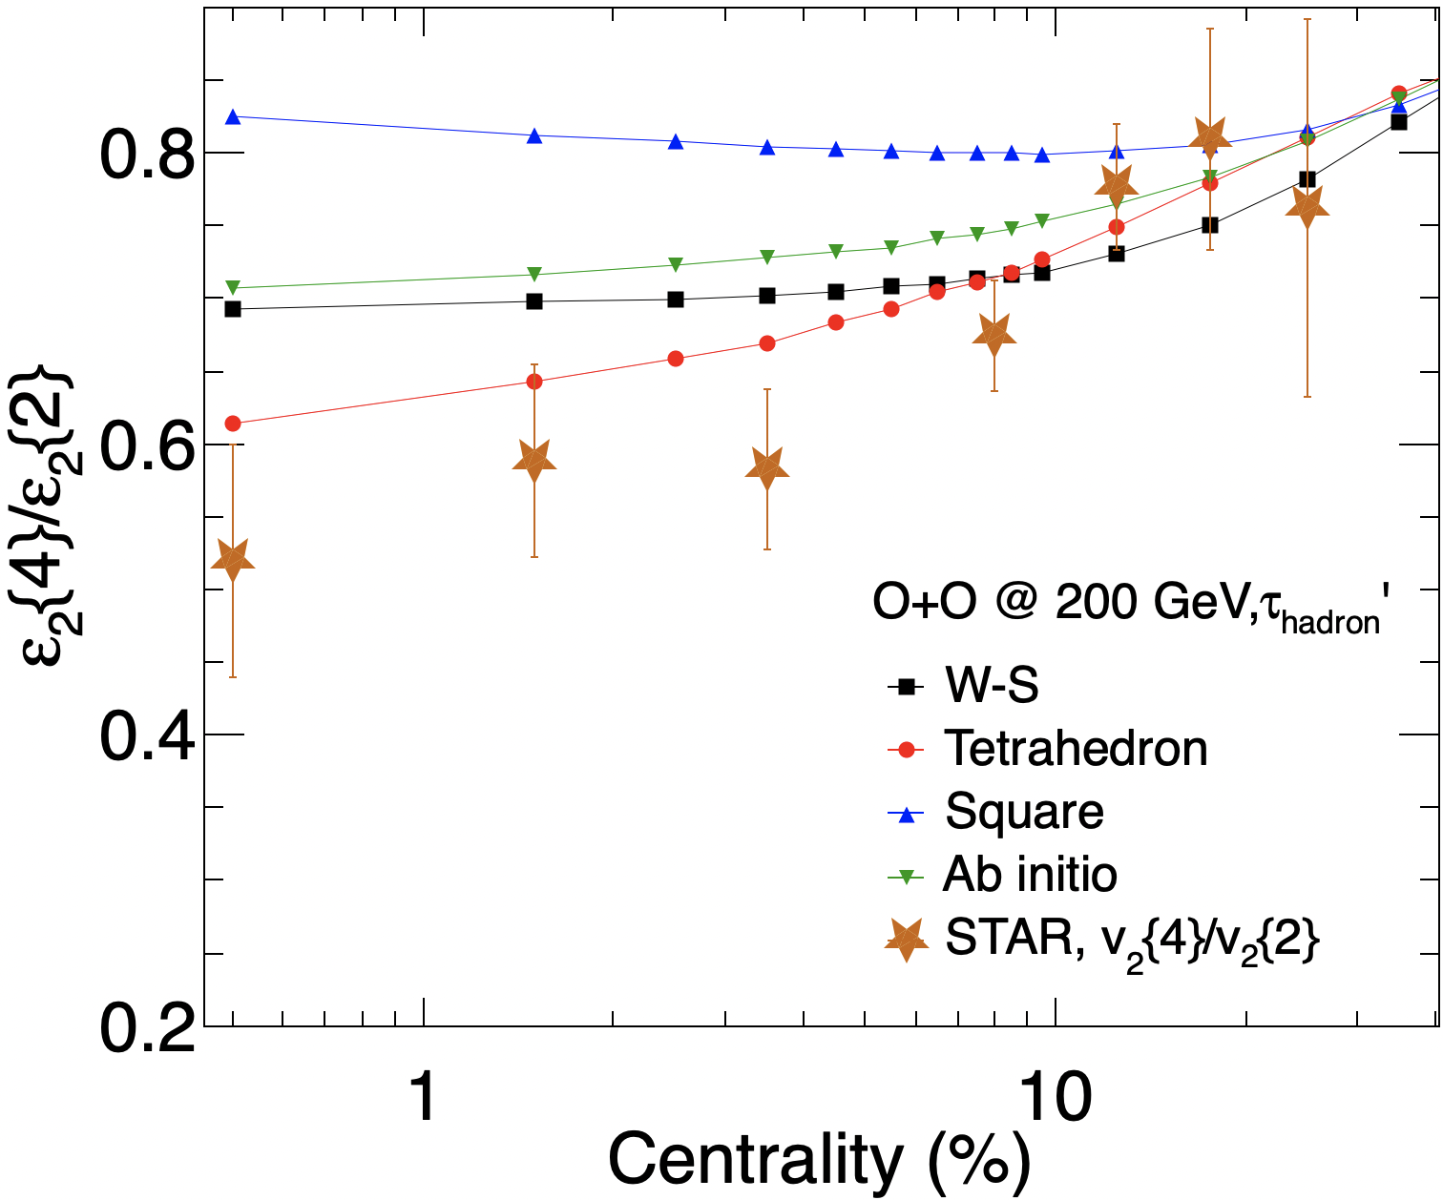
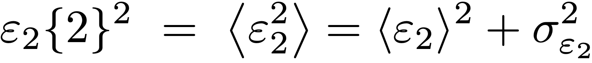
$ε_{2}\left\{4\right\}/ε_{2}\left\{2\right\}$ Results for ¹⁶O+ ¹⁶O
$ε_{2}\left\{4\right\}/ε_{2}\left\{2\right\}$ for tetrahedron is close to STAR data.

Slide 20
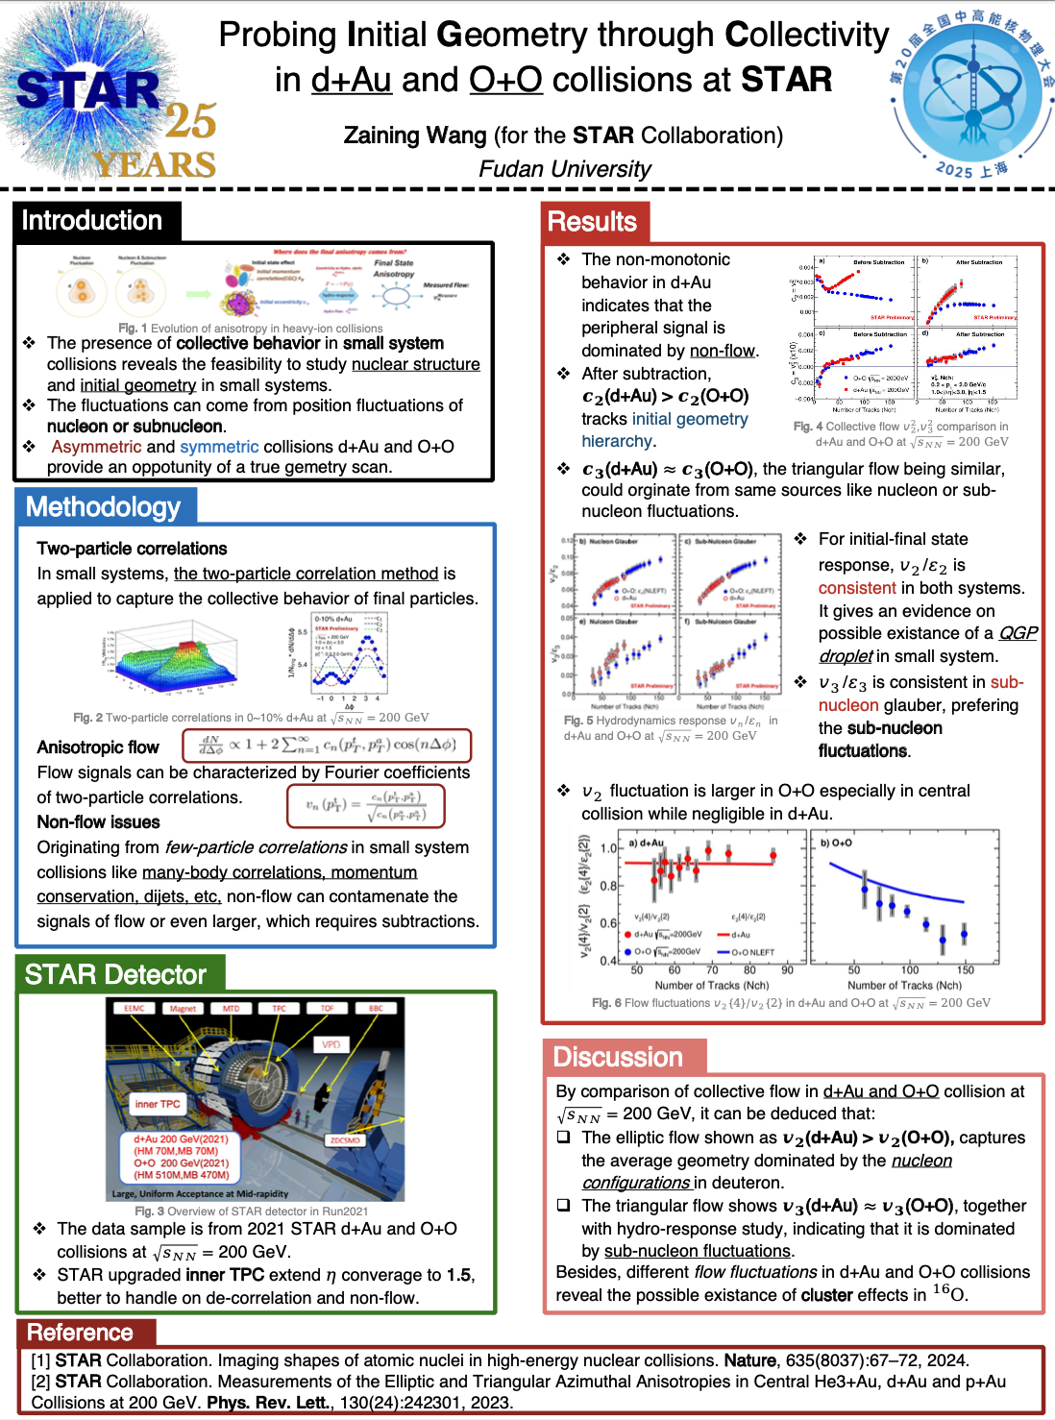
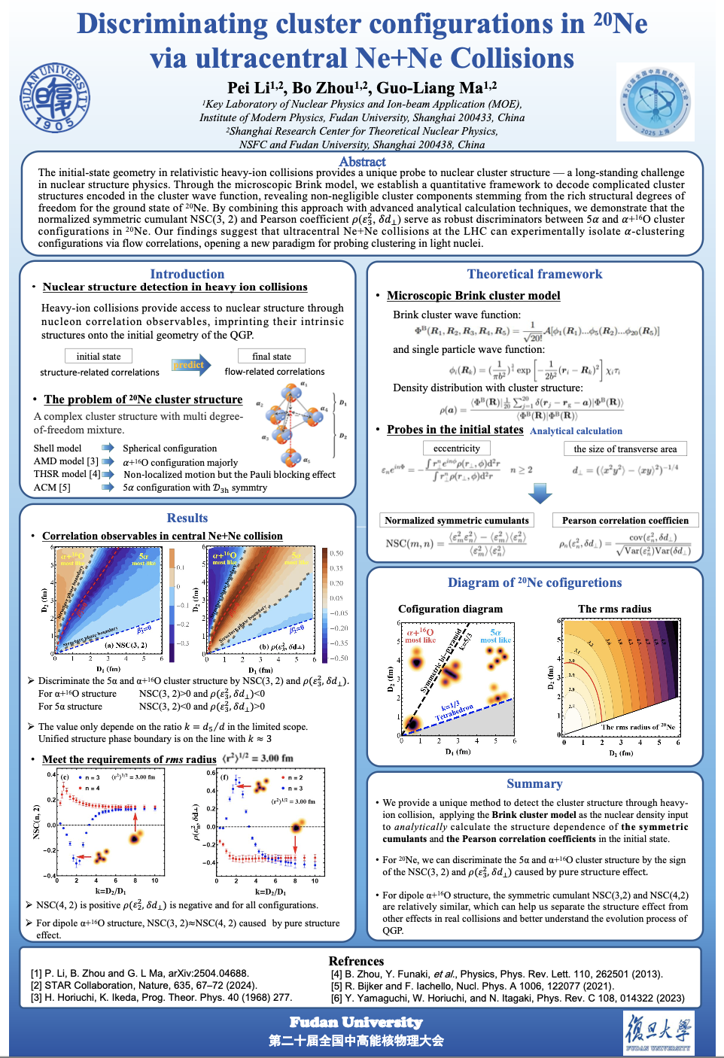
$ε_{2}\left\{4\right\}/ε_{2}\left\{2\right\}$ Results for ¹⁶O+ ¹⁶O
汪在宁，海报ID40-实验
O+O collisions @ STAR
李沛，海报ID117-soft probe
Ne+Ne collisions
$ε_{2}\left\{4\right\}/ε_{2}\left\{2\right\}$ for tetrahedron is close to STAR data.

Slide 21
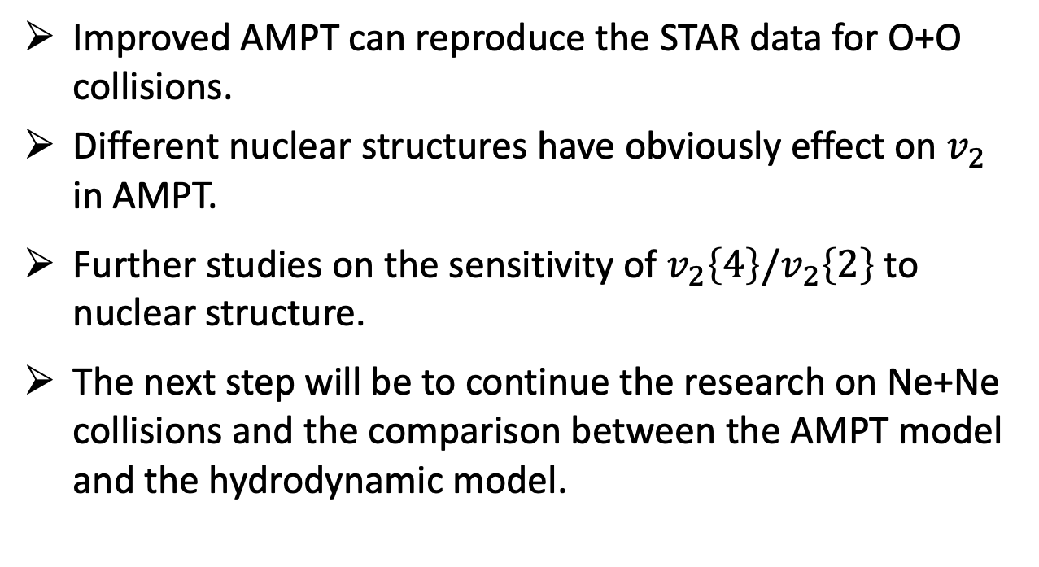
Summary & Outlook
Improved AMPT can reproduce the STAR data for O+O collisions.
Different nuclear structures have obviously effect on $v_{2}$ in AMPT.
Further studies on the sensitivity of $v_{2}\left\{4\right\}/v_{2}\left\{2\right\}$ to nuclear structure.
The next step will be to continue the research on Ne+Ne collisions and the comparison between the AMPT model and the hydrodynamic model.

Slide 22
Summary & Outlook
Improved AMPT can reproduce the STAR data for O+O collisions.
Different nuclear structures have obviously effect on $v_{2}$ in AMPT.
Further studies on the sensitivity of $v_{2}\left\{4\right\}/v_{2}\left\{2\right\}$ to nuclear structure.
The next step will be to continue the research on Ne+Ne collisions and the comparison between the AMPT model and the hydrodynamic model.
Thank you for your attention!

Slide 23

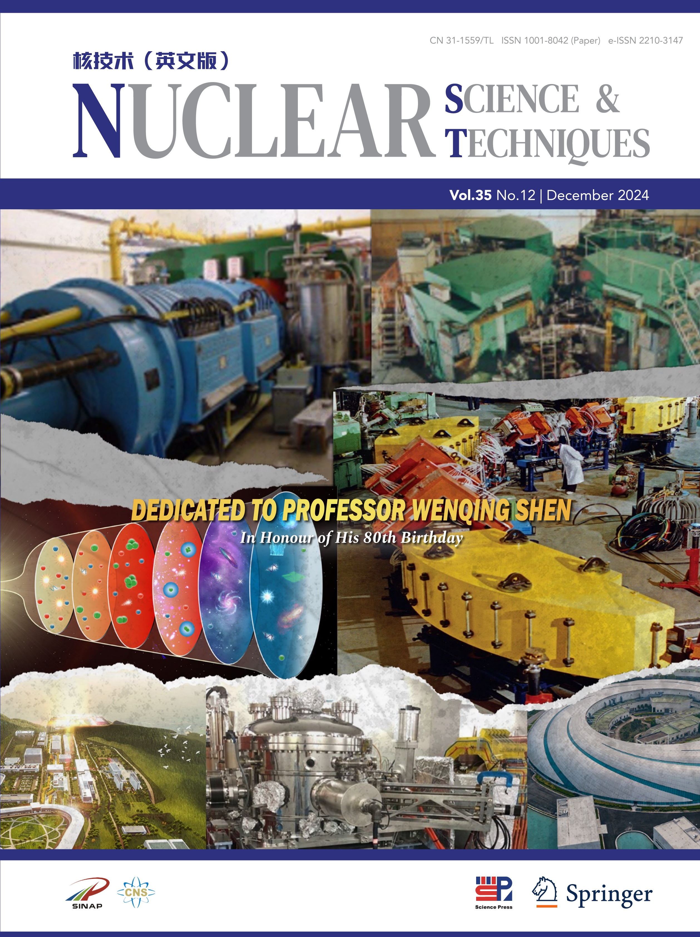

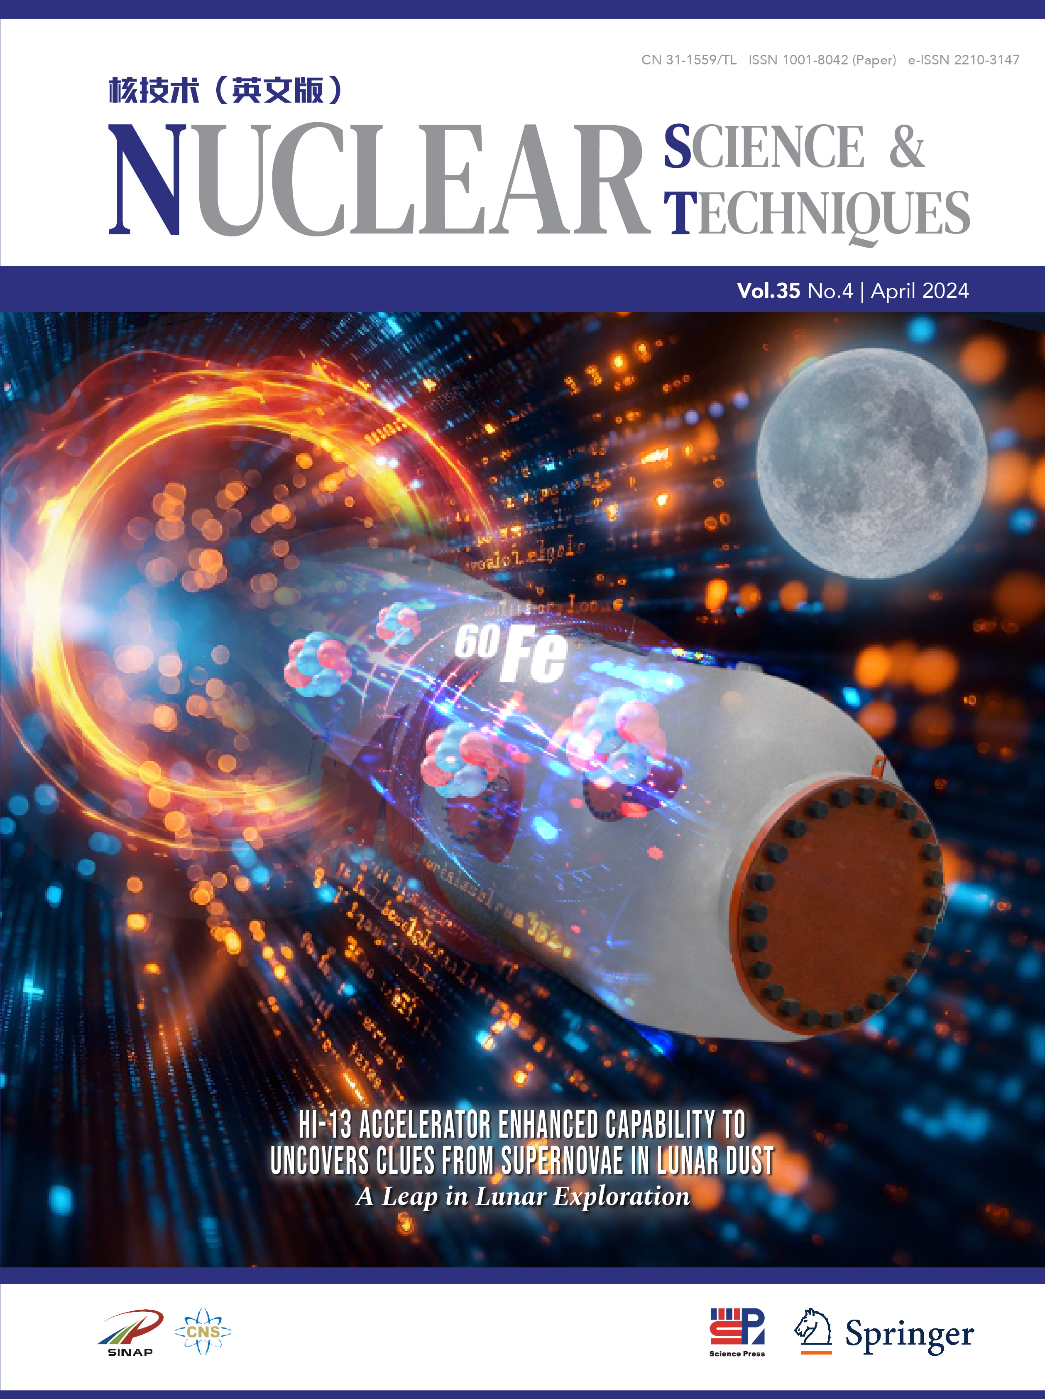


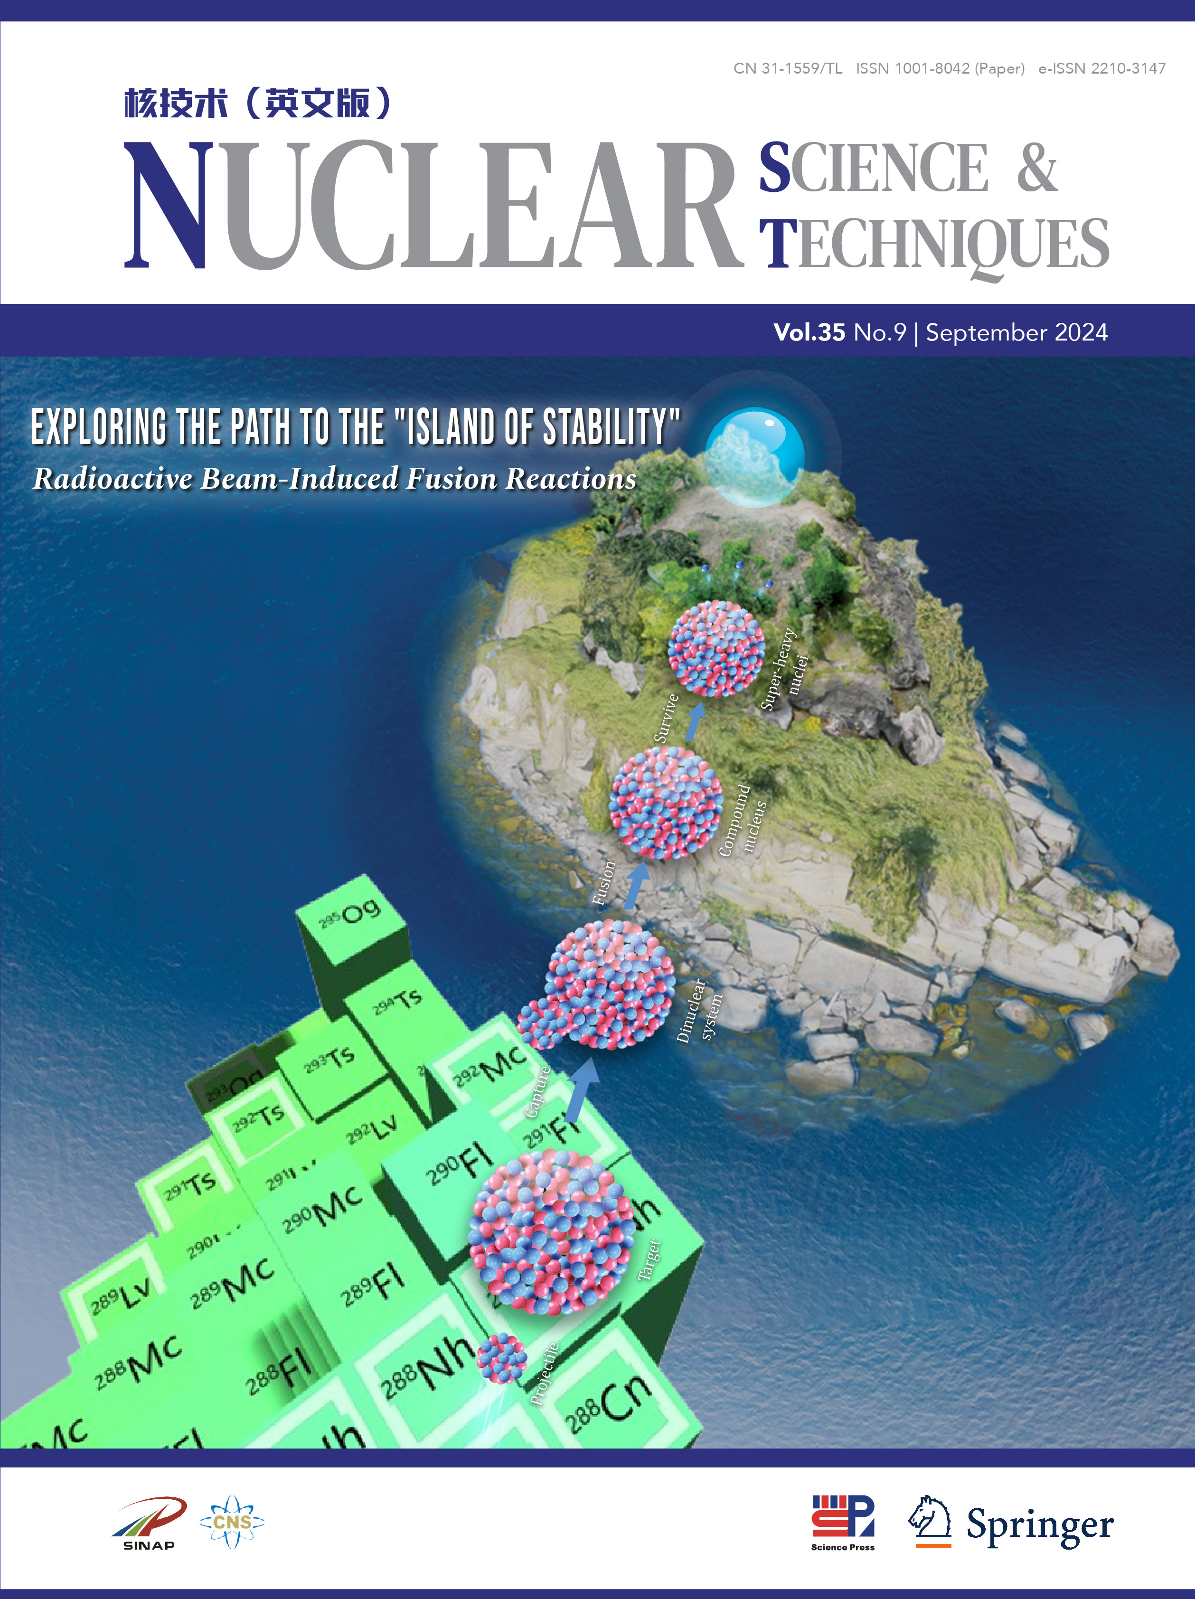







IF 2023=3.6, Q1 in Physics, Nuclear
中科院分区表 物理大类 1区 TOP期刊
Nuclear Science and Techniques (NST) reports scientific findings, technical advances and important results in the fields of nuclear science and techniques.
Focus:
• Nuclear physics and interdisciplinary research
• Nuclear energy science and engineering
• Synchrotron radiation applications, beamline technology
• Accelerator, ray technology and applications
• Nuclear electronics and instrumentation
• Nuclear chemistry, radiochemistry, nuclear medicine
Editor-in-Chief
Yu-Gang Ma
Enhanced
Reading
Experience
conference
poster
Online
Social
Communities
www.nst.sinap.ac.cn Email：nst@sinap.ac.cn Submit Today：https://mc03.manuscriptcentral.com/nst

