Slide 1

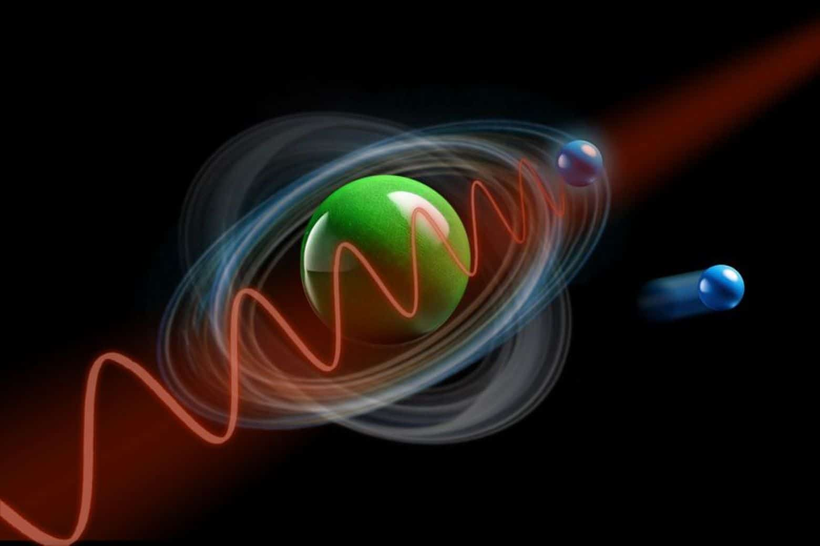
第二十届全国中高能核物理大会
2025年4月24-28日, 复旦大学, 上海
Entanglement in the nuclear
collective motion
Qibo Chen (陈启博)
East China Normal University
Notes:
Thanks for introduction.

Slide 2
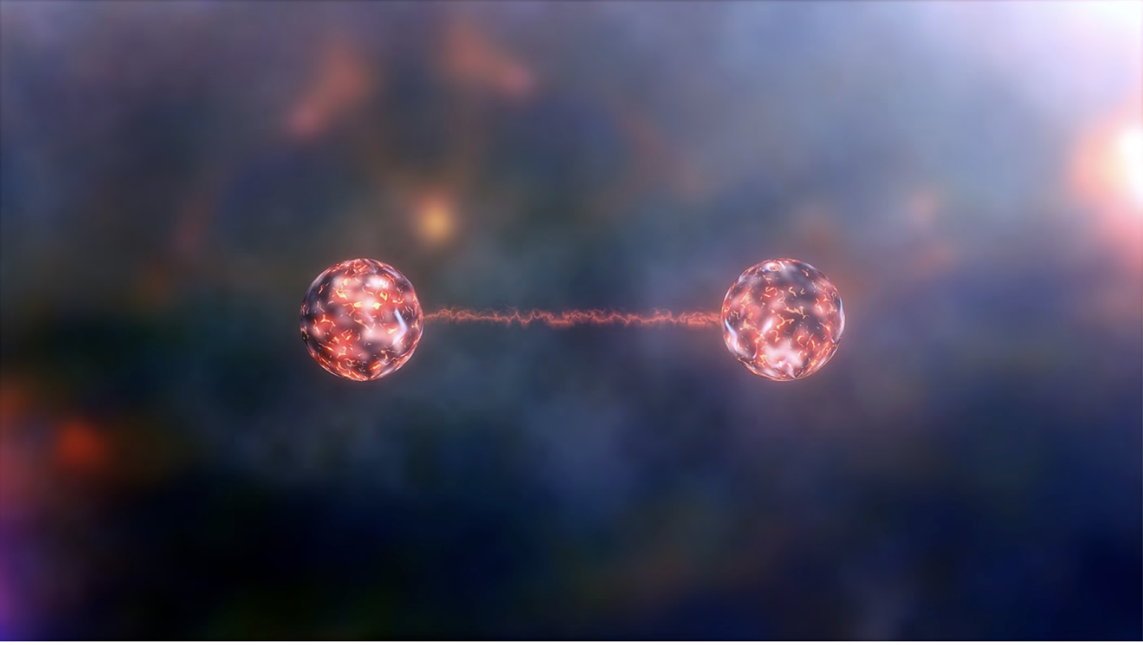

Entanglement
Entanglement is at the heart of quantum physics and future quantum technologies.
When two particles become entangled, they remain connected even when separated by vast distances.
Entanglement arises from the connection between particles.

Slide 3
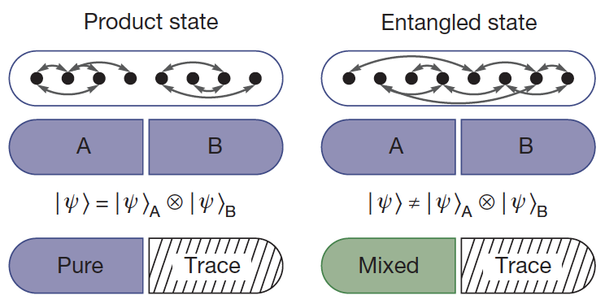
Entanglement
Figure from: Nature 528, 77 (2015)
ρ²=ρ, 1 eigenvalue e_{v}=1 and the rest e_{v}=0: system is pure.
ρ²≠ρ, more non-zero e_{v}: two subsystems are entangled.

Slide 4

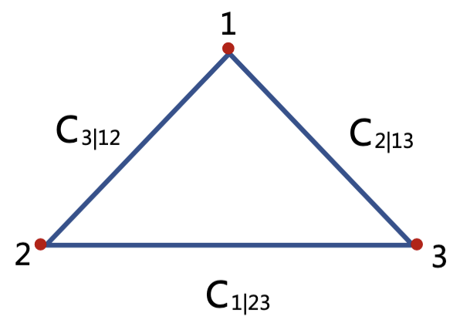
How to quantify the entanglement?
Entropy: quantitative measure of the degree of quantum entanglement (disorder) between two subsystems
basis independent
p_{m}: eigenvalues
von Neumann entropy
S=0, pure state; S>0, entangled; S_{max}=ln d (d: dimension)
Concurrence triangle: measure of the degree of mixing
C=0, separatable

Slide 5
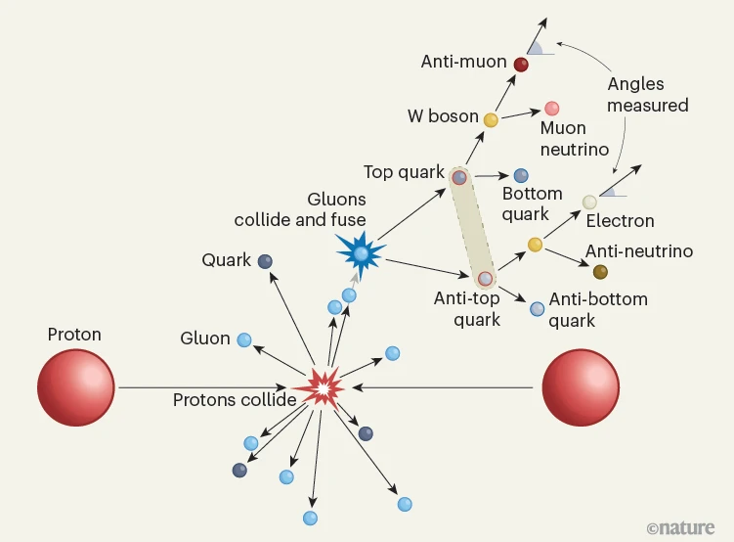
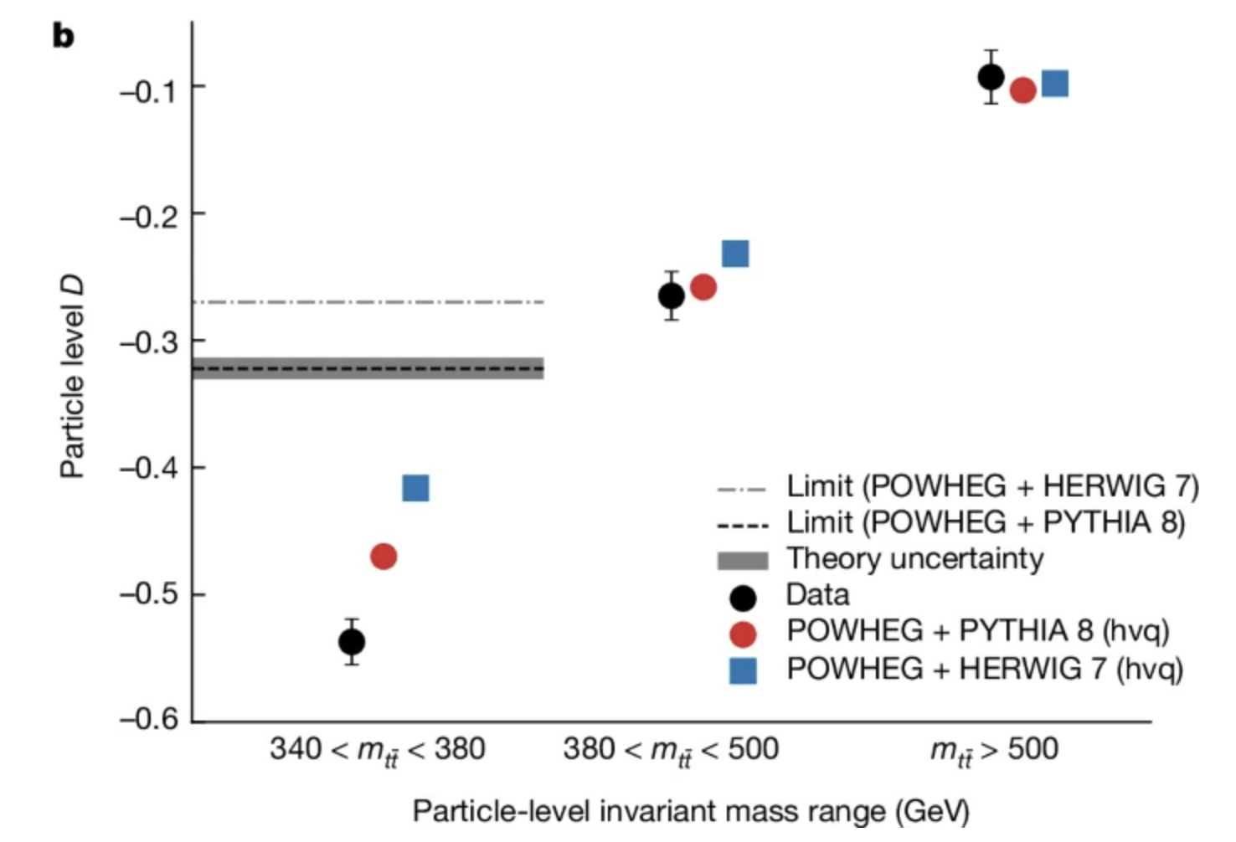
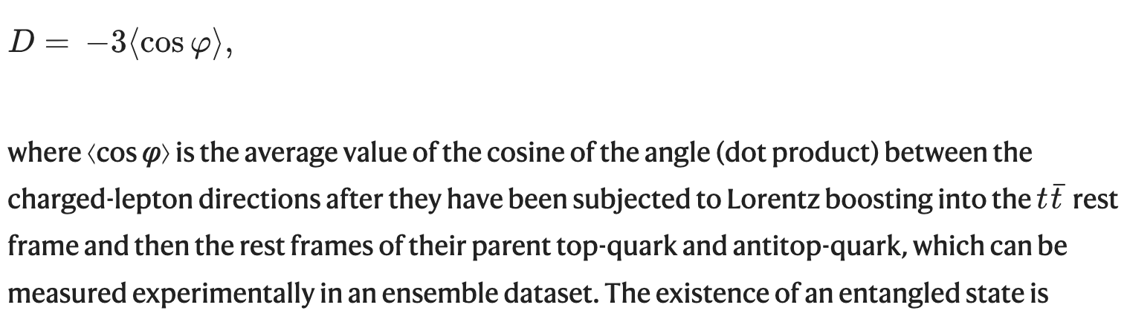
Entanglement in high energy physics
proton–proton collision: Nature 653, 542 (2024), Observation of quantum entanglement with top quarks at the ATLAS detector

Slide 6
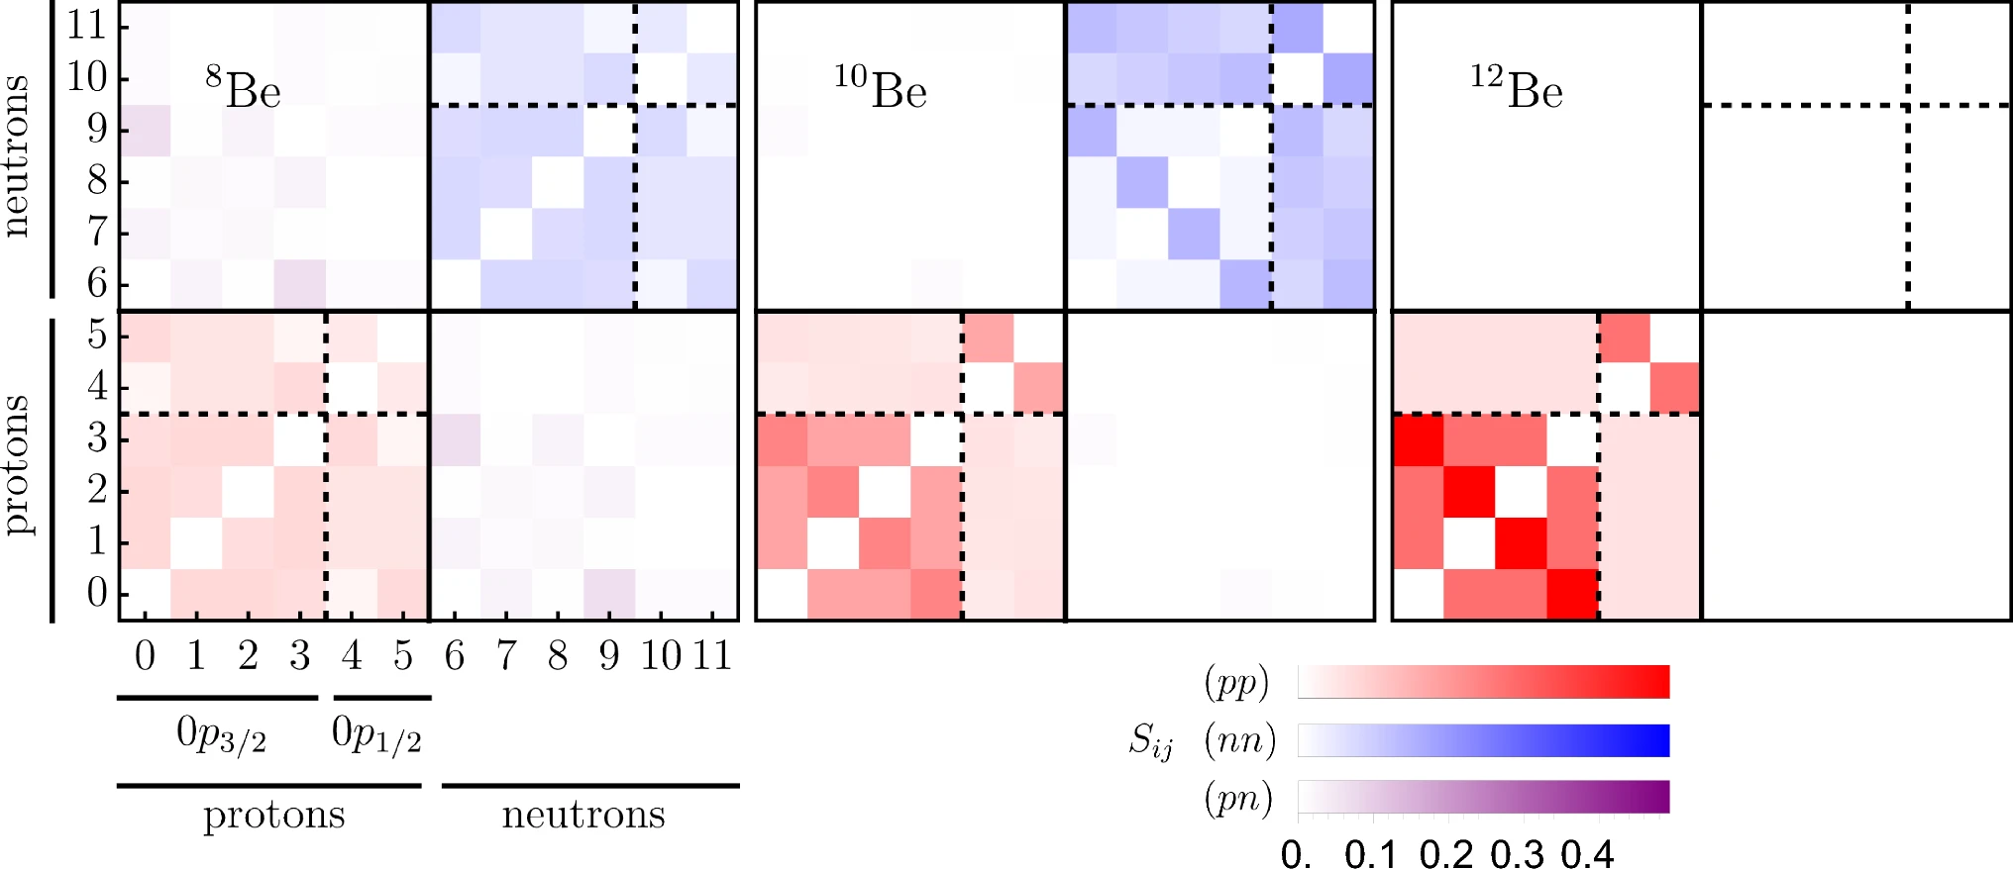
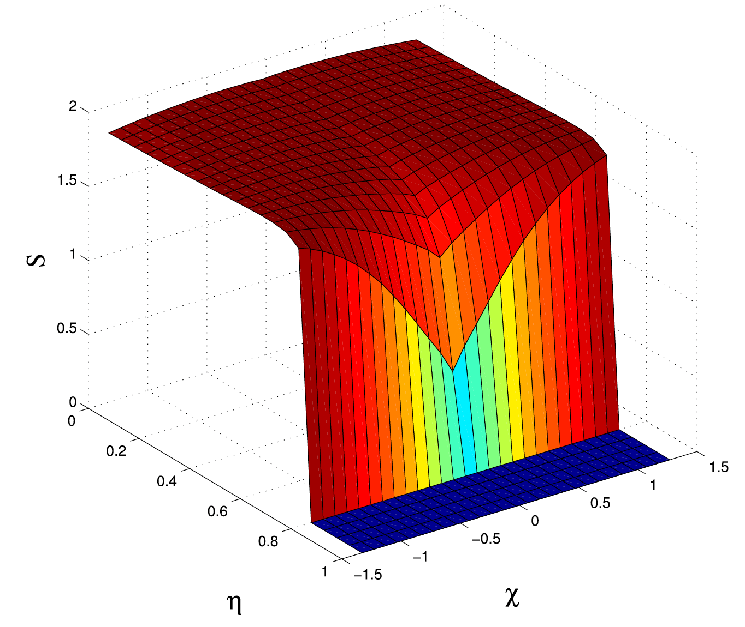
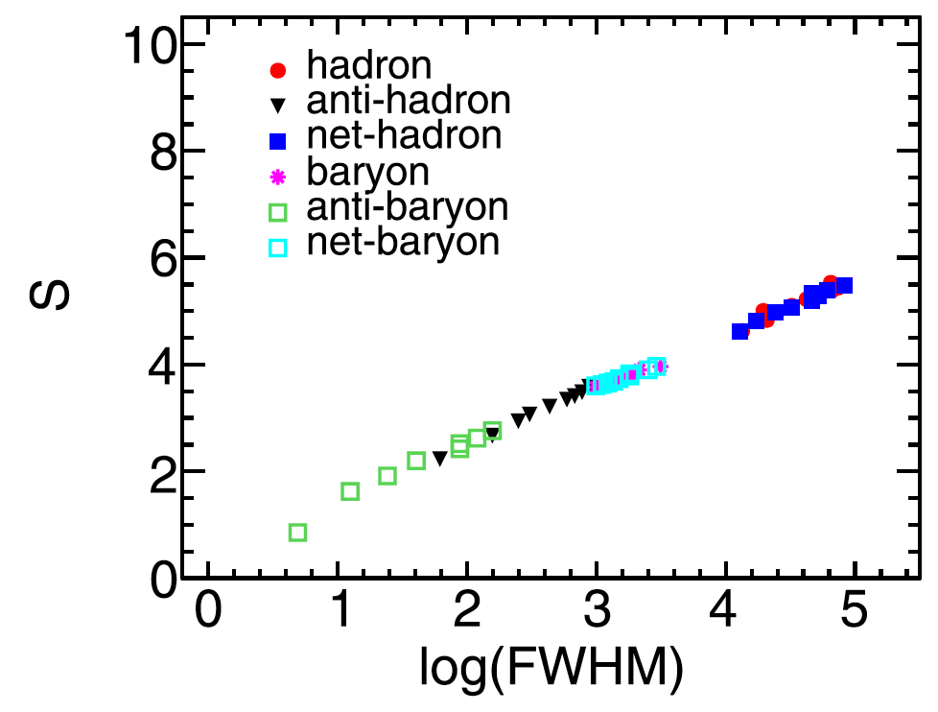
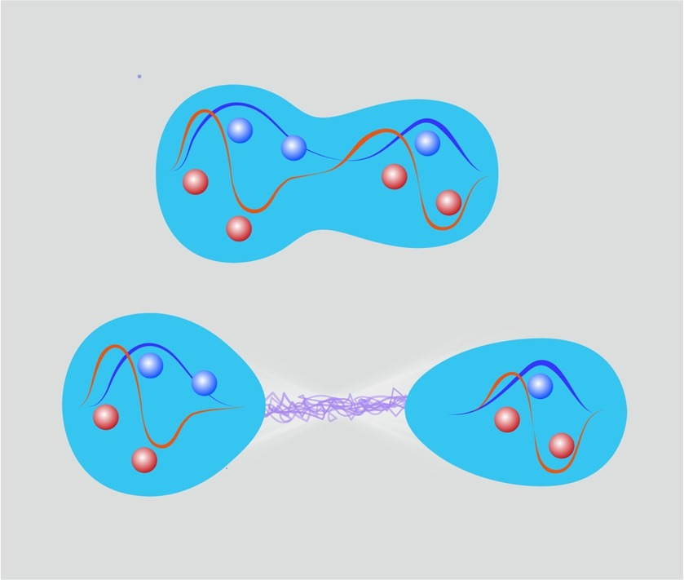
Entanglement in nuclear physics
shell: EPJA 59, 240 (2023)
shape: NPA 1053, 122960 (2025)
collisions: PRC 111, 014904 (2025), FDU
fission: PLB 861, 139248 (2025), PKU

Slide 7
Entanglement in collective motion
  Wobbling motion: rotation-proton
  Chiral rotation: rotation-proton-neutron
  Low-lying spectra: rotation-shape

Slide 8
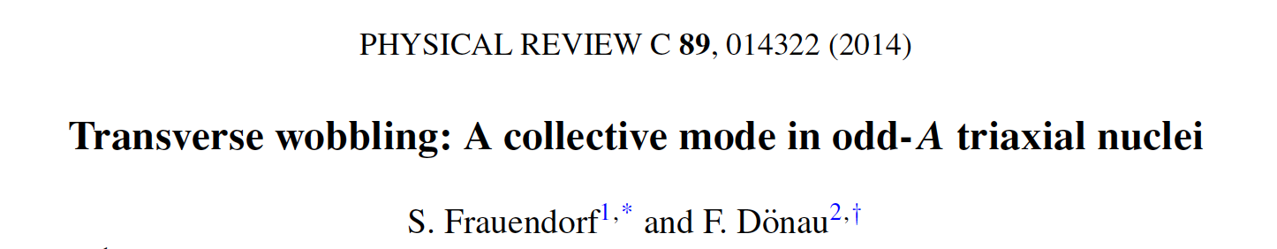

Wobbling motion
Frozen alignment approximation
$$Ψ\left(J,j\right)=ψ(J)φ(j)$$
TW: decreased Ewob
LW: increased Ewob
To what extend can one interpret the coupled system in terms of a particle and a rotor state?
Quantify their entanglement!

Slide 9
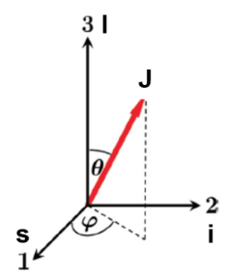
Calculate entanglement in particle-rotor model
Hamiltonian:
d.o.f: K (I) and k (j), bipartition
Coupling basis
Reduced density matrix for total or particle AM
Azimuthal/Spin coherent state plots
Spin squeezed state plots
Chen, QB, Luo, Meng, Zhang, PRC 96, 051303(R) (2017); QB, Frauendorf, EPJA 58, 75 (2022)
QB, Frauendorf, PRC 109, 044304 (2024)

Slide 10
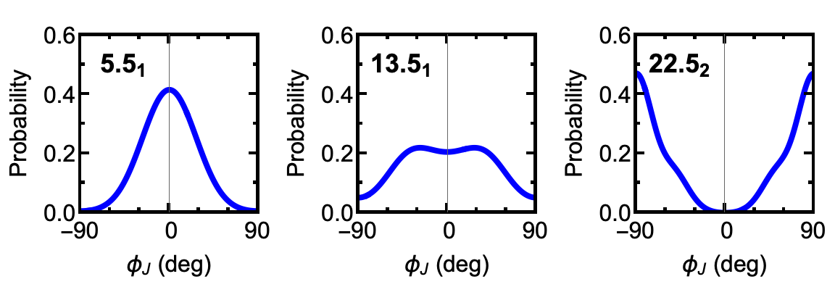
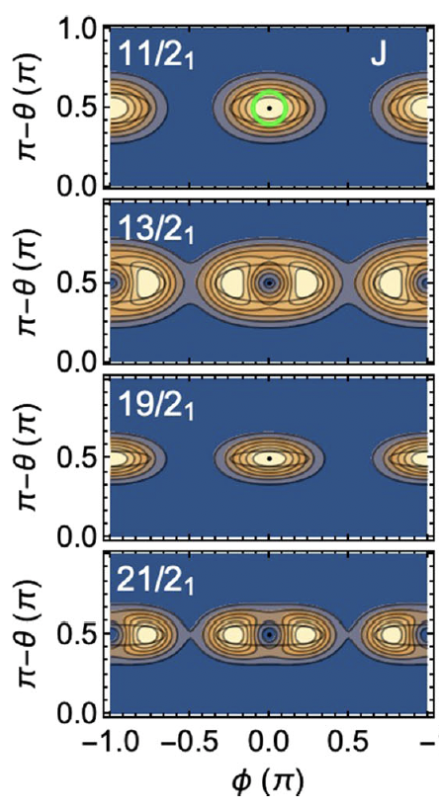
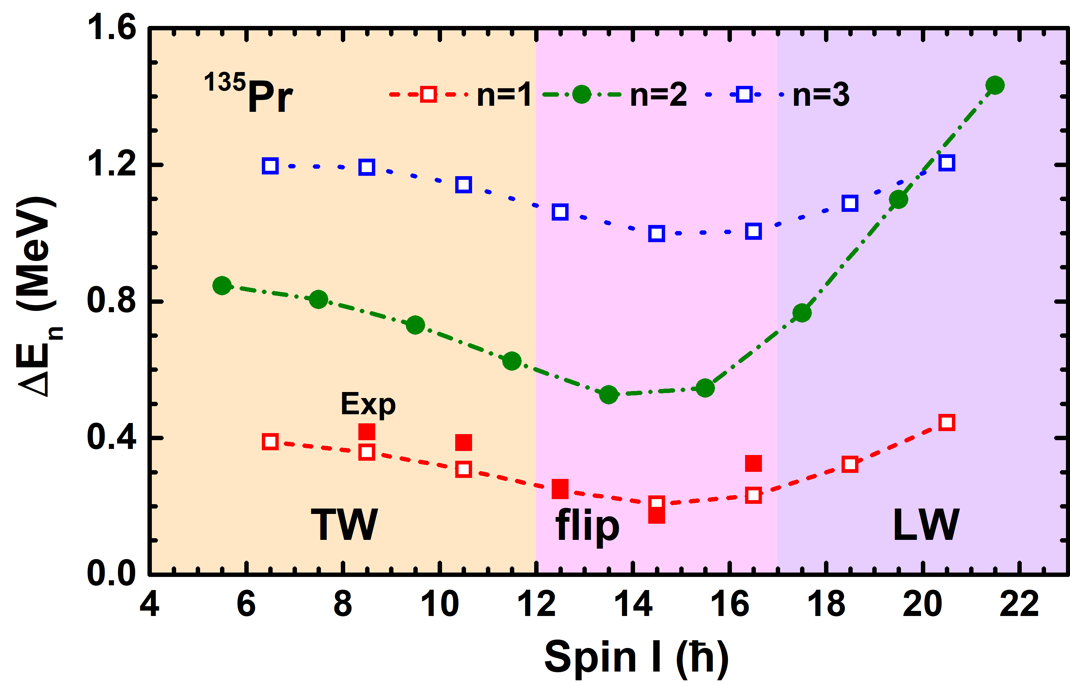
Visualization examples
SCS
¹³⁵Pr: h_{11/2}¹
SSS
n=0
TW: s
flip
LW: m
n=1
n=0
n=1
Determined by the coupling/Coriolis interaction between total and particle angular momenta.

Slide 11
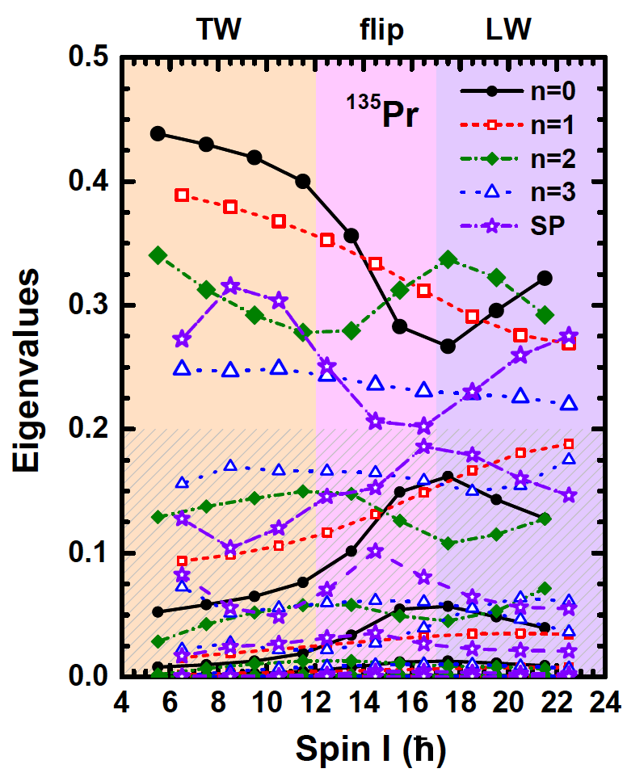
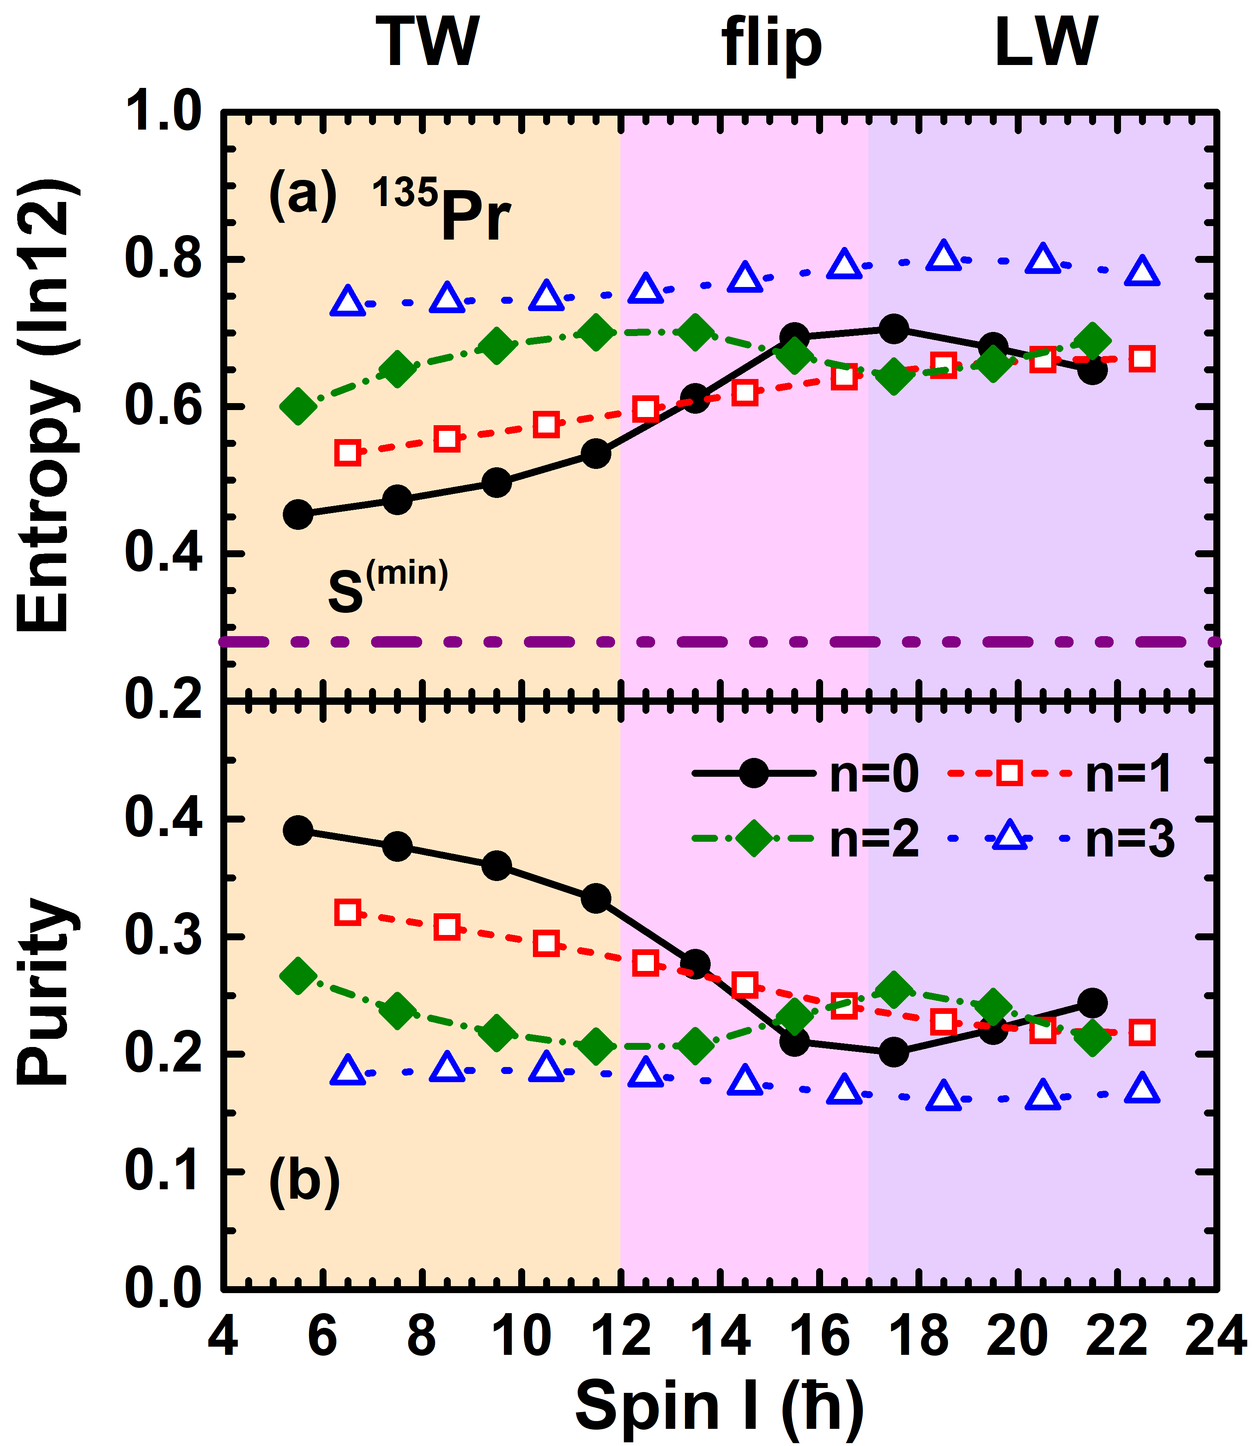
Entanglement in ¹³⁵Pr: entropy and purity
¹³⁵Pr: 1qp
QB, Frauendorf, PRC 110, 064322 (2024)
TW collapses: entropy increases
LW established: entropy decreases
one main state with large eigenvalue
Particle and Rotor states are entangled!

Slide 12
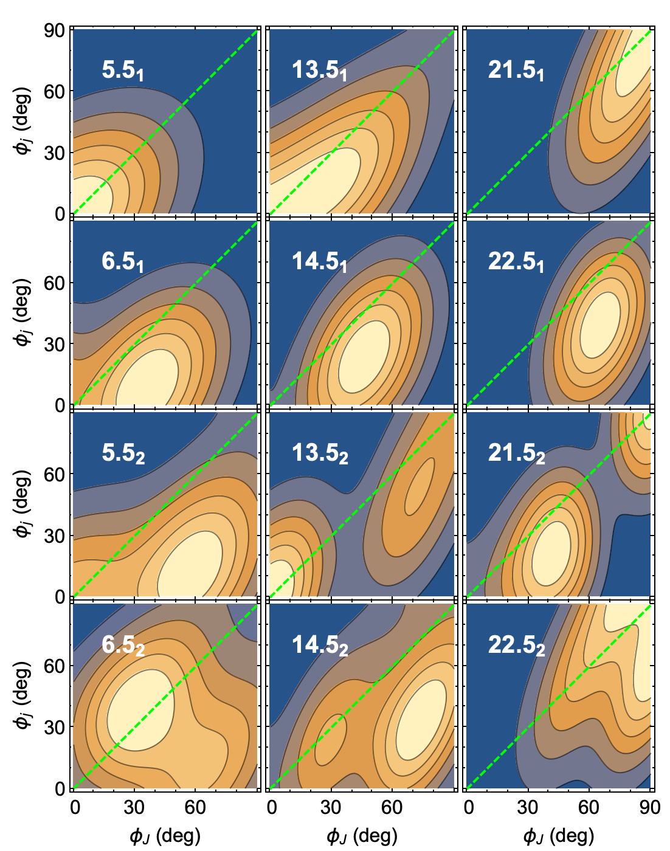
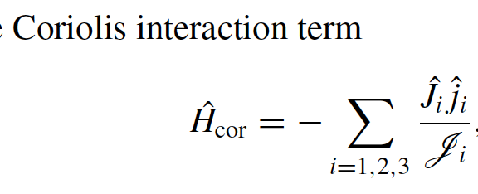
Entanglement between Particle and Rotor
TW collapse: φ_{j}<φ_{J}, entropy increases
LW establish: φ_{j}~φ_{J}, entropy decreases
Orientation angle of J and j

Slide 13
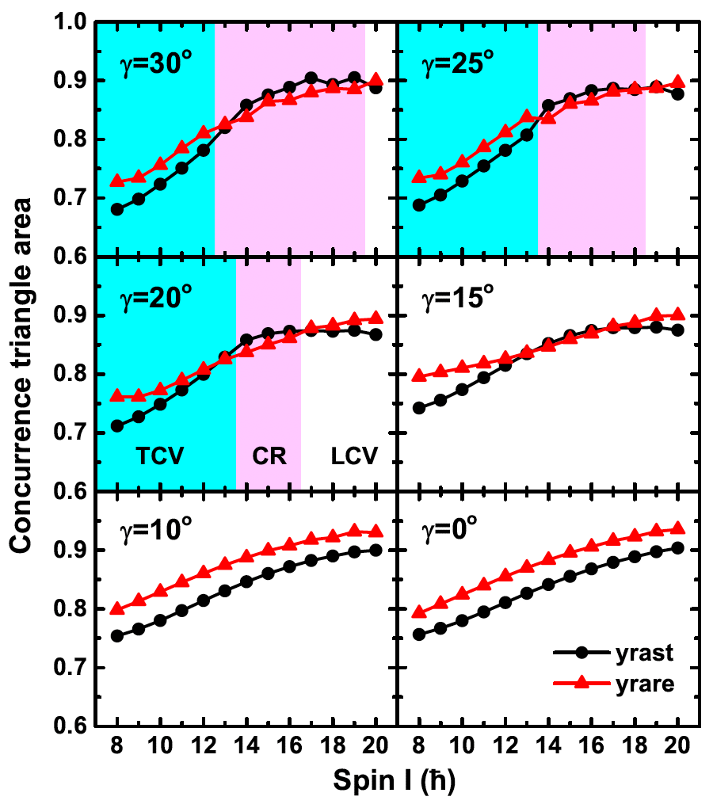
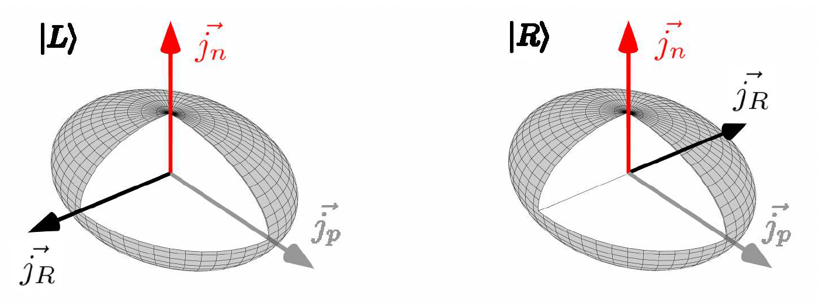
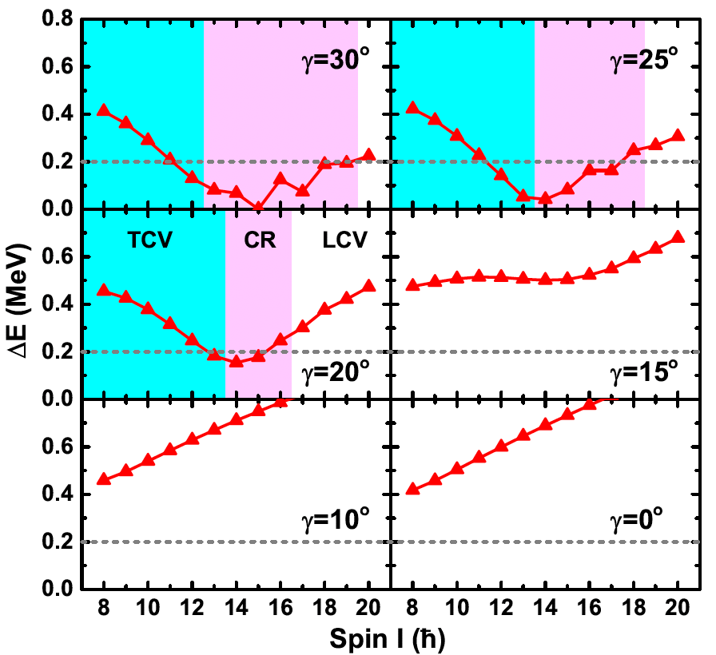
Entanglement in the chiral rotation
Chiral rotation
Q.B. Chen, Frauendorf, submitted
NPA 617, 131 (1997)
Entanglement depends on the triaxial deformation.

Slide 14
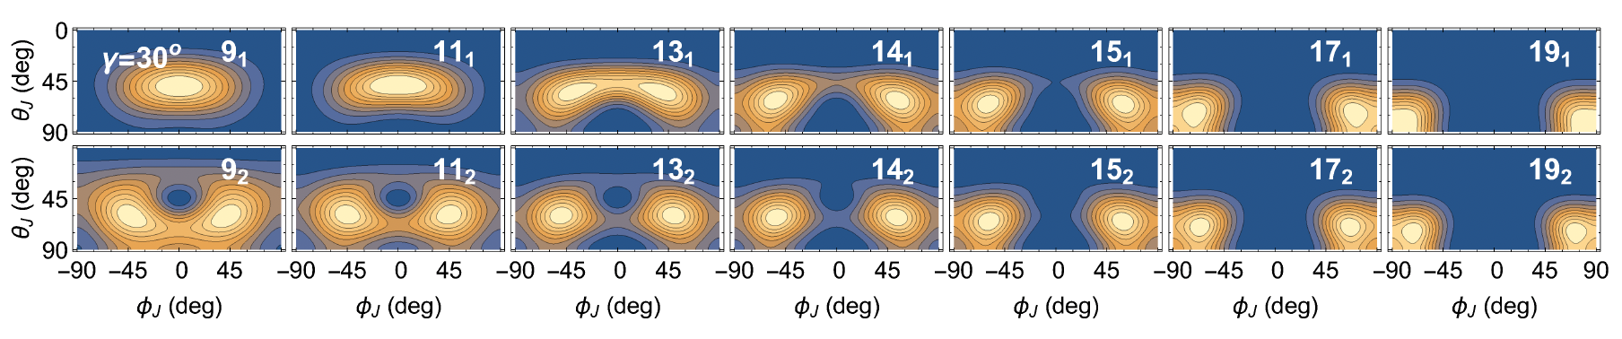
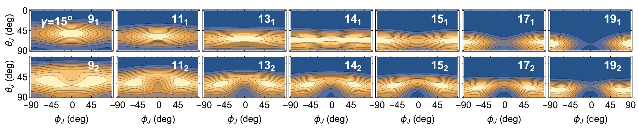
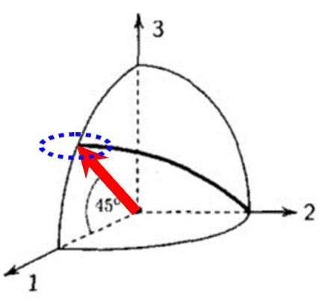
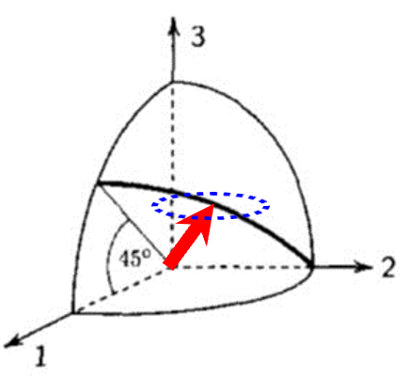
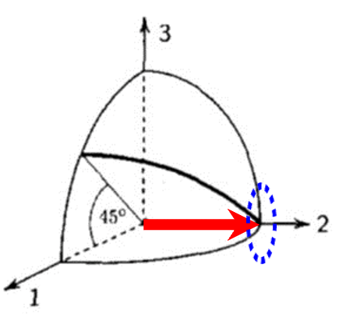
Entanglement in the chiral rotation
Evolution of chiral modes
Q.B. Chen, Frauendorf, submitted
chiral vibration
chiral rotation
Entanglement crossing can be treated as fingerprint of chiral rotation.

Slide 15
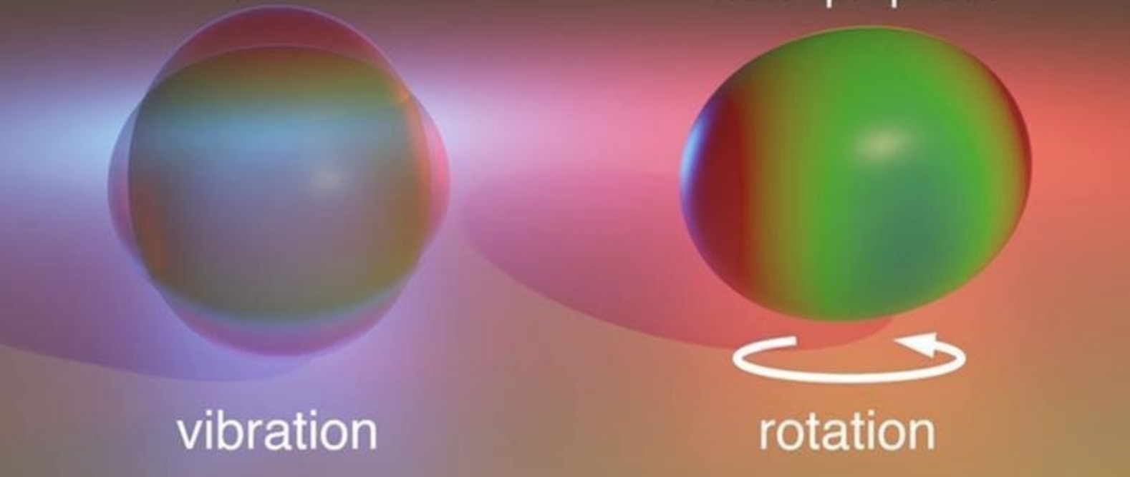
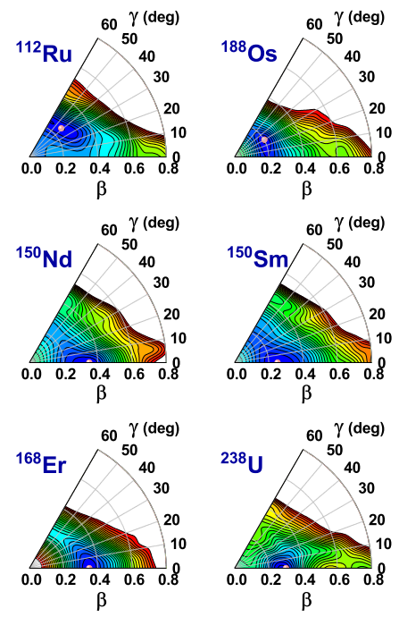
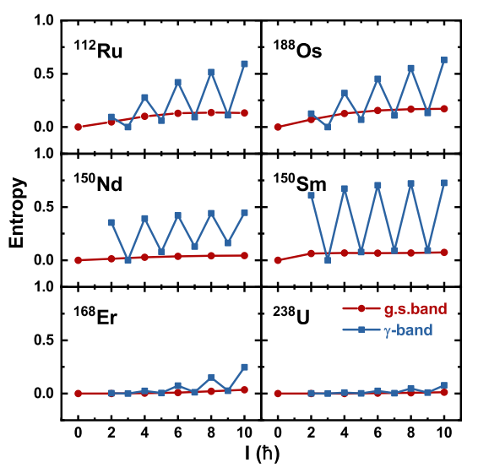
Entanglement in the low-lying states
Rotation-vibration
Y. M. Wang and Q.B. Chen, submitted
Entanglement entropy exhibits diverse trends across different deformed nuclei.
Triaxial
Axial γ-soft
Axial γ-rigid

Slide 16
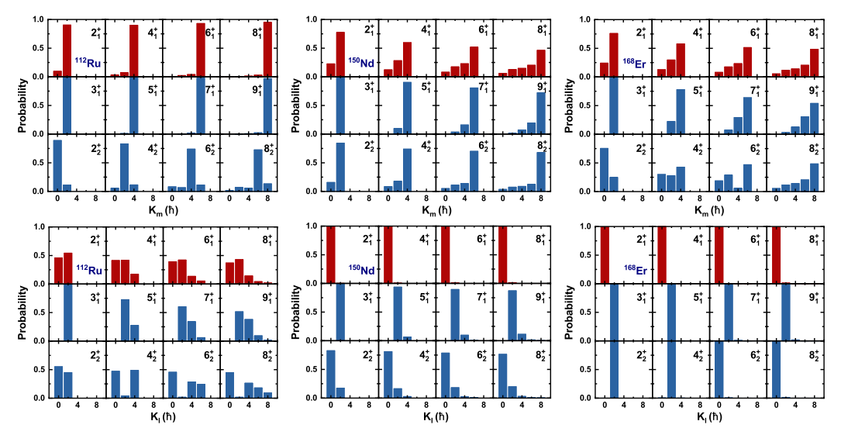
Entanglement in the low-lying states
K-distributions
Y. M. Wang and Q.B. Chen, submitted
The m-axis (triaxial) or l-axis (axial) is pure state.

Slide 17

Summary
  Entanglements are studied for the wobbling motion in ¹³⁵Pr and ¹³⁰Ba in the one-particle-rotor model, for the chiral rotation in the two-particle-rotor model, as well as for the low-lying energy spectra in the five-dimensional collective Hamiltonian.
  When transverse wobbling collapses: entropy increases; when longitudinal wobbling is established, entropy decreases.
  The crossing of entanglement can be treated as the signature of chiral rotation.
  The shape determines the rotational modes and the entanglement.
  Observables that can reveal the entanglement are to be explored.

