Slide 1

第二十届全国中高能核物理大会
中国地质大学 (武汉)
Structure, oscillations and gravitational wave of compact stars
Huan Chen (陈欢)
In collaboration with: T.-T. Sun, J.-B. Wei, Z.-Y. Zheng,
X.-P. Zheng, G. F. Burgio, H.-J. Schulze
2025-4-27
Shanghai • China
Huan Chen (陈欢） 1

Slide 2

Outline
中国地质大学 (武汉)
Background
Equation of state and structure of (P)NS
Radial oscillations of (P)NS
Non-radial oscillations and Gravitational wave radiation
Summary
Ting-Ting Sun ,et al. PRD103(2021)103003
Ting-Ting Sun ,et al. PRD111(2025)043008
Zi-Yue Zheng ,et al. PRD107(2023)103048
Zi-Yue Zheng ,et al. PRD111(2025)063069
Huan Chen (陈欢） 2

Slide 3
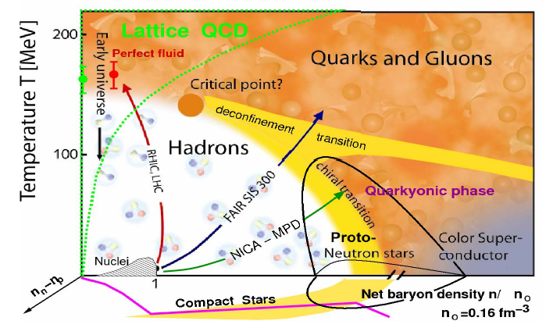
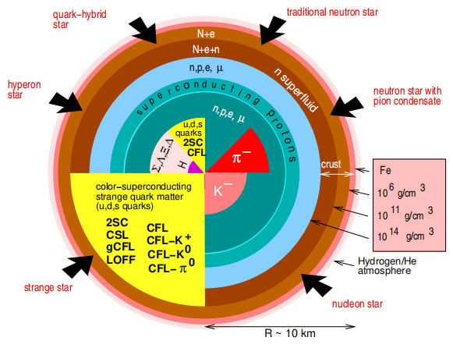
Background
中国地质大学 (武汉)
Phase diagram of QCD ：
Temperature, density, and other degrees of freedom
Possible structure of neutron stars.
(PPNP,54 (2005) 193)
Huan Chen (陈欢） 3

Slide 4
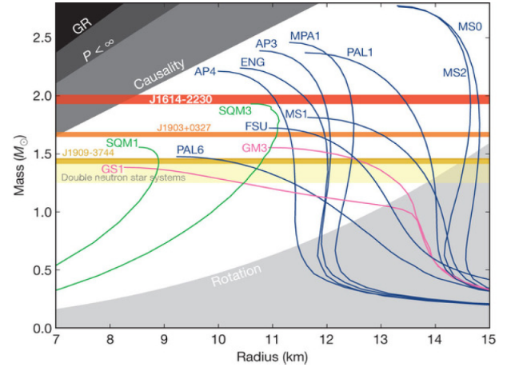
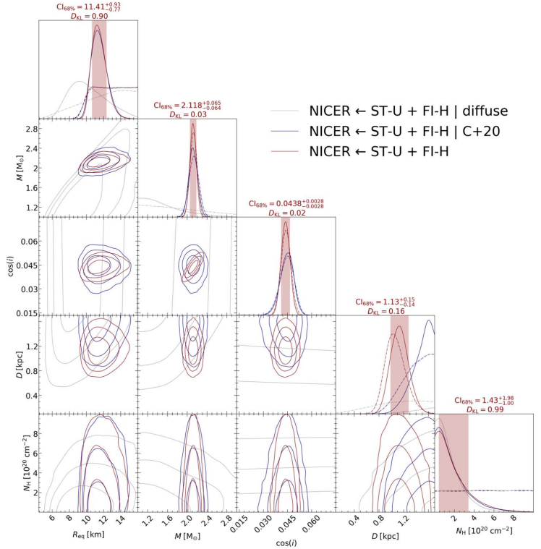
Background
中国地质大学 (武汉)
the Neutron Star Interior Composition Explorer (NICER)
Nature 467(2010)1081;
Science 340(2013)1233232;
Astrophys. J. 832(2016)167;
Nat.Astron. 4(2019)72.
APJL 918(2021)L27
Huan Chen (陈欢） 4

Slide 5
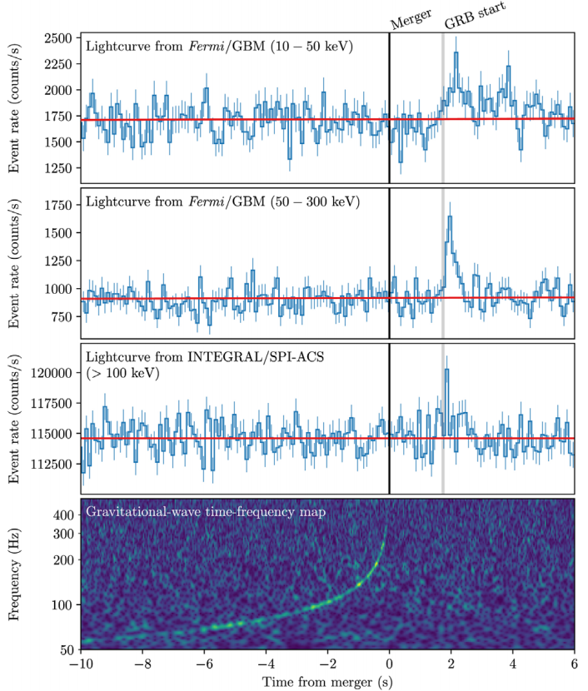
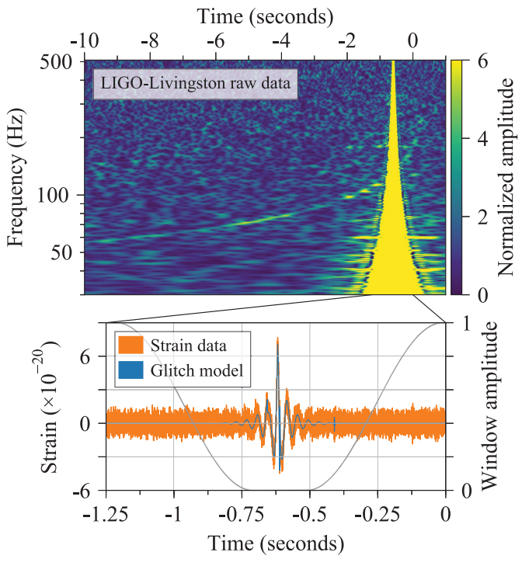
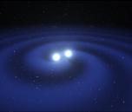
Background
中国地质大学 (武汉)
GW170817:The first detection of gravitational wave signals from binary neutron star mergers in 2017 opened a new era of multi-messenger astronomy.(PRL 119(2017)161101)
Huan Chen (陈欢） 5

Slide 6



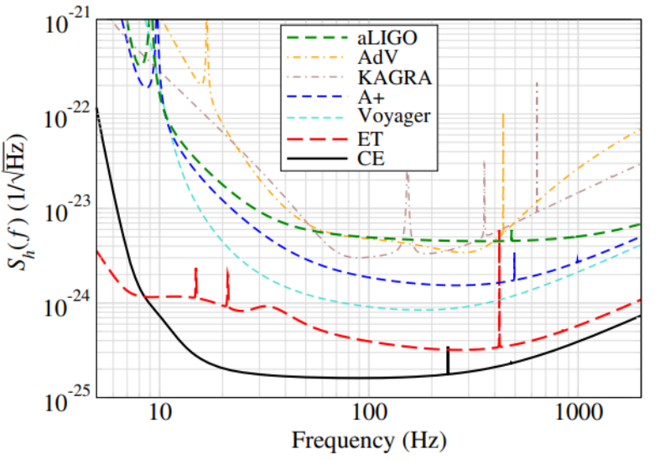


Background
中国地质大学 (武汉)
Current and planed GW detectors
KAGRA
LlGO
VIRGO
Cosmic Explorer
Einstein Telescope
(Phys.Rev.Lett. 118,151105)
Huan Chen (陈欢） 6

Slide 7
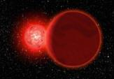
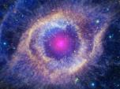
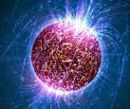
Background
中国地质大学 (武汉)
GW sources with NSs
Binary merger
supernova explosion
neutron star oscillations
Neutron stars emit gravitational waves through nonradial oscillations
It is a widely existing stable gravitational wave source.
Huan Chen (陈欢） 7

Slide 8
Background
中国地质大学 (武汉)
Strong interaction - QCD
1. Quarks-gluons form hadrons
2. Asymptotic freedom(UV) –
non-perturbative (IR)
3. Color confinement
4. Dynamical Chiral Symmetry Breaking
EOS of hybrid star:
Hadronic matter :
1. Relativistic mean-field (RMF) models
2. Brueckner-Hartree-Fock (BHF) theory
3. ......
Quark matter :
1. MIT bag model
2. Nambu-Jona-Lasinio model
3. Dyson-Schwinger equation
4. ......
Huan Chen (陈欢） 8

Slide 9
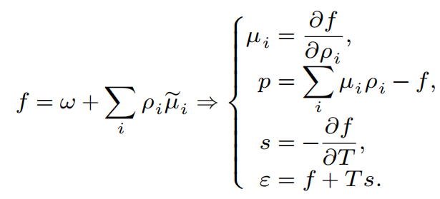
EOS and Structure of NSs
中国地质大学 (武汉)
Brueckner-Hartree-Fock (BHF) theory
Scatter matrix under finite temperature and density ==》 free energy
two-body force : Argonne V18 (V18), Bonn B (BOB), …
three-body force : Density dependent two-body force - microscopic or phenomenological （urbana）
Thermodynamic relationship:
PRC100,054335(2019)
Huan Chen (陈欢） 9

Slide 10
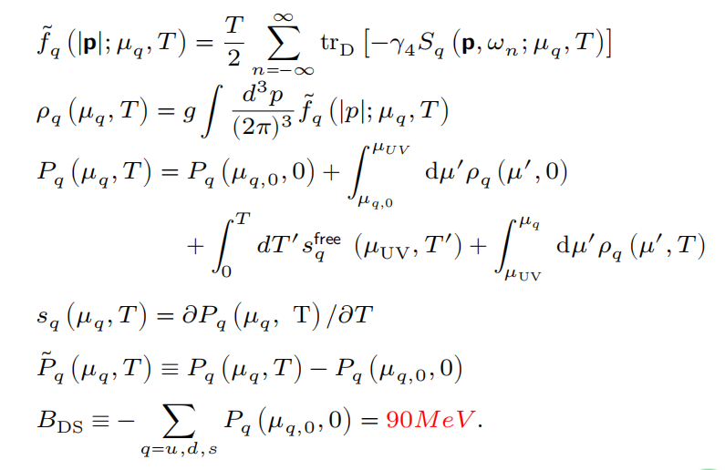


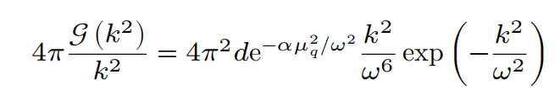
EOS and Structure of NSs
中国地质大学 (武汉)
Dyson-Schwinger Equation (DSE)
quark propagator
vertex (Rainbow approximation) , ，
Modified Gaussian model under finite chemical potential :
where ω = 0.5GeV, d = 1GeV² , m_{u,d} = 0, m_{s} = 0.115GeV, ɑ is a phenomenological parameter .
Each flavor of quark is independent. Wigner solution : Chiral symmetric, deconfinement, neglecting colorl superconductivity. PRD84,105023(2011)
Huan Chen (陈欢） 10

Slide 11
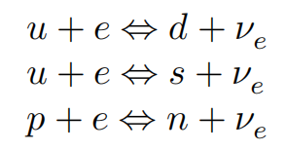



EOS and Structure of NSs
中国地质大学 (武汉)
β equilibrium
Proto neutron star （ neutrinos capture)
β equilibrium
electrical neutrality
conservation of lepton
numbers
Cold neutron star (neutrino free)
Huan Chen (陈欢) 11

Slide 12
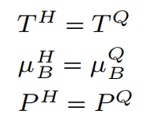
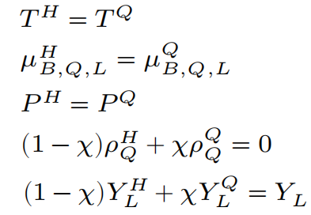
EOS and Structure of NSs
中国地质大学 (武汉)
Structure of Maxwell phase transition
1. thermal equilibrium
2. chemical equilibrium
3. mechanical equilibrium
Structure of Glendenning （Gibbs） phase transition
1. thermal equilibrium
2. chemical equilibrium
3. mechanical equilibrium
4. Global charge neutrality
5. Global conservation of lepton numbers
（χ volume fraction of QM）
Note: In a cold neutron star, neutrinos escape freely and the number of leptons is not conserved.
Huan Chen (陈欢） 12

Slide 13

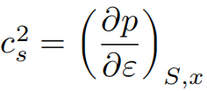

EOS and Structure of NSs
中国地质大学 (武汉)
1. : equilibrium speed of sound. Jumps when new degrees of freedom appear.
2. : adiabatic sound speed, without jumps.
Considering three time scales: weak interactions τ_{weak}、 strong phase transition τ_{strong} and oscillation τ_{o s}
Pure nucleonic phase: τ_{o s} < τ_{weak} . Neither β equilibrium, the fraction of each particle remain unchanged.
Mixed phase: τ_{o} _{s} < τ_{weak} , τ_{o} _{s}<τ _{strong} , Neither β Equilibrium nor phase equilibrium, and the fraction of each particle in its own phase remains unchanged, but the quark volume fraction changes to maintain mechanical equilibrium. Universe 7, 493 (2021) .
3. : BV frequency, The ‘local frequency’ of fluid microelements, subjected to simple harmonic oscillations under Newton's approximation of buoyancy.
Huan Chen (陈欢） 13

Slide 14
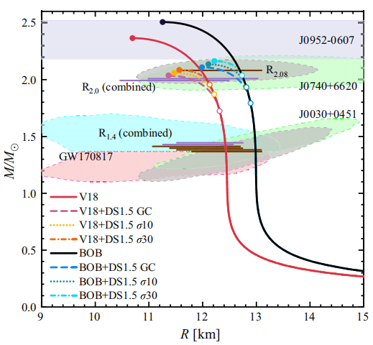
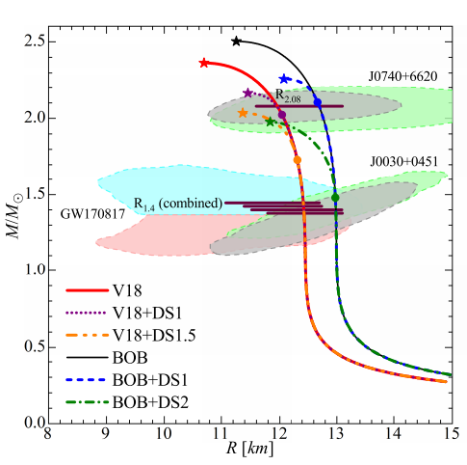
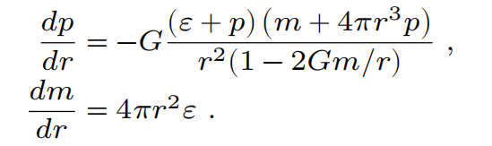
EOS and Structure of NSs
中国地质大学 (武汉)
Stellar equilibrium structure :
General static spherical symmetry metric
TOV equation
EOS + TOV equation => mass-radius relations
Due to the uncertainty of theory and observation, it is difficult to strictly distinguish pure neutron stars from hybrid stars based on the mass radius relationship.
The mass-radius relationships of pure neutron stars and hybrid stars obtained from different state equations.
Zi-Yue Zheng ,et al. PRD111(2025)063069
Huan Chen (陈欢） 14

Slide 15
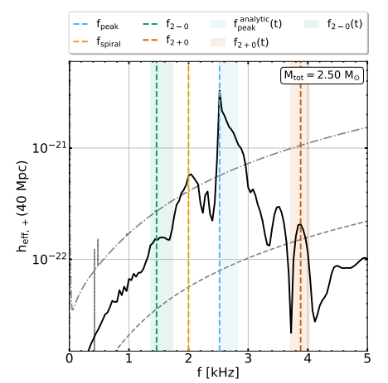
Equilibrium to oscillations of NSs
中国地质大学 (武汉)
Purpose ： Distinguishing pure NS and HSs
。
Mass-radius relationship （ difficult ）
。
NSs oscillations (?)
。
Radial oscillation
。
Quadrupole non radial oscillation
。
Gravitational wave radiation
Simulation of effective gravitational wave spectrum after binary merger ：
f_{peak} —Quadrupole fundamental mode oscillation
f_{2—O}
f_{2十O} —Coupling of Quadrupole Mode and Quasi Radial Mode
Gravitational wave radiation is closely related to oscillation modes!
PRD 105,043020 (2022)
Huan Chen (陈欢） 15

Slide 16
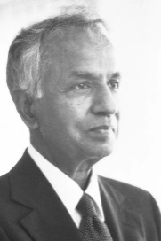
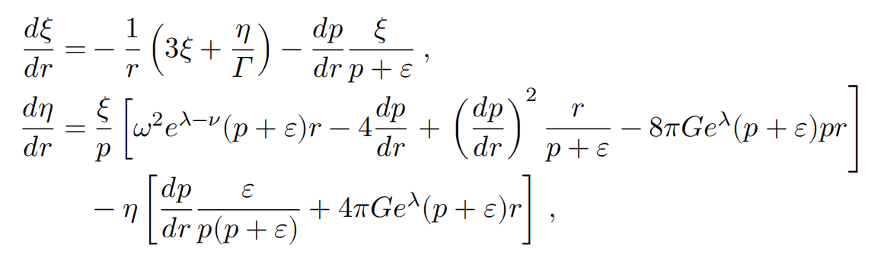
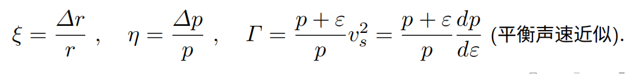
Radial oscillations of NSs
中国地质大学 (武汉)
S. Chandrasekhar, ApJ. 140, 417 (1964); G. Chanmugam, ApJ. 217, 799 (1977).
Radial perturbation of fluids and metrics X(r,θ,φ,t)≡ x(r) e^{-iωt}
Equation of fluid radial oscillation based on Einstein's field equation :
Chandrasekhar
where
（ Equilibrium sound speed approximation ）
Boundary condition : [η + 3Γξ](0) = 0 , η(R) = 0 .
Huan Chen (陈欢） 16

Slide 17
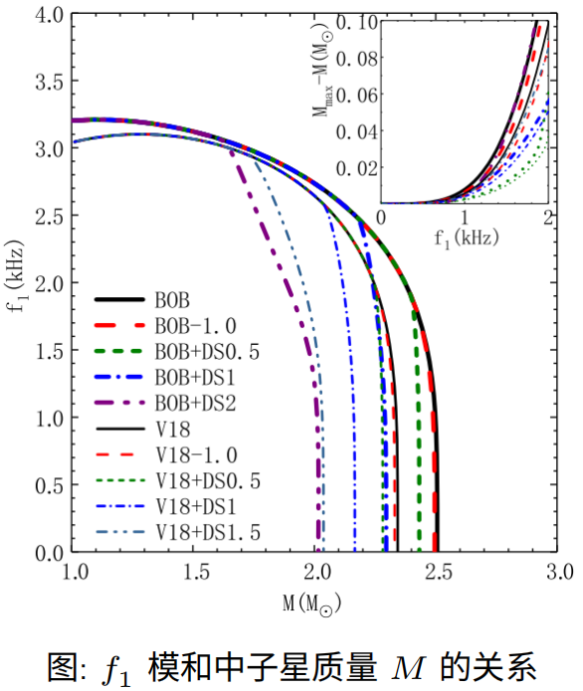
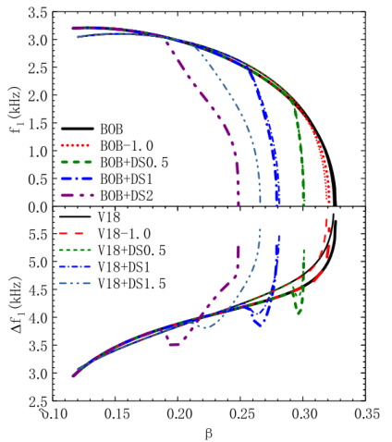
Radial oscillations of NSs
中国地质大学 (武汉)
1. As NS mass approach the maximum
f₁ decreases to 0,
consistent with the stability criterion dM/dρ_{c}≥ 0 .
2. Smaller f₁ can provide an accurate estimate of the maximum mass.
3. Smaller β with smaller f₁ or larger ∆f₁ helps to distinguish HSs from pure NSs.
Fundamental frequency f₁ and Δf₁ = f₂-f₁ as functions of NS mass and compact parameter β
T.-T. Sun, et al. PRD 103, 103003 (2021)
Huan Chen (陈欢） 17

Slide 18
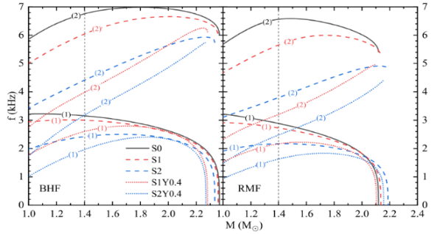
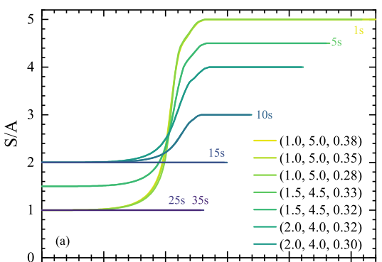
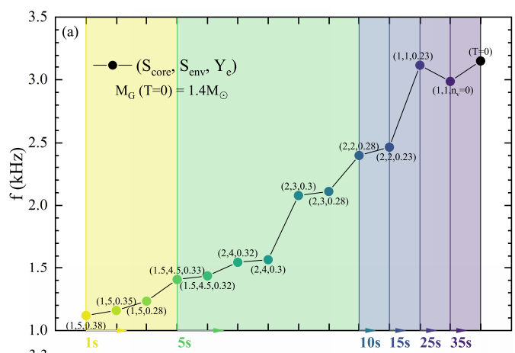
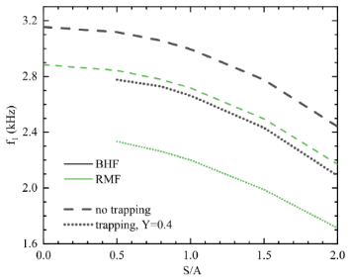
Radial oscillations of (P)NSs
中国地质大学 (武汉)
NS vs. PNS
1. f₁ decreases to 0
at M_{max} ，
consistent with
dM/dρ_{c}≥ 0 .
2. f₁ with small mass
decrease with S/A and Y_{e}.
3. PNS with 1.4M_{ʘ}
f₁ ~1kHz at early time.
T.T.Sun, et al. PRD111(2025)043008.
18
Huan Chen (陈欢） 18

Slide 19


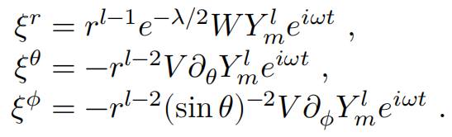
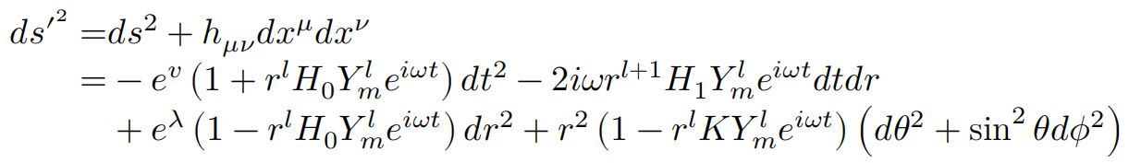
Non-radial oscillations of NSs
中国地质大学 (武汉)
K. S. Thorne and A. Campolattaro, ApJ. 149, 591(1967).
Fluid perturbations
expanded in spherical harmonic
form
Corresponding metric under perturbations:
equation of non radial oscillation based on Einstein's field equation
Static spherical symmetric equilibrium and the lowest order GW radiation: Quadrupole (l = 2)
K. S. Thorne
Huan Chen (陈欢） 19

Slide 20
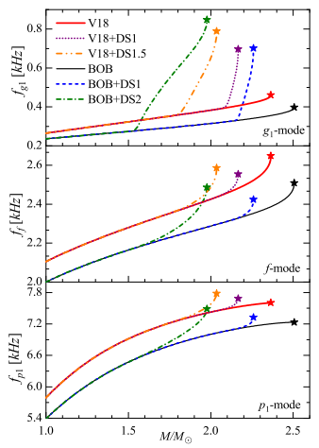
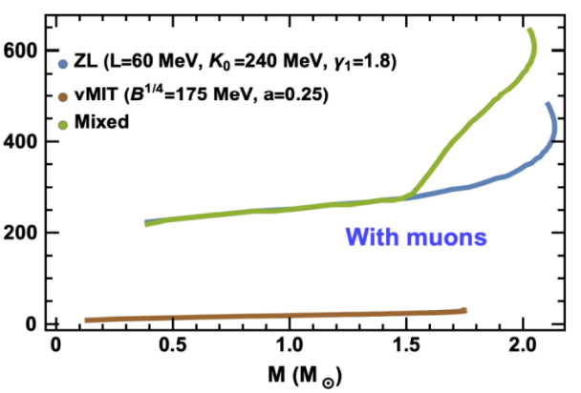
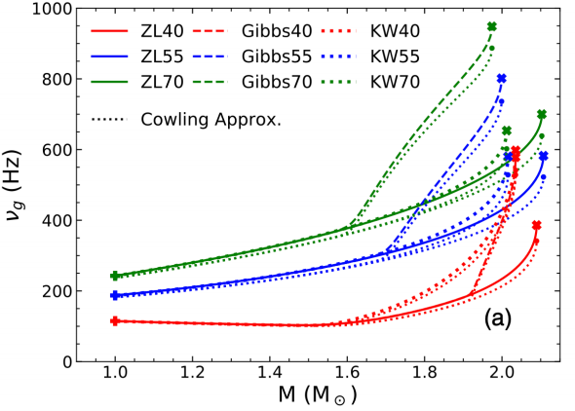
Non-radial oscillations of NSs
中国地质大学 (武汉)
Cowling approximation
with only fluid oscillation
For pure NSs, the first-order g-mode frequency is f_{g1} ~ 300 Hz, and increases slowly with the increase of star mass
HSs, f_{g1} increases rapidly with mass and can exceed 700 Hz
The f_{g1} are all within the sensitive range of current GW detectors
Phys. Rev. D 103, 123009 (2021)
Z.Y.Zheng, et al.,PRD107,103048(2023)
Phys. Rev. D 105, 103025 (2022)
Huan Chen (陈欢） 20

Slide 21
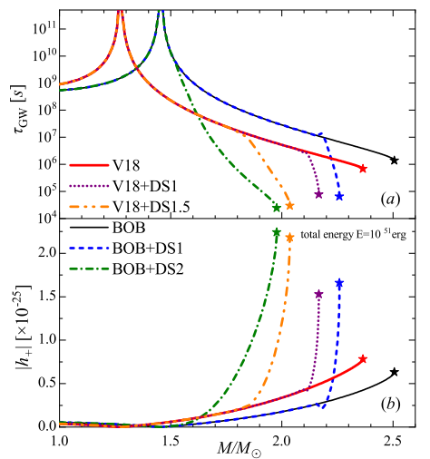
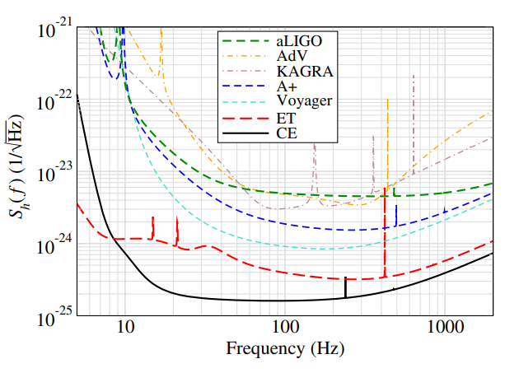
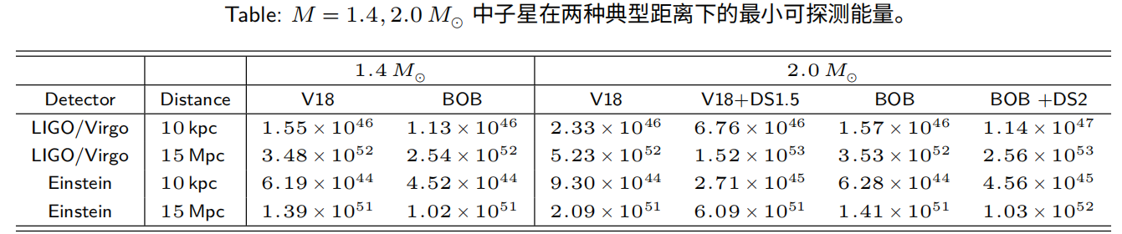
Non-radial oscillations of NSs
中国地质大学 (武汉)
Power spectrum density of various detectors
(PRL 118,151105)
Damping time and GW strain -g₁ mode
D = 15MPc, E_{tot} = 10⁵¹erg
Minimum detectable GW energies by GW detectors -g₁ mode
Z.Y.Zheng, et al.,PRD107(2023)103048
Huan Chen (陈欢) 21

Slide 22
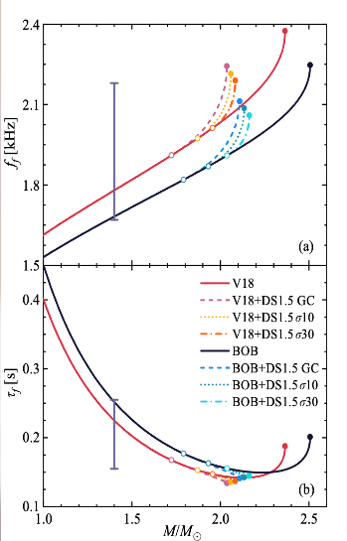
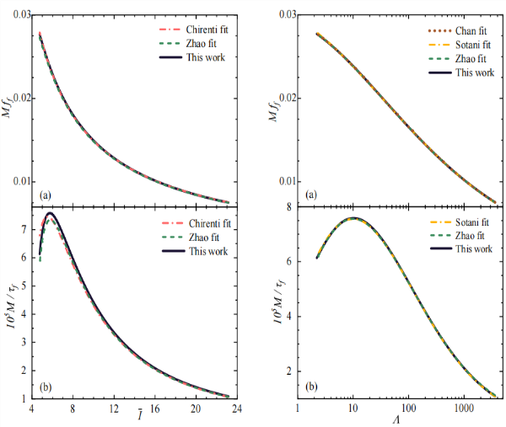




Non-radial oscillations of NSs
中国地质大学 (武汉)
f-mode
Full GR solution vs.Cowling appr. lower frequencies
f ≈1.5-2.5kHz
similar for HSs and pure NSs
Damping time ≈ s
Universal Relations of NS and HSs with pasta structure
Z.Y.Zheng,et al., PRD111(2025)063069
(see also , PRC99,045806;PRD106,123002; PRD91,044034;PRD104, 123002.)
22
Huan Chen (陈欢） 22

Slide 23
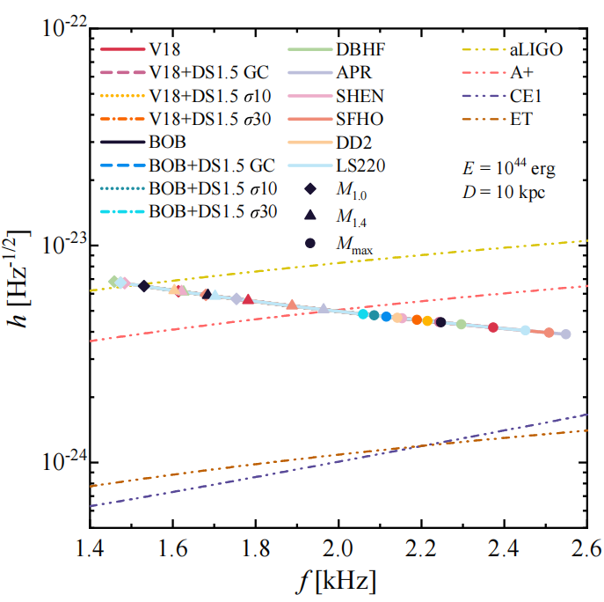
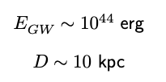

Non-radial oscillations of NSs
中国地质大学 (武汉)
Excitation of the f mode
by galactic glitch:
Z.Y.Zheng,et al., PRD111(2025)063069
GW peak strain as functions of frequency
Huan Chen (陈欢) 23

Slide 24
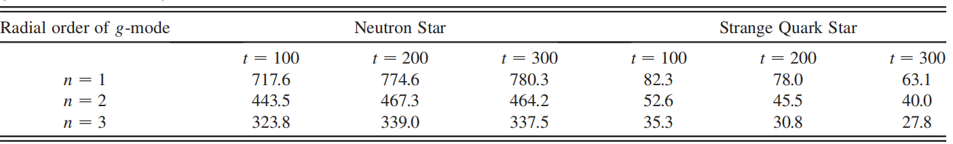
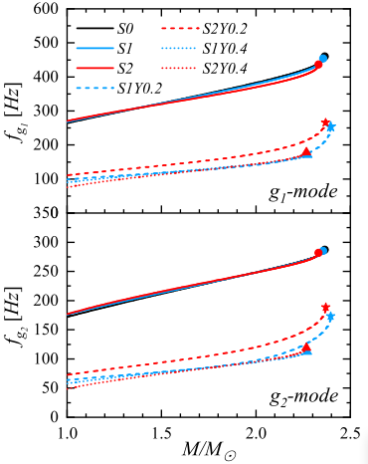
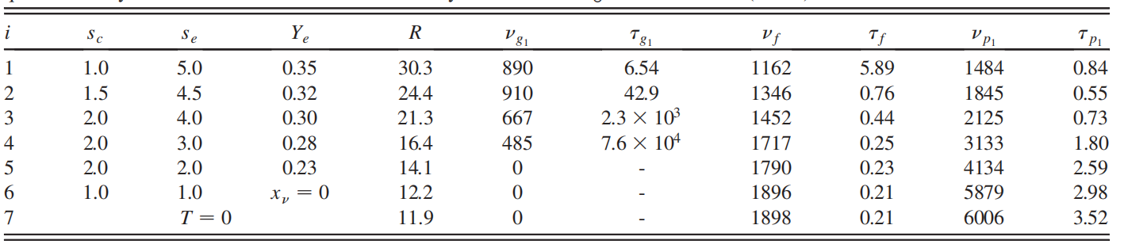
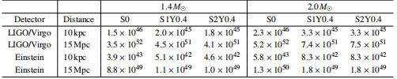
NRO of PNSs
中国地质大学 (武汉)
g-mode
W.-j. Fu, et.al., PRL101,181102(2008).
G. Burgio et.al.,PRD84, 044017.
Y.L.Tao,et al.,submitted to EPJA
Huan Chen (陈欢) 24

Slide 25
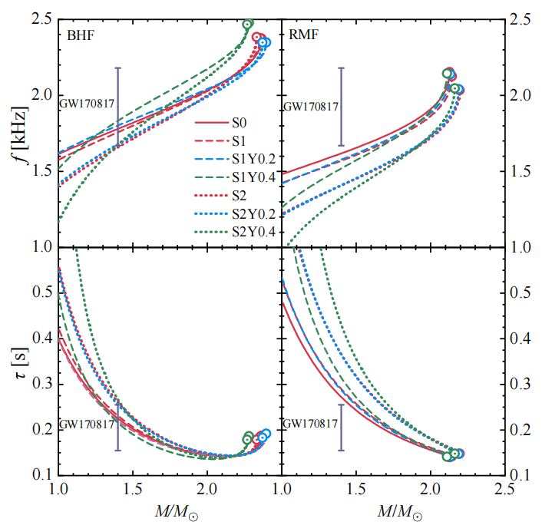
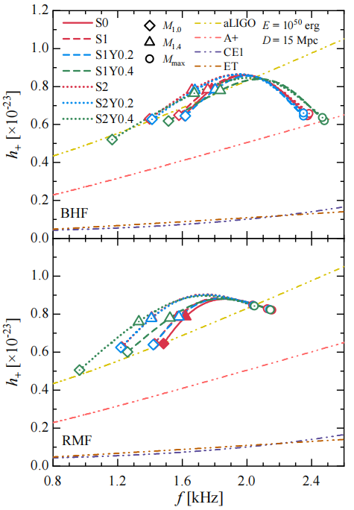
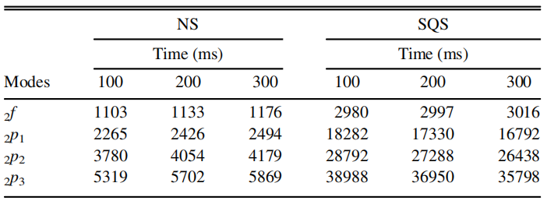
NRO of PNSs
中国地质大学 (武汉)
f-mode
Z. Bai, et.al., APJ922,266(2021).
G. Burgio et.al.,PRD84, 044017.
Frequencies and damping time of f-mode
The amplitude of the GW strain for E_{GW} = 10⁵⁰ erg, D = 15Mpc,
Z.Y.Zheng,et al.,in preparation
Huan Chen (陈欢) 25

Slide 26

NRO of PNSs
中国地质大学 (武汉)
f-mode
UR followed
Z.Y.Zheng,et al.,in preparation
Huan Chen (陈欢) 26

Slide 27




NRO of PNSs
中国地质大学 (武汉)
f-mode
Modeling the profile at different time snap from simulation.
(Handbook of Supernovae)
Z.Y.Zheng,et al.,in preparation
Huan Chen (陈欢) 27

Slide 28
Summary and Outlook
The radial oscillation of (P)NSs f₁=0 is consistent with the stability criterion dM/dρ_{c}≥0.
HSs : smaller compact parameter β with a smaller f₁ or a larger ∆f₁ .
For pure NSs, f_{g1} ~ 300Hz, and slowly increases with the increase of the star mass. For HSs, f_{g1} can exceed 700Hz. All within the sensitive range of current ground-based GW detectors.
HSs: shorter GW damping times for g₁ mode, larger GW strain amplitudes and GW power. GW from pure NSs and HSs in the Milky Way can be detected by current and next-generation detectors.
f -mode of NS, HS and PNS with higher frequencies and strong GW strain to be detected, the same UR.
Investigating oscillations and GW of proto-hybrid stars.
Combine with more realistic simulation of PNS and the remnant of binary NS merger
Huan Chen (陈欢） 28

Slide 29

第二十届全国中高能核物理大会
Thanks for your attention !
Welcome to CUG (Wuhan)!
Huan Chen (陈欢） 29

