Slide 1

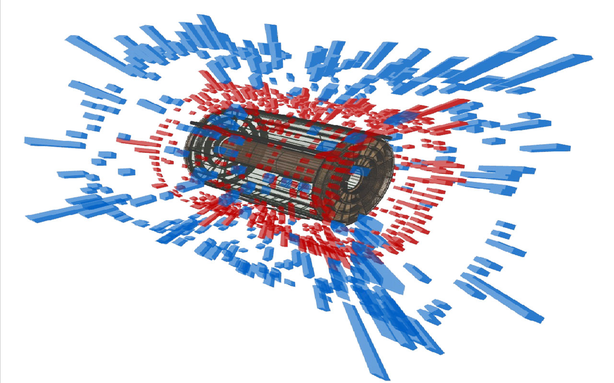

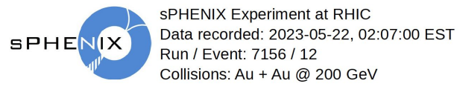
The Status of sPHENIX Experiment at RHIC
Weihu Ma
For the sPHENIX Collaboration
Fudan University
2025/4/26

Slide 2

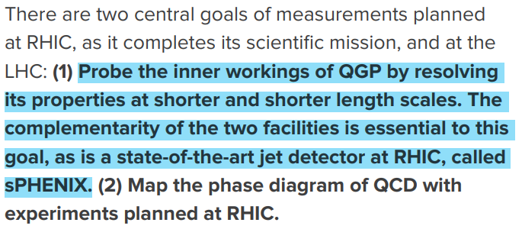
sPHENIX Science Mission
sPHENIX is the first new collider detector at RHIC in over twenty years;
performing very high precision studies of jet production, jet substructure and open and hidden heavy flavor over an unprecedented kinematic range at RHIC;
distinguished by high rate capability and large acceptance, combined with high precision tracking and electromagnetic and hadronic calorimetry.
To successfully conclude the RHIC science mission, it is essential to complete the sPHENIX science program as highlighted in the 2015 Long Range Plan, and analyze the data.
Weihu Ma
sPHENIX

Slide 3
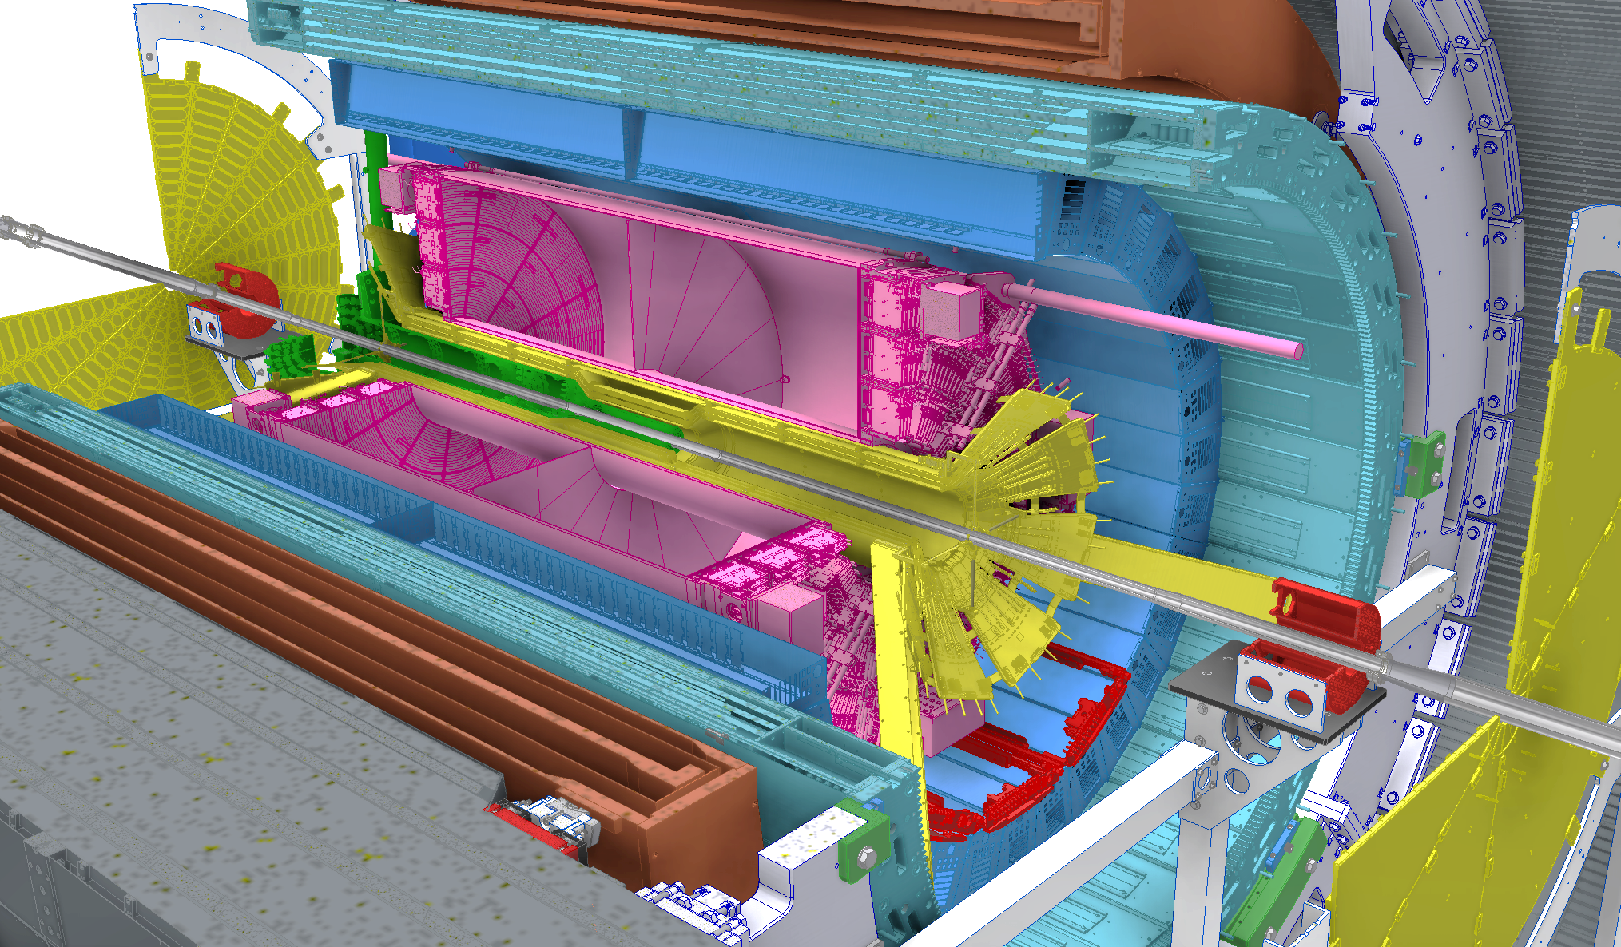
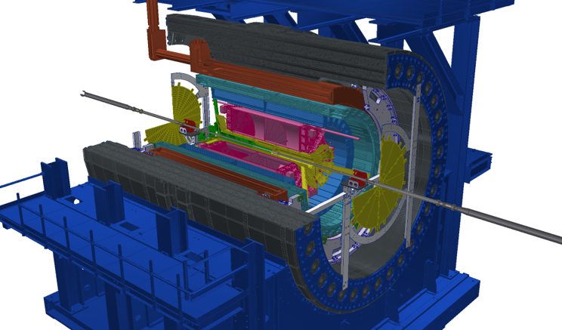
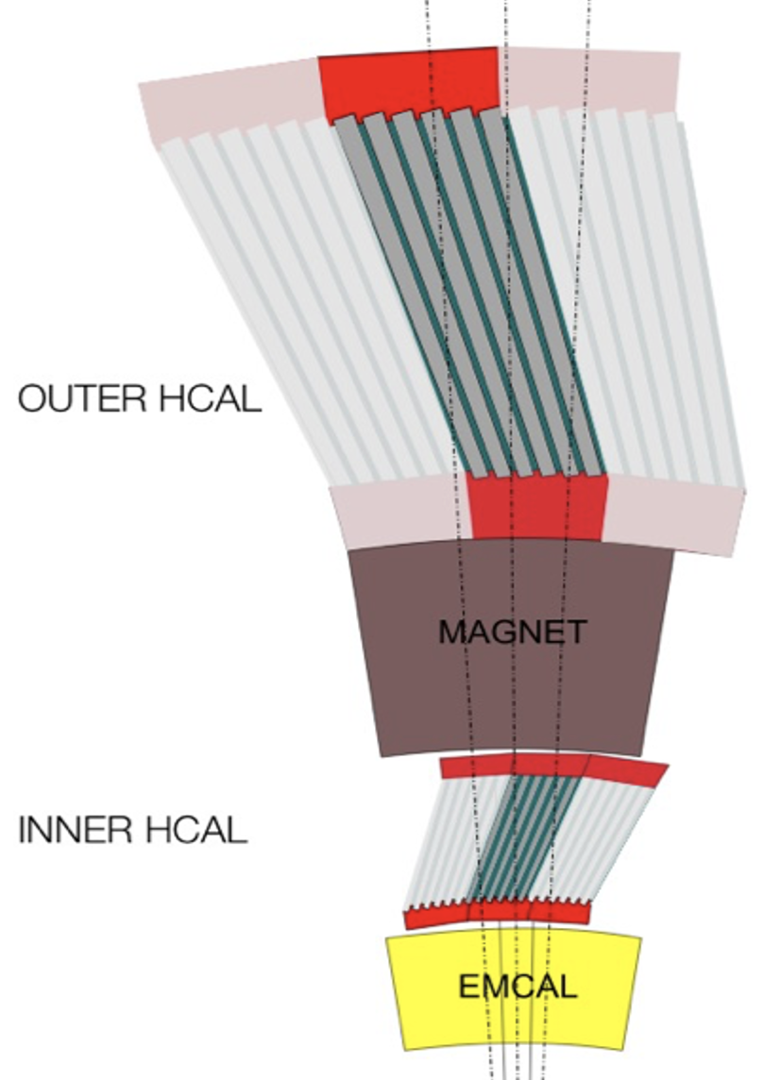

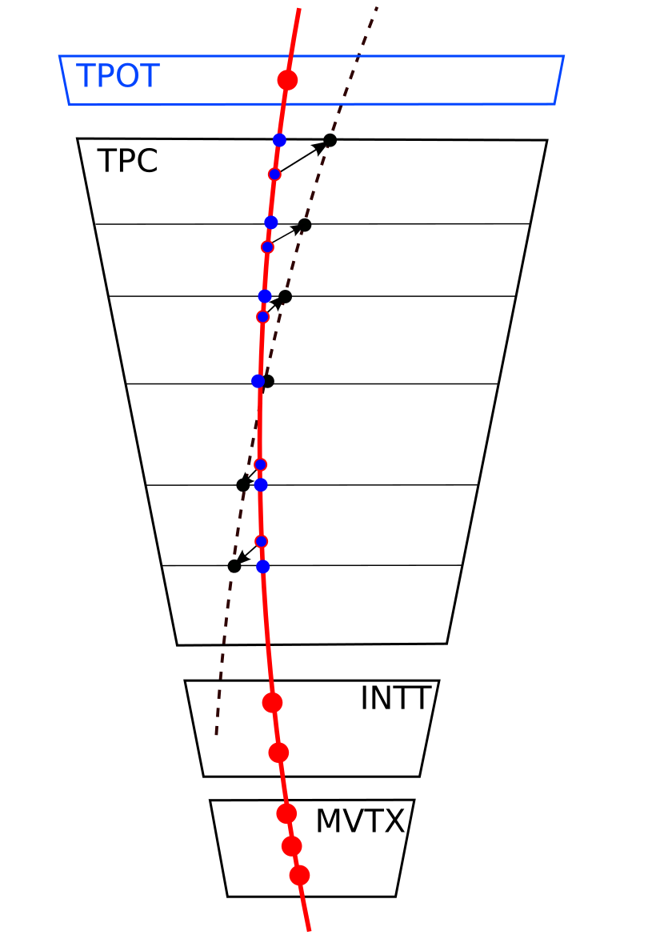
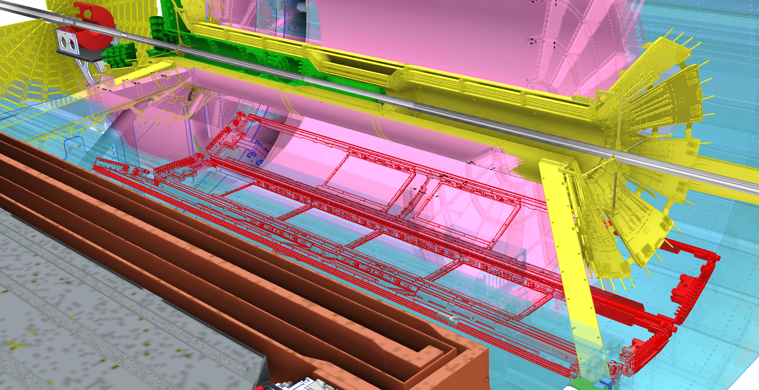
sPHENIX Detector
sEPD
TPC
iHCal
Calorimeter system
oHCal
EMCal
MVTX
MBD
iHCal
◙ High DAQ rate 15 kHz
◙ Trigger system
- jets and photons
◙ Precision tracking
MAGNET
INTT
oHCal
oHCal
◙ All Tracking detectors capable of streaming readout
◙ Hermetic EM + HCAL Coverage in |η|<1.1, 2π in φ
◙ Brings first full jet reconstruction & b-jet tagging at RHIC
TPOT
Tracking system
Weihu Ma
support carriage
sPHENIX

Slide 4
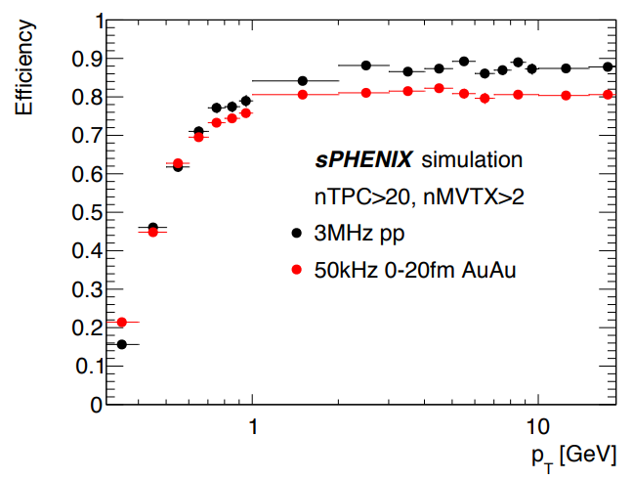
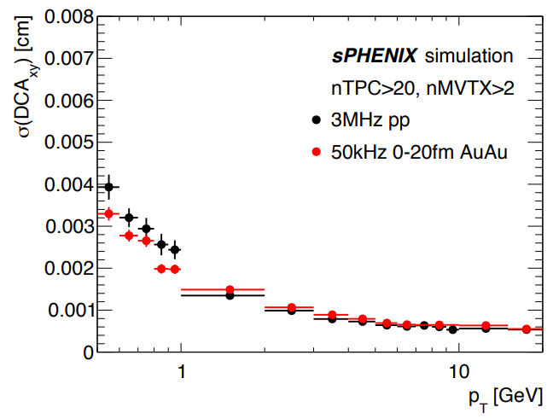
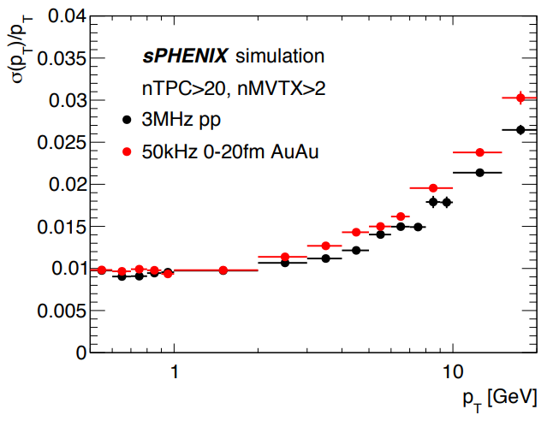
Tracking Performance
sPHENIX tracking performance
Eff.~90% for pp at pT>1 GeV. → promising to measure rare processes: e.g. Υ(nS).
DCA resolutions in r-ɸ, z < 40μm at pT>0.5 GeV. → crucial for open heavy-flavor.
pT resolution < 2% for pT < 10 GeV. → meets δM < 125 MeV for Υ(nS) separation.
Weihu Ma
sPHENIX

Slide 5
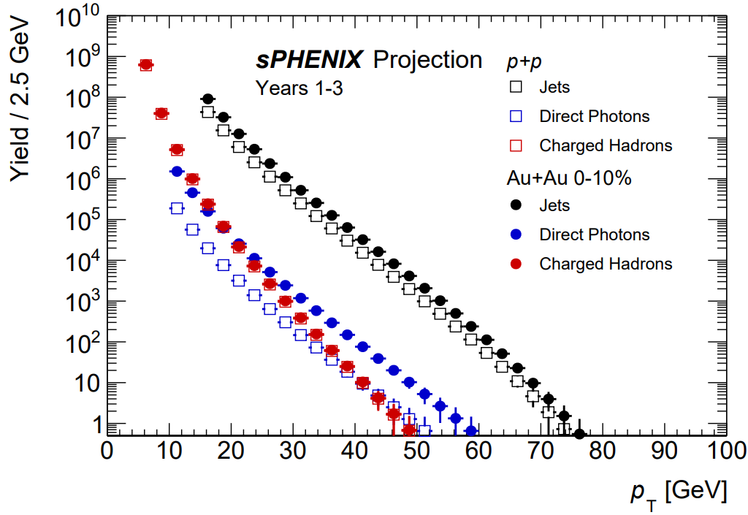
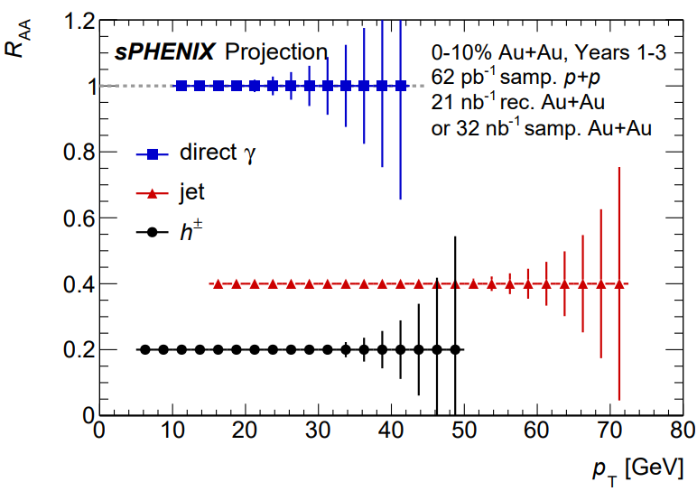
sPHENIX Projections: Physics Objects
High-pT Probes: probing the QGP with precise jet, direct photon, and hadron measurements
BUP2023
BUP2023
High data rates & hermetic EMCal+HCal offer wide pT range for jet reconstruction.
sPHENIX can precisely measure the low pT region, which is challenging at the LHC.
sPHENIX will have kinematic reach out to ∼ 70 GeV for jets, kinematic overlap with the LHC.
Weihu Ma
5
sPHENIX

Slide 6
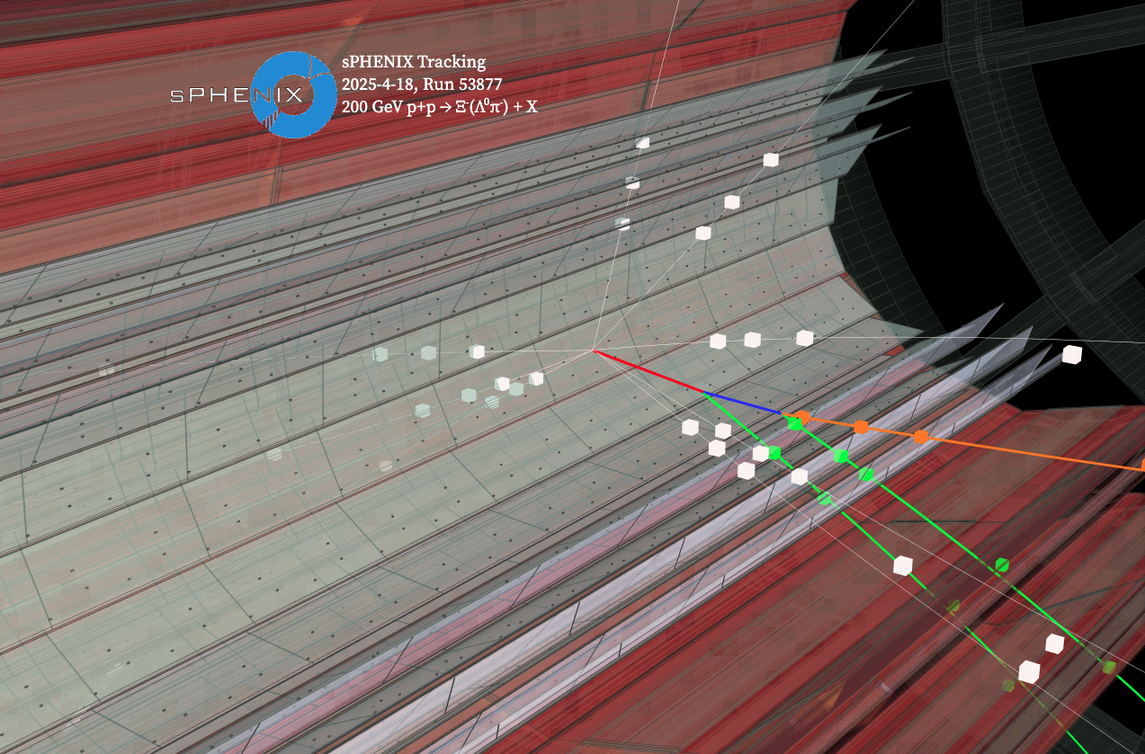

Tracks Reconstruction from Data
Reconstructed tracks matched through the full tracking system
Tracks from Au+Au collision at 200 GeV
$${p+p→Ξ}^{−}(Λ^{0}π^{−}+X)$$
Weihu Ma
6
sPHENIX

Slide 7
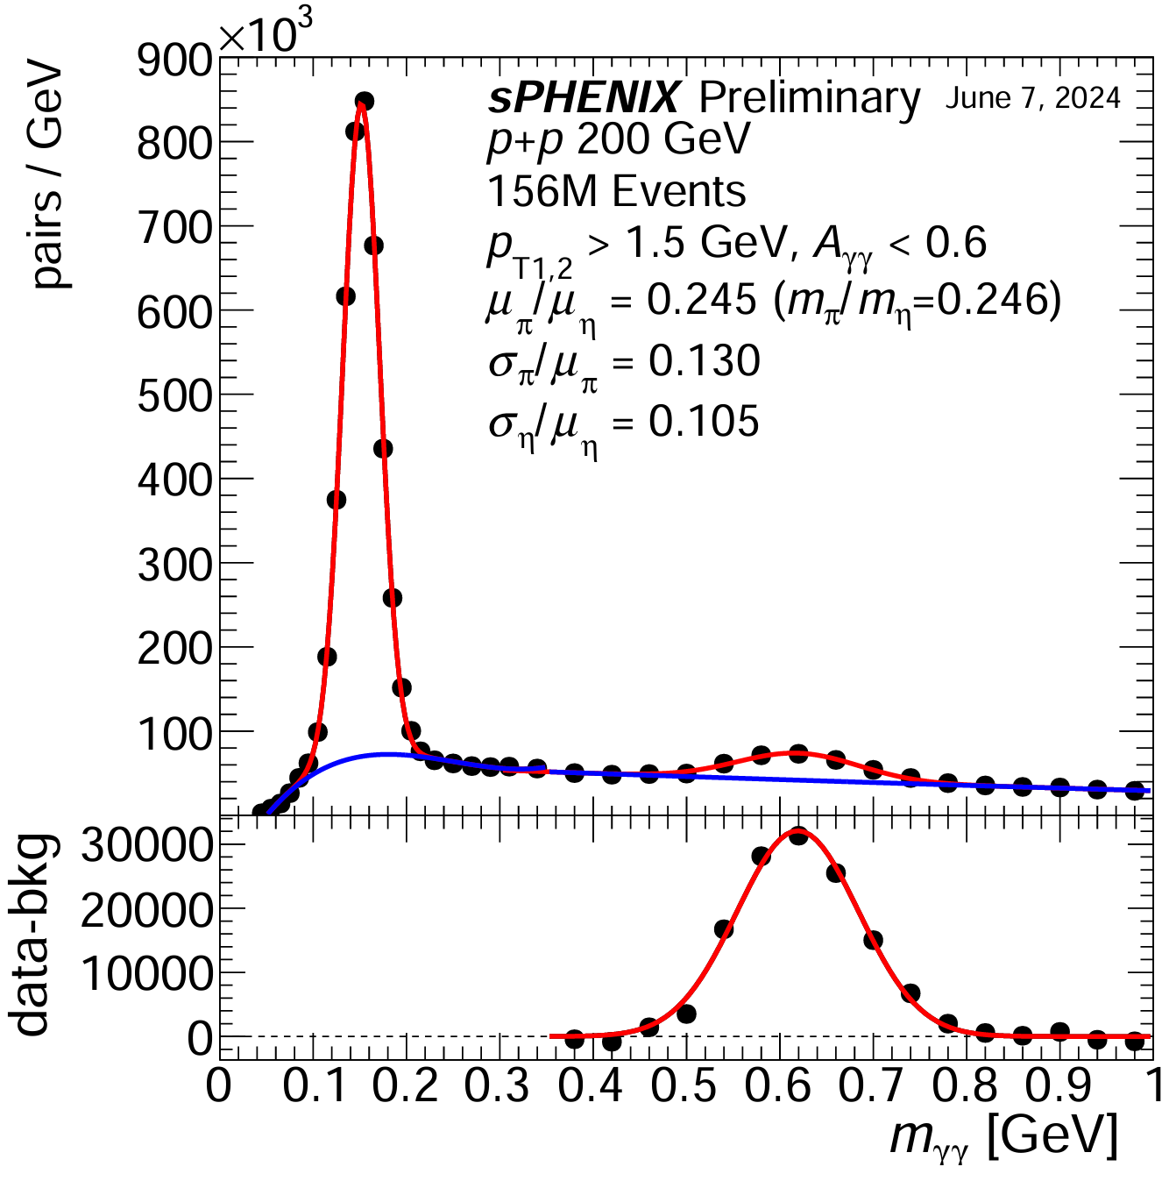
Calorimeters Reconstruction from Data
Weihu Ma
7
sPHENIX

Slide 8
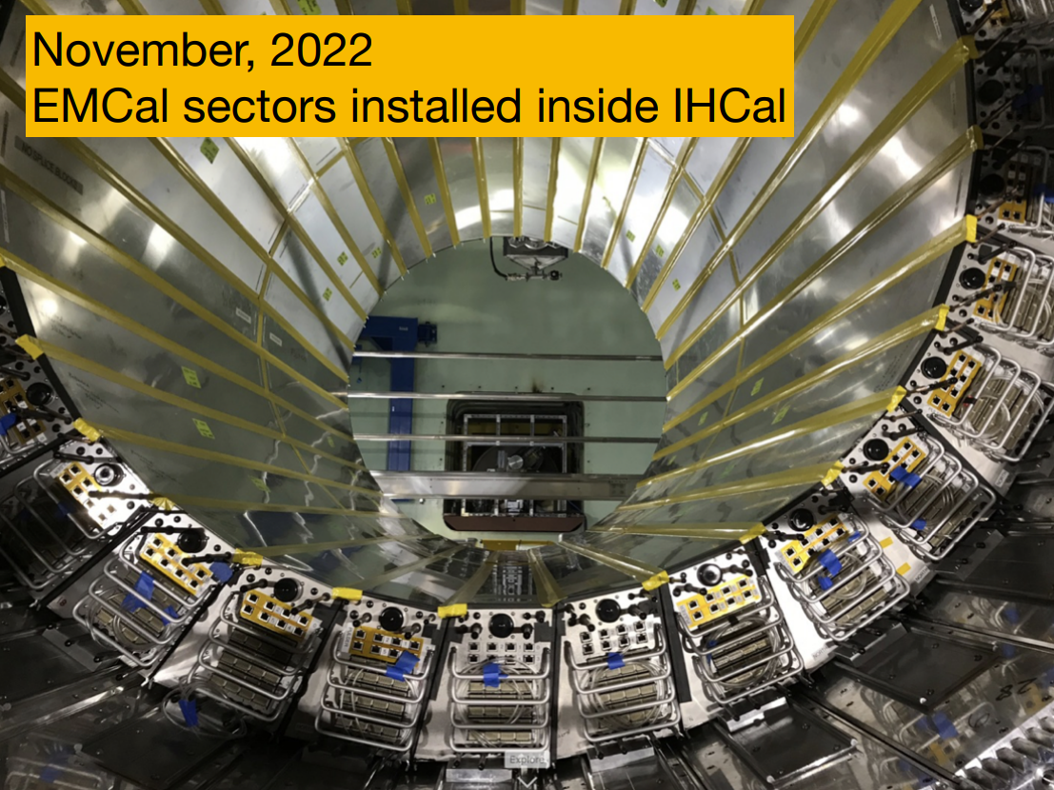
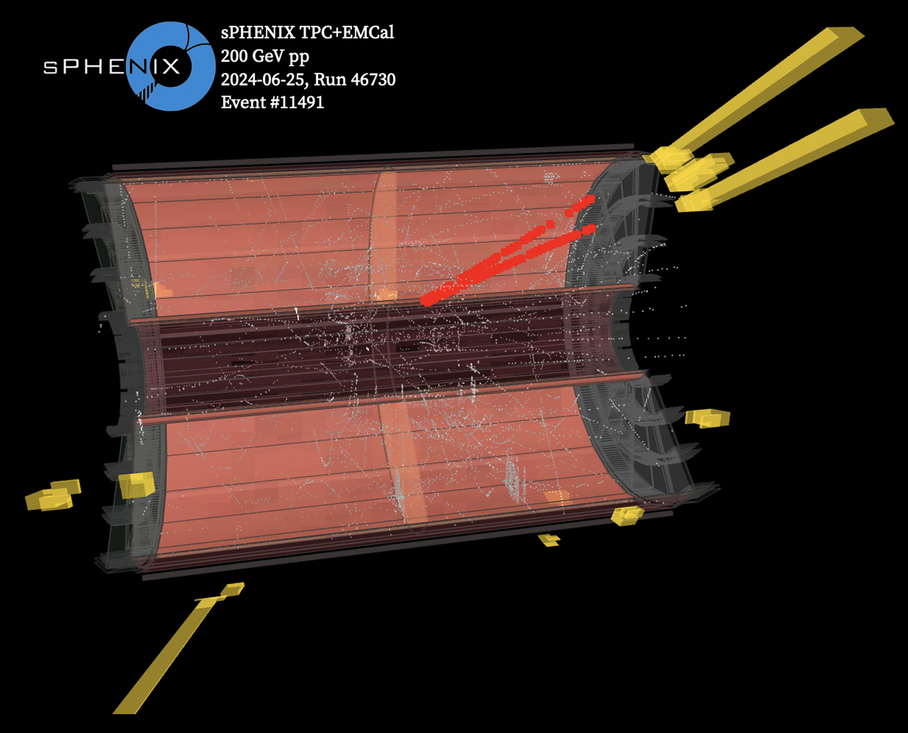
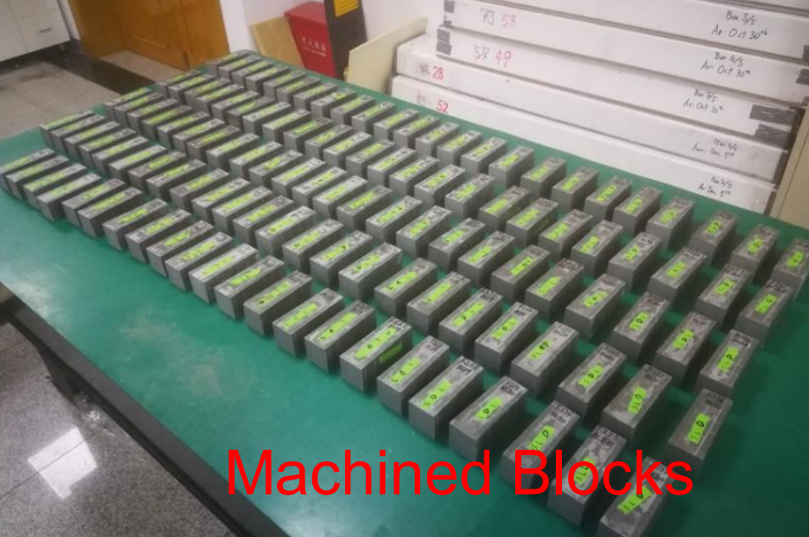
Event display from Data
Event display of a photon conversion event
TPC track-hits (red)
Tracks from Au+Au collision at 200 GeV
Fudan, Peking & CIAE
Energy deposits in the EMCal towers (yellow)
Weihu Ma
8
sPHENIX

Slide 9
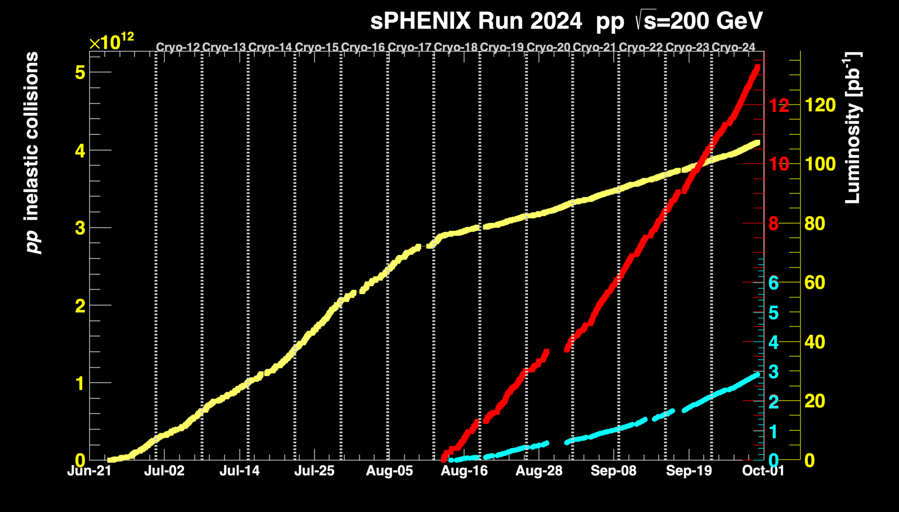
Timeline and Data Taking
2015
2016
2017
2018
2019
2020
2021
2022
2023
DOE CD-0
“Mission need” approval
DOE CD-1/3A
Cost, schedule, advance purchase approval
Installation and commissioning
Detector installation
completed
sPHENIX science collaboration
2023
Au+Au Commissioning run
Cut short by accelerator incident
  Calorimeter data: 107.4 pb-1
  Triggered data full detector: 13.28 pb-1
  Tracker Streaming Data: 2.9pb-1
p+p production run
Finalize commissioning
of tracking detectors
Short Au+Au run
2024
Au+Au production run
Target Luminosity 7nb-1
2025
Weihu Ma
sPHENIX

Slide 10
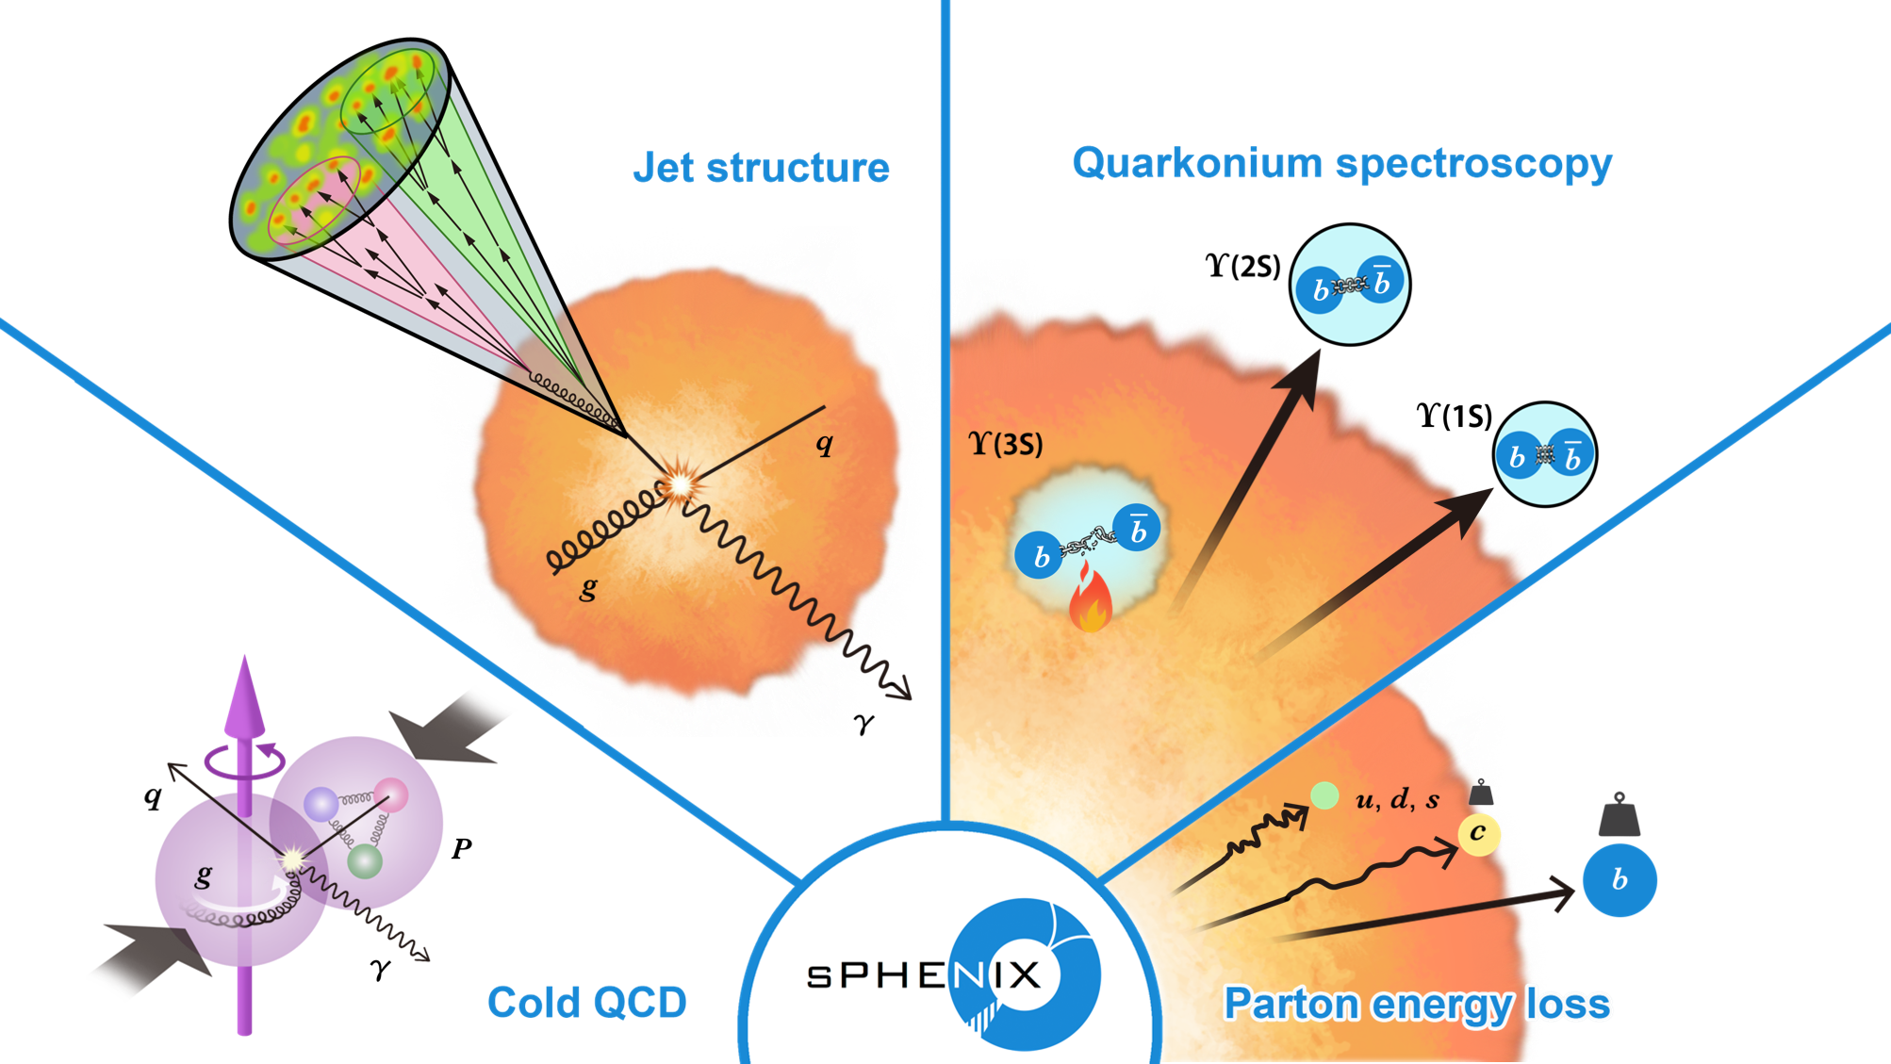
Physics Programs
Weihu Ma
sPHENIX

Slide 11
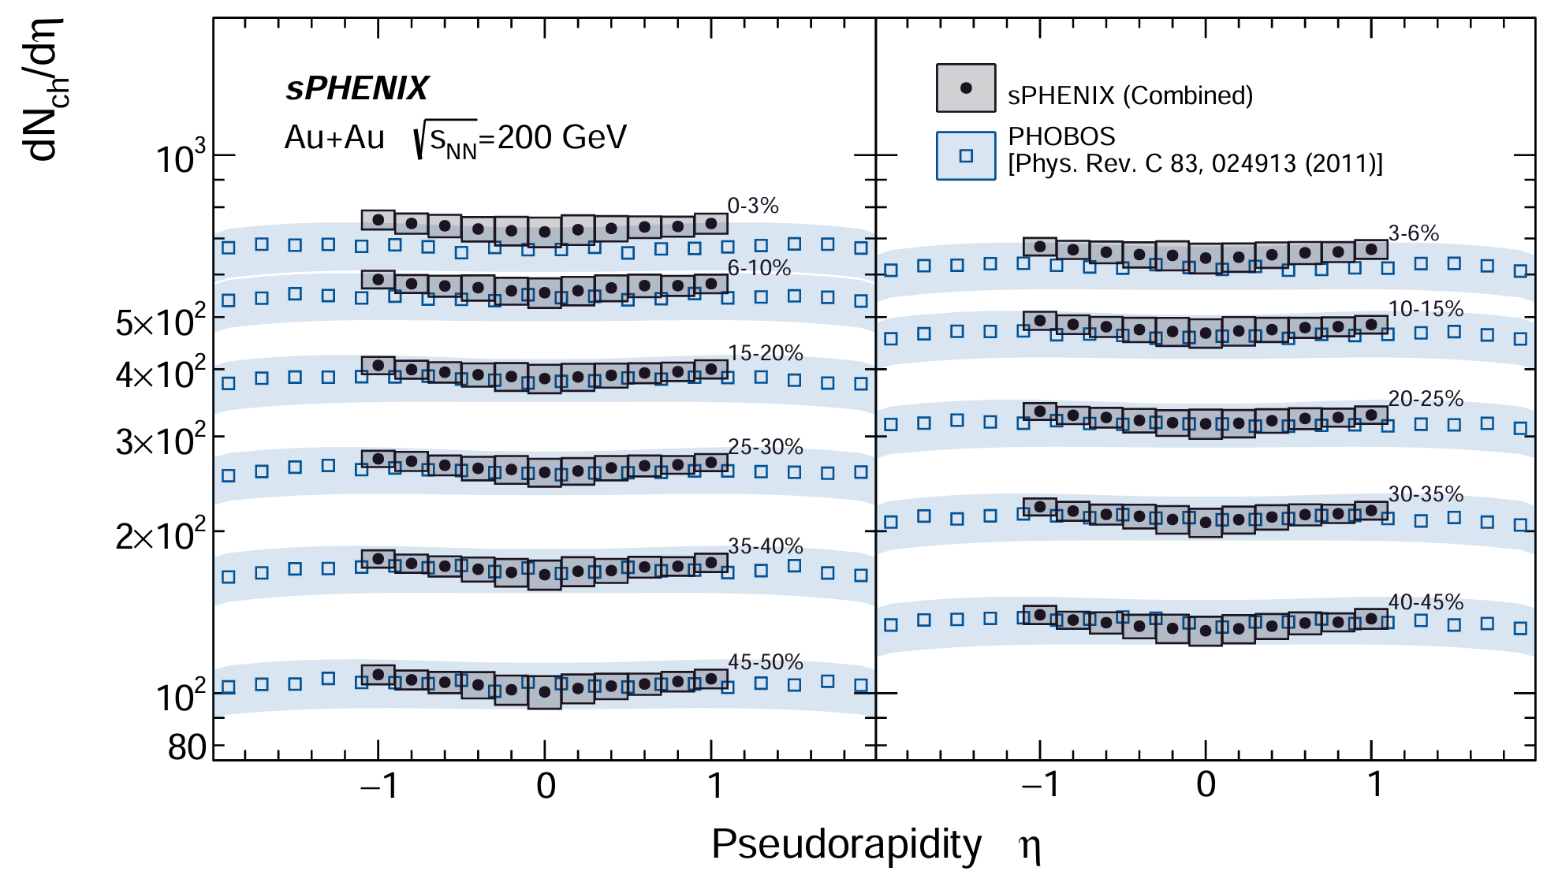
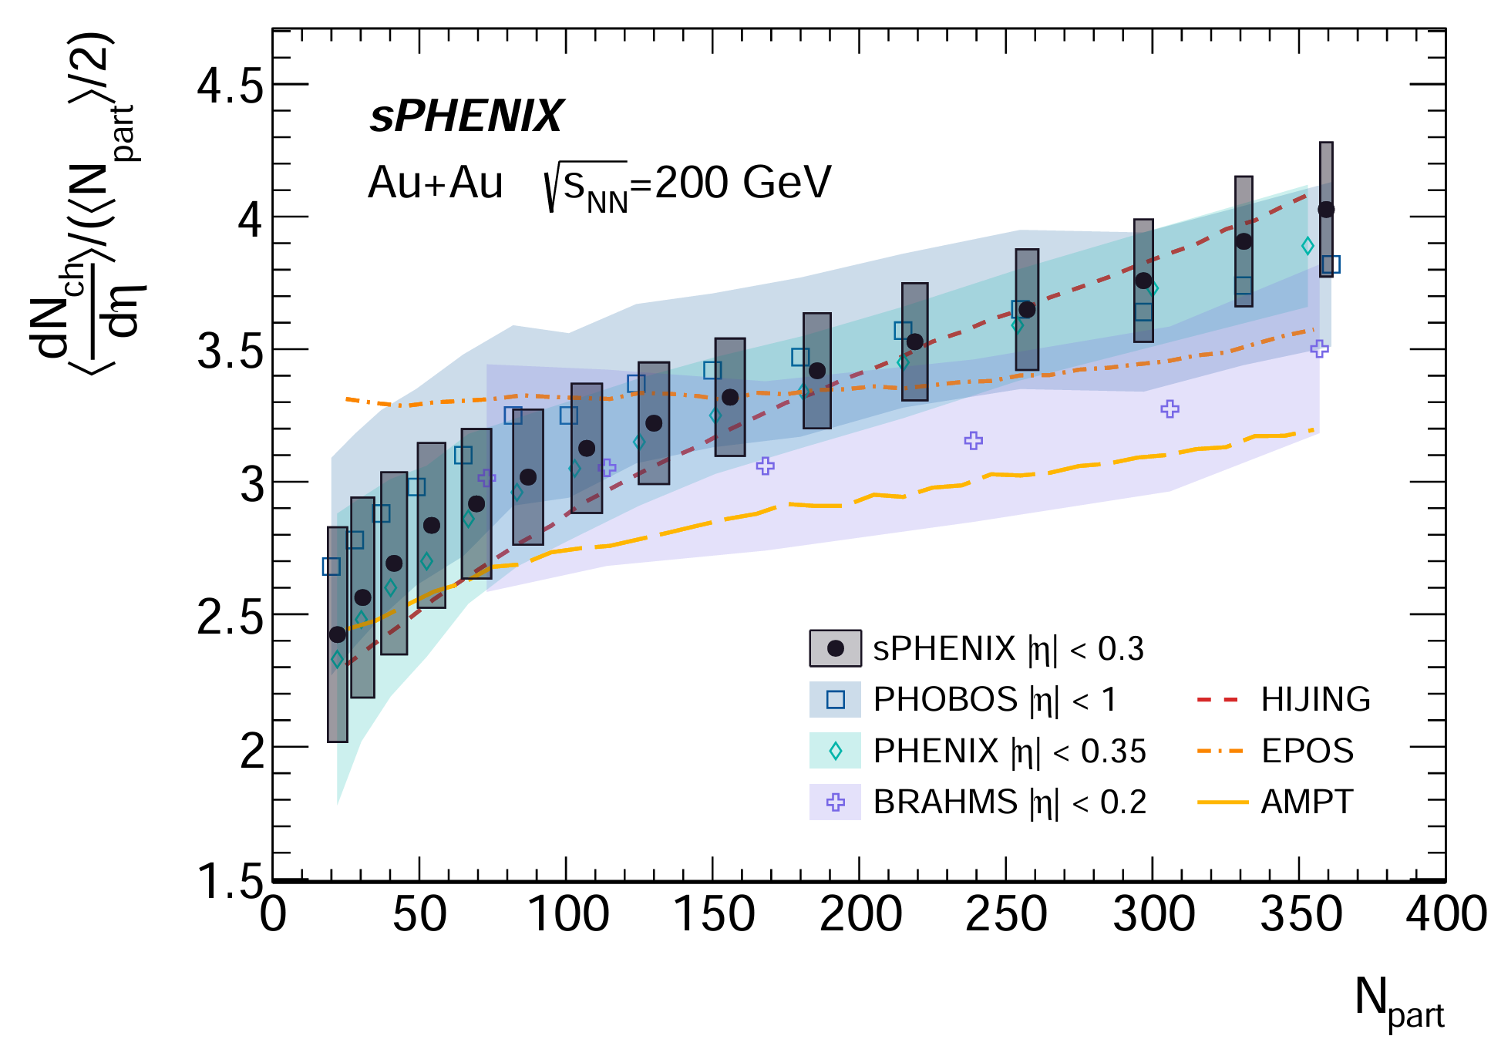
Bulk Observables: Au+Au dNch/dη
arXiv:2504.02240
The average pseudo-rapidity density of charged hadrons at mid-rapidity.
Measured with INTT.
Featuring full azimuthal coverage at mid-rapidity.
Supporting the broader sPHENIX physics program.
Weihu Ma
11
sPHENIX

Slide 12
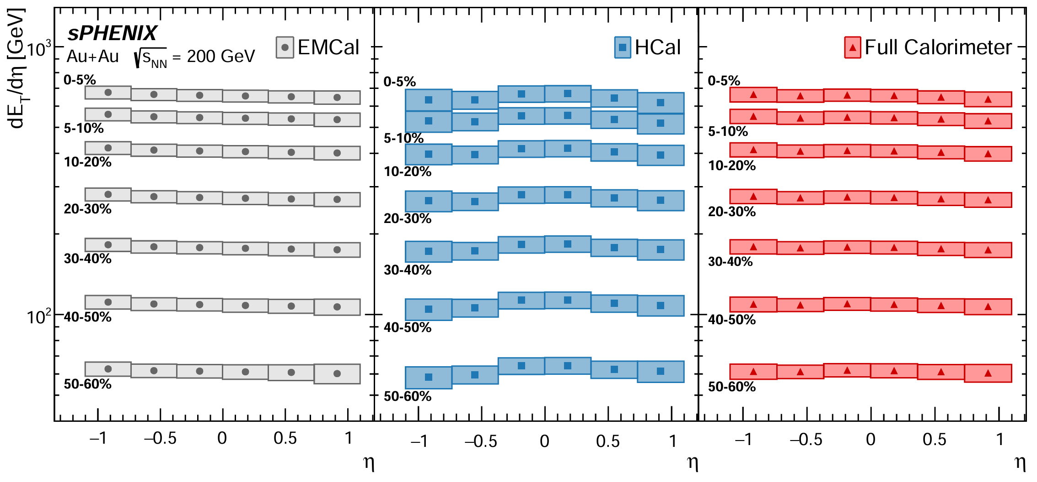
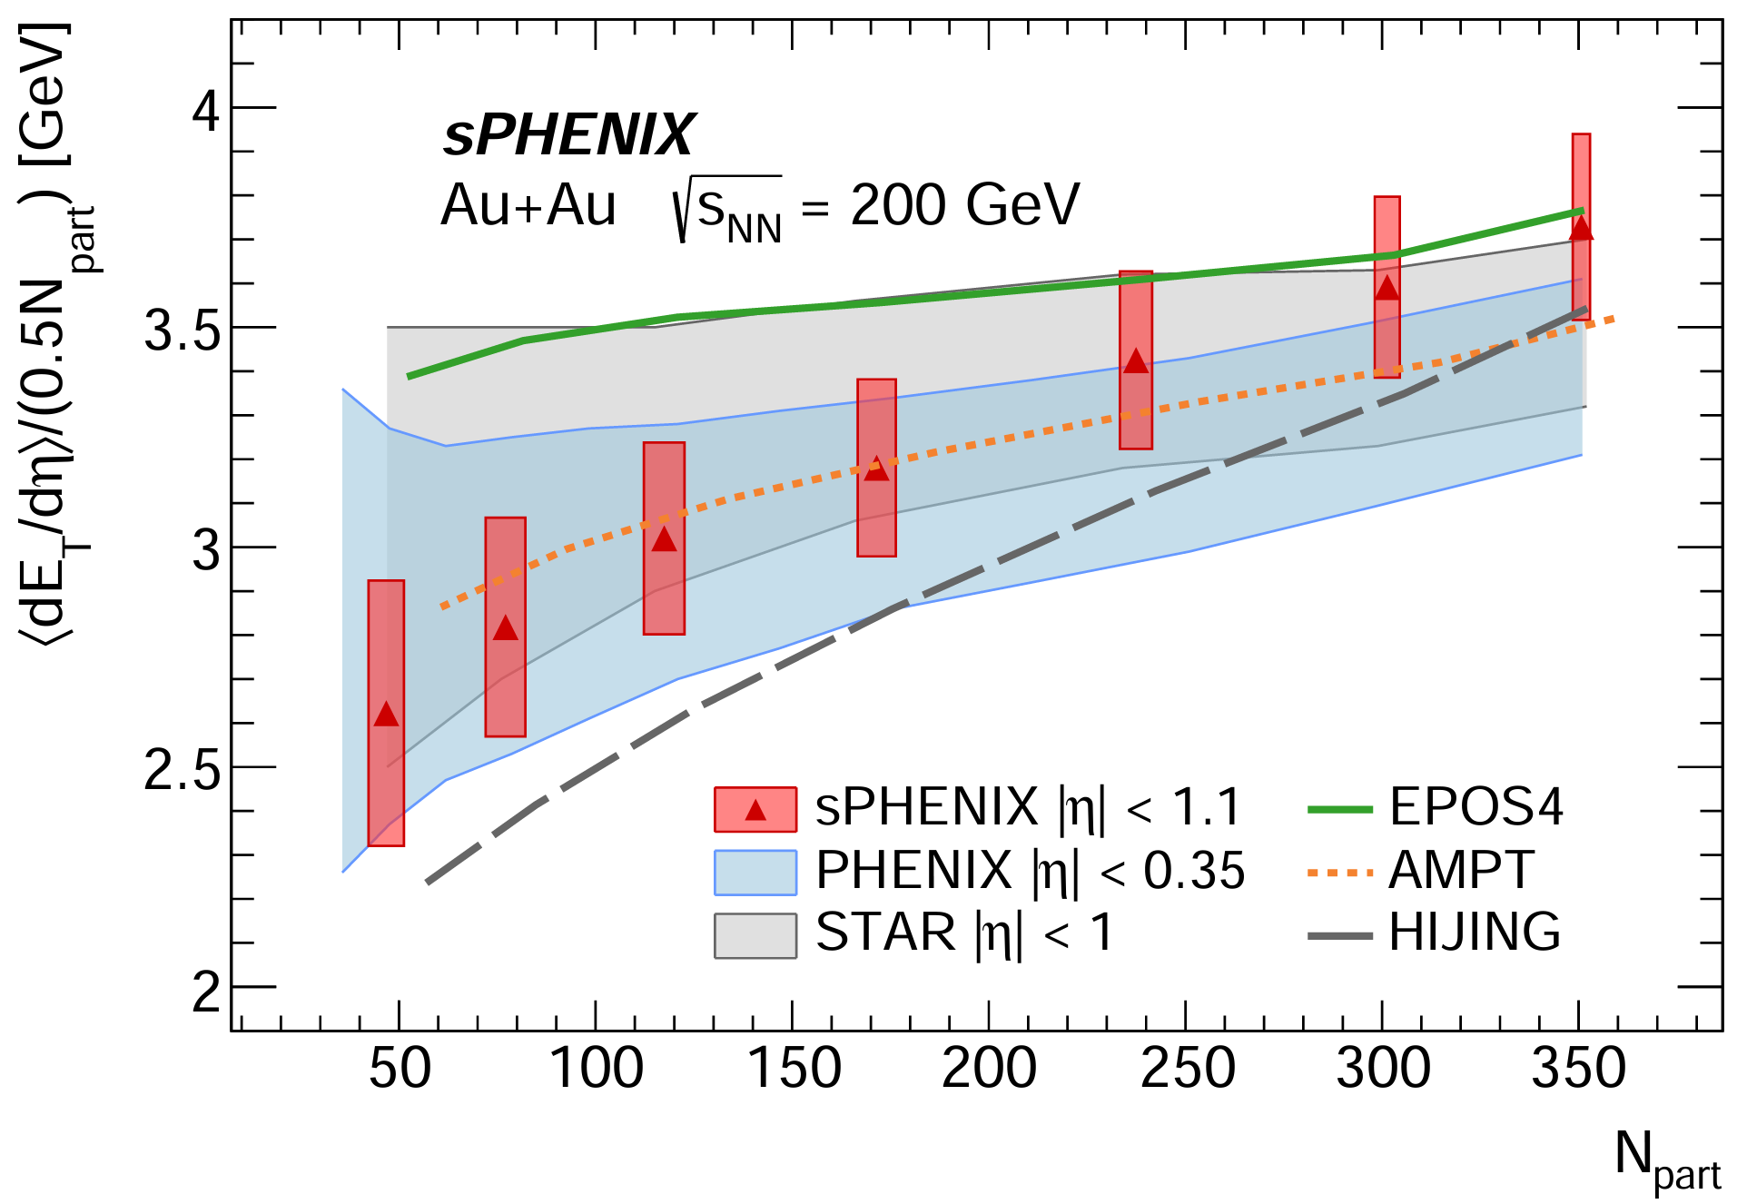
Bulk Observables: Au+Au dET/dη
arXiv:2504.02242
  The transverse energy per unit pseudo-rapidity.
  Measured with EM and Hadronic calorimeters.
  dET/dh gives estimate of initial energy density.
The results are in agreement with previous measurements at RHIC, and feature an improved granularity in η and improved precision in low-Npart events.
Weihu Ma
12
sPHENIX

Slide 13
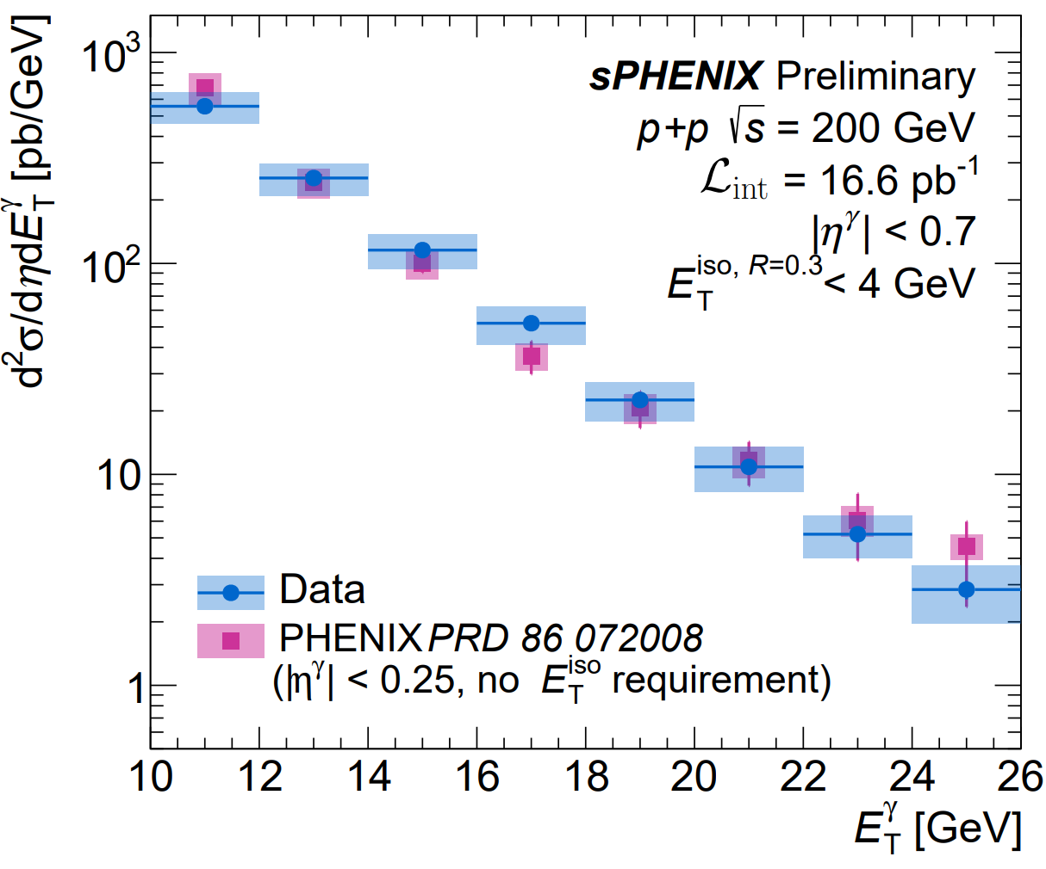
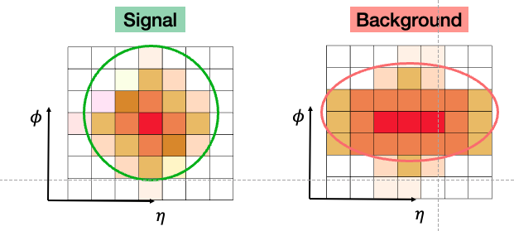
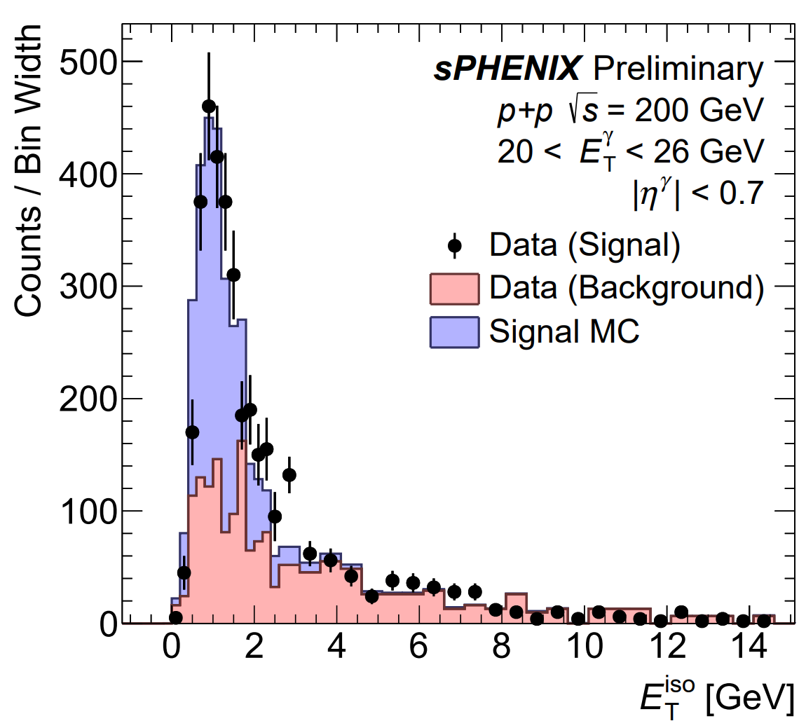
Run-24 p+p: High pT Isolated Photons
Shower Shape - EMCAL
γ
γ
γ
π0
Isolation – EMCAL + HCAL
Used to constrain initial state PDFs and NLO calculations
Reference for Au+Au
Weihu Ma
sPHENIX

Slide 14
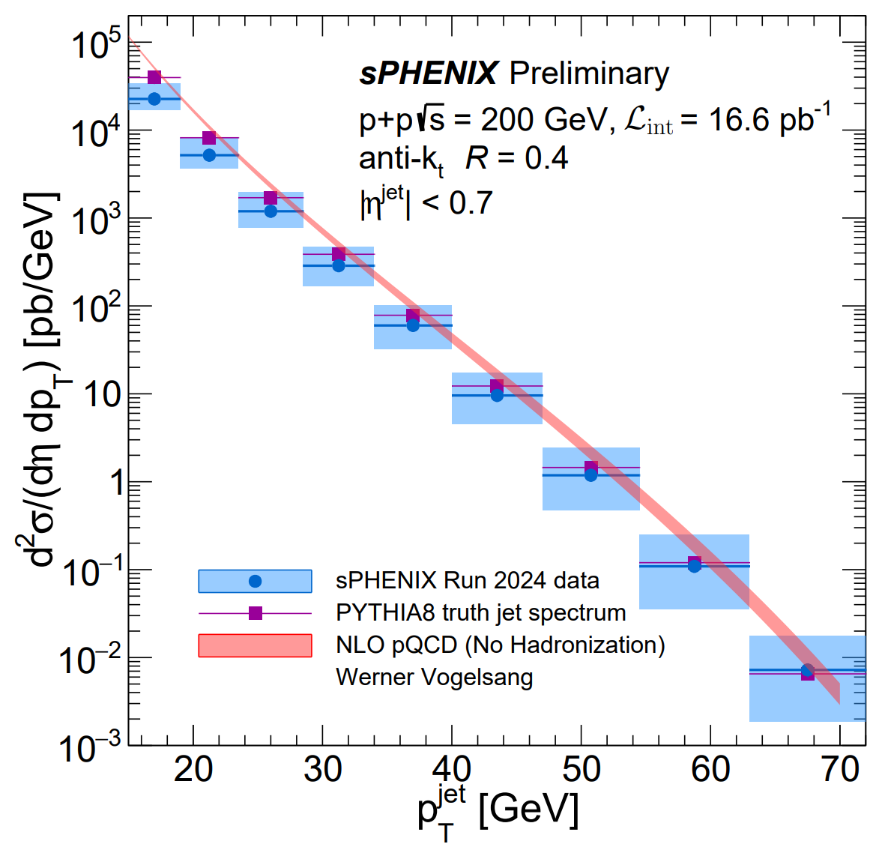
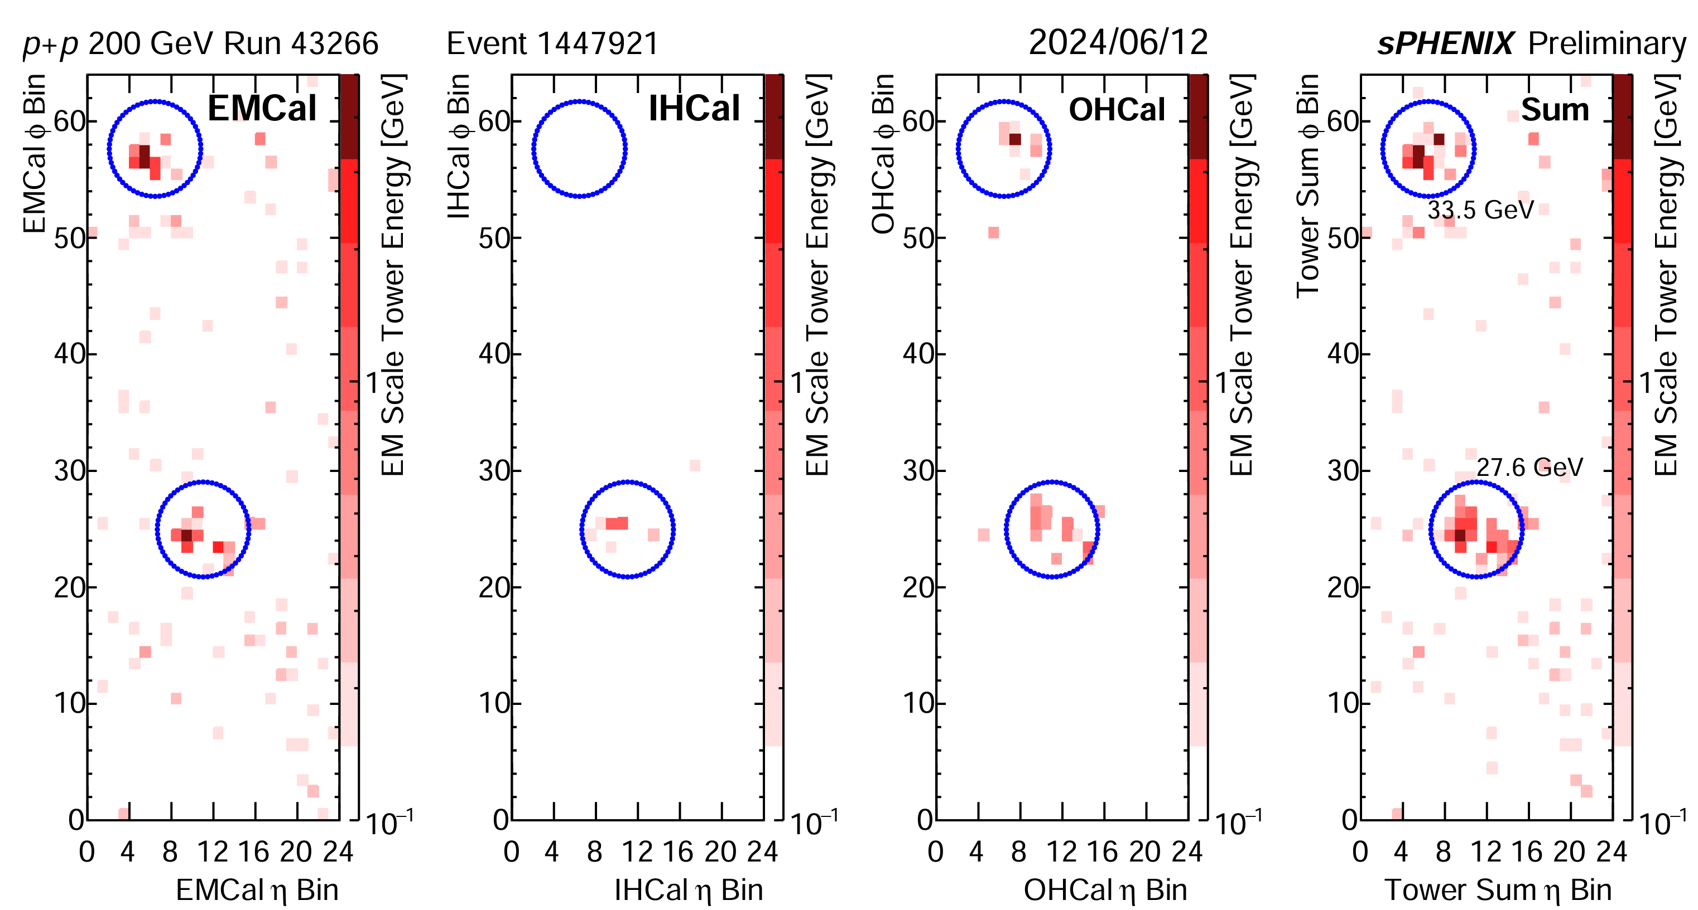
Run-24 p+p: Inclusive spectra of Jets
Corrected for jet pT scale
Unfolded to MC final state particle level
Event display of a dijet in Run24 p+p running, measured with the calorimeter system.
  Unprecedented pT reach at RHIC
  Only 15% of full luminosity used for this analysis
Weihu Ma
14
sPHENIX

Slide 15
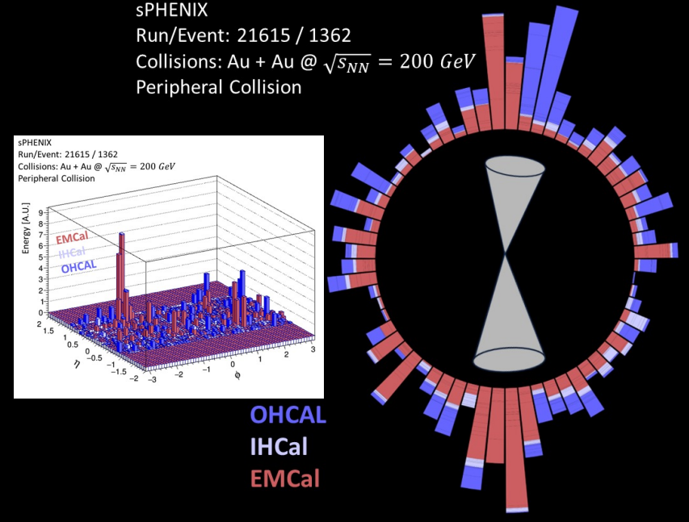
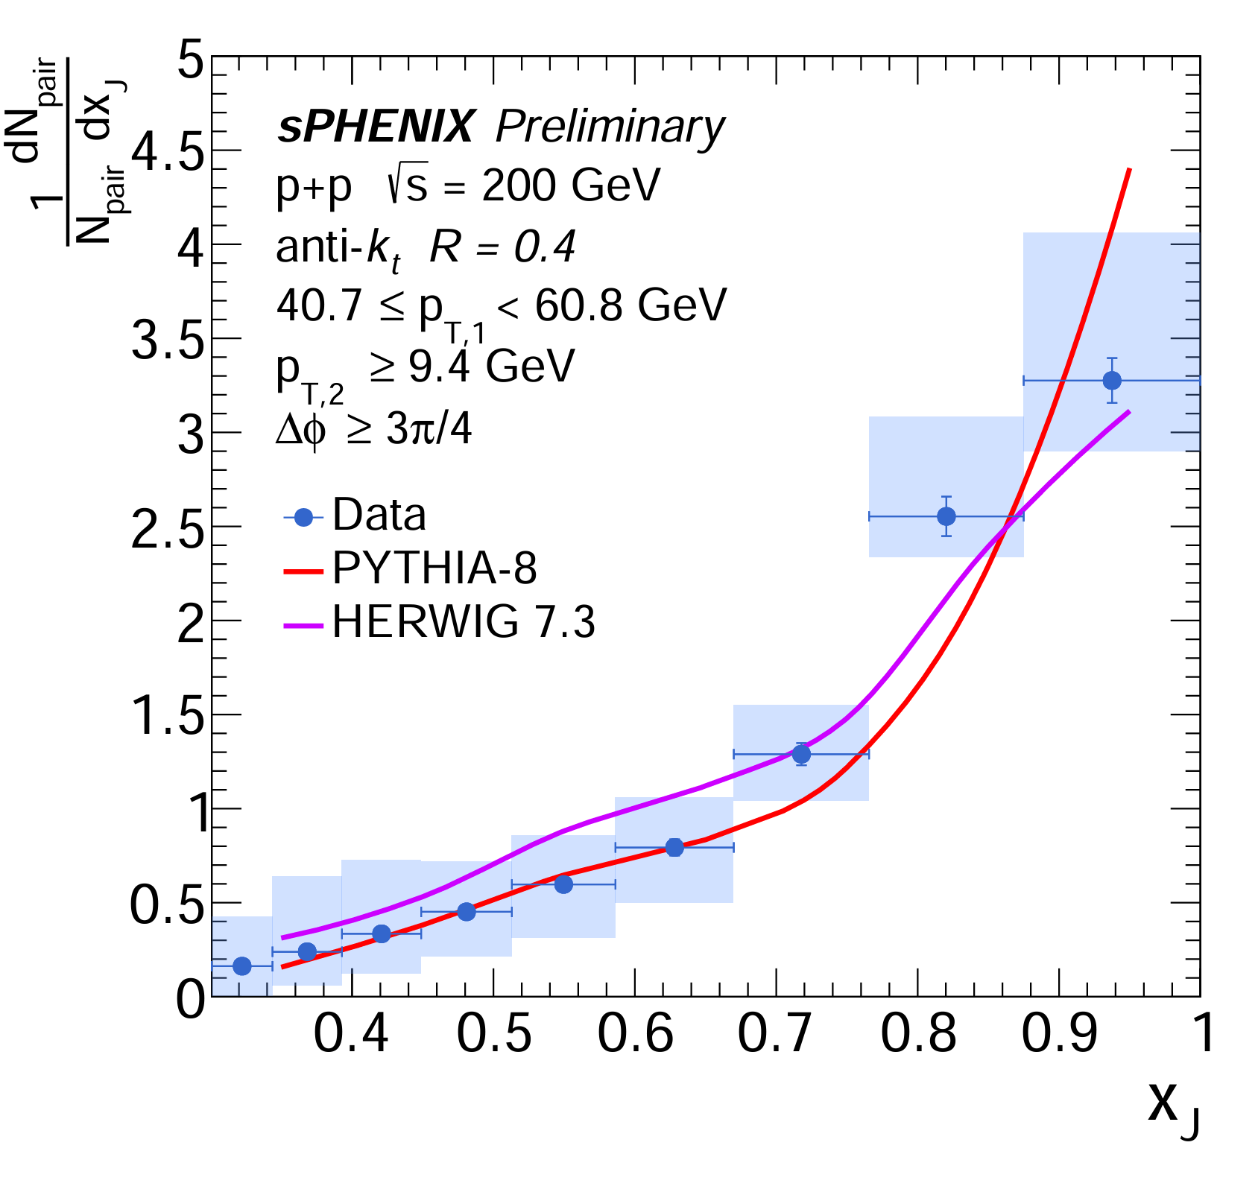
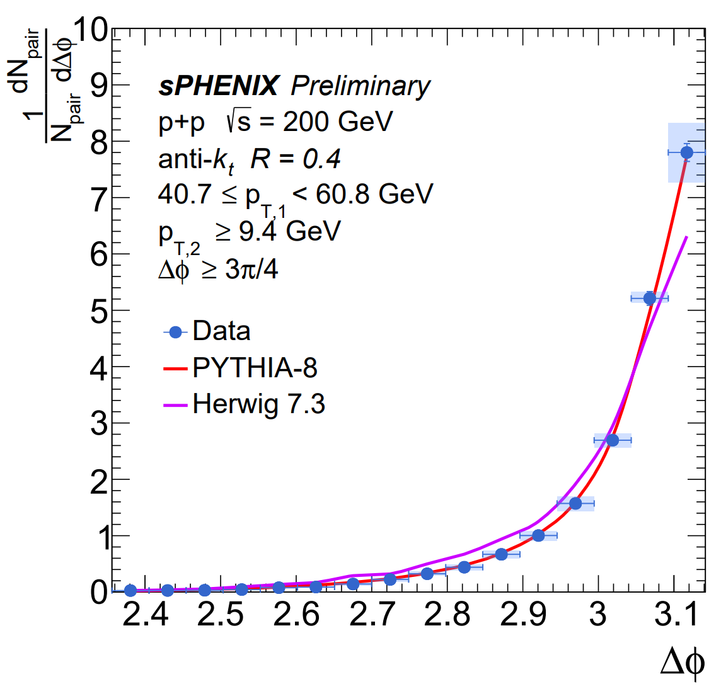


Run-24 p+p: Dijet correlations
$$Δφ$$
Data well described by PYTHIA
Important reference for Au+Au
Dijet pT balance $x_{J}=p_{T}^{2}/p_{T}^{1}$
Dijet angular correlation
Weihu Ma
15
sPHENIX

Slide 16
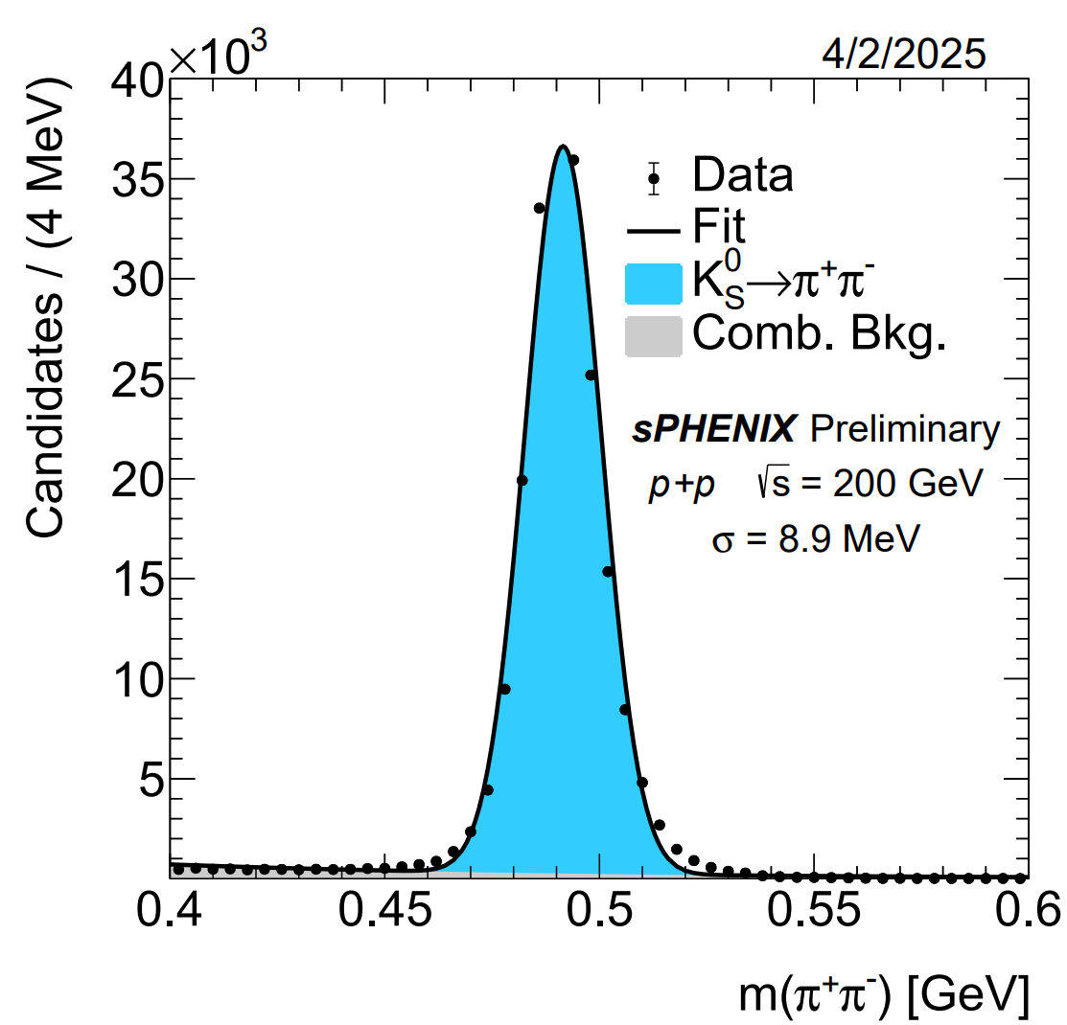
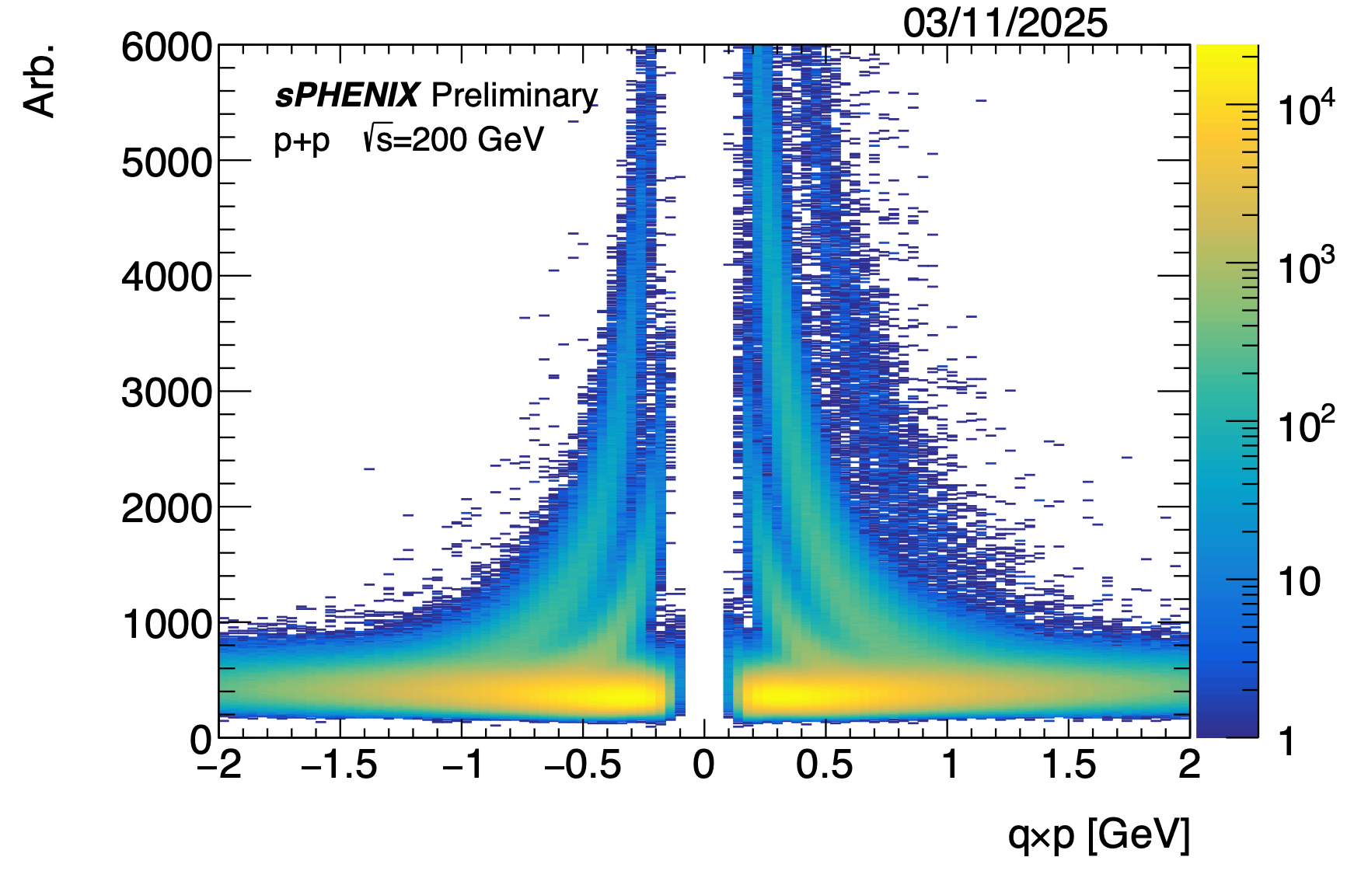

Run-24 p+p: Tracking
$K_{S}^{0}→$ π+π−
d
p
K
dE/dx [a.u.]
π
q x p [GeV]
Early alignment, calibrations and distortion corrections
Vertex reconstruction from matching to Silicon detectors
TPC provides momentum and dE/dx for PID
Weihu Ma
sPHENIX

Slide 17
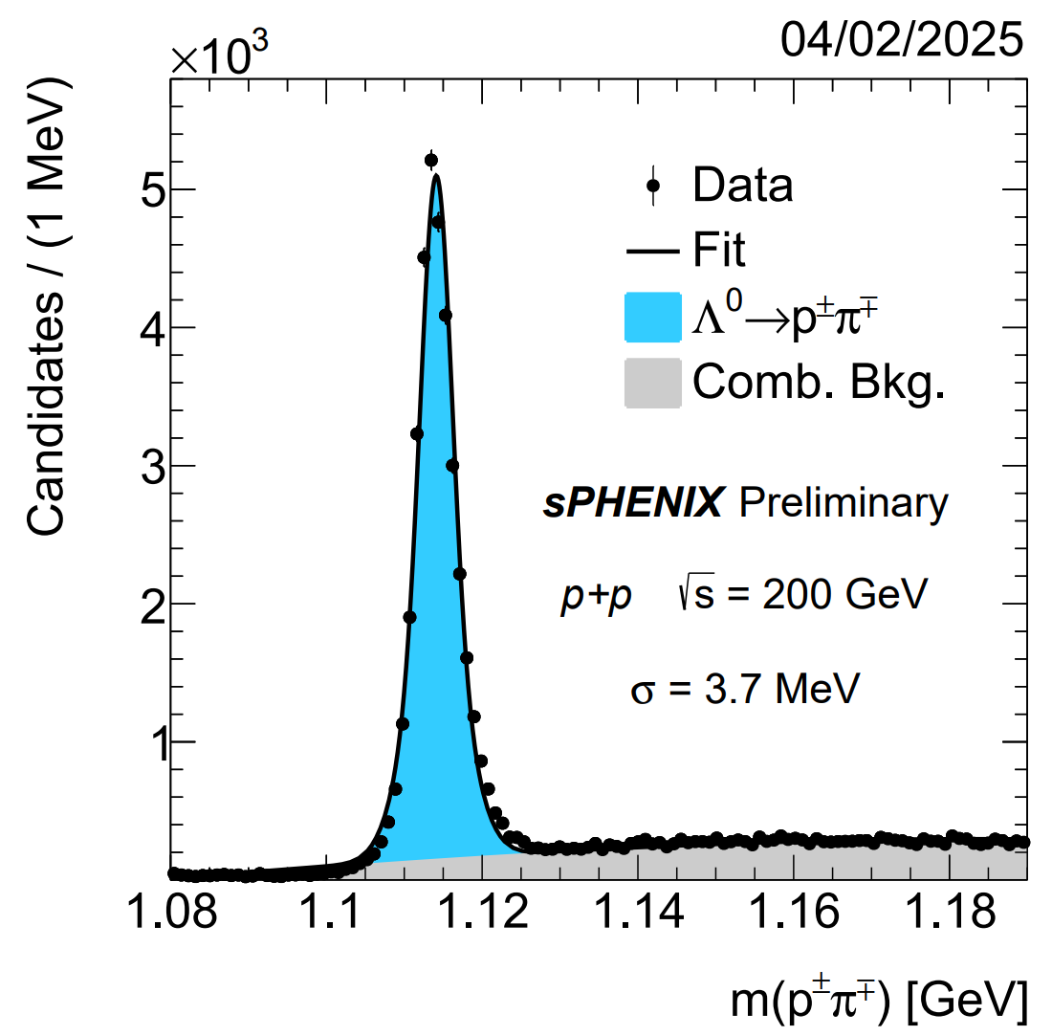
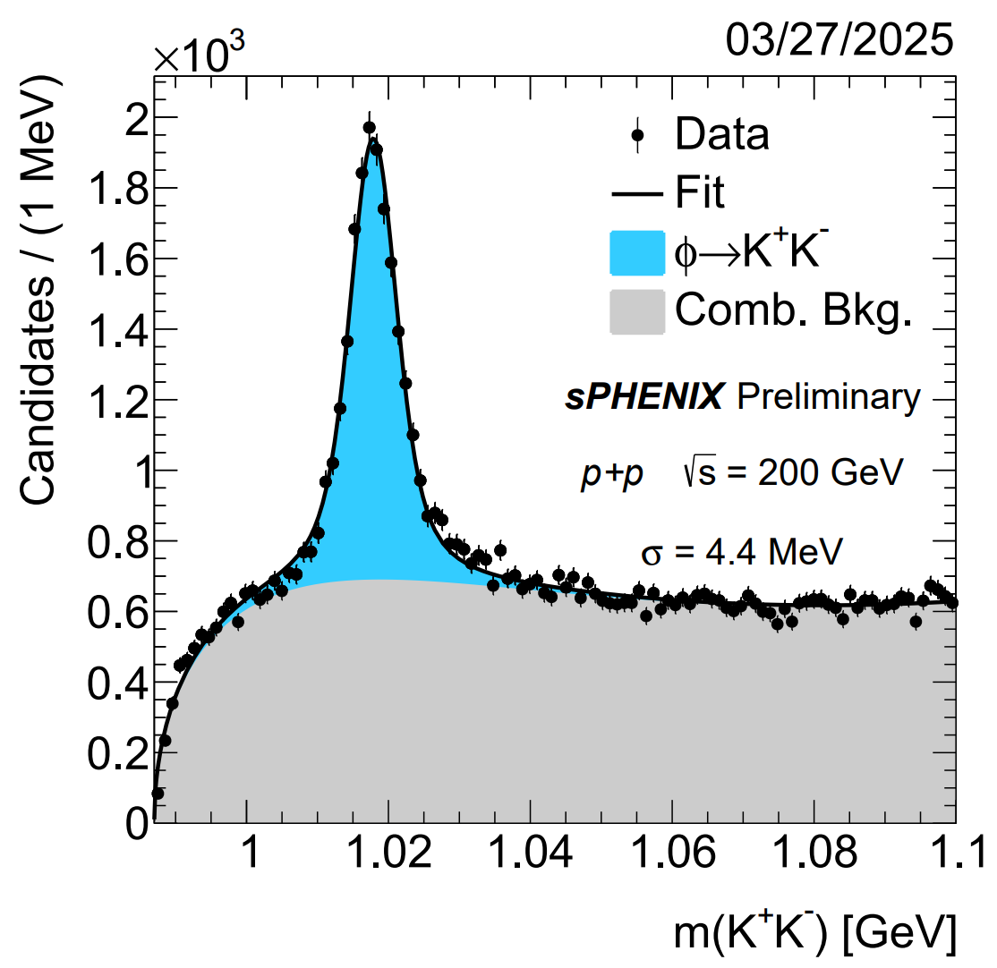
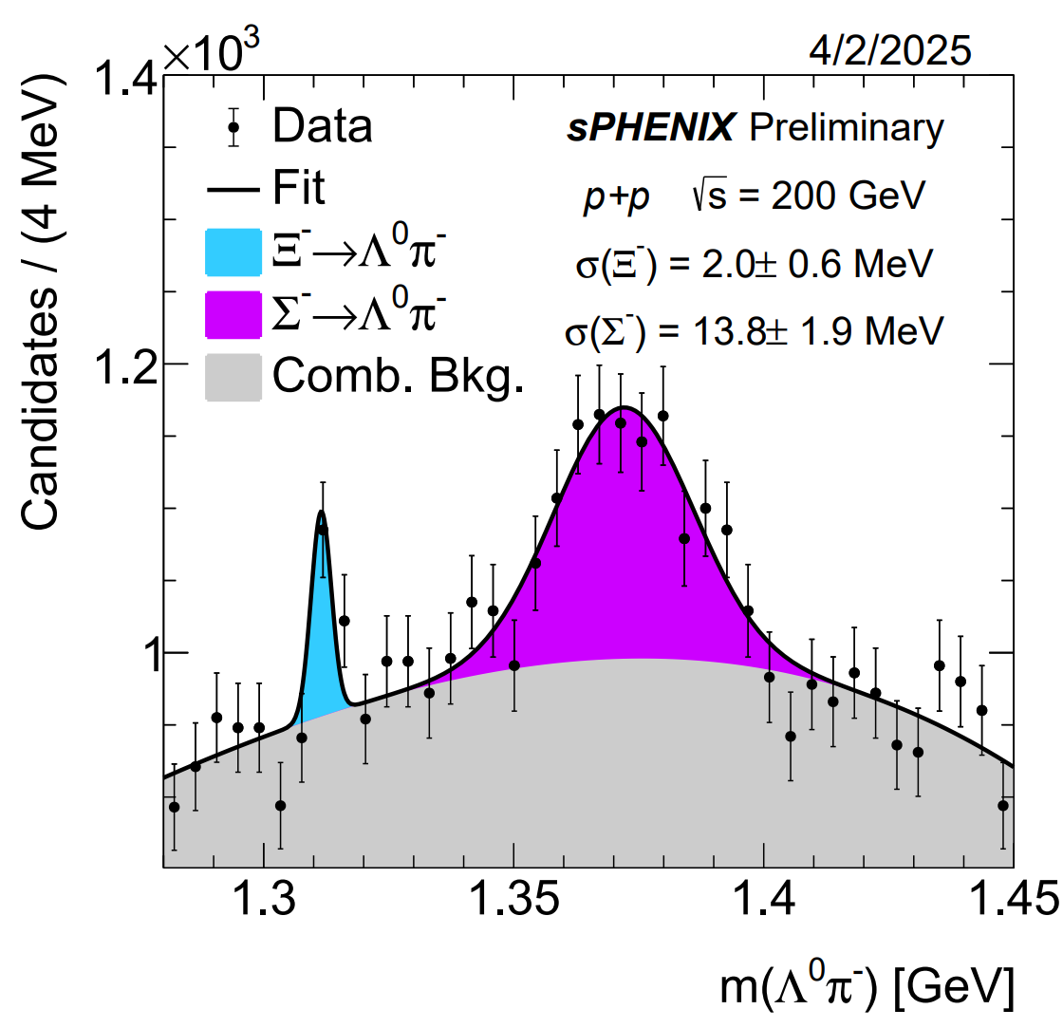
Run-24 p+p: Strangeness
Λ0 p±π±
φ K+ K−
Ξ− Σ− Λ0π−
Early alignment, calibrations and distortion corrections
Vertex reconstruction from matching to Silicon detectors
TPC provides momentum and dE/dx for PID
Weihu Ma
sPHENIX

Slide 18
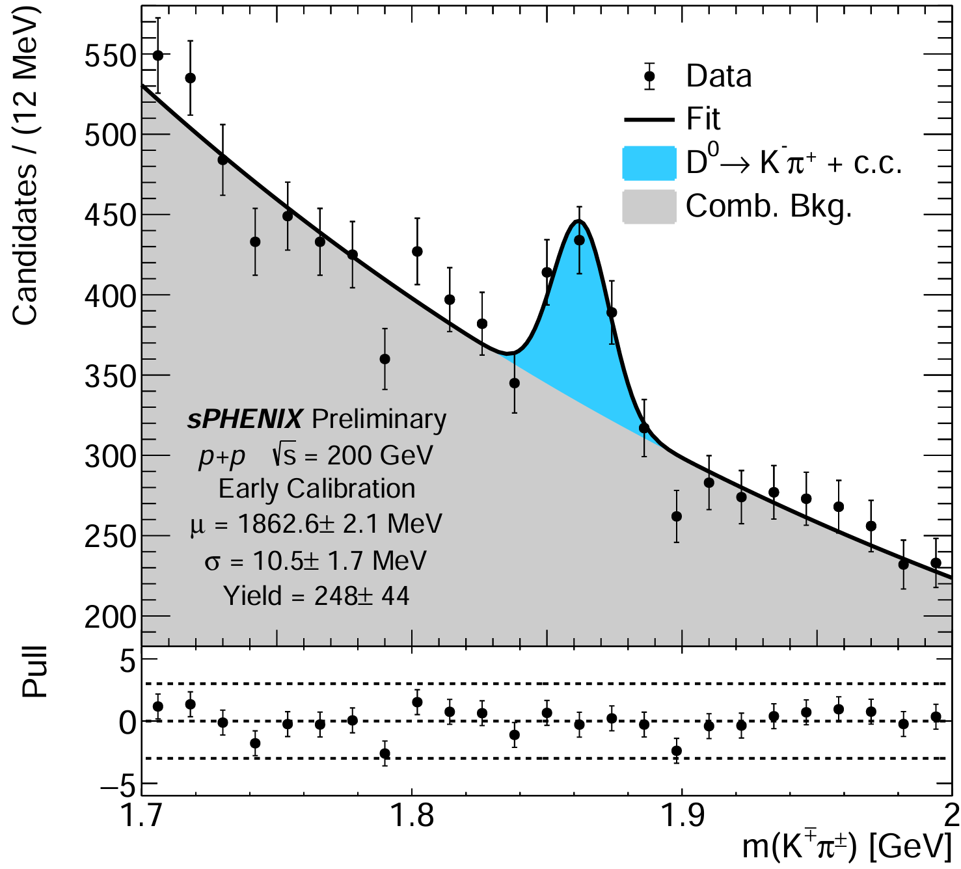
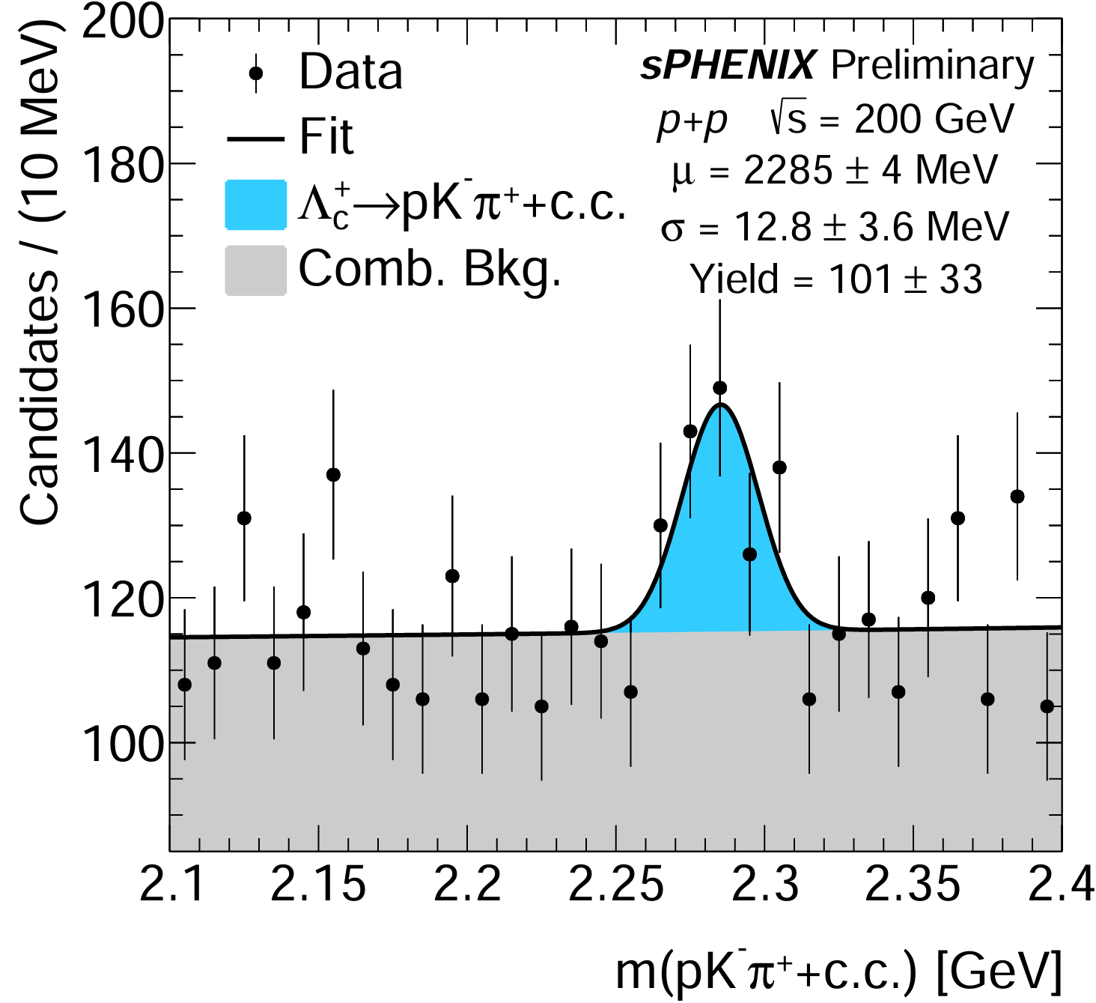

Run-24 p+p: Heavy Flavor Reconstruction
Xudong Yu from Peking U. contributes！
Observe first signal of D0 and $Λ_{c}$ decays
from ~1 hour of pp data and early stage calibrations
Weihu Ma
18
sPHENIX

Slide 19
Summary
Fully commissioned and operational: sPHENIX is now up and running, producing high-quality physics data.
2024 p+p reference dataset: Collected a substantial proton–proton dataset, establishing a solid baseline for upcoming heavy‑ion measurements.
Reconstruction & analysis demonstrated: Successfully validated jet, photon and track reconstruction, and showcased full-scale physics analysis on large datasets.
Standard candles validated: Re‑evaluated key physics benchmarks to ensure detector performance and calibration.
First publications submitted: Initial scientific results have been prepared and sent for peer review.
Ready for the RHIC science mission: The experiment is fully equipped to tackle its core objectives.
Looking ahead to Au+Au 2025: All systems are go for a productive Au+Au collision run next year.
Weihu Ma
19
sPHENIX

Slide 20
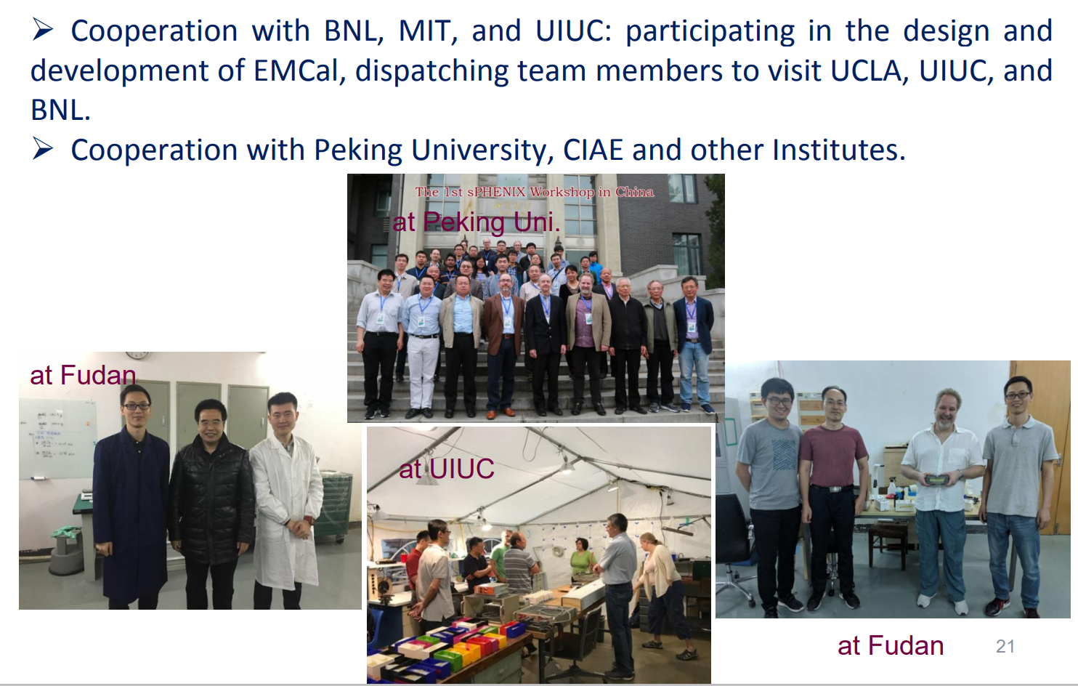
Collaboration Consortium in China
Weihu Ma
20
sPHENIX

Slide 21


Thanks !
www.themegallery.com

Slide 22
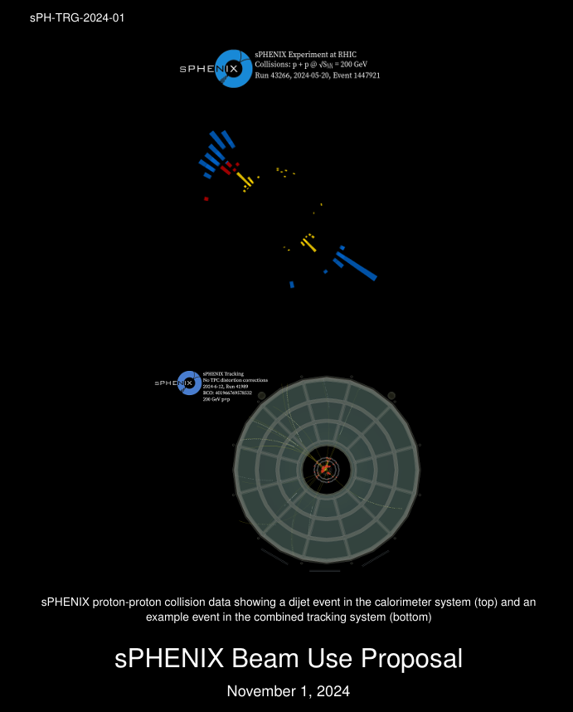
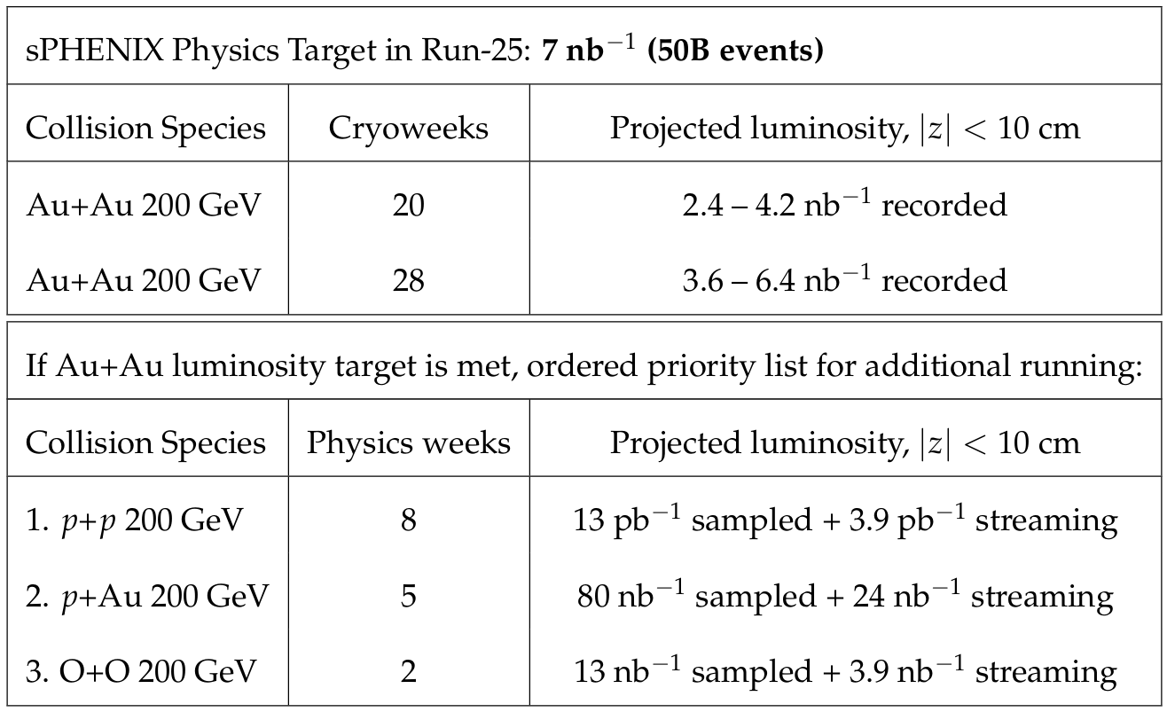
Run-24 summary and Run plan of 2025-2026
sPHENIX Beam Use Proposal
Weihu Ma
sPHENIX

Slide 23
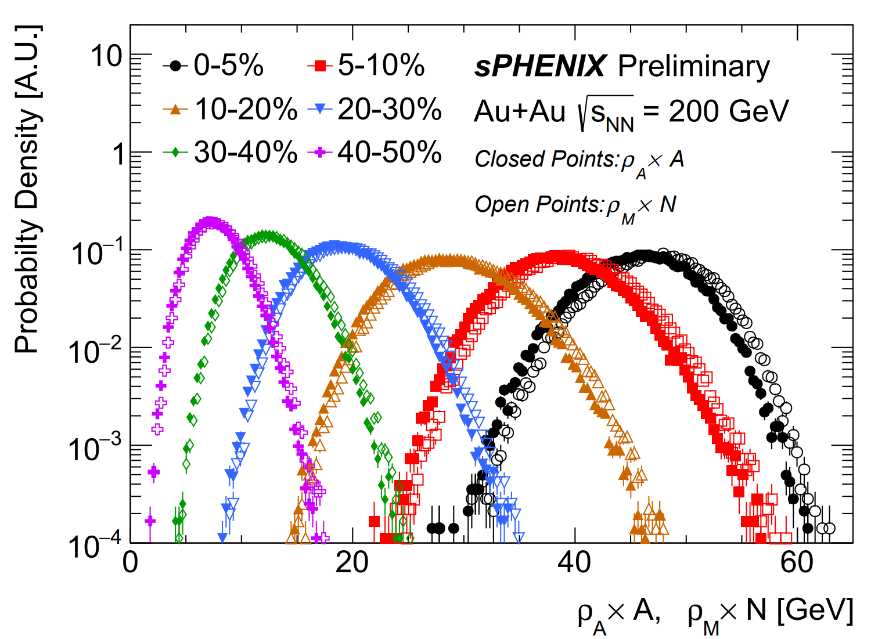
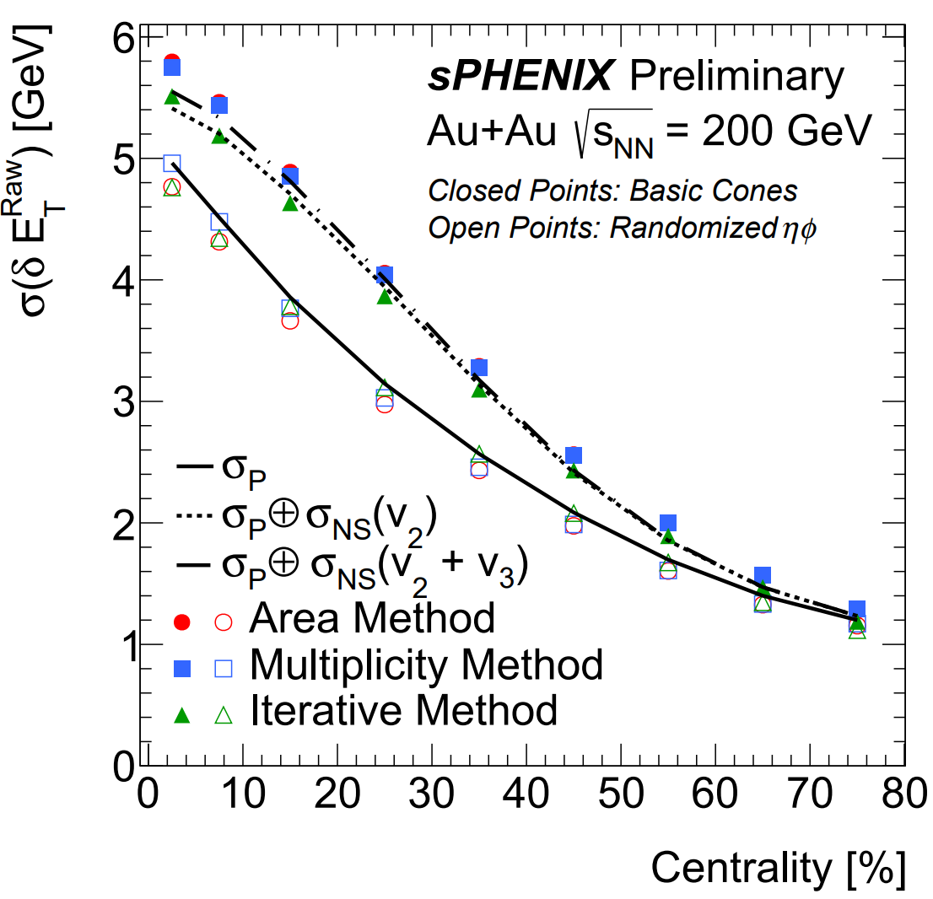
Jets in Au+Au: Underlying event
Underlying event characterization for jet reconstruction
Comparisons of jet background fluctuations between subtraction methods
Weihu Ma
sPHENIX

Slide 24
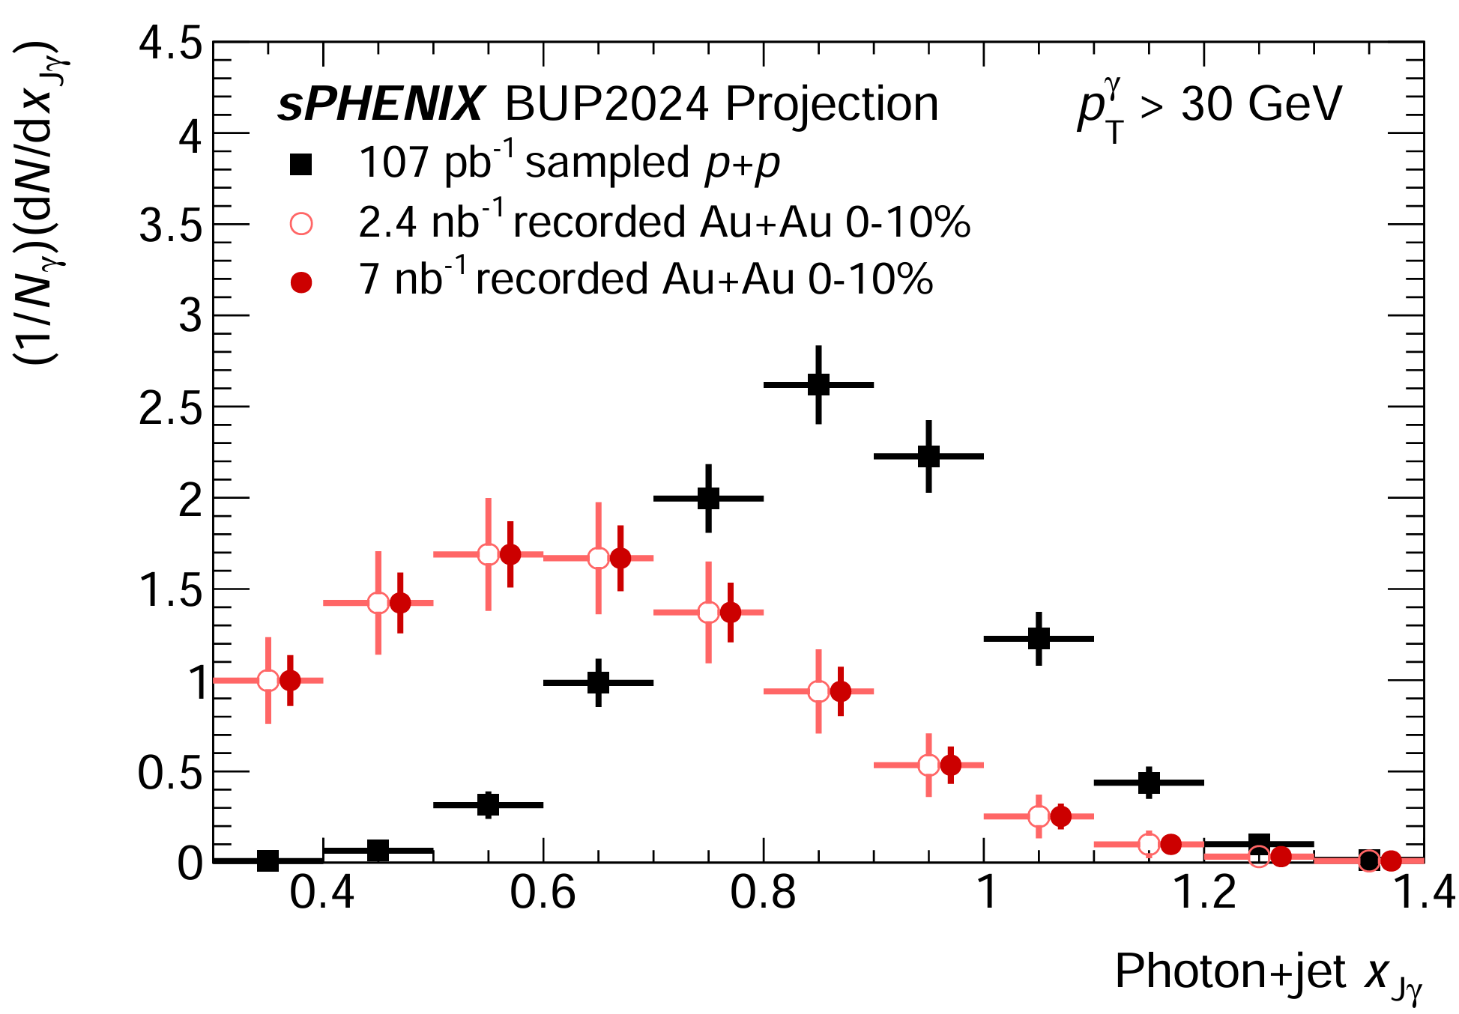
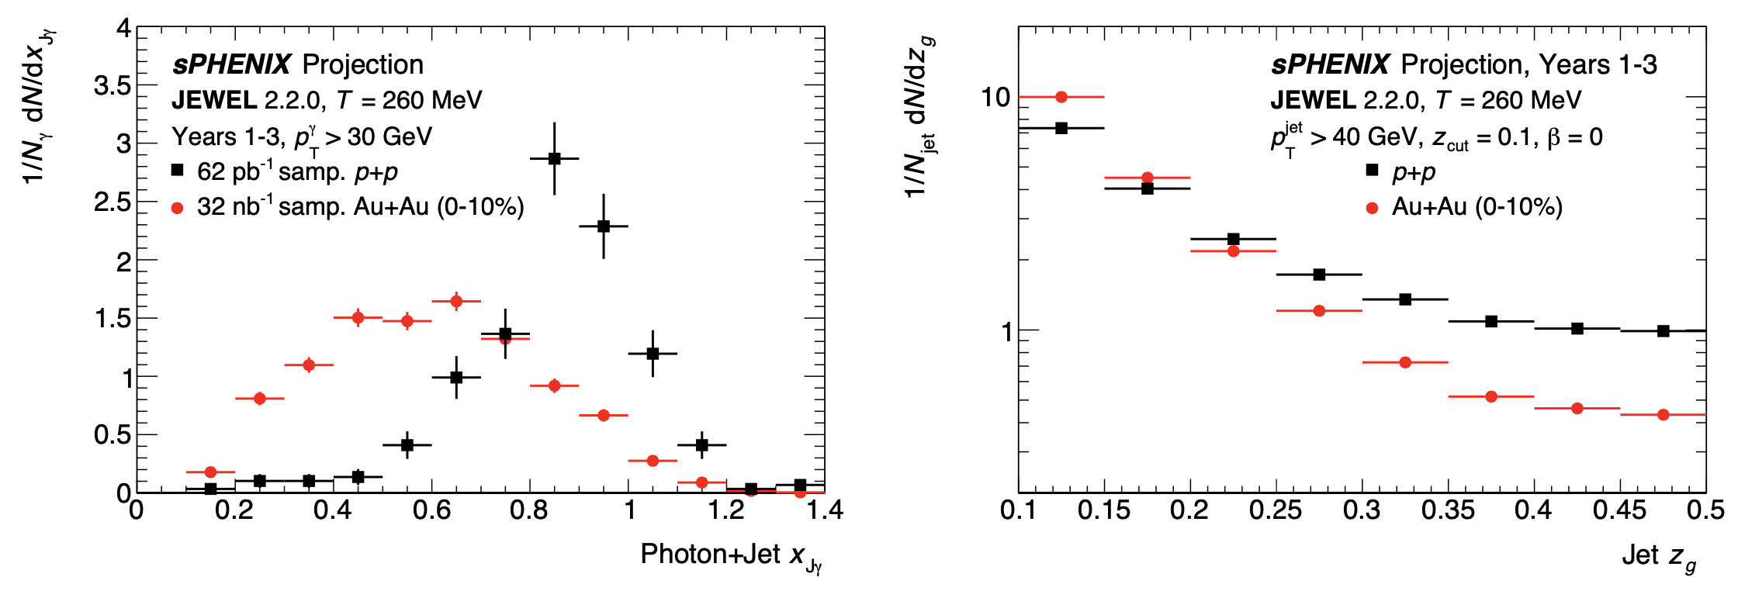
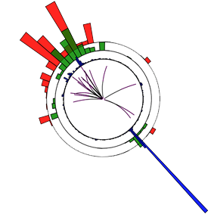
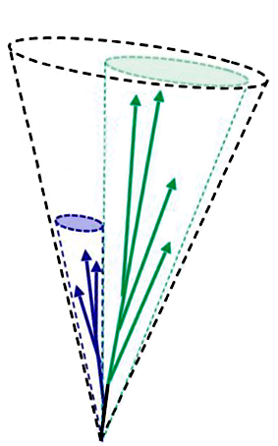


sPHENIX Projections: Jet Physics
Backup
BUP2023
Jet
pT,1
pT,2
Jet-to-photon momentum balance
Groomed momentum fraction
Photon
sPHENIX G4 simulation
Pythia8, γ+jet event
Jet substructure measurements thanks to the fine segmentation of calorimeter + good tracking resolution.
Study evolution of parton shower.
Providing a glimpse into fundamental splittings at parton level.
A “flagship” measurement.
Photon+jet measurements with high statistics.
A direct measure of the jet energy loss.
Weihu Ma
sPHENIX

Slide 25
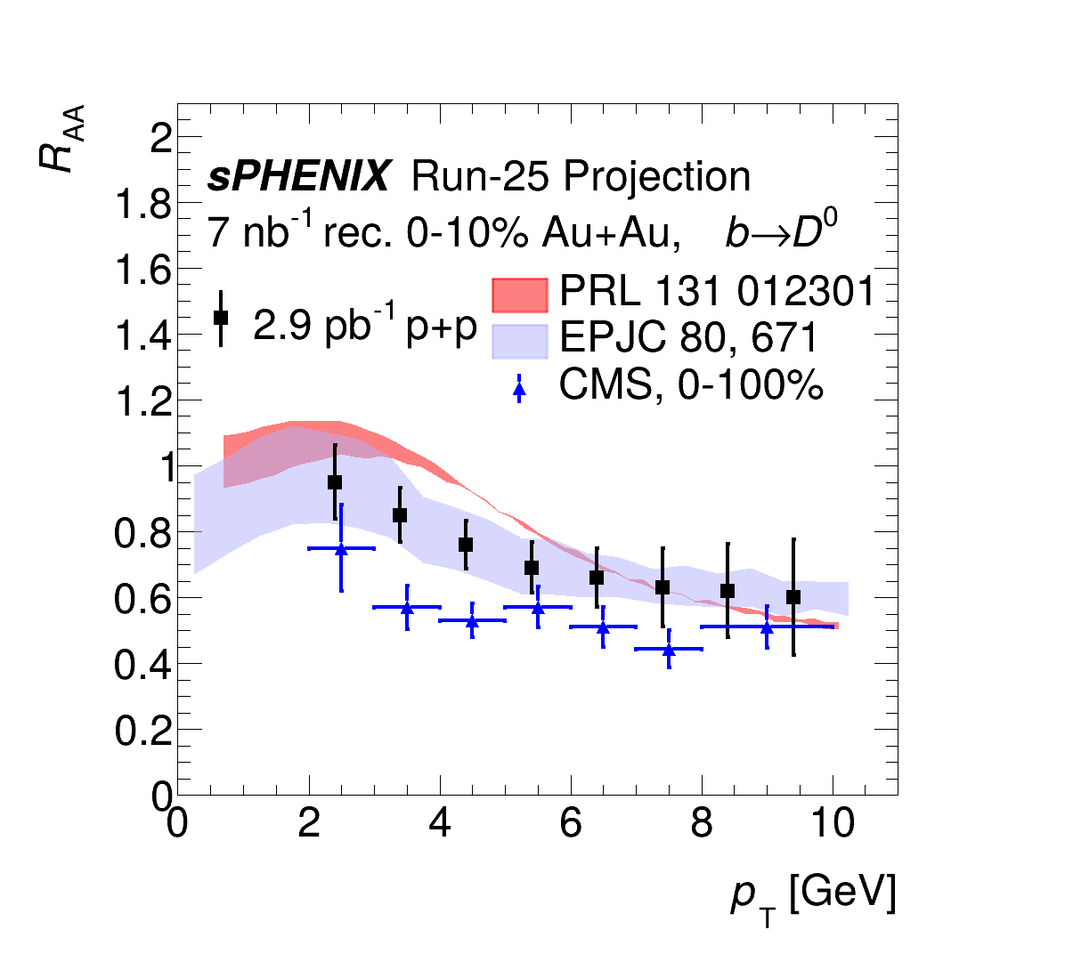
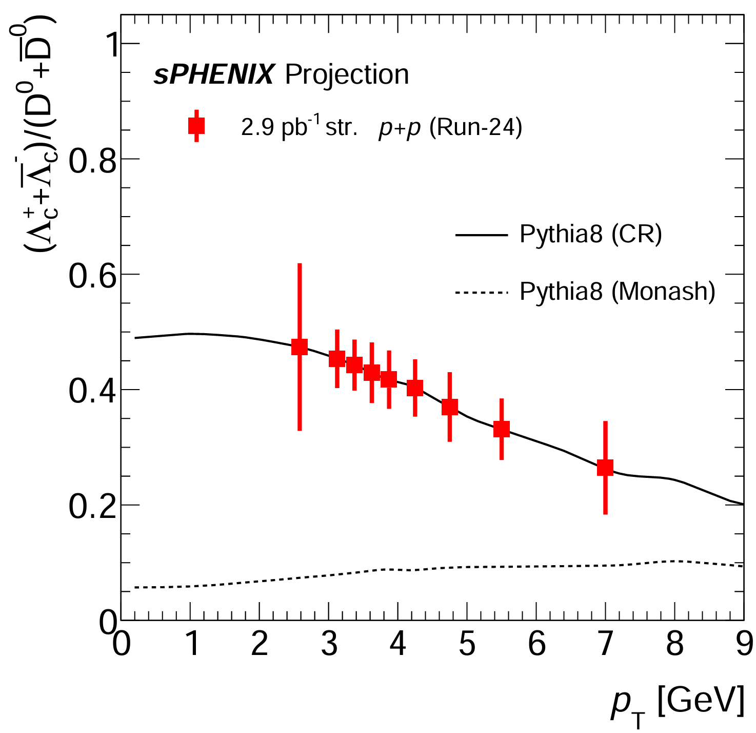

sPHENIX Projections: Open Heavy Flavor
Backup
RAA of non-prompt b → D0’s
Projections for $Λ_{c}^{+}{/D}_{0}$ with recorded luminosity highlight statistical reach enabled by streaming readout
BUP2024
BUP2024
sPHENIX on the way towards precise open heavy flavor measurements to realize complementarity between RHIC and LHC.
Weihu Ma
25
sPHENIX

Slide 26



sPHENIX Projections: Upsilon RAA
Backup
Mass reconstruction
Color dipoles probing the QGP at three length scales.
The centrality dependence and particularly the pT dependence are critical measurements for comparison between RHIC and the LHC.
sPHENIX is using ML algorithms to reject hadronic bkg.
Weihu Ma
26
sPHENIX

Slide 27


sPHENIX Projections: Cold QCD
Backup
TSSA for D0
TSSA for direct photon
BUP2023
Spin measurements such as transverse single spin asymmetry (TSSA) can be achieved using the beam polarization.
Study the nucleon spin structure and parton dynamics.
Weihu Ma
27
sPHENIX

Slide 28



Tracking System
Backup
MAPS-based micro-VerTeX detector (MVTX)
Intermediate Silicon Tracker (INTT)
Based on ALICE Inner Tracking System (ITS-2)
3-layer Monolithic Active Pixel Sensors (MAPS)
Excellent 2-D DCA resolution, < 10 μm for pT > 2 GeV/c
Two Barrels (four Layers) silicon strips
Fast O(100 ns) integration time; can resolve one beam crossing
MVTX
INTT
TPC Outer Tracker (TPOT)
TPC
Time Projection Chamber (TPC)
8 modules of Micromegas inserted between TPC and EMCal
Calibration of beam-induced space charge distortions in the TPC
Compact
Δp/p~1% at 5 GeV/c
48 layers (20-78 cm radius)
Quad-GEM electron multiplier + chevron readout pads
Gateless, continuous readout
TPOT

Slide 29

MVTX
Backup
Correlation seen between different MVTX layers

Slide 30


INTT, TPOT
Backup
TPOT
• 99 % of channels working
• Detector routinely read out
with other detectors
• partial acceptance
• one layer of micromegas
• read out with streaming
• ϕ, z measurement

Slide 31



Electromagnetic Calorimeter (EMCal)
Backup
Calorimeter System(EMCal+iHCal+ oHCal)
Compact, coverage |η| <1.1, 2π in φ
SiPM readout for both EMCal and HCal
Less-biased jet measurement
All Calorimeters installation and electronics complete!
EMCal
Electromagnetic Calorimeter (EMCal)
Tungsten/scintillating fiber SPACAL
~7mm radiation length
high granularity Δη x Δφ = 0.025 x 0.025
Good energy resolution σE/E ≤ 16%/√E
Installation complete!
EMCal sector
EMCal block

Slide 32


Hadronic Calorimeter (HCal)
Backup
Tight iHCal-oHCal correlation with commissioning data
oHCal
iHCal
Aluminum-scintillating tiles with embedded WLS fibers,
EM-shower tail catcher
Tilted steel plates/scintillator tiles with embedded WLS fibers

Slide 33




sEPD and MBD
Backup
sEPD sector
sEPD: Measure event plane and centrality outside of mid-rapidity
MBD
Correlations: sEPD-MBD, sEPD-EMCal

Slide 34

RHIC & LHC Complementarity
Backup
Different initial conditions and evolution for QGP between RHIC and LHC, allows study of scale and temperature dependence.
Same hard probes at RHIC overlap with LHC kinematic range
Opportunity for new probes at RHIC at the lower energy scale

Slide 35

sPHENIX Readout
Backup
Hybrid DAQ
Two paths for data
  Triggered (calorimeters)
  Streamed (trackers)
Streamed trigger:
Records ~10% of all collisions
Significantly increases p+p data collected
Crucial for open heavy flavor physics as well as cold QCD measurements

