Slide 1
Properties of dense stellar matter in an extended NJL model
第二十届全国中高能核物理大会
2025年4月24-28日
Phys. Rev. D 110 (2024) 014022
Phys. Rev. D 110 (2024) 114024
arXiv: 2411.06679
Xia, Cheng-Jun (夏铖君)
Center for Gravitation and Cosmology,
Yangzhou University
Collaborators:
T. Maruyama, Y.-T. Rong, T.-T. Sun, T. Tatsumi and N. Yasutake
@ 复旦大学
2025年4月27日

Slide 2
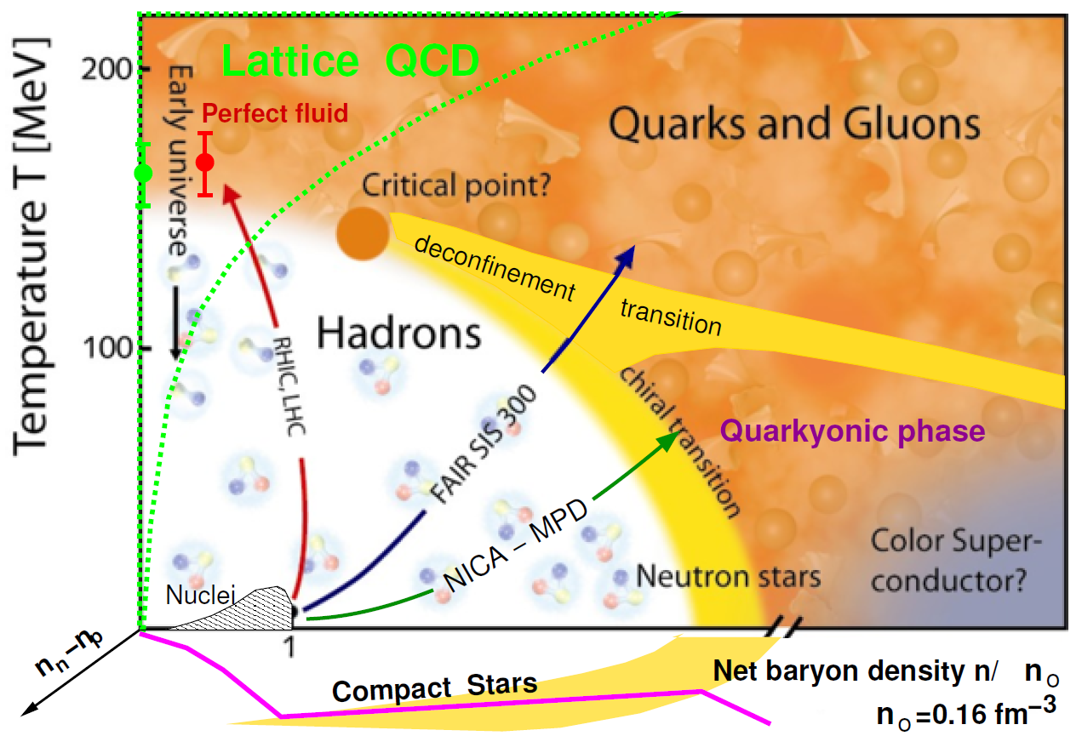
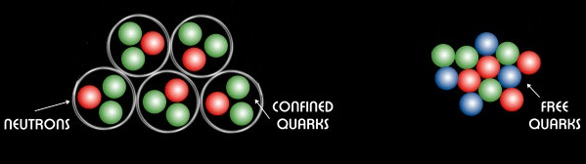
QCD Phase Diagram [McLerran2009_NPB195-275]
First-order/
Crossover?
Quark matter
First-order: Important interface effects (surface tension, curvature, quark depletion, ...)
background

Slide 3
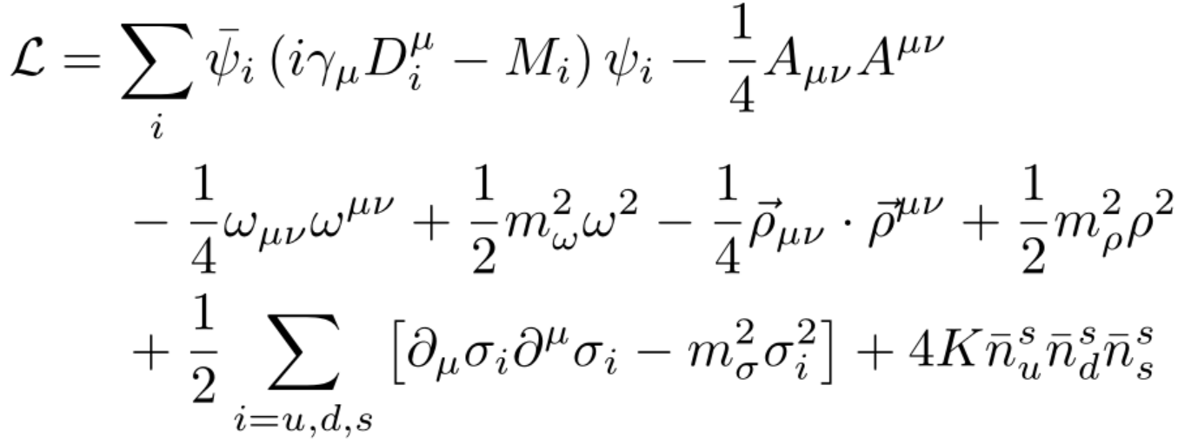
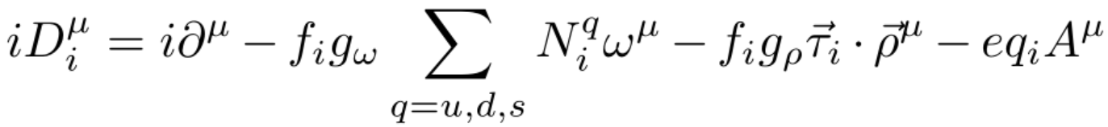
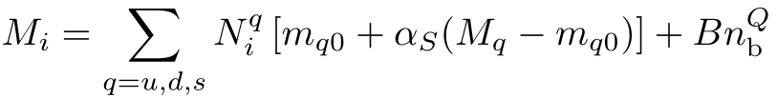
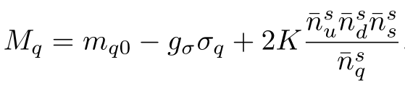
Extended NJL model
The Lagrangian density of an extended SU(3) NJL model:
Energy
n_{b} = n_{b}^{B} + n_{b}^{Q}
Baryon number densities of nuclear matter (n_{b}^{B}) and quark matter (n_{b}^{Q}).
Baryons:
Quarks:
Quarkyonic transition: emergence of quasi-free quarks;
Deconfinement: baryon melting (Mott transition)
Parameters RKH [Rehberg_Klevansky_Hüfner1996_PRC53-410]: λ = 602.3 MeV, m_{u0} = m_{d0} = 5.5 MeV, m_{s0} = 140.7 MeV, G_{S} = g_{σ}²/4m_{σ}² = 1.835/λ² , K = 12.36/λ⁵
unified Description

Slide 4

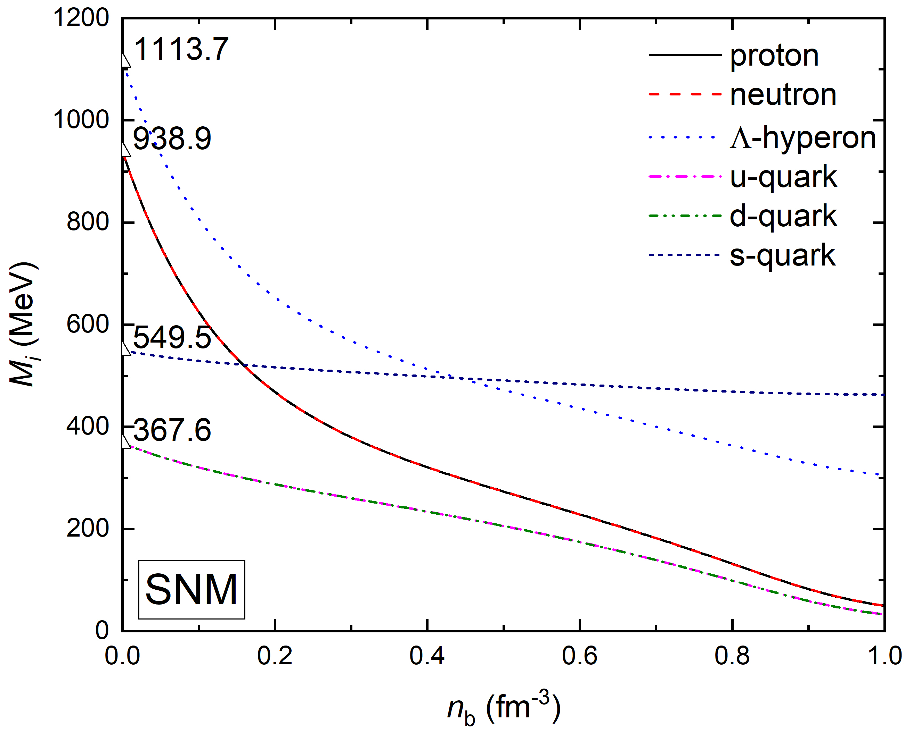
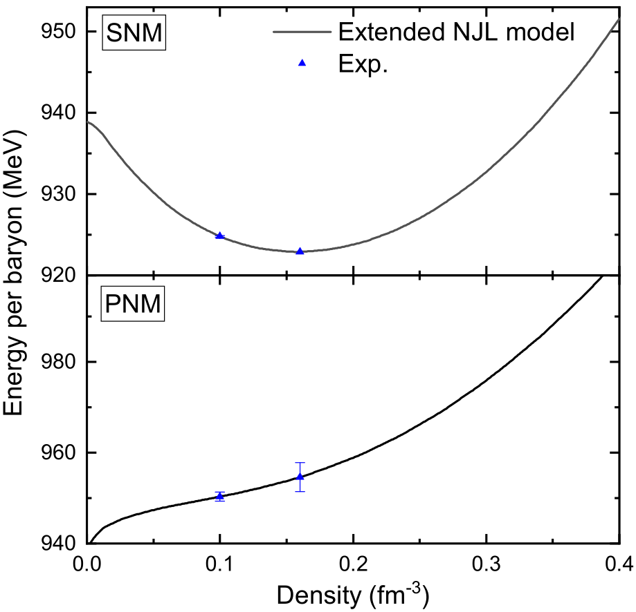
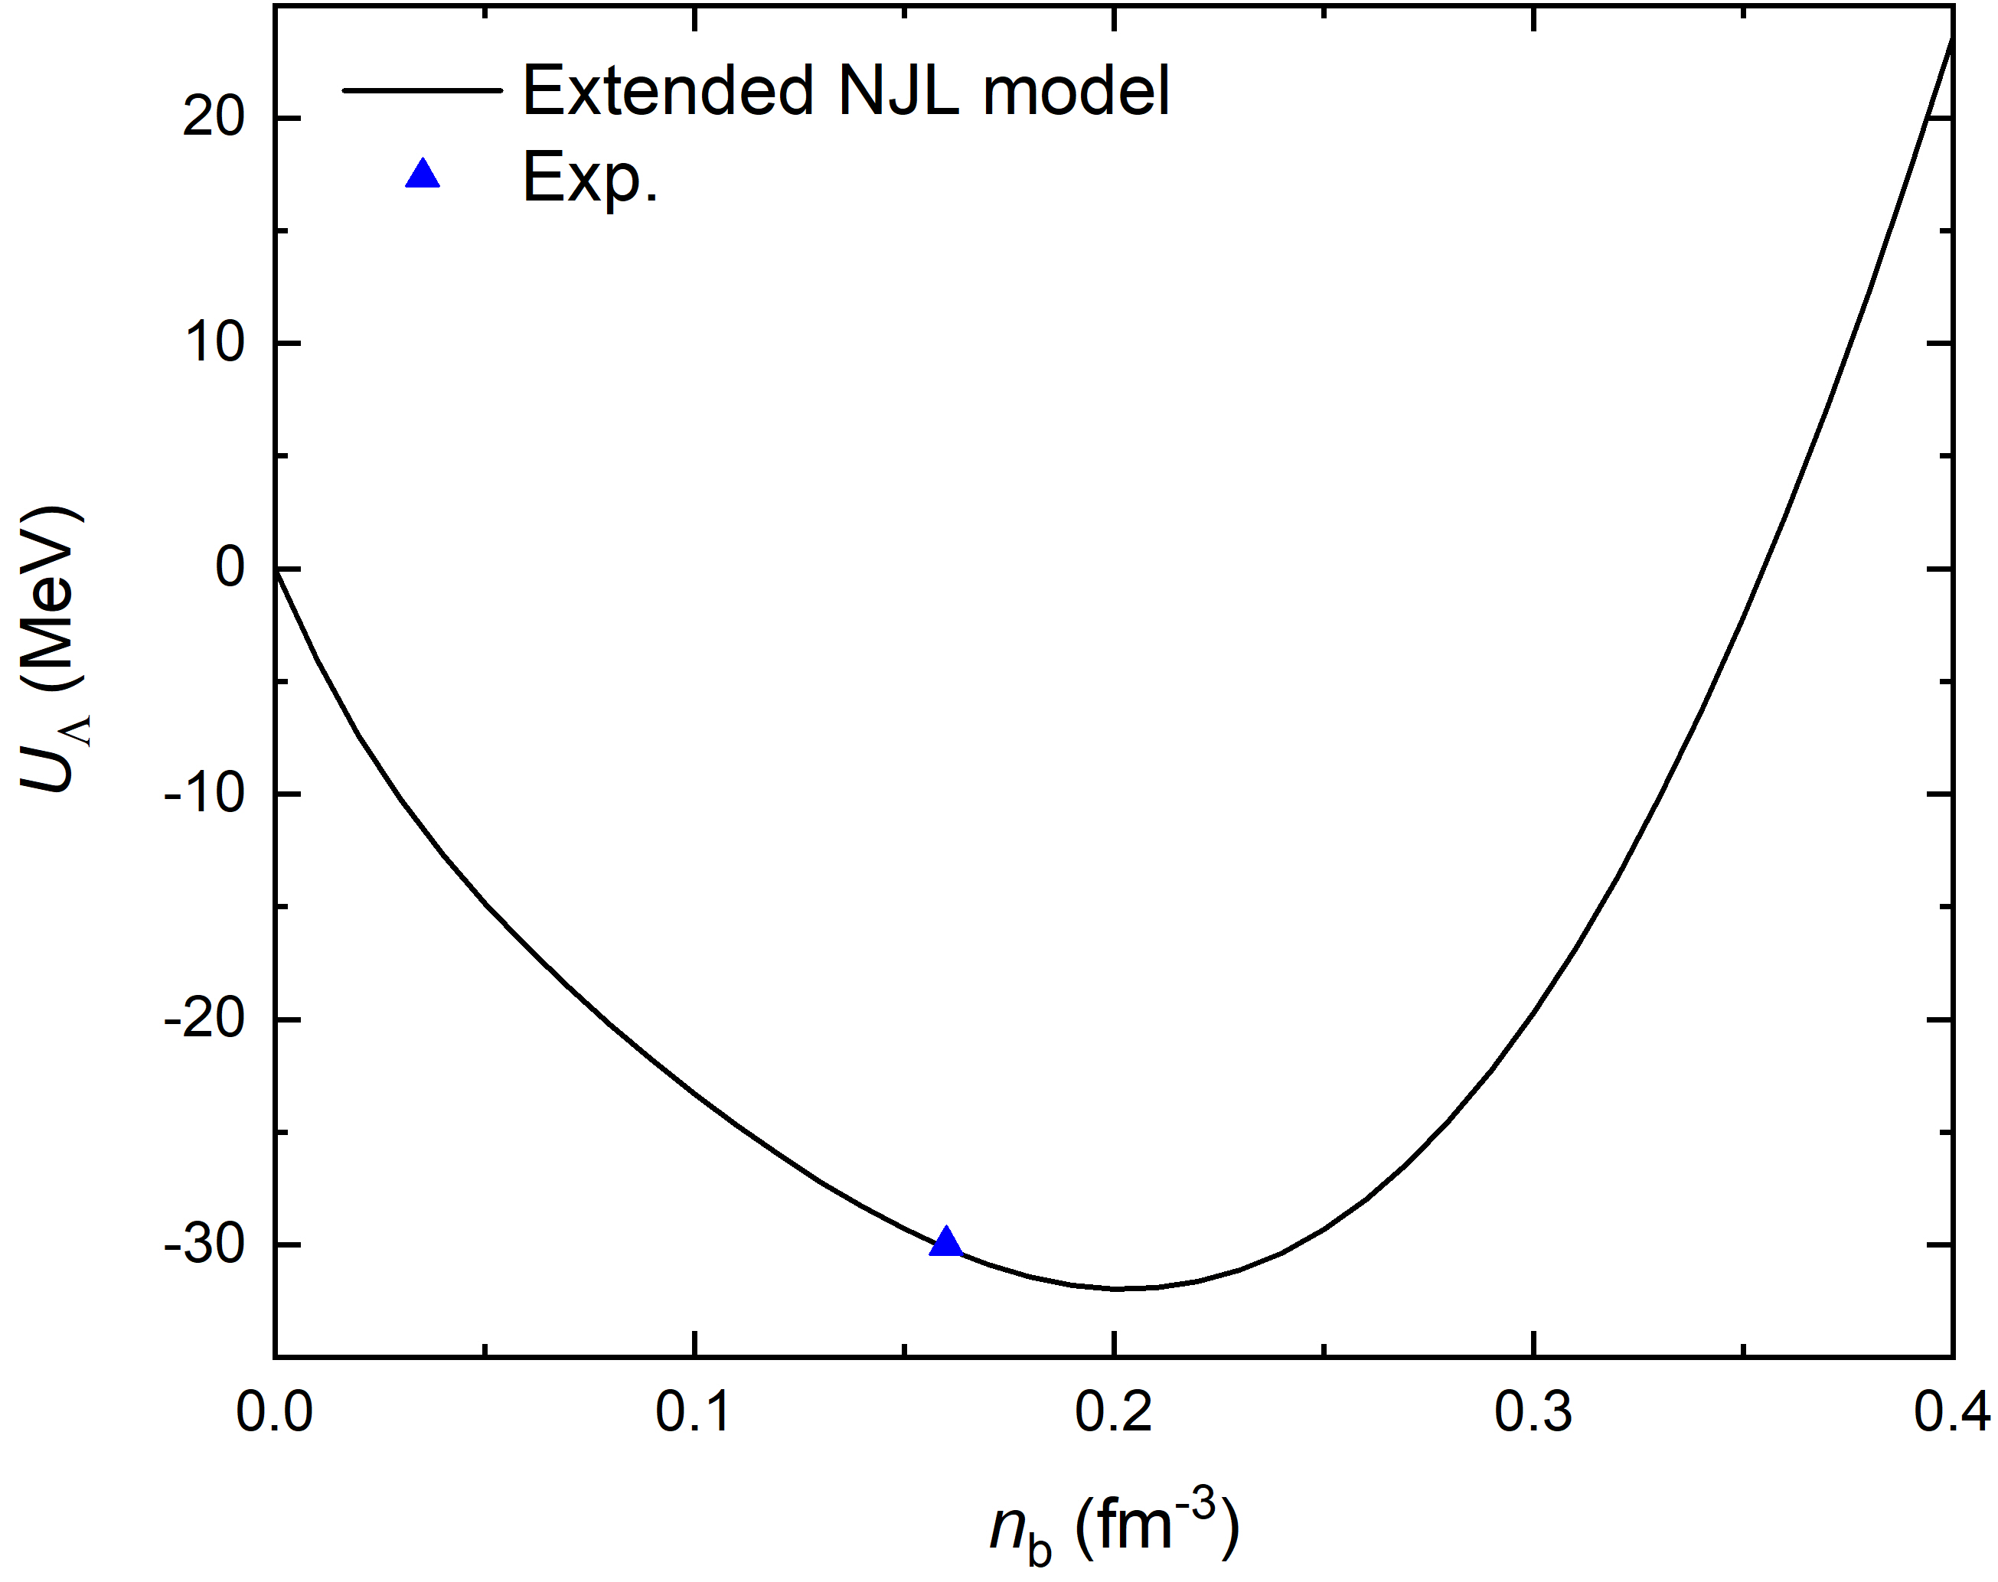
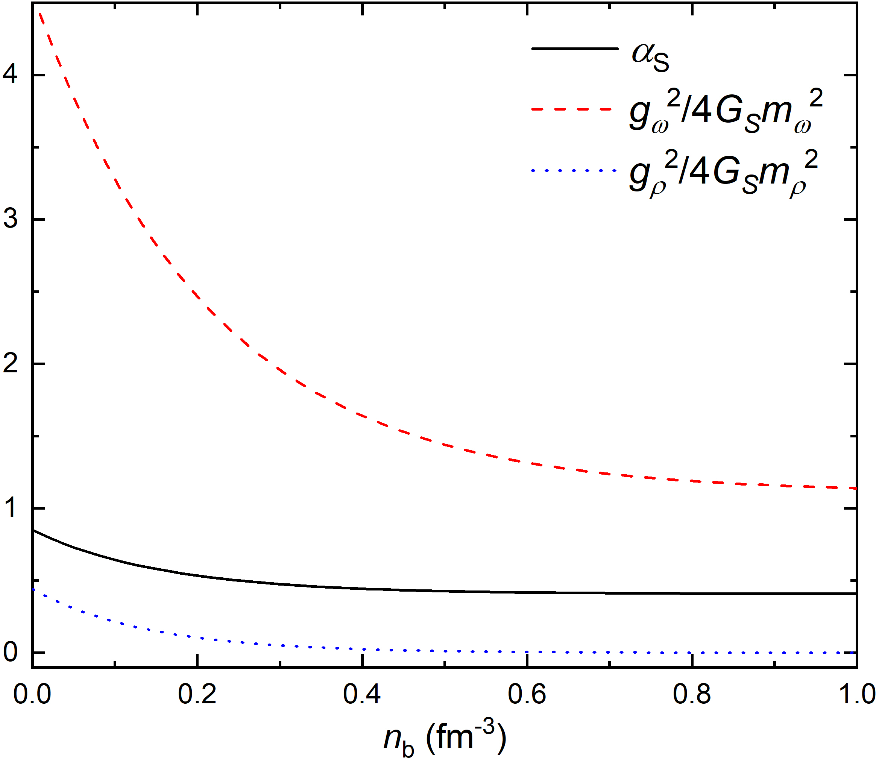



Coupling constants
unified Description

Slide 5
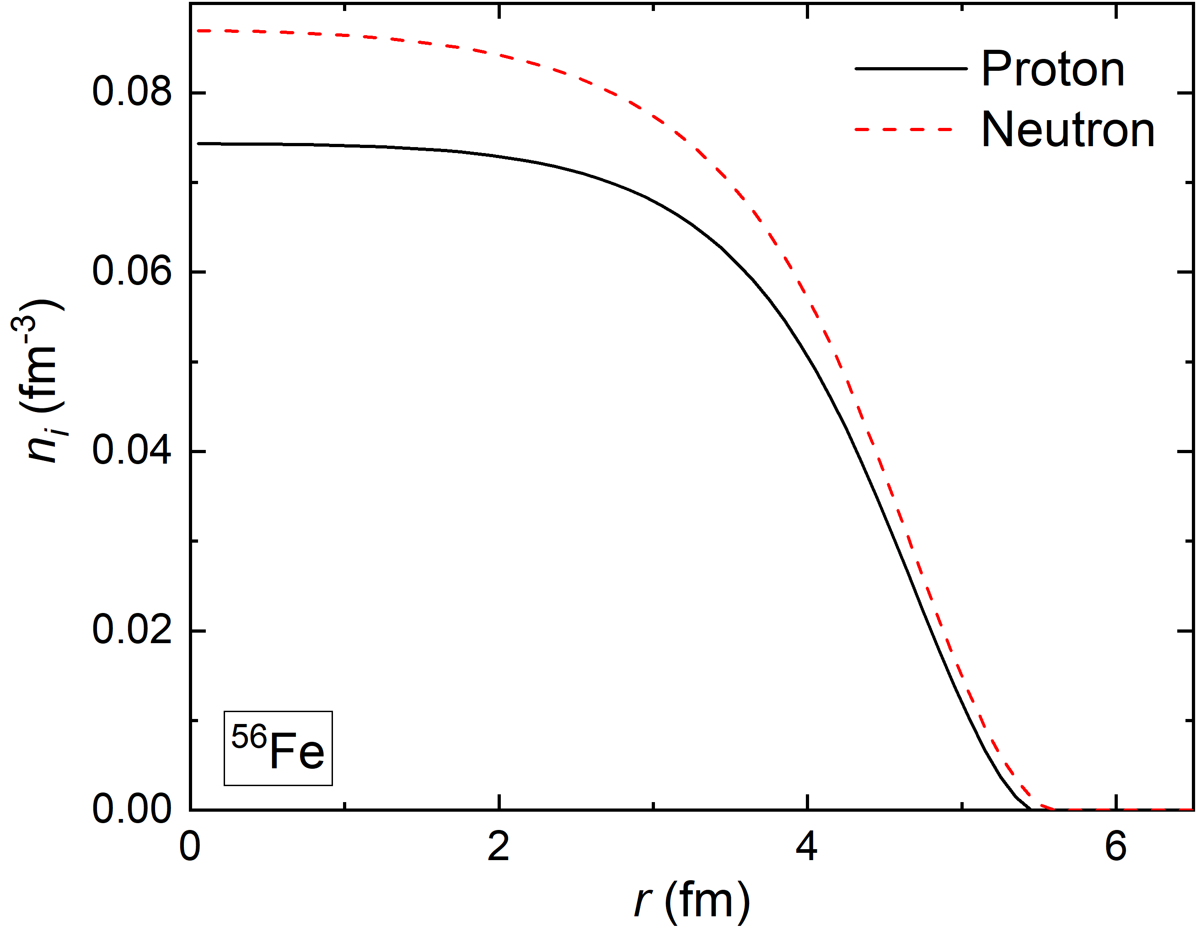
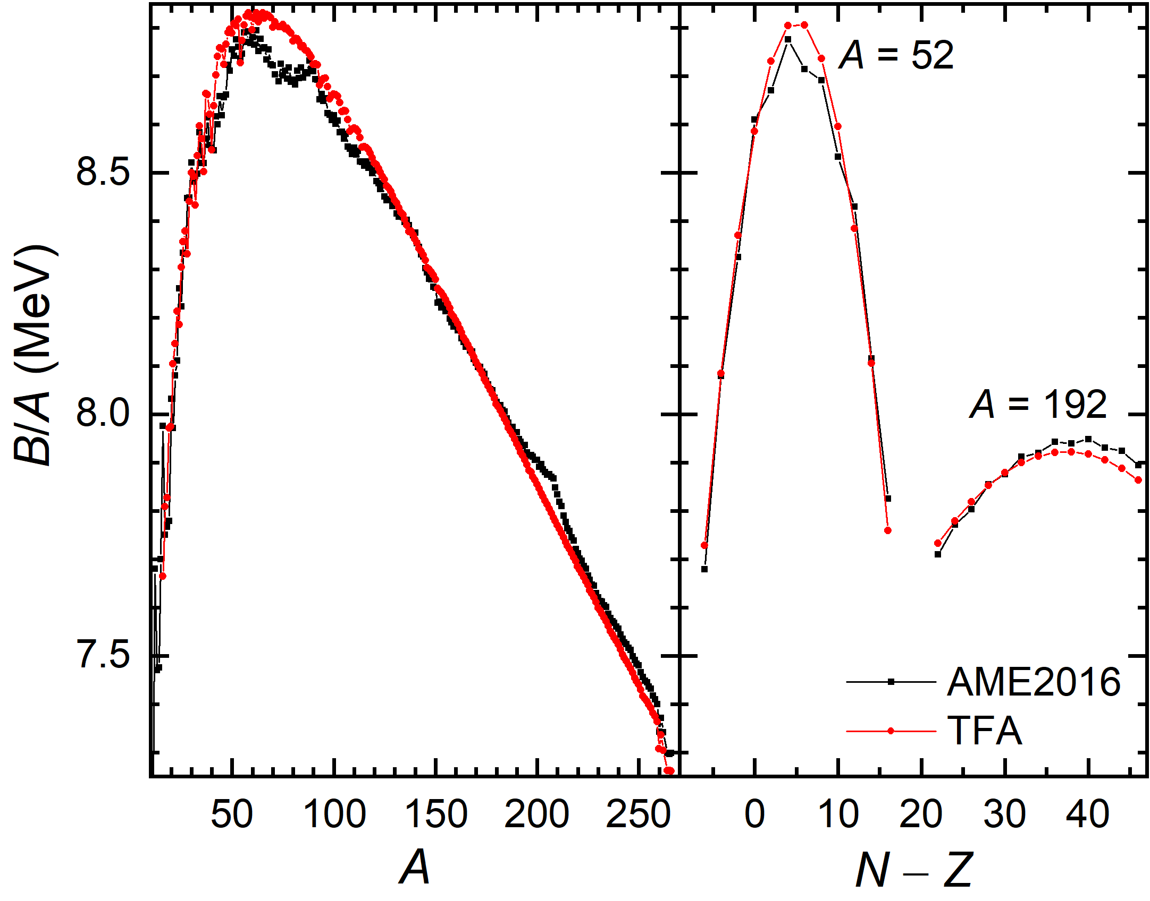
Finite nuclei
unified Description

Slide 6
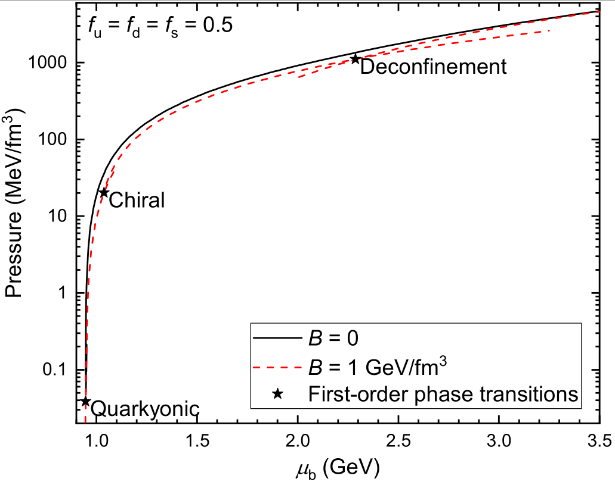
Phase transitions of NS matter
unified Description

Slide 7
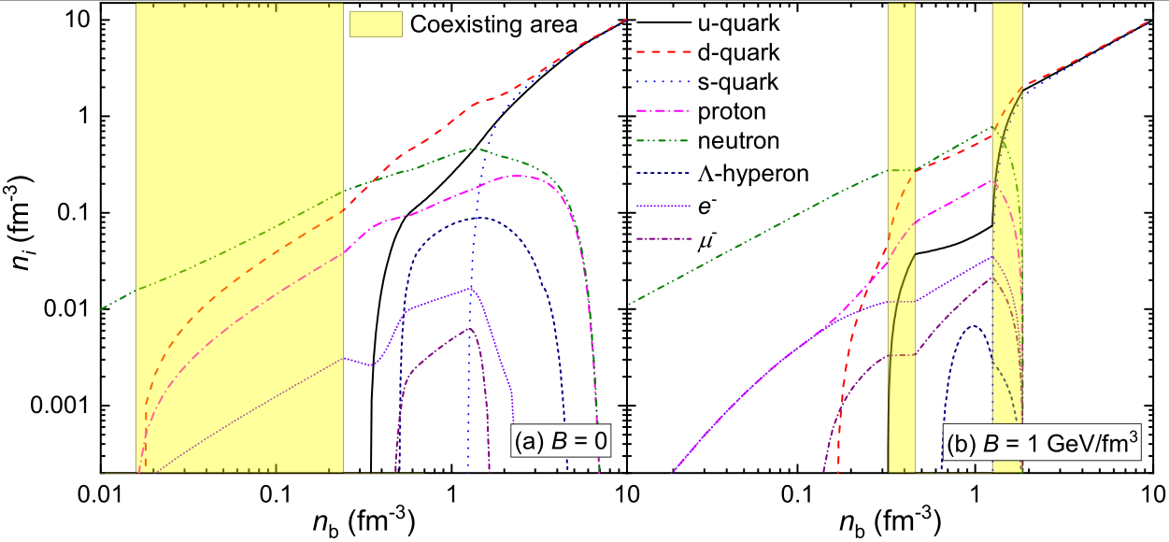
Particle fractions
first-order
third-order
Quarkyonic transition
unified Description

Slide 8
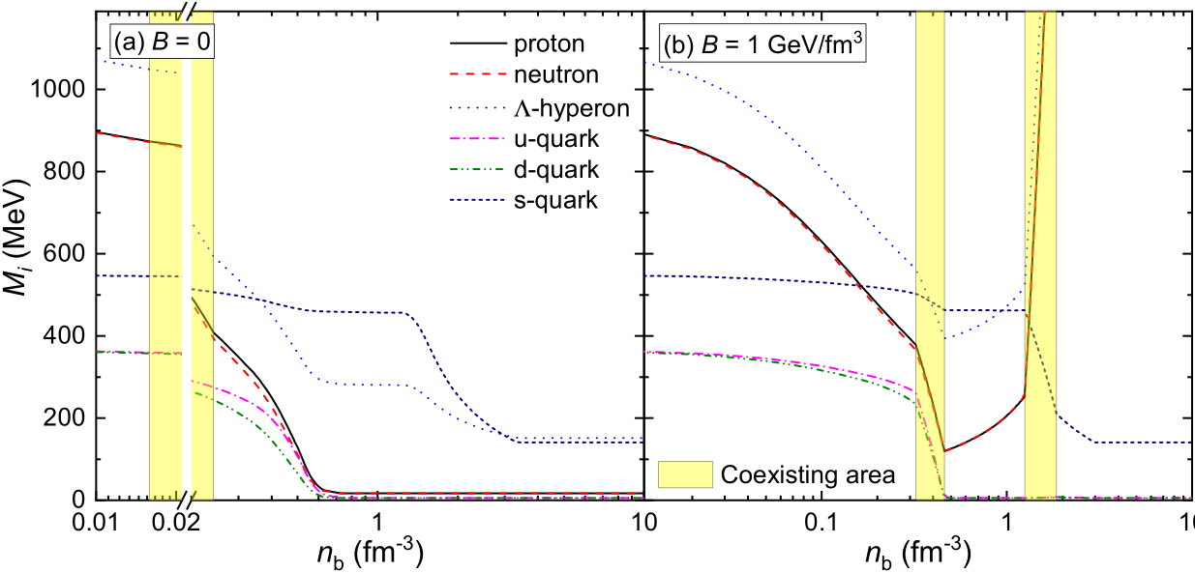
Masses
unified Description

Slide 9
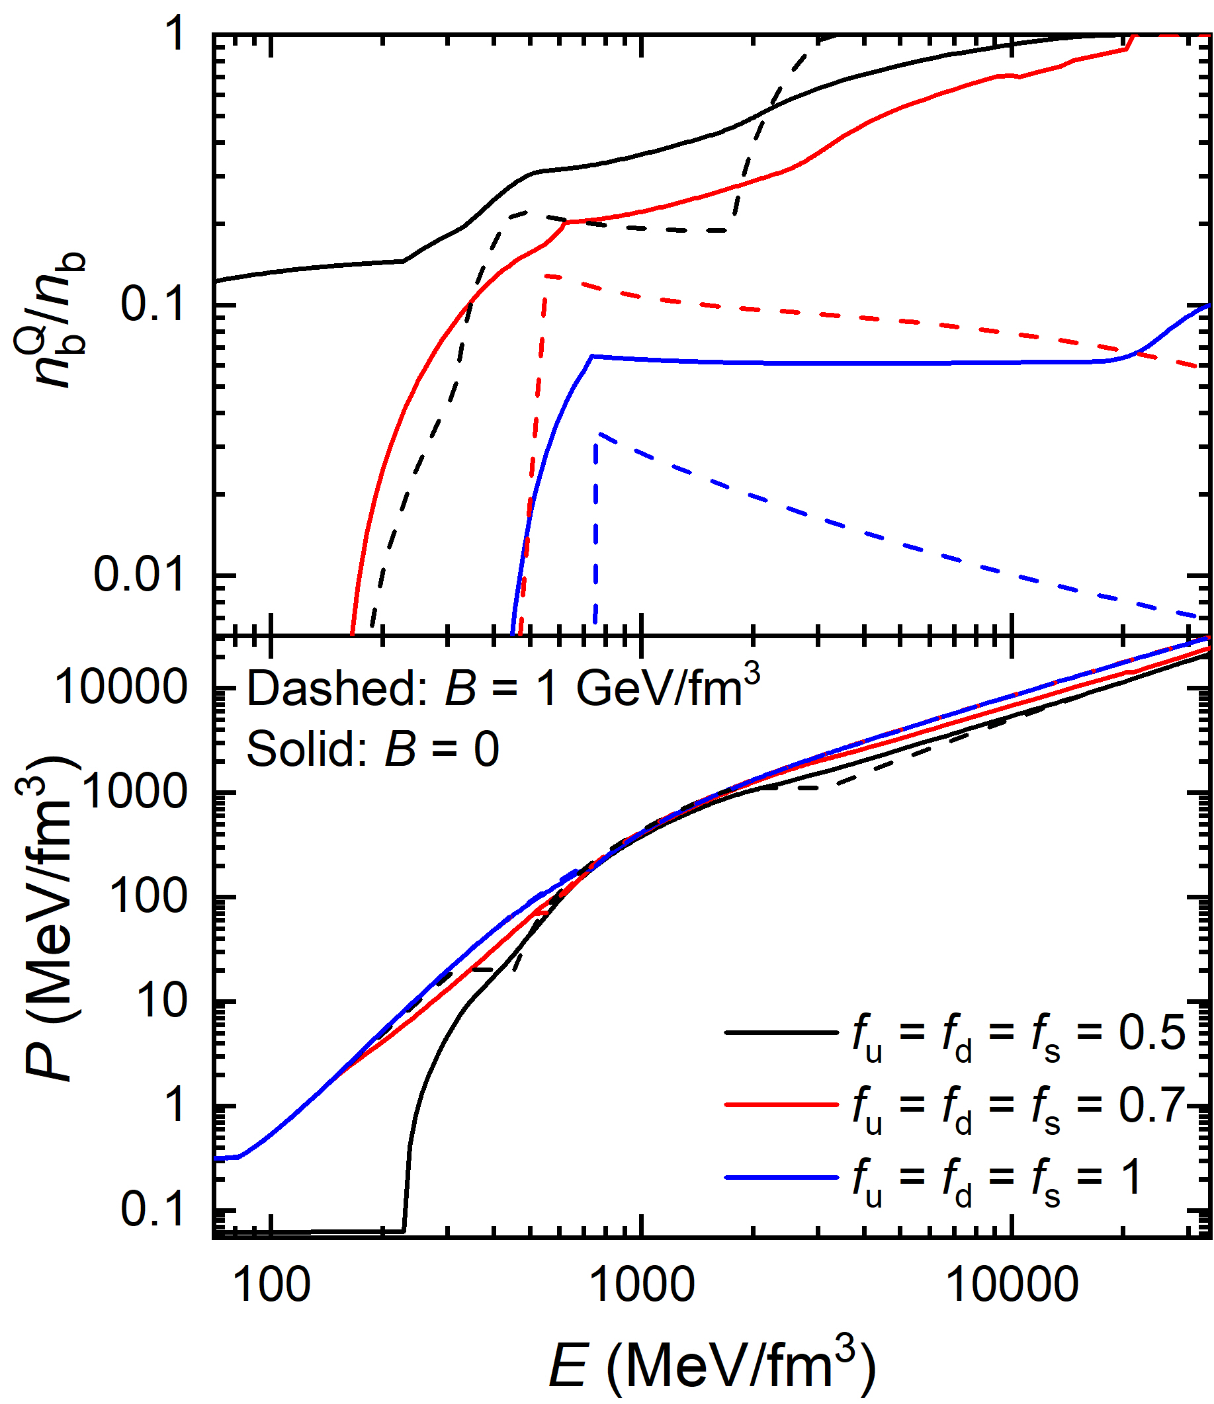
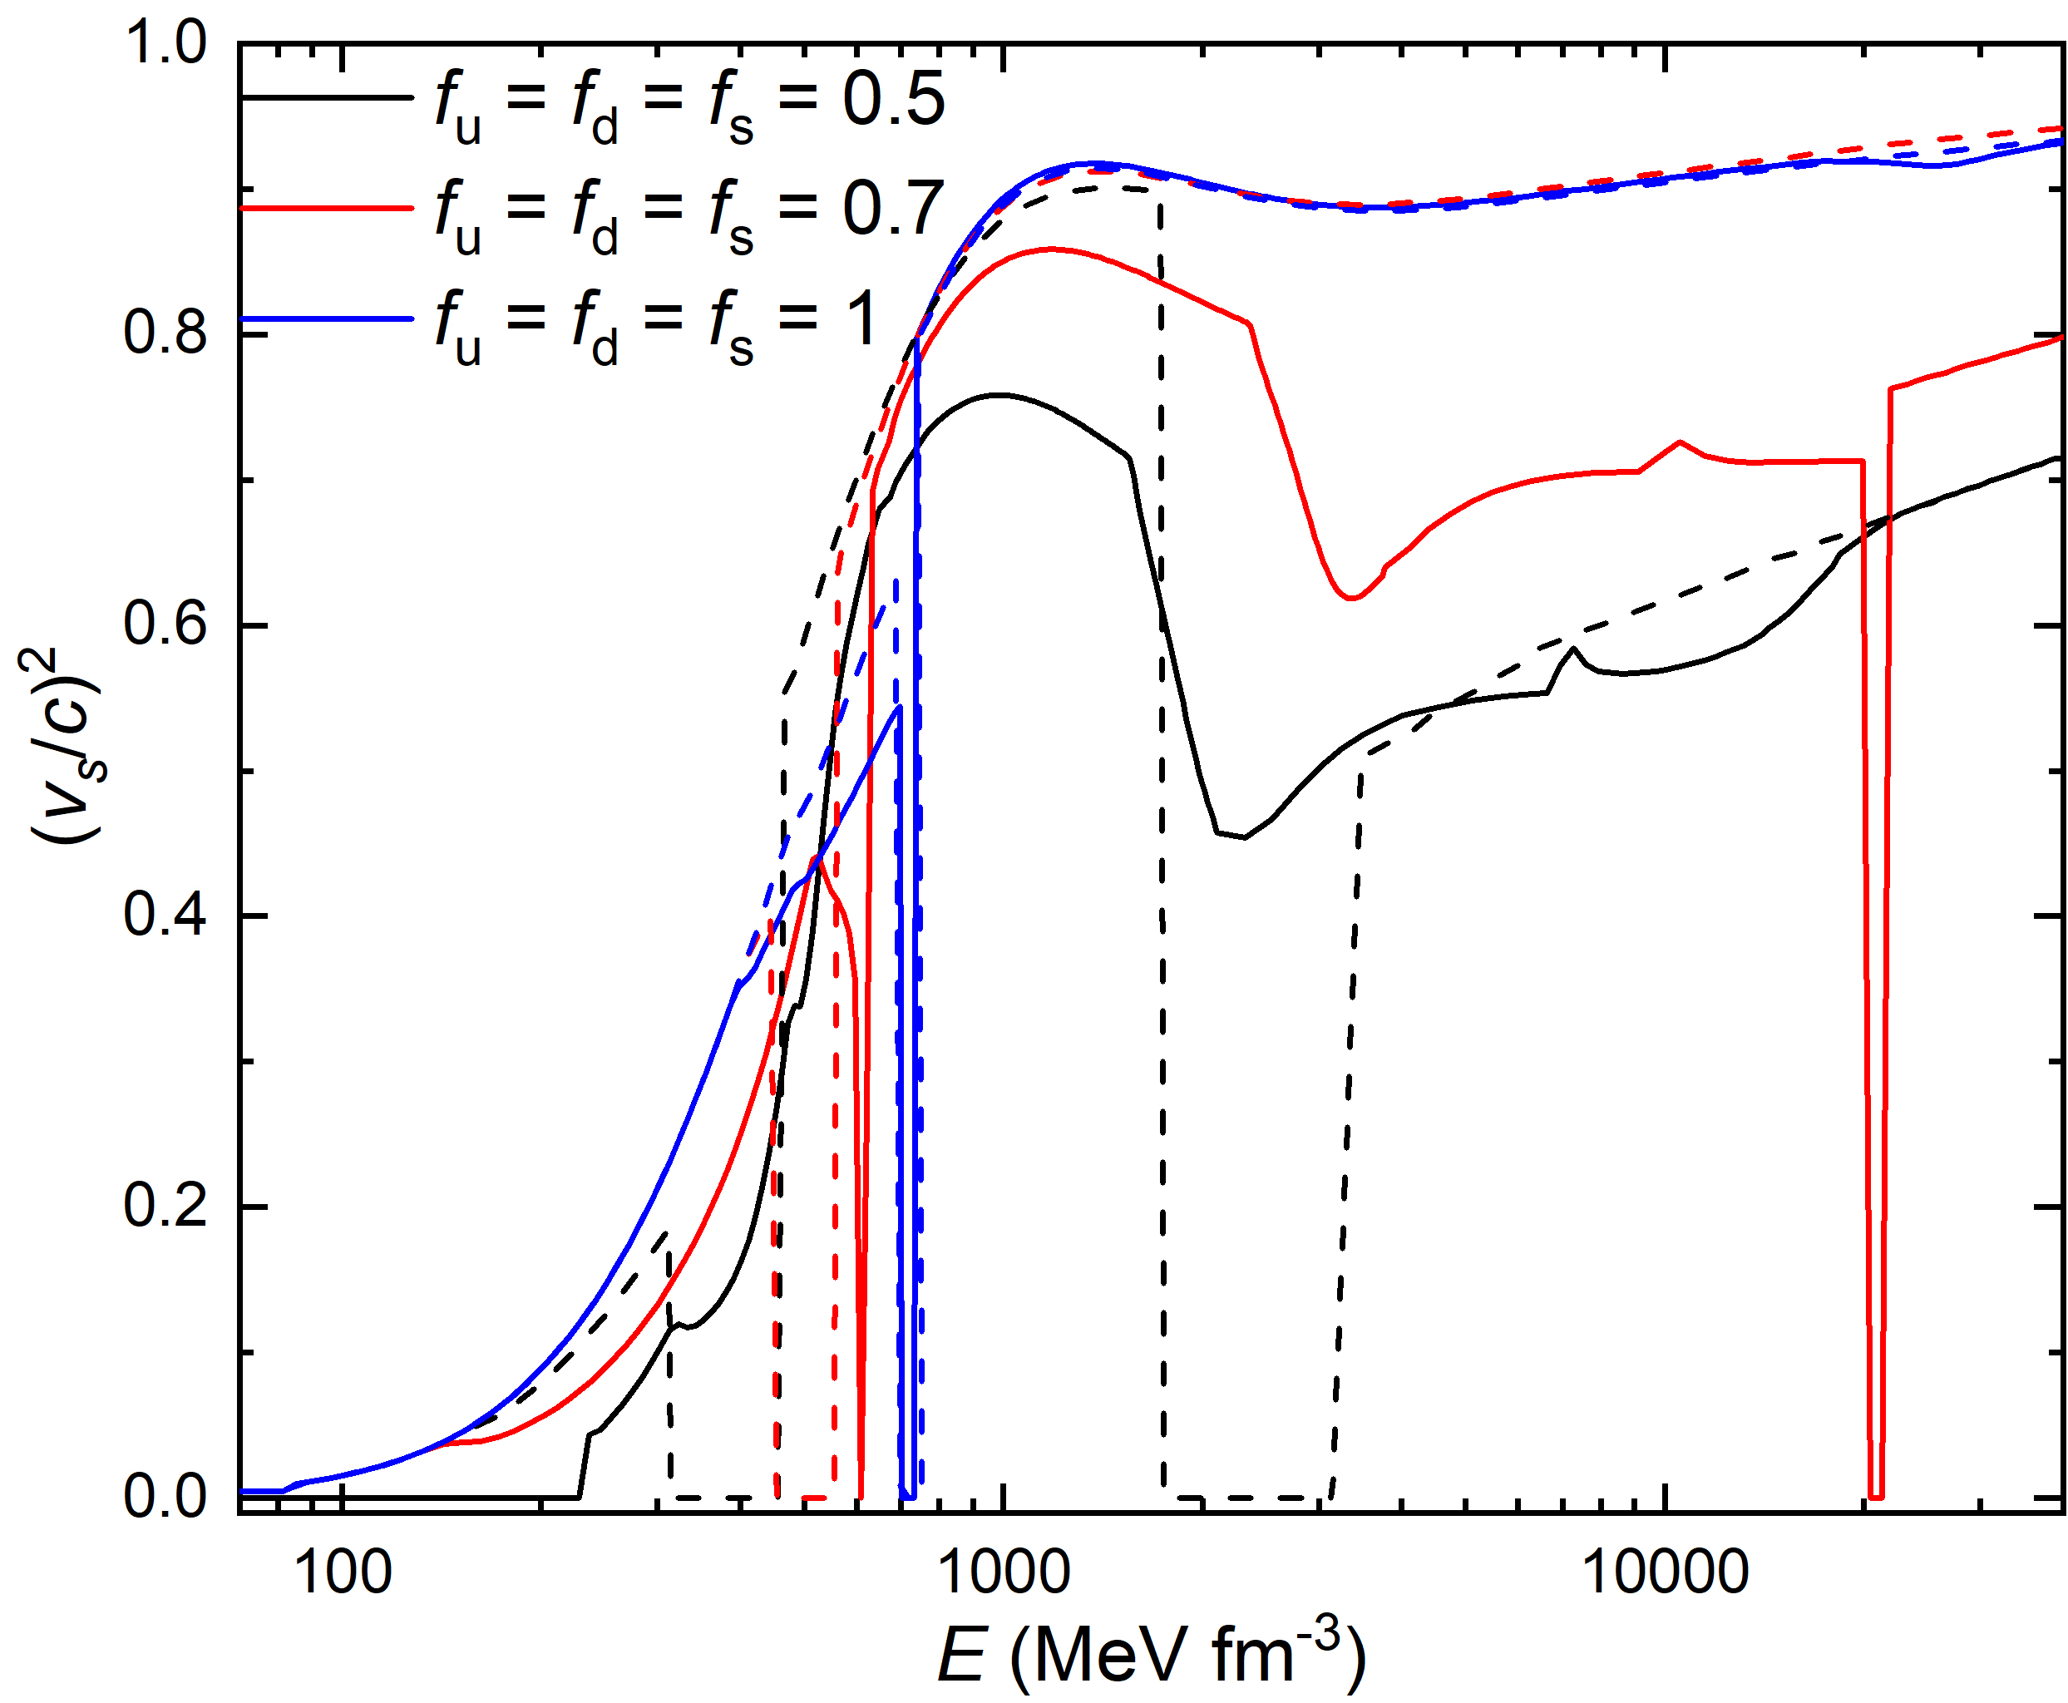

Equation of state
unified Description

Slide 10
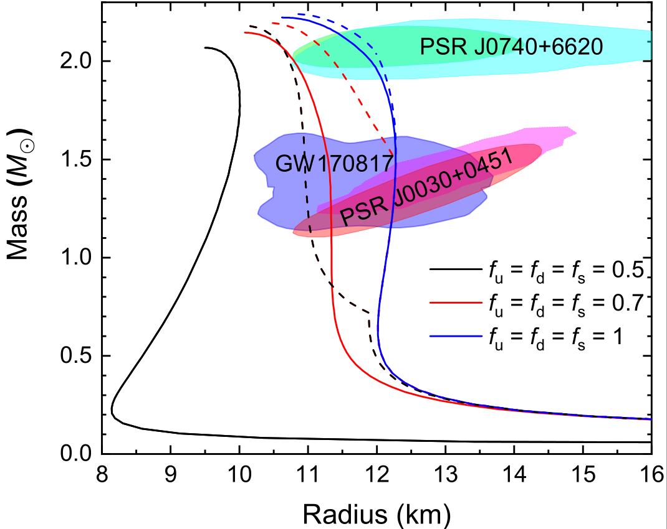
Mass-radius relations
unified Description

Slide 11
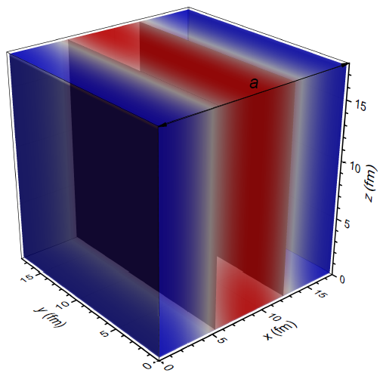
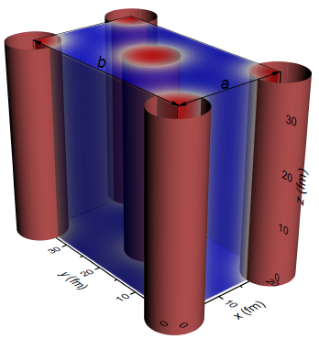
Nonuniform structure
The boson
Droplet/Bubbles in BCC and FCC lattices (D=3)
The boson
Slabs (D=1)
The boson
Rods/Tubes in simple and honeycomb configurations
(D=2)
(D=2)
Single nucleus
approximation：assume spherical and cylindrical shapes for Wigner-Seitz (WS) cells
unified Description
Notes:
To minimize the uncertainties on the nuclear matter structures, we estimate the EOSs and microscopic structures of nuclear matter by searching for the most stable configuration at fixed density, where nucleons and electrons move freely in a periodic unit cell.
SNA

Slide 12
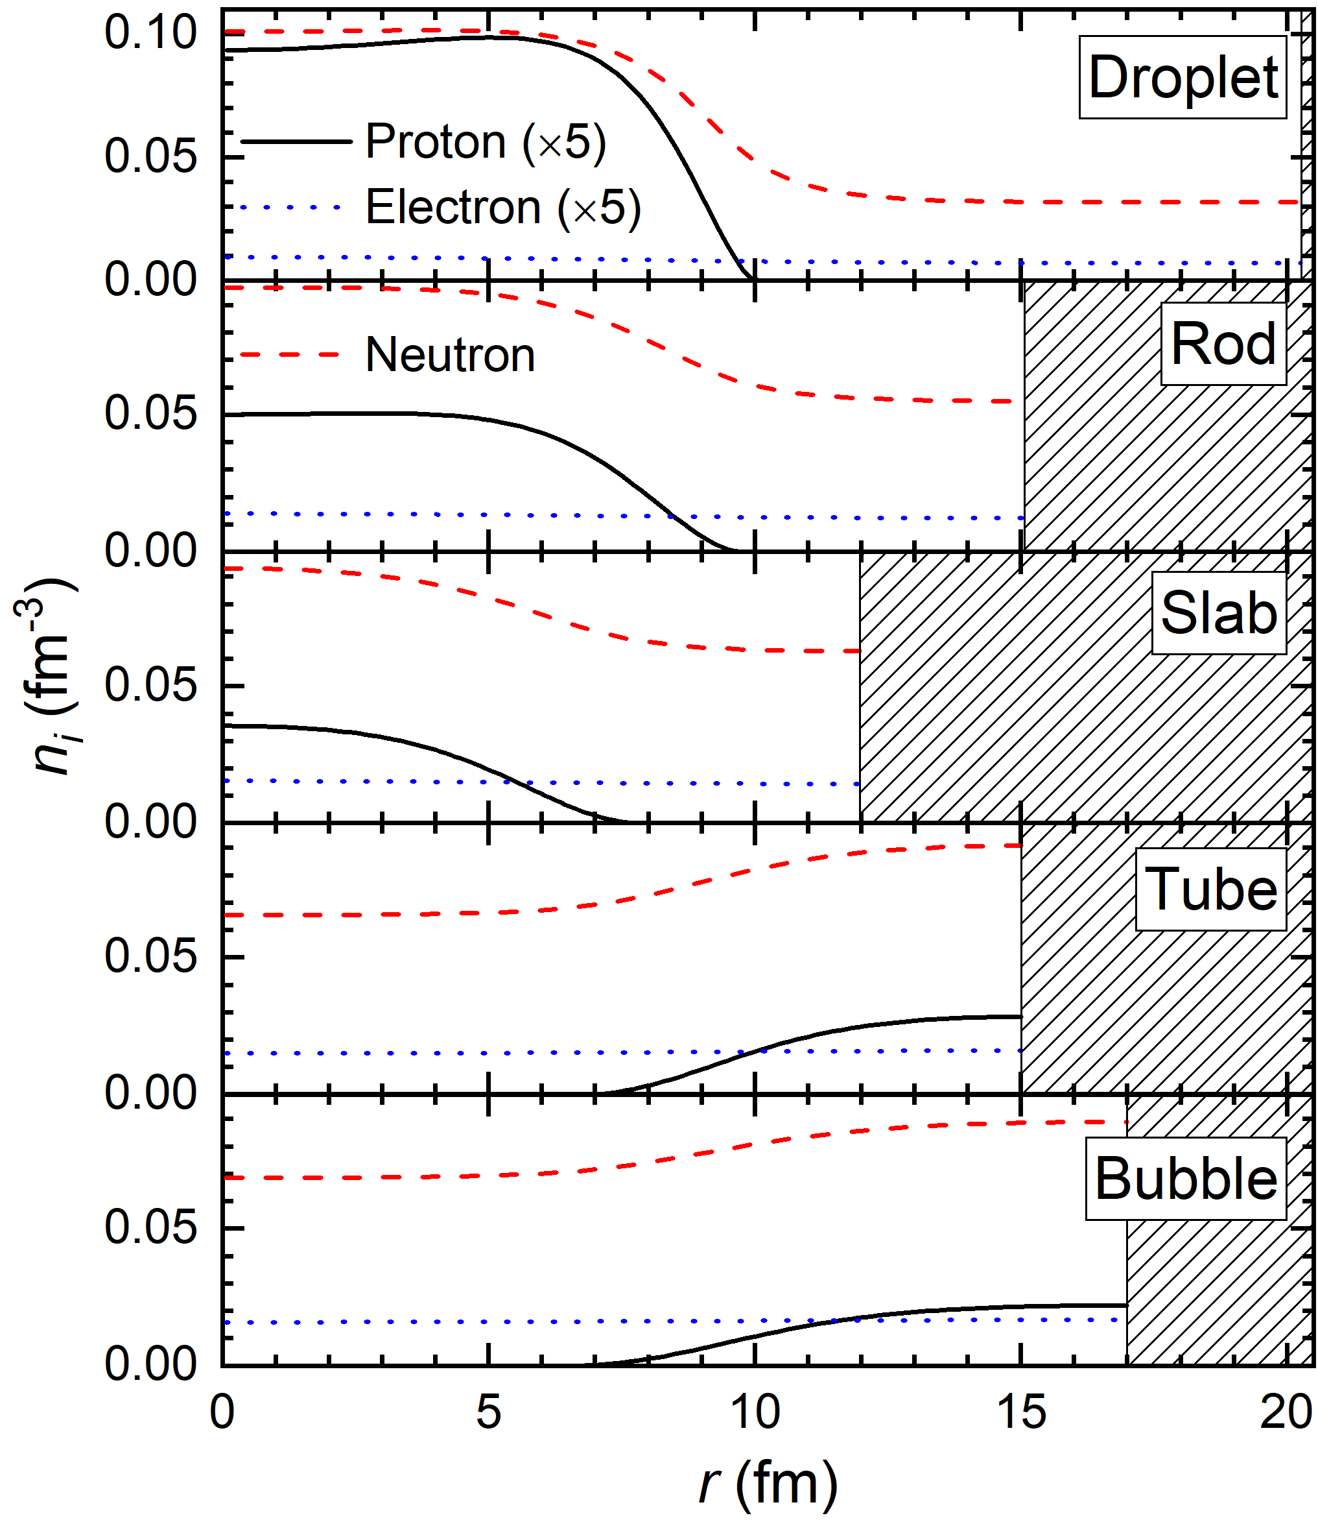

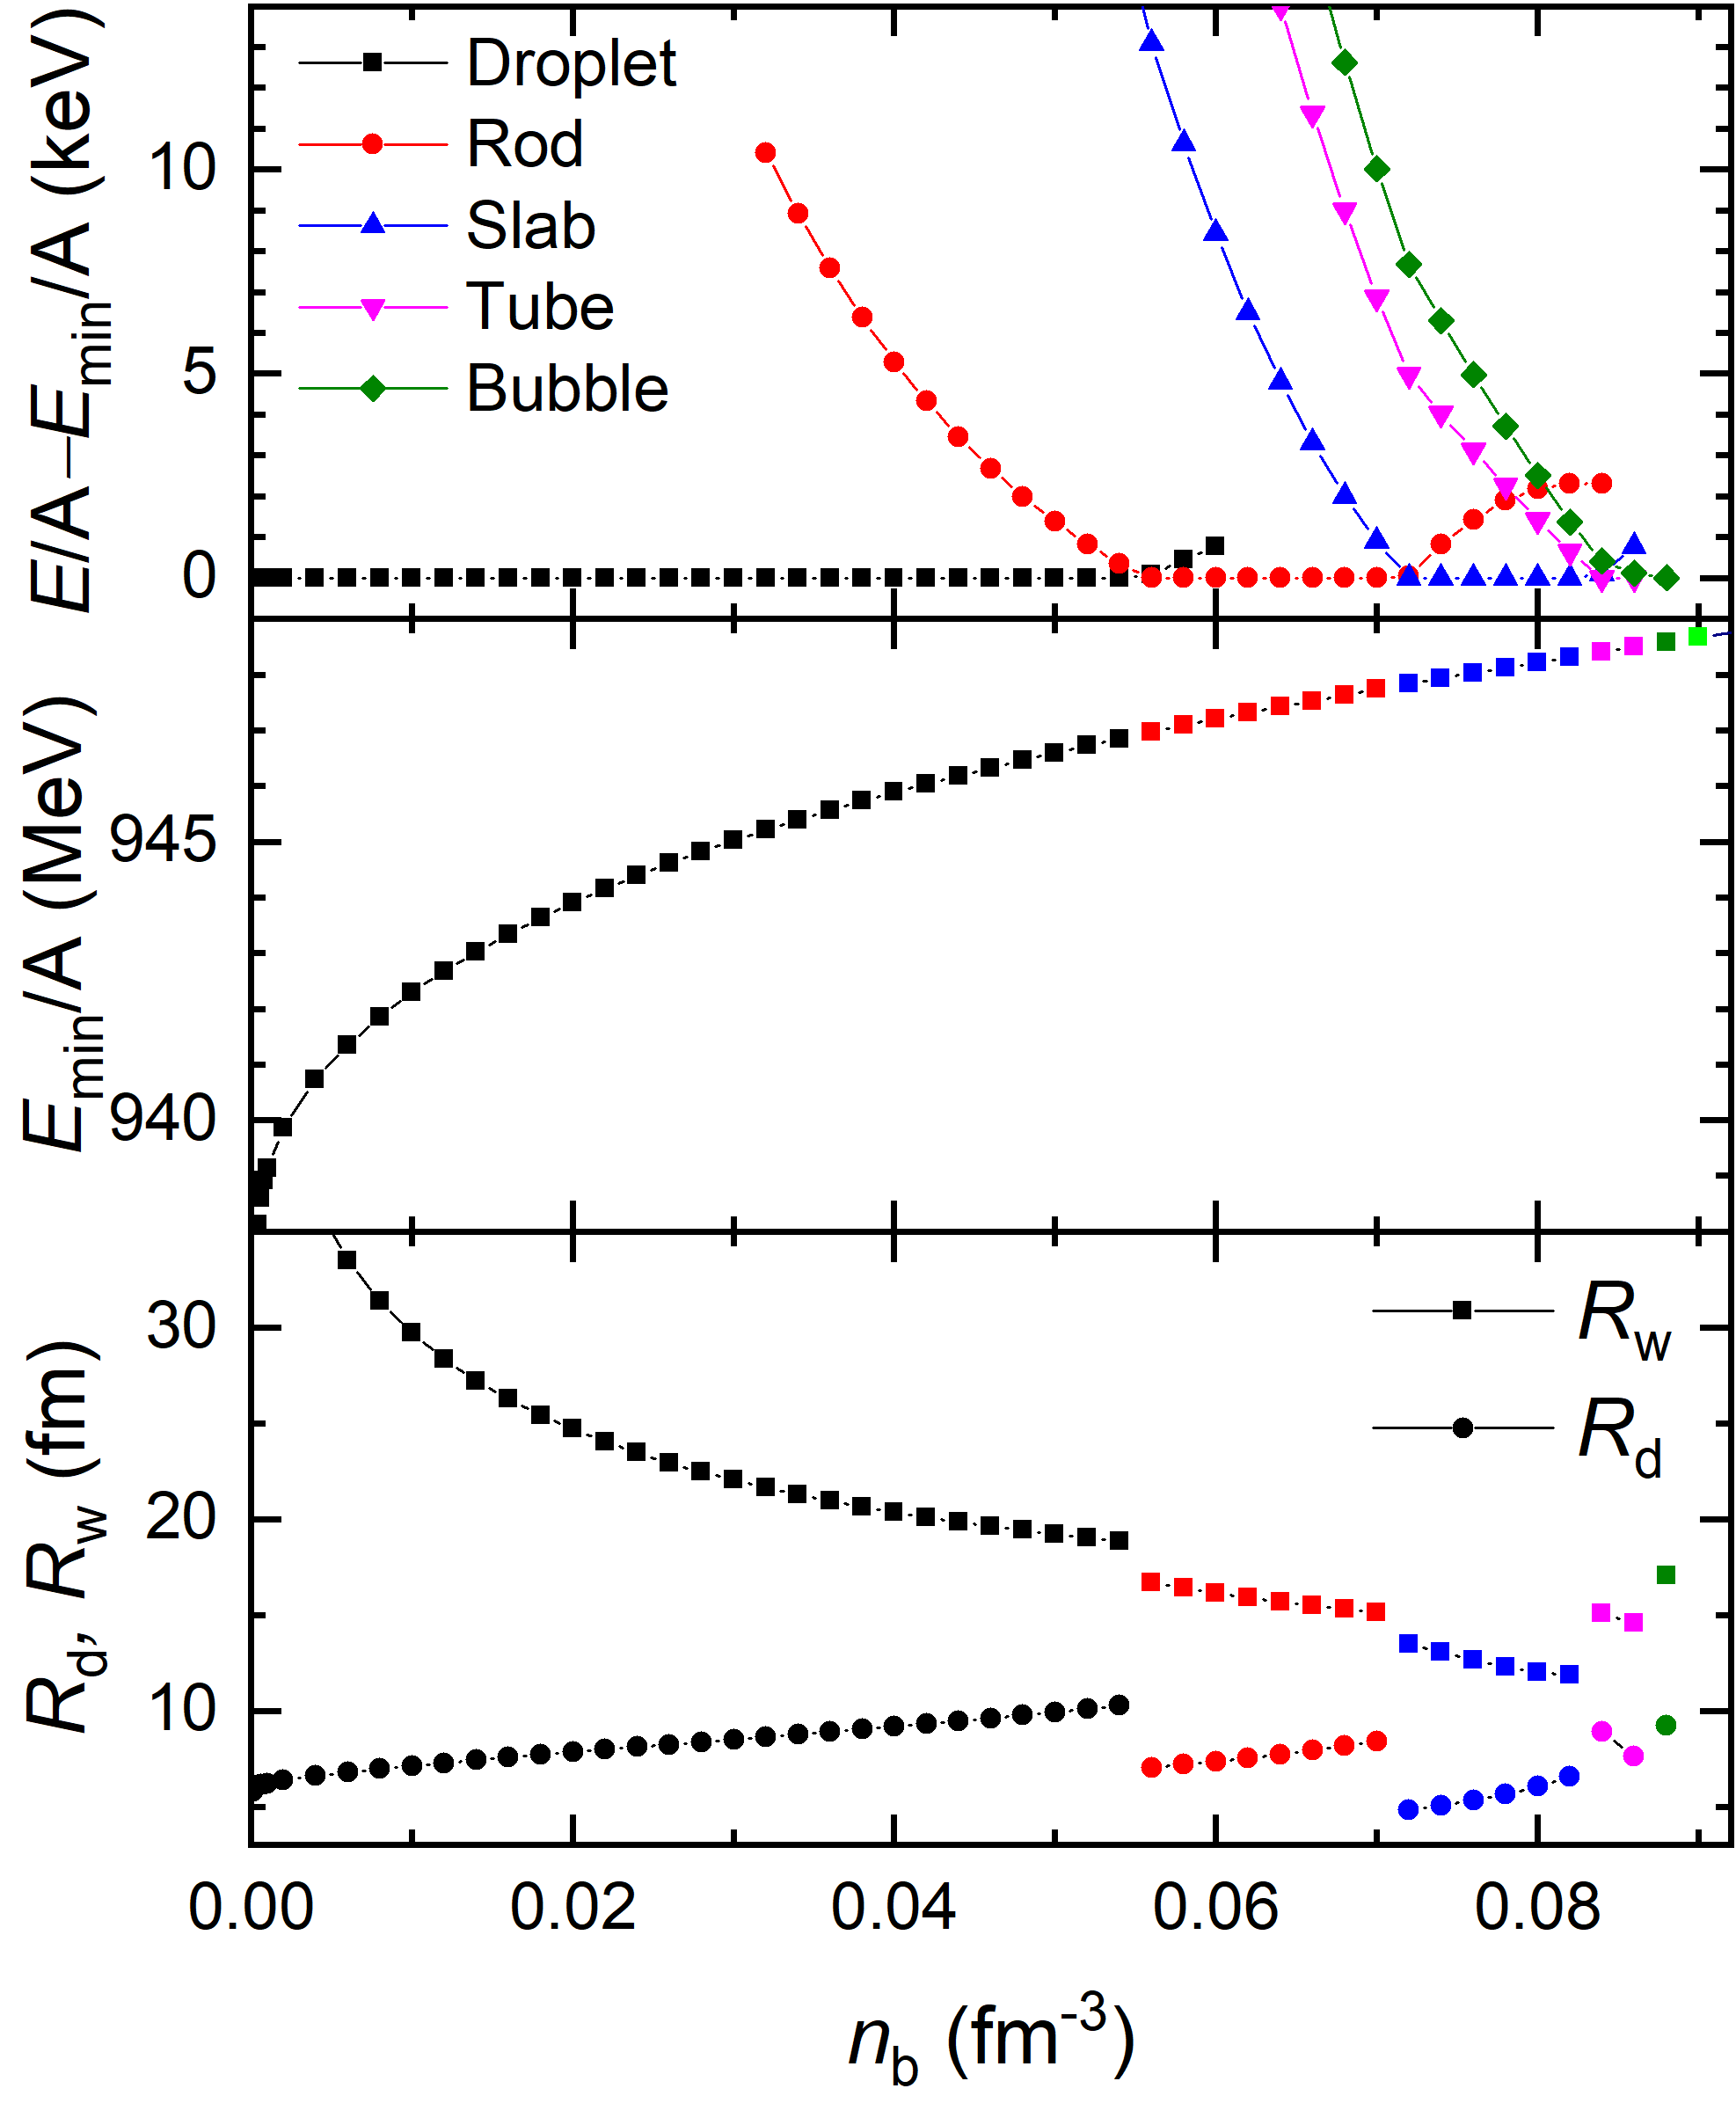




Nuclear pasta
unified Description
Notes:
电荷屏蔽效应
reflective boundary conditions at r = 0 and r = R W

Slide 13
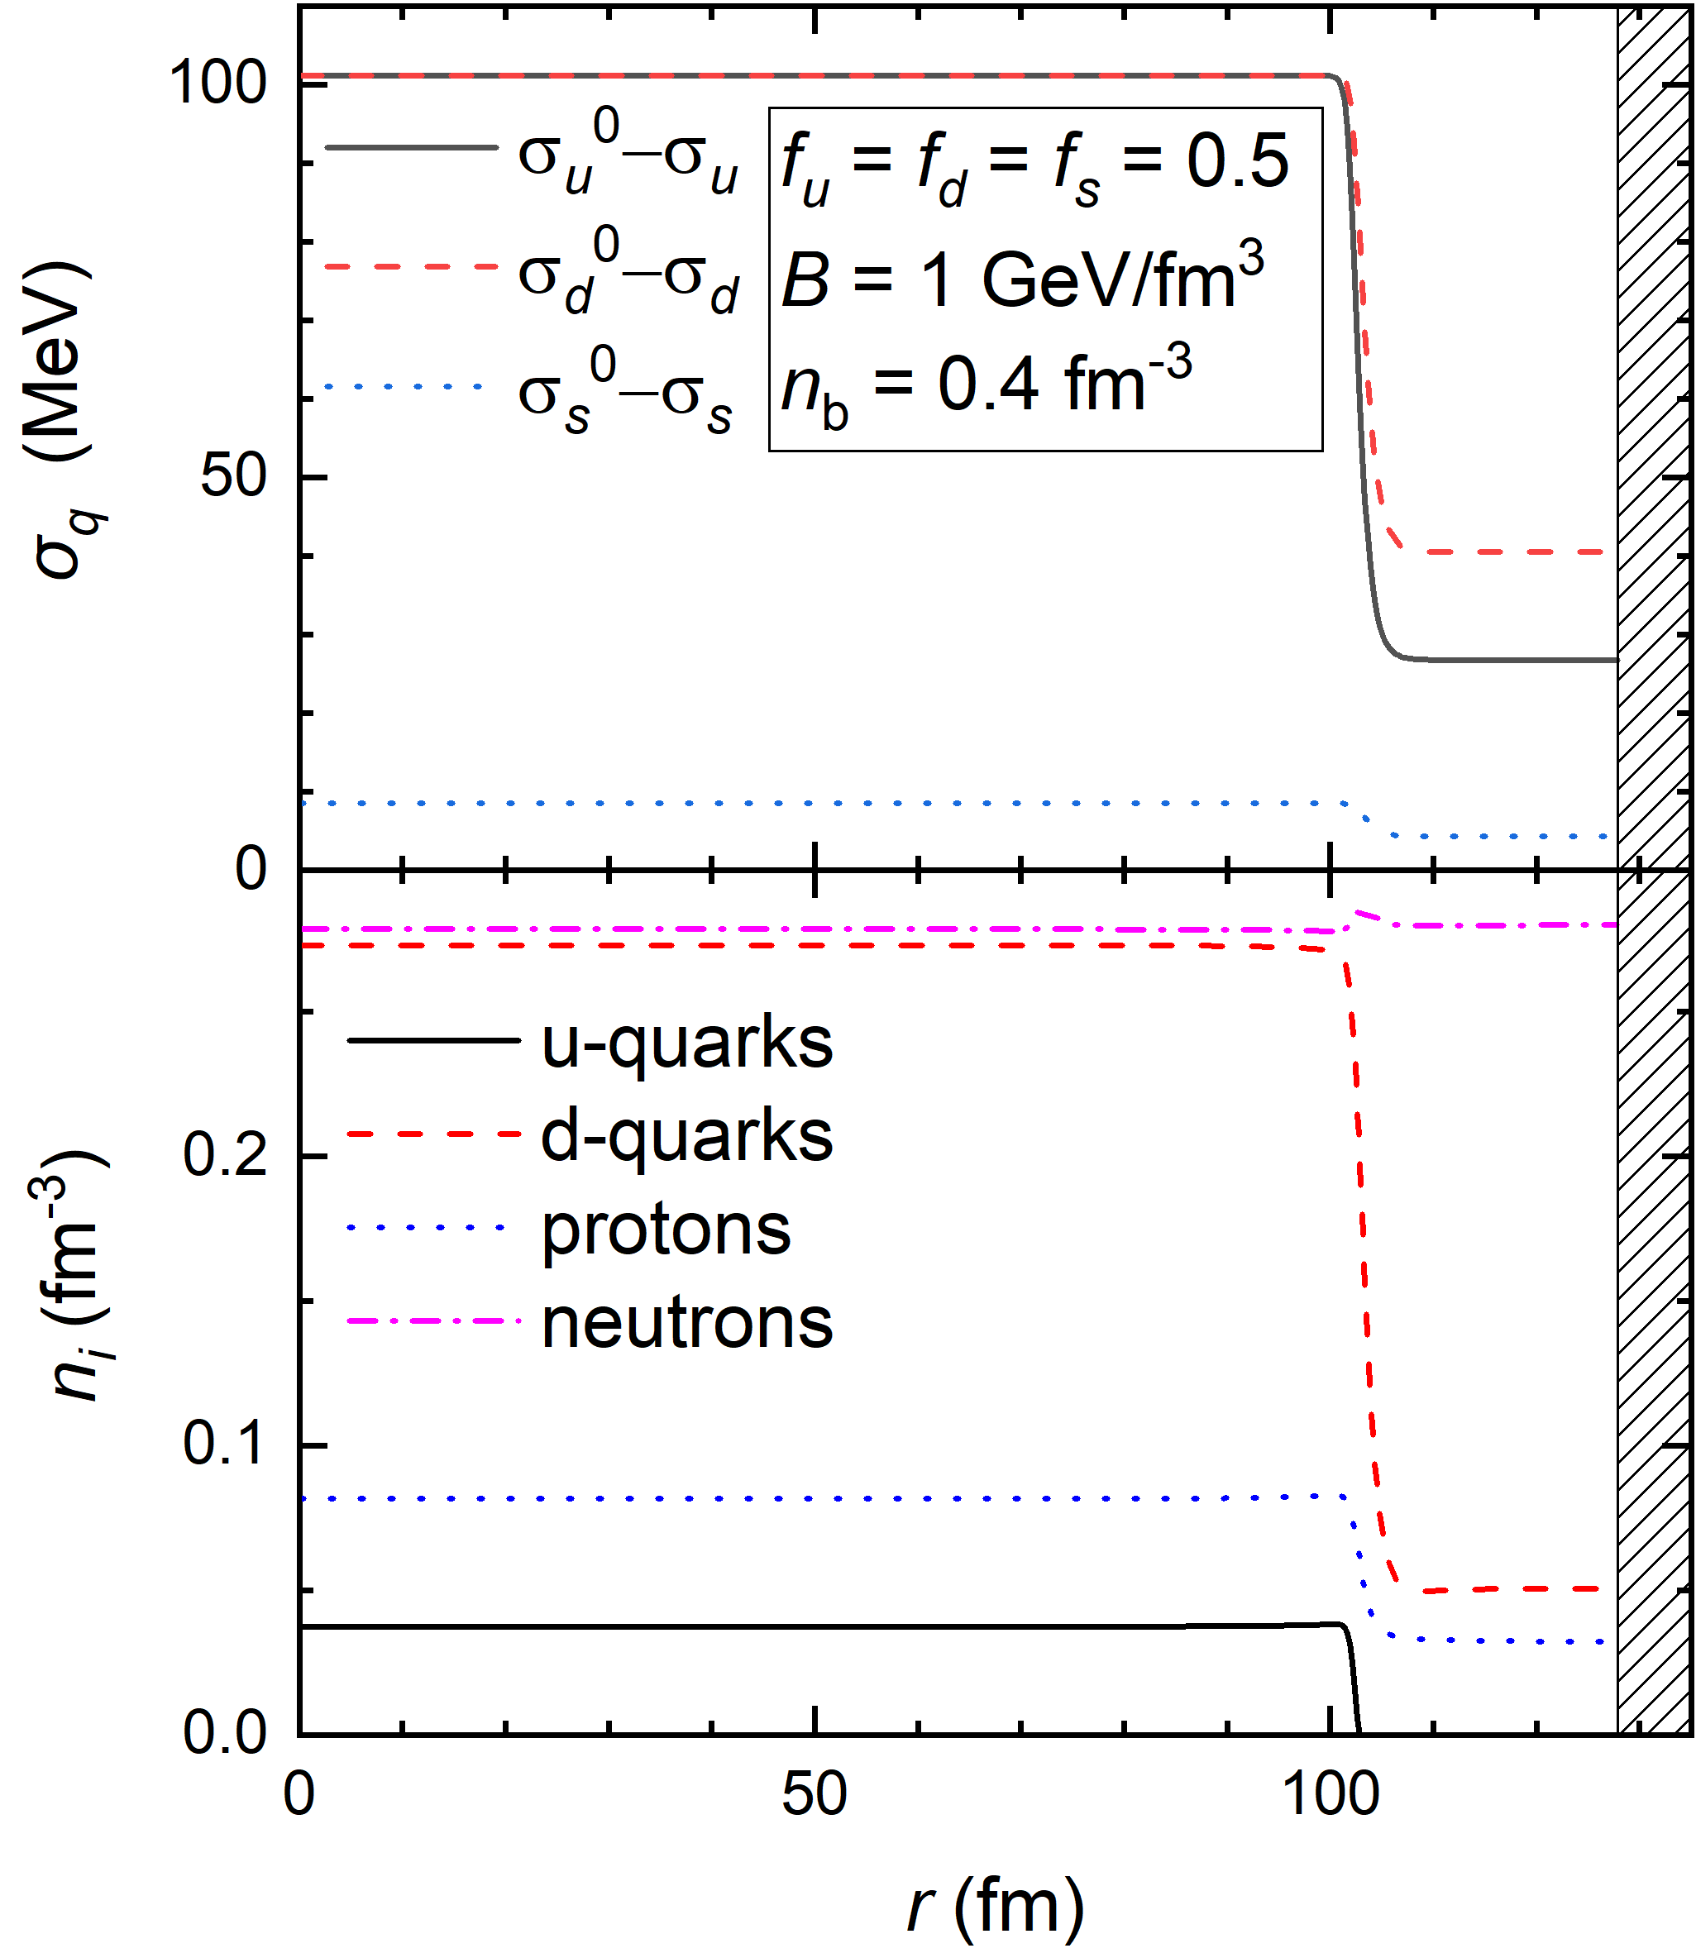
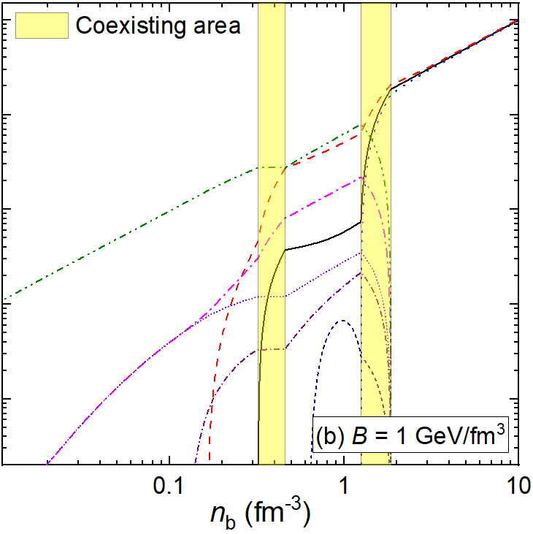
Chiral phase transition
unified Description

Slide 14
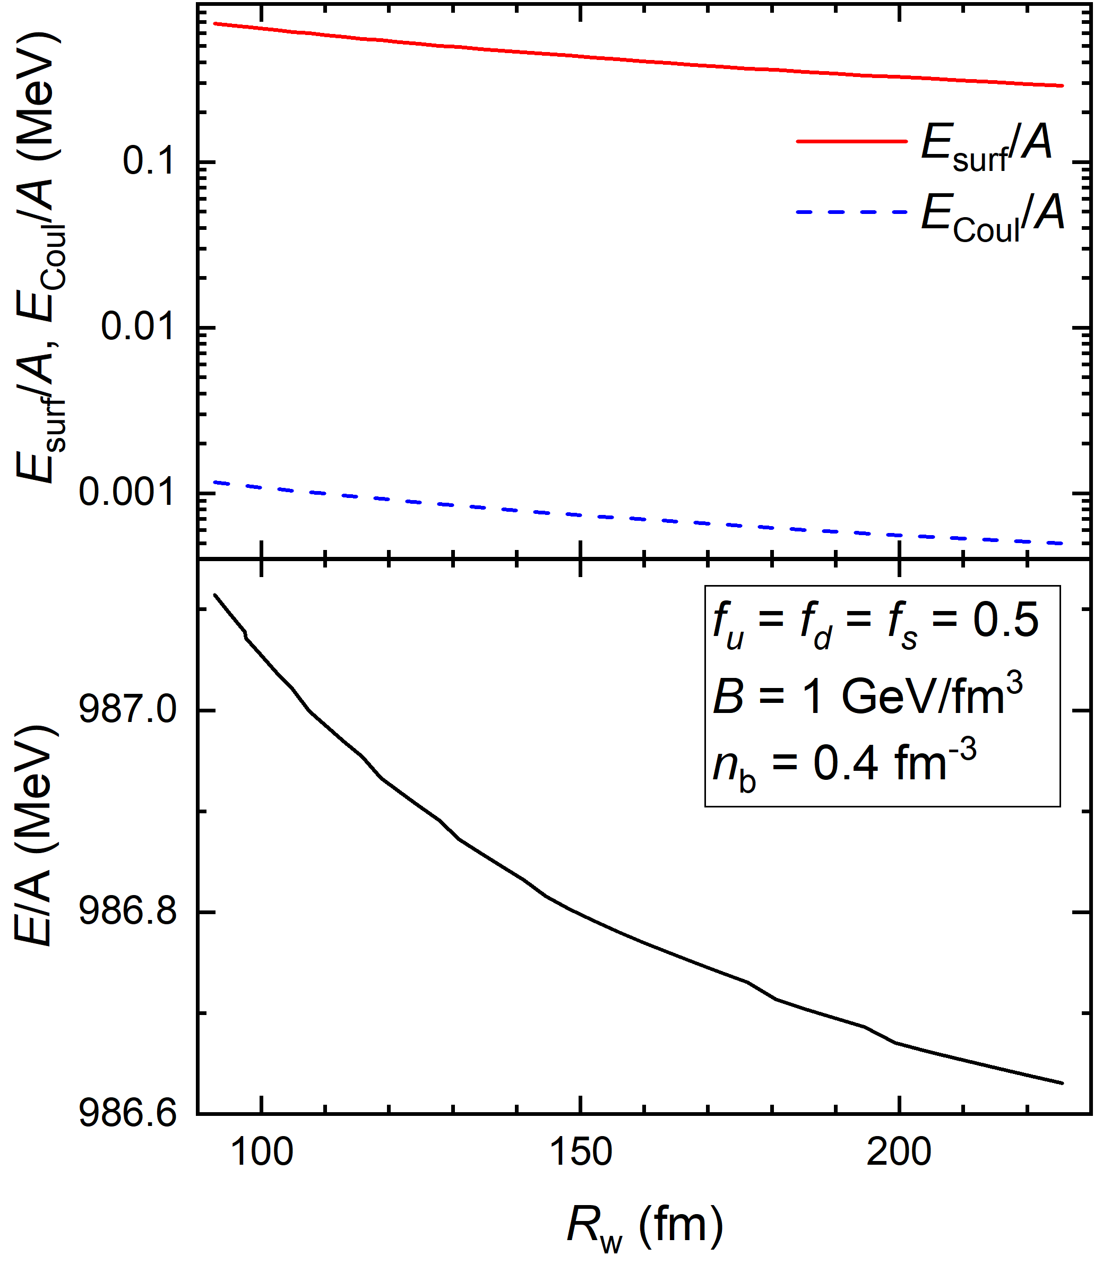
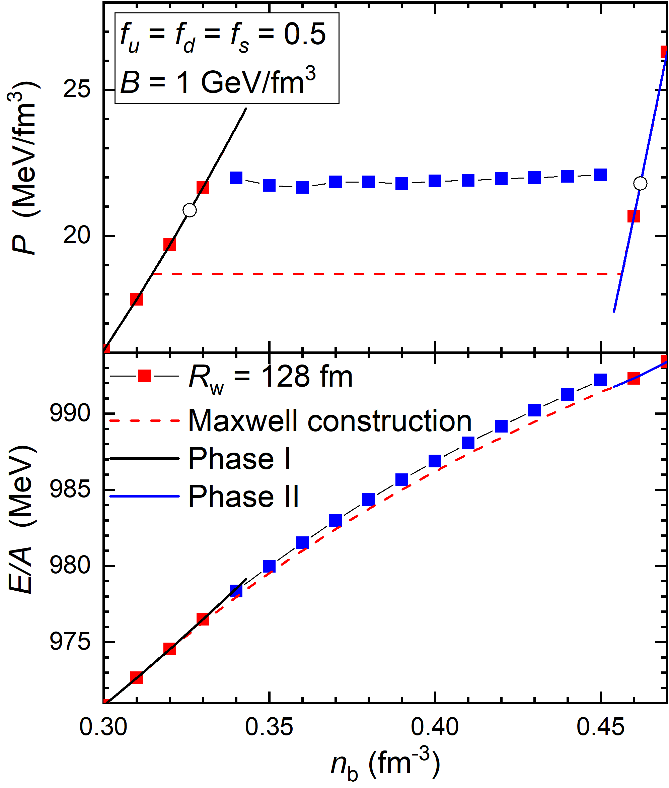
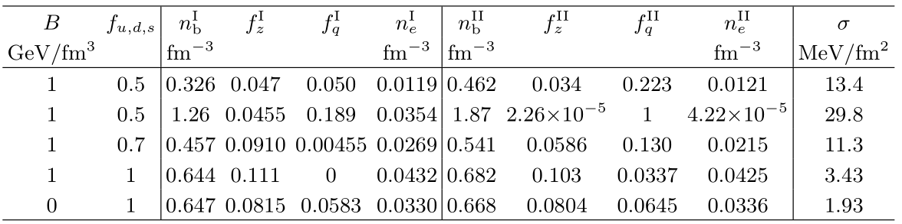
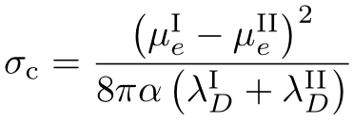
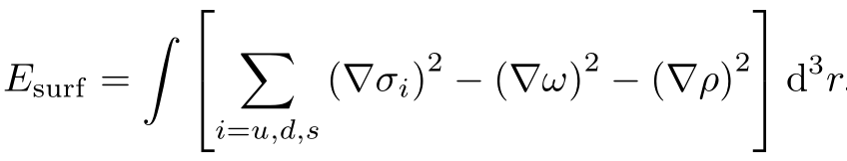
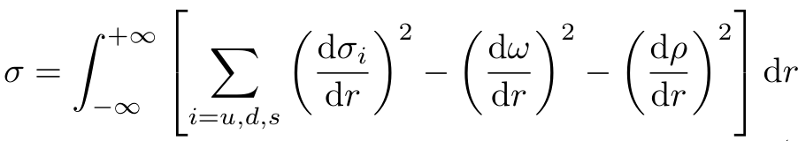
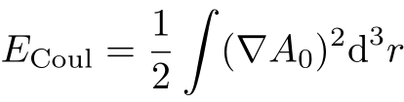
Chiral phase transition
unified Description

Slide 15
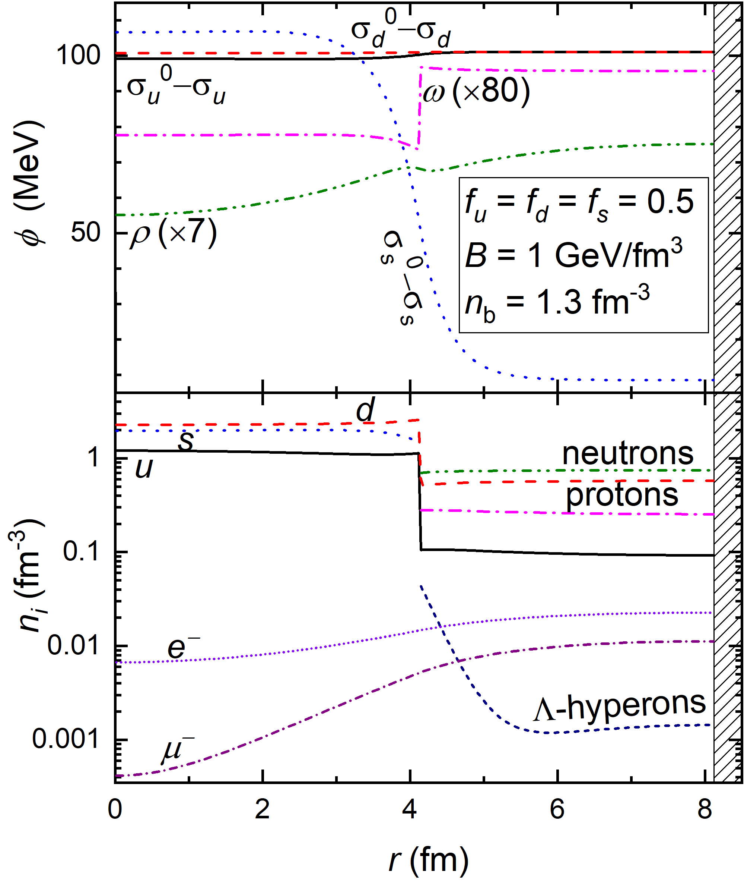
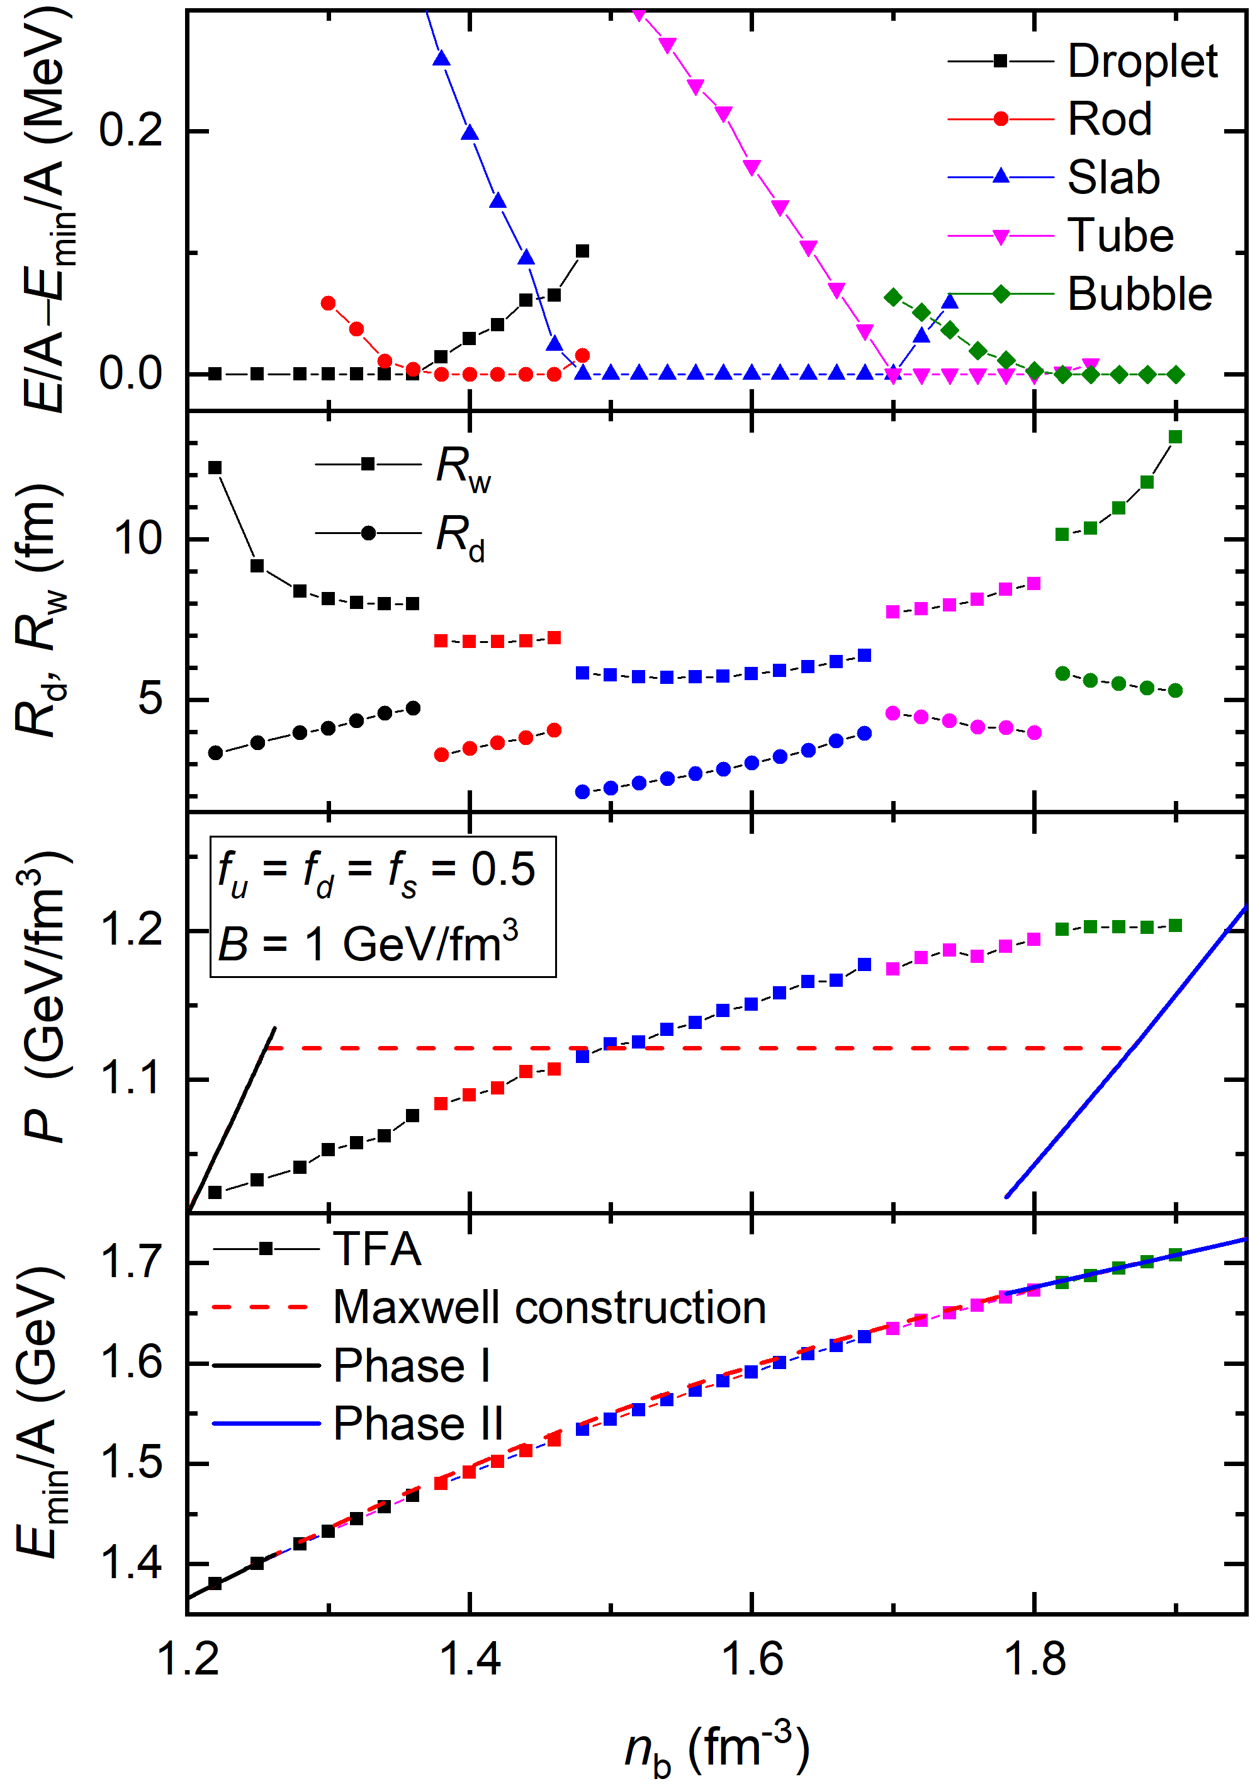
Deconfinement
unified Description

Slide 16
Summary
There exist two possible types of deconfinement phase transition, i.e., first-order and crossover.
By considering baryons as clusters of quarks, we investigate the properties of dense matter by extending the NJL model;
Two types of quarkyonic transitions are observed, i.e., the first-order and third-order phase transitions;
The chiral phase transitions are generally of first-order while the geometrical structures are unstable;
Deconfinement phase transition is entangled with chiral phase transition for s quarks, while various geometrical structures for the mixed phases can take place.
Thank you!!!
Summary

Slide 17



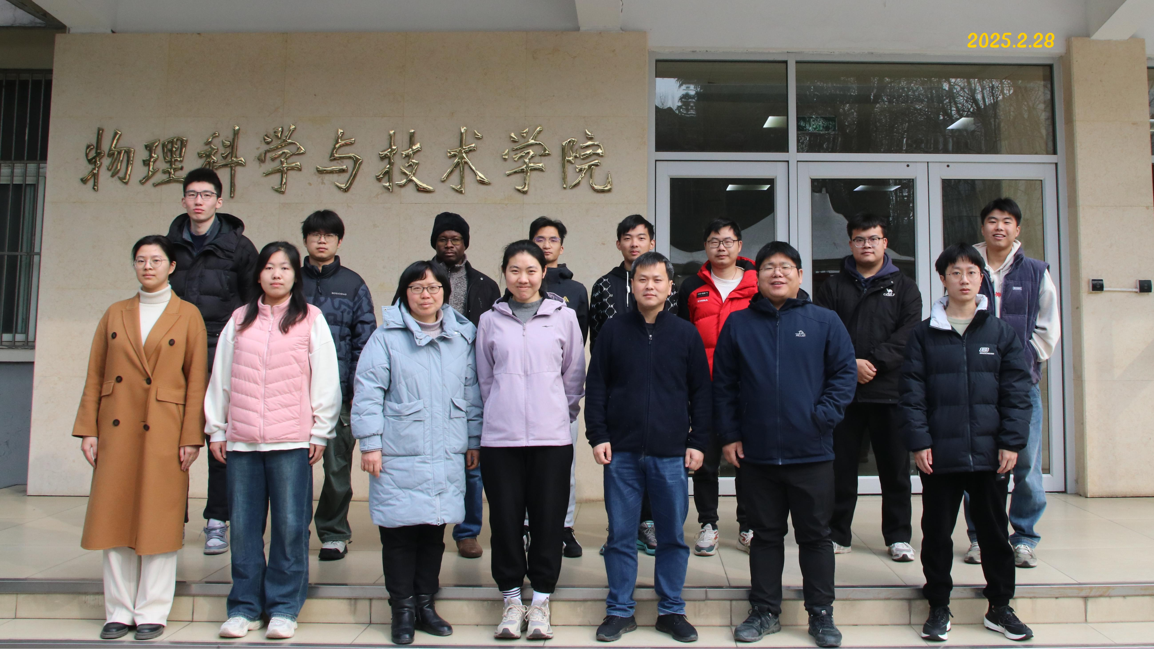
Welcome to Yangzhou！

Slide 18
Neutron stars
Annala et al.2020_NatPhys2101-03193
background

Slide 19
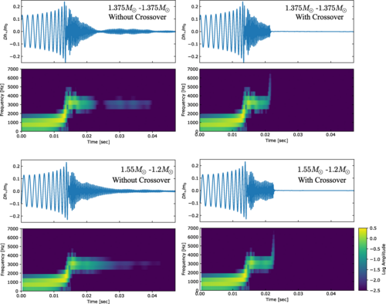
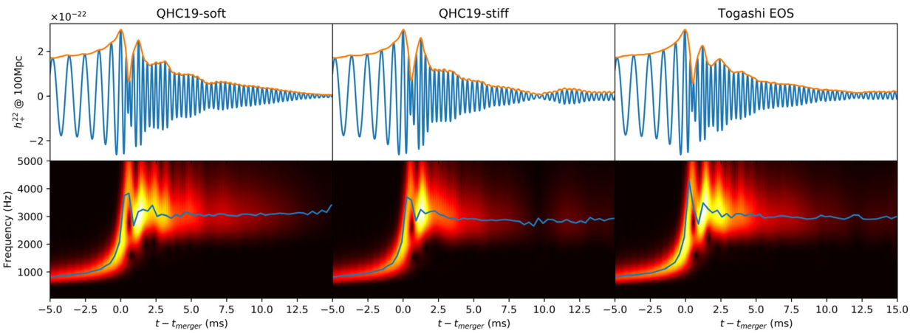
Binary neutron star merger
Fujimoto et al.2023_PRL130-91404
Bauswein et al. 2019_PRL122-061102
Huang et al.2022_PRL129-181101
background

Slide 20
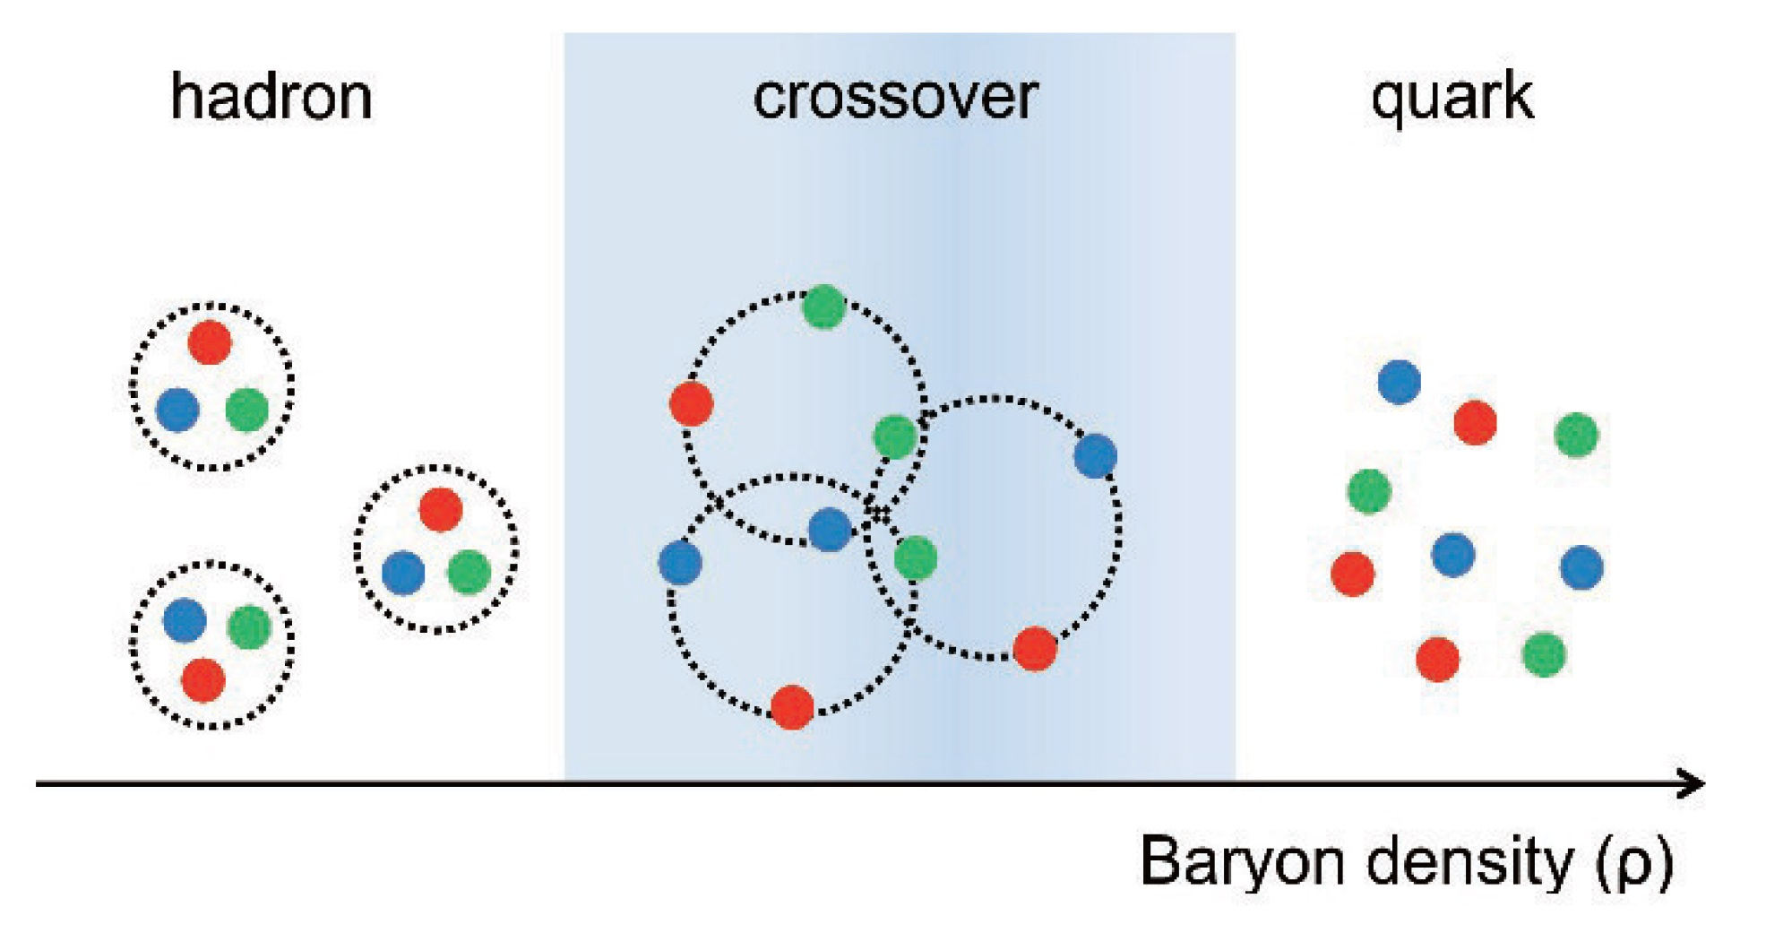
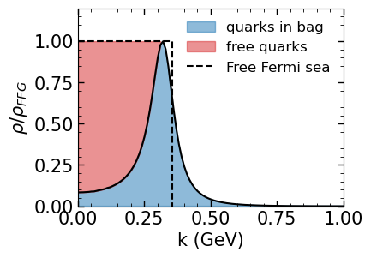
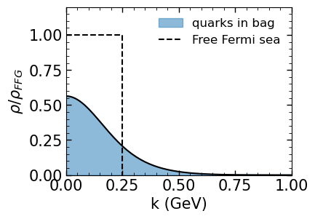
Hadron-quark transition (Crossover)
Masuda_Hatsuda_Takatsuka2016_EPJA52-1
Hadron-quark crossover can be bridged by the quarkyonic matter; The growing contributions of many-body correlations can be attributed to the increasing numbers of exchanged quarks [Fukushima_Kojo2016_ApJ817-180]
n_{b} = 0.2 fm⁻³
Quarkyonic matter: quark Fermi sea + baryonic Fermi surface [McLerran_Pisarski2007_NPA796-83, in lage N_{C} limit]; a quark does not know which baryon it belongs to and can be viewed as quasi-free particles [McLerran2009_NPA830-709c].
n_{b} = 0.5 fm⁻³
Credit: Tianqi Zhao
Hadron-quark Crossover

Slide 21
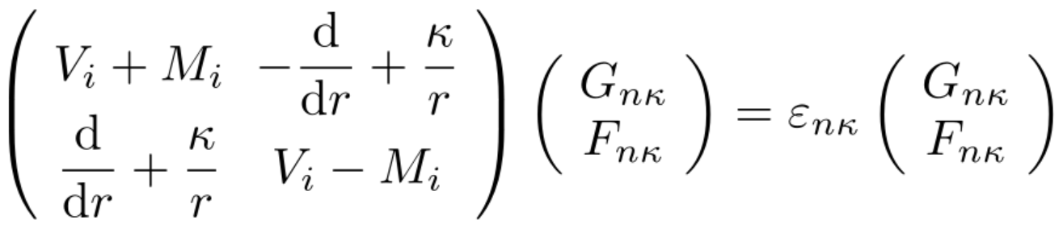
Dirac equation
For spherically symmetric systems, the Dirac spinor of nucleons is
spinor spherical harmonics
radial wave functions
Dirac equation for the radial wave functions
Mean field potentials：
Finite nuclei

Slide 22
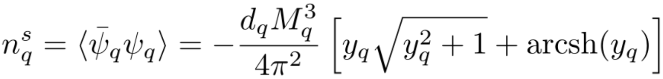
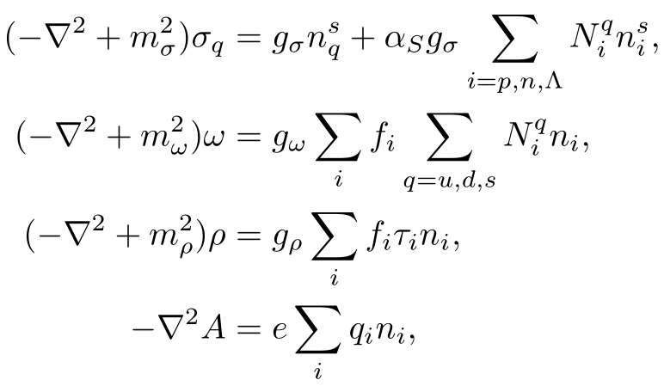

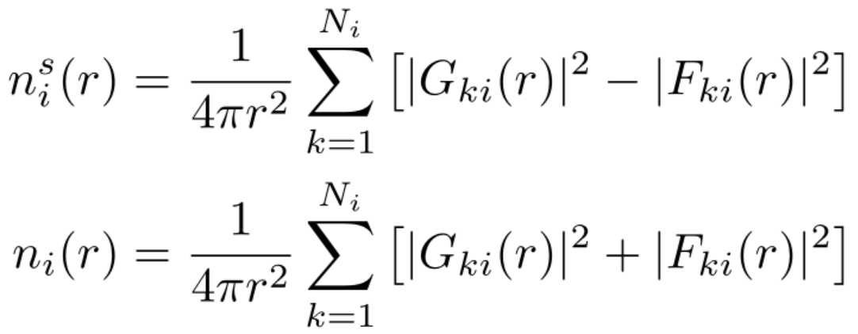
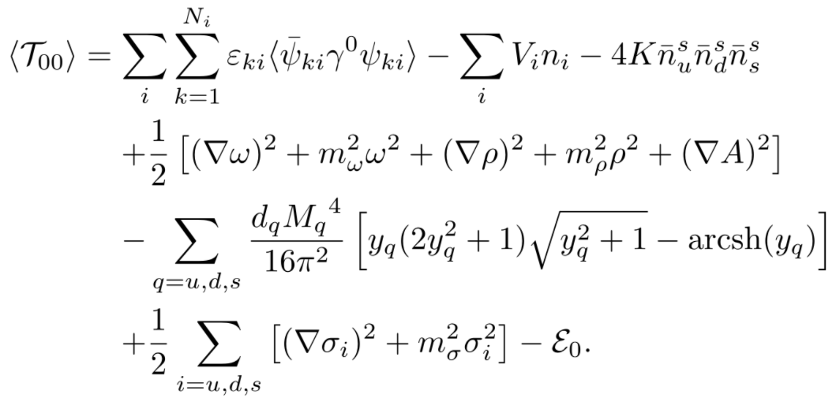
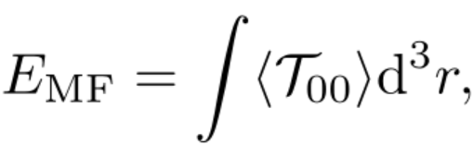
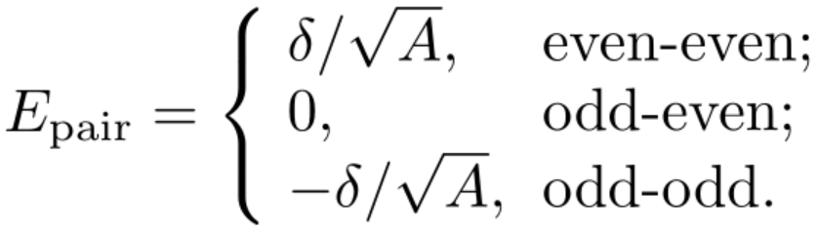

Mean fields and energy
Source currents:
Equations of motion for bosons:
quarks in the Dirac sea:
nucleons in the Fermi sea:
Energy (E):
－Pairing correction:
:
Finite nuclei

Slide 23
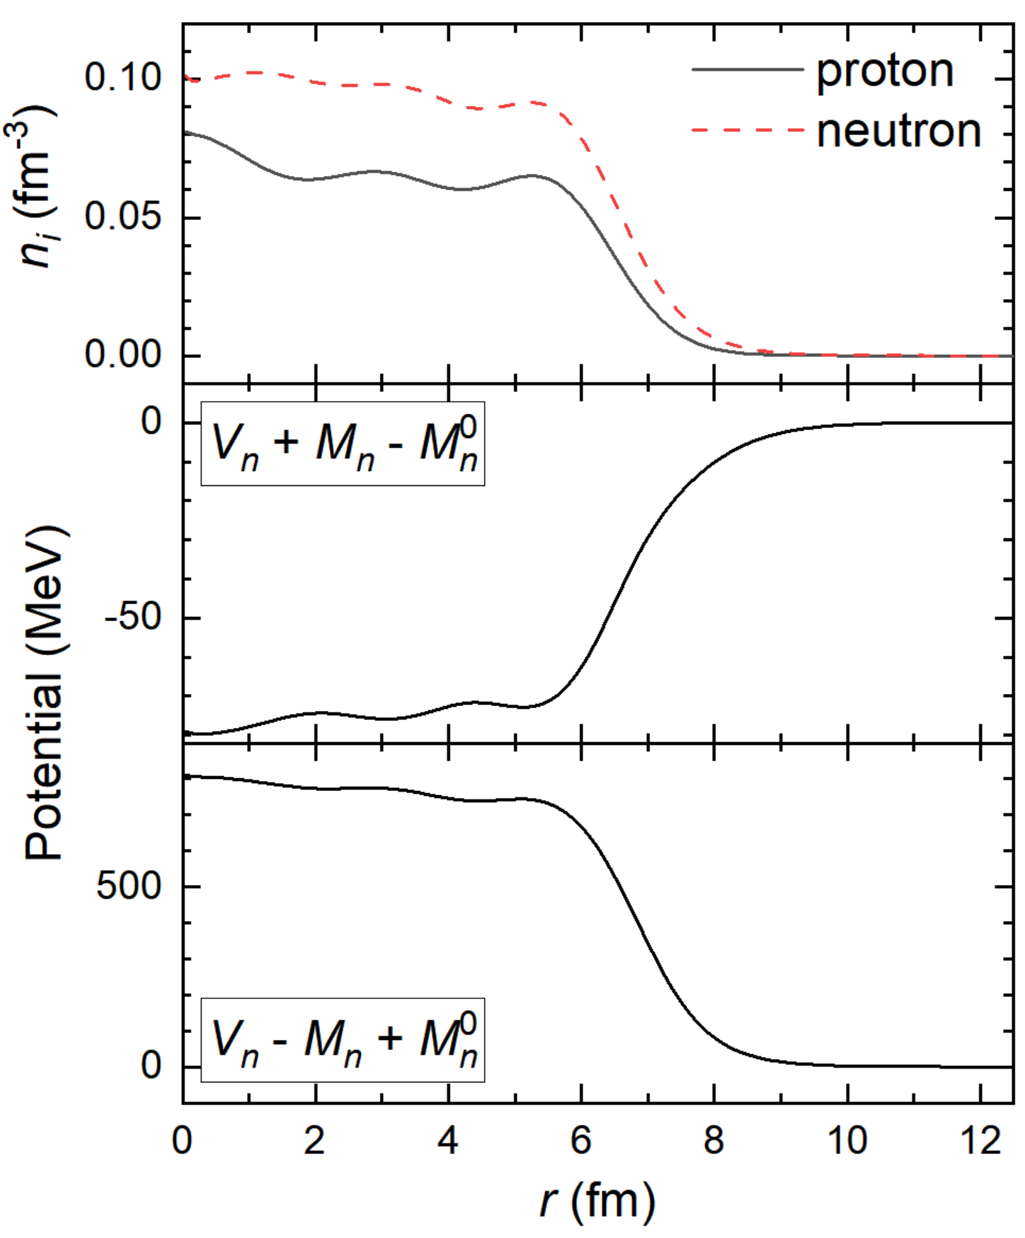
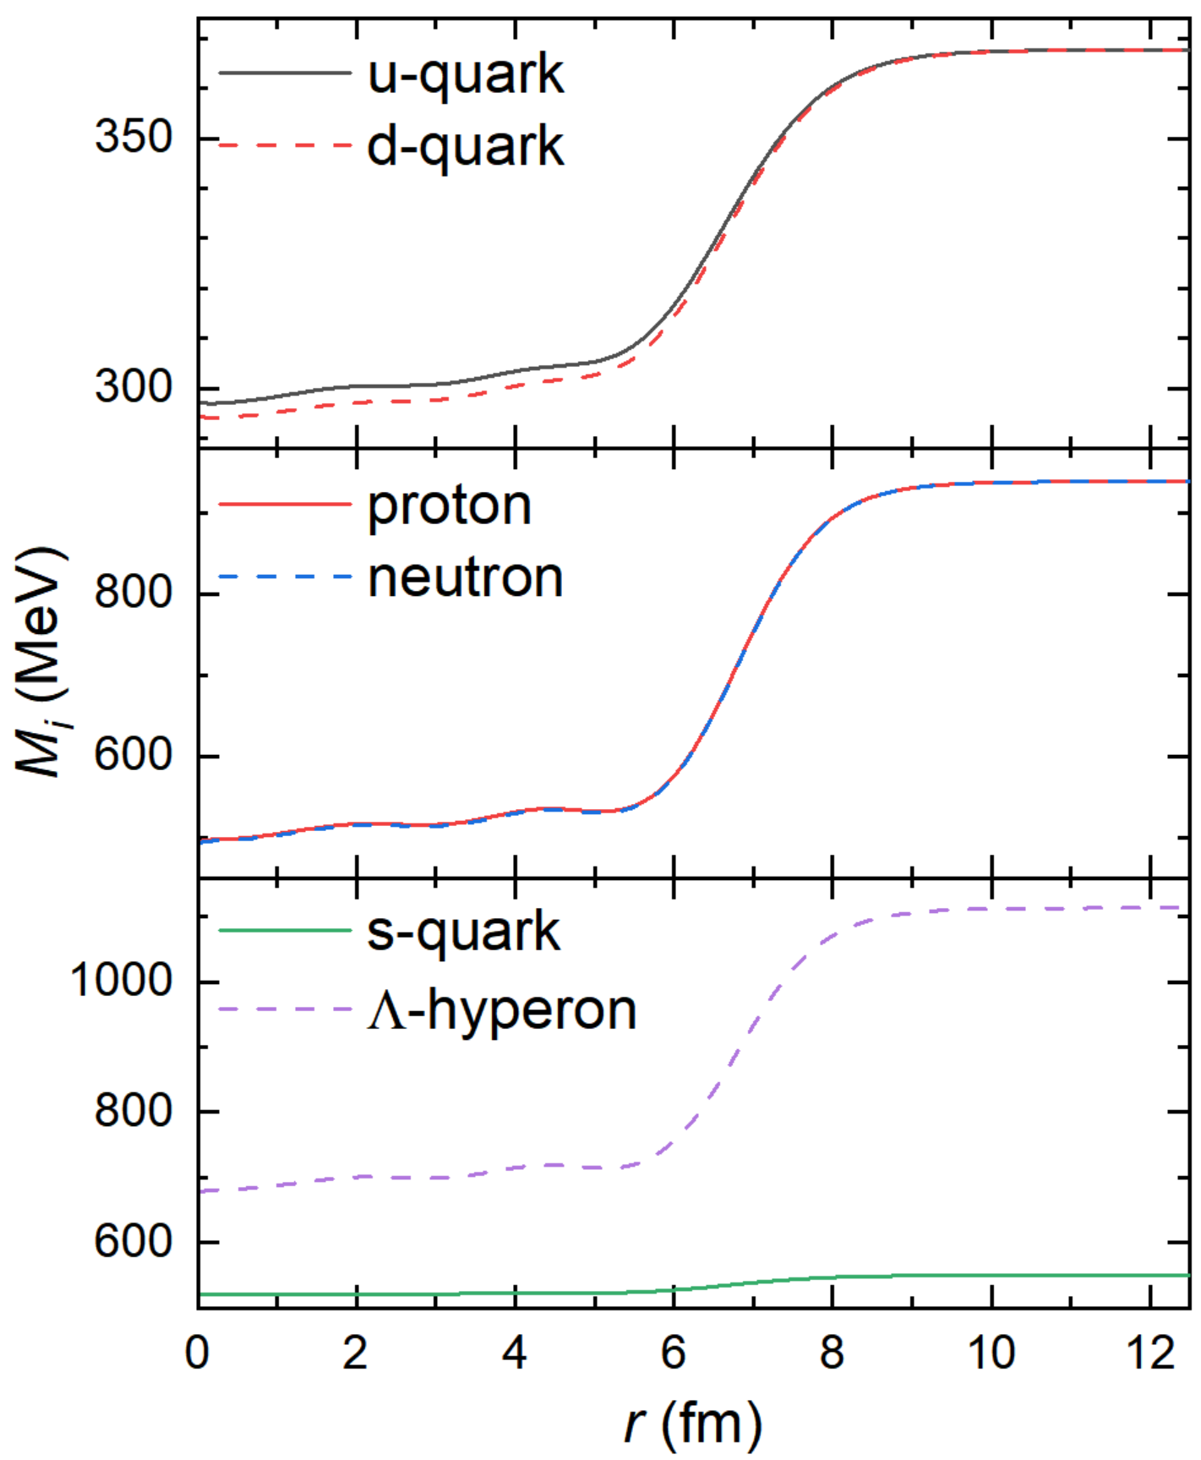
Mean field potential
²⁰⁸Pb
Finite nuclei

Slide 24
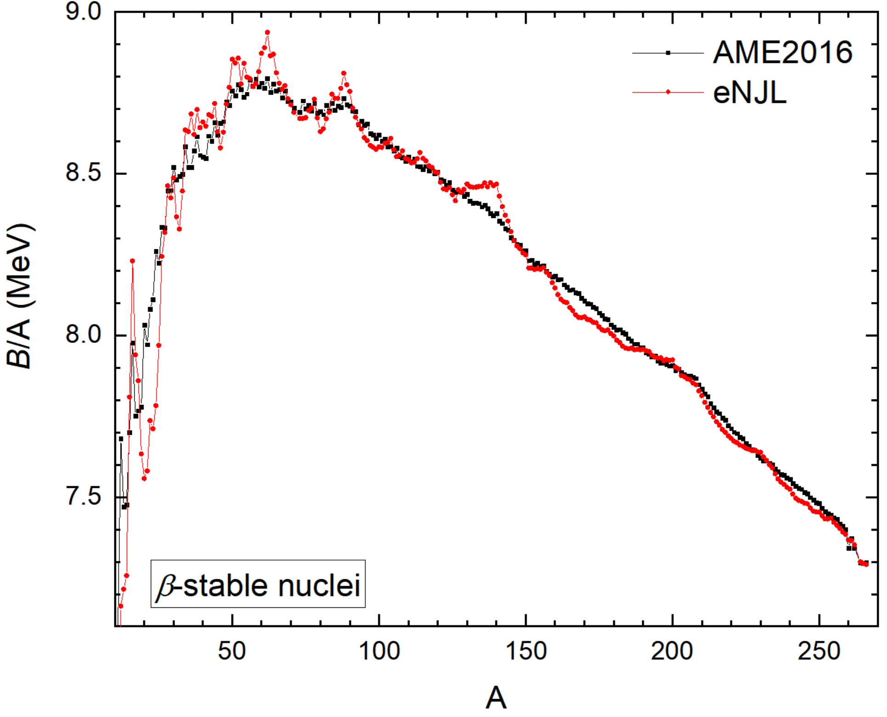
β-stable nuclei
Finite nuclei

Slide 25
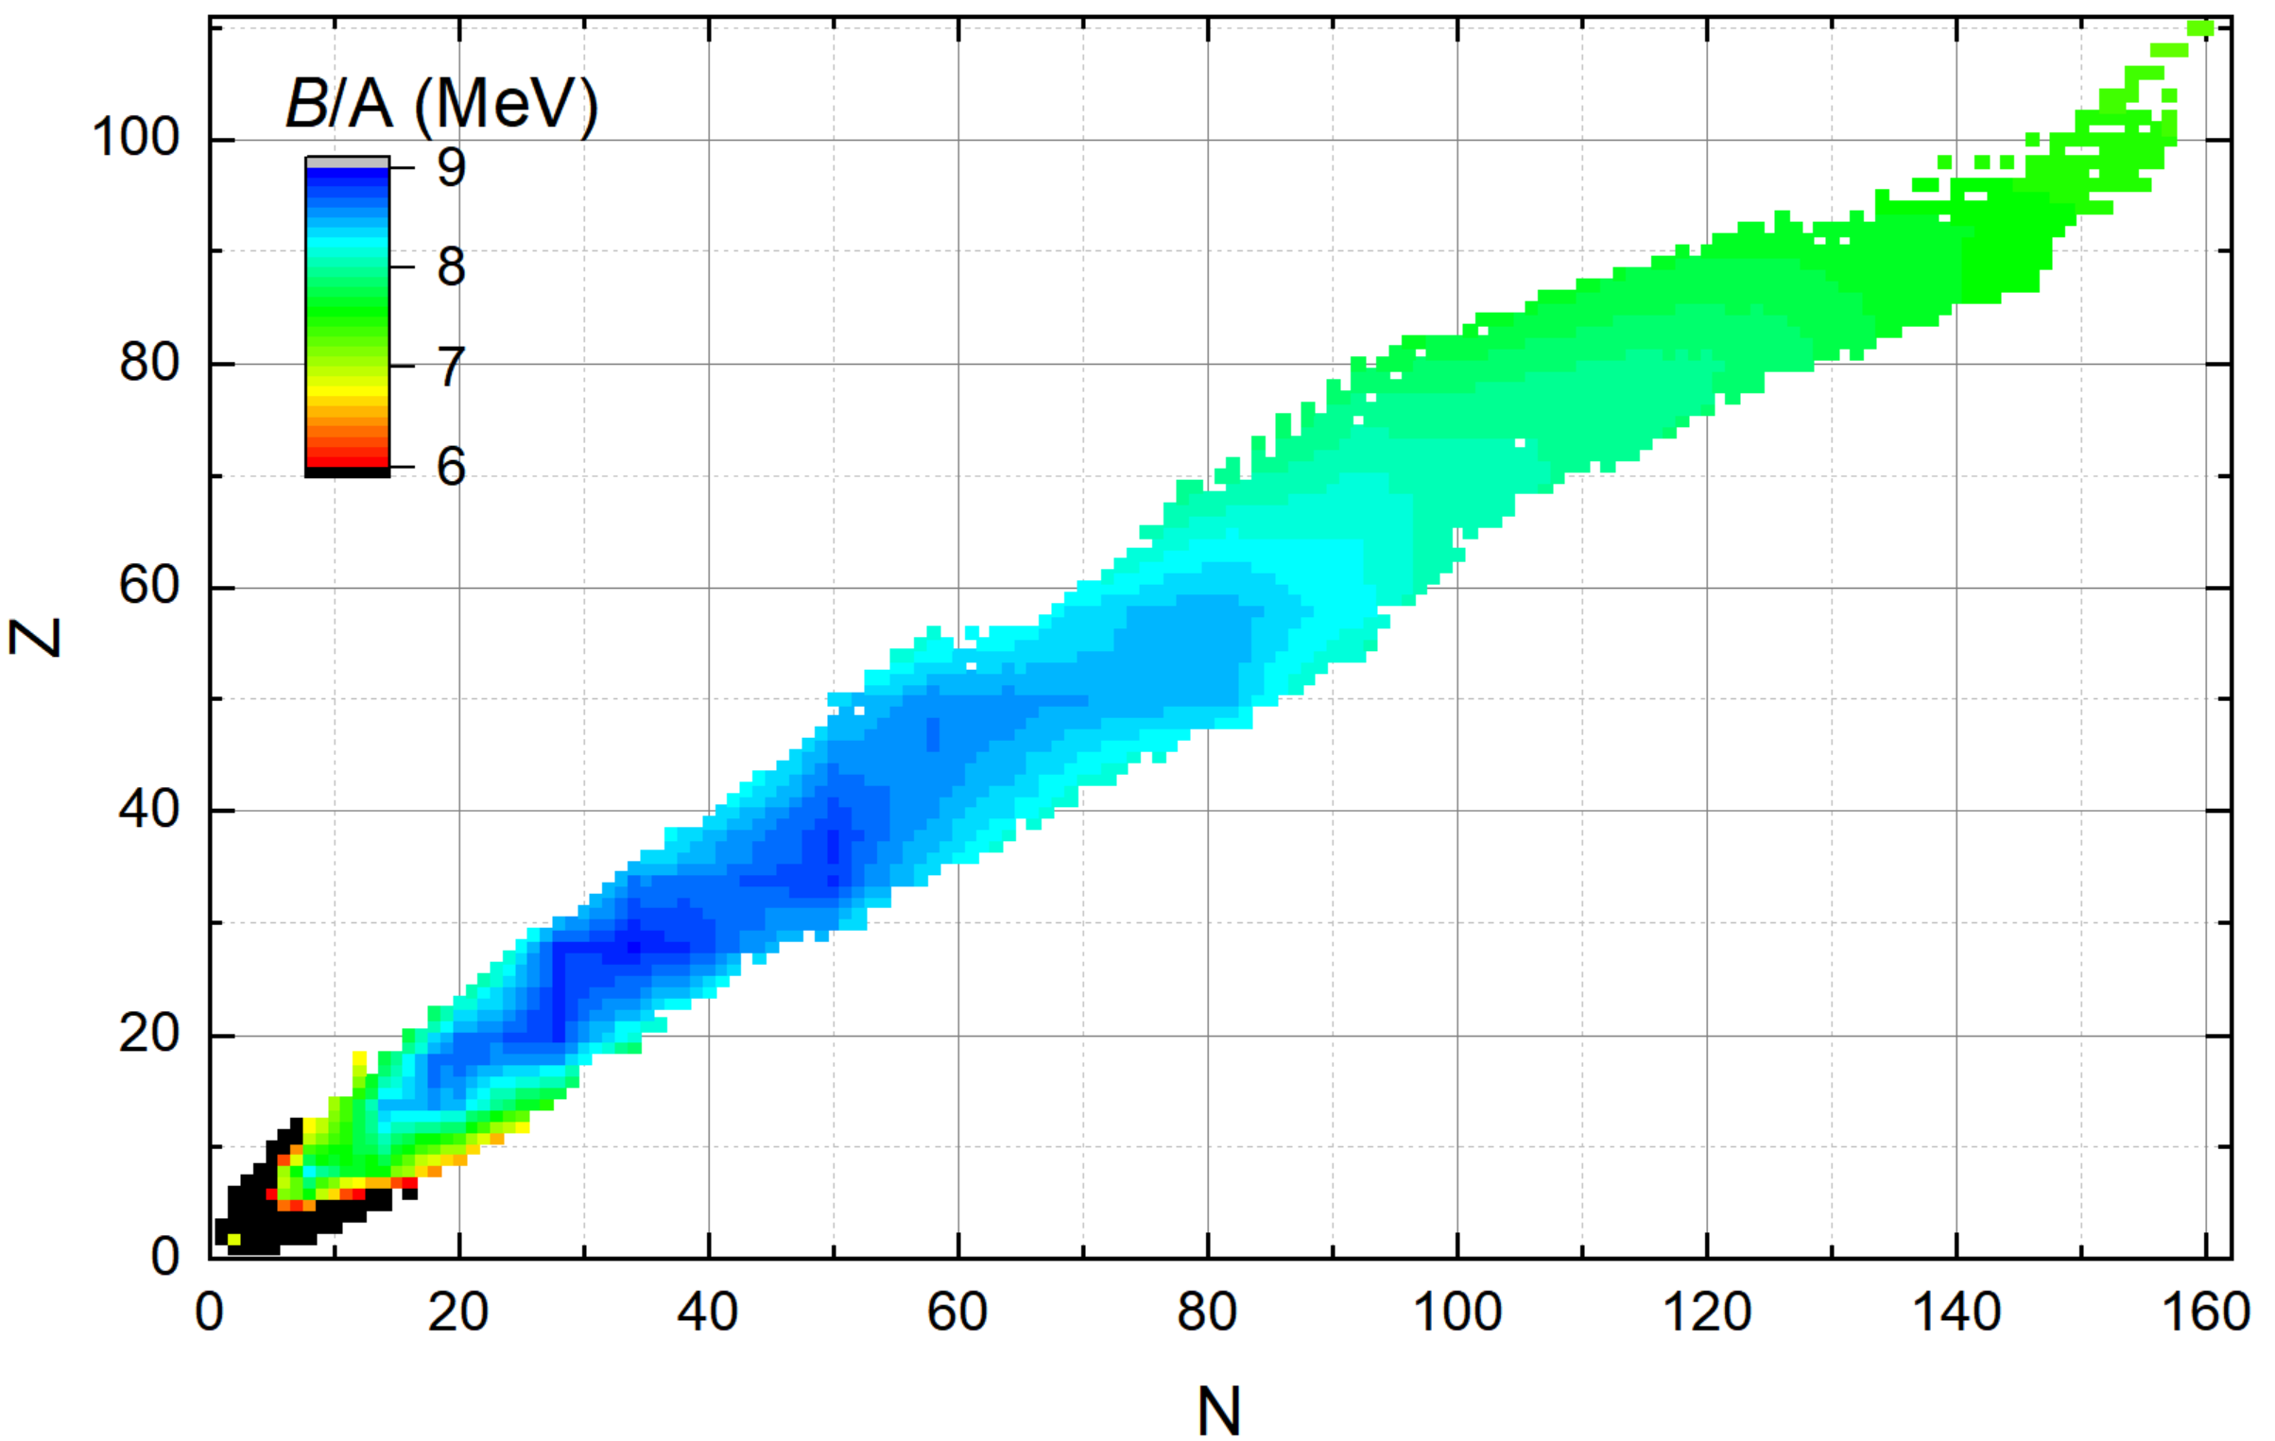
Binding energy
B = M_{n}⁰×A － E
Finite nuclei

Slide 26

Binding energy
ΔB = B_{the} - B_{exp}
r.m.s. deviations:
5.38 MeV
Finite nuclei

Slide 27

Binding energy
34
50
58
58
80
50
76
28
92
40
18
121
154
92
8
138
44
12
12
25
87
146
44
65
101
4
4
72
Finite nuclei

Slide 28

Charge radii
ΔR = R_{exp} － R_{the}
Long et al.2004_PRC69-034319:
r.m.s. deviations:
0.127 fm
Angeli_Marinova2013_ADNDT99-69
Finite nuclei

Slide 29

Charge radii
ΔR = R_{exp} － R_{the}
r.m.s. deviations:
0.127 fm
Finite nuclei

Slide 30

Isotopic chains
28
20
58
64
82
8
114
126
14
Finite nuclei

Slide 31


Isotopic chains
Finite nuclei

