Slide 1
Production of pion string in a hot and dense quark matter
Mao Hong (毛鸿)
School of Physics, Hangzhou Normal University
With: Yige Zhou(周逸歌), Yidian Chen（陈亦点）
Refs: HM, Nuclear Physics A 925, 185 (2014)
Fan Lu, Qichang Chen and HM,PhysRevD.92.085036 (2015)
Yige Zhou, Yidian Chen and HM, in preparation
第二十届全国中高能核物理大会，上海, 26/04/2025

Slide 2
Outline
What is the pion string?
Pion string at finite temperature
  The usual CJT formulism
  The Symmetry improved CJT effective potential
  The solution of the pion string
  The Kibble-Zurek mechanism
Pion string at finite chemical potential
  The quark meson model
  The solution of the pion string
  The production of the pion string
Summary

Slide 3
I. What is the pion string?
The Lagrangian density of the SU(2)×SU(2) symmetry linear sigma model in chiral limit has the form
where the potential is parametrized

Slide 4
In our discussion of the pion string it proves convenient
to define the new fields
Then, the time-independent equations of motion

Slide 5
X.M. Zhang, T. Huang, and R. H. Brandenberger, Pion and eta strings, Phys. Rev. D 58, 027702 (1998).
Tao Huang, Yunde Li, HM, Michiyasu Nagasawa and Xinmin Zhang, Signal of the pion string at high-energy collisions, Phys. Rev. C 71, 014902 (2005)
The global pion string solutions:
The energy per unit length of the string can be expressed as

Slide 6
II. Pion string at finite temperature
2.1 The usual CJT formulism (2PI)
Where

Slide 7
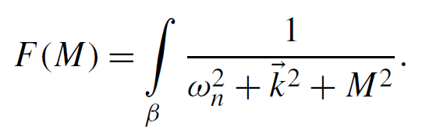
Minimizing the effective potential with respect to full propagators we obtain the following system of non-linear gap equations:
(1)
(2)
(3)
Minimizing the potential with respect to the expectation value for the sigma field φ,we obtain one more the stationarity equation:

Slide 8
N. Petropoulos, Linear sigma model and chiral symmetry at finite temperature, J. Phys. G 25, 2225 (1999).
Results: the thermodynamic properties of the model at T in Hatree approximation in chiral limit
Two major problems in chiral limit: (1) the CJT effective action violates the Goldstone theorem and gives massive pions in the spontaneous symmetry breaking phase; (2) it predicts a first order phase transition.

Slide 9
Apostolos Pilaftsis and Daniele Teresi, Symmetry Improved CJT Effective Action, Nucl.Phys. B 874 (2013) 594-619
HM, On the symmetry improved CJT formalism in the O(4) linear sigma model, Nuclear Physics A 925, 185 (2014)
2.2 The Symmetry improved CJT effective potential
The gap equations:
(1)
(2)
(3)
(3’)
For the SCJT formulism, the stationarity equation (3) has been replaced by the constraint:

Slide 10
The numerical results:
Solution of the gap equations in the case of chiral limit for SCJT formalism.

Slide 12
The Symmetry improved CJT effective potential

Slide 13
Fan Lu, Qichang Chen and HM, Pion string evolving in a thermal bath, Phys. Rev. D 92 085036 (2015)
2.3 The solution of the pion string
If we approximately treat a hot thermal medium as a
uniform thermal bath with pion strings embedded in it, a
new set of coupled equations of motion for the pion string could be derived by simply replacing the relevant classical potential with the above appropriately modified thermal effective potential.

Slide 14
(a) The profile functions of pion strings as function of the radius r at various temperatures. (b) The energy densities as a function of the temperature T.

Slide 15
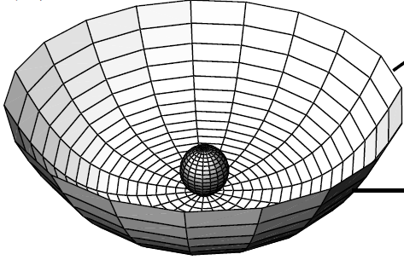
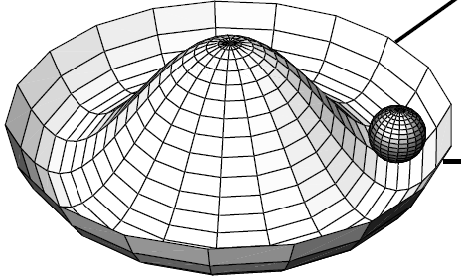
W. H. Zurek, Cosmological experiments in superfluid helium?, Nature (London) 317, 505 (1985); Cosmological experiments in condensed matter systems, Phys. Rep. 276, 177 (1996).
2.4 The Kibble-Zurek mechanism
T>T_{c}
In a second order phase transition, because of fluctuations of the order parameter, the new symmetry-broken-phase starts to form simultaneously and independently. Subsequently, these independent regions grow together to form the new symmetry-broken phase randomly. At the boundaries, a network of strings is formed if the broken symmetry is the U(1) symmetry.
T<T_{c}

Slide 16
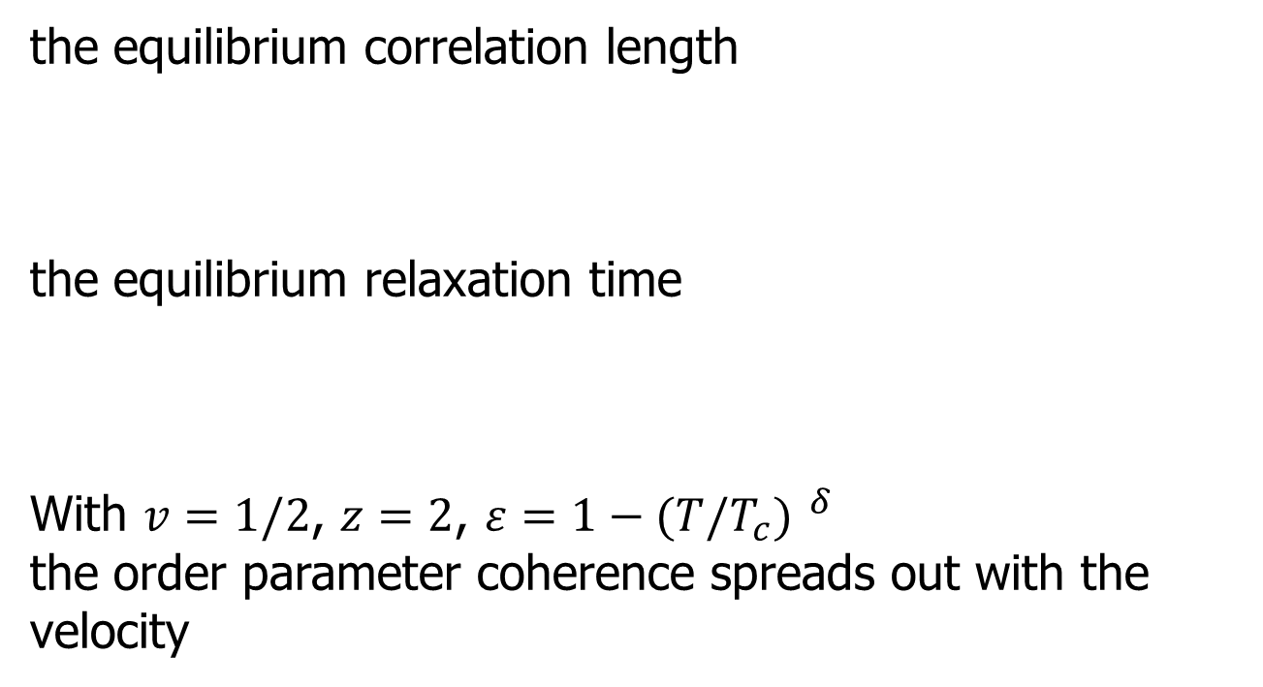
A. del Campo and W. H. Zurek, Universality of phase transition dynamics:
Topological defects from symmetry breaking, International Journal of Modern Physics A 29, No. 8 (2014) 1430018
The Kibble-Zurek mechanism

Slide 17
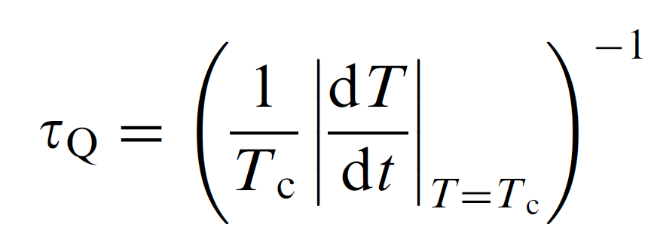
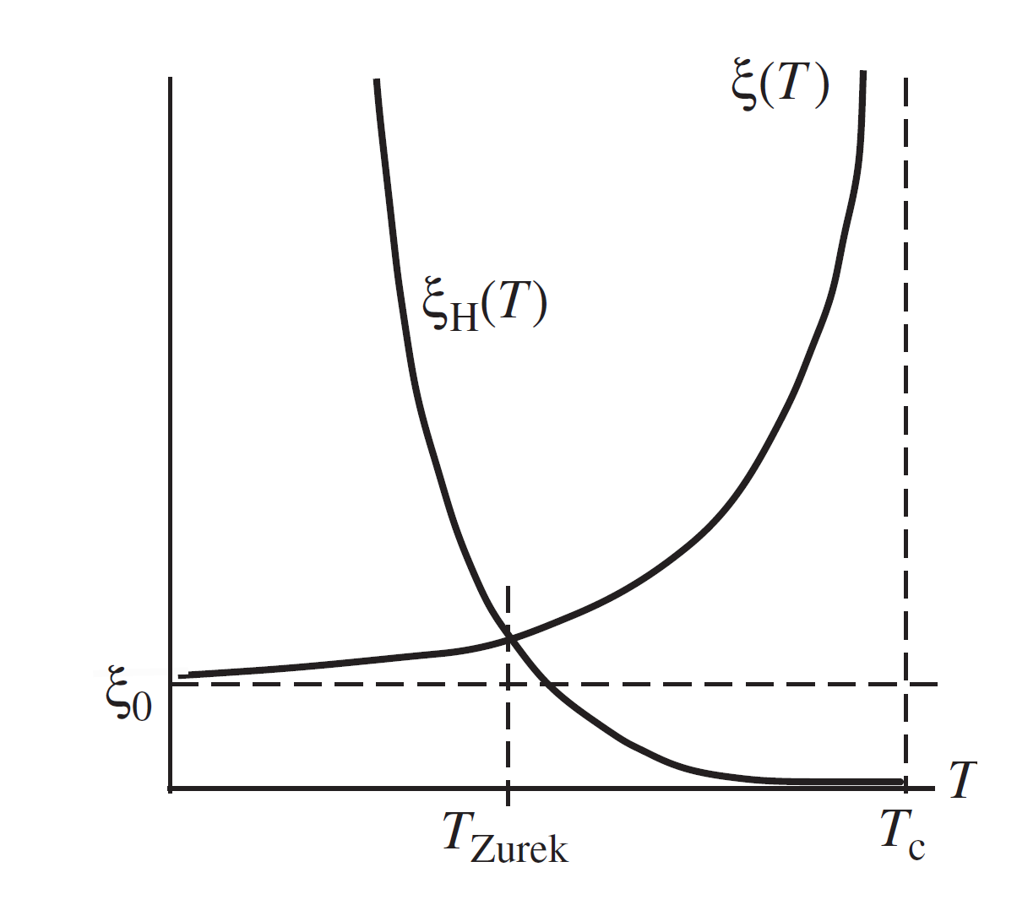
At the freeze-out temperature T_{z} (T_{z}= T_{ch}), the causal horizon has increased to the distance
with the transition speed with a quench time

Slide 18
Yige Zhou, Yidian Chen and HM, in preparation
III. Pion string at finite chemical potential
3.1 The quark meson model

Slide 19
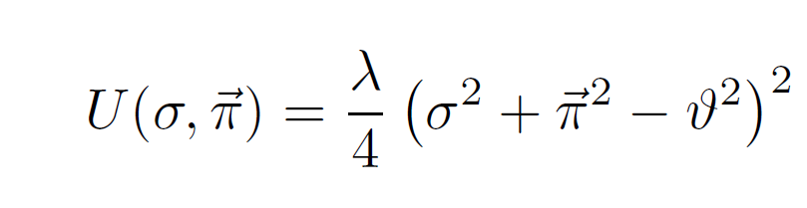
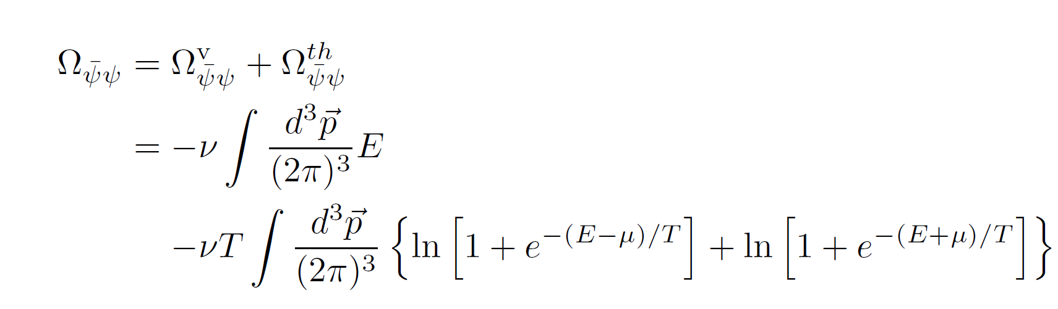
In the mean-field approximation
The fermion vacuum one-loop contribution

Slide 21
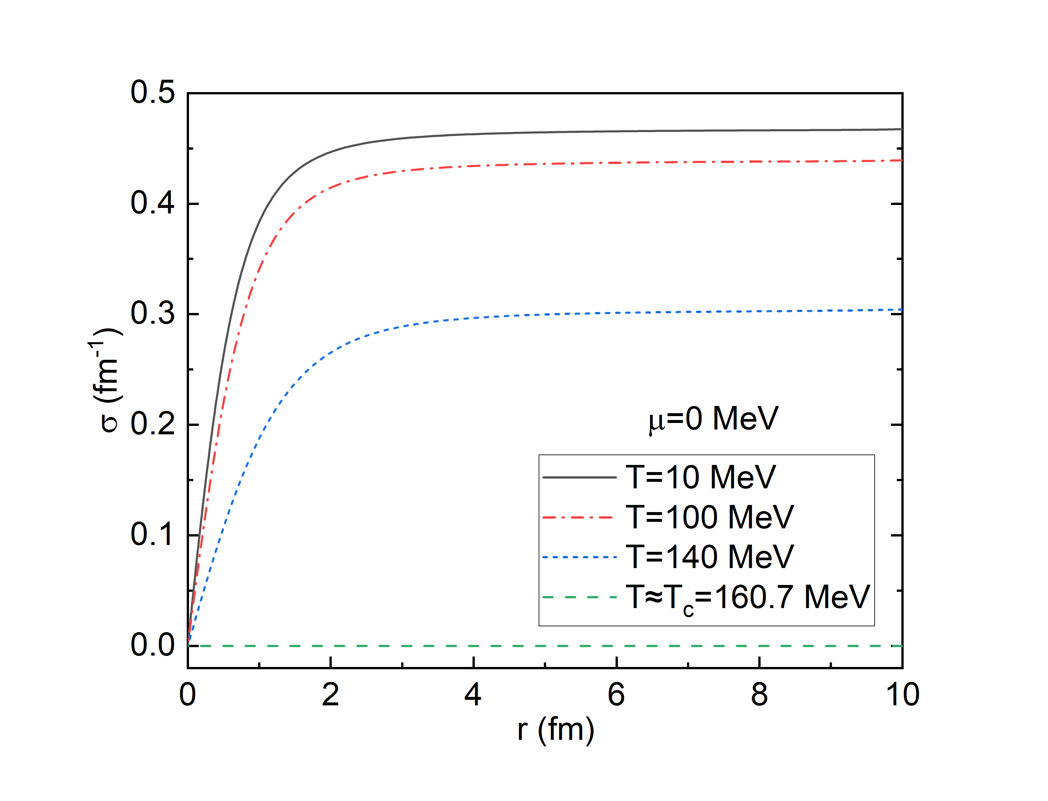
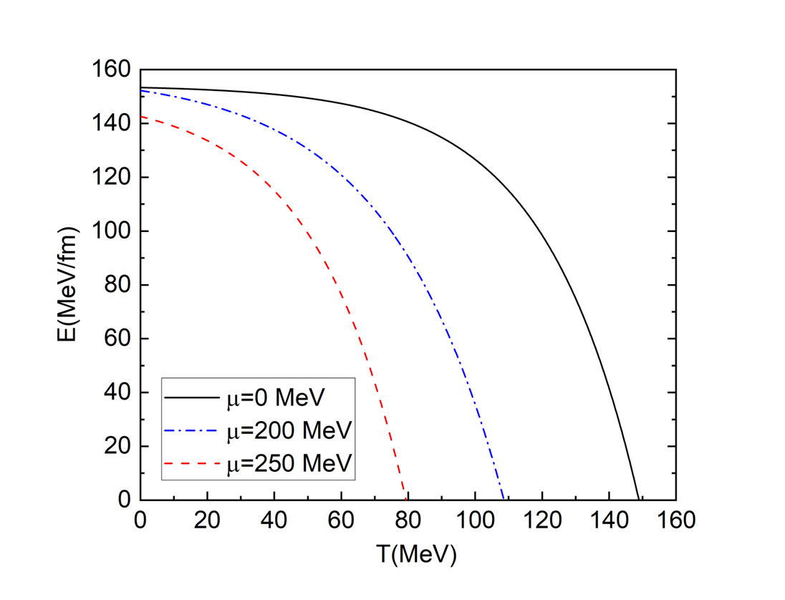
3.2 The solution of the pion string
(1) Field configuration and energy of the pion strings for the second-order phase transition

Slide 22
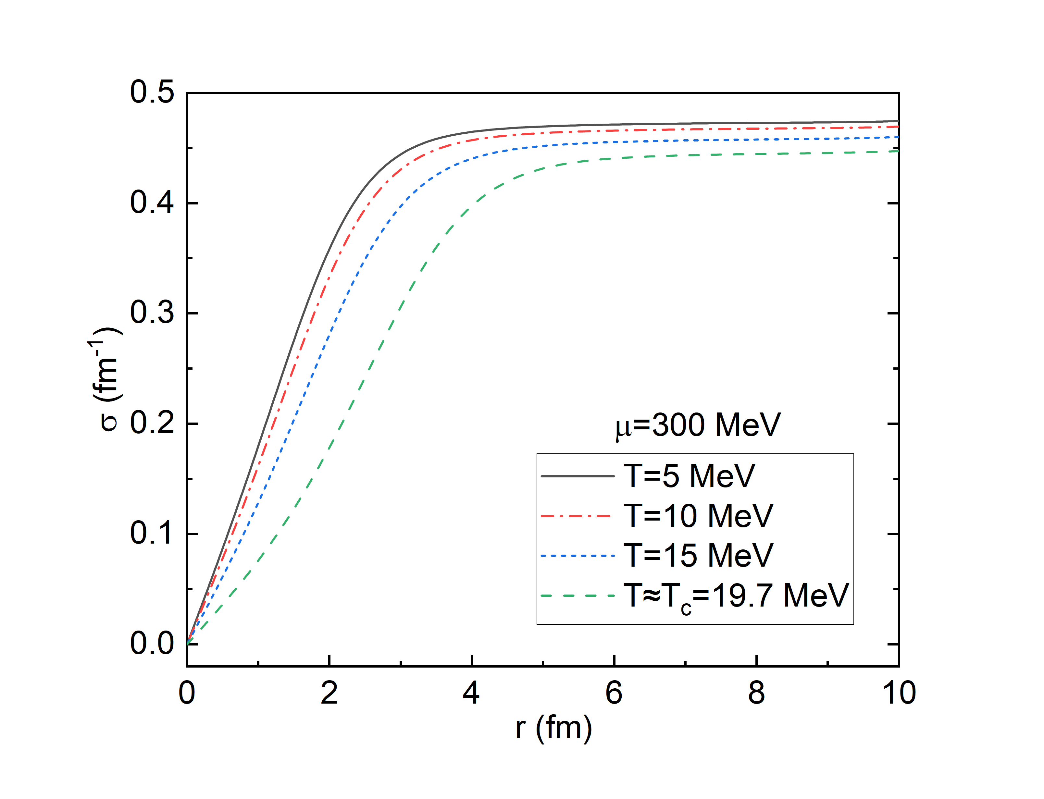
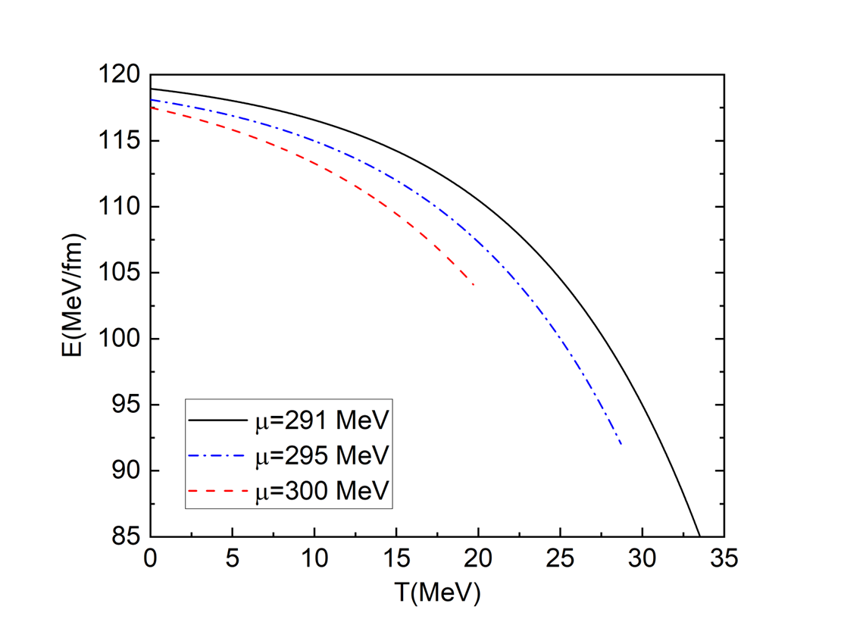
(2) Field configuration and enery of the pion string for the first-order phase transition

Slide 23
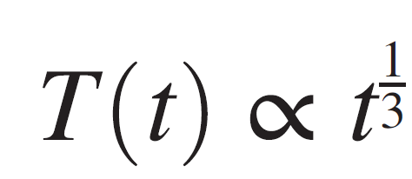
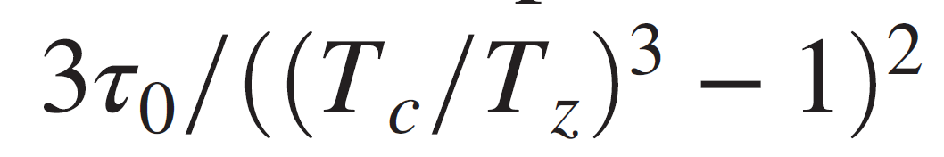
3.3 The production of the pion string
For a second-order phase transition
In heavy ion collisons

Slide 24
Taking T_{z}=T_{ch}
S. Chatterjee et al, Freeze-Out Parameters in Heavy-Ion Collisions at AGS, SPS, RHIC, and LHC Energies, Advances in High Energy Physics Volume 2015, 349013

Slide 25
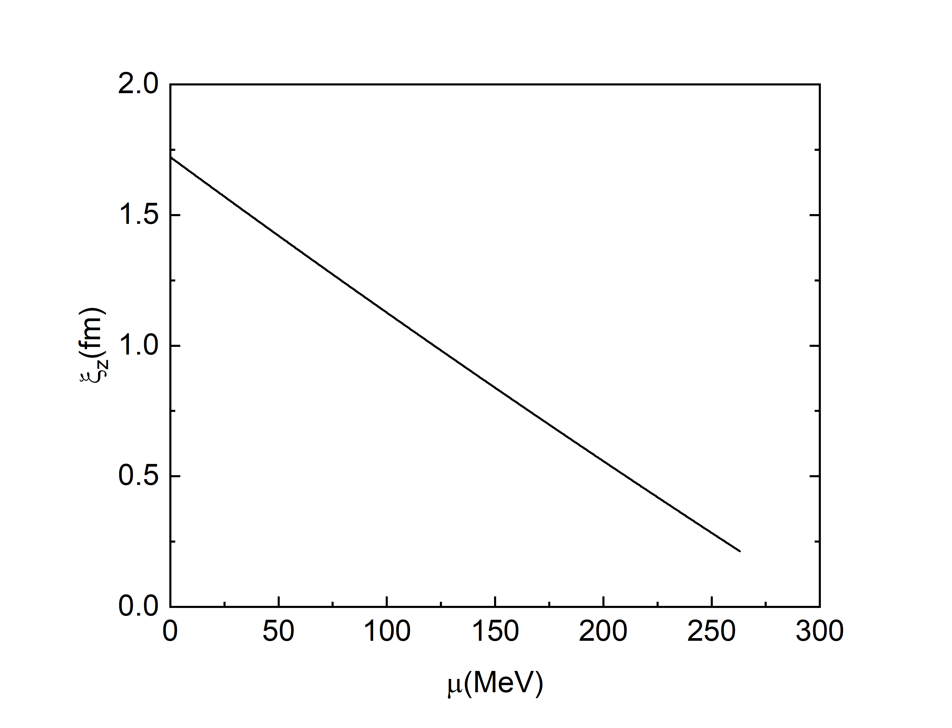
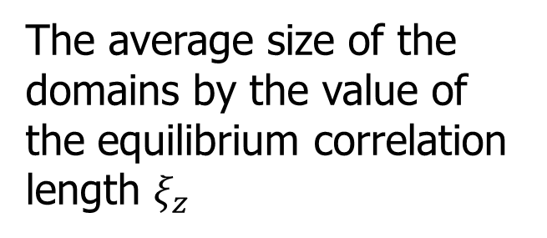
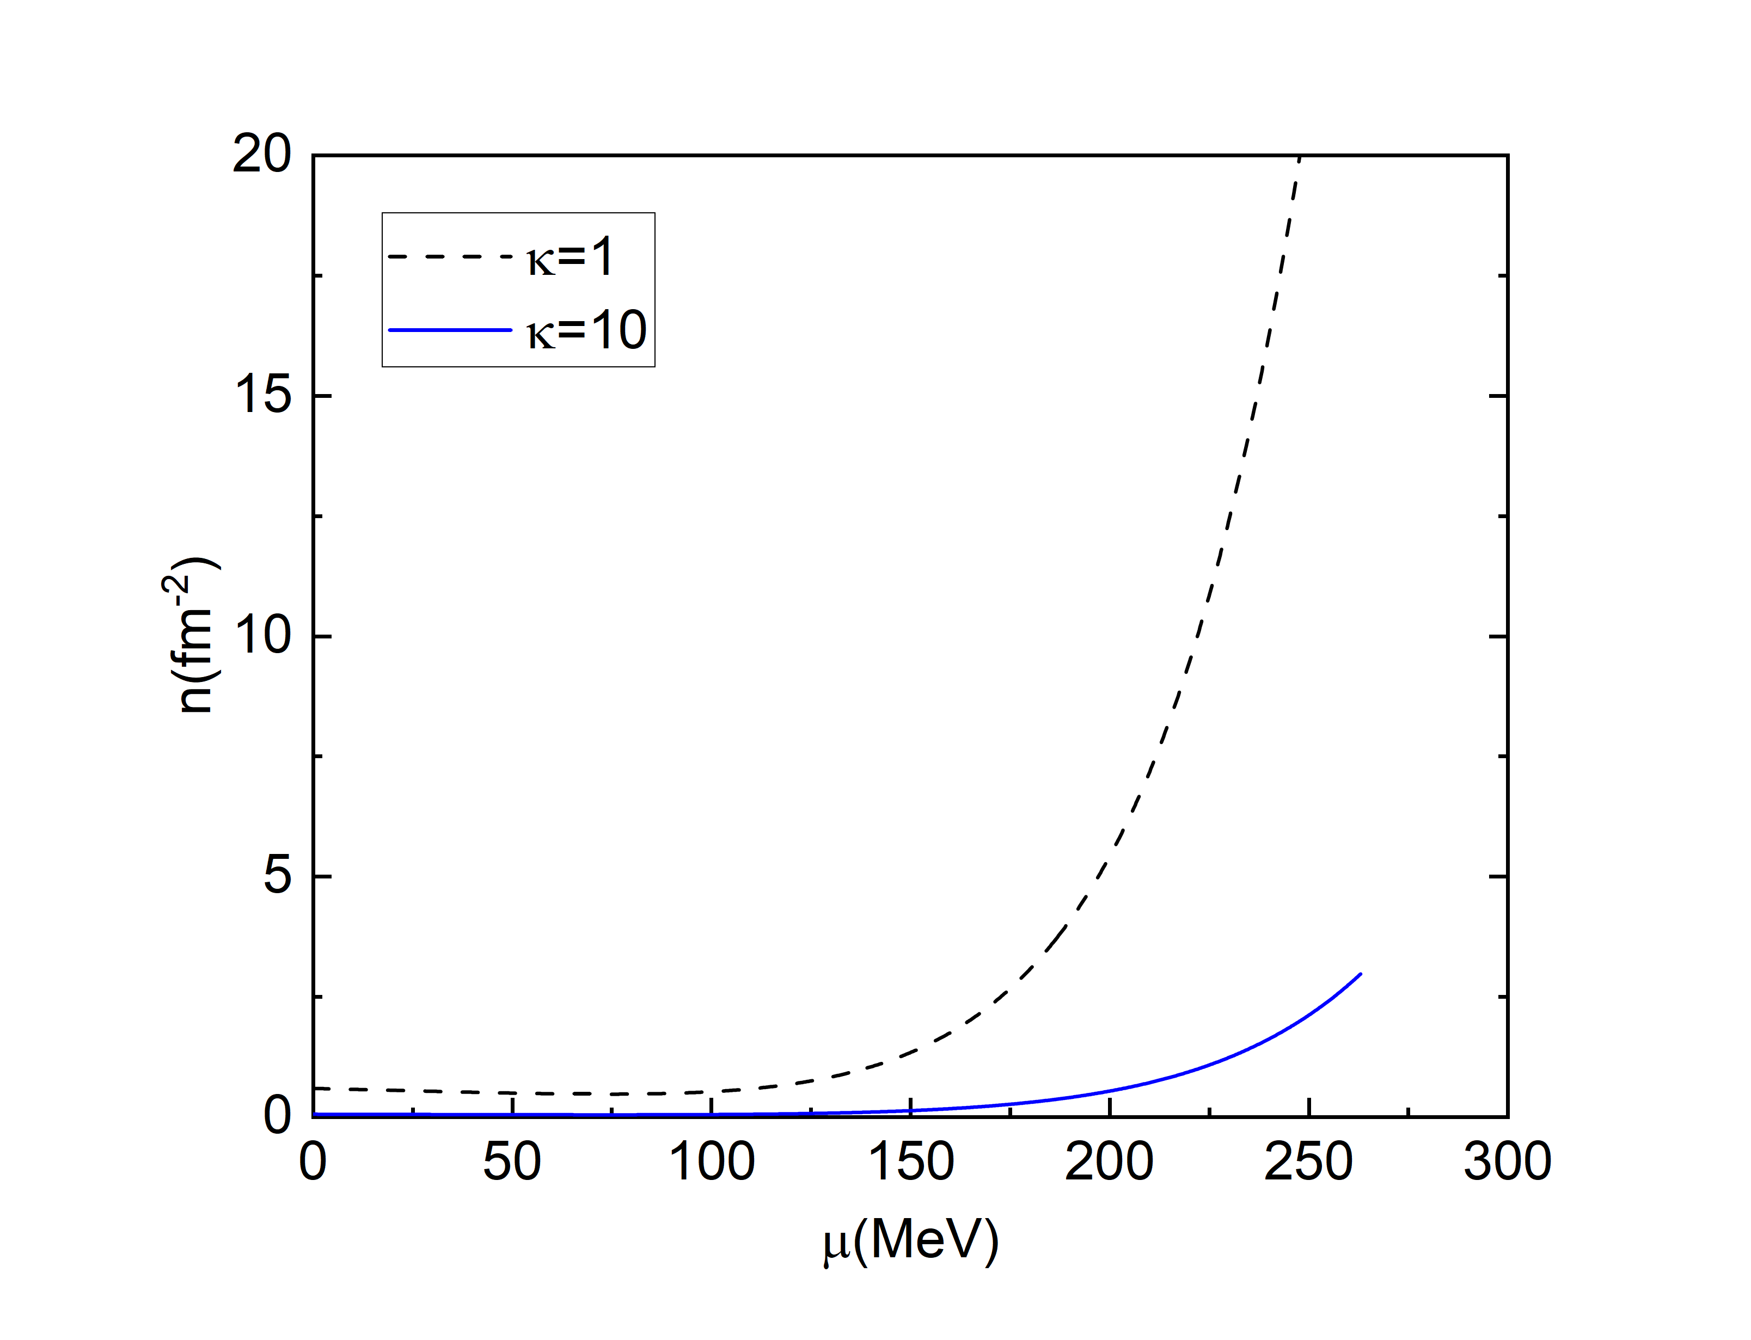
the resulting density of pion strings

Slide 26
(2) For a first-order phase transition
(a). Homogeneous thermal nucleation
the false vacuum
the true vacuum

Slide 27
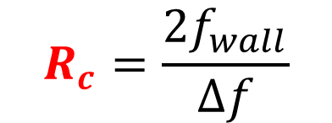
(b) The critical radius
an interface
the energy cost from the creation of an interface
R
the false vacuum
the true vacuum
the free energy gain from the phase conversion of the bulk

Slide 29
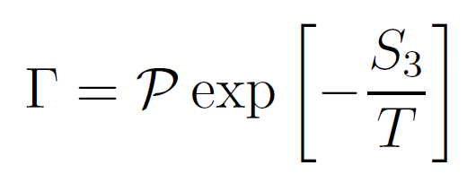
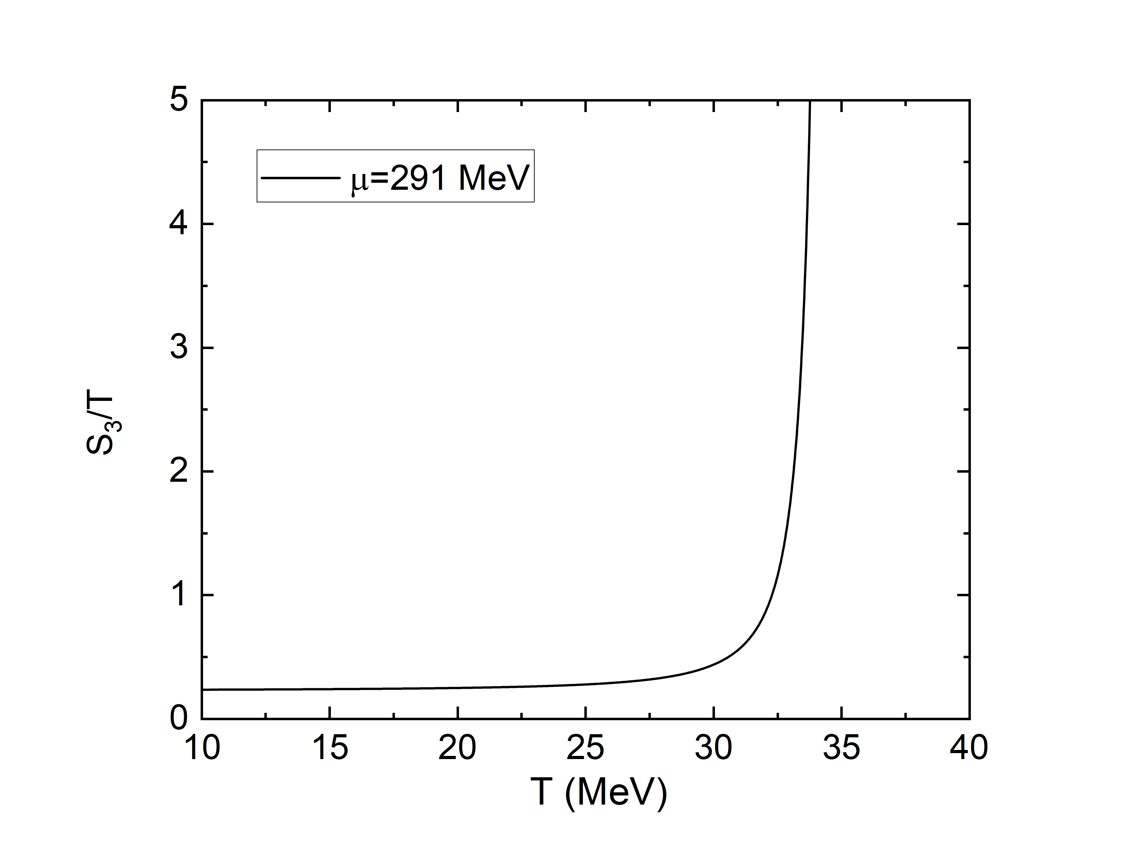
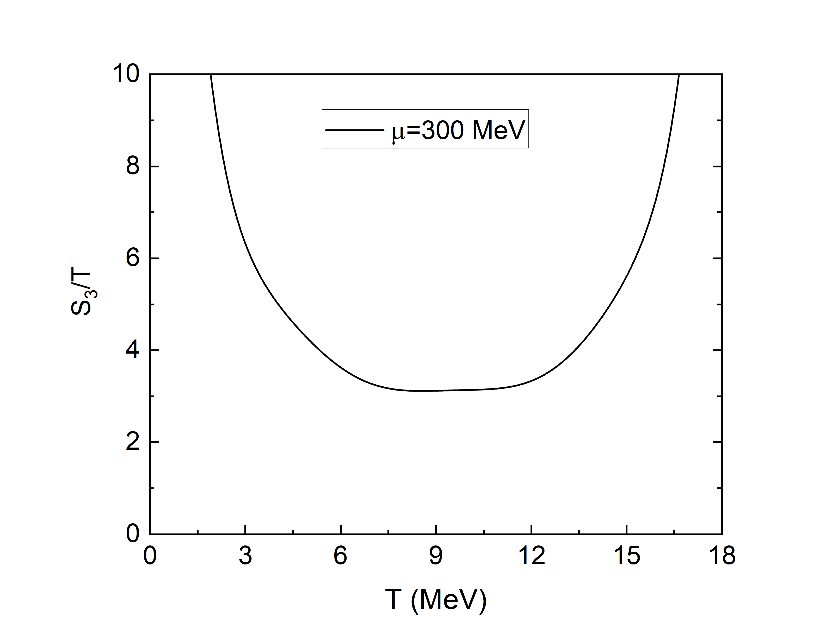
(c) The nucleation rate

Slide 30
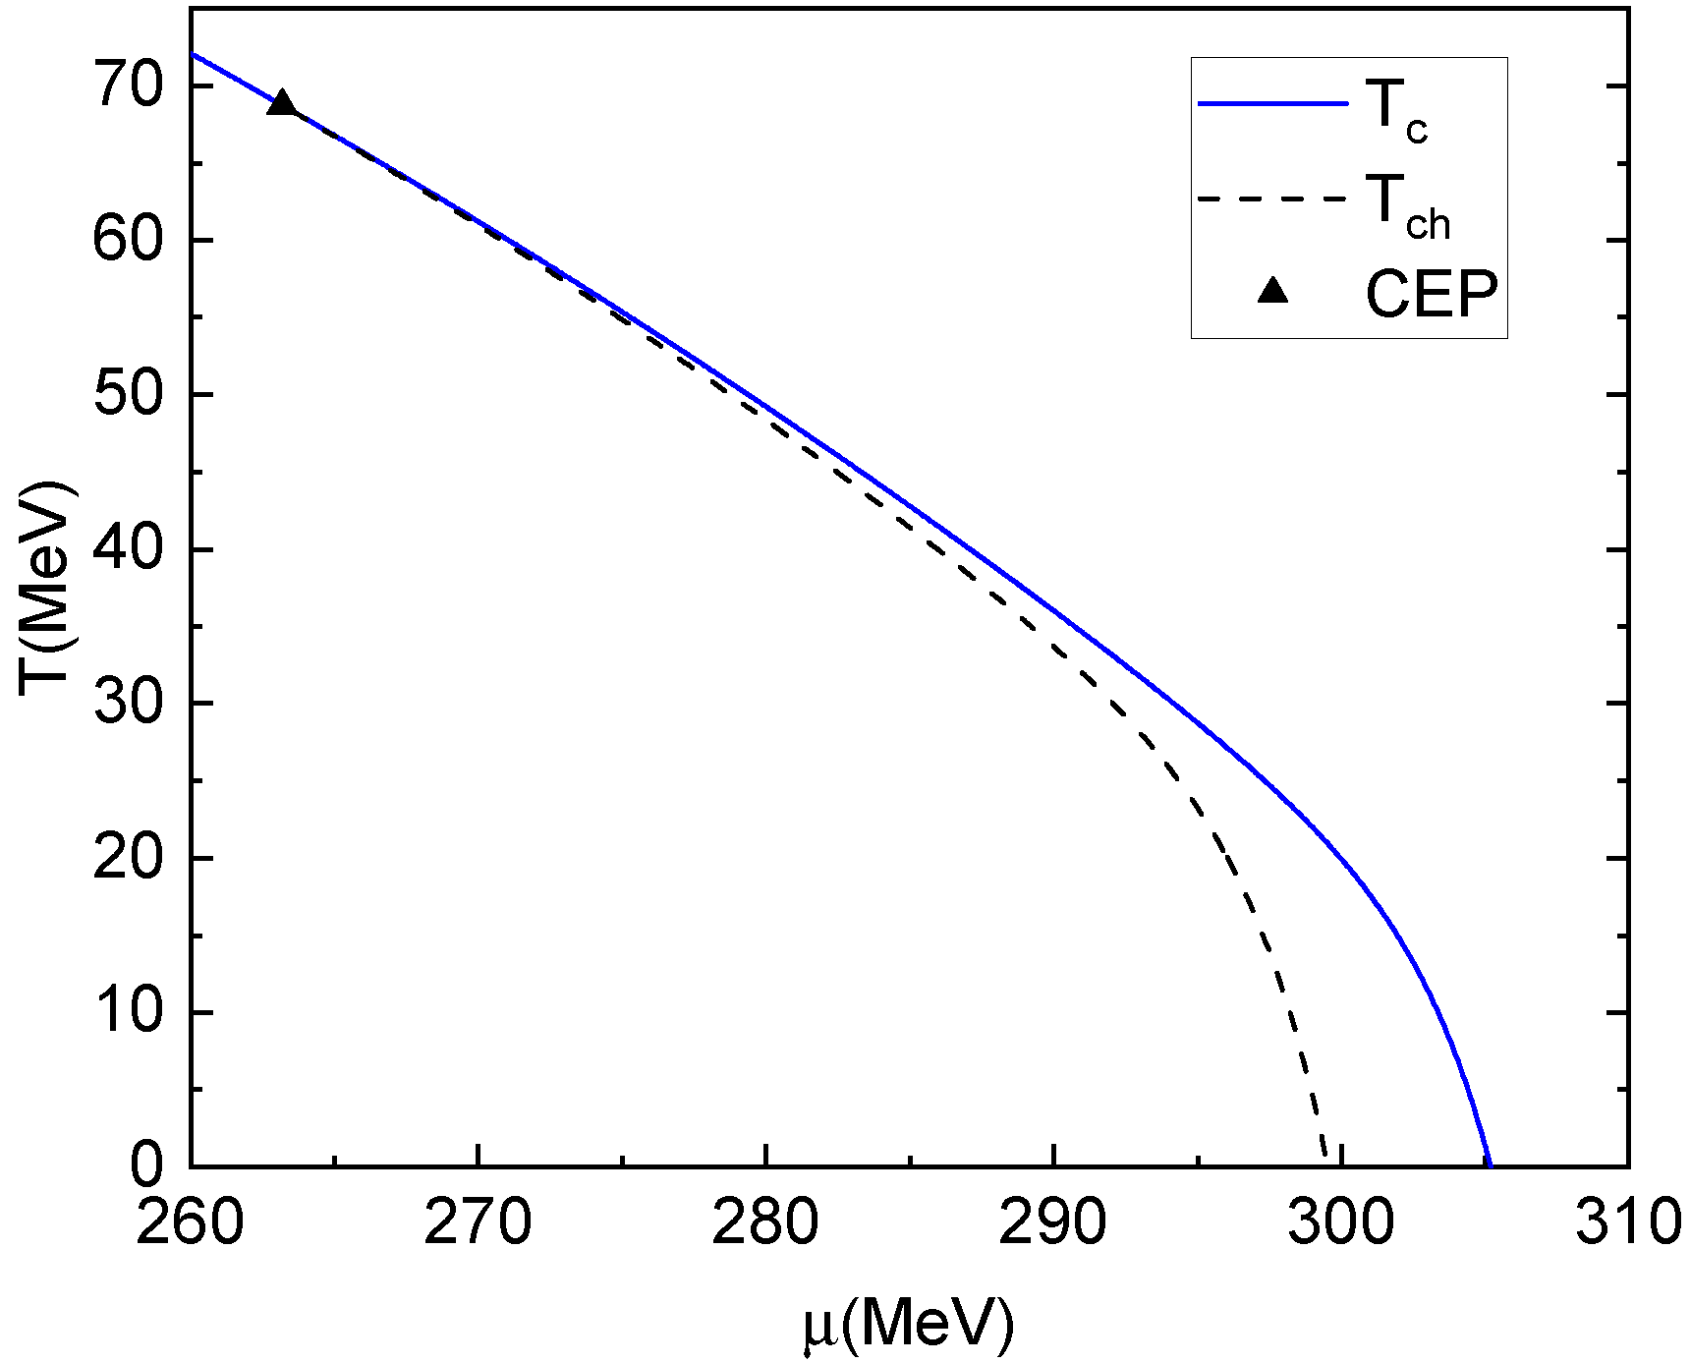

Slide 31
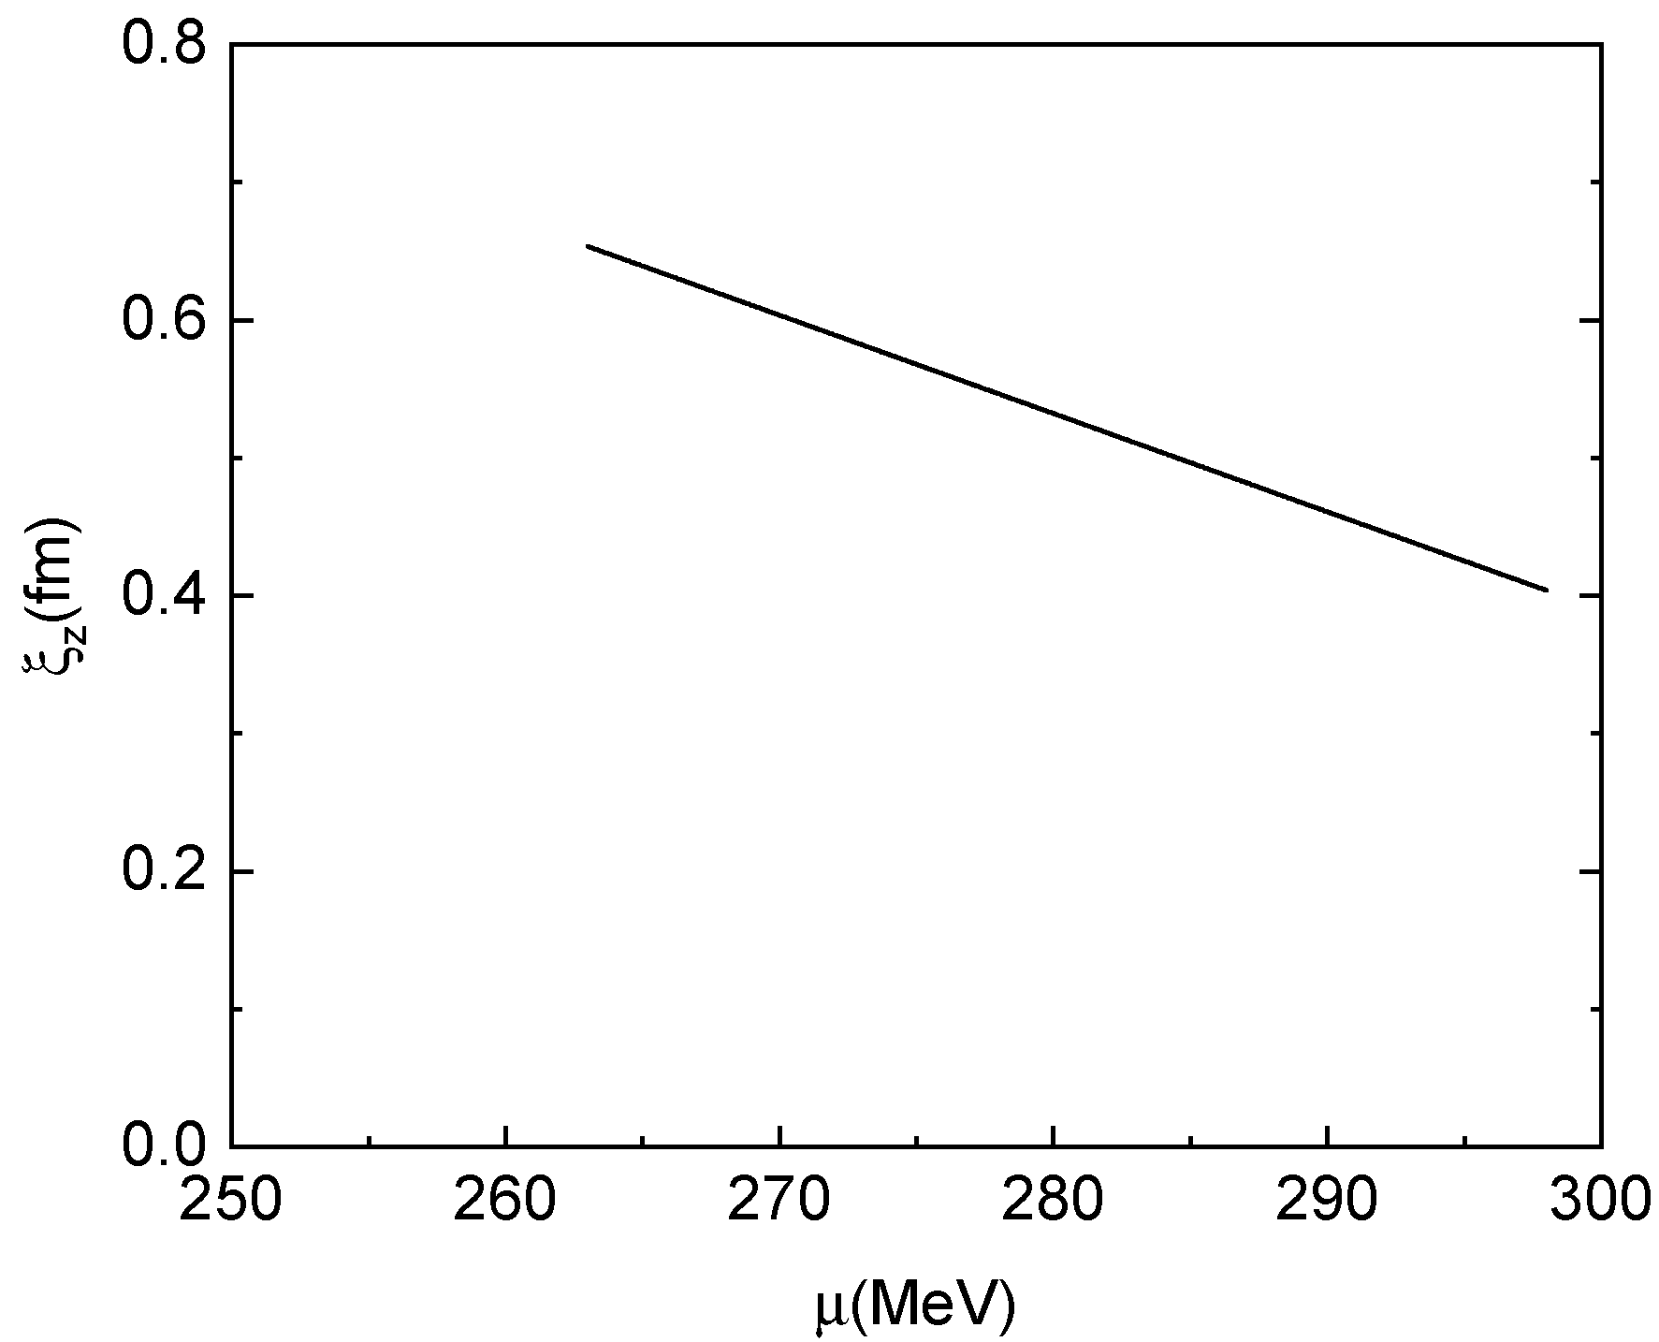
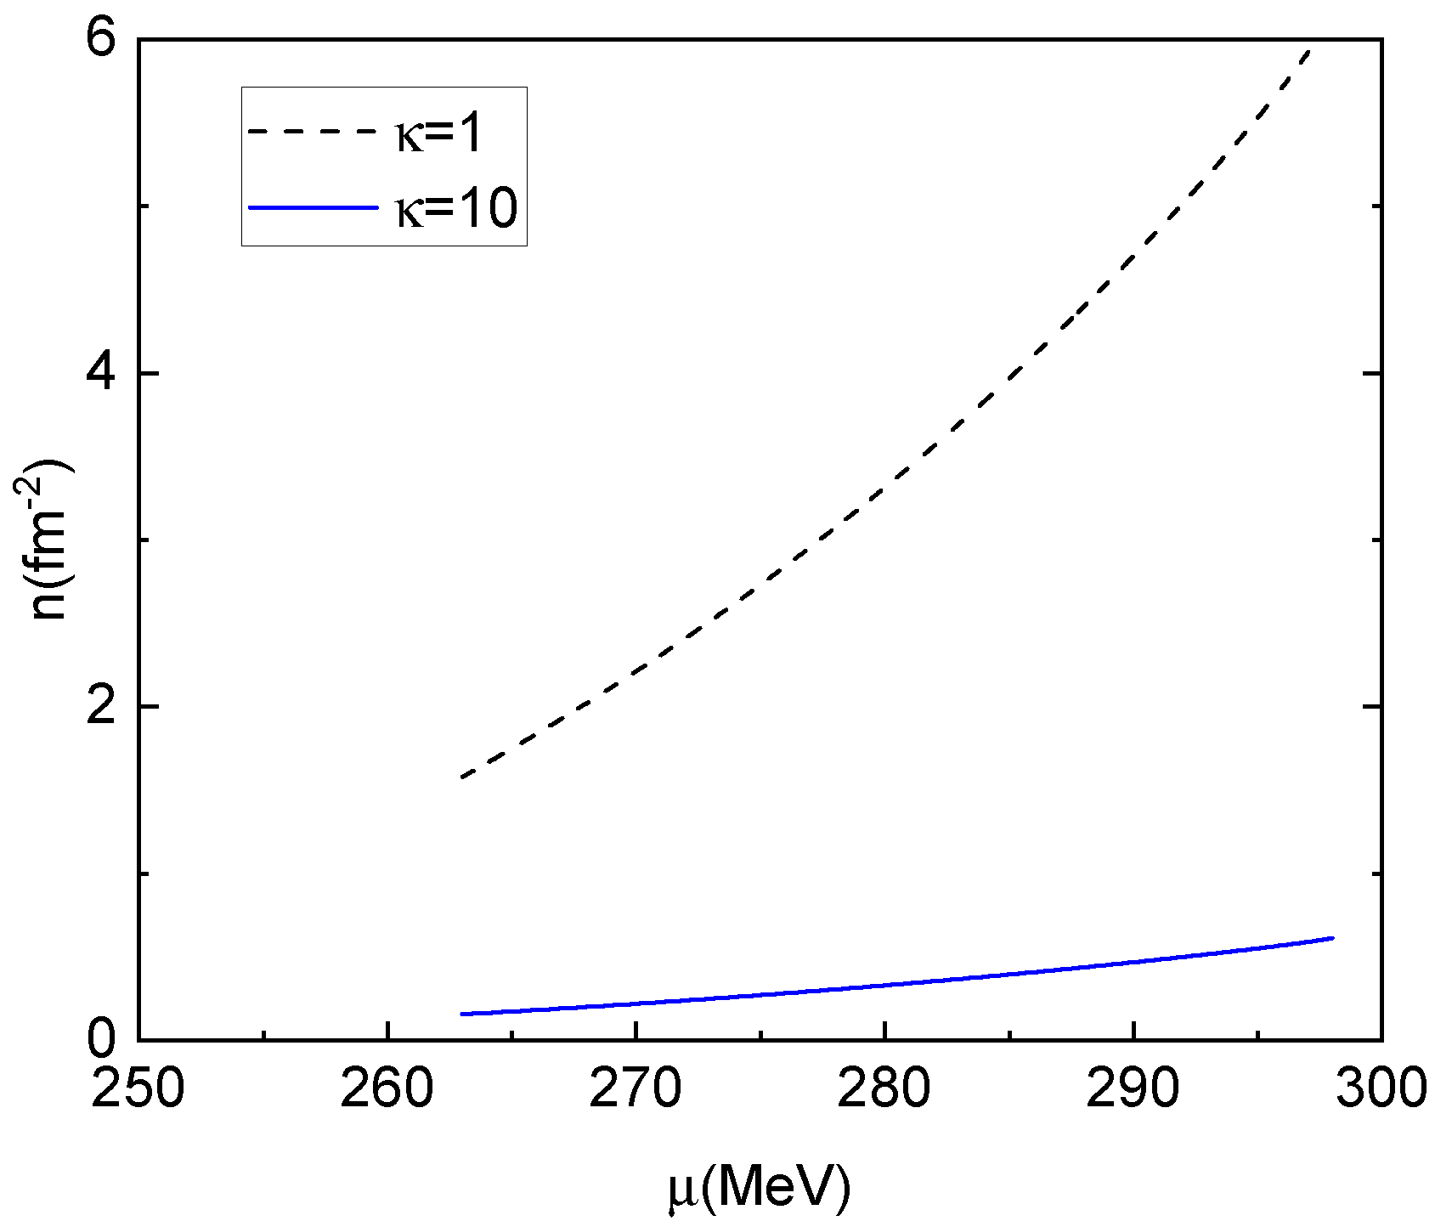

the resulting density of pion strings

Slide 32
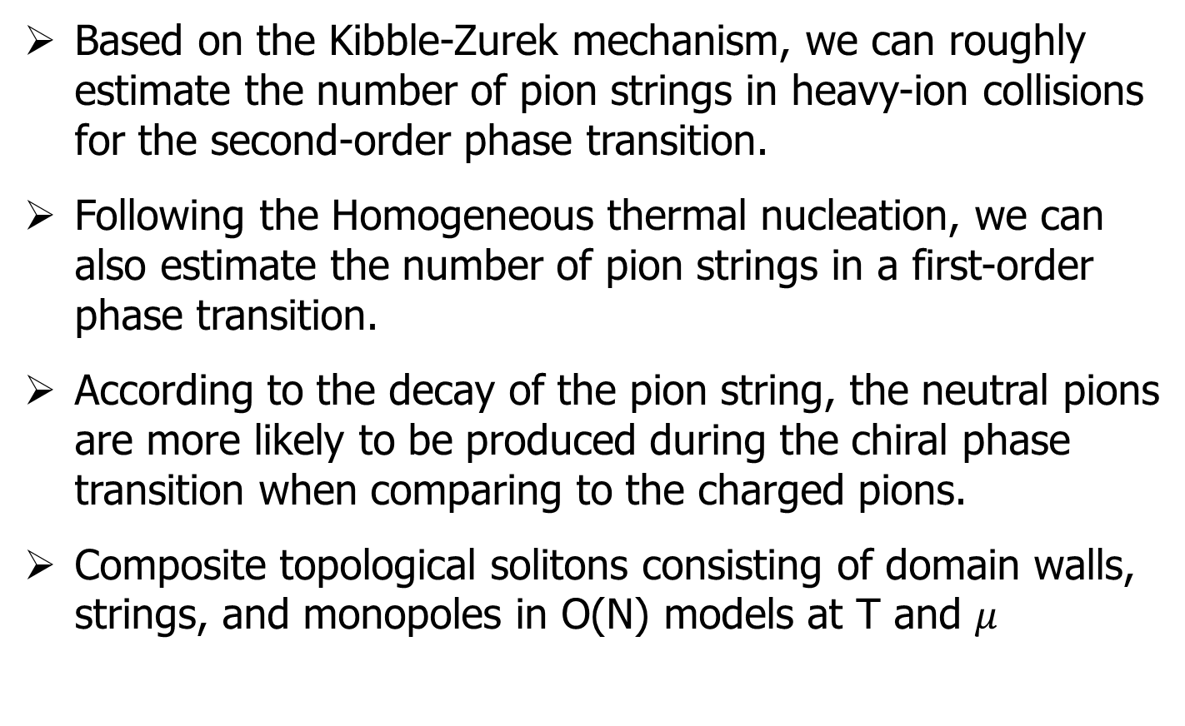
IV. Summary
Based on the Kibble-Zurek mechanism, we can roughly estimate the number of pion strings in heavy-ion collisions for the second-order phase transition.
Following the Homogeneous thermal nucleation, we can also estimate the number of pion strings in a first-order phase transition.
According to the decay of the pion string, the neutral pions are more likely to be produced during the chiral phase transition when comparing to the charged pions.
Composite topological solitons consisting of domain walls, strings, and monopoles in O(N) models at T and $μ$

Slide 33
Thanks!

