Slide 1
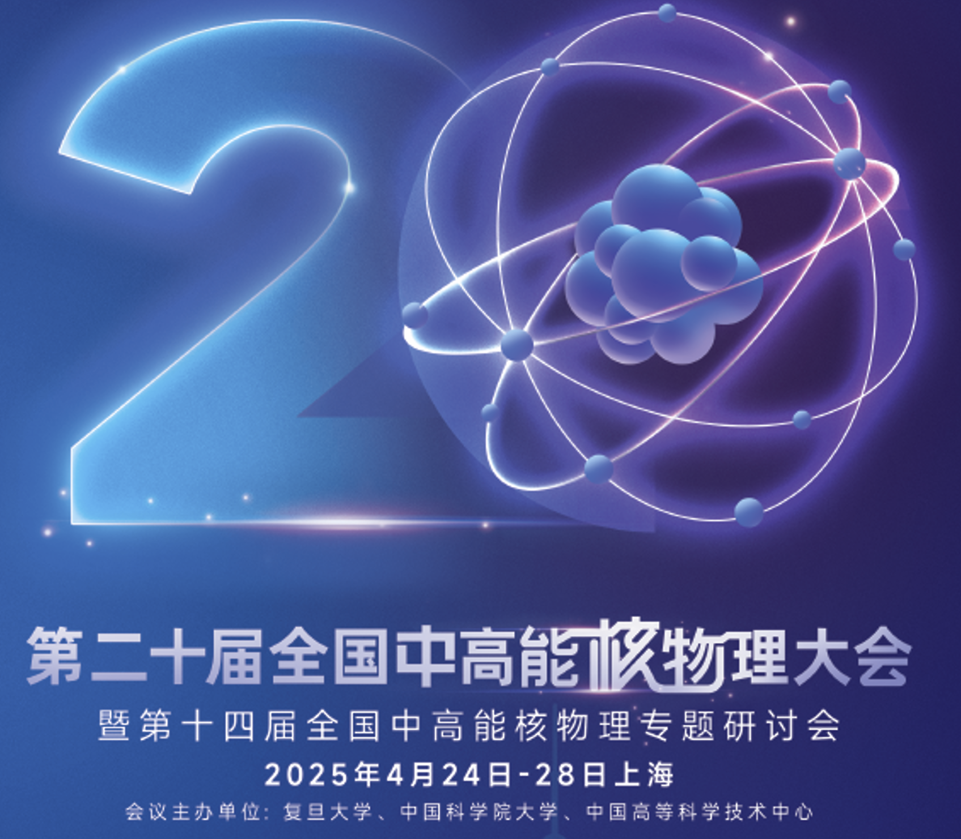
The effect of vorticity on the dynamical magnetic fields in heavy-ion collisions
报告人：Anping Huang（黄安平）
合作者：Xiangyu Wu, Mei Huang
中国矿业大学 材料与物理学院
2025年4月26日
Physical Review D 110 (9), 094032
Notes:
My topic is thermal production of charms and charmonia in quark-gluon plasma. This work is collaborated with Kai Zhou, Carsten Greiner and Pengfei Zhuang.

Slide 2
Outline
Introduction
Framework
Results
Conclusion and Future
Notes:
This is the outline of my talk. Firstly, I will give a introduction. Then I will describe thermal production of charms in QGP. Subsequently, the mechanism of thermal charmonium production in QGP will be also indicated. I will present our numerical results on thermal production of charms and charmonia at LHC energy 2.76TeV and 5.5TeV and FCC energy 39TeV. At the end I will give summary for our work.

Slide 3
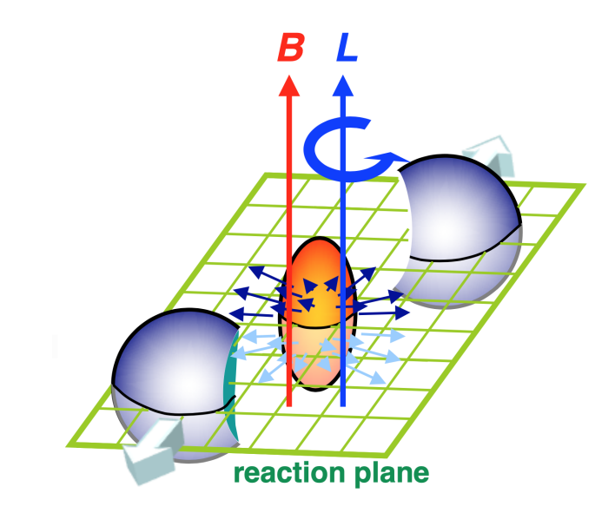
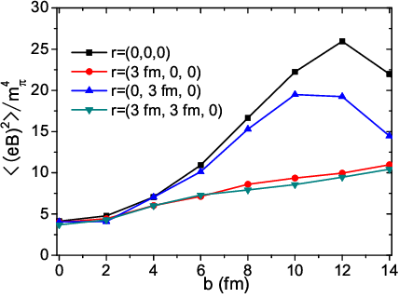
Introduction
Bloczynski-Huang-Zhang-Liao
Maxim Chernodub
$eB∼m_{π}^{2}∼{10}^{18}G$
地表磁场:$eB∼0.25−0.65G$

Slide 4
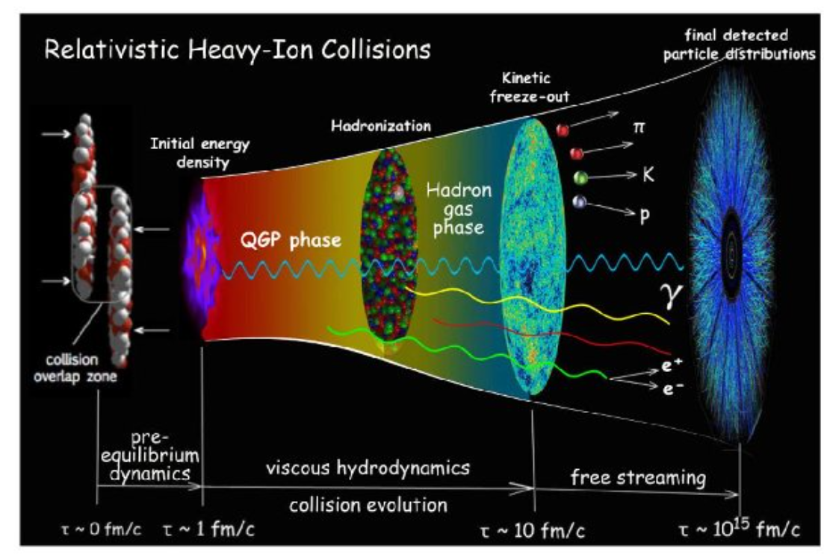
Introduction

Slide 5
Introduction
涡旋场
手征涡旋效应
$$ω^{μ}$$
$${σ_{ω}∝μ}_{5}∗μ$$
电导率
手征磁效应
$$σ$$
$\vec{E}$,$\vec{B}$(t)
$${σ_{χ}∝μ}_{5}$$
热电场
磁矩（反常）效应
$${\vec{E}=S}_{e}∂_{x}T$$
$$q_{f}k_{f}\left\langle {\overline{ψ}}_{f}σ^{μν}ψ_{f}\right\rangle$$
The evolution of the electromagnetic field is influenced by various factors, such as classical factors: conductivity, vortex fields, thermoelectric effects, etc.; and quantum factors: chiral magnetic effect, chiral vortex effect, anomalous magnetic moment effect, etc.

Slide 6
Introduction
The Maxwell equation
$$∂_{μ}F^{μν}=J^{ν},∂_{μ} {\tilde{F}}^{μν}=0$$
$$J^{μ}=n_{e}u^{μ}+ν^{μ}+σE^{μ}−σ_{e}S_{e}∇_{μ}T+σ_{χ}B^{μ}+σ_{ω}ω^{μ}+∂_{μ}G^{μν}$$
经典部分
量子部分
It is difficult to analytically solve the Maxwell equations due to the complexity of the current. Therefore, our study is based on numerical methods.

Slide 7
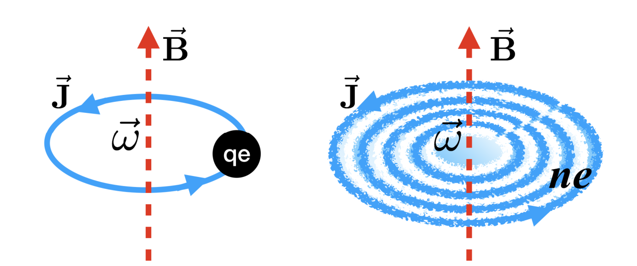
Introduction
涡旋产生磁场
Maxim Chernodub
Guo, Xingyu, et al. Scientific Reports 10.1 (2020): 2196.

Slide 8
Framework
CLVisc 3+1D
Maxwell equations
$$D_{μ}F^{μν}=J^{ν},$$
$$D_{μ} {\tilde{F}}^{μν}=0$$
$D_{μ}T^{μν}=$0, $D_{μ}J_{B}^{μ}=0$
$$T,μ,u^{μ},n_{B}$$
$$J^{μ}=n_{e}u^{μ}+ν^{μ}+σ\left(T\right)E^{μ}$$
$$n_{e}=0.4 n_{B}$$
We take the weak field method: field effects on hydro are not considered, only hydro effects on fields are considered.

Slide 9
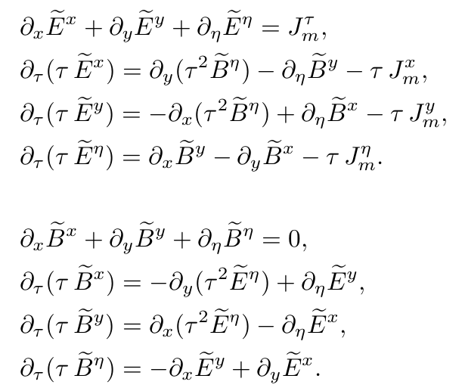
Framework
Maxwell equations
$$D_{μ}F^{μν}=J^{ν},$$
$$D_{μ} {\tilde{F}}^{μν}=0$$
Yee-grid algorithm

Slide 10
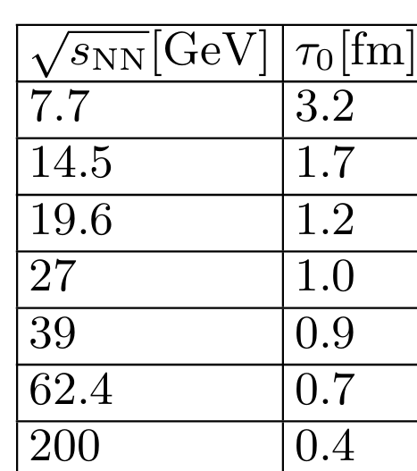
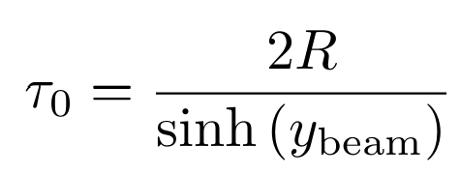
Framework
CLVisc 3+1D
$D_{μ}T^{μν}=$0, $D_{μ}J_{B}^{μ}=0$

Slide 11
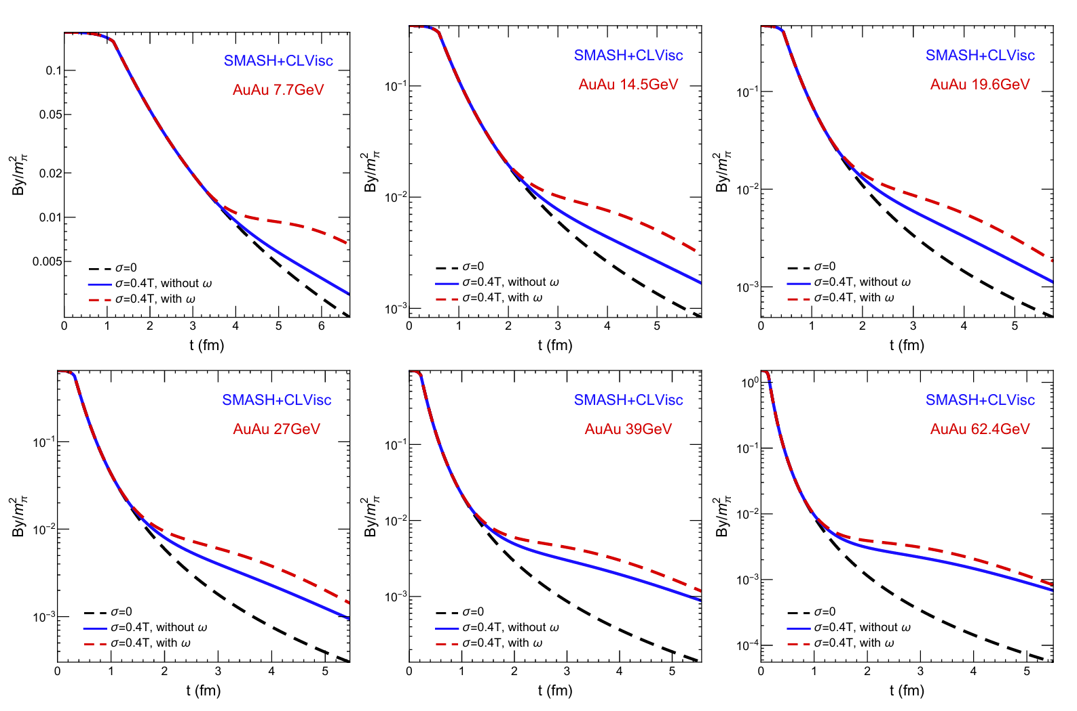
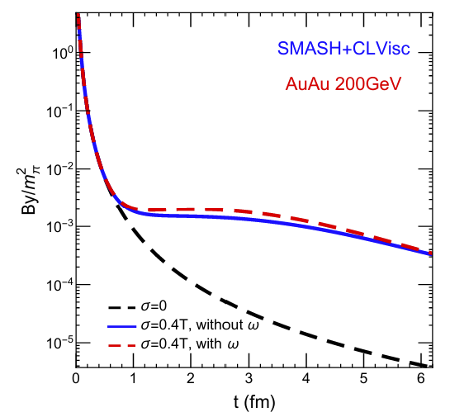
Results
1. The magnetic field decays is delayed due to the fluid vorticity of QGP fireball.

Slide 12
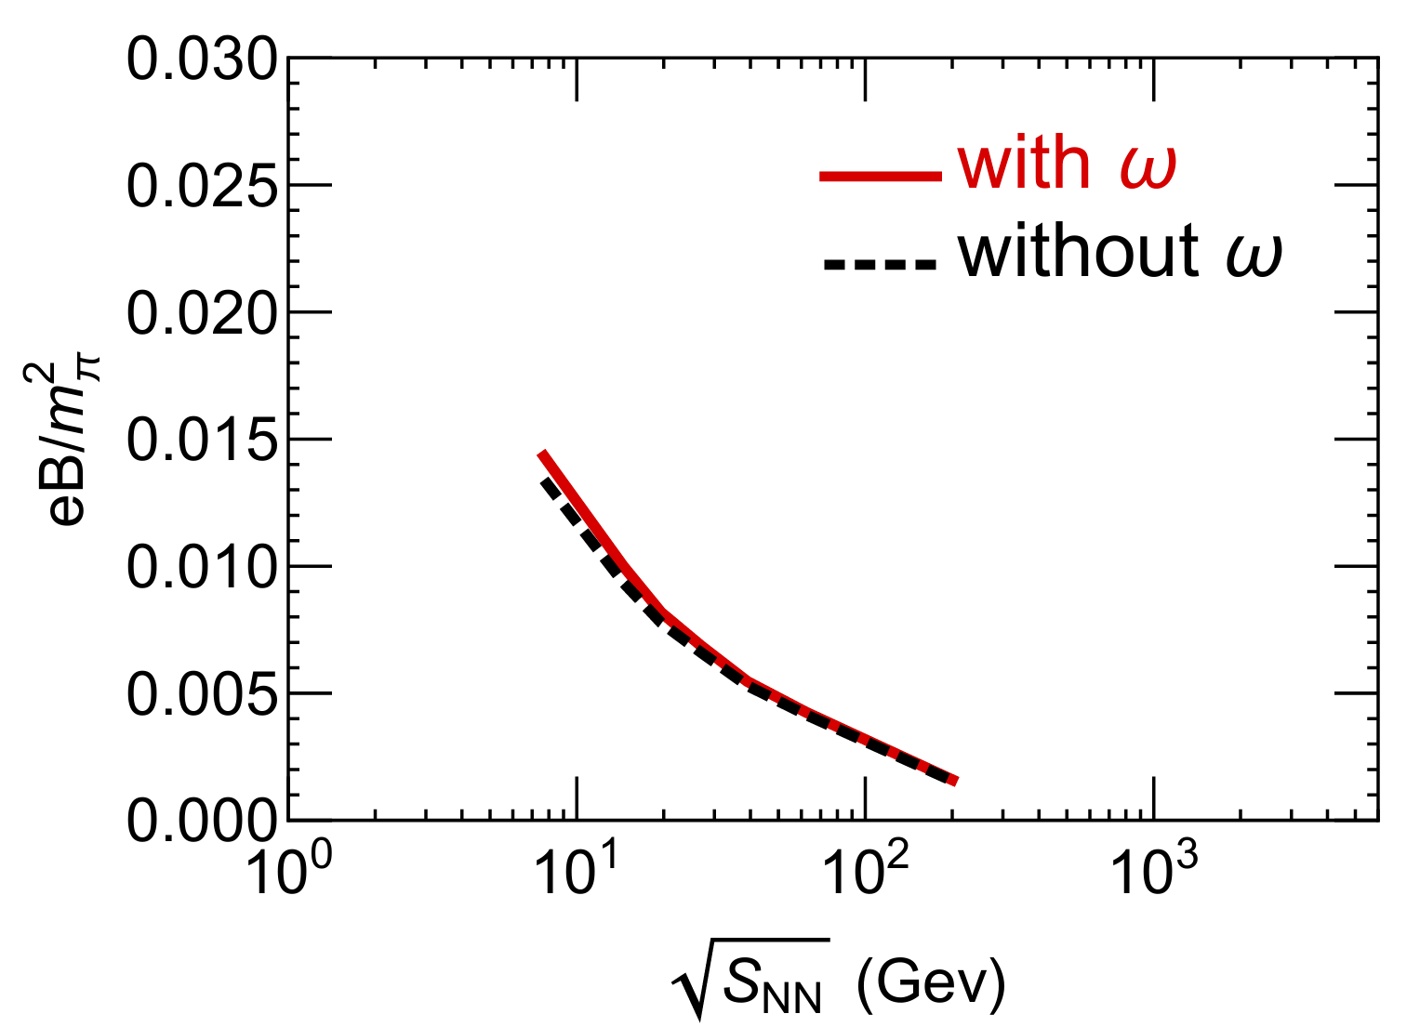
Results
2. The effect of vorticity on the magnetic field at the freeze-out surface.

Slide 13
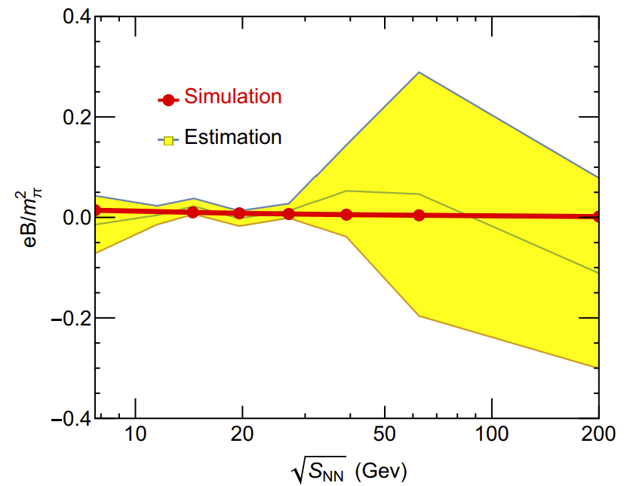
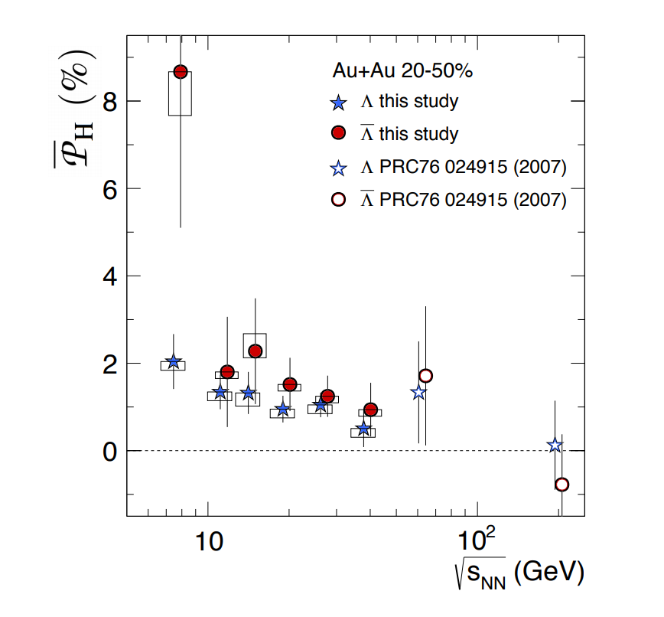
Results
3.Comparison with experiment data

Slide 14
Conclusion and Future
1）The magnetic field decays is delayed due to the fluid vorticity of QGP fireball, especially for 7.7Gev Au+Au.
2）Our simulation results align with the values inferred from experimental data of $\overline{Λ}−Λ$, within the error margins。

Slide 15
Conclusion and Future
涡旋场
手征涡旋效应
$$ω^{μ}$$
$${σ_{ω}∝μ}_{5}∗μ$$
电导率
手征磁效应
$$σ$$
$\vec{E}$,$\vec{B}$(t)
$${σ_{χ}∝μ}_{5}$$
热电场
磁矩（反常）效应
$${\vec{E}=S}_{e}∂_{x}T$$
$$q_{f}k_{f}\left\langle {\overline{ψ}}_{f}σ^{μν}ψ_{f}\right\rangle$$
The evolution of the electromagnetic field is influenced by various factors, such as classical factors: conductivity, vortex fields, thermoelectric effects, etc.; and quantum factors: chiral magnetic effect, chiral vortex effect, anomalous magnetic moment effect, etc.

Slide 16
Thank You!

Slide 17
Appendix
Longgang Pang
流体$v_{2}$
夸克自旋极化
Li Yan
光子$v_{2}$
$\vec{E}$,$\vec{B}$(t)
CME: ${\vec{J}∝σ}_{χ}\vec{B}$
矢量介子$v_{1}$
$Λ$自旋极化

