Slide 1
$$Pion and Kaon Condensation \\ from Holographic QCD$$
Yidian Chen 陈亦点
School of Physics, Hangzhou Normal University
Based on arXiv: 2408.17080, 2505.xxxxx
Collaborators: Mingshan Ding, Danning Li, Kazem Bitaghsir Fadafan, and Mei Huang
Apr. 27, 2024

Slide 2
Outline
Introduction
Holographic Model and Pion Condensation
Pionic Equation of State and Pion Star
Kaon Condensation
Conclusion and discussion

Slide 3
I. Introduction

Slide 4
Isospin
The relevant QCD degrees of freedom at low energies are pions
Chiral perturbation theory (T=0)
D.T. Son, M. Stephanov, PRL 2001
• vacuum at
• pion BEC at (2nd order phase transition)
Lattice QCD
Brandt, Endrodi, Schmalzbauer, PRD2018
• no sign problem at finite
• physical quark masses achieve
• consistent with 𝜒PT predictions

Slide 5
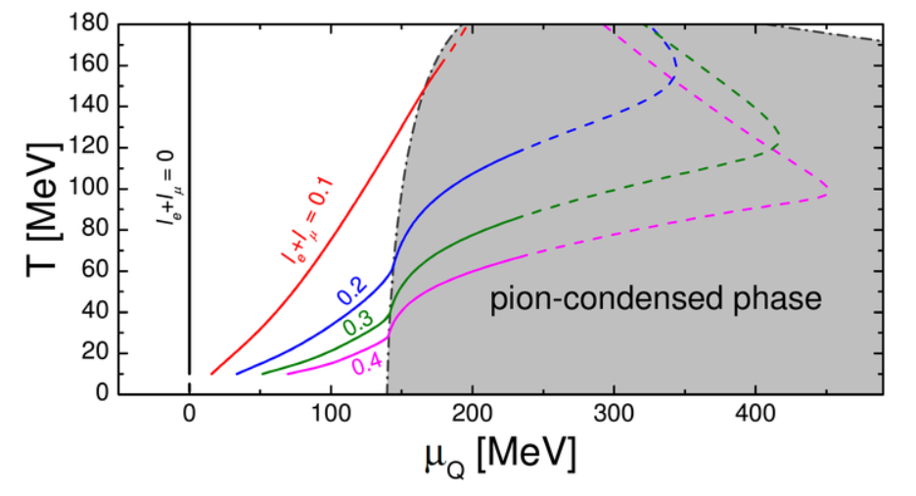
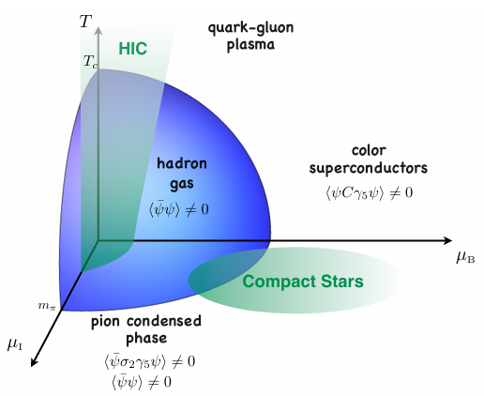
Pion Condensation
Vovchenko et al., PRL126, 012701 (2021)
Mannarelli, Particles (2019)

Slide 6
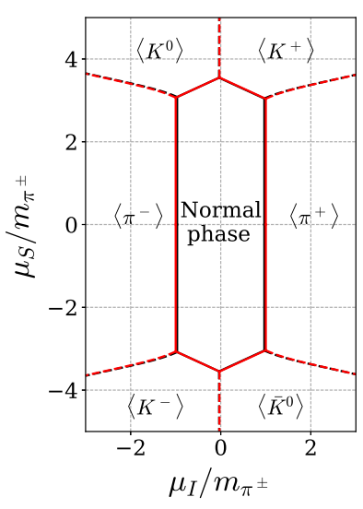
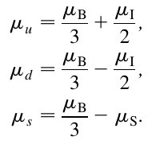
Strangeness and Kaon Condensation
For three flavor, we can introduce the baryon, isospin, and strangeness chemical potentials $μ_{B}$, $μ_{I}$, and $μ_{S}$
Andersen et al., PRD111, 034017 (2025)

Slide 7
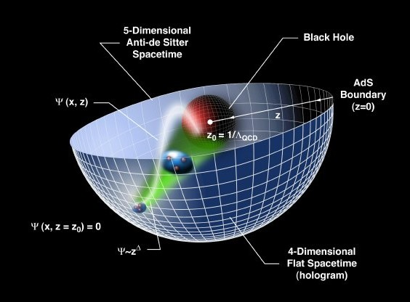
Gauge/Gravity duality
AdS/CFT correspondence
relates gravity theories on anti-de Sitter spacetimes (AdS) to conformal field theories
General Gauge/Gravity duality

Slide 8
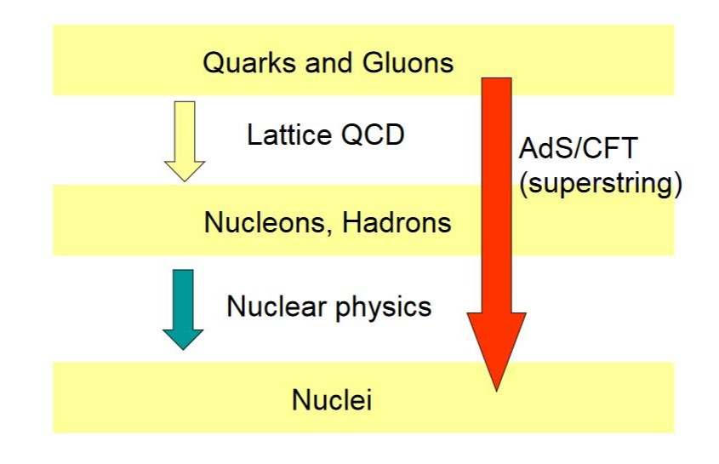
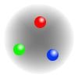
QCD
Effective field theories and models
FRG
DSE
QM, NJL, SM, HLS,
CHPT, NRQCD,
color flux tube,
Dual superconductor ……

Slide 9
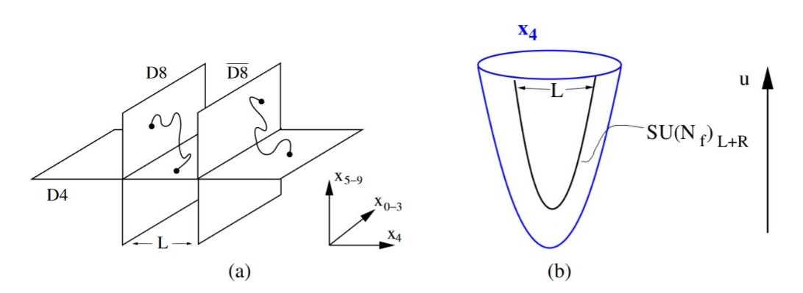
Top-down vs Bottom-up
Top-down：based on string theory and D-brane
D3-D7,
D4-D6,
D4-D8,
STU model
…
Bottom-up：from symmetry of QCD
hard-wall, soft-wall, Gubser model, improved holographic QCD, VQCD, dynamical holographic QCD …
1) 5D effective action
2) IR cutoff or dilaton to realize confinement
Hadron spectra, chiral symmetry breaking & linear confinement, phase transitions, equation of state, transport properties…

Slide 10
Holographic dictionary
Boundary QFT Gravity
Local operator Field
conformal dimension $Δ$, p-form field $p$
Strongly coupled Weakly coupled semi-classical

Slide 11
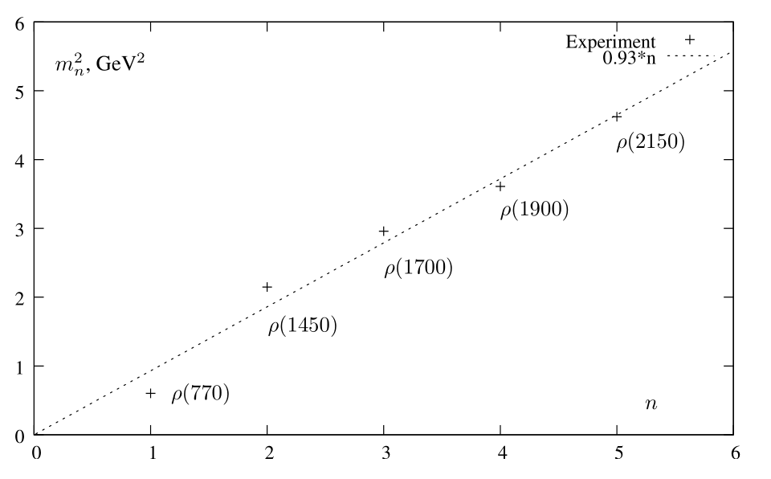
Soft-Wall Model
Karch et al., Phys.Rev.D (2006)
5D action
To realize the linear Regge trajectory
Conformal AdS₅
Schroedinger-like equation

Slide 12
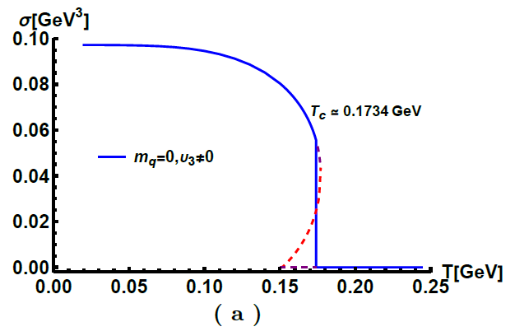
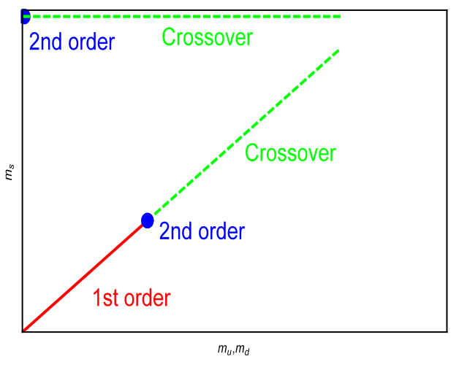
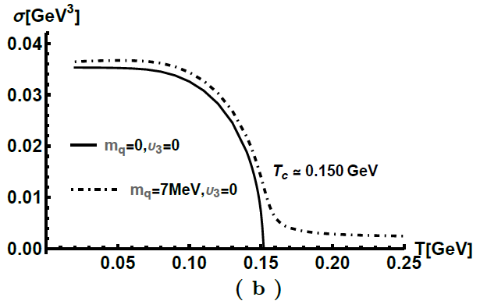
Chiral Condensation
Chelabi et al., Phys.Rev.D (2016)
Chelabi et al., JHEP (2016)
5D action

Slide 13
II. Holographic Model and Pion Condensation

Slide 14
Model
Y. Chen, M. Ding, K. Bitaghsir Fadafan,
D. Li and M. Huang, arXiv: 2408.17080
The holographic QCD model with Nf = 2 is constructed from SU(2)L × SU(2)R ≡ SU(2)V × SU(2)A flavor symmetry. The probe action is given as
The vacuum of scalar corresponds to sigma condensate and pion condensate can be given as $X=\frac{1}{2}\left(Σt^{0}+Π^{a}t^{a}\right)$. The nonzero gauge field of model is $V_{0}^{(3)}≡v=μ_{I}−ρ_{I}z^{2}$, with isospin chemical potential and isospin density. And the background metric is AdS-black hole
we have considered two possible forms of the five-dimensional mass squared as follows:
$$f_{π}=70.7 MeV$$
$$f_{π}=92.4 MeV$$

Slide 15
Model
Y. Chen, M. Ding, K. Bitaghsir Fadafan,
D. Li and M. Huang, arXiv: 2408.17080
The equations of motion of the holographic model are obtained as
For the fields, the expansions are

Slide 16
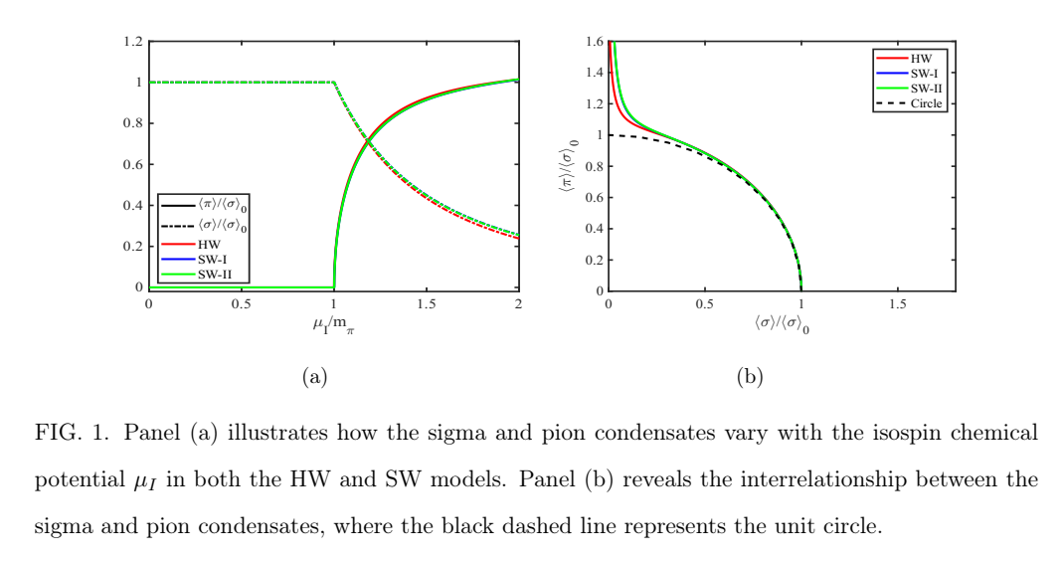
Condensation
Y. Chen, M. Ding, K. Bitaghsir Fadafan,
D. Li and M. Huang, arXiv: 2408.17080

Slide 17
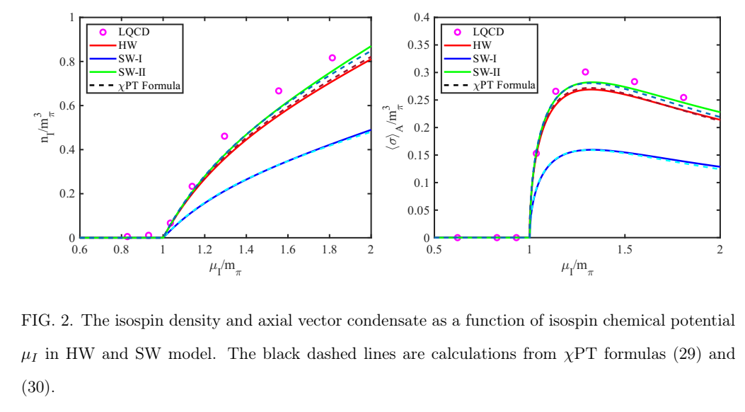
Condensation
Y. Chen, M. Ding, K. Bitaghsir Fadafan,
D. Li and M. Huang, arXiv: 2408.17080
According to χPT, the expressions for isospin density and axial-vector condensation can be simplified to

Slide 18
III. Pionic Equation of State and Pion Star

Slide 19
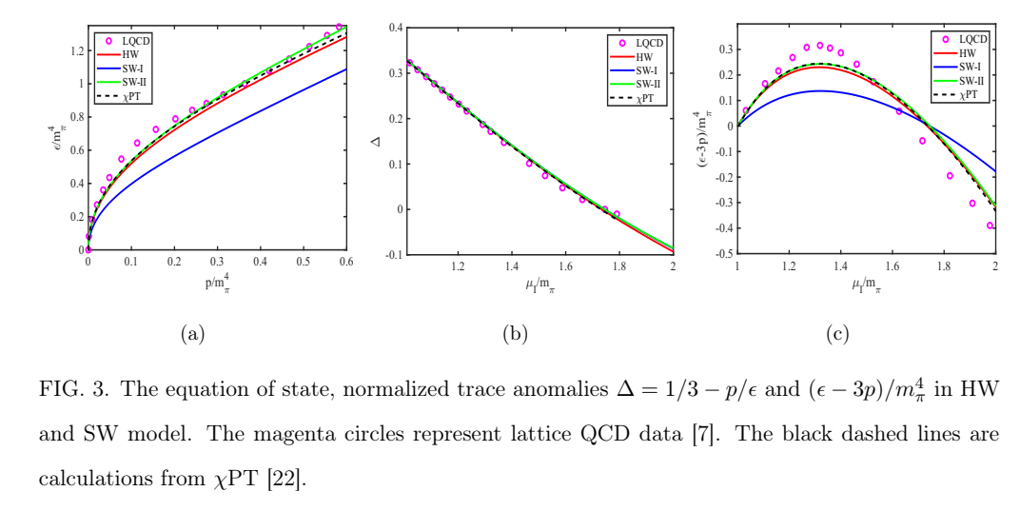
Thermodynamics
Y. Chen, M. Ding, K. Bitaghsir Fadafan,
D. Li and M. Huang, arXiv: 2408.17080
At zero temperature, the pionic pressure p and energy density ϵ can be given by thermodynamic relations

Slide 20
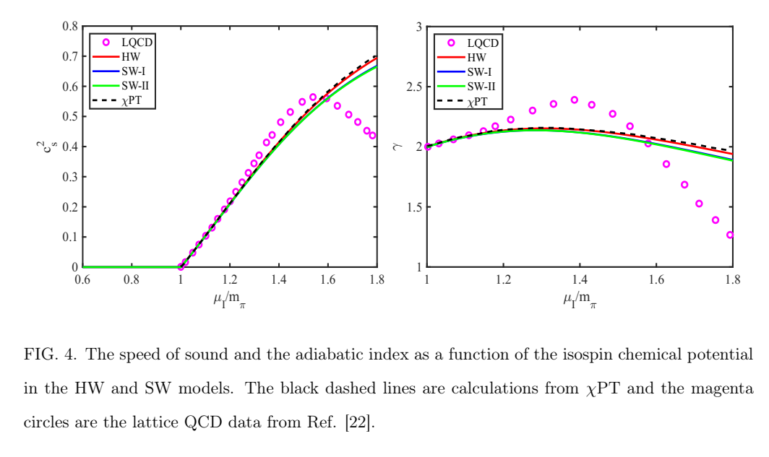
Speed of Sound
Y. Chen, M. Ding, K. Bitaghsir Fadafan,
D. Li and M. Huang, arXiv: 2408.17080
The square of the speed of sound and adiabatic index is given as are defined as

Slide 21
Pion Star
Y. Chen, M. Ding, K. Bitaghsir Fadafan,
D. Li and M. Huang, arXiv: 2408.17080
The form of the TOV equations are as follow
The dimensionless tidal deformability Λ
where

Slide 22
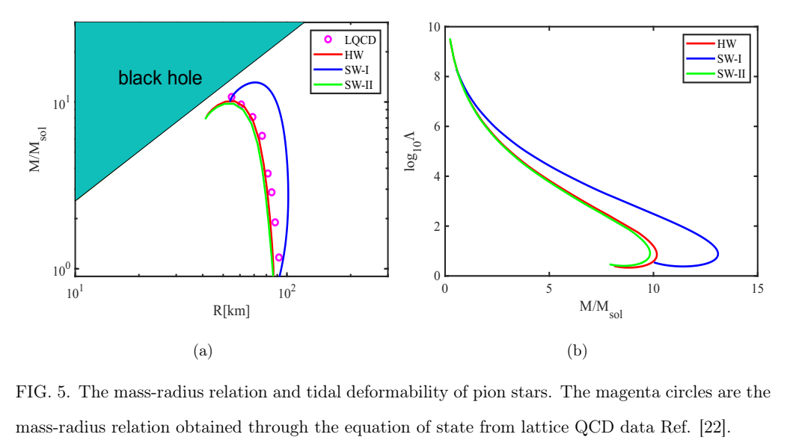
Pion Star
Y. Chen, M. Ding, K. Bitaghsir Fadafan,
D. Li and M. Huang, arXiv: 2408.17080

Slide 23
IV. Kaon Condensation

Slide 24
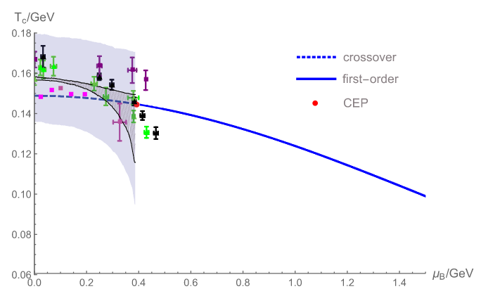
Model
The holographic QCD model with Nf = 3 is given as
Fang et al., PRD100, 054008 (2019)

Slide 25
Model
Y. Chen, M. Ding, K. Bitaghsir Fadafan,
D. Li, and M. Huang, arXiv: 2505.xxxxx
The holographic QCD model with Nf = 3 is given as
The nonzero vector fields of model are $V_{0}^{(3)}$ and $V_{0}^{(8)}$
The vacuum of scalar can be given as

Slide 26
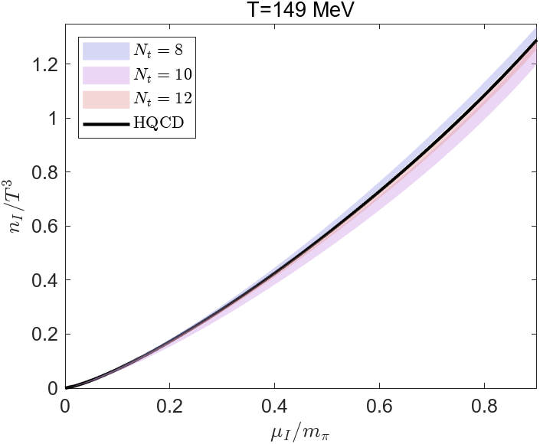
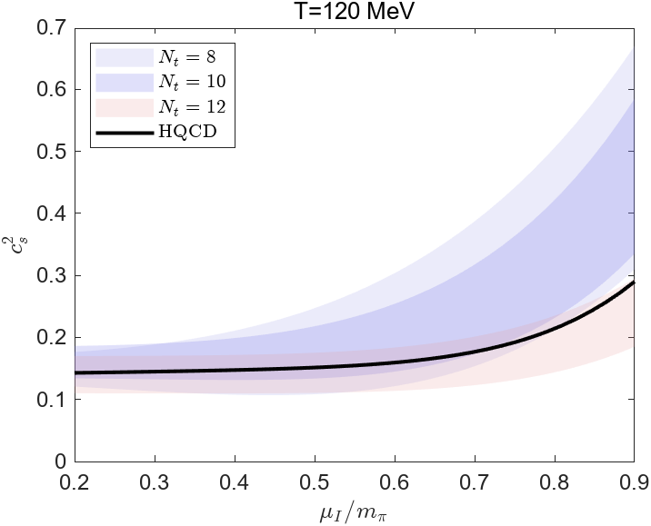
Model
Y. Chen, M. Ding, K. Bitaghsir Fadafan,
D. Li, and M. Huang, arXiv: 2505.xxxxx

Slide 27
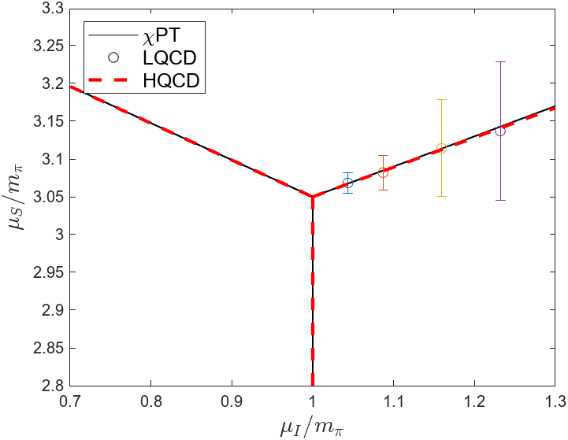
Model
Y. Chen, M. Ding, K. Bitaghsir Fadafan,
D. Li, and M. Huang, arXiv: 2505.xxxxx

Slide 28
IV. Conclusion and discussion

Slide 29
Summary
1) The results from the holographic models show good agreement with lattice QCD in terms of isospin density, axial-vector condensation, EoS, phase diagram and normalized trace anomaly. However, discrepancies were found in the calculations of the sound speed and adiabatic index at zero temperature.
2) Further analysis shows that the results from the holographic models are very similar to those from χPT.
3) Our calculations revealed that the typical radius of a pion star is approximately 100 kilometers, with a mass around $10M_{☉}$. The tidal deformability, Λ, ranges from 10 to ${10}^{8}$.

Slide 30
Thanks！

