Slide 1


Φ⁴场模拟早期热化和喷注的介质响应
Early Thermalization and Jet-induced Medium Excitation With a Φ⁴ Simulation
邓建 (山东大学)
合作者: 周治国，曹杉杉
第二十届全国中高能核物理大会，上海，2025年4月24-28日

Slide 2
Outlines
Motivation
Set up the frame work
EOS and quasi-thermalization
Jet induced excitation
Summary and outlook

Slide 3
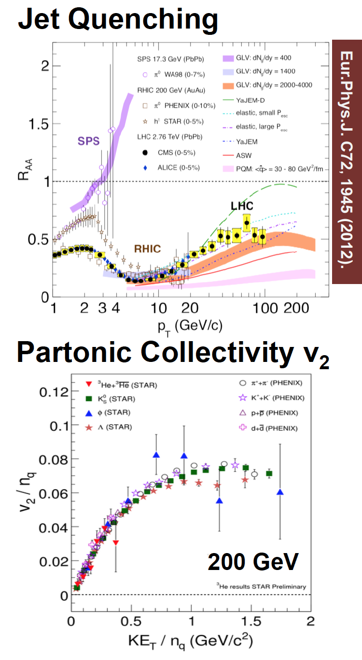
QGP with Little Bang
Strongly coupled QGP is created in HIC.
Collectivity and Jet quenching.
How about the fast thermalization of the medium?
Does the deposit energy thermalized?
3/16

Slide 4
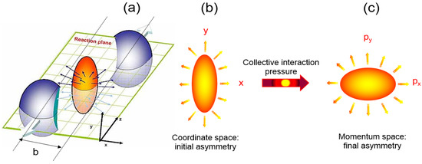
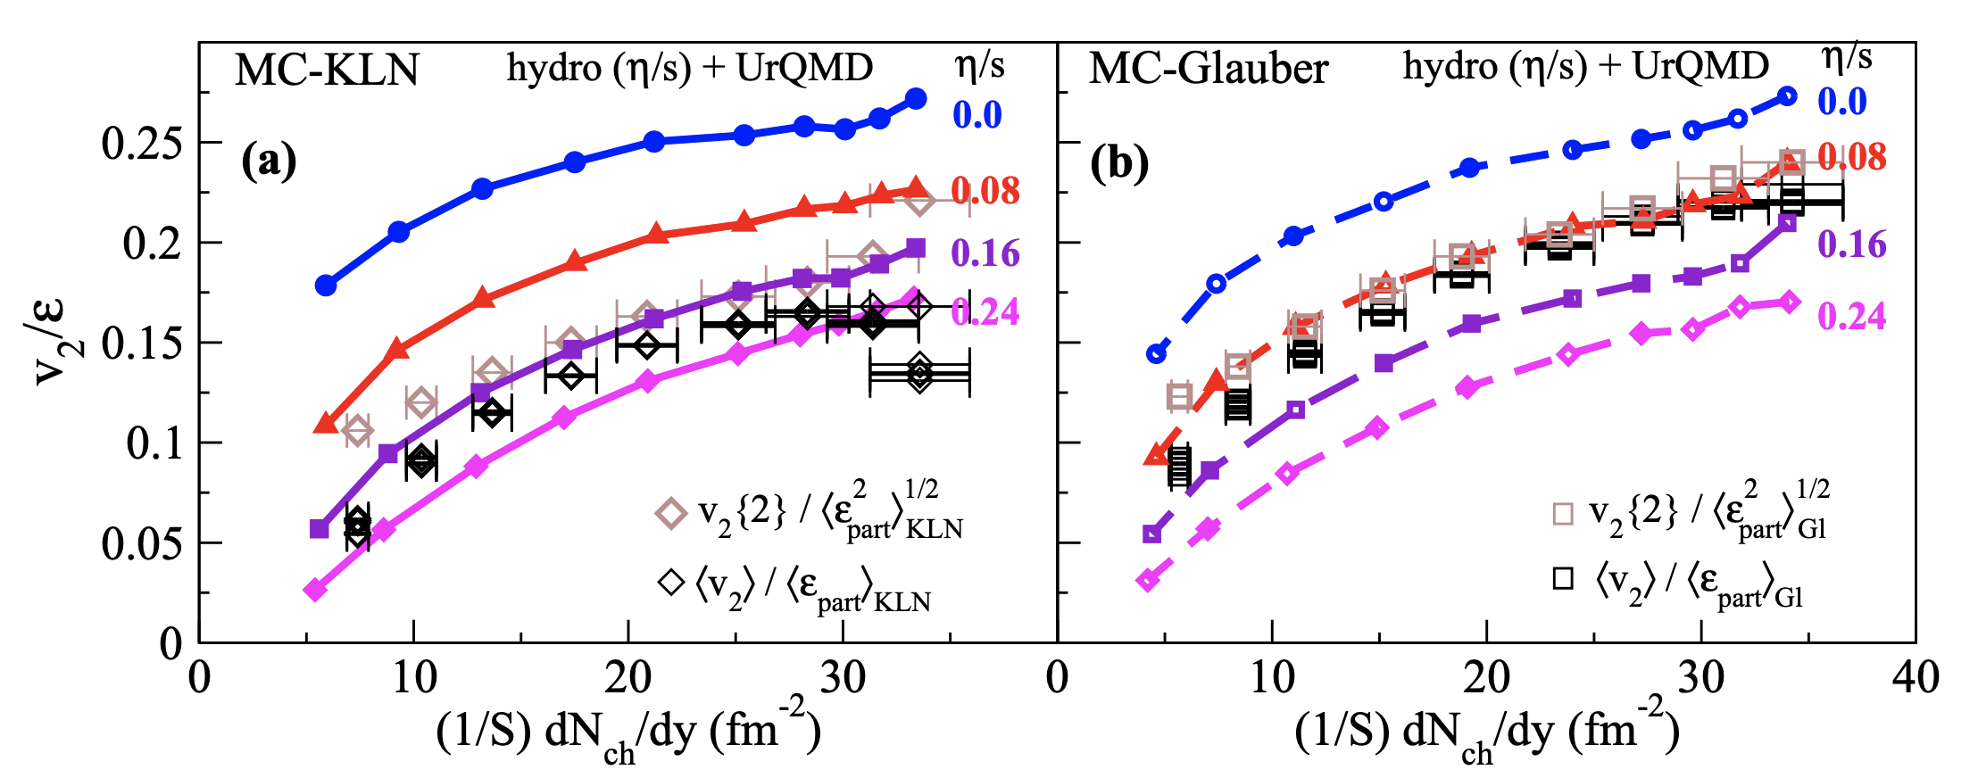
Collectivity with Hydrodynamics
H-C. Song, S. Bass, U. Heinz, et al. PRL 106 (2011) 192301
4/16

Slide 5
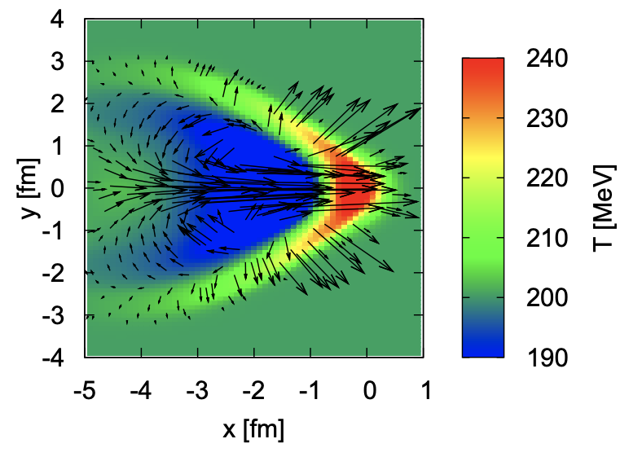
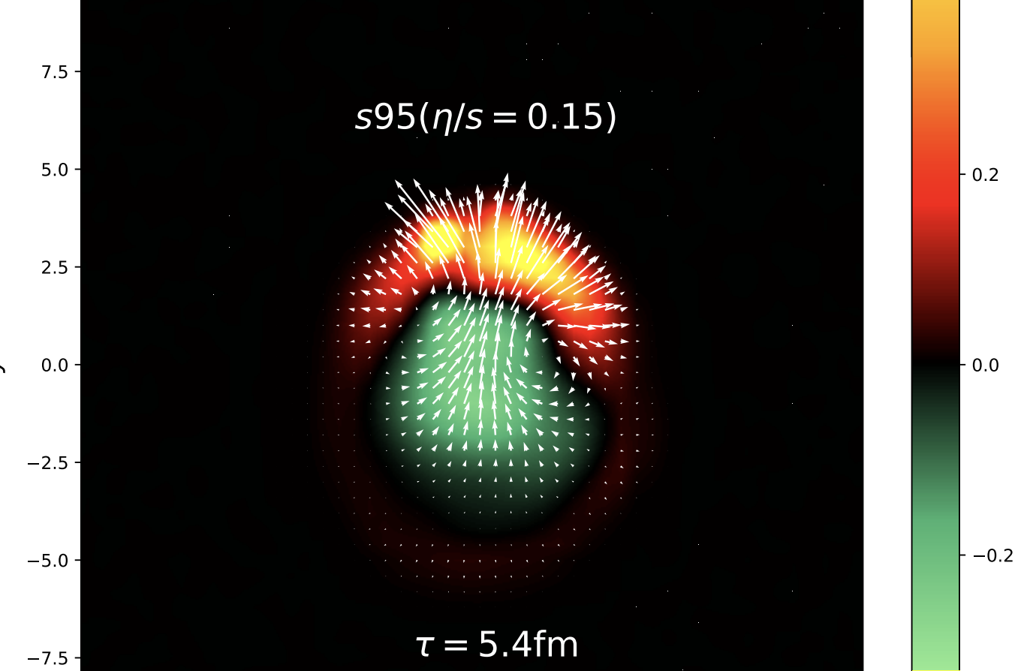
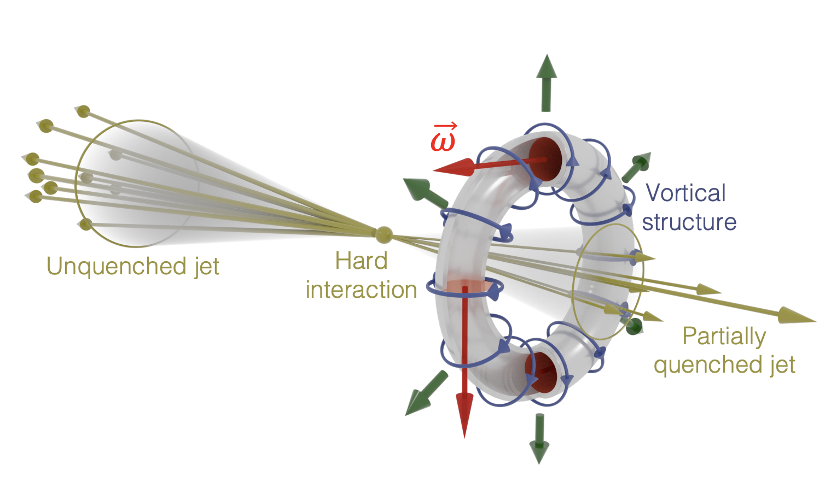
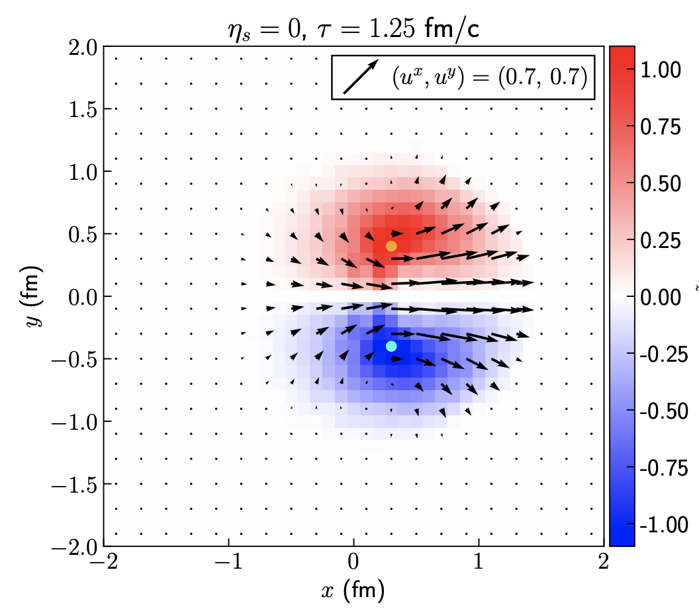
Jet within a thermal bath
Jet-induced Mach cone, diffusion wake and vortex ring
Hydro
Hydro + CoLBT
Betz, Noronha, Torrieri, et al. PRC 79 (2009) 034902
Yang, Luo, Chen, Pang, Wang, PRL 130 (2023) 5, 052301
Hydro
Serenone, Barbon, Chinellato, et al. PLB 820 (2021) 136500
Ribeiro, Chinellato, Lisa, et al. PRC 109(2024), 1, 014905
5/16

Slide 6
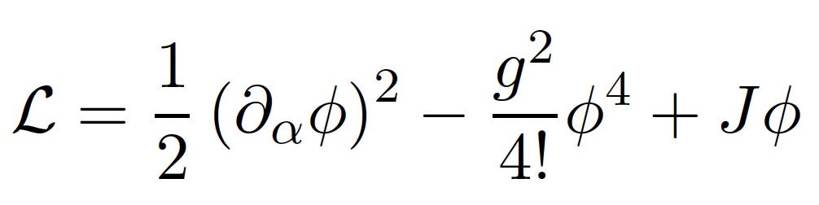
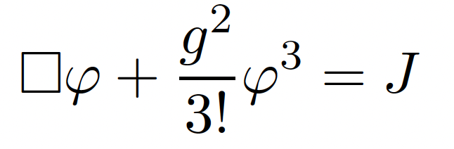
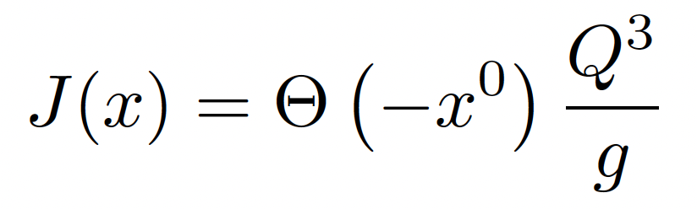
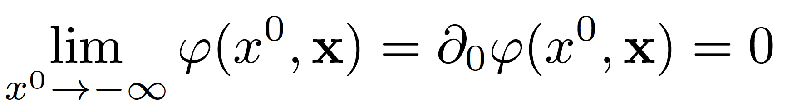
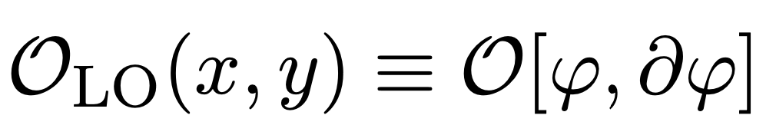
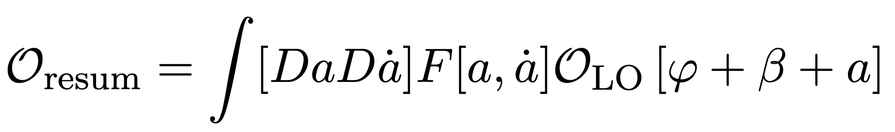
Classical Φ⁴ simulation
Start with a massless, self-interacting scalar field, stimulated by a source
g: coupling constant
J(x,t): external source
CGC, f>>1
EOM
HIC source
The validity and application range of classical field simulation
Dusling, Epelbaum, Gelis, Venugopalan,
Nulc. Phys. A 850 (2011) 69.
Epelbaum, Gelis,
Nulc. Phys. A 872(2011)210.
Berges, Boguslavski, Schlichting, Venugopalan, JHEP 05(2014)054.
Observables:
6/16

Slide 7
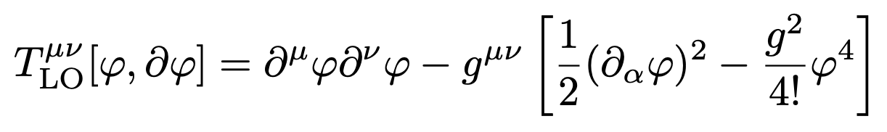
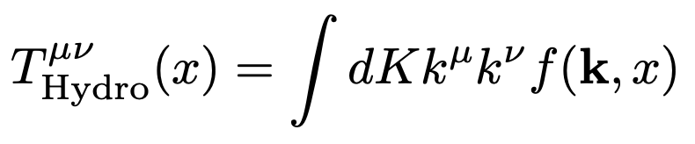
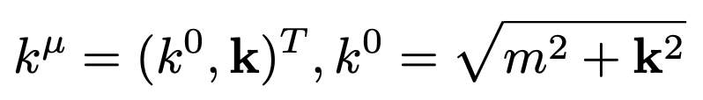
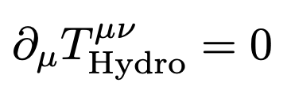
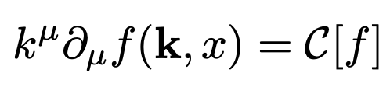
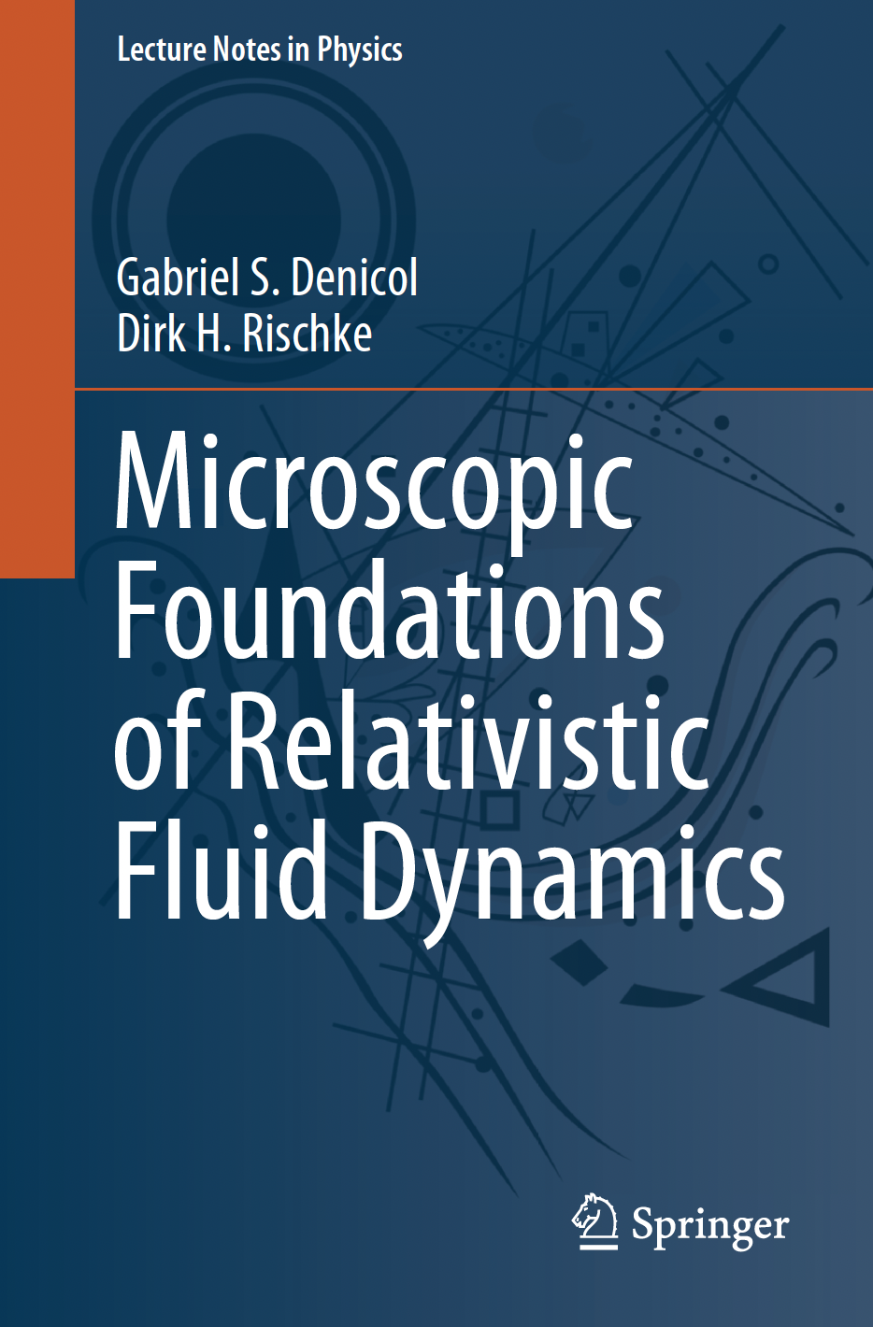
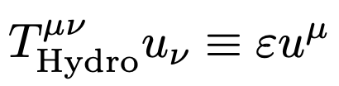
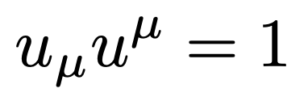
Connection between field and Hydro.
E-M tensor of field
?
E-M tensor of fluid
EOM
EOS and transport coefficients ➔ Hydrodynamics.
(Quasi-)Particle picture ➔Boltzmann Equation
Landau frame
7/16

Slide 8
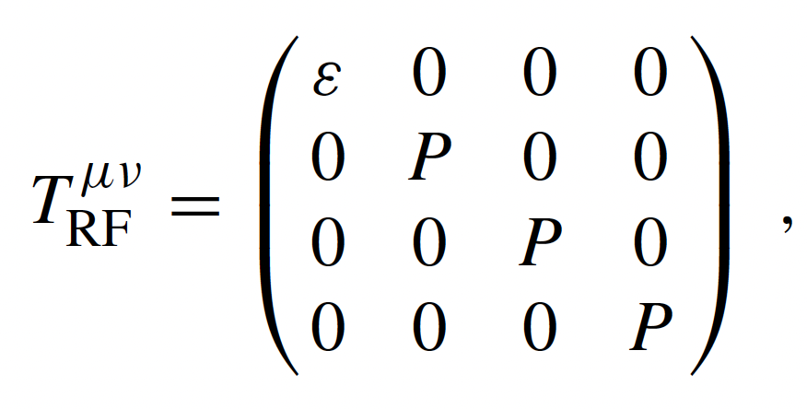
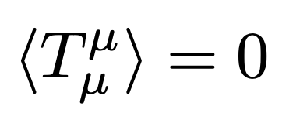

Achieving equation of state
Equation of state for a massless boson gas can be achieved with larger ensemble average.
Isotropic + Ergodic(各态遍历)
Principle of equal a priori probabilities
8/16

Slide 9
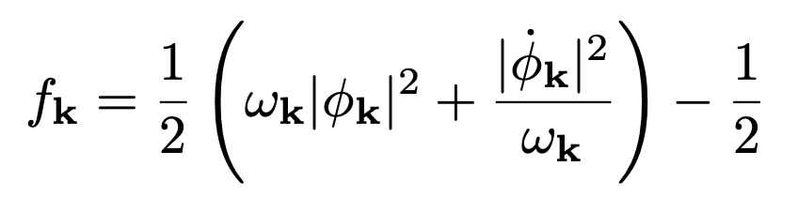
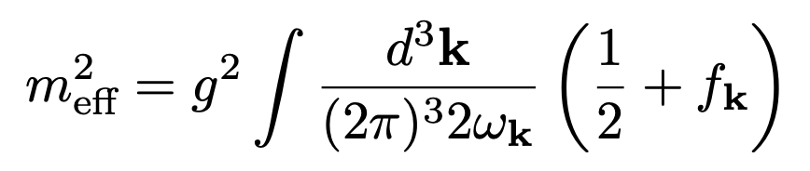
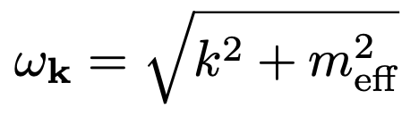
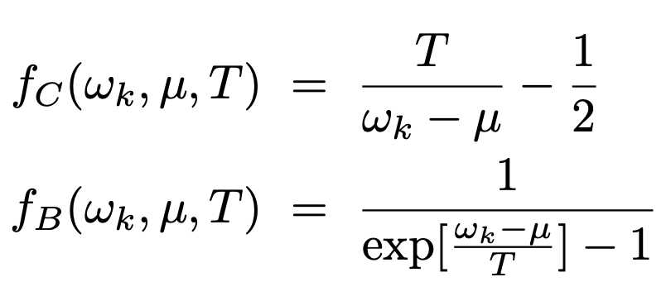
Quasi particle spectra
Boltzmann Equation for classical and quantum field:
A. H. Mueller, D. T. Son
Phys. Lett. B 582(2004) 279.
S. Jeon, Phys. Rev. C 72(2005) 014907.
T. Epelbaum, F. Gelis, N. Tanji, B. Wu
Phys. Rev. D 90(2014)125032
Over-occupied initial condition ➔ BEC
Relativistic process ➔ instability ➔ Resonance ➔ speed up
Approaching quasi-equilibrium of classic field
9/16

Slide 10
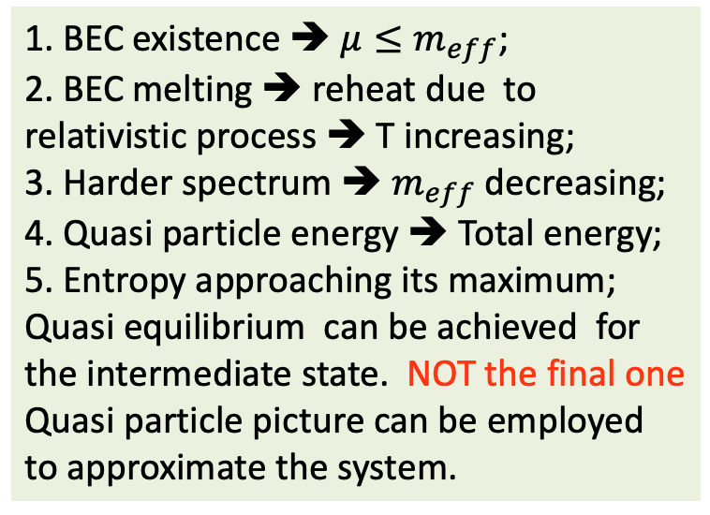
Evolution of state’s properties
1. BEC existence ➔ $μ≤m_{eff}$;
2. BEC melting ➔ reheat due to relativistic process ➔ T increasing;
3. Harder spectrum ➔ $m_{eff}$ decreasing;
4. Quasi particle energy ➔ Total energy;
5. Entropy approaching its maximum;
Quasi equilibrium can be achieved for the intermediate state. NOT the final one
Quasi particle picture can be employed to approximate the system.
10/16

Slide 11
Jet speed up the formation of EOS
11/16

Slide 12
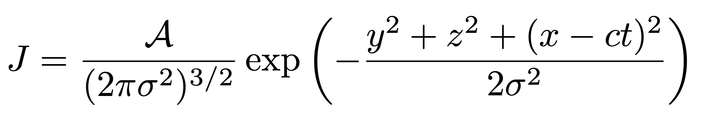
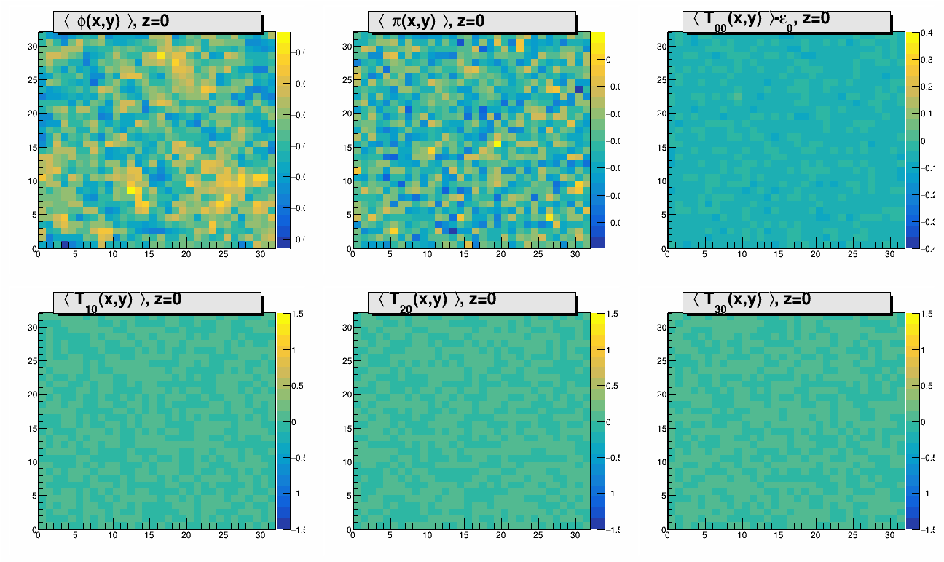
Jet In Medium
Jet source
Ensemble average of field and E-M Tensor of the medium + Jet
12/16

Slide 13
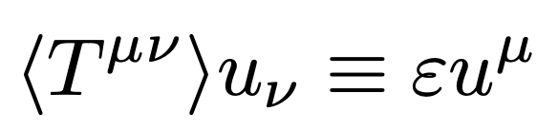
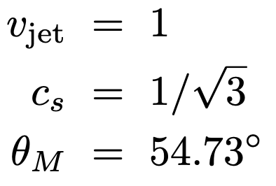
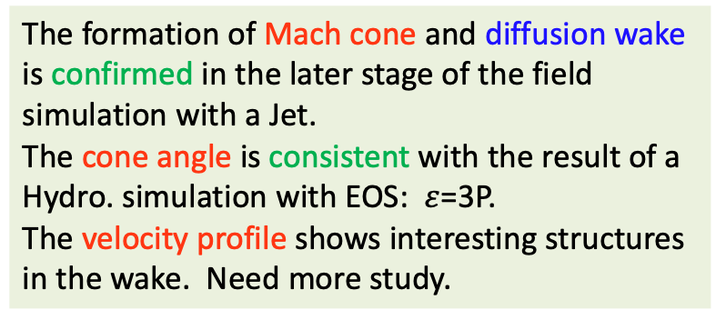
Mach Cone and diffusion wake
The formation of Mach cone and diffusion wake is confirmed in the later stage of the field simulation with a Jet.
The cone angle is consistent with the result of a Hydro. simulation with EOS: $ε$=3P.
The velocity profile shows interesting structures in the wake. Need more study.
13/16

Slide 14
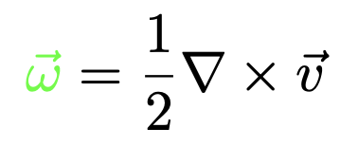
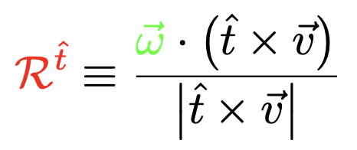
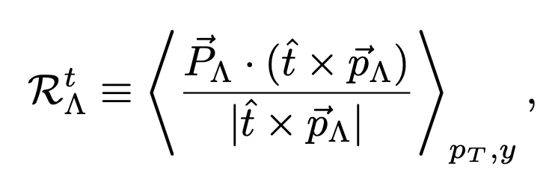
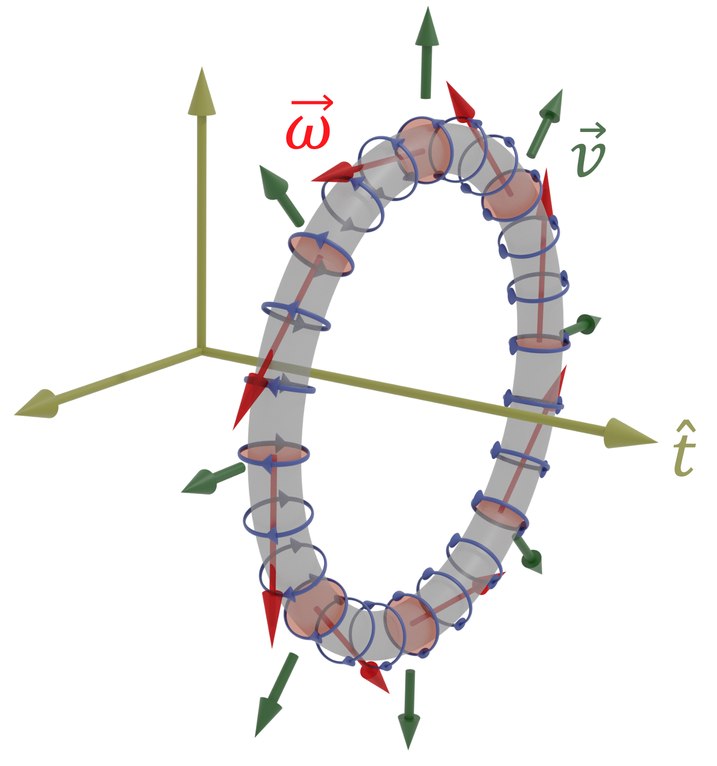
Vortex ring and internal rotation
Ribeiro, Chinellato, Lisa, et al. PRC 109(2024), 1, 014905
In the transverse plane, the velocity goes outside on the cone of the jet,
in the wake, the velocity goes inside;
The vorticity/local rotation induced by the jet is visiable;
The three vectors define a observable, which can be measured.
14/16

Slide 15

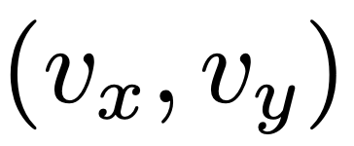
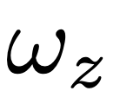
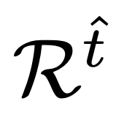
Evolution of the profiles
T_{JET} = 2
T_{JET} = 7
T_{JET} = 14
15/16

Slide 16
Summary
Early thermalization and jet-induced medium excitation are studied with a self-interacting scalar field simulation.
The setting-up of quasiparticle picture and EOS is verified, which can be speed up by random jets. But the momentum distribution of quasiparticles is still far from a thermodynamic limit.
Jet-induced Mach cone, diffusion wake and vortex ring are confirmed with an ensemble average of classical field simulation.
The energy and momentum deposited from a jet can be thermalized rapidly, the medium response resembles hydrodynamic behavior.
16/16

Slide 17
Summary
Early thermalization and jet-induced medium excitation are studied with a self-interacting scalar field simulation.
The setting-up of quasiparticle picture and EOS is verified, which can be speed up by random jets. But the momentum distribution of quasiparticles is still far from a thermodynamic limit.
Jet-induced Mach cone, diffusion wake and vortex ring are confirmed with an ensemble average of classical field simulation.
The energy and momentum deposited from a jet can be thermalized rapidly, the medium response resembles hydrodynamic behavior.
Thanks
16/16

