Slide 1
Magnetic Field Effects on Photons in Heavy Ion Collisions
Xinyang Wang
Center for Fundamental physics
Anhui University of Science and Technology

Slide 2
Photons in HIC
Photons is a Thermometer of QGP
Photons are emitted at all stages of evolution
Weak interacting with matter
https://u.osu.edu/vishnu/category/visualization/

Slide 3
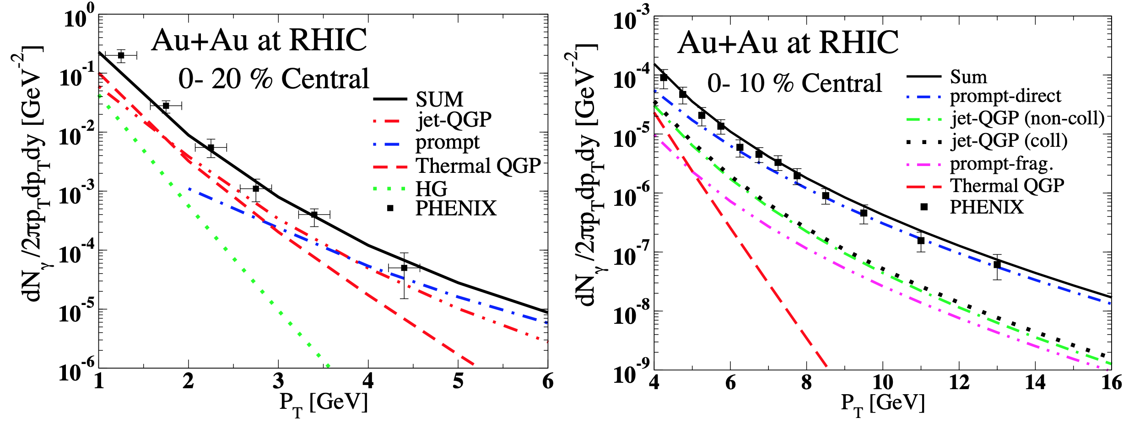
Photon sources in HIC
[Turbide et al,, Phys. Rev. D, 2008]

Slide 4
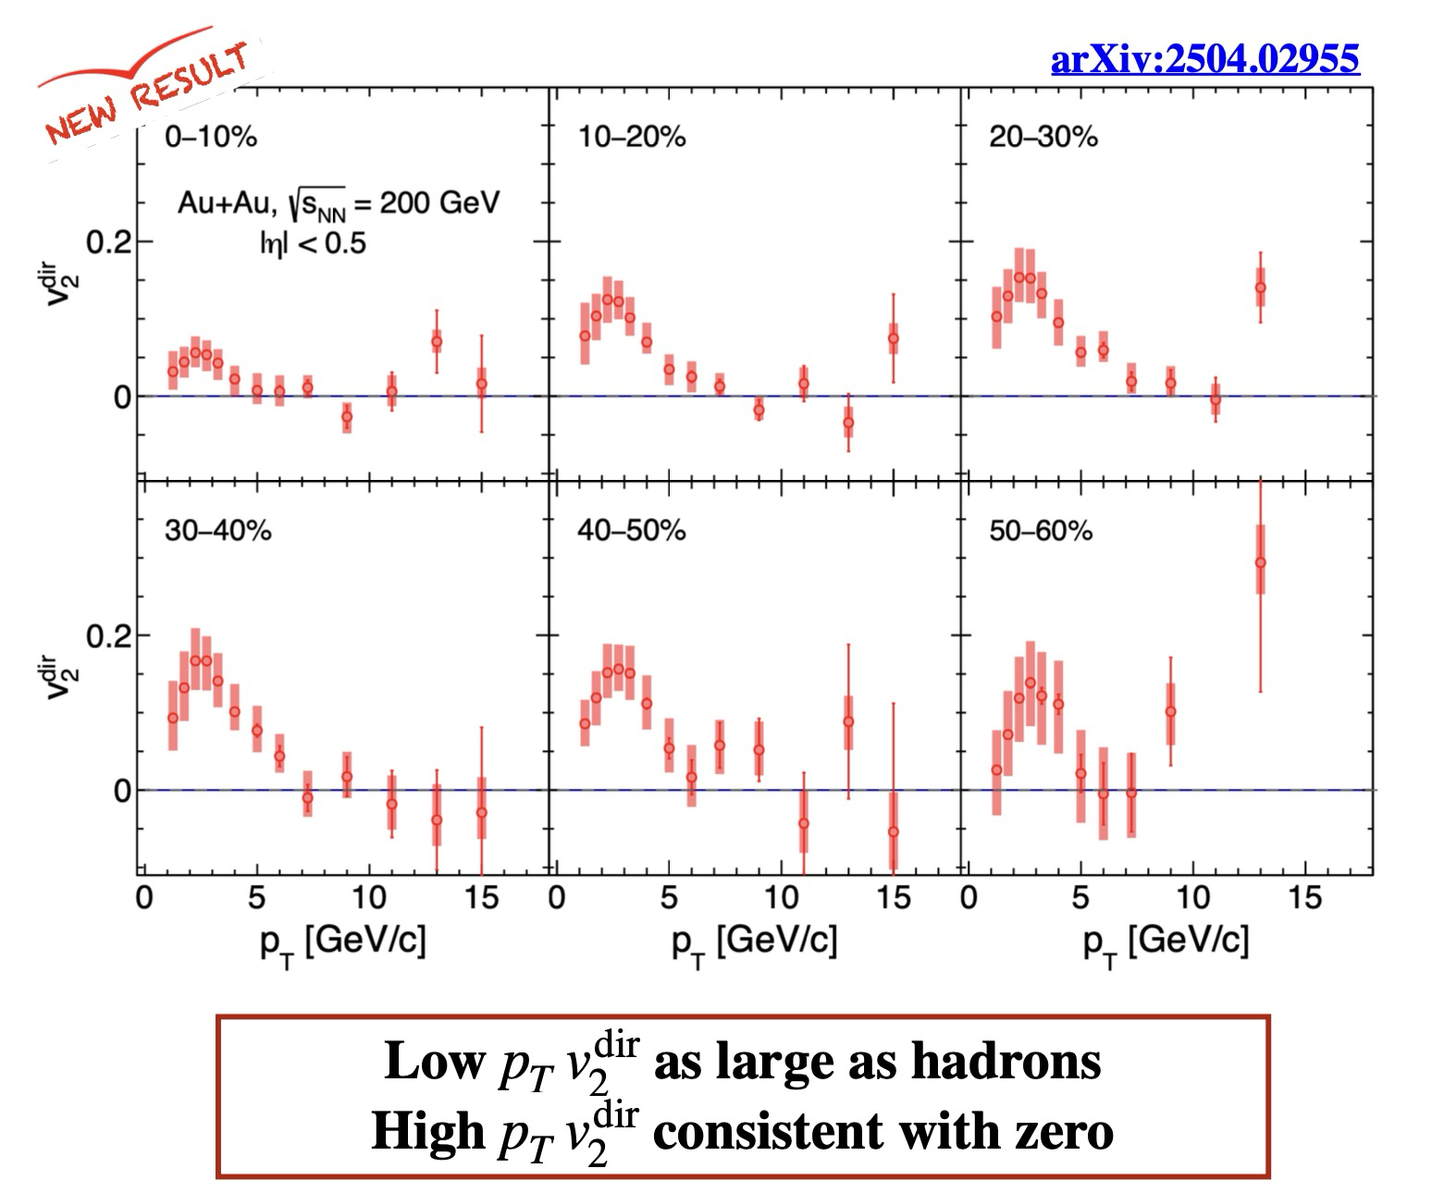
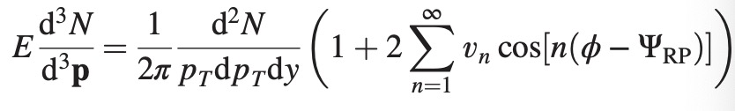
Photon v₂ puzzle
Most photons are produced early (before flow develops)
Thus, v₂ for photons should be very small
Credit by Roli Esha

Slide 5
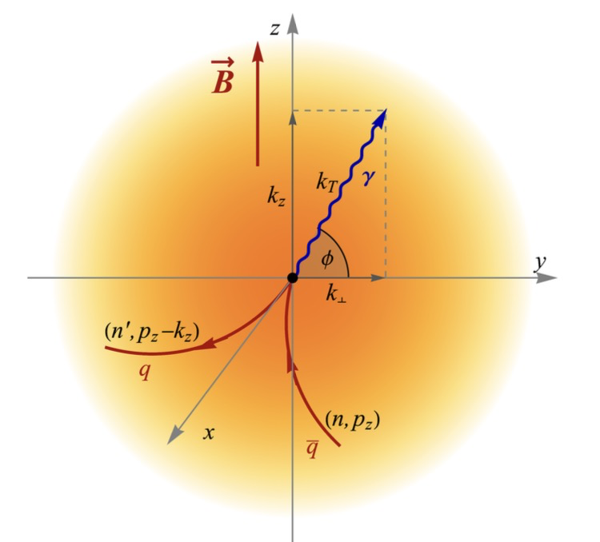
Photons from magnetized plasma
[X.W., Igor Shovkovy, Lang Yu, Mei Huang, PRD, 2020]
[X.W., Igor Shovkovy, PRD, 2021]

Slide 6
Physics processes
Real solutions to the energy conservation equation
can be found under the following conditions:

Slide 7
The thermal photon production rate

Slide 8
Nonzero elliptic “flow” ($v_{2}$)

Slide 9

Photon $v_{4 }and{ v}_{6}$
[X.W., Igor Shovkovy, PRD, 2024]

Slide 10
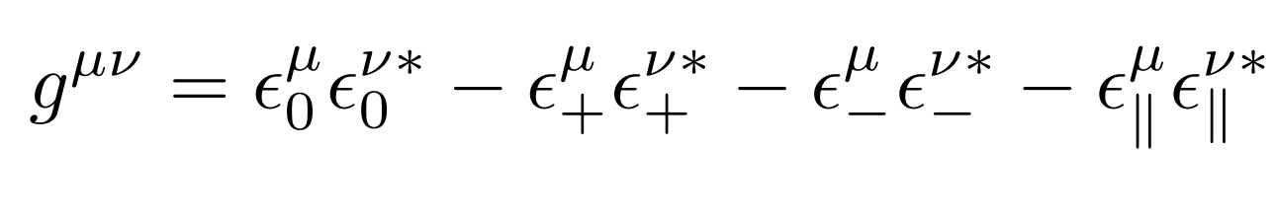
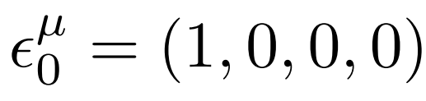
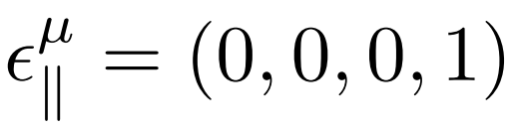
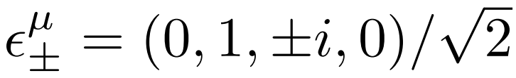
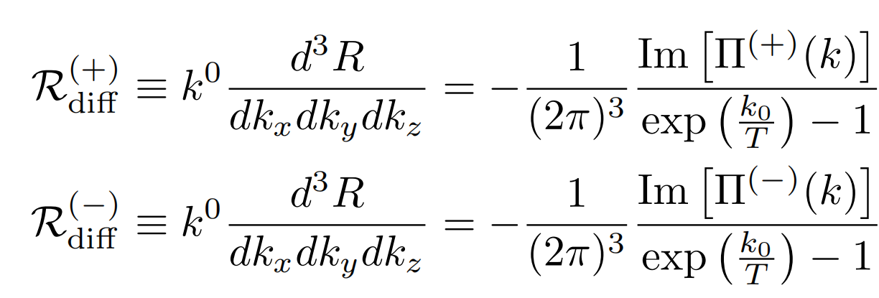
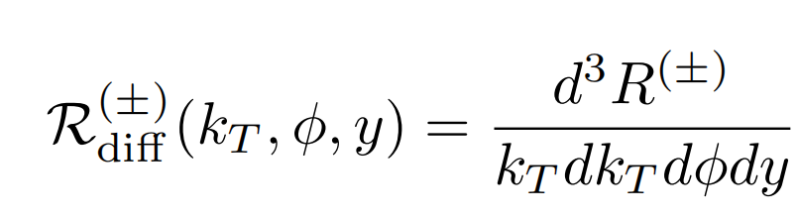
Polarization decomposition
[X.W., Igor Shovkovy, EPJC, 2021]
[X.W., Igor Shovkovy, PRD, 2024]

Slide 11
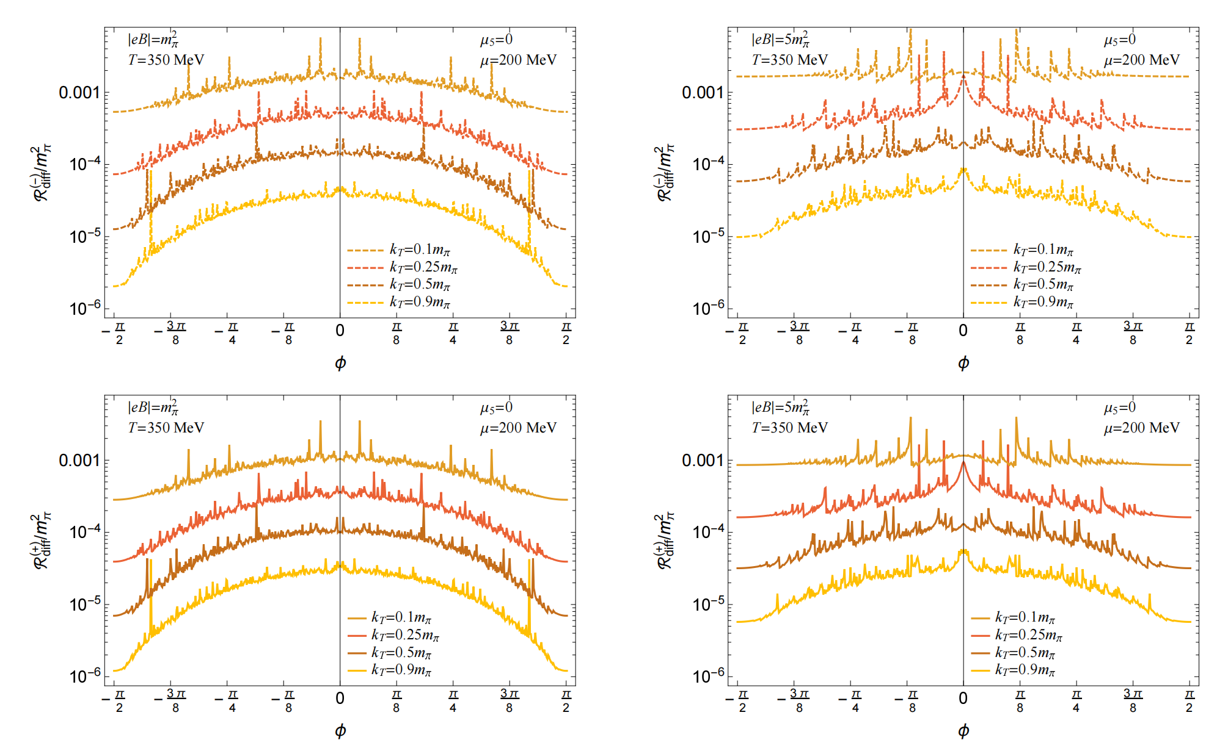
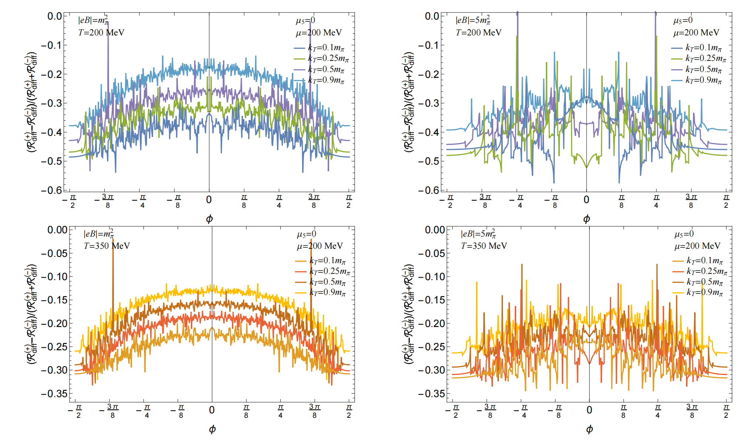
Nonzero chemical potential

Slide 12
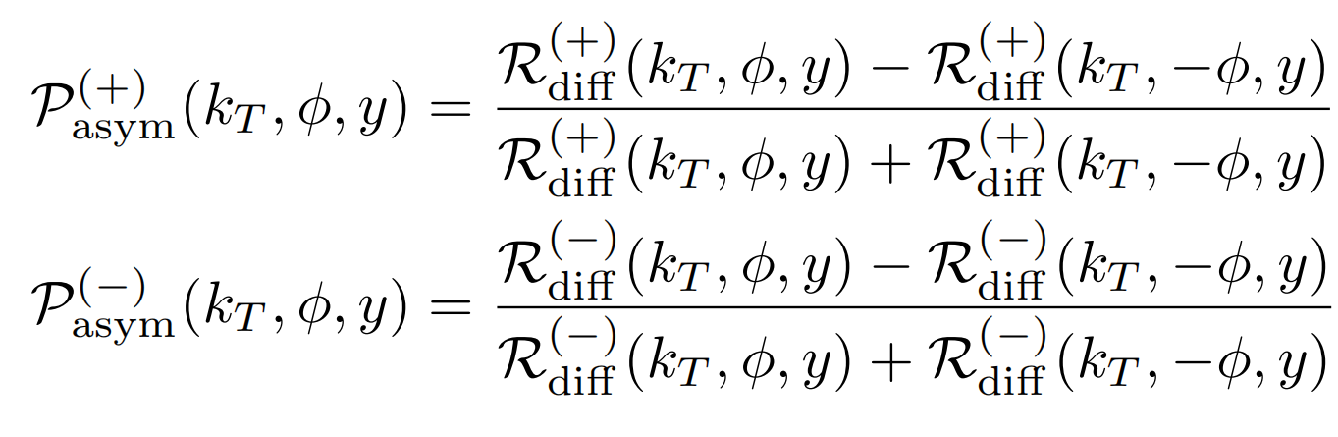
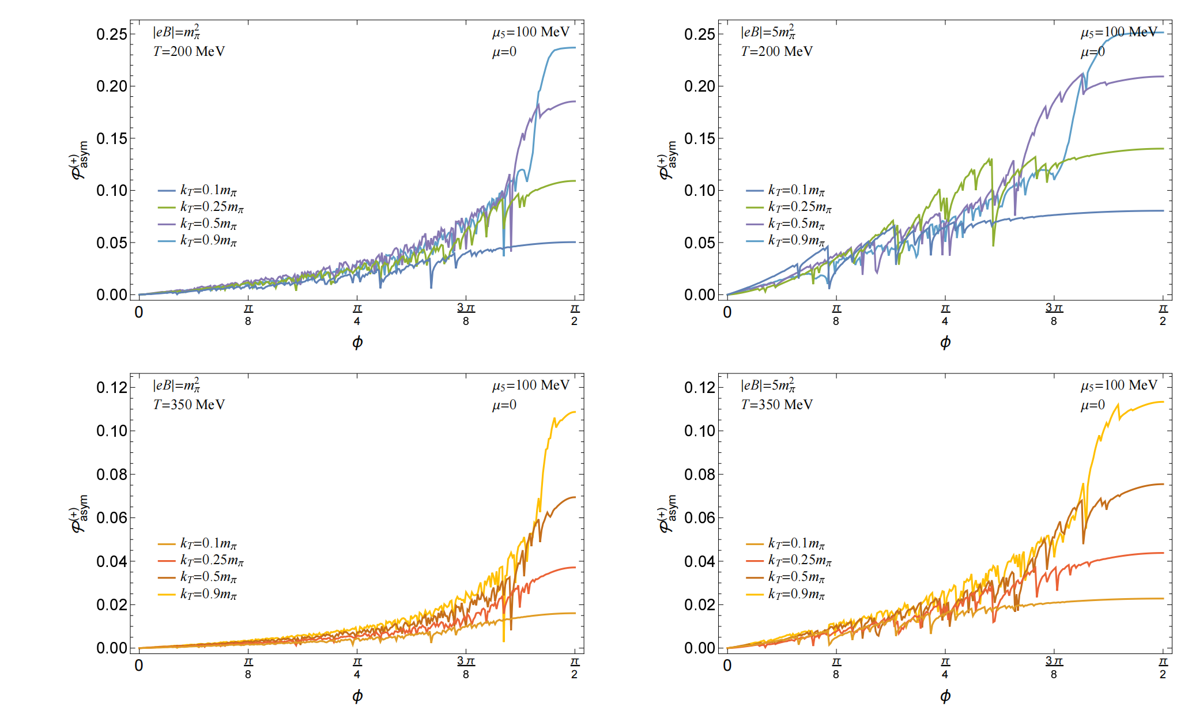
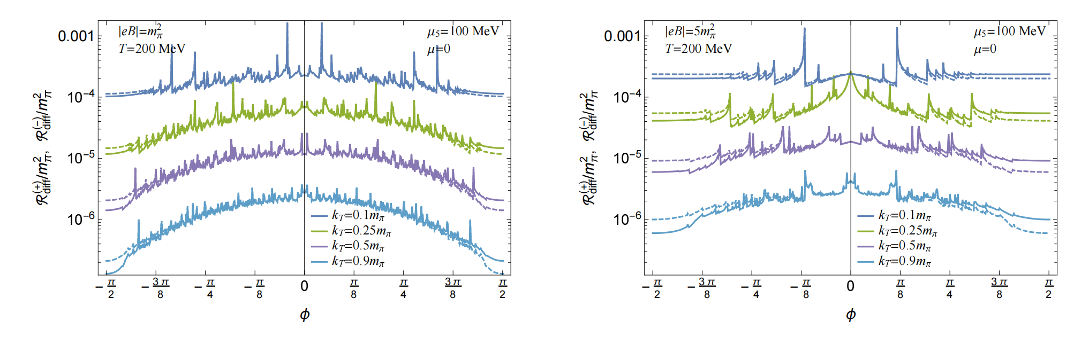
Nonzero chiral chemical potential

Slide 13
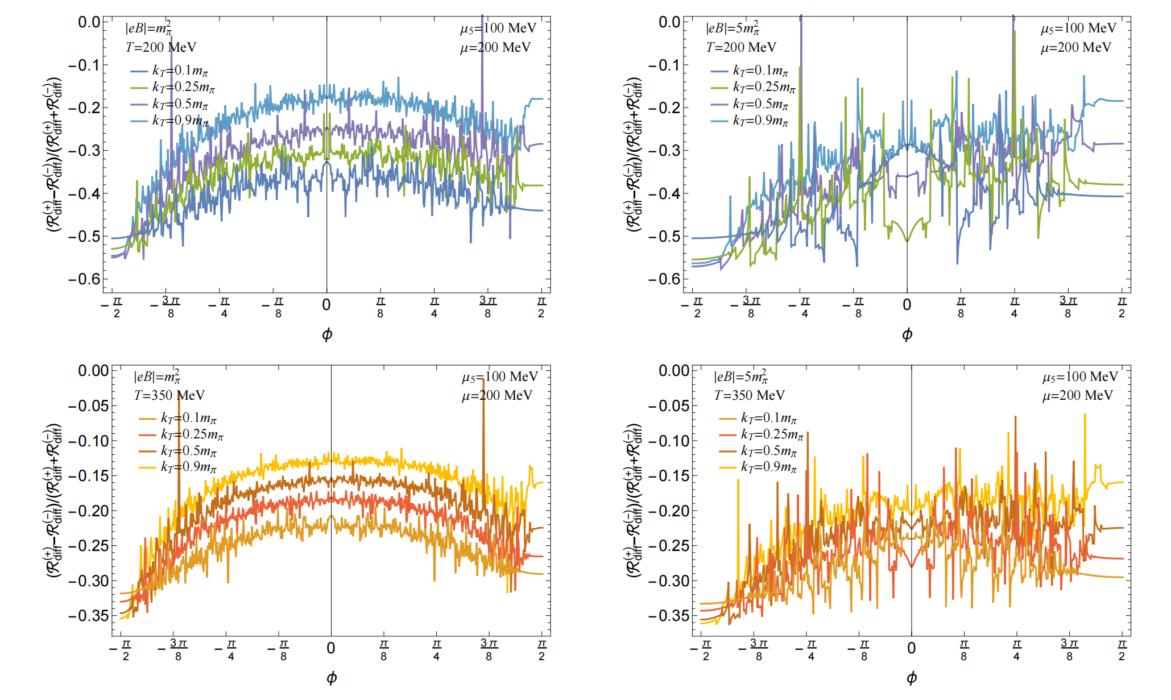
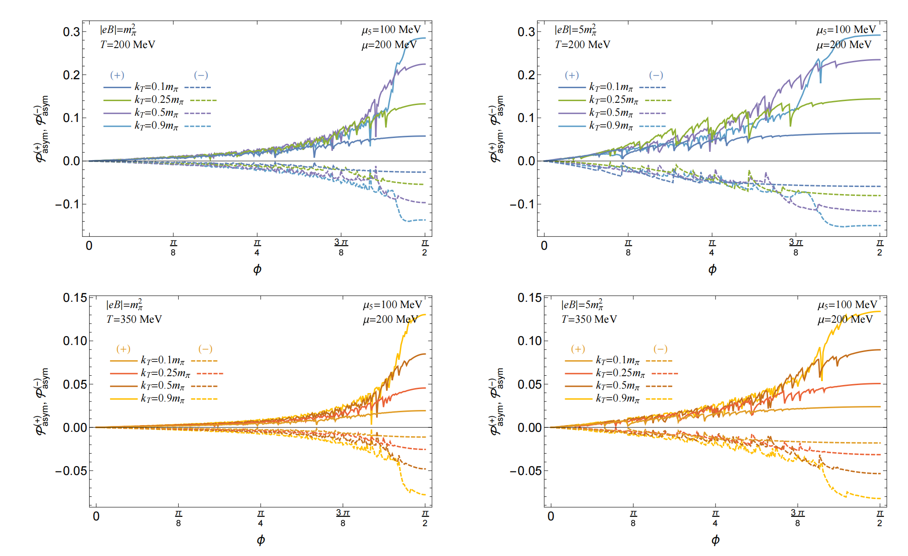
Both nonzero

Slide 14
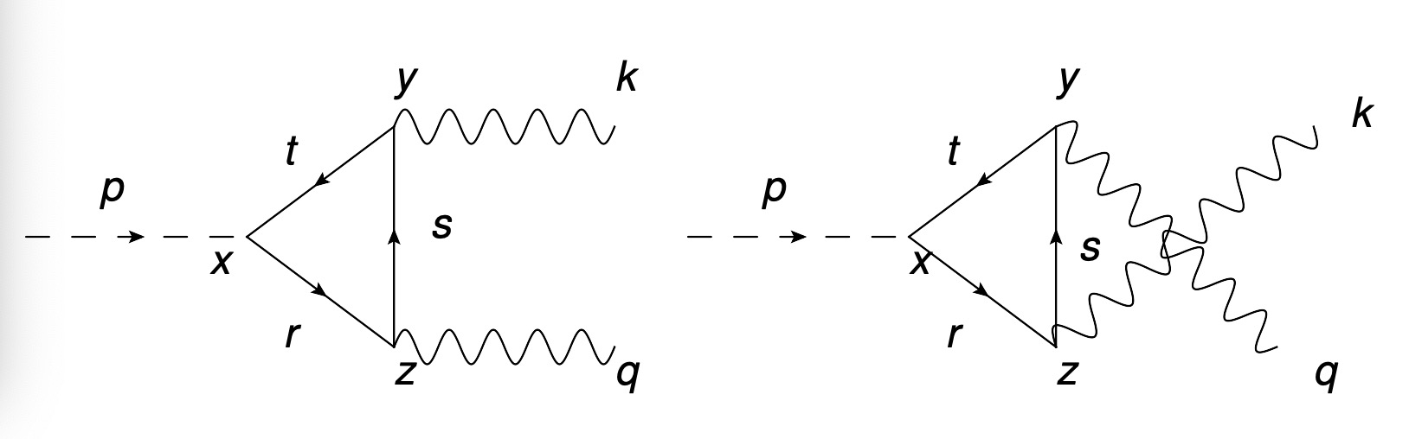
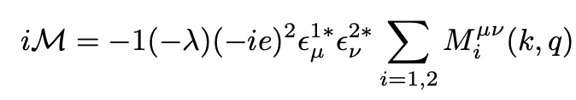
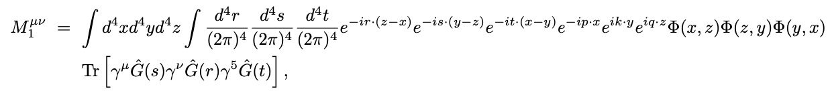

Pion decay in a weak magnetic hadron gas
[X.W., in preparation, 2025]

Slide 15

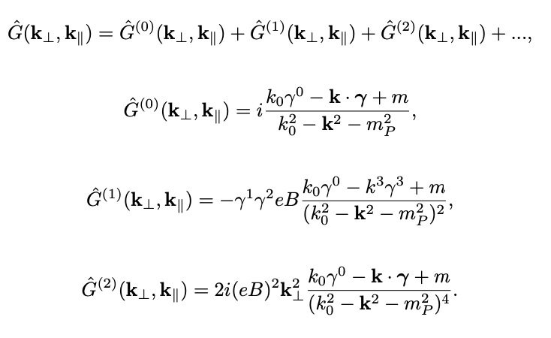

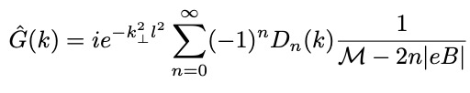
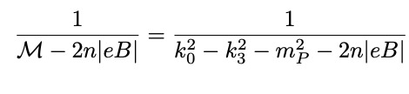
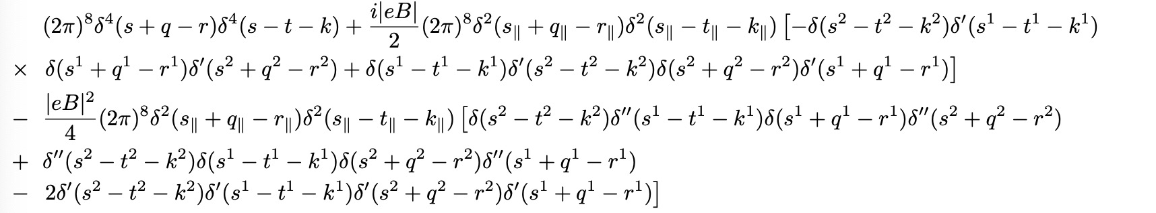
Weak field expansion

Slide 16
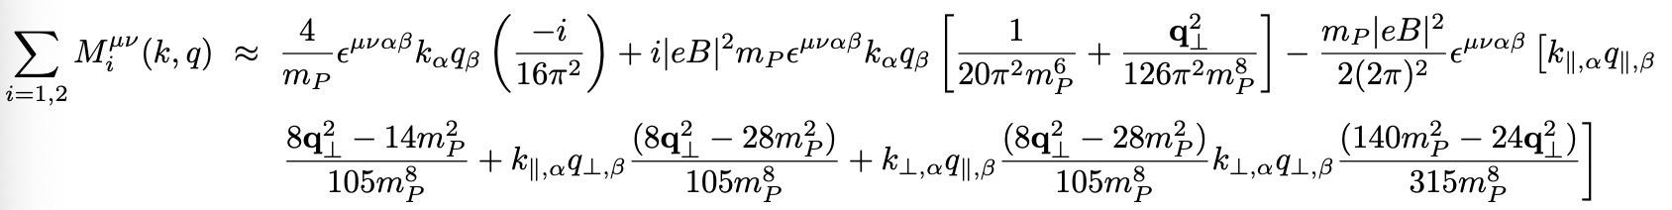
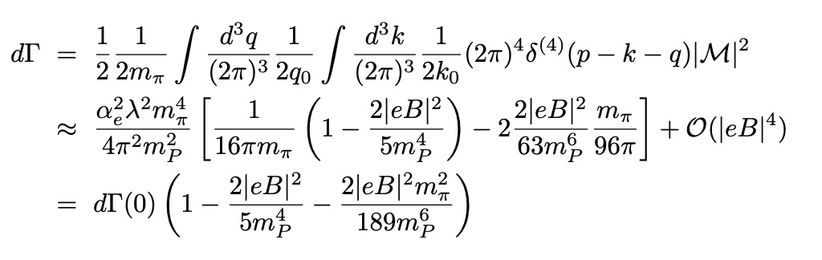
Results in rest frame

Slide 17
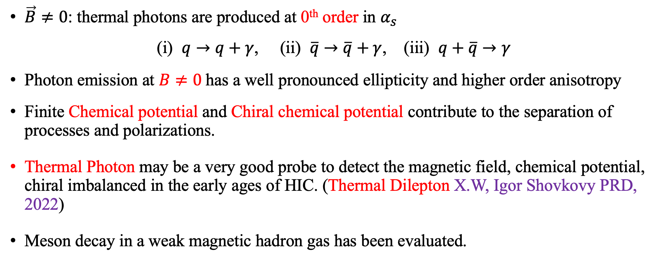
Summary
$\vec{B}≠0$: thermal photons are produced at 0th order in $α_{s}$
(i) $q→q+γ$, (ii) $\overline{q}→\overline{q}+γ$, (iii) $q+\overline{q}→γ$
Photon emission at $B≠0$has a well pronounced ellipticity and higher order anisotropy
Finite Chemical potential and Chiral chemical potential contribute to the separation of processes and polarizations.
Thermal Photon may be a very good probe to detect the magnetic field, chemical potential, chiral imbalanced in the early ages of HIC. (Thermal Dilepton X.W, Igor Shovkovy PRD, 2022)
Meson decay in a weak magnetic hadron gas has been evaluated.

Slide 18
Thank you!

