Slide 1


Recent Results of Baryon Electromagnetic Form Factors at BESIII
Jifeng Hu (胡继峰) (on behalf of BESIII Collaboration)
South China Normal University
第二十届全国中高能核物理大会@复旦大学 2025年4月27日

Slide 2
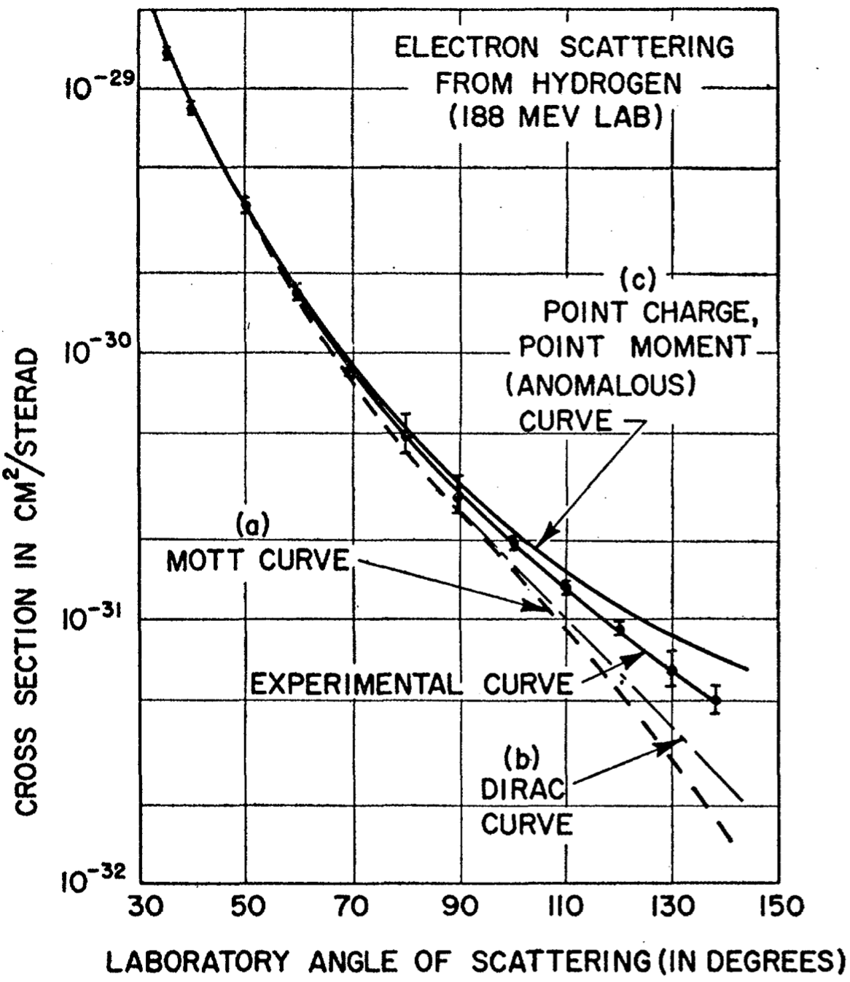
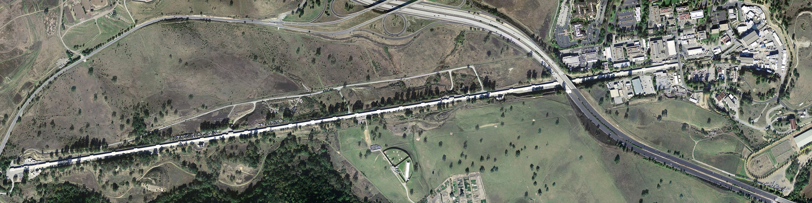
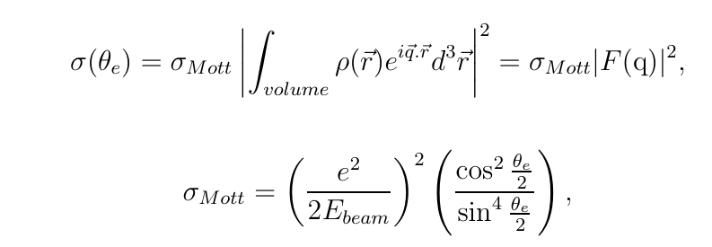


Historic Milestones
Electron Scattering (1950s)
Hofstadter R. etc., “electron scattering and nuclear structure”
Rev. Mod. Phys. 28, 214–254 (1956)
Developments of the definition
Sachs formula
$$G_{E}=F_{1}+{τF}_{2}, G_{M}=F_{1}+F_{2}$$
Fermi FF
Pauli FF
Electric FF
Magnetic FF

Slide 3
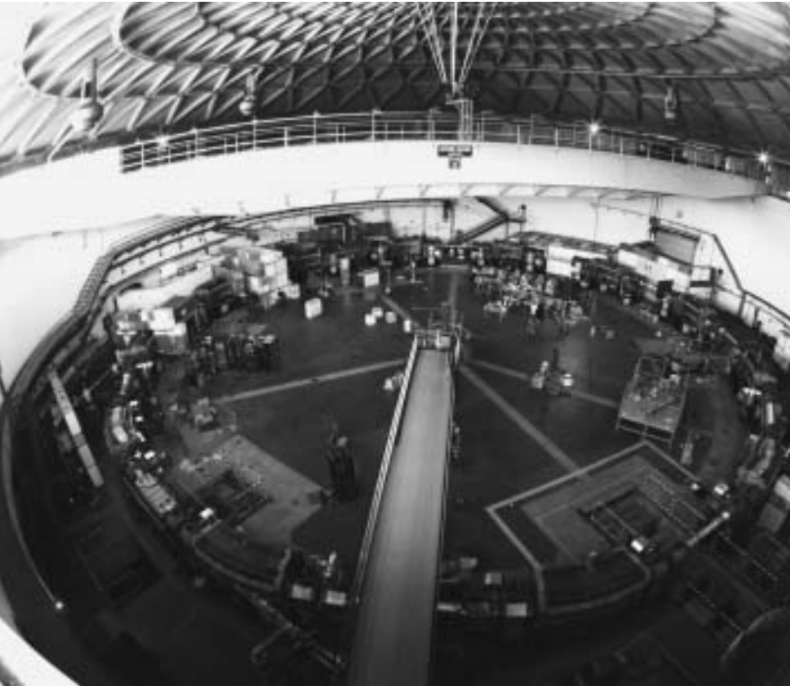
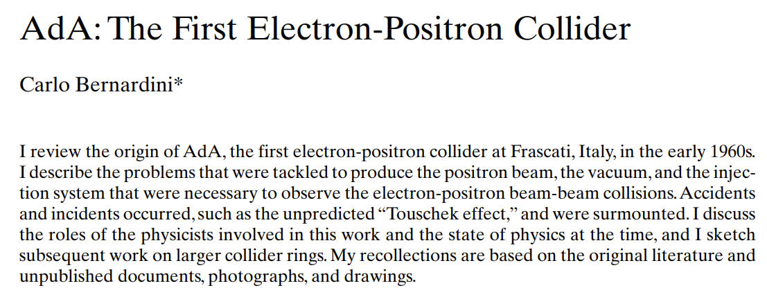
Historic Milestones
https://cas.web.cern.ch/sites/default/files/lectures/baden-2004/bernardini.pdf
Electron Scattering (1950s)
e+e- → ppbar (1972)
Hofstadter R. etc., “electron scattering and nuclear structure”
Rev. Mod. Phys. 28, 214–254 (1956)

Slide 4
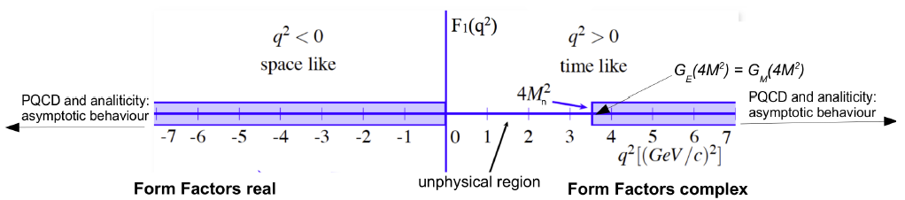
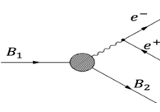
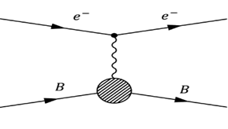
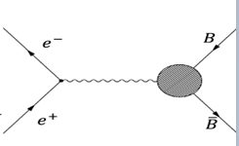
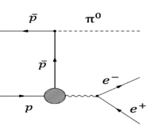




Space-like versus Time-like
fundamental observable bridging hadronic physics, nucleon physics to others.
This talk
Dispersion relation
$$\left|G_{M,E}(−∞)\right|=\left|G_{M,E}\left(∞\right)\right|$$
Notes:
加入dispersion relation

Slide 5
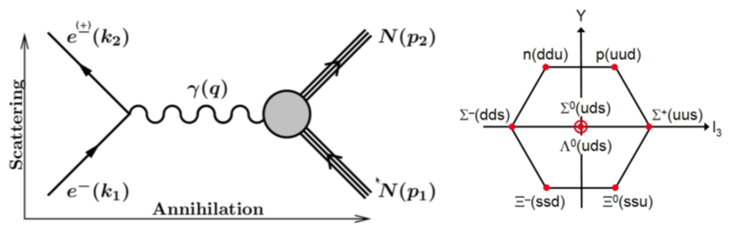






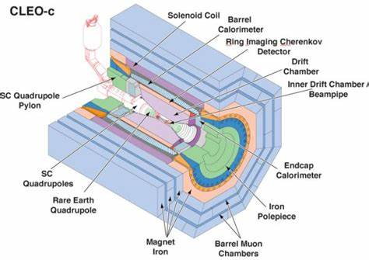
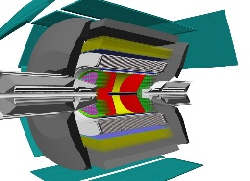
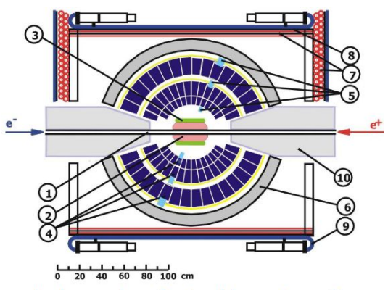
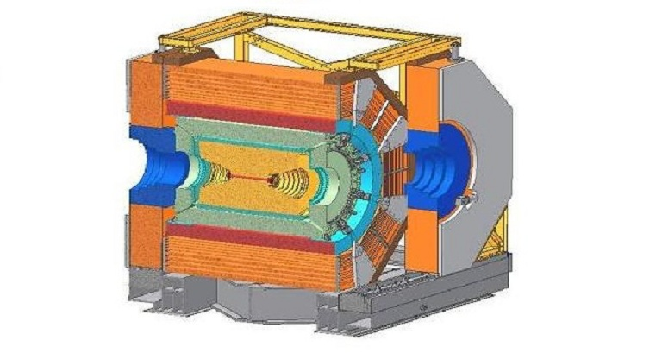
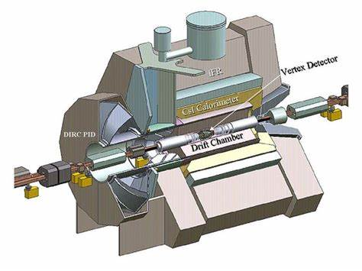
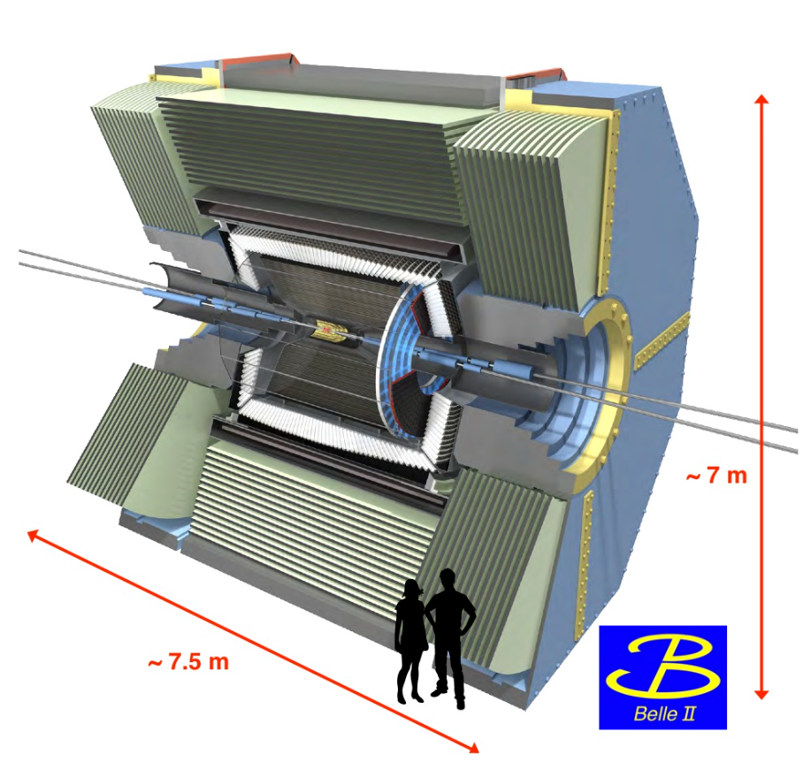

Unique Features at e⁺e⁻ Collider
Unique access to non-stable baryons in the TL region at electron-positron collider.
The relative phase ($\frac{G_{E}}{G_{M}}e^{i∆Φ}$) is accessible via weak decay of hyperons.
878 s
>1029 years
10⁻¹⁰ s
10⁻²¹ s
10⁻¹¹ s
N = Λ, Σ ...
Leading order
10⁻¹⁰ s
10⁻¹⁰ s
10⁻¹⁰ s
CLEO-c
CMD-3

Slide 6
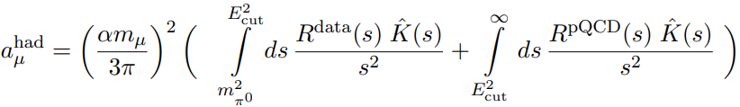


Picture of Baryon Structure at e⁺e⁻ Collider
e+ e- → hadrons
inclusive
semi-inclusive
e+ e- → h + X
Fragmentations: $D_{q}^{h}\left(x\right)$ for example.
exclusive
e+ e- → h + anti-h
Electromagnetic Form Factor
one of the pictures

Slide 7
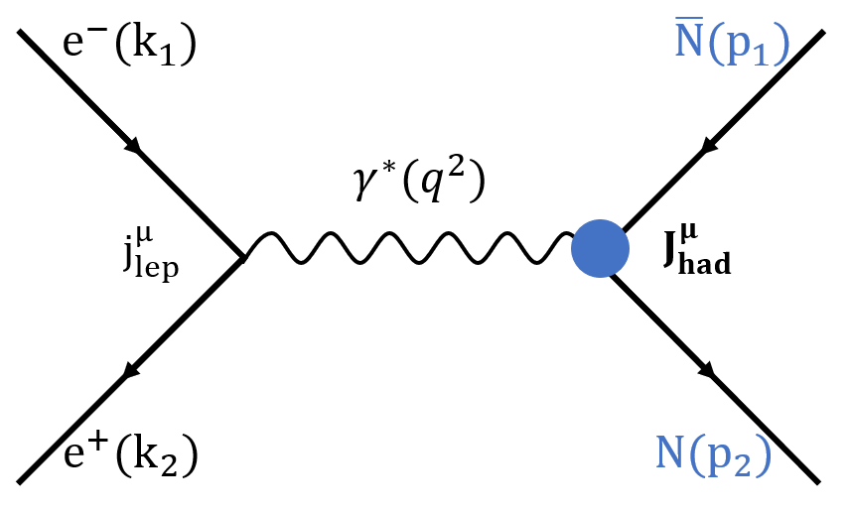
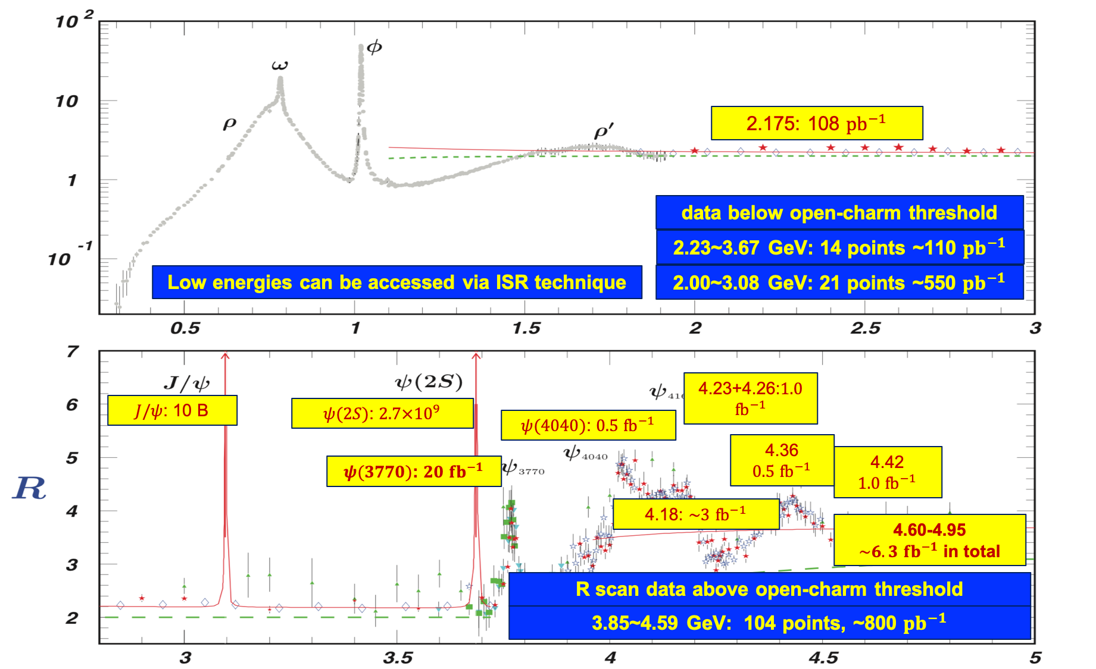
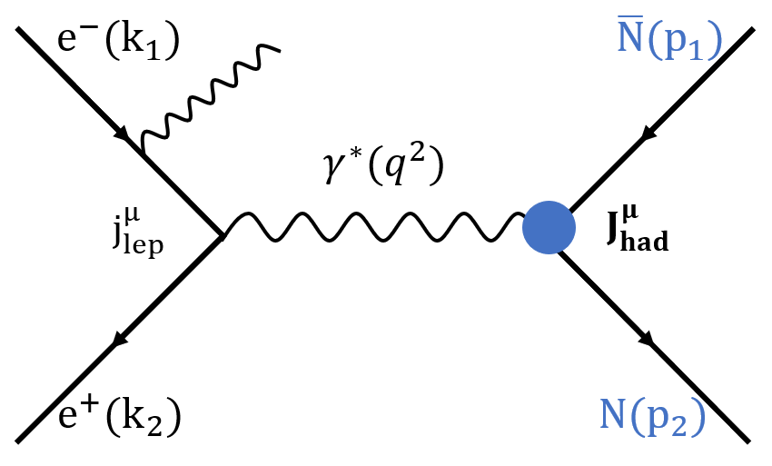
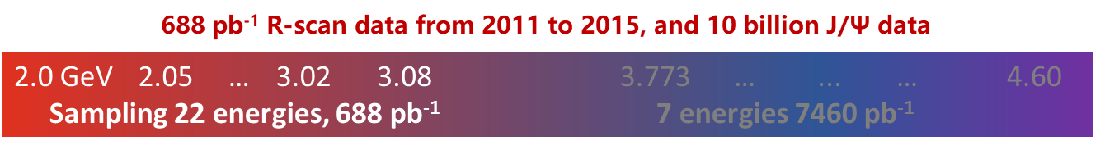
How to Measure EMFFS at BESIII
Energy scan
48 fb⁻¹ integrated luminosity from 2.0-4.95 GeV in total.
comparison
Initial-state-radiation

Slide 8



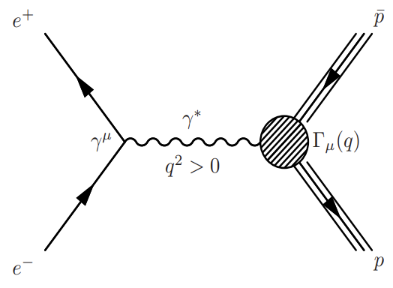
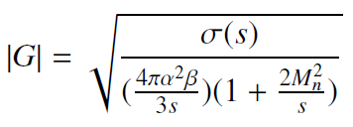
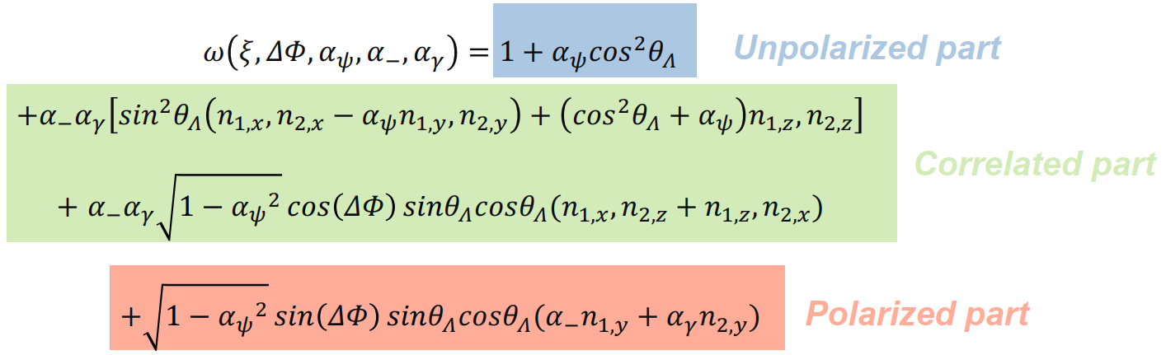
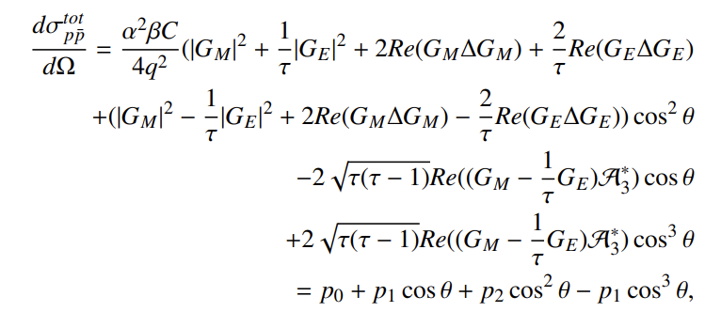
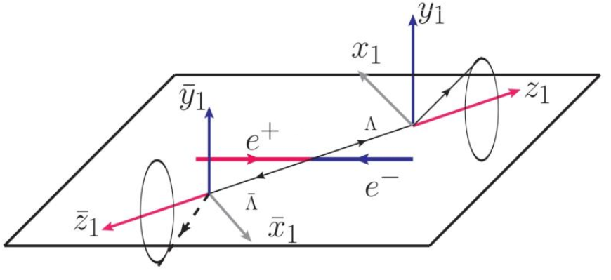
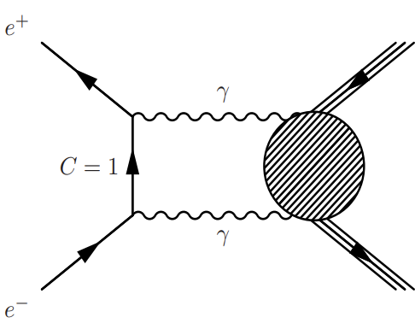
How to Analyze?
实验截面
理论截面
电形状因子|G_{E}|、磁形状因子|G_{M}|、
比值 R_{em}
有效形状因子|G|
积分截面分析
微分截面分析
微分截面
|G_{E}|、|G_{M}|、R_{em、}G_{E}、G_{M}的相位差ΔΦ、极化参数α
|G_{E}|、|G_{M}|、R_{em、}高阶贡献、Re(A₃*)
联合角分布分析
微分截面分析

Slide 9
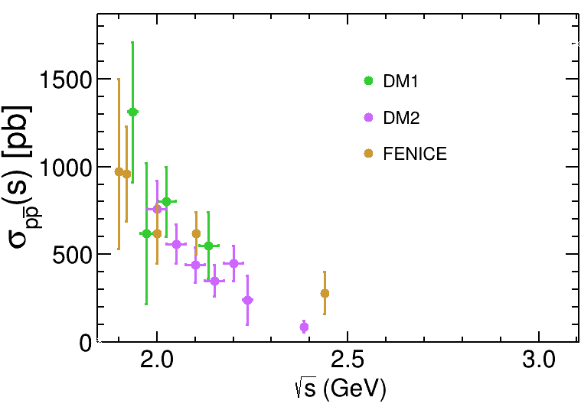
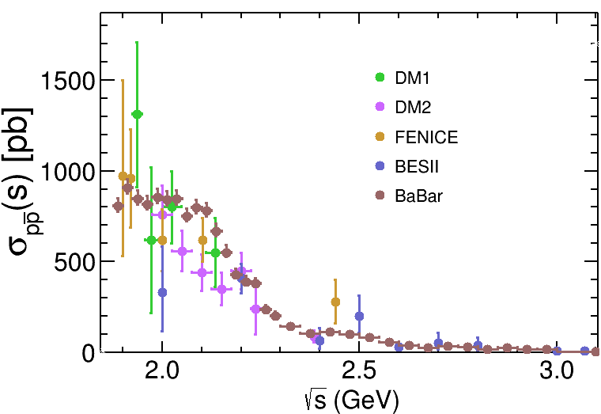
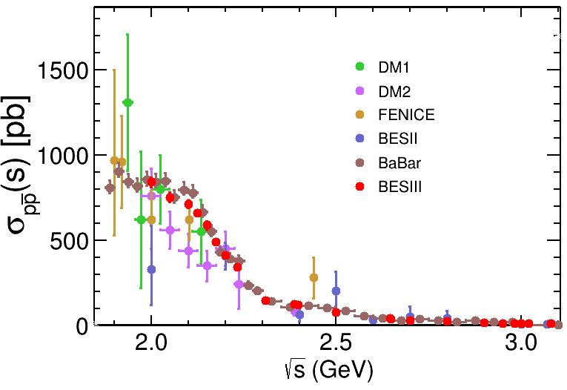
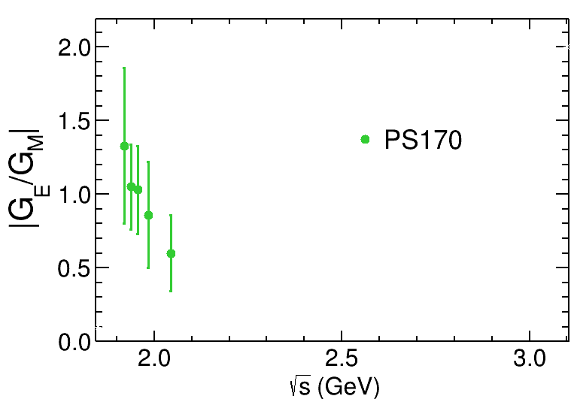
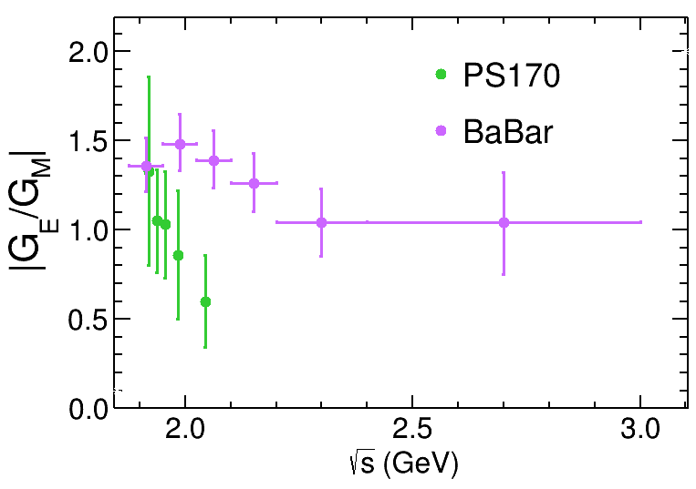
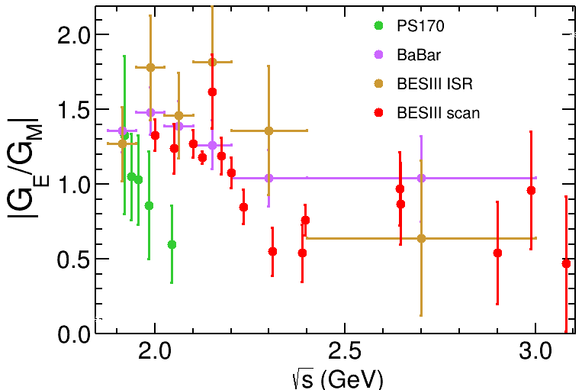
Overview of the Proton EMFFs
PRL 124, 042001 (2020)
PRD 91, 112004 (2015)

Slide 10
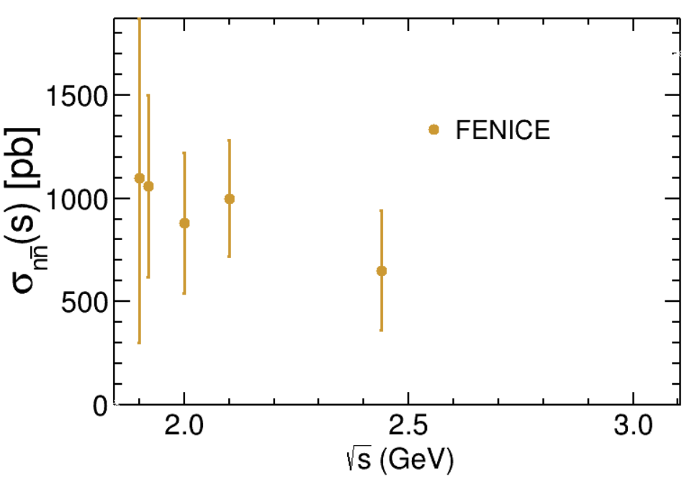
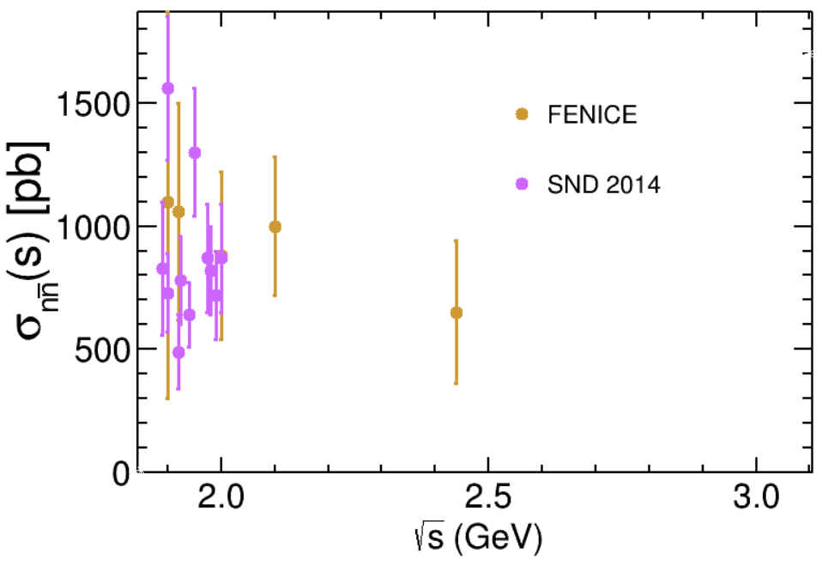
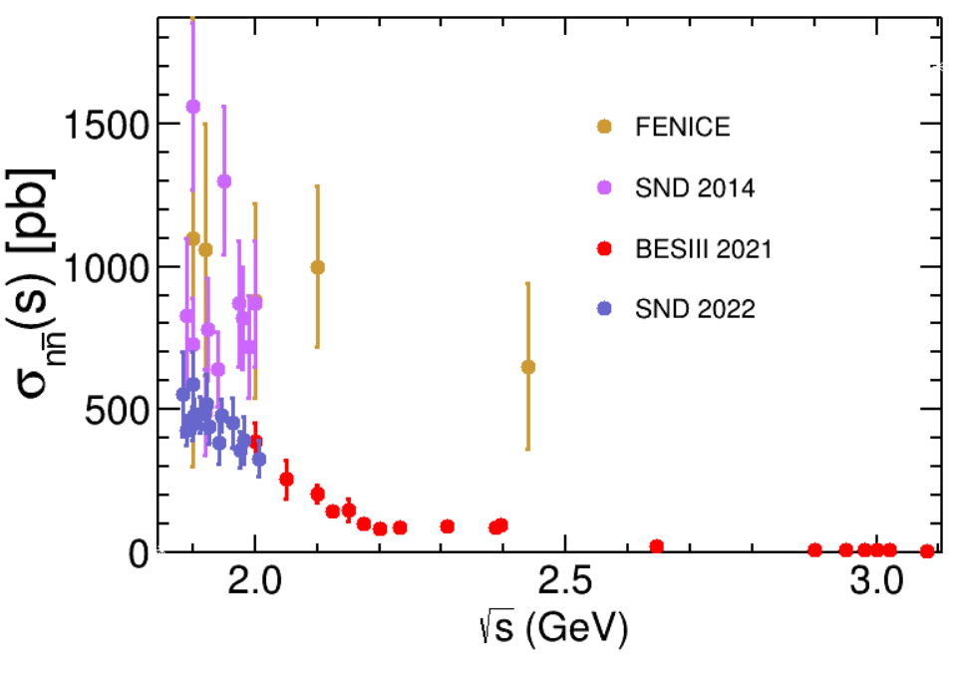
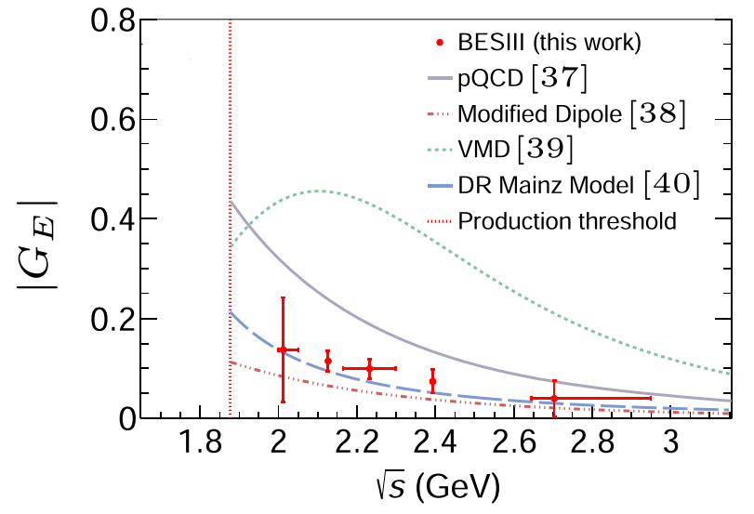
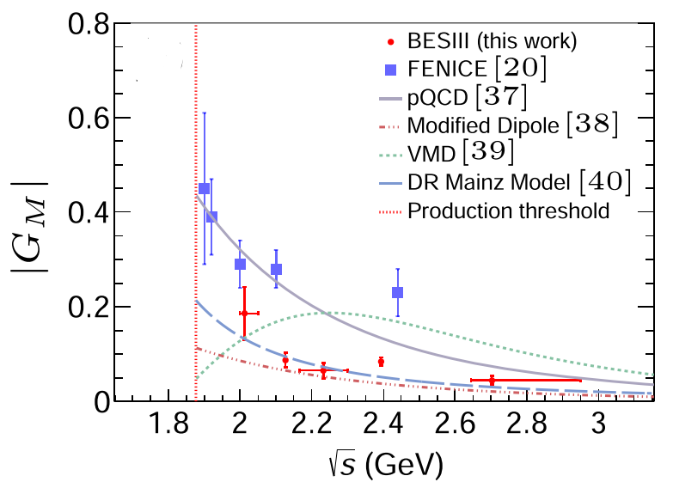
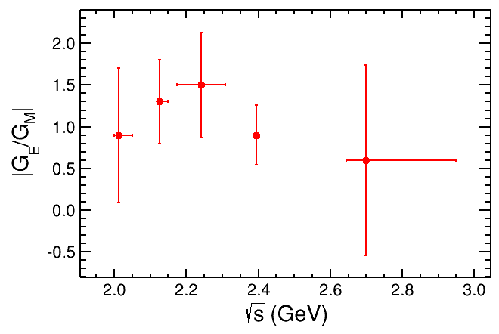
Overview of the Neutron EMFFs
Nucl. Phys. B 517, 3 (1998).
Phys. Rev. D 90, 112007 (2014).
Nat. Phys. 17, 1200–1204 (2021)
PRL 130, 151905 (2023)
2023
First results
2023
PRL 130.151905 (2023)
Most precise and richest results from BESIII.
First separation of the neutron |G_{E}|、|G_{M}|、Rem.

Slide 11
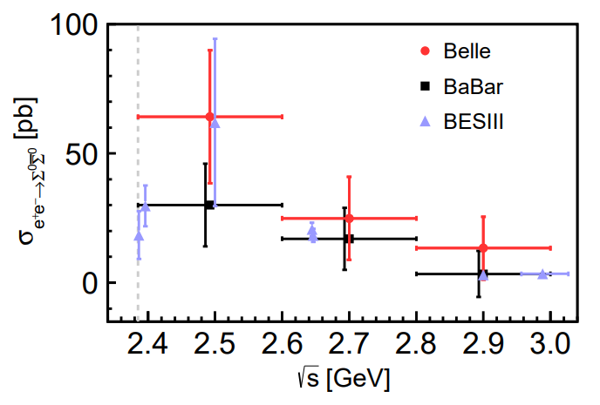
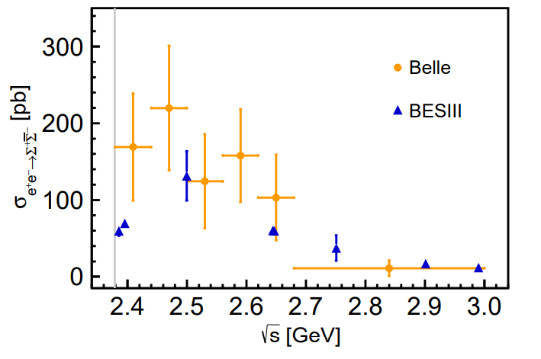
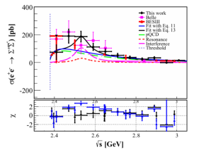
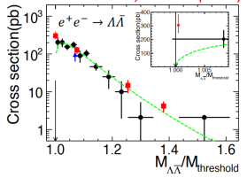
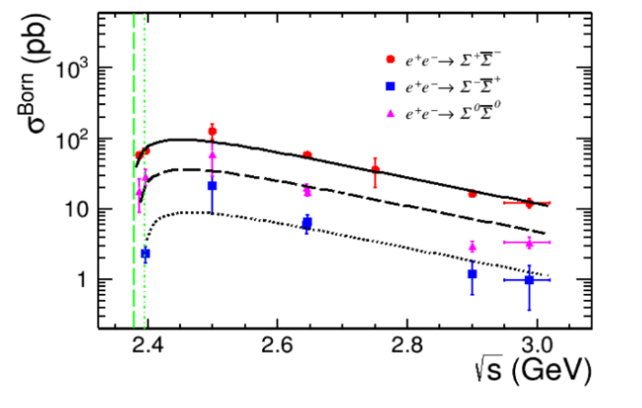
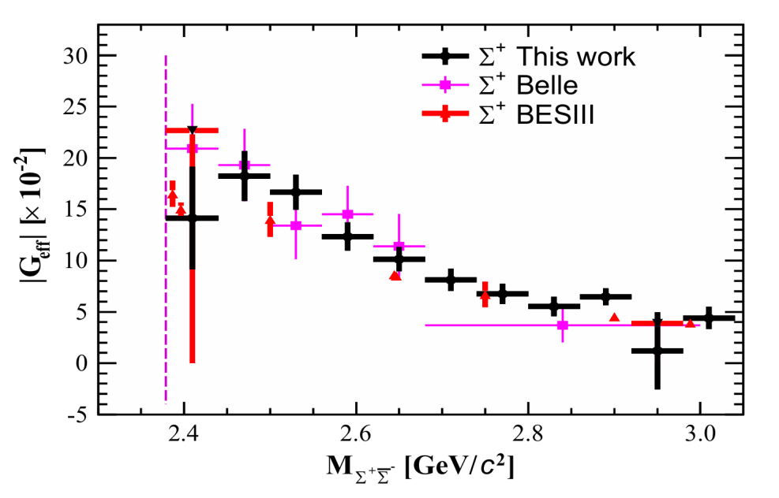

Overview of Λ and Σ Production Cross-sections
Energy scan method, BESIII data up to @$\sqrt{s}=$3.02 GeV
PRD 107, 072008(2023)
L_{belle}=980 fb⁻¹
PRD 109, 034029 (2024)
PLB 814, 136110 (2021)
PLB 831, 137187 (2022)
PRD 109, 034029 (2024)
PRD 97, 032013 (2018)
Cross-section ratio ~ $9.7±1.3 : 3.3±0.7 :1$

Slide 12
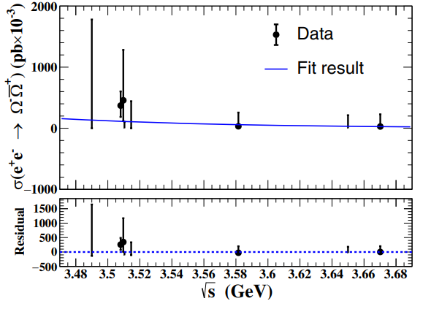
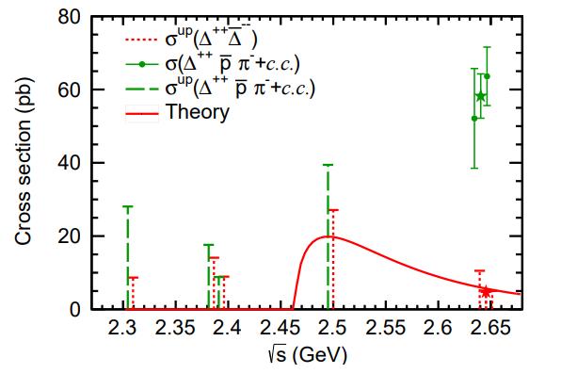

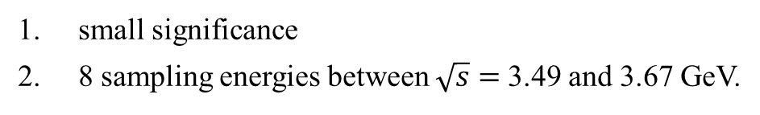
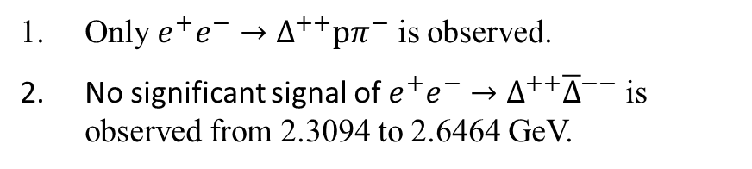
Overview of $e^{+}e^{−}→Ω\overline{Ω}/Δ\overline{Δ}$
PRD 107, 052003, 2023
PRD 108, 072010 (2023)
small significance
8 sampling energies between $\sqrt{s}=$3.49 and 3.67 GeV.
Only $e^{+}e^{−}→Δ^{++}pπ^{−}$ is observed.
No significant signal of $e^{+}e^{−}→Δ^{++}{\overline{Δ}}^{−−}$ is observed from 2.3094 to 2.6464 GeV.

Slide 13







Overview of Λ_{c} Production Cross-sections
Scan method, BESIII data up to $\sqrt{s}=$4.6 GeV
$R_{em}(4.5745)=\text{1.14}\text{±0.}\text{14}\text{±}\text{0.07}$
$R_{em}(4.5995)=\text{1.23}\text{±0.}\text{05}\text{±}\text{0.03}$
PRL 120, 132001 (2018)
PRL 101, 172001 (2008)
PRL 131, 191901 (2023)
c.m. energies: 4.64-4.95 GeV

Slide 14


Several Keys, γ*-N Coupling Puzzle
Nucl. Phys. B 517, 3 (1998).
Phys. Rev. D 90, 112007 (2014).
Nat. Phys. 17, 1200–1204 (2021)
Nucl. Phys. B 517, 3 (1998).
Phys. Rev. D 90, 112007 (2014).
EPJ Web Conf. 212, 07007 (2019).
L=647.9 pb⁻¹
A coupling puzzle observed by two experiments.
Clarifying the coupling puzzle over 20 years.

Slide 15




Several Keys, Fine Structure of the Proton
Damped oscillation behavior around the modified dipole.
PLB 817, 136328 (2021)
Modified dipole

Slide 16


Several Keys, Fine Structure of the Neutron
Oscillating phase for neutron approximately almost orthogonal to that of proton (BESIII).
Different extrapolations to low energies (SND).
L=647.9 pb⁻¹
L~30 pb⁻¹
Eur.Phys.J.C 82 (2022) 8, 761
Nat. Phys. 17, 1200–1204 (2021)
Modified dipole
phenomena discussion only.
dipole

Slide 17


Several Key, Analyticity of the Neutron EMFFs
PRL 130.151905 (2023)
Phragmèn–Lindelöf (P–L) theorem states that the SL asymptotic behavior can be extended to any direction in the q² complex plane, as a consequence:

Slide 18








Several Key, Threshold Enhancement
PRD 73 (2006) 012005
Eur.Phys.J.C 82 (2022) 8, 761
proton
neutron
Λ
PRD 97, 032013 (2018)
PLB 794 (2019) 64-68
Neutron
to be measured
at BESIII.
Λ_{c}
proton
FSI
$\left|G^{p}\right|≈1$，proton behaves like a point particle near threshold.
The way in extracting proton |G| from cross-sections.
What about neutrally charged baryons ?
$$σ\left(4M^{2}\right)\sim \frac{πα^{2}β}{2M^{2}}\frac{πα}{β}{\left|G\right|}^{2}$$
$$σ\left(4M^{2}\right)\sim \frac{πα^{2}β}{2M^{2}}C{\left|G\right|}^{2}$$

Slide 19





Phases Measurements
large data needed
$$P_{y}=−\frac{\sin{2θ}Im\left[G_{E}G_{M}^{∗}\right]/\sqrt{τ}}{\frac{{\left|G_{E}\right|}^{2}\sin^{2}θ}{τ}+{\left|G_{M}\right|}^{2}(1+\cos^{2}θ)}$$
Λ
PRL 132.081904 (2024)
Σ
Σ
Nuov Cim A 109 (1996)
PRL 123, 122003 (2019)

Slide 20



Fine EM Structure of the Proton
A chance of making deeper insight into the proton ？
Interference

Slide 21


Outlook
@BESIII Chin. Phys. C 44, 04001 (2020)
@STCF *Sensitivity estimated based on $ℒ=1$ ${ab}^{−1}$

Slide 22
Summary
BESIII published rich measurements w.r.t hadrons production in recent years.
These results are good enough to for some specific discussion.
Remaining issues, for example, phases of the proton (neutron) EMFFs are undergoing.

Slide 23
BESIII Detector

