Slide 1

第二十届全国中高能核物理大会
@复旦大学
A Lattice QCD Journey: From Nucleon Electric Polarizabilities to Electroweak Pion Production off a Nucleon
Xu Feng (Peking U.)
2025.04.25

Slide 2

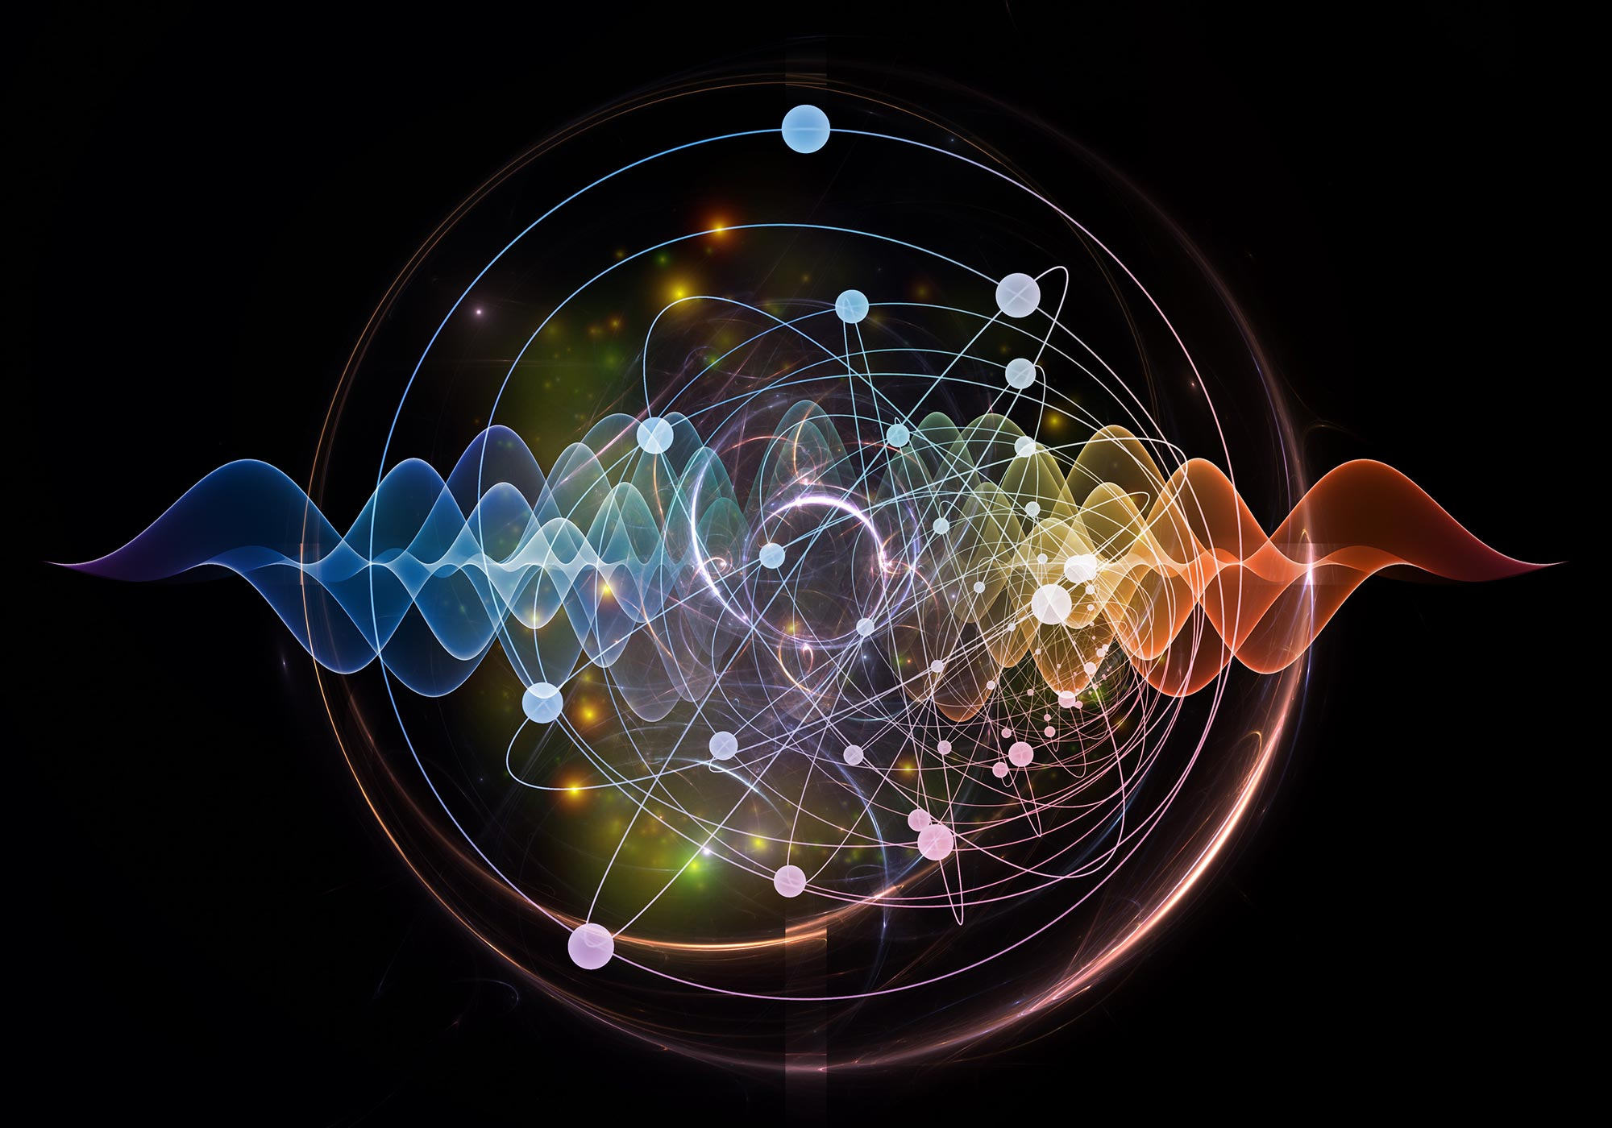
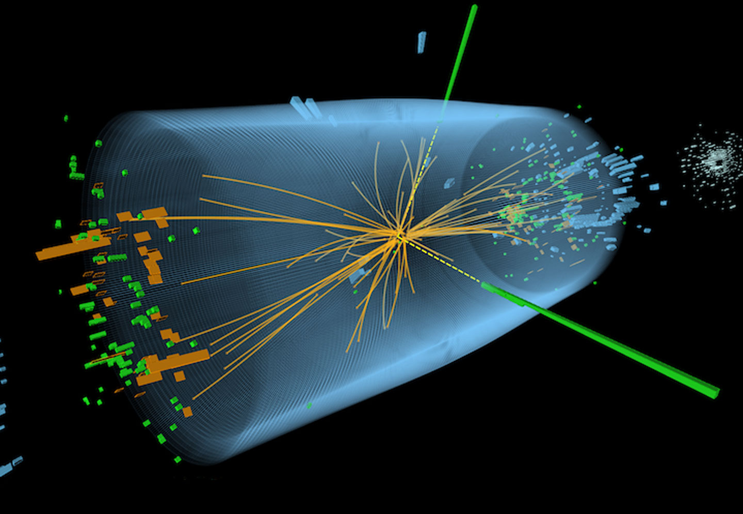
When relativity meets quantum mechanics
Approaching the speed of light
→ relativistic effects E=mc²
Reaching atomic scales
→ quantum effects E=ℏ𝜔
Quantum field theory
combination of relativity and quantum mechanics
Particle creation and annihilation
2

Slide 3
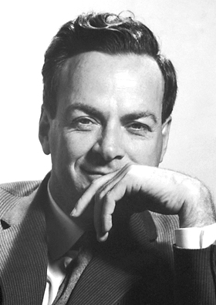
Feynman diagrams - visual representation of QFT
Electron-positron collision producing muon and antimuon pairs
Electron
Muon
Virtual photon
Positron
Antimuon
R. Feynman
3

Slide 4
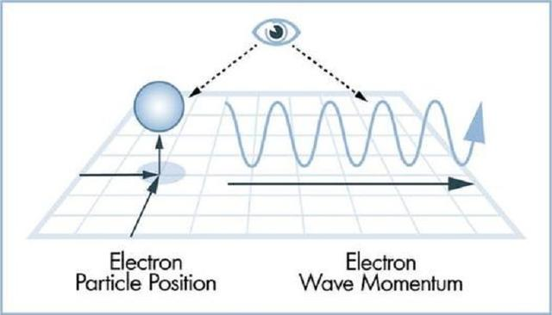
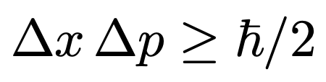
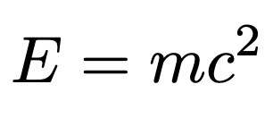
Quantum fluctuations: the creation and annihilation of particles
Heisenberg Uncertainty Principle
Energy can fluctuate significantly over short periods of time
Special Theory of Relativity
Energy and mass can be converted into each other
Electron
Muon
When large energy converts into mass, new particles are born
Virtual photon
Positron
Antimuon
4

Slide 5
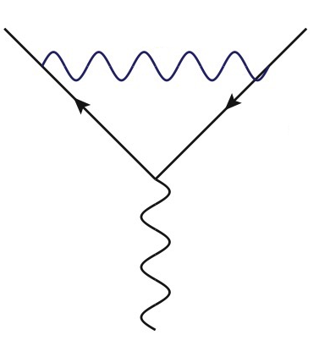
Quantum fluctuations can be highly complex
Within a quantum fluctuation, new fluctuations can emerge
Virtual particles can give rise to even more virtual particles
If the interaction is weak enough, no need to calculate to very high orders
5

Slide 6
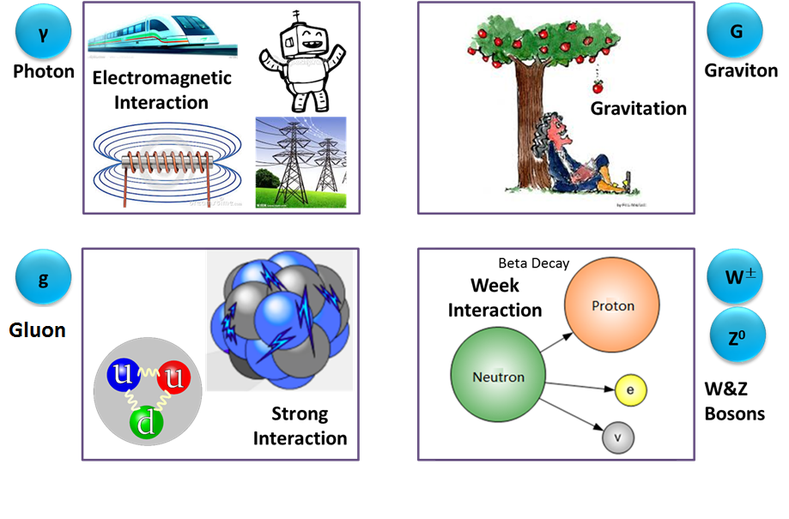
The four fundamental interactions
Relative strength: Strong ≫ Electromagnetic ≫ Weak ≫ Gravitational
O(1)
O(10⁻²)
O(10⁻⁵)
O(10⁻³⁹)
6

Slide 7
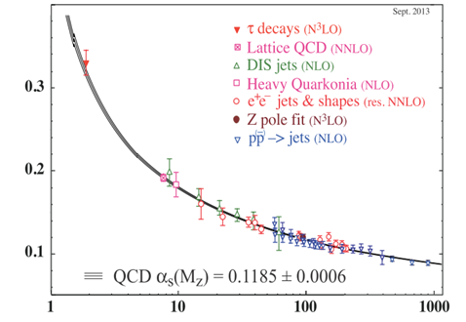


The Special Nature of the Strong Interaction
Strong interaction between quarks and gluons is described by Quantum Chromodynamics (QCD)
Non-perturbative regime
As energy increases, interaction becomes very weak
Asymptotic freedom
Interaction Strength
Perturbative regime
2004
D. Gross
F. Wilczek
Energy
D. Politzer
As energy decreases, QCD enters the non-perturbative regime
7

Slide 8
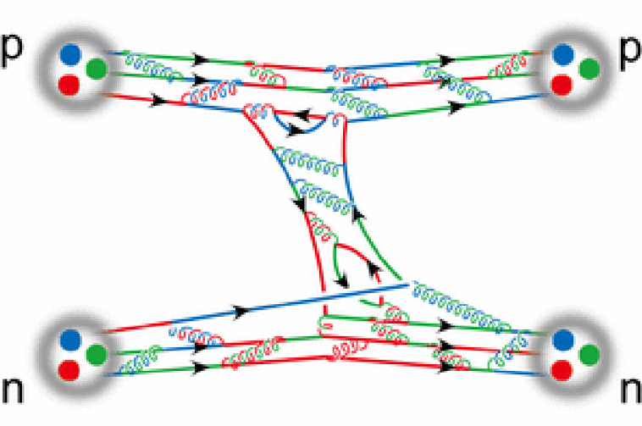
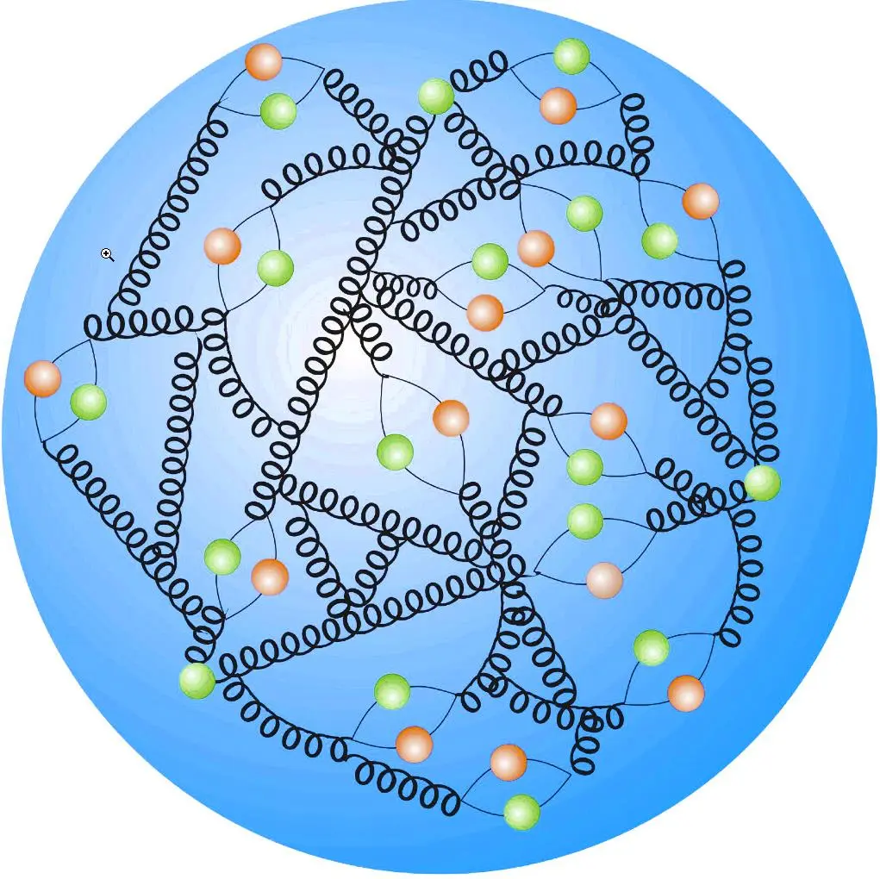

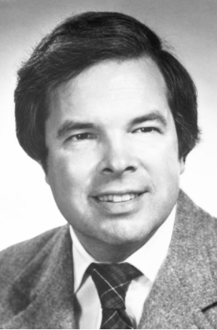
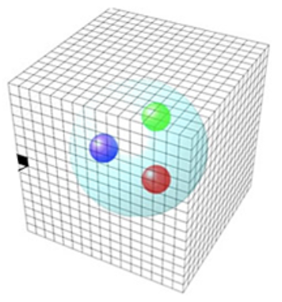
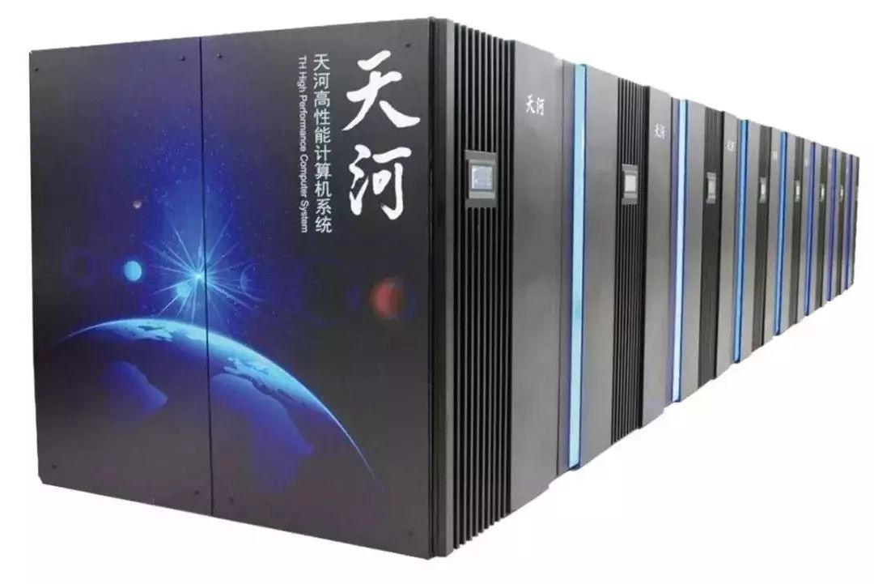
Non-perturbative regime of QCD
The essence of the nuclear force is the quark-gluon interaction
More is different
—— P. W. Anderson
An infinite number of 0
How to ensure first-principles QCD + precision in the non-perturbative regime
1982
Supercomputers enable precise calculations
K. G. Wilson
Lattice QCD
8

Slide 9
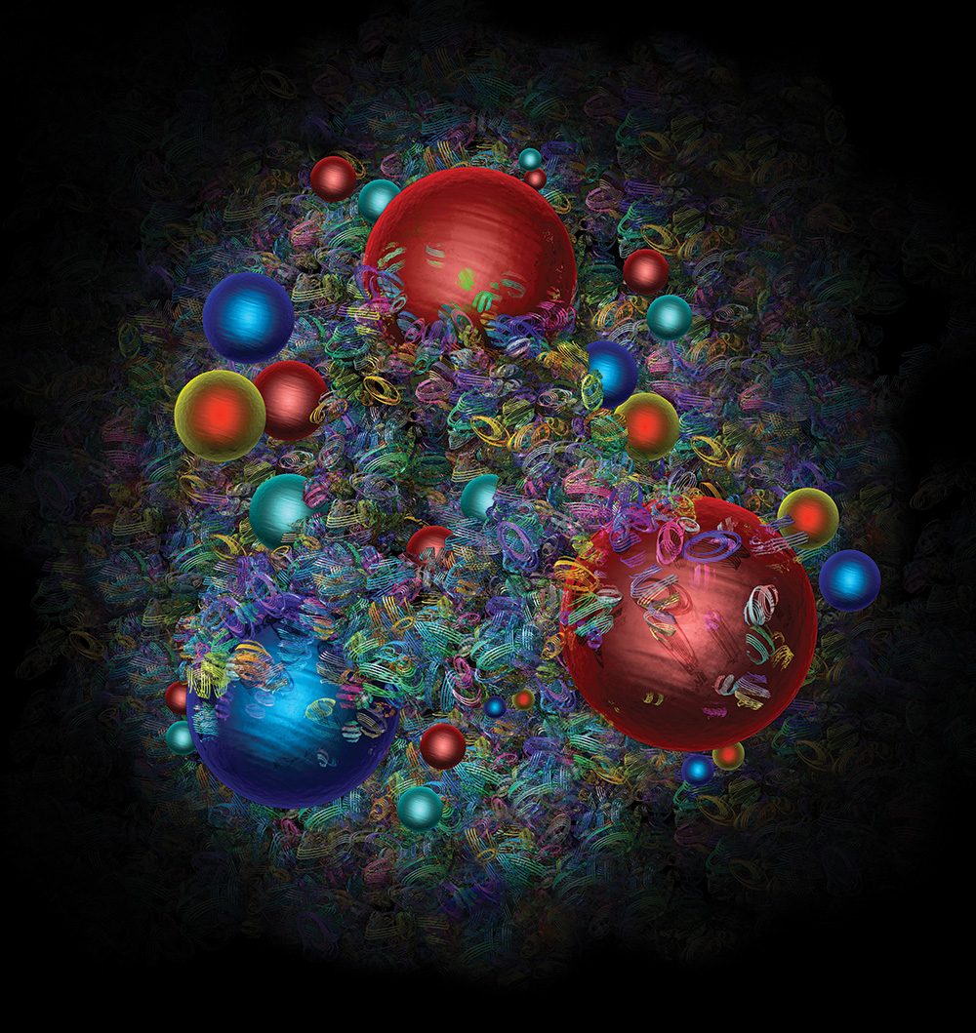
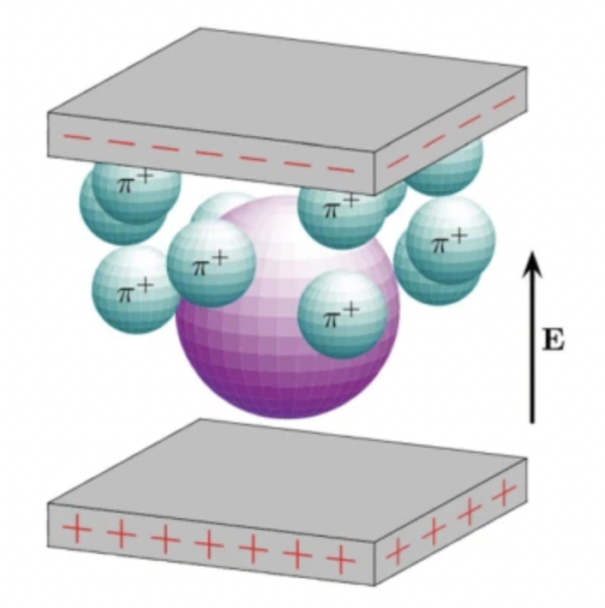
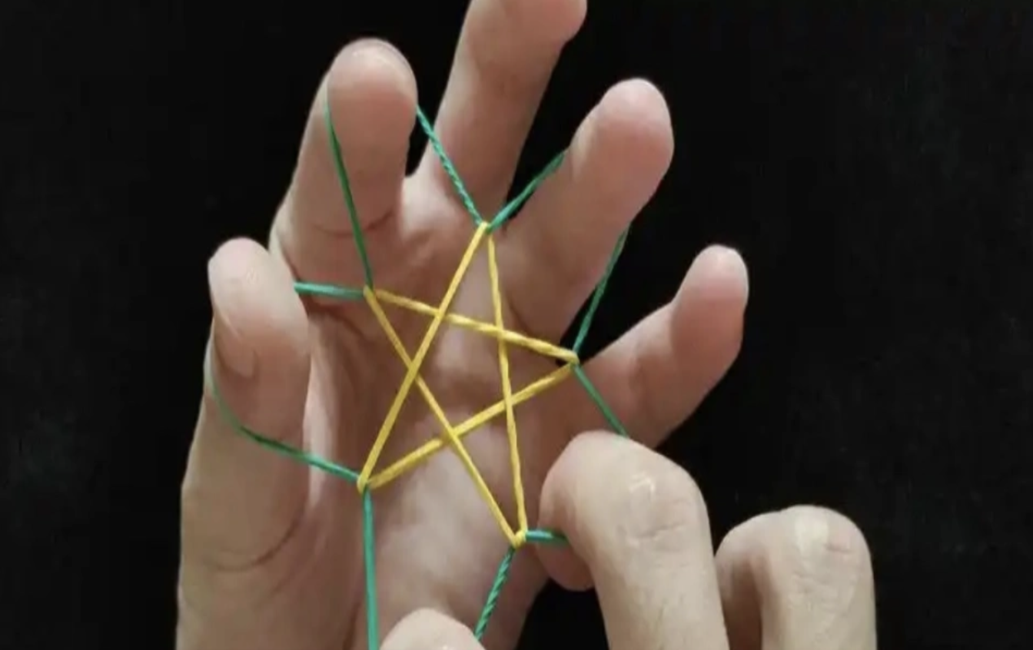
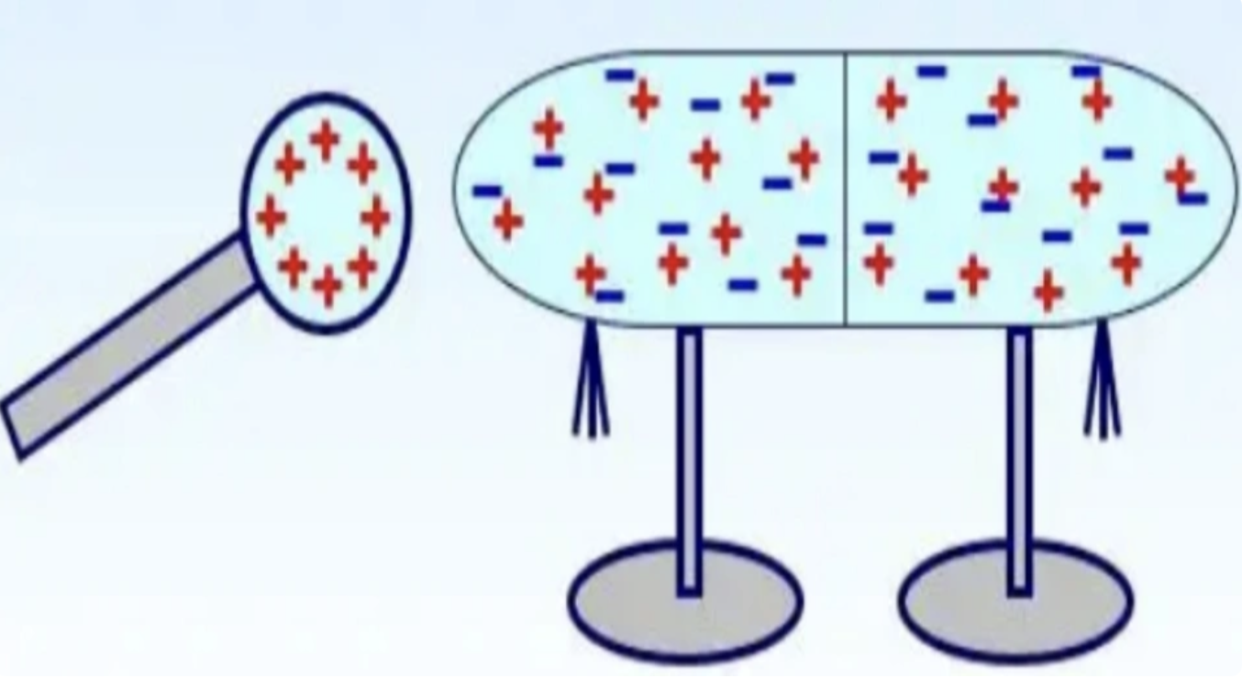

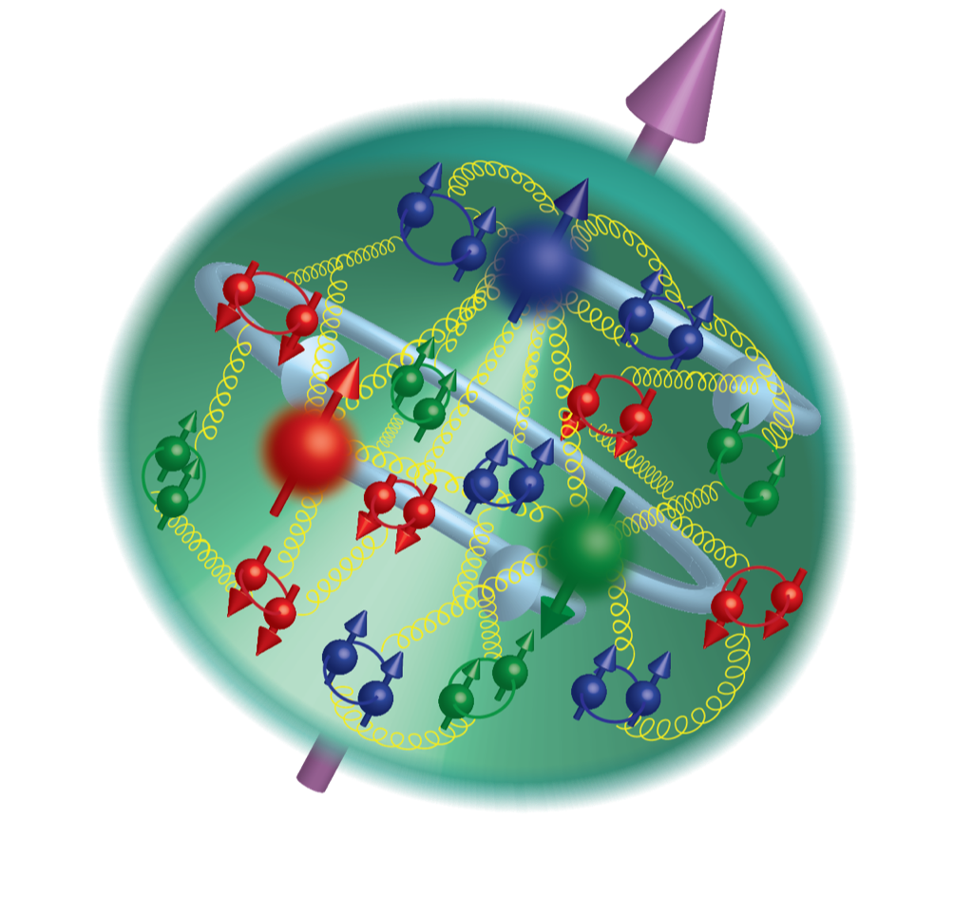
Complicated nucleon structure
Polarization
Polarizabilities
Polarizabilities
– Intrinsic property of medium
Spin distribution
Charge radius
9

Slide 10
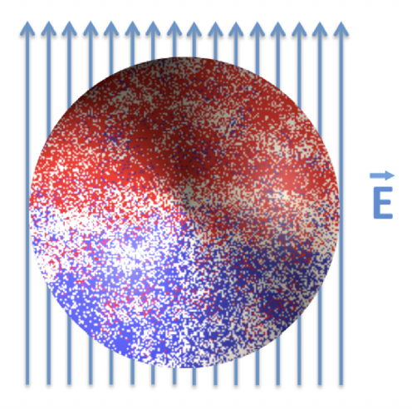
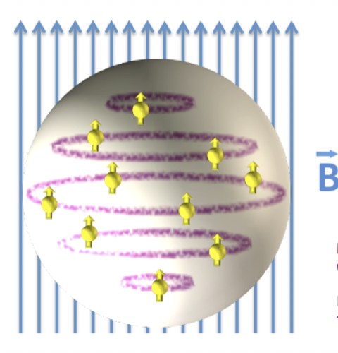




Electromagnetic polarizabilities
Polarizabilities offer insights into the distribution of charge and magnetism within nucleons, revealing their response to external electromagnetic fields
$$H_{eff}^{\left(2\right)}=−\frac{4π}{2}α_{E}E^{2}−\frac{4π}{2}β_{M}B^{2}$$
Polarization modifies the nucleon's energy, described by an effective Hamiltonian
Experimental determination of polarizabilities relies on Compton scattering, wherein external E&M fields polarize the target nucleon or deuteron
photon
$$μ$$
$$ν$$
nucleon
$$T^{μν}$$
10

Slide 11




Nucleon polarizabilities and Compton scattering
Nucleon E&M polarizability are most central quantities relevant for Compton scattering
$$q$$
$$μ$$
$$ν$$
$$P$$
$$T^{μν}$$
Unpolarized doubly virtual Compton scattering
$$T^{μν}\left(P,q\right)=T_{Born}^{μν}+\frac{8πM}{e^{2}}\left[−(β_{M}+O(q))K_{1}^{μν}+\left(α_{E}+β_{M}+O(q)\right)K_{2}^{μν}\right]$$
Born term
Polarizabilities
+
+……
Intermeidate states: $N$
Intermeidate states: $Nπ,N^{∗},Δ, ⋯$
11

Slide 12
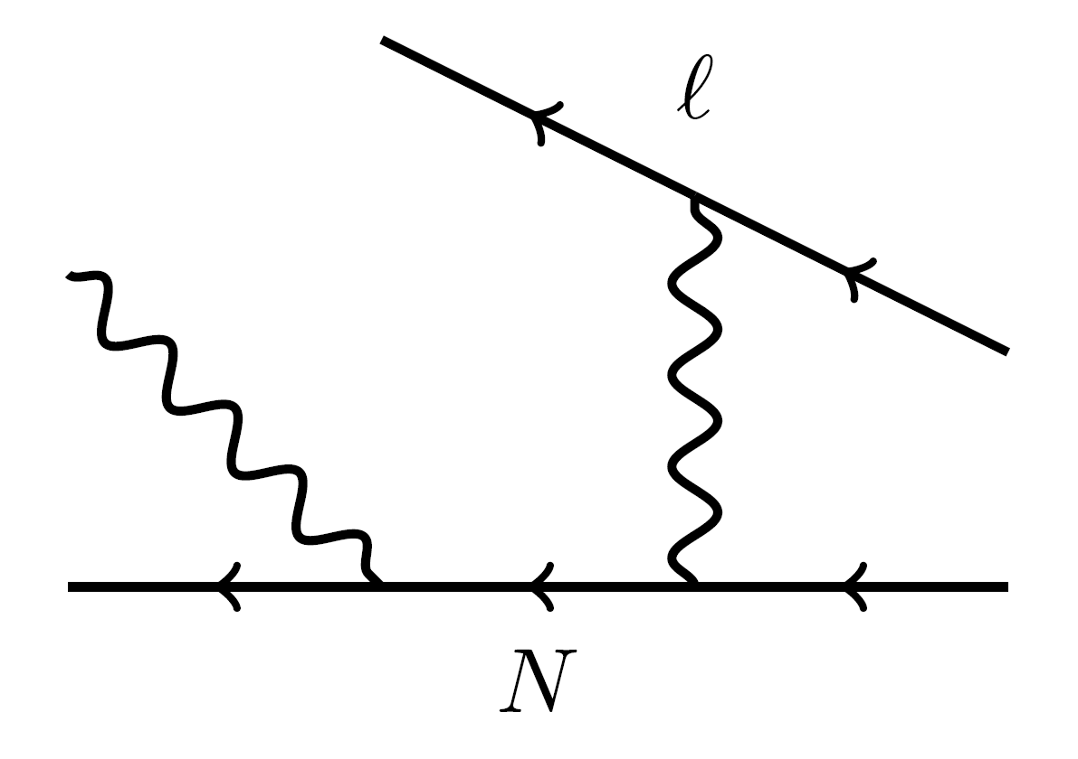



Generalized electric polarizabilities
In real-virtual Compton scattering
Measured proton E&M structure deviates from theoretical predictions
$$α_{E}$$
$$α_{E}(Q^{2})$$
$$Q$$
R. Li et al., Nature 611 (2022) 7935, 265-270
Abnormal peak of generalized proton electric polarizability at $Q^{2}≈0.35 GeV^{2}$ ?
12

Slide 13
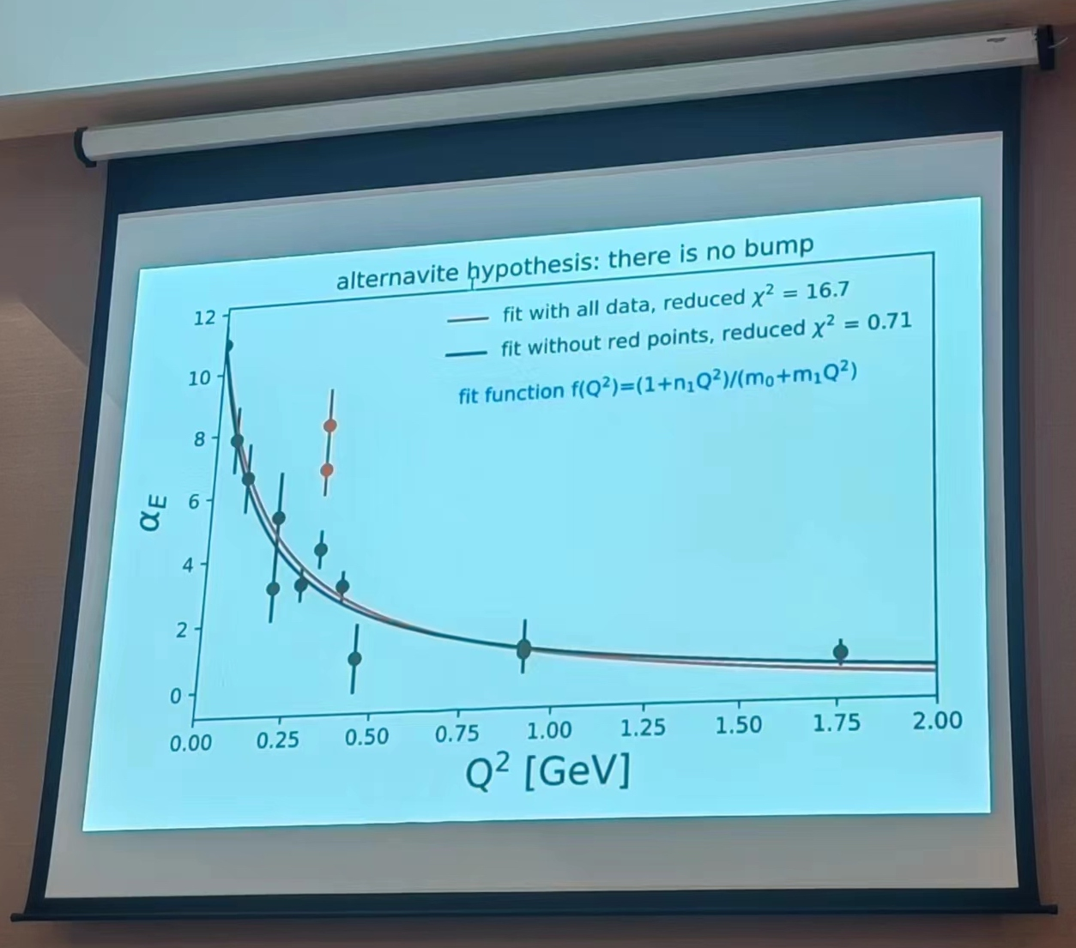
Generalized electric polarizabilities
Measured proton E&M structure deviates from theoretical predictions
Different viewpoints
VS
Figure shown by D. Higinbotham
@ 2nd Workshop on Nucleon Structure at Low Q, 2023
R. Li, N. Sparveris, et. al. Nature 611 (2022) 265
13

Slide 14
Determination of electric polarizabilities
Proton
Neutron
Experiment
Lattice QCD
14

Slide 15
Determination of electric polarizabilities
What is the primary source of discrepancy between lattice QCD and other studies?
Lattice calculations are performed at unphysical pion masses, ranging from 227 - 759 MeV
Unphysical quark mass effects
Background field technique is used, which converts 4pt function to 2pt function using Feynman-Hellman theorem
Hard to explore intermediate-state contributions and control systematics
Perform calculation at physical pion mass, using 4pt function
15

Slide 16
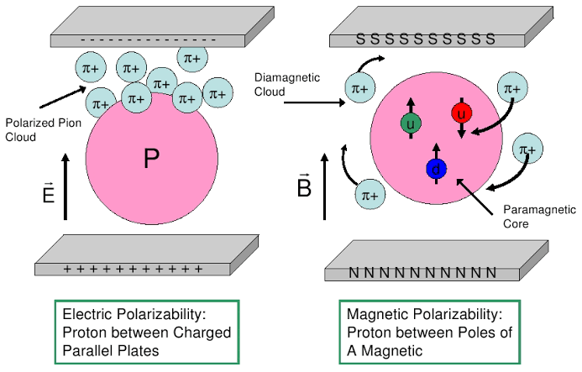
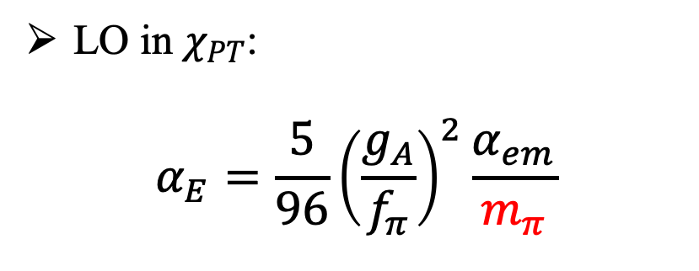
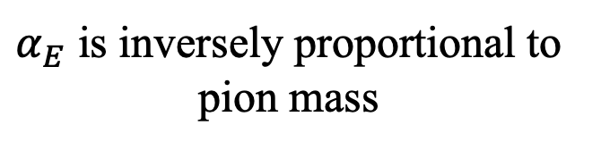
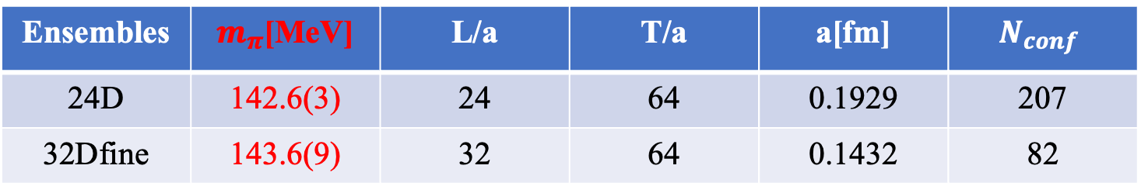
Why physical pion mass is important
Pion cloud in nucleon polarizabilities
LO in $χ_{PT}$:
$$α_{E}=\frac{5}{96}{\left(\frac{g_{A}}{f_{π}}\right)}^{2}\frac{α_{em}}{m_{π}}$$
V. Bernard et al., Phys. Rev. Lett. 67 (1991) 1515
$α_{E}$ is inversely proportional to pion mass
Use two DWF ensembles @ physical π mass
Ensembles | $m_{π}$[MeV] | L/a | T/a | a[fm] | $$N_{conf}$$
24D | 142.6(3) | 24 | 64 | 0.1929 | 207
32Dfine | 143.6(9) | 32 | 64 | 0.1432 | 82
16

Slide 17
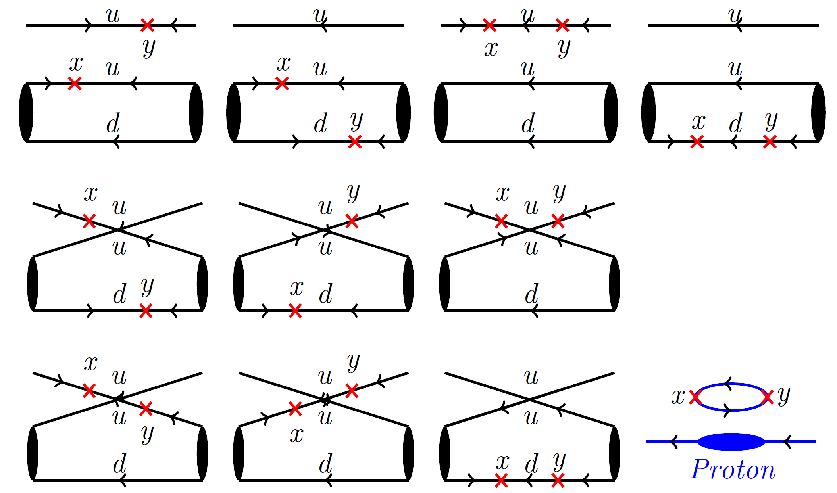
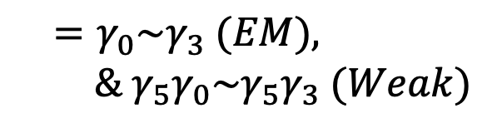
Numerical calculations
$$μ$$
$$ν$$
Complicated quark field contractions with two current insertions
$$T^{μν}$$
$$=γ_{0}\sim γ_{3} (EM),$$
$$\& γ_{5}γ_{0}\sim γ_{5}γ_{3} (Weak)$$
17

Slide 18

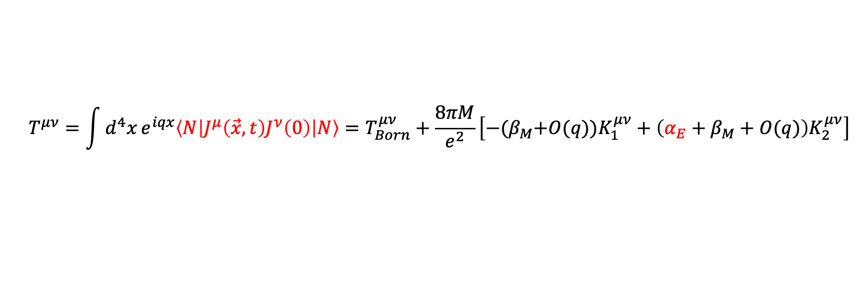


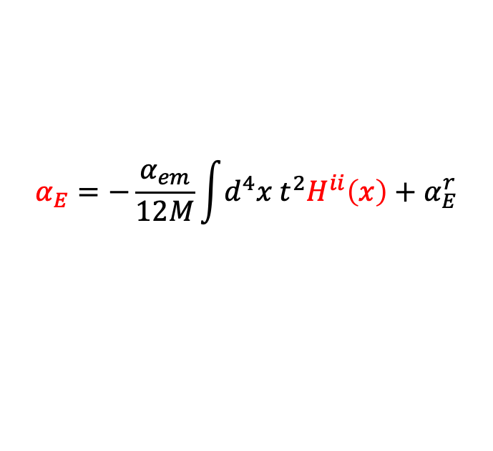


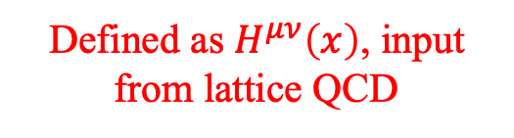

Electric polarizability from 4-pt function
Compton tensor
$$q$$
$$μ$$
$$ν$$
$$P$$
$$T^{μν}$$
$$T^{μν}=\int{d^{4}x}e^{iqx}\left\langle N\left|J^{μ}\left(\vec{x},t\right)J^{ν}\left(0\right)\right|N\right\rangle =T_{Born}^{μν}+\frac{8πM}{e^{2}}\left[−{(β}_{M}+O(q))K_{1}^{μν}+\left(α_{E}+β_{M}+O(q)\right)K_{2}^{μν}\right]$$
Defined as $H^{μν}\left(x\right)$, input from lattice QCD
$$α_{E}=−\frac{α_{em}}{12M}\int{d^{4}x{ t}^{2}H^{ii}\left(x\right)}+α_{E}^{r}$$
$$H^{ii}\left(\vec{x},t\right)=⟨N|J^{i}\left(\vec{x},t\right)J^{i}\left(0\right)|N⟩$$
18

Slide 19
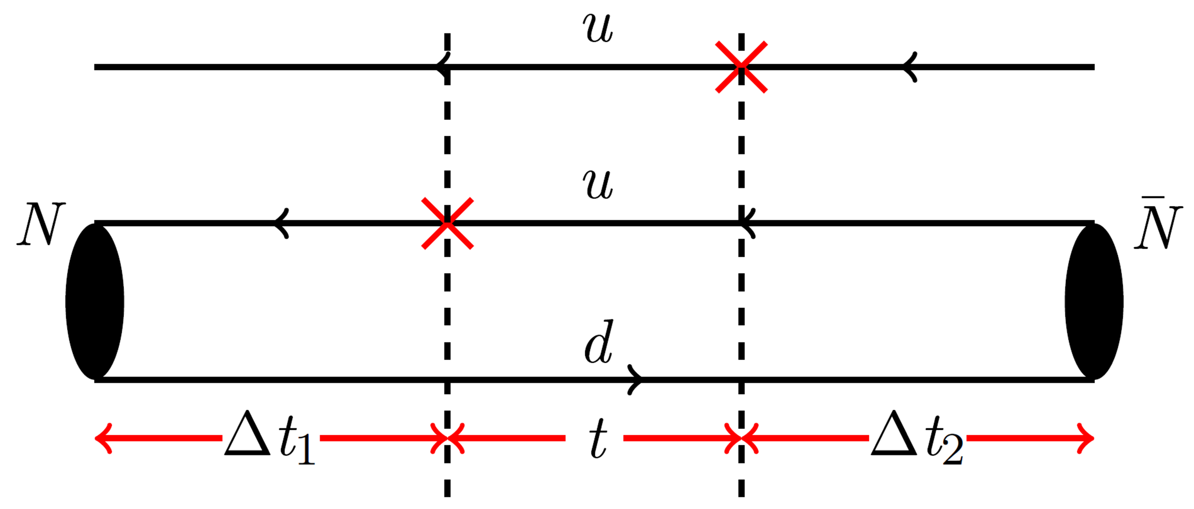
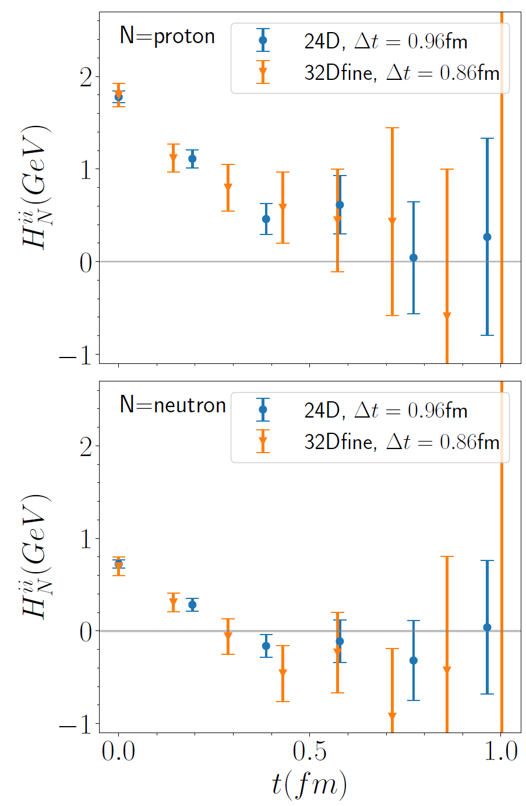
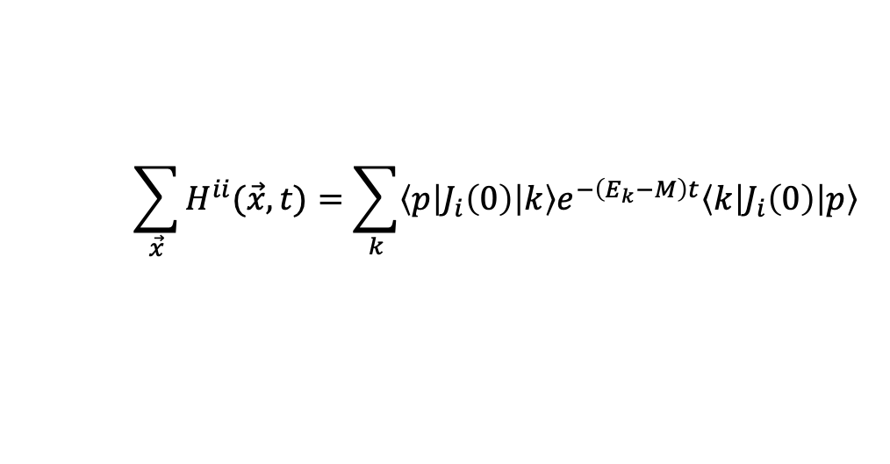
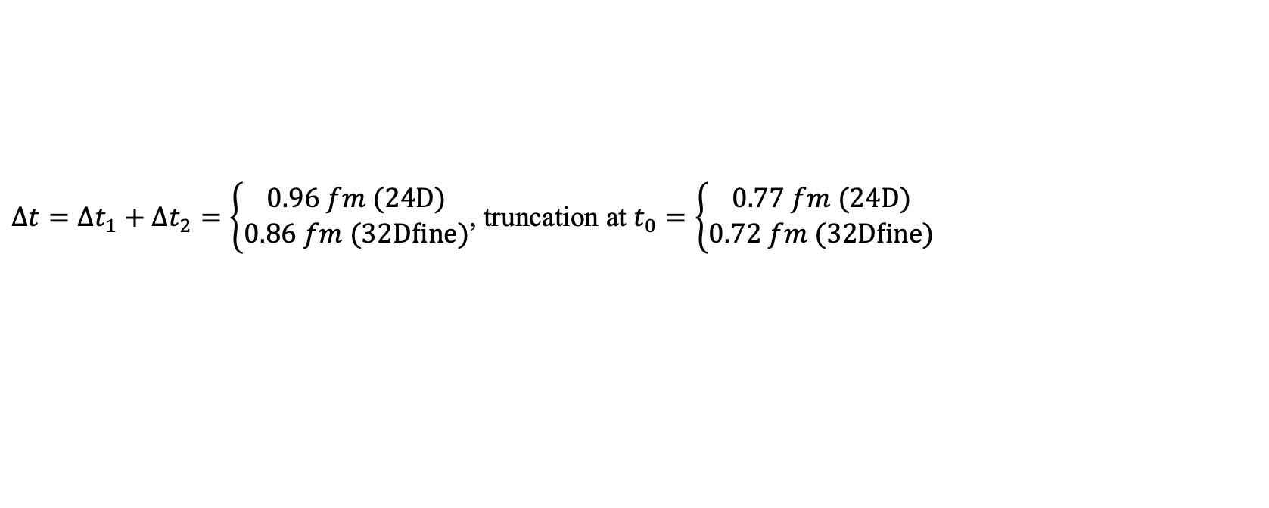
Signal of hadronic function
$$\sum_{\vec{x}}{H^{ii}(\vec{x},t)}=\sum_{k}{\left\langle p\left|J_{i}\left(0\right)\right|k\right\rangle e^{−\left(E_{k}−M\right)t}\left\langle k\left|J_{i}\left(0\right)\right|p\right\rangle }$$
signal region
Truncation
Truncation
$Δt=Δt_{1}+Δt_{2}=\left\{\begin{aligned}0.96 fm (24D) \\ 0.86 fm (32Dfine)\end{aligned}\right.$, truncation at $t_{0}=\left\{\begin{aligned}0.77 fm (24D) \\ 0.72 fm (32Dfine)\end{aligned}\right.$
In total, $Δt_{1}+Δt_{2}+t_{0}\sim$1.6-1.8 fm
19

Slide 20
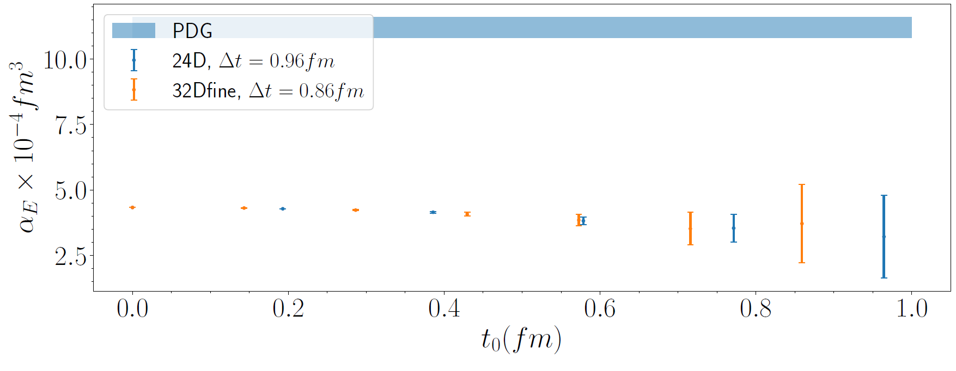
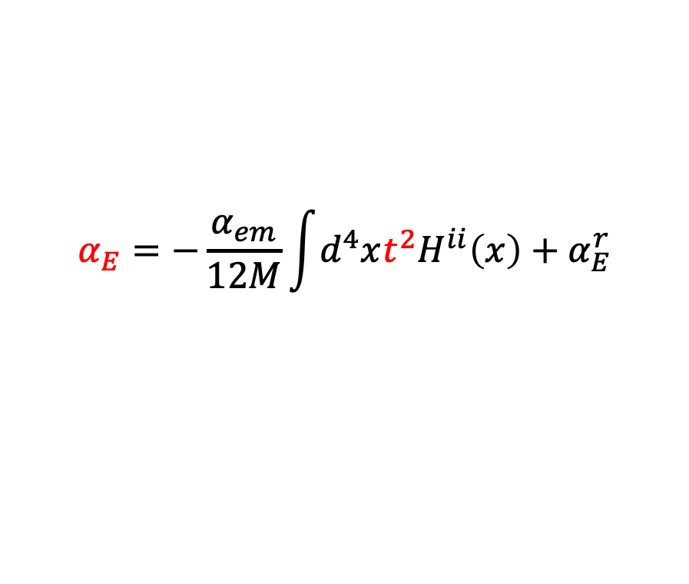

Polarizability $α_{E}$ from $H_{ii}(x)$
$$α_{E}=−\frac{α_{em}}{12M}\int{d^{4}xt^{2}H^{ii}\left(x\right)}+α_{E}^{r}$$
Polarizability extraction
Proton
PDG
Our truncation at $t_{0}$
Neutron
Experiment
Lattice QCD
However, lattice results are significantly below the PDG value.
20

Slide 21

Polarizability $α_{E}$ from $H_{ii}(x)$
$$α_{E}=−\frac{α_{em}}{12M}\int{d^{4}xt^{2}H^{ii}\left(x\right)}+α_{E}^{r}$$
Polarizability extraction
PDG
Our truncation at $t_{0}$
However, lattice results are significantly below the PDG value.
Need new insight to turn the decent to the magic!
21

Slide 22
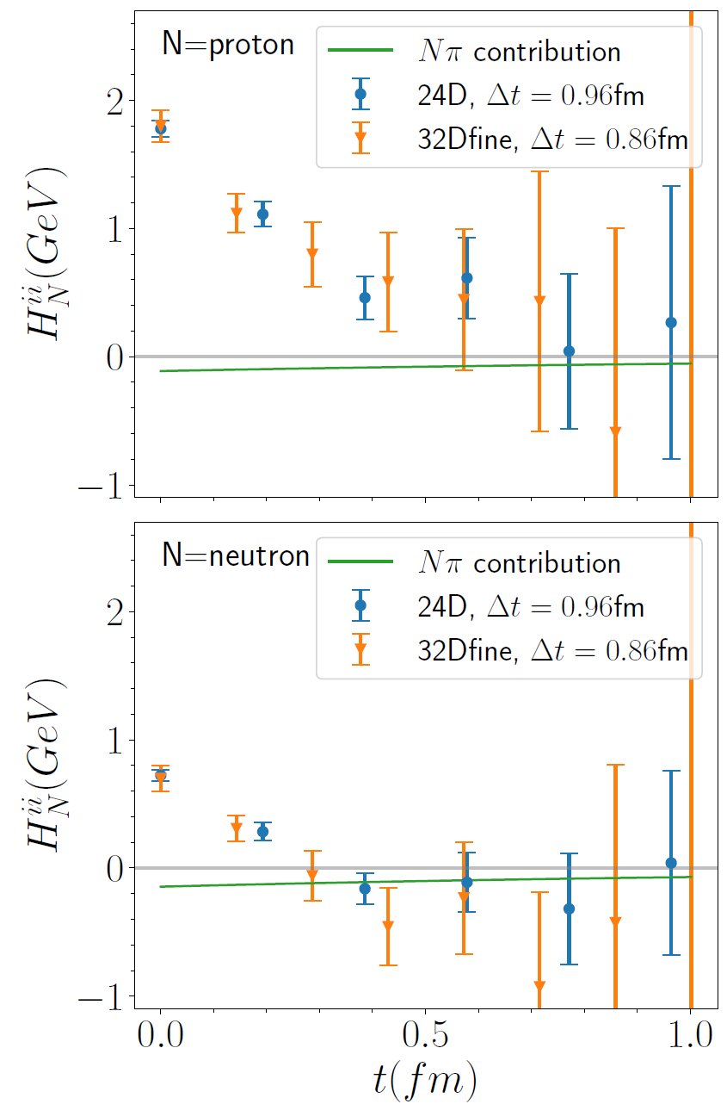
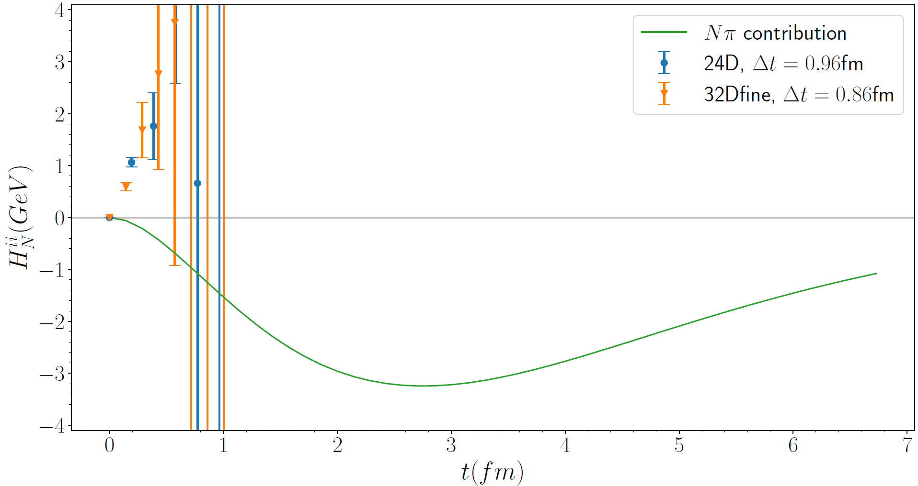
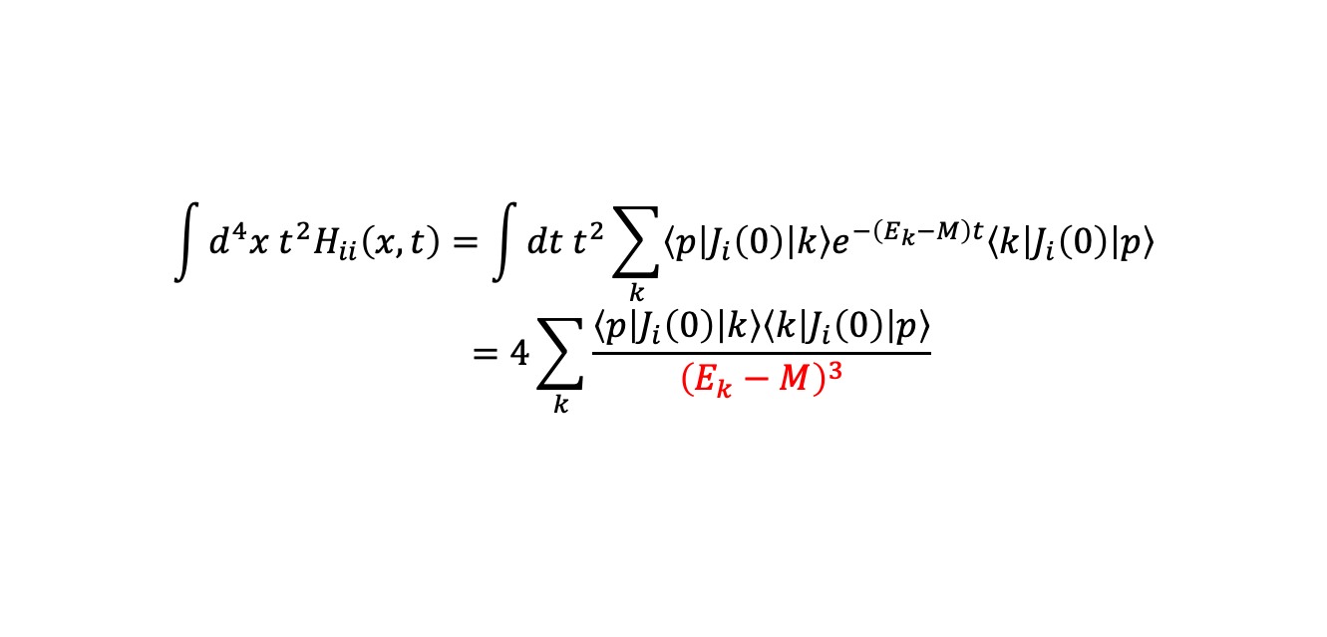




Nucleon polarizabilities and 𝑁𝜋 scattering
$$\int{d^{4}x t^{2}H_{ii}\left(x,t\right)=\int{dt t^{2}\sum_{k}{\left\langle p\left|J_{i}\left(0\right)\right|k\right\rangle e^{−\left(E_{k}−M\right)t}\left\langle k\left|J_{i}\left(0\right)\right|p\right\rangle }}}$$
$$=4\sum_{k}{\frac{\left\langle p\left|J_{i}\left(0\right)\right|k\right\rangle \left\langle k\left|J_{i}\left(0\right)\right|p\right\rangle }{{\left(E_{k}−M\right)}^{3}}}$$
Structure of hadronic function
The dominant contribution is given by $\left|k\right\rangle =|Nπ⟩$ states
$$t^{2}$$
Weight function
$$|Nπ⟩$$
$$|Nπ⟩$$
$|Nπ⟩$
$|Nπ⟩$ states contribution exhibits a peak at $t=2.8 fm$, far exceeding our truncation at $t_{0}≈0.75 fm$
Must calculate $Nπ$ contribution directly!
22

Slide 23
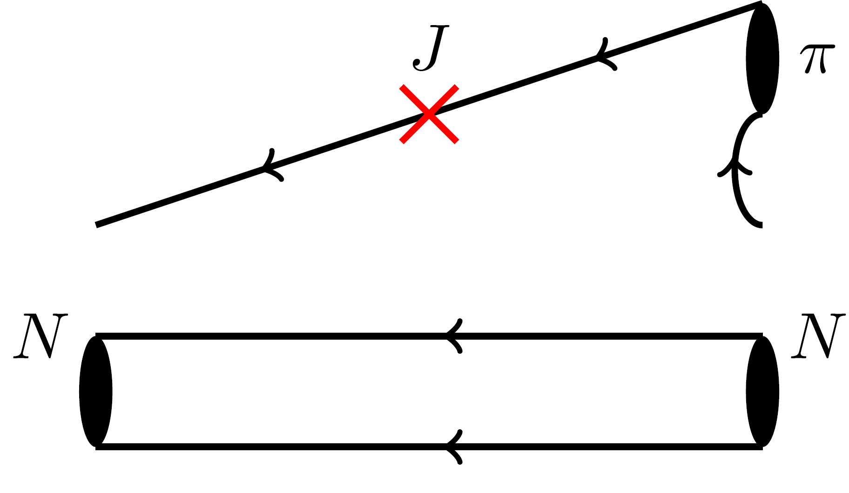
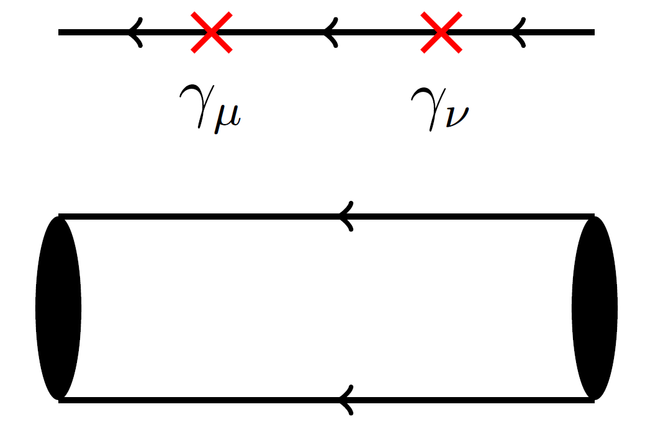
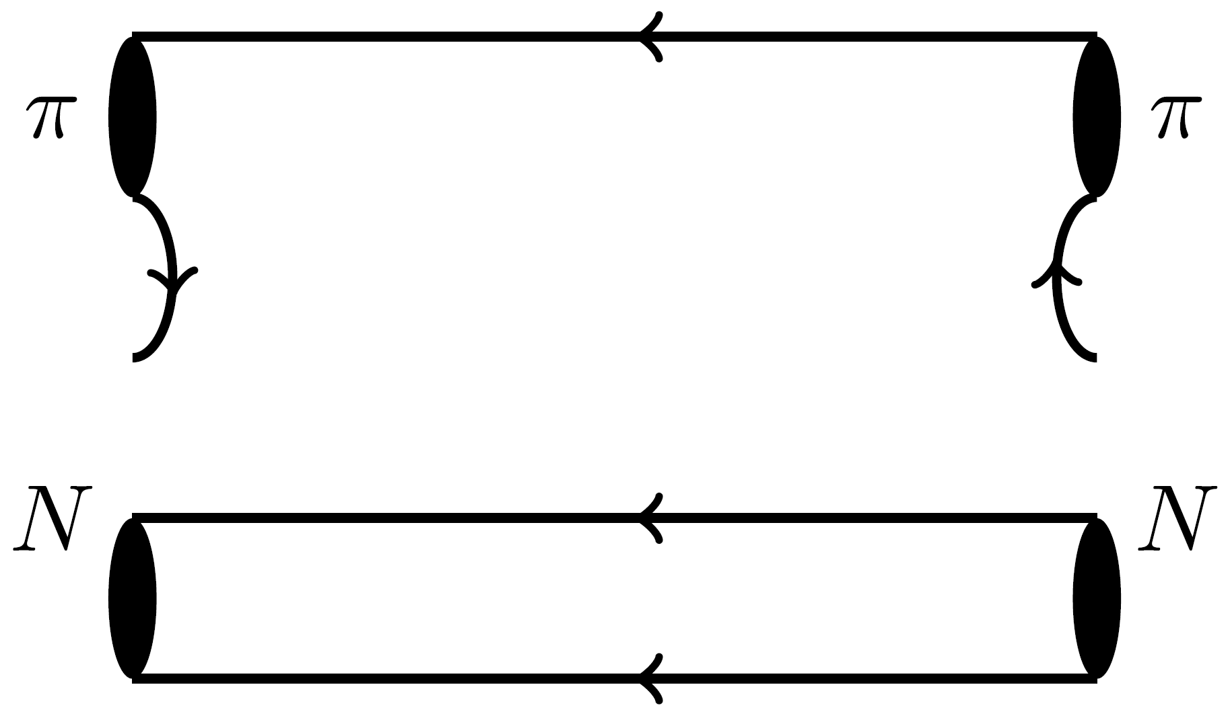


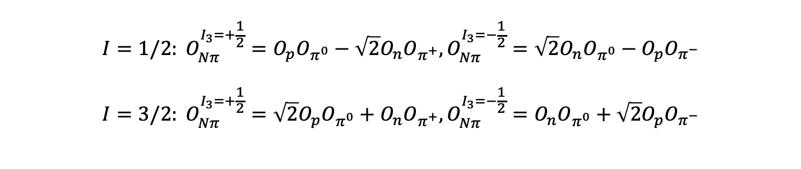
Wick contraction of $Nπ$ rescattering
$$N$$
$$N$$
$$I=1/2: O_{Nπ}^{I_{3}=+\frac{1}{2}}=O_{p}O_{π^{0}}−\sqrt{2}O_{n}O_{π^{+}},O_{Nπ}^{I_{3}=−\frac{1}{2}}=\sqrt{2}O_{n}O_{π^{0}}−O_{p}O_{π^{−}} \\ I=3/2: O_{Nπ}^{I_{3}=+\frac{1}{2}}=\sqrt{2}O_{p}O_{π^{0}}+O_{n}O_{π^{+}},O_{Nπ}^{I_{3}=−\frac{1}{2}}=O_{n}O_{π^{0}}+\sqrt{2}O_{p}O_{π^{−}}$$
}
Operators
23

Slide 24
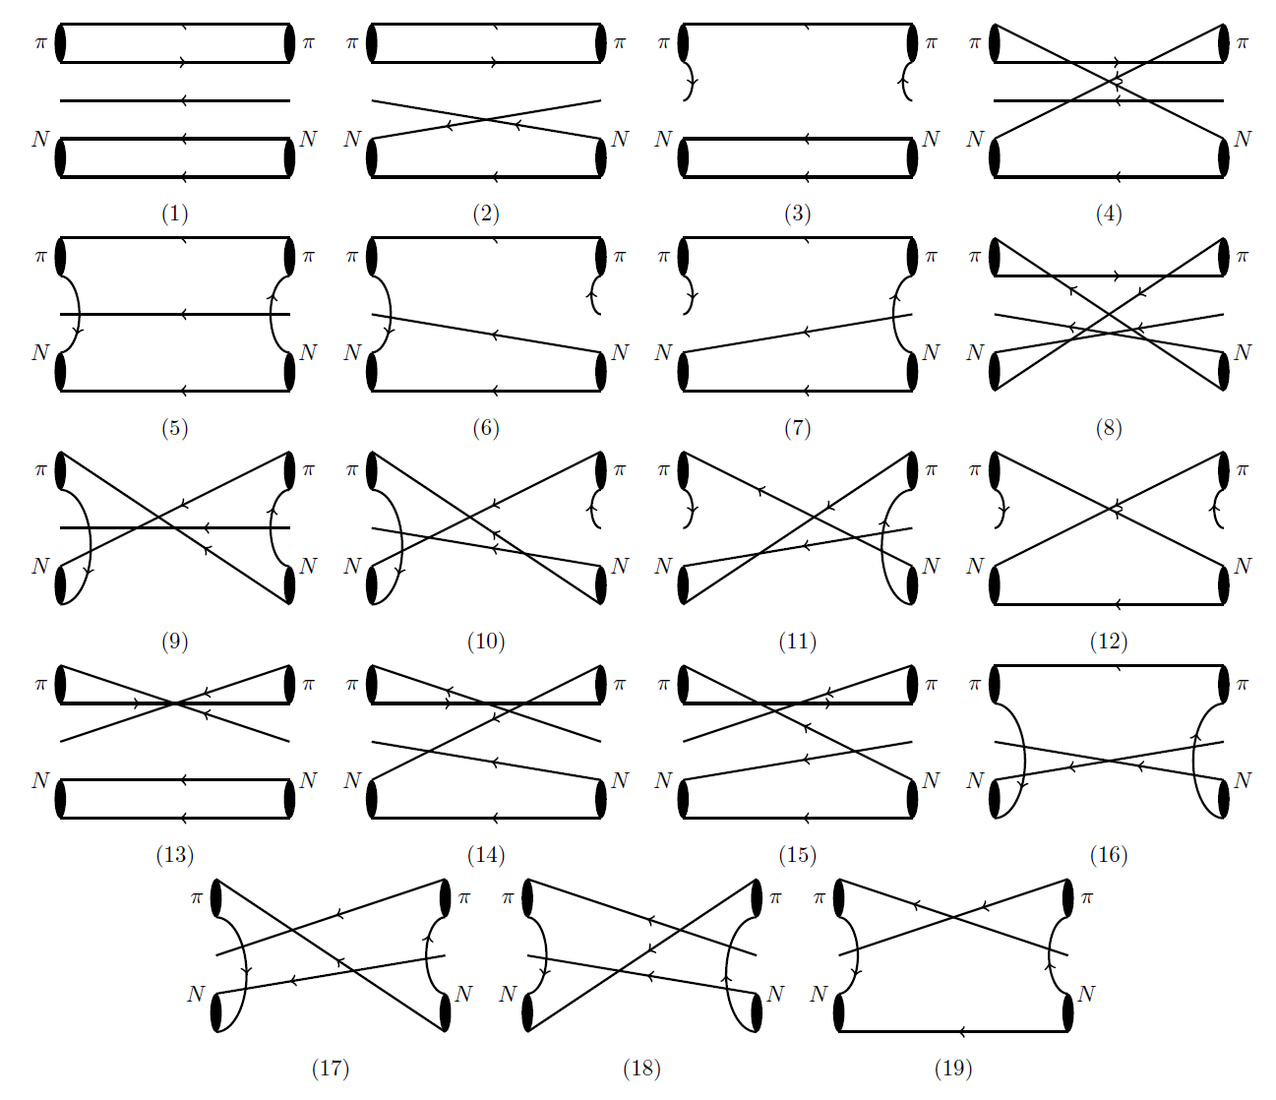
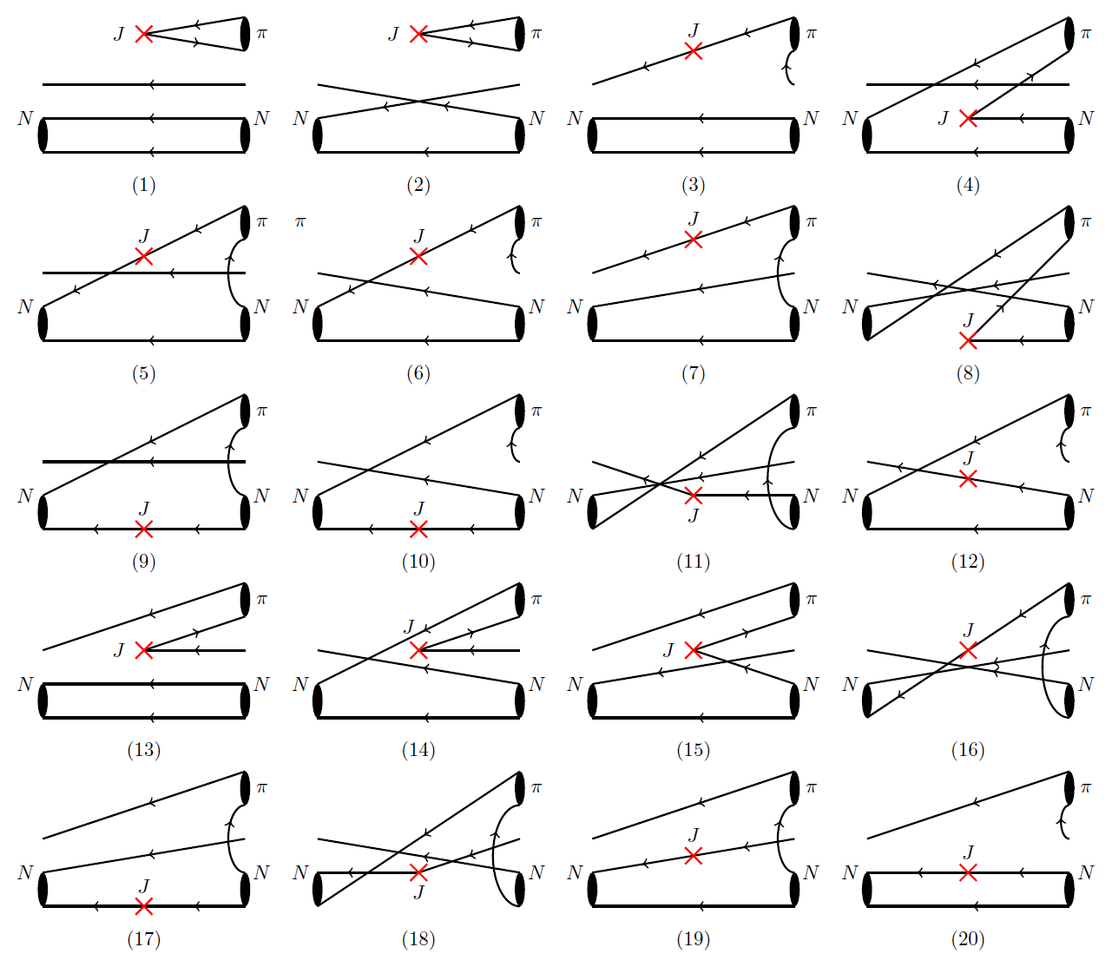
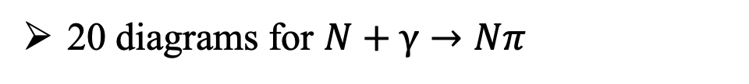
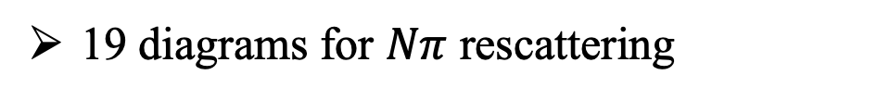
Wick contraction of $Nπ$ Rescattering
19 diagrams for $Nπ$ rescattering
20 diagrams for $N+γ→Nπ$
24

Slide 25
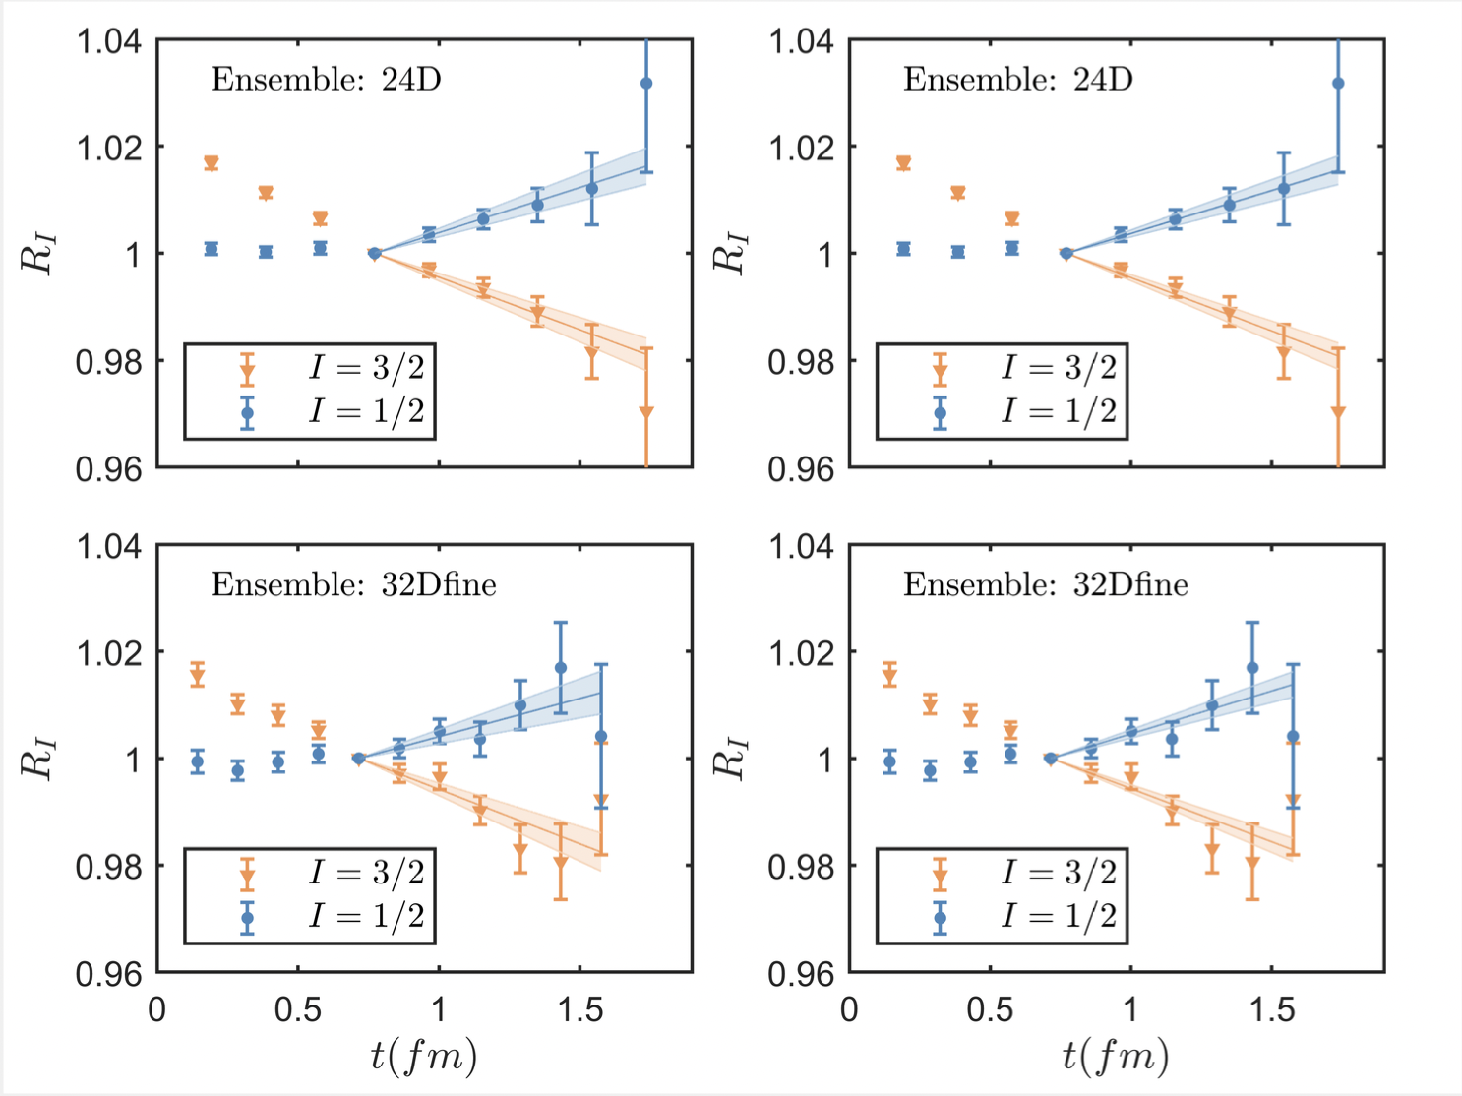



Results of $Nπ$ Scattering
Nπ scattering at m_{π}=142 MeV
combined
fit
$$R=\frac{C_{2}^{Nπ}\left(t\right)}{C_{2}^{N}\left(t\right)C_{2}^{π}\left(t\right)} \\ =\frac{A_{Nπ}}{A_{N}A_{π}}\frac{e^{−E_{Nπ}t}}{e^{−(M_{N}+M_{π})t}} \\ ≈R_{0}(1−ΔEt)$$
with $ΔE=E_{Nπ}−M_{N}−M_{π}$
Results using data at threshold
$$a_{0}^{1/2}m_{π}=0.157\left(31\right), { a}_{0}^{3/2}m_{π}=−0.104\left(18\right)$$
ETMC [arXiv: 2307.12846] $a_{0}^{3/2}m_{π}=−0.13\left(4\right)$
Analysis based on cross section and πH, πD spectrum
$$a_{0}^{1/2}m_{π}=0.170\left(2\right), { a}_{0}^{3/2}m_{π}=−0.087\left(2\right)$$
Scattering for different isospin channel
$I=1/2$, $ΔE<0$, attractive interaction
$I=3/2$, $ΔE>0$, repulsive interaction
~1σ
M. Hoferichter et al, PLB 843 (2023) 138001
25

Slide 26




Matrix elements of 𝑁𝛾→𝑁𝜋
Nπ at the threshold
Normalization for $_{I}⟨Nπ|J_{i}^{I^{′}}|N⟩$
$$R=\frac{C_{NJNπ}\left(t_{1},t_{2}\right)}{C_{Nπ}\left(t_{1}+t_{2}\right)} \\ ×\sqrt{\frac{C_{N}\left(t_{1}\right)C_{Nπ}\left(t_{2}\right)C_{Nπ}(t_{1}+t_{2})}{C_{Nπ}\left(t_{1}\right)C_{N}\left(t_{2}\right)C_{N}(t_{1}+t_{2})}}$$
Maiani L. NPB, 293, 420(1987)
Summed insertion
$$S\left(T_{s}\right)=\sum_{t_{1}+t_{2}=T_{s}}{R(t_{1},t_{2})} \\ \underset{→}{T_{s}→∞}c_{0}+\frac{1}{\sqrt{2M}} _{I}⟨Nπ|J_{i}^{I^{′}}|N⟩⋅T_{s}$$
Linear fit $S\left(T_{s}\right)$ with $T_{s}$ to extract
26

Slide 27
Numerical results
Need to calculate $Nπ$ scattering and $π$-production, in total 3 times of workload
Reconstruction of contributions from $Nπ$ states – 60% for proton & 90% for neutron
X. Wang, Z. Zhang, X. Cao, XF, et. al. PRL 133 (2024) 141901
Our lattice results
27

Slide 28




Hadronic tensor – a common structure in physical processes
Compton scattering
X. Wang, Z. Zhang, X. Cao, XF et.al. PRL 133 (2024) 141901
𝛾W box diag. in β decays
Hadron mass splitting
Two-photon exchange
XF, M. Gorchtein, L. Jin et. al
PRL 124 (2020) 192002
P. Ma, XF, M. Gorchtein, L. Jin et.al
PRL 132 (2024) 191901
XF, L. Jin
PRD 100 (2019) 094509
XF, L. Jin, M. Riberdy
PRL 128 (2022) 052003
Y. Fu, XF, L. Jin, C. Lu
PRL 128 (2022) 172002
Y. Fu, XF, L. Jin, C. Liu, S. Wen
PRL 134 (2025) 071903
28

Slide 29


Extended projects – Take two-photon exchange as an example
2010, proton charge radius from μH
Precision 10 times better than before
4% smaller radius
【Nature 466 (2010) 213】
5σ deviation → Proton size puzzle
2
3
1
4
Largest theoretical uncertainties from two-photon exchange (TPE) contribution
Upgrade of CREMA@PSI can reduce experimental error by a factor of 5
Target: Compute TPE from first-principles → precision size of proton
29

Slide 30

Lattice QCD calculation @ 2022
@m_{π}=140 MeV, TPE contribution has been computed for the first time using lattice QCD
Y. Fu, XF, L. Jin, C. Lu, PRL 128 (2022) 172002
Use infinite-volume method to resolve IR divergence → reliability of results
Develop new subtraction scheme to improve precision by 6 without increasing resources
Dispersive analysis
relies on data + models
ranges from 20 to 50 μeV
Lattice results
- desirable to improve precision
30

Slide 31


Updated results
Second ensemble: finer lattice spacing, same pion mass and volume
More statistics & gauge ensembles are on-going!
31

Slide 32


Joint dispersion relation & lattice QCD approach
Recall once-subtracted dispersion relation
Hadronic input for TPE
Subtraction function
Input from experimental data
Input from lattice QCD
32

Slide 33

Lattice QCD computation of subtraction function
ChPT
Lattice QCD
Nπ contribution
Perturbation Theory
Y. Fu, XF, L. Jin, et.al PRL 128 (2022) 172002
Reconstruction Nπ contribution is essential
LQCD provide accurate input for subtraction function
Joint approach: uncertainty reduced by ~4 times compared to full lattice results
33

Slide 34

Extended projects – Threshold pion electro-weak production
In QCD, fluctuations of gluon fields are essential for understanding key features like quark confinement
If energy allows, quantum fluctuations manifest as the production of real particle, such as a pion
Electromagnetic process γ*(k)+N(p₁) → π(q)+N(p₂)
Weak process W*(k)+N(p₁) → π(q)+N(p₂)
Probe chiral dynamics of QCD
DUNE Conceptual Design Report
Substitute for exp. measurement, such as MAMI
Uncertainties exceeding 1% for signals and 5% for backgrounds could significantly degrade sensitivity to CP violation and neutrino mass hierarchy
34

Slide 35
Extended projects – Threshold pion electro-weak production
V.Bernard, N.Kaiser, T.Lee, U.-G.Meißner, Phys.Rept. (1994)
The central object is to calculating the matrix element:
Electromagnetic current
Weak current
Extracting S-wave multipole amplitudes
35

Slide 36

Extended projects – Threshold pion electro-weak production
Vector multipoles
Y. Gao, Z. Zhang, XF, L. Jin, et.al, 2502.12074, accepted by PRL
Low energy theorem
– higher-order corrections omitted
Lattice results
– with two lattice spacings
Analysis of experimental data
– does not incorporate matching with
ChPT at low energies and momenta
36

Slide 37

Extended projects – Threshold pion electro-weak production
Axial multipoles
Y. Gao, Z. Zhang, XF, L. Jin, et.al, 2502.12074, accepted by PRL
Comparable lattice results with predictions from low-energy theorem
A starting point for lattice QCD exploration of inelastic neutrino-nucleon scattering
37

Slide 38

Conclusion & outlook – A lattice QCD journey
Nucleon electric polarizability
Complication of 4pt correlation function
Reconstruction of Nπ contributions
Resolve the puzzle
Provide accurate subtraction function
Open new direction for pion EW production
Start a new journey
Towards the shallow inelastic νN scattering
Parity violating e-p scattering
……
New frontiers, new methodology and new findings!
38

Slide 39



第五届中国格点量子色动力学研讨会
将于2025年10月9日-10月12日在广东惠州举办（10月9日报到），由中国科学院近代物理研究所承办。

