Slide 1


Recent Progress in
Basis Light-Front Quantization
Xingbo Zhao
With
Siqi Xu, Chandan Mondal, Yang Li, James P. Vary
Institute of Modern Physics, Chinese Academy of Science
第二十届全国中高能核物理大会 上海 2025.4.27

Slide 2
Outline
Basis Light-front Quantization (BLFQ)
  Light front quantization
  Basis
Recent progress
  Full Light-front QCD Hamiltonian
Conclusion and Outlook

Slide 3
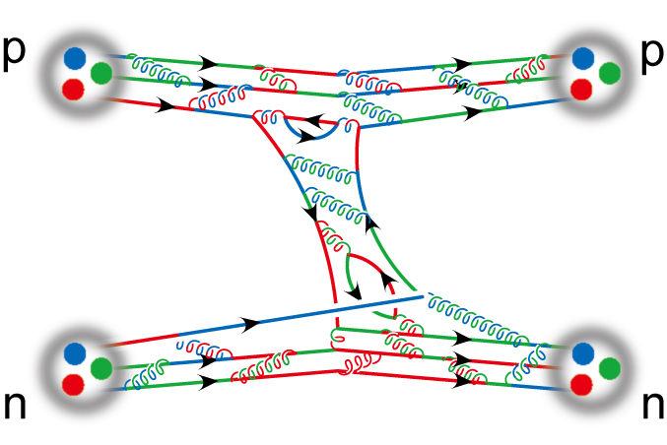
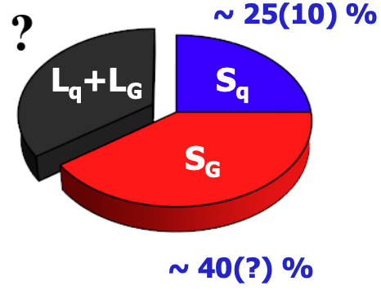
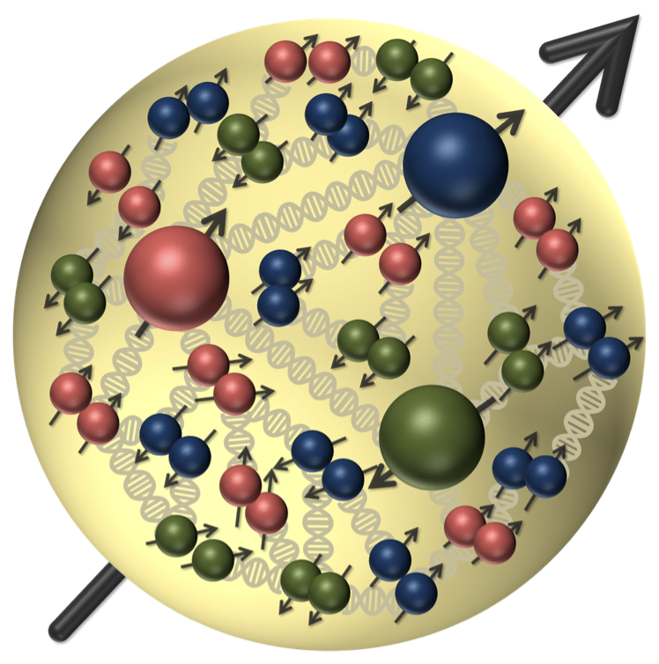


Major Questions in Nuclear Physics
Origin of mass
Spin puzzle
Nuclear force
Ortibal angular momentum
$$\vec{L}=\vec{r}×\vec{p}$$
Need to know 3D tomography of nucleon from QCD
?
$$ℒ_{QCD}=\left( {\overline{ψ}}_{q}(iD −m_{q})ψ_{q}\right)−\frac{1}{4}G_{μν}^{α}G_{α}^{μν}$$
/

Slide 4
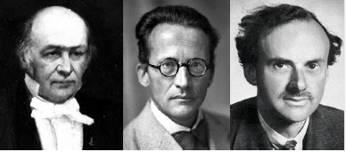
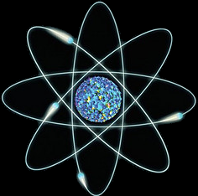
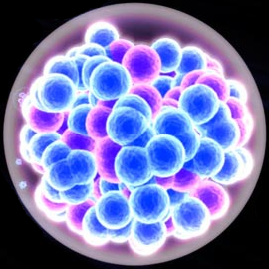
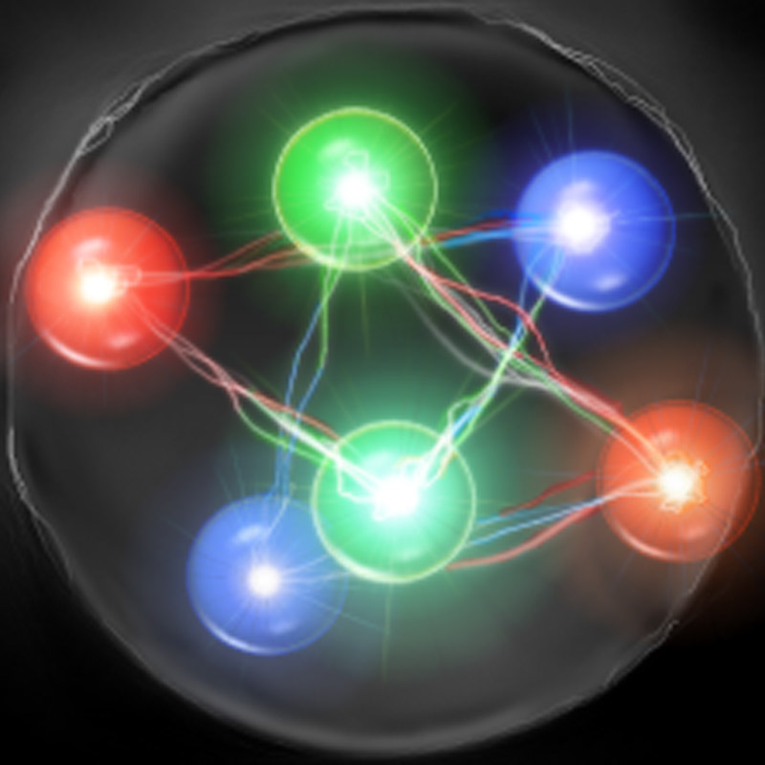
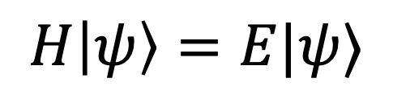
Nonperturbative Approach
Hamiltonian formalism describes bound-state structure
$$H|ψ〉=E|ψ〉$$
Eigenstates $|ψ〉$ encode full information of the system
Nonrelativistic
Nonrelativistic
Relativistic
atom
nucleus
nucleon
Relativity retardation effect
Notes:
not instantly but through mediating particles, like the photon or gluon, which are emitted at an earlier time. Here comes a problem: in relativistic systems

Slide 5
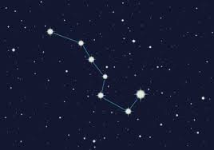


Structure of Relativistic Bound States
Challenge: retardation effect
Solution: light-front time
PDFs are defined on the light front:
$$x^{+}$$
$$f\left(x\right)\sim {\left.\left\langle N\left|\overline{ψ}\left(x\right)γ^{+}ψ\left(0\right)\right|N\right\rangle \right|}_{x^{+}=x^{⊥}=0}$$

Slide 6
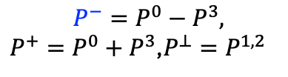


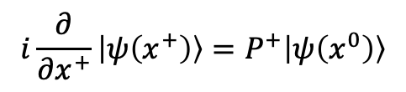
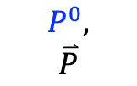
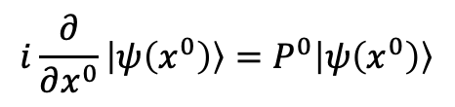

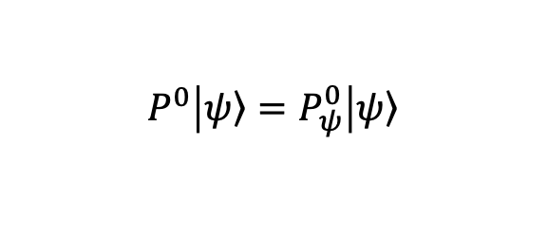
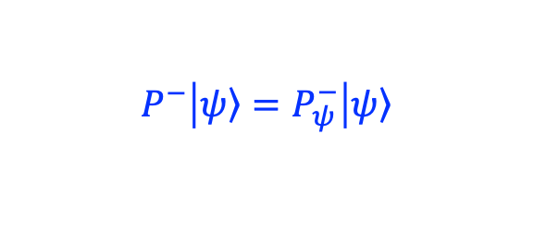
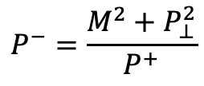
Equal Time vs. Light-front Quantization
Equal time quantization
Light-front quantization
[Dirac, 1949]
$$x^{0},$$
$$x^{1},x^{2},x^{3}$$
$${x^{+}=x}^{0}+x^{3}$$
$${x^{−}=x}^{0}−x^{3},x^{⊥}=x^{1,2}$$
$$P^{0},$$
$$\overset{⃑}{P}$$
$${P^{−}=P}^{0}−P^{3},$$
${P^{+}=P}^{0}+P^{3}$,$P^{⊥}=P^{1,2}$
$$i\frac{∂}{∂x^{0}}\left|ψ\left(x^{0}\right)\right\rangle =P^{0}\left|ψ\left(x^{0}\right)\right\rangle$$
$$i\frac{∂}{∂x^{+}}\left|ψ\left(x^{+}\right)\right\rangle =P^{+}\left|ψ\left(x^{0}\right)\right\rangle$$
$$P^{0}=\sqrt{M^{2}+P^{2}}$$
$$P^{−}=\frac{M^{2}+P_{⊥}^{2}}{P^{+}}$$
$$P^{0}\left|\left.ψ\right\rangle =P_{ψ}^{0}\right|\left.ψ\right\rangle$$
$$P^{−}\left|\left.ψ\right\rangle =P_{ψ}^{−}\right|\left.ψ\right\rangle$$
Notes:
Light front was first proposed by Dirac, at 1949.
1. First, what is light-front. Different from equal time theory. We define light-front time as a linear combination of the regular time and one of the spatial coordinate, usually we choose z direction.
So our field quantized at this equal light-front time plane. Where in equal time quantization, they quantized at this equal time plane.
X minus is longitudinal coordinate. P minus is light front Hamiltonian. P plus is longitudinal momentum.
This is light front version of schordinger equation.
Please note that it is not just a coodernate transformation, it is a new theory in a different quantization.
Why go to light front? For we can get Frame Independent wavefunction. Which encods all the information of the bound state structure. It has simple vacuum structure. The theory is boost invariant. And there is no square root in Hamiltonian p minus.

Slide 7
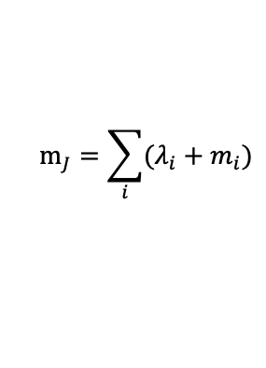

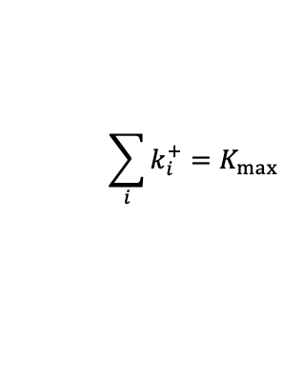
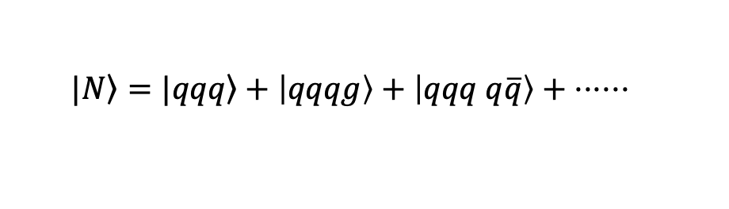
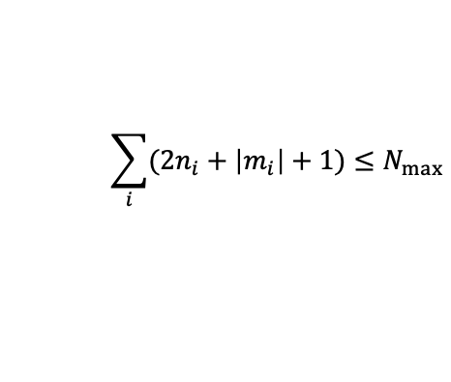


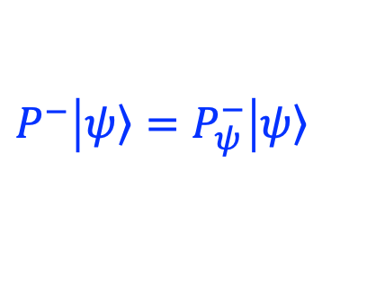
Basis Light-Front Quantization
$$P^{−}\left|\left.ψ\right\rangle =P_{ψ}^{−}\right|\left.ψ\right\rangle$$
[Vary, et.al, 2010]
Guiding principle: preserve symmetries in Hamilonian
  rotational symmetry in transverse directions
  symmetry among identical particles
Basis setup and truncation:
  Fock sector expansion:
  $$|\left.N\right\rangle =|\left.qqq\right\rangle +\left|qqqg\right\rangle +\left|qqq q\overline{q}\right\rangle + ⋅⋅⋅⋅⋅⋅$$
single particle basis:
$$\left|qqq\right\rangle =|n_{1},m_{1},n_{2},m_{2},n_{3},m_{3}⟩$$
$$⨂ |k_{1}^{+}, k_{2}^{+},k_{3}^{+}⟩$$
$$⨂|λ_{1},λ_{2},λ_{3},C⟩$$
2-d harmonic oscillator (2DHO)
Discretized longitudinal momentum
Helicity and color
$$\sum_{i}{(2n_{i}+\left|m_{i}\right|+1)}≤N_{max}$$
$$\sum_{i}{k_{i}^{+}}=K_{max}$$
$$m_{J}=\sum_{i}{(λ_{i}+m_{i})}$$

Slide 8
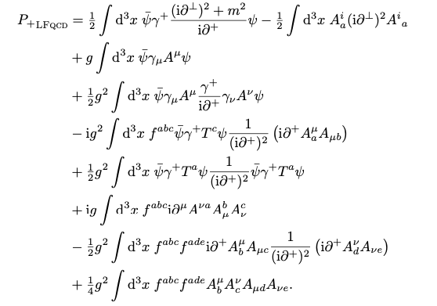
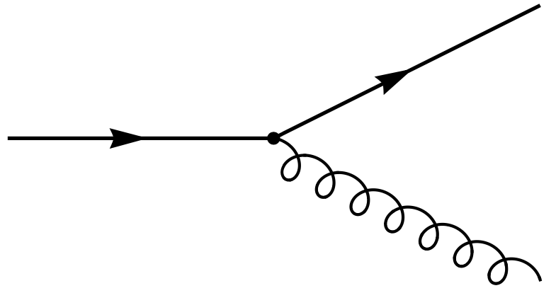
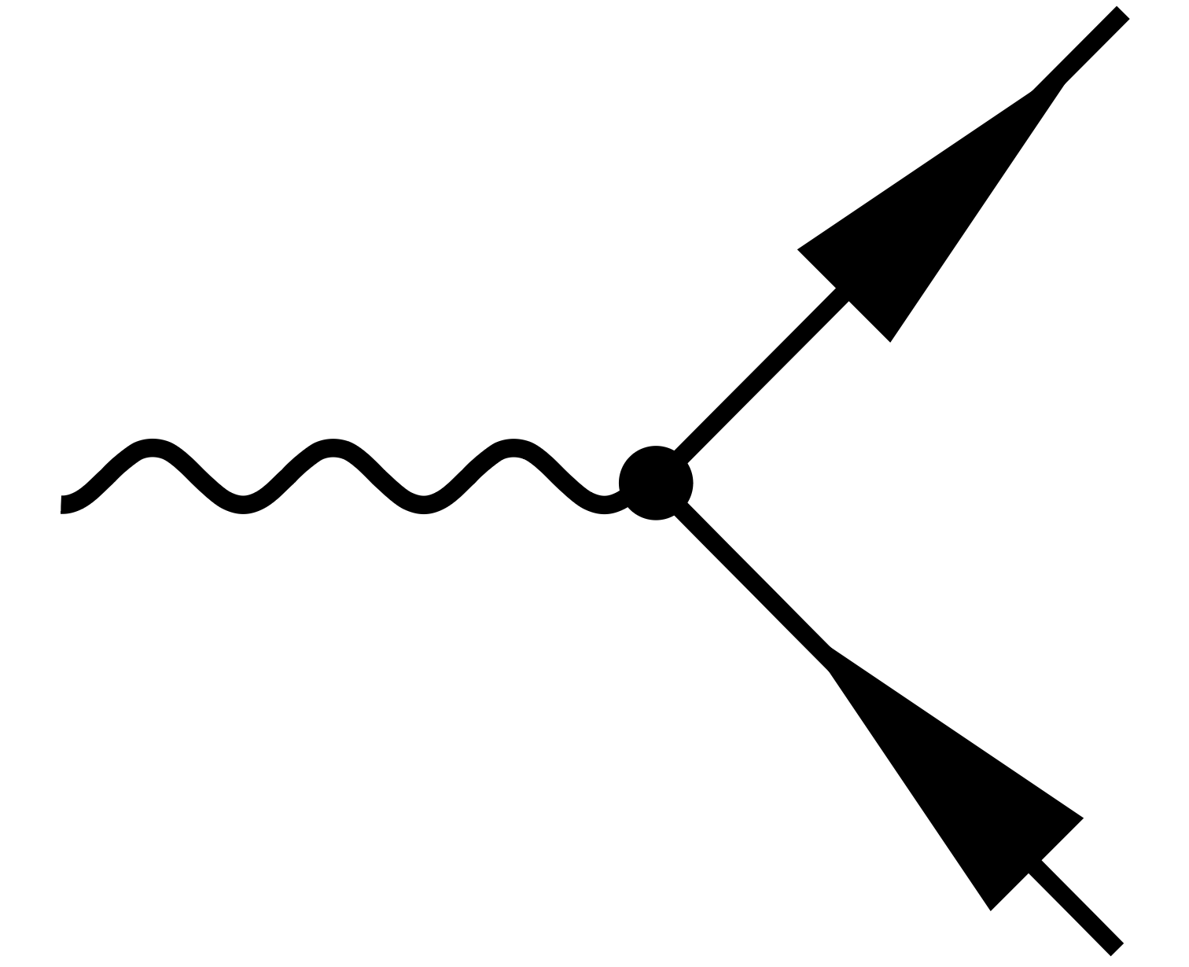
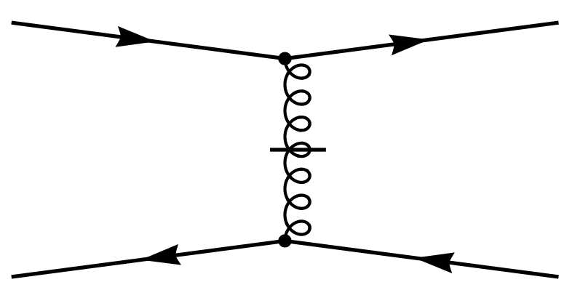
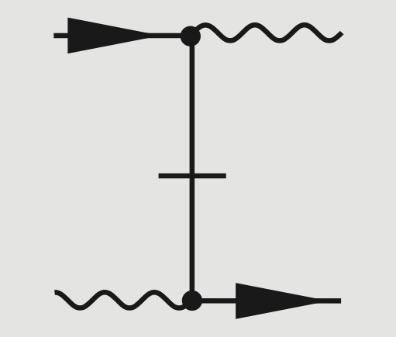
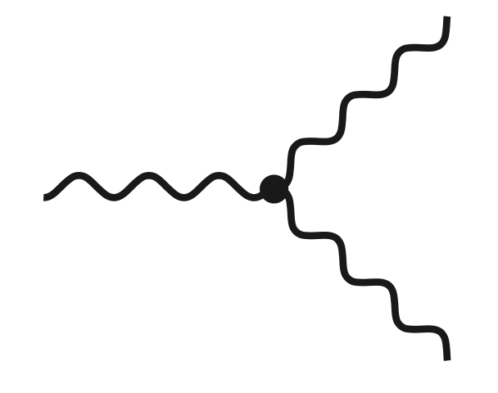
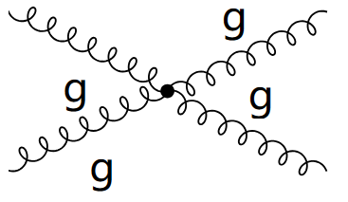



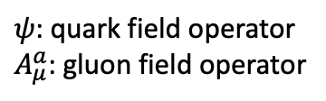



QCD Light-front Hamiltonian
[S. Brodsky, H-C Pauli, S. Pinsky, ‘97]
QCD light-front Hamiltonian from QCD Lagrangian:
$$ℒ_{QCD}=\overline{ψ}\left(iD−m\right)ψ−\frac{1}{4}G_{μν}^{α}G_{α}^{μν}$$
$$A^{+}=0$$
/
$${ P}_{QCD}^{−}=H_{K}+H_{I}$$
$$H_{K}=$$
$$H_{I}=$$
$ψ$: quark field operator
$A_{μ}^{a}$: gluon field operator
7 terms in $H_{I}$
Notes:
Add Fock sector

Slide 9

BLFQ Algorithm Flowchart
Basis Enumeration
Hamiltonian Matrix Generation
Diagonalize Hamiltonian Matrix
Light-Front Wave Functions
Observables: $O≡\left\langle N | \hat{O} | N\right\rangle$
Distribution Functions, Form Factors, PDFs, GPDs, TMDs…

Slide 10
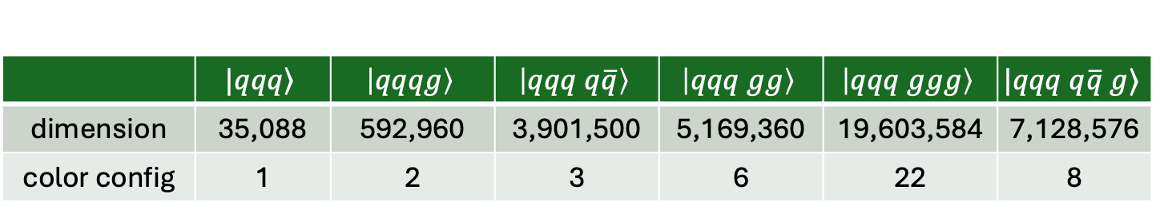
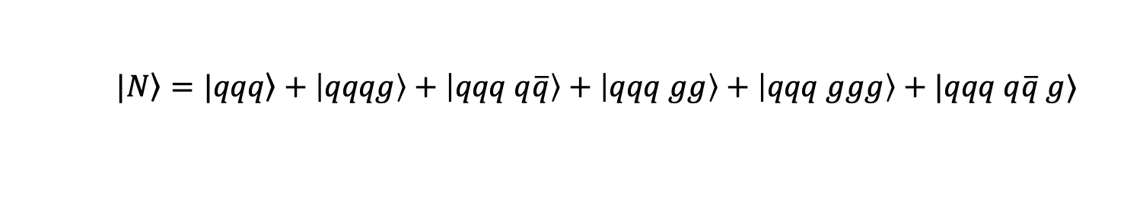
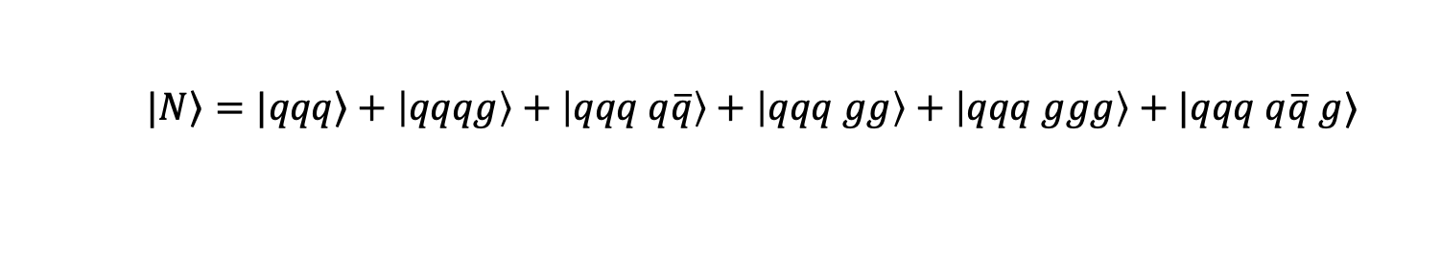
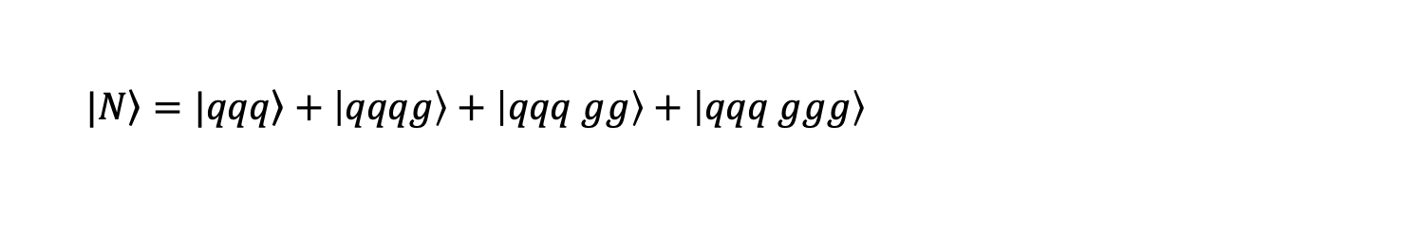
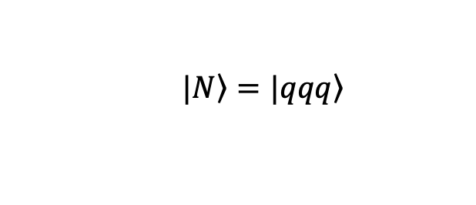

Dimension of Basis Space
Expansion in BLFQ basis
  $$|\left.N\right\rangle =|\left.qqq\right\rangle +\left|qqqg\right\rangle +\left|qqq q\overline{q}\right\rangle +\left|qqq gg\right\rangle +\left|qqq ggg\right\rangle +|qqq q\overline{q} g⟩$$
$$N_{max}=7, K_{max}=16$$
 | $$|\left.qqq\right\rangle$$ | $$\left|qqqg\right\rangle$$ | $$\left|qqq q\overline{q}\right\rangle$$ | $$\left|qqq gg\right\rangle$$ | $$\left|qqq ggg\right\rangle$$ | $$|qqq q\overline{q} g⟩$$
dimension | 35,088 | 592,960 | 3,901,500 | 5,169,360 | 19,603,584 | 7,128,576
color config | 1 | 2 | 3 | 6 | 22 | 8
  $$|\left.N\right\rangle =|\left.qqq\right\rangle$$
Basis Dimension= 35, 088
  $$|\left.N\right\rangle =|\left.qqq\right\rangle +\left|qqqg\right\rangle +\left|qqq gg\right\rangle +\left|qqq ggg\right\rangle$$
Basis Dimension= 25,400,992
  $$|\left.N\right\rangle =|\left.qqq\right\rangle +\left|qqqg\right\rangle +\left|qqq q\overline{q}\right\rangle +\left|qqq gg\right\rangle +\left|qqq ggg\right\rangle +|qqq q\overline{q} g⟩$$
Basis Dimension= 58,491,220

Slide 11
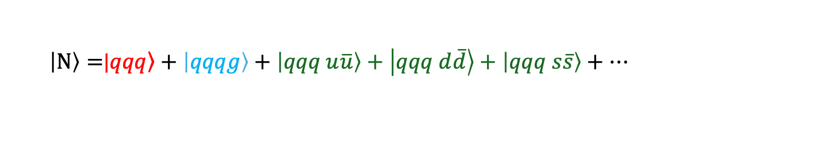
Progress toward First Principles
  $\left|N\right\rangle =$|$\left.qqq\right\rangle +\left|qqqg\right\rangle +\left|qqq u\overline{u}\right\rangle +\left|qqq d\overline{d}\right\rangle +\left|qqq s\overline{s}\right\rangle +…$
Wave Functions:
[PRD,102,016008] (2019)
[PRD,108 9, 094002] (2023)
[arXiv:2408.11298] (2024)
GPDs:
[PRD,104,094036] (2021)
[PRD,105,094018] (2022)
[PRD,109,014015] (2024)
[PLB,855,138809] (2024)
[PLB,847,138305] (2023)
[PRD,110.056027] (2024)
[PLB,860,139153] (2025)
TMDs:
[PLB,833,137360] (2022)
[PRD,108,036009] (2023)
[PLB,855 138831] (2024)
Higher-twist Distribution (GPD,TMD,DPD):
[PRD,109,034031] (2024)
[PLB,855 138829] (2024)
[arXiv:2410.11574] (2024)
Gravitational Form Factors:
[PRD,110,056027] (2024)

Slide 12

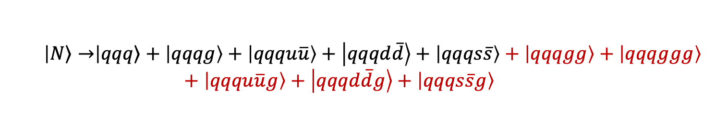
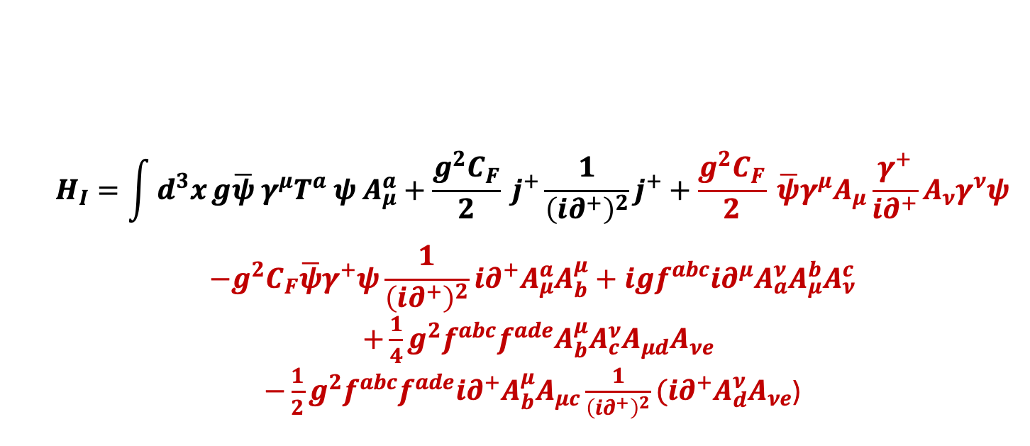
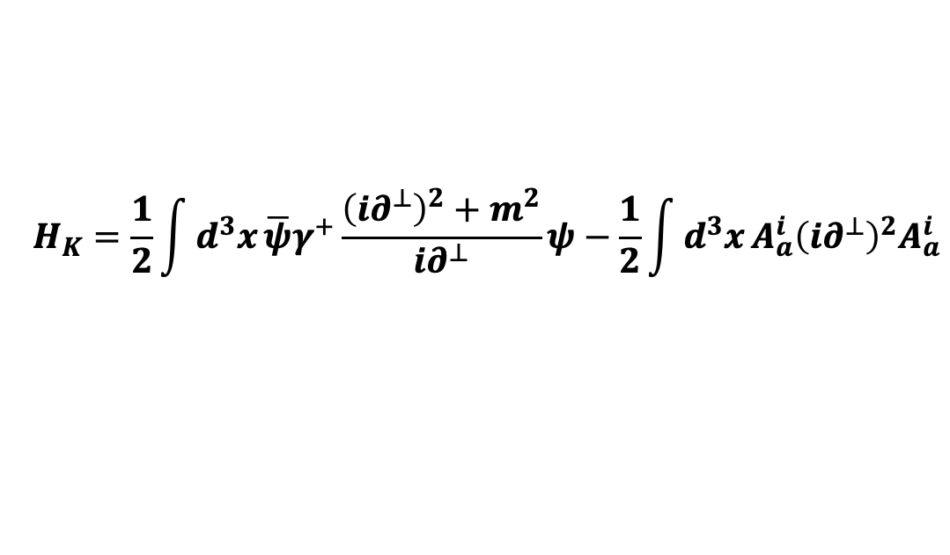
Proton with Full QCD Hamiltonian
  $$\left|\left.N\right\rangle →\right|\left.qqq\right\rangle +\left|qqqg\right\rangle +\left|qqqu\overline{u}\right\rangle +\left|qqqd\overline{d}\right\rangle +\left|qqqs\overline{s}\right\rangle +\left|qqqgg\right\rangle +\left|qqqggg\right\rangle +\left|qqqu\overline{u}g\right\rangle +\left|qqqd\overline{d}g\right\rangle +\left|qqqs\overline{s}g\right\rangle$$
$$P^{−}=H_{K}+H_{I}$$
$$H_{K}=\frac{1}{2}\int{d^{3}x}\overline{ψ}γ^{+}\frac{{\left(i∂^{⊥}\right)}^{2}+m^{2}}{i∂^{⊥}}ψ−\frac{1}{2}\int{d^{3}x}A_{a}^{i}{\left(i∂^{⊥}\right)}^{2}A_{a}^{i}$$
$$H_{I}=\int{d^{3}x}g\overline{ψ} γ^{μ}T^{a} ψ A_{μ}^{a}+\frac{g^{2}C_{F}}{2} j^{+}\frac{1}{{\left(i∂^{+}\right)}^{2}}j^{+}+\frac{g^{2}C_{F}}{2} \overline{ψ}γ^{μ}A_{μ}\frac{γ^{+}}{i∂^{+}}A_{ν}γ^{ν}ψ$$
$$−g^{2}C_{F}\overline{ψ}γ^{+}ψ\frac{1}{{\left(i∂^{+}\right)}^{2}}i∂^{+}A_{μ}^{a}A_{b}^{μ}+igf^{abc}i∂^{μ}A_{a}^{ν}A_{μ}^{b}A_{ν}^{c}$$
$+\frac{1}{4}g^{2}f^{abc}f^{ade}A_{b}^{μ}A_{c}^{ν}A_{μd}A_{νe}$
$−\frac{1}{2}g^{2}f^{abc}f^{ade}i∂^{+}A_{b}^{μ}A_{μc}\frac{1}{{\left(i∂^{+}\right)}^{2}}(i∂^{+}A_{d}^{ν}A_{νe}$)

Slide 13














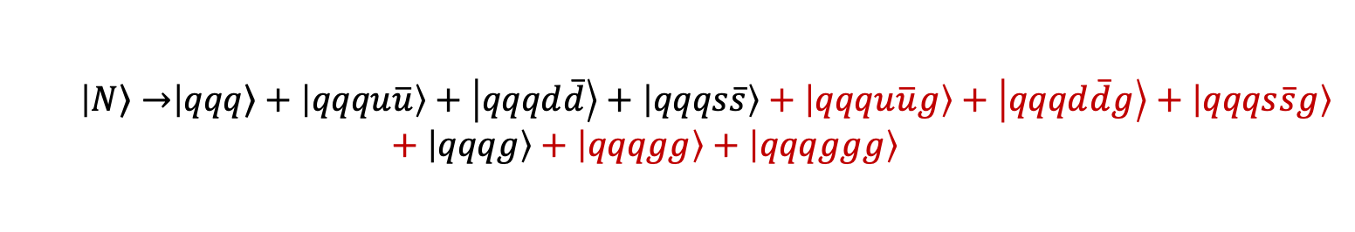




Color Structure in Basis States
  $$\left|\left.N\right\rangle →\right|\left.qqq\right\rangle +\left|qqqu\overline{u}\right\rangle +\left|qqqd\overline{d}\right\rangle +\left|qqqs\overline{s}\right\rangle +\left|qqqu\overline{u}g\right\rangle +\left|qqqd\overline{d}g\right\rangle +\left|qqqs\overline{s}g\right\rangle +\left|qqqg\right\rangle +\left|qqqgg\right\rangle +\left|qqqggg\right\rangle$$
$\left|qqq\right\rangle$ ～ 1 color singlet state
$\left|qqq g\right\rangle$ ～ 2 color singlet states
2 octet $⨂$ octet
$\left|qqq q\overline{q}\right\rangle \sim 3$ color singlet states
1 singlet $⨂$ singlet
2 octet $⨂$ octet
$\left|qqq gg\right\rangle \sim 6$ color singlet states
1 singlet $⨂$ singlet
4 octet $⨂$ octet
1 decuplet $⨂$ octet $⨂$ octet
$\left|qqq q\overline{q}g\right\rangle \sim 8$ color singlet states
3 singlet $⨂$ octet $⨂$ octet
4 octet $⨂$ octet $⨂$ octet
1 decuplet $⨂$ octet $⨂$ octet
$\left|qqq ggg\right\rangle \sim 22$ color singlet states
16 octet $⨂$ octet
2 singlet $⨂$ singlet
4 decuplet $⨂$ octet $⨂$ octet $⨂$ octet

Slide 14
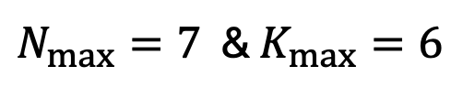
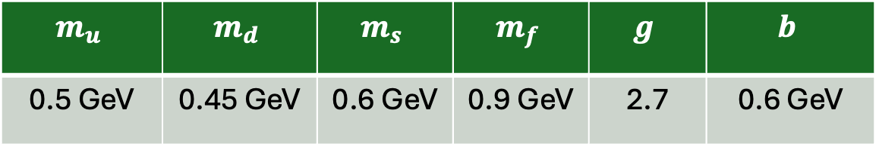


Input Parameters
  $$\left|\left.N\right\rangle →\right|\left.qqq\right\rangle +\left|qqqu\overline{u}\right\rangle +\left|qqqd\overline{d}\right\rangle +\left|qqqs\overline{s}\right\rangle +\left|qqqu\overline{u}g\right\rangle +\left|qqqd\overline{d}g\right\rangle +\left|qqqs\overline{s}g\right\rangle +\left|qqqg\right\rangle +\left|qqqgg\right\rangle +\left|qqqggg\right\rangle$$
Truncation Parameters:
$N_{max}=7$ & $K_{max}=6$
Model Parameters:
$$m_{u}$$ | $$m_{d}$$ | $$m_{s}$$ | $$m_{f}$$ | $$g$$ | $$b$$
0.5 GeV | 0.45 GeV | 0.6 GeV | 0.9 GeV | 2.7 | 0.6 GeV
$m_{f}$ denotes the fermion mass in the QCD vertex interaction
Model parameters are determined by reproducing:
  proton mass ($M_{p}=0.98 GeV)$
  electromagnetic form factors

Slide 15
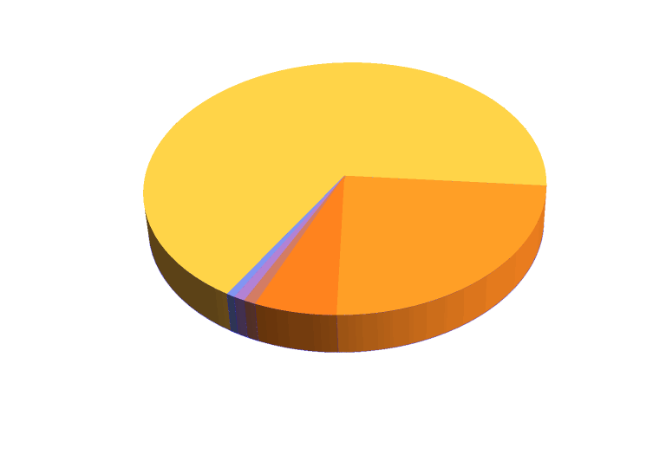



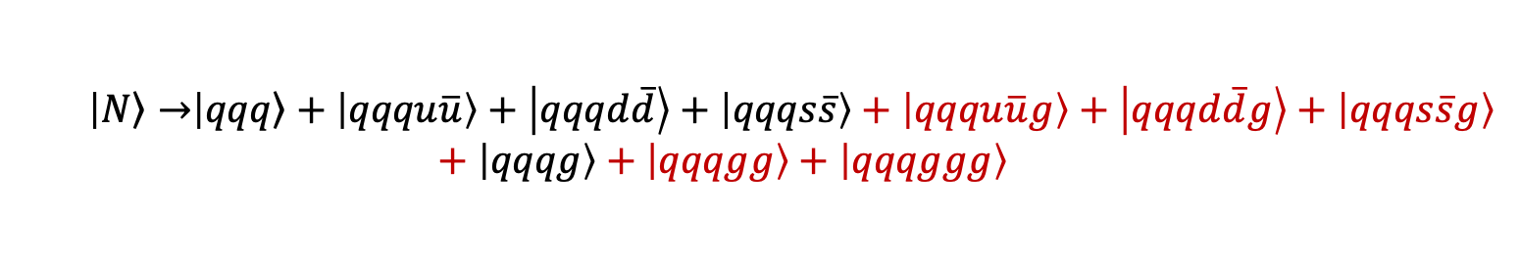
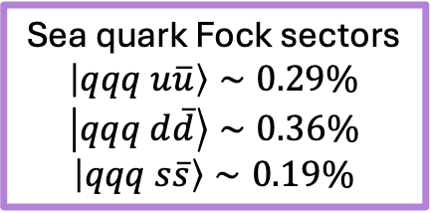

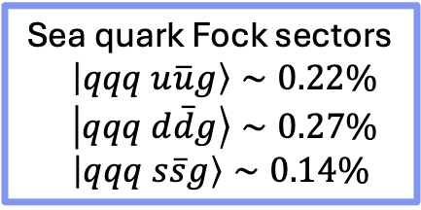
Fock Sector Decomposition
  $$\left|\left.N\right\rangle →\right|\left.qqq\right\rangle +\left|qqqu\overline{u}\right\rangle +\left|qqqd\overline{d}\right\rangle +\left|qqqs\overline{s}\right\rangle +\left|qqqu\overline{u}g\right\rangle +\left|qqqd\overline{d}g\right\rangle +\left|qqqs\overline{s}g\right\rangle +\left|qqqg\right\rangle +\left|qqqgg\right\rangle +\left|qqqggg\right\rangle$$
Valence Fock sector
$$\left|qqq\right\rangle ∼67.84\%$$
Sea quark Fock sectors
$\left|qqq u\overline{u}g\right\rangle ∼0.22\%$
$\left|qqq d\overline{d}g\right\rangle ∼0.27\%$
$\left|qqq s\overline{s}g\right\rangle ∼0.14\%$
Dynamic gluon Fock sectors
$\left|qqqg\right\rangle ～23.74\%$
Sea quark Fock sectors
$$\left|qqq u\overline{u}\right\rangle ∼0.29\%$$
$$\left|qqq d\overline{d}\right\rangle ∼0.36\%$$
$$\left|qqq s\overline{s}\right\rangle ∼0.19\%$$
Dynamic gluon Fock sectors
$$\left|qqq gg\right\rangle ～6.07\%$$
Dynamic gluon Fock sectors
$$\left|qqq ggg\right\rangle ∼0.88\%$$

Slide 16
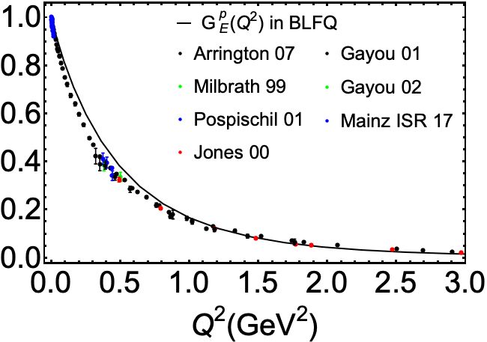
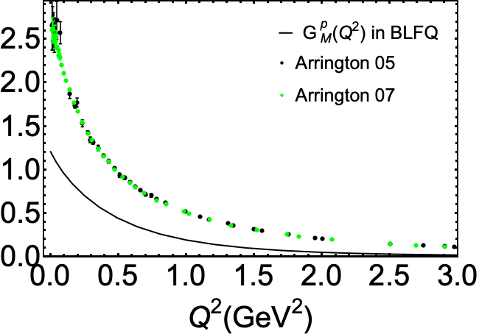
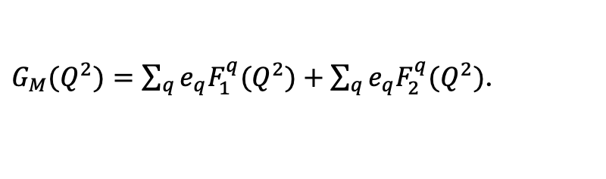
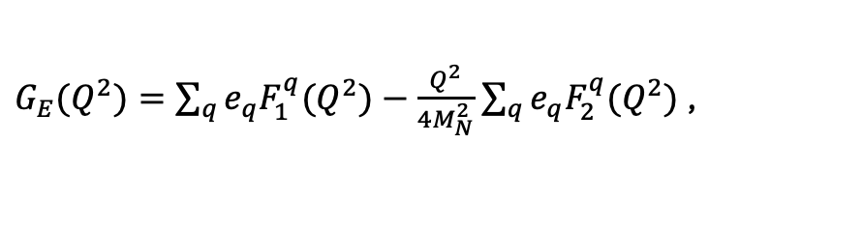
Electromagnetic Form Factors
$$\left\langle N\left(p^{′}\right)\left|J^{μ}\left(0\right)\right|N\left(p\right)\right\rangle =\overline{u}\left(p^{′}\right)\left[γ^{μ}F_{1}\left(Q^{2}\right)+\frac{iσ^{μν}q_{ν}}{2m_{N}}F_{2}\left(Q^{2}\right)\right]u(p)$$
$G_{E}(Q^{2})=\sum_{q}{e_{q}F_{1}^{q}(Q^{2})}−\frac{Q^{2}}{4M_{N}^{2}}$ $\sum_{q}{e_{q}F_{2}^{q}(Q^{2})}$ ,
$G_{M}(Q^{2})=\sum_{q}{e_{q}F_{1}^{q}(Q^{2})}+$ $\sum_{q}{e_{q}F_{2}^{q}(Q^{2})}$.
Preliminary
BLFQ results qualitatively agree with the experimental data for Dirac and Pauli FFs

Slide 17




Axial Form Factor
Provide information on axial charge distributions
$$G_{A}\left(Q^{2}\right)=G_{u}\left(Q^{2}\right)−G_{d}(Q^{2})$$
Black line: BLFQ
Reasonably agree with the experimental data

Slide 18


Unpolarized Parton Distribution Functions
Unpolarized PDFs:
Particle number density distribution
Preliminary
All results are at the initial scale

Slide 19






Helicity Parton Distribution Functions
Helicity PDFs:
Including Higher Fock sectors
Significantly increasing the helicity contribution of gluon to proton spin
$$ΔΣ_{u}=1.16$$
$$ΔΣ_{d}=−0.32$$
$$ΔΣ=0.84$$
$$ΔG=0.1 (JAM:0.2)$$
Preliminary

Slide 20

Conclusions
Basis Light-Front Quantization (BLFQ)
  nonperturbative approach to QFT in Minkowski spacetime
Recent Progress
  include Fock sectors up to 6 partons ($\left|qqqq\overline{q}g\right\rangle$ and $\left|qqq ggg\right\rangle$) for nucleon
  include all interaction terms in light-front QCD Hamiltonian
  obtain reasonable parton helicity structure

Slide 21
Thank you!

Slide 22



Outlook
Current status
Deutron calculation
$$\left|qqq qqq\right\rangle +\left|qqq qqq g\right\rangle$$
Full QCD interaction
EMC effect
Intrinsic charm
Sea asymmetry
Origin of spin and mass

Slide 23
BLFQ Algorithm Flowchart
Basis Enumeration
Fock-Sector Dependent Renormalization
Hamiltonian Matrix Generation
Diagonalize Hamiltonian Matrix
Light-Front Wave Functions
Nucleon Structure:
Distribution Functions, Form Factors, PDFs, GPDs, TMDs…

Slide 24








Fock Sector Dependent Renormalization
  $$\left|\left.N\right\rangle →\right|\left.qqq\right\rangle +\left|qqqu\overline{u}\right\rangle +\left|qqqd\overline{d}\right\rangle +\left|qqqs\overline{s}\right\rangle +\left|qqqu\overline{u}g\right\rangle +\left|qqqd\overline{d}g\right\rangle +\left|qqqs\overline{s}g\right\rangle +\left|qqqg\right\rangle +\left|qqqgg\right\rangle +\left|qqqggg\right\rangle$$
mass counterterm $δm_{i}^{q/g}$
      -- generated from the single particle system
$P^{−}$: Light-Front Hamiltonian
$|\left.q/g\right\rangle$: Eigenstates of quark & gluon
$M_{q/g}^{2}$: Quark & gluon mass
$$P^{−}P^{+}\left|\left.q/g\right\rangle =M_{q/g}^{2}\right|\left.q/g\right\rangle$$
Renormalization Condition: $M_{q}=m_{q}$, $M_{g}=0$
Different Fock sector expansion Different order Mass counterterm
For Quark:
$$\left|q\right\rangle =\left|q\right\rangle +\left|qg\right\rangle +\left|qq\overline{q}\right\rangle +\left|qgg\right\rangle +\left|qq\overline{q}g\right\rangle +\left|qggg\right\rangle$$
For Gluon:
$$\left|g\right\rangle =\left|g\right\rangle +\left|q\overline{q}\right\rangle +\left|gg\right\rangle +\left|q\overline{q}g\right\rangle +\left|ggg\right\rangle$$
$$i=1$$
$$i=2$$
$$i=3$$

Slide 25


Fock Sector Dependent Renormalization
  $$\left|\left.N\right\rangle →\right|\left.qqq\right\rangle +\left|qqqu\overline{u}\right\rangle +\left|qqqd\overline{d}\right\rangle +\left|qqqs\overline{s}\right\rangle +\left|qqqu\overline{u}g\right\rangle +\left|qqqd\overline{d}g\right\rangle +\left|qqqs\overline{s}g\right\rangle +\left|qqqg\right\rangle +\left|qqqgg\right\rangle +\left|qqqggg\right\rangle$$
mass counterterm
      -- generated from the single particle system calculation

Slide 26

Progress toward First Principles
  $\left|Meson\right\rangle =$|$\left.q\overline{q}\right\rangle +\left|q\overline{q}g\right\rangle +\left|q\overline{q}u\overline{u}\right\rangle +\left|q\overline{q}d\overline{d}\right\rangle +\left|q\overline{q}s\overline{s}\right\rangle +…$
Wave Functions:
PLB,758,118-124(2016)
PRD,96,016022(2017)
PRC,99,035206 (2019)
PRL,122,172001(2019)
PRD,101,034024(2019)
PRD,102,014020(2020)
PRD,104,11401(2021)
PRD,104,094034(2021)
PLB,825,136890(2022)
2406.18878 [hep-ph]
PLB,851,138563(2024)
2408.06870 [hep-ph]
PLB,839,137808(2023)
[xxxx.xxxxx](2025)
PDFs:
GPDs/TMDs:
Transition FFs:
Higher-twist Distribution (GPD,TMD,DPD):
Notes:
From File: for_prof_zhao_20241109 . . .

Slide 27




Dimension of Basis Space
Expansion in BLFQ basis
  $$|\left.N\right\rangle =|\left.qqq\right\rangle +\left|qqqg\right\rangle +\left|qqq q\overline{q}\right\rangle +\left|qqq gg\right\rangle +\left|qqq ggg\right\rangle +|qqq q\overline{q} g⟩$$
$$N_{max}=7, K_{max}=16$$
 | $$|\left.qqq\right\rangle$$ | $$\left|qqqg\right\rangle$$ | $$\left|qqq q\overline{q}\right\rangle$$ | $$\left|qqq gg\right\rangle$$ | $$\left|qqq ggg\right\rangle$$ | $$|qqq q\overline{q} g⟩$$
dimension | 35,088 | 592,960 | 3,901,500 | 5,169,360 | 19,603,584 | 7,128,576
color config | 1 | 2 | 3 | 6 | 22 | 8
  $|\left.N\right\rangle =|\left.qqq\right\rangle +\left|qqqg\right\rangle +\left|qqq u\overline{u}\right\rangle +\left|qqq d\overline{d}\right\rangle$+ $\left|qqq s\overline{s}\right\rangle$
Basis Dimension= 12,332,548
  $|\left.N\right\rangle =|\left.qqq\right\rangle +\left|qqqg\right\rangle +\left|qqq u\overline{u}\right\rangle +\left|qqq d\overline{d}\right\rangle$+ $\left|qqq s\overline{s}\right\rangle +|qqq gg⟩$
Basis Dimension= 17,501,908
  $$|\left.N\right\rangle =|\left.qqq\right\rangle +\left|qqqg\right\rangle +\left|qqq q\overline{q}\right\rangle +\left|qqq gg\right\rangle +\left|qqq ggg\right\rangle$$
Basis Dimension= 37,105,492
  $$|\left.N\right\rangle =|\left.qqq\right\rangle +\left|qqqg\right\rangle +\left|qqq q\overline{q}\right\rangle +\left|qqq gg\right\rangle +\left|qqq ggg\right\rangle +|qqq q\overline{q} g⟩$$
Basis Dimension= 58,491,220

Slide 28
BLFQ with Heterogeneous Computing
Basis Enumeration
Hamiltonian Matrix Generation
Optimized on GPU
Diagonalize Hamiltonian Matrix
Light-Front Wave Functions
Distribution Functions, Form Factors, PDFs, GPDs, TMDs…

Slide 29
BLFQ Optimization - Hamiltonian
Hamiltonian Matrix Generation
High Concurrency
Algorithm for GPU:
AtomicAdd and Parallel Sorting
Hamiltonian Matrix Generation
- Optimized for GPU
 | n=7 k=8 | n=7 k=10 | n=9 k=6 | n=7 k=14 | n=7 k=16
CPU(s) | 245.9 | 1098.699 | 2318.8 | 10805.2 | 30793.2
GPU(s) | 73.3 | 343.7 | 188.8 | 920.3 | 1887.5
Ratio | 3.35 | 3.2 | 12.28 | 11.74 | 16.31

Slide 30


BLFQ Optimization - Diagonalization
https://github.com/opencollab/arpack-ng
Diagonalization: Arpack
Replace the Basic function
BLAS -> HIPBLAS
LAPACK -> GPU Adaptation
Reprogram the Kernel:
Arpack Kernel, Matrix Multiplication
56 CPU threads vs 4 GPUs

