Slide 1
Electromagnetic Effect on Particle Production
in Relativistic Heavy Ion Collisions
Pengfei Zhuang @ Tsinghua University

Slide 2
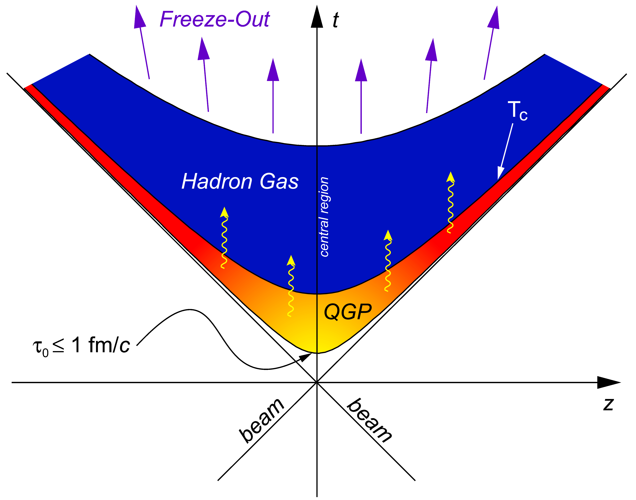
Electromagnetic effects
Effects on matter:
QCD phase structure
黄梅, Friday afternoon;
毛施君,冯笙琴,温睿,Sunday morning
CME
申迪宇,Sunday afternoon
Vorticity
黄安平,Saturday afternoon
……
Effects on particles:
Polarization
梁作堂，Friday morning
Photons
王昕杨,Saturday afternoon;
魏明华,Sunday morning
……
B
We discuss particle production in the initial stage.
1)Heavy quark production
2)Drell-Yan process
Advantage: the magnetic field here is the strongest!
(arXiv:2401.17559)
(arXiv:2503.08313)
陈诗乐 赵佳星

Slide 3
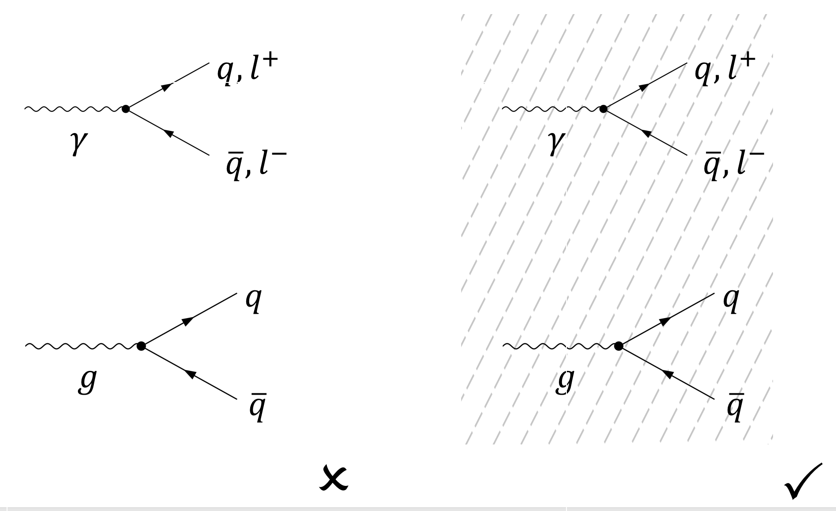
What is the importance in a magnetic field？
Symmetry breaking !
The translation invariance is broken, momentum is no longer conserved.
$p_{x},p_{y},p_{z} → p_{z},p_{⊥}$
$$\vec{E}, \vec{B}$$
$$→$$
G.Wunner, PRL42, 79(1979); J.K.Daugherty and R.W.Bussard, Astrophys. J.238, 296(1980)

Slide 4
Feynman rules in a magnetic field
D.B.Meirose and A.J.Parle, Austral. J. Phys. 36, 755(1983), A.Kostenko and C. Thompson, Astrophys. J. 869, 44(2018).
Stationary state in an external electric field, Xuan Zhao, in progress

Slide 5
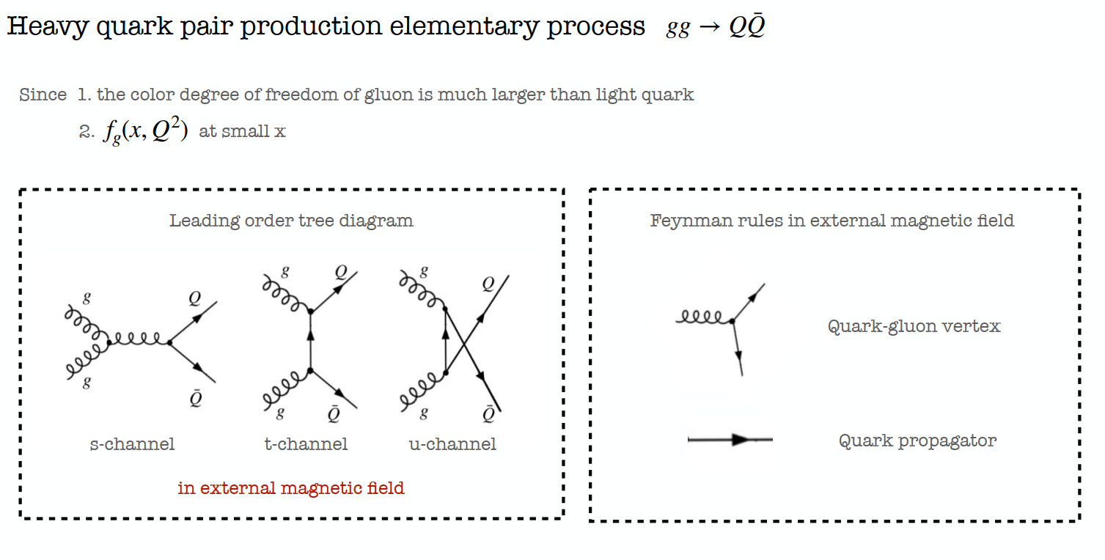
Heavy quark pair production

Slide 6
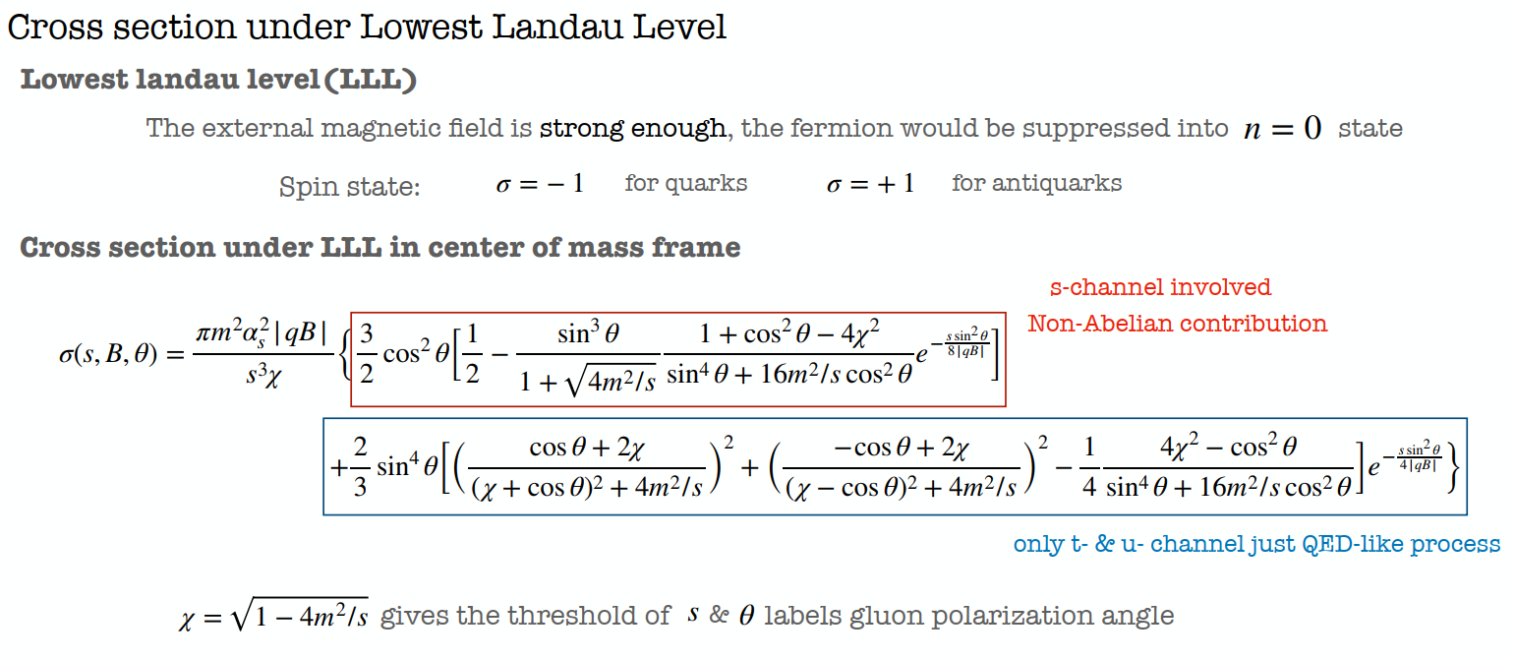

Slide 7
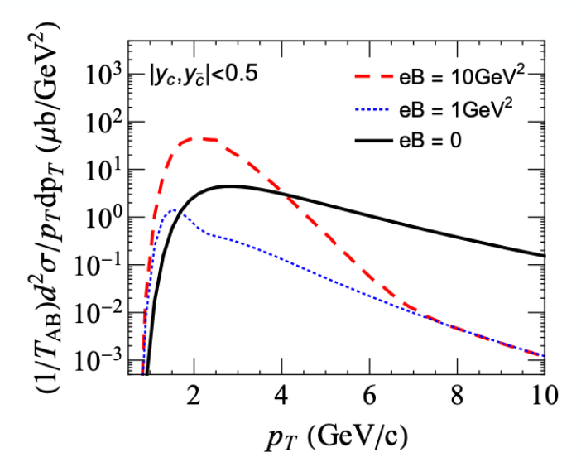
Low momentum enhancement and high momentum suppression

Slide 8
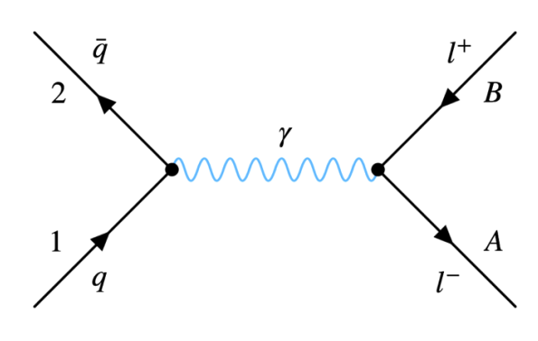
Drell-Yan process in magnetic field
Cross section at LLL:
Photon decay rate:
The magnetic field dependence is hidden in the decay rate.
$Photon energy$ $ω→ω − iΓ/$2

Slide 9
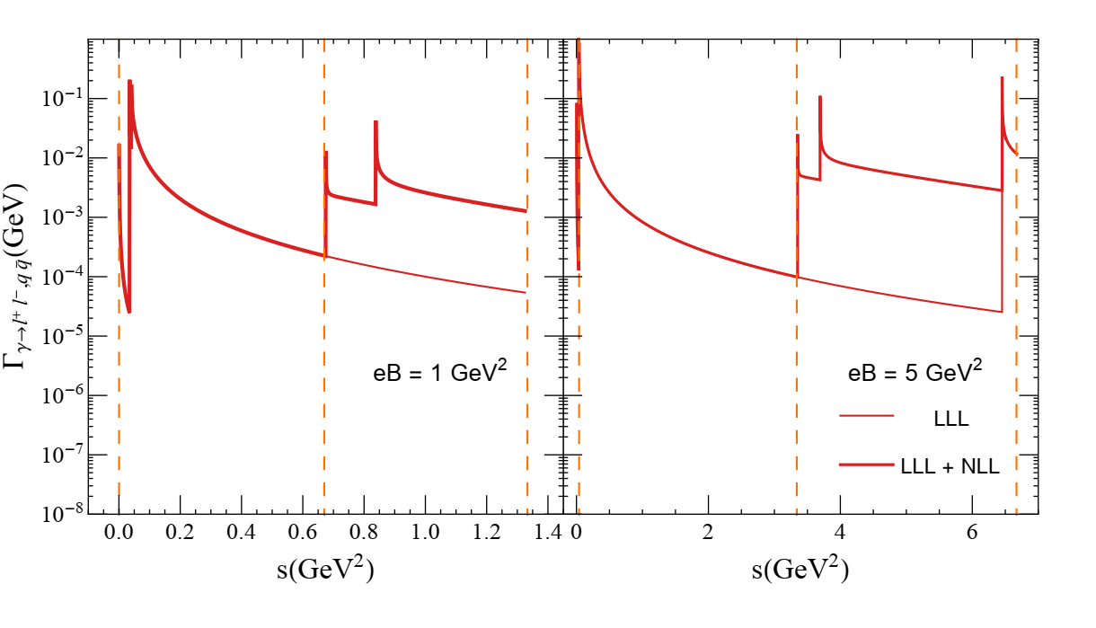
Total decay rate
LLL+NLL (Landau level n=0,1) is a good approximation in strong
magnetic field and/or at low colliding energy.
LLL+NLL
LLL

Slide 10
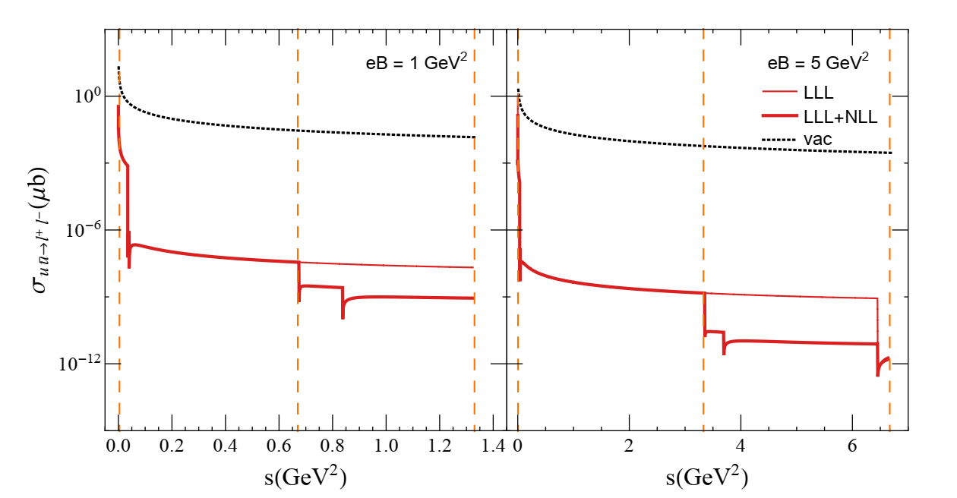
Cross section
With increasing energy, more decay channels open which leads
to a decreased cross section.

Slide 11
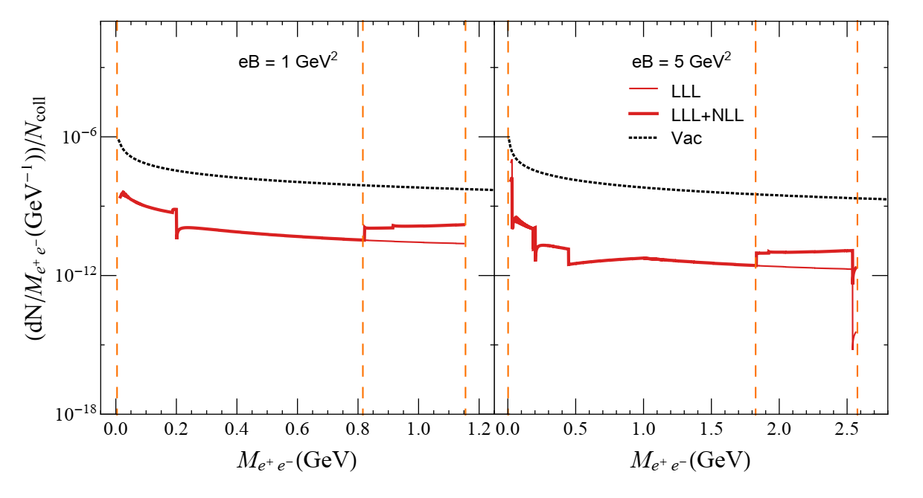
Dielectron spectrum
The Drell-Yan process is suppressed by the photon decay
in a magnetic field!

Slide 12
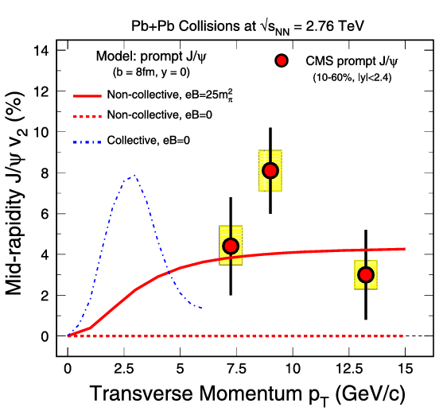
Summary
The strong magnetic field in the initial stage changes dramatically the
particle production.
The changes can be tested in the future heavy ion collisions at LHC. For instance, the quarkonia might be enhanced at low pt and are easy to be thermalized with a larger elliptic flow.
Looking forward to the collaboration with experimentalists! .
X.Guo, S.Shi, N.Xu, Z.Xu and P.Zhuang,
PLB751, 215(2015)
Thank you for your attention!

