Slide 1

HIAF Physics
- Physics at High Baryon Density
- $Λ$ Polarization and Its Spin Structure
许 怒 (CCNU / IMP CAS)
Nu Xu
May 16, 2022

Slide 2
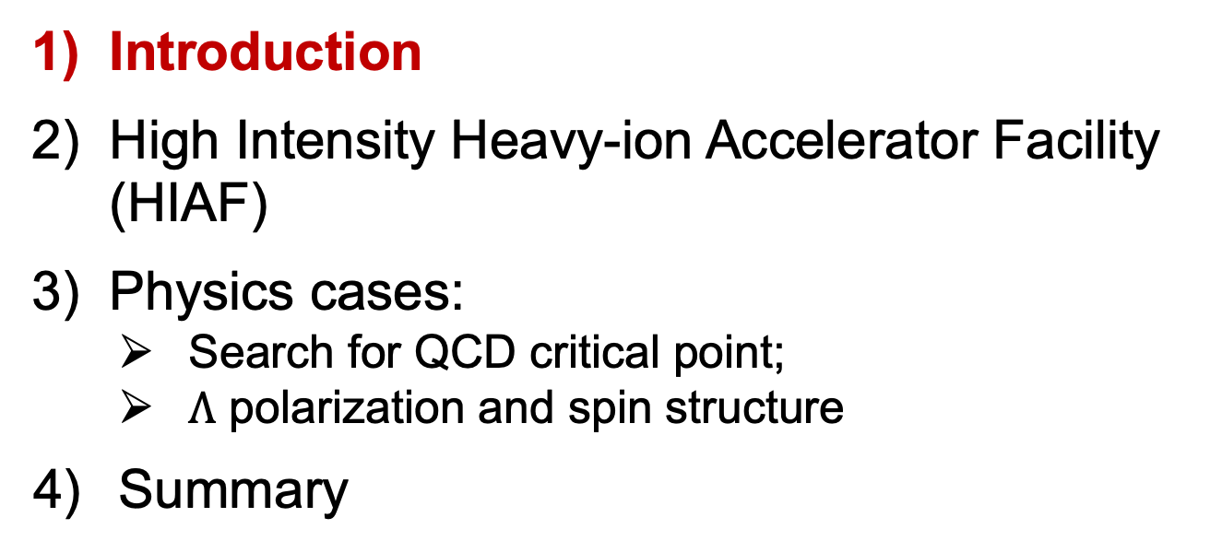
Outline
Introduction
High Intensity Heavy-ion Accelerator Facility (HIAF)
Physics cases:
Search for QCD critical point;
$Λ$ polarization and spin structure
4) Summary

Slide 3
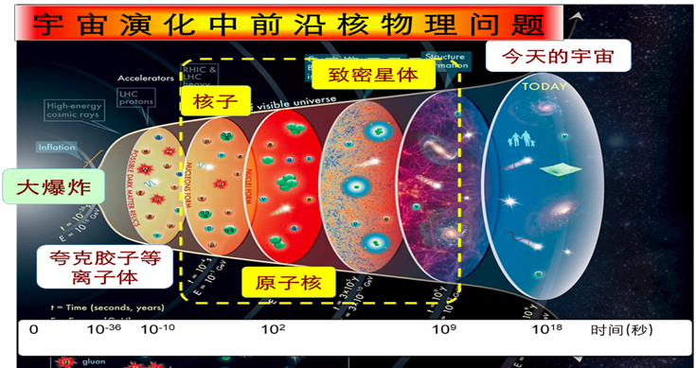
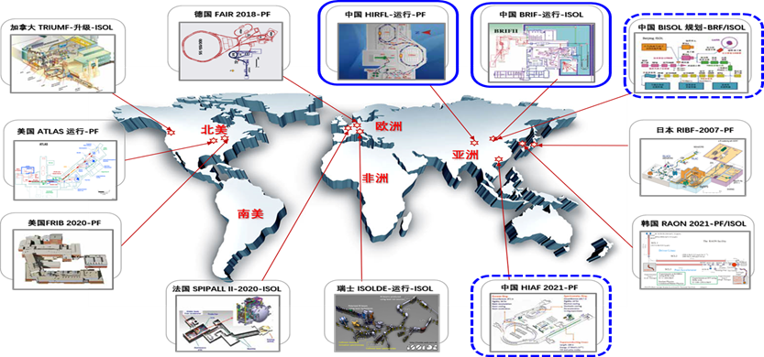
Introduction
1)可见物质(核物质) 质量 自旋起源、结构、性质和演化的研究是物质科学前沿；
2) 重离子碰撞是实验室产生和研究核物质的最佳手段之一；
3) 世界科技强国正在或者计划建造下一代强流离子加速器大科学装置

Slide 4
Nuclear Collisions and QCD Phase Diagram
Early Universe
High baryon density:
Inner structure of
compact stars
RHIC BES: $→$ search for 1st-order phase transition and QCD critical point;
Baryon interactions (e.g. $N−N,$ $Y−N$) $→$ inner structure of compact stars

Slide 5
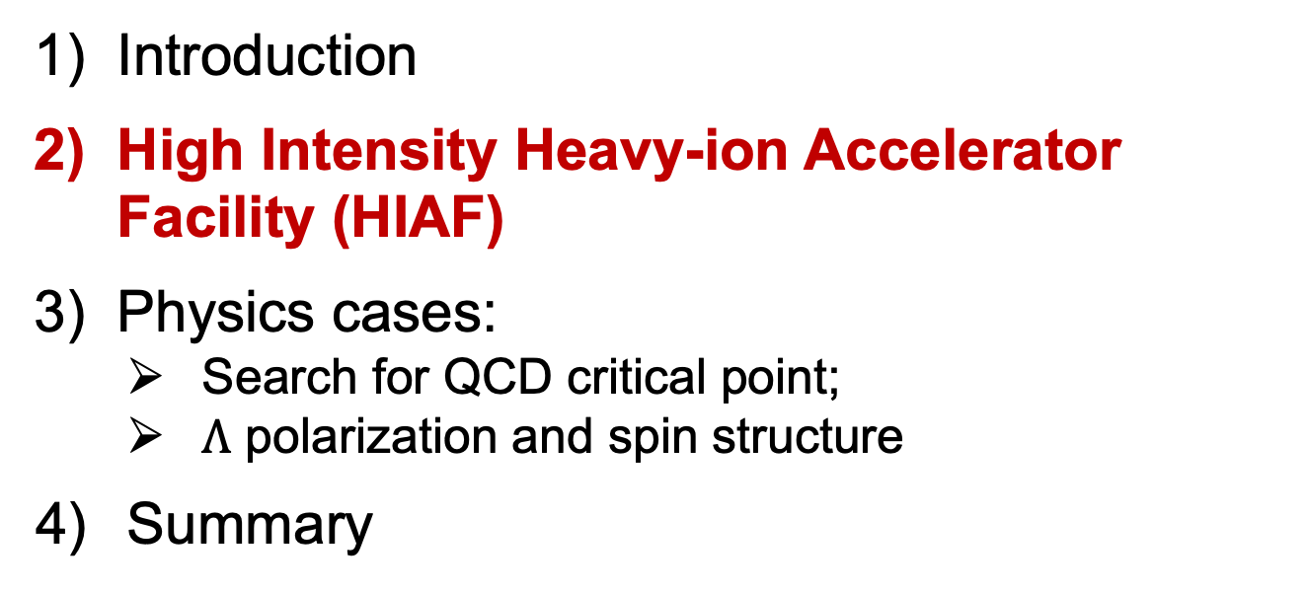
Outline
Introduction
High Intensity Heavy-ion Accelerator Facility (HIAF)
Physics cases:
Search for QCD critical point;
$Λ$ polarization and spin structure
4) Summary

Slide 6
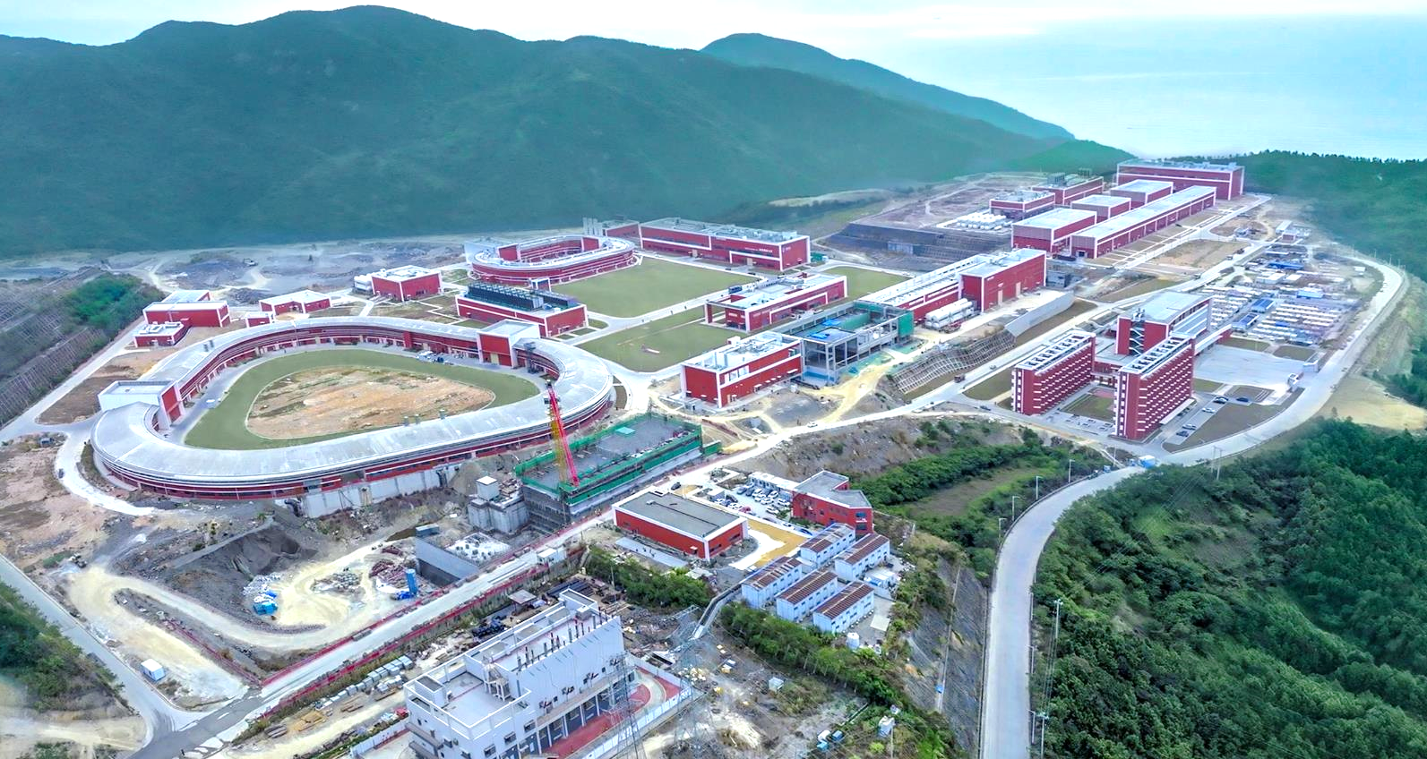
Outline
强流重离子加速器装置 ( 广东 惠州 )
High Intensity Heavy-ion Accelerator Facility (HIAF)
“十二五”国家重大科技
基础设施建设项目
计划2025年开始调束

Slide 7
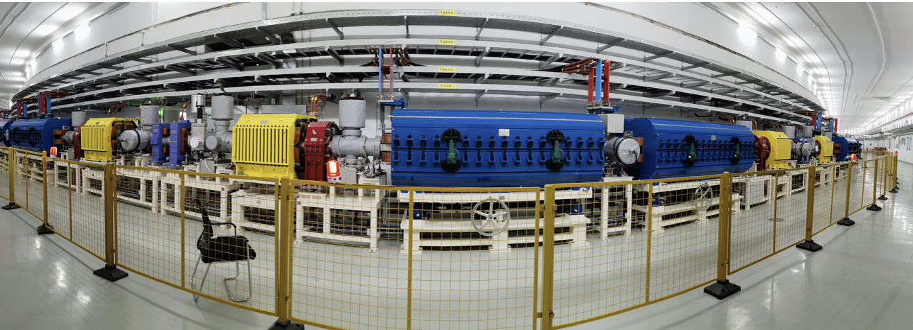
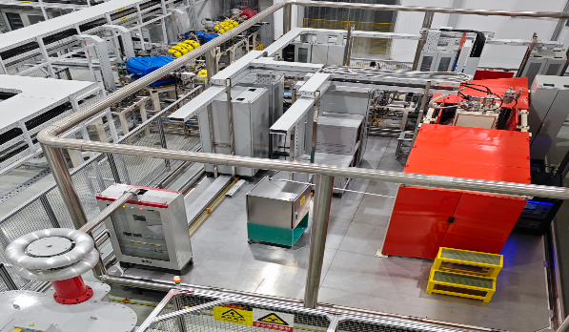
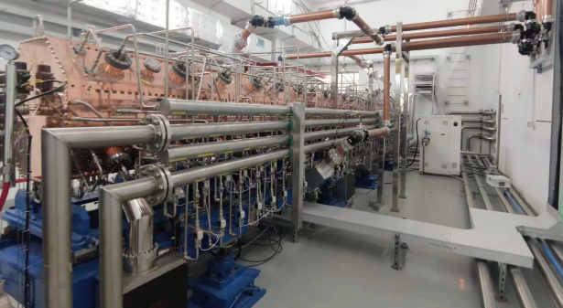
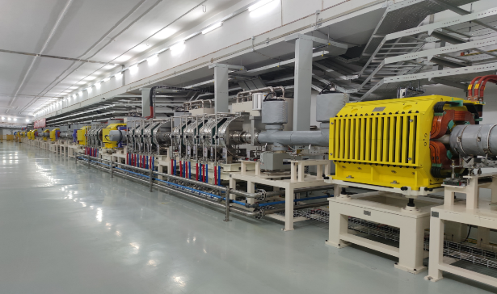
HIAF
HIAF 安装进展
粒子源
直线加速器
回旋加速器

Slide 8
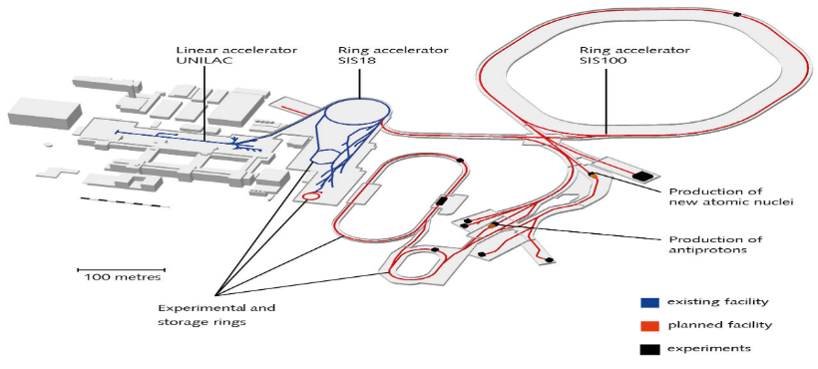
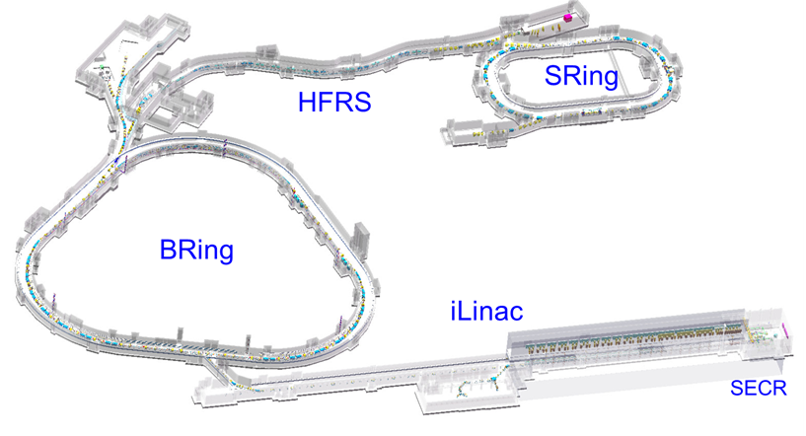
HIAF 和 FAIR 重离子加速器装置
HIAF特色和优势：束流指标和时间窗口
德国 - FAIR
研究所 | 装置 | 重复 频率 | 离子 种类 | 设计 流强 | 达到 流强
BNL | AGS Booster | / | Au³²⁺ | / | 5×10⁹
CERN | LEIR | / | Pb⁵⁴⁺ | / | 9×10⁸
JINR | NICA | / | Au³²⁺ | 4×10⁹ | /
GSI | SIS18 | 2.7Hz | U²⁸⁺ | 1.0×10¹¹ | 3×10¹⁰
FAIR | SIS100 | 2.7Hz | U²⁸⁺ | (1.0-2.0)×10¹¹ | /
IMP | HIAF-BRing | 3-5Hz | U⁴⁵⁺ | 2.0×10¹¹ | /
IMP | HIAF-SRing | / | U⁴⁵⁺ | 1.0×10¹² | /
33亿欧元，~2028调试
中国 - HIAF
国际上脉冲流强最高的快循环重离子同步加速器、精度最高的核质量环形谱仪
28亿人民，2025调试

Slide 9
HIAF Beam Parameters
Ion | Intensity (ppp) | Kinetic Energy (GeV/u)
²³⁸U³⁵⁺ | 2.0×10¹¹ | 0.84
²³⁸U⁷⁶⁺ | 5.0×10¹⁰ | 2.5
¹²⁹Xe²⁷⁺ | 3.6×10¹¹ | 1.4
⁷⁸Kr¹⁹⁺ | 5.0×10¹¹ | 1.7
⁴⁰Ar¹²⁺ | 7.0×10¹¹ | 2.3
¹⁸O⁶⁺ | 8.0×10¹¹ | 2.6
p | 5.0×10¹² | 9.3

Slide 10
HIAF未来升级计划（HIAF-U）
研究机构 | 加速器 | 建成时间 | 典型离子束 | 典型离子束能量 | 束流强度或束流功率
德国 GSI | FAIR SIS100 | 2025 | ²³⁸U²⁸⁺ | 2. 7 GeV/u | 5×10¹¹ ppp
俄罗斯 JINR | NICA-Booster | 2023 | ¹⁹⁷Au³²⁺ | 4. 5 GeV/u | 4×10⁹ ppp
中国 IMP | HIAF | 2025 | ²³⁸U³⁵⁺ | 0. 8 GeV/u | 1.0-2. 0×10¹¹ ppp
 |  |  | ²³⁸U⁷⁶⁺ | 2. 45 GeV/u | 0.5-1.0×10¹¹ ppp
 |  |  | p | 9.3 GeV/u | 5×10¹³
 | HIAF-U BRing-S | 2027-2032 | ²³⁸U³⁵⁺ | 2. 95 GeV/u | 2. 0×10¹² ppp
 |  |  | ²³⁸U⁷⁶⁺ | 7. 3 GeV/u | 1.0×10¹² ppp
 |  |  | ²³⁸U⁹²⁺ | 9. 1 GeV/u | 1.0×10¹² ppp
 |  |  | p | 25.0 GeV/u | 4.0×10¹⁴
 | HIAF-U MRing | 2027-2032 | ²³⁸U⁹²⁺ | 4. 4 GeV/u | 2×10¹² ppp
 | HIAF-U iLinac | 2027-2032 | ²³⁸U⁴⁶⁺ | 150-200 MeV/u | 1 emA
 | HIAF-ISOL 驱动加速器 | 2027-2032 | H⁻, H⁺ | 0. 5-1. 0 GeV/u | 5-10 mA （2.5~10 MW）
为建设 中国电子-粒子对撞机 EicC 奠定基础

Slide 11
Future High Rates Experiments
$μ_{B}$ (MeV) 800 200 20
HIAF
HIAF: 2025;
FAIR: 2028;
ALICE3: 2034

Slide 12
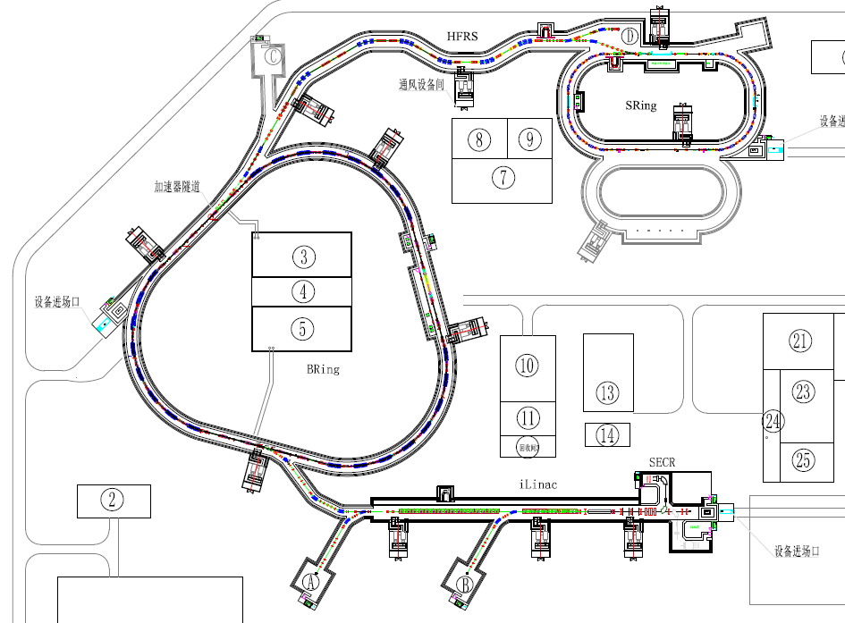


强流超导直线(iLinac)、快循环同步环(Bring)与六大实验终端结合
④ 外靶实验终端
⑥ 高精度核质量环形谱仪
强流离子源系统 (SECR)
② 高能综合研究终端
超导直线加速器 (iLinac)
加速器
增强器 (BRing)
③ 放射性次
级束分离器
QCD
束线系统
⑤ 电子-离子复合谱仪
低能综合研究终端
HFRS
高能综合研究终端
BRing
放射性次级束流分离器
119 120
实验终端
外靶实验终端
电子-离子复合共振谱仪
HIAF Physics：
atomic physics;
nuclear physics;
applied research in biology and material science etc.
iLinac
高精度环谱仪(SRing)
SECR
HIAF
公共配套设施
配套设施
通用设施及其他
① 低能综合终端
土建工程

Slide 13
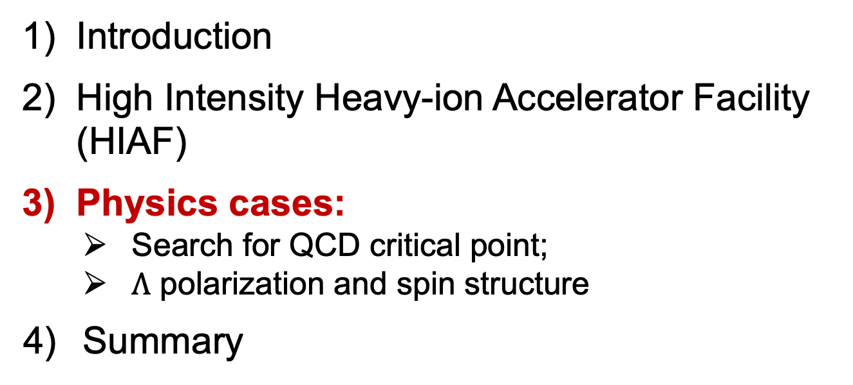
Outline
Introduction
High Intensity Heavy-ion Accelerator Facility (HIAF)
Physics cases:
Search for QCD critical point;
$Λ$ polarization and spin structure
4) Summary

Slide 14
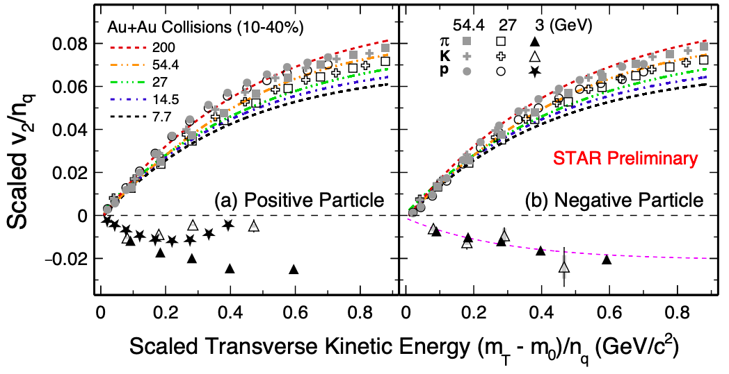
Disappearance of Partonic Collectivity
Hadronic Matter
QGP
At 3 GeV, NCQ scaling is absent；
Transport model calculations, with baryonic mean field, reproduce both v₁ and v₂ results；
hadronic interactions dominant!
STAR: PLB827, 137003(2022)

Slide 15
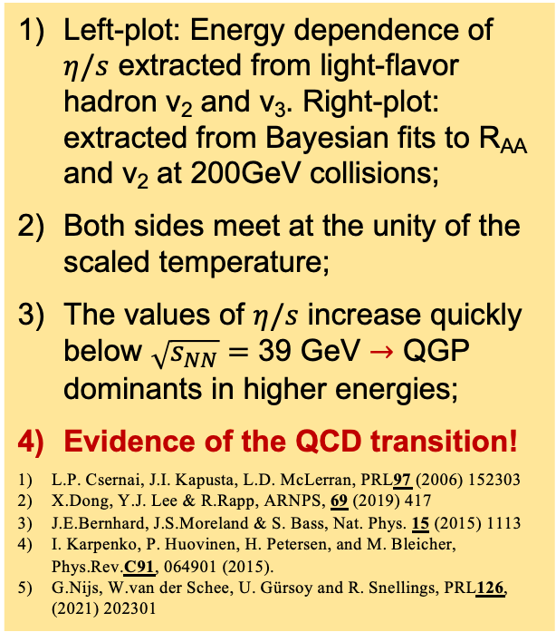
Equation of State for Strong Interaction
Left-plot: Energy dependence of $η/s$ extracted from light-flavor hadron v₂ and v₃. Right-plot: extracted from Bayesian fits to R_{AA} and v₂ at 200GeV collisions;
Both sides meet at the unity of the scaled temperature;
The values of $η/s$ increase quickly below $\sqrt{s_{NN}}=$ 39 GeV $→$ QGP dominants in higher energies;
Evidence of the QCD transition!
L.P. Csernai, J.I. Kapusta, L.D. McLerran, PRL97 (2006) 152303
X.Dong, Y.J. Lee & R.Rapp, ARNPS, 69 (2019) 417
J.E.Bernhard, J.S.Moreland & S. Bass, Nat. Phys. 15 (2015) 1113
I. Karpenko, P. Huovinen, H. Petersen, and M. Bleicher, Phys.Rev.C91, 064901 (2015).
G.Nijs, W.van der Schee, U. Gürsoy and R. Snellings, PRL126, (2021) 202301
7.7 GeV
200GeV & 2.76TeV
Quantum limit
39 GeV

Slide 16
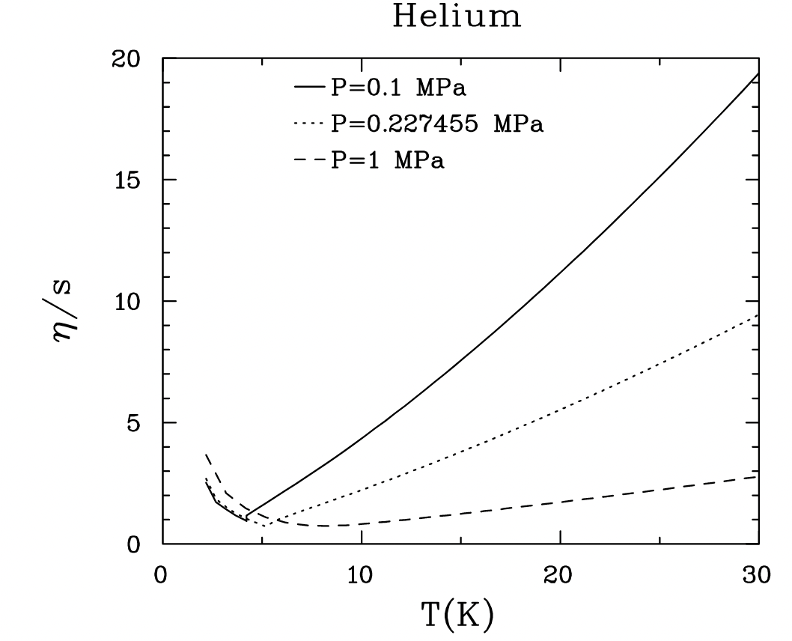
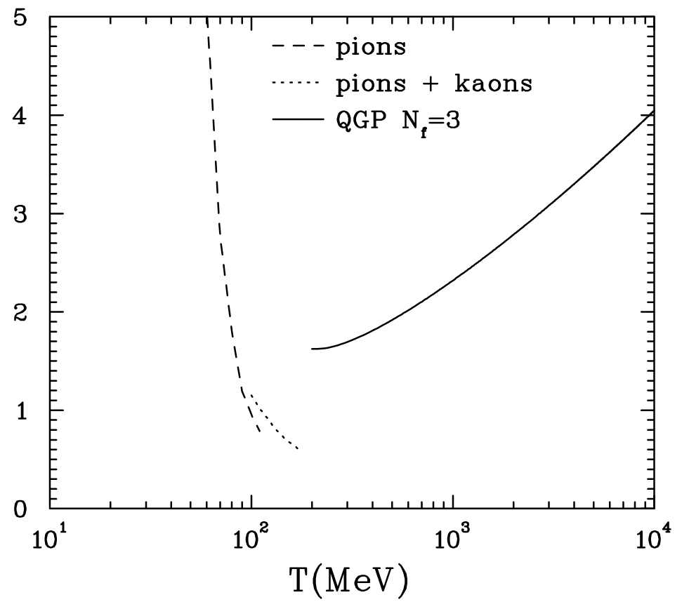
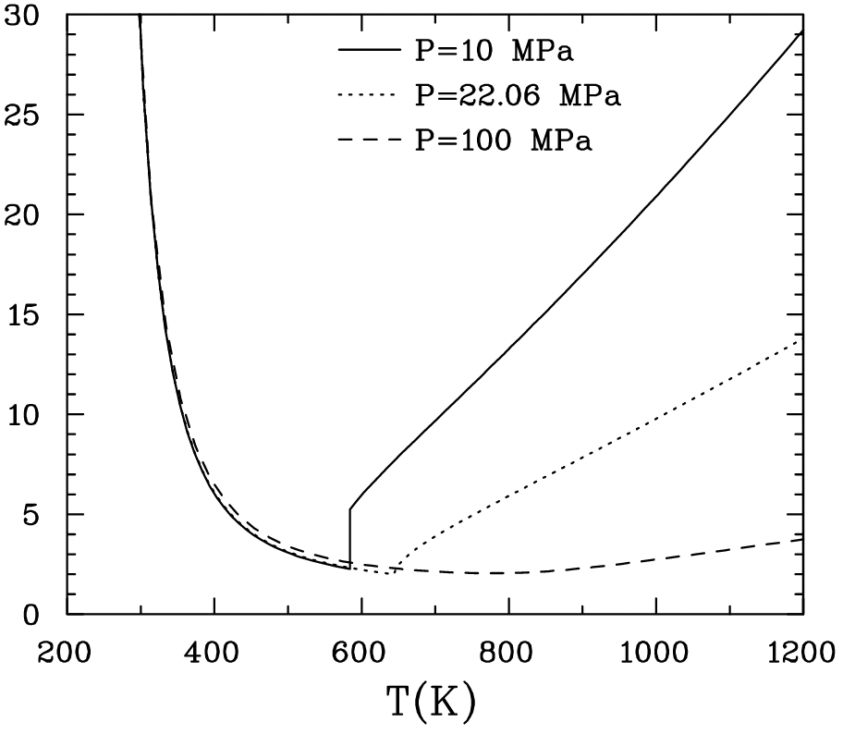
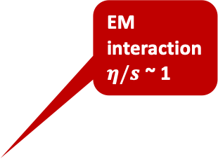


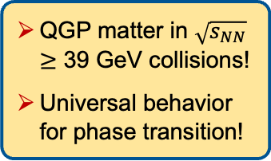

Strongly-Interacting Low-Viscosity Matter
EM
interaction
$η/s$ ~ 1
Helium
$$η/s$$
NM
L.P. Csernai, J.I. Kapusta, L.D. McLerran, PRL97 (2006) 152303
Strong
Interaction
$η/s$ ~ 0.1
Viscosity over Entropy Ratio$η/s$
H₂O
QGP matter in $\sqrt{s_{NN}}$ $≥$ 39 GeV collisions!
Universal behavior for phase transition!

Slide 17

LGT Calculation: QCD Phase Structure
$$T_{C}^{0}$$
T_{PC}
T^{TriC}
T^{CEP}
QCD transition temperature:
$T_{PC}=156.5±1.5$ MeV
2) Chiral crossover line
$T_{PC}\left(μ_{B}\right)=T_{PC}^{0}\left[1−κ_{2}{\left(\frac{μ_{B}}{T_{PC}^{0}}\right)}^{2}−κ_{4}{\left(\frac{μ_{B}}{T_{PC}^{0}}\right)}^{4}\right]$
${ κ}_{2}=0.012\left(4\right),$ ${ κ}_{4}=0.00\left(4\right)$
3) Chiral transition temperature:
${ T}_{C}={132}_{−6}^{+3}$ MeV
4) QCD critical end point, if exits:
${ T}^{CEP}<T_{C}$, $μ_{B}^{CEP}≳3T_{C}$
HotQCD: Phys.Lett.B795, 15(2019);
Phys. Rev. Lett. 123, 062002(2019)
F. Karsch et al., 2020

Slide 18
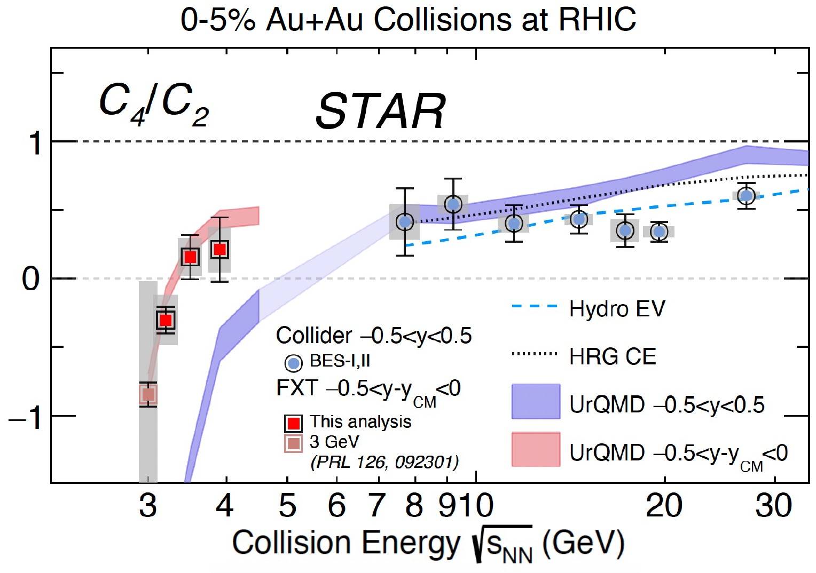
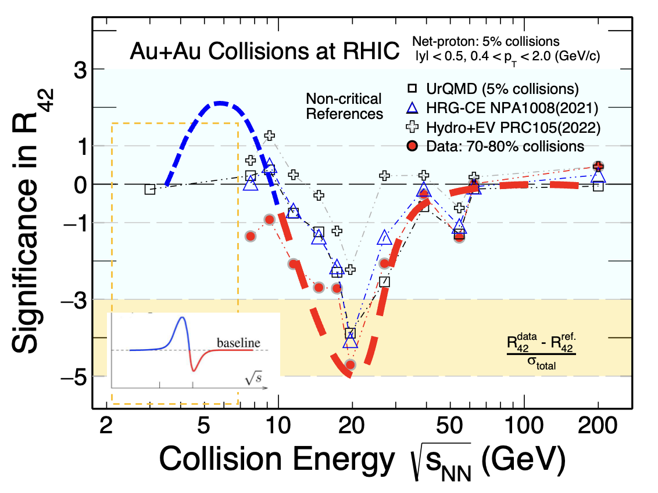
Search for the QCD Critical Point
罗晓峰
0-5% Au+Au Collisions at RHIC
Experimental results between 3.5 – 8 GeV are crucial;
CEE at HIRFL and HNS at HIAF will play important role for the search of the QCD critical point

Slide 19
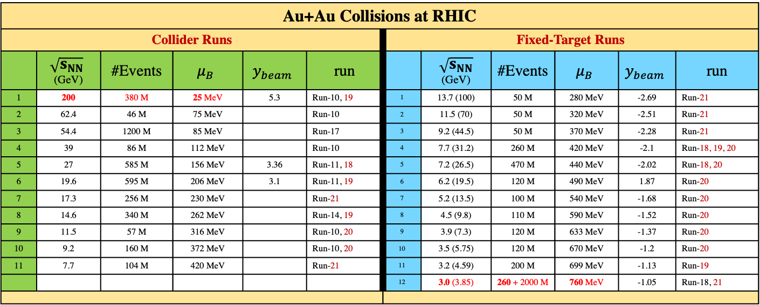

STAR BES-I and BES-II Data Sets
Au+Au Collisions at RHIC
Collider Runs |  |  |  |  |  | Fixed-Target Runs
 | $$\sqrt{s_{NN}}$$ (GeV) | #Events | $$μ_{B}$$ | $$y_{beam}$$ | run |  | $\sqrt{s_{NN}}$ (GeV) | #Events | $$μ_{B}$$ | $$y_{beam}$$ | run
1 | 200 | 380 M | 25 MeV | 5.3 | Run-10, 19 | 1 | 13.7 (100) | 50 M | 280 MeV | -2.69 | Run-21
2 | 62.4 | 46 M | 75 MeV |  | Run-10 | 2 | 11.5 (70) | 50 M | 320 MeV | -2.51 | Run-21
3 | 54.4 | 1200 M | 85 MeV |  | Run-17 | 3 | 9.2 (44.5) | 50 M | 370 MeV | -2.28 | Run-21
4 | 39 | 86 M | 112 MeV |  | Run-10 | 4 | 7.7 (31.2) | 260 M | 420 MeV | -2.1 | Run-18, 19, 20
5 | 27 | 585 M | 156 MeV | 3.36 | Run-11, 18 | 5 | 7.2 (26.5) | 470 M | 440 MeV | -2.02 | Run-18, 20
6 | 19.6 | 595 M | 206 MeV | 3.1 | Run-11, 19 | 6 | 6.2 (19.5) | 120 M | 490 MeV | 1.87 | Run-20
7 | 17.3 | 256 M | 230 MeV |  | Run-21 | 7 | 5.2 (13.5) | 100 M | 540 MeV | -1.68 | Run-20
8 | 14.6 | 340 M | 262 MeV |  | Run-14, 19 | 8 | 4.5 (9.8) | 110 M | 590 MeV | -1.52 | Run-20
9 | 11.5 | 57 M | 316 MeV |  | Run-10, 20 | 9 | 3.9 (7.3) | 120 M | 633 MeV | -1.37 | Run-20
10 | 9.2 | 160 M | 372 MeV |  | Run-10, 20 | 10 | 3.5 (5.75) | 120 M | 670 MeV | -1.2 | Run-20
11 | 7.7 | 104 M | 420 MeV |  | Run-21 | 11 | 3.2 (4.59) | 200 M | 699 MeV | -1.13 | Run-19
 |  |  |  |  |  | 12 | 3.0 (3.85) | 260 + 2000 M | 760 MeV | -1.05 | Run-18, 21
Most precise data to map the QCD phase diagram
3 $< \sqrt{s_{NN}}<200 GeV; 760> μ_{B}>25 MeV$

Slide 20
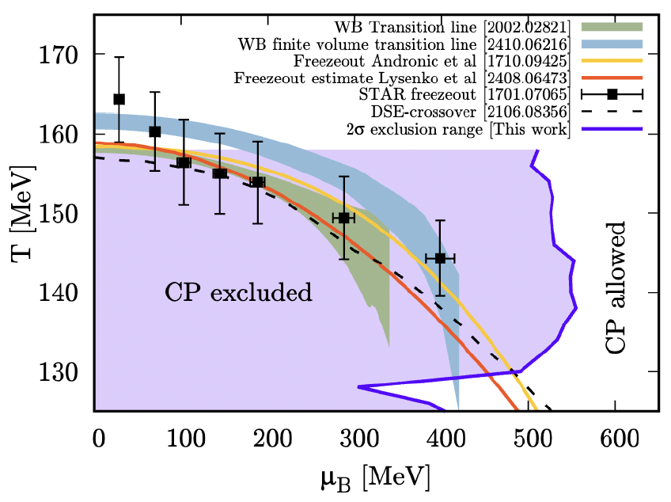
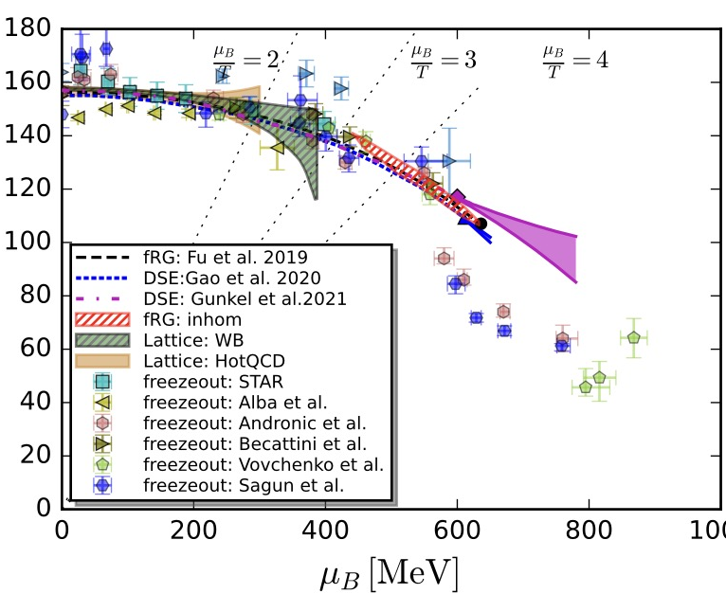
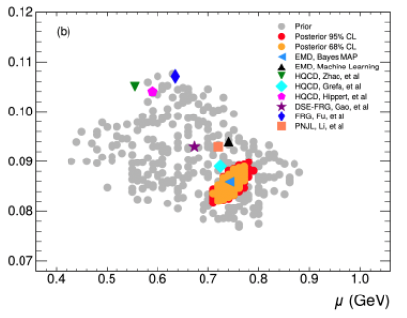
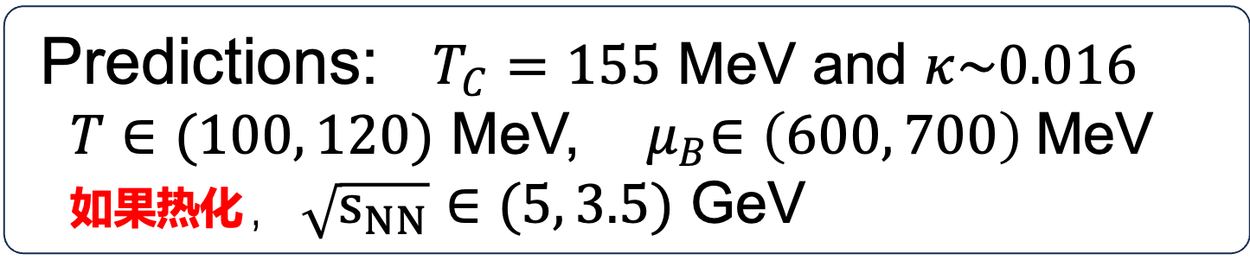
Estimations on QCD Critical Point
黄梅
高飞
黄梅，周凯等
Predictions: $T_{C}=155$ MeV and $κ\sim 0.016$
$T∈(100, 120)$ MeV, ${ μ}_{B}∈\left(600, 700\right)$MeV
如果热化，$\sqrt{s_{NN}}∈(5, 3.5)$ GeV

Slide 21
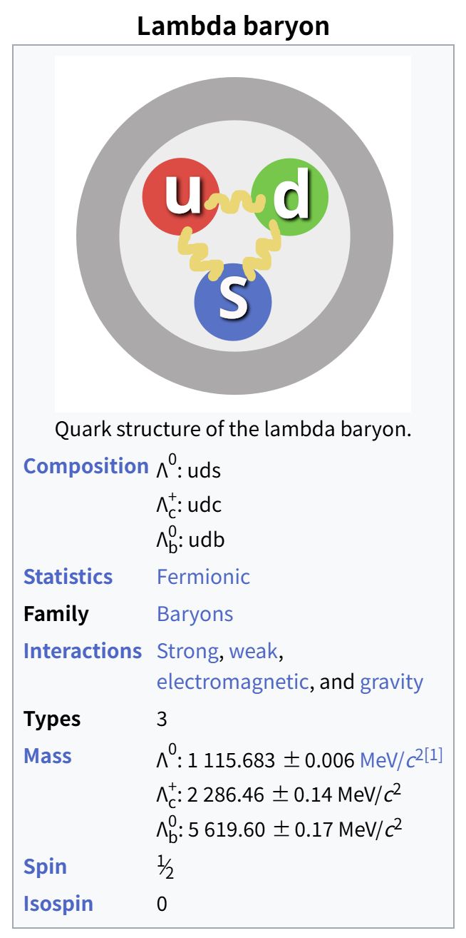

强相互作用与强子自旋
自旋是每个强子的内禀量子数
强相互作用与自旋紧密相关
$Λ$ 极化起源、自旋结构？
其他重子极化吗，p？
$Λ$ 全局极化，局域极化与$Λ$ 极化的联系？
…
Z.T. Liang, Y.T. Liang, Q.H. Xu, Y.X. Zhao

Slide 22
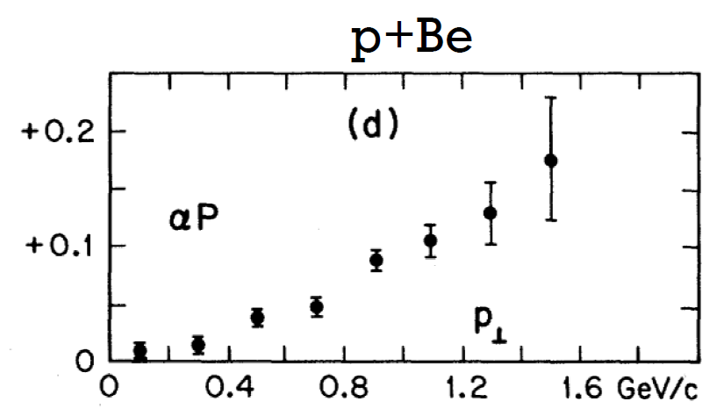
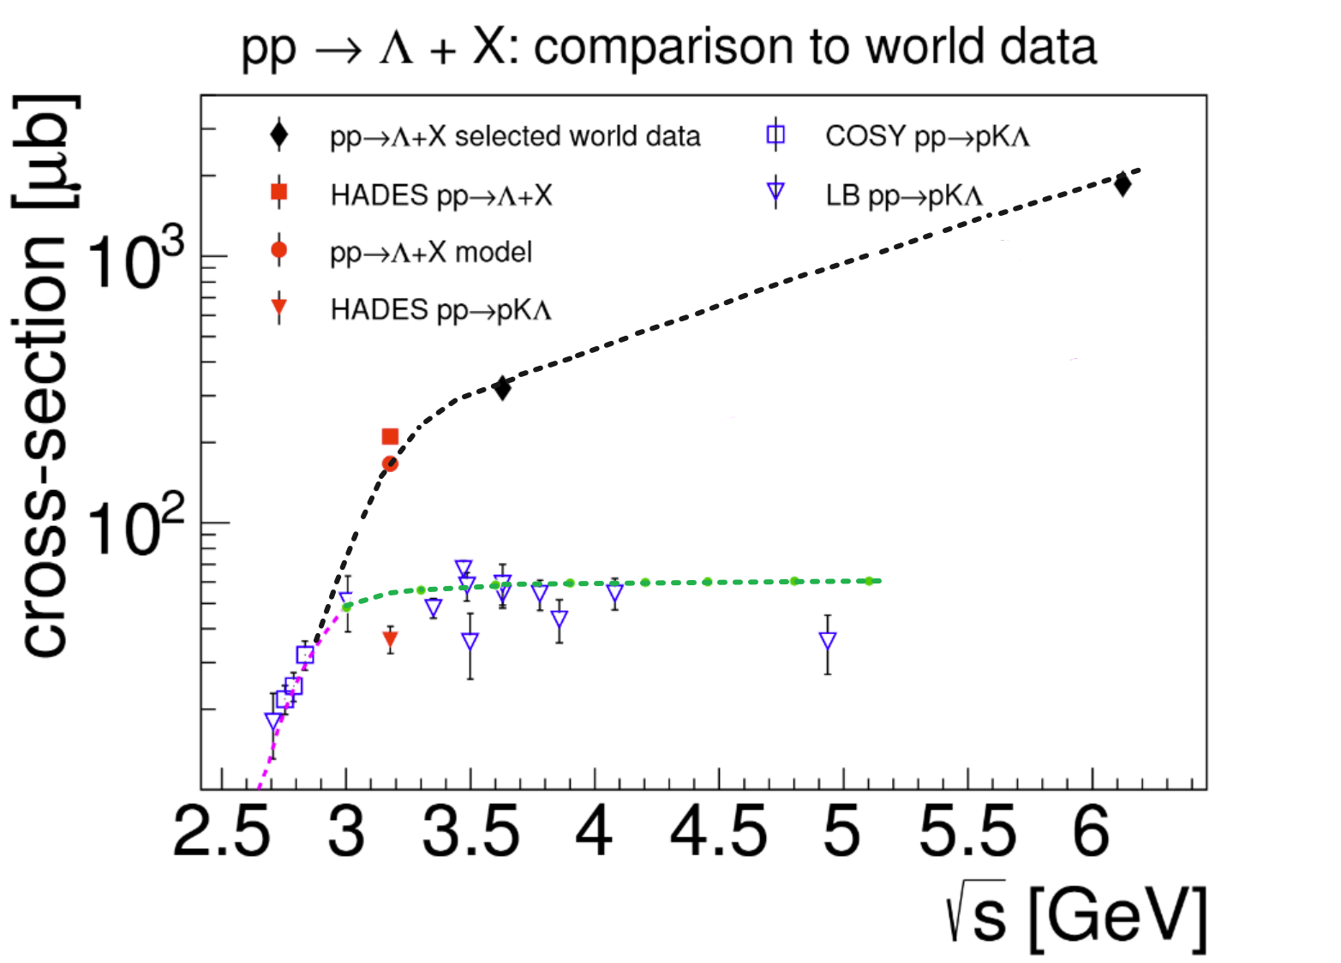

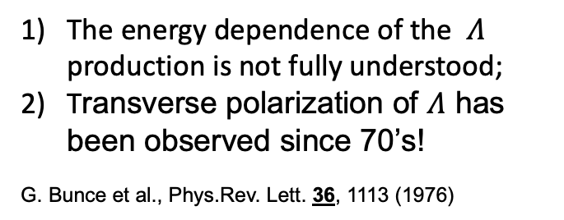
$Λ$ Production and Polarization
The energy dependence of the $Λ$ production is not fully understood;
Transverse polarization of $Λ$ has been observed since 70’s!
G. Bunce et al., Phys.Rev. Lett. 36, 1113 (1976)
赵宇翔

Slide 23
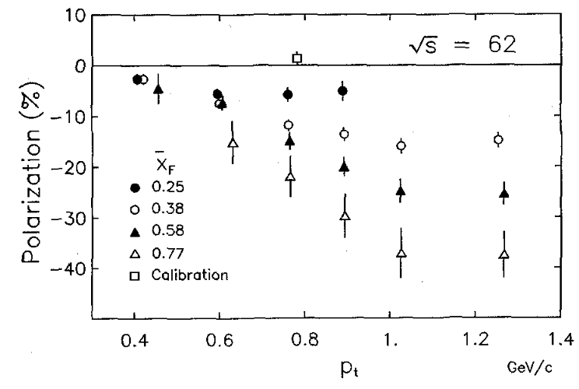
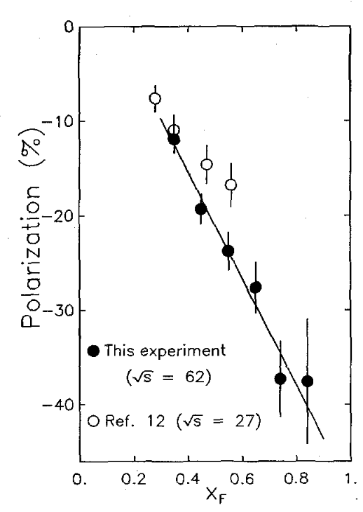
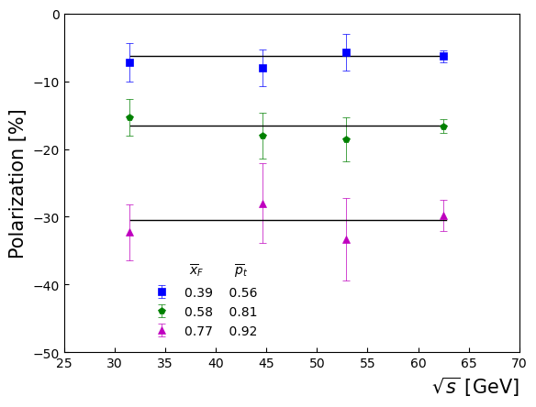




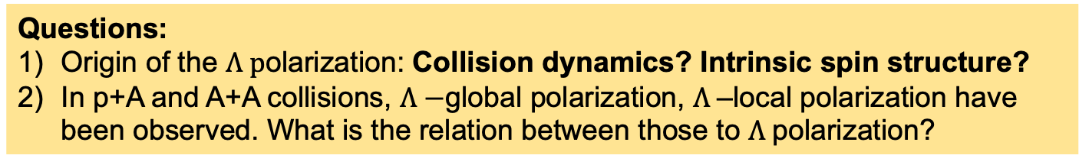
$Λ−$Polarization: $x_{f}$- anf $p_{T}$-scaling (?)
R608: 10.1016/0370-2693(87)91556-5
赵宇翔
$$p_{T}$$
$$x_{f}$$
$${scaling}_{}$$
Questions:
Origin of the $Λ p$olarization: Collision dynamics? Intrinsic spin structure?
In p+A and A+A collisions, $Λ−$global polarization, $Λ$–local polarization have been observed. What is the relation between those to $Λ$polarization?

Slide 24
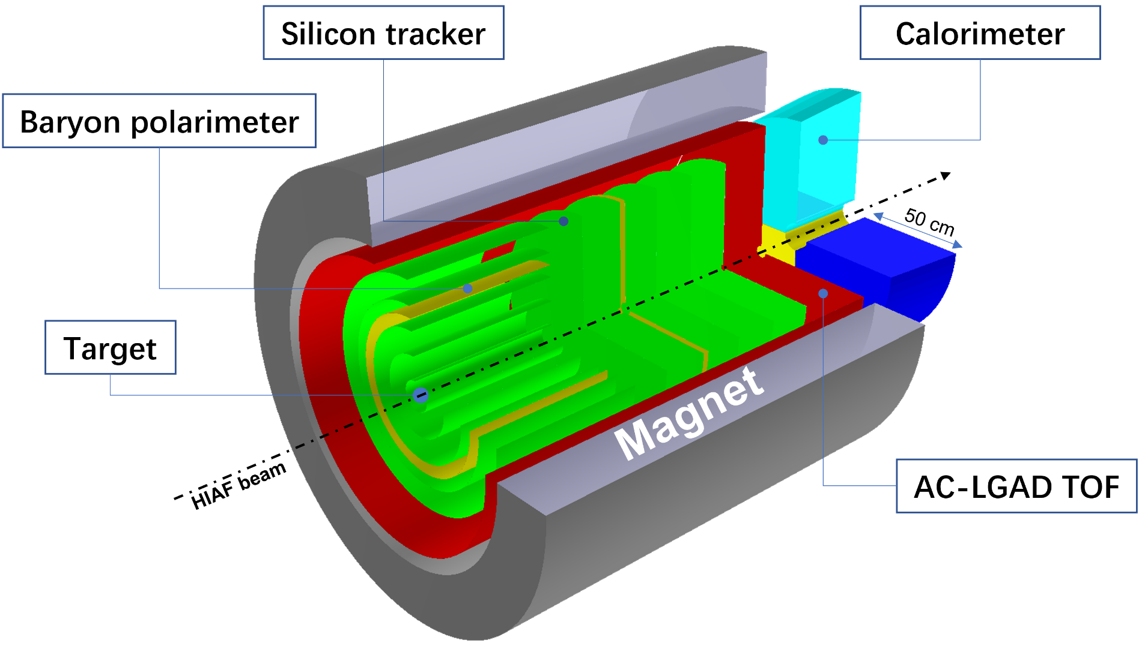
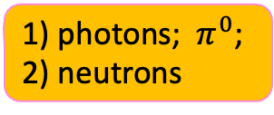
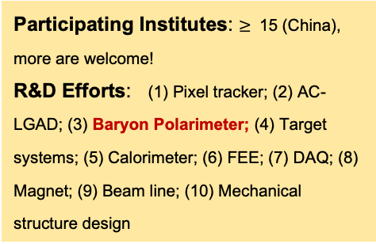
超子-核子谱仪 概念设计
photons; $π^{0}$;
neutrons
Participating Institutes: $≥$ 15 (China), more are welcome!
R&D Efforts: (1) Pixel tracker; (2) AC-LGAD; (3) Baryon Polarimeter; (4) Target systems; (5) Calorimeter; (6) FEE; (7) DAQ; (8) Magnet; (9) Beam line; (10) Mechanical structure design
梁羽铁 重子极化测量
梁羽铁、赵宇翔 HNS / 仇浩 HHaS

Slide 25

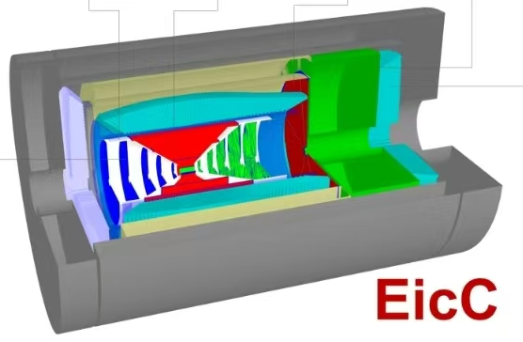
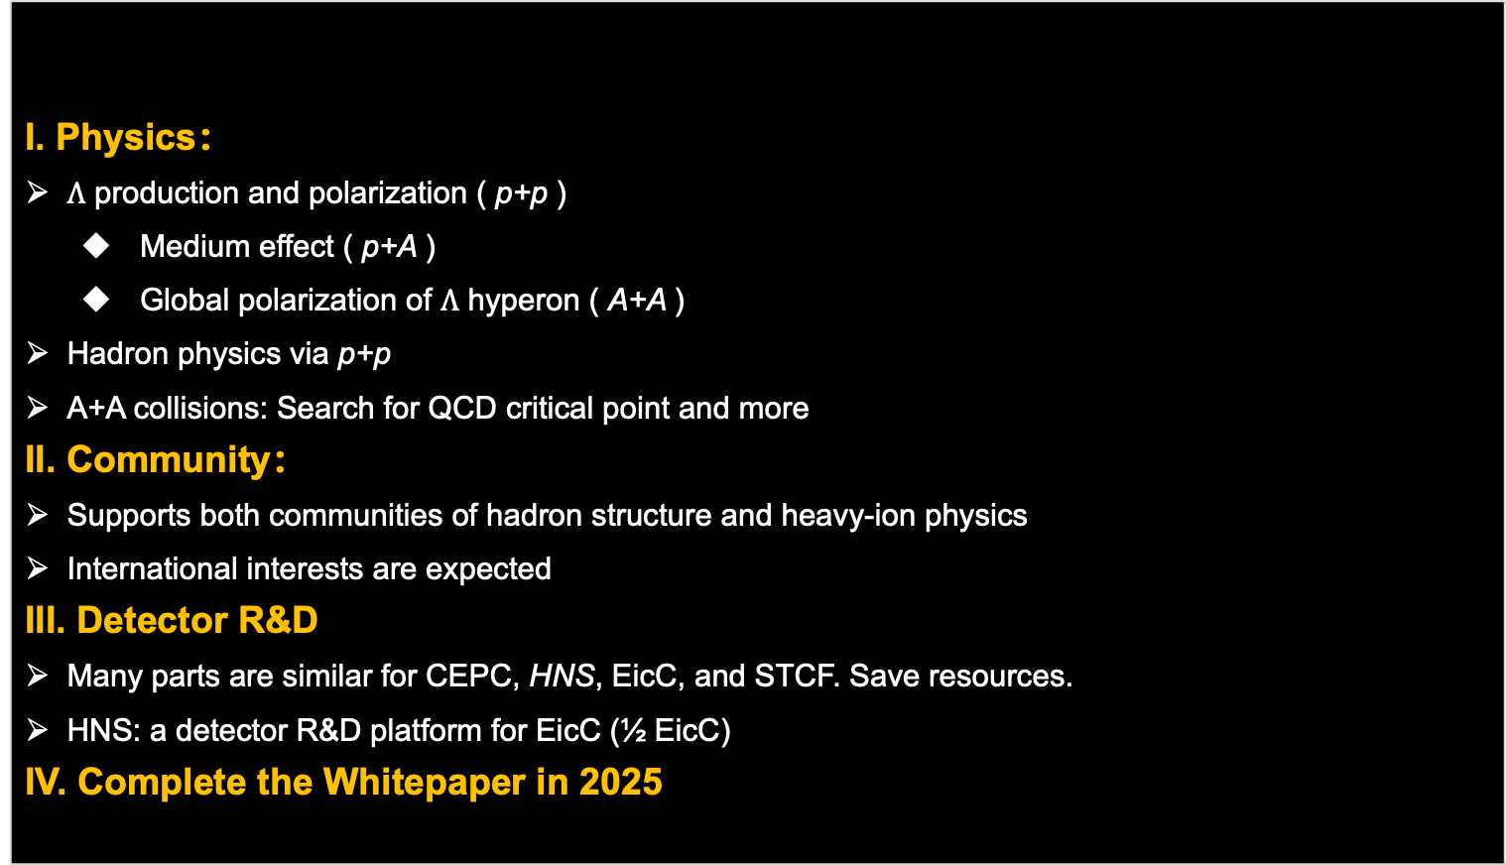
HNS
I. Physics：
$Λ$ production and polarization ( p+p )
  Medium effect ( p+A )
  Global polarization of $Λ$ hyperon ( A+A )
  Hadron physics via p+p
  A+A collisions: Search for QCD critical point and more
II. Community：
Supports both communities of hadron structure and heavy-ion physics
International interests are expected
III. Detector R&D
Many parts are similar for CEPC, HNS, EicC, and STCF. Save resources.
HNS: a detector R&D platform for EicC (½ EicC)
IV. Complete the Whitepaper in 2025
e
p

Slide 26
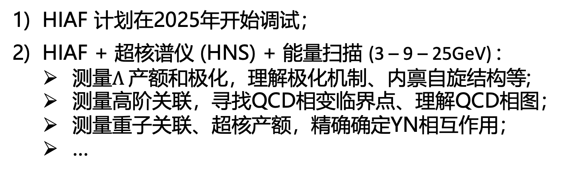
HIAF Physics
HIAF 计划在2025年开始调试；
HIAF + 超核谱仪 (HNS) + 能量扫描 (3 – 9 – 25GeV) :
测量$Λ$产额和极化，理解极化机制、内禀自旋结构等;
测量高阶关联，寻找QCD相变临界点、理解QCD相图；
测量重子关联、超核产额，精确确定YN相互作用；
…
HIAF 将极大促进中国核物理研究的发展！
让我们欢迎中高能核物理新的春天！

Slide 27
Acknowledgements:
P. Braun-Munzinger, X. Dong, S. Esumi, F. Karsch, V. Koch, XF. Luo, B. Mohanty, A. Pandav, A. Rustamov, K. Redlich, M. Stephanov, J. Stachel, J. Stroth, V. Vovchenko, Y. Zhang
A.Q. Guo, Y.T. Liang, Z.T. Laing, J.J. Wu, Q.H. Xu, Y.X. Zhao
// BLUE: Theory // RED: Exp. //
Thank you for your attention!

