Slide 1
Examination of T/CP Invariance in the $e^{+}e^{−}→^{+}^{−}$Reaction at BESIII
Yunhe Yang¹, Ziyu Zhang¹, Aiqiang Guo², Chunxu Yu¹
¹NanKai University
²Institute of Modern Physics, Chinese Academy of Sciences

Slide 2
outline
MC sample
Event selection
Background analysis
<A> and R

Slide 3
Signal MC
MC sample | Number 2021 (M) | Generated Model
$$τ^{+}→e^{+}ν_{e}{\overline{ν}}_{τ}$$ $τ^{−}→μ^{−}{\overline{ν}}_{μ}ν_{τ}$ | 0.5 | PHOTOS TAULNUNU
$$τ^{+}→e^{+}ν_{e}{\overline{ν}}_{τ}$$ $τ^{−}→μ^{−}{\overline{ν}}_{μ}ν_{τ}$ | 0.5 | PHOTOS TAULNUNU

Slide 4
Exclusive MC and Inclusive MC
We generated several kinds exclusive MC, which are used to distinguish electron, muon, pion and kaon.
MC sample | Number(M) | Generated Model
$$ψ\left(2S\right)→τ^{+}τ^{−}→e^{±}e^{∓}4ν$$ | 0.5 | PHOTOS TAULNUNU
$$ψ\left(2S\right)→τ^{+}τ^{−}→μ^{±}μ^{∓}4ν$$ | 0.5 | PHOTOS TAULNUNU
$$ψ\left(2S\right)→τ^{+}τ^{−}→π^{±}π^{∓}2ν$$ | 0.5 | TAUSCALARNU
$$ψ\left(2S\right)→τ^{+}τ^{−}→K^{±}K^{∓}2ν$$ | 0.5 | TAUSCALARNU
MC sample | Number 2021 (M)
Inclusive MC | 2300

Slide 5
Event selection
Good Charged Choose
$\left|V_{r}\right|<1.0cm, \left|V_{Z}\right|<10cm, \left|cosθ\right|<0.93$
$N_{total}=2$
Good Photon Choose
$dang≥{10}^{◦}, 0≤TDC≤700ns$
$Barrel EMC: \left|cosθ\right|≤0.8, E_{γ}≥25MeV$
$Endcap EMC: 0.86≤\left|cosθ\right|≤0.92, E_{γ}≥50MeV$
$N_{γ}=0$

Slide 6
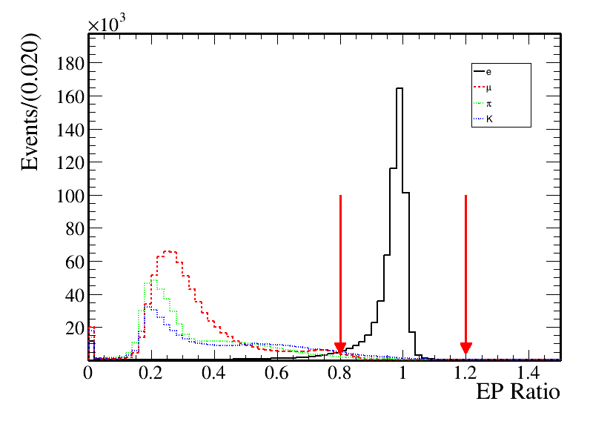
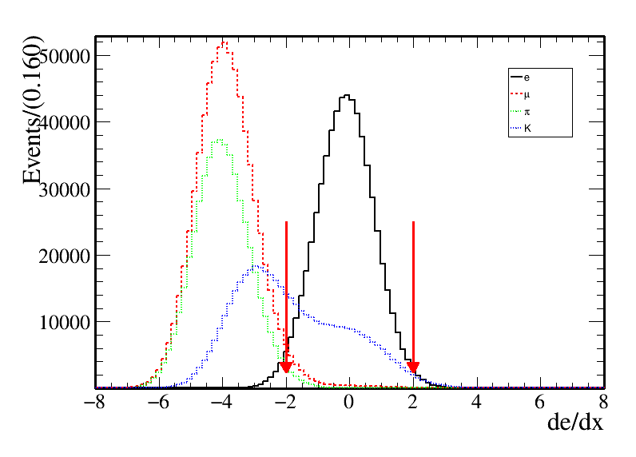
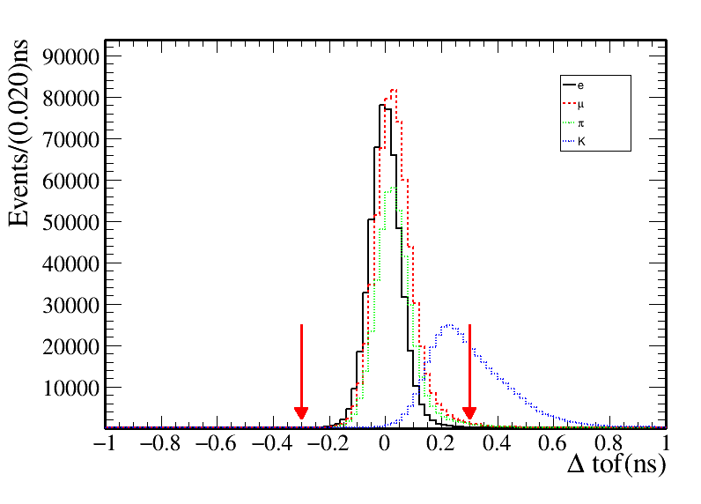
Electron identification
$0.8<E/P>1.2,$ E is the energy in EMC, P is momentum in MDC
Number of electron: $N_{e}=1$
Difference between the expected flight time and the measured time in TOF under e hypothesis : $\left|Δtof\right|<0.3$
dE/dx of MDC under e hypothesis: $−2{<χ}_{dE/dx}^{e}<2$

Slide 7
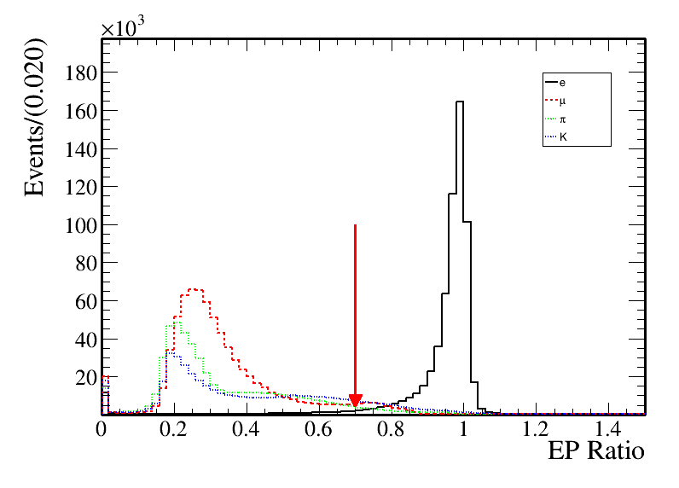
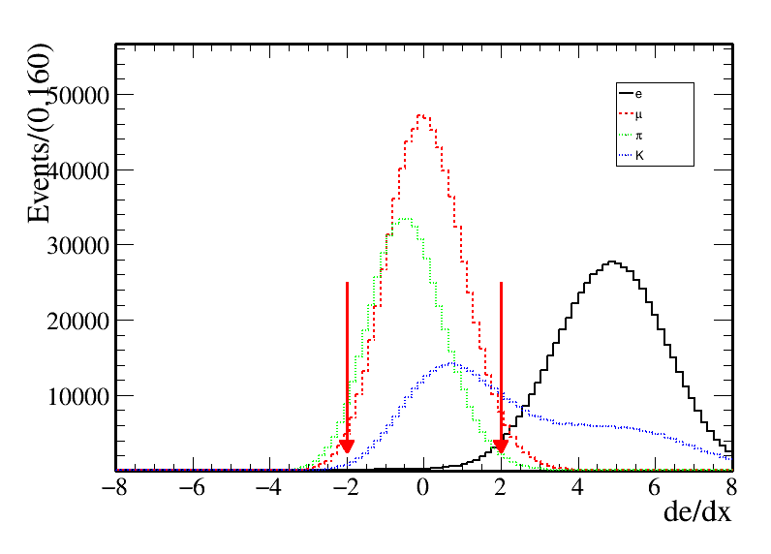
Muon identification
$E/P<0.7,$E is the energy in EMC, P is momentum in MDC
Number of muon: $Nμ=1$
Difference between the expected flight time and the measured time in TOF under mu hypothesis : $\left|Δtof\right|<0.3$
dE/dx of MDC under mu hypothesis: $−2<χ_{dE/dx}^{e}<−2$

Slide 8
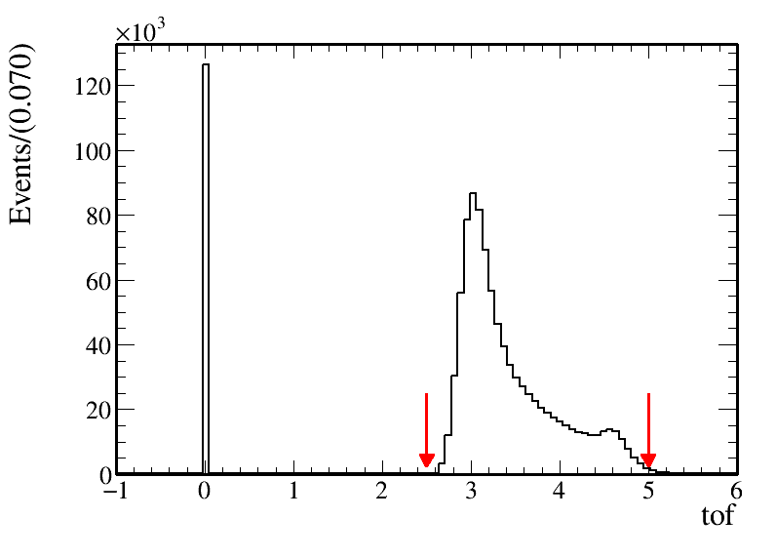
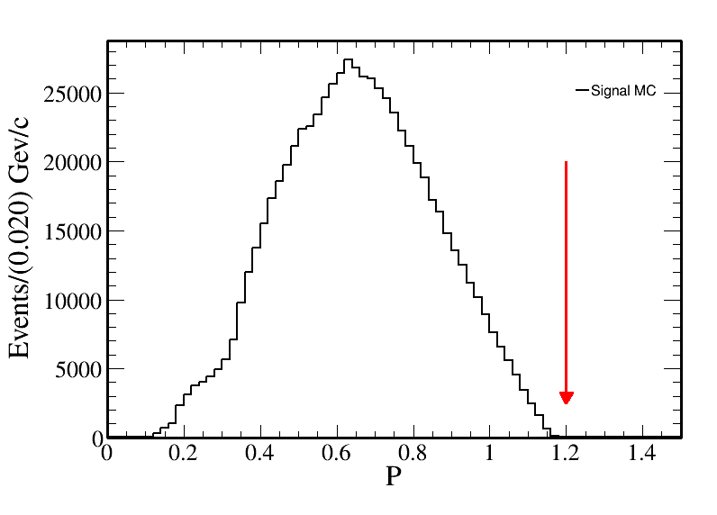
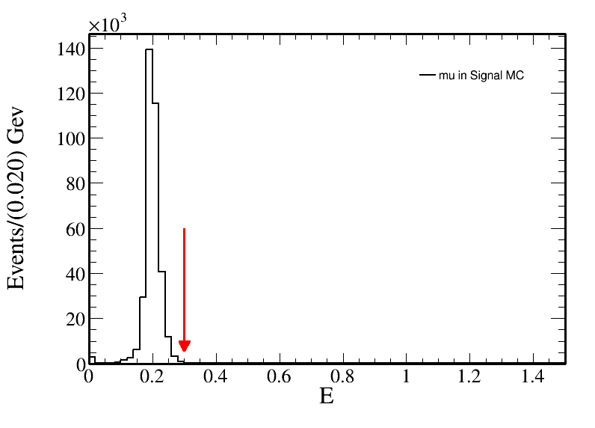
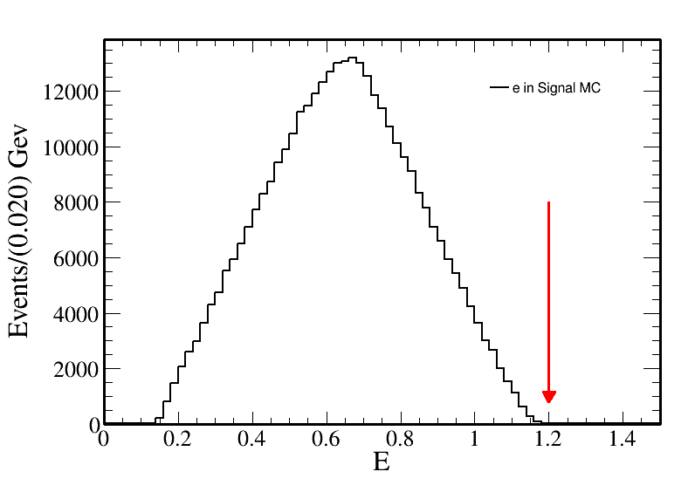
Further selection
Momentum in MDC: $P<1.2$
The energy in EMC: $E_{e}<1.2$
The energy in EMC: $E_{μ}<0.3$
The time in TOF: $2.5<tof<5$

Slide 9
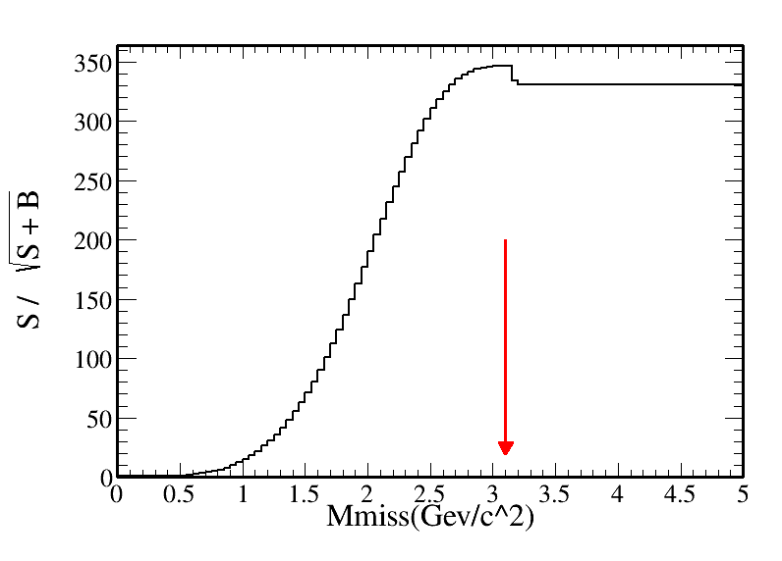
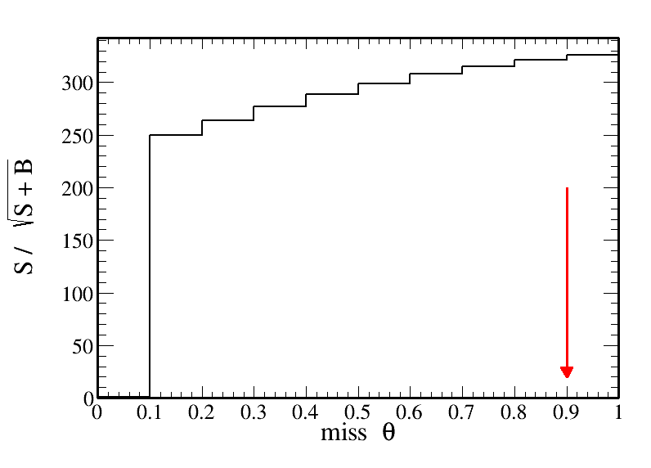
Further selection
$M_{miss}=\left(P4_{ψ\left(2S\right)}−P4_{ll}\right)∙m()$
$cosθ_{miss}=\frac{−{\left(p_{1}+p_{2}\right)}_{z}}{|p_{1}+p_{2}|}$
$FOM=S/{\sqrt{S+B}}$
The missing mass: $M_{miss}<3.10$
The missing cos theta: $|cosθ|<0.9$

Slide 10
Background analysis
Total | Signal | Background | Background / Inclusive MC
213730 | 156157 | 57573 | 26.94%

Slide 11
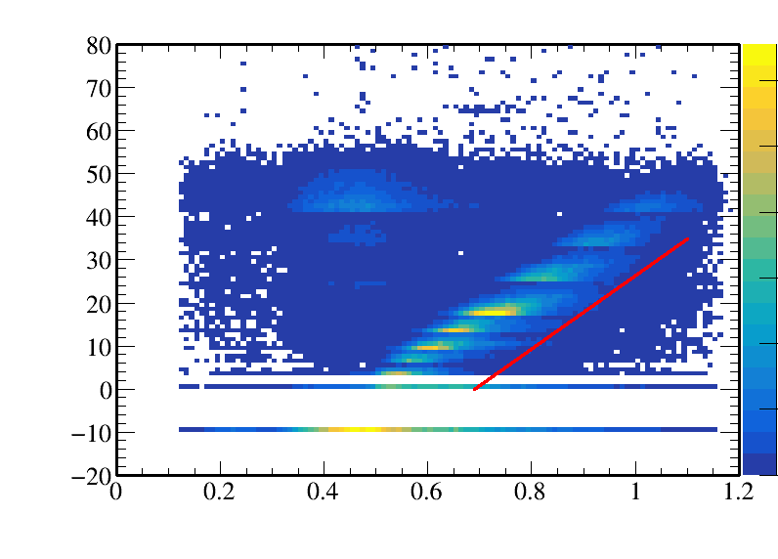
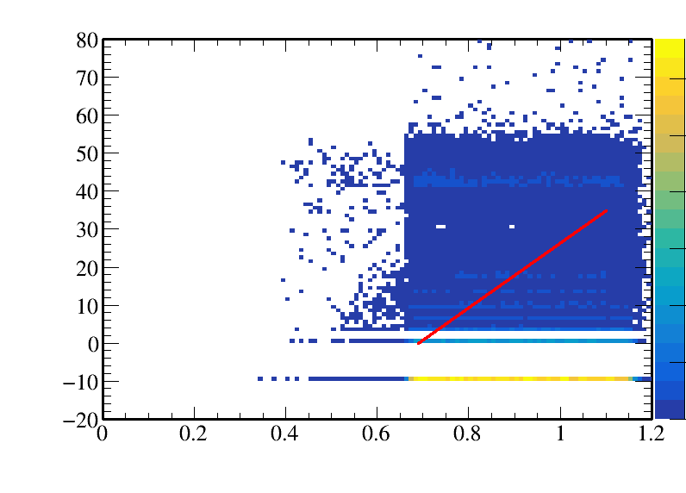
Background analysis
Use the relationship between P and depth in the MUC
$muc_{depth}>85×(P−0.69)$
a | b | FOM
85 | 0.69 | 351.54

Slide 12
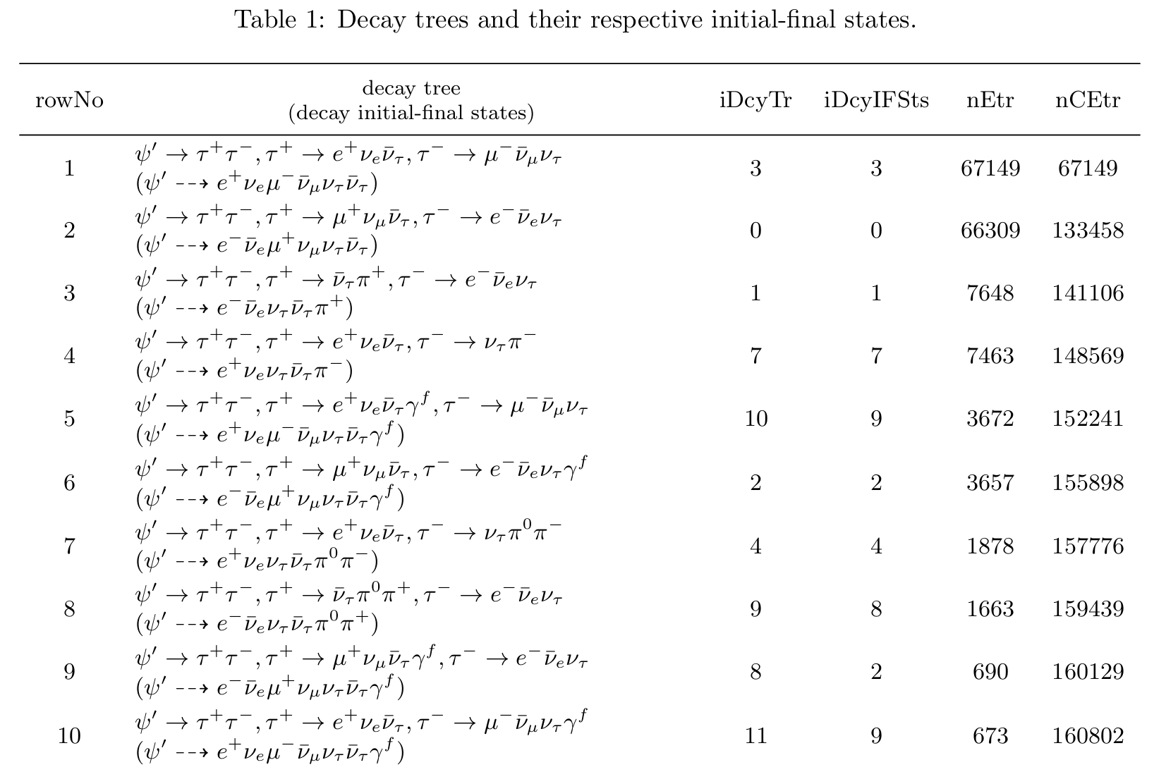
Background analysis
Total | Signal | Background | Background / Inclusive MC
163761 | 142259 | 21502 | 13.13%

Slide 13
<A> and R
$<A>=<p_{1}∙(p_{2}×p_{3})>$
$p_{1}$ is the unit vector of incident $e^{−}$ (or $e^{+}$) momentum and $p_{2}$ and $p_{3}$ are the unit vectors of the outgoing $μ$ and $e$ momenta.
$R≡\frac{N\left(eμ; >\right)}{N\left(eμ; <\right)}=1+2Δ$
$N\left(eμ; >\right)$ is the number of $<A>$ greater than zero, $N(eμ; <)$ is less than zero.
$$p=p_{2}×p_{3}=\begin{matrix}i & j & k \\ p_{2x} & p_{2y} & p_{2z} \\ p_{3x} & p_{3y} & p_{3z}\end{matrix}=\left(p_{2x}p_{3z}−p_{2z}p_{3y}\right)i−\left(p_{2x}p_{3z}−p_{2z}p_{3x}\right)j+\left(p_{2x}p_{3y}−p_{2y}p_{3x}\right)k$$
$$p_{1}∙p=p_{1x}p_{x}+p_{1y}p_{y}+p_{1z}p_{z}$$

Slide 14
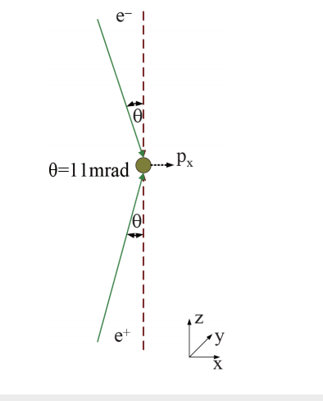
<A> and R
$$p_{1}\left(−cosθ,0,sinθ\right) or (cosθ,0,sinθ)$$
Use inclusive MC
$$A_{plus}$$ | $$A_{minus}$$ | R
163761 | 163761 | 1
Inclusive MC 的结果就应该是1，因为产生的时候没有CP破坏？

Slide 15
上次的问题
中微子质量为什么这么大?

Slide 16
Next work
Keep lowering the background.
Run data and get root file.

