Slide 1
General information
Reminder: timeline for CEPC Detector Ref-TDR
October 21-23, 2024: First IDRC Review Meeting
By the end of 2024: Ref-TDR draft ready
April 2025: Finish international reviews
Jun 30, 2025: Release of the Ref-TDR
From Software Group: tdr24.10.0 release
Major updates include muon detector geo./digi., track reference points in PFO, event size reduced, etc.
CEPC physics analysis tutorial conducted this morning
Thanks to Gang Li, Kaili Zhang, Zebing Wang, Chenguang Zhang, Hongbo Liao
Many comments/recommendations from IDRC review received (see next slides). No showstoppers from IDRC review.
Follow recommendations to improve our work plan and do real works
Start to write TDR document, and to have a draft within 1-2 months
Notes:
另外每周一下午3-4点是CEPC软件组周会，与咱们密切相关，需要相互及时反馈、交流、促进。
每周二上午是CEPC RefTDR plenary meeting，每个子系统都需要汇报进展及计划，包括物理。

Slide 2
Comments/Recommendations on Performance
The planned list of channels looks a bit too high for a few months of work, better to focus on demonstrating that the reference detector reaches adequate performance for physics
Select fewer channels, aimed at demonstrating that the reference detector reaches adequate performance for physics. Include some simple topology (e.g. Z→mumu). Encompass H, Z, W and top physics.
Foresee in the TDR results and figures about performance on basic objects (leptons, photons, jets) as a function of energy and polar angle
A measurement of V_cs during the WW run is probably a more relevant benchmark than V_cb ;
in addition which channel to be used for the measurement of the electroweak mixing angle should be clarified.
Strategy for the measurement of absolute luminosity
which is necessary for absolute cross-sections and has relevant applications (e.g. ν counting at the Z)
Is the measurement of absolute luminosity based only on Bhabha, how the luminometer is going to be used, is the measurement complemented by ee→gamma-gamma events ?
Clarify in the TDR the strategy on the measurement of absolute luminosity
The use of resonant depolarization to measure the Z mass and W mass with high precision.
These are key observables, whose precision must be improved in order to make full use of Higgs precision measurements (e.g. Higgs couplings)
Include in the TDR at least a brief description of the plans

Slide 3
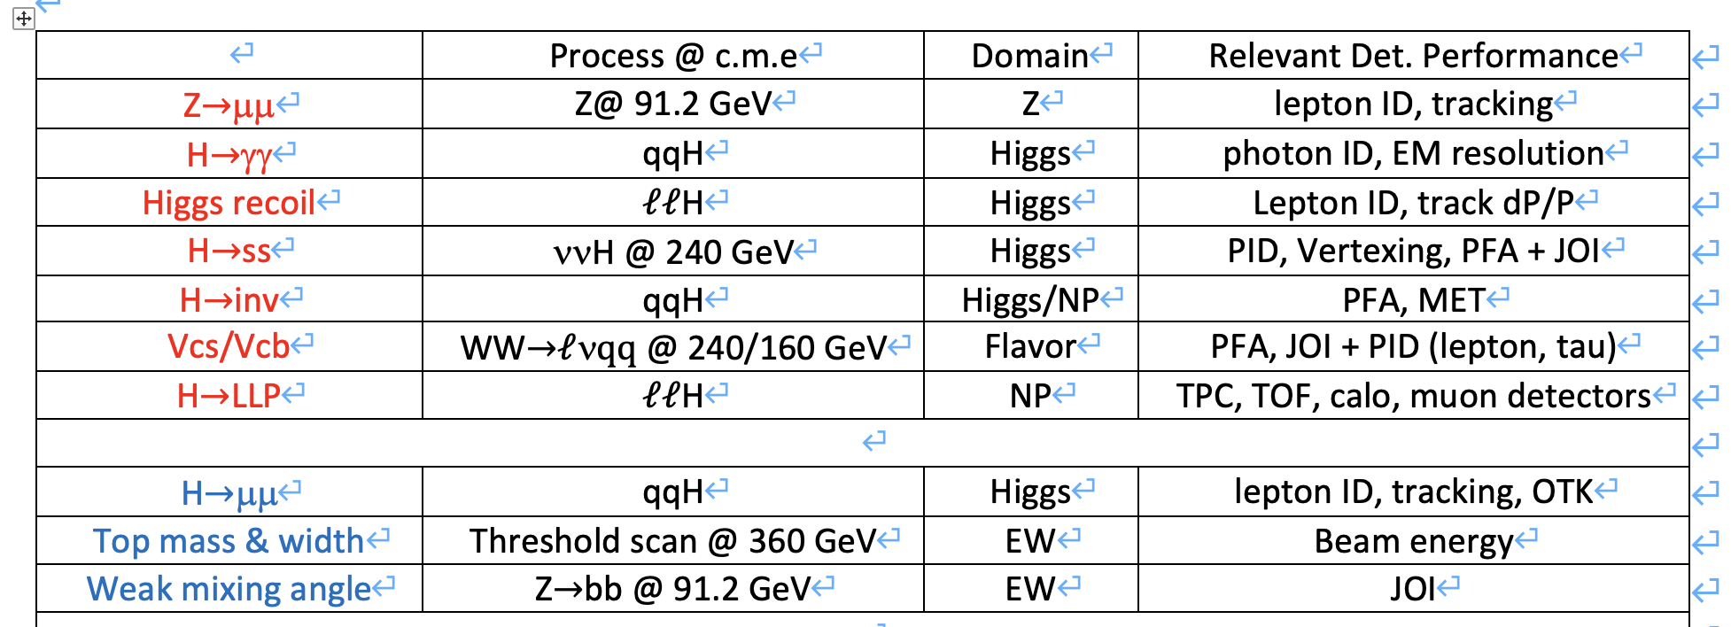
Reduced list of benchmarks (TBD)

Slide 4
Comments/Recommendations on Performance
(longer term) Note down the main points of detector configuration optimisations that can be further explored versus the presented performance for the RefTDR, given the limited time available
(longer term) Address the impact of the performance studies on the technology choices?
Explain how the various sub-detector will be calibrated with physics processes.
The performance of crystal ECAL on boson mass resolution and Jet Origin ID should be simulated in a consistent way. The impact of crystal ECAL on PFA and jet flavor tagging capability should be estimated.
Notes:
Physics benchmarks: select fewer channels, aimed at demonstrating that the reference detector reaches adequate performance for physics. Include some simple topology (e.g. Z→mumu)
Foresee in the TDR results and figures about performance on basic objects (leptons, photons, jets) as a function of energy and polar angle

Slide 5
Other related feedbacks from IDRC review
It is not clear if there will be any physics Z pole runnings during ZH period (the first 10 years) or if running at the Z will just be required for calibration.
Further justify the decisions on the detector technologies and demonstrate how these technologies will enhance the detector's physics capabilities. This will require achieving the necessary level of simulation to evaluate low-level object performance, which is critical and should be prioritized.
Tracking: Assess the Outer Tracker (OTK) influence on the global momentum resolution and its impact to PID. To achieve this, a realistic full simulation is needed that accounts for the following aspects: Alignment between ITK and OTK , Quantifying the Overall PID Improvement (OTK to PID in forward regions outside TPC coverage is particularly important )

Slide 6
Other related feedbacks from IDRC review
Ecal: Developing and perfecting the Particle-flow algorithms including the effective pattern recognition and minimization of ambiguity issue;
Calo: Design choices should be thoroughly justified by physics goals achieved with simulation of a full detector model. Alternative parameter choices should be considered and evaluated for physics outcomes. For example, ECal crystals of 1 cm (transverse) x 2 cm (depth) would reduce channel count and cost. Does it impact physics performance?
Calo: Some specific performance issues that would be interesting to more fully understand. These include higher energy pi zero reconstruction, which may benefit, for example, from a staggered bar arrangement or finer granularity in the first few layers. Also electron ECal resolution when the bending of electrons match the 12 degree incline angle. Does this impact electron measurements?

Slide 7
Other related feedbacks from IDRC review
Muon: Momentum global resolution (combined muon and tracking tracks); Muon Identification and Fake Rate Studies
Software:
Ensure that the reference detector model used for the full simulation uses realistic material budgets in the tracking region containing/representing supports, services, cooling etc.
Focus on a complete and well tested full reconstruction for the reference detector in time for the RefTDR in order to demonstrate that detector/software performance goals like tracking and jet energy resolutions have been met. Where needed, one could fall back for now to already existing software for alternative technologies (e.g. use pad based TPC reconstruction if pixel based will not be available on time). Use full reconstruction to create basic detector performance plots, with realistic assumptions on detector resolutions, such as (non exclusive list)
Track momentum resolution (single muons) as function of p_t for different values of cos(theta)/ or theta
Impact parameter resolutions in r-phi, z
(jet) energy resolution as a function of cos(theta), e.g. w/ uds di-jet events w/o ISR
Flavour tagging performance
PID performance (using dN/dx and TOF) including separation power for K/pi, K/p

Slide 8
Backup

Slide 9
General information
2024.10.14
Current computing time for Sim+Digi+Tracking+Reco in V240901
still missing digi+reco of endcap calo
~1 minute/event, for vvH(gg)
at least 200 events/job is OK
speed and memory seems manageable
1 million events feasible with 1000 CPUs in a single day
will test 4jets events
Objects performance studies and physics analyses are encouraged
Tracking of full acceptance available
Analyses can begin with barrel region selection
Recipes for PID and Jets will be provided
Two task forces created, please join the studies
Tracking/PID: contact Chenguang Zhang
Jets/Clusters: contact Zebing Wang/Kaili Zhang
Notes:
另外每周一下午3-4点是CEPC软件组周会，与咱们密切相关，需要相互及时反馈、交流、促进。
每周二上午是CEPC RefTDR plenary meeting，每个子系统都需要汇报进展及计划，包括物理。

Slide 10
Tracking/PID performance studies
Differential tracking efficiency/resolution
Tracking efficiency/resolution vs pT and/or cos𝜃
@different level: Vertex+ITK+TPC+OTK, Vertex+ITK, TPC only, etc.
Tracking angular resolutions vs pT and/or cos𝜃
detector design requirements: pT>∼100MeV, |cos(𝜃)|<0.99, δ(pT)~0.1% in barrel
Differential resolution of track impact parameters
dx, dy, dz, 𝛿(𝑑0/𝑧0) vs pT, etc.
detector design requirements: in the barrel δ(d0/z0)~3 micro meter at 20 GeV
Differential PID capability: eff, mis-ID rates, purity
1d/2d distributions on eff/mis-ID vs. pT/cos𝜃
and for different particles (𝜋,𝑘,𝑝,𝑒,𝜇)
with/without TOF
relative resolution of dE/dX
detector design requirements: eff*purity>90% for all charged Kaon with E>2GeV(@Z pole); ~relative resolution of dE/dX better than 3%.; ToF of 50ps; efficiency >99% for 3-prong tau
vvH(μμ): H invariant mass resolutions in barrel and endcap
Z(μμ)H: recoil mass resolutions in barrel and endcap

Slide 11
Jet/Clusters performance studies
Differential efficiency, and energy/angular resolution for photon, neutron, charge hadrons
detector design requirements: - EM resolution: 3%/√E⊗0.5% ( Ref:JHEP12(2022)135 ) - Had resolution: 50%/√E⊗2% ( Ref:CDR baseline performance)
Differential efficiency and energy/angular resolution for jet
and for different jet reconstruction algorithms
H->diphoton mass resolutions for barrel and endcap
π⁰ eff and resolution vs. pT/cos𝜃
dijet resolution for different flavors, versus pT/cos𝜃

