Slide 1
Heavy quarkonium probes in small and large systems
On behalf on LHCb collaboration
Youen Kang
November 14th, 2024
Notes:
It is my great honor on behalf of LHCb to introduce the Recent conventional and exotic charmonia results from LHCb

Slide 2
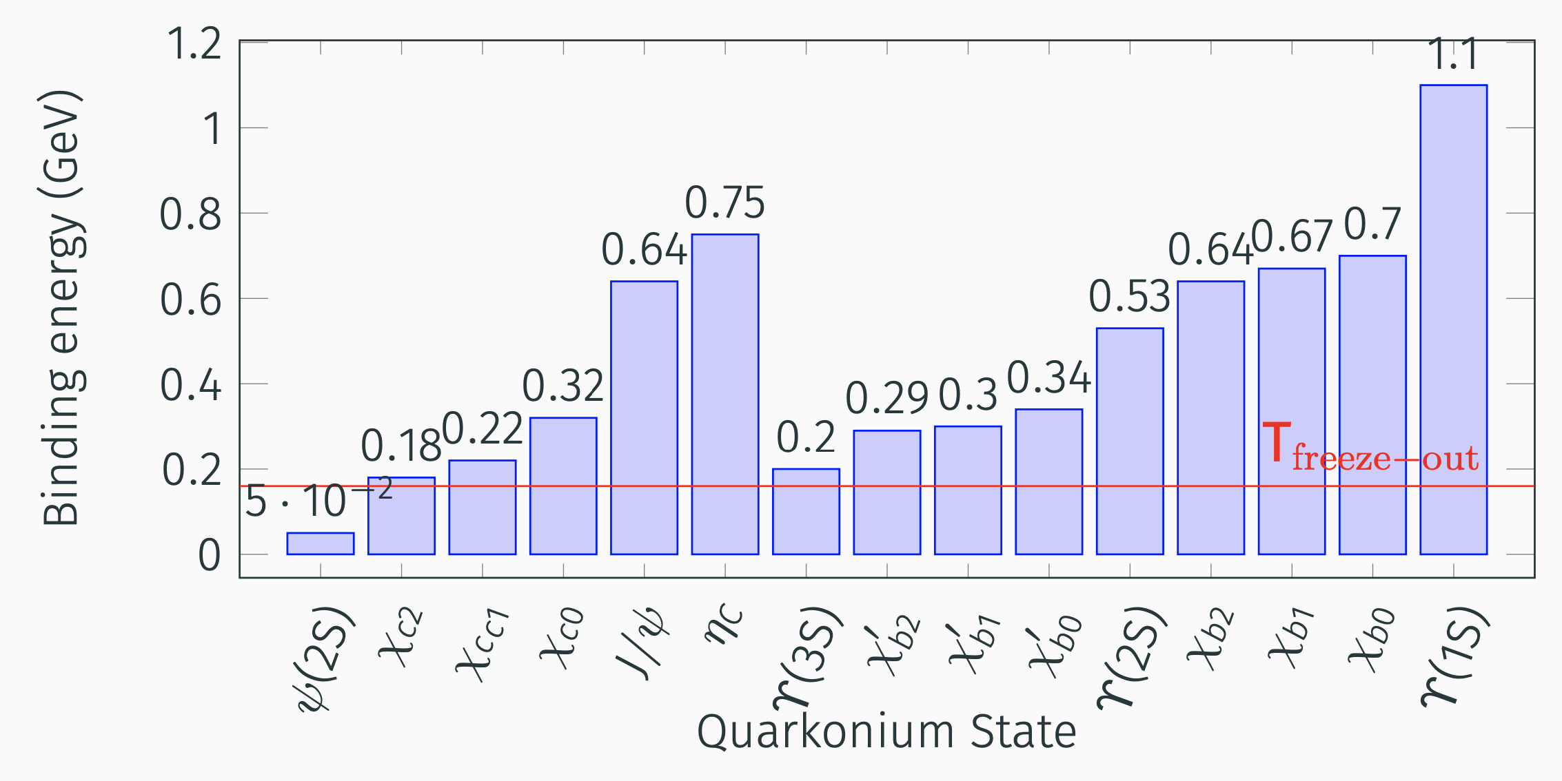
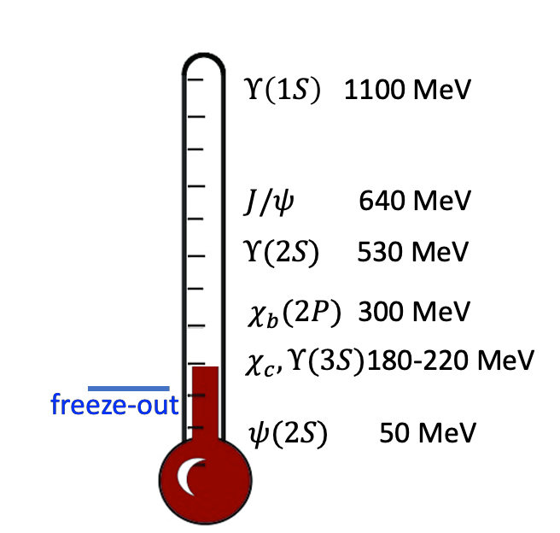
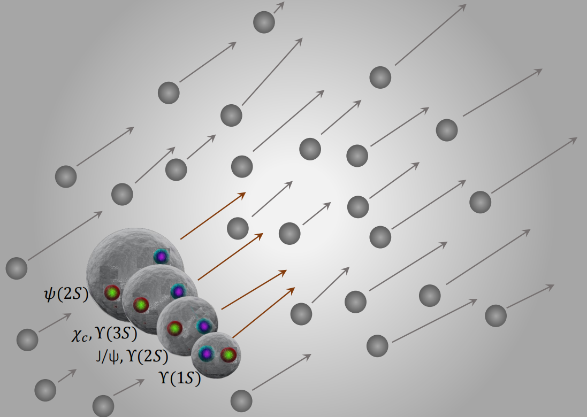
Quarkonium states
Prog.Part.Nucl.Phys. 122 (2022) 103906
Quarkonium is sensitive to the environment where it is produced:
Quarkonium is inhibit to produce when temperature is higher than its binding energy [ PRC 99 (2019) 044914]
Quarkonium dissociate when interacting with co-moving particles [Ferrero, PLB749, 98 (2015)]
Quarkonium of higher states with larger radius tends to dissociate first.
Excited-to-ground ratio probes for final-state effects (Initial-state effects cancel out).
Notes:
Quarkonium is sensitive to the environment where it is produced. It can be used to probe initial-state effects and final-state effects.
When the temperature of collisions is higher than the binding energy of quarkonium, it is inhibit to produce. Some of the quarkonium may even dissociate when the temperature has not yet reached the freeze-out temperature, which is the critical temperature for Quark-gluon plasma, like psi(2S).
There are also some final-state effects like co-mover effect, which states that the quarkonium may dissociate when interacting with comoving particles.
In either case, quarkonium of higher states with larger radius tends to dissociate first. By exploring the excite-to-ground ratio, the initial-state effects can be canceled and we can probe for final-state effects.

Slide 3
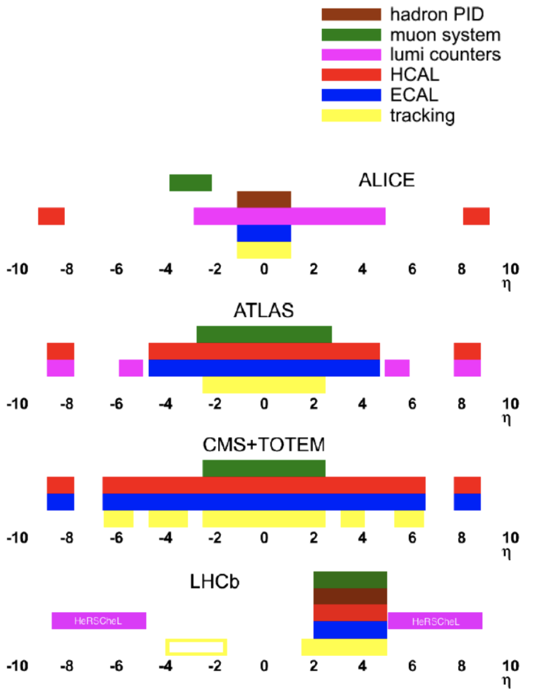
The LHCb detector
Adv.Ser.Direct.High Energy Phys. 23 (2015) 31-59
EPJ Web Conf. 70 (2014) 00058
Optimum detector for quarkonium study
Unique forward instrumentation for heavy ion physics
$e,μ,π,K,p,γ$ jet identification in 1<p<100 GeV/c
Notes:
LHCb detector is a single-arm forward detector cover the pseudo-rapidity two to five.
It has excellent particle identification and is optimum detectir for quarkonium study.
It is also a Unique forward instrumentation for heavy ion physics

Slide 4
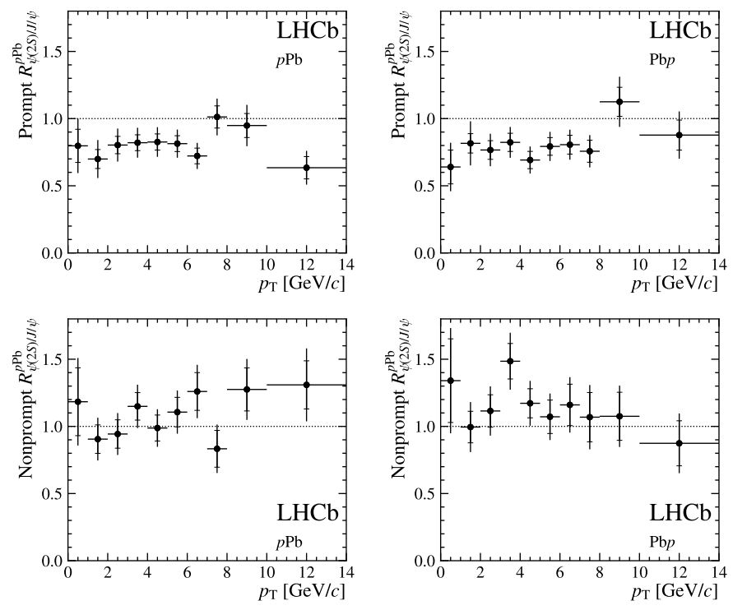
$ψ(2S)$-to-$J/ψ$ double ratio at $\sqrt{s_{NN}}=8.16$ TeV
Non-prompt double ratio consistent with unity, affected by b production only
Prompt double ratio lower than one, $ψ(2S)$ is affected more by final-state effects, given $J/ψ$ is mainly affected by initial-state effects [PLB774, 159 (2017)]
Only prompt double ratio is suppressed, consistent with co-mover model [PLB749m 98(2015)]
JHEP 04 (2024) 111
Notes:
Recently we have some conventional and exotic charmonia results from LHCb.
First let us see the psi(2S) to J/psi double ratio in pLead collisions at center-of-mass energy 8.16TeV
The double ratio is defined as the ratio of nuclear modification factor for psi(2S) and J/psi.
The value of this ratio is expected to be equal to one for nonprompt production since the modifications of the production only affect the the b-hadron production but not the final ψ(2S) or J/ψ states.
For prompt double ratio, it should also be equal to one if the production of the ψ(2S) and J/ψ in proton-lead collisions is only modified by initial-state effects and not final-state effects.
But the prompt double ratio is smaller than one, it means that ψ(2S) was affected by final-state effects, given that the J/psi in pPb collisions at 8TeV is mainly affected by Initial-state effect.
These results are consistent with co-mover model prediction

Slide 5
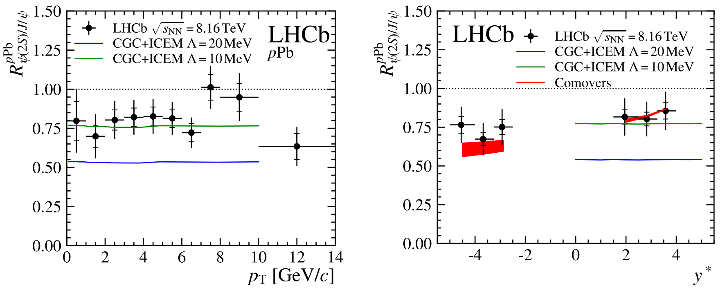
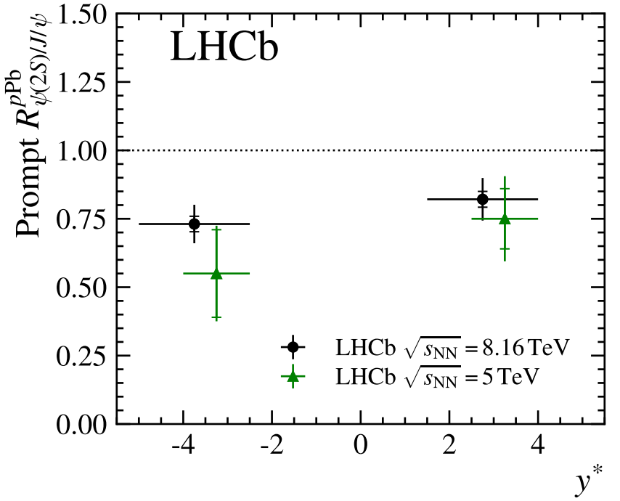
$ψ(2S)$-to-$J/ψ$ double ratio at $\sqrt{s_{NN}}=8.16$ TeV
Initial-state effects canceled
The prompt double ratio can be explained by co-mover model and CGC+ICEM for appropriate parameters (also applied to lower energy data from RHIC)
Result consistent with 5 TeV result, a much high precision is achieved
JHEP 04 (2024) 111
Notes:
The transverse momentum and rapidity spectrum for the double ratio is also compared to the co-mover model prediction and CGC+Improved CEM model. The results can be predicted by co-mover model and CGCICEM model for appropriate parameters.
The results are also consistent with the 5TeV result, with a much higher precision.

Slide 6
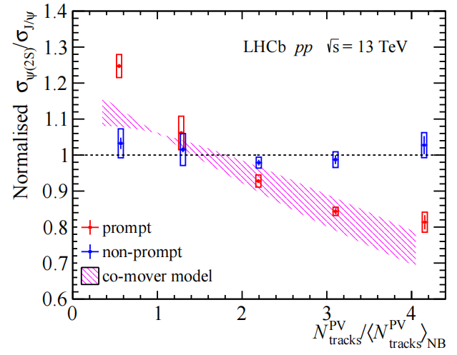
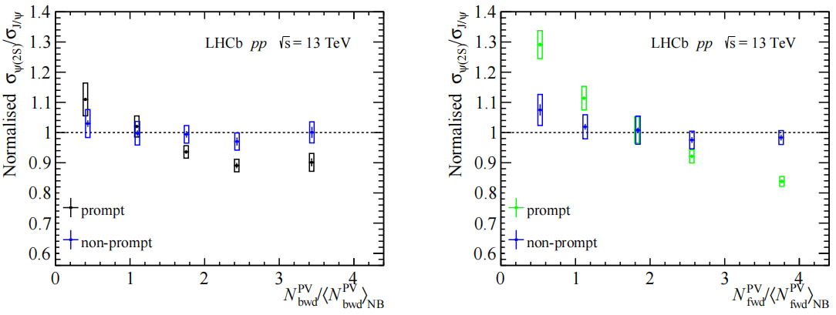
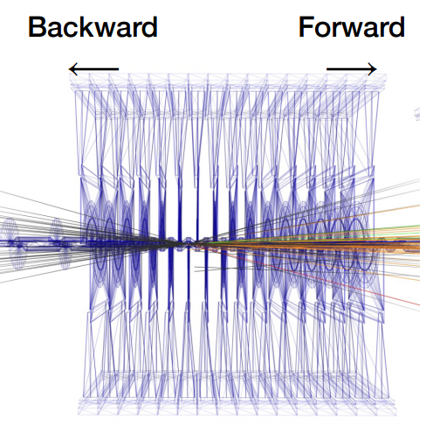
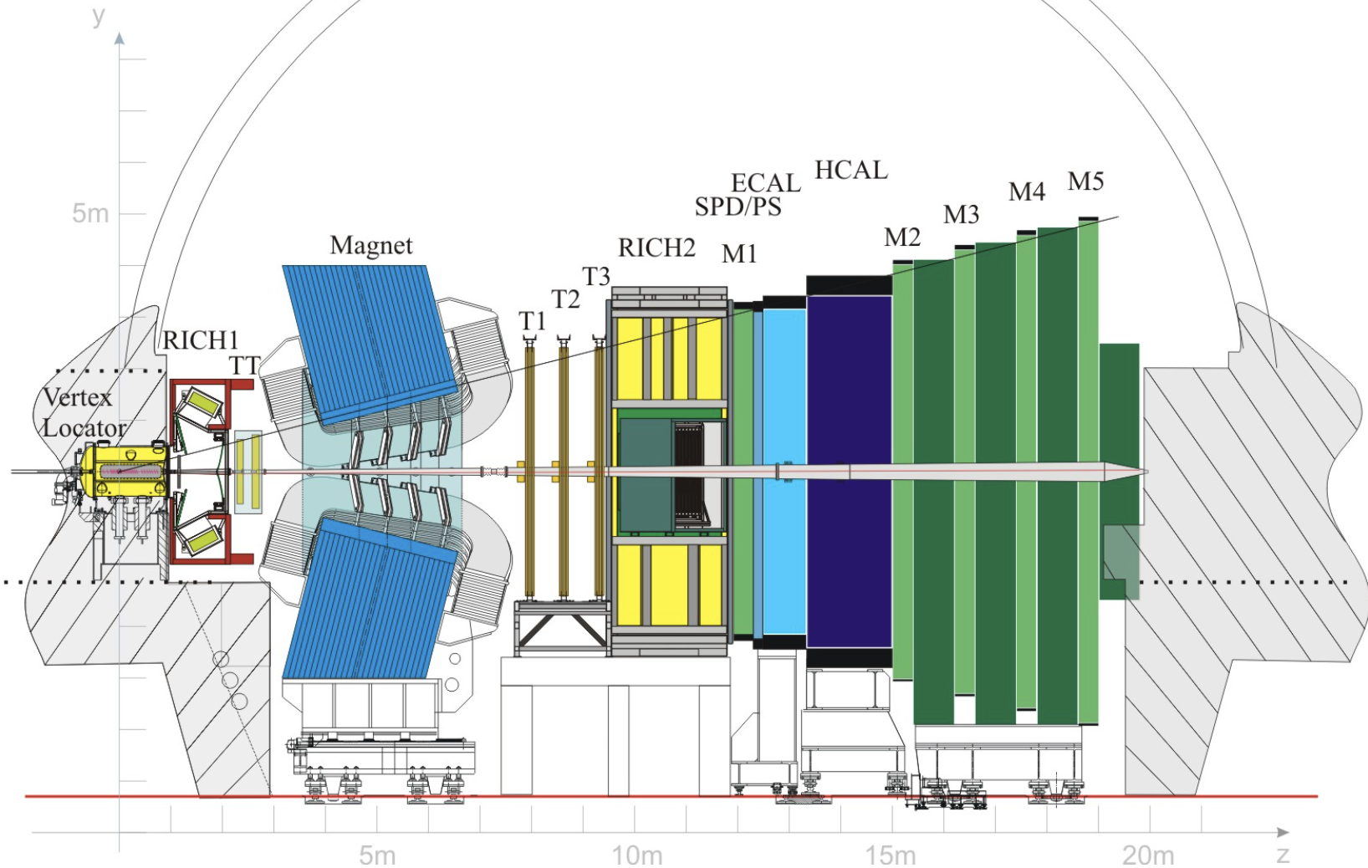
$ψ(2S)$-to-$J/ψ$ production ratio at $\sqrt{s}=13$ TeV
JHEP05(2024)243
Initial-state effects canceled
Prompt ratio decrease with multiplicity, highly dependent on forward multiplicity, consistent with co-mover model[PLB749m 98(2015)]
Non-prompt ratio independent of any multiplicity variables, consistent with co-mover model
$$N_{bwd}^{PV}$$
$$N_{fwd}^{PV}$$
$$N_{track}^{PV}=N_{fwd}^{PV}+N_{bwd}^{PV}$$
JINST 3 (2008) S08005
Notes:
In pp collisions, we also measure the multiplicity dependence of psi(2S) to J/psi ratio at 13 TeV, in different multiplicity scheme.
The multiplicity variable we use is shown in the bottom right sketch, the multiplicity close to the primary vertex is NPVtracks, which is the number of tracks used when reconstruct a PV. The Nforward tracks and Nforward Tracks are the charged tracks multiplicity in the forward and backward rapidity region, which is in the same and opposite direction where we measure the charmonium production.
The non-prompt ratio, represented by the blue dots in the plots, is independent of multiplicity no matter which multiplicity variable we use.
The prompt ratio decrease with NPV tracks and Nforward Tracks, this is consistent with co-mover prediction, in which only the particles flying in the same direction may interact with charmonium. we also find that the ratio is much less dependent on Nbackward tracks, where it is measured in the opposite direction of charmonium measurement.

Slide 7
$ψ(2S)$-to-$J/ψ$ production ratio at $\sqrt{s}=13$ TeV
JHEP05(2024)243
Prompt ratio show higher dependence on multiplicity at low $p_{T}$ region
Prompt ratio show similar dependence on multiplicity in different $y$ regions
Notes:
The multiplicity dependence of the prompt ratio is found to be obvious in low transverse momentum regions, which is represented by black and red dots in the left plot, and in the low transverse momentum region, the multiplicity dependence become lower, almost independent when transverse momentum larger than 8GeV.
While the multiplicity dependence in different rapidity regions are almost the same.

Slide 8
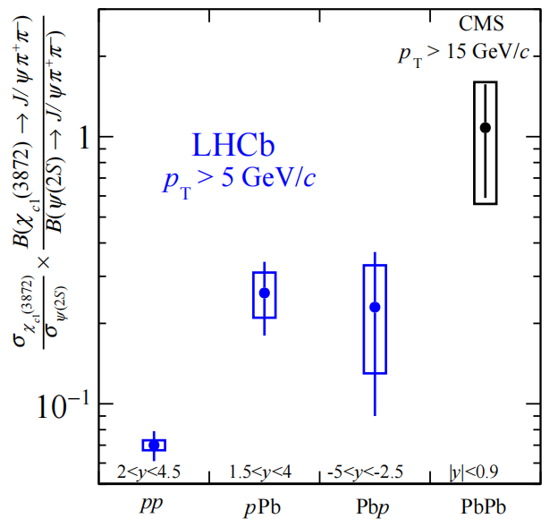
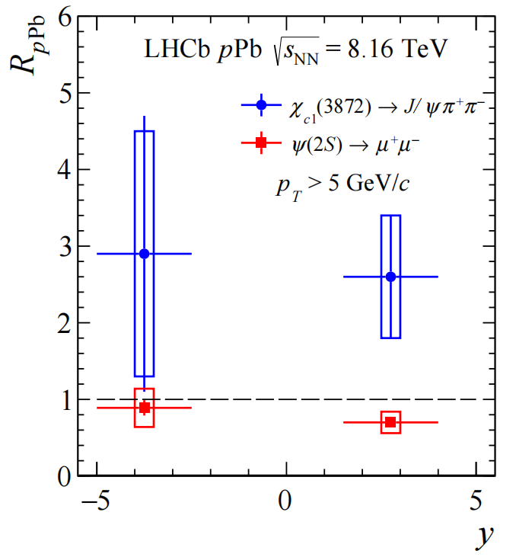
$χ_{c1}(3872)$ relative to $ψ(2S)$
arXiv:2402.14975v1 [hep-ex]
The exotic $χ_{c1}(3872)$ experiences different dynamics than conventional charmonium state $ψ(2S)$
Notes:
The left graph is the chi c1 to the psi(2S) ratio in different collision systems, with the system size becoming larger, the ratio increase.
when psi2s is suppressed in pPb collisions, the chi c1 is enhanced, which reveals that the chi c1 experiences different dynamics than conventional charmonium state psi2s

Slide 9
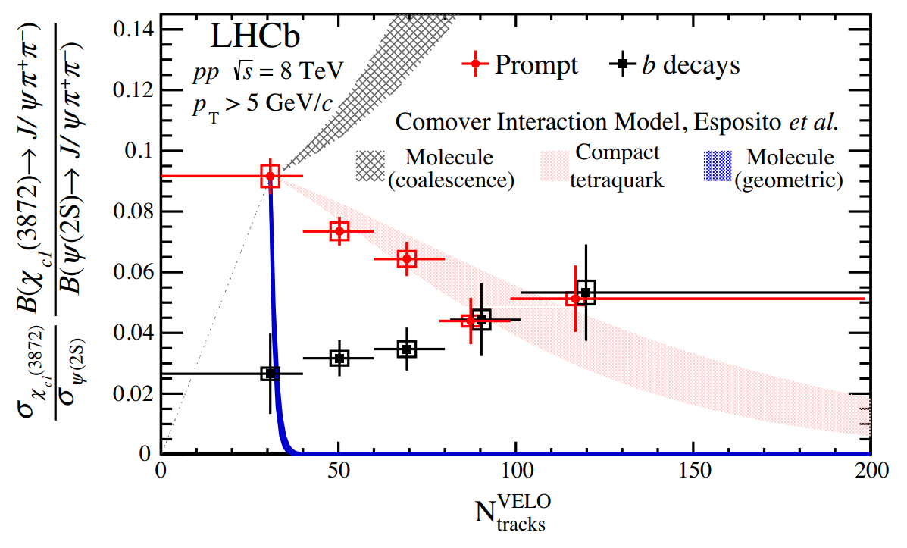
$χ_{c1}(3872)$ relative to $ψ(2S)$
Initial-state effects canceled
Ratio increase with system sizes, but decrease with multiplicity in pp collisions, indicate coalescence is allowed to become the dominant mechanism towards large system
The exotic $χ_{c1}(3872)$ experiences different dynamics than conventional charmonium state $ψ(2S)$
Phys.Rev.Lett. 126 (2021) 9, 09200
arXiv:2402.14975v1 [hep-ex]
Notes:
Even though the ratio increases with the system size, if we look into the pp collision result, we may supprisingly find that the prompt production decrease with multiplity.
This indicate the coalenscence is allowed to become the dominant mechanism towards large systems. In pPb collisions, the pseudorapidity density of produced charged particles is significantly higher than in pp collisions, providing an increased probability for quarks to overlap in position and velocity space and potentially coalesce.

Slide 10
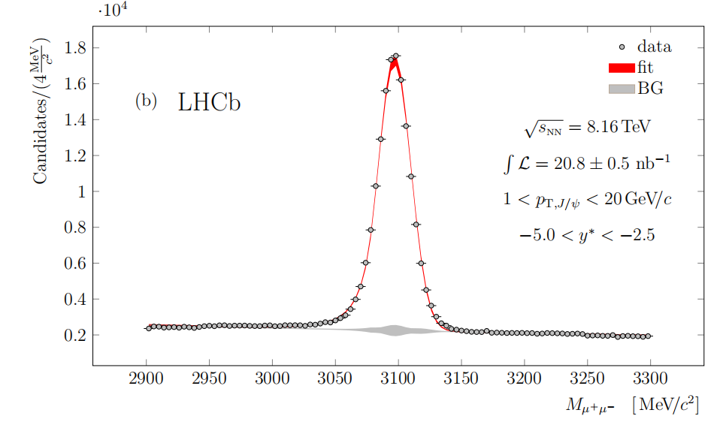
$χ_{c}$ relative to $J/ψ$
Phys. Rev. Lett. 132 (2024) 102302
$χ_{c1}+χ_{c2}$ measured in $χ_{c}→J/ψγ→μ^{+}μ^{−}γ$
$γ$ measured by ECAL with $p_{T}>0.4$ GeV/c
Notes:
The chi c production is also measured in chi c to jpsi photon and jpsi to dimuon channel, where the photon is measured by Electromagnetic calorimeter with its transverse momentum larger than 400 MeV

Slide 11
$χ_{c}$ relative to $J/ψ$
Phys. Rev. Lett. 132 (2024) 102302
Initial-state effects canceled
Forward rapidity consistent with pp results
Backward rapidity 2.4 $σ$ higher than the forward for low $p_{T}$ regions, could result from larger suppression of $ψ(2S)$ in backward
Result consistent with lower energy measurements from HERA-B and PHENIX.
Prompt $J/ψ$ composition:
Direct $J/ψ$
$χ_{c}$ → $J/ψ$𝛾 decays
$ψ(2S)$ → $J/ψ$ +𝑋 decays
exotics
Notes:
By comparing the chi c production to jpsi production, we found the forward pLead result is consistent with the pp collision result.
The backward result is slighter larger than the forward result, it could result from the larger suppression for the psi2s in the backward, subsequently, it will lower the production of prompt jpsi which is from psi2s feed-down.
And the results in low transverse momentum region is consistent with lower energy measurement from HERA-B and PHENIX.

Slide 12
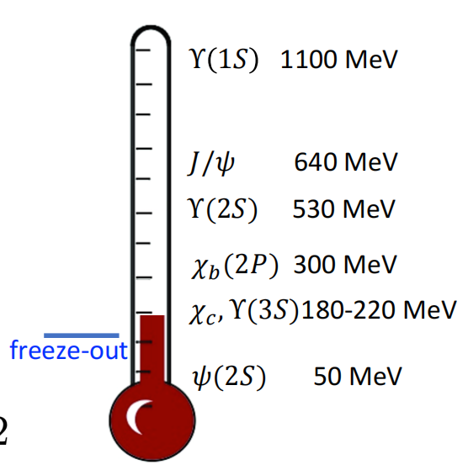
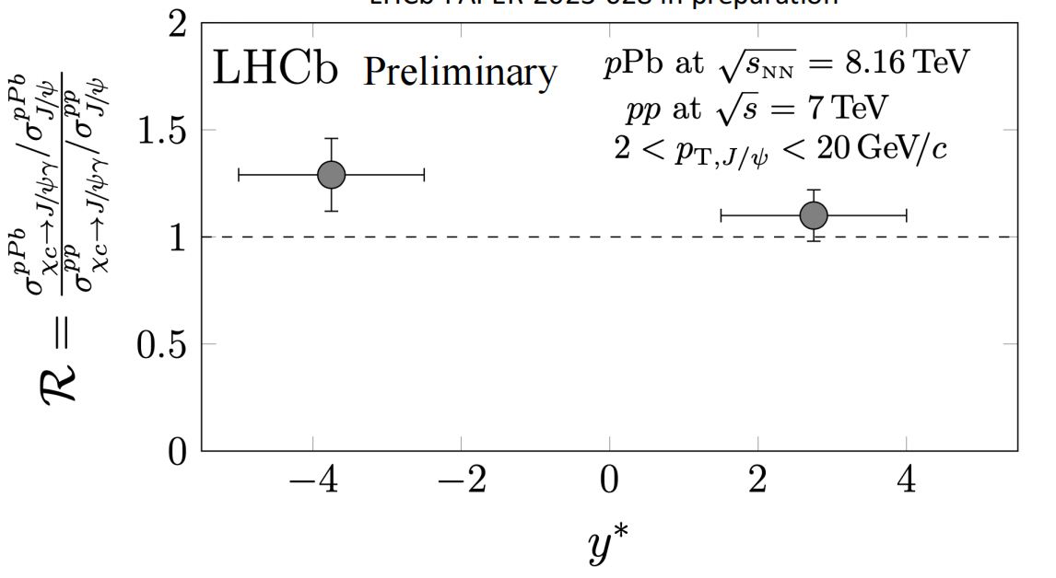
$χ_{c}$-to-$J/ψ$ double ratio
Phys. Rev. Lett. 132 (2024) 102302
Initial-state effects canceled
No dissociation due to final-state effects for $χ_{c}$ observed
The medium temperature formed in pPb collisions cannot inhibit the formation of charmonium states with binding energy larger than 180 MeV
$Υ(3S)$ dissociate, with similar size and binding energy, can due to its heavier and slower, more easily interact with co-mover
Notes:
By measuring the double ratio of chi c to jpsi, we found that chi c is not suppressed due to final-state effects in pLead collisions.
The medium temperature formed in pLead collisions cannot inhibit the formation of charmonium states with binding energy larger than 180 MeV.
If it is inhibit to produce in pPb, then the double ratio should be smaller than one compared to that in pp collisions.
$Υ(3S)$ dissociate, with similar size and binding energy, that indicates that its dissociation could result from final-state effects like co-mover.

Slide 13
Summary
Result of $ψ(2S)$, $J/ψ$, and $χ_{c}$ in pp and pPb collisions are presented
The $ψ(2S)$ is influenced by final-state effects in pp and pPb collisions
The exotic $χ_{c1}(3872)$ is found to experience different dynamics than conventional charmonium
The $χ_{c}$ is not inhibit to produce in pPb collisions with its binding energy only 20MeV above freeze-out temperature

Slide 14
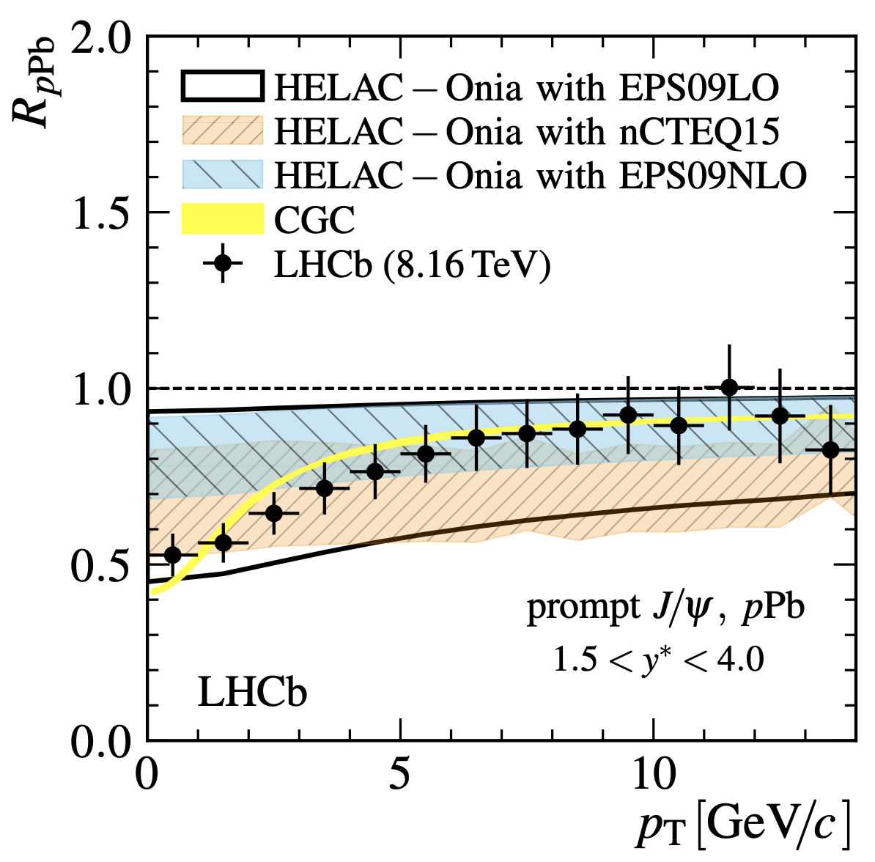
BackUp 1: Jpsi, Initial state effect
PLB774, 159 (2017)
𝐽 /𝜓 nuclear modification factor largely comes from Initial-State Effects

Slide 15
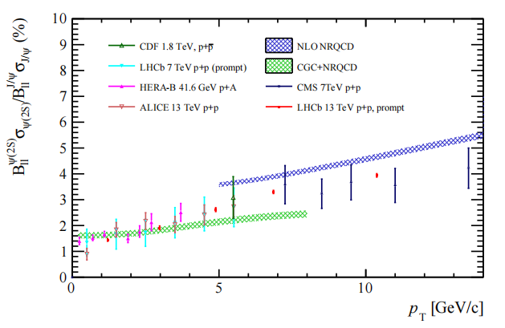
BackUp 2: pT spectrum of psi2s/Jpsi
pp 13TeV results

Slide 16
BackUp 3: Back- and For-ward mul.
Dependence on backward multiplicity might come from the correlation between forward and backward multiplicity.
JHEP05(2024)243

Slide 17
BackUp 4: X(3872) molecule, tetra-quark?

Slide 18
BackUp 5: prompt proportion X(3872), psi(2S)
Prompt proportion decrease with multiplicity, but still be the main component in different multiplicity regions.

Slide 19
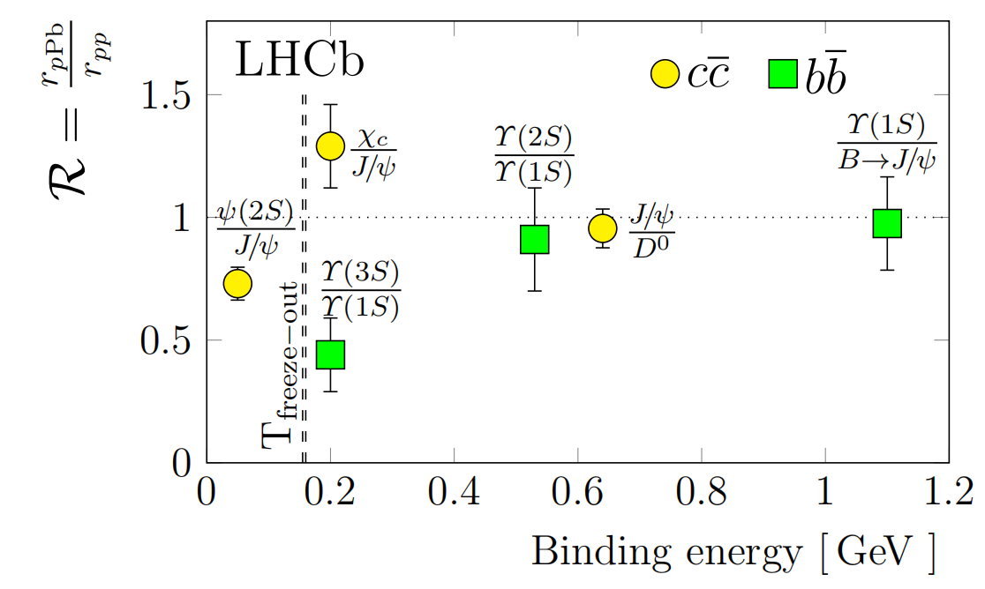
BackUp 6: Chi_c1 to J/psi

Slide 20
BackUp 7: radii

