Slide 1
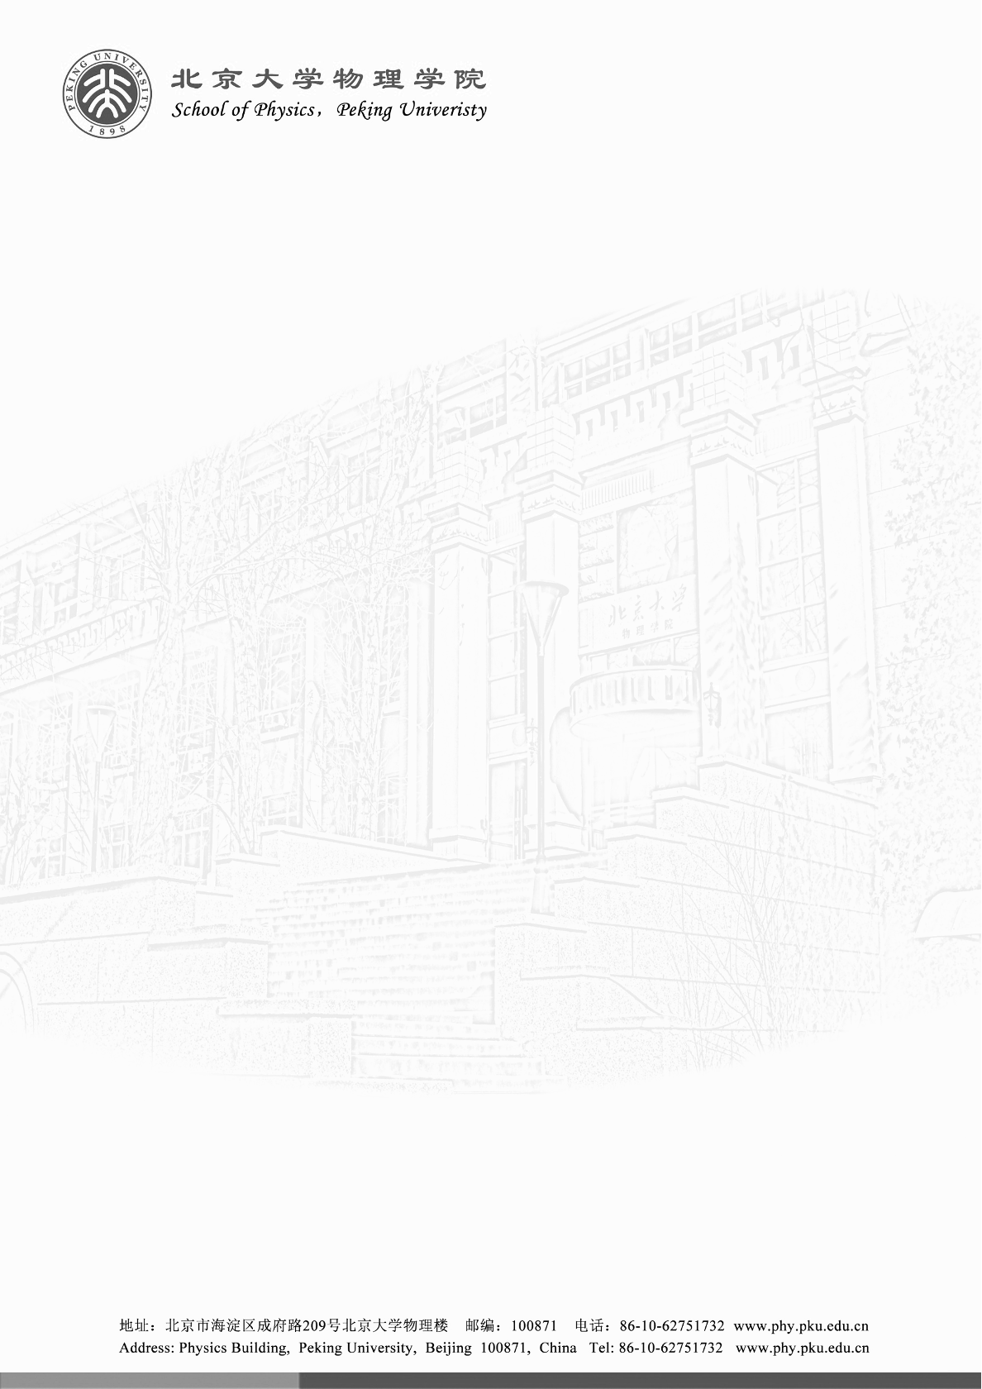

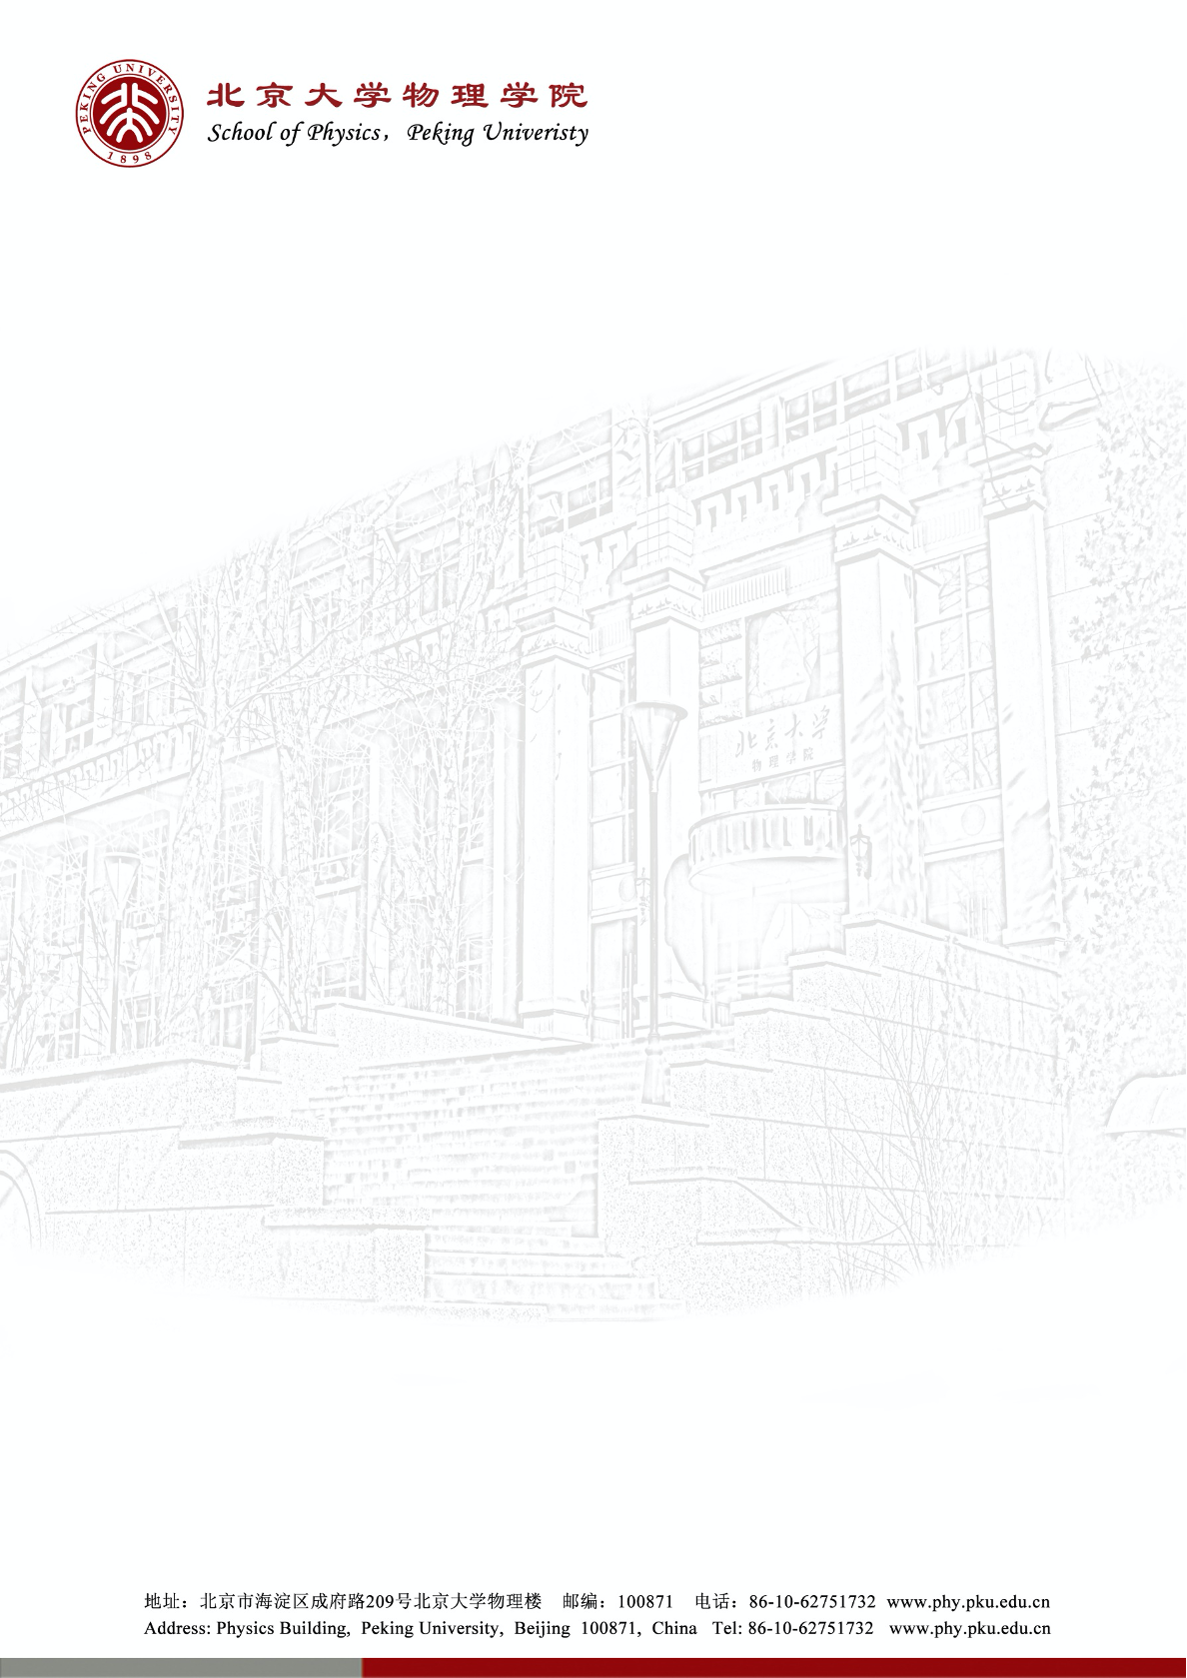

Measurement of $Λ_{b}^{0}, Λ_{c}^{+}$ and $Λ$ decay parameters
王禹昊
北京大学
第十届中国 LHC 物理会议（CLHCP2024 青岛）
2024.11.15

Slide 2
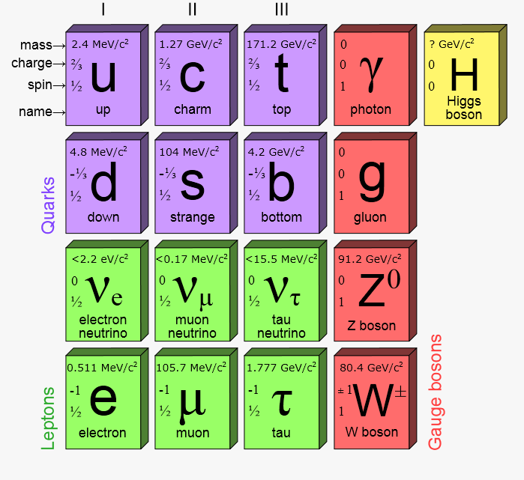
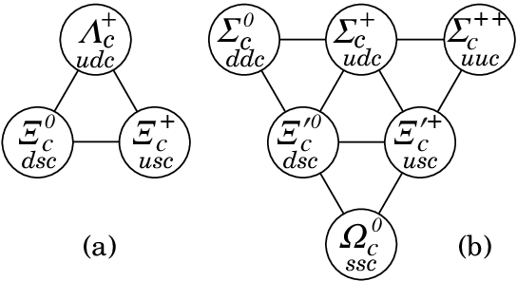
Introduction
Heavy flavor physics
  Test standard model (QCD, electroweak)
  Indirectly probe new physics
Rich study on beauty and charm baryons
  Spectroscopy
  Lifetime
  CP violation
  Radiative decay
  …

Slide 3
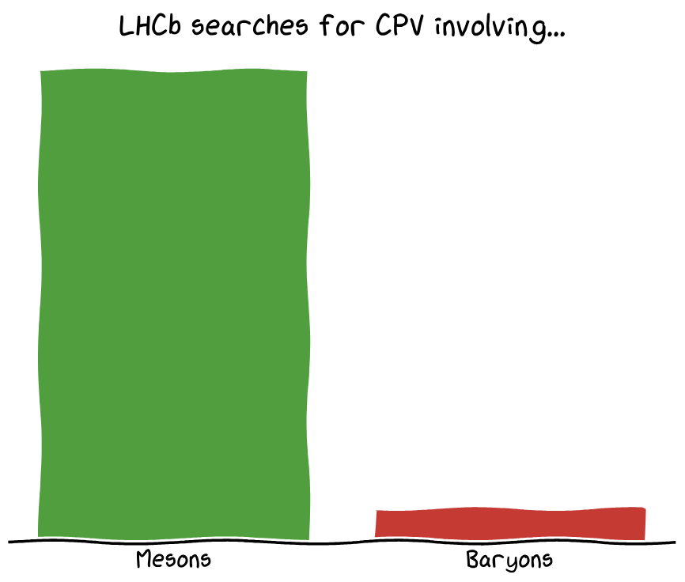
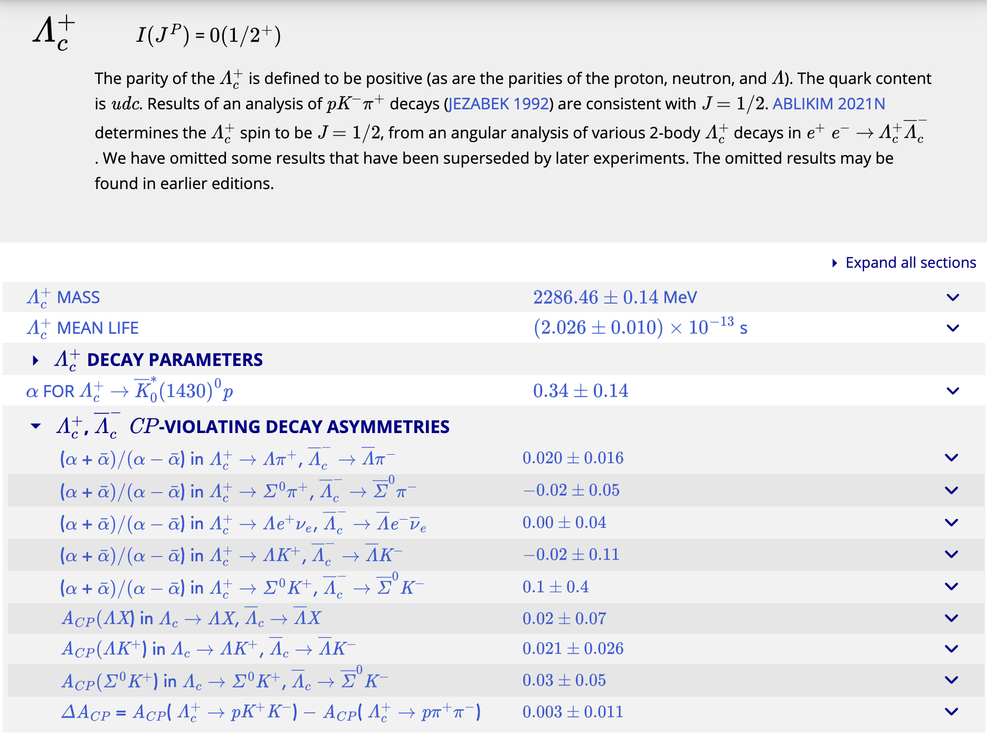
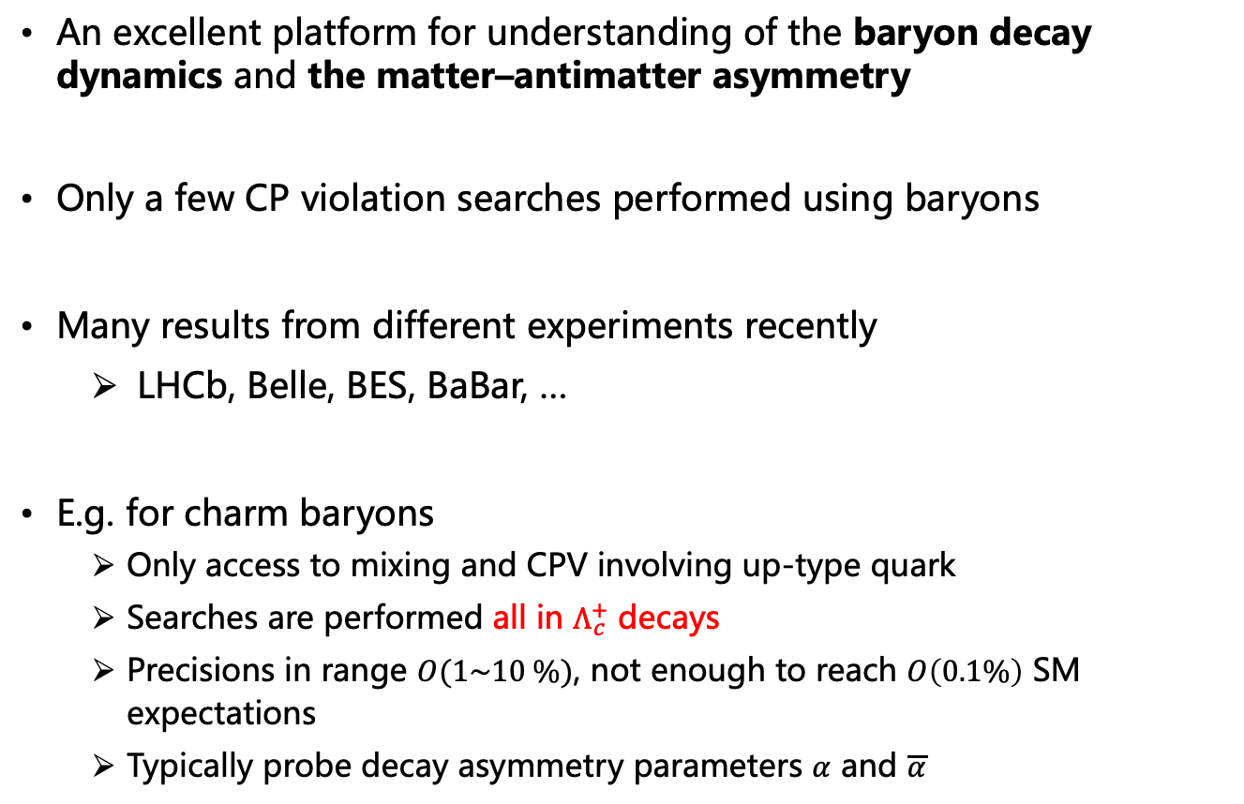
CPV in baryon system
An excellent platform for understanding of the baryon decay dynamics and the matter–antimatter asymmetry
Only a few CP violation searches performed using baryons
Many results from different experiments recently
  LHCb, Belle, BES, BaBar, …
E.g. for charm baryons
  Only access to mixing and CPV involving up-type quark
  Searches are performed all in $Λ_{c}^{+}$ decays
  Precisions in range $O(1\sim 10 \%)$, not enough to reach $O\left(0.1\%\right)$ SM expectations
  Typically probe decay asymmetry parameters $α$ and $\overline{α}$
[Chin.J.Phys. 78 (2022) 324-362]

Slide 4
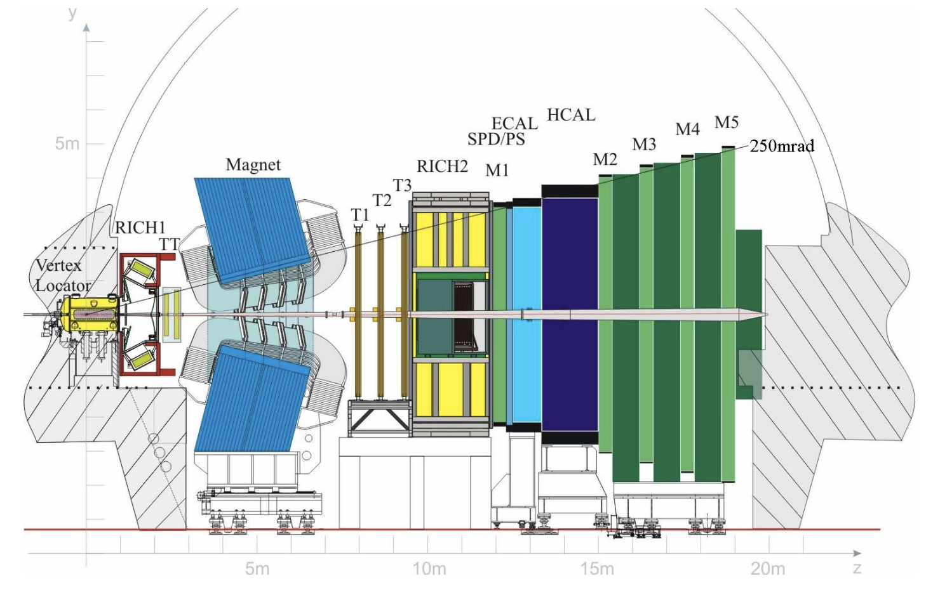
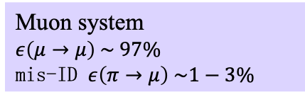
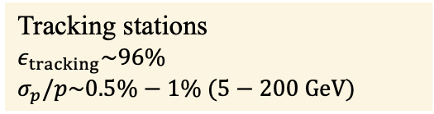
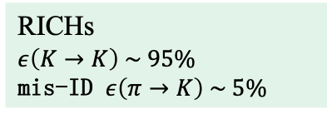
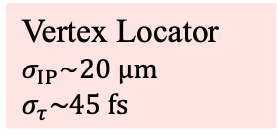
LHCb detector
A single-arm forward spectrometer covering the pseudorapidity range 2 < η < 5
Vertex Locator
$σ_{IP}\sim 20 μm$
$σ_{τ}\sim 45 fs$
Tracking stations
$ε_{tracking}\sim 96\%$
$σ_{p}/p\sim 0.5\%−1\% (5−200 GeV)$
RICHs
$ε\left(K→K\right) \sim 95\%$
mis-ID $ε\left(π→K\right) \sim 5\%$
Muon system
$ε\left(μ→μ\right) \sim 97\%$
mis-ID $ε\left(π→μ\right) \sim 1−3\%$
[JINST 3 (2008) S08005]
[IJMPA 30 (2015) 1530022]
Notes:
LHC

Slide 5
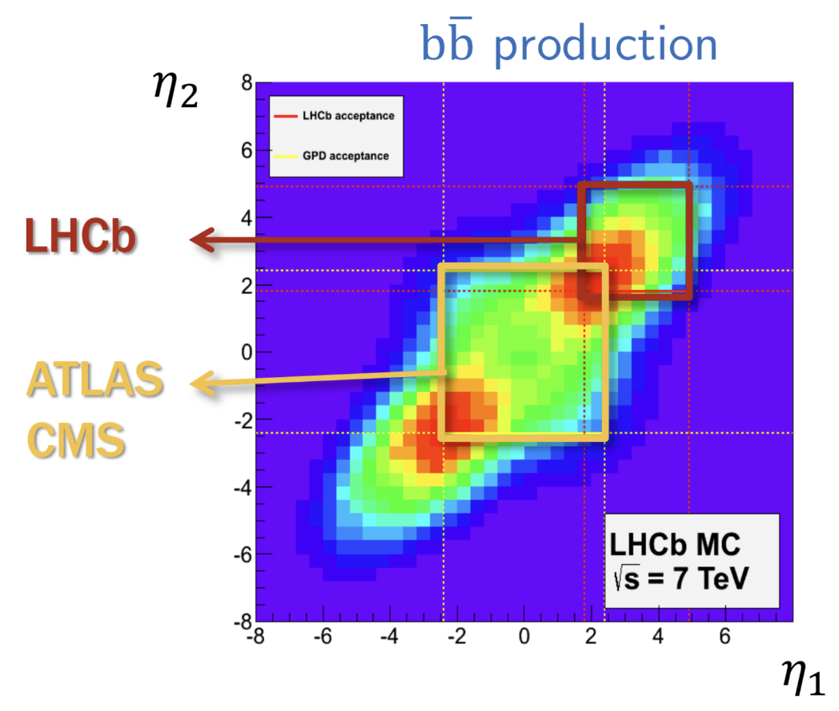

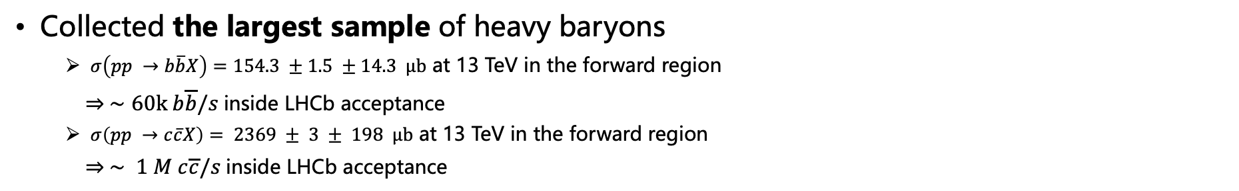




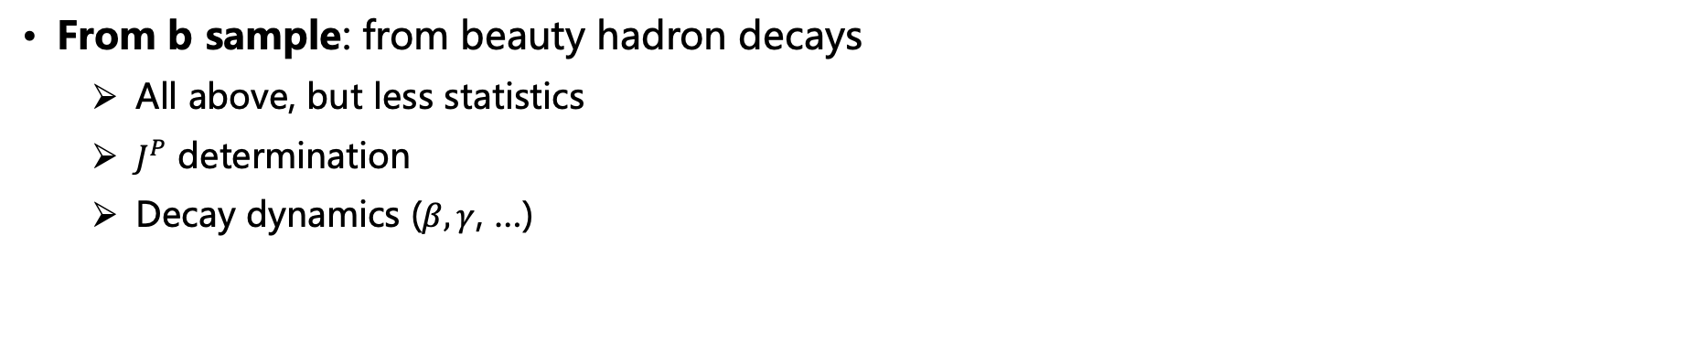

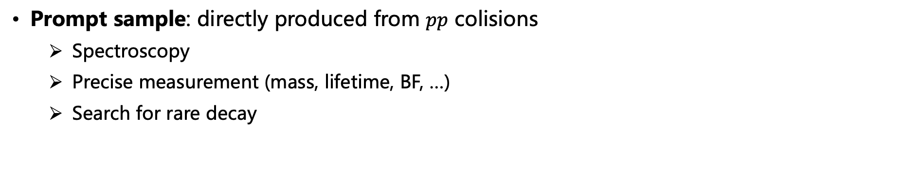

Charm baryons at LHCb
Collected the largest sample of heavy baryons
  $σ\left(pp →b\overline{b}X\right)=154.3 ±1.5 ±14.3 μb$ at 13 TeV in the forward region
  $⇒ ∼60k b\overline{b}/s$inside LHCb acceptance
  $σ\left(pp →c\overline{c}X\right)= 2369 ± 3 ± 198 μb$ at 13 TeV in the forward region
  $⇒ ∼ 1 M c\overline{c}/s$inside LHCb acceptance
Prompt sample: directly produced from $pp$ colisions
  Spectroscopy
  Precise measurement (mass, lifetime, BF, …)
  Search for rare decay
$$Λ_{c}^{+}$$
Large statistics
$$p$$
$$p$$
From b sample: from beauty hadron decays
  All above, but less statistics
  $J^{P}$ determination
  Decay dynamics ($β, γ$, …)
$$Λ_{c}^{+}$$
$$Λ_{b}^{0}$$
$$π^{−}$$
High purity,
with polarization
$$p$$
$$p$$

Slide 6
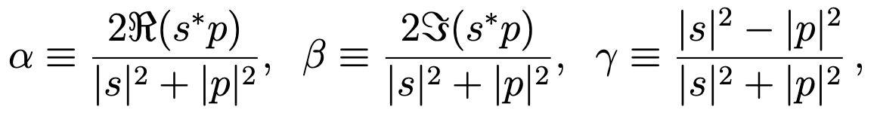


Motivation
Decay parameters can be defined for ${\frac{1}{2}}^{+}→{\frac{1}{2}}^{+}0^{−}$ decays, by $s$ and $p$ waves
$$M\sim ψ_{2}^{+}\left(s+p \vec{σ}⋅\vec{n}\right)ψ_{1}$$
with
Proposed by Lee and Yang to search for parity violation in hyperon decays
[Phys. Rev. 108 (1957) 1645]
[Int.J.Mod.Phys.A 37 (2022) 27, 2250169]

Slide 7
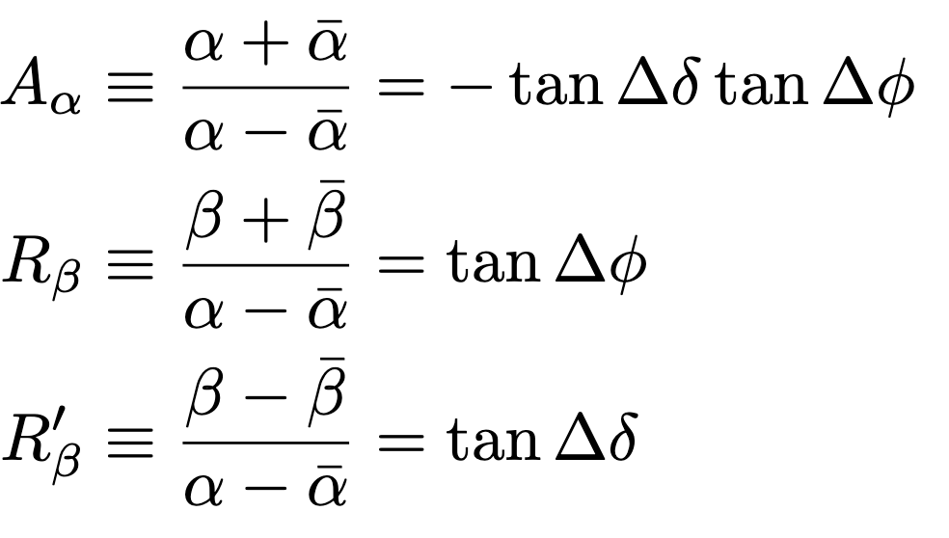

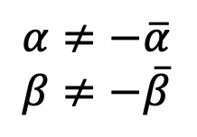




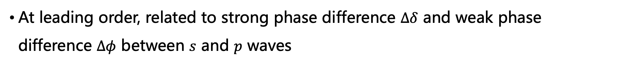


CP violation
Probe parity (P) and charge conjugation parity (CP) violation
$$α≠−\overline{α}$$
$$β≠−\overline{β}$$
$$α≠0$$
P violation
CP violation
CP violation quantified by
$$s=\left|s\right|e^{iδ_{s}}e^{iφ_{s}},$$
$$\overline{s}=−\left|s\right|e^{iδ_{s}}e^{−iφ_{s}}$$
$$p=\left|p\right|e^{iδ_{p}}e^{iφ_{p}},$$
$$\overline{p}=\left|p\right|e^{iδ_{p}}e^{−iφ_{p}}$$
$$Δδ=δ_{s}−δ_{p}$$
$$Δφ=φ_{s}−φ_{p}$$
At leading order, related to strong phase difference $Δδ$ and weak phase difference $Δφ$ between $s$ and $p$ waves
[PRD 34 (1986) 833]

Slide 8

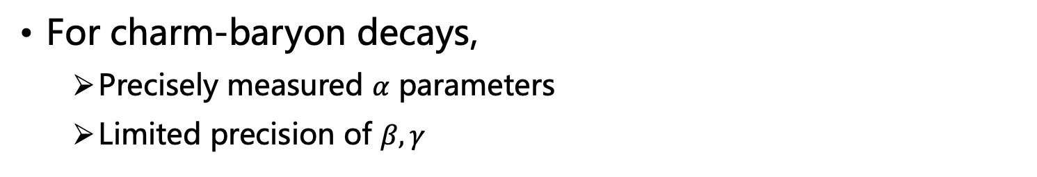
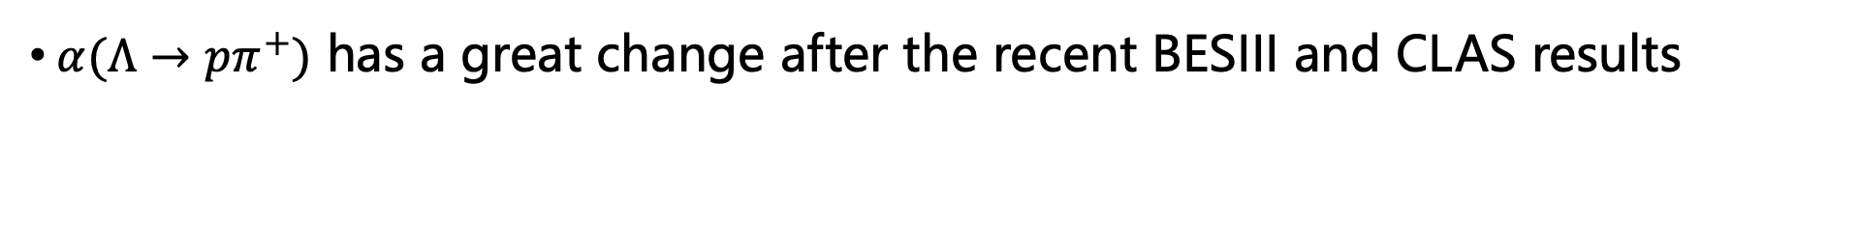
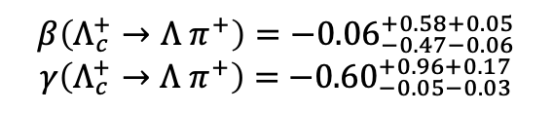
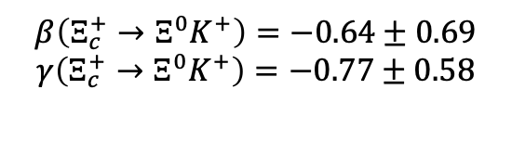
Status of decay parameter measurements
No result for bottom-baryon decay
For charm-baryon decays,
  Precisely measured $α$ parameters
  Limited precision of $β, γ$
$$β\left(Λ_{c}^{+}→Λ π^{+}\right)=−{0.06}_{−0.47−0.06}^{+0.58+0.05}$$
$γ\left(Λ_{c}^{+}→Λ{ π}^{+}\right)=$ $−{0.60}_{−0.05−0.03}^{+0.96+0.17}$
[PRD 100 (2019) 072004]
[PRD 100 (2019) 072004]
[Sci. Bull. 68 (2023) 583]
$$β\left(Ξ_{c}^{+}→Ξ^{0}K^{+}\right)=−0.64±0.69$$
$$γ\left(Ξ_{c}^{+}→Ξ^{0}K^{+}\right)=−0.77±0.58$$
[PRL 132 (2024) 031801]
$α(Λ→pπ^{+})$ has a great change after the recent BESIII and CLAS results
$$0.642±0.013 →0.747±0.009$$
[Nature Phys. 15 (2019) 631]
[PRL 129 (2022) 131801]
[PRL 123 (2019) 182301]

Slide 9
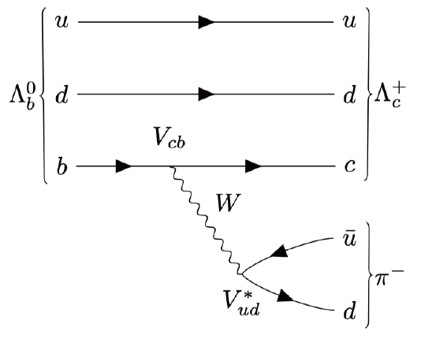
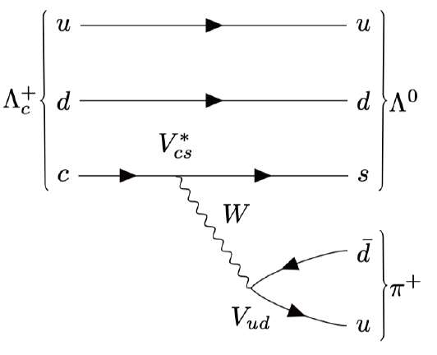
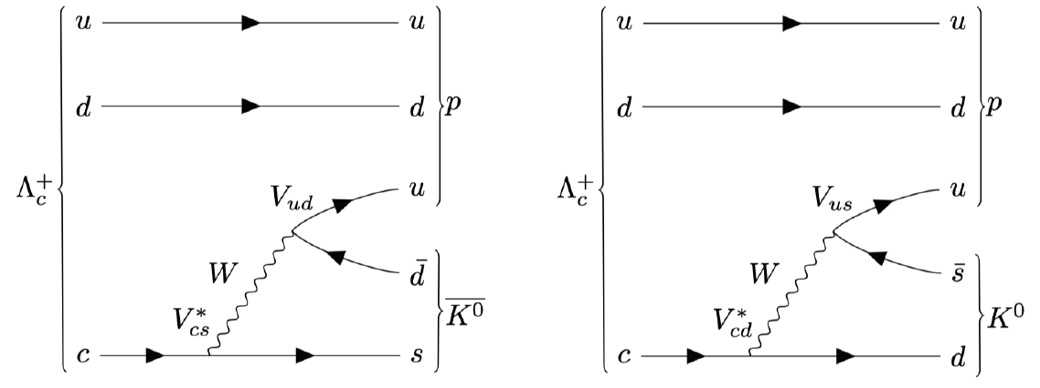
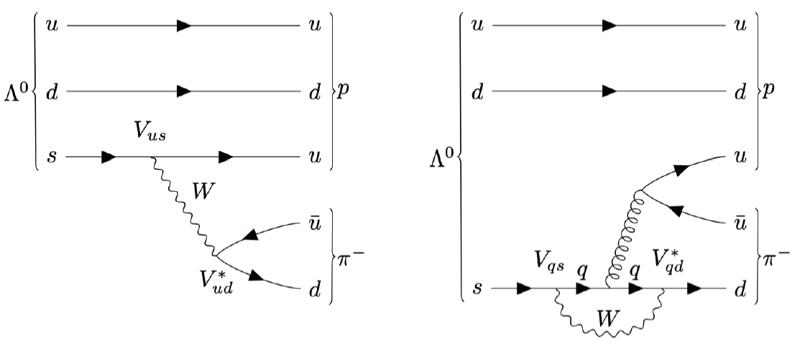
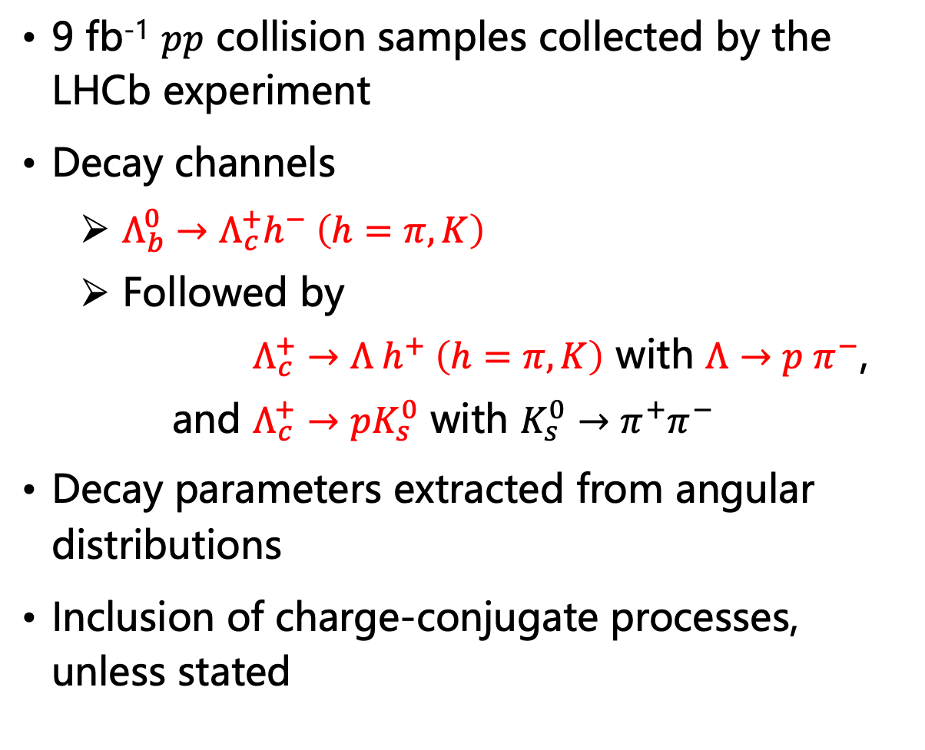
Analysis overview
9 fb⁻¹ $pp$ collision samples collected by the LHCb experiment
Decay channels
  $Λ_{b}^{0}→Λ_{c}^{+}h^{−} \left(h=π, K\right)$
  Followed by
  $Λ_{c}^{+}→Λ h^{+} \left(h=π, K\right)$ with $Λ→p π^{−}$,
  and $Λ_{c}^{+}→pK_{s}^{0}$ with $K_{s}^{0}→π^{+}π^{−}$
Decay parameters extracted from angular distributions
Inclusion of charge-conjugate processes, unless stated

Slide 10
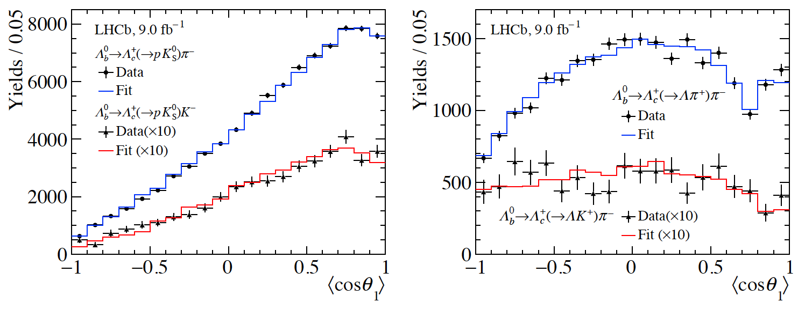
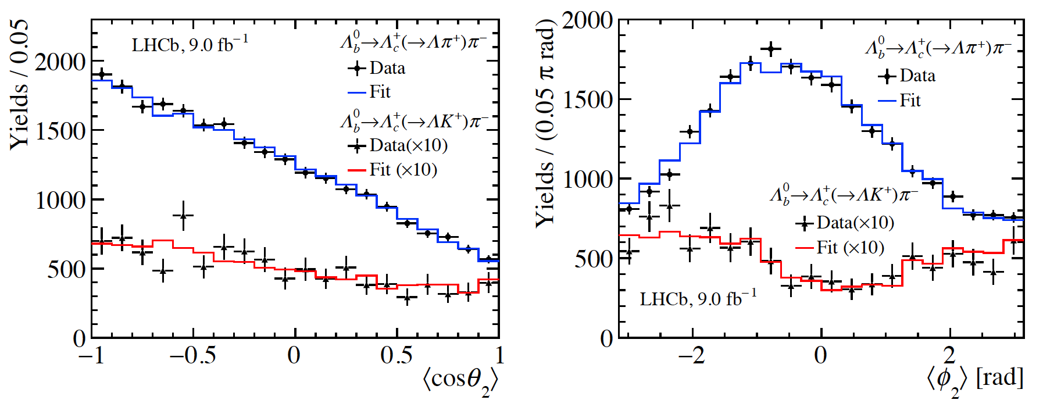
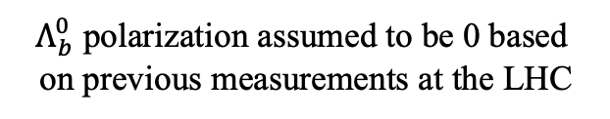
Angular fit
Joint unbinned maximum-likelihood fit of five channels
Eight independent fit parameters, without external input
sFit method for background subtraction
[Nucl. Instrum. Meth. A555 (2005) 356]
$Λ_{b}^{0}$ polarization assumed to be 0 based
on previous measurements at the LHC
[Phys. Lett. B724 (2013) 27]
[Phys. Rev. D89 (2014) 092009]
[Phys. Rev. D97 (2018) 072010]

Slide 11
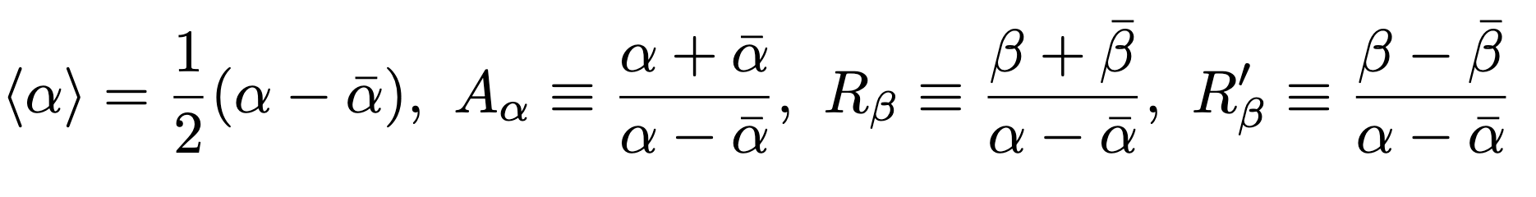
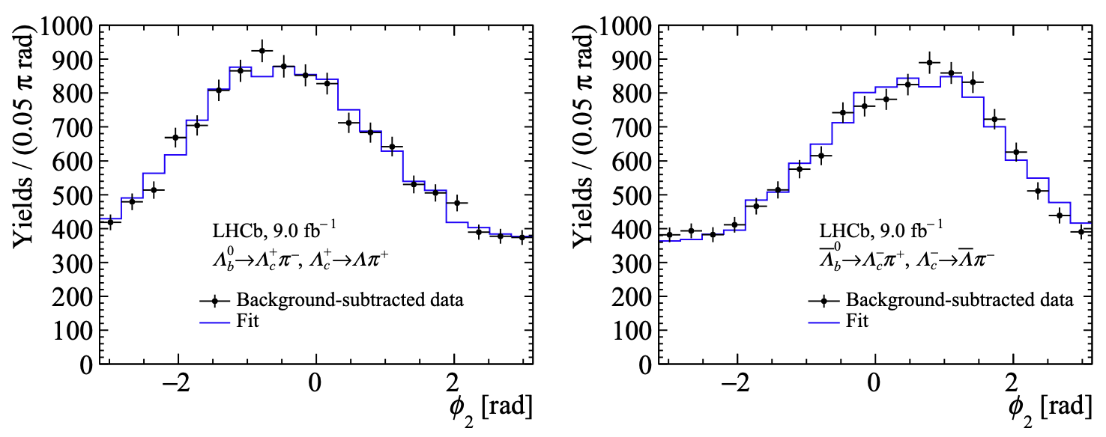

CP measurement
Fit to $Λ_{b}^{0}$ and ${\overline{Λ}}_{b}^{0}$ samples simultaneously
Using CP-related parameters as fit parameters
No significant CP violation found

Slide 12
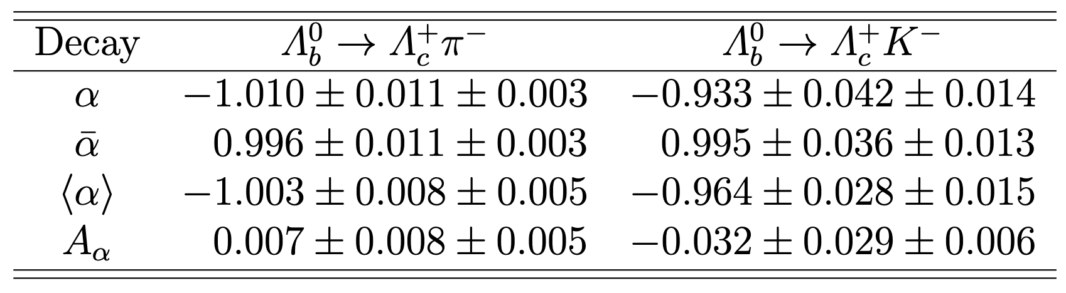

Results of $Λ_{b}^{0}$ decays
First measurement
$α≈−1$ V − A nature of the weak current and maximal parity violation
Various model calculations predict $α≈−1$
[Phys. Rev. D105 (2022) 073005]

Slide 13
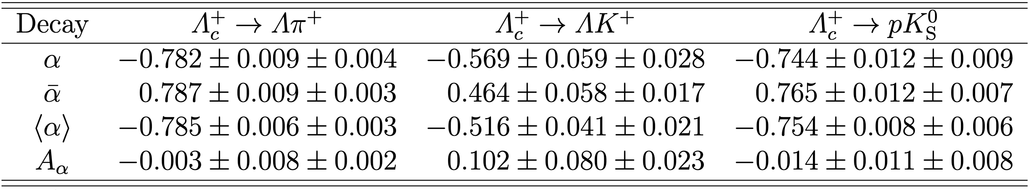
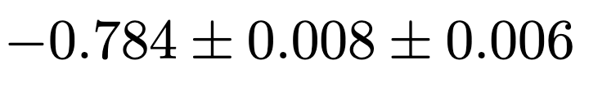
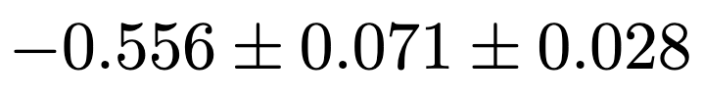
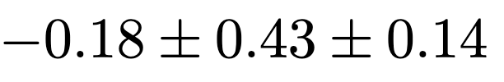

Results of $Λ_{c}^{+}$ decays
The most precise measurement
Benefit from the large $Λ_{c}^{+}$ polarization from $Λ_{b}^{0}$ decay
BESIII: [Phys. Rev. D100 (2019) 072004]
Belle : [Sci. Bull. 68 (2023) 583]
(Belle)
(Belle)
(BESIII)
[Chin.J.Phys. 78 (2022) 324-362]
Theoretical predictions complicated due to nonfactorizable contributions
(PDG)
Notes:
10 times larger yield (Belle)

Slide 14
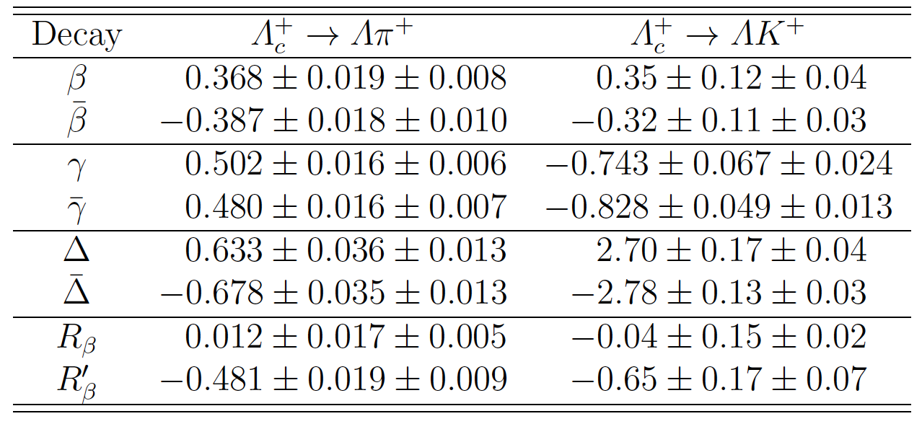
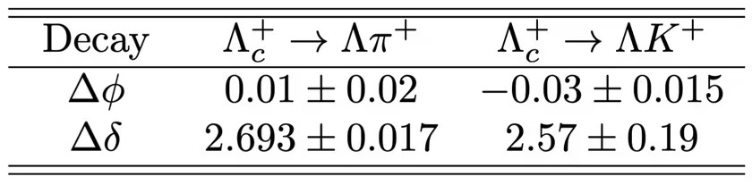
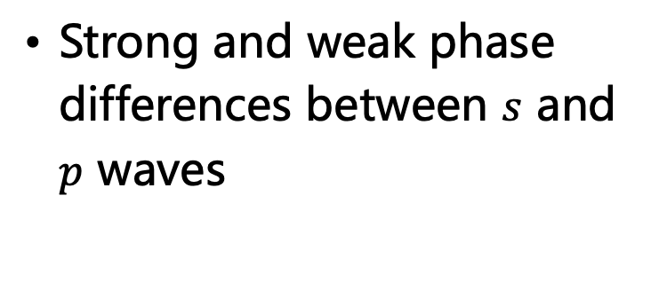
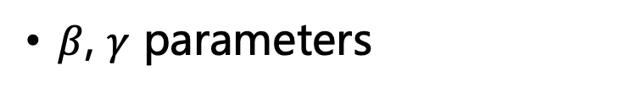
Results of $Λ_{c}^{+}$ decays (cont.)
Strong and weak phase differences between $s$ and $p$ waves
$β$, $γ$ parameters
Serve as essential inputs for some theoretical models
  Topological diagrams
[PRD 109 (2024) 114027]

Slide 15
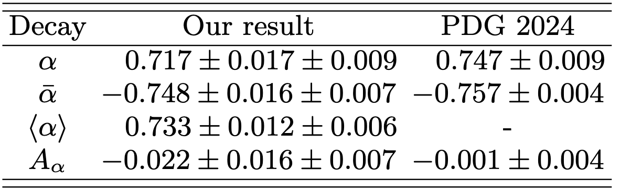
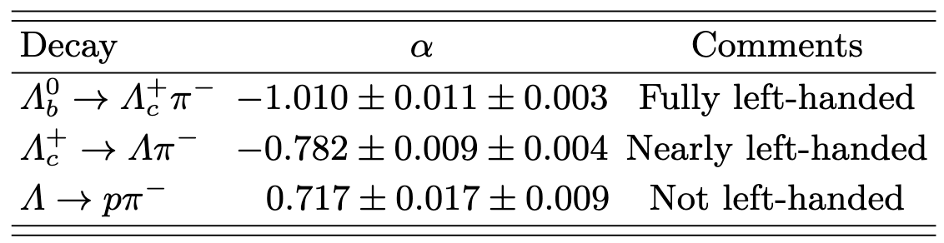
Results of $Λ$ decay
Independent measurement, consistent with BESIII results
Dominated by BESIII results
Comparison between baryon decays with different flavors

Slide 16
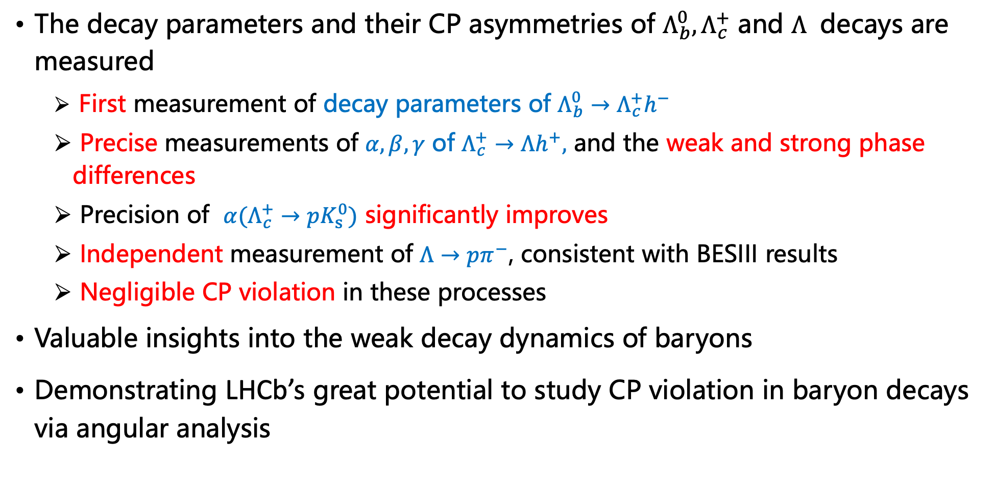
Summary
The decay parameters and their CP asymmetries of $Λ_{b}^{0}, Λ_{c}^{+}$ and $Λ$ decays are measured
  First measurement of decay parameters of $Λ_{b}^{0}→Λ_{c}^{+}h^{−}$
  Precise measurements of $α,β,γ$ of $Λ_{c}^{+}→Λh^{+},$ and the weak and strong phase differences
  Precision of $α(Λ_{c}^{+}→{pK}_{s}^{0})$ significantly improves
  Independent measurement of $Λ→pπ^{−}$, consistent with BESIII results
  Negligible CP violation in these processes
Valuable insights into the weak decay dynamics of baryons
Demonstrating LHCb’s great potential to study CP violation in baryon decays via angular analysis
Notes:
arxiv in this month

Slide 17
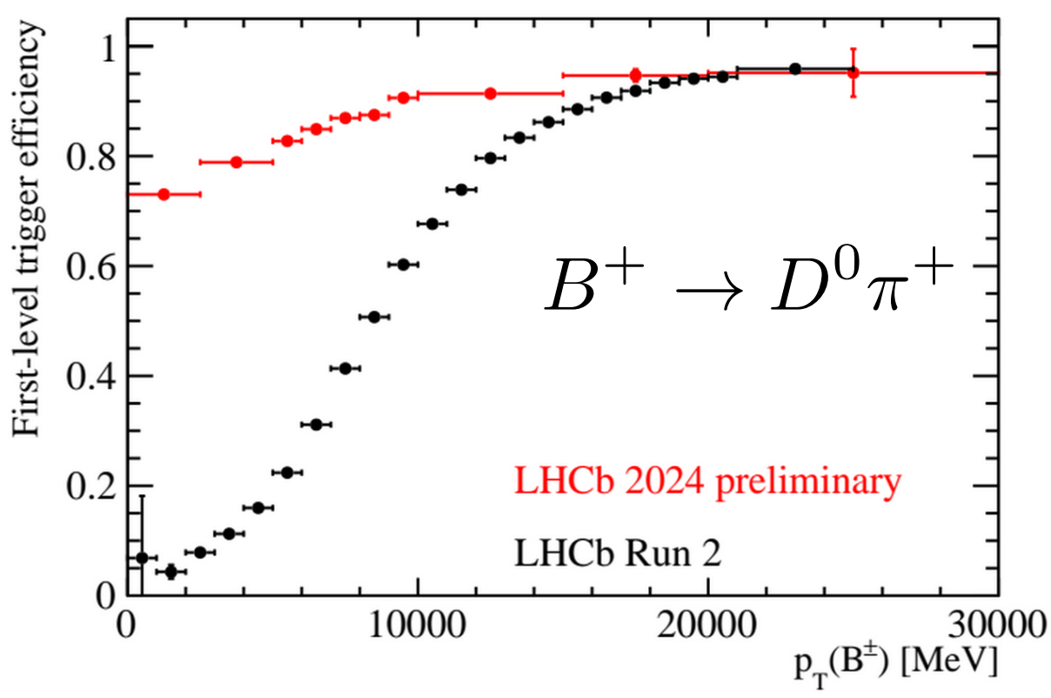



Outlook
LHCb is highly active in beauty and charm sector and leading many studies of heavy baryons
  One of the largest recorded $b/c$ samples with high purity and excellent PID information
  Many still ongoing analyses using Run 1 and Run 2 data
In RunIII, the LHCb experiment will keep making important contributions to charm sector with
  Higher luminosity ($L_{Run3}>L_{Run1}+L_{Run2}$)
  Upgraded detector (e.g. UT)
  Improved techniques (e.g. fully reconstruction in software trigger)
  …
We are here
Many Thanks!

Slide 18
Backup

Slide 19

Topological diagrams

Slide 20

Yields

Slide 21




Angular distributions
For $Λ_{b}^{0}→Λ_{c}^{+}\left(→pK_{s}^{0}\right)h_{2}^{−}$
For $Λ_{b}^{0}→Λ_{c}^{+}\left(→Λh_{1}^{+}\right)h_{2}^{−}$
$Λ_{b}^{0}$ polarization assumed to be 0 based
on previous measurements at the LHC
[Phys. Lett. B724 (2013) 27]
[Phys. Rev. D89 (2014) 092009]
[Phys. Rev. D97 (2018) 072010]

Slide 22



Angular fit
Joint unbinned maximum-likelihood fit of five channels
sFit method for background subtraction
Eight independent fit parameters, without external input
[Nucl. Instrum. Meth. A555 (2005) 356]
or
Helicity amplitude

Slide 23




Helicity formalism expansion
1

Slide 24


Helicity formalism expansion (cont.)
1

Slide 25


Angular fit method
sFit method for background subtraction
Constant to correct reported statistical uncertainties
Monte Carlo integration method
Angular acceptance corrected

