Slide 1
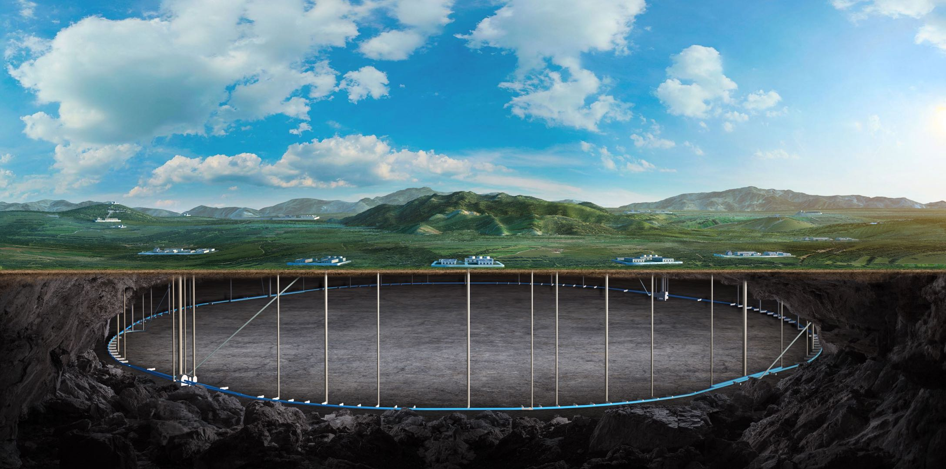
Feedback from 1st IDRC review
Zhijun Liang
(On behalf of the CEPC physics and detector group)
Oct. 21st, 2024, CEPC Detector Ref-TDR Review

Slide 2
Comment to overall tracking
The design and technology choices for the vertex detector, inner (ITK), and outer tracker (OTK) are particularly ambitious, incorporating the latest advances in silicon detector technology.
This places the detector at the cutting edge of technological development but also necessitates the engagement of a much larger community to complete the prototyping and construction phases. The progress made by the groups working on the silicon trackers, considering the wide number of participating institutes, is truly remarkable.
Work plan
expanding international collaboration (DRD3 …) and explore synergies with other projects, to enlarge our community

Slide 3
Vertex finding 1
The Vertex detector aims to utilize Depleted Monolithic Active Sensors (DMAPS) to achieve a high position resolution of 3-5 μm, with a readout speed of approximately 43 MHz and an ultra-low material budget of <0.15% per layer, all while maintaining a power consumption of 40 mW/cm2. This presents a significant technical challenge, but development can benefit from parallel efforts in ALICE ITS3, although the CEPC design is even more demanding, particularly with its tighter bending radius requirement of 11 mm.
The baseline solution involves a <65 nm process, which would reduce power consumption to acceptable levels and facilitate large-scale stitching. The availability of thin epi-layers favors a small electrode design with a modified or non-standard doping profile (low-doped n-layer). This technology is accessible through TowerJazz cooperation, and the 55 nm process with SIMC is also under investigation.

Slide 4
Vertex finding 2
A notable achievement is the development of the TauichiPix3 sensor (engineering run with TowerJazz at 180 nm). While it does not fully meet the power requirements, it demonstrated excellent position resolution (<5 μm) and serves as an excellent test platform for further advancements. This sensor was used to construct a vertex detector prototype with ladders, which was successfully tested at DESY.
As a fallback, a solution using three double layers of DMAPS on ladders (providing six tracking points) is feasible if a thin, bent vertex detector cannot be achieved. This alternative would come with a slightly higher material budget and result in lower pT resolution at lower energies. Mechanical tests of the baseline design, which consists of four bendable silicon layers and a ladder-based double layer, were successfully conducted using dummy thinned silicon (40 μm), bent to 12 mm, very close to the design goal.

Slide 5
Comment 1 on vertex
The timeline of the CEPC project raises concerns that the process with the required features, such as modified doping profiles, may not be available when needed. Therefore, early communication with the vendor is essential, along with exploring potential developments with a secondary supplier. This proactive approach could also prove to be cost-effective in the long term.
Work plan:
Plan to work with TPSCo 65 nm in next few years to develop stitched MAPS
Exploring potential of SMIC 55nm as secondary supplier

Slide 6
Comment 2 on vertex
Regarding the mechanical design, it is still in the early stages of development. A significant challenge remains in cooling the vertex detector, especially with airflows exceeding several meters per second, which poses technical difficulties.
Work plan
Do more experiments with dummy wafer and thermal mockup system

Slide 7
Recommendations 1 for vertex
Thorough analysis and simulation of the background are essential, as they directly influence key aspects of detector design and operation, such as data rates and power consumption.
Work plan: joint efforts with MDI and electronics teams
Explore carefully the background for low-lumi Z operations
Work with electronics team to refine power consumption estimation

