Slide 1
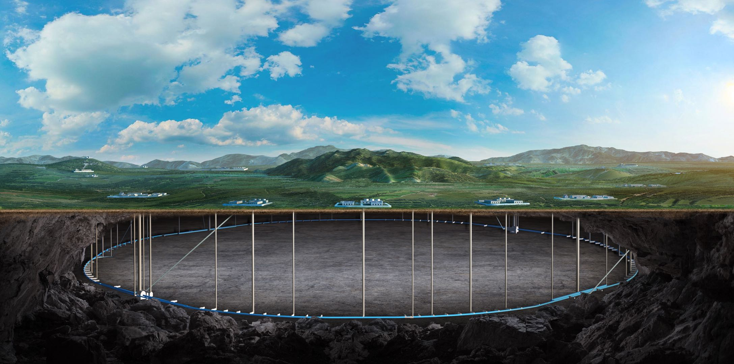
Feedback of IRDC Report
for TDAQ
Fei Li
On behalf of CEPC TDAQ Group
Oct. 28th, 2024, CEPC Detector Ref-TDR Meeting

Slide 2
Findings
The baseline plan is to transmit the full raw data to the front-end electronics and connect the trigger to the back-end electronics.
Transmit the full raw data from front-end electronics(on-detector) to back-end electronics(off-detector)
A hierarchical trigger scheme is foreseen to bring event data rates down from ~3MHz to ~1kHz in ZH running and ~40MHz to ~100kHz at the Z pole.
The bunch cross rate in ZH running is about 1.34 MHz when bunch space is 346.2 ns (2.9 MHz) and there is 54% bunch train gap.

Slide 3
Comments
The detailed (bottom-up) design of the TDAQ must await further details on the sub detector design.
We will closely follow the design of each sub detector. Especially background study and data rate estimation from each sub detectors.
Work on the trigger primitives is needed to bring the rate down to an acceptable input for the second-level trigger, and to inform further planning for the processing farms in the DAQ design. Should it be needed, a track trigger could provide a powerful additional primitive.
More simulation works needed on trigger primitive study based on discussion with physics and detector experts.
High-level triggering will also need to weigh the physics-versus-bandwidth tradeoff for lower-energy events, e.g. from gamma-gamma collisions.
We need to evaluate offline reconstruction algorithms and software as reference. It requires cooperation from offline for HLT design.

Slide 4
Recommendations
A simple simulation of sub detector-based trigger inputs using simple, robust algorithms should be prioritized to allow more detailed specification of the requirements for TDAQ hardware and identify areas that need further attention. This should include an appropriate safety factor for beam-related backgrounds.
Basic trigger simulation study for each sub detectors are in progress.
More man power and help from sub detector are needed.
And the safety factor needs to be discussed carefully.
Further work should include an evaluation of benefits of implementing a track trigger as a complement to the calorimeter and muon primitives, and to clarify the bandwidth foreseen for gamma-gamma events.
We should move forward with this after finish simple trigger simulation. Gamma-gamma events are generated and will be studied soon.

Slide 5
Working Plan
TDR draft
Nov. ~ Dec.
Background study and data rate estimation
Nov.
Basic trigger simulation and algorithm study
Dec.
Detailed hardware trigger and interface design
Dec.
Finalize TDAQ and online design scheme
Jan. 2025

Slide 6
Backup

Slide 7
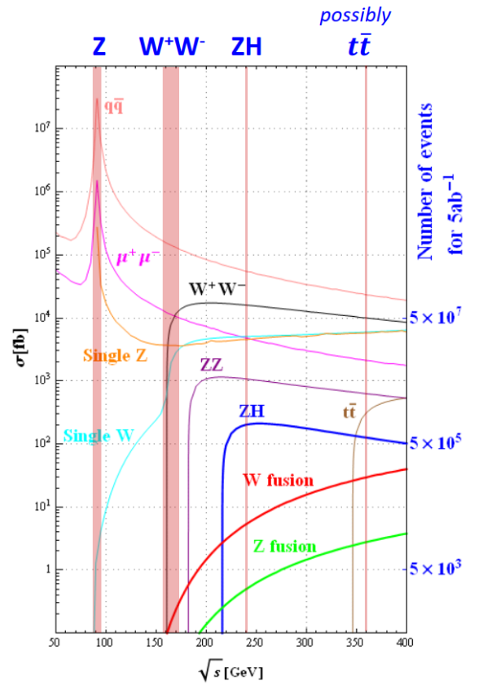
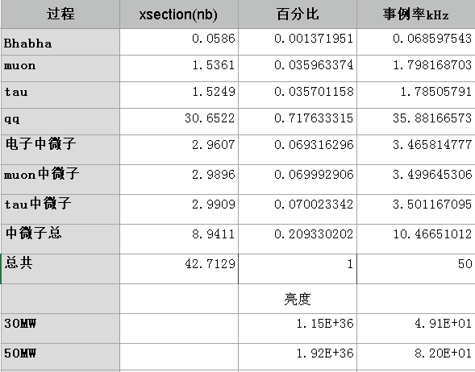
Event Rate
Higgs 240GeV(30MW/50MW)
BX rate:0.8/1.34(2.9)MHz
Physical event rate: 5Hz/8Hz (Higgs: 0.02Hz)
Z pole 91GeV(30MW/50MW)
BX rate:35.9/39.4(43.3)MHz
Physical event rate: 50kHz/82kHz
Higgs，Sample generation for CEPC, August 24, 2020
Z pole, ref：MC /cefs/data/stdhep/CEPC91/ 2fermions/wi_ISR_20220618_50M/2fermions/

Slide 8
Data Rate
Data rate before trigger
<1 TB/s @ Higgs
Several TB/s @ Z
L1 trigger rate
O(1k) Hz @ Higgs
O(100k) Hz @ Z
Event size < 2 MB
Related to occupancy and read out window
Storage rate after HLT
<100 Hz(200 MB/s) @ Higgs
100 kHz (200 GB/s) @ Z
 | Vertex | Pix(ITKB) | Strip (ITKE) | OTKB | OTKE | TPC | ECAL-B |  | ECAL-E | HCAL-B | HCAL-E | Muon
Channels per chip | 512*1024 | 512*128 | 1024 | 128 |  | 128 | 8~16
Data Width /hit | 32bit | 42bit | 32bit | 48bit |  | 48bit | 48bit
Avg. data rate / chip | 0.18Gbps/chip, 1Gbps/chip inner | 3.53Mbps/chip | 21.5Mbps/chip | 2.9Mbps/chip | 38.8Mbps/chip | ~70Mbps/module Inmost | 10kHz/ch | 10kHz/ch |  | 5kHz/channel | 5kHz/channel | 10kHz/channel
Detector Channel/module | 1882 chips @Stch &Ladder | 30,856 chips 2204 modules | 23008 chips 1696 modules | 83160 chips 3780 modules | 11520 chips 720 modules | 492 Module | 0.96M chn ~60000 chips 480 modules | 0.39 M chn |  | 3.38M chn 5536 aggregation board | 2.24M chn 1536 Aggregation board | 43,176 chn, 288 modules
Avg Data Vol before trigger | 474.2 Gbps | 101.7 Gbps | 298.8 Gbps | 249.1 Gbps | 27.9 Gbps | 34.4 Gbps | 460.8 Gbps | 187 Gbps |  | 811.2 Gbps | 537.6 Gbps | 24 Gbps
Occupancy(%) | 0.022 | 0.025(Strip) |  | 0.35(Strip) |  | 0.0028 | 0.58 |  |  | 0.002 |  | 0.038
Sum | 3.2 Tbps = 400GB/s
Collected from each detectors @Higgs

