Slide 1
Progress and plan of DAQ and SC
Tingxuan Zeng, Sheng Dong, Si Ma
2024-10-28

Slide 2
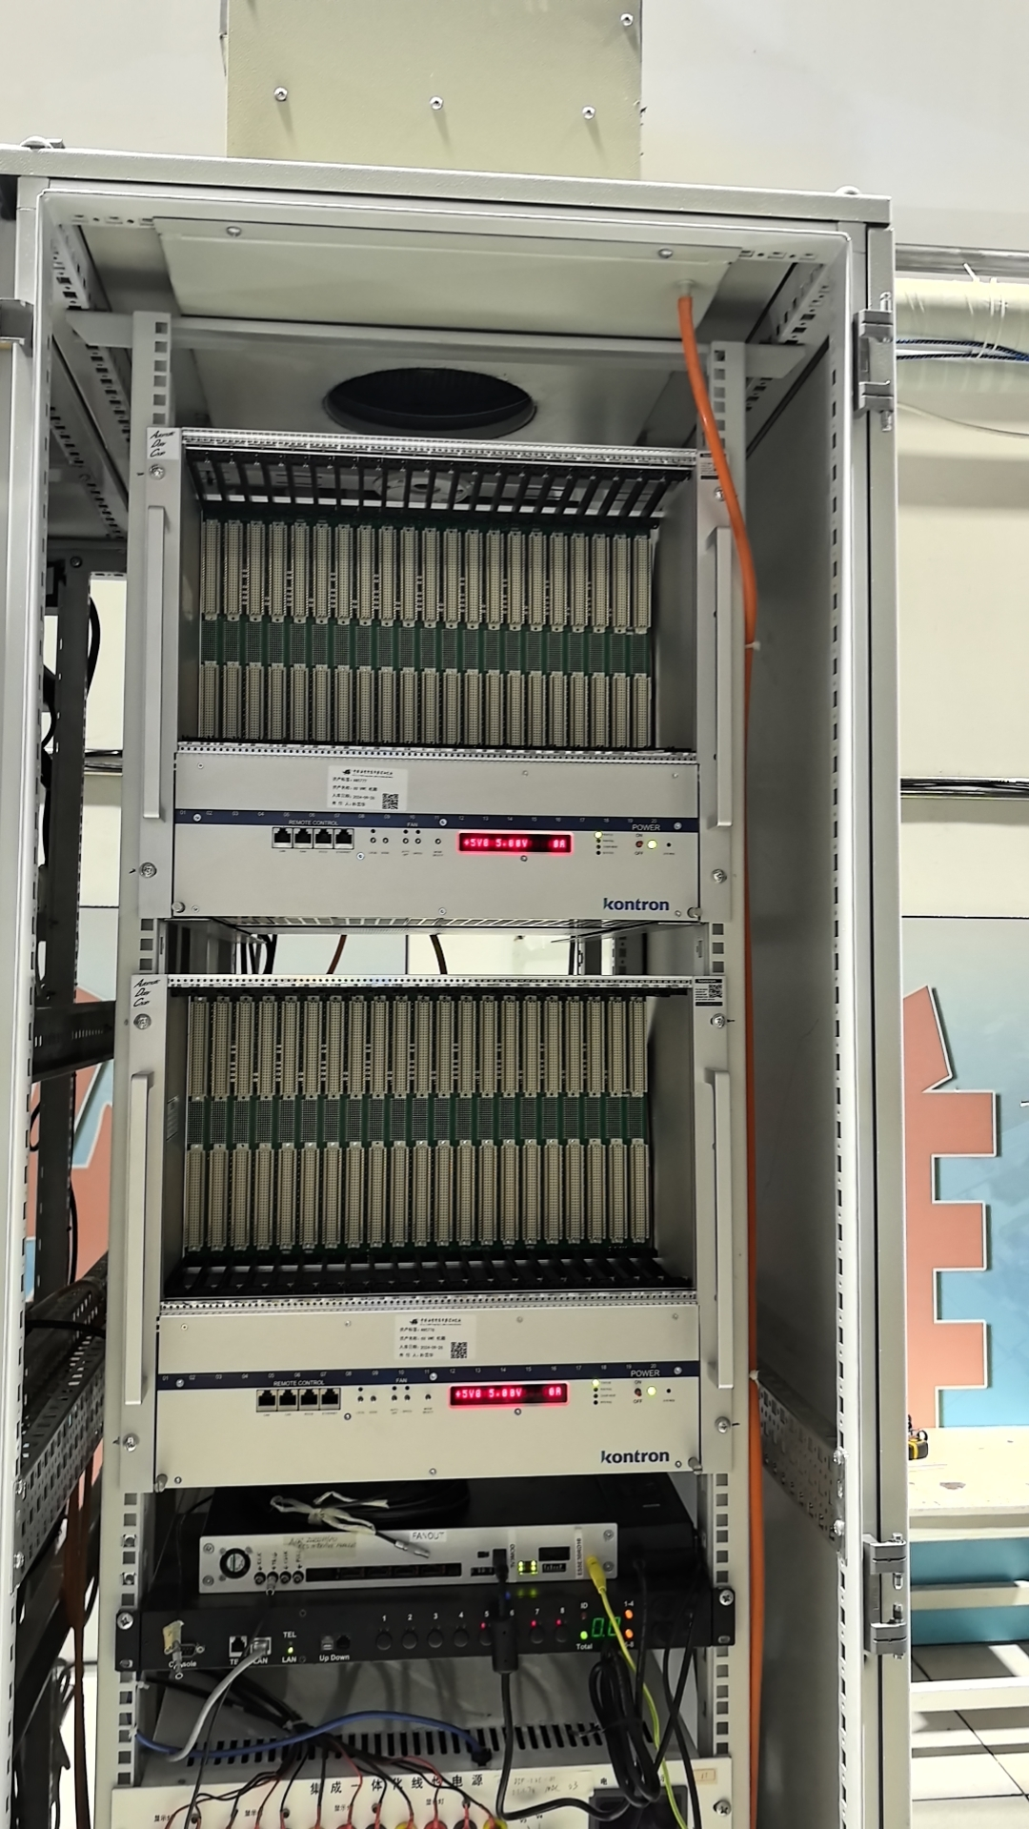
CGEM DAQ
Help with the installation of VME crate.
Purchase of the serial cable and ethernet cables
for the PPC connection.
Begin the cable connection and configuration
of the crate and PPC.
Clarify the requirement further and start the
code integration of the FEE configuration.

Slide 3
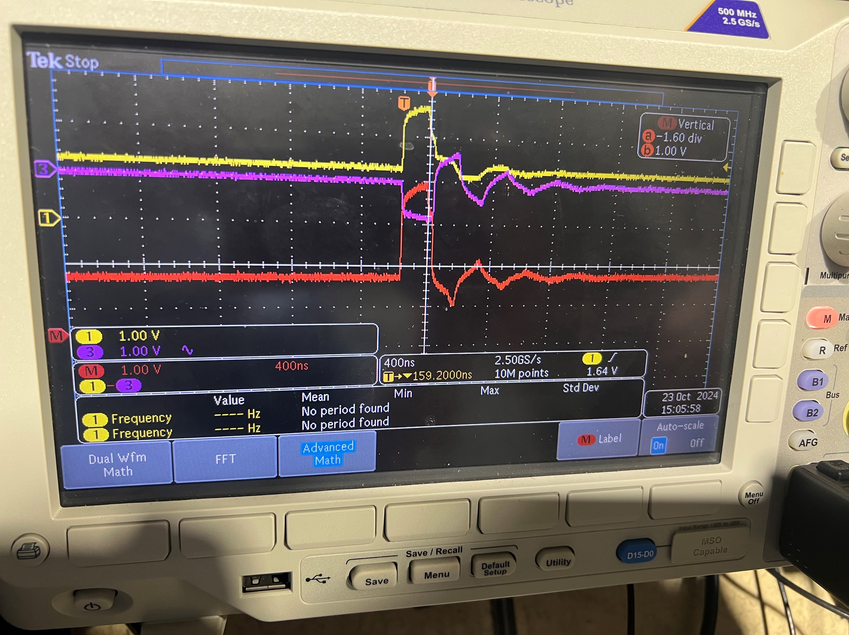
Trigger for CGEM
The trigger signal (L1) based on EMC has been tested and applied in the CGEM readout system.
The yellow and pink lines represent the L1 differential signal, while the red line shows the differential calculation result measured by the oscilloscope.
The trigger signal received by the GEMROC.
Notes:
I'd like to give an update on the current status of the BES3 trigger.
Last week, we successfully generated a trigger signal using the EMC detector and applied it to the CGEM readout test.
This image here shows the trigger signal received by the GEMROC.
That’s all from me, thank you!

Slide 4
Need to confirm
when will the commissioning of the DAQ and slow control start ?

