Slide 1


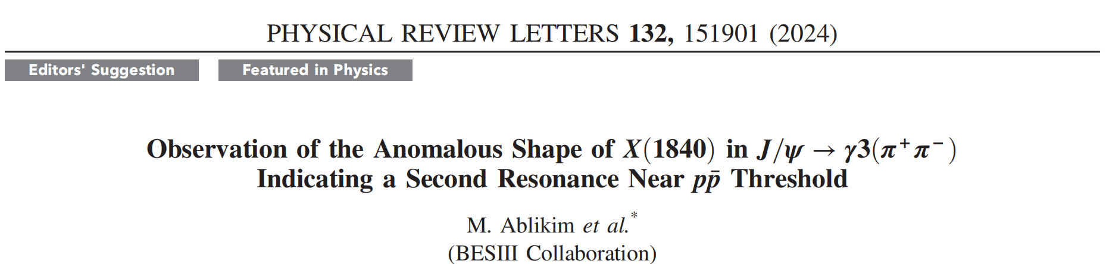
Discovery of the X(1880) at BESIII
Liqing QIN (秦丽清)
Guangxi Normal University
(on behalf of the BESIII Collaboration)
第8届强子谱与强子结构研讨会, 2025.07.13

Slide 2
OUTLINE
p‾p bound state ?
X(p‾p ) , X(1835), X(1840) at BESII
Anomalous line-shapes of the structure at 1.84 GeV
Summary

Slide 3
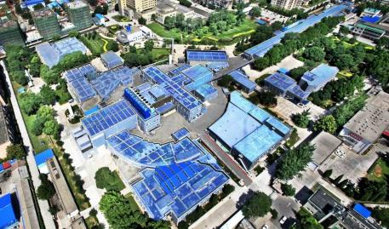
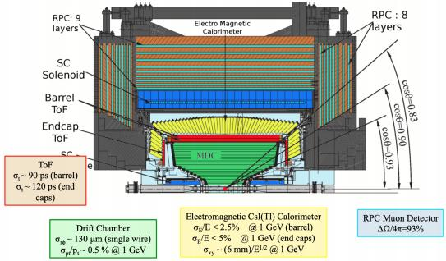
BESIII at BEPCII
Symmetric e⁺e⁻ collider BEPC II
√s = 2.0 - 4.6 GeV (~5 GeV since 2019)
design luminosity achieved:
1x10³³ cm⁻²s⁻¹ (at ) operating since 2008
LINAC
BES III
BEPC II
BESIII detector
charged particle tracking
particle identification
electromagnetic calorimeters almost 4π coverage
2

Slide 4






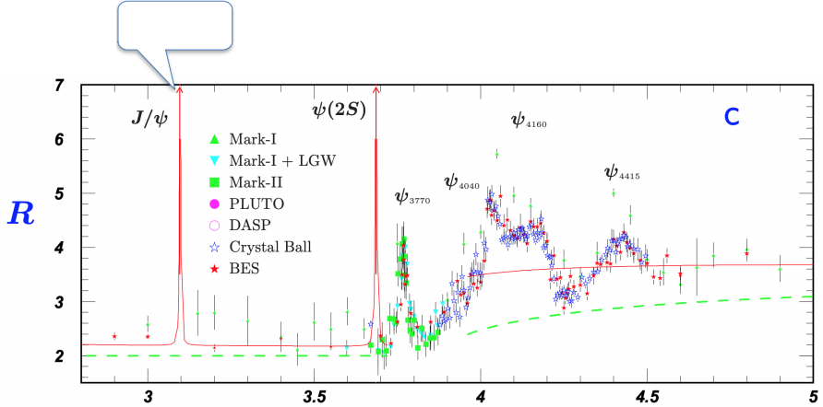

Data Samples
2.7 x10⁹ events
2.9/fb
0.5/fb
3.2/fb
1.9/fb
10 x109
events
1.1/fb
5.
at 10
6/fb
points
R
22/fb XYZ scan data
J/ψ decays are well suited for light hadron spectroscopy
3

Slide 5



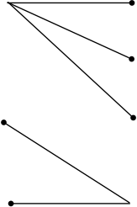




Exotic Hadrons
Conventional mesons (qq)
Exotic hadrons: other color-neutral configurations
multi-quarks (qqqq)
molecules [qq][qq]
compact
tetraquarks qqqq
diquark-antidiquarks
hybrids (qqg)
glueballs (gg, ggg)
gluonic degrees of freedom
4

Slide 6
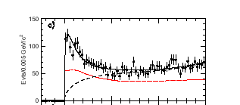
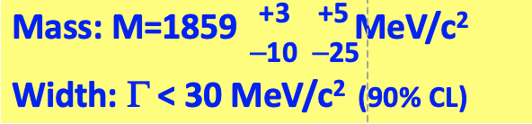
First result：$p\overline{p}$ threshold enhancement at BES
Fitted peak
J/ψ→γ p pbar
C-parity = +
J^{PC}= 0⁻⁺ (0⁺⁺?) state
M(pp)-2m_{p} (GeV)
BG curve
Eff. curve
3

Slide 7
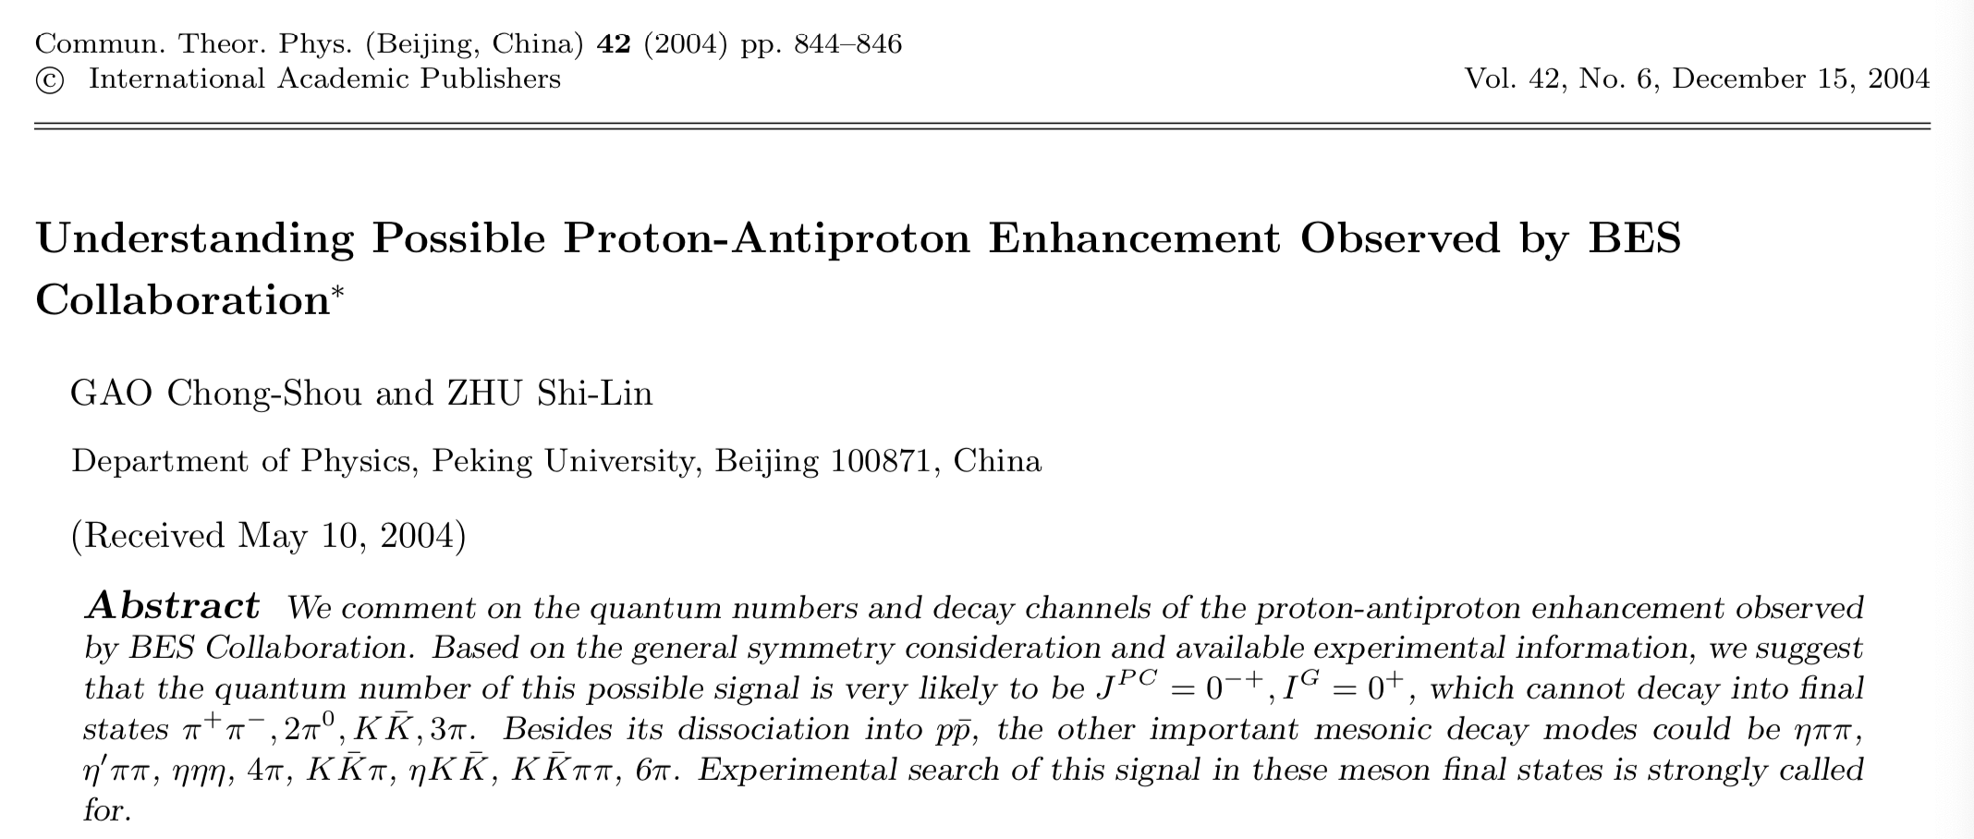
Theoretical speculations on its nature
Conventional meson? FSI, baryonium state?
Baryonium interpretation would be supported by observation of the resonance in decay modes which are expected for a 𝑝𝑝̅ bound state.
Observation of its new decay modes strongly needed!
  π⁺π⁻π⁺π⁻η ,π⁺π⁻η′ ?
C.S. Gao, S.L. Zhu, Commun.Theor.Phys. 42 (2004) 844;
G.J. Ding, M.L. Yan, Phys.Rev.C 72 (2005) 015208

Slide 8
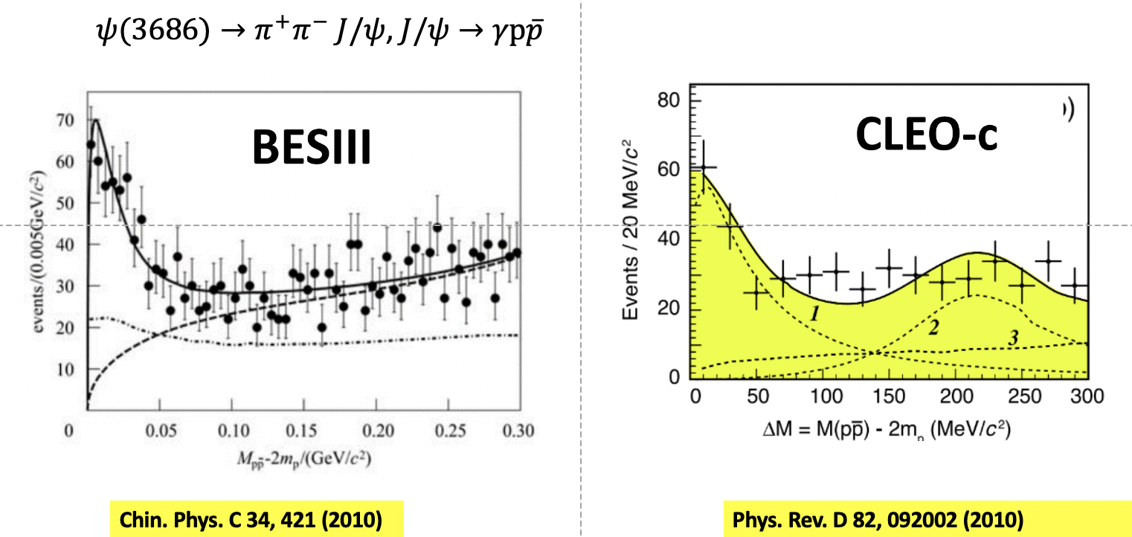




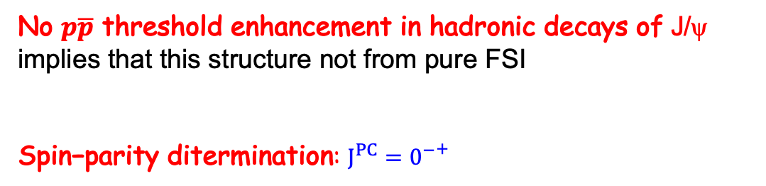
$\text{Confirmed} p\overline{p}$ threshold enhancement in $ψ$(2S)
No $p\overline{p}$ threshold enhancement in hadronic decays of J/ψ implies that this structure not from pure FSI
$\text{Spin}\text{−}\text{parity} \text{ditermination}$: $J^{PC}={0^{−}}^{+}$
PRD87,112014(2013)
PRD93,052010(2016)
PR D99 112010(2019)
PRL 108 112003(2012)

Slide 9
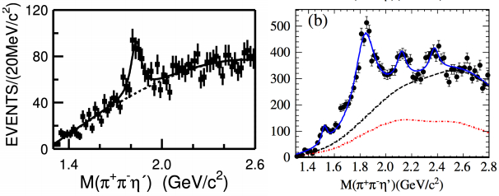
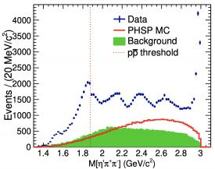
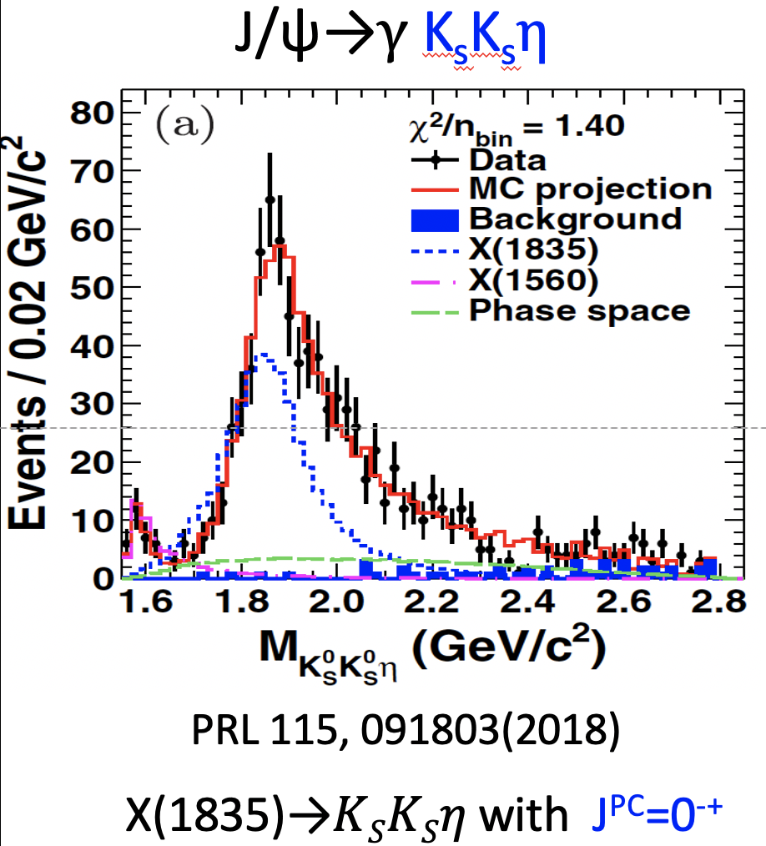
Discovery of the X(1835) via J/ψ → γπ⁺ π ⁻ η ‘
58M J/ψ events
225M J/ψ events
1090M J/ψ events
BESIII, PRL 117, 042002 (2016)
BES, PRL 95, 262001 (2005) | BESIII, PRL 106, 072002 (2011)
Structure at or close to the pp threshold: X(1835)
  pseudoscalar particle: J^{PC} = 0⁻⁺
Additional structures with increasing statistics:
X(2120), X(2370) and … .
X(1835) consistent with 0⁻
5

Slide 10
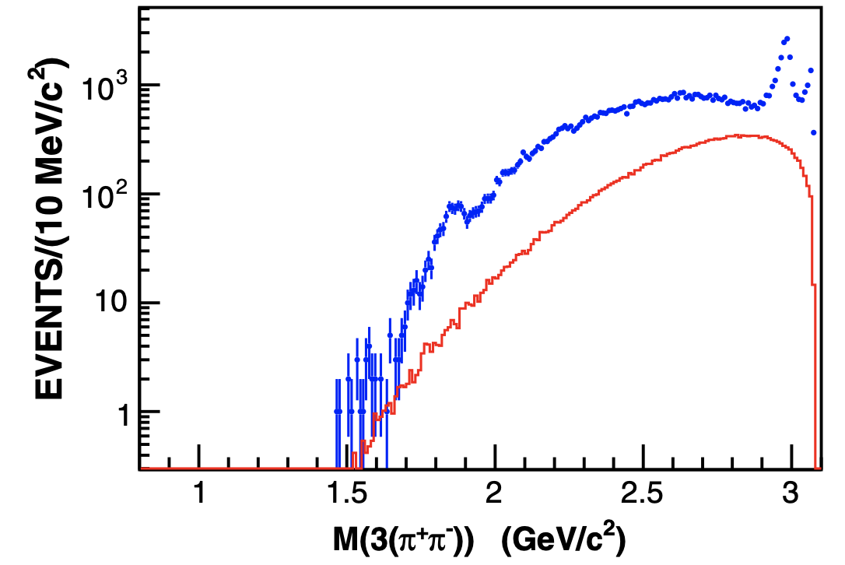
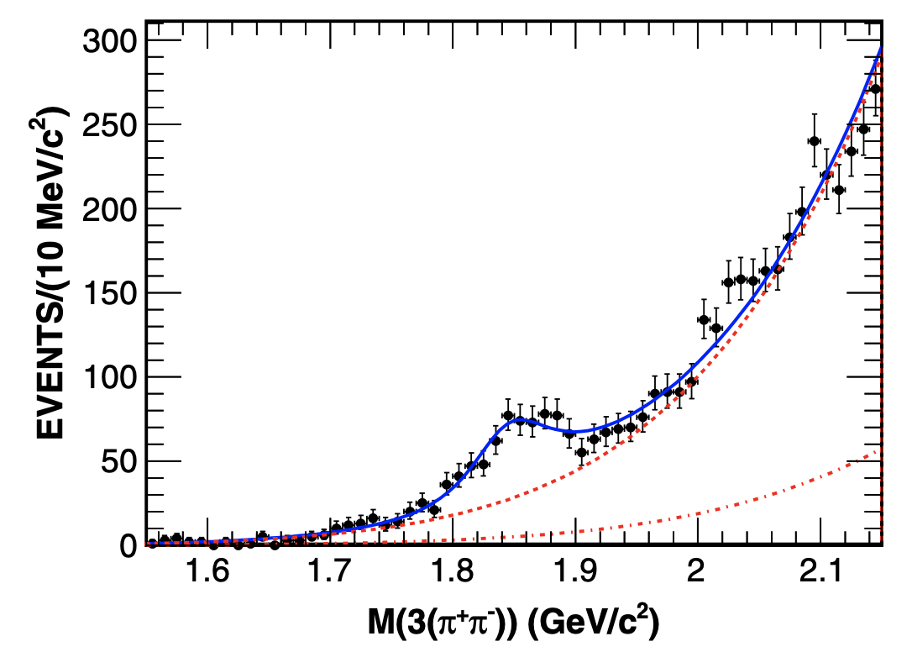



Observation of the X(1840) via J/ψ → 3γ (π⁺ π ⁻ )
PRD 88, 091502 (2013). 225M J/ψ
X(1840): 7.6σ
Six charged pions is a known decay mode of the η_{c}, J/ψ → 3 γ(π⁺ π ⁻ ) may be a favorable channel to search for the X states in [1.8-1.9] GeV.
X(1840) resonance：
8
Notes:
6pi过程可能是搜寻[1.8-1.9] GeV能区X粒子的优势衰变道。

Slide 11
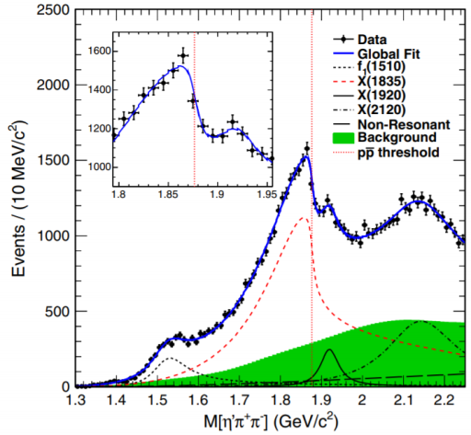
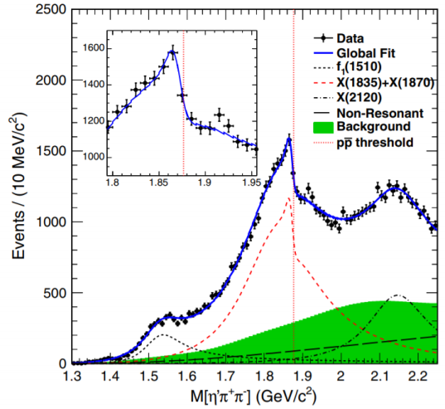
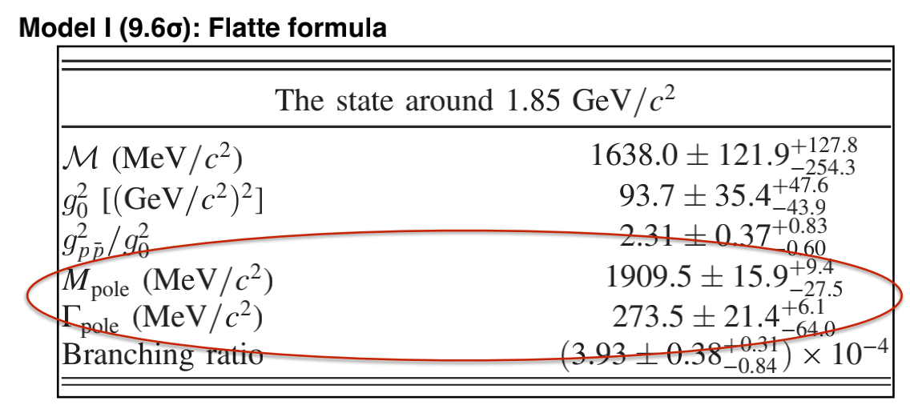
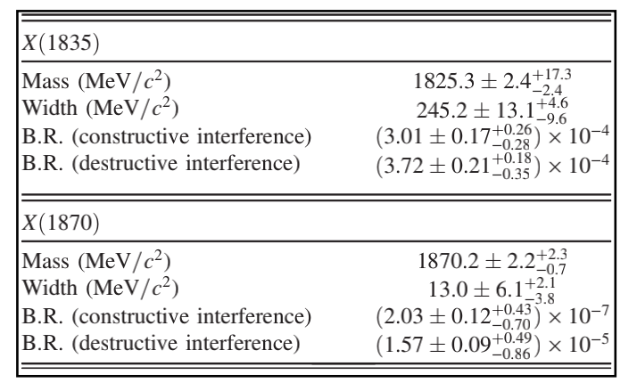

Anomalous line shape of ${η^{′}π}^{+}π^{−}$ near ppbar threshold
First establish the direct link between the X(1835) and X(ppb)
1.09 billion $J/ψ$
PRL 117, 042002（2016）
Model II: two resonances
Lineshape parameterization: Flatte or two interfering Breit-Wigner
  Both models describe data with almost equally good fit quality
The ppb threshold structure is a molecule state or a bound state?
6

Slide 12
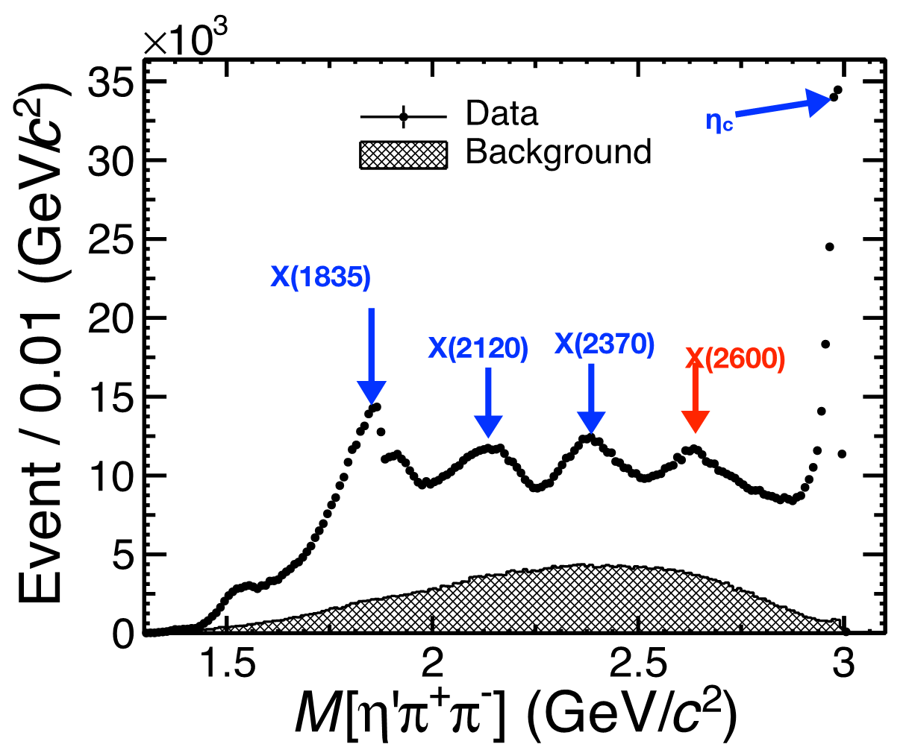
Anomalous line-shape of ${η^{′}π}^{+}π^{−}$ with 10 billion $J/ψ$
PRL129 (2022) 042001
QCD sum rules arXiv:2206.13133
X(2600) new glueball candidates ?
7

Slide 13
Further Study on the X(1840) via J/ψ → 3γ (π⁺ π ⁻ )
Higher statistics data sample: 10B J/ψ
  Good opportunity to confirm the existence of the X(1840)
  Search for possible related states that decay to six pions
  Obvious fast drop phenomenon near the ppbar ﻿mass threshold: J/ψ → γπ⁺ π ⁻ η’ ‘
  ﻿ ﻿Further study to better understand the nature of Xs is ﻿strongly needed.
8
Notes:
6pi过程可能是搜寻[1.8-1.9] GeV能区X粒子的优势衰变道。

Slide 14
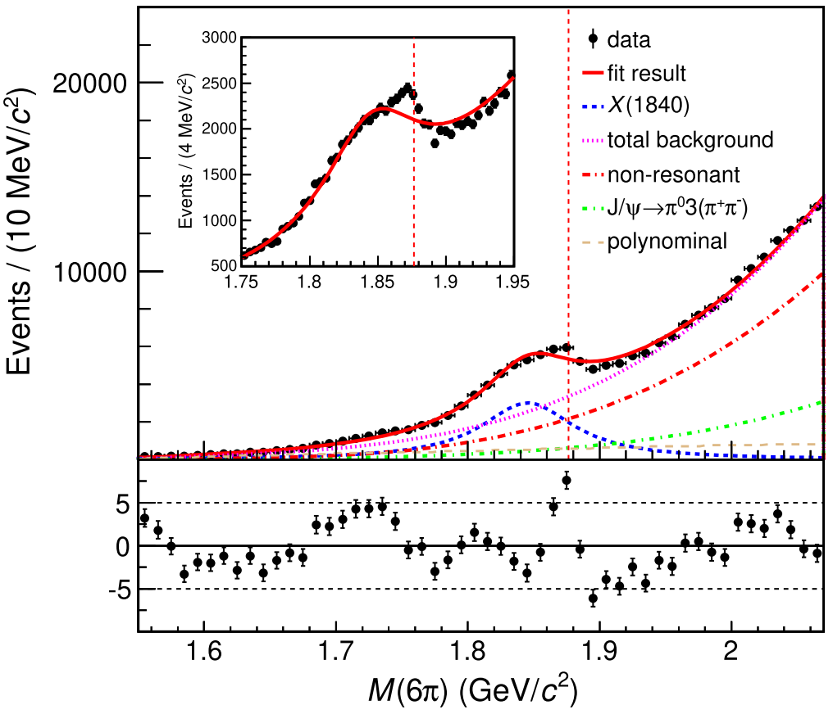
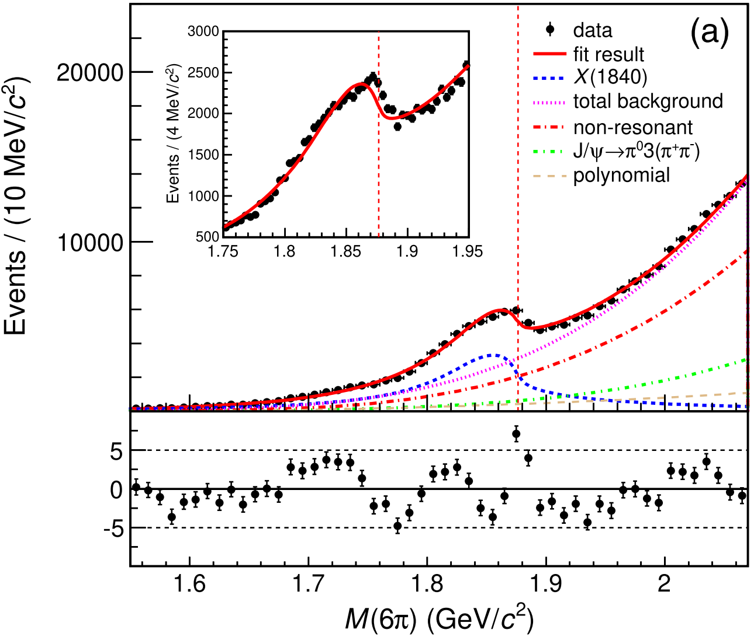
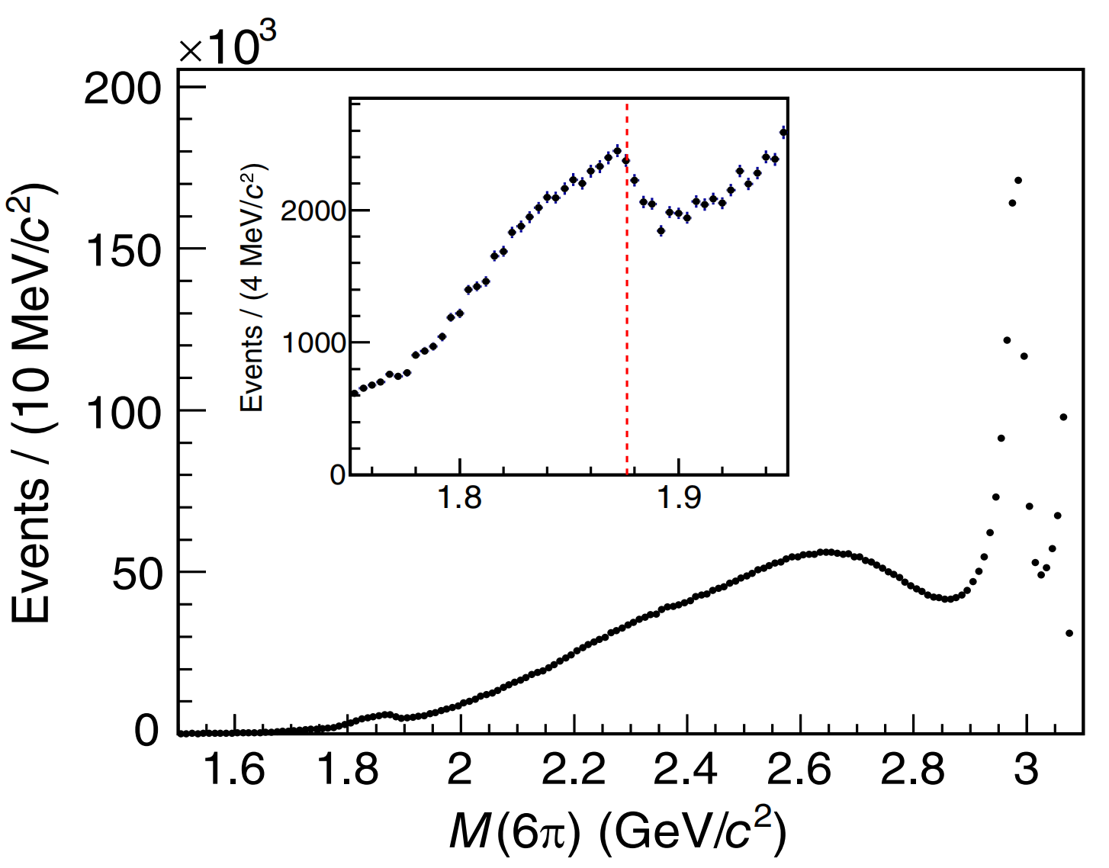

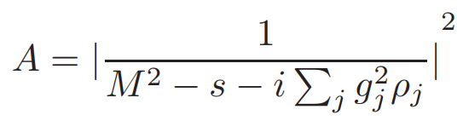
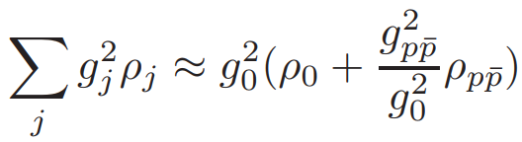

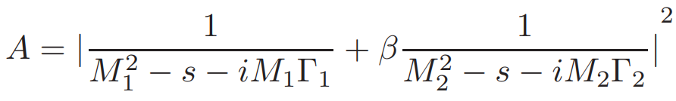





Observation of the Anomalous Shape of X(1840)
PRL 132, 151901(2024) 10 B J/ψ
﻿45 times larger statistics
$$ηc$$
X(1840)
A simple BW
Model I
χ²/ndf=8.87
χ²/ndf=7.32
First observation of the significant distortion of the M(6π) distribution near the ppbar ﻿threshold:
  ﻿analogous to the case of X(1835)
﻿A few ﻿interpretations are tested:
  x: ﻿a simple BW
  x: ﻿with threshold effect
  a coherent sum of two structures (Model II)
﻿
﻿﻿﻿Model I: line-shape above the ppbar mass threshold affected by the ﻿opening of the ﻿decay
ρ_{j}﻿: phase space for the decay mode j
﻿coresponding coupling strength
﻿non-zero :: 9.2σ

Slide 15
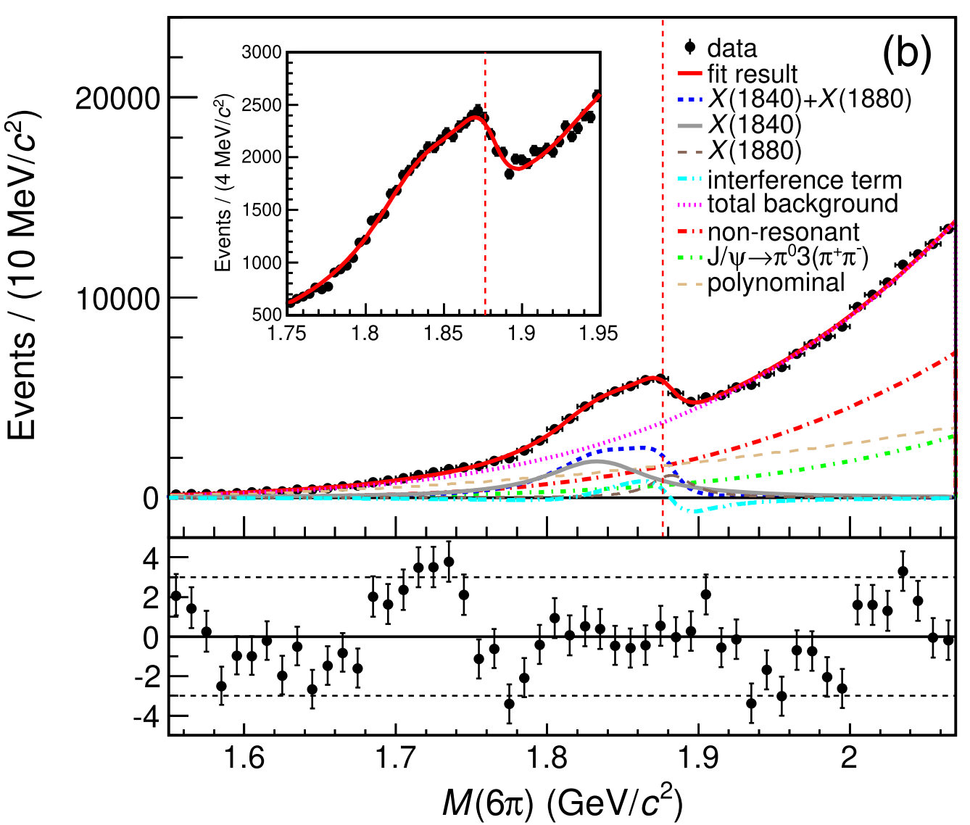
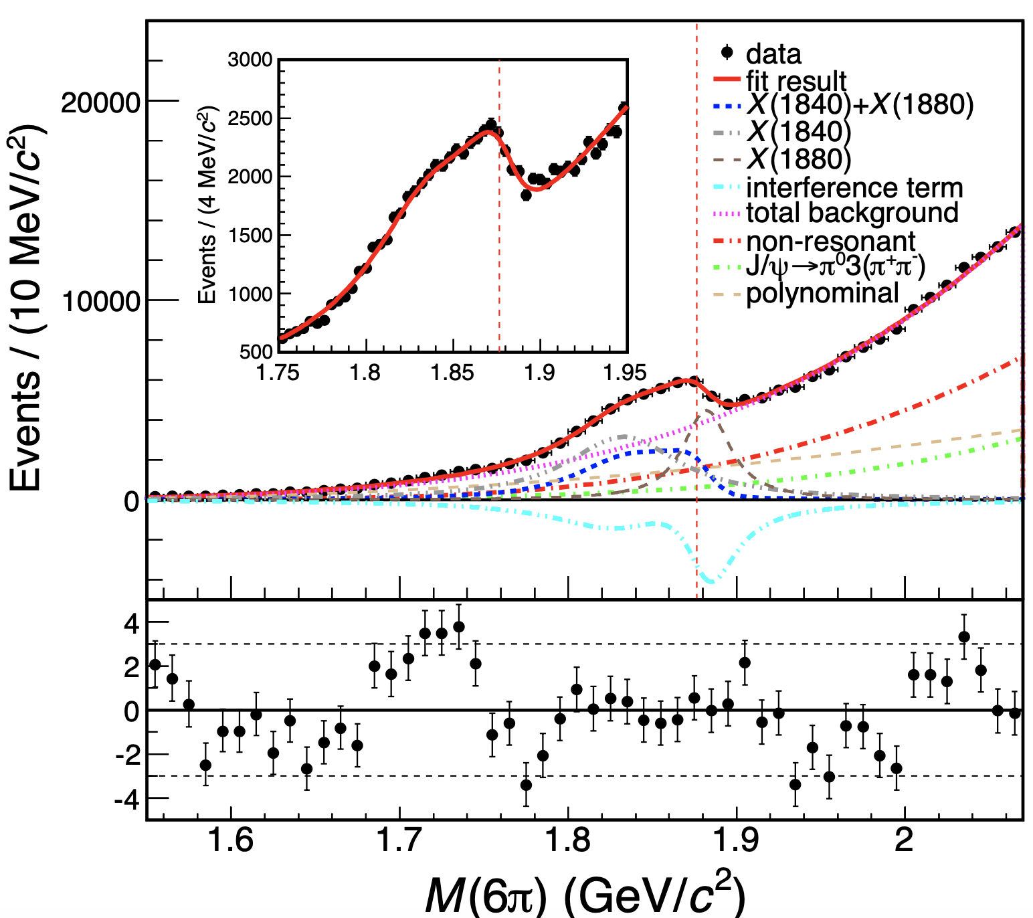
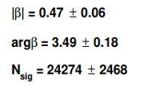
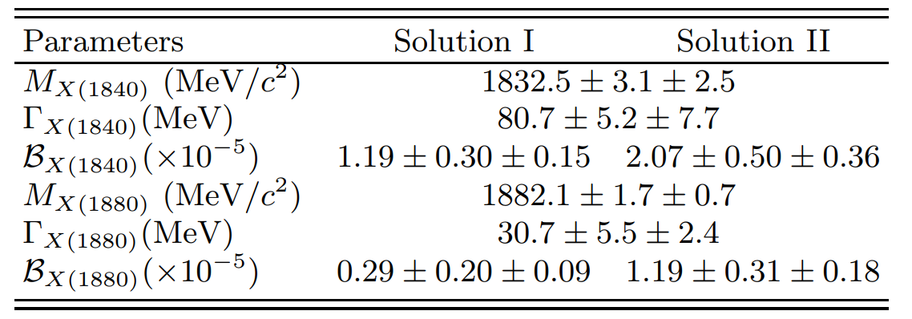


Observation of the Anomalous Shape of X(1840)
PRL 132, 151901(2024) 10 B J/ψ
Model II:
﻿constructive interference
﻿destructive interference
χ²/ndf=3.78
First observation of the significant distortion of the M(6π) distribution near the ppbar ﻿threshold:
  ﻿analogous to the case of X(1835)
﻿A few ﻿interpretations are tested:
  x: ﻿a simple BW or with threshold effect
  a coherent sum of two structures
﻿
X(1840):﻿ in agreement with the previous work
X(1880): 14.7σ, in reasonable agreement with X(1870)
10

Slide 16
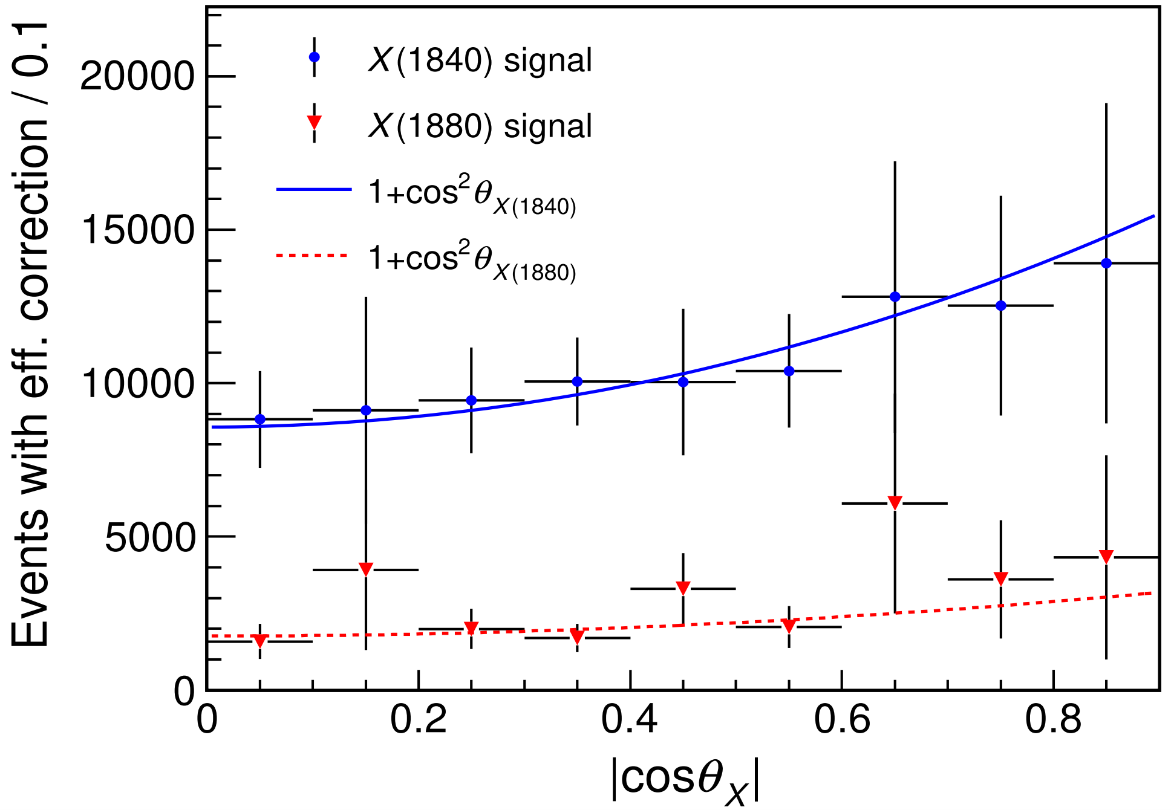
Observation of the Anomalous Shape of X(1840)
PRL 132, 151901(2024) 10 B J/ψ
﻿acceptance-corrected angular distribution:
﻿θ: polar angle of the photon in the J/ψ rest frame
expected to follow a 1 + cos²θ distribution
Favors ﻿pseudoscalar mesons
﻿Our result further supports the existence of a ppbar bound state just below the ppbar mass threshold.
﻿More sophisticated parameterizations cannot be ruled out:
  ﻿a mixture of above two models
11

Slide 17
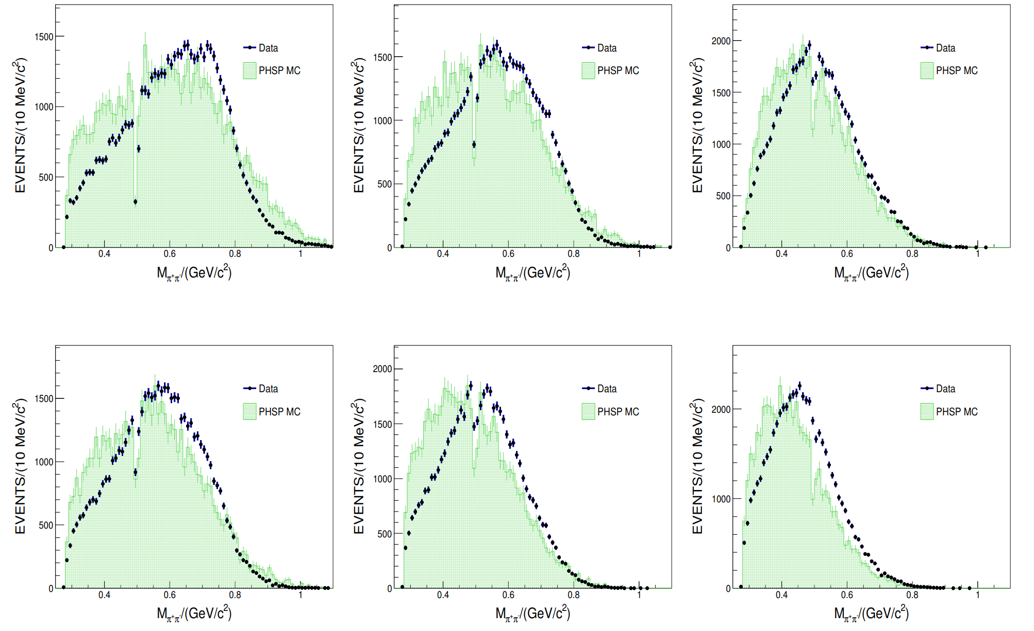
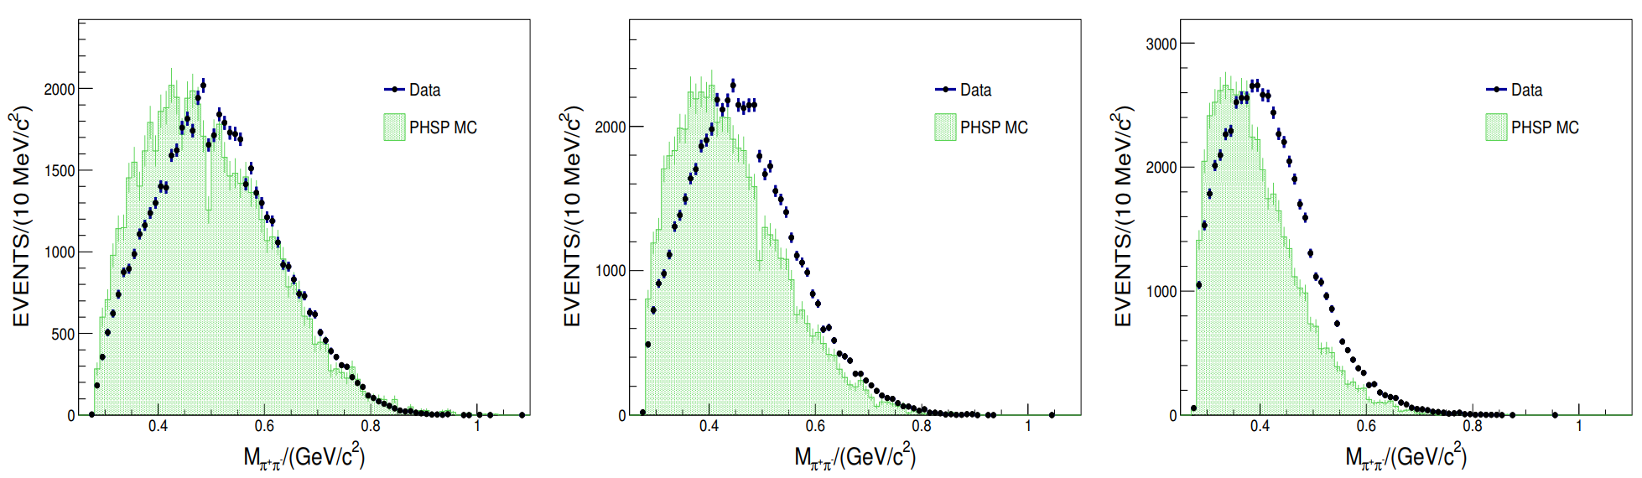

﻿Investigate the possible intermediate states
﻿No evident structure is observed in M(π⁺ π ⁻ )
Ks cut for vetoing
12

Slide 18
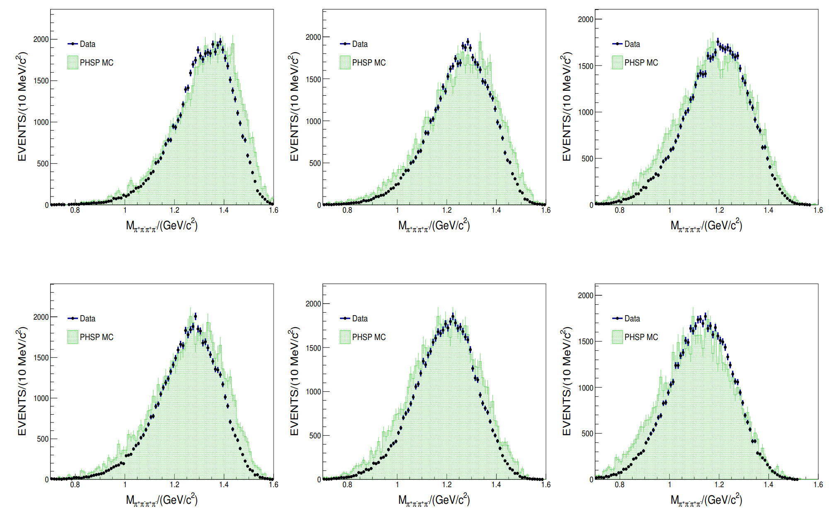
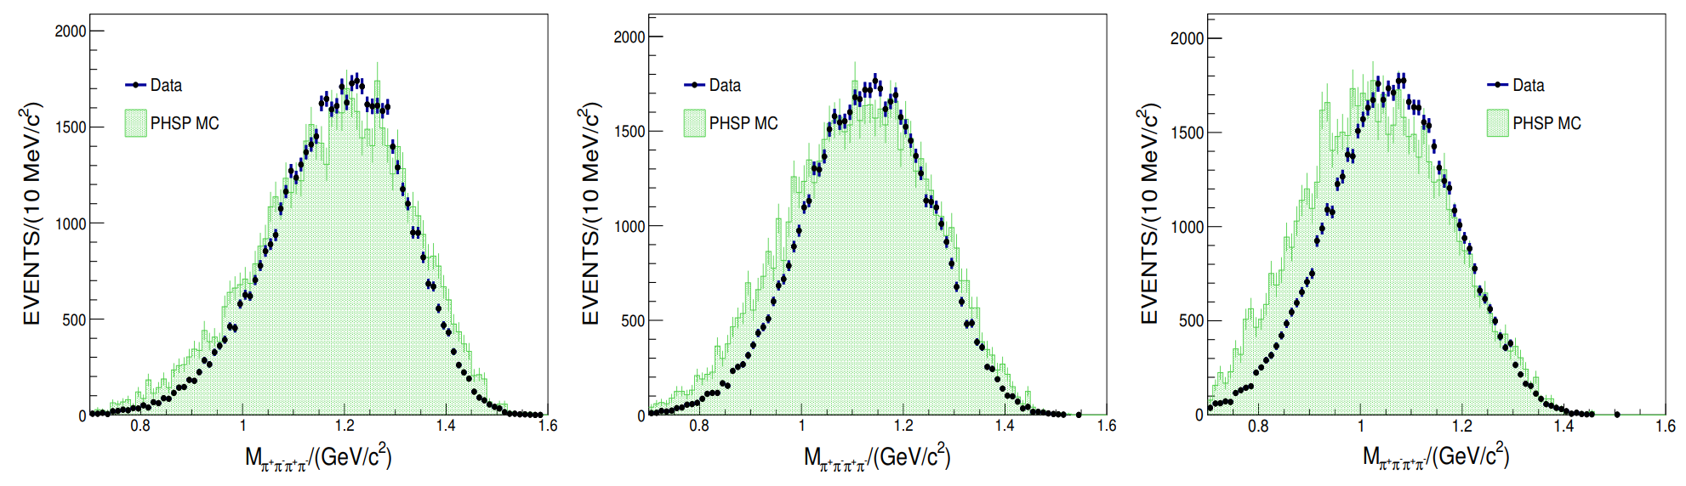
﻿Investigate the possible intermediate states
﻿No evident structure is observed in M(π⁺ π ⁻ π⁺ π ⁻ )
13

Slide 19
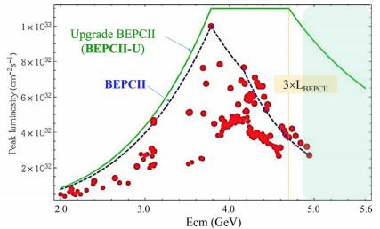
﻿Summary and Outlook
BESIII offers high precision measurements around 1.84 GeV
𝑝𝑝̅ mass threshold enhancement confirmed
Observed new decay modes in radiative decays, while not in hadronic decays
Anomalous line-shapes of π⁺π⁻η′ and 3(π⁺π⁻) suggest a narrow state strongly coupling to 𝑝𝑝̅
More works needed to understood
the connections in [1.8, 1.9] GeV：
  spin-parity quantum numbers ﻿measurement
  coupled channel amplitude analysis
BEPCII upgrades:
c.m. energy up to 5.6 GeV
3x luminosity increase in the XYZ region

Slide 20


Slide 21
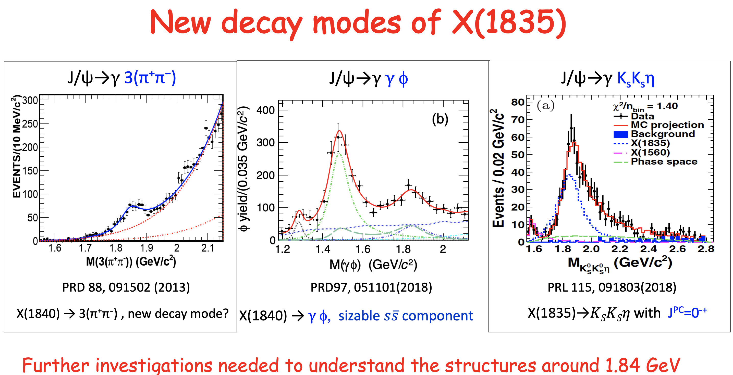

Slide 22
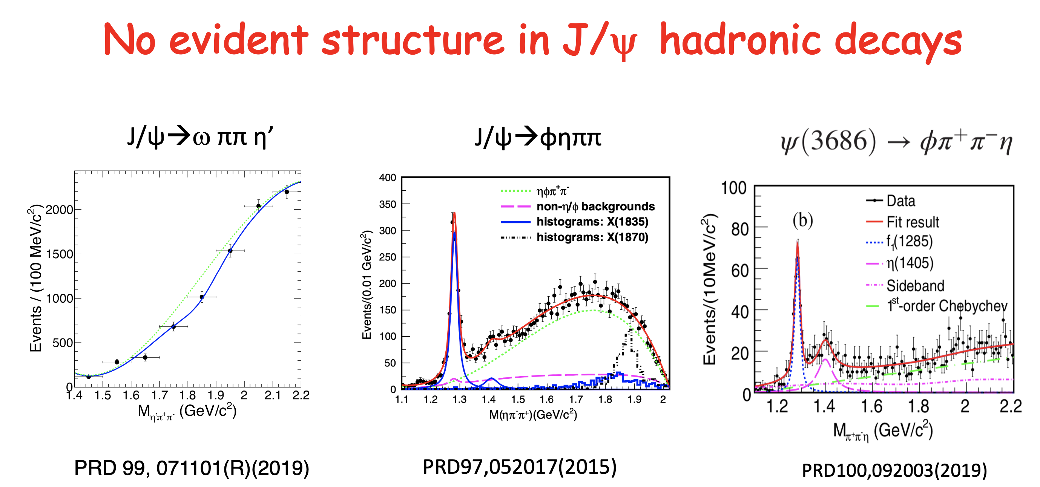

Slide 23
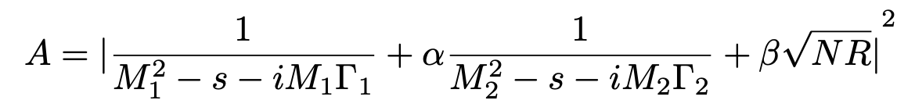
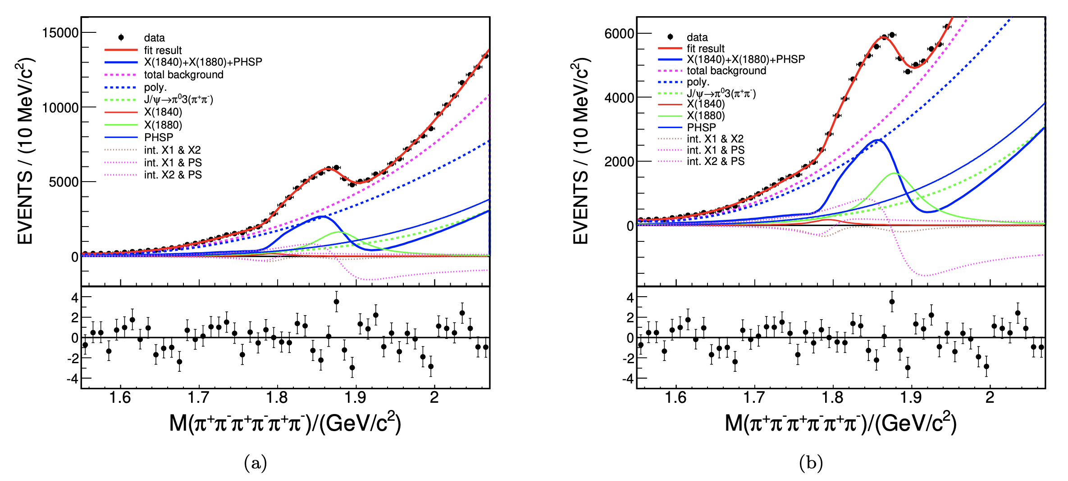
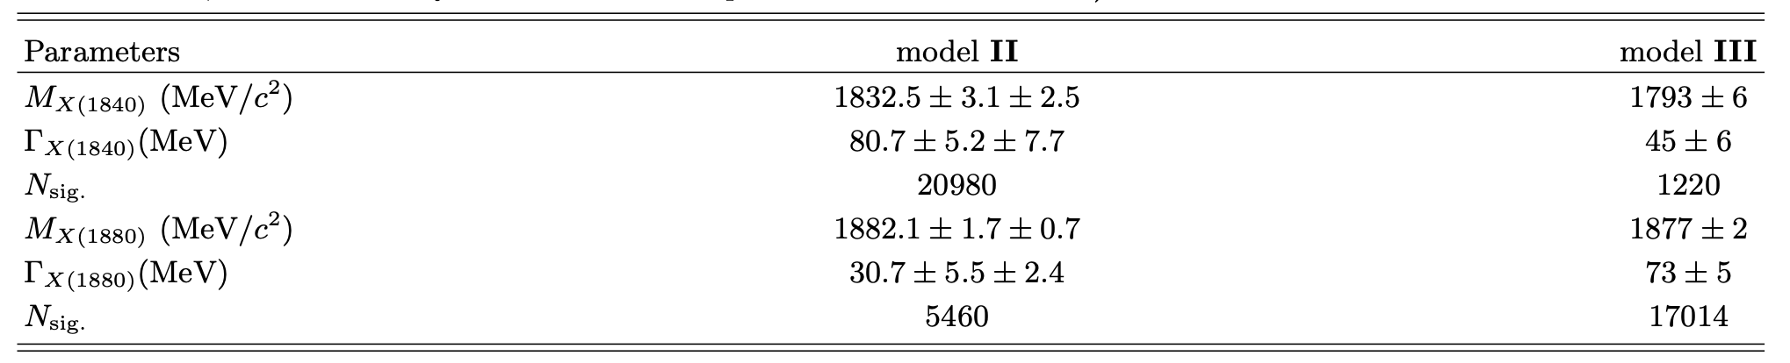
Model III： coherent sum of two BW functions and non-resonant contribution
zoom
change significantly

Slide 24
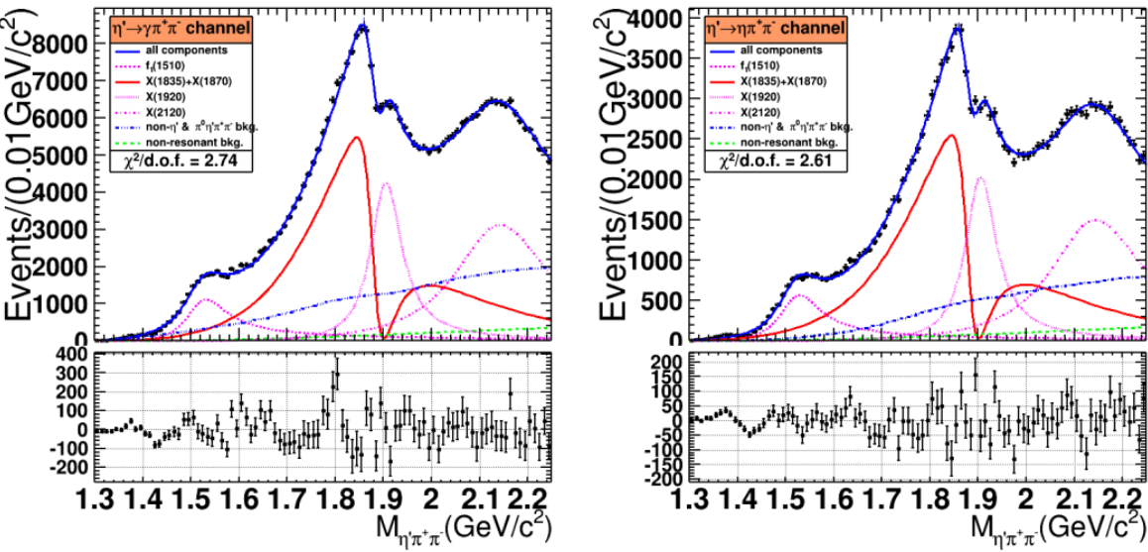
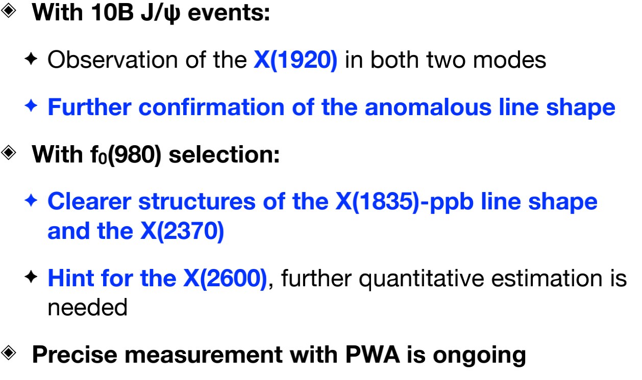
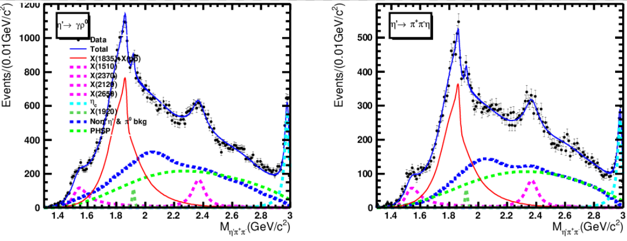
Confirmation of the anomalous ππη’ line shape

