Slide 1
第八届强子谱强子结构研讨会
Emergence of charm-strange dibaryons with negative parity via baryon-baryon interactions
Yu-yue Cui(崔雨月)
Supervisor: Rui Chen
Collaborators：Xiao-mei Tang, Qi Huang

Slide 2
Outline
Background
The one-boson-exchange model Results and discussions
Summary
1
2
3
4
第八届强子谱强子结构研讨会
2025年7月11日-15日 广西•桂林

Slide 3
1.1 QCD color singlet
Meson
Baryon
Exotic
states
Experiments ：reported a series of new hadron structures.
Hadron
Two key characteristics:
Inconsistent with the predictions of the conventional quark mode.
Close to the threshold of a pair of traditional hadrons.
Hybrid Glueball Tetraquark
Pentaquark Molecular state
第八届强子谱强子结构研讨会
2025年7月11日-15日 广西•桂林

Slide 4
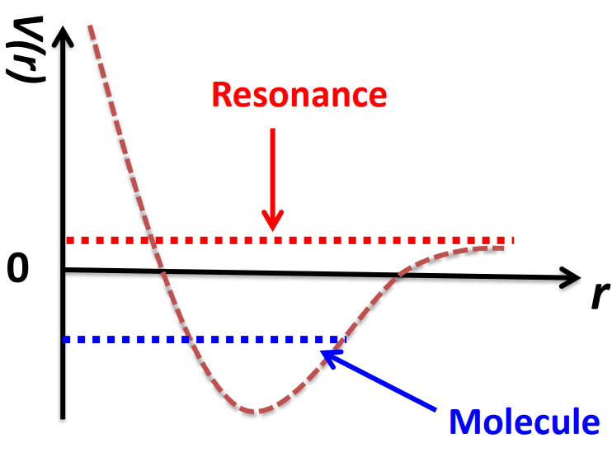
1.2 Why do we study P system?
Predicting possible molecular states of nucleons with $Ξ_{c}N{，Ξ}_{c}^{′}N,Ξ_{c}^{∗}N$
[Phys. Rev. D 110 (2024) 5, 054040]
S-D wave interactions ;coupled channel effects.
Result : Search for hadronic molecule candidates and predict the existence of resonance states.
P− wave systems: $\frac{l\left(l+1\right)}{r^{2}}$
[Phys. Rev. Lett. 133 (2024) 24, 241903]
The paper identifies G(3900) as the first P-wave $D{\overline{D}}^{∗}/\overline{D}D^{∗}$ molecular resonance.
第八届强子谱强子结构研讨会
2025年7月11日-15日 广西•桂林

Slide 5
Outline
Background
The one-boson-exchange model Results and discussions
Summary
1
2
3
4
第八届强子谱强子结构研讨会
2025年7月11日-15日 广西•桂林

Slide 6
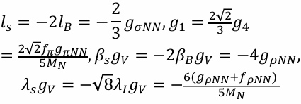
2.1 Effective potentials
P-wave interactions ; coupled-channel effects. Systems:$Ξ_{c}N,Λ_{c}Σ,Ξ_{c}^{′}N,Σ_{c}Λ,Ξ_{c}^{∗}N,Σ_{C}^{∗}Λ,Σ_{C}Σ,Σ_{c}^{∗}Σ$.
For the interactions between the light baryons and the light mesons:
$g_{\text{σ}\text{NN}}$=8.46,
$g_{\text{π}\text{NN}}$=13.07,
$g_{\text{ρ}\text{NN}}$ =3.25,
$f_{\text{ρ}\text{NN}}$=19.82.
Phys. Rept.149, 1 (1987).
Phys.Rev.C63, 024001(2001).
Phys. Rev. C 81, 065201 (2010)
S U(3) symmetry
Effective Lagrangians for the interaction between hadrons and light mesons:
Estimated from the quark model
heavy quark symmetry; chiral symmetry; hidden local symmetry.
第八届强子谱强子结构研讨会
2025年7月11日-15日 广西•桂林

Slide 7
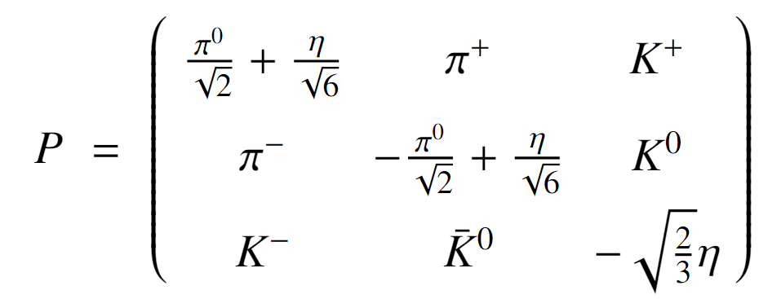
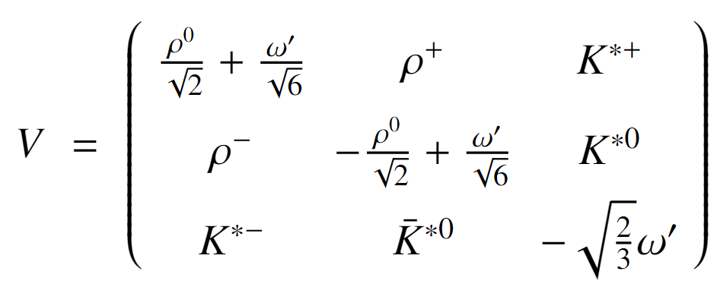
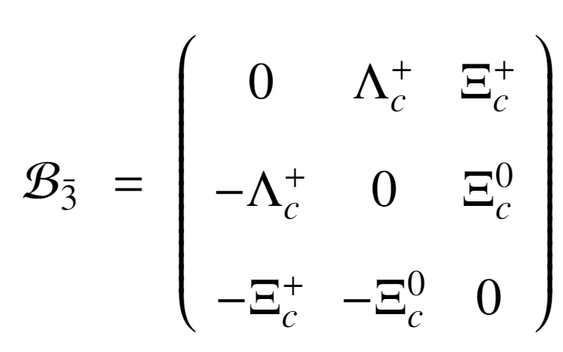
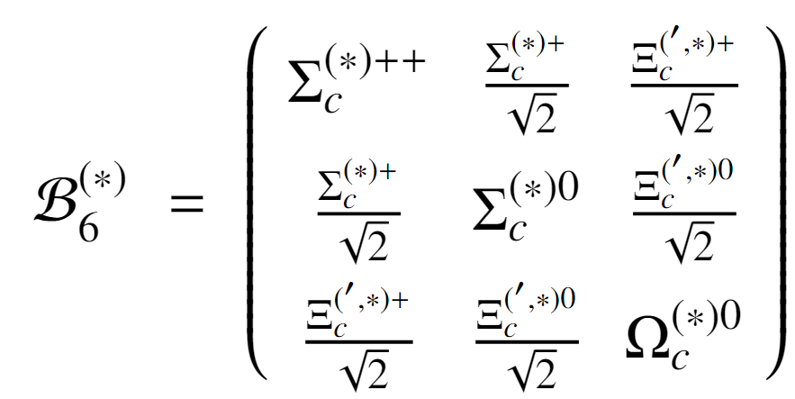
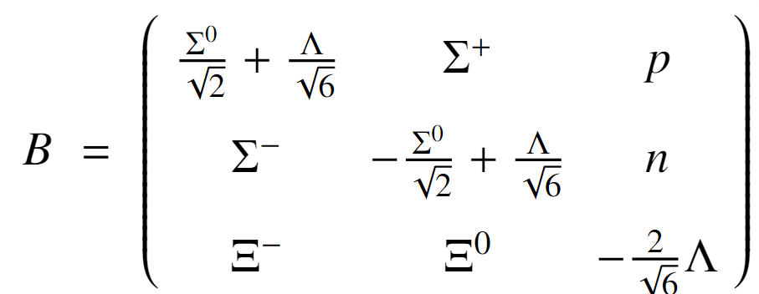
2.1 Effective potentials
P and V denote the pseudoscalar meson matrix and vector meson matrix under SU(3) symmetry, respectively.
B denotes the SU(3) baryon octet;
B₃ represents the triplet heavy-flavor baryons;
B₆ represents the sextet heavy-flavor baryons.
第八届强子谱强子结构研讨会
2025年7月11日-15日 广西•桂林

Slide 8
2.2 One-boson-exchange (OBE) model
Scattering amplitude
Effective potential in momentum space
Effective potential in coordinate space
$$M(a+b→c+d)$$
Interaction Lagrangian
Feynman Rules
$V\left(\vec{q}\right)≈−M(a+b→c+d)$/$\sqrt{2m_{a}2m_{b}2m_{c}2m_{d}}$
Breit approximation
$$\int{\frac{ⅆ^{3}q}{{\left(2π\right)}^{3}}}ⅇ^{i\vec{q}⋅\vec{r}}V\left(\vec{q}\right)F^{2}\left(q^{2},m_{E}^{2}\right)$$
Fourier transformation
$V\left(r\right)$=
a
c
Form factor $F\left(q^{2},m_{E}^{2}\right)=\frac{Λ^{2}−m^{2}}{Λ^{2}−q^{2}}$ $∧($One free parameter$<2GeV$), m and q are the cutoff, mass and four-momentum of the exchanged meson, respectively.
$$(σ,π,η,ρ,ω)$$
b
d
第八届强子谱强子结构研讨会
2025年7月11日-15日 广西•桂林

Slide 9
Outline
Background
The one-boson-exchange model Results and discussions
Summary
1
2
3
4
第八届强子谱强子结构研讨会
2025年7月11日-15日 广西•桂林

Slide 10
3.11 Hadronic molecular states
Loosely bound molecular states in the single system
Method：the multi-Gaussian expansion method.
${I\left(J^{p}\right)=0\left(0^{−}\right) The Σ}_{C}^{∗}Σ$single-channel system;
$R=$ $R_{Σ_{c}^{∗}}$+ $R_{Σ}$（the size of the system should be larger than the size of all component hadrons）.
Mass$M=$ $M_{Σ_{c}^{∗}}$+ $M_{Σ}$-$\left|E\right|$,E: binding energy.
$$Σ_{c}^{∗}$$
$$Σ$$
第八届强子谱强子结构研讨会
2025年7月11日-15日 广西•桂林

Slide 11
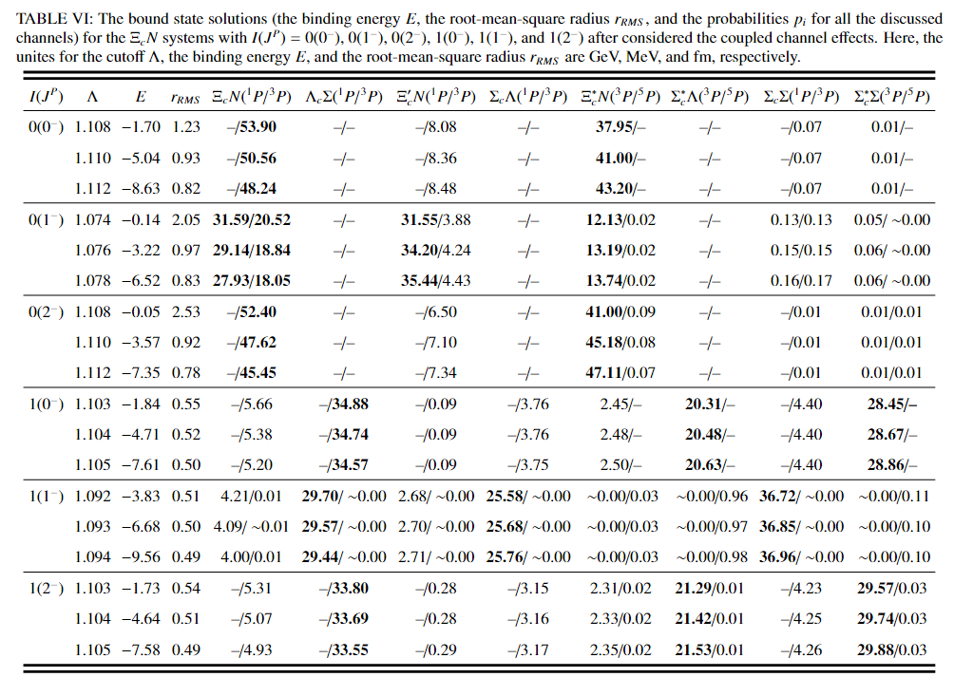
3.12 $Ξ_{c}N$System
Single-channel system :
No bound state solution.
Coupled channel bound states:
The obtained binding energies are very sensitive with the cutoff value.
The dominant channels are not the lowest channel $Ξ_{c}N$ , which leads to the small size of these bound states.
Thus, we cannot recommend these coupled channel bound states as prime molecular candidates.
第八届强子谱强子结构研讨会
2025年7月11日-15日 广西•桂林

Slide 12
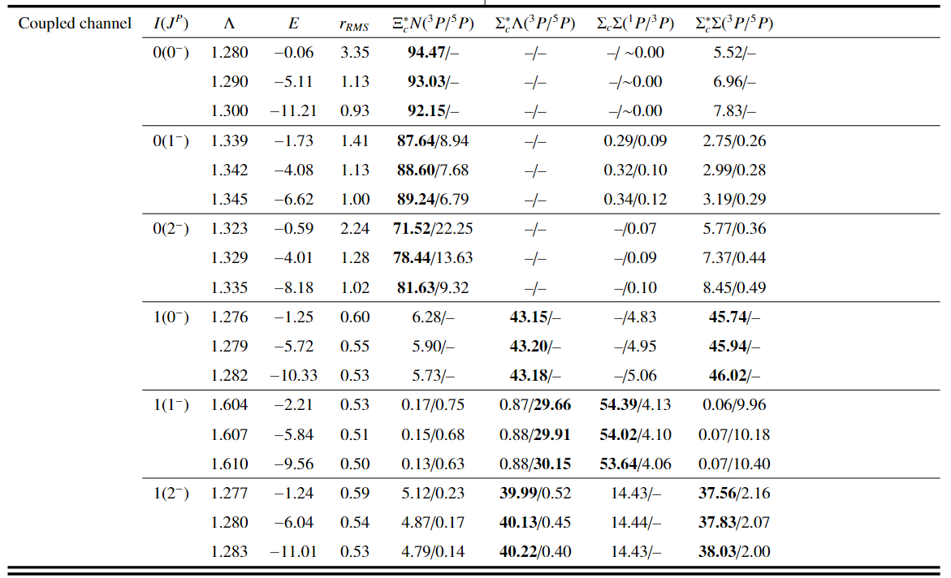
3.13${ Ξ}_{c}^{∗}N$System
In the cutoff Λ ≤ 2.00 GeV, we can obtain the bound state solutions for the single ${ Ξ}_{c}^{∗}N$ states with $0\left(0^{−}\right)$, $0\left(1^{−}\right)$, and $0\left(2^{−}\right)$.
For other quantum numbers, we did not find hadronic molecular states and thus made corresponding selections.
第八届强子谱强子结构研讨会
2025年7月11日-15日 广西•桂林

Slide 13
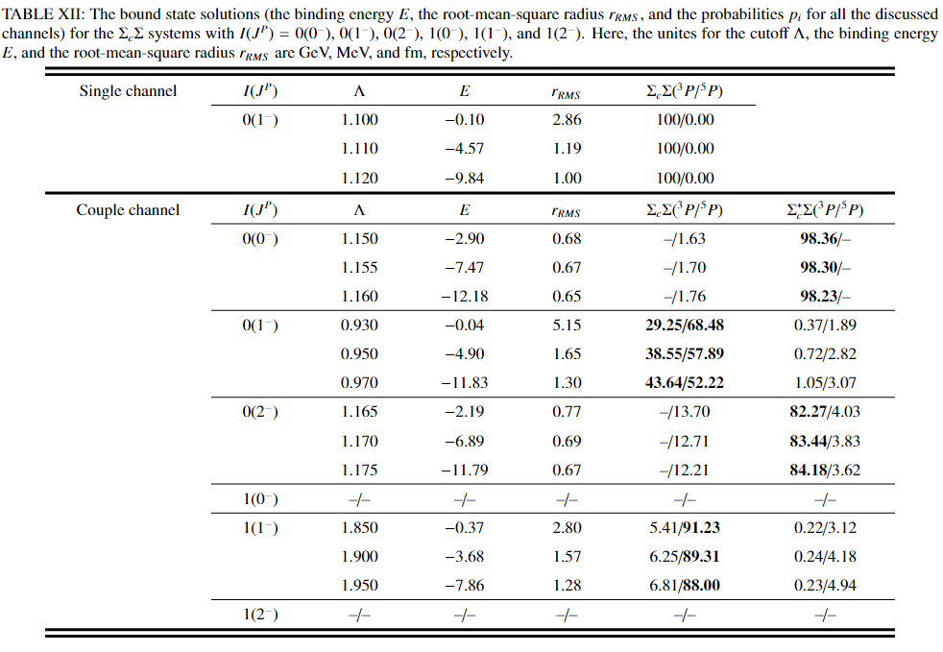
3.14 ${ Σ}_{C}Σ$ System
For the single-channel system of${ Σ}_{C}Σ$ with $I\left(J^{p}\right)0\left(1^{−}\right)$ bound state solutions exist. The coupled-channel effect has a positive effect on this molecular state.
The ${ Σ}_{C}Σ$/ $Σ_{C}^{∗}Σ$ coupled molecular state with $1\left(1^{−}\right)$ .
第八届强子谱强子结构研讨会
2025年7月11日-15日 广西•桂林

Slide 14
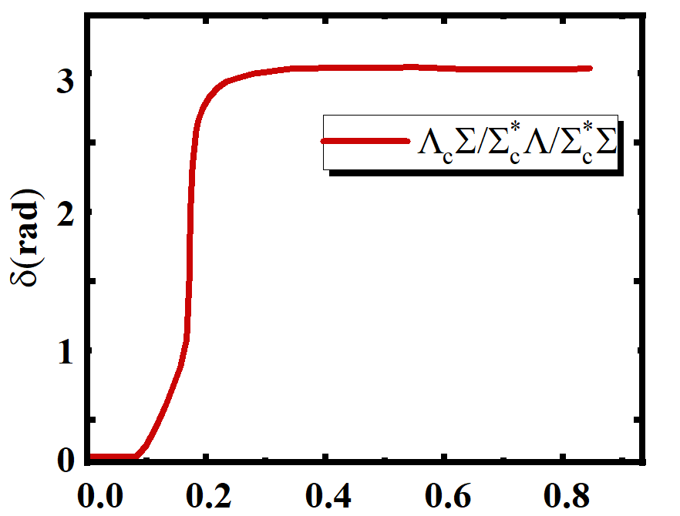
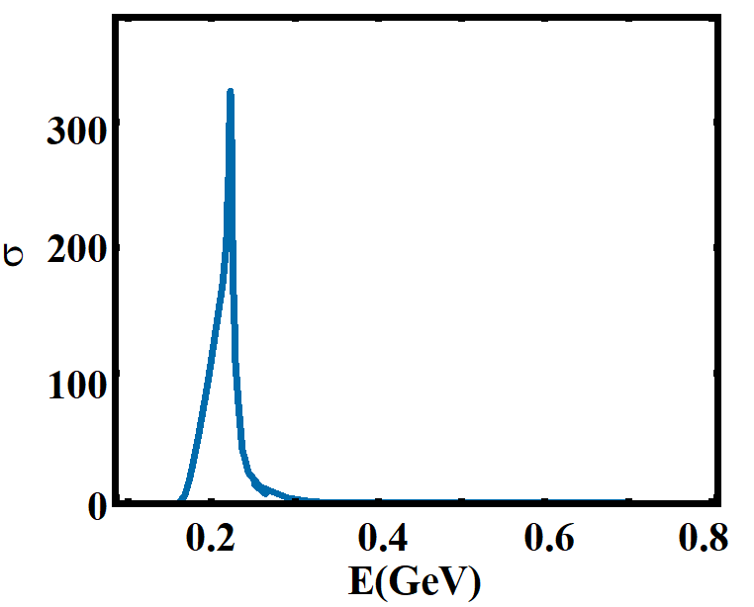
3.21 Resonances
Shape-type
Resonances
Feshbach-type
For the :$Λ_{c}Σ, Σ_{C}^{∗}Λ,Σ_{c}^{∗}Σ$. interactions with $0\left(0−\right)$ ;
This leads to themaximum of the scattering cross section,
The resonant width is defined as$Γ_{r}=2/{{\left(\frac{ⅆδ}{ⅆE}\right)}_{E_{r}}}$，
M$saa:M=M_{Λ_{c}}+M_{Σ}+E$。
$σ_{t}=\frac{4π}{2μE}\sum_{l=0}^{∞}{\left(2l+1\right)\sin^{2}{δ_{l}\left(E\right)}}$
$$δ_{l}\left(E_{r}\right)=\left(n+1/2\right)π，n=0，1，2⋯$$
$Λ\text{=}1.07$GeV E= 0.14GeV $Γ\text{=}0.06$GeV
第八届强子谱强子结构研讨会
2025年7月11日-15日 广西•桂林

Slide 15
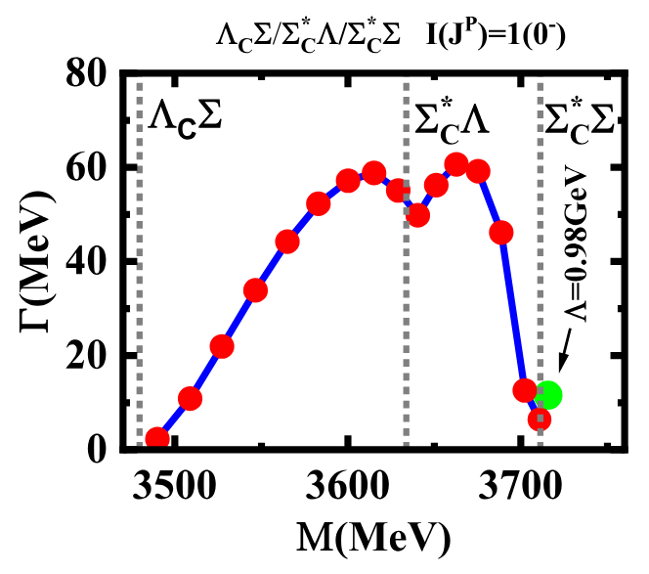
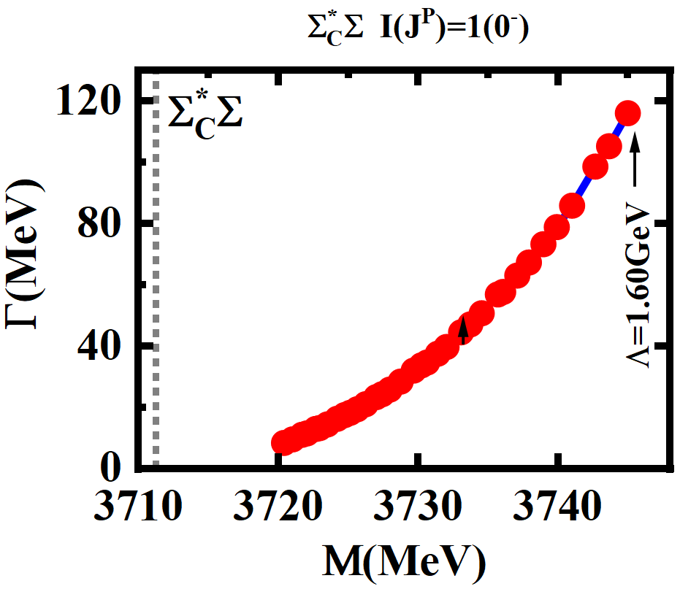
3.21${ I\left(J^{P}\right)=1(0}^{−}){ Σ}_{C}^{∗}Σ$ Resonances
We can not obtain the loosely bound state solutions for the $Σ_{C}^{∗}Σ$ molecule with 1($0^{−}$) in the reasonable cutoff region.
Thus , this state is a shape-type resonance dominated by the $Σ_{C}^{∗}Σ$ channel.
第八届强子谱强子结构研讨会
2025年7月11日-15日 广西•桂林

Slide 16
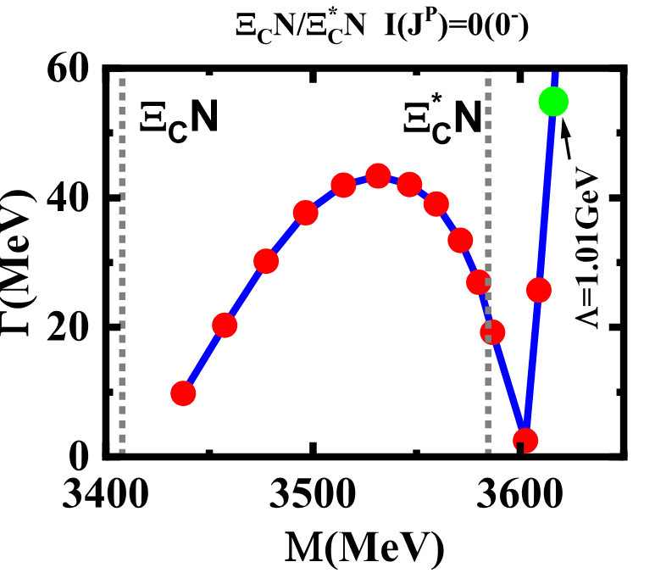
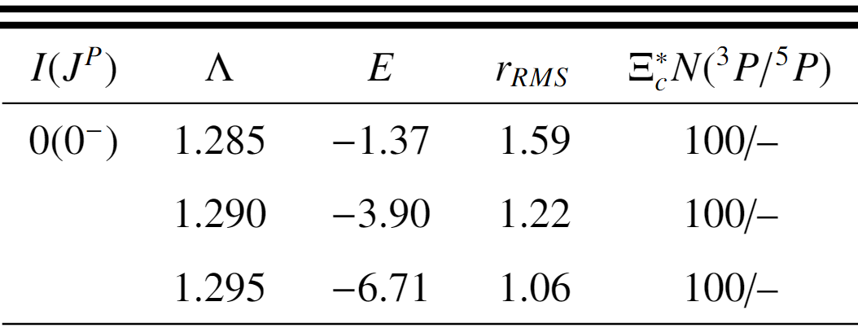
3.22 ${ I\left(J^{P}\right)=0(0}^{−}) Ξ_{c}^{∗}N$ bound state
The obtained resonance here is not an independent state, but corresponds to the $Ξ_{c}^{∗}N$molecule with 0(0−).
The current results can provide the important information of the total decay width for the $Ξ_{c}^{∗}N$bound state.
第八届强子谱强子结构研讨会
2025年7月11日-15日 广西•桂林

Slide 17
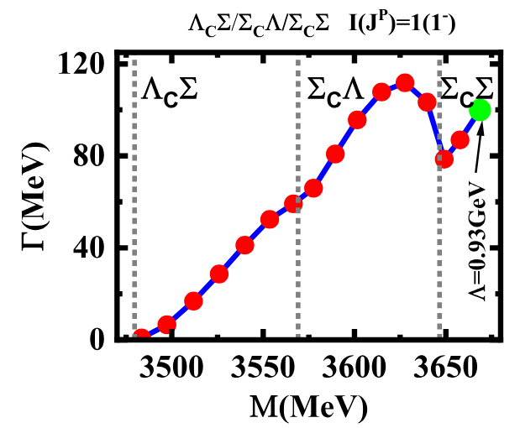
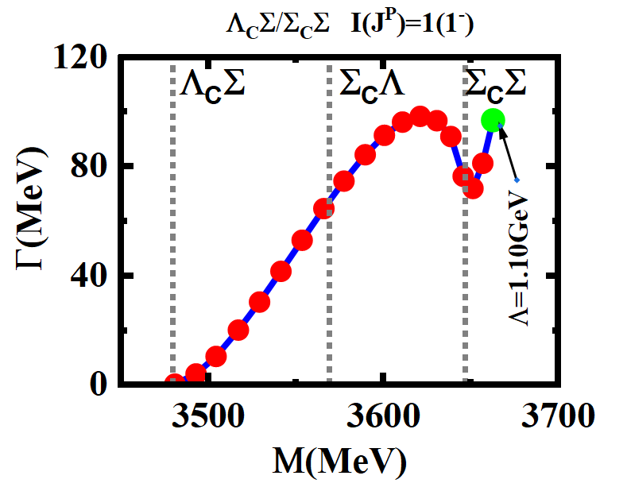
3.23 ${{ I\left(J^{P}\right)=1(1}^{−}){\text{Λ}}_{C}Σ\text{ /}Σ}_{C}Σ$ Feshbach-type resonance
The ${\text{Λ}}_{C}Σ$ / ${ Σ}_{C}Σ$ coupled interactions and the ${\text{Λ}}_{C}Σ$ / ${ Σ}_{C}\text{Λ}$/ ${ Σ}_{C}Σ$ coupled interactions are very similar.
This indicates that the resonance is a Feshbach-type resonance, where both the ${\text{Λ}}_{C}Σ$ and ${ Σ}_{C}Σ$ channels play important roles.
第八届强子谱强子结构研讨会
2025年7月11日-15日 广西•桂林

Slide 18
Outline
Background
The one-boson-exchange model Results and discussions
Summary
1
2
3
4
第八届强子谱强子结构研讨会
2025年7月11日-15日 广西•桂林

Slide 19
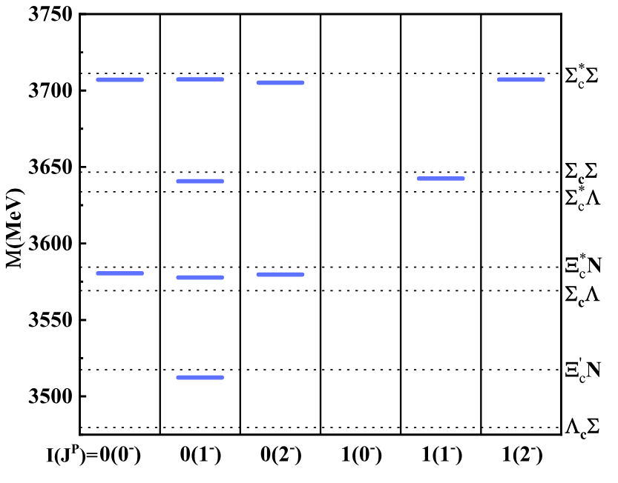
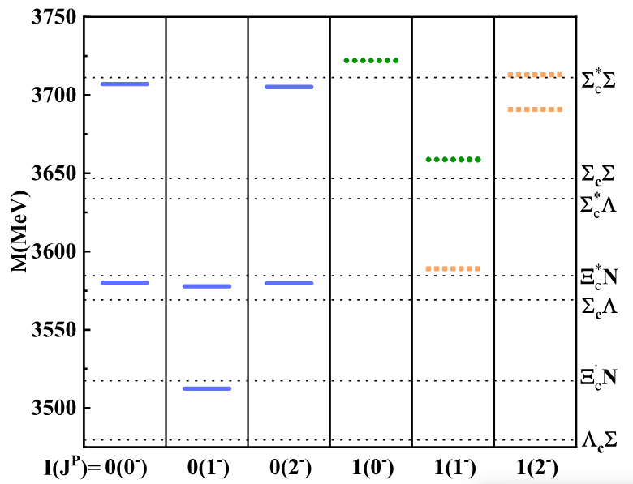
4. Summary
In this work, we systematically study the P−wave interactions between the charmed and light baryons by using the OBE model. The research results are as follows：
hadronic molecule candidates shape-type resonance Feshbach-type resonance
第八届强子谱强子结构研讨会
2025年7月11日-15日 广西•桂林

Slide 20
Thanks for your attention
第八届强子谱强子结构研讨会
2025年7月11日-15日 广西•桂林

