Slide 1
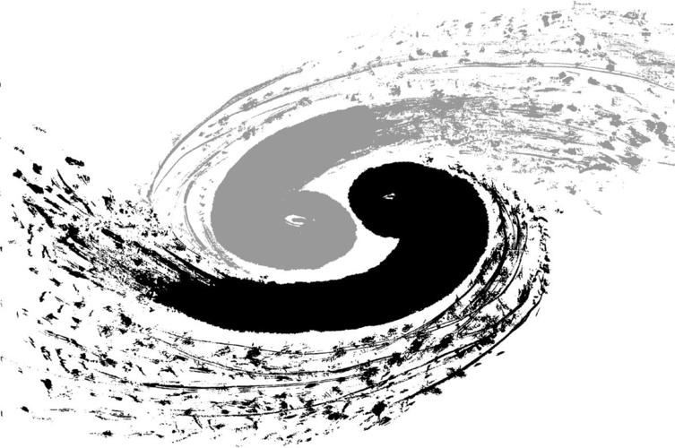
Observation of X(6900) and evidence of X(7100) in the J/ψψ(2S) → μ⁺μ⁻μ⁺μ⁻ mass spectrum
CMS : BPH-22-004
Jinjing Gu
NNU-THU Group
第八届强子谱和强子结构研讨会
2025.7.13

Slide 2
Current Status
Progress
Start since August, 2020
Cadiline BPH-22-004 in May, 2022
Unblind Run II dataset in May, 2022
Add Run III dataset in Nov, 2023
Unblind Run III dataset in March, 2024
Pre-approval in November, 2024
Approval in March, 2025
PAS published in April, 2025
Paper draft ready
Collaborated institutes:
Nanjing Normal University
Tsinghua University
Zhejiang University
Institute for High Energy Physics
Fudan University
Henan Normal University
University of Shanghai for Science and Technology
…

Slide 3
Contents
Motivation
Dataset samples
Event selection
Fitting models and results
Summary

Slide 4
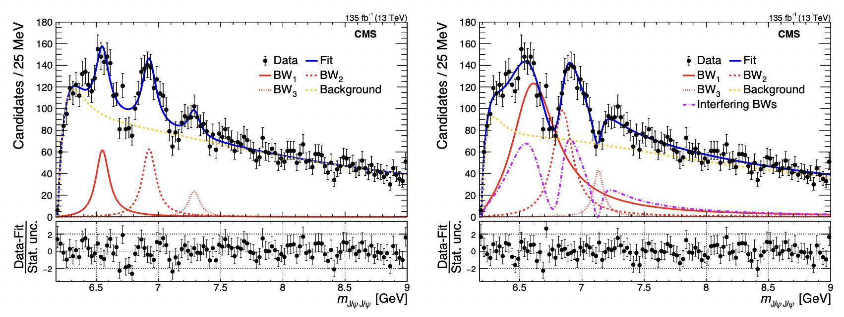
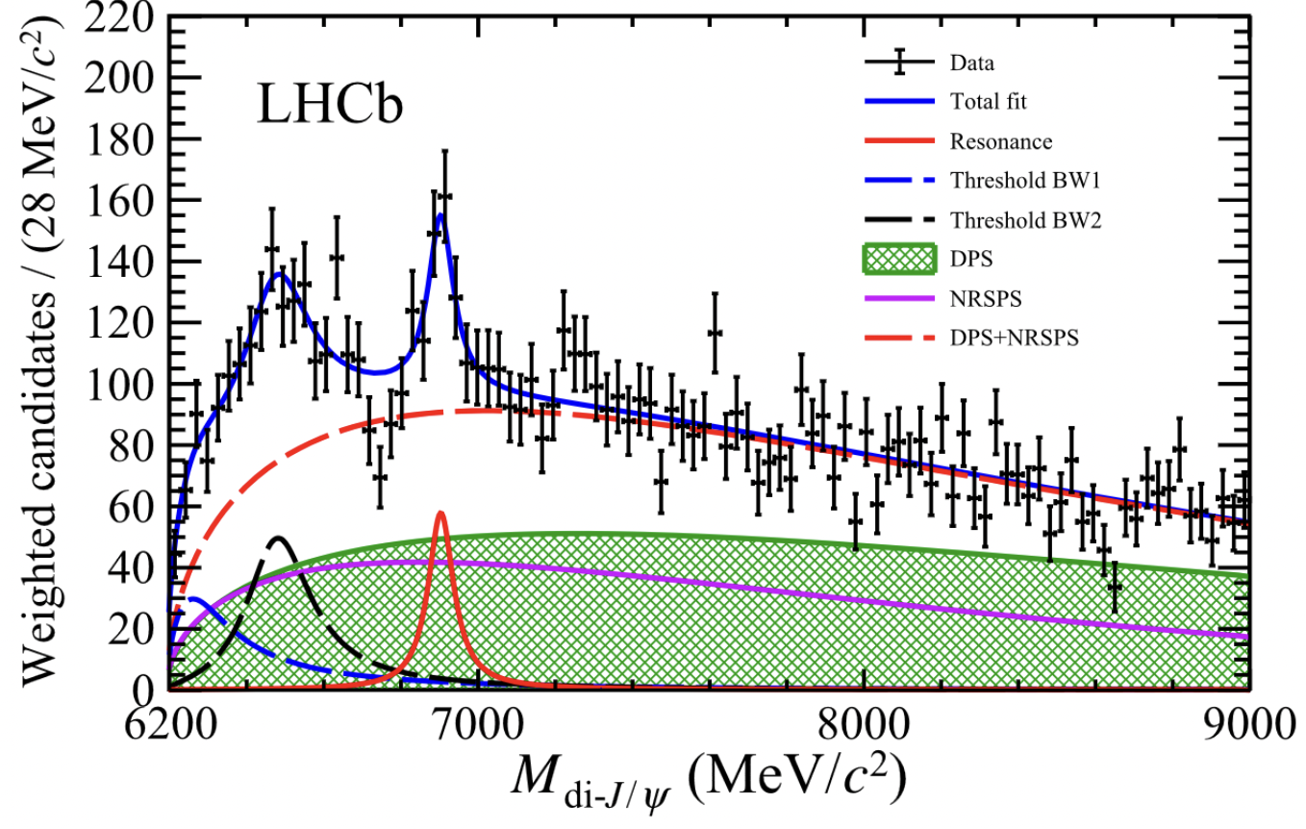
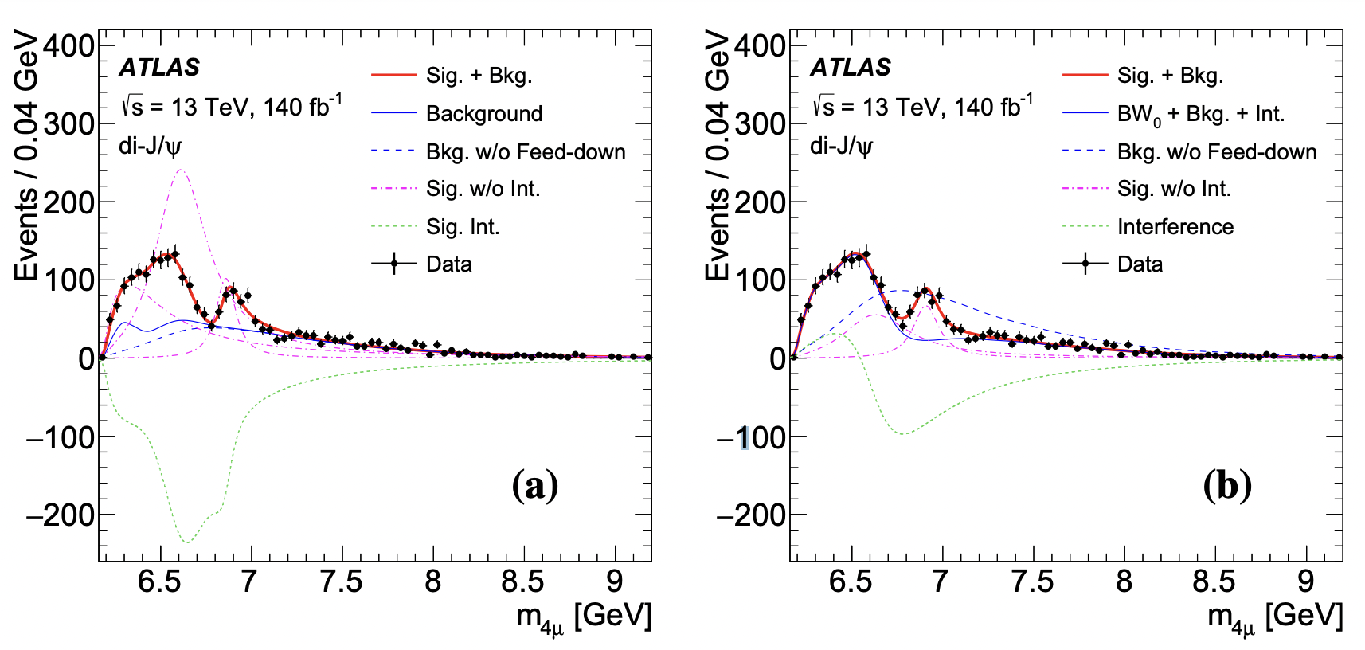
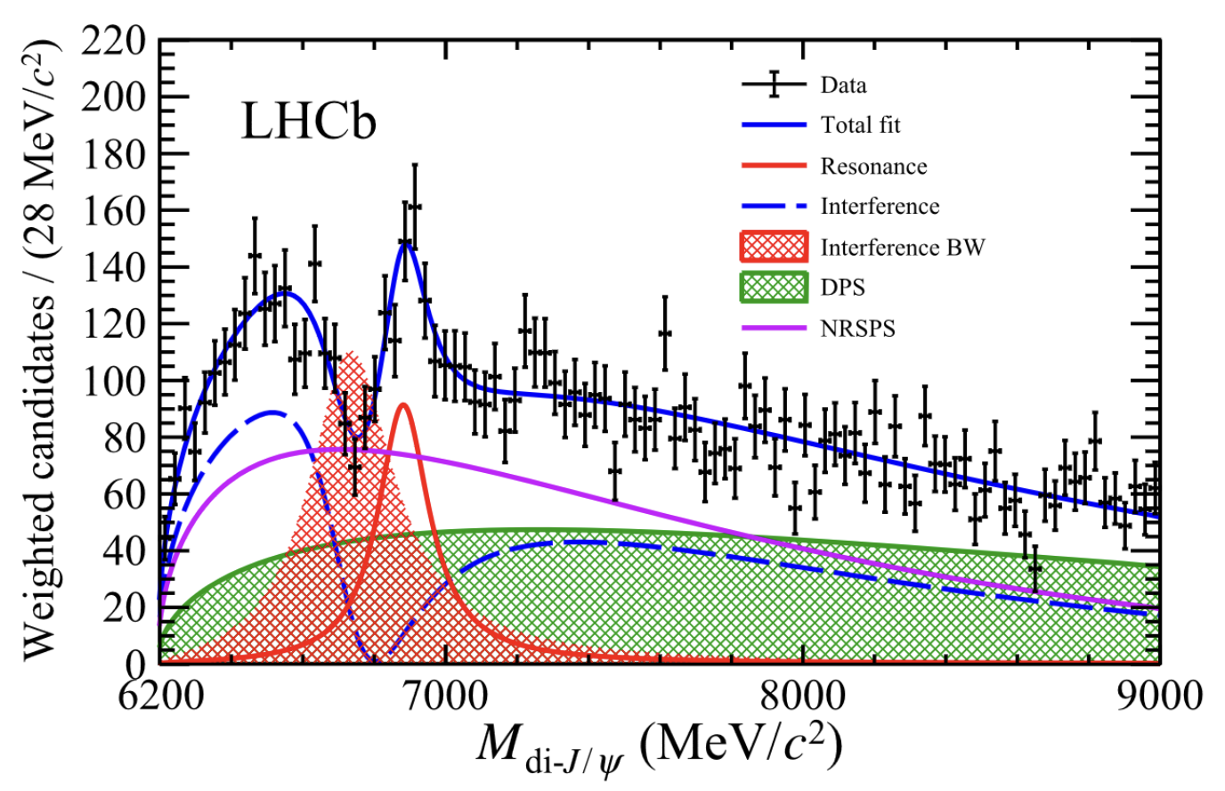
Motivation: X$→$J/ΨJ/Ψ
CMS : arXiv:2306.07164
ATLAS : arXiv:2304.08962
LHCb : Sci.Bull.65(2020)1983
X->J/ΨJ/Ψ
X
X(6900) consistent with LHCb
X(6900) observed by 3 experiment
CMS adds X(6600) & X(7100)
X(6600) below J/ΨΨ(2S) threshold
X(6900)/X(7100) above threshold
Debate: Tetraquark? Dynamical?
Further studies vital: other channels?
Observed structure at 6.9 GeV, > 5σ
M ~ 6900 MeV, Γ ~ 100 MeV
X(6900) consistent with LHCb
New state X(6600) with 6.5σ
Evidence of X(7100) with 4.1σ

Slide 5
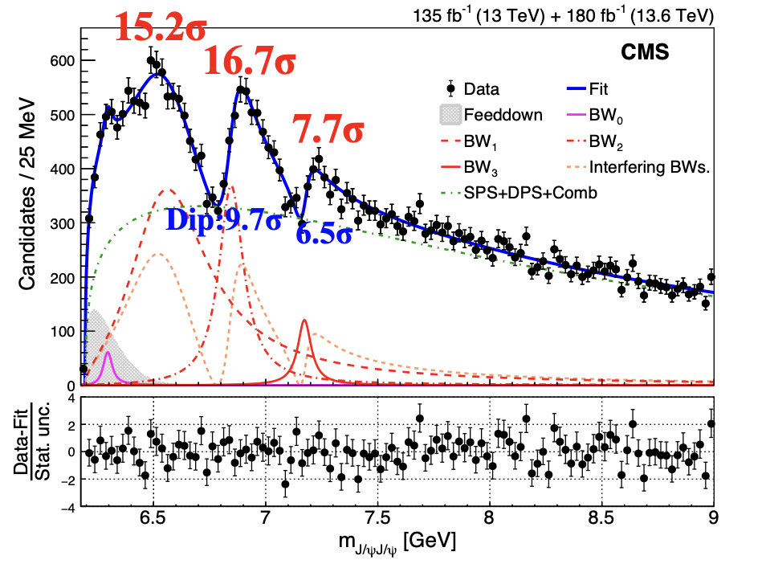
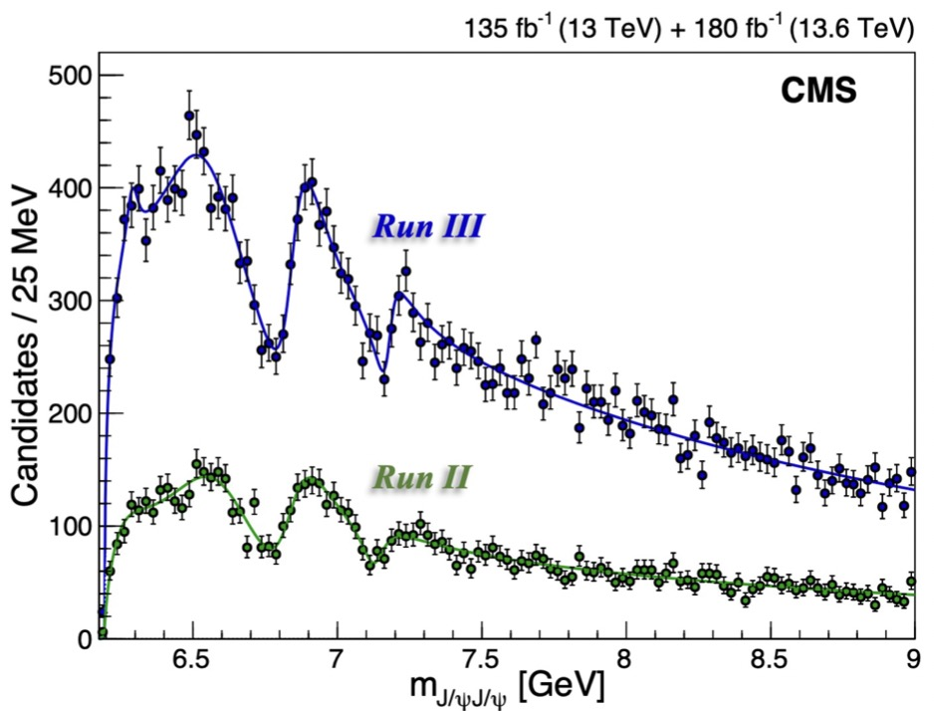
Motivation: X$→$J/ΨJ/Ψ
CMS : BPH-24-003
>5σ
>5σ
CMS established candidates for all-charm tetra-quark family
Each peak and each dip is well over 5σ in complete dataset
This defines our model: two peaks with interference

Slide 6
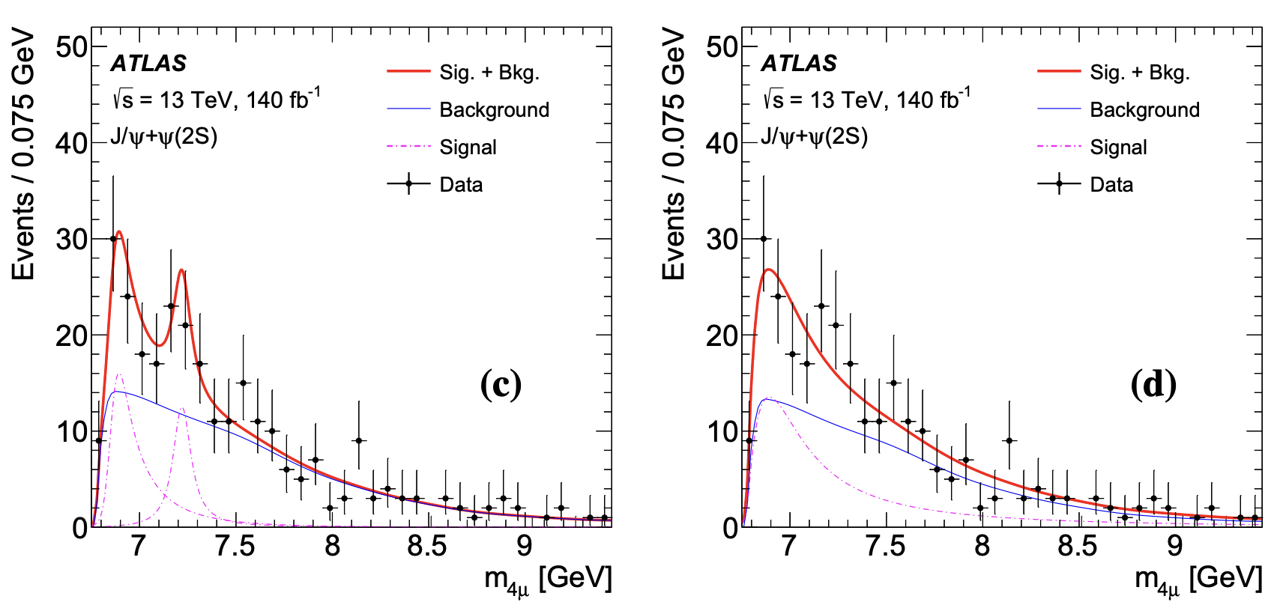
Motivation: X$→$J/ΨΨ(2S)
If seen in J/ψ/J/ψ, probably in ψ(2S)J/ψ?
Possibility of non-resonant "threshold effects”?
X(6900) is just above threshold
ATLAS has published spectrum
They do see excess
LEFT: Assumed X(6900) with J/ψ/J/ψ values (4.7σ) & find weak X(7100) signal (3σ local)
ATLAS compatible with CMS no-interf fit
RIGHT: One BW fit -- very fat!
NOT very consistent with X(6900) (4.3σ)
Is excess X(6900)? ATLAS doesn't actually claim it!
Can we see it? Can CMS clarify??
X$→$J/ΨΨ(2S)
ATLAS : Phys. Rev. Lett. 131, 151902

Slide 7
Dataset samples
Charmonium dataset
135 fb-1 CMS data taken in 2016, 2017 and 2018 LHC runs (13 TeV)
180 fb-1 CMS data taken 2022, 2023 and 2024 LHC runs (13.6 TeV)
315 fb-1
Using J/ψJ/ψ selection as first step
Preliminary event selections:
Fire trigger
Standard soft muon ID
pT(μ）≥ 2.0 GeV
| η(μ) | ≤ 2.4
4μ total charge = 0
Vtx(4μ) ≥ 0.5%
Vtx(μ⁺μ⁻)≥ 0.5% (HLT)
m(μ⁺μ⁻) within 3σ (EBE) of J/ψ or ψ (2S),scale factor 1.16
m(μ⁺μ⁻) constrained to J/ψ or ψ (2S) mass
Resolve pairing confusion using mass chisq

Slide 8
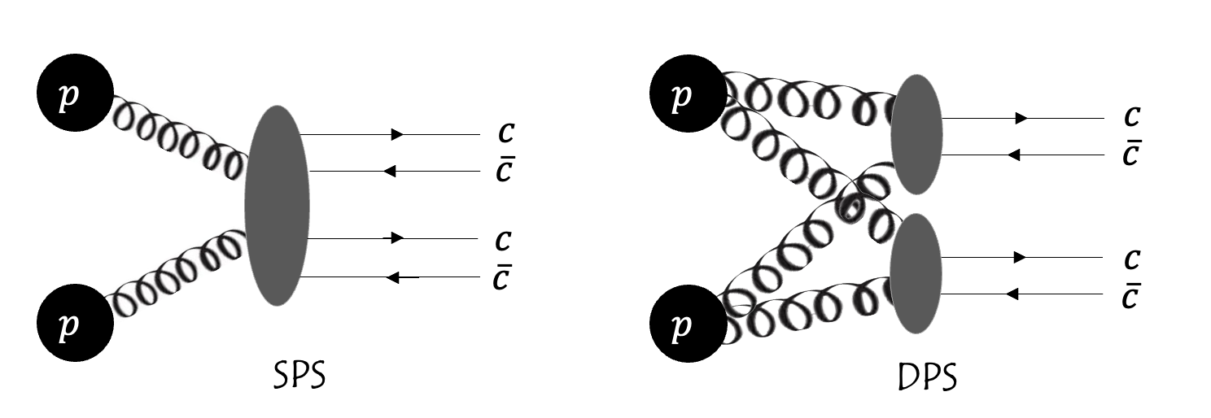
MC simulation
Background
Single Parton Scattering (NRSPS) to 𝐽/𝜓𝜓(2𝑆) sample by Pythia8
Double Parton Scattering (DPS) to 𝐽/𝜓𝜓(2𝑆) sample by Pythia8
Signal
$gg→X→\text{J}\text{/}\text{ψψ}\text{(2}\text{S}\text{)}$ by JHUGen - Default
$gg→X→\text{J}\text{/}\text{ψψ}\text{(2}\text{S}\text{)}$ by Higgs model in Pythia - Systematic

Slide 9
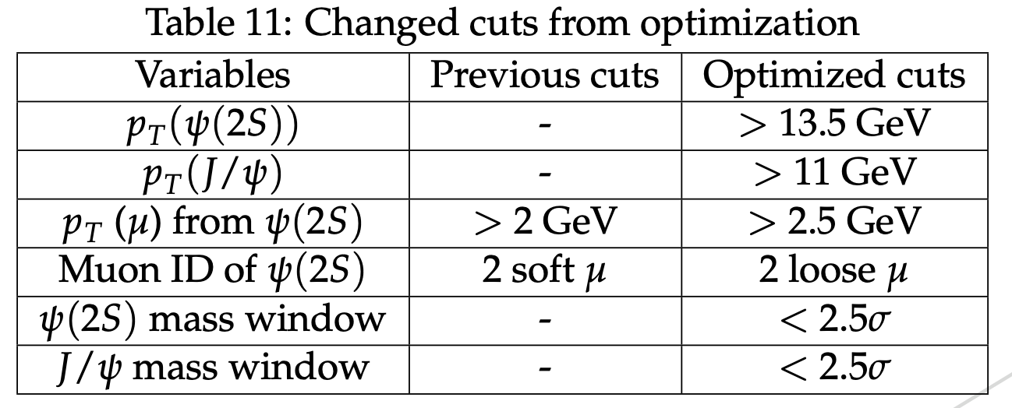
Optimization procedure
Optimize X(6900) signal (JHUgen) (though model dependent)
Procedure:
Optimize one variable at a time
Cycle through all variables
From "optimal point" iterate new optimization cycle
Iterate until stable
To avoid over-optimizing on fluctuations:
try to round final optimum to 0.5 GeV increments
Defined signal mass window (6.7 ~ 7.1 GeV)
Use as FOM
S from X(6900) MC
B from data
Not need to do normalization

Slide 10
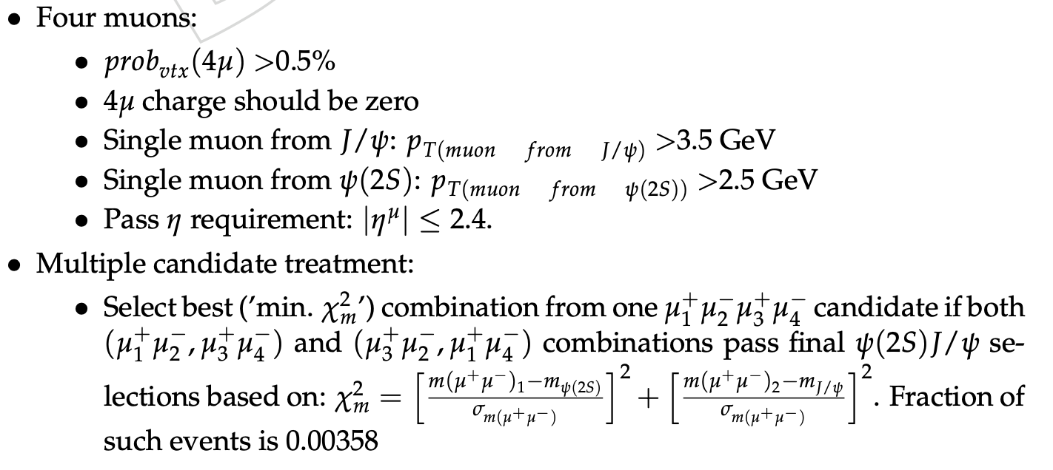
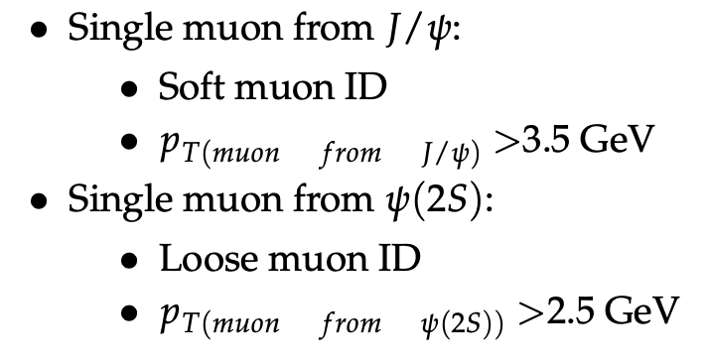
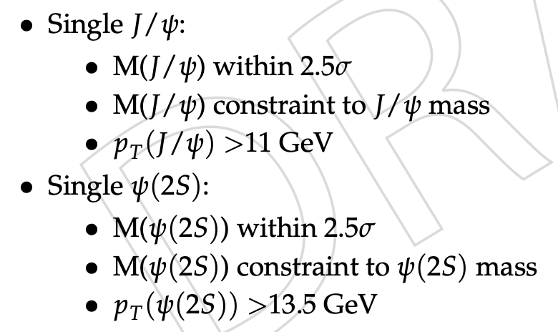
Event selection
Same cuts for Run2 and Run3 data except triggers

Slide 11
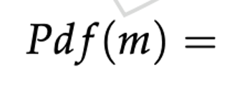
Fitting Strategy
Same signal function as 𝐽/𝜓𝐽/𝜓 analysis (Relativistic Breit-Wigner)
Non-interference model:
Interference model:
$R\left(M_{j}\right) \& ε\left(M_{j}\right)$: resolution & efficiency at $M_{j}$
$f_{SPS},f_{DPS},f_{combinatorial}$: shapes of SPS, DPS and combinatorial background
BW: relativistic Breit-Wigner
$r_{k},φ_{k}$: coupling magnitude and relative phase of interfering Breit-Wigner
Resolution and efficiency included in the default model

Slide 12
Significance calculation
Constrain mass & width of both peaks within 1σ of J/ψJ/ψ values
Model I: X(6900) & X(7100) with interference (NLL = -2056.83):
Contents: X(6900) + X(7100) Interf. + Background
Floating Params (7) : Number of NRSPS, number of DPS, number of combinatorial bkg, number of X(6900)X(7100), amplitude of X(7100), phi angle of X(7100), p2 of NRSPS
Constrained Params (4, regarded as fixed) : Mass of X(6900) & X(7100), width of X(6900) & X(7100)
Model II: X(6900) only (NLL = -2045.87):
Contents: X(6900) + Background
Floating Params (5) : Number of NRSPS, number of DPS, number of combinatorial bkg, number of X(6900), p2 of NRSPS
Constrained Params (2, regarded as fixed) : Mass of X(6900), width of X(6900)
Model III: X(7100) only (NLL = -2021.63):
Contents: X(7100) + Background
Floating Params (5) : Number of NRSPS, number of DPS, number of combinatorial bkg, number of X(7100), p2 of NRSPS
Constrained Params (2, regarded as fixed) : Mass of X(7100), width of X(7100)
Model I vs III
Degrees of freedom = 2
$χ^{2}$ = 2 * $ΔNLL$
Significance of X(6900) > 5$σ$
Model I vs II
Degrees of freedom = 2
$χ^{2}$ = 2 * $ΔNLL$
Significance of X(7100) > 3$σ$
Can use J/ψψ(2S) to make independent mass & width measurements?

Slide 13
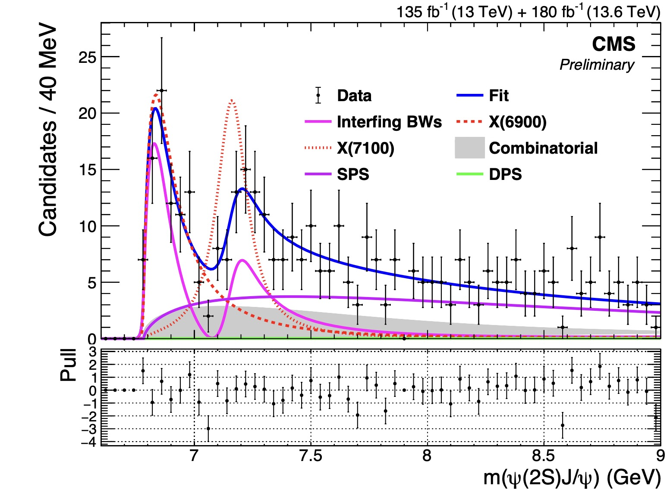
Independent measurement - 2BW (Interference) - X(6900)&X(7100)
Parameter | X(6900) Mass (MeV) | X(6900) Width (MeV)
Value | $${6876}_{−29}^{+46}$$ | $${253}_{−101}^{+285}$$
Parameter | X(7100) Mass (MeV) | X(7100) Width (MeV)
Value | $${7169}_{−52}^{+26}$$ | $${154}_{−82}^{+112}$$
NLL = -2045.55
Signal: X(6900) & X(7100)
Background: NRSPS, DPS, Comb bkg
Fit range : 6.6 - 15 GeV
(J/ψJ/ψ mass/width constraints removed)

Slide 14
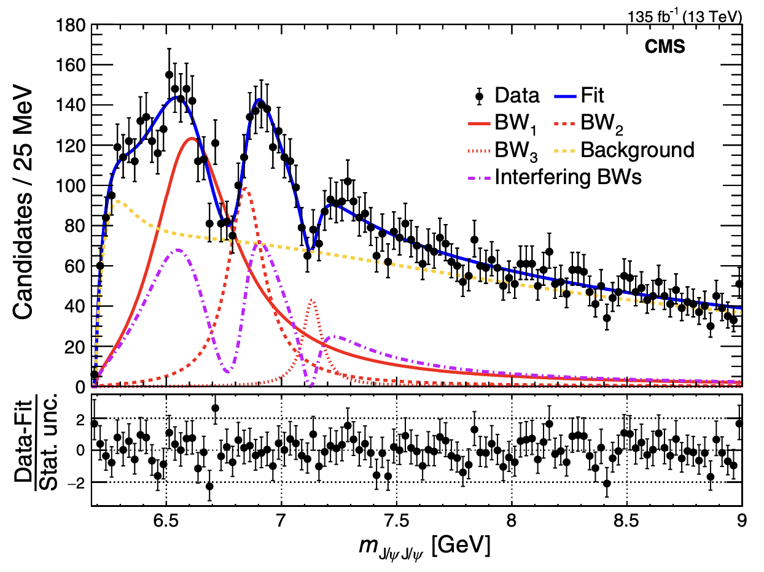
Comparison to J/ψJ/ψ analysis
ψ(2S)J/ψ
J/ψJ/ψ
Mass of both peaks consistent
Width of both peaks consistent

Slide 15
Systematic uncertainties
Do systematic for interference model with X(6900) & X(7100)
Variations are below
Signal Shape
Default: BW function with L=0
Alternative:
L=1/2, d=2/3/4
Flatte
SPS shape
${func}_{default}\left(SPS\right)→{func}_{default}(DPS)$
DPS shape
${func}_{default}\left(DPS\right)→{func}_{default}(SPS)$
Combinatorial backgroud shape
Nine-tile -> sPlot
Mass resolution
Take extremes of mass resolution dependence
Efficiency
Increase/Decrease the weight of Run3 efficiency
Add X(6600) tail
X(6600) mass/width/coef fixed to J/ψJ/ψ fit values
Fitter bias
Toy MC

Slide 16
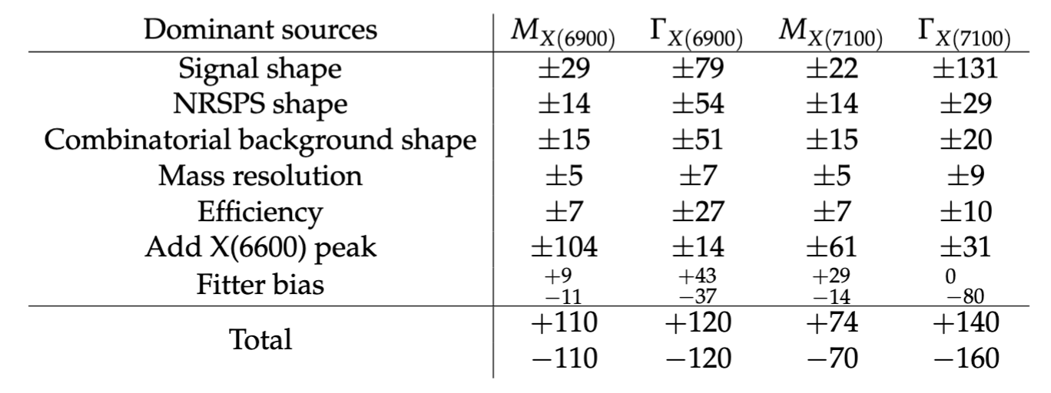
Results listed in PAS
Significance of X(6900) / X(7100) : >5σ / >3σ
Alternatives with no significant changes are not listed in the table, such as DPS shape

Slide 17
Summary
An excess observed in 𝜓(2𝑆)𝐽/𝜓 channel [Significance: BW2 ($>5σ$), BW3 ($>3σ$)]
With interference:
BW2:$m={6876}_{ −29}^{ +46}\left(stat\right) _{−110}^{+110}\left(syst\right) MeV, Γ={253}_{ −100}^{ +290}\left(stat\right) _{−120}^{+120}\left(syst\right) MeV$
BW3:$m={7169}_{ −52}^{ +26}\left(stat\right) _{−70}^{+74}\left(syst\right) MeV, Γ={154}_{ −82}^{ +110}\left(stat\right) _{−160}^{+140}\left(syst\right) MeV$
Consistent with interfering X(6900) and X(7100) as observed in 𝐽/𝜓𝐽/𝜓 analysis

Slide 18
Thanks !
Jinjing Gu
2025.7.13

