Slide 1

高能对撞机上双粲四夸克态产生机制的研究
牛娟娟
广西师范大学
In collaboration with 马鸿浩、陶正奎
Based on: Phys.Rev.D 111, 014019 (2025)
e-Print: 2506.16721
第八届强子能谱和强子结构研讨会
July 12th -14th 2025,广西师范大学

Slide 2
Contents
Background and motivation
Indirect Production ：Higgs W⁺ Z⁰ decay
Photoproduction ：photon-gluon channel
Summary

Slide 3
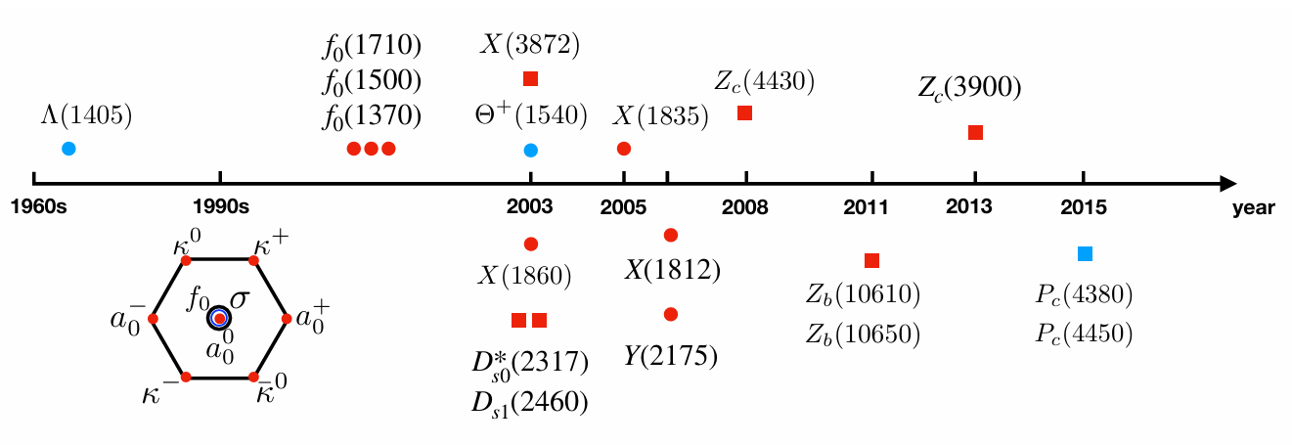
Motivation
Motivation
Doubly charmed tetraquark
Photoproduction
Summary
粲奇异介子D_{S0}*(2317) by BABAR (2003)
类粲偶素 X(3872) by Belle (2003)
Z_{C}(3900) by BESIII and Belle (2013)
五夸克态P_{C} states by LHCb (2015)
, X (6900)
Y. R. Liu, H. X. Chen, W. Chen, X. Liu and S. L. Zhu,
Prog. Part. Nucl. Phys. 107, 237 (2019)

Slide 4
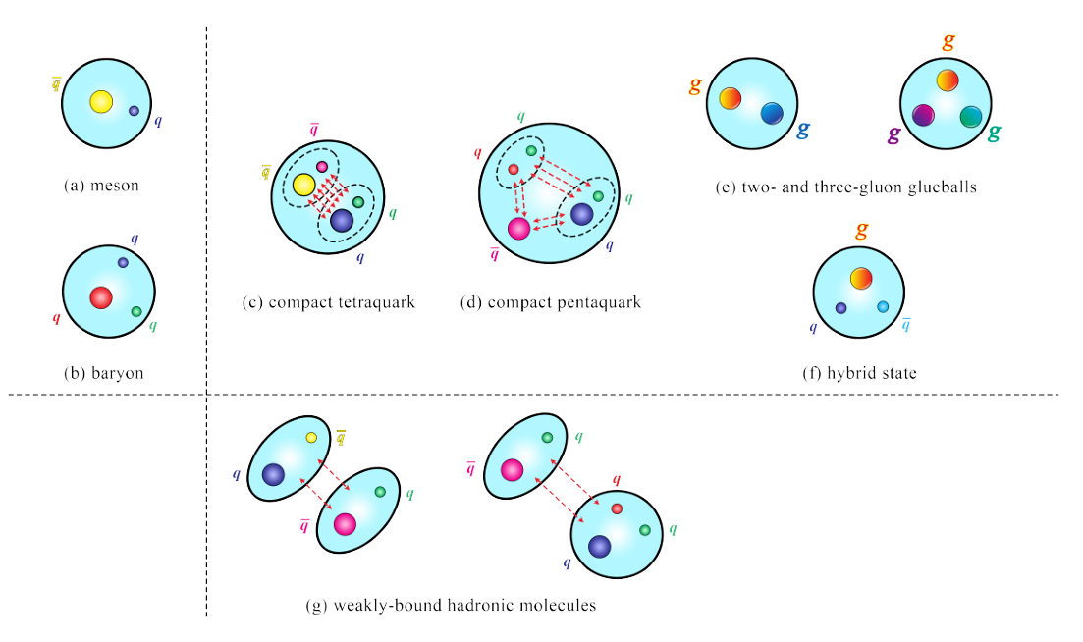
Motivation
Doubly charmed tetraquark
Photoproduction
Summary
这些奇特强子态是近年来强子物理
研究的焦点之一，为我们理解低能强
相互作用提供了新的平台和机遇，
同时也带来了很大的挑战。
Sum Rule、HQEFT和BOEFT等
H.X. Chen, W. Chen, X. Liu, Y.R. Liu, S.L. Zhu, Rep. Prog. Phys. 86, 026201 (2023).

Slide 5
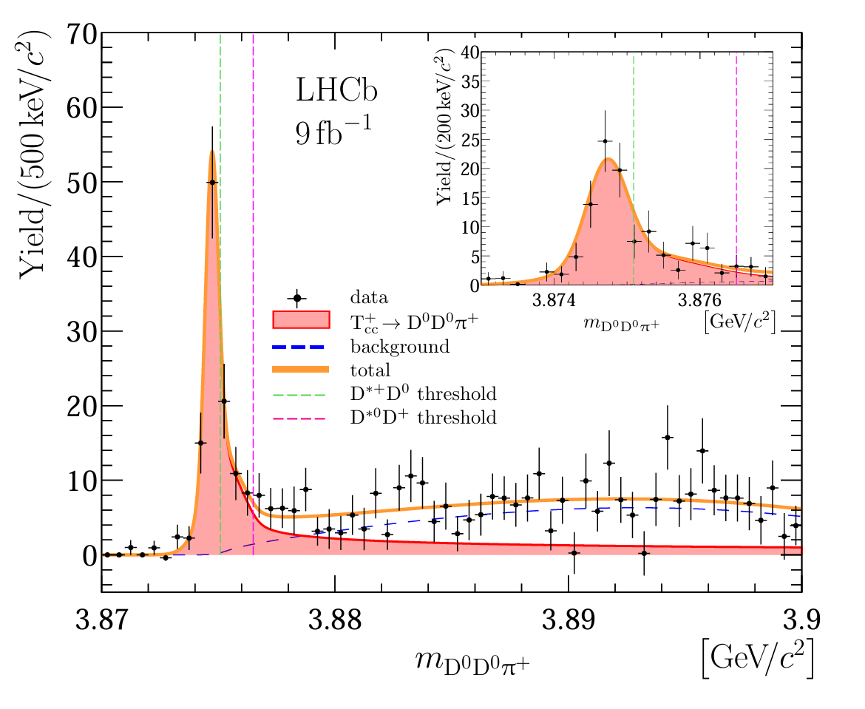
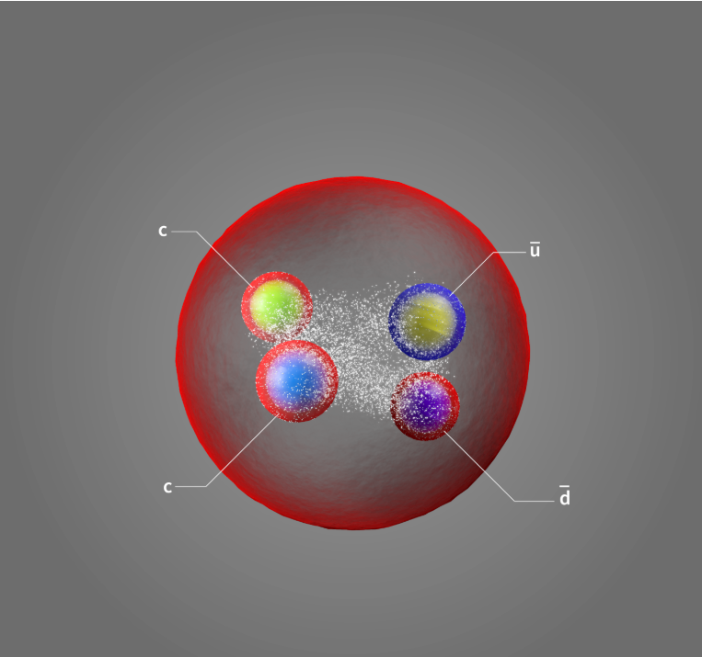
Motivation
Doubly charmed tetraquark
Photoproduction
Summary
N. Li, Z. F. Sun, X. Liu and S. L. Zhu,
Phys. Rev. D 88, 114008 (2013) (理论预言)
R. Aaij et al. [LHCb], Nature Phys. 18, 751-754 (2022)
R. Aaij et al. [LHCb], Nature Commun. 13, 3351 (2022)

Slide 6
Motivation
Doubly charmed tetraquark
Photoproduction
Summary
Meson molecule ?
Z. G. Wang and T. Huang, Eur. Phys. J. C 74, 2891 (2014).
F. K. Guo, C. Hanhart, U. G. Meißner, Q. Wang, Q. Zhao,
and B. S. Zou, Rev. Mod. Phys. 90, 015004 (2018); 94, 029901(E) (2022).
Hadroquarkonium ?
J. Ferretti and E. Santopinto, , J. High Energy Phys. 04 (2020) 119.

Slide 7
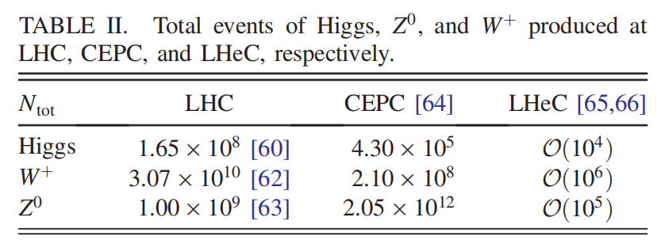
Motivation
Doubly charmed tetraquark
Photoproduction
Summary
LHC, CEPC，ILC
Direct production:
Indirect production:
hadronic production
Y. q. Chen and S. z. Wu, Phys. Lett. B 705, 93-97 (2011).
Q. Qin, Y. F. Shen, F. S. Yu, Chin. Phys. C 45, 103106 (2021).
H. Yang, J. Jiang, B. Long, Phys. Rev. D 109, 114034 (2024).
electron-positron production
T. Hyodo, Y. R. Liu, M. Oka, K. Sudoh and S. Yasui, Phys. Lett. B 721, 56-60 (2013)
photon-photon fusion
J. Jiang, S. Y. Li, X. Liang, Y. R. Liu, Z. G. Si and Z. J. Yang, Phys. Lett. B 866, 139543 (2025).
high energy and high luminosity
High resolution and detection ability
CEPC/ILC Relatively clean background
Super factory of Higgs, W⁺ and Z⁰

Slide 8
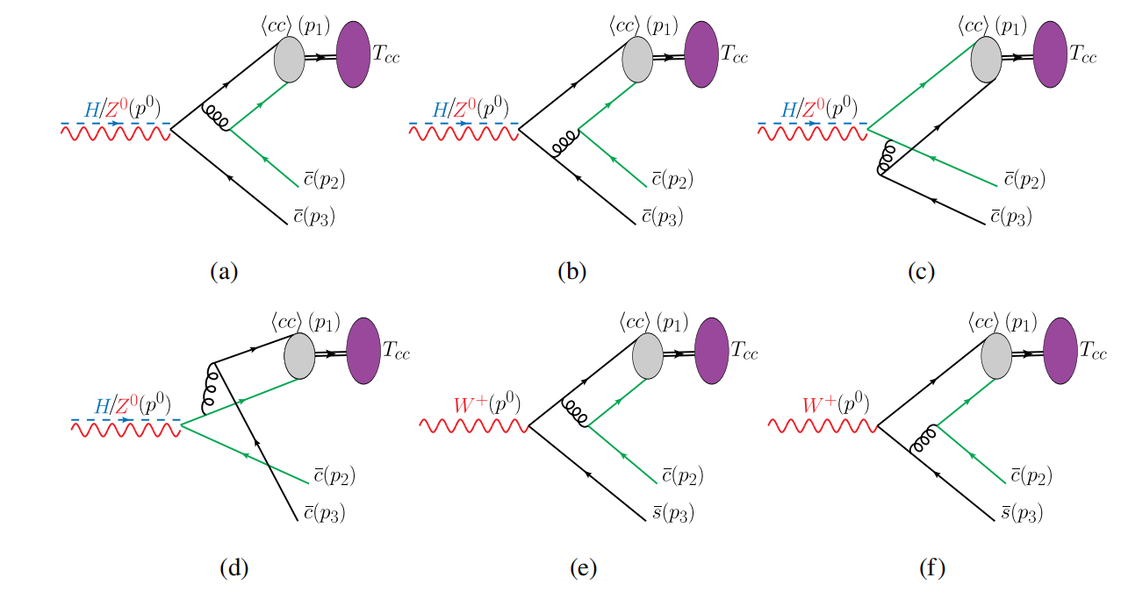
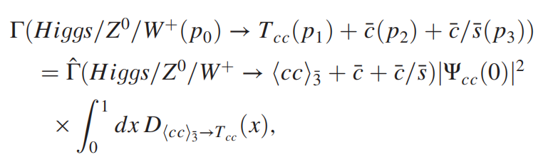


Production of doubly charmed tetraquark
Motivation
Direct production
Photoproduction
Summary
J. J. Niu, B. B. Shi, Z. K. Tao and H. H. Ma, PRD 111, 014019 (2025)
NRQCD因子化
perturbative region
nonperturbative region
G. T. Bodwin, E. Braaten and G. P. Lepage, Phys. Rev. D 51, 1125 (1995).
A. F. Falk, M. E. Luke, M. J. Savage and M. B. Wise, Phys. Rev. D 49, 555-558 (1994).

Slide 9
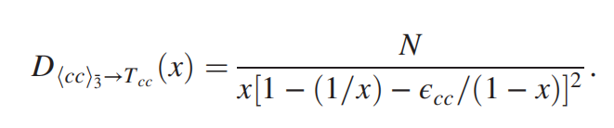
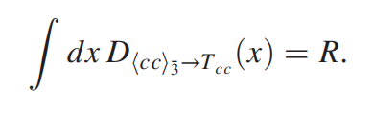
Motivation
Direct production
Photoproduction
Summary
NRQCD因子化
Peterson model
=?
C. Peterson, D. Schlatter, I. Schmitt, and P. M. Zerwas, Phys. Rev. D 27, 105 (1983).
Y. q. Chen and S. z. Wu, Phys. Lett. B 705, 93 (2011).

Slide 10
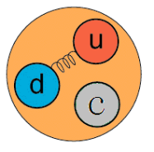
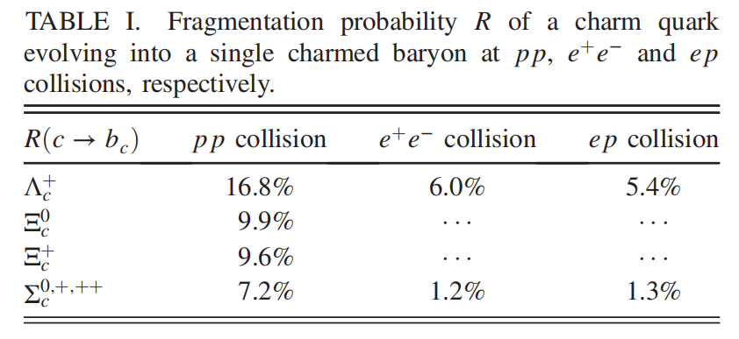

Motivation
Direct production
Photoproduction
Summary
Figure from BEPC
(cc) diquark in color antitriplet acting as an antiquark has a heavy diquark-antiquark symmetry (HDAS)
Y. q. Chen and S. z. Wu, Phys. Lett. B 705, 93 (2011).

Slide 11
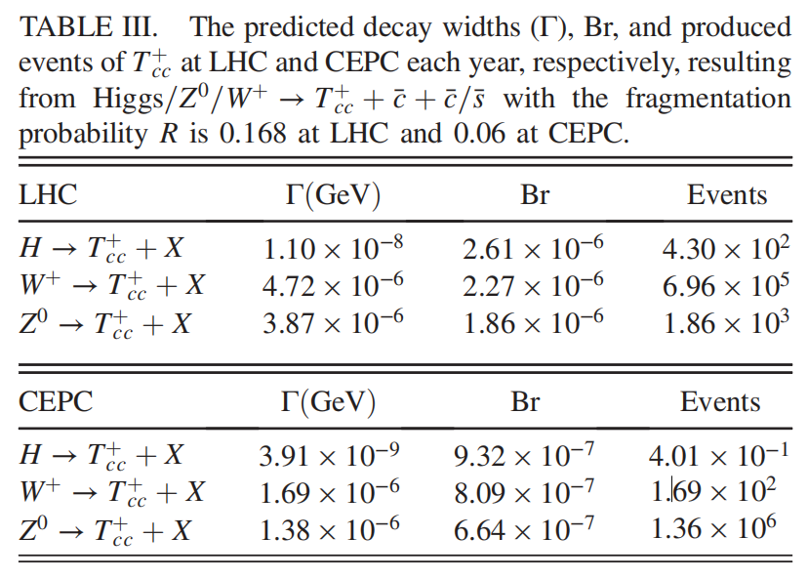

Motivation
Direct production
Photoproduction
Summary
Branching ratio, events, and distributions
Consistent with the prediction made by
Qin Qin et al CPC 45,103106(2021 )!
Instead of HDAS model, one can also use the harmonic oscillator potential (HOP) to obtain the long distance matrix elements (LDMEs).
不确定性较大！
T. Hyodo, Y. R. Liu, M. Oka, K. Sudoh and S. Yasui, Phys. Lett. B 721, 56-60 (2013)

Slide 12
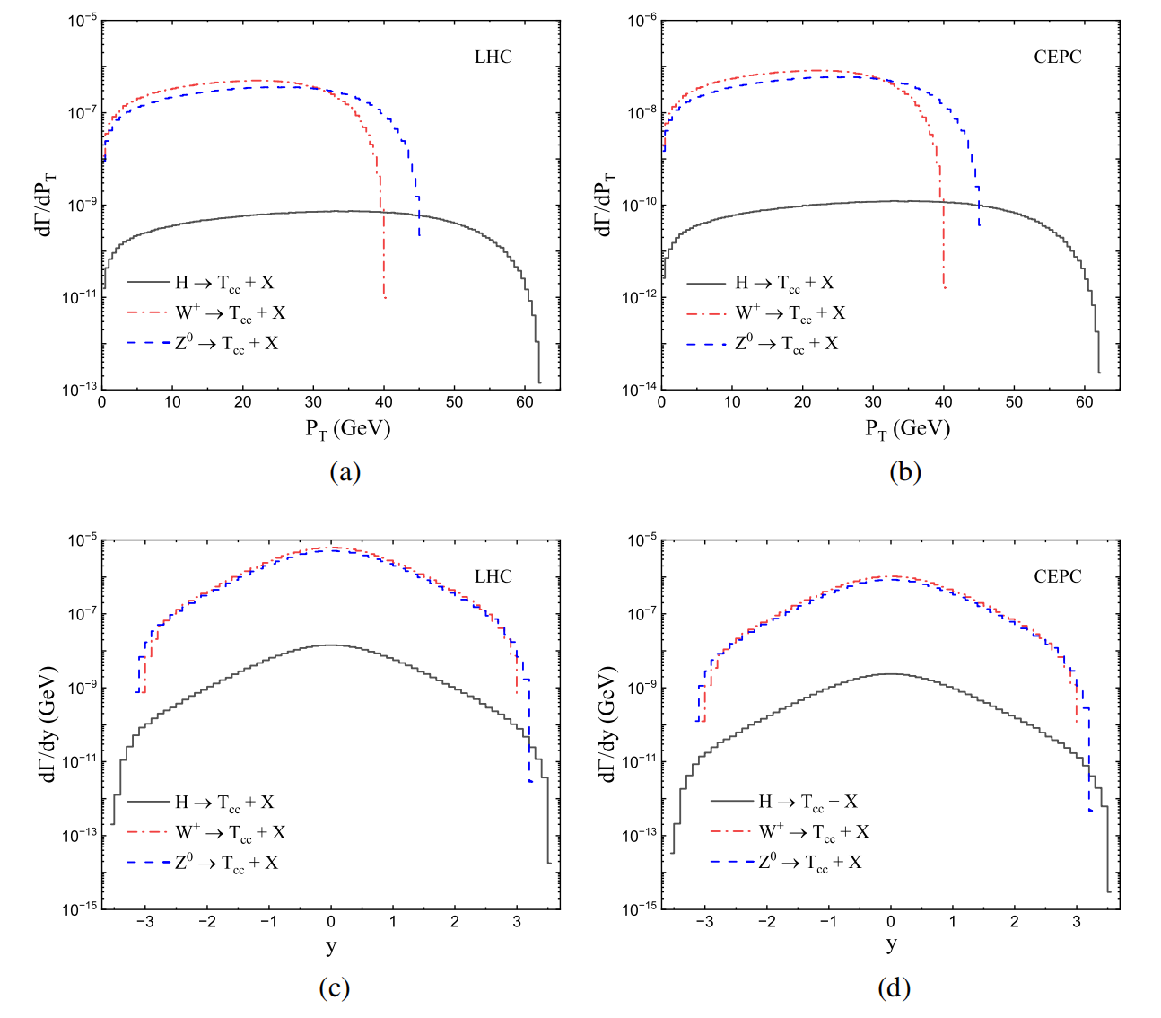
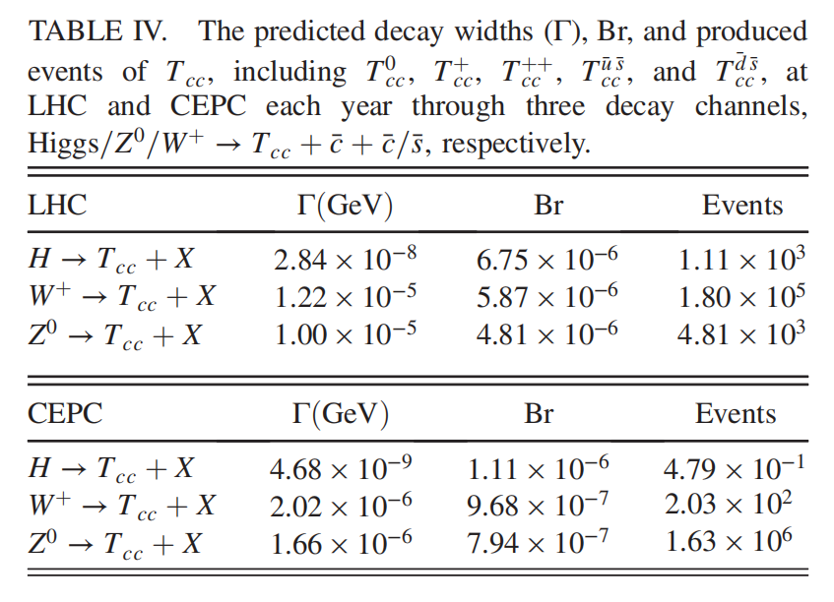
Motivation
Direct production
Photoproduction
Summary
Branching ratio, events, and distributions

Slide 13
Motivation
Direct production
Photoproduction
Summary
小结
CEPC provides a good experimental platform for study doubly charmed tetraquark.
The largest contribution for the production of Tcc is through Z⁰ decays, about 1.63 × 10⁶ events produced in one operation year.
LHC is very likely to find other components of .
The produced events through W⁺ decays is 1.80 × 10⁵, nearly 2 orders of magnitude larger than that by Higgs decays (1.11 × 10³) and Z⁰ decays (4.81 × 10³) per year.

Slide 14
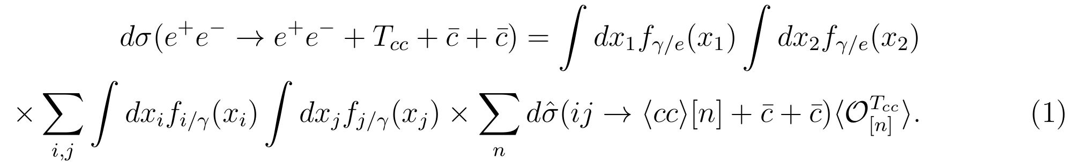
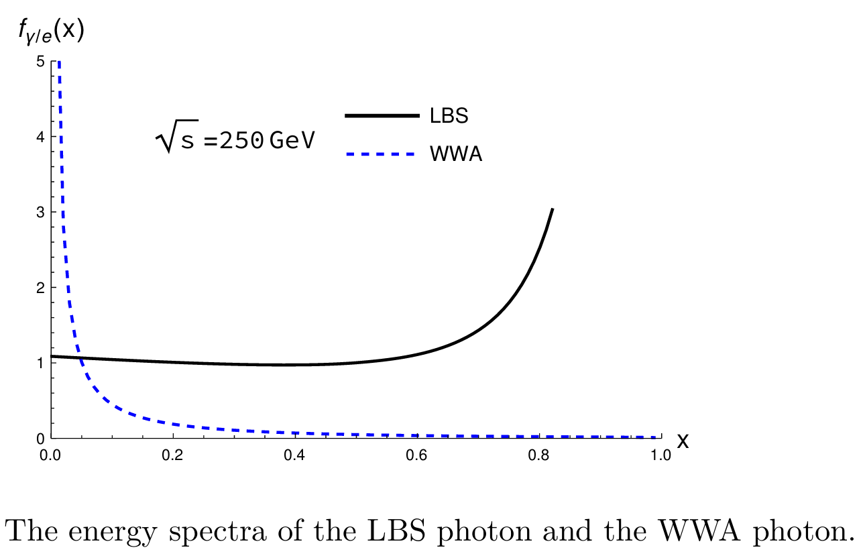
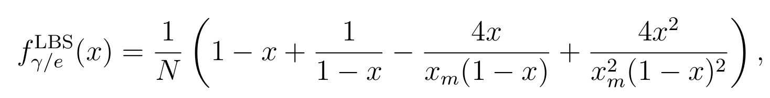
Photoproduction of doubly charmed tetraquark
Motivation
Direct production
Photoproduction
Summary
J. J. Niu，H. H. Ma, arXiv：2506.16721.
Xi-Jie Zhan, Xing-Gang Wu and Xu-Chang Zheng, JHEP11(2023)029
X. W. Bai, F. Feng, C. M. Gan, Y. Huang, W. L. Sang and H. F. Zhang, JHEP 09, 002 (2024)

Slide 15
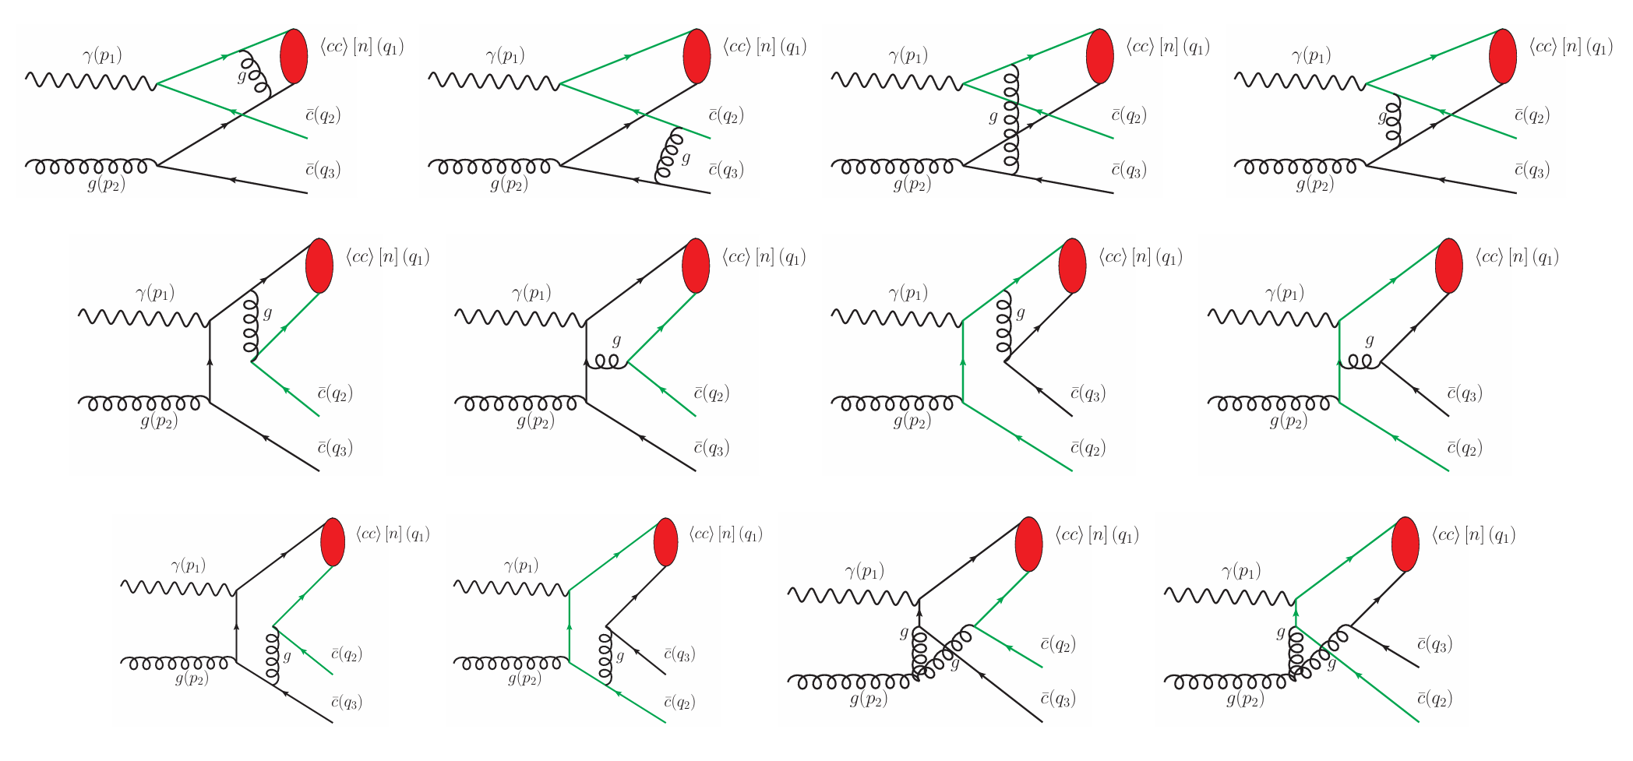
Motivation
Direct production
Photoproduction
Summary
photon-gluon fusion

Slide 16
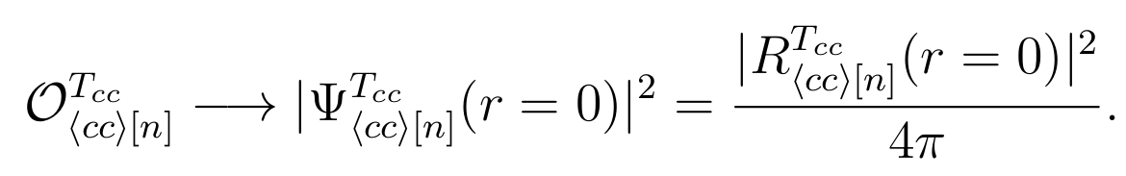
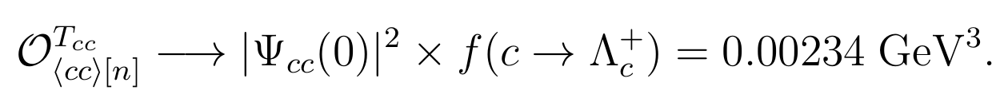
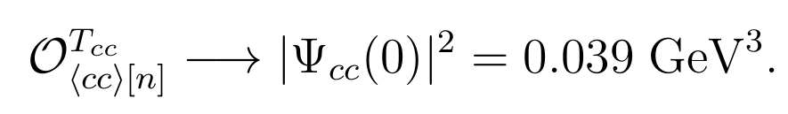



Motivation
Direct production
Photoproduction
Summary
01
HOP (harmonic oscillator potential)
= 0.089 GeV³
02
HDAS
03
DAS（doubly charmed baryon）

Slide 17
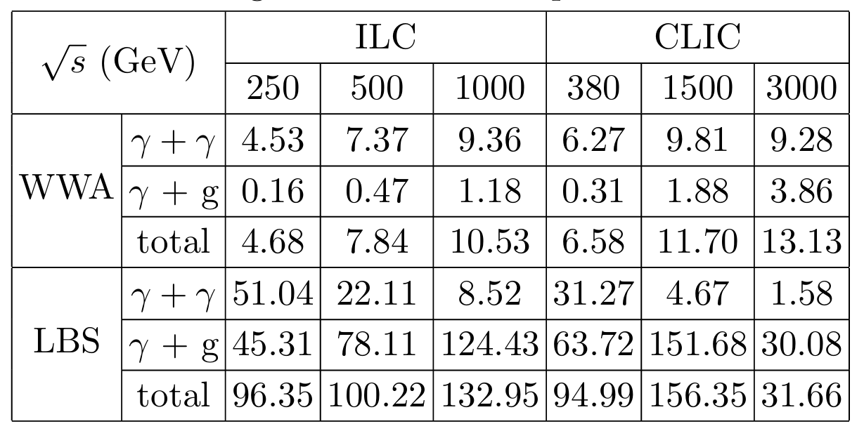






Motivation
Doubly charmed tetraquark
Photoproduction
Summary
Cross sections，branching ratio，and events
Consistent with the prediction made by
J. Jiang, et al, Phys. Lett. B 866, 139543 (2025)
ILC: 3.53%, 6.38%, 12.61%
88.77%, 3.53, 14.60
ILC:
CLIC

Slide 18
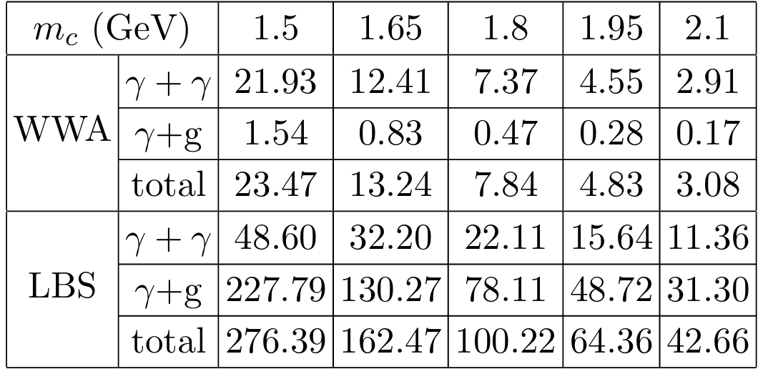
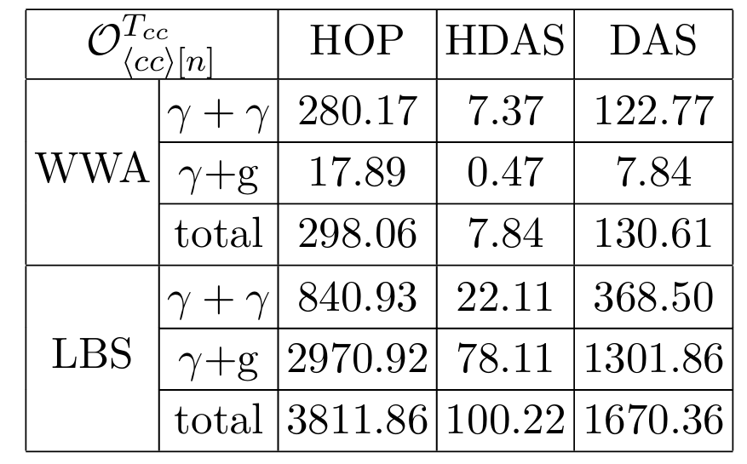

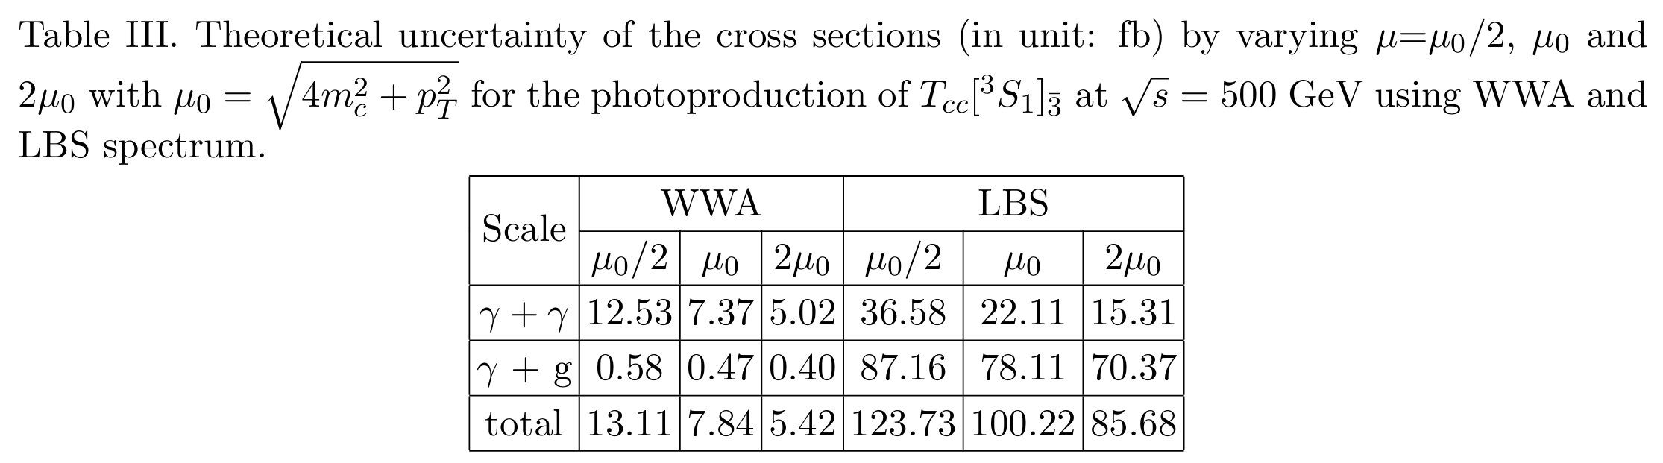
Motivation
Doubly charmed tetraquark
Photoproduction
Summary
Theoretical uncertainty
SCALE

Slide 19
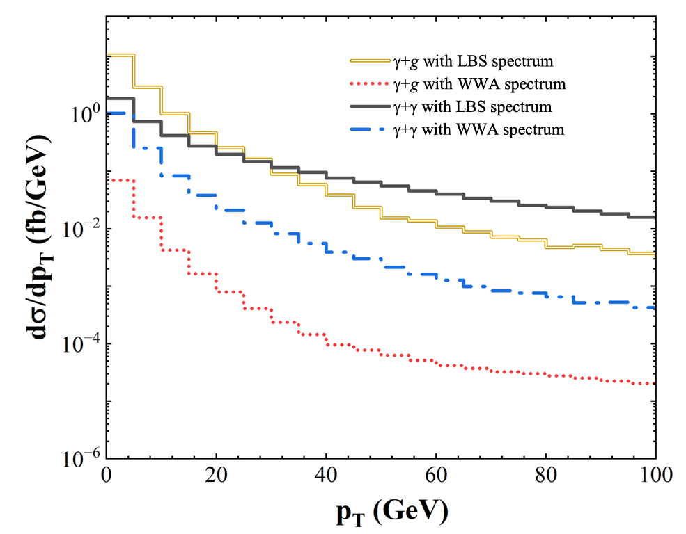

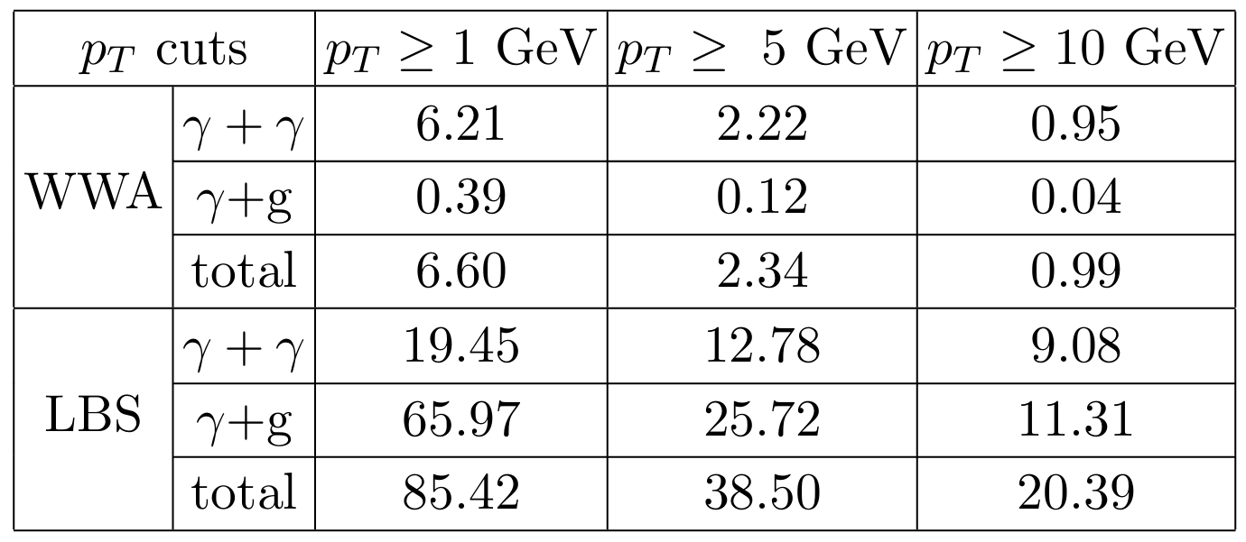
Motivation
Doubly charmed tetraquark
Photoproduction
Summary
Differential Distributions

Slide 20
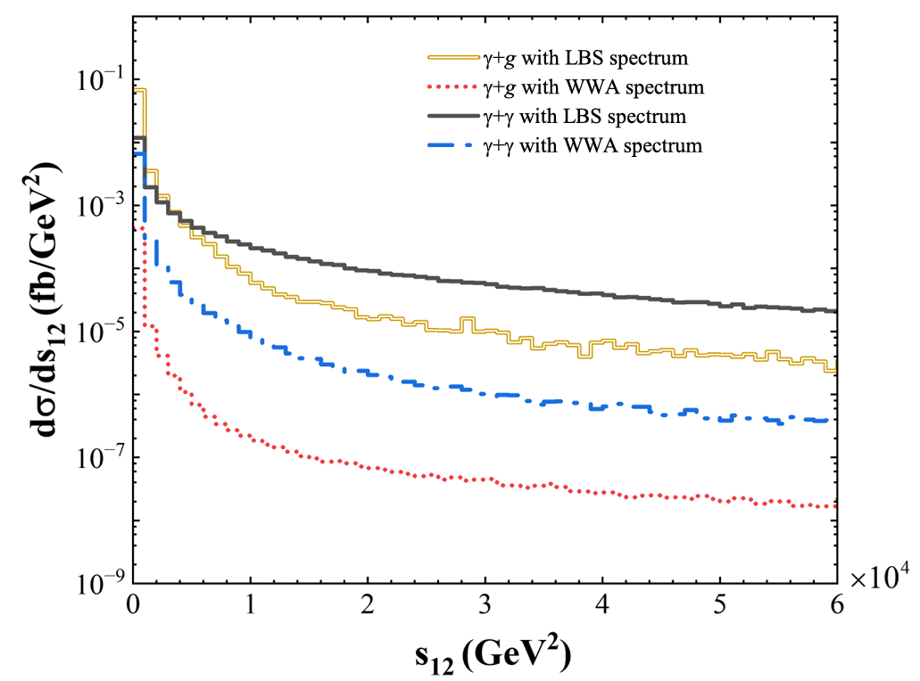
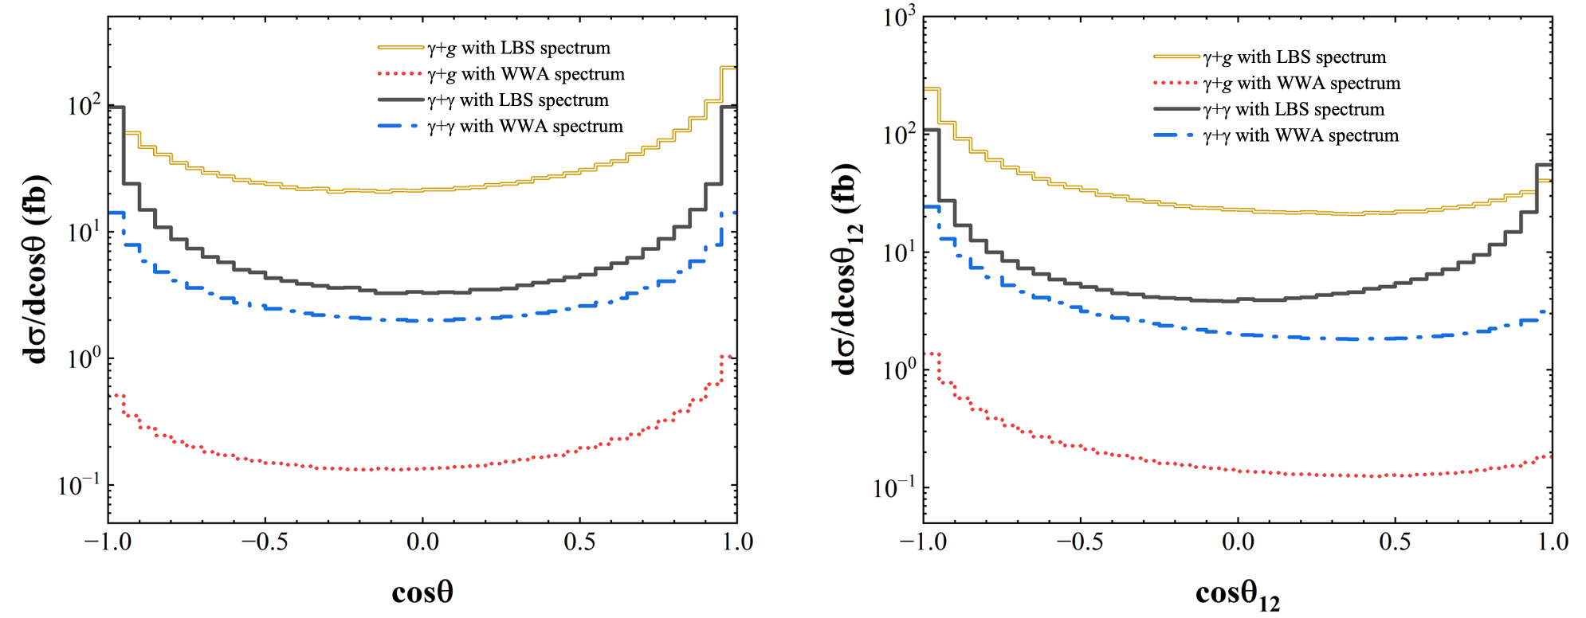
Differential Distributions

Slide 21
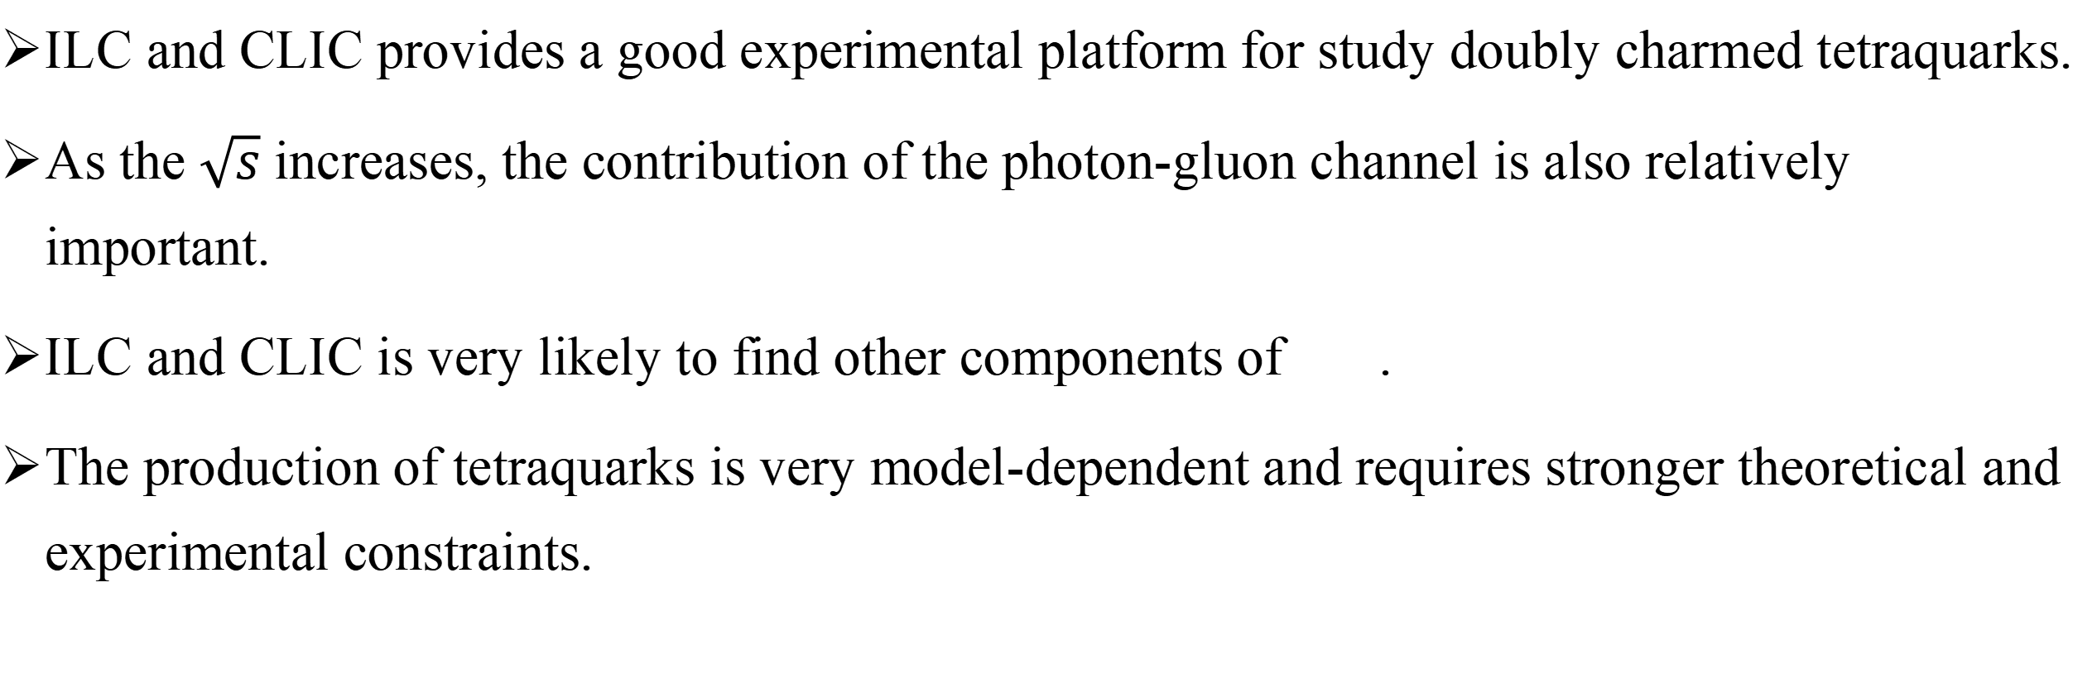
Summary
Motivation
Doubly charmed tetraquark
Photoproduction
Summary
ILC and CLIC provides a good experimental platform for study doubly charmed tetraquarks.
As the $\sqrt{s}$ increases, the contribution of the photon-gluon channel is also relatively important.
ILC and CLIC is very likely to find other components of .
The production of tetraquarks is very model-dependent and requires stronger theoretical and experimental constraints.

Slide 22
Thanks for your attention!

