Slide 1

Charmonium-like States with J^{PC}=3⁻⁺
through QCD Sum Rules
报告人：席洪洲
Collaborators: Hua-Xing Chen, Wei Chen, T. G. Steele, Dan Zhou
第八届强子谱和强子结构研讨会
2025.07.14

Slide 2
1
Overview of Exotic Hadrons
2
Method: QCD Sum Rules
Outline
3
Numerical Analysis
4
Summary
Jul.14, 2025 | Hong-Zhou Xi (SEU) | Charmonium-like States with J^{PC}=3⁻⁺ through QCD Sum Rules | 2/19

Slide 3
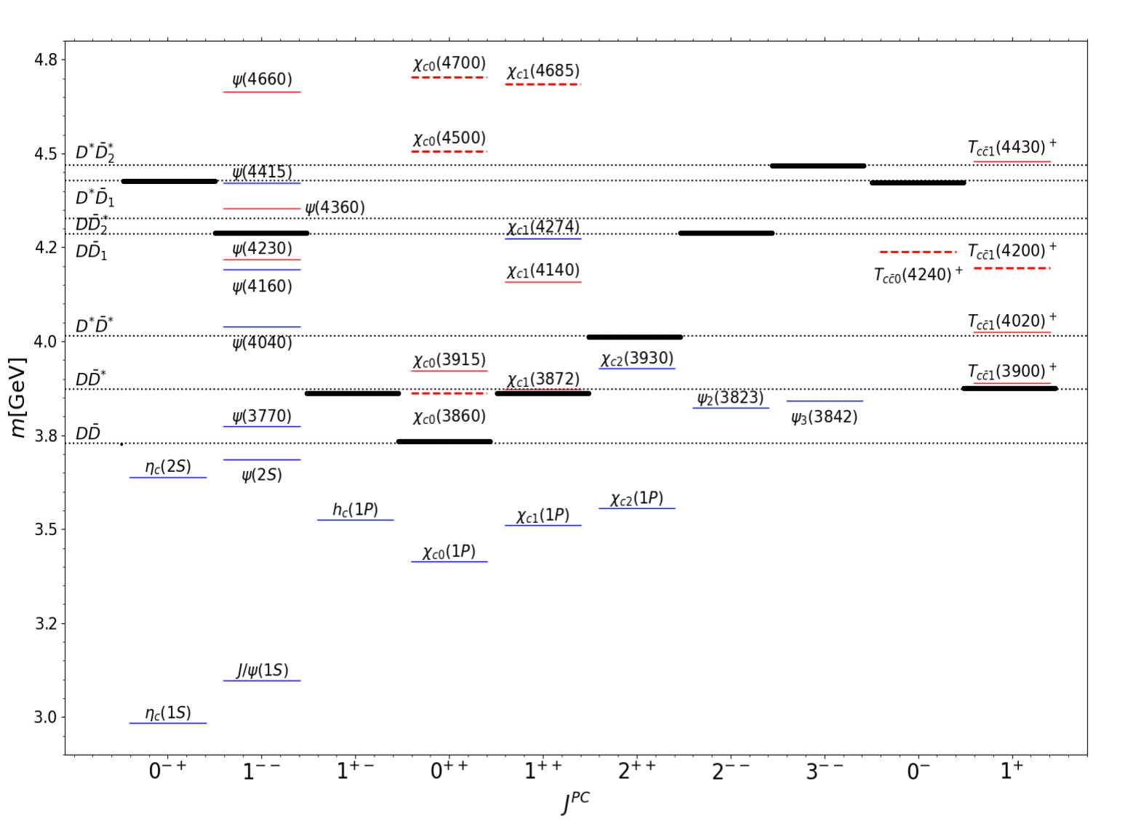
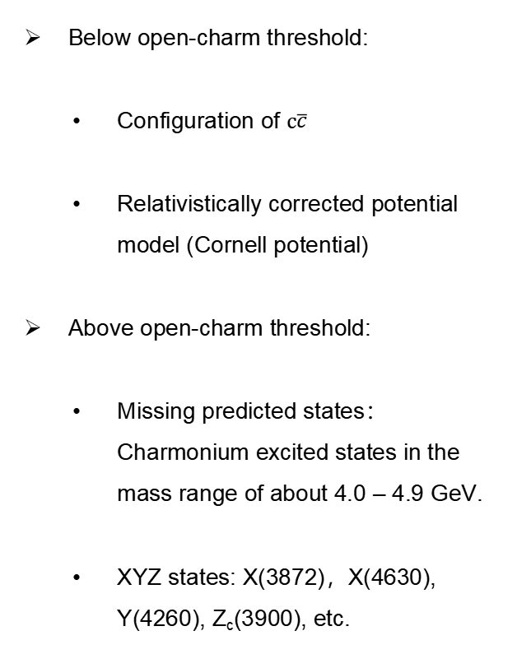
Current spectrum of charmonium and charmonium-like states
Below open-charm threshold:
Configuration of $c\overline{c}$
Relativistically corrected potential model (Cornell potential)
Above open-charm threshold:
Missing predicted states：Charmonium excited states in the mass range of about 4.0 – 4.9 GeV.
XYZ states: X(3872)，X(4630), Y(4260), Z_{c}(3900), etc.
Solid lines: well established
Dashed lines: to be confirmed
Blue lines: consistent with the quark model
Red lines: unconventional properties
Thin dashed lines: thresholds for the particle pairs
The thick, solid lines: lowest thresholds
Jul.14, 2025 | Hong-Zhou Xi (SEU) | Charmonium-like States with J^{PC}=3⁻⁺ through QCD Sum Rules | 3/19
Notes:
two narrow open charm states can combine to the given quantum numbers

Slide 4
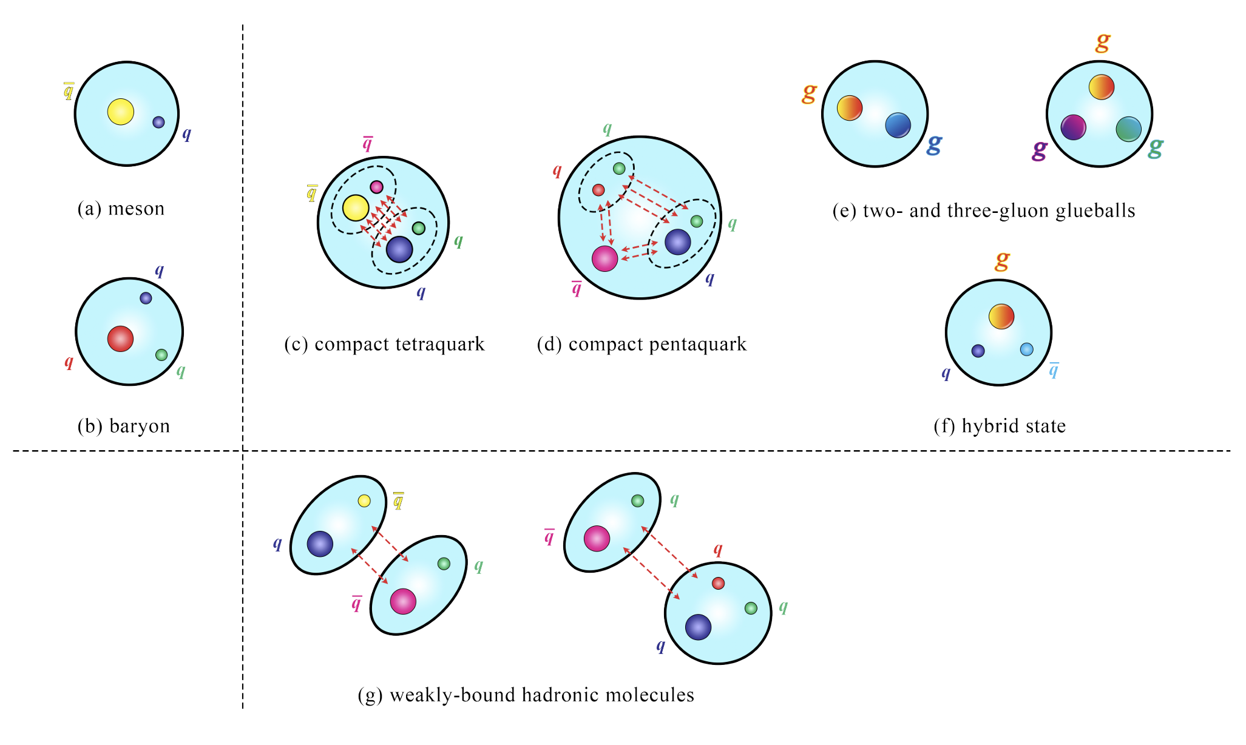
Categorization of hadrons according to the color degree of freedom
The hadrons in the left panel are conventional hadrons, and those in the right panel are exotic hadrons. The hadrons in the top panel are tightly bound by the strong interaction, and those in the bottom panel are weakly bound by the residual strong interaction.
Recent reviews:
A. Hosaka et al., PTEP 062C01(2016); Hua-Xing Chen et al., Phys.Rept. 639 (2016), 1-121;
A. Esposito et al., Phys.Rept.668(2017)1-97; F.-K. Guo et al., Rev.Mod.Phys.90(2018)015004;
S. L. Olsen et al., Rev.Mod.Phys.90(2018)015003; Y.-R. Liu et al.,Prog.Part.Nucl.Phys.107(2019)237-320;
N. Brambilla et al., Phys.Rept.873(2020)1-154; Hua-Xing Chen et al., Rept.Prog.Phys. 86 (2023) 2, 026201
Jul.14, 2025 | Hong-Zhou Xi (SEU) | Charmonium-like States with J^{PC}=3⁻⁺ through QCD Sum Rules | 4/19
Notes:
why exotic JPC

Slide 5
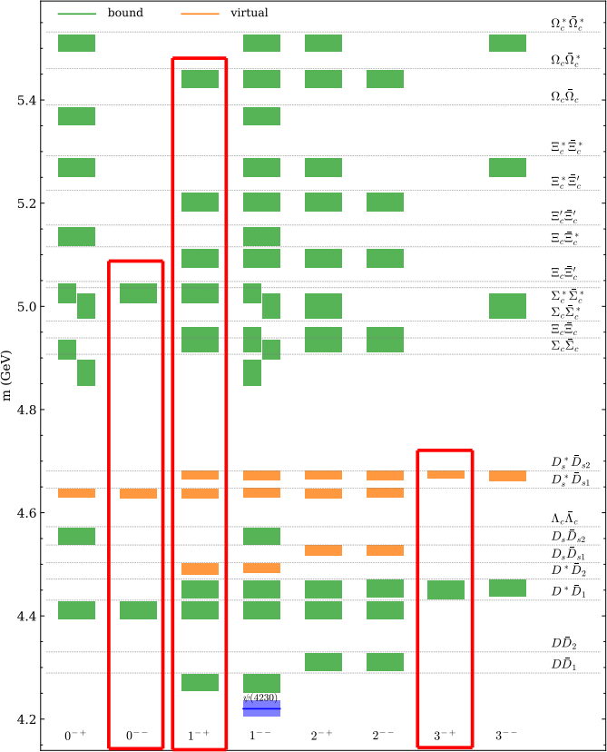
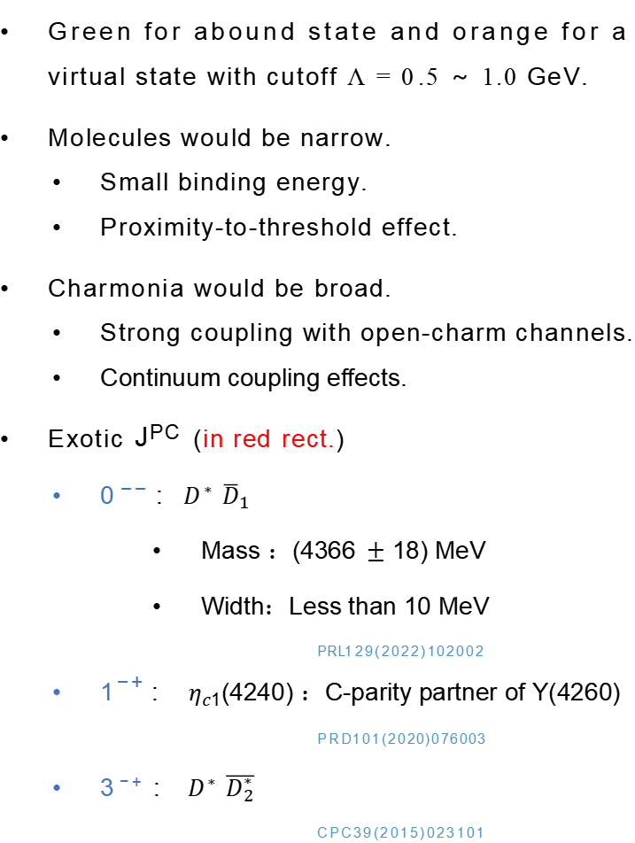
The spectrum of hadronic molecules consisting of a pair of charmed-anticharmed hadrons with I = 0, P = −
Green for abound state and orange for a virtual state with cutoff Λ = 0 .5 ~ 1.0 GeV.
Molecules would be narrow.
Small binding energy.
Proximity-to-threshold effect.
Charmonia would be broad.
Strong coupling with open-charm channels.
Continuum coupling effects.
Exotic J^{PC} (in red rect.)
  0 ⁻⁻ : $D^{∗}$ ${\overline{D}}_{1}$
  Mass ：(4366$±$ 18) MeV
  Width：Less than 10 MeV
PRL129(2022)102002
  1⁻⁺ : $η_{c1}$(4240) ：C-parity partner of Y(4260)
PRD101(2020)076003
3 ⁻⁺ : ${ D}^{∗}$ $\overline{D_{2}^{∗}}$
CPC39(2015)023101
Prog. Phys., 41(2): 65-93 (2021)
Jul.14, 2025 | Hong-Zhou Xi (SEU) | Charmonium-like States with J^{PC}=3⁻⁺ through QCD Sum Rules | 5/19
Notes:
HQSS OBE OBE χc0/2 0++ 2++ C=+ Y(4260)(1^−−可能并非纯粲偶素态，而是混杂态（Hybrid）或四夸克态，导致其C-parity与partner的关联更复杂

Slide 6
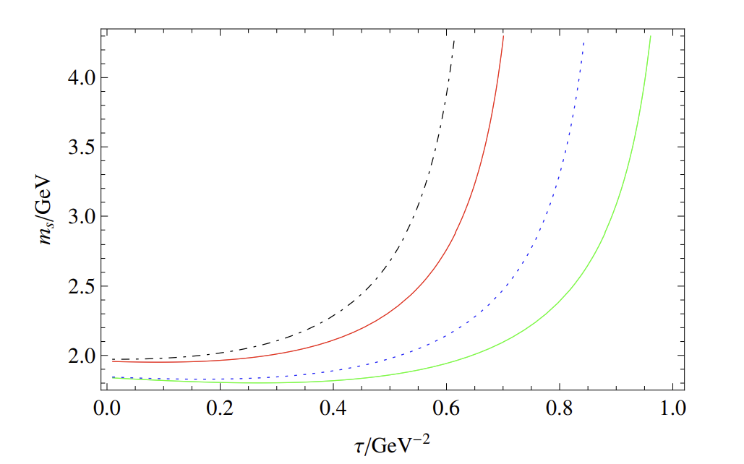
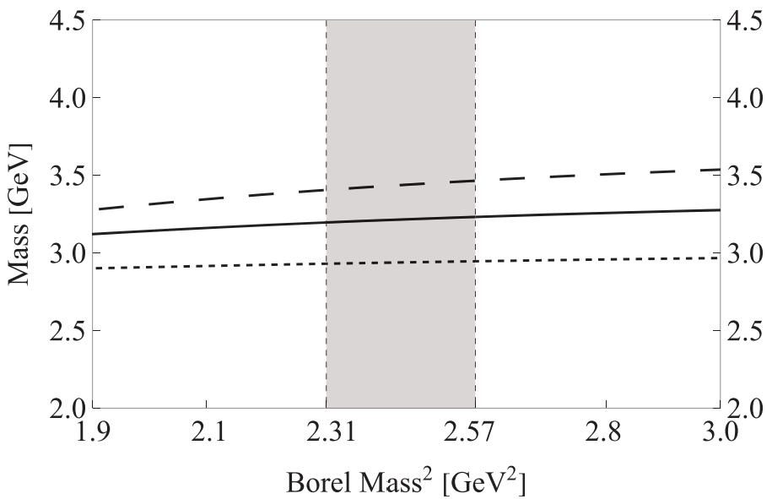
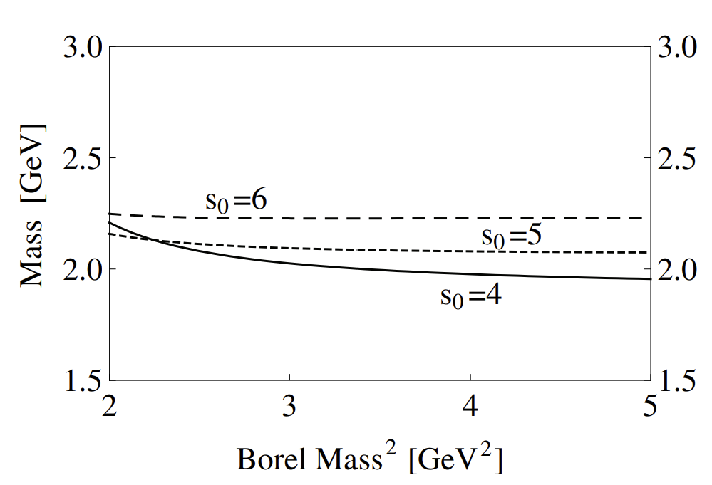
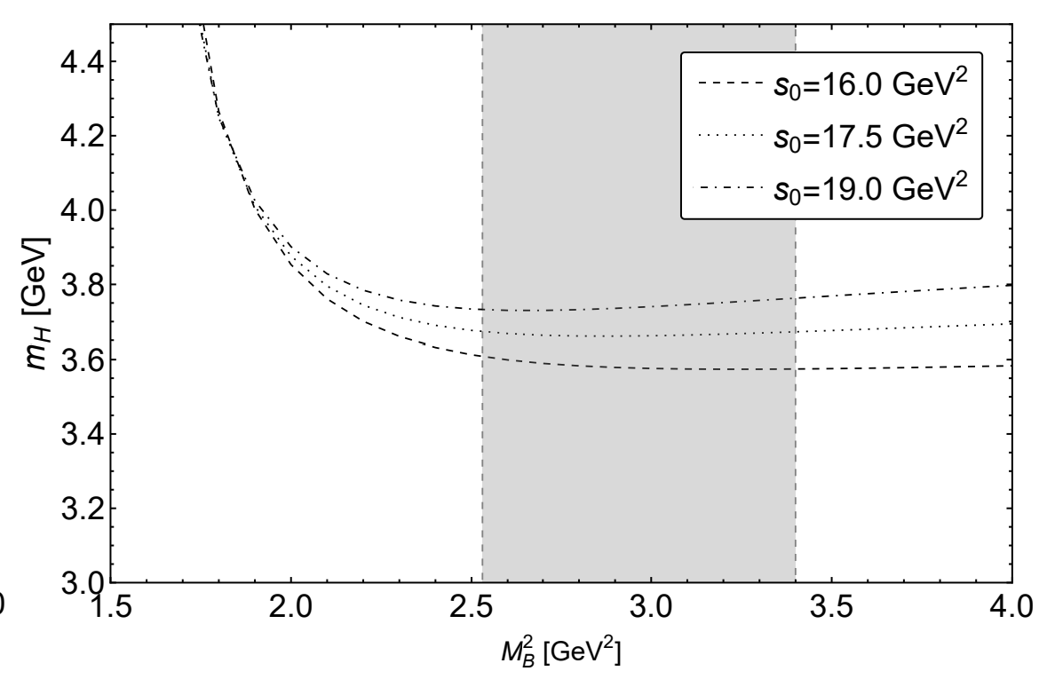
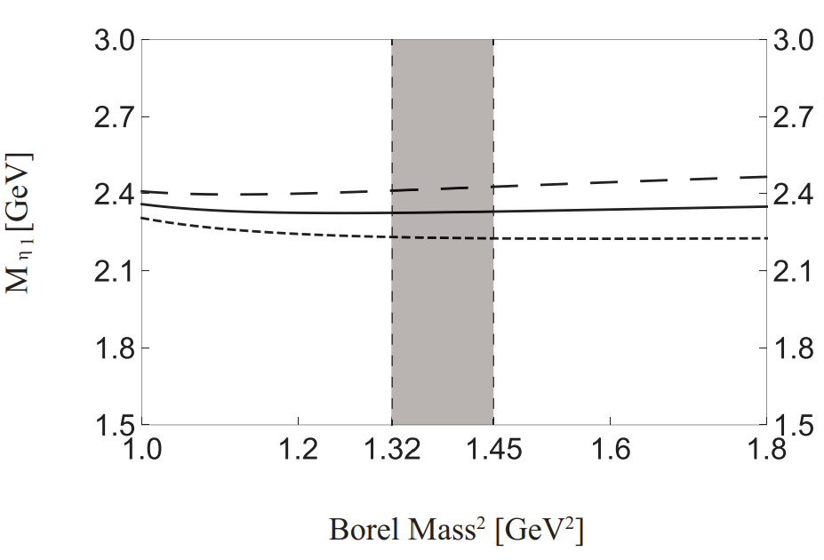
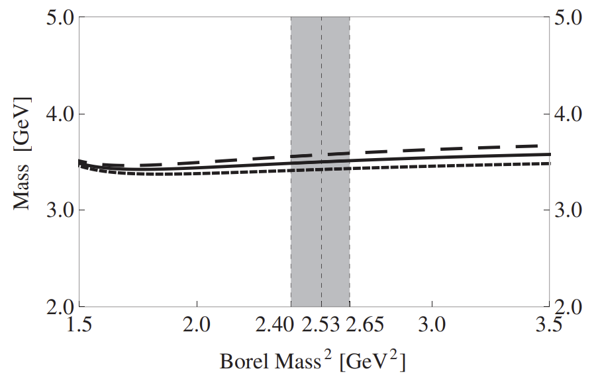
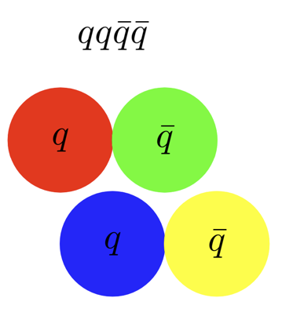
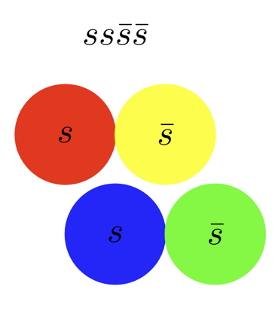
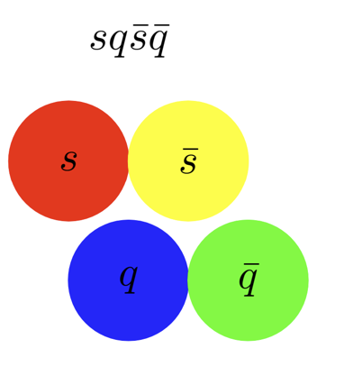
Tetraquark states with exotic quantum number which are investigated by QCD sum rules
PRD 95, 076017 (2017)
PRD 108, 094019 (2023)
PRD 78, 117502 (2008)
0⁻⁻
0⁺⁻
1⁻⁺
PRD 110, 034022 (2024)
PRD 103, 054006 (2021)
EPJC 82, 983 (2022)
2⁺⁻
3⁻⁺
4⁺⁻
For high spin states (J ≥ 3), higher-order gluon field tensors or higher-order derivative terms are involved, resulting in a significant increase in computational complexity, and the convergence and stability may deteriorate.
The masses of light tetraquark states are usually less than 2 GeV. Non perturbative effects (such as quark condensation and gluon condensation) are dominant. QCD sum rules is better at dealing with these effects in the low energy region.
Jul.14, 2025 | Hong-Zhou Xi (SEU) | Charmonium-like States with J^{PC}=3⁻⁺ through QCD Sum Rules | 6/19

Slide 7
1
Overview of Exotic Hadrons
2
Method: QCD Sum Rules
Outline
3
Numerical Analysis
4
Summary
Jul.14, 2025 | Hong-Zhou Xi (SEU) | Charmonium-like States with J^{PC}=3⁻⁺ through QCD Sum Rules | 7/19

Slide 8
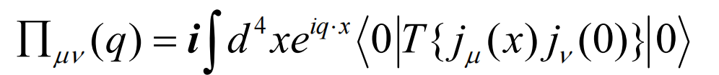
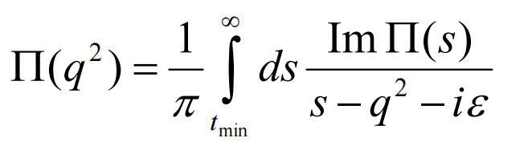
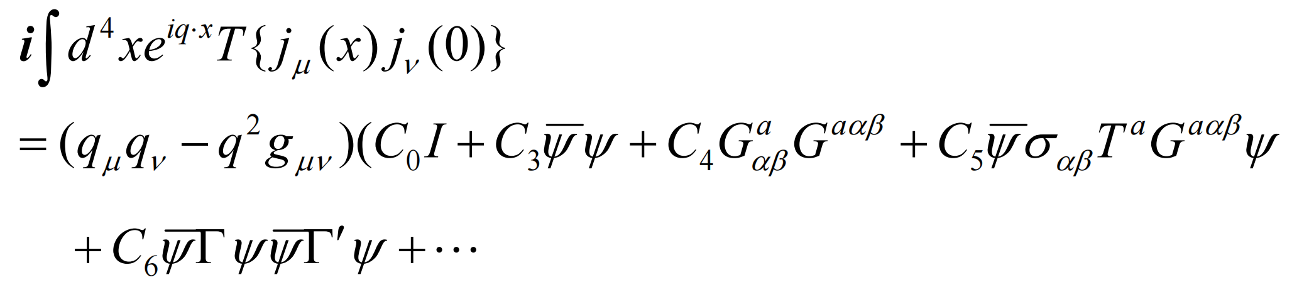
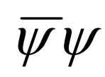
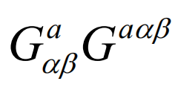
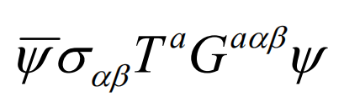
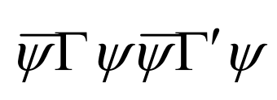
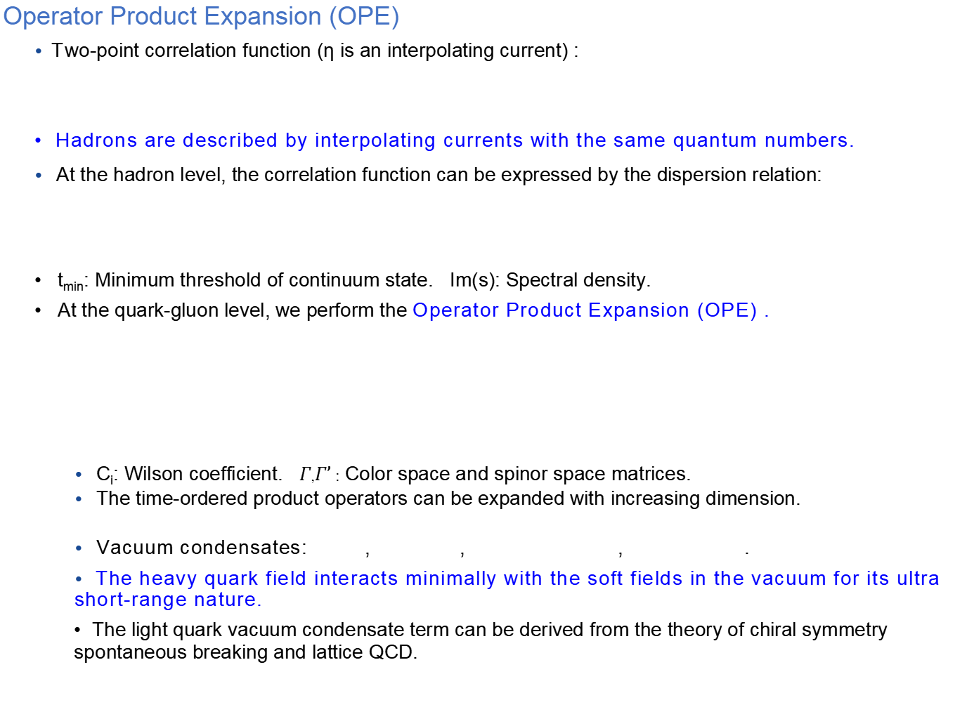
Operator Product Expansion (OPE)
• Two-point correlation function (η is an interpolating current) :
Hadrons are described by interpolating currents with the same quantum numbers.
• At the hadron level, the correlation function can be expressed by the dispersion relation:
t_{min}: Minimum threshold of continuum state. Im(s): Spectral density.
At the quark-gluon level, we perform the Operator Product Expansion (OPE) .
• C_{i}: Wilson coefficient. $Γ$,$Γ’$ : Color space and spinor space matrices.
• The time-ordered product operators can be expanded with increasing dimension.
• Vacuum condensates: , , , .
• The heavy quark field interacts minimally with the soft fields in the vacuum for its ultra short-range nature.
The light quark vacuum condensate term can be derived from the theory of chiral symmetry spontaneous breaking and lattice QCD.
Jul.14, 2025 | Hong-Zhou Xi (SEU) | Charmonium-like States with J^{PC}=3⁻⁺ through QCD Sum Rules | 8/19

Slide 9

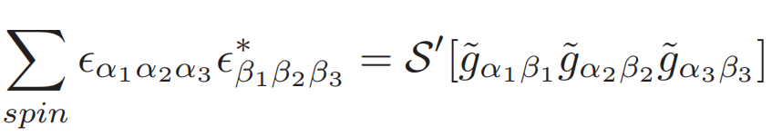
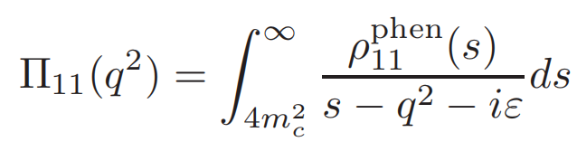
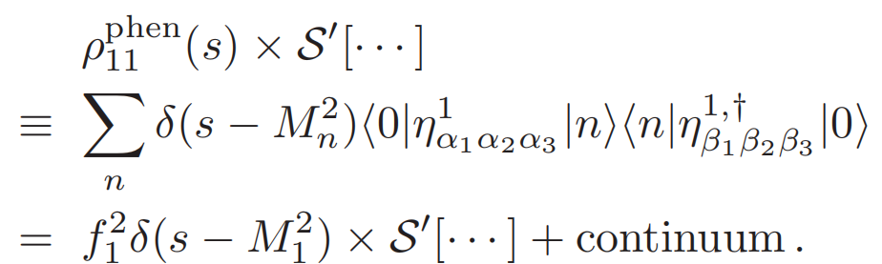
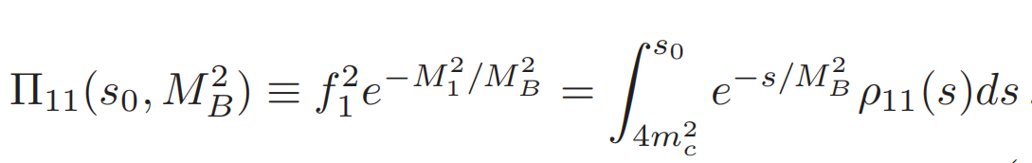
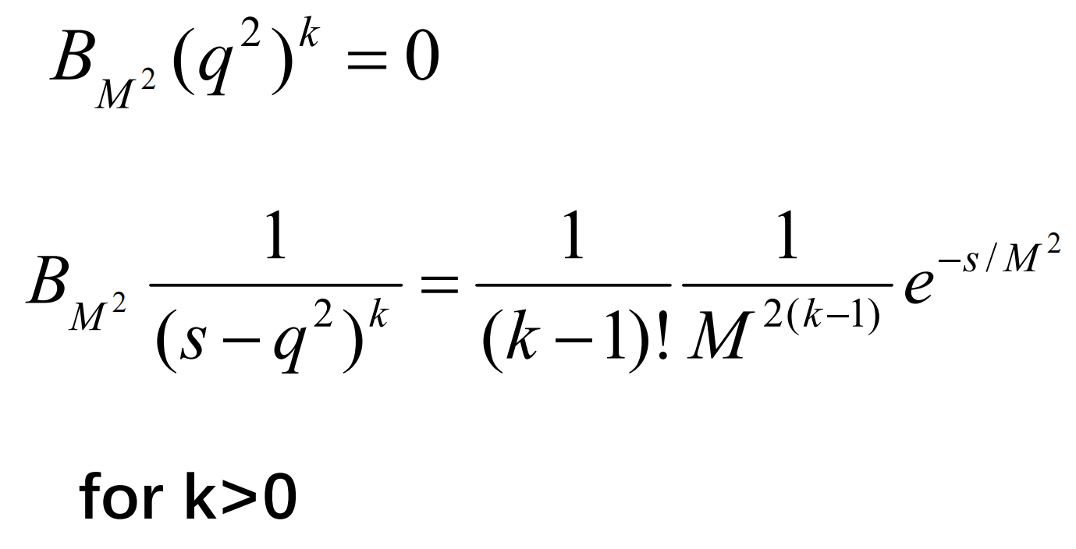
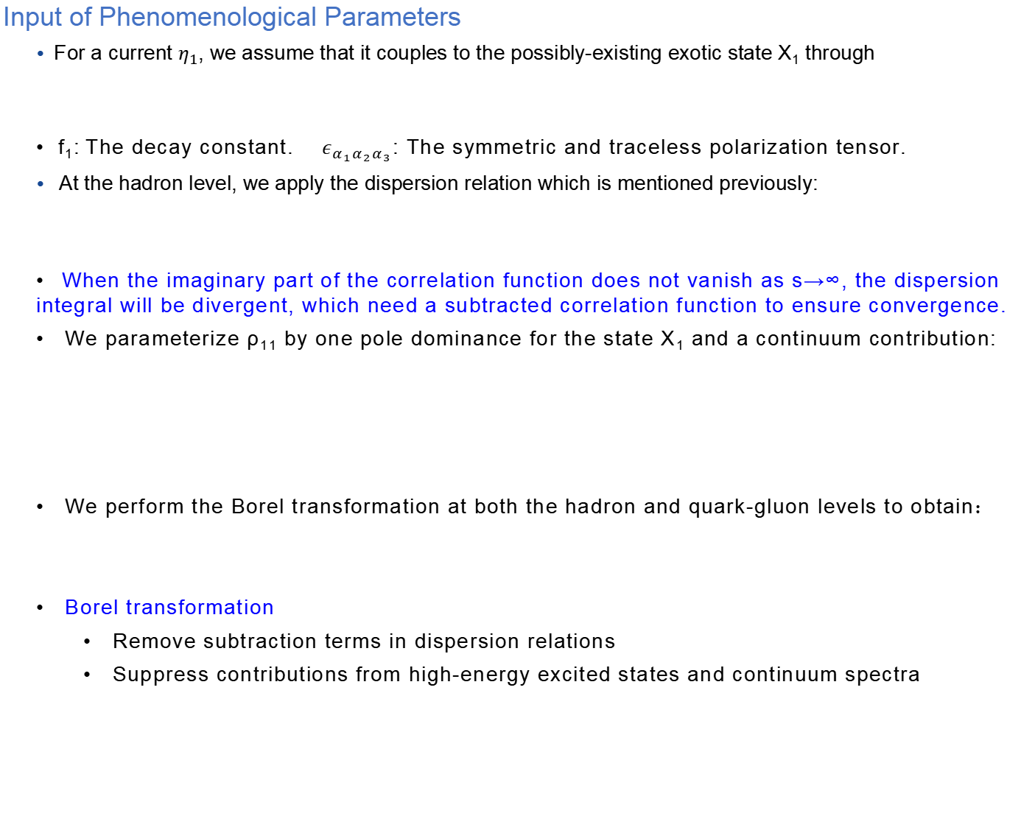
Input of Phenomenological Parameters
• For a current $η_{1}$, we assume that it couples to the possibly-existing exotic state X₁ through
f₁: The decay constant. $ε_{α_{1}α_{2}α_{3}}$: The symmetric and traceless polarization tensor.
• At the hadron level, we apply the dispersion relation which is mentioned previously:
When the imaginary part of the correlation function does not vanish as s→∞, the dispersion integral will be divergent, which need a subtracted correlation function to ensure convergence.
We parameterize ρ₁₁ by one pole dominance for the state X₁ and a continuum contribution:
We perform the Borel transformation at both the hadron and quark-gluon levels to obtain：
Borel transformation
  Remove subtraction terms in dispersion relations
  Suppress contributions from high-energy excited states and continuum spectra
Jul.14, 2025 | Hong-Zhou Xi (SEU) | Charmonium-like States with J^{PC}=3⁻⁺ through QCD Sum Rules | 9/19

Slide 10
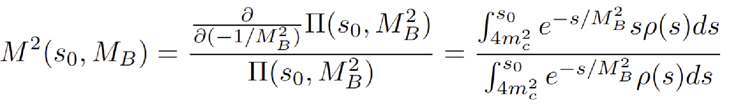
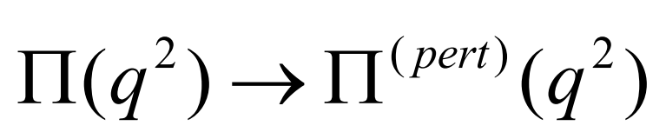
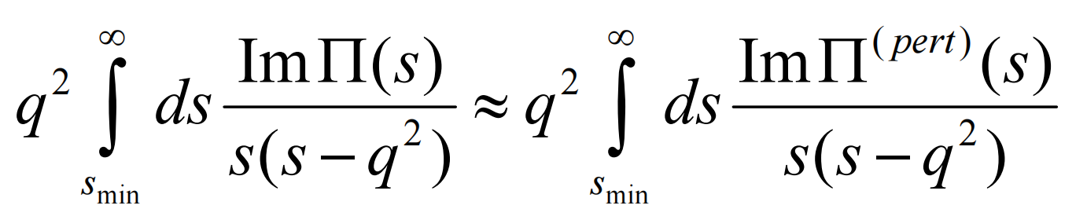
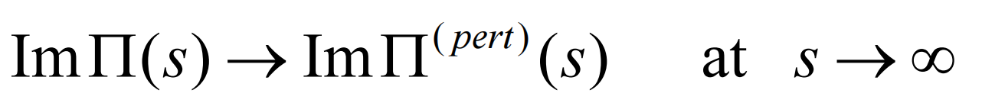
Input of Phenomenological Parameters
Quark-Hadron Duality
In the limit of q²→−∞, the correlation function is entirely dominated by perturbative contributions and the condensate contributions being negligible:
Threshold s₀
Borel mass M_{B}
Global Quark-Hadron Duality
Local Quark-Hadron Duality
Through this approximation, the spectral density contributions in correlation function can be subtracted by replacing the hadronic description with the OPE.
Jul.14, 2025 | Hong-Zhou Xi (SEU) | Charmonium-like States with J^{PC}=3⁻⁺ through QCD Sum Rules | 10/19
Notes:
深度类空 高能标下OPE的微扰项主导，非微扰凝聚贡献随维度增加快速衰减，确保对偶性成立

Slide 11
1
Overview of Exotic Hadrons
2
Method: QCD Sum Rules
Outline
3
Numerical Analysis
4
Summary
Jul.14, 2025 | Hong-Zhou Xi (SEU) | Charmonium-like States with J^{PC}=3⁻⁺ through QCD Sum Rules | 11/19

Slide 12
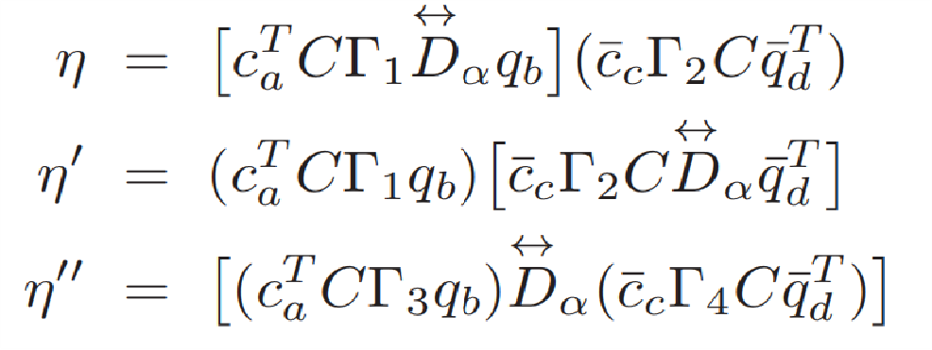


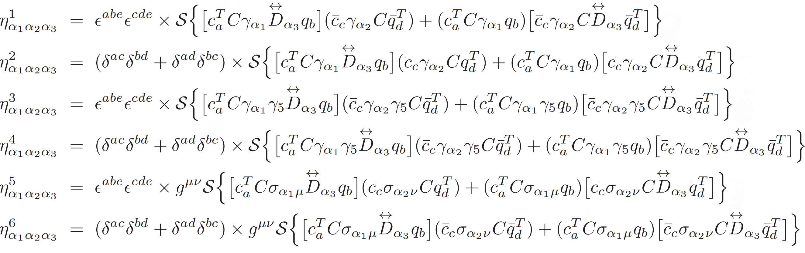
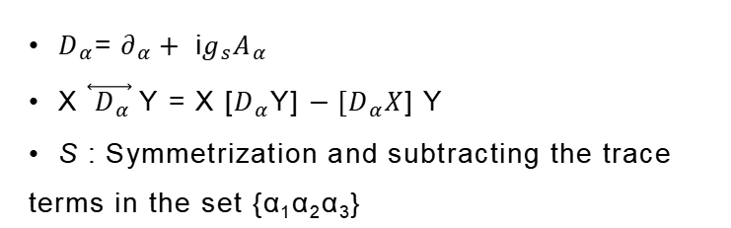
Interpolating currents (for diquark-antidiquark currents)
$D_{α}$=${ ∂}_{α}+$i$g_{s}A_{α}$
X $\overset{⃡}{{ D}_{α}}$Y = X [$D_{α}$Y] $−{[D}_{α}X$] Y
S : Symmetrization and subtracting the trace terms in the set {α₁α₂α₃}
Locality of the covariant derivative
Constraints on color structure：color singlet
Local interaction
Jul.14, 2025 | Hong-Zhou Xi (SEU) | Charmonium-like States with J^{PC}=3⁻⁺ through QCD Sum Rules | 12/19
Notes:
协变导数仅描述夸克间由胶子场传递的局域强相互作用 避免破坏色单态结构或导致非物理的高维表示

Slide 13
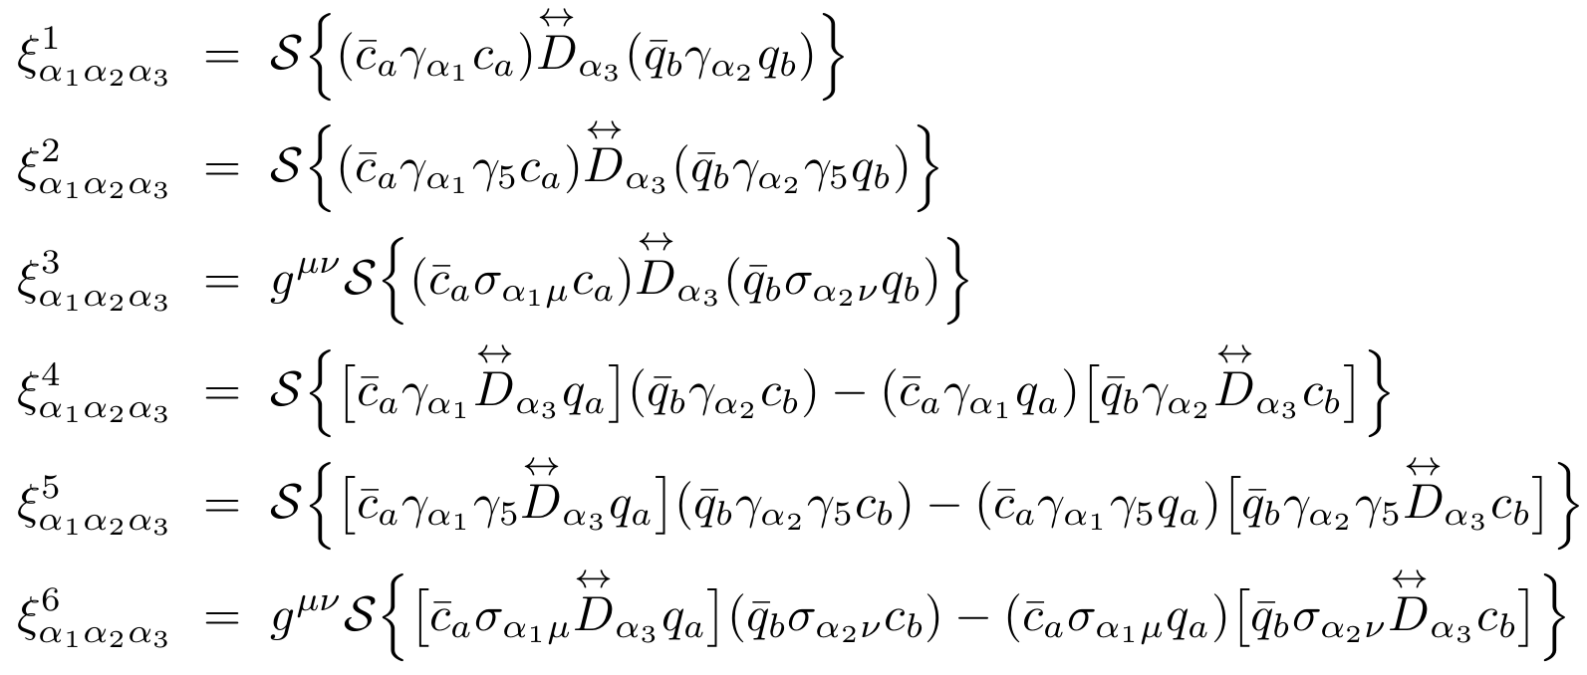
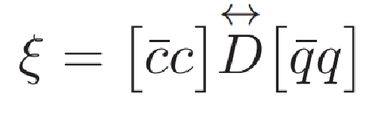
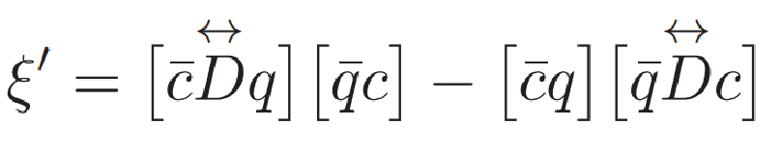
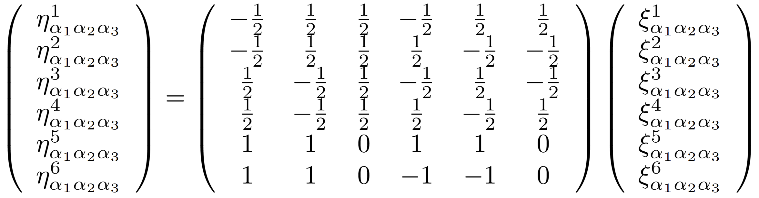
Interpolating currents (for meson-antimeson currents)
Fierz rearrangement
Jul.14, 2025 | Hong-Zhou Xi (SEU) | Charmonium-like States with J^{PC}=3⁻⁺ through QCD Sum Rules | 13/19
Notes:
可能导致色非单态、排斥势或非物理的对称性破坏 D to describe non-local Long-range interactions

Slide 14
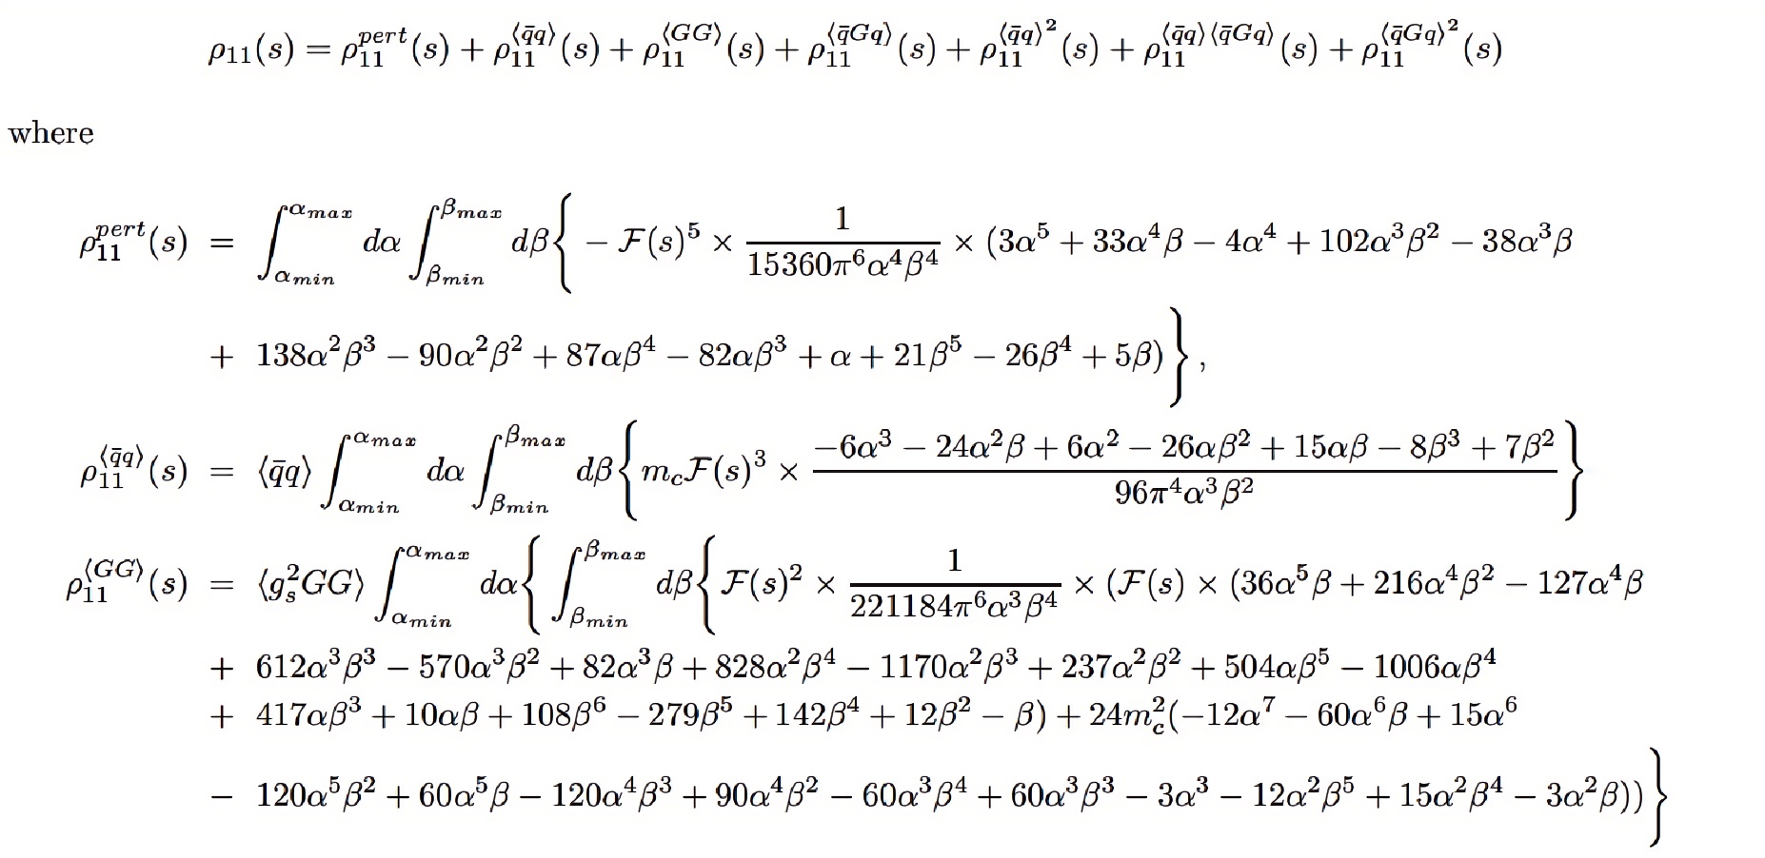
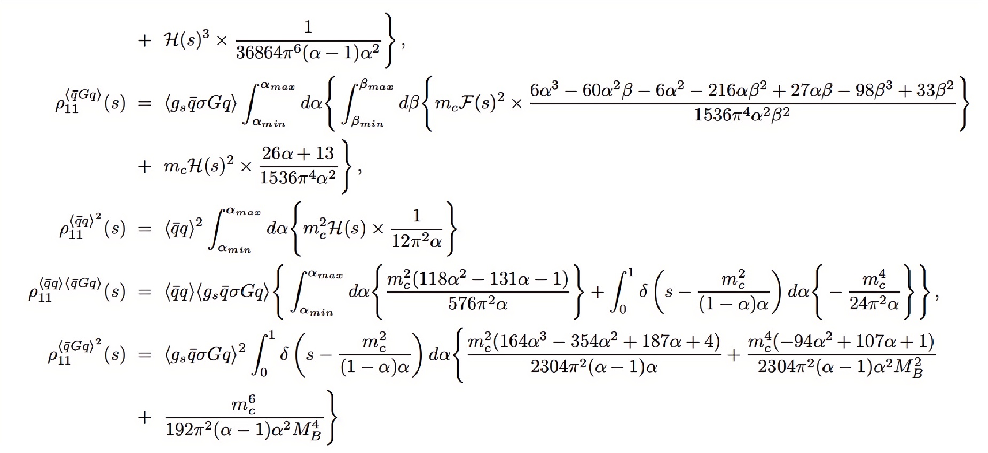
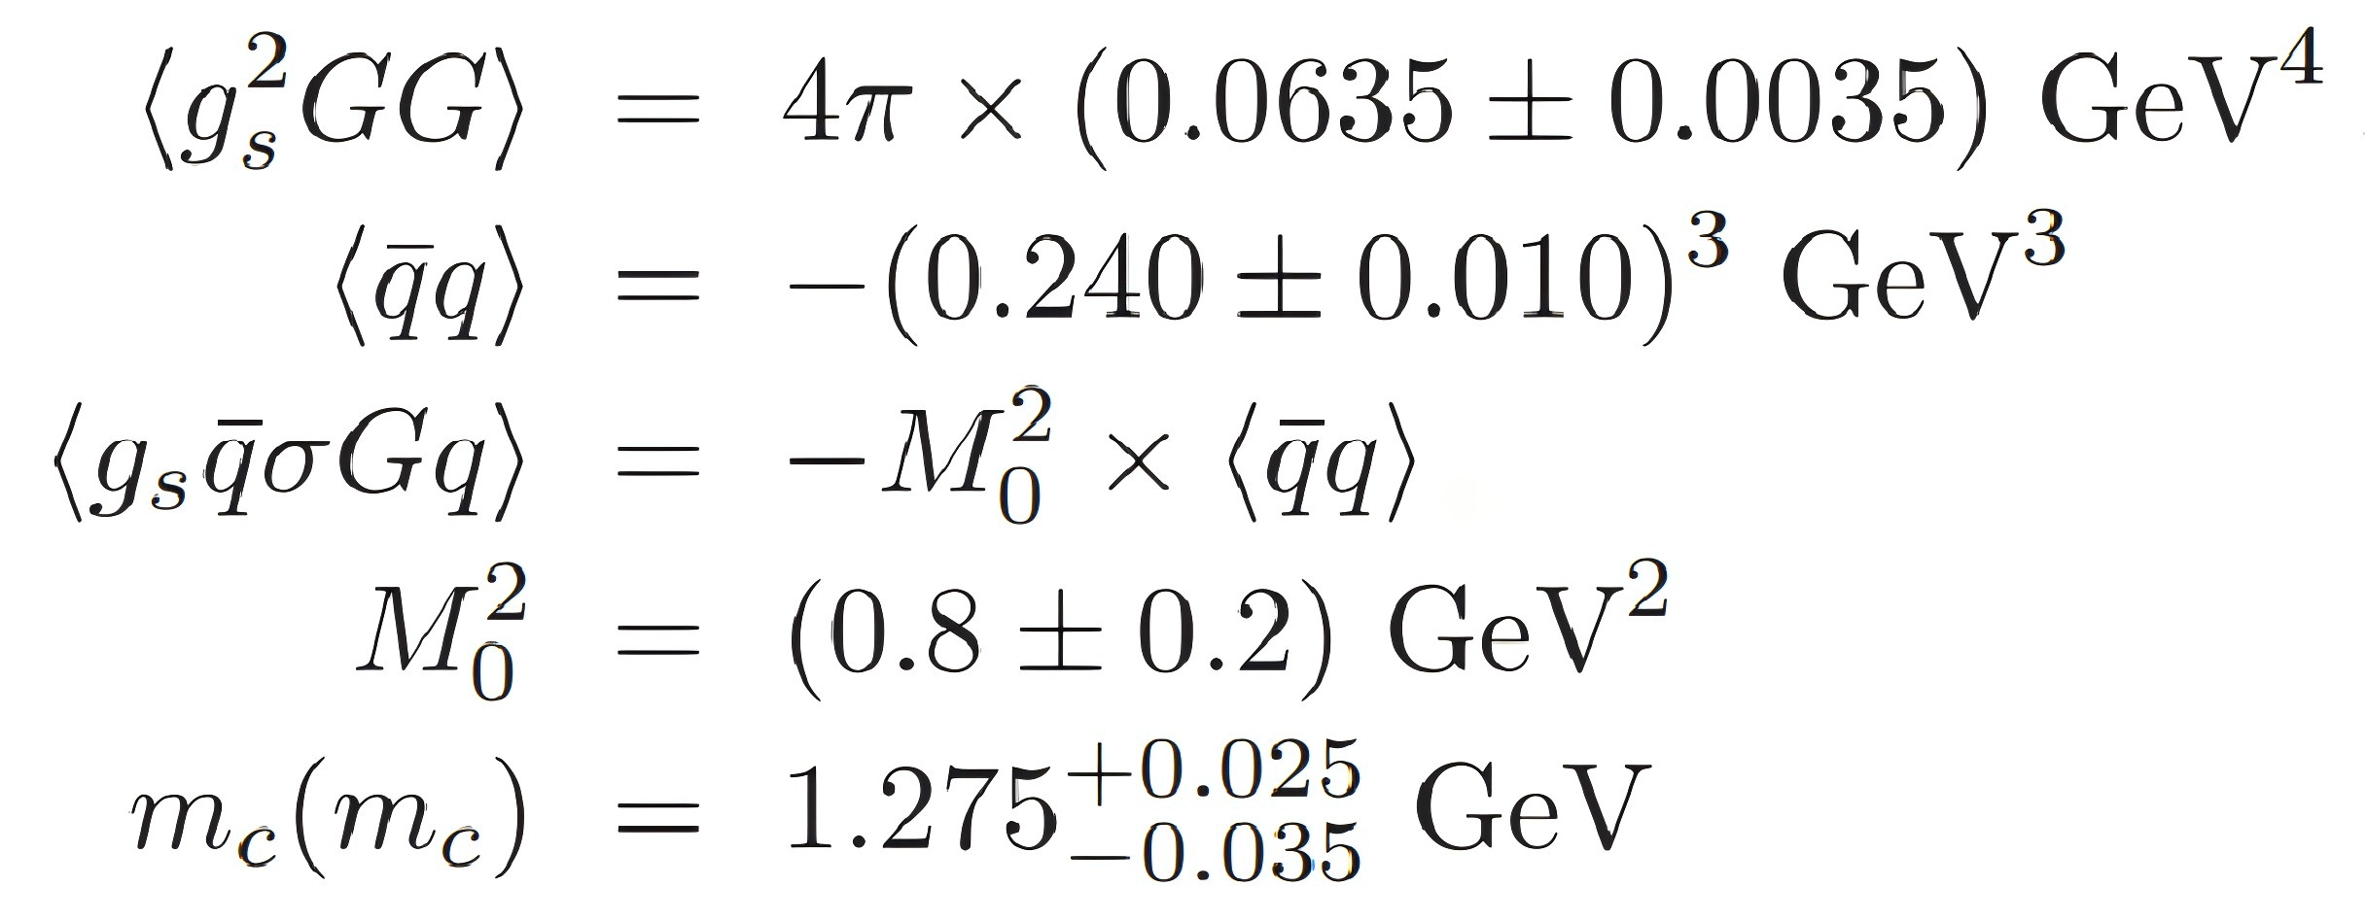
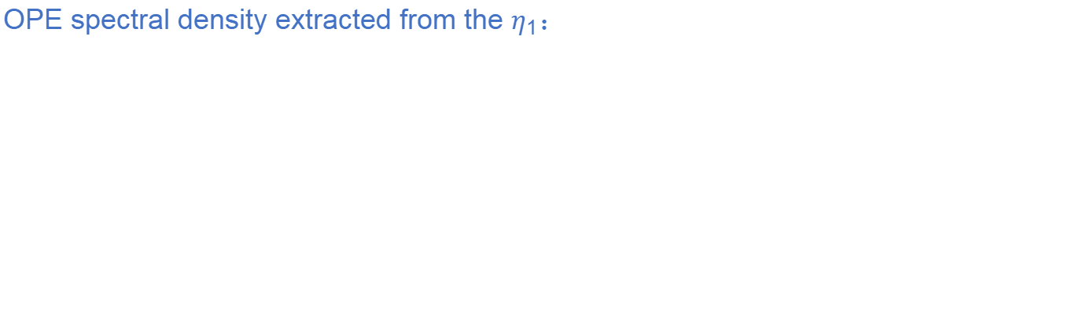
OPE spectral density extracted from the $η_{1}$：
The leading-order QCD spectral density ρ(s) includes contributions up to dimension-10 in the OPE.
The values of various QCD sum rule parameters are listed here :
Jul.14, 2025 | Hong-Zhou Xi (SEU) | Charmonium-like States with J^{PC}=3⁻⁺ through QCD Sum Rules | 14/19

Slide 15
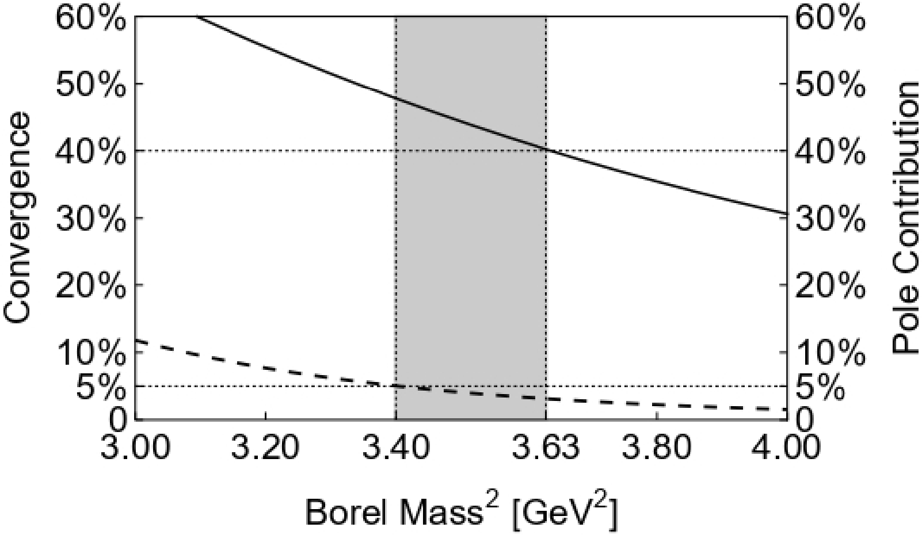
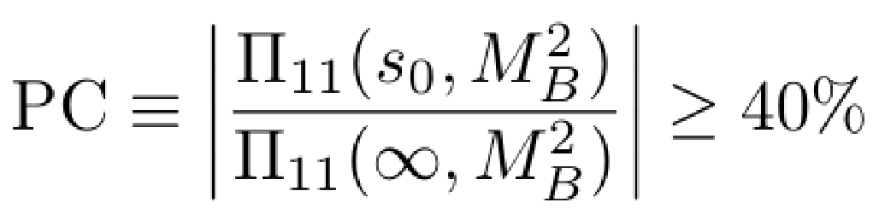
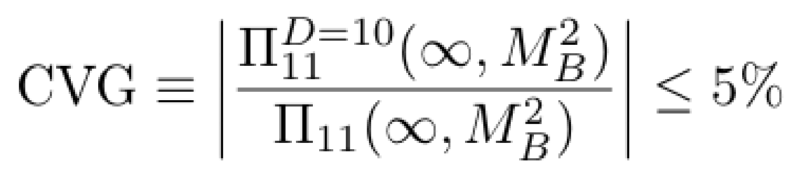
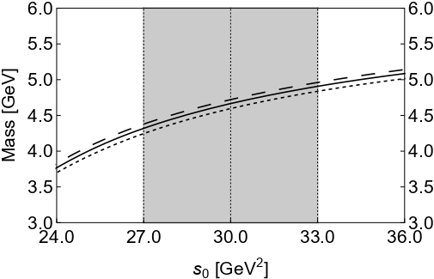
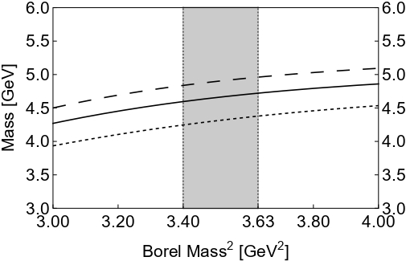
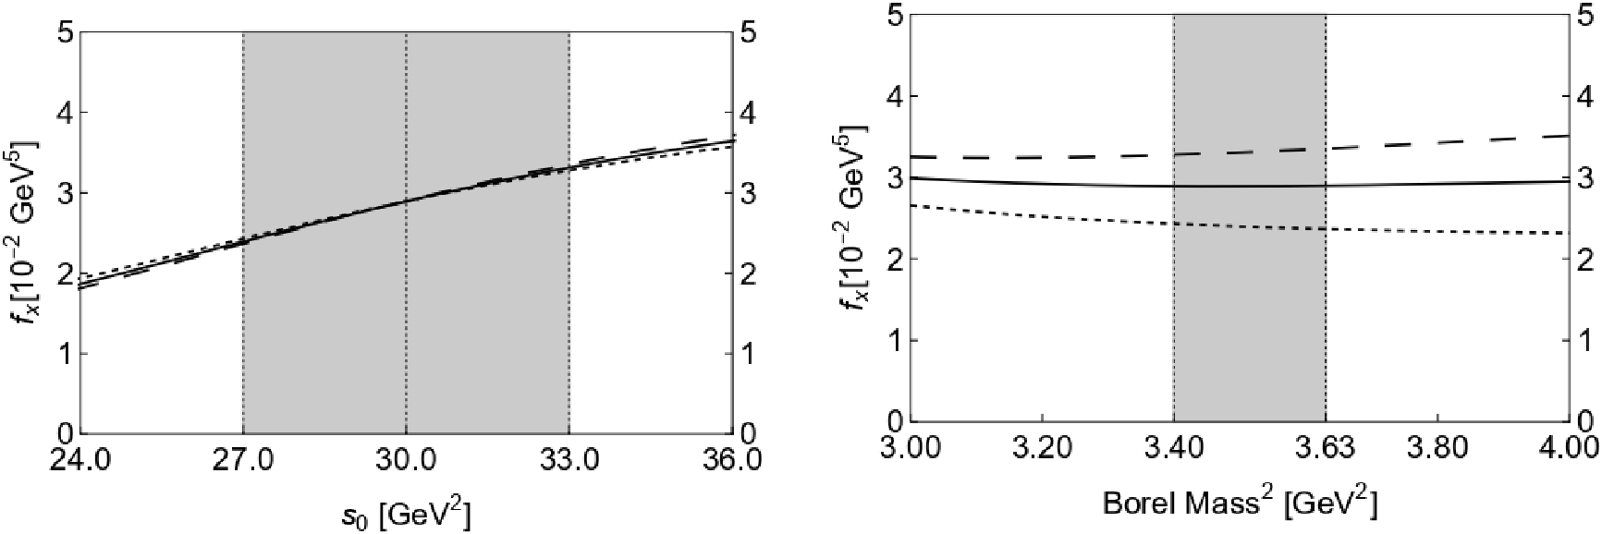
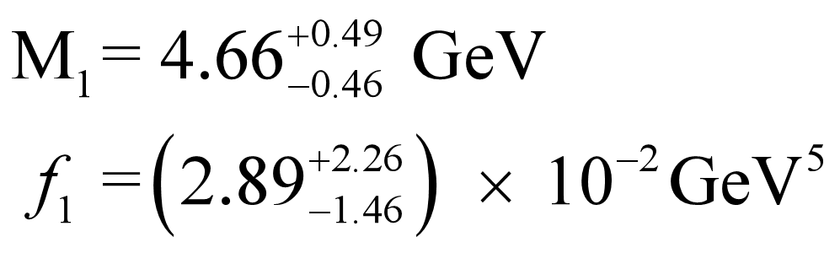
Search for the Borel window
Pole Dominance
OPE Convergence
The Borel window to be 3.40 GeV² ≤ $M_{B}^{2}$ ≤ 3.63 GeV² when setting s₀ = 30.0 GeV².
Parameter Dependence
Non-vanishing Borel windows as long as s₀ ≥ 28.4 GeV² .
We choose the threshold value to be 27.0 GeV² ~ 33.0 GeV² .
In this working regions, we obtain :
Jul.14, 2025 | Hong-Zhou Xi (SEU) | Charmonium-like States with J^{PC}=3⁻⁺ through QCD Sum Rules | 15/19

Slide 16








Decay Channels
ass
ass
ass
ass
ass
ass
ass
ass
ass
Covariant derivative between two quark pairs:
This induces an orbital angular momentum excitation while quark pairs remain in the ground state.
Covariant derivative within a single quark pair:
One quark pair transitions to an excited state, while the other retains its ground state.
Jul.14, 2025 | Hong-Zhou Xi (SEU) | Charmonium-like States with J^{PC}=3⁻⁺ through QCD Sum Rules | 16/19

Slide 17
1
Overview of Exotic Hadrons
2
Method: QCD Sum Rules
Outline
3
Numerical Analysis
4
Summary
Jul.14, 2025 | Hong-Zhou Xi (SEU) | Charmonium-like States with J^{PC}=3⁻⁺ through QCD Sum Rules | 17/19

Slide 18


Results obtained from the diquark-antidiquark currents and its mixing currents
Anomalous mass regularity
Significant breaking of SU(3)_{F} symmetry ?
The lowest mass is very close to the threshold of $D^{∗}$ $\overline{D_{2}^{∗}}$ (≈ 4.47GeV) .
A weakly-bound molecular state ?
Jul.14, 2025 | Hong-Zhou Xi (SEU) | Charmonium-like States with J^{PC}=3⁻⁺ through QCD Sum Rules | 18/19
Notes:
由于反对称结构可能导致更紧密的结合导致质量降低，因此反对称135电流计算的质量应小

Slide 19

Summary
We investigate the charmonium-like states with J^{PC} =3⁻⁺ by QCD sum rules and find that the corresponding interpolating currents are composed of two quark fields, two antiquark fields, and one covariant derivative operator.
The mass of the lowest-lying state is around 4.49 GeV, which closely matches the results previously obtained by OBE.
The potential decay channels include P-wave [ρ J/ψ]/[ω J/ψ] modes and S-wave $D^{∗}$ $\overline{D_{2}^{∗}}$mode.
We hope such states will be observed in future experiments at BESIII, Belle II, LHCb, etc.
Thanks for your attention!
Jul.14, 2025 | Hong-Zhou Xi (SEU) | Charmonium-like States with J^{PC}=3⁻⁺ through QCD Sum Rules | 19/19

