Slide 1

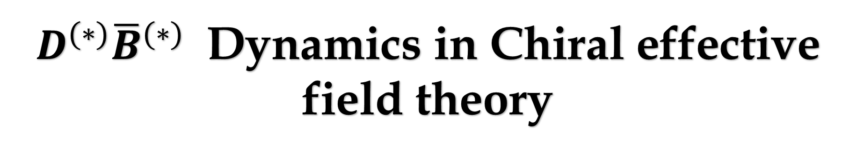
$D^{(∗)}{\overline{B}}^{(∗)}$ Dynamics in Chiral effective field theory
刘喆 兰州大学
arXiv：2503.10299
合作者: 许豪, 刘翔
.
桂林
第八届强子谱和强子结构研讨会
2025年7月11日-15日

Slide 2
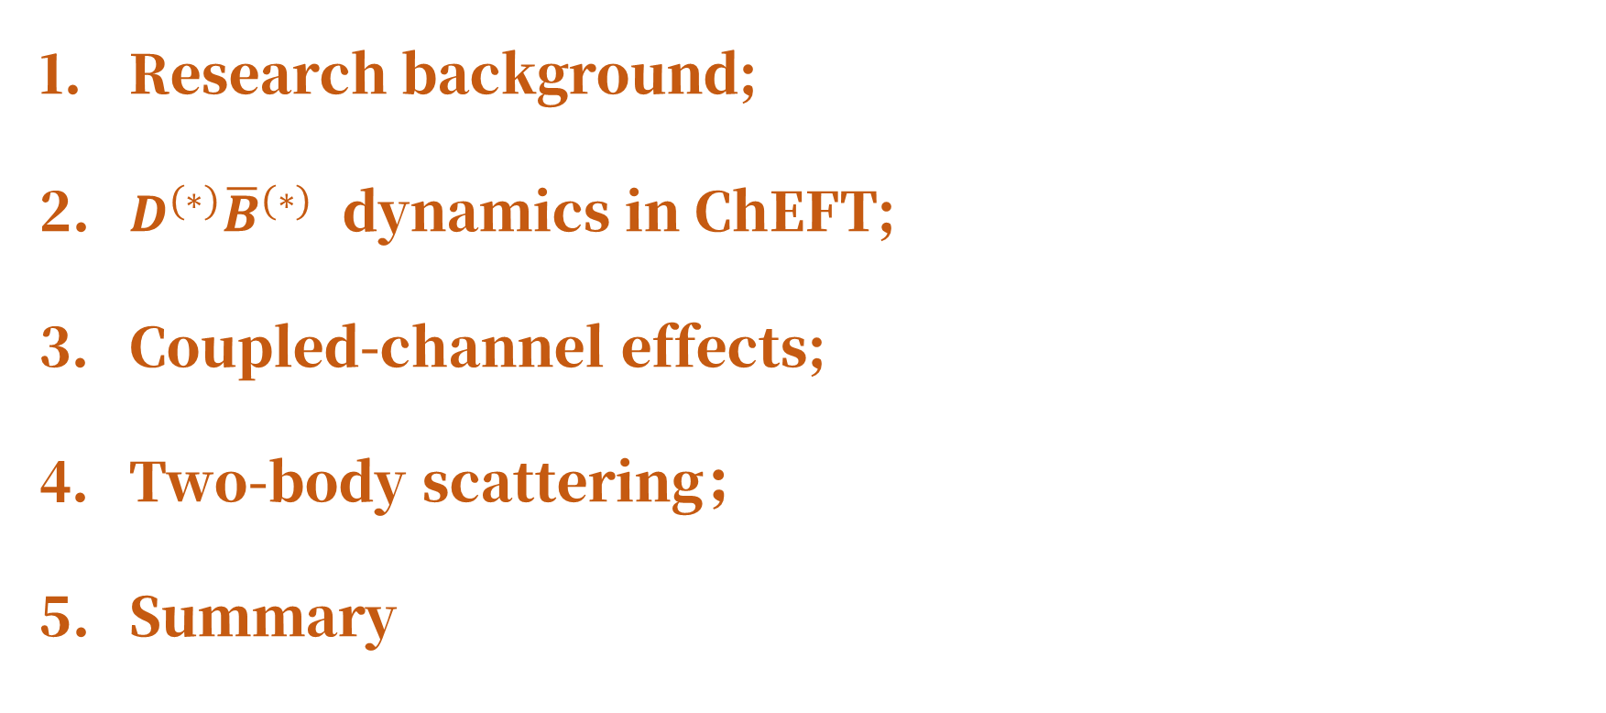
Outline
Research background;
$D^{(∗)}{\overline{B}}^{(∗)}$ dynamics in ChEFT;
Coupled-channel effects;
Two-body scattering；
Summary

Slide 3
1. Research background

Slide 4
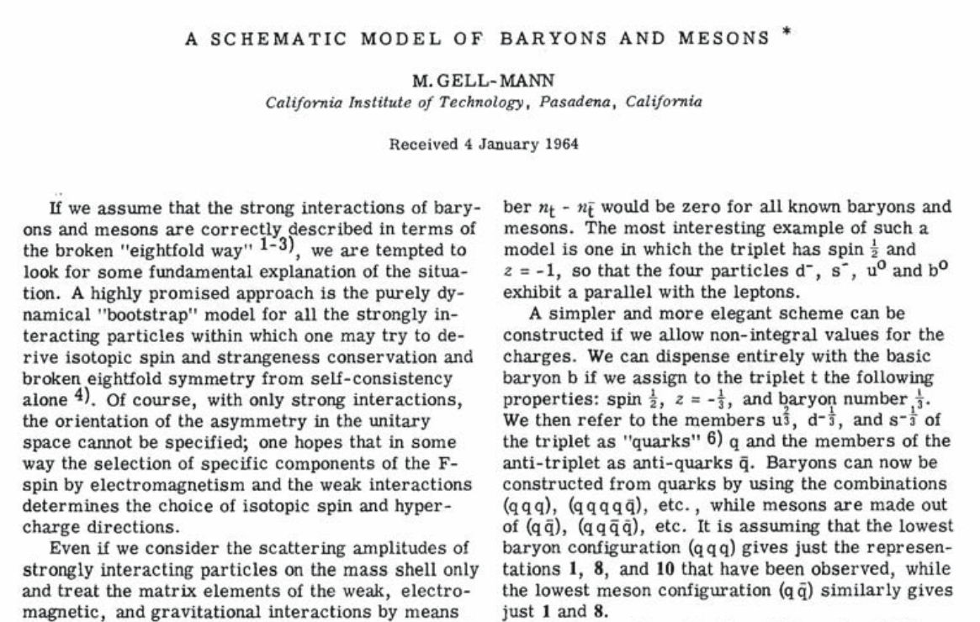
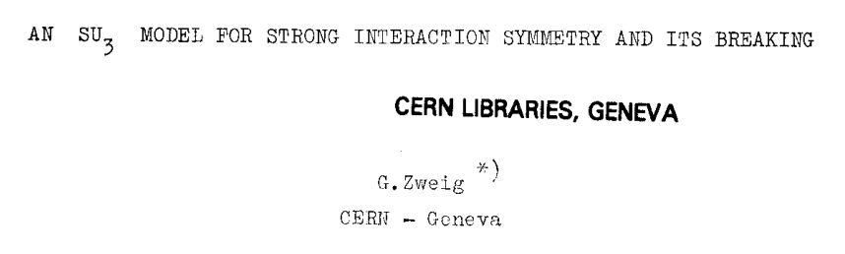
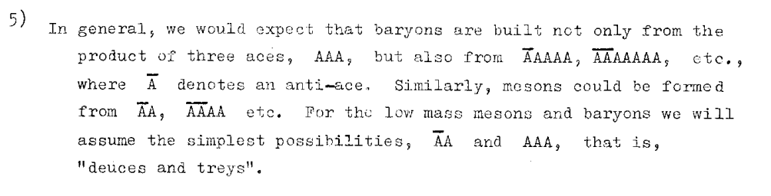

Slide 5
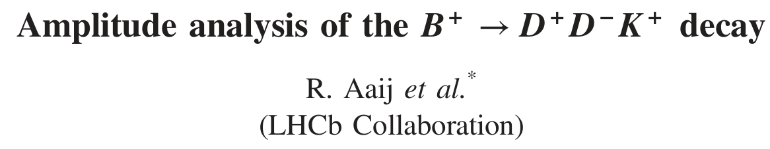
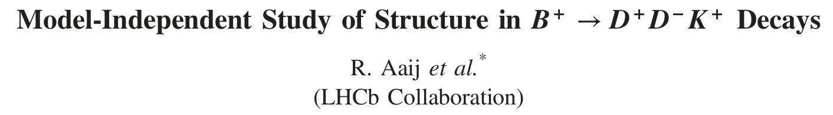
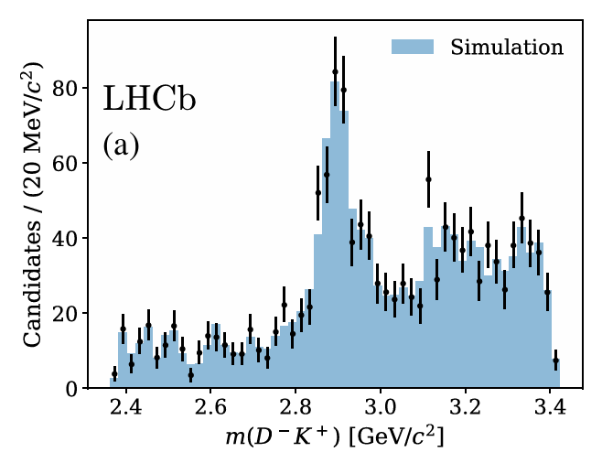
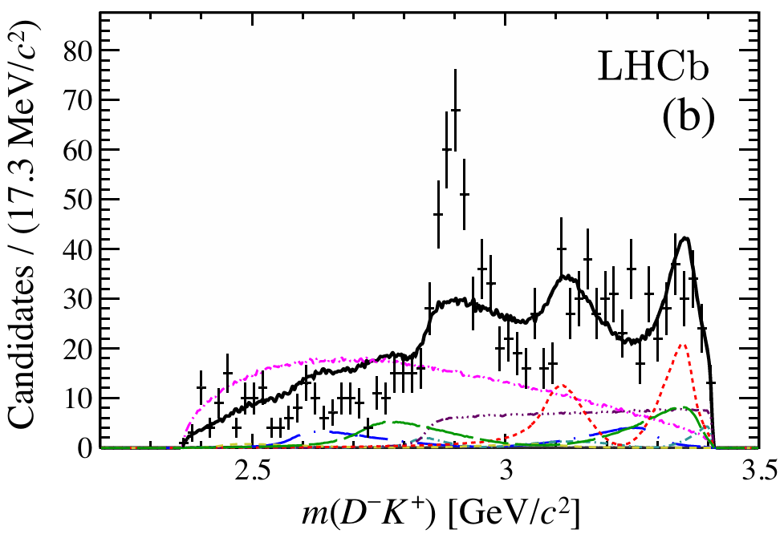
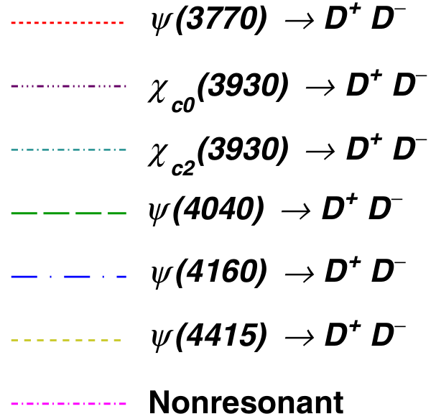
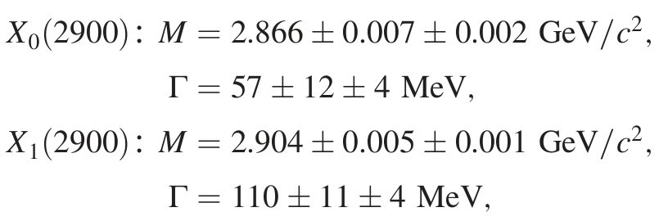
Phys. Rev. D 102, 112003(2020)
Phys. Rev. Lett 125, 242001 (2020)

Slide 6
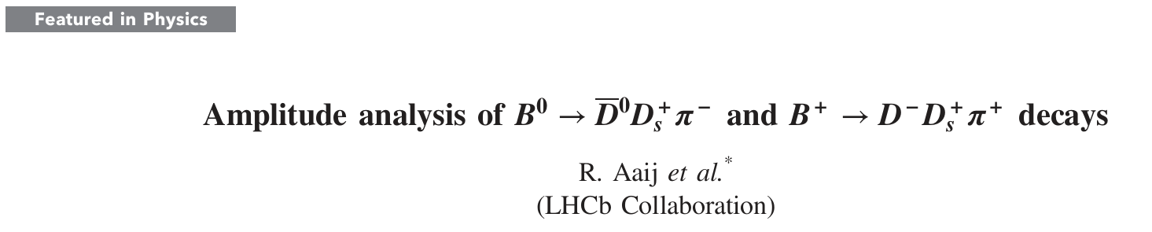

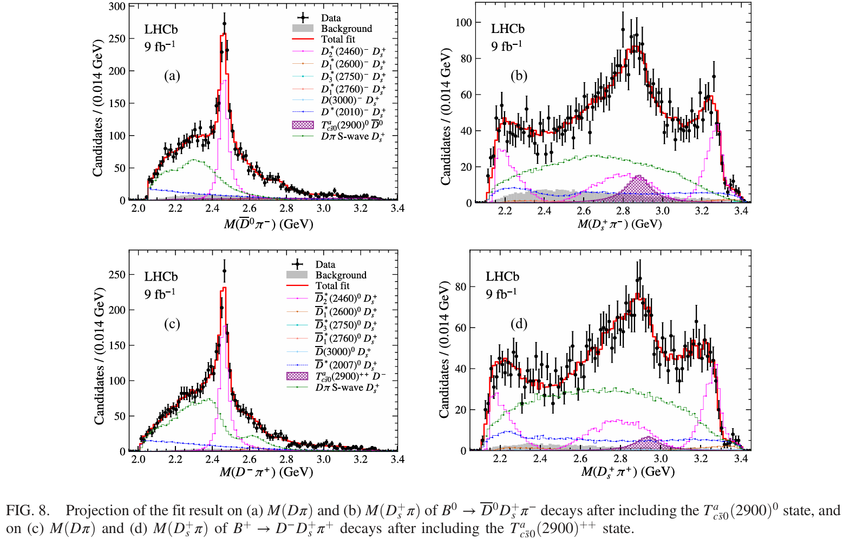
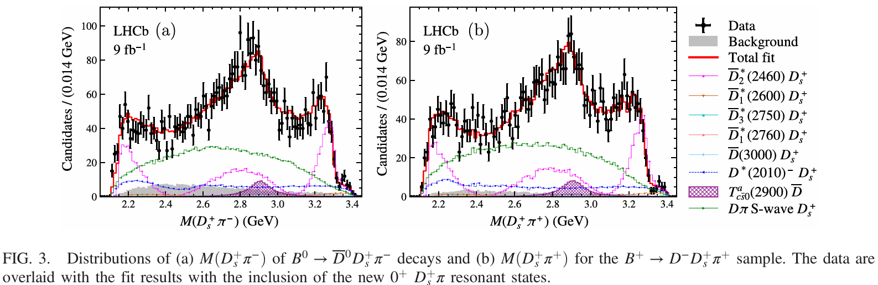
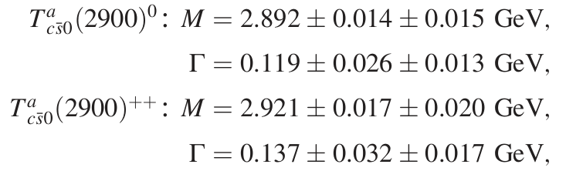
Phys. Rev. D 108, 012017 (2023)
Phys. Rev. Lett 131, 041902 (2023)

Slide 7

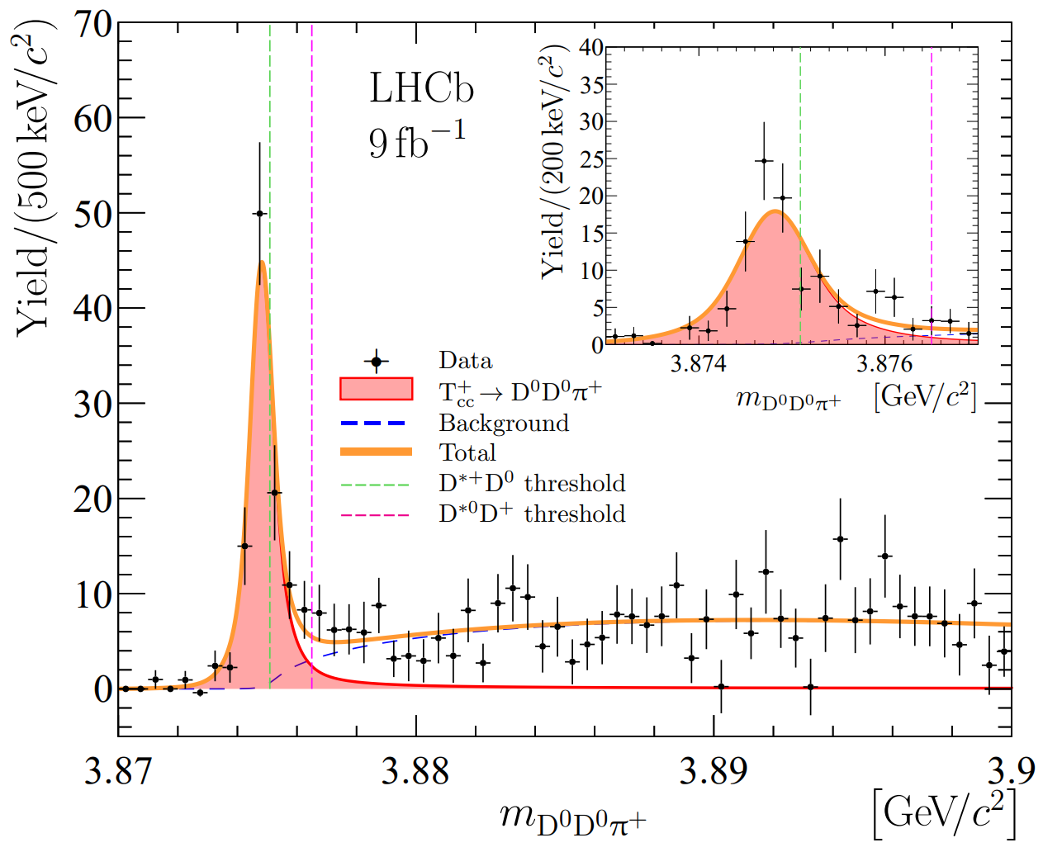
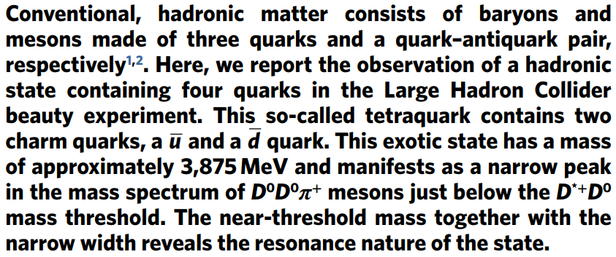
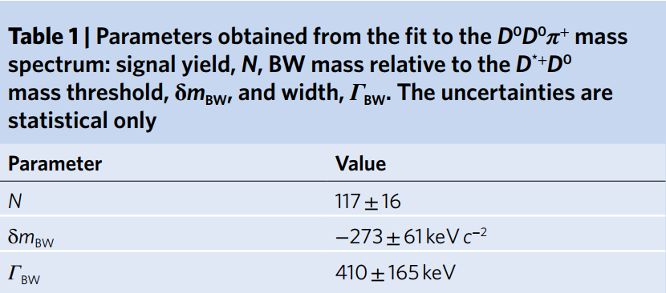
Nature Phys. 18 (2022) 7, 751-754.

Slide 8
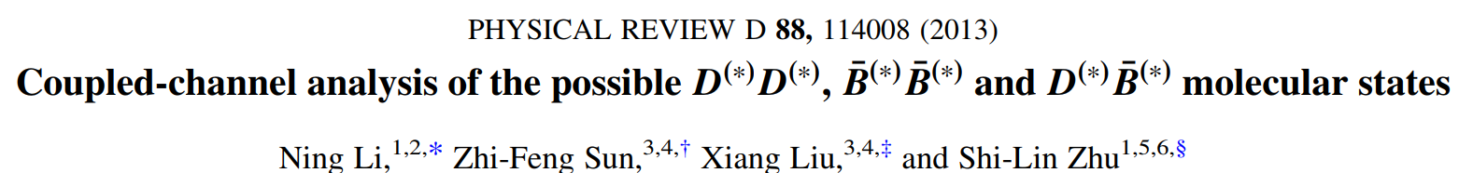
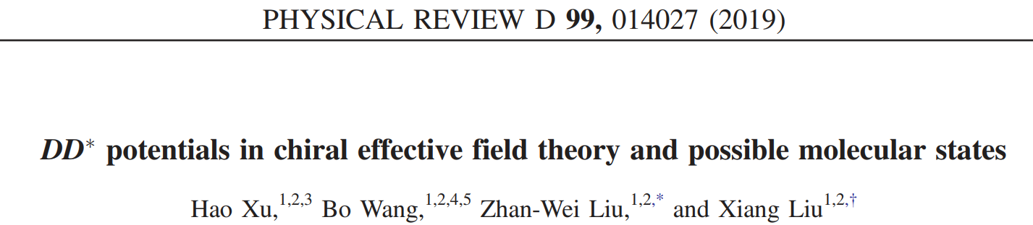
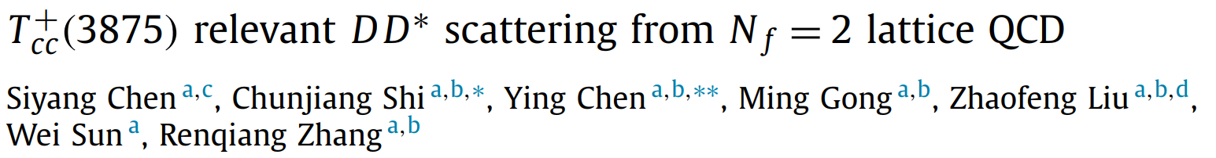
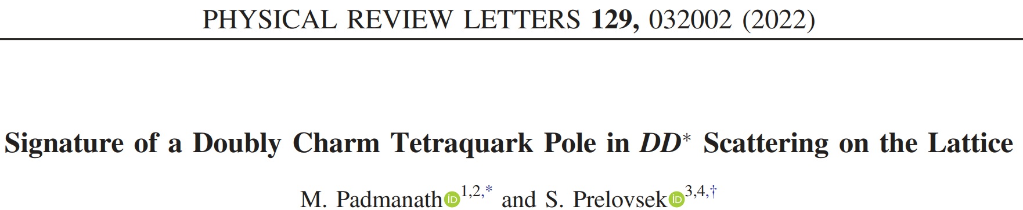
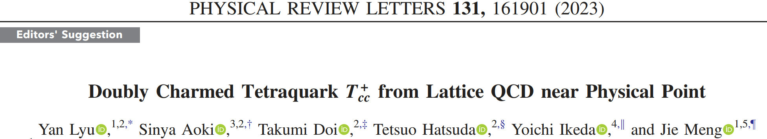
Physics Letters B 833, 137391 (2022)

Slide 9
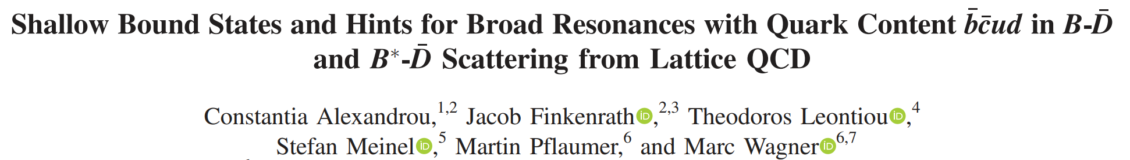
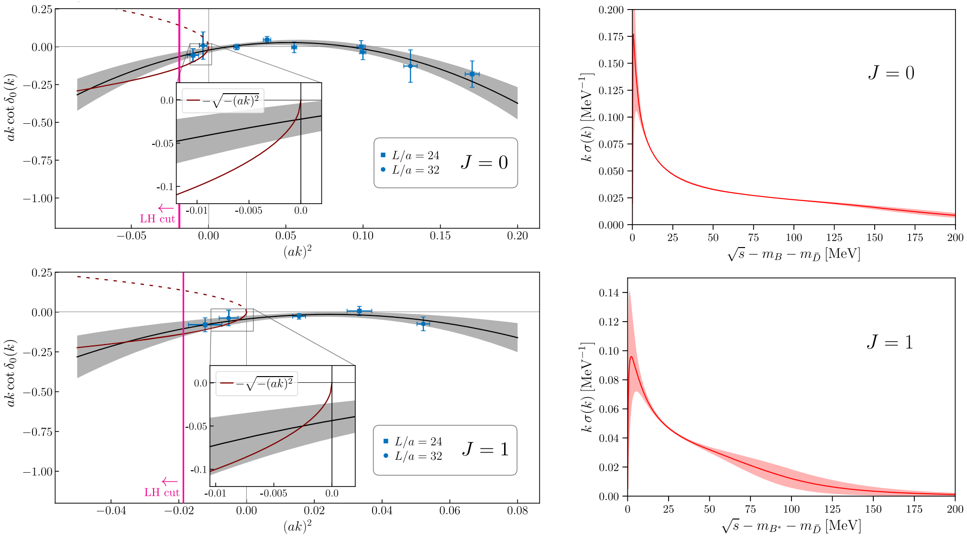
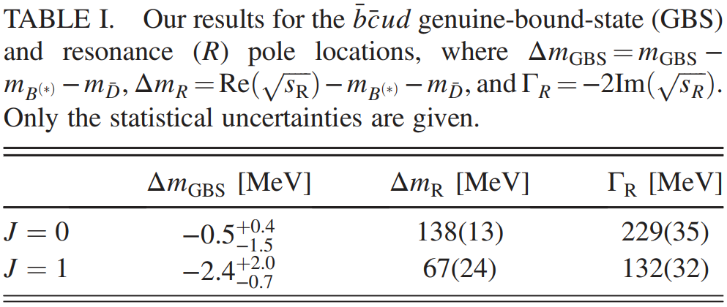


Phys. Rev. Lett 132, 151902 (2024)
pion mass of approximately $220 MeV$
Scattering rate represents the probability per unit time for a scattering event.

Slide 10

2. $D^{(∗)}{\overline{B}}^{(∗)}$ interactions with ChEFT

Slide 11
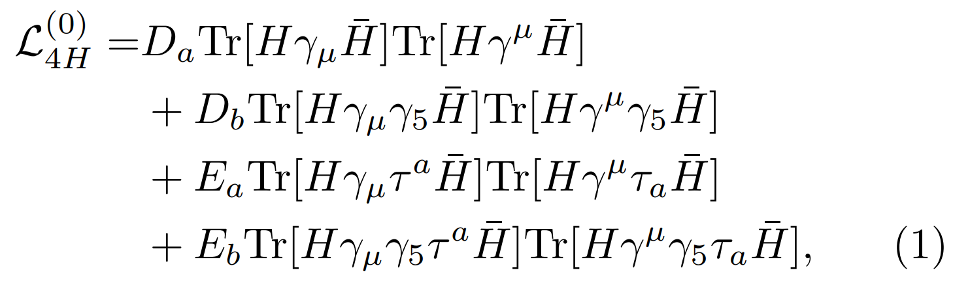
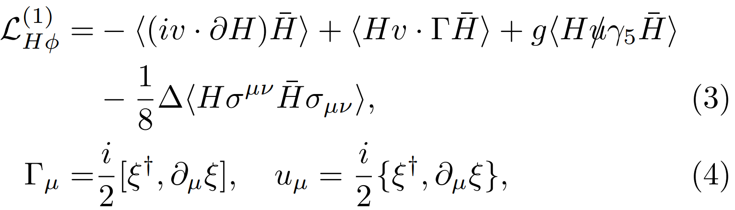
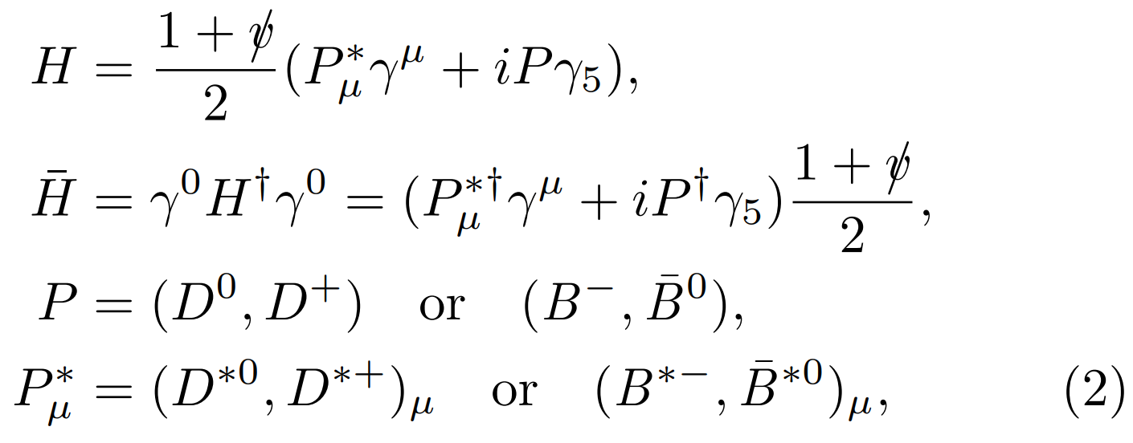
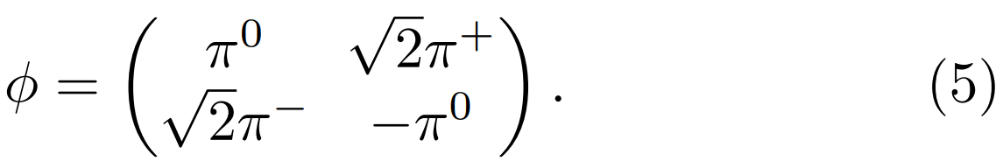
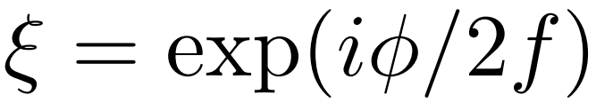
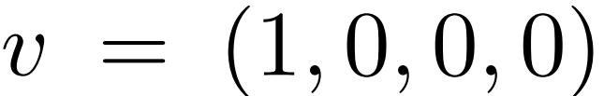


Effective Lagrangians
The leading-order contact interaction:
The Lagrangian for the LO $HHφ$ vertex:
chiral connection
axial vector current
The $H$ field in the heavy hadron formalism:
The pion field:
bare pion decay constant
is the four-velocity of the heavy mesons.

Slide 12
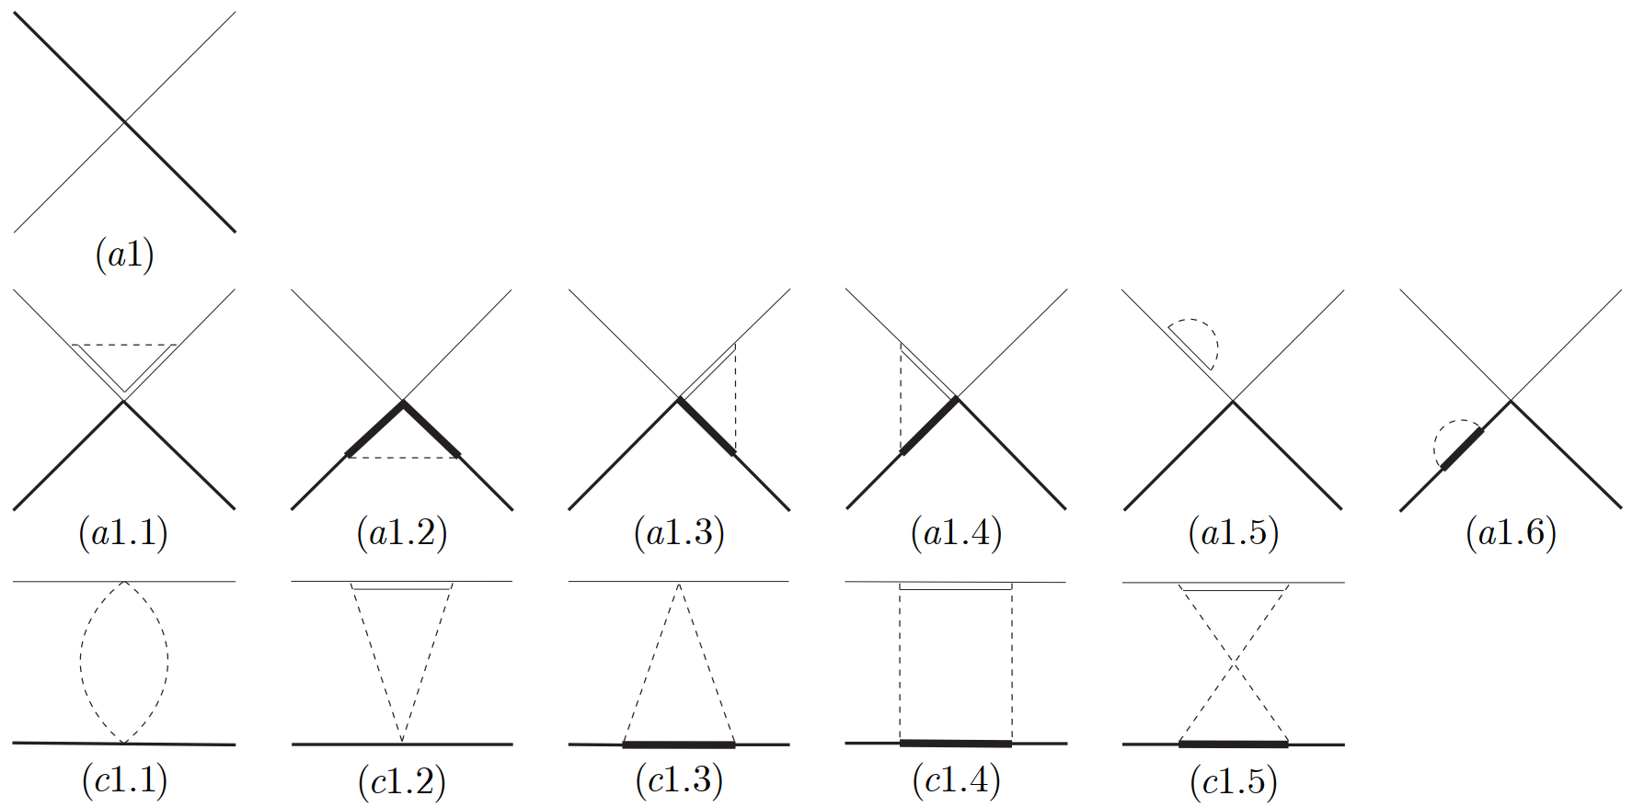
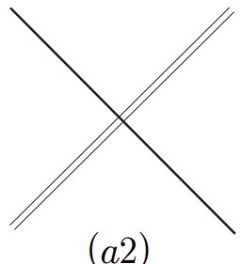
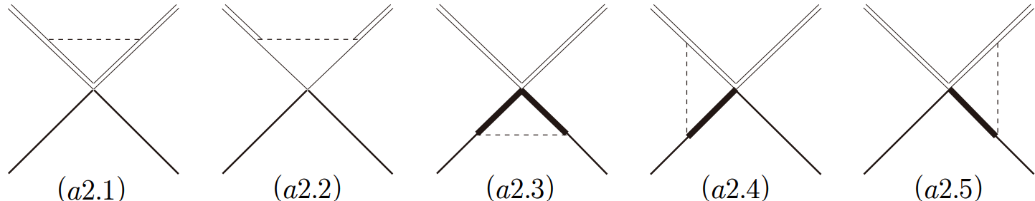
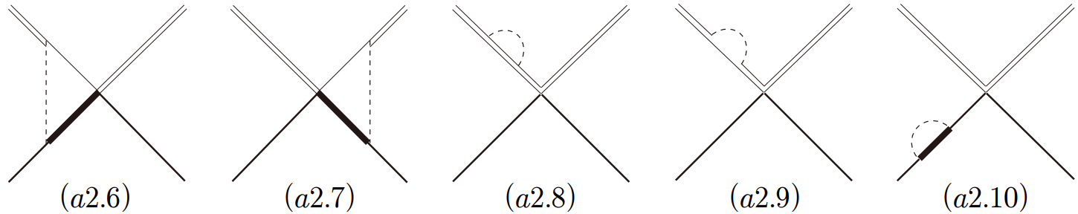
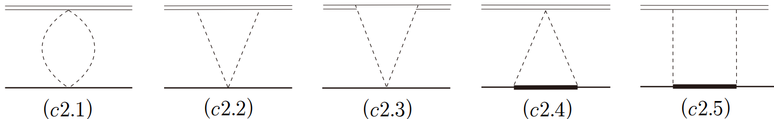
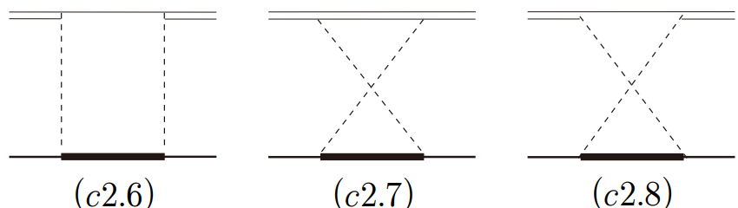

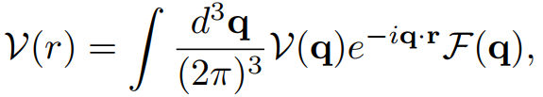



$\text{diagrams} \text{of} \text{the} \text{process} D\overline{B}−D\overline{B}$
$$\text{diagrams} \text{of} \text{the} \text{process} D{\overline{B}}^{∗}−D{\overline{B}}^{∗}$$
Breit approximation:
Fourier
transform
Gaussian regulator

Slide 13
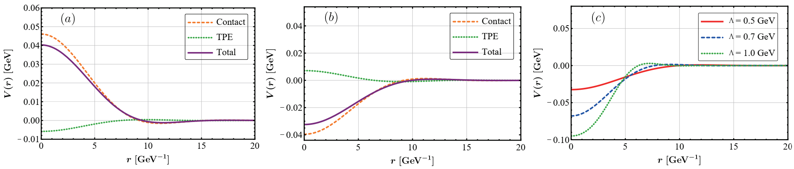
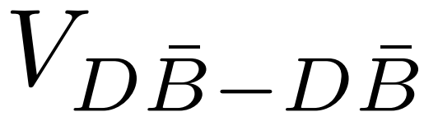
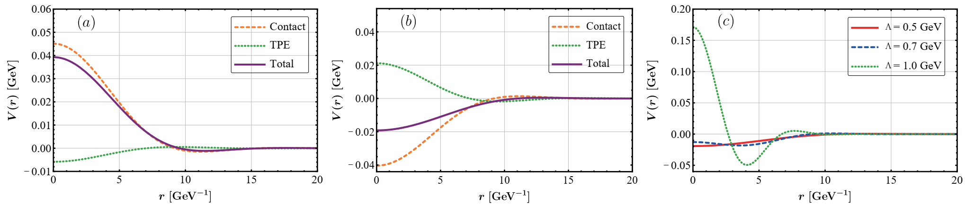







Effective potentials
$$I\left(J^{P}\right)=1\left(0^{+}\right)$$
$$I\left(J^{P}\right)=0\left(0^{+}\right)$$
$$I\left(J^{P}\right)=0\left(0^{+}\right)$$
$$I\left(J^{P}\right)=1\left(1^{+}\right)$$
$$I\left(J^{P}\right)=0\left(1^{+}\right)$$
$$I\left(J^{P}\right)=0\left(1^{+}\right)$$

Slide 14
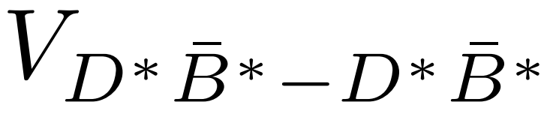
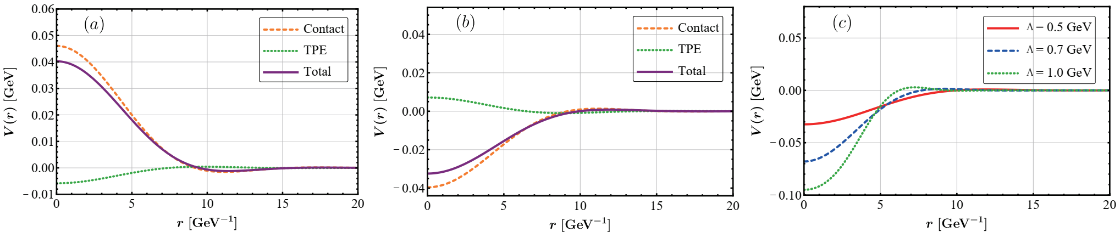
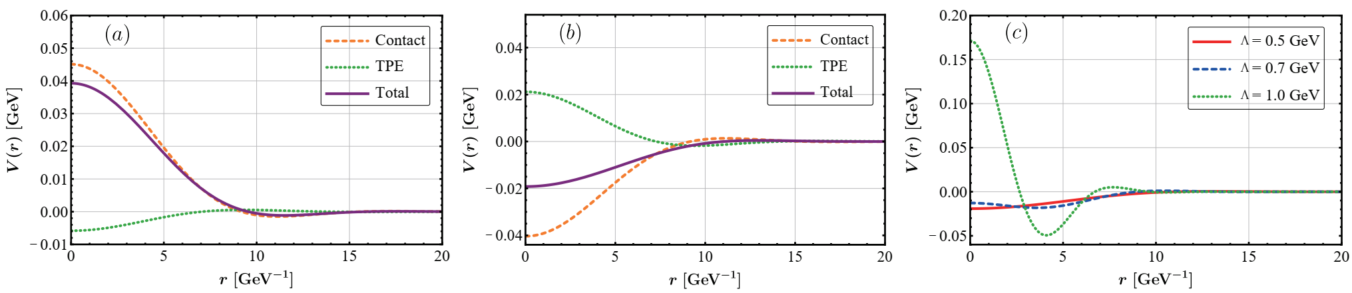
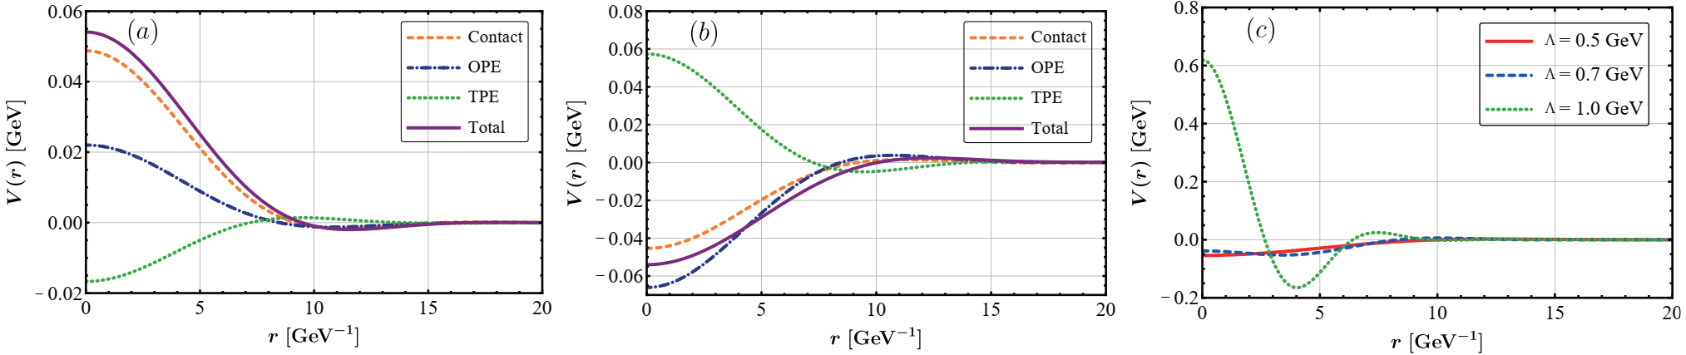





Effective potentials
$$J^{P}=0^{+}$$
$$J^{P}=1^{+}$$
$$J^{P}=2^{+}$$
$$I=1$$
$$I=0$$

Slide 15
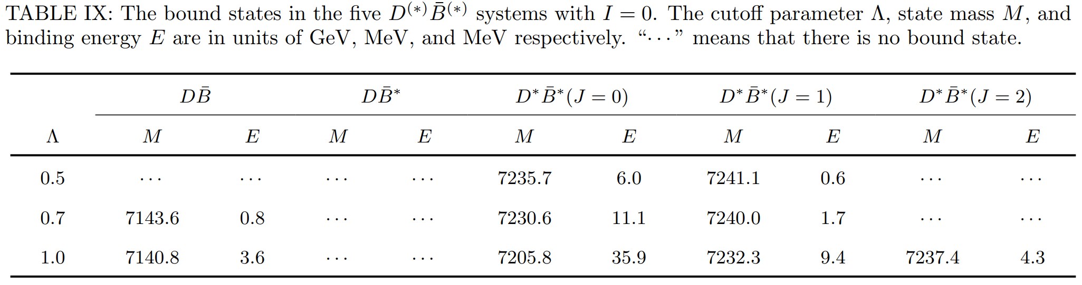
The bound states for $D^{\left(∗\right)}{\overline{B}}^{\left(∗\right)}(I=0)$ systems

Slide 16
3. Coupled-channel effects

Slide 17
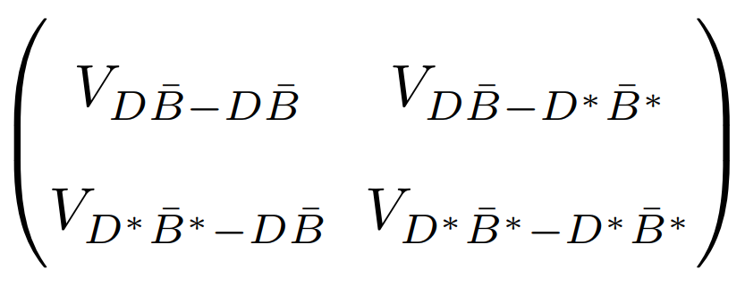
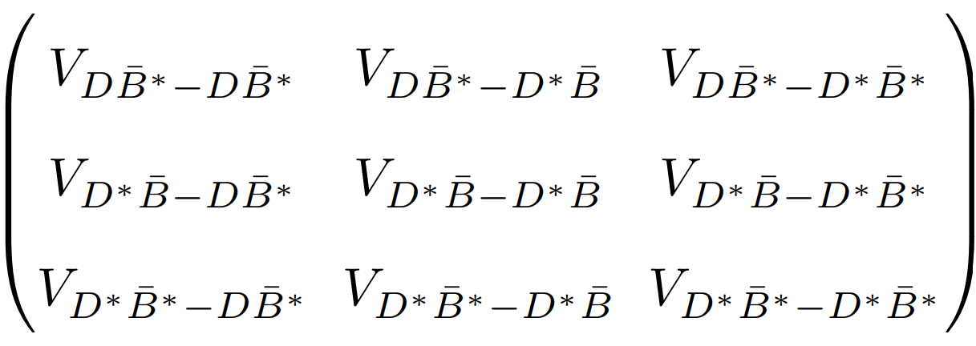
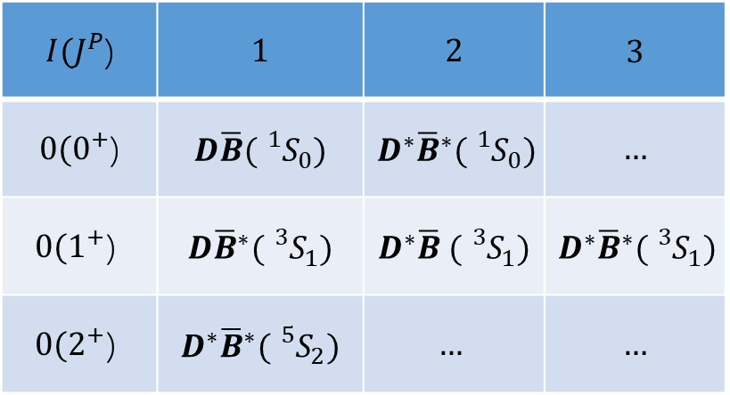


The different channels for $D^{\left(∗\right)}{\overline{B}}^{\left(∗\right)}(I=0)$ systems
For $D^{\left(∗\right)}{\overline{B}}^{\left(∗\right)}[0(0^{+}$)] system, we have
$I(J^{P}$) | $$1$$ | $$2$$ | $$3$$
$0(0^{+}$) | $$D\overline{B}({}_{}^{1}{S_{0}})$$ | $$D^{∗}{\overline{B}}^{∗}({}_{}^{1}{S_{0}})$$ | $$…$$
$$0(1^{+}\text{)}$$ | $$D{\overline{B}}^{∗}({}_{}^{3}{S_{1}})$$ | $$D^{∗}\overline{B} ({}_{}^{3}{S_{1}})$$ | $$D^{∗}{\overline{B}}^{∗}({}_{}^{3}{S_{1}})$$
$$0(2^{+}\text{)}$$ | $$D^{∗}{\overline{B}}^{∗}({}_{}^{5}{S_{2}})$$ | $$…$$ | $$…$$
For $D^{\left(∗\right)}{\overline{B}}^{\left(∗\right)}[0(1^{+}$)] system, we have

Slide 18


$D\overline{B}−D^{∗}{\overline{B}}^{∗}\left(J=0\right)$ system
$$B.E./MeV$$ | $$D\overline{B}$$ | $$D^{∗}{\overline{B}}^{∗}(J=0)$$
$$Λ=0.5 GeV$$ | $$−$$ | $$6.0$$
$$Λ=0.7 GeV$$ | $$0.8$$ | $$11.1$$
$$Λ=1.0 GeV$$ | $$3.6$$ | $$35.9$$
 | $$Λ=0.5 GeV$$ | $$Λ=0.7 GeV$$ | $$Λ=1.0 GeV$$
$$B.E./MeV$$ | $$−$$ | $$1.1$$ | $$7.3$$
$$P_{1}$$ | $$99.9\%$$ | $$99.7\%$$ | $$99.3\%$$
$$P_{2}$$ | $$0.1\%$$ | $$0.3\%$$ | $$0.9\%$$

Slide 19













The effective potentials
$$I\left(J^{P}\right)=1\left(1^{+}\right)$$
$$I\left(J^{P}\right)=0\left(1^{+}\right)$$
$$I\left(J^{P}\right)=0\left(1^{+}\right)$$

Slide 20


$D^{(∗)}{\overline{B}}^{(∗)}−D^{∗}{\overline{B}}^{∗}\left(J=1\right)$ system
$$B.E./MeV$$ | $${D\overline{B}}^{∗}$$ | $$D^{∗}\overline{B}$$ | $$D^{∗}{\overline{B}}^{∗}(J=1)$$
$$Λ=0.5 GeV$$ | $$−$$ | $$−$$ | $$0.6$$
$$Λ=0.7 GeV$$ | $$−$$ | $$−$$ | $$1.7$$
$$Λ=1.0 GeV$$ | $$−$$ | $$−$$ | $$9.4$$
 | $$Λ=0.5 GeV$$ | $$Λ=0.7 GeV$$ | $$Λ=1.0 GeV$$
$$B.E./MeV$$ | $$−$$ | $$−$$ | $$−$$
$$P_{1}$$ | $$99.9\%$$ | $$99.7\%$$ | $$99.5\%$$
$$P_{2}$$ | $$0.1\%$$ | $$0.3\%$$ | $$0.5\%$$
$$P_{3}$$ | $$0.0\%$$ | $$0.0\%$$ | $$0.0\%$$

Slide 21
4. Two-body scattering

Slide 22










Lippmann-Schwinger (L-S) equation
The partial-wave two-body scattering amplitudes:
and is the reduce mass.
The Green’s function:
The relation between the T matrix and the phase shift:
Considering the S-wave, in the low-energy limit, we have
scattering length
effective range
S-wave scattering cross section

Slide 23




Two-body scattering

Slide 24

Two-body scattering

Slide 25

Summary
We investigate the $D^{(∗)}{\overline{B}}^{(∗)}$ interactions in ChEFT in heavy hadron formalism and find possible bound states.
We calculate the coupled-channel effects in $D^{\left(∗\right)}{\overline{B}}^{\left(∗\right)}$ systems.
We obtain the scattering rates, scattering lengths and effective ranges of the two-body scattering processes by solving L-S equation.
Finally, we strongly recommend the experiment to find the $D^{\left(∗\right)}{\overline{B}}^{\left(∗\right)}$ with $I=0$ tetraquark systems.

Slide 26

Thanks for your attention！

Slide 27










$$V_{D^{∗}{\overline{B}}^{∗}−D^{∗}{\overline{B}}^{∗}}$$

Slide 28


$$V_{D\overline{B}−D^{∗}{\overline{B}}^{∗}}$$

Slide 29


$$V_{D^{∗}\overline{B}−D^{∗}\overline{B}}$$

Slide 30


$$V_{D{\overline{B}}^{∗}−D^{∗}\overline{B} }$$

Slide 31


$$V_{D{\overline{B}}^{∗}−D^{∗}{\overline{B}}^{∗}}$$

Slide 32


$$V_{D^{∗}\overline{B}\text{−}D^{∗}{\overline{B}}^{∗}}$$

