Slide 1

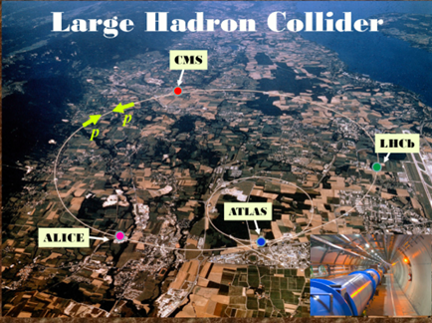
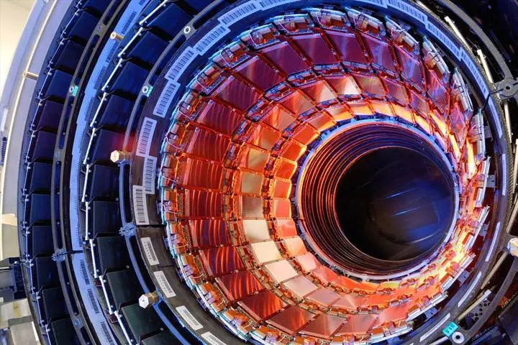
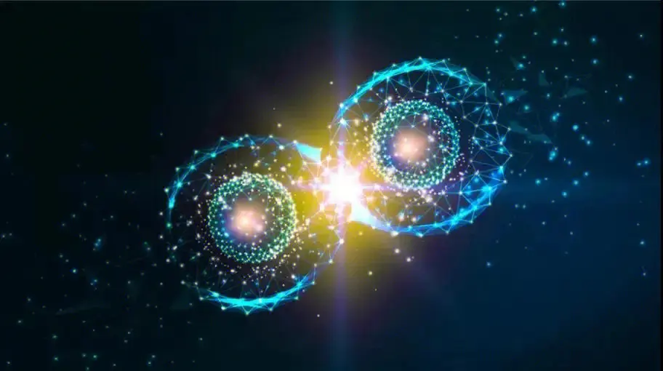
$$Λ_{c}\left(2910\right) and Λ_{c}\left(2940\right) production in π^{−}p scattering process$$
Student：Quan-Yun Guo
Professor ：Dian-Yong Chen
Southeast University- Physics College
Date：2025. 7. 14
Based on Quan-Yun Guo, Dian-Yong Chen Published in: Phys.Rev.D 111 (2025) 11, 114011

Slide 2

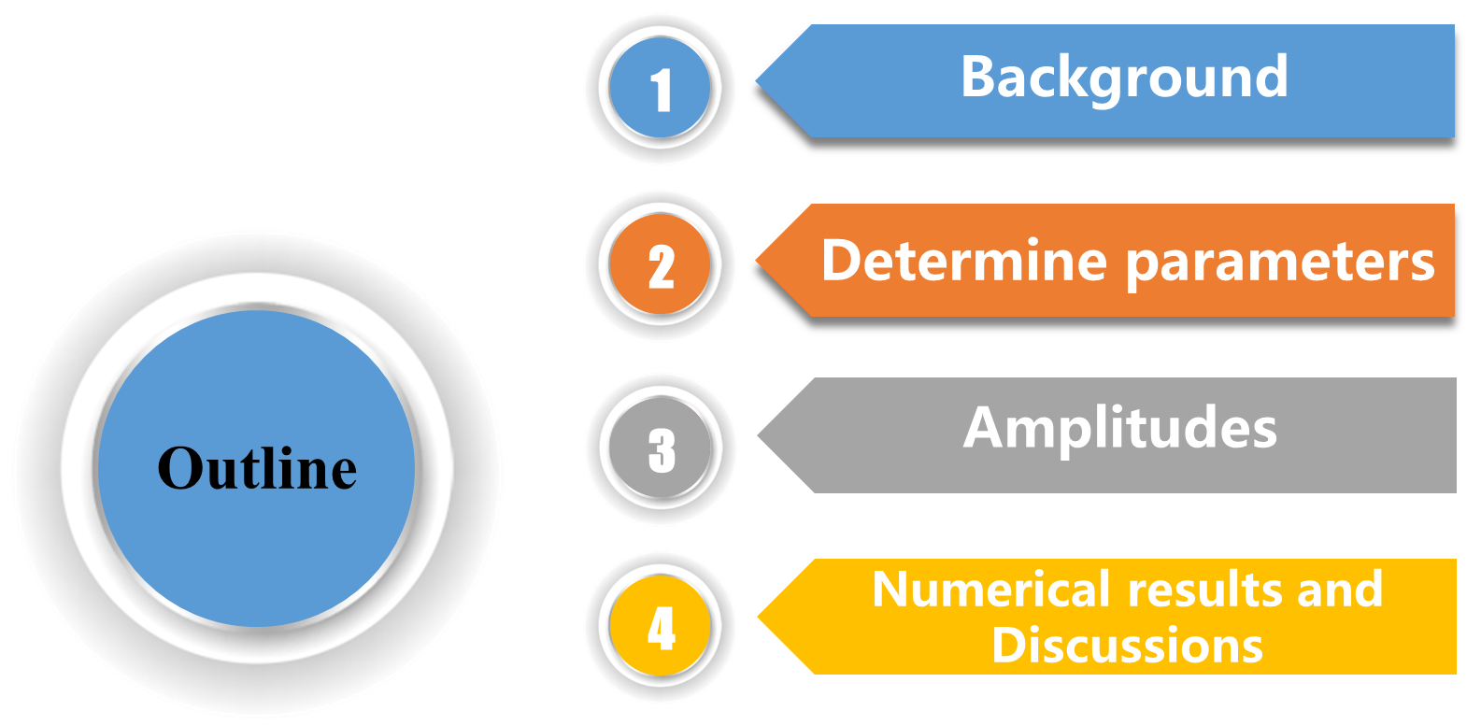


Slide 3
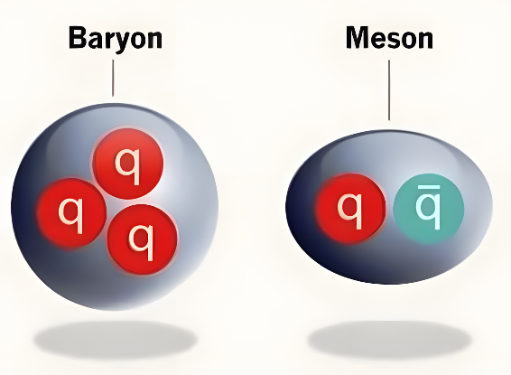
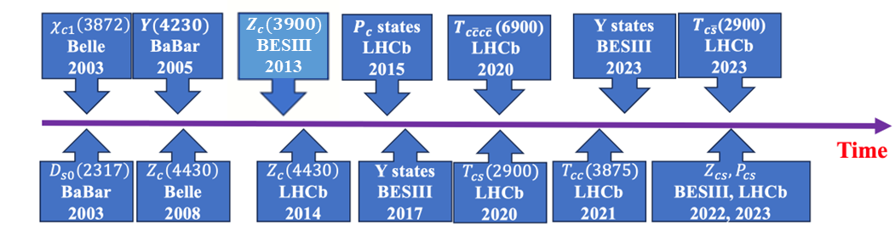
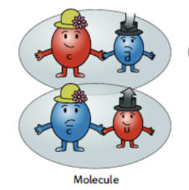
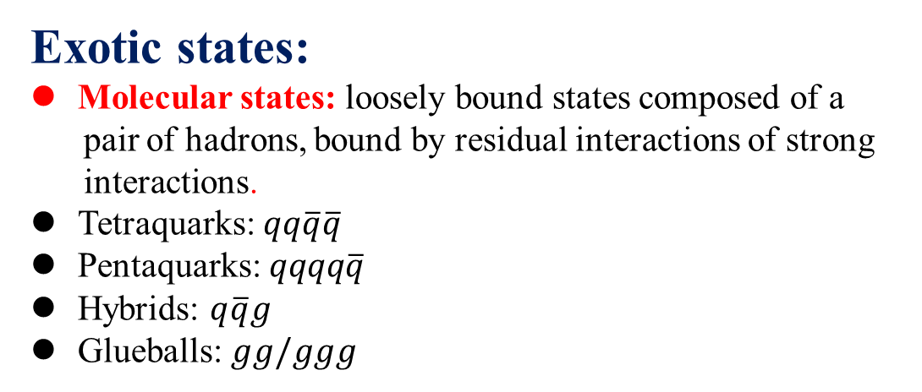

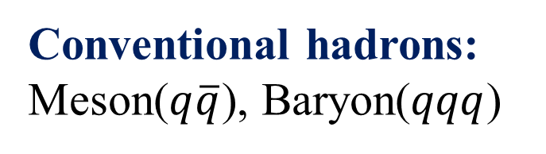

Background
Conventional hadrons:
Meson($q\overline{q}$), Baryon($qqq$)
Exotic states:
Molecular states: loosely bound states composed of a
pair of hadrons, bound by residual interactions of strong
interactions.
Tetraquarks: $qq\overline{q}\overline{q}$
Pentaquarks: $qqqq\overline{q}$
Hybrids: $q\overline{q}g$
Glueballs: $gg/ggg$
$$Λ_{c}(2910)$$
$$Λ_{c}(2940)$$

Slide 4
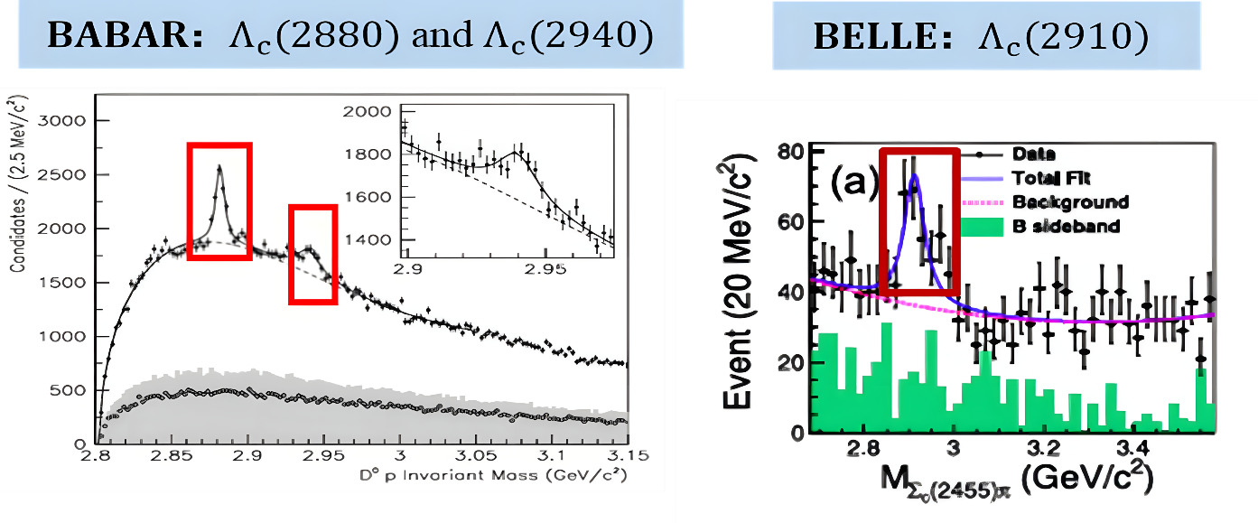


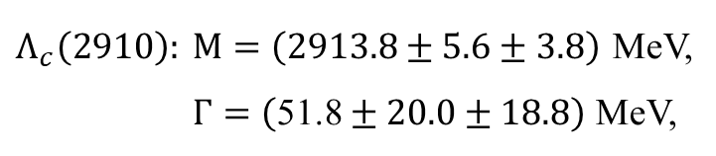
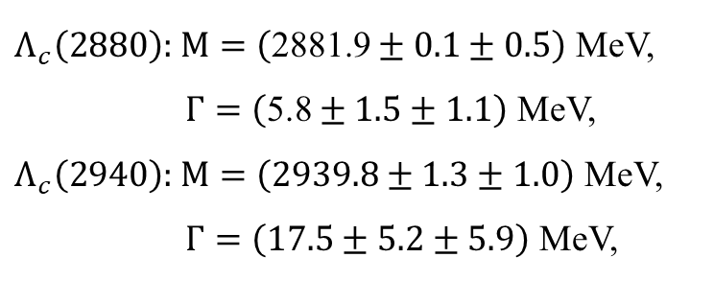

Experimental background
Phys.Rev.Lett. 98 (2007) 012001
Phys.Rev.Lett. 130 (2023) 3, 031901
$Λ_{c}\left(2880\right):$ $M=\left(\text{2881.9}±0.1±0.5\right)$ MeV,
$Γ=\left(\text{5.8}±1.5±1.1\right)$ MeV,
$Λ_{c}\left(2940\right):$ $M=\left(2939.8±1.3±1.0\right)$ MeV,
$Γ=\left(\text{17.5}±5.2±5.9\right)$ MeV,
$Λ_{c}\left(2910\right):$ $M=\left(2913.8±5.6±3.8\right)$ MeV,
$Γ=\left(\text{5}\text{1.}\text{8}±20.0±18.8\right)$ MeV,
${Λ_{c}\left(2880\right)}^{+}→ D^{0}p,$
${Λ_{c}\left(2940\right)}^{+}→ D^{0}p$
${\overline{B}}^{0}→ {Σ_{c}(2455)}^{0,++}π^{±}\overline{p}$
Open question: How to describe $Λ_{c}(2910)$ and $Λ_{c}(2940)$ states ?

Slide 5
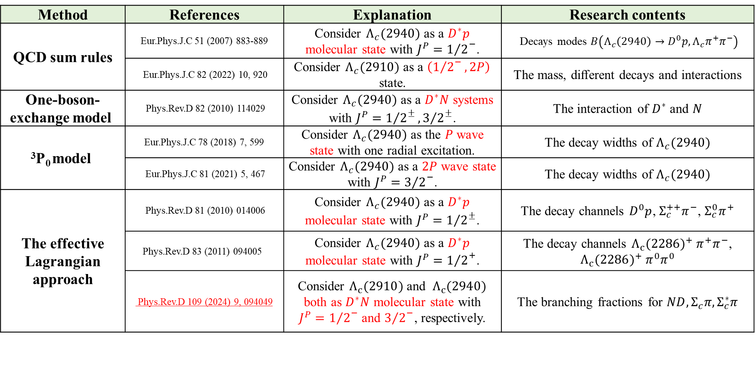
Theoretical background
Method | References | Explanation | Research contents
QCD sum rules | Eur.Phys.J.C 51 (2007) 883-889 | Consider $Λ_{c}(2940)$ as a $D^{∗}p$ molecular state with $J^{P}={1/2}^{−}$. | Decays modes $B\left(Λ_{c}\left(2940\right)→D^{0}p, Λ_{c}π^{+}π^{−}\right)$
 | Eur.Phys.J.C 82 (2022) 10, 920 | Consider $Λ_{c}(2910)$ as a $\left({1/2}^{−}, 2P\right)$ state. | The mass, diﬀerent decays and interactions
One-boson-exchange model | Phys.Rev.D 82 (2010) 114029 | Consider $Λ_{c}(2940)$ as a $D^{∗}N$ systems with $J^{P}={1/2}^{±}, {3/2}^{±}$. | The interaction of $D^{∗}$ and $N$
³P₀ model | Eur.Phys.J.C 78 (2018) 7, 599 | Consider $Λ_{c}(2940)$ as the $P$ wave state with one radial excitation. | The decay widths of $Λ_{c}(2940)$
 | Eur.Phys.J.C 81 (2021) 5, 467 | Consider $Λ_{c}(2940)$ as a $2P$ wave state with $J^{P}={3/2}^{−}$. | The decay widths of $Λ_{c}(2940)$
The effective Lagrangian approach | Phys.Rev.D 81 (2010) 014006 | Consider $Λ_{c}(2940)$ as a $D^{∗}p$ molecular state with $J^{P}={1/2}^{±}$. | The decay channels $D^{0}p$, $Σ_{c}^{++}π^{−}$, $Σ_{c}^{0}π^{+}$
 | Phys.Rev.D 83 (2011) 094005 | Consider $Λ_{c}(2940)$ as a $D^{∗}p$ molecular state with $J^{P}={1/2}^{+}$. | The decay channels ${Λ_{c}(2286)}^{+} π^{+}π^{−}$, ${Λ_{c}(2286)}^{+} π^{0}π^{0}$
 | Phys.Rev.D 109 (2024) 9, 094049 | Consider $Λ_{c}(2910)$ and $Λ_{c}(2940)$ both as $D^{∗}N$ molecular state with $J^{P}={1/2}^{−}$ and ${3/2}^{−}$, respectively. | The branching fractions for $ND, Σ_{c}π, Σ_{c}^{∗}π$

Slide 6
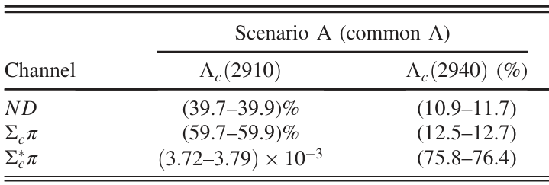

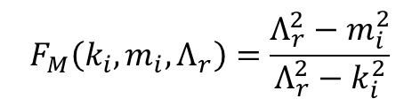
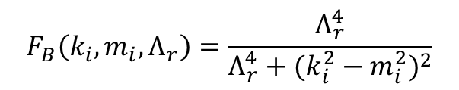
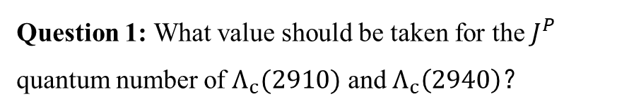
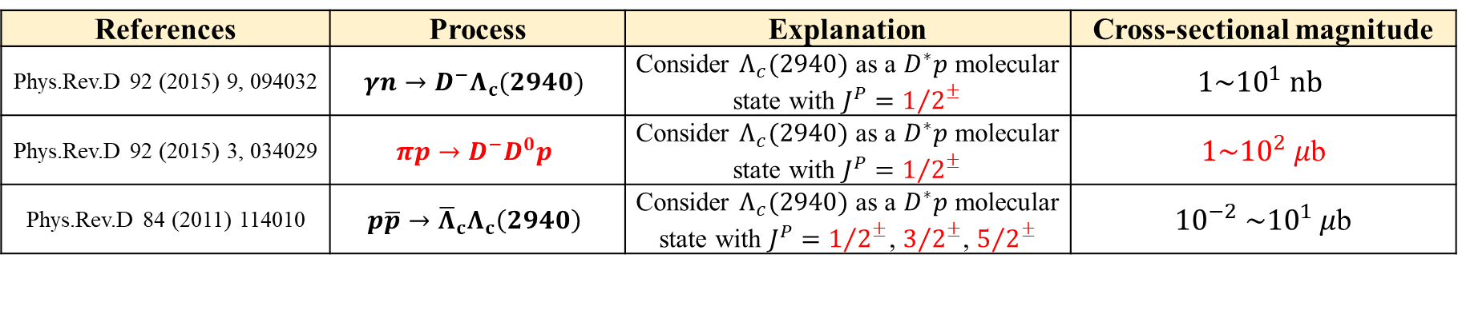

Production processes
References | Process | Explanation | Cross-sectional magnitude
Phys.Rev.D 92 (2015) 9, 094032 | $$γn→D^{−}Λ_{c}(2940)$$ | Consider $Λ_{c}(2940)$ as a $D^{∗}p$ molecular state with $J^{P}={1/2}^{±}$ | $$1\sim {10}^{1} nb$$
Phys.Rev.D 92 (2015) 3, 034029 | $$πp→D^{−}D^{0}p$$ | Consider $Λ_{c}(2940)$ as a $D^{∗}p$ molecular state with $J^{P}={1/2}^{±}$ | $1\sim {10}^{2} μ$b
Phys.Rev.D 84 (2011) 114010 | $$p\overline{p}→{\overline{Λ}}_{c}Λ_{c}\left(2940\right)$$ | Consider $Λ_{c}(2940)$ as a $D^{∗}p$ molecular state with $J^{P}={1/2}^{±}$, ${3/2}^{±}$, ${5/2}^{±}$ | ${10}^{−2} \sim {10}^{1} μ$b
Question 1: What value should be taken for the $J^{P}$ quantum number of $Λ_{c}(2910)$ and $Λ_{c}\left(2940\right)？$
Question 2: How to determine the value of model parameter $Λ_{r}？$
$$F_{B}\left(k_{i},m_{i},Λ_{r}\right)=\frac{Λ_{r}^{4}}{Λ_{r}^{4}+{(k_{i}^{2}−m_{i}^{2})}^{2}}$$
$$F_{M}\left(k_{i},m_{i},Λ_{r}\right)=\frac{Λ_{r}^{2}−m_{i}^{2}}{Λ_{r}^{2}−k_{i}^{2}}$$
Phys.Rev.D 109 (2024) 9, 094049
$$Λ_{r}=3.0 GeV$$

Slide 7
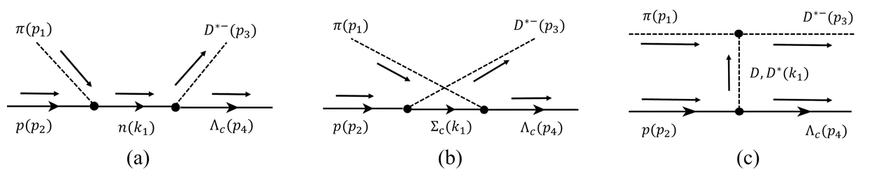
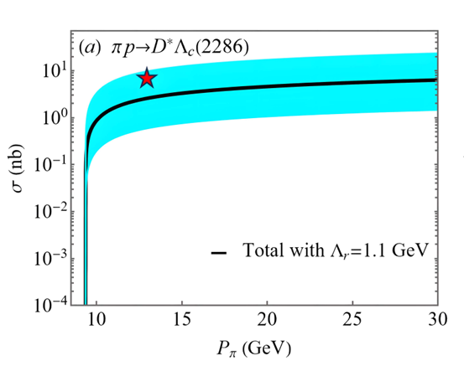

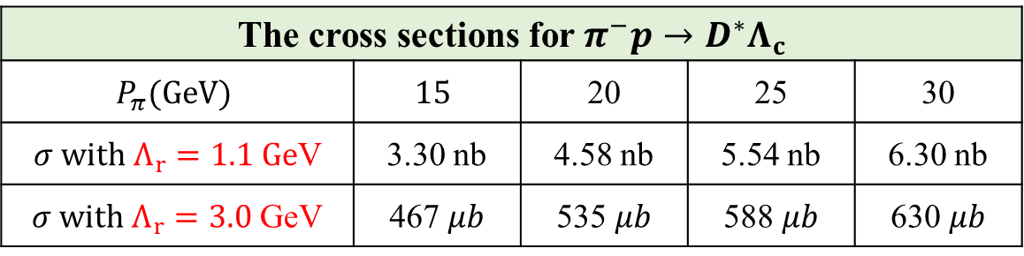

Question 2 ：Determine parameters $\left(Λ_{r}\right)$
In 1985, Ref.[2] proposed the upper limit of cross section $σ=7$nb at $P_{π}=13$GeV for $π^{−}p→D^{∗}Λ_{c}$
The cross sections for $π^{−}p→D^{∗}Λ_{c}$
$$P_{π}(GeV)$$ | $$15$$ | 20 | 25 | 30
$σ with Λ_{r}=1.1 Ge$V | 3.30 nb | 4.58 nb | 5.54 nb | 6.30 nb
$σ with Λ_{r}=3.0$ GeV | 467 $μb$ | 535 $μb$ | 588 $μb$ | 630 $μb$
$Λ_{r}$ has great significance when determining the cross section.
$$Λ_{r}=1.1 GeV$$
[2] Phys. Rev. Lett., 55:154, 1985.

Slide 8
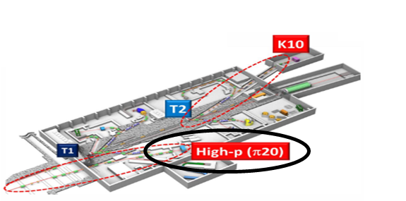
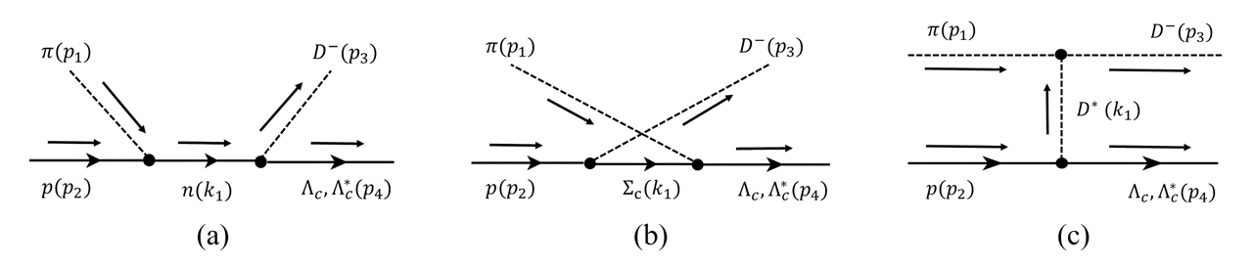
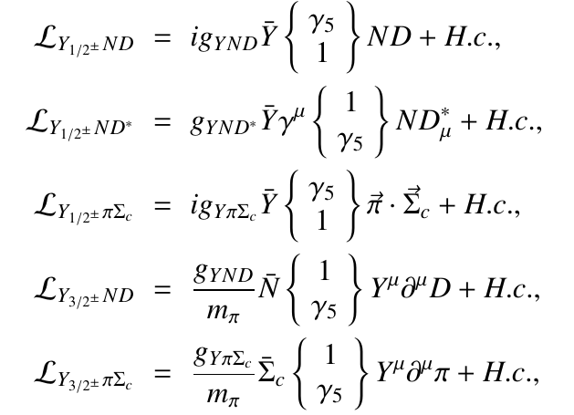
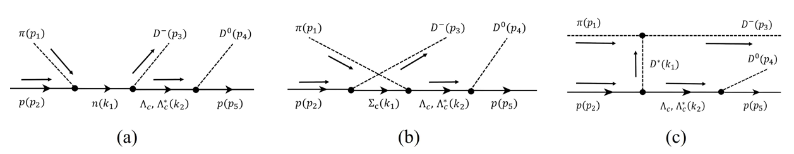


Research contents
The J-PARC hadron facility [1] proposes that the expected pion energy will reach over 20 GeV.
Experimental condition
$$π^{−}p→DΛ_{c}/Λ_{c}(2910)/Λ_{c}(2940)$$
The effective Lagrangians
$$π^{−}p→D^{−}D^{0}p$$
[1] e-Print: 2110.04462 [nucl-ex].

Slide 9
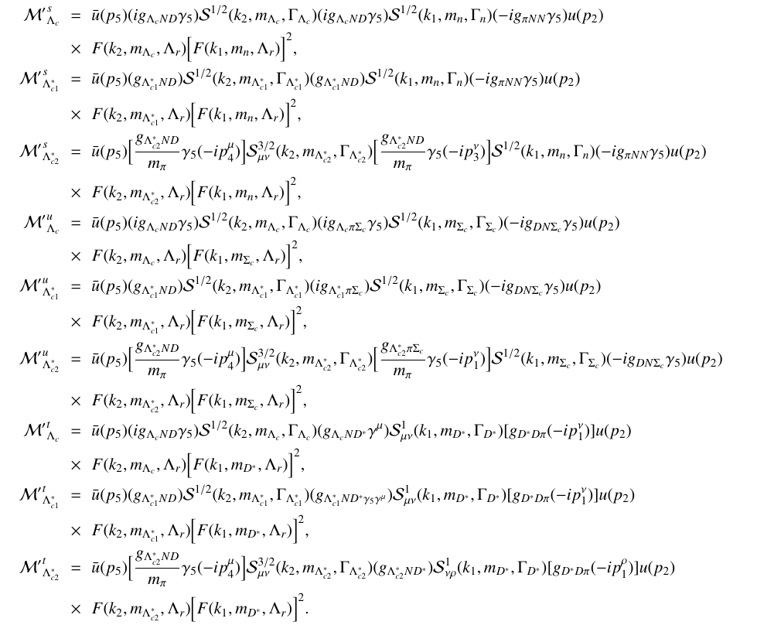


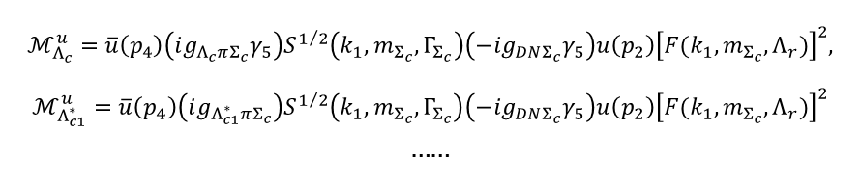
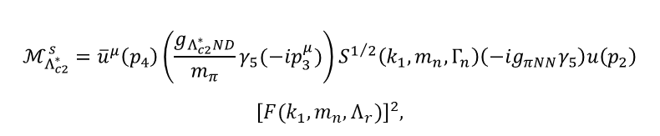

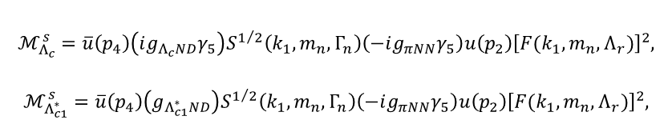
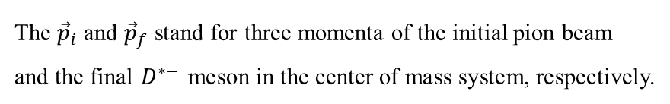

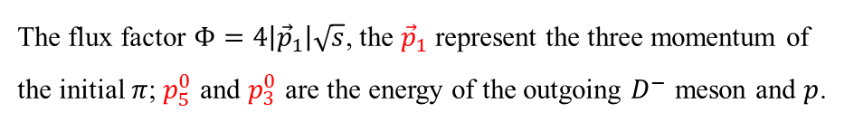
Amplitudes
$$π^{−}p→D^{−}Λ_{c}/Λ_{c}(2910)/Λ_{c}(2940)$$
$$π^{−}p→D^{−}D^{0}p$$
$$ℳ_{Λ_{c}}^{s}=\overline{u}\left(p_{4}\right)\left(ig_{Λ_{c}ND}γ_{5}\right)S^{1/2}\left(k_{1}, m_{n}, Γ_{n}\right)\left(−ig_{πNN}γ_{5}\right)u\left(p_{2}\right){\left[F(k_{1},m_{n},Λ_{r})\right]}^{2},$$
$$ℳ_{Λ_{c1}^{∗}}^{s}=\overline{u}\left(p_{4}\right)\left(g_{Λ_{c1}^{∗}ND}\right)S^{1/2}\left(k_{1}, m_{n}, Γ_{n}\right)\left(−ig_{πNN}γ_{5}\right)u\left(p_{2}\right){\left[F(k_{1},m_{n},Λ_{r})\right]}^{2},$$
$$ℳ_{Λ_{c2}^{∗}}^{s}={\overline{u}}^{μ}\left(p_{4}\right)\left(\frac{g_{Λ_{c2}^{∗}ND}}{m_{π}}γ_{5}(−ip_{3}^{μ})\right)S^{1/2}\left(k_{1}, m_{n}, Γ_{n}\right)\left(−ig_{πNN}γ_{5}\right)u\left(p_{2}\right)$$
$${\left[F(k_{1},m_{n},Λ_{r})\right]}^{2},$$
$$ℳ_{Λ_{c}}^{u}=\overline{u}\left(p_{4}\right)\left(ig_{Λ_{c}πΣ_{c}}γ_{5}\right)S^{1/2}\left(k_{1}, m_{Σ_{c}}, Γ_{Σ_{c}}\right)\left(−ig_{DNΣ_{c}}γ_{5}\right)u\left(p_{2}\right){\left[F(k_{1},m_{Σ_{c}},Λ_{r})\right]}^{2},$$
$$ℳ_{Λ_{c1}^{∗}}^{u}=\overline{u}\left(p_{4}\right)\left(ig_{Λ_{c1}^{∗}πΣ_{c}}\right)S^{1/2}\left(k_{1}, m_{Σ_{c}}, Γ_{Σ_{c}}\right)\left(−ig_{DNΣ_{c}}γ_{5}\right)u\left(p_{2}\right){\left[F(k_{1},m_{Σ_{c}},Λ_{r})\right]}^{2}$$
……
……
The cross section
The cross section
$$\frac{dσ}{dcosθ}=\frac{1}{32πs}\frac{\left|{\vec{p}}_{f}\right|}{\left|{\vec{p}}_{i}\right|}\left(\frac{1}{2J+1}{\left|\overline{ℳ}\right|}^{2}\right)$$
$$dσ=\frac{1}{8{(2π)}^{4}}\frac{1}{Φ}{\left|\overline{ℳ}\right|}^{2}dp_{5}^{0}dp_{3}^{0}dcosθdη$$
The ${\vec{p}}_{i}$ and ${\vec{p}}_{f}$ stand for three momenta of the initial pion beam and the final $D^{∗−}$ meson in the center of mass system, respectively.
The flux factor $Φ=4\left|{\vec{p}}_{1}\right|\sqrt{s}$, the ${\vec{p}}_{1}$ represent the three momentum of the initial $π$; $p_{5}^{0}$ and $p_{3}^{0}$ are the energy of the outgoing $D^{−}$ meson and $p$.

Slide 10
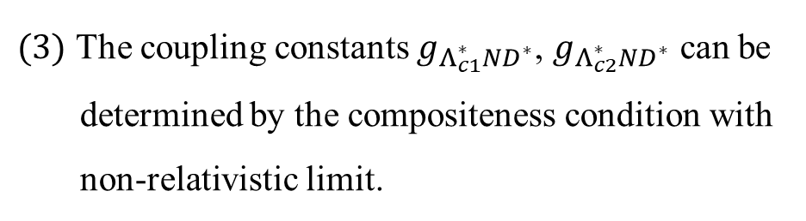
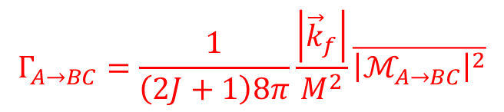
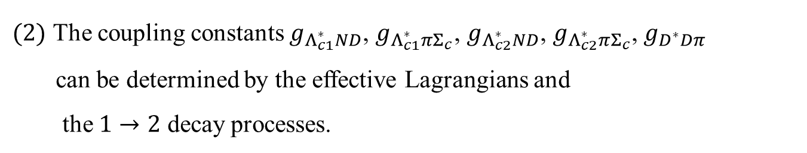

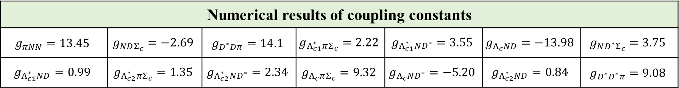
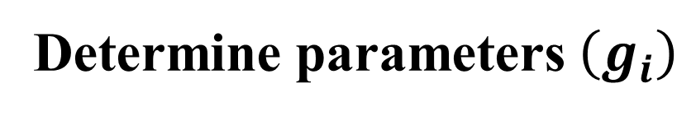
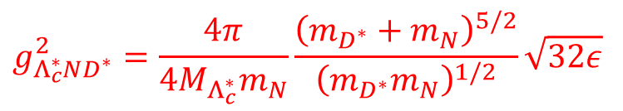
Determine parameters $\left(g_{i}\right)$
$(1)$ The coupling constants $g_{πNN}$, $g_{Λ_{c}ND}$, $g_{Λ_{c}ND^{∗}}$, $g_{Λ_{c}πΣ_{c}}$, $g_{NDΣ_{c}}$, $g_{ND^{∗}Σ_{c}}$ can be determined by $SU(4)$ symmetry.
$(2)$ The coupling constants $g_{Λ_{c1}^{∗}ND}$, $g_{Λ_{c1}^{∗}πΣ_{c}}$, $g_{Λ_{c2}^{∗}ND}$, $g_{Λ_{c2}^{∗}πΣ_{c}}$, $g_{D^{∗}Dπ}$
can be determined by the effective Lagrangians and
the $1→2$ decay processes.
$$Γ_{A→BC}=\frac{1}{\left(2J+1\right)8π}\frac{\left|{\vec{k}}_{f}\right|}{M^{2}}\overline{{\left|ℳ_{A→BC}\right|}^{2}}$$
$(3)$ The coupling constants $g_{Λ_{c1}^{∗}ND^{∗}}$, $g_{Λ_{c2}^{∗}ND^{∗}}$ can be
determined by the compositeness condition with
non-relativistic limit.
$$g_{Λ_{c}^{∗}ND^{∗}}^{2}=\frac{4π}{4M_{Λ_{c}^{∗}}m_{N}}\frac{{\left(m_{D^{∗}}+m_{N}\right)}^{5/2}}{{\left(m_{D^{∗}}m_{N}\right)}^{1/2}}\sqrt{32ε}$$
Numerical results of coupling constants
$$g_{πNN}=13.45$$ | $$g_{NDΣ_{c}}=−2.69$$ | $$g_{D^{∗}Dπ}=14.1$$ | $$g_{Λ_{c1}^{∗}πΣ_{c}}=2.22$$ | $$g_{Λ_{c1}^{∗}ND^{∗}}=3.55$$ | $$g_{Λ_{c}ND}=−13.98$$ | $$g_{ND^{∗}Σ_{c}}=3.75$$
$$g_{Λ_{c1}^{∗}ND}=0.99$$ | $$g_{Λ_{c2}^{∗}πΣ_{c}}=1.35$$ | $$g_{Λ_{c2}^{∗}ND^{∗}}=2.34$$ | $$g_{Λ_{c}πΣ_{c}}=9.32$$ | $$g_{Λ_{c}ND^{∗}}=−5.20$$ | $$g_{Λ_{c2}^{∗}ND}=0.84$$ | $$g_{D^{∗}D^{∗}π}=9.08$$
$$Λ_{c1}^{∗}≡Λ_{c}\left(2910\right), Λ_{c2}^{∗}≡Λ_{c}\left(2940\right)$$

Slide 11
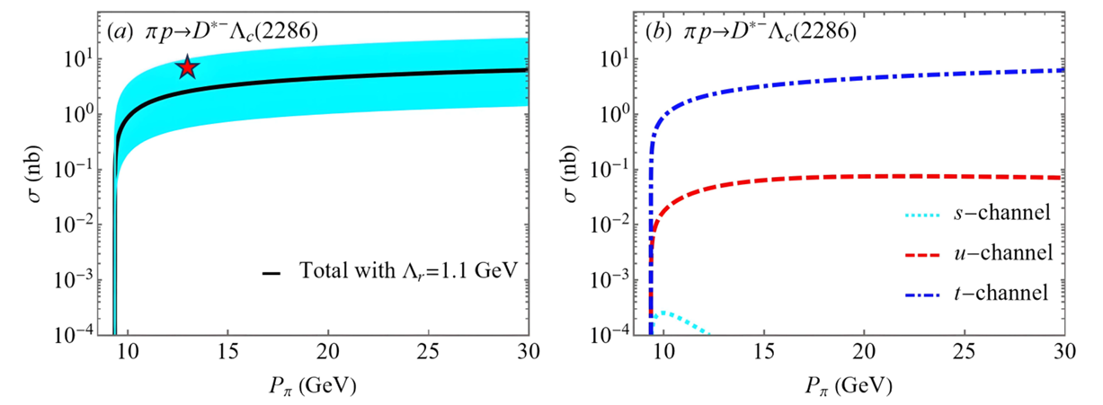
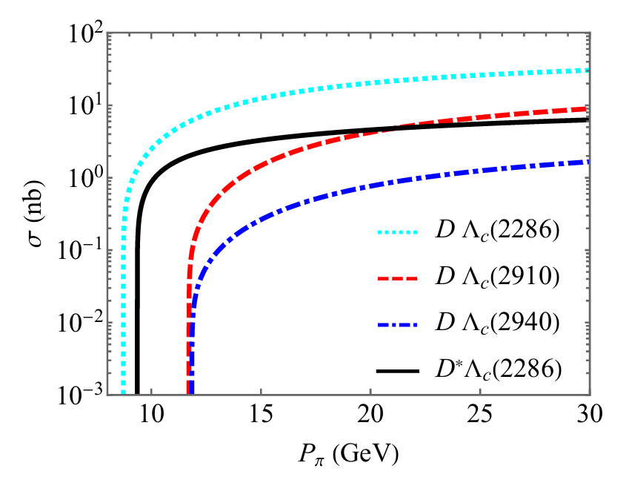
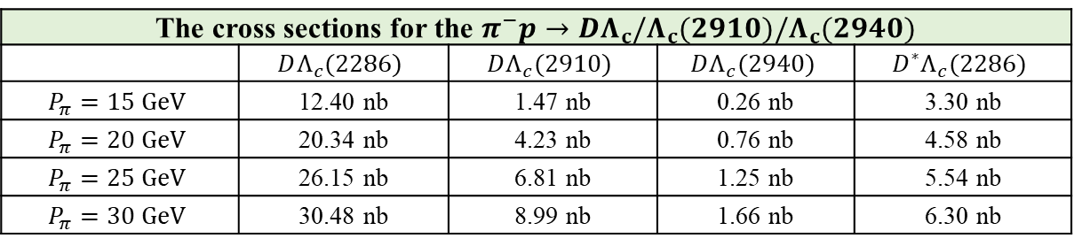


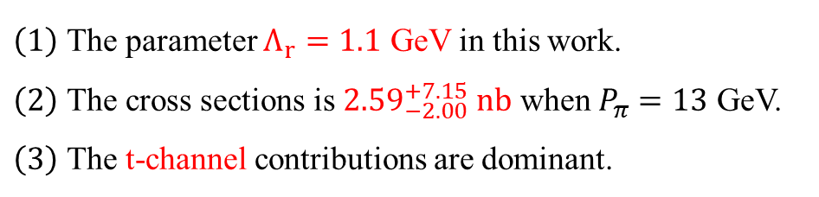
Numerical results and Discussions
$$π^{−}p→D^{∗}Λ_{c}$$
$\left(1\right)$ The parameter $Λ_{r}=1.1$ GeV in this work.
$\left(2\right)$ The cross sections is ${2.59}_{−2.00}^{+7.15} nb$ when $P_{π}=13$ GeV.
$\left(3\right)$ The t-channel contributions are dominant.
$$π^{−}p→DΛ_{c}/Λ_{c}(2910)/Λ_{c}(2940)$$
The cross sections for the $π^{−}p→DΛ_{c}/Λ_{c}(2910)/Λ_{c}(2940)$
 | $$DΛ_{c}(2286)$$ | $$DΛ_{c}(2910)$$ | $$DΛ_{c}(2940)$$ | $$D^{∗}Λ_{c}(2286)$$
$$P_{π}=15 GeV$$ | 12.40 nb | 1.47 nb | 0.26 nb | 3.30 nb
$$P_{π}=20 GeV$$ | 20.34 nb | 4.23 nb | 0.76 nb | 4.58 nb
$$P_{π}=25 GeV$$ | 26.15 nb | 6.81 nb | 1.25 nb | 5.54 nb
$$P_{π}=30 GeV$$ | 30.48 nb | 8.99 nb | 1.66 nb | 6.30 nb
The ratio of cross sections for these four processes is $1:0.29:0.05:0.21$ when $P_{π}=30$GeV

Slide 12
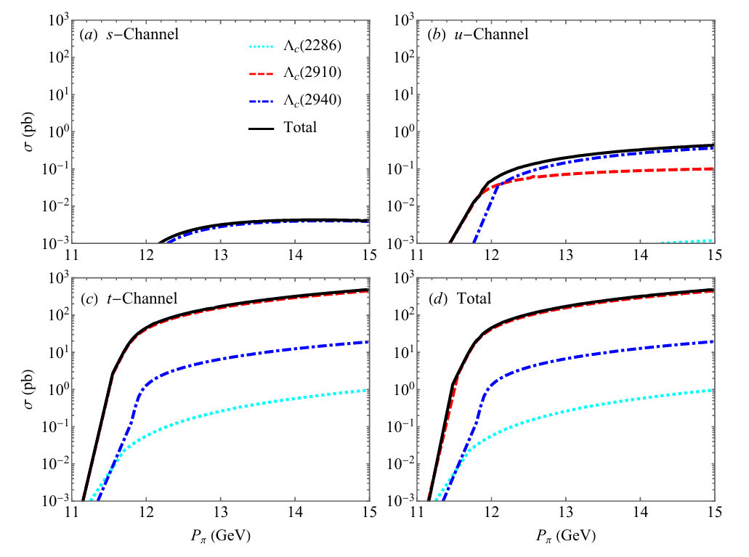
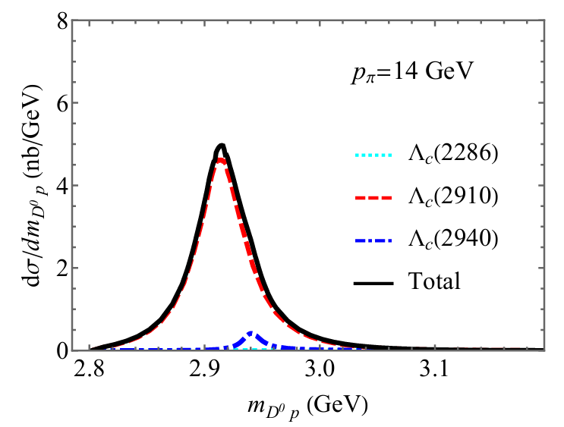
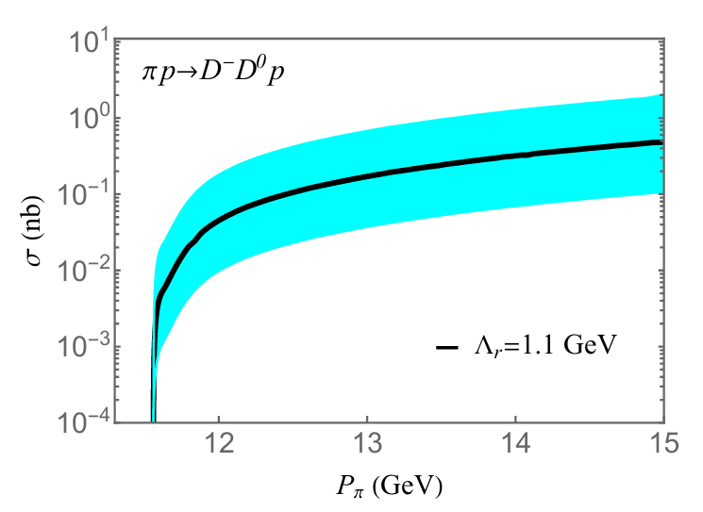
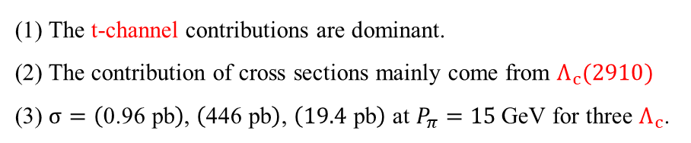

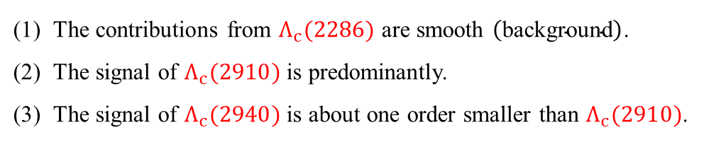
$$π^{−}p→D^{−}D^{0}p$$
The individual cross sections
The invariant mass distributions
The total cross sections
The contributions from $Λ_{c}(2286)$ are smooth $\left(\text{background}\right)$.
The signal of $Λ_{c}(2910)$ is predominantly.
The signal of $Λ_{c}(2940)$ is about one order smaller than $Λ_{c}(2910)$.
(1) The t-channel contributions are dominant.
(2) The contribution of cross sections mainly come from $Λ_{c}(2910)$
(3) $σ=\left(\text{0.96} \text{pb}\right)$, $\left(\text{446} \text{p}\text{b}\right)$, $\left(\text{19.4} \text{p}\text{b}\right)$ at $P_{π}=15$ GeV for three $Λ_{c}$.
(4) The total cross section are ${0.49}_{−0.38}^{+1.56}$ nb at $P_{π}=15$ GeV.

Slide 13
Summary
1. The BABAR and Belle Collaborations observed $Λ_{c}(2910)$ and $Λ_{c}\left(2940\right).$
2. The J-PARC hadron facility provides experimental conditions.
3. The parameter $\left(Λ_{r}=1.1\right)$ should be determined with experimental data.
4. The cross sections for two-body and three-body processes are estimated
5. The signal of $Λ_{c}(2910)$ is predominantly in $D^{0}p$ invariant mass spectrum.
6. We hope our work can be tested by further experimental measurements.

Slide 14
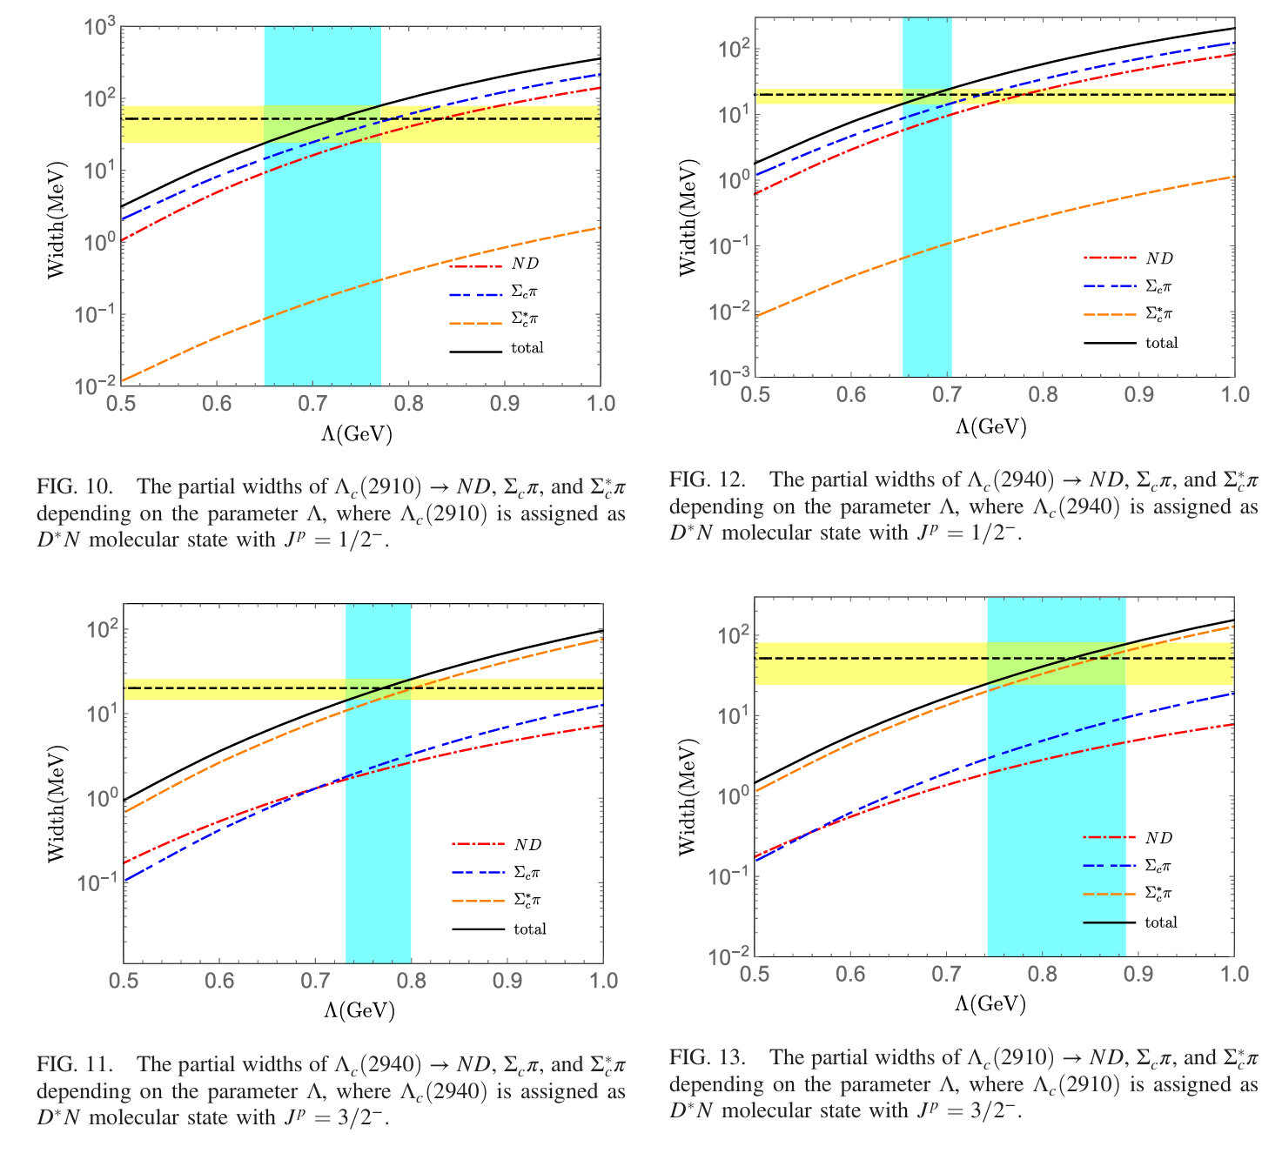
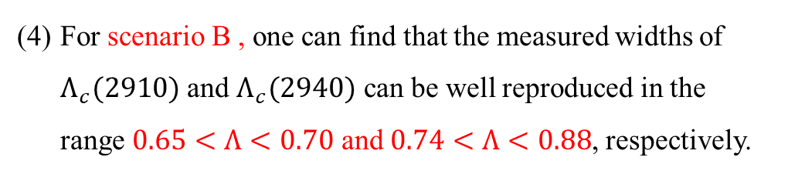
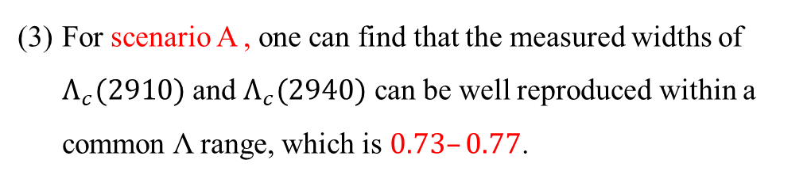
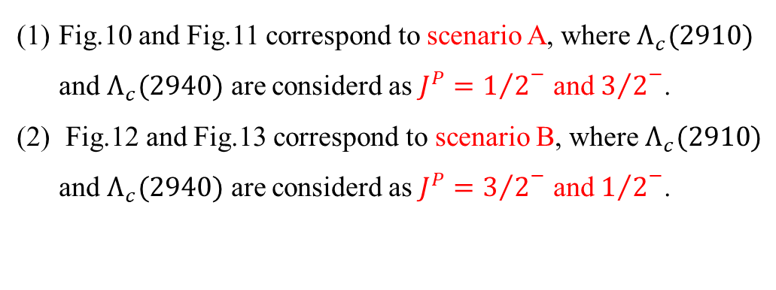

APPENDIX
Question 1 ： Determine $J^{P}$ quantum number
Scenario A
Scenario B
Fig.10 and Fig.11 correspond to scenario A, where $Λ_{c}(2910)$ and $Λ_{c}(2940)$ are considerd as $J^{P}={1/2}^{−}$ and ${3/2}^{−}$.
Fig.12 and Fig.13 correspond to scenario B, where $Λ_{c}(2910)$ and $Λ_{c}(2940)$ are considerd as $J^{P}={3/2}^{−}$ and ${1/2}^{−}$.
For scenario A , one can find that the measured widths of $Λ_{c}(2910)$ and $Λ_{c}(2940)$ can be well reproduced within a common Λ range, which is $0.73–0.77$.
For scenario B , one can find that the measured widths of $Λ_{c}(2910)$ and $Λ_{c}(2940)$ can be well reproduced in the range $0.65<Λ<0.70$ and $0.74<Λ<0.88$, respectively.
Phys.Rev.D 109 (2024) 9, 094049

Slide 15

Thank you very much

