Slide 1
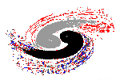



Institute of High Energy Physics, CAS
Isospin violating decays via intermediate meson loops
Qiang Zhao
Division of Theoretical Physics
Institute of High Energy Physics, CAS
zhaoq@ihep.ac.cn
第八届强子谱和强子结构研讨会
2025年7月11-16日，桂林

Slide 2
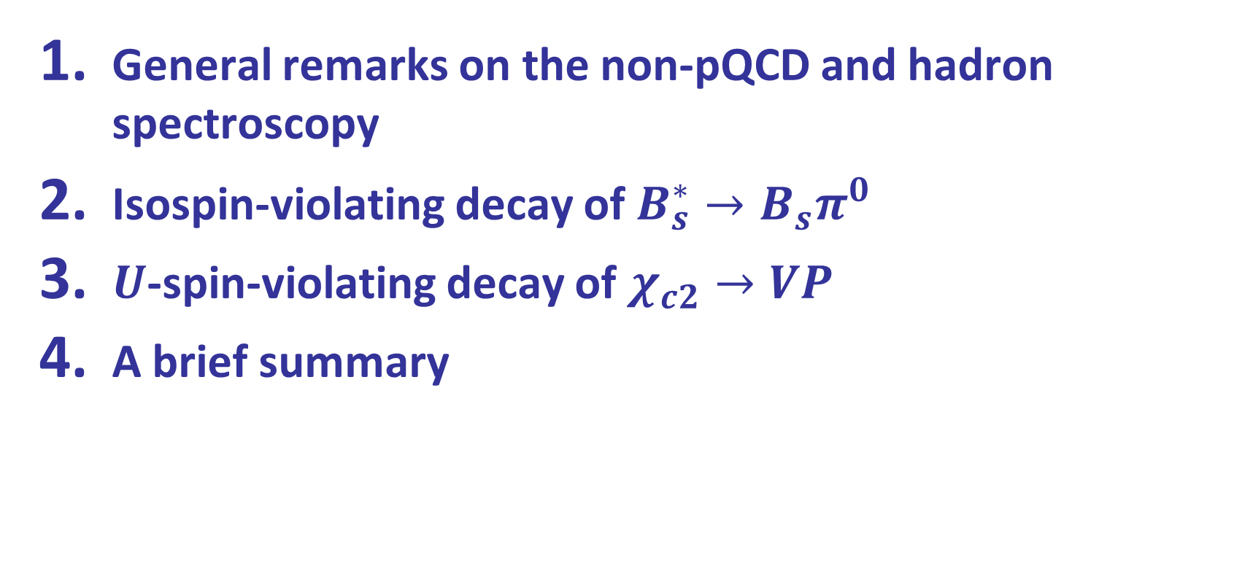
Outline
General remarks on the non-pQCD and hadron spectroscopy
Isospin-violating decay of $B_{s}^{∗}→B_{s}π^{0}$
$U$-spin-violating decay of $χ_{c2}→VP$
A brief summary

Slide 3
Our comprehension of the non-perturbative QCD seems to be much less than we thought!
meson
baryon
Conventional quark model prescription
Exotic states are expected by QCD
Hybrid
Glueball
Tetraquark
Pentaquark
Hadronic molecule
How the non-pQCD manifest itself in the quark-gluon interactions?
What is the proper effective degrees of freedom in the description of hadron structures?

Slide 4
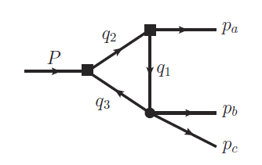
Hadrons beyond the conventional quark model
Exotics of Type-I:
J^{PC} are not allowed by Q‾Q configurations, e.g. 0⁻⁻,1⁻⁺ …
Direct observation
Exotics of Type-II:
J^{PC} are the same as Q‾Q configurations
Outnumbering of conventional QM states?
Peculiar properties?
“Exotics” of Type-III:
Leading kinematic singularity can cause measurable effects, e.g. the triangle singularity.
What’s the impact?
How to distinguish a genuine state from kinematic effects?

Slide 5

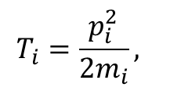
Success of Quark Model:
Hadrons are made of quarks (antiquarks) as QCD color singlet
Hamiltonian in a non-relativistic quark model :
$$T_{i}=\frac{p_{i}^{2}}{2m_{i}},$$
Cornell potential model
Godfrey-Isgur model
A lot of recent development …
Potential smearing factor
Coulomb
Spin-spin correl.

Slide 6
The connection between the quark model and QCD ONLY becomes clear in certain circumstances: in the heavy quark limit the soft QCD for quark-antiquark or quark-quark interactions can become much simpler.
Quenched LQCD simulation
G. S. Bali, et al., Phys. Rev. D62, 054503 (2000)
M. Foster and C. Michael (UKQCD), Phys. Rev. D59, 094509 (1999)

Slide 7


The QM state $χ_{c1}(2P)$ is about 60 MeV higher than the physical state $X(3872)$.
$D{\overline{D}}^{∗}$
$$X(3872)$$
W.J. Deng et al., PRD95, 034026 (2017)
[8] T. Barnes, S. Godfrey, and E. S. Swanson, PRD 72, 054026 (2005).
[11] B. Q. Li and K. T. Chao, PRD 79, 094004 (2009).
Godfrey and Isgur, PRD32, 189 (1985)

Slide 8
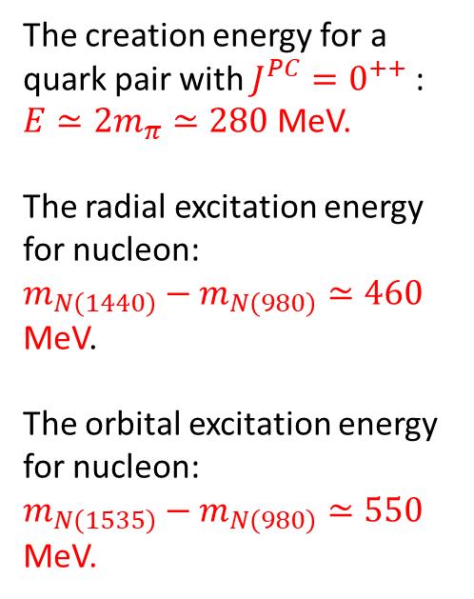
Open threshold effects: A missing piece of dynamics in the potential QM
Quenched LQCD simulation
The creation energy for a quark pair with $J^{PC}=0^{++}$ :
$E≃2m_{π}≃280$ MeV.
The radial excitation energy for nucleon:
$m_{N\left(1440\right)}−m_{N\left(980\right)}≃460$ MeV.
The orbital excitation energy for nucleon:
$m_{N\left(1535\right)}−m_{N\left(980\right)}≃550$ MeV.
Unquenched LQCD simulation
However, the effects of the open channels on the soft QCD potential is also evident!
G. S. Bali, et al., Phys. Rev. D62, 054503 (2000)
M. Foster and C. Michael (UKQCD), Phys. Rev. D59, 094509 (1999)
J. Bulava, et al., Phys. Lett. B793, 493 (2019)

Slide 9


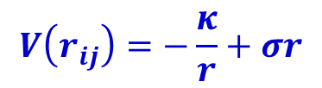
Open threshold effects: A missing piece of dynamics in the potential QM
$$V\left(r_{ij}\right)=−\frac{κ}{r}+σr$$
Color screening effects? String breaking effects?
$\overline{q}q$creation
The effect of vacuum polarization due to dynamical quark pair creation may be manifested by the strong coupling to open thresholds and compensated by that of the hadron loops, i.e. coupled-channel effects.
1 fm
$$r_{ij}$$
g_{eff}
E. Eichten et al., PRD17, 3090 (1987); E. J. Eichten, K. Lane, and C. Quigg, Phys. Rev. D 69, 094019 (2004)
B.-Q. Li and K.-T. Chao, Phys. Rev. D79, 094004 (2009);
T. Barnes and E. Swanson, Phys.Rev. C77, 055206 (2008)

Slide 10




Typical processes where the open threshold coupled channels can play a role
The open channel couplings introduce NOT ONLY additional dynamics (add. effective DOF) into the hadron structures, BUT ALSO novel kinematic effects, i.e. triangle singularity …
Y.J. Zhang et al, PRL(2009);
X. Liu, B. Zhang, X.Q. Li, PLB(2009)
Q. Wang et al. PRD(2012), PLB(2012)
“ρπ puzzle”
X.-H. Liu et al, PRD81, 014017(2010);
X. Liu et al, PRD81, 074006(2010)
Q. Wang et al, PRD2012
G. Li and Q. Zhao, PRD(2011)074005
F.K. Guo, C. Hanhart, G. Li, U.-G. Meiβner and Q. Zhao, PRD82, 034025 (2010); PRD83, 034013 (2011)
F.K. Guo and Ulf-G Meiβner, PRL108(2012)112002
J. Wang and Q. Zhao, PRD111, 096007 (2025)
The mass shift in charmonia and charmed mesons, E.Eichten et al., PRD17(1987)3090
X.-G. Wu and Q. Zhao, PRD85, 034040 (2012)
Hadronic molecules

Slide 11
The narrow two-body open thresholds:
Their possible impact on the spectrum should be systematically investigated.
S-wave thresh.
P-wave thresh.
g_{eff}
h₁ (P, V, A, …)
M
h₂ (P, V, A …)

Slide 12
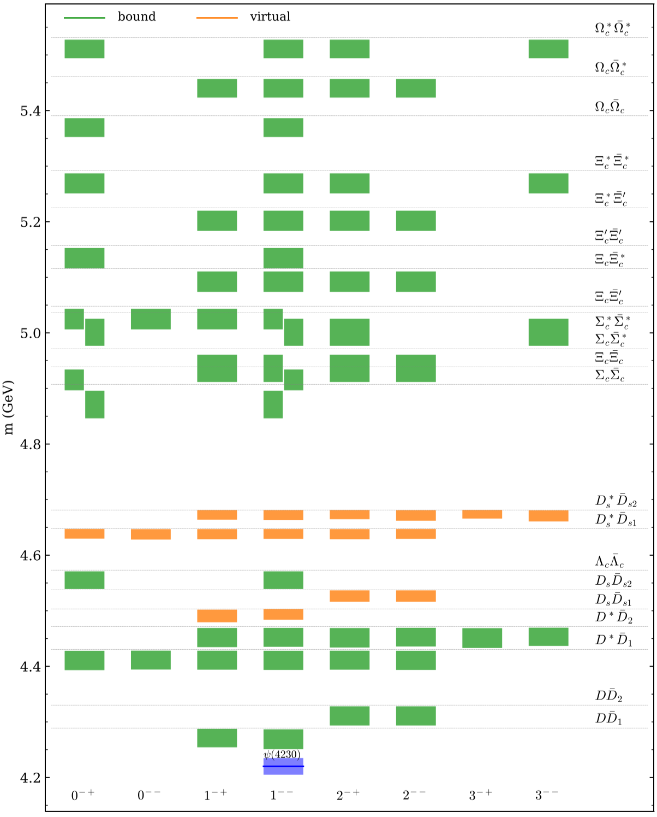
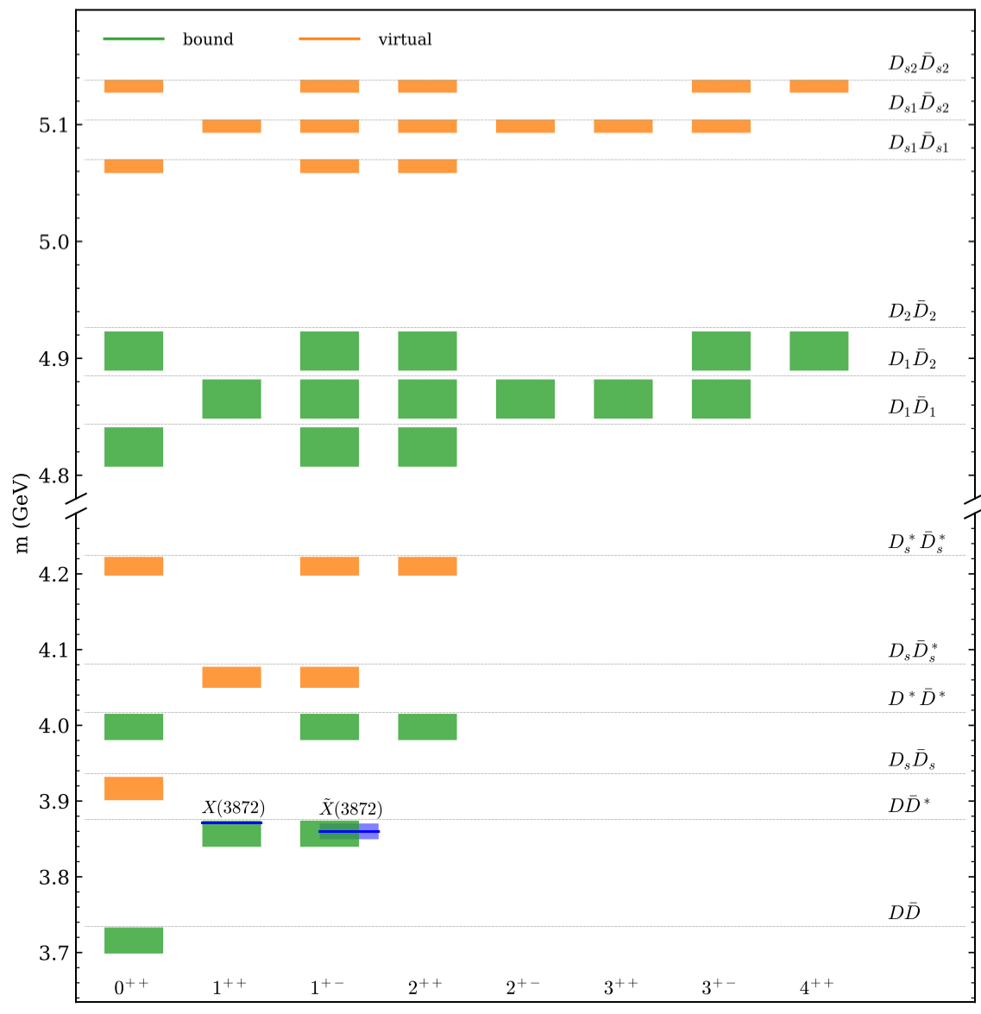
X.-K. Dong, F.-K. Guo, B.-S. Zou, Progr. Phys. 41 (2021) 65 [arXiv:2101.01021]

Slide 13
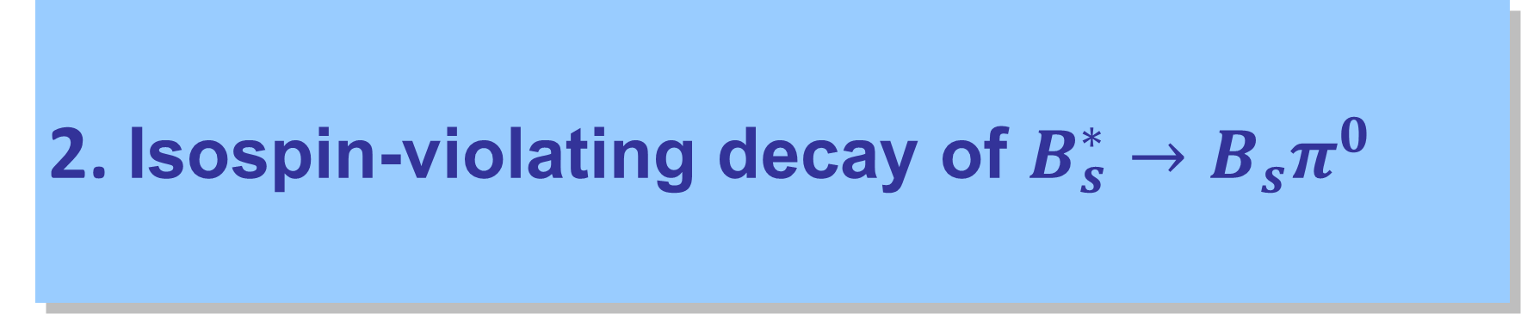
2. Isospin-violating decay of $B_{s}^{∗}→B_{s}π^{0}$
J. Wang and Q. Zhao, PRD 111 (2025) 096007, 2503.13138 [hep-ph]

Slide 14



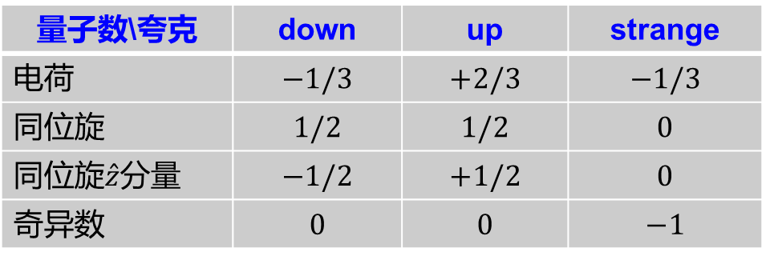
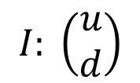





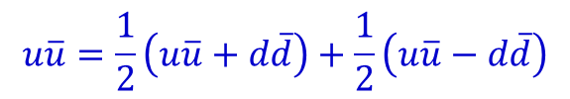

Isospin symmetry and SU(2) flavor doublets
三类轻味夸克：
SU(3) flavor triplet with $I, U, V$SU(2) doublets
量子数\夸克 | down | up | strange
电荷 | $$−1/3$$ | $$+2/3$$ | $$−1/3$$
同位旋 | $$1/2$$ | $$1/2$$ | $$0$$
同位旋$\hat{z}$分量 | $$−1/2$$ | $$+1/2$$ | $$0$$
奇异数 | $$0$$ | $$0$$ | $$−1$$
$$m_{u}≃m_{d}<m_{s}$$
$$I: \left(\begin{matrix}u \\ d\end{matrix}\right)$$
$$d$$
$$u$$
$$q\overline{q}=(u\overline{u}+d\overline{d}+s\overline{s})/\sqrt{3}$$
$$U: \left(\begin{matrix}d \\ s\end{matrix}\right)$$
$$V: \left(\begin{matrix}u \\ s\end{matrix}\right)$$
$$u\overline{u}=\frac{1}{2}\left(u\overline{u}+d\overline{d}\right)+\frac{1}{2}\left(u\overline{u}−d\overline{d}\right)$$
$$s$$
$$I=0$$
$$I=1$$

Slide 15
Measurement of the quantum numbers for the first time in 2023!
BESIII, PL B846 (2023)138245

Slide 18
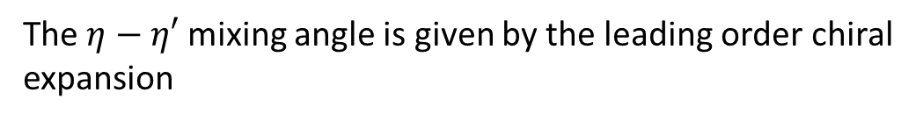

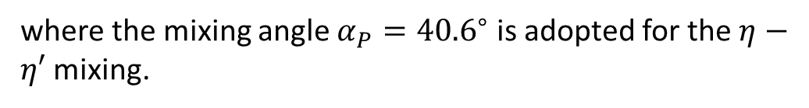
Isospin-violating through $η−π^{0}$ mixing
For $D_{s}^{∗+} → D_{s}^{+} η$, the corresponding effective Lagrangian is
where the mixing angle $α_{P}={40.6}^{∘}$ is adopted for the $η−η′$ mixing.
The $η−η′$ mixing angle is given by the leading order chiral expansion
with
Since $θ_{ηπ^{0}}$ is small, we can make the following approximation:
J. Gasser and H. Leutwyler, Chiral perturbation theory: Expansions in the mass of the strange quark, Nucl. Phys.B250, 465 (1985).

Slide 19
Effective Lagrangians

Slide 20
For the light hadron vertices, we adopt the following effective Lagrangians:
The following coupling constants are adopted:
with

Slide 21
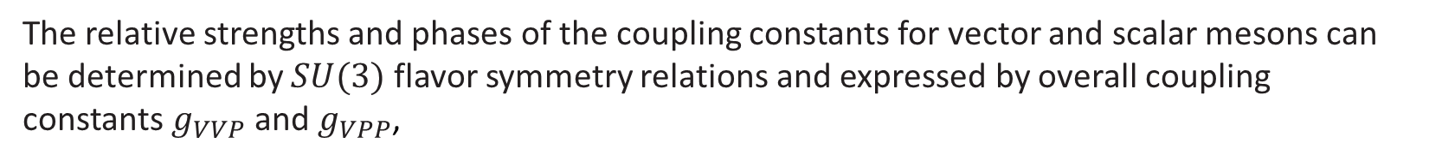
The relative strengths and phases of the coupling constants for vector and scalar mesons can be determined by $SU(3)$ flavor symmetry relations and expressed by overall coupling constants $g_{VVP}$ and $g_{VPP}$,

Slide 22
The tree-level amplitude:
with
The loop amplitude at one-loop level without $η−π^{0}$ mixing:

Slide 23

Examples:
with a UV cutoff
and
$Λ_{QCD}=220$ MeV

Slide 24
The loop amplitude at one-loop level with $η−π^{0}$ mixing:

Slide 25
Power counting of the loop amplitude:
Assuming the intermediate mesons are close to being on-shell, the propagator reads
The integrand counts:
For the two loop amplitudes which cancel each other, we have
Loop power suppression
Isospin breaking term
The loop amplitude can be expressed as
The total amplitude can be written as

Slide 26
Tree and loop amplitudes of $D_{s}^{∗+}→D_{s}^{+} γ$in the VMD model
The radiative decay of $D_{s}^{∗}$ and its loop correction can be evaluated in the same framework
where $g_{tree}^{γ}$ can be calculated using the VMD model
where $V=ρ,ω, φ, J/ψ$ and $e/f_{V}$ can be determined by $V→e^{+}e^{−}$.

Slide 27
To match the coupling constants in heavy quark effective field theory, we have
For the tree-level $V=φ, J/ψ$, the coupling constant can be extracted:
with

Slide 28
Loop amplitudes based on the VMD:

Slide 29
Contact diagrams induced by the requirement of Lorentz gauge invariance:
√
×
×
×

Slide 30
Meson-photon coupling via the VMD model:
where $R=0.8$ is the SU(3) flavor-symmetry-breaking parameter for processes involving the strange quark pair.

Slide 32
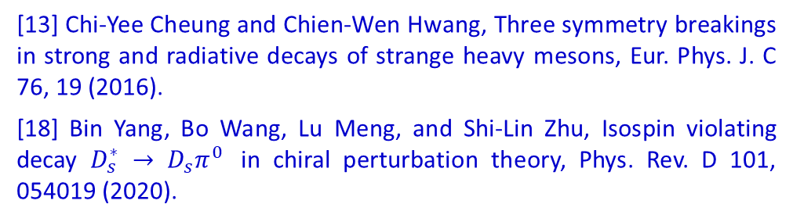
Numerical results:
[13] Chi-Yee Cheung and Chien-Wen Hwang, Three symmetry breakings in strong and radiative decays of strange heavy mesons, Eur. Phys. J. C 76, 19 (2016).
[18] Bin Yang, Bo Wang, Lu Meng, and Shi-Lin Zhu, Isospin violating decay $D_{s}^{∗} → D_{s}π^{0}$ in chiral perturbation theory, Phys. Rev. D 101, 054019 (2020).

Slide 33



















Connection and difference between $D_{s}^{∗}→D_{s}π^{0}$ and $D_{s}^{∗}→D_{s}γ$
$$c$$
$$D_{s}$$
$$D_{s}$$
$$\overline{s}$$
$$c$$
$$\overline{s}$$
$$\overline{s}$$
Cancellation occurs between the $φ$ and $J/ψ$ term.
$$c$$
$$D_{s}^{∗}$$
$$D_{s}^{∗}$$
$$s$$
$$\overline{c}$$
$$\overline{s}$$
$$c$$
$$\overline{s}$$
$$η/φ$$
$$J/ψ$$
$$c$$
The main uncertainties come from the $g_{J/ψDD}$ coupling with $g_{J/ψDD}=7.0∼7.5$.
Precise measurement of $D_{s}^{∗}$ width can provide a strong constraint on this coupling.

Slide 34
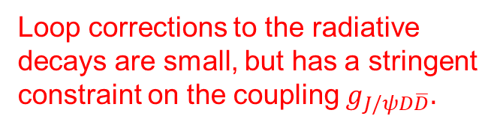
Loop corrections to the radiative decays are small, but has a stringent constraint on the coupling $g_{J/ψD\overline{D}}.$

Slide 35
The total width of $D_{s}^{∗}$ with uncertainty estimation.

Slide 36
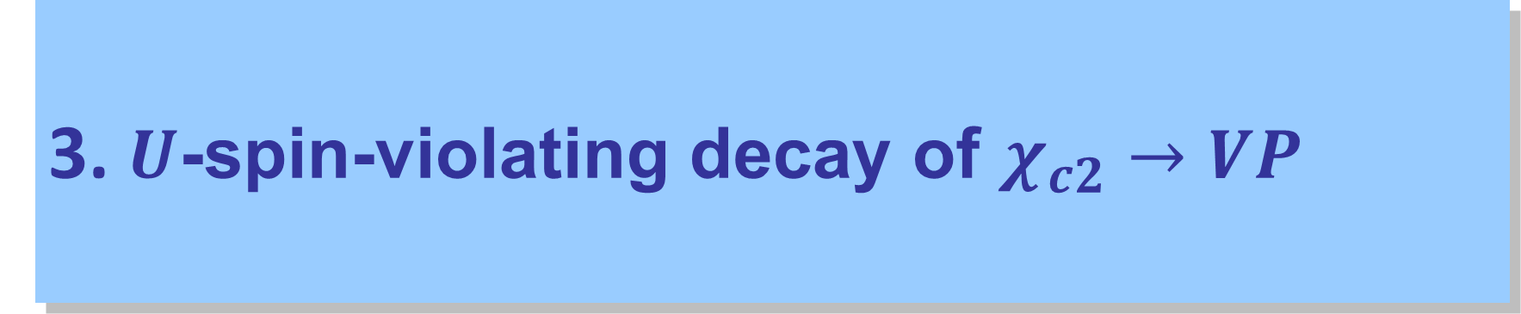
3. $U$-spin-violating decay of $χ_{c2}→VP$
X.H. Liu and Q. Zhao, Evasion of helicity selection rule in $χ_{c1}→VV$and $χ_{c2}→VP$ via intermediate charmed meson loops, PRD 81, 014017 (2010)

Slide 37




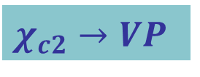

$χ_{c2}→VP$
Further suppressed by approximate G-parity or isospin/U-spin conservation.
Decay to neutral VP is forbidden by C-parity conservation.
$$c$$
g
$$V$$
Short-ranged mechanism
$$χ_{c2}$$
$$P$$
Long-ranged mechanism
$$\overline{c}$$

Slide 38

Predictions for the U-spin-violating decays of $χ_{c2}→VP$
BESIII, PR D96 (2017) 111102
α=0.3 ~ 0.33
X.H. Liu and Q. Zhao, Evasion of helicity selection rule in $χ_{c1}→VV$and $χ_{c2}→VP$ via intermediate charmed meson loops, PRD 81, 014017 (2010)

Slide 39
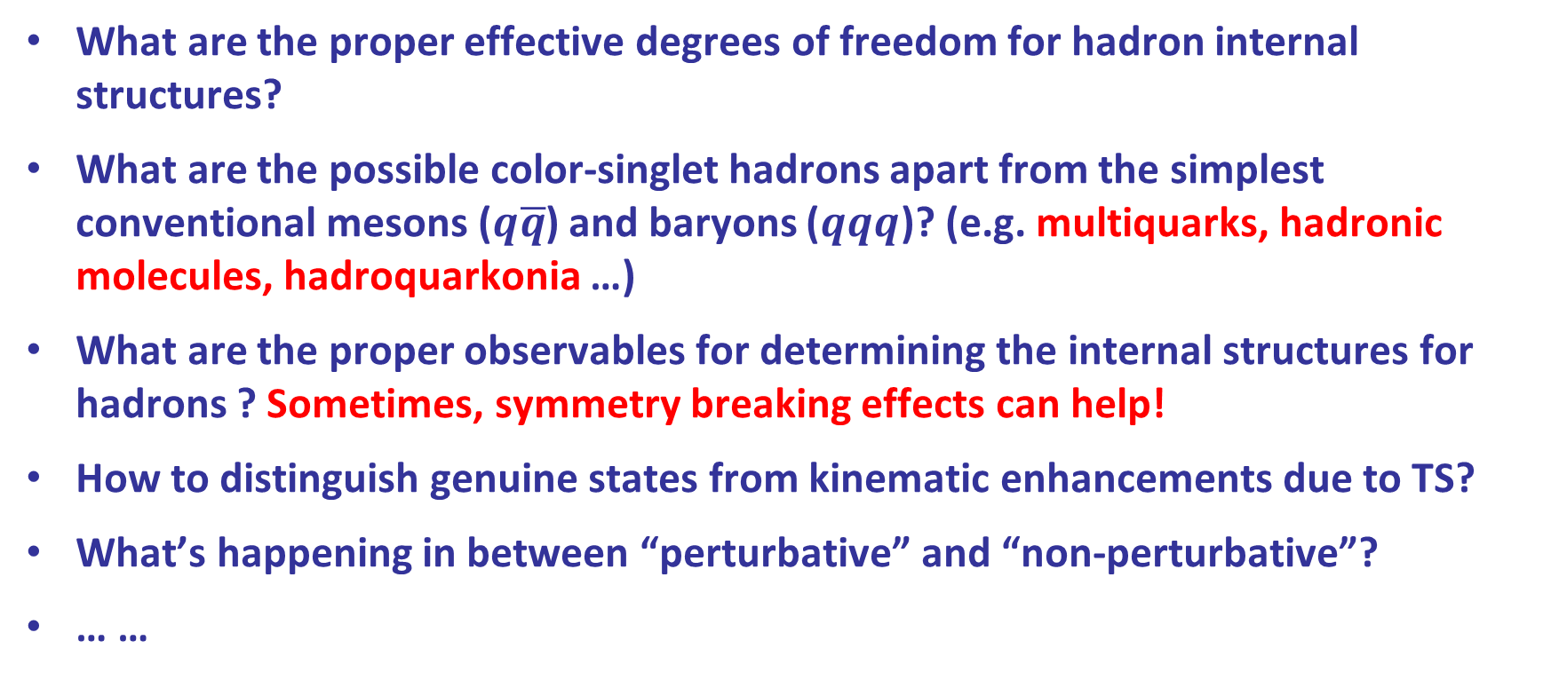
4. A brief summary
What are the proper effective degrees of freedom for hadron internal structures?
What are the possible color-singlet hadrons apart from the simplest conventional mesons ($q\overline{q}$) and baryons ($qqq$)? (e.g. multiquarks, hadronic molecules, hadroquarkonia …)
What are the proper observables for determining the internal structures for hadrons ? Sometimes, symmetry breaking effects can help!
How to distinguish genuine states from kinematic enhancements due to TS?
What’s happening in between “perturbative” and “non-perturbative”?
… …
Thanks for your attention!

