Slide 1




Mixing Effect Between Molecular and Diquark-Antidiquark States in Tetraquarks
兰州大学物理科学与技术学院
Zhi-Feng Sun
2025. 7. 14
Collaborators: Z. H. Cao, W. He, Y. Ma, C. Q. Pang, J. F. Wang,
C. W. Xiao, D. S. Zhang

Slide 2
Outline
Introduction
Mixture of molecular and diquark-antidiquark states
Study of X(4500), Z_{c}(3900) and T_{cs0}(2900)
Summary
*
-

Slide 3
Introduction

Slide 4
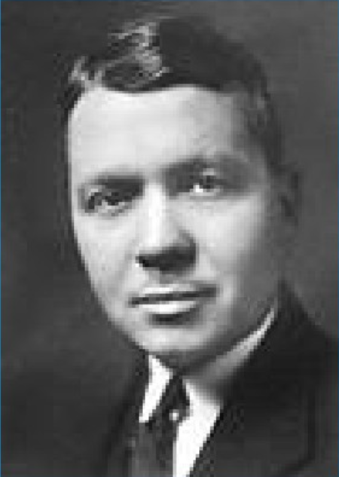
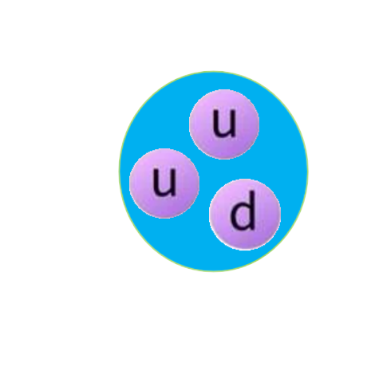
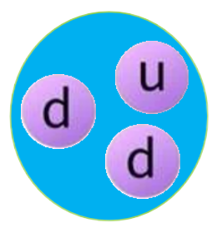
Short review of molecular state
• Molecular state：also named hadronic molecule,
composed of two or more hadrons
• First molecular state: deuterium, observed in 1931,
(before the observation of neutron)
Harold Clayton Urey
1934 Nobel Prize in Chemistry
 In 1931, the atomic weight of the hydrogen atom was
measured using the chemical scale and the physical scale,
with results of 1.00777 and 1.00778, respectively (the
atomic weight of hydrogen is expressed as a decimal)
 Menzel and others proposed that hydrogen should have
an isotope with mass number 2, and calculated that the
ratio of ¹H to ²H atoms is 4500:1.
deuterium
 Urey and others discovered the isotope of hydrogen, i.e., deuterium.
4 L of liquid hydrogen were slowly evaporated at a temperature of 14 K,
leaving a final residue of 1 mL. Using this remaining residue as a sample,
grating spectroscopic analysis was performed. The results showed new
spectral lines within the hydrogen atom's Balmer series; the positions of
these lines matched the predicted positions for ²H, thereby confirming
the existence of deuterium.

Slide 5
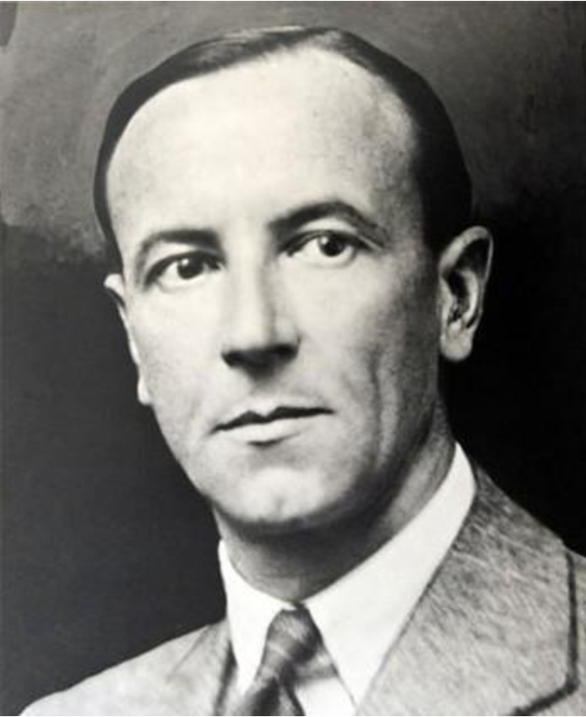
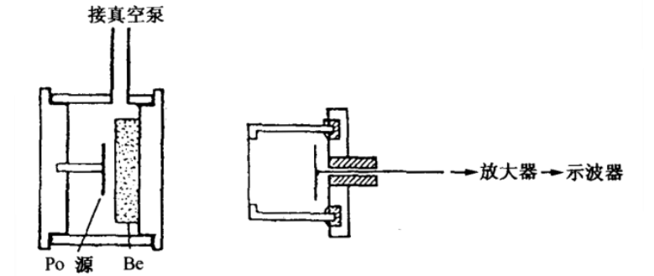
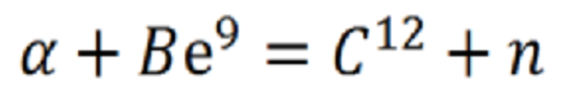
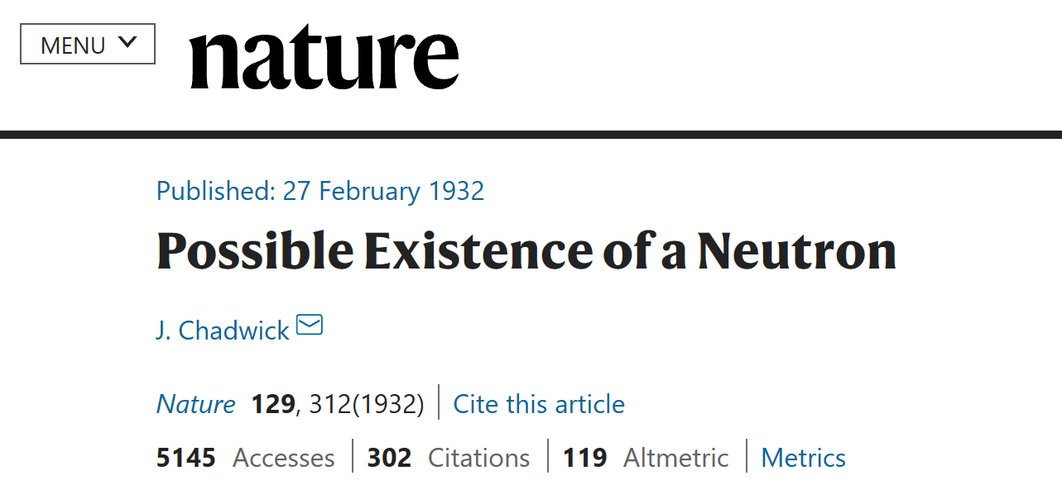
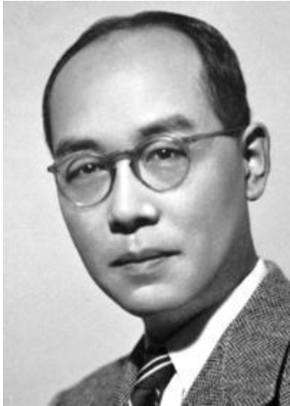


• Observation of neutron: a milestone in nuclear physics
James Chadwick
1935 Nobel Prize in Physics
• Nuclear structure was understood
• Interaction between nucleons: Yukawa potential
• exchange pion, proposed by Yukawa
• the form of the potential:
$$φ=ge^{−m_{π}r}/r$$
• interaction constant:
$$g^{2}≈15$$
Hideki Yukawa
1949 Nobel Prize in Physics
• proton and neutron form a loosely bound state with
J^{P}=1⁺ and binding energy E = 2.225 MeV

Slide 6
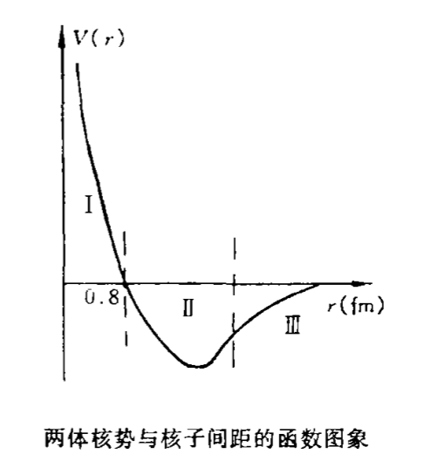


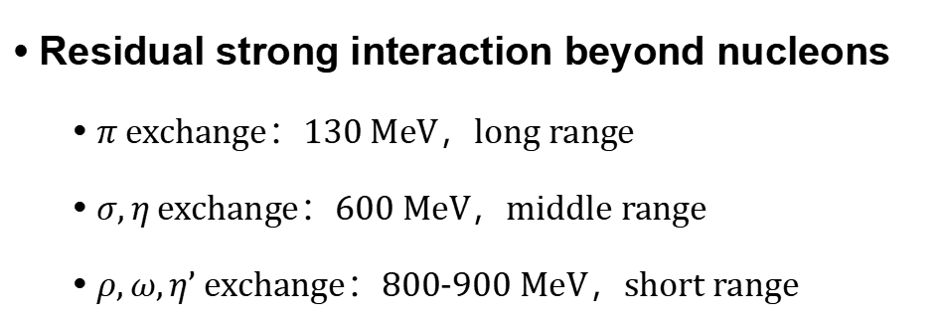

Further development of nuclear force:
• Interaction between nucleons
矢量粒子$ρ、ω$, 赝标粒子$η’$
• Residual strong interaction beyond nucleons
• $π$ exchange：130 MeV，long range
• $σ,η$ exchange：600 MeV，middle range
• $ρ,ω,η’$ exchange：800-900 MeV，short range
标量粒子$σ$, 赝标粒子$η$
赝标粒子$π$
• Extended to meson and baryon effective field
theory

Slide 7
Early studies of molecular states
• Molecular states composed of charmed (bottomed) and anti-charmed
(anti-bottomed) mesons
JETP Lett. 23 (1976) 333; Pis’ma Zh. Eksp. Teor. Fiz. 23 (1976) 369;
PRL 38 (1977) 317;
Z. Phys. C 61 (1994) 525;
Nuovo Cimento A 107 (1994) 2471
• Molecular state composed of a nucleon and D_{s} meson
Phys. Lett. B 195 (1987) 484
_
• Weinstein and Isgur proposed the f₀(980) and a₀(980) as the KK molecular states;
However, their partner states within the nonet can not be explained within this
molecular scheme.
PRL 48 (1982) 659;
PRD 27 (1983) 588;
PRD 41 (1990) 2236
• The advent of the chiral unitary approach has brought new light into this issue
and all those states are generated from a coupled channels unitary approach
based on the interaction provided by the chiral Lagrangians;
PRD 59 (1999) 074001
• Before 2003, most observed states could be accommodated within the quark
model easily.

Slide 8
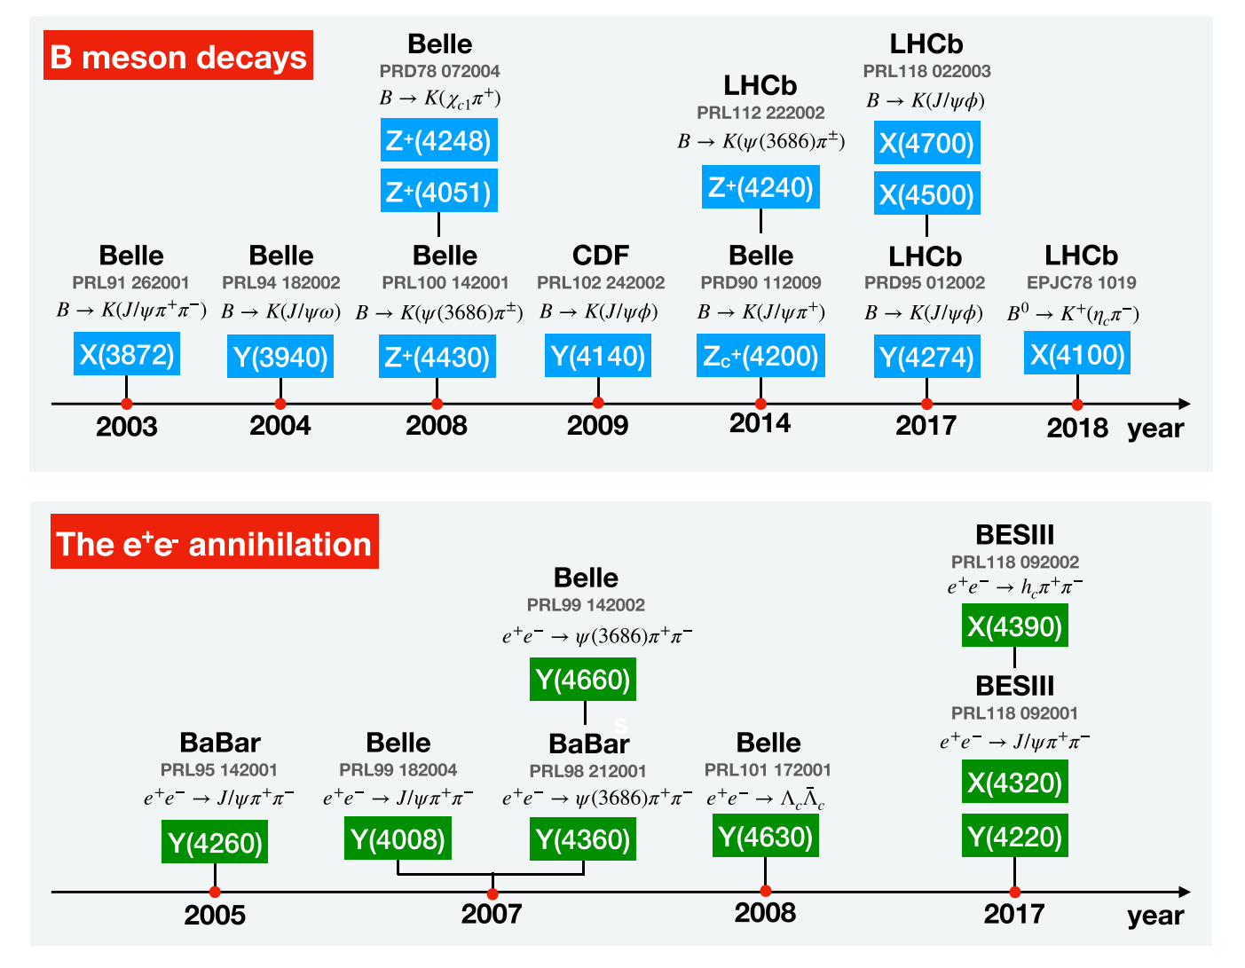
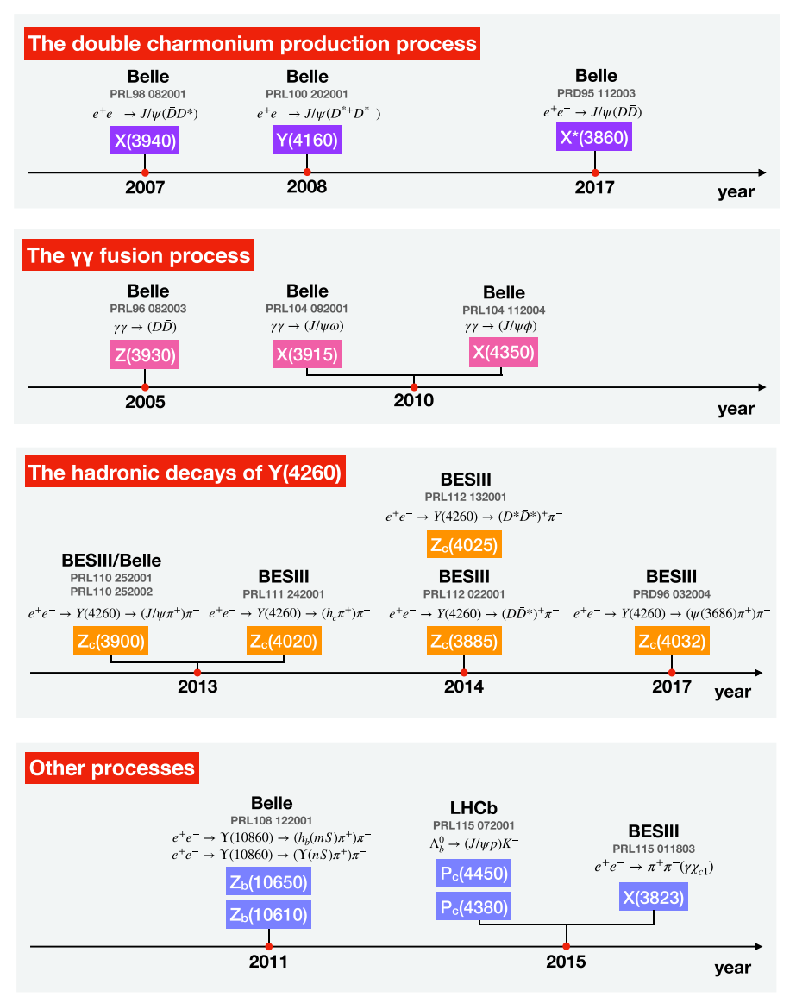
• Since 2003, many candidates of molecular states have been observed
• The topic of molecular state becomes hot
one-boson-exchange model
lattice QCD
quark model
QCD sum rules
Phys. Rept. 639, 1
Rev. Mod. Phys. 90, 015004
Prog. Part. Nucl. Phys. 107, 237
Commun. Theor. Phys. 73, 125201
Rept. Prog. Phys. 86, 026201
Phys. Rept. 1108, 1
Symmetry 12, 1869 (2020)
arXiv: 2502. 11351

Slide 9
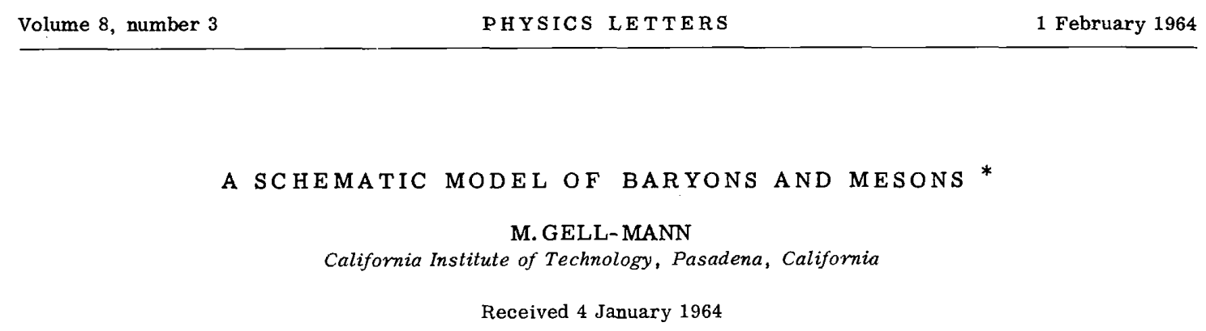
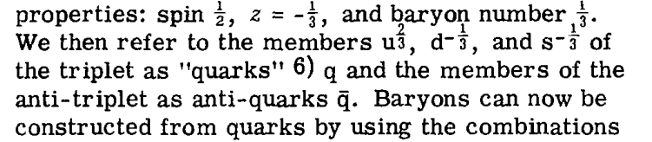
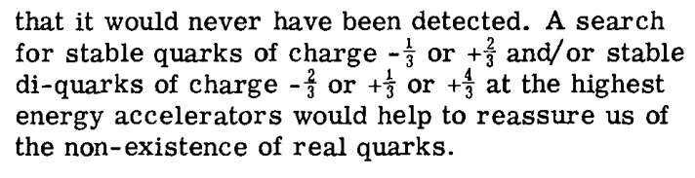
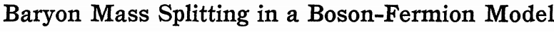
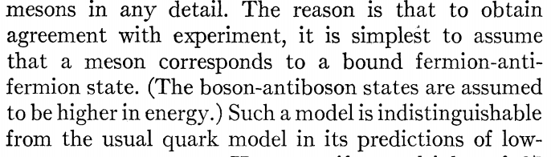
Short review of diquark-antidiquark state
Phys. Lett. 8 (1964) 214-215
• color antitriplet: attactive force between two quarks
• color sextet: repulsive force between two quarks
• light flavor: qq
• heavy flavor: Qq, QQ
Phys. Rev.155 (1967)1601
D. B. Lichtenberg, L. J. Tassie
• diquark-antidiquark state was proposed

Slide 10
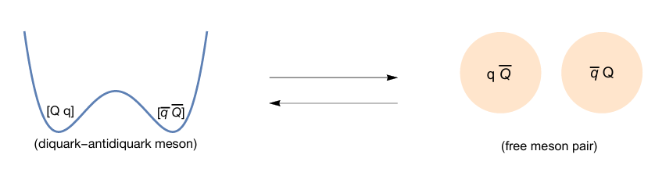
• Picture of diquark-antidiquark state
Phys. Lett. B 778 (2018) 247
• Methords for diquark-antidiquark state
• diquark model
Phys. Rev. Lett. 91, 232003 (2003)
Phys. Rev. D 94, 054026 (2016)
Phys.Rev.D 103 (2021) 094038
Phys. Rev. D 89, 114010 (2014)
• QCD sum rules
Phys.Rev.D 108 (2023) 094019
Chin.Phys.C 45 (2021) 9, 093102
Eur. Phys. J. C 77 (2017) 78
Phys.Rev.D 87 (2013) 014003
• quark model
Phys. Rev. D 92 (2015) 034027
Phys. Rev. D 90, 054009 (2014)
arXiv:1608.07900
arXiv:1707.01180

Slide 11
Mixture of molecular and diquark-antidiquark states

Slide 12
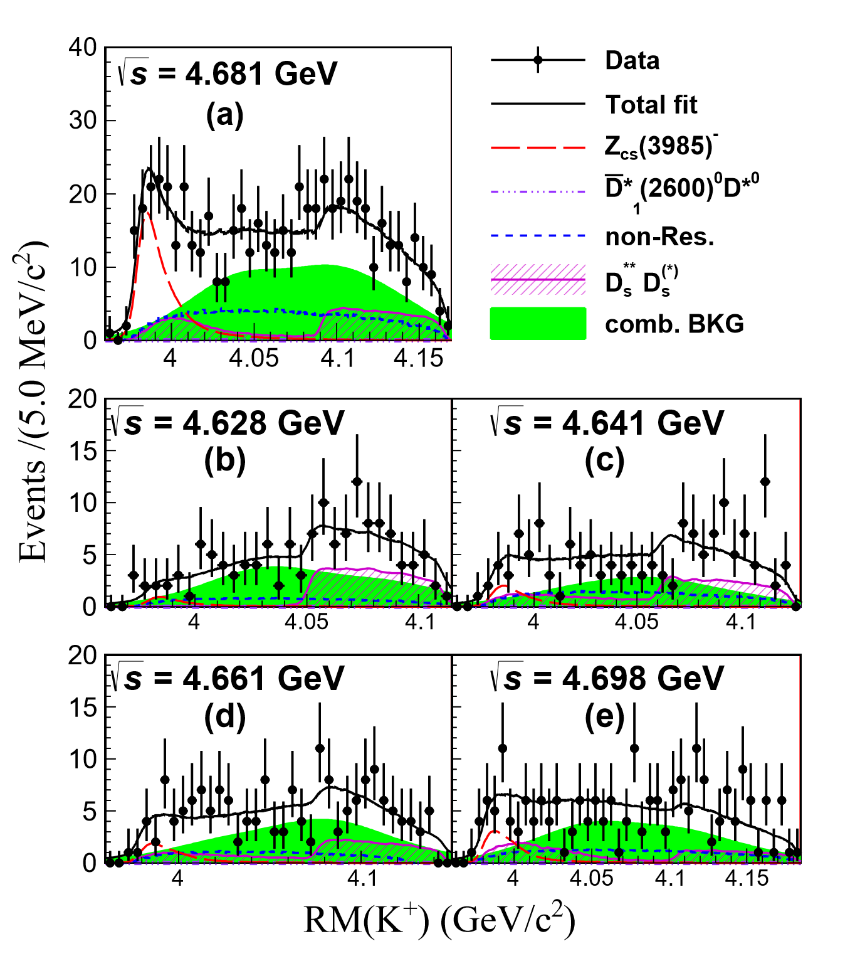
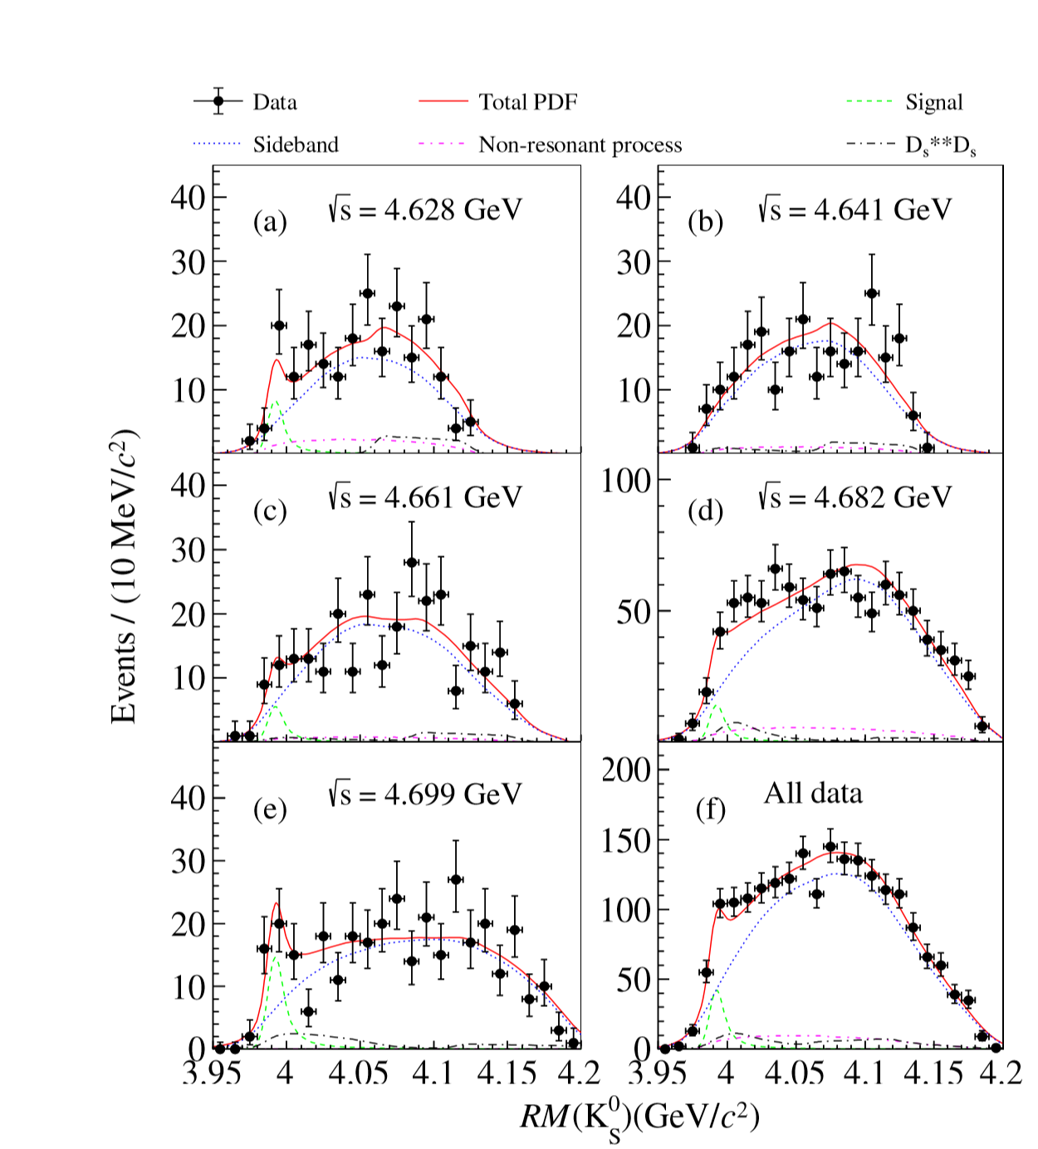
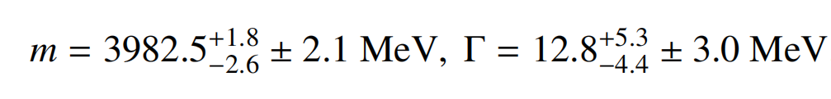


Z_{cs}(3985)：
PRL126,102001(2021)
PRL129, 112003(2022)

Slide 13
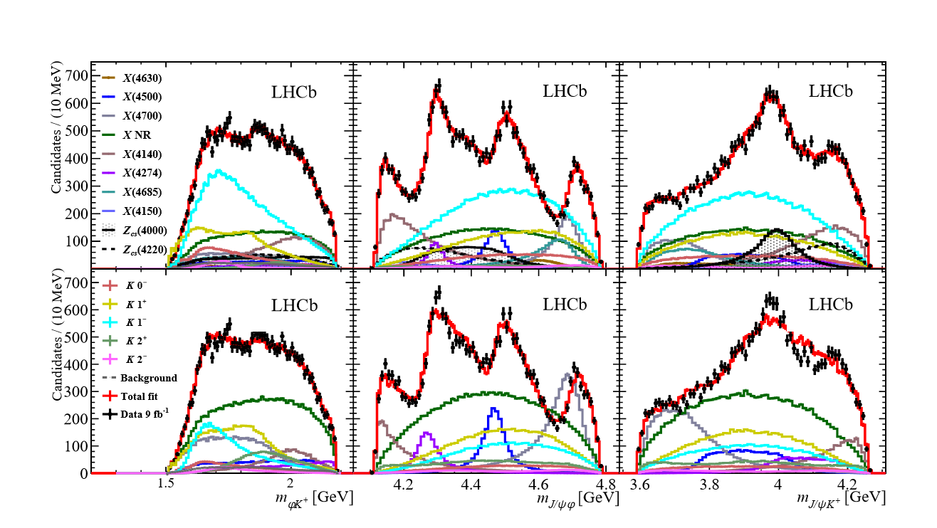
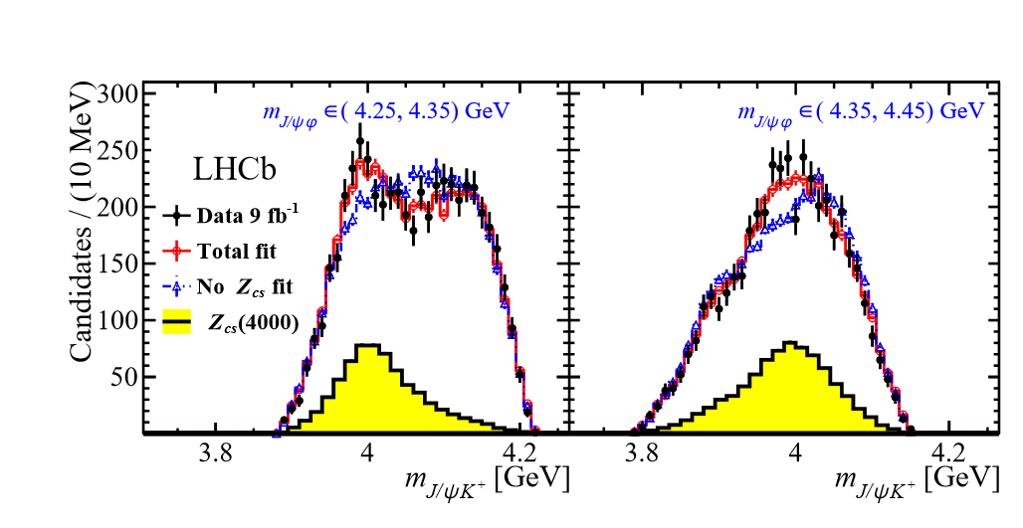
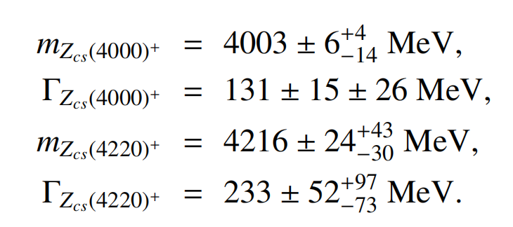
Z_{cs}(4000)、Z_{cs}(4220)：
_
_
quark components：ccus
PRL127, 082001 (2021)

Slide 14
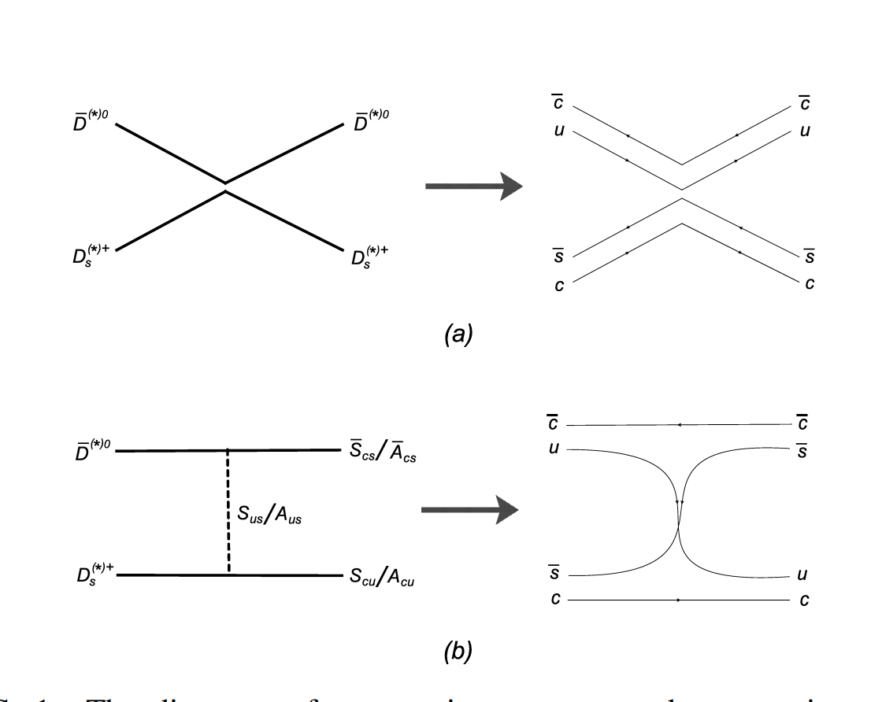
• Treating Z_{cs} as pure molecular state:
hadron level
quark level
• the process is OZI-suppressed
• it is not so natural
OZI rule：
For quark-level Feynman diagrams (omitting gluon lines), if the diagram can be divided into two or more parts without crossing any hadrons or quark lines, the corresponding amplitude is suppressed.

Slide 15
How to solve the problem?
diquark exchange contribution !!!
notice: meson
composed of a quark and an antiquark
diquark composed of two quarks

Slide 16
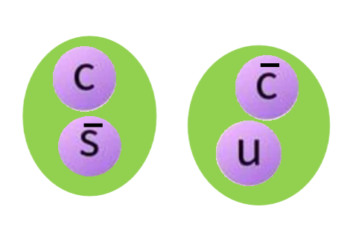
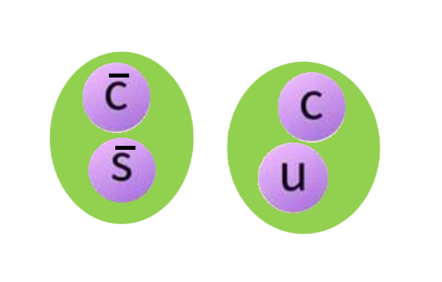
Advantages of diquark-exchange potential:
• solve the problem of OZI suppressed amplitude
• study the mixing effect of molecular and diquark-antidiquark states
• only color antitriplet diquarks are considered (attractive force between
quarks)
• the diquark components in tetraquark are studied via effective field
theory for the first time
+

Slide 17
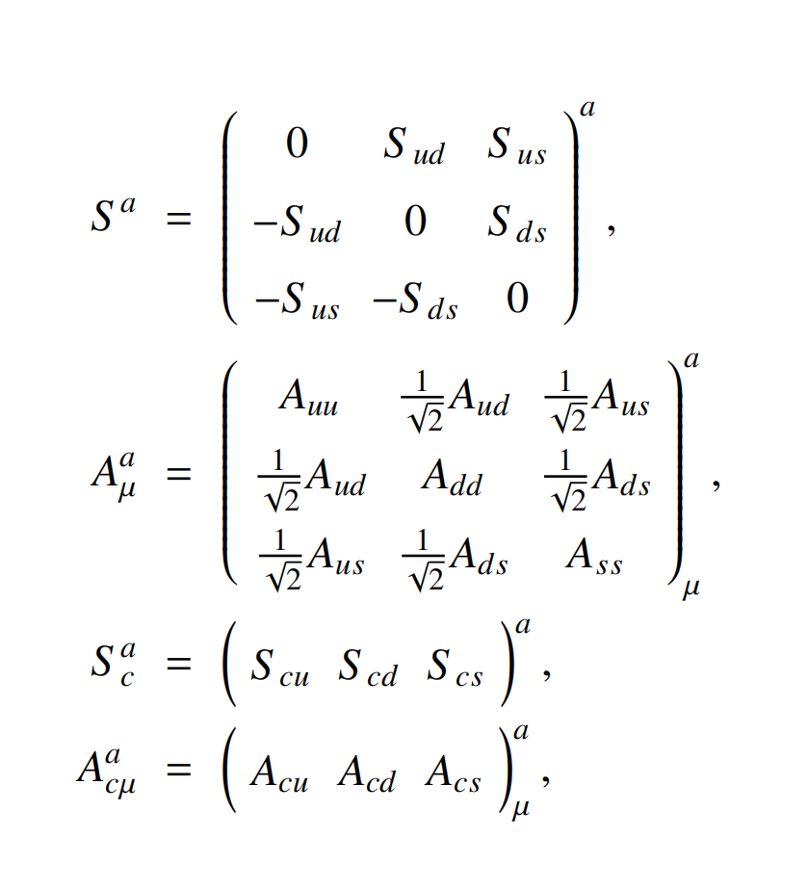
Diquark fields:
这些矩阵是SU(3)对称性下的张量结构

Slide 18

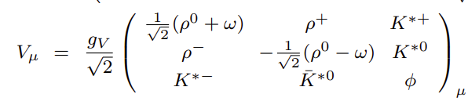
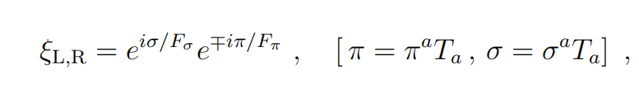
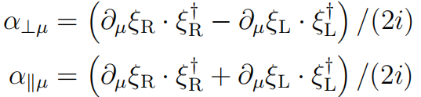
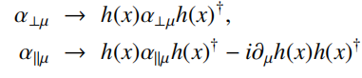

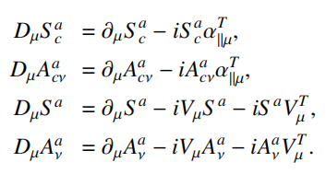

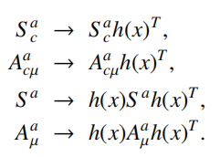





Hidden Local Symmetry:
• vector mesons are introduced as gauge bosons
gauge field strength:
• building blocks and transformation rule

Slide 19
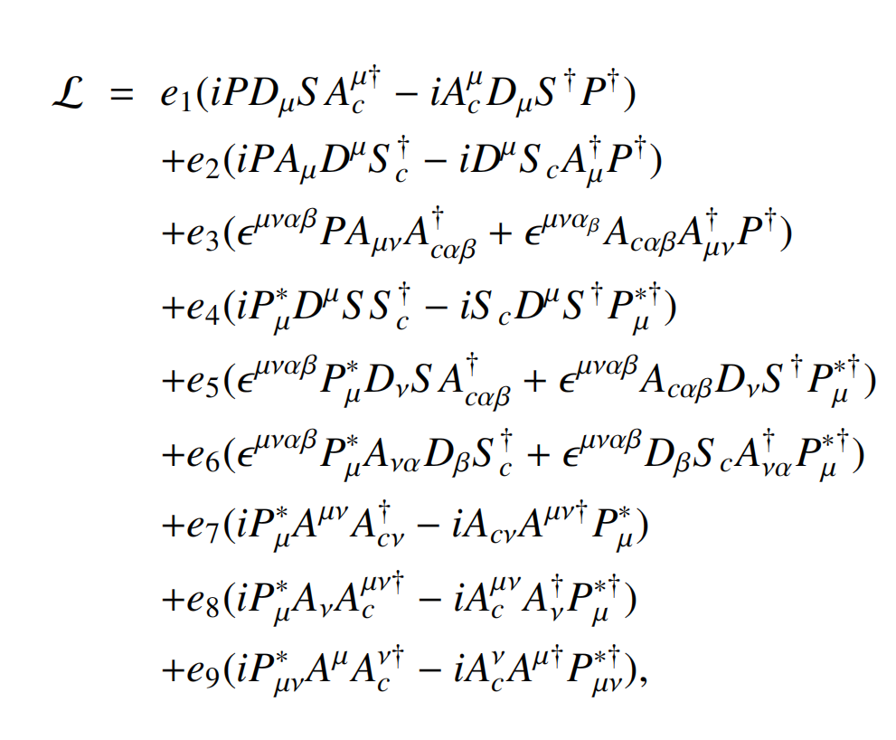
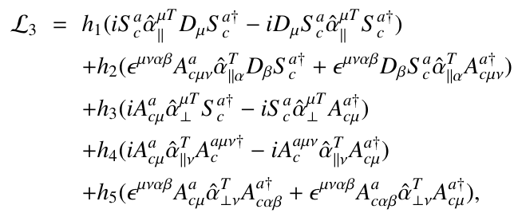

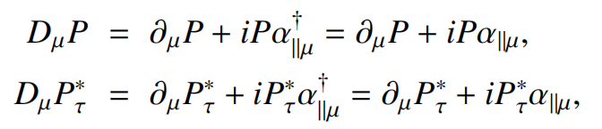
Lagrangians (HLS, P and C)：

Slide 20
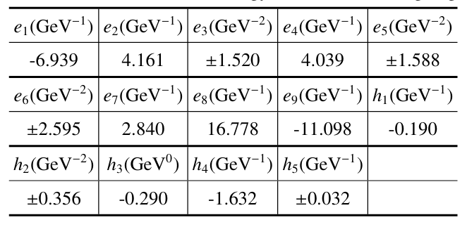
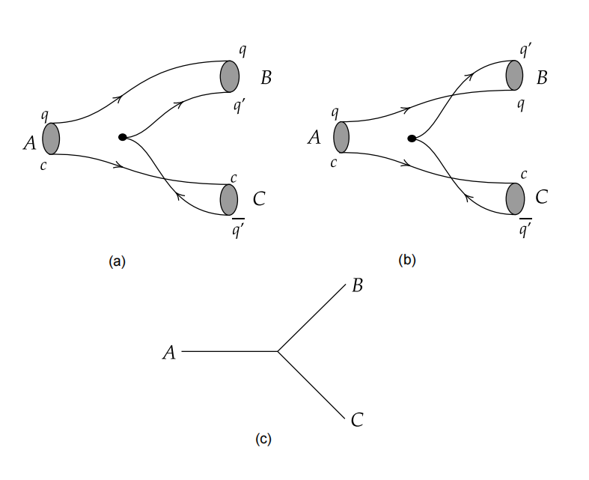
using ³P₀ model to determine the constants:
quark level
hadron-diquark level

Slide 21
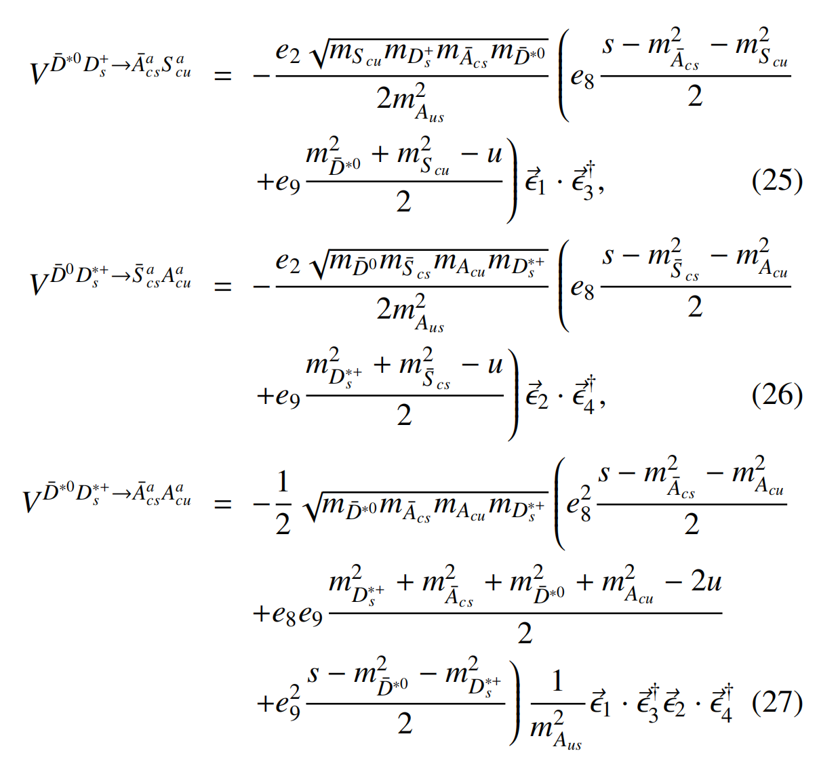
non-zero amplitudes：

Slide 22
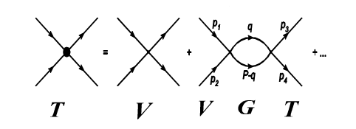
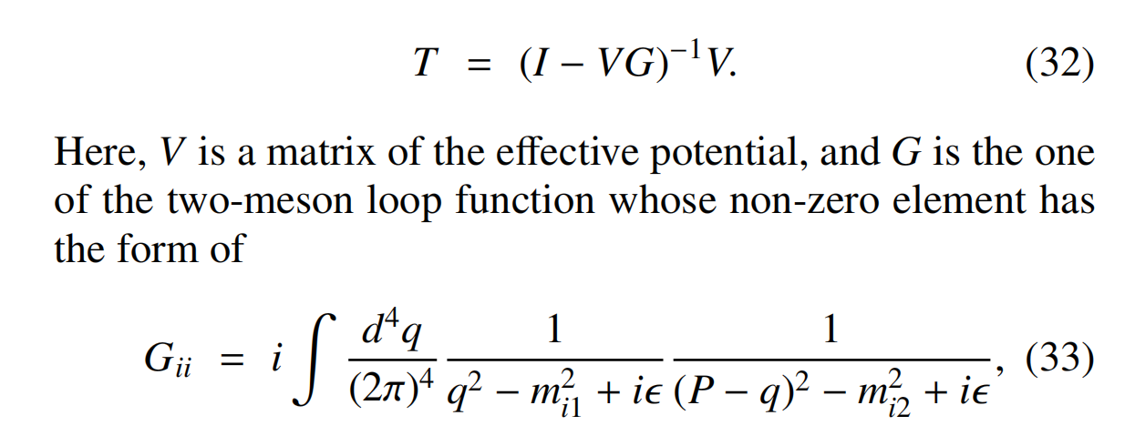
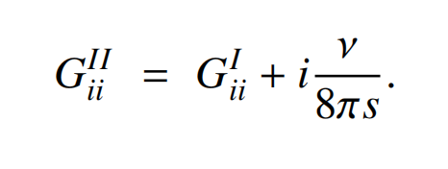
BS equation (on-shell approximation):
V
Analytic continuation：
• first Riemann sheet: bound state
• second Riemann sheet: resonance, virtual state

Slide 23
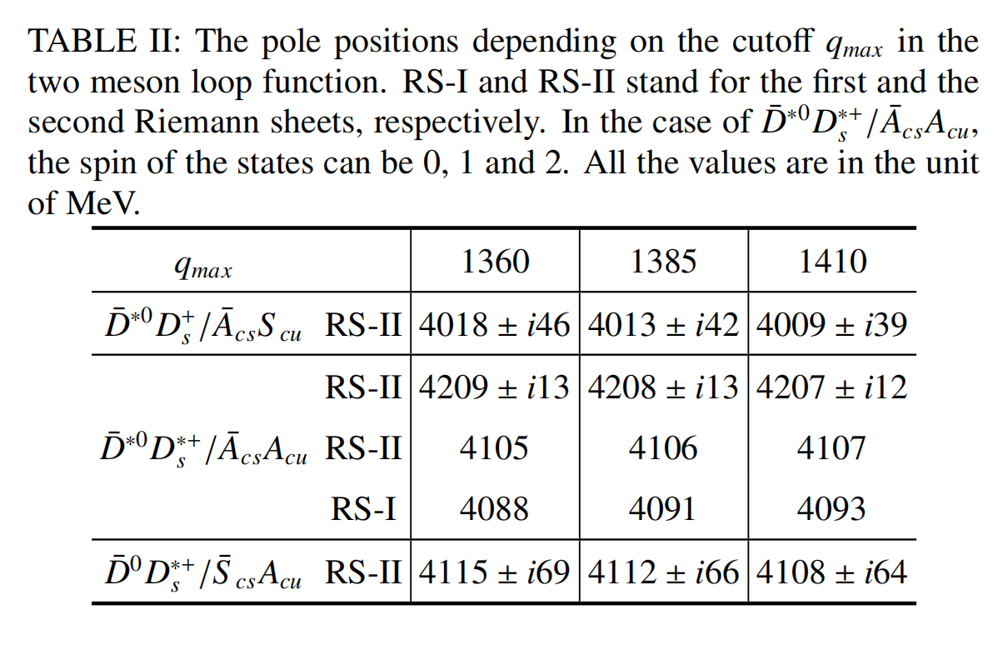
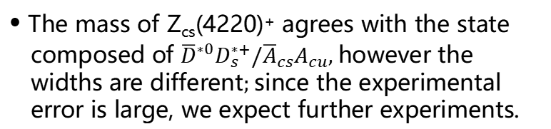

• Numerical results：
自旋为0、1、2
注：表格中数值的单位为MeV
• Z_{cs}(4000)⁺: mixture of ${\overline{D}}^{∗0}D_{s}^{+}/{\overline{A}}_{cs}S_{cu}$
• The mass of Z_{cs}(4220)⁺ agrees with the state
composed of ${\overline{D}}^{∗0}D_{s}^{∗+}/{\overline{A}}_{cs}A_{cu}$, however the
widths are different; since the experimental
error is large, we expect further experiments.

Slide 24
Studies of X(4500), Z_{c}(3900) and T_{cs0}(2900)
*
-

Slide 25
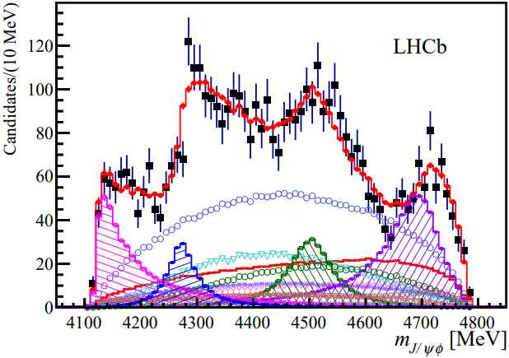
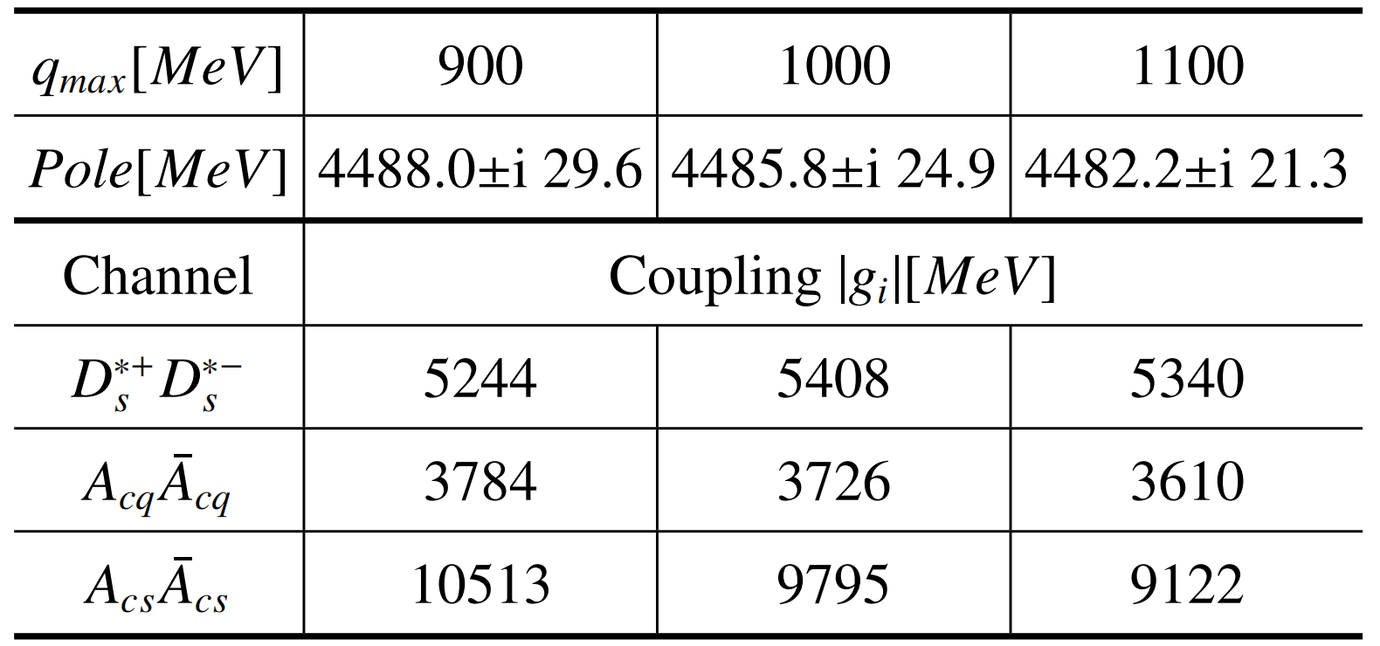
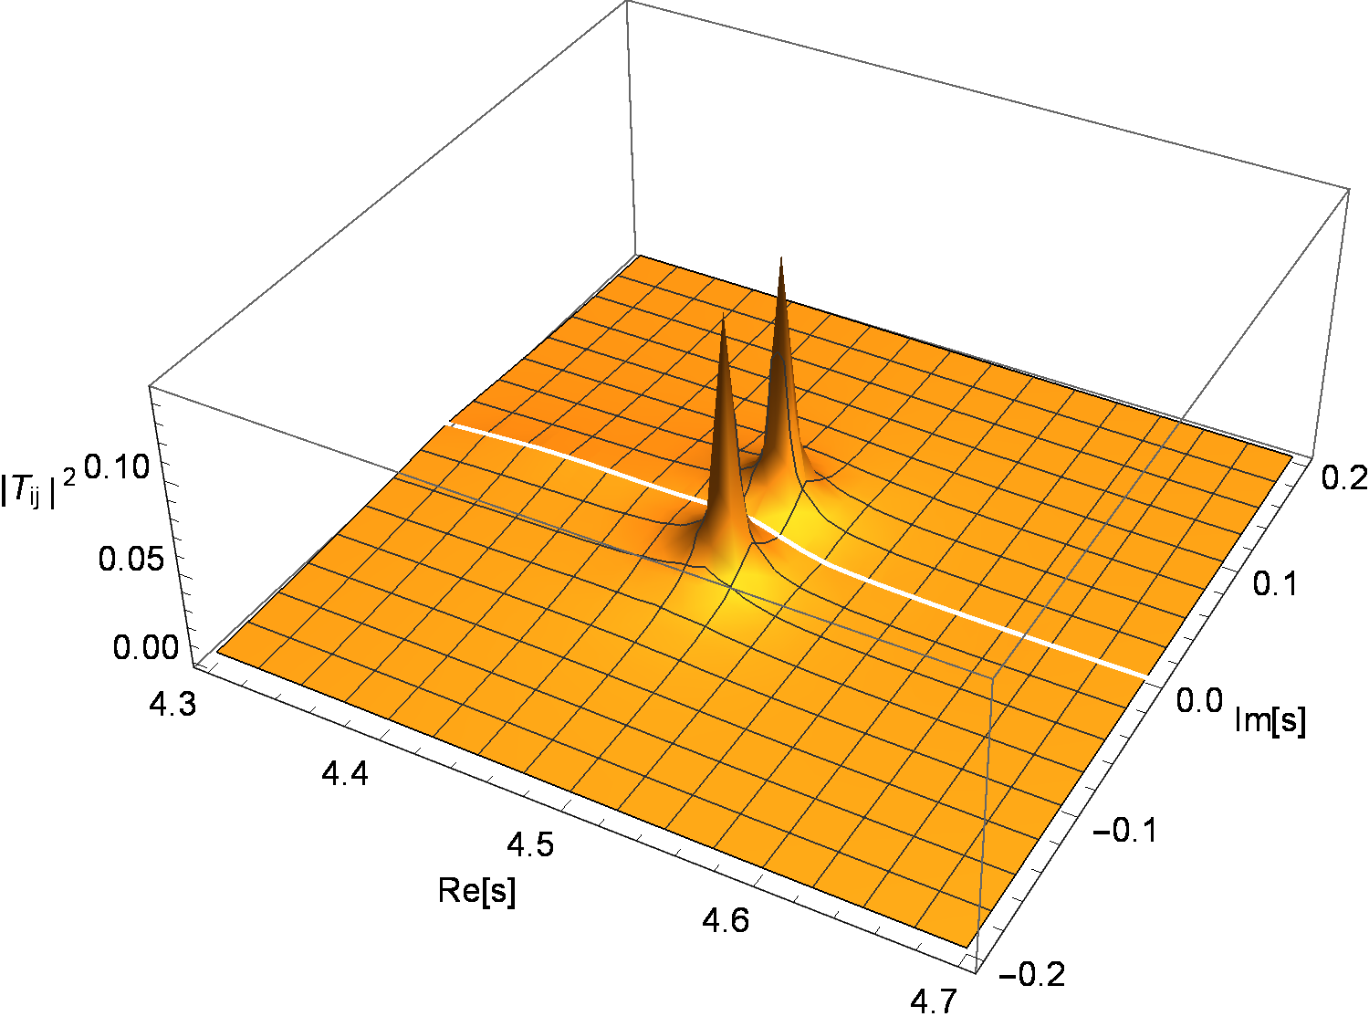





• Observation of X(4500)：
PRL118.022003(2017)
quark components：$c\overline{c}q\overline{q}$
$$I^{G}\left(J^{pc}\right)=0^{+}0^{++}$$
• The structure of X(4500) is not so clear:
diquark-antidiquark state, rescattering effects, 4P charmonium, ...
• Numerical results：
X(4500) can be explained as a mixture of molecular and diquark-antidiquark states
The diquark-antidiquark components are very important
$$|g_{D_{s}^{∗+}D_{s}^{∗−}}|$$
arXiv:2410.05749
$$|g_{A_{cq}{\overline{A}}_{cq}}|$$
$$|g_{A_{cs}{\overline{A}}_{cs}}|$$

Slide 26
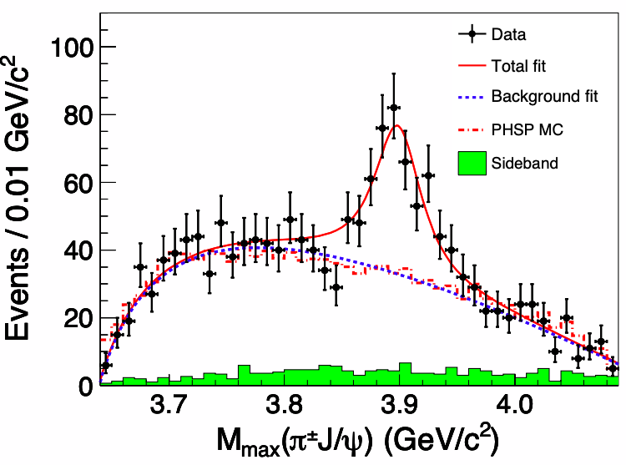
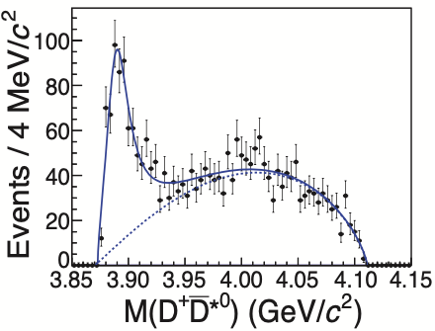









• Experiments of Z_{c}(3900)：
PRL110 (2013), 252001
PRL112 (2014) 2, 022001
PRL115 (2015) 11, 112003
PRL115 (2015) 22, 222002
Events/0.01 GeV/c²
Events/4 MeV/c²
Events/(10 MeV/c²)
Events/(10 MeV/c²)
$$M_{max}(π^{±}J/ψ)(GeV/c^{2})$$
$$M(D^{+}{\overline{D}}^{∗0})(GeV/c^{2})$$
$$M_{π^{0}J/ψ} (GeV/c^{2})$$
$$M(D{\overline{D}}^{∗})(GeV/c^{2})$$
$$m=3893.1±2.2±3.0 MeV$$
$Γ=44.4±5.2±14.0 MeV$
• Our previous work does not support the existance of the
DD* bound state
_
Chin.Phys.C 36 (2012) 194
• Numerical results：
Z_{c}(3900) can be explained as a mixture of molecular and diquark-antidiquark components
The diquark-antidiquark components are very important
arXiv:2412.11144
• Molecular and non-molecular components are of similar importance
Sci.China Phys. Mech. Astron. 67 (2024) 291011

Slide 27




*
-
• Experiments for T_{cs0}(2900)：
*
fit without T_{cs0}(2900)
-
*
fit with T_{cs0}(2900)
-
Phys. Rev. Lett. 131 (2023) 041902

Slide 28



• Coupled channels:
• Feynman diagrams:

Slide 29



• Lagrangians for light diquarks and mesons:
Phys. Rept. 381 (2003) 1-233

Slide 30

• Numerical results：
*
-
T_{cs0}(2900) can be explained as a mixture of molecular and diquark-antidiquark components
The coupling to the diquark-antidiquark component is as large as each molecular component

Slide 31

总结
• Lagrangians involving diquarks are constructed
• employ diquark exchange potential to study the mixing effect of
molecular and diquark-antidiquark states
• solved the problem of OZI suppressed amplitude if treating Z_{cs} as
molecular states
• Z_{cs}(4000)⁺ can be explained as a mixture of ${\overline{D}}^{∗0}D_{s}^{+}/{\overline{A}}_{cs}S_{cu}$
• The mass of Z_{cs}(4220)⁺ agrees with the mixing state of ${\overline{D}}^{∗0}D_{s}^{∗+}/$
${\overline{A}}_{cs}A_{cu}$, however the widths are different; since the experimental
error is large, we expect further experiments.
• X(4500), X(3900) and T_{cs0}(2900) can be explained as a mixture
of molecular and diquark-antidiquark states.
*
-

Slide 32
谢谢！

