Slide 1
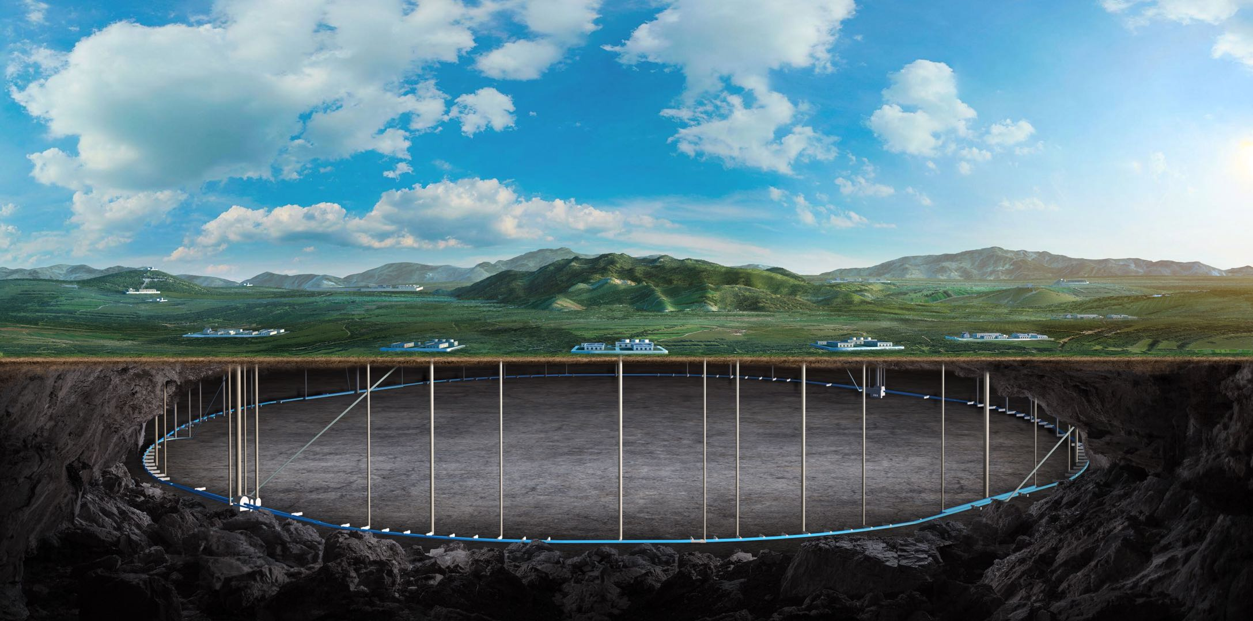
CEPC Detector Mechanical Integration
Ji Quan Xia Shang
(On behalf of the CEPC Mechanics Working Group)
Oct. 22th, 2024, CEPC Detector Ref-TDR Review

Slide 2
Content
Introduction
Requirements
Technical challenges
Overall installation plan
Detail installation design
Our Team
Summary and working plan

Slide 3
Introduction
CEPC Detector Mechanical Integration : (Ref-TDR)
1. Overall mechanical layout
Based on design requirements of sub-detectors and their electronics
2. Connection structure between sub-detectors and the installation of sub-detectors
Provide design guidance for the interface of each sub-detector
3. Configuration of the underground experimental Hall
Space for the detector and installation
Vertical shaft hoist, lifting equipment, and other essential infrastructure
4. Others
Underground auxiliary hall, Ground Halls

Slide 4
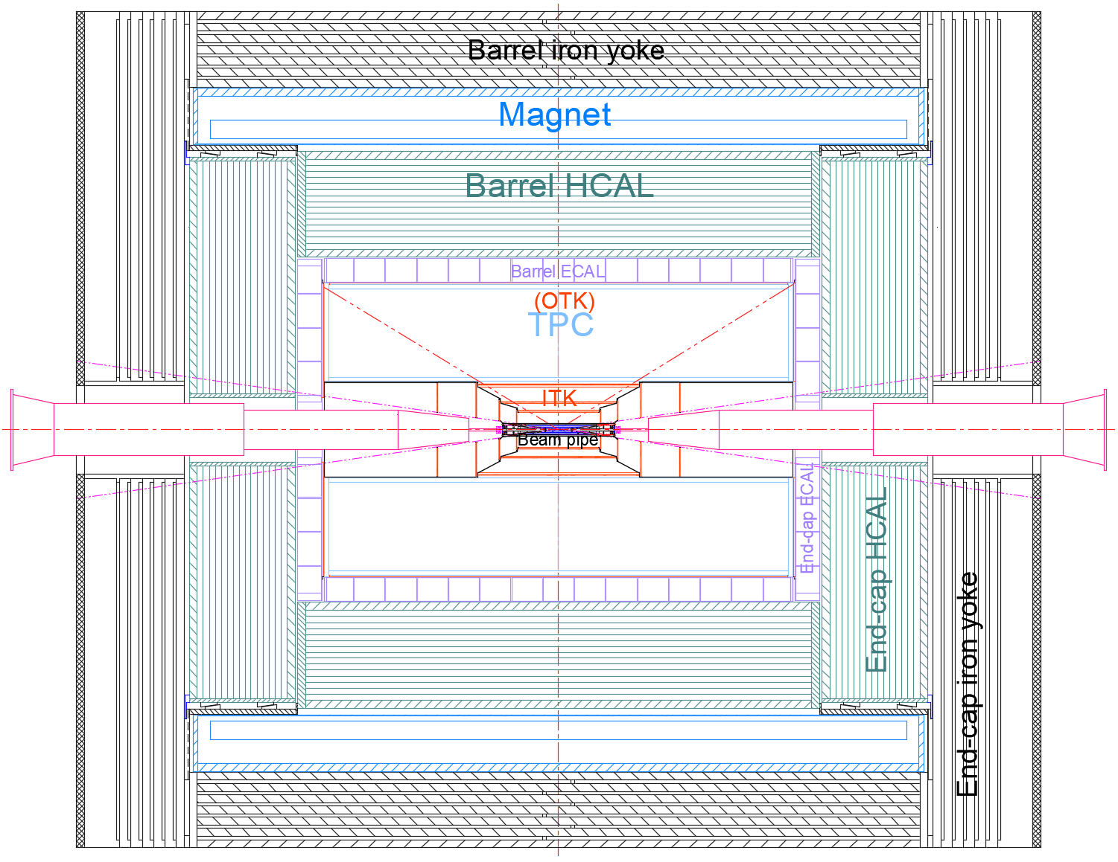
Introduction
1. Overall mechanical layout:
From outmost to innermost
Barrel(7)
Endcap(3)
MDI(1)
Yoke
(Muon)
Magnet
HCAL
ECAL
TPC
(OTK)
ITK
Beam pipe
(VTX LumiCal)
Yoke
(Muon)
HCAL
ECAL
(OTK)
ACC component
Paraffin

Slide 5
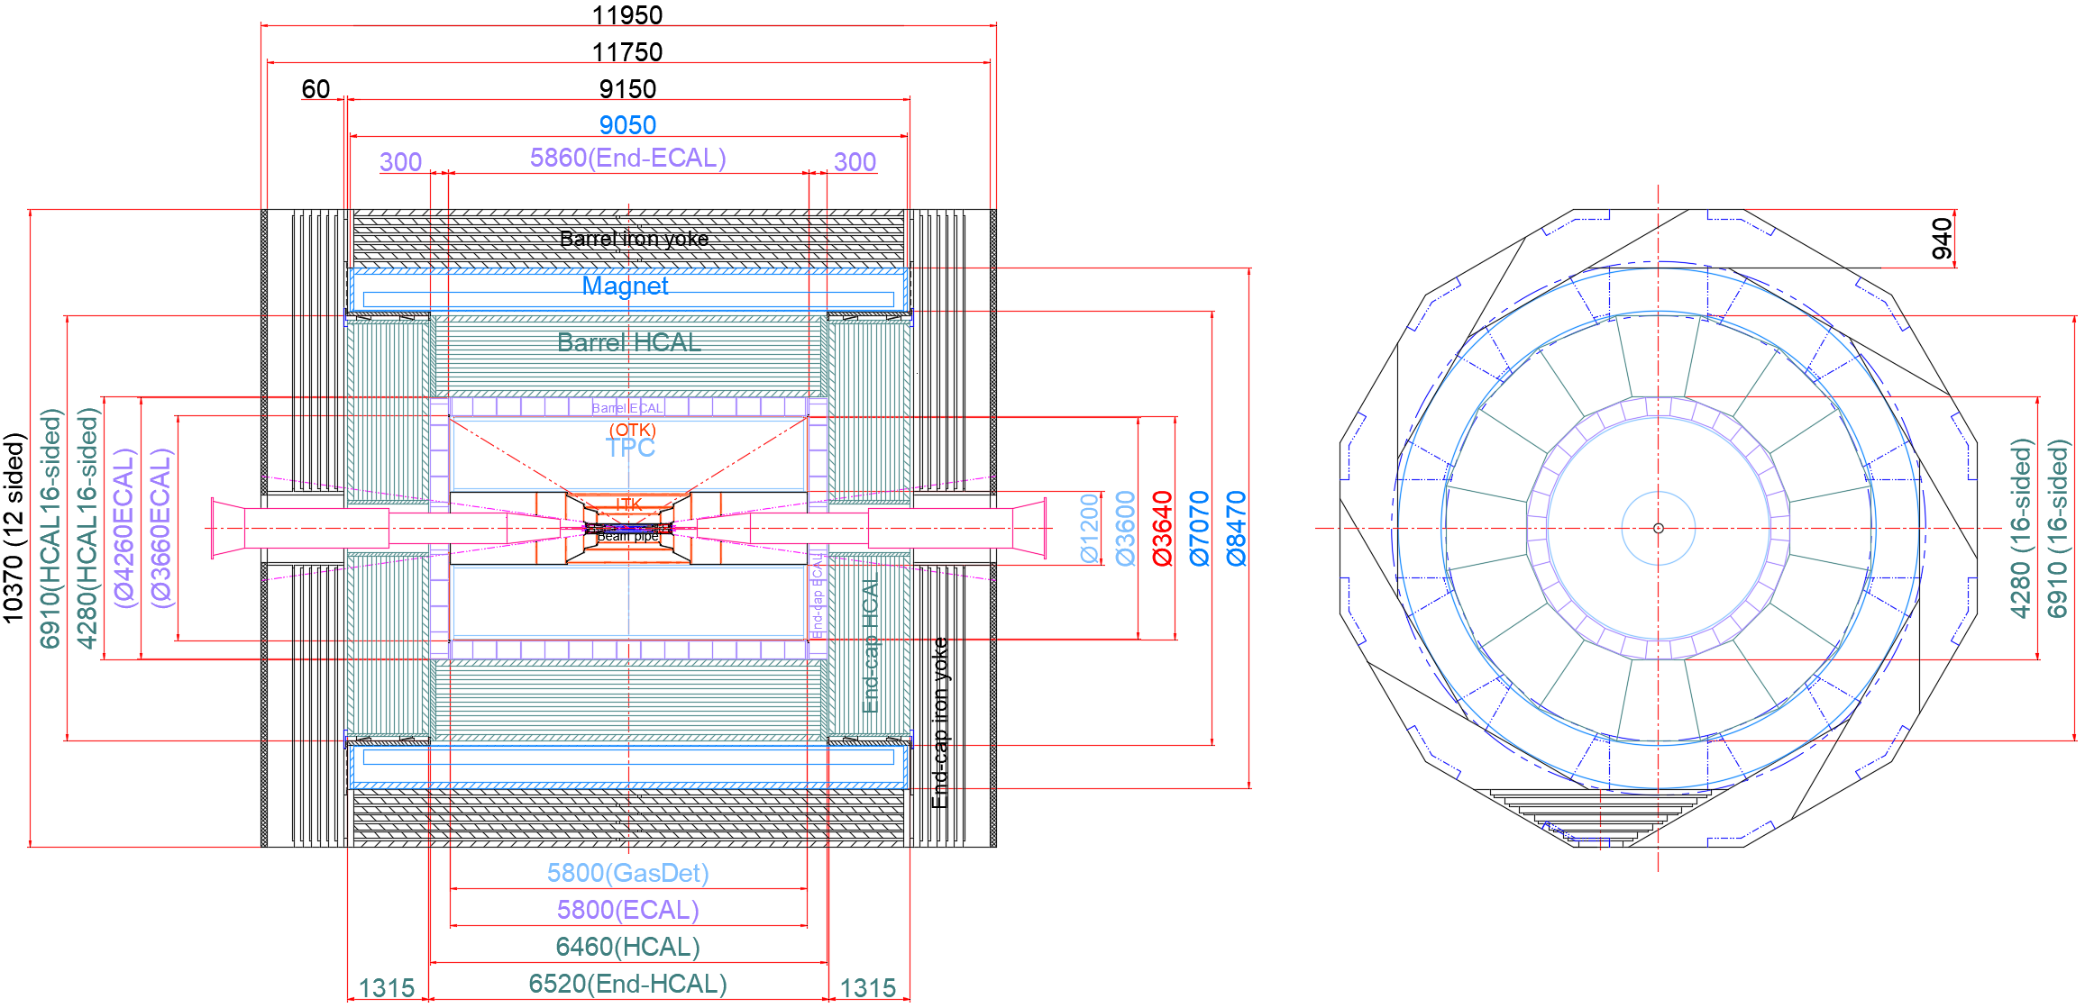
Introduction
2. Detector layers and dimensions:
Overall dimension :
length : 11,950 mm
Height : 10,370 mm
Further optimization and improvement are needed

Slide 6
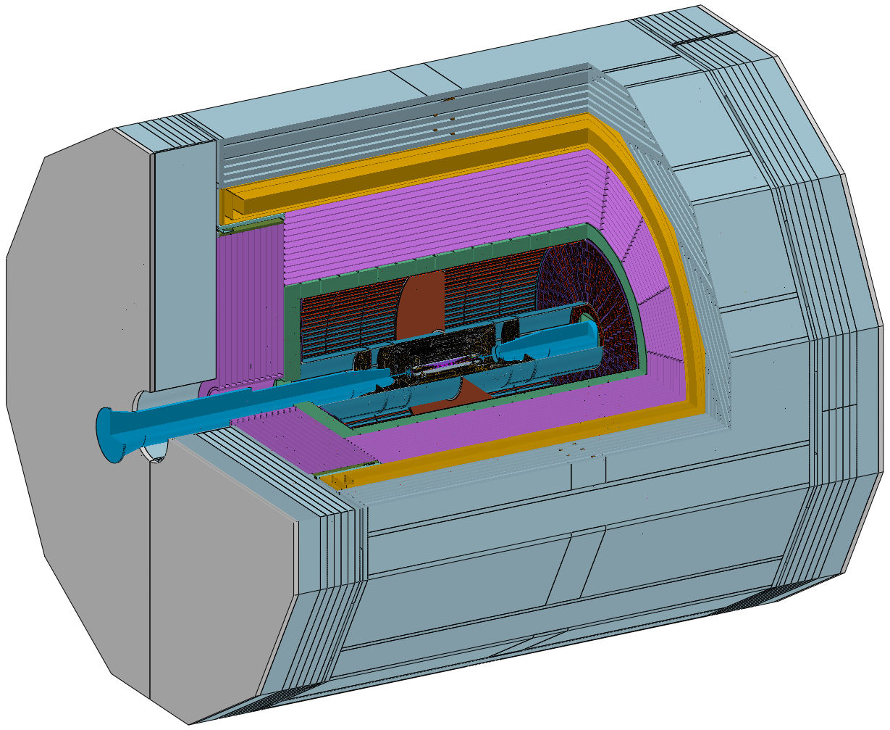
Introduction
Total weight :
≈ 5,150 t
Yoke ≈ 2,960 t
(Barrel: 1560 t Endcap: 700 X 2 t)
Magnet ≈ 290 t
HCAL ≈ 1,660 t
(Barrel: 960 t Endcap: 350 X 2 t)
……

Slide 7
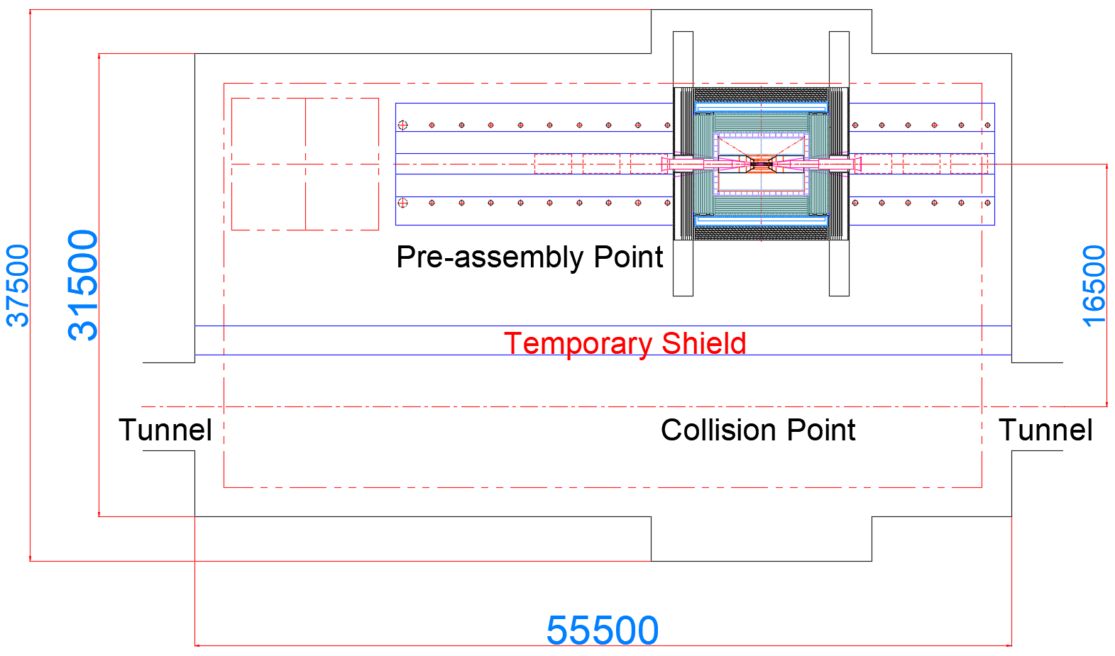
Introduction
3. Layout of the installation scheme with a “Pre-assembly point“ :
Main width : 31,500 mm
Length : 55,500 mm
Beam-tuning experiments and detector installation
can be carried out in parallel
Installation starts at the
Pre-assembly point

Slide 8
Requirements
1. Installation clearance and accuracy :
Profile Tolerance(mm) |  | installation accuracy(mm) |  | positioning accuracy Coaxiality(mm)
 |  | Collimation accuracy (mm) | GAP (mm)
Yoke | ± 1 | < 1 |  | ±0.5
Magnet | Outer: 0 to -5, inner: 0 to +5 | < 2 | 10 | ± 1
HCAL | Outer: 0 to -5, inner: 0 t0 +5 | ± 2 | 10 | ± 0.5
ECAL | Outer: 0 to -5, Inner: 0 t0 +5 | ± 2 | 10 | ± 0.5
TPC | Outer: 0 to -2, Inner: 0 t0 +2 | ± 1 | 5 | ± 0.1
ITK | Outer: 0 to -2, Inner: 0 t0 +2 | ± 1 | 5 | ± 0.1
Beampipe | Outer: 0 to -0.3, Inner: 0 t0 +0.3 | ± 0.5 | 2 | ± 0.1
Minimum gap principle :
As small as possible
Note :
1. The deformation during the installation procedures of the sub-detector must meet the gap requirements.
2. The data in the table will be continuously to be optimized as the design evolves.

Slide 9
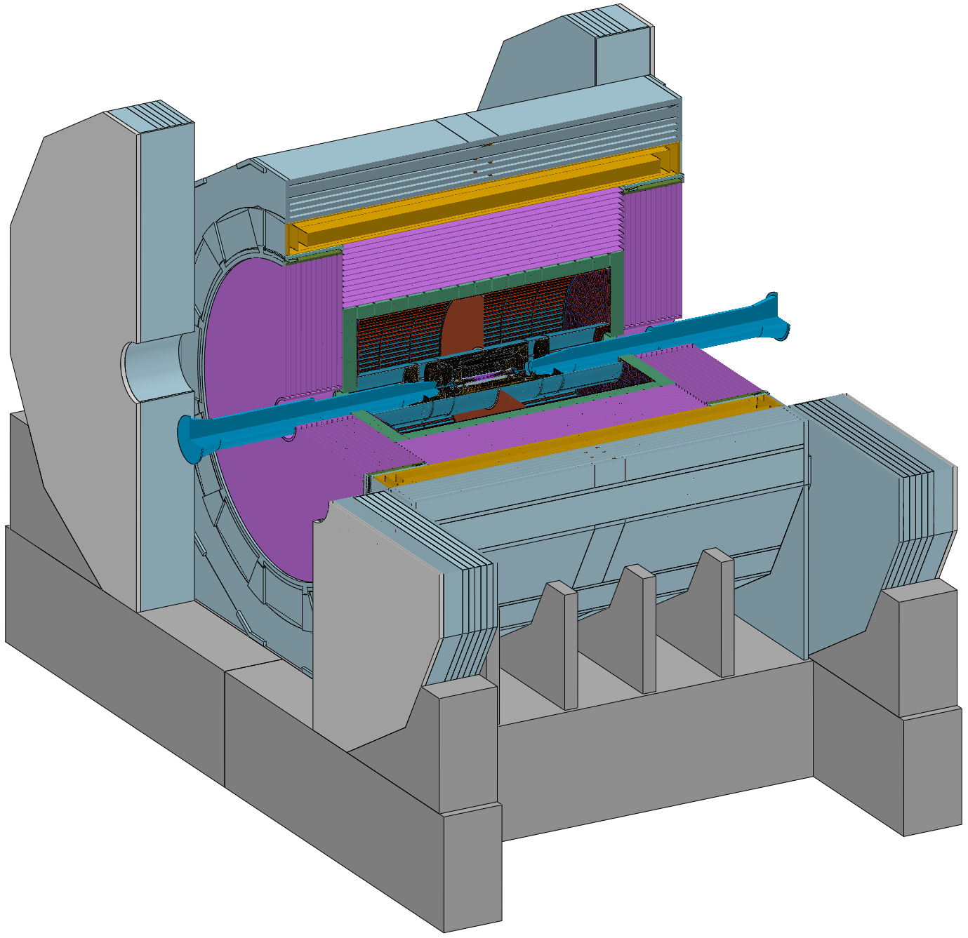
Requirements
Connection design :
1. The connection structure should be proximity
2. The connection structure should be adjustable (Remote automatic)
Barrel Yoke : Fixed on the ground Base
Magnet : Fixed on the Barrel Yoke
Barrel HCAL : Fixed on the Barrel Yoke
Barrel ECAL : Fixed on the Barrel HCAL
TPC+OTK : Fixed on the Barrel ECAL
ITK : Fixed on the TPC
Beampipe(Vertex and LumiCal) : Fixed on the ITK
End-cap ECAL+OTK : Fixed on the Barrel HCAL
End-cap HCAL : Fixed on the Barrel HCAL
(Auxiliary ring or Flange)
End Yoke : Fixed on the ground Base
Base

Slide 10
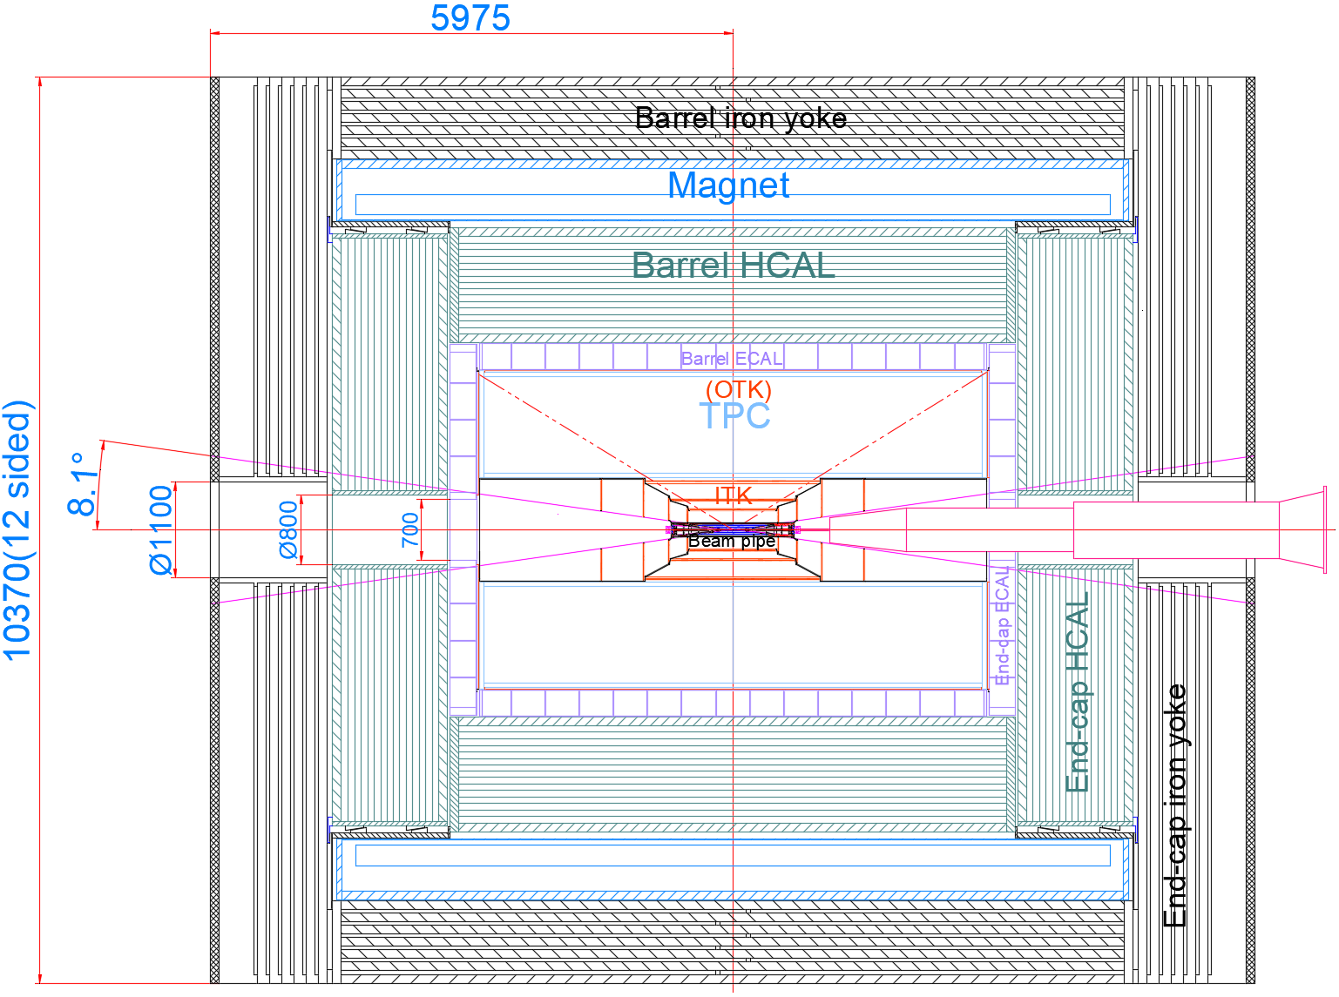
Requirements
MDI boundary
Consists of 4 sections :
Detection coverage: 8.1 ° (cosθ=0.99)
(Before ECAL)
(After ECAL)
ECAL : 700 X 700 mm
HCAL : Ø800 mm
Yoke : Ø1100 mm
Conical hole and stepped holes are
reserved for accelerators

Slide 11
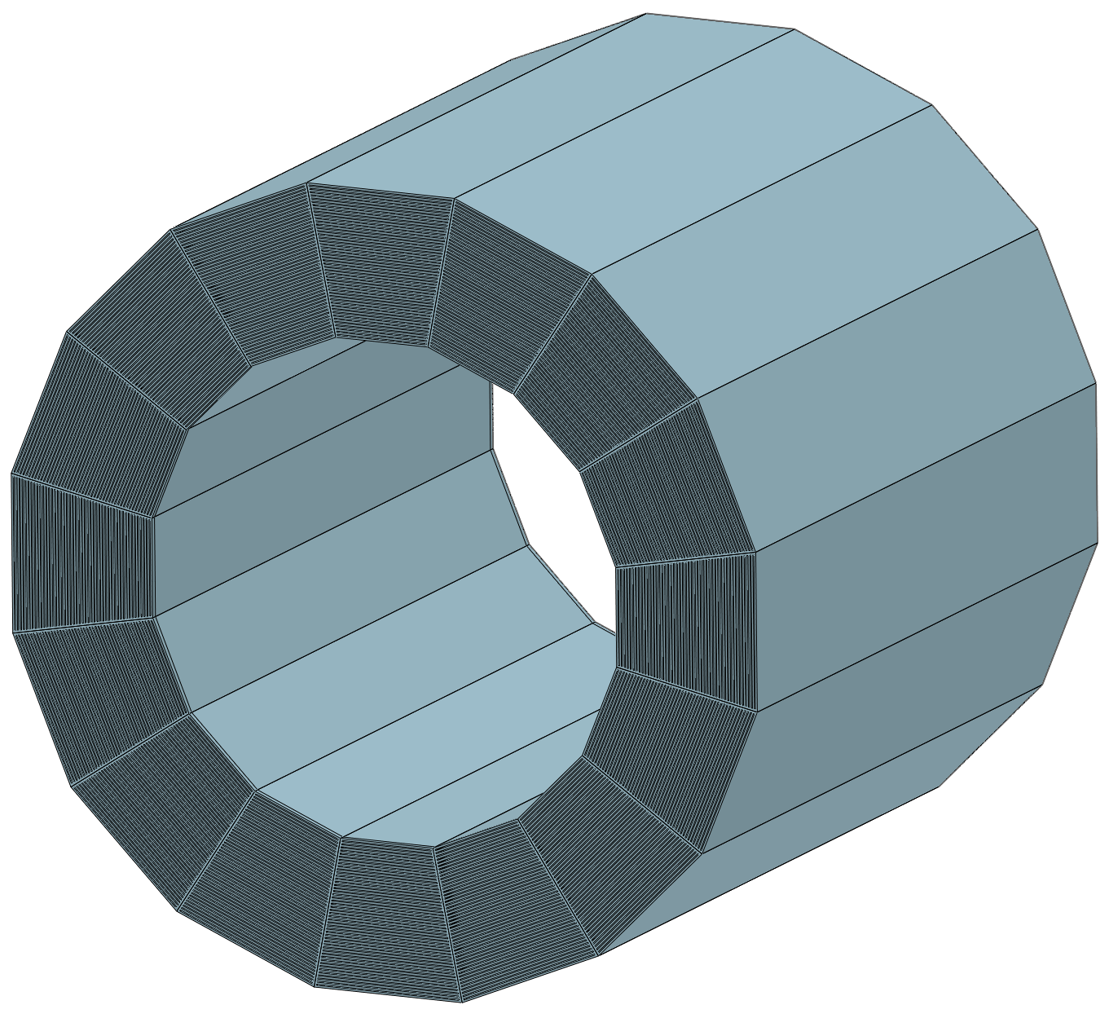
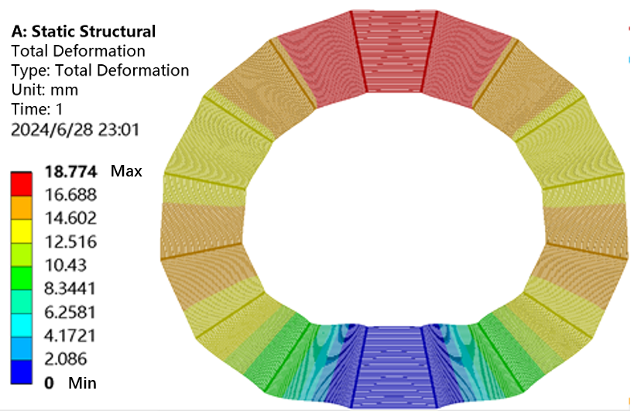
Technical Challenges
In the mechanical design process, we are facing several technical challenges:
1. Self-weight deformation VS installation clearance
How to
Handle Deformation ?
for HCAL
Key :
Deformation must be controlled
by the mechanical structure design
HCAL Structure
HCAL deformation calculation results
Requirements :
GAP between HCAL and Magnet : 10 mm
GAP between HCAL and ECAL : 10 mm
Self-weight deformation :
18.8 mm (> 10 mm)

Slide 12
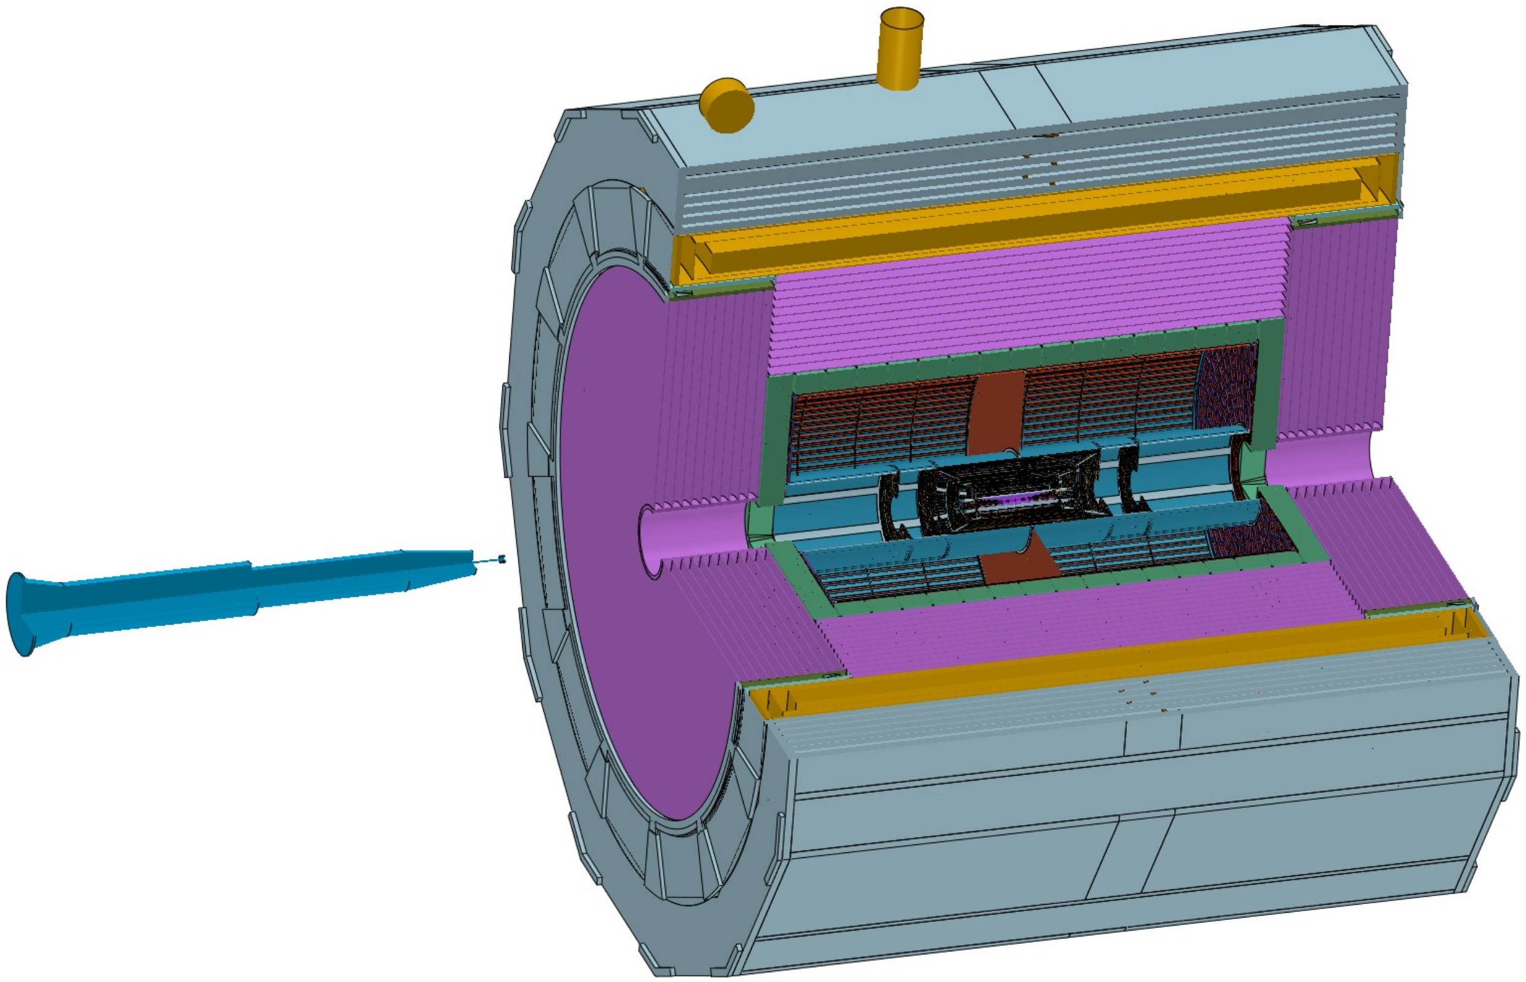
Technical Challenges
In the mechanical design process, we are facing several technical challenges:
2. Vacuum sealed Connection between Accelerator component and the Be beampipe
This connection
cannot be operated
using conventional methods
Accelerator
MDI component
Technical challenge :
leak rate : 2.66 X 10 ⁻¹¹ Pa *m³ /s
Beampipe
Further improvement is needed in pillow seals technology
Pillow seals may be used for remote vacuum connections automatically.

Slide 13
Overall Installation Plan
Follow three principles ：
1. Installation location :
Pre-assembly point
Advantage : Beam-tuning experiments and detector installation can be carried out in parallel
with the accelerator installation and commissionning
2. Installation design :
● Installation and disassembly processes are reversible
● Installation rails will be kept permanently
Purpose: To facilitate the maintenance and replacement of the detectors

Slide 14
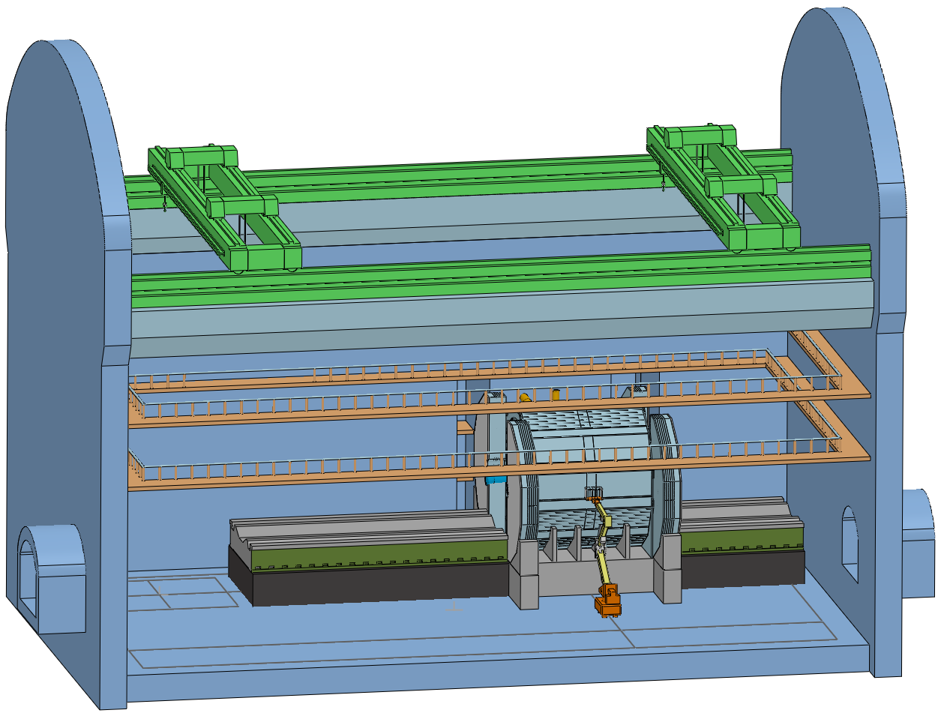
Overall Installation Plan
3. Installation procedures:
Installation should be designed to allow the use of robotic arms
Overhead travelling crane
Design principles :
1. Minimal Tooling
2. Simplified Operation
If Possible
Installations will be easily through a combination of
robotic arms and two overhead cranes.
Collision point
robotic arm

Slide 15
Detailed Installation Design
Detailed installation design:
1. Reliability and safety assessment of the detector integration and their connection structures
(FEA --- stress and deformation)
2. Overall installation procedures
3. Detailed Installation procedures
4. Modular lifting and lifting of integral components

Slide 16
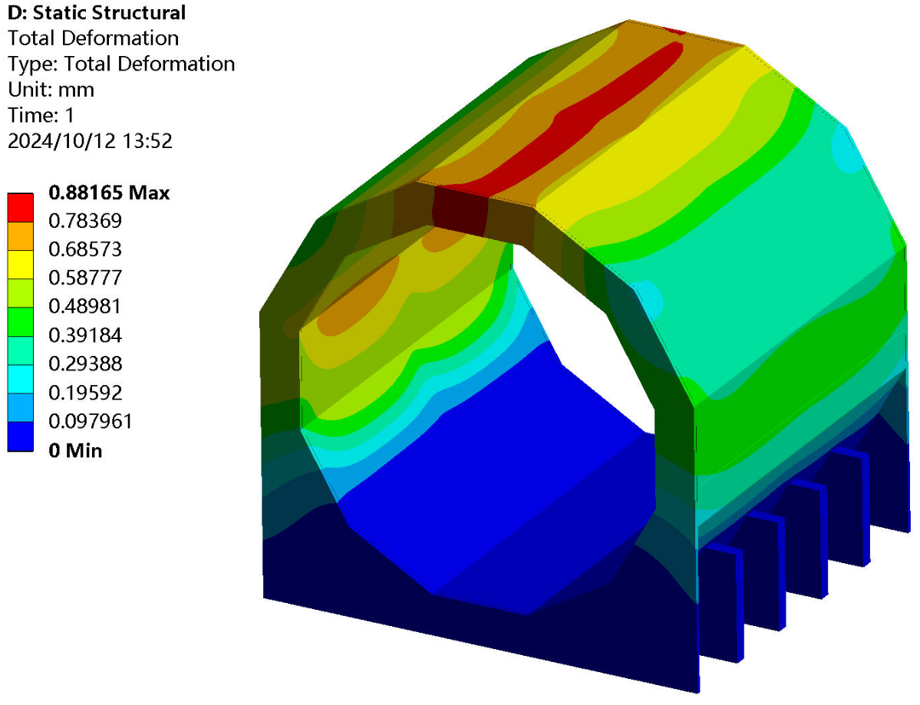
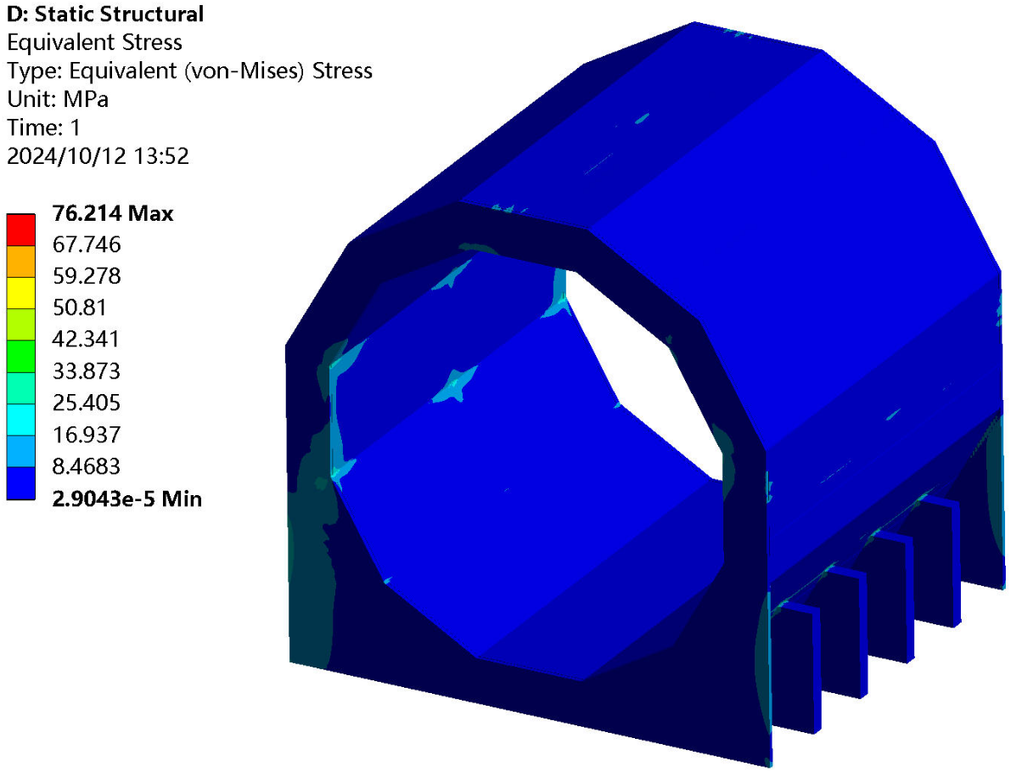
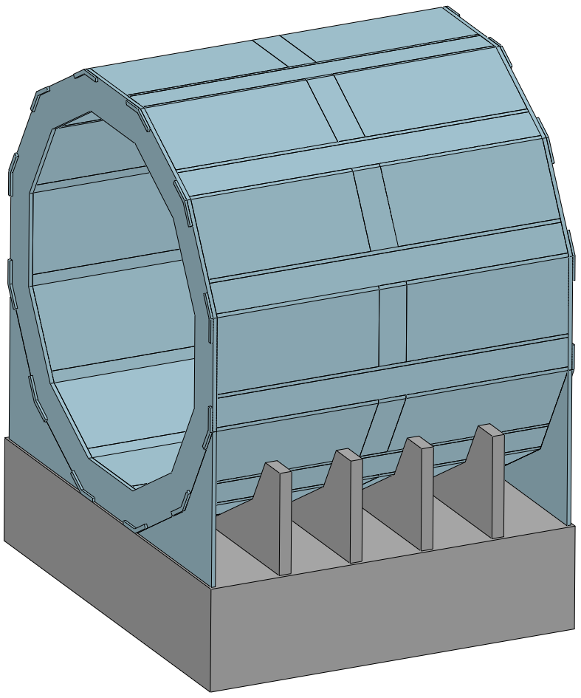
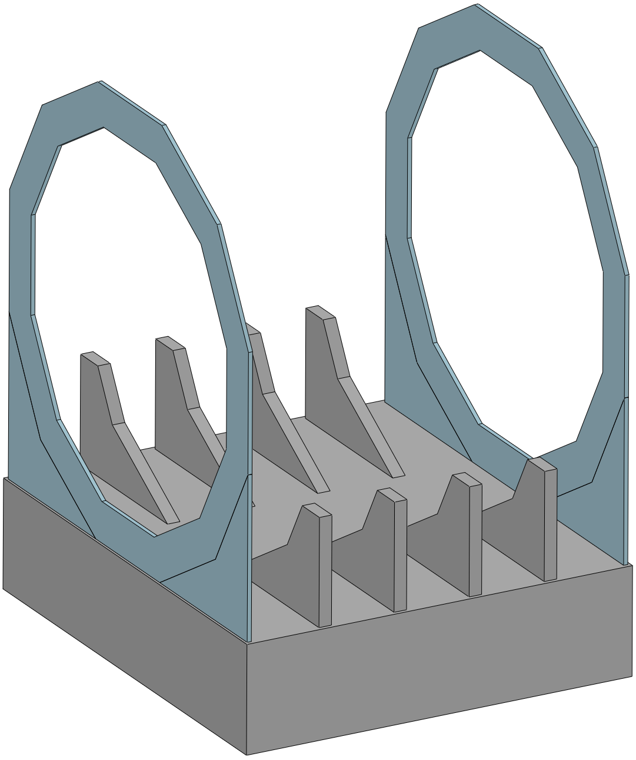
Detailed installation Design
1. Overall reliability and safety assessment
Yoke : 1560 t
Deformation of yoke
without detectors
Deformation : ≈ 0.9 mm
Stress : ≈ 76 MPa
Conclusion :
Meet requirement
(< 1 mm)
Two end flanges
and
barrel supports
can reduce the deformation
End Support
Barrel supports
Drawing of the Endcap and Barrel support

Slide 17
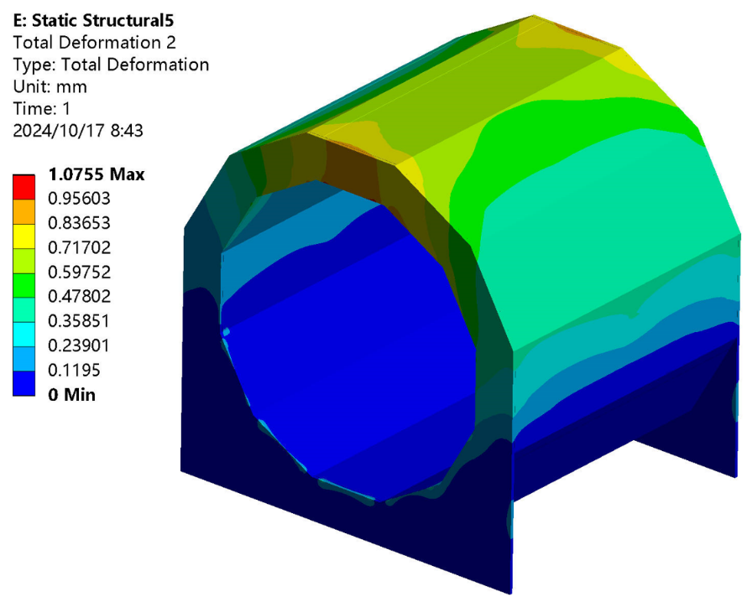
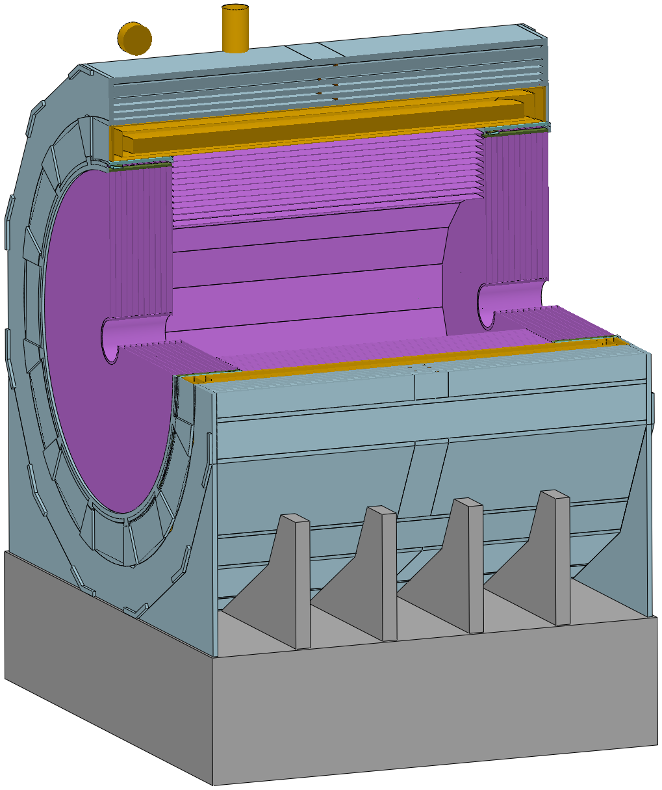
Detailed installation Design
1. Overall reliability and safety assessment
deformation of the Yoke
Deformation of the yoke
in the presence of sub-detectors
Yoke : 1560 t
Magnet : ≈ 290 t
HCAL : ≈ 1660 t
(Barrel: 960 t End: 350 X 2 t)
1950 t
Load
Other lighter components
are ignored
Deformation within requirement
Deformation : 1.07 mm
It’s safe
Deformation ≈ 0.9 mm

Slide 18
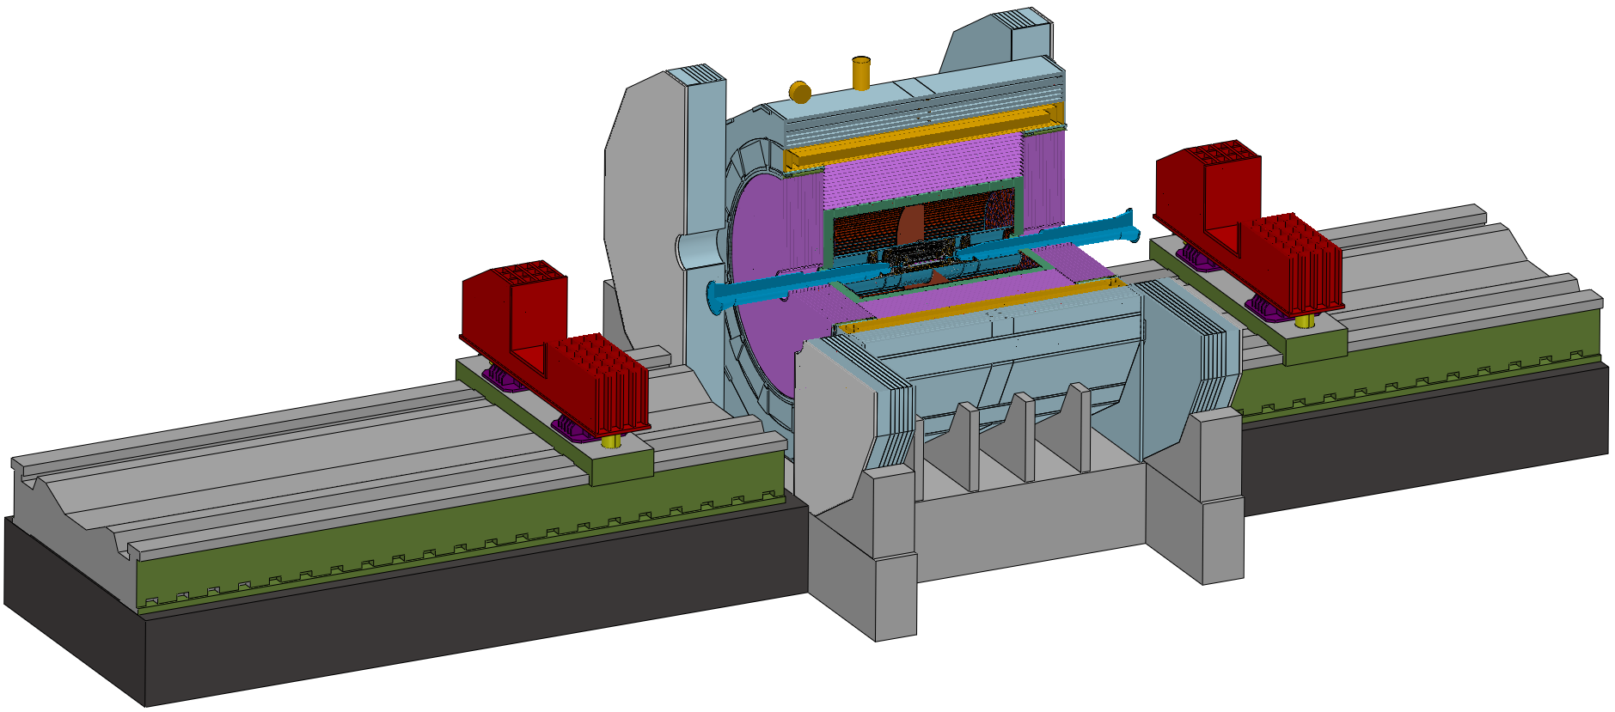
Detailed Installation Design
2. Overall installation procedures
General installation drawing
Barrel Yoke
Note :
Installation guide rails is the benchmark,
and must be pre-aligned with the yoke
Installation guide rails
The main procedures are as follows :
1. In the ground hall
Complete the assembly work of each sub-detector, including electronics, etc.
2. Transport through the shaft
Each sub-detector is lifted into the underground experimental hall through the vertical shaft one by one
3. In the underground experimental hall ---
Assemble each sub detector on the guide rails and push them into the yoke in sequence
most important part of the installation

Slide 19
Detailed Installation Design
2. Overall installation procedures
Installation sequence of detectors(As shown in the following exploded view) :
Step 1 Install the barrel sub-detector first, in the following order :
Yoke, Magnet, HCAL, ECAL, TPC(OTK), ITK, Beampipe(Vertex)
Step 2 Install the endcap sub-detectors, in the following order :
End ECAL(OTK), End HCAL, End Yoke
ACC Component
Beampipe
(Vertex)
End HCAL
End ECAL(OTK)
ITK
TPC(OTK)
ECAL
HCAL
Magnet
Yoke

Slide 20
Detailed Installation Design
3. Detailed Installation procedures
Step 1 Alternating installation : Yoke and Magnet (2) --- Barrel Detectors
Step 2 Core shaft installation : Barrel HCAL and Barrel ECAL (2) --- Barrel Detectors
Step 3 Cantilever installation : TPC(OTK) ITK Beampipe(Vertex + LumiCal) (3) --- Barrel Detectors
End HCAL and End ECAL (2) --- End Detectors
Step 4 Lifting Installation : Yoke --- End Detectors
Step 5 Move the detectors from the Pre-assembly point to the Collision point
Push the accelerator vacuum component into the center of the detector and connect it with the Be beampipe

Slide 21
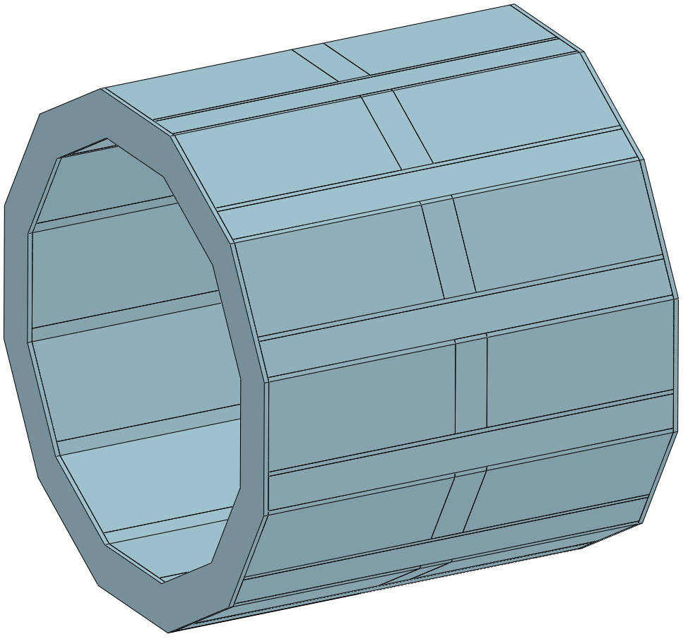
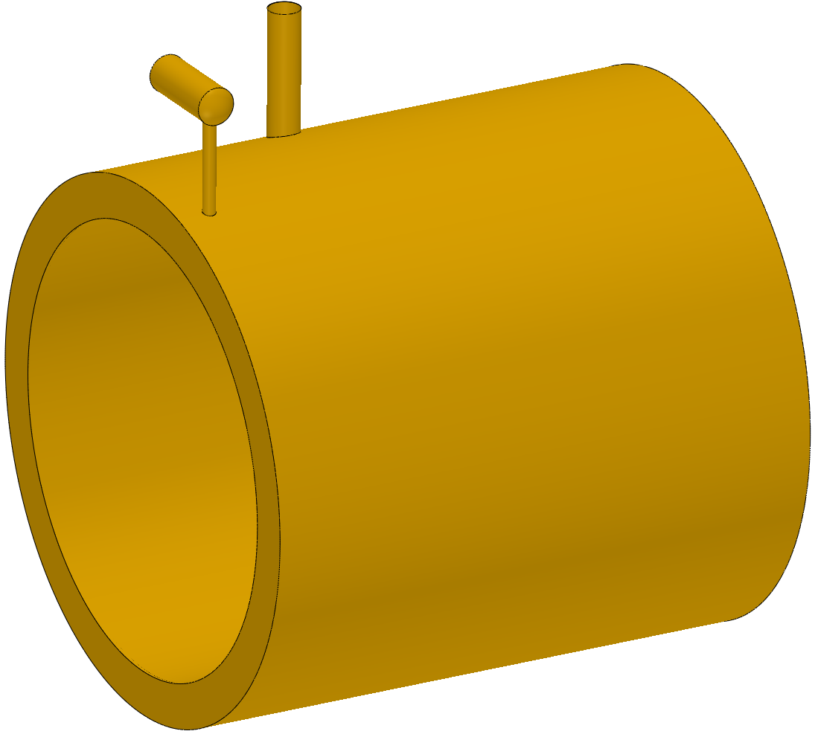
Detailed Installation Design
3. Detailed Installation procedures
Step 1 Alternating installation : Yoke and Magnet (2) --- Barrel Detectors
Method :
‘zero-tool’ assembly
Advantage :
No redundant tooling, reduces installation time
Install Yoke and Magnet (2)
Yoke
Magnet
This is an efficient installation design
(‘zero-tool’ achieves the installation of two detectors)
Yoke and Magnet

Slide 22
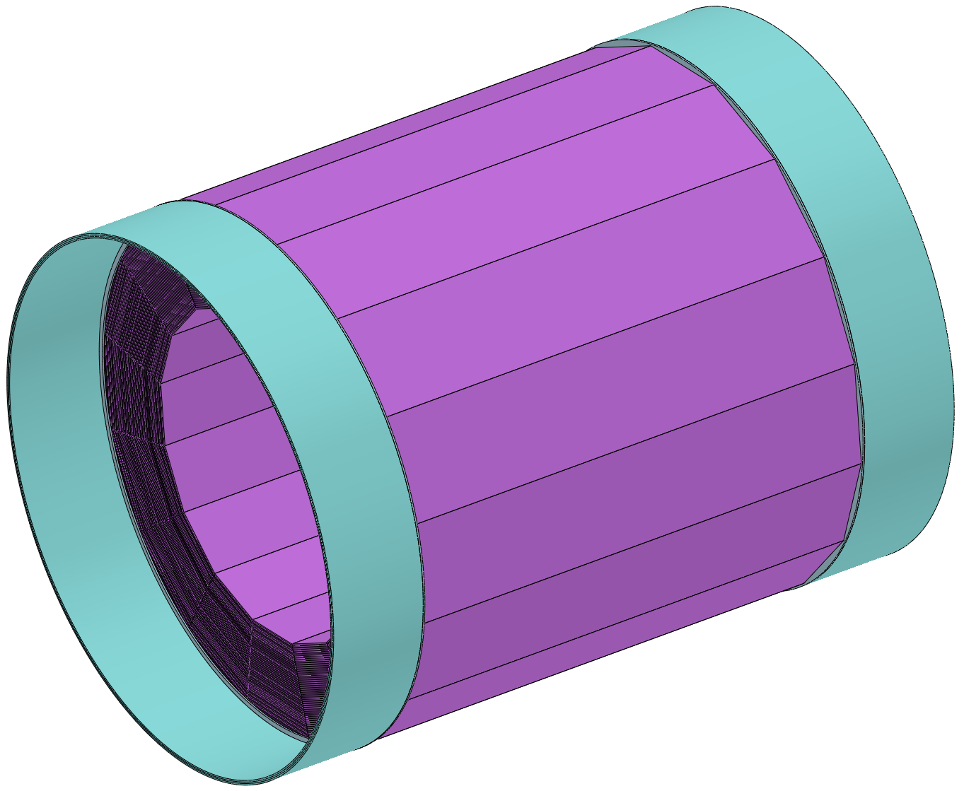
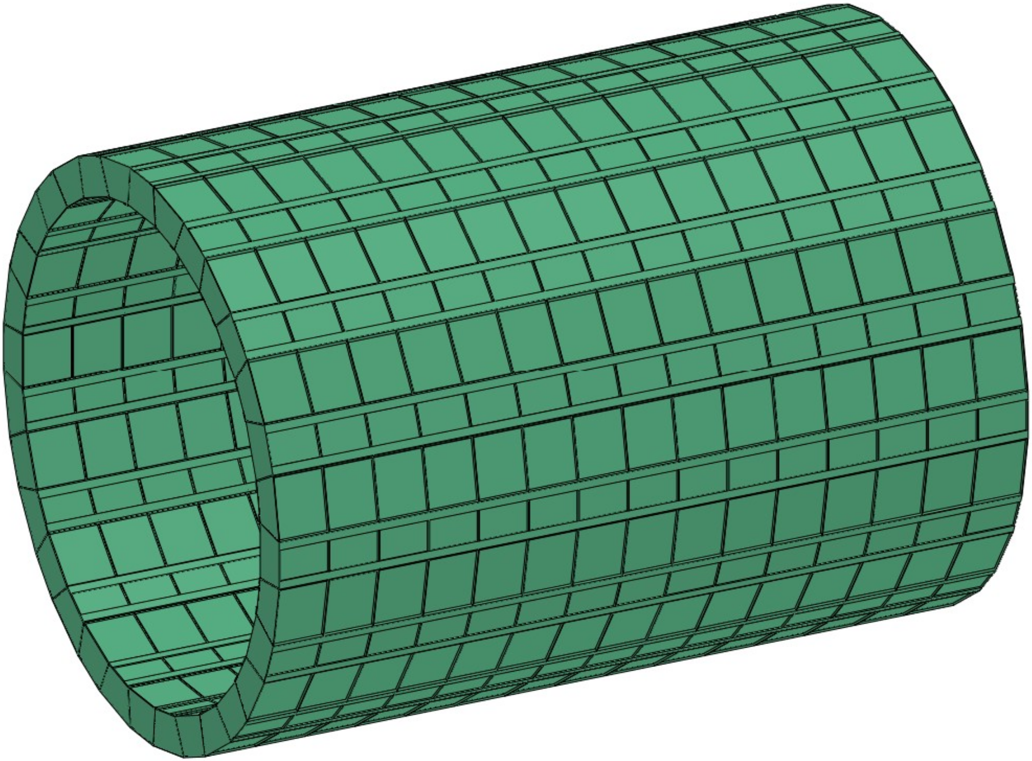
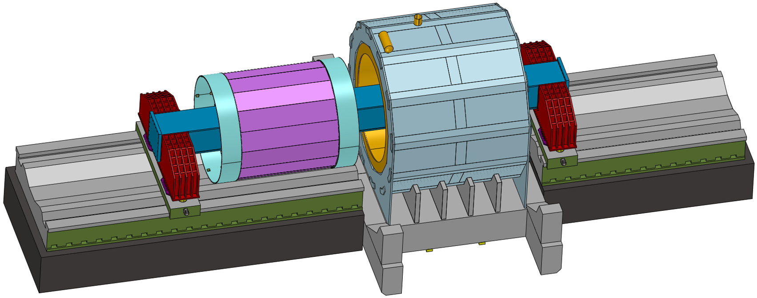
Detailed Installation Design
3. detailed Installation procedures
Step 2 Core shaft method installation : HCAL and ECAL (2) --- Barrel Detectors
Clearance requirement : 10 mm
External Guide rails
There is no space for guide rails
Installation Method :
1. Place HCAL (or ECAL) on the core shaft
2. Move the HCAL(or ECAL) using external guide rails
Core shaft method installation of HCAL

Slide 23
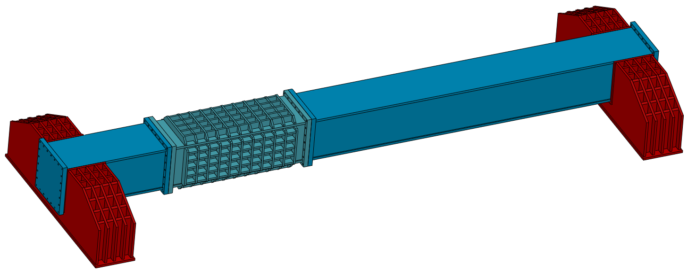
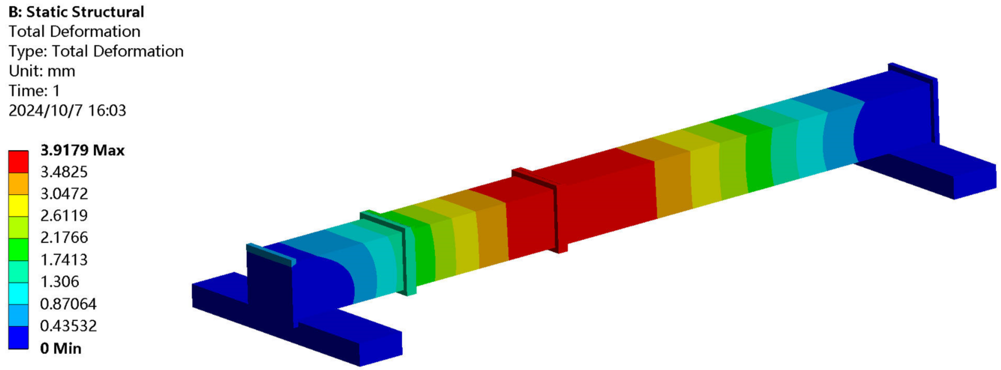
Detailed Installation Design
3. detailed Installation procedures
Constraints :
Fixed at both ends
Step 2 Core shaft method installation : HCAL and ECAL (2) --- Barrel Detectors
Load :
1. Self-weight
2. 1,000 tons HCAL
(ECAL 150 tons)
Design of the core shaft:
Adjustable base
Short core shaft
Long core shaft
Result :
Max Deformation ≈ 3.9 mm
< 10 mm (Gap)
Middle core shaft
Hight : 2,000 mm
Width : 2,000 mm
Length : 27,300 mm
Conclusion :
Meet installation requirement
For HCAL and ECAL

Slide 24
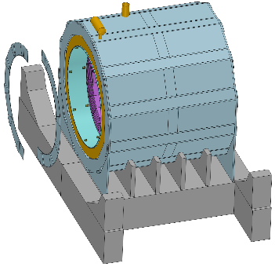
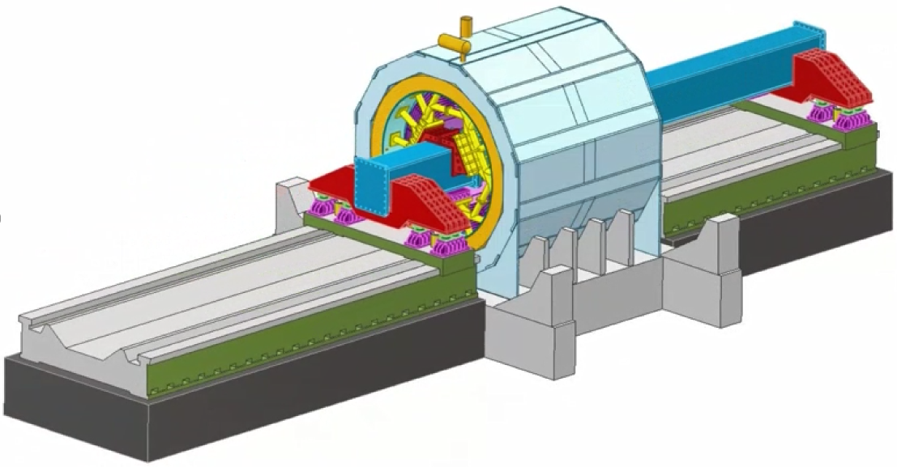
Detailed Installation Design
3. Detailed Installation procedures
Step 2 Core shaft method installation : HCAL and ECAL (2) --- Barrel Detectors
Method :
Assembled in the same way as the yoke
Install Barrel HCAL
Barrel HCAL
adjust
Barrel HCAL
Connection structure
Adjustable base
Coaxial adjustment
HCAL rings

Slide 25
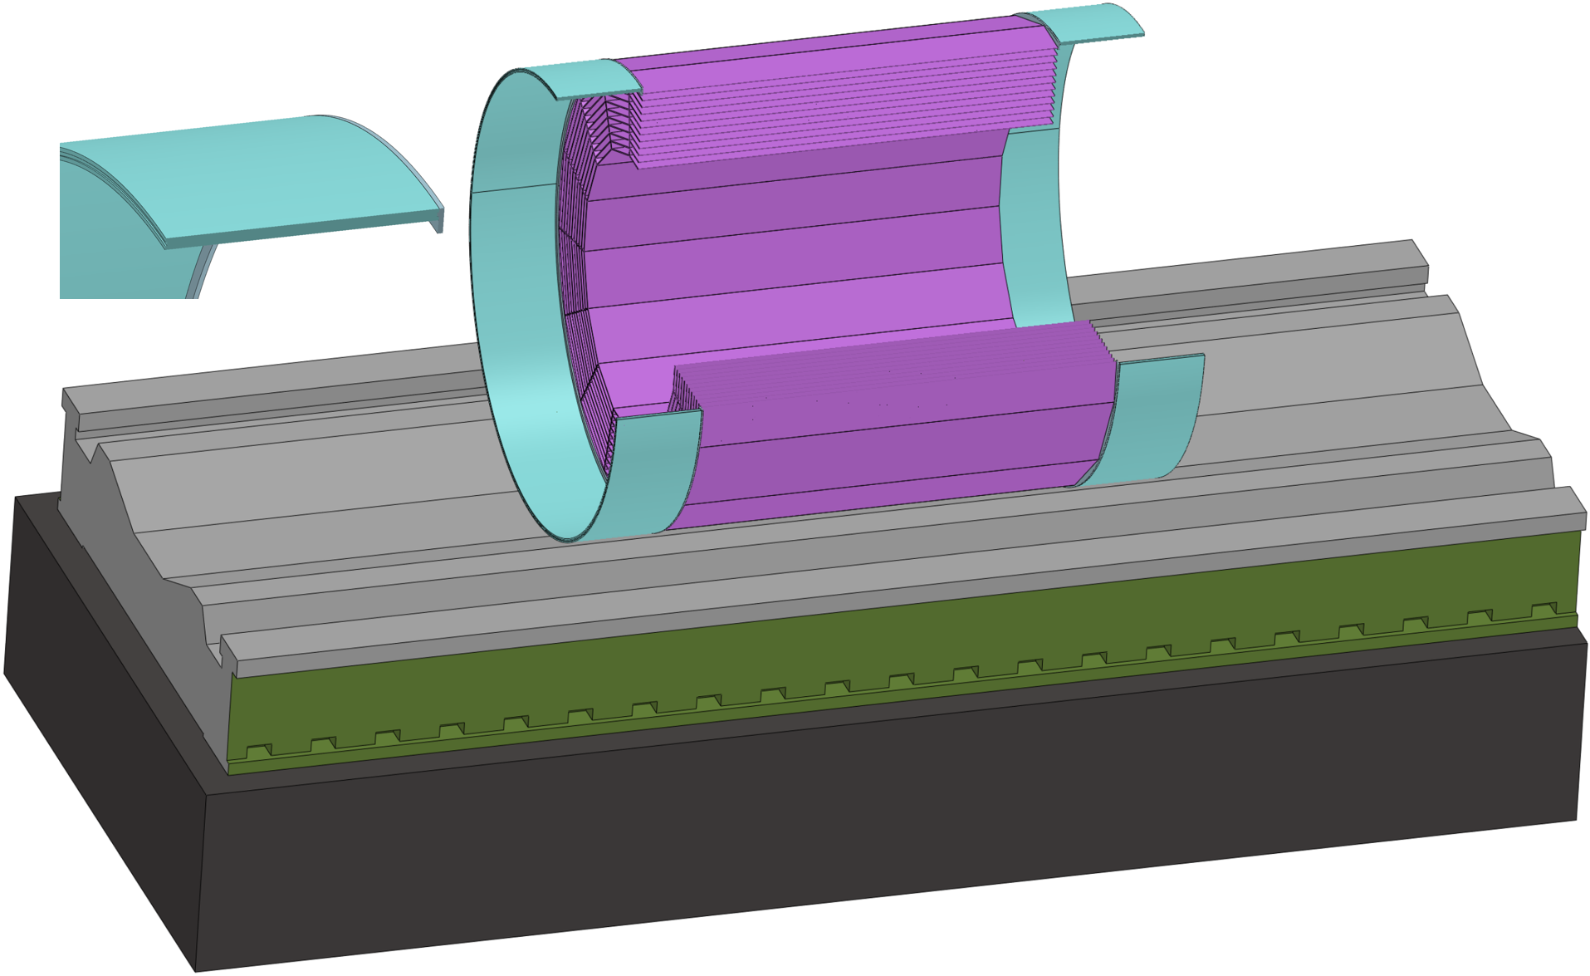
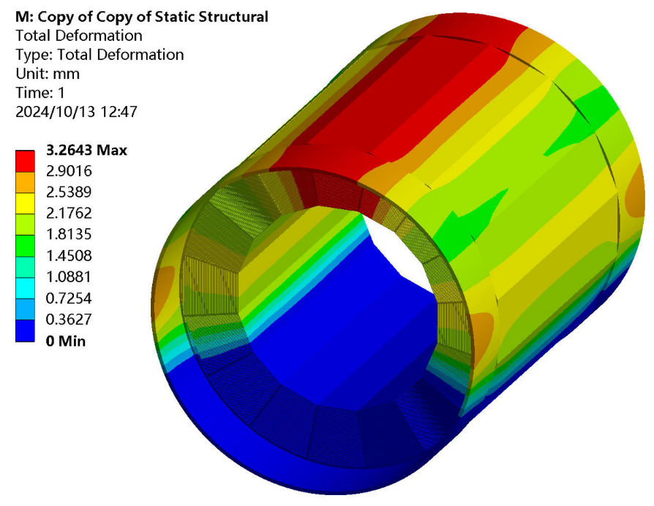
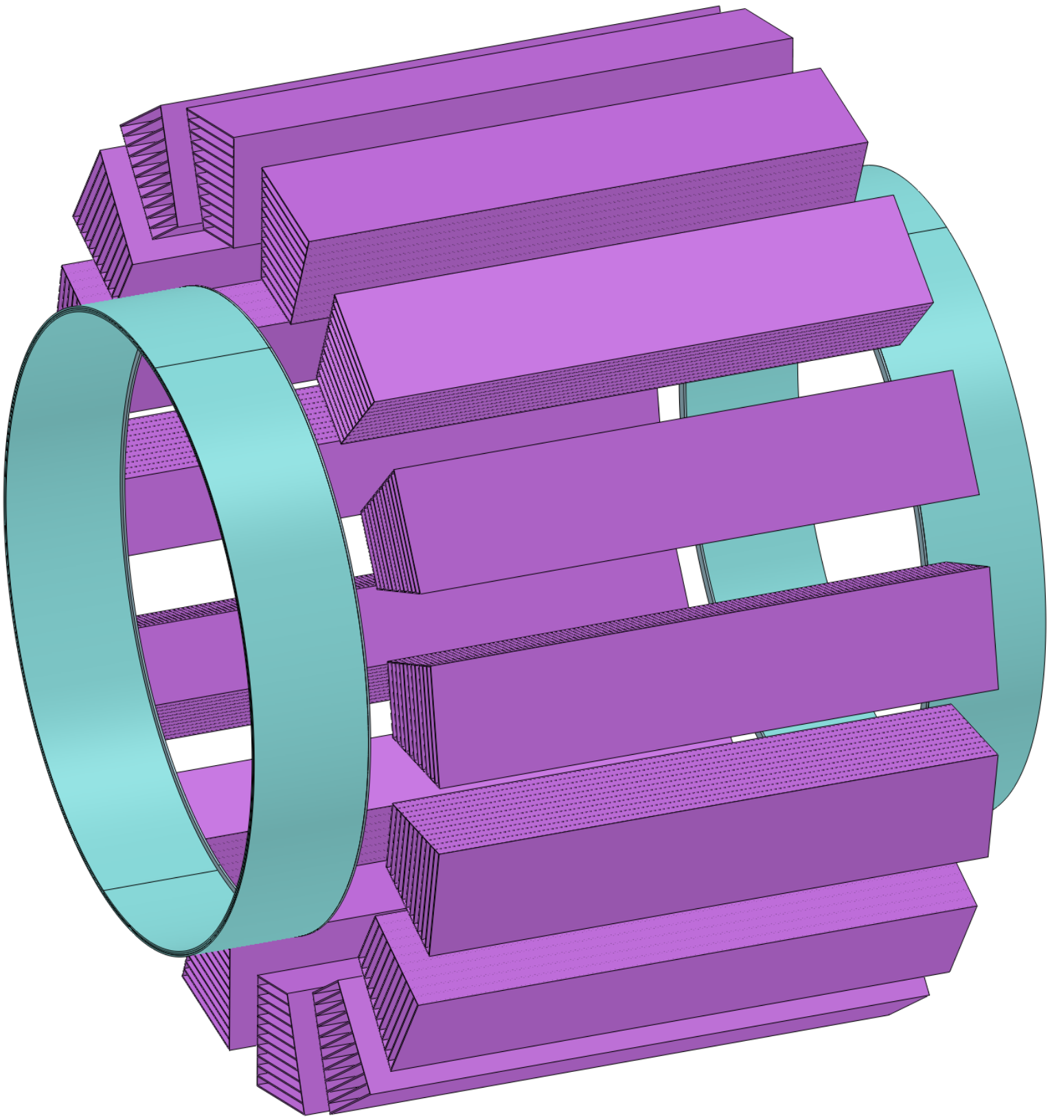
Overall Installation Design
3. Detailed Installation procedures
Step 2 Core shaft method installation : HCAL and Barrel ECAL (2) --- Barrel Detectors
How to
Handle Deformation ?
For HCAL
Deformation : 18.8 mm
Just two auxiliary rings
Deformation : 3.3 mm
L-shaped
End Ring
The animation has given
the solution!
Further optimization can be implemented to achieve smaller deformation

Slide 26
Detailed Installation Design
3. Detailed Installation procedures
Step 2 Core shaft method installation : HCAL and ECAL (2) --- Barrel Detectors
Assembly of Core shaft :
Assembled in the same way as the HCAL
Install Barrel ECAL
Installation Steps :
1. Lift into the hall from the vertical shaft
2. Connected to the core shaft
3. Move ……

Slide 27
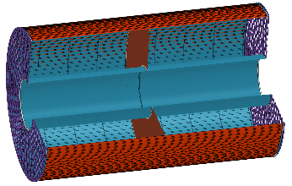
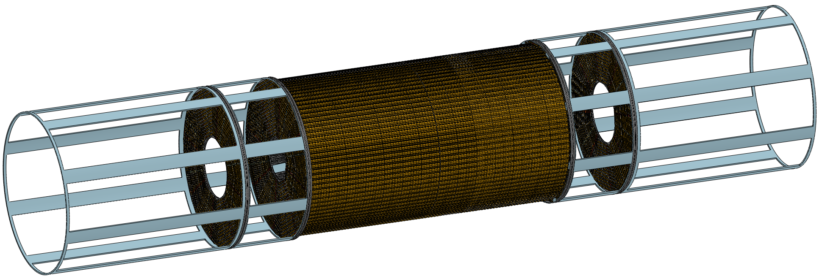
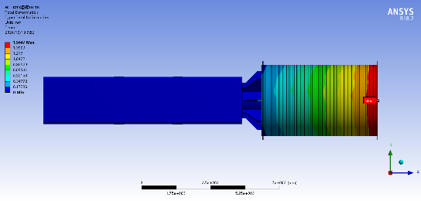
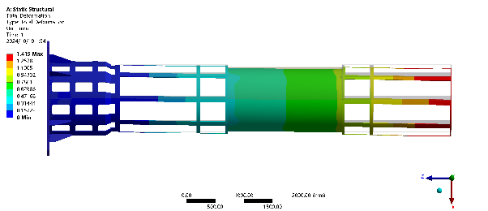
Detailed Installation Design
3. detailed Installation procedures
Step 3 Cantilever method installation : TPC(OTK) ITK Beampipe(Vertex + LumiCal) (3) --- Barrel Detectors
Installation Steps :
1. Lift into the hall from the vertical shaft
2. Connected to the core shaft
3. Move ……
TPC
ITK
Install TPC(OTK) and ITK (2)
TPC Deformation : 1.6 mm
ITK Deformation : 1.4 mm
Installing deformation simulation
Deformations meet GAP requirements (< 5 mm)

Slide 28
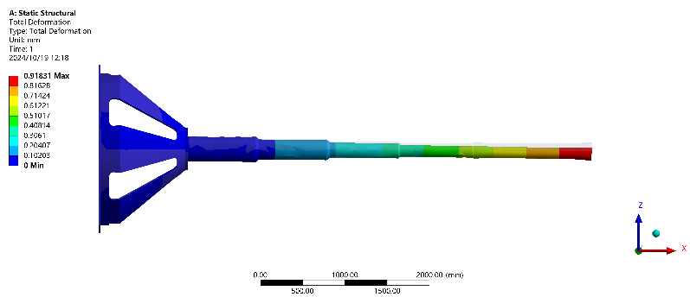
Detailed Installation Design
3. detailed Installation procedures
Step 3 Cantilever method installation : TPC(OTK) ITK Beampipe(Vertex + LumiCal) (3) --- Barrel Detectors
Installation Steps :
1. Lift into the hall from the vertical shaft
2. Connected to the core shaft
3. Move ……
Beampipe
Install Beampipe(Vertex + LumiCal)
Deformation : 0.9 mm
Installing deformation simulation
Deformation meet GAP requirement (< 2 mm)

Slide 29
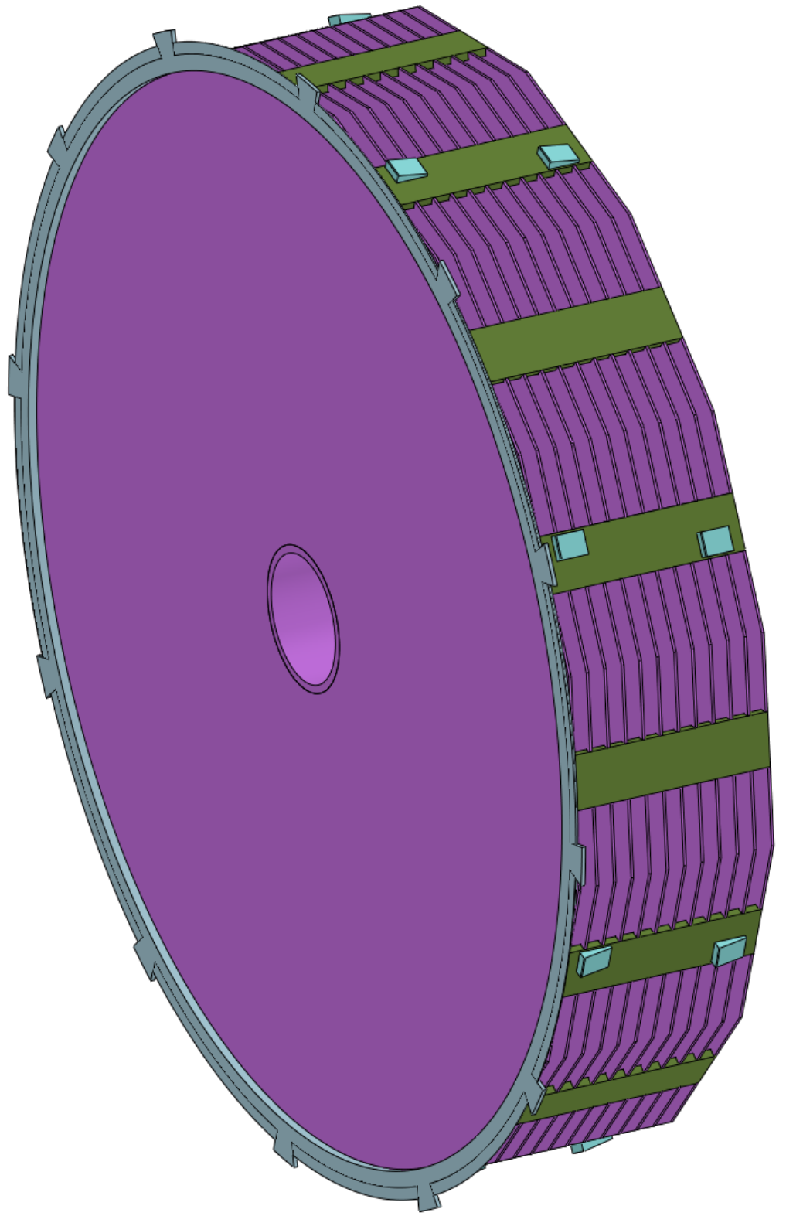
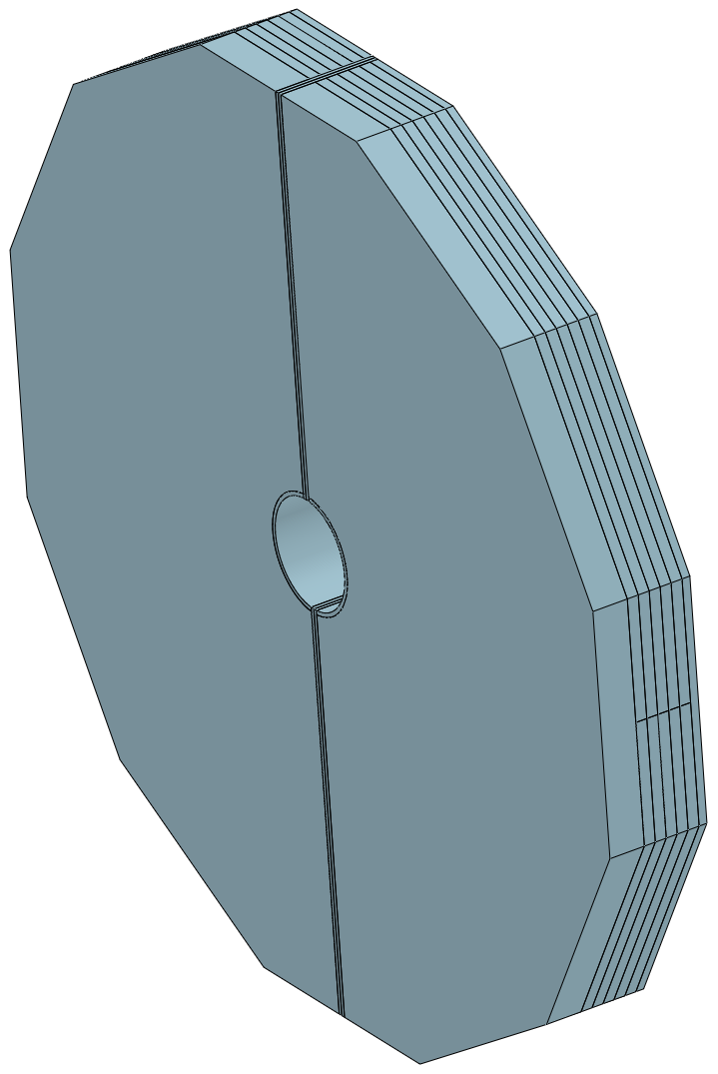
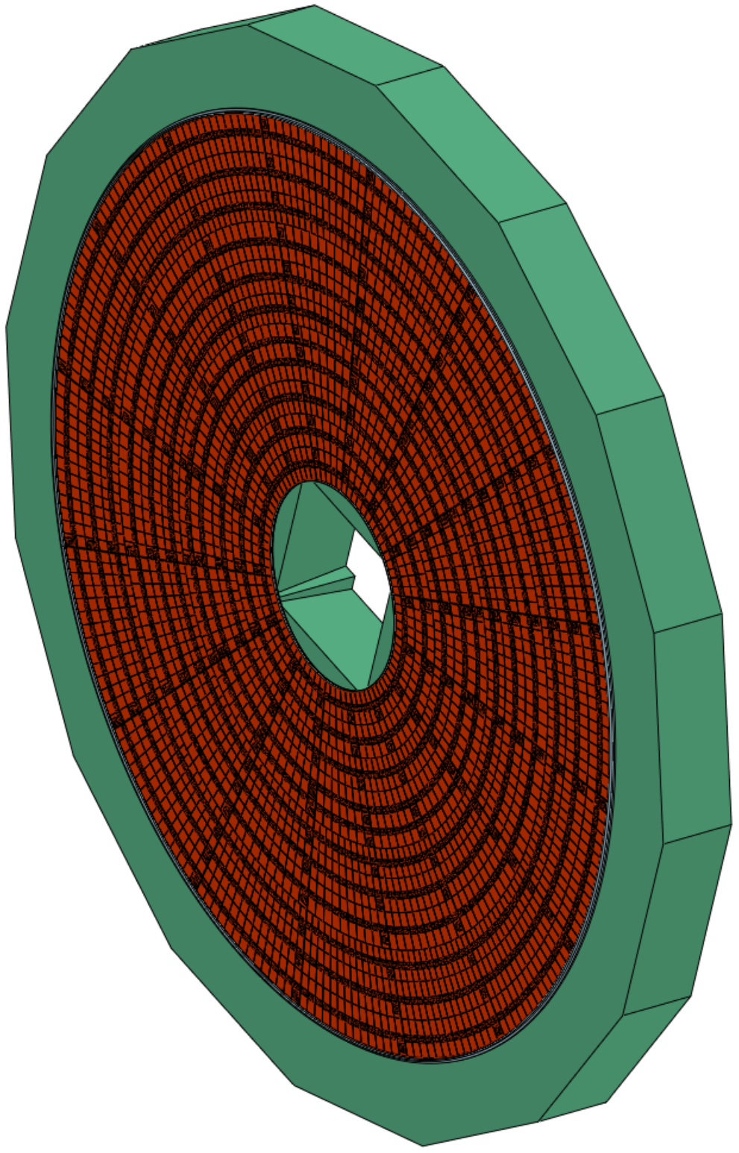
Detailed Installation Design
3. Detailed Installation procedures
Step 4 Cantilever method installation : ECAL(OTK) HCAL --- End (2) --- End Detectors
Lifting Installation : Yoke --- End Detectors
Install ECAL(OTK) HCAL YOKE (3)
Installation Steps :
1. Lift into the hall from the vertical shaft
2. Connected to the core shaft
3. Move ……

Slide 30
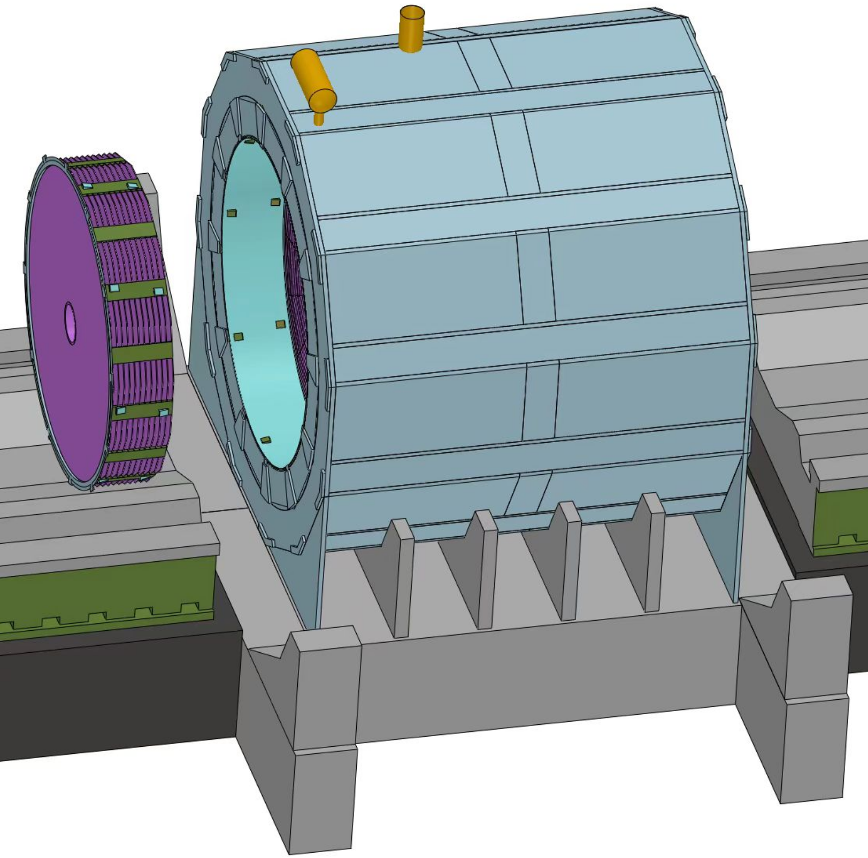
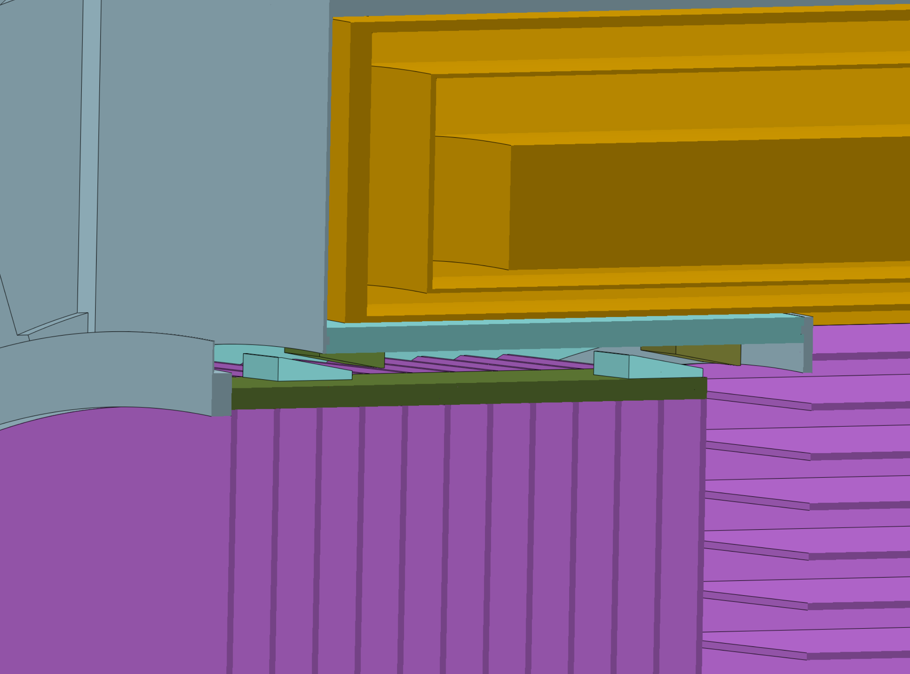
Detailed Installation Design
3. Detailed Installation procedures
Step 4 Installation : ECAL(OTK) HCAL Yoke --- End (3) --- End Detectors
Connection and adjustment of HCAL
End HCAL
Connection Structure
In the Axial direction :
Two Adjustable Pad Irons
Circumferential direction :
Eight pairs
Connection :
Fixed to the HCAL rings
End HCAL
adjust
Hydraulic adjustment

Slide 31
Detailed Installation Design
3. Detailed Installation procedures
Step 5 Move the Detectors from the Pre-assembly point to the Collision point
Push the accelerator vacuum component into the center of the detector and connect it to the Be beampipe
Design parameters of hydraulic cylinder :
Move distance : 16,500 mm
Hydraulic cylinder movement span: ≈ 2.1 m
Hydraulic cylinder thrust : 50 t (> 30 t)
(hydrostatic guide rail 6000*0.005 = 30 t)
Installation Summary :
1. This is a conceptual installation design
2. We will continue to optimize and improve the design in the future

Slide 32
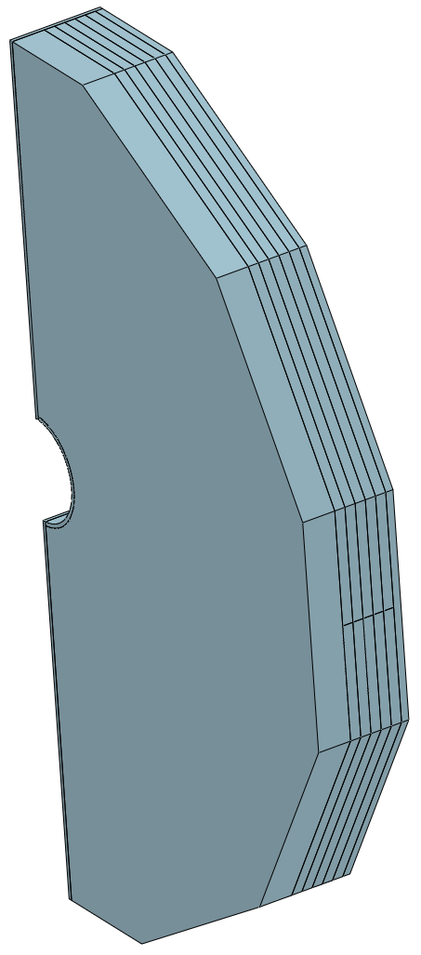
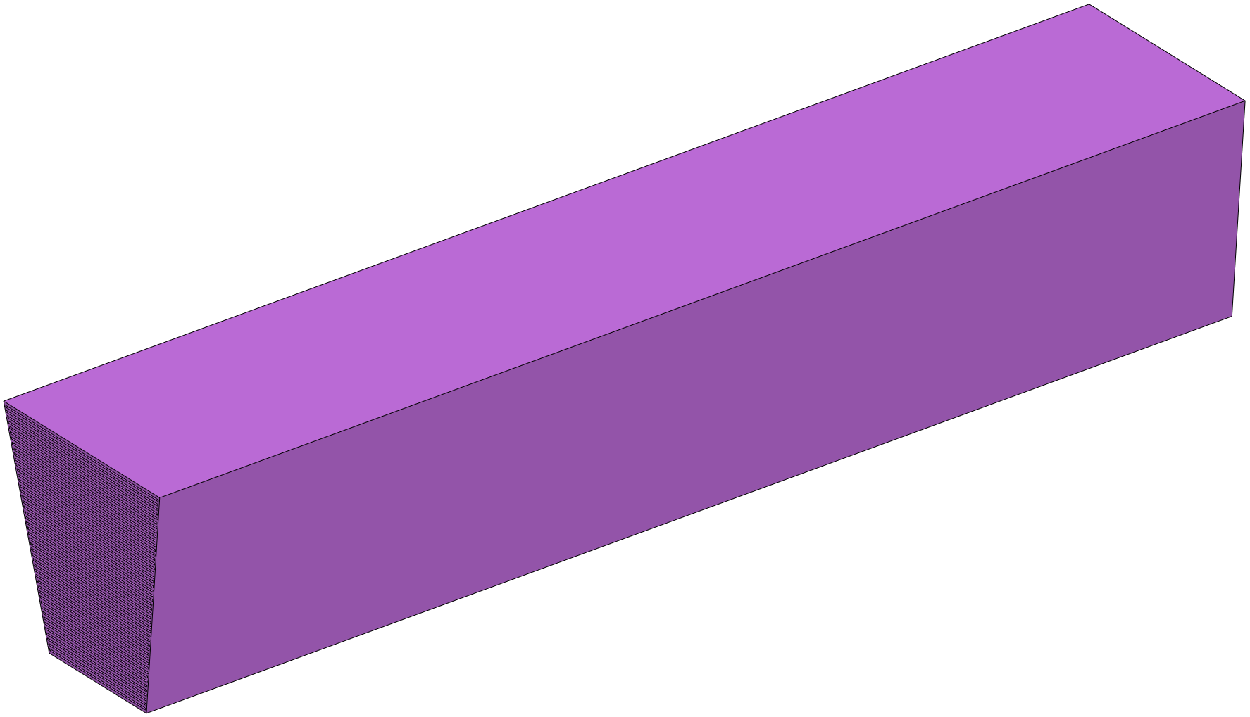
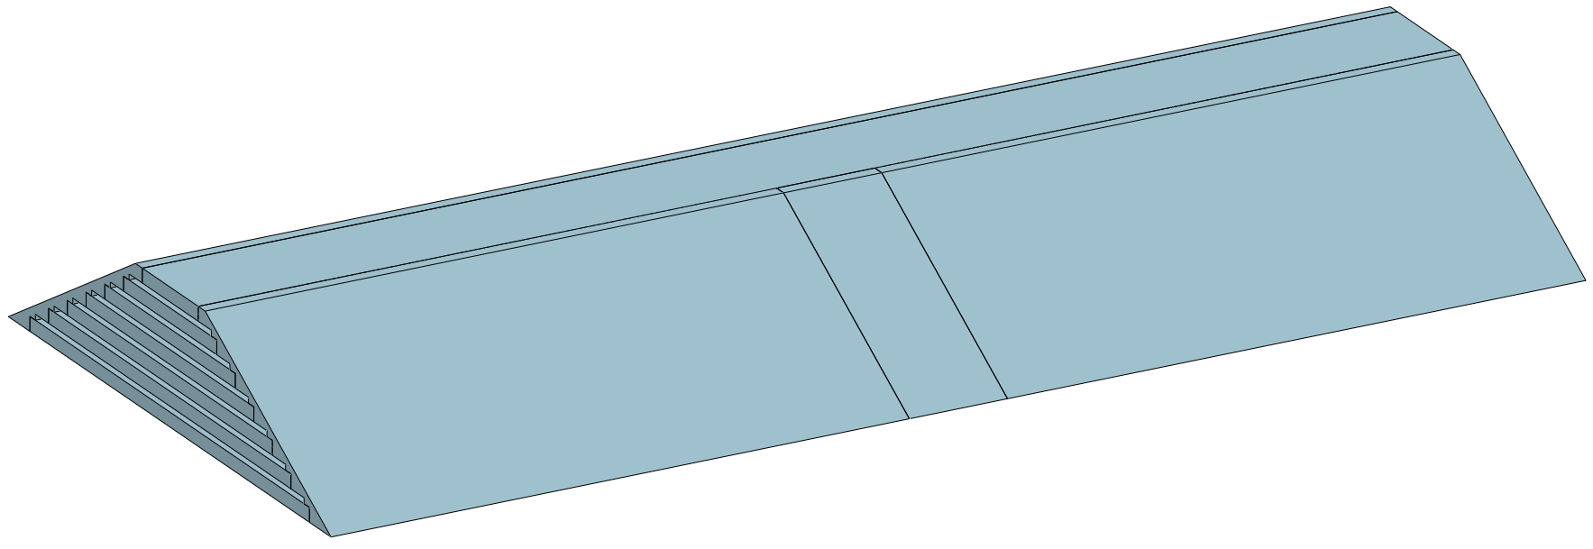
Detailed Installation Design
4. Modular lifting and lifting of integral components : (relate to the design of the vertical shaft and the hoists)
Modular lifting (3)
lifting of integral (7)
heaviest single module
≈ 350 t
Largest single size
9050 L X Ф 8470
Magnet
ECAL
TPC+OTK
Yoke
End Yoke
HCAL
ITK
Beampipe
End - ECAL
End - HCAL

Slide 33
Our Team
1. IHEP mechanical engineers as the core for the design and optimization
2. Use as much possible outside resources
Universities
Hunan University
University of South China
Southwest Jiaotong University
Students (3)
Calculation team
IHEP (5)
Design companies
Zhejiang University Affiliated Company
Manufacturing companies
CITIC Heavy Industry
Design team
Future plan:
1. Allocate more mechanical engineers, including those at JUNO now
2. Seeking cooperation partners in special fields
3. Seek international cooperation

Slide 34
Summary and Working Plan
Summary
1. The overall concept of the installation scheme has been completed
2. The connection structure of the Barrel HCAL and END HCAL are designed,
and they can be remotely and automatically adjusted
3. The connection structure for the other sub-detectors has been designed,
but is difficult to operate and needs to be optimized

Slide 35
Summary and Working Plan
Working plan
1. Optimization and refinement of existing installation programmes
2. Refine the connection design of sub detectors
3. Optimize the layout of the underground experimental hall and its auxiliary hall
4. Start planning the layout design of the ground hall

Slide 36
Thank you for your attention!
Aug. 7th, 2024, CEPC Detector Ref-TDR Review

