Slide 2
Top Quark EW Coupling Precision Measurement
27/12/2024

Slide 3
Using for example : the usual form factors denoted F1, F2 defined :
Top EW Couplings Parametrizations
Which can be translated to :
Relation :
Maximize numerically a global likelihood L with respect to all form factors:
Where :

Slide 4
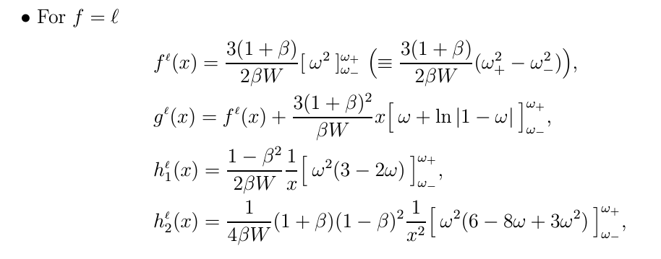
The double distribution of the angle and the rescaled energy of :
arxiv.org/pdf/hep-ph/0004223
The energy dependence is specified by the functions $Θ_{i}^{f}$ ($x_{f}$ ):
They are parameterized both by production and decay form factors.
The differential top-quark decay rates in e+e− cm frame.

Slide 5
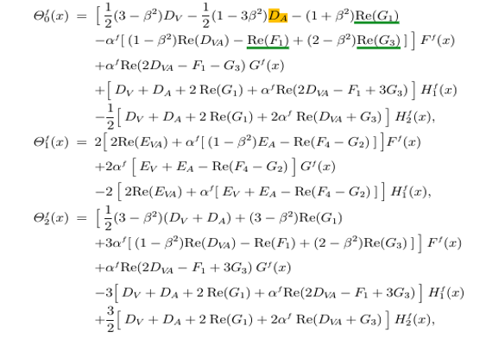
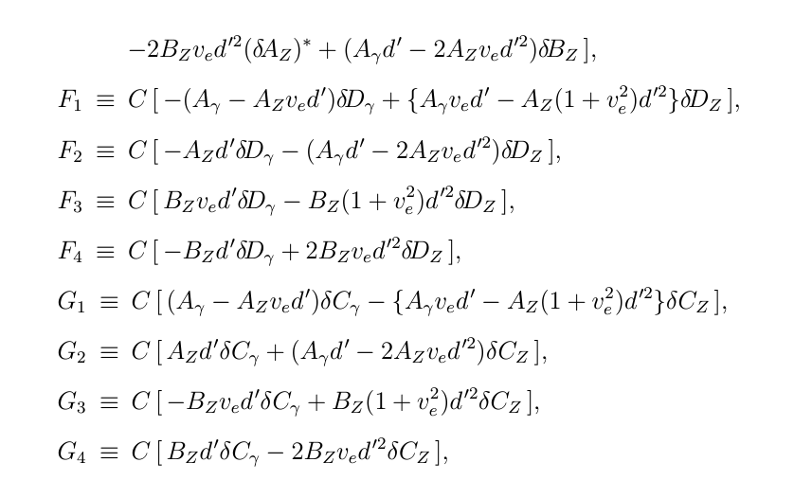
The Explicit Formula describing the energy-dependent coefficients for the angular and energy distributions :
arxiv.org/pdf/hep-ph/9911505
arxiv.org/pdf/hep-ph/9710358
Dv, DA, DVA, EV, EVA, Fi, Gi {i=1,2,3,4} , which are related the Form facotrs in ttZ/$γ$ Couplings !

Slide 6
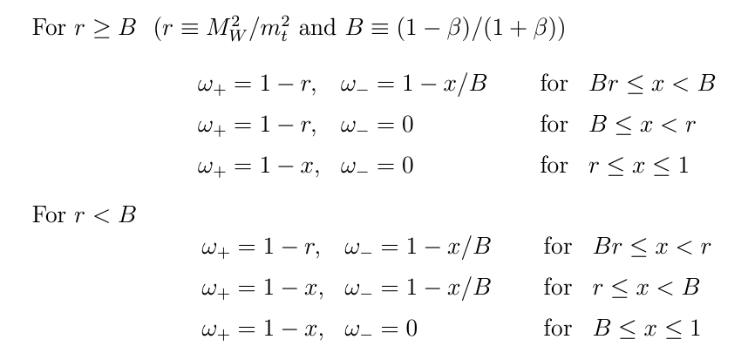
CEPC @360GeV:
Cases for $ω$ : Only one solution will be True ! :
B == cte., r ==cte !
Inputs :
The normalized Lepton energy is given by :
Where $β$is the Top Velocity.

Slide 7
Explicit formulas : of S0 Contribution:
Added these non-Form Factors into the calculations : set all of them to 0.05 base on ILC study :

Slide 8
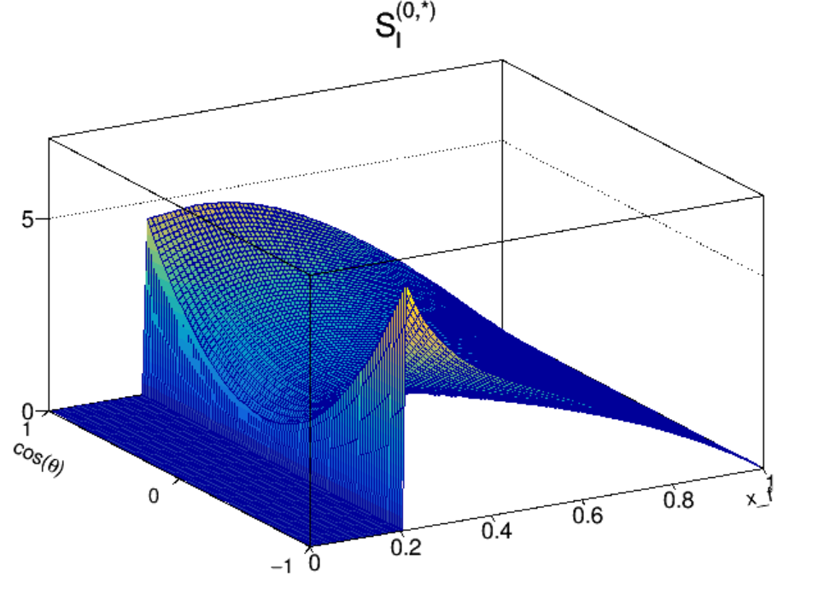
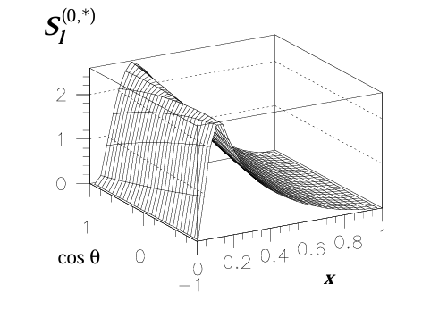
SM Contribution
- Tried to plot the 2D plot of the function in terms of the Lepton polar angle and normalized Energy :
For Truth case :
- The Lepton Energy
- The$\sin^{2}θ$ is set to 0.23.
- Mass of Z to 91 GeV.
- Fine structure to 0.0072973525643.
CEPC @360GeV:
ILC case : 500 GeV

Slide 9
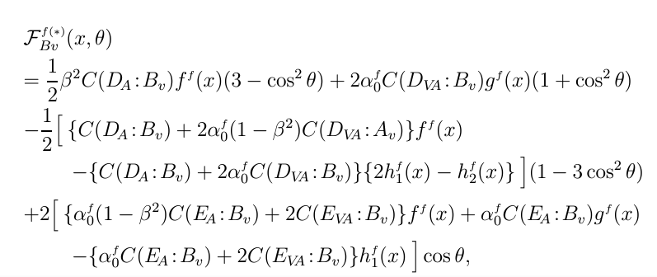
Where the polarization factors :
Non SM-FORM Factors
Explicit formulas of the coefficient functions for the 9 anomalous form factors : arxiv.org/pdf/hep-ph/0004223
CEPC : $P_{⊕ }$= 0$,P_{⊗}$ = 1
With :
.....

