Slide 1
Progress and Plan
Mingyi Dong
2024.11.4

Slide 2
Progress last week
 | Planned tasks last week | Time needed (day) | person in charge | Status
1 | MDC gas leakage checking and sealing | 3 | Mingyi Dong | done
2 | Removal of target bases on connecting flanges | 2 | Mingyi Dong | done
3 | MDC HV test and training | 3 | Mingyi Dong | done

Slide 3
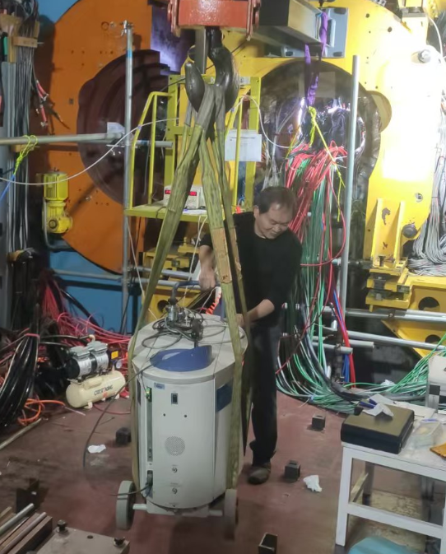
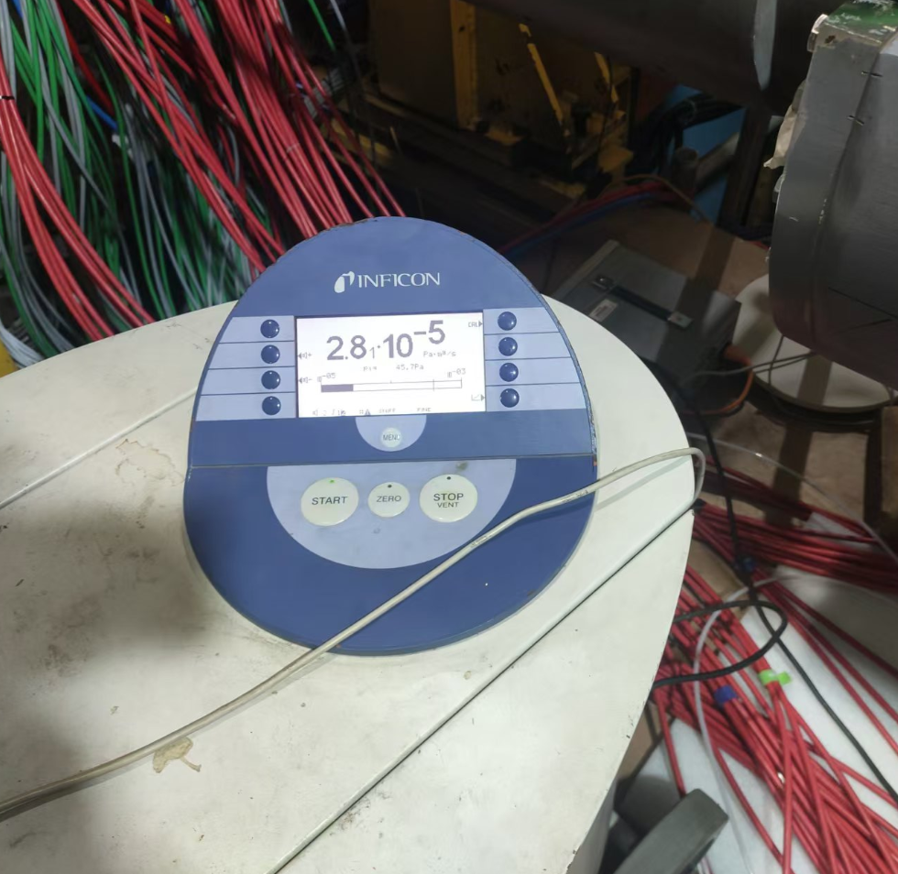
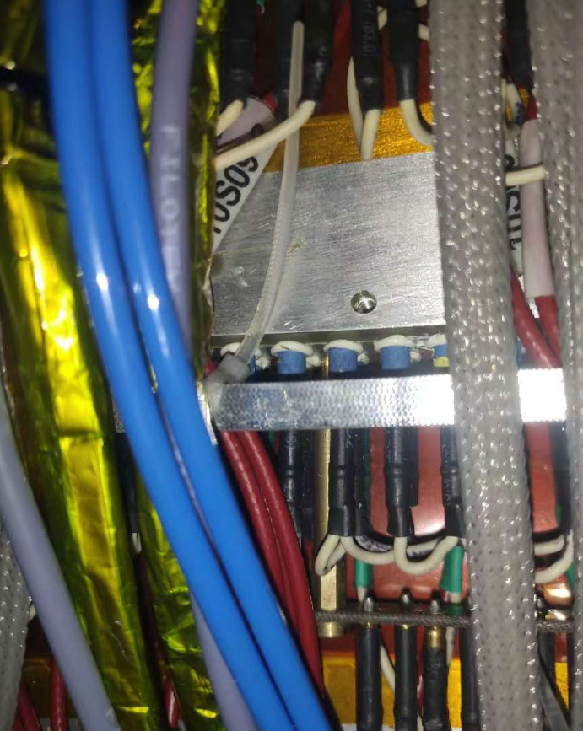
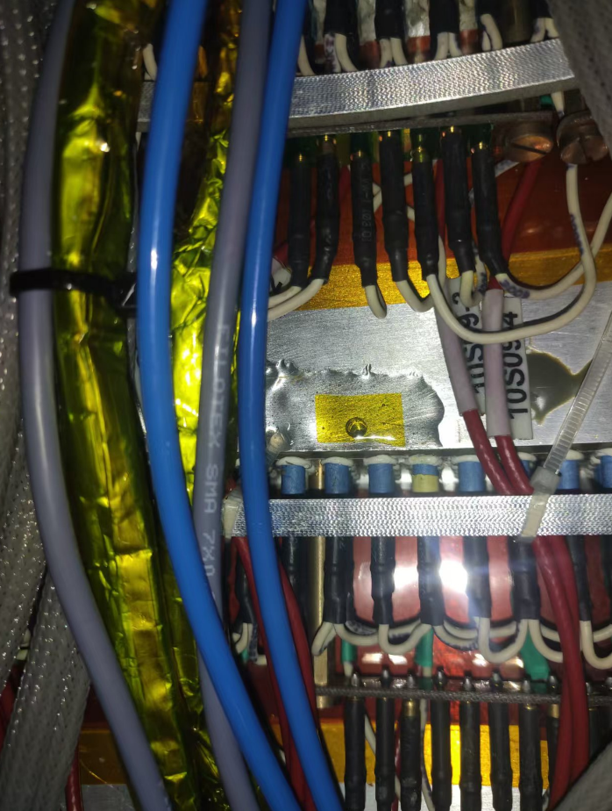
Gas sealing
Oct. 29-31
Q196 is sensitive to helium, argon, flammable gas, etc. It cannot accurately locate the leakage point. Checked leakage on both side with specialized helium leak detector
Leakage was found on step2 (a Φ3 hole in r direction). Sealed it with glue
After sealing, the average leakage rate is about 3 ×10 ⁻⁵ pa m³/s on both sides. The leakage rate of special point (-X axis on east side, +Y on west side ) is about 2 ×10 ⁻⁴ pa m³/s, which is acceptable

Slide 4
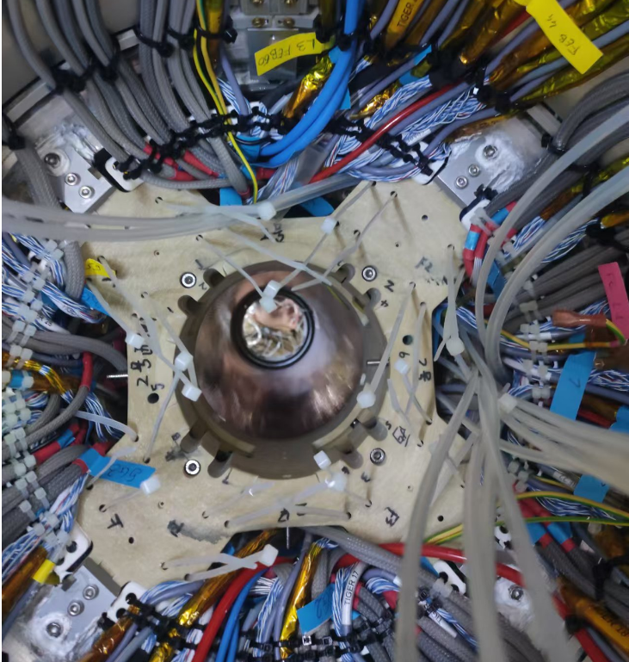
Removal of the target bases
Oct. 29, 31
Removed the target bases on the connecting flanges on both sides

Slide 5
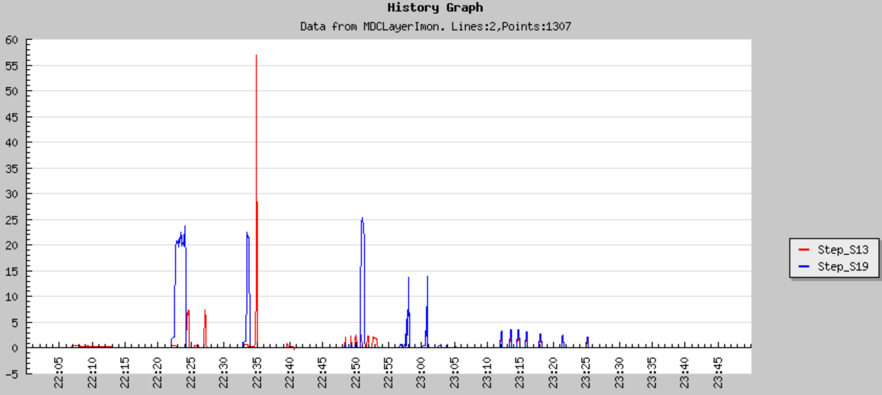
MDC HV test
Oct. 29-31
large leakage current was found on two preamplifier boards ( W13-12, and W19-16). W13-12 is adjacent to the FEB of CGEM (no problem was found after extraction of inner chamber)
Informed Michela, and Michela agreed to check the gap between the CGEM FEB boards and MDC preamplifier boards
Other layers can work normally under operating HV

Slide 6
Plan for next week
 | Tasks | Time needed (day) | person in charge
1 | Check and fix the preamplifier boards of W13-12, and W19-16 | 2 | Mingyi Dong
2 | MDC HV test and Cosmic-ray test | 2 | Mingyi Dong
3 | Preinstall shielding plates for CGEM | 2 | Italy team, Jinyu Fu

Slide 7
Backup

Slide 8
Schedule (may be updated each week)
No. | tasks | Duration（day） | Start time and stop time | Sub-system involved | Status
1 | Removal of equipment of machine |  | July 1- Aug. 6 | Utility, Small angle lum. Detector and ZDD, Beam pipe, slow control | done
2 | Pull-out of EEMC |  |  | Utility, EMC, TOF, MDC | done
3 | Removal of inner chamber（Operate simultaneously on both sides ） | 51 | Aug. 7- Sep.7 Sep.8- Sep. 28 | MDC, MDC electronics, Gas, Mechanics, Laser measurement group, Trigger, DAQ, Slow control | done
4 | Installation of CGEM | 44 | Sep.29- Nov. 11 | CGEM group, MDC, MDC electronics, Gas, Mechanics, Laser measurement group, Trigger, DAQ, Slow control | On Schedule
5 | Recover EEMC |  | Nov. 12-Dec.30 | Utility, EMC, TOF, MDC
6 | Recover equipment of machine |  |  | Utility, Small angle lum. Detector, ZDD, Beam pipe, slow control
total |  | 180 days | July 1- Dec.30

