Slide 1
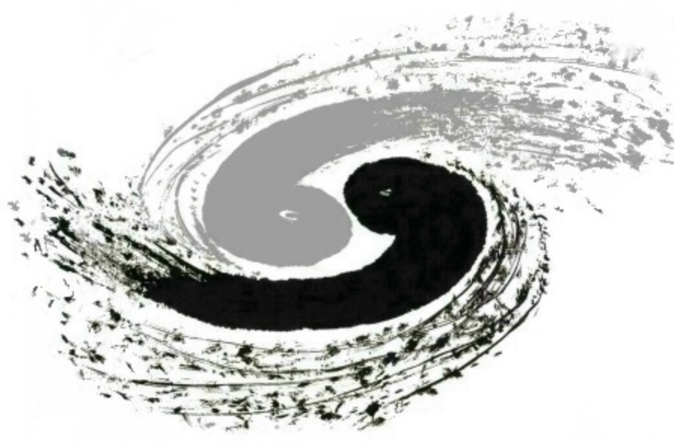
Rediscovery of Numerical Luescher’s Formula from the Neural Network
Based on Chin.Phys.C 48 (2024) 7, 073101
Yu Lu (陆宇)
In collaboration with
Yi-Jia Wang (王一佳) Ying Chen (陈莹) Jia-Jun Wu (吴佳俊)
2024.11.08 @IHEP

Slide 2
Contents
Three Aspects of the Neural Network(NN)
Whether → Architecture
What → Loss
How → Training
Examples
Extension of Architecture
Variational Auto Encoder (VAE)
Other examples & Comments
Rediscovery of Luescher’s Formula
Comment & Outlook

Slide 3
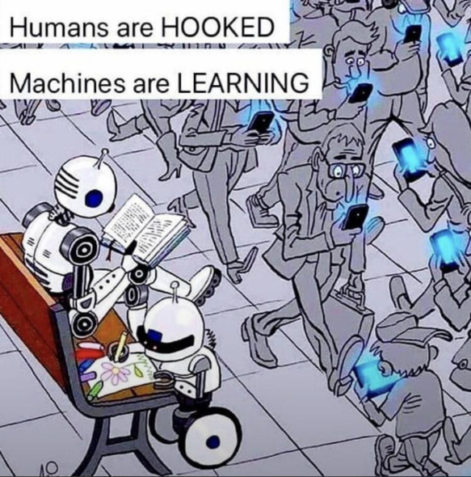
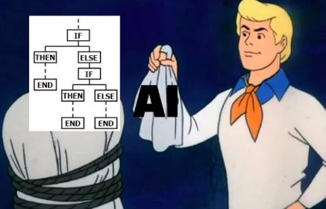
Roadmap
Hard-Code(硬编码) → Knowledge Base(知识库) → Design Complicate Rules
有多少人工就有多少智能(still true more or less)
e.g., cat-dog, ears? shape? size?
Mis-impression:
Machines are stubborn, they can never be “creative”
Machines can only learn/memorize what people teach them
☆Self-discovery of the pattern/representation
Simple Concepts → Hierarchy → Complicate Concepts
Multilayer perceptron (MLP, 多层感知机) or Feed Forward Neural Network(NN) (前向全连通神经网络)
AI = Machine Learning(ML) ＞(≈?)NN

Slide 4
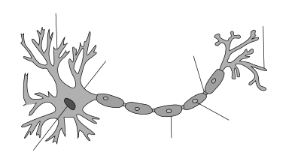
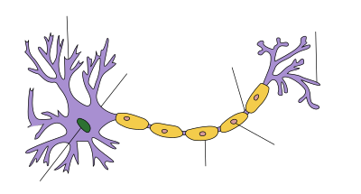
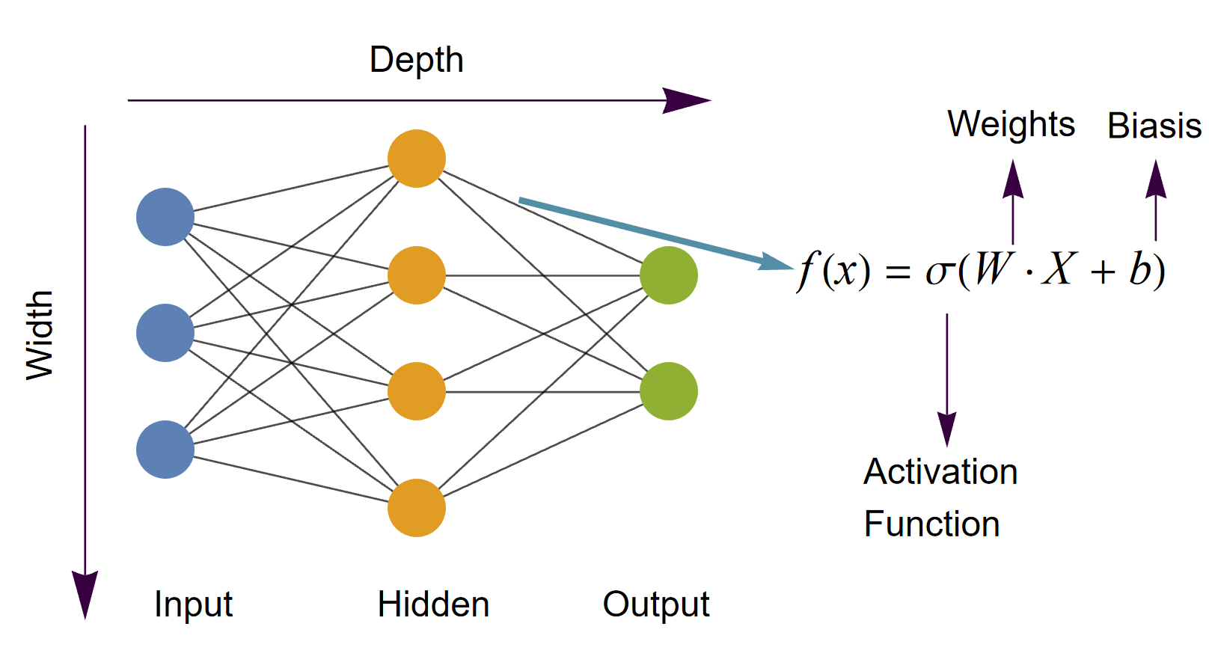
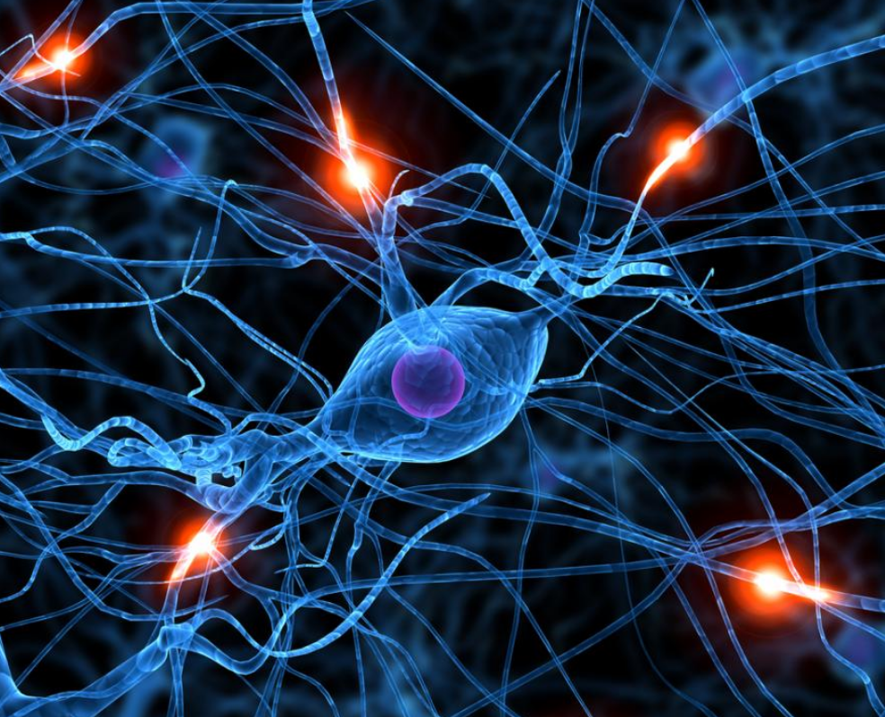
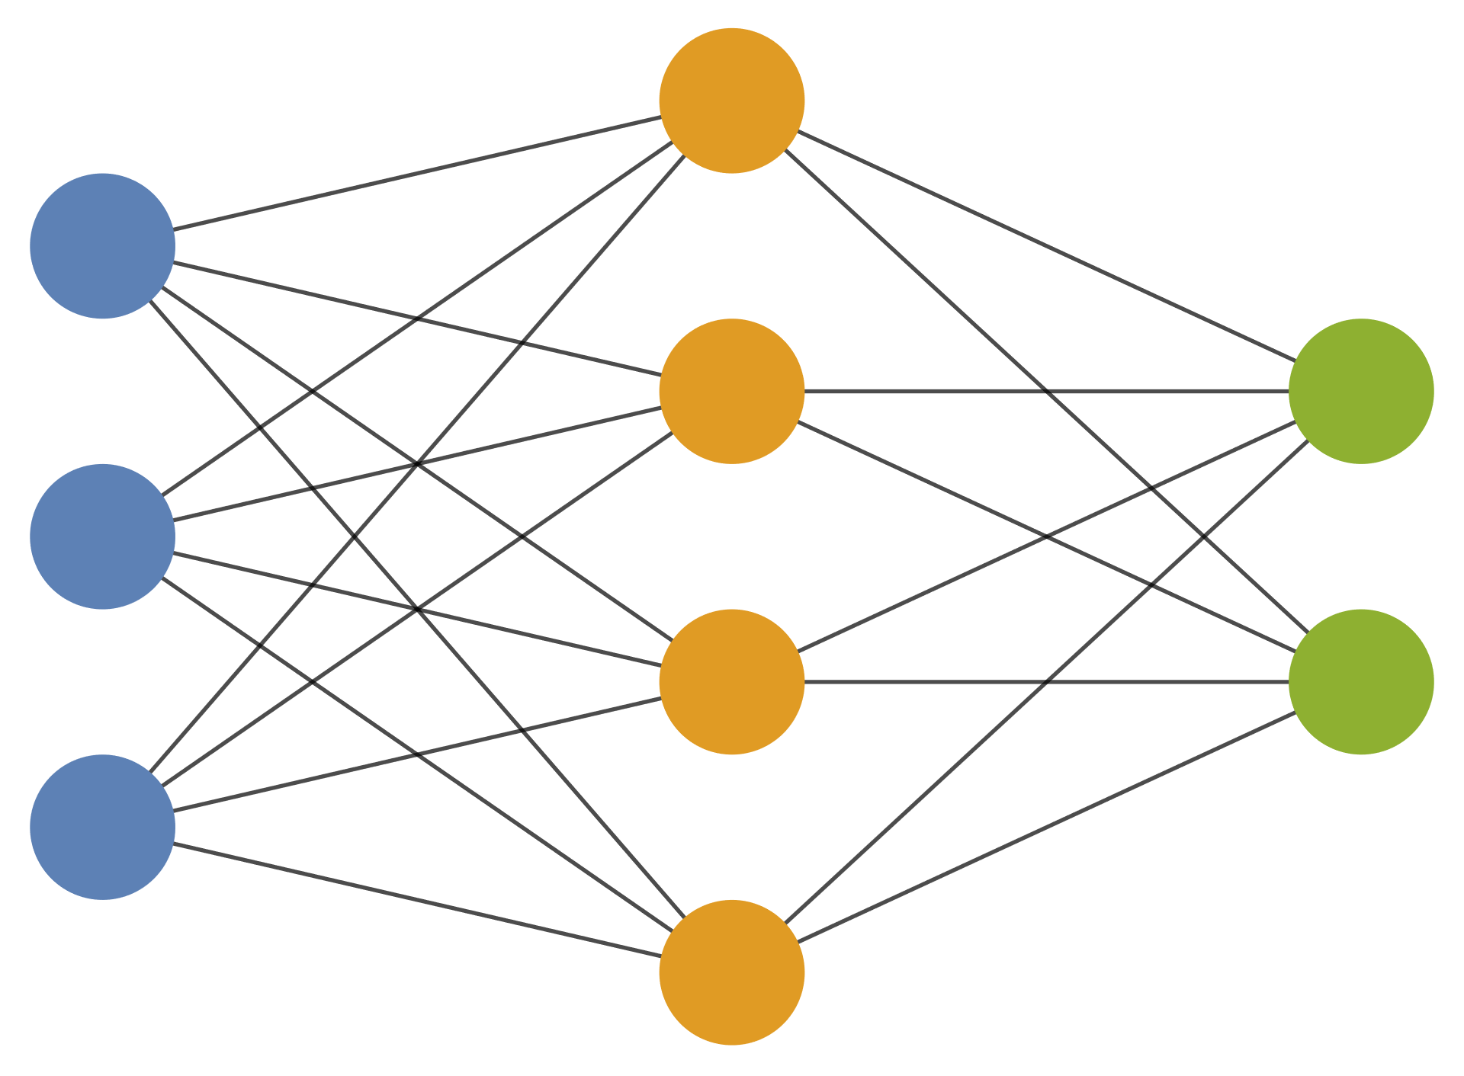
NN Architecture
Anatomy | NN
Dendrite(树突) Nucleus(细胞核) | Node Input/Output/Hidden Float Points 1D Vector, 2D Matrix, nD Tensor…
Axon(轴突) Synapse(突触) | Activation Functions Typically Predefined Affine Transformation Everywhere
Complicate Network | Stack of Layers (Except GNN)
Dendrite (树突)
Synapse
(突触)
Learning Parameter
Nucleus (细胞核)
Axon (轴突)
Essentially a nesting of simple functions
$$x^{\left(i\right)}=f_{i}\left(x^{\left(i−1\right)};θ\right), θ=\left\{W_{i},b_{i}\right\}$$
NN = Nonlinear functions + Affine Transformation
How to choose f?

Slide 5
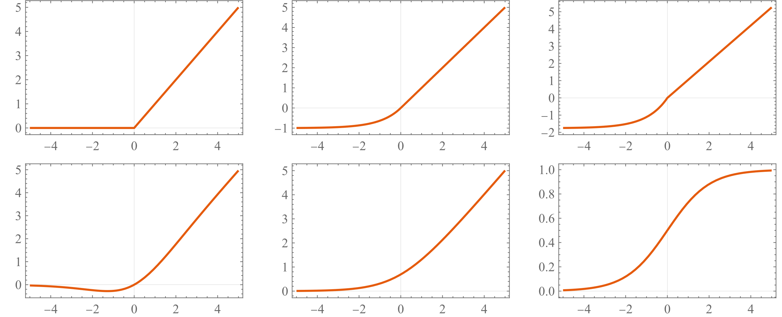
Activation Functions
Learning Parameter
Principles
Can be any continuous function
Typically has threshold/saturation + Varying Region
Simple Function V.S. Complex Structure
Some Examples
Rectified Linear Unit (ReLU, 整流线性激活函数)
Piecewise linear function
Simple but unexpectedly effective (in CV, NLP, etc)
Nearly dominates NN (not in our work)
SoftPlus: $\log\left(e^{x}+1\right)$
Smooth Version of ReLU
Triangular Functions
sin, cos, etc…
That’s All~
ReLU
ELU
SELU
Swish
SoftPlus
Sigmoid

Slide 6
NN Can Approximate “Any” Function
Universal Approximation Theorem (UAT)
$≈$ A deep and wide-enough NN can approximate "any" functionwith “suitable activation functions”
Versatile, can do anything
Increasing depth is more efficient than expanding the width $→$ Deep Learning
… With the cost of exploding number of parameters
UAT: Hornik et. al, Neural Networks 2, 359; ibid, 4, 251; ibid, 6, 861

Slide 7
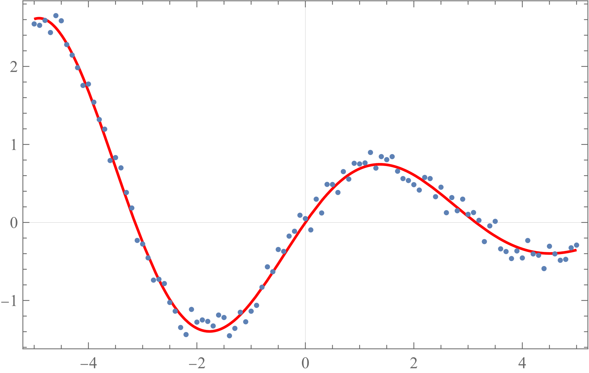
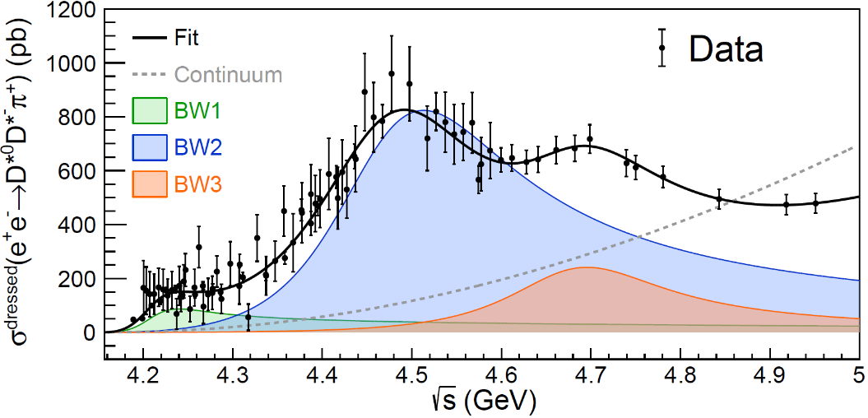
How to distinguish Good or Bad
In phenomenology:
a good description ≈ a good fit
$χ^{2}$-fit, F-test…
What is a good NN? Let loss functions judge!
NN is nothing but a function: $x→NN\left(x;θ\right)$
$NN\left(x^{\left(i\right)};θ\right)$V.S. $y^{\left(i\right)}$
Regression → Mean Square Error or $χ^{2}$
$MSE ≔ \sum_{i}{{\left({\hat{y}}_{i}−f\left(x_{i};θ\right)\right)}^{2}}$
Loss function Judges All
Different Problems are defined by different loss functions

Slide 8
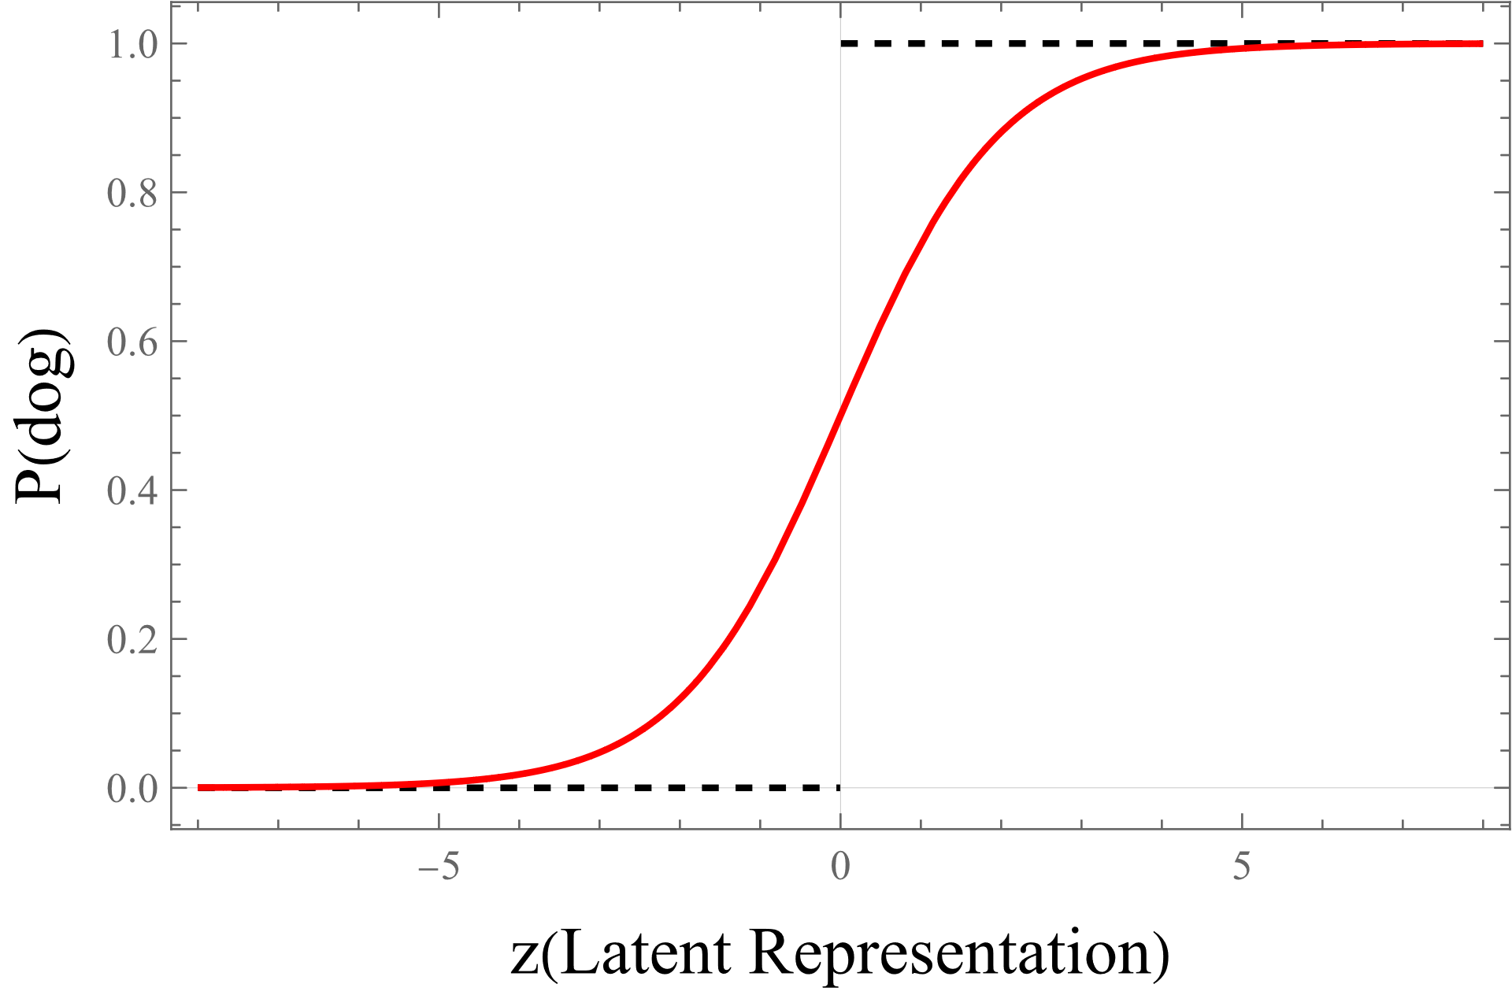
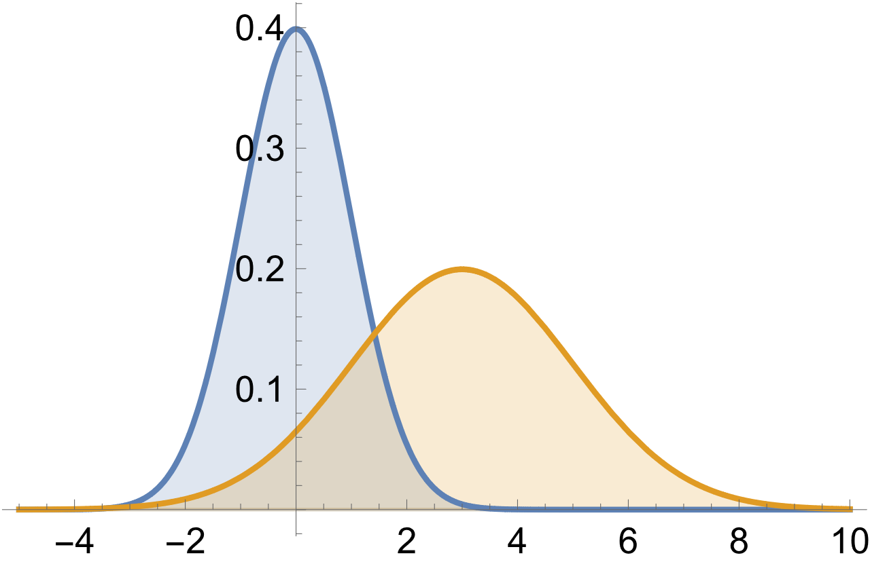
Loss function of Classification Problem
Softmax activation
SoftMax: $\frac{\exp\left(z_{i}\right)}{\sum_{j}{\exp\left(z_{j}\right)}}$ Sigmoid : $\frac{1}{\exp\left(−z\right)+1}$
Probability summation =1
Differentiable version of Max
Cross Entropy
$H\left(p,q\right)=− \sum_{x}{p\left(x\right) log q\left(x\right)}$
Generalizations
KL Divergence etc
$$q_{cat}=0.7$$
$$q_{dog}=0.3$$
$$H =−\log{0.7}≈ 0.357$$
$$D_{KL}\left(p||q\right)≔ \sum_{x}{p\left(x\right) log\frac{p\left(x\right)}{q\left(x\right)}}$$

Slide 9
How to Train a NN
 | Physical Model | Neural Network
Parameters | ~10(<100) | >10^5 (even 10^9, 10^10)
Calculations | Integral, Differential, Recursive… | Affine Transformation (Matrix Multiplication)
Type | Non-Linear | Non-Linear
Difficulty | Hard | Simple (in some sense)
Device | (mainly) CPU | GPU/TPU
Method | “Orthodox” Numerical Methods (Quasi-) Newton Method | Automatic Differentiation Stochastic Gradient Descent Back Propagation
Tools | ROOT/Minuit/D.I.Y | PyTorch/JAX/TensorFlow/MXNet

Slide 10
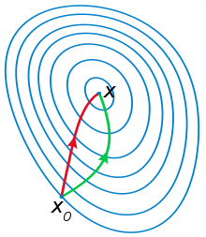
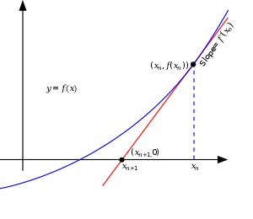
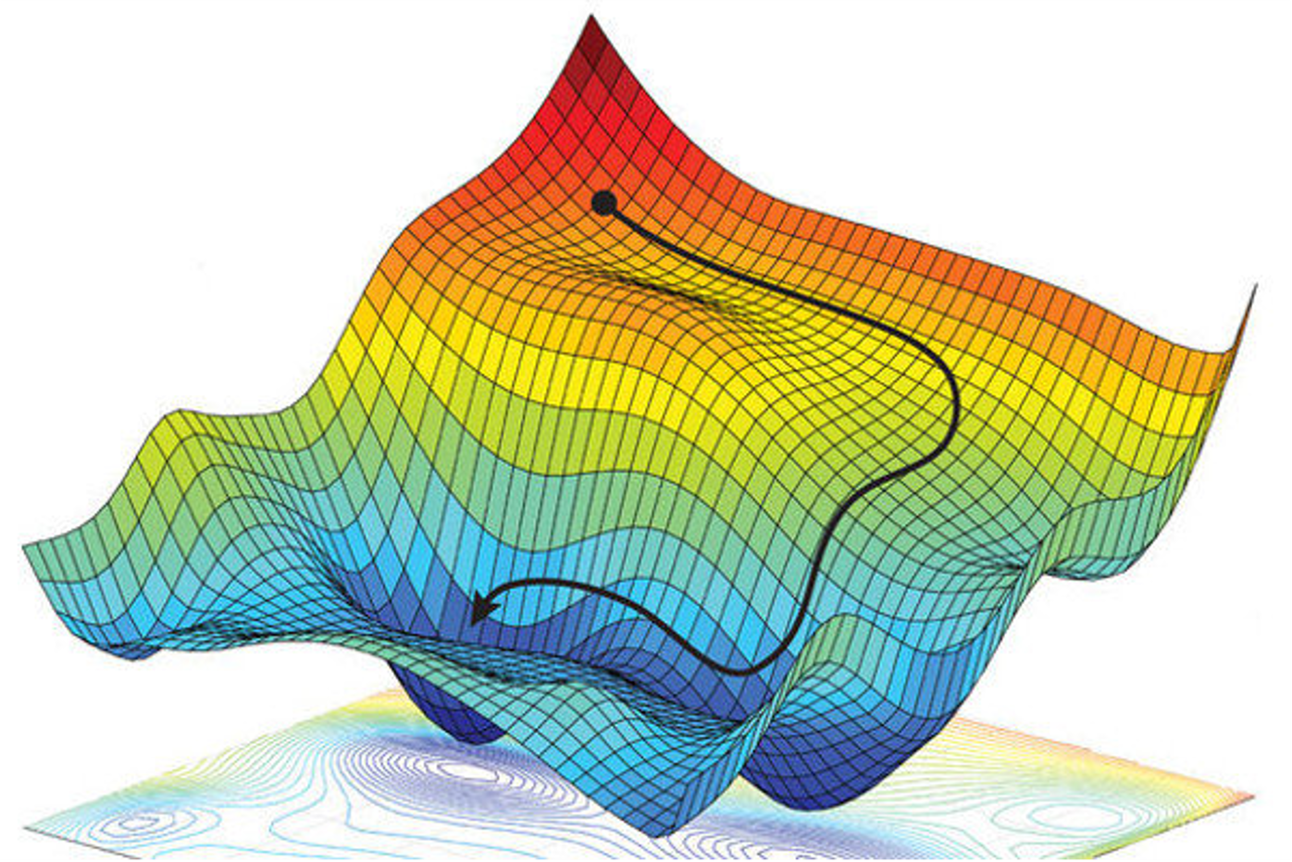
How to Train a NN
Every problem is an optimization problem
Hamiltonian ↔ Lagrangian
Differential Equation ↔ Least Action Principle
Orthodox way
Newton’s method in Root Finding: $x_{n+1}=x_{n}−f\left(x\right)/f^{′}\left(x\right)$
Newton’s Method In Optimization:
$$x_{n+1}=x_{n}−f′\left(x\right)/f^{′′}\left(x\right)$$
$f^{′}\left(x\right), f′′\left(x\right)$ may be difficult
Use approximated $f^{′′}\left(x\right)$
Quasi-Newton methods: e.g. BFGS etc
Challenges from NN
many saddle points / local minima
NN tells Newton:
Don’t pursue perfection
Just do it Slooowly!

Slide 11
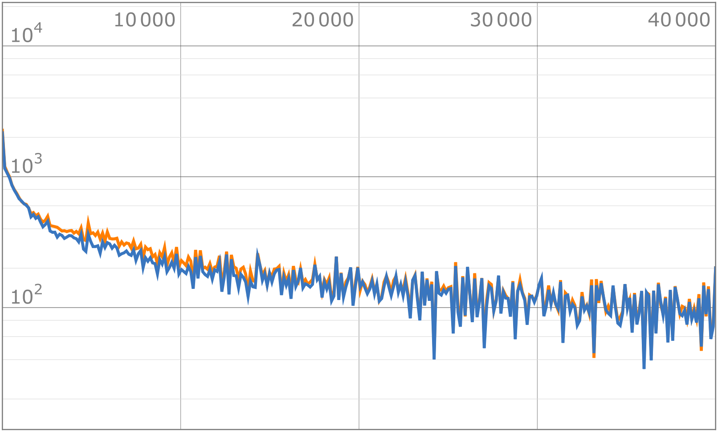
How to Train a NN
$$x_{n+1}=x_{n}−f′\left(x\right)/f^{′′}\left(x\right)$$
$$x_{n+1}=x_{n}−ε f′\left(x\right)$$
☆Eliminate correlation
Stochastic Gradient Descent (SDG)
In practice: Randomize the data, then mini-batch
learning rate $ε$, (typically ${\sim 10}^{−3}$) (randomly selected )mini batch $\left\{x^{\left(1\right)},x^{\left(2\right)},…,x^{\left(m\right)}\right\}$ $θ→θ −ε \frac{1}{m}∇_{θ} \sum_{i}{L\left(NN\left(x^{\left(i\right)};θ\right),y^{\left(i\right)}\right)}$
$∇_{θ}^{2}$ is expensive, rarely used in practice
How to get $∇_{θ}L$?
SGD
SGD
Mini-batch Gradient Descent
☆Benefit from $σ/\sqrt{n}$
& Parallelization
(Full) Batch Gradient Descent

Slide 12
Automatic Differentiation + Back Propagation
$∇_{θ}L$is the crux
Back Propagation
Each activation function is “simple”
Hierarchy -> Chain rule
$∇_{θ_{1}}f\left(g\left(x;θ_{1}\right);θ_{2}\right)=∇_{θ_{1}}g\left(x;θ_{1}\right)∗f′\left(g\left(x;θ_{1}\right);θ_{2}\right)$
$f\left(x;θ\right)≔f\left(W.X+b\right)$ (affine transformation) -> GPU
Implemented in Pytorch, Mathematica (MXNet)…
General Technique: Automatic Differentiation (AD)
Not numerical $f\left(x+δ\right)−f\left(x\right)$, nor symbolic
“Differentiate” the code (including loops): $\sin{x}→\cos{x}$
Get $f^{′}\left(x\right)$ along the way
Packages: Jax (Python), NiLang (Julia) …
Not sure ROOT has implement this or not
forward
$$X$$
$$f\left(X;θ\right)$$
$$∇_{θ_{1}}f\left(X;θ_{1}\right)$$
$$∇_{θ_{n}}f\left(X;θ_{n}\right)$$
backward
See “Deep Learning” Chapter 6.5 for the details

Slide 13
Short Summary
Architecture (Whether)
Loss Function (What)
Optimization (How)
UAT

Slide 14
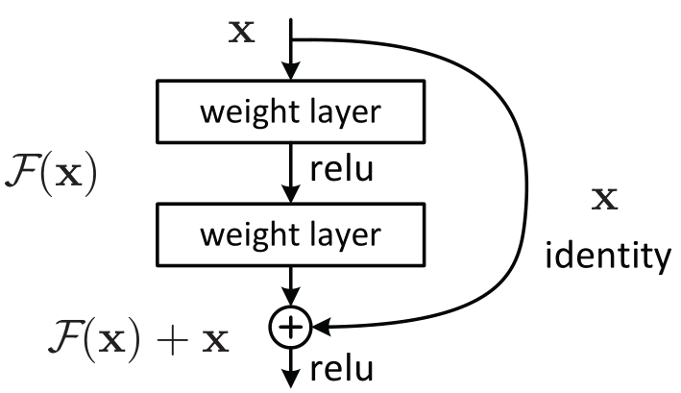
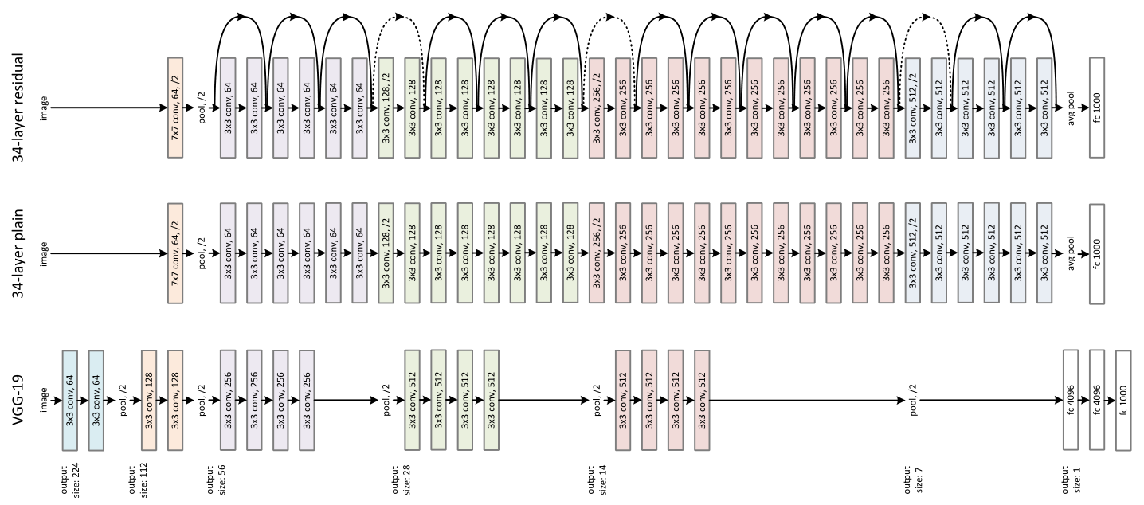
Architecture Extensions
ResNet
Introduce Jump-Link to Accelerate Training & Inference
$F_{n+1}\left(x\right)=x+F_{n}\left(x\right)$
Alleviate the Gradient-Vanishing/Exploding Problem
Make training deep NN possible
One small step for a NN
one giant leap for the ML community!
Kaiming He (何恺明) et. al [arXiv:1512.03385]
KAN. Ziming Liu et. al [arXiv:2404.19756] UATs are still not fully understood!
Much to explore

Slide 15
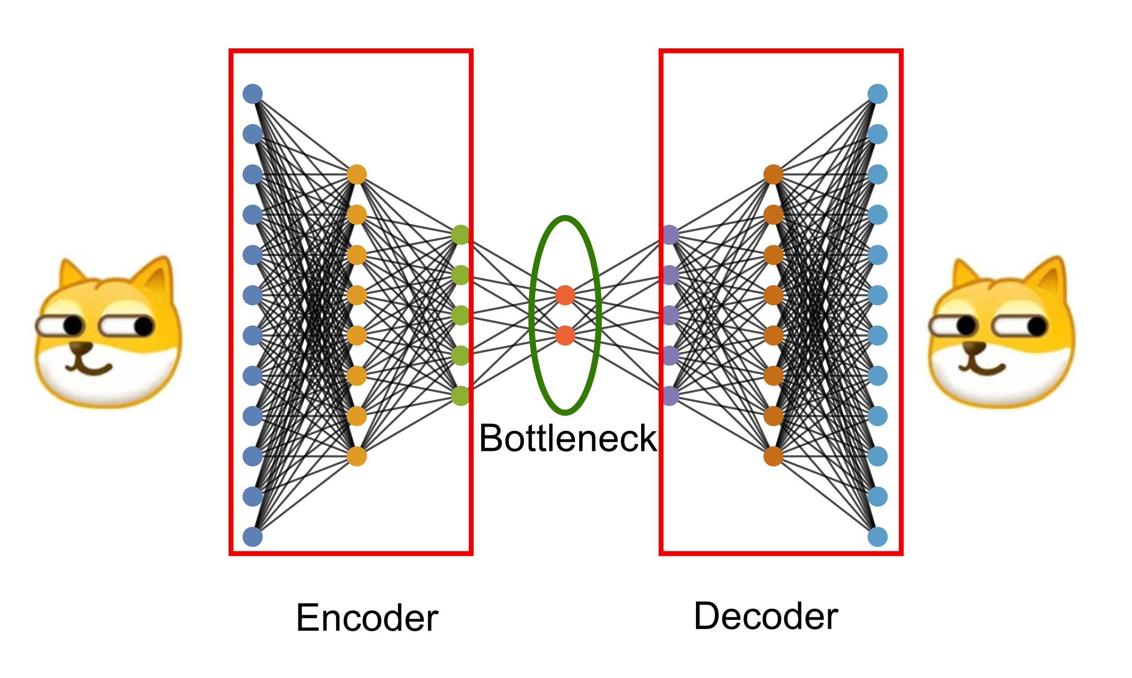
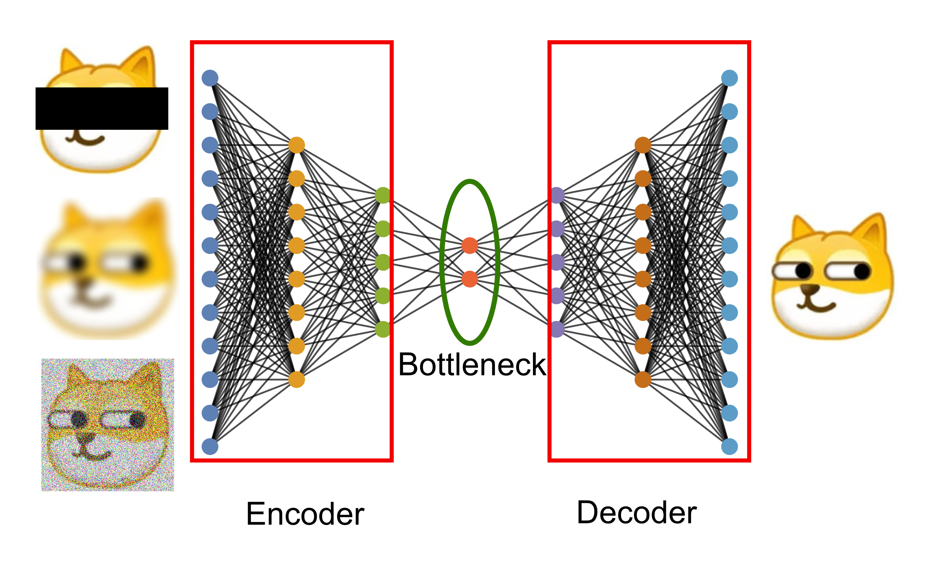
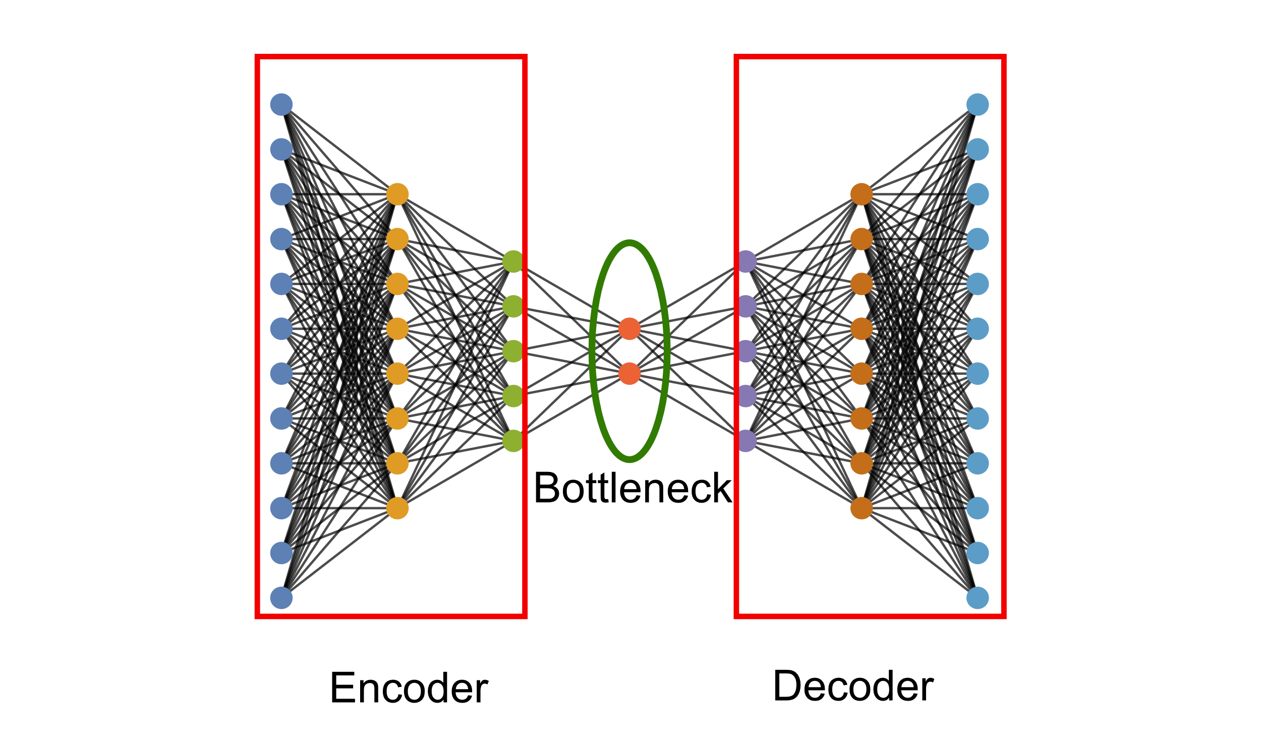
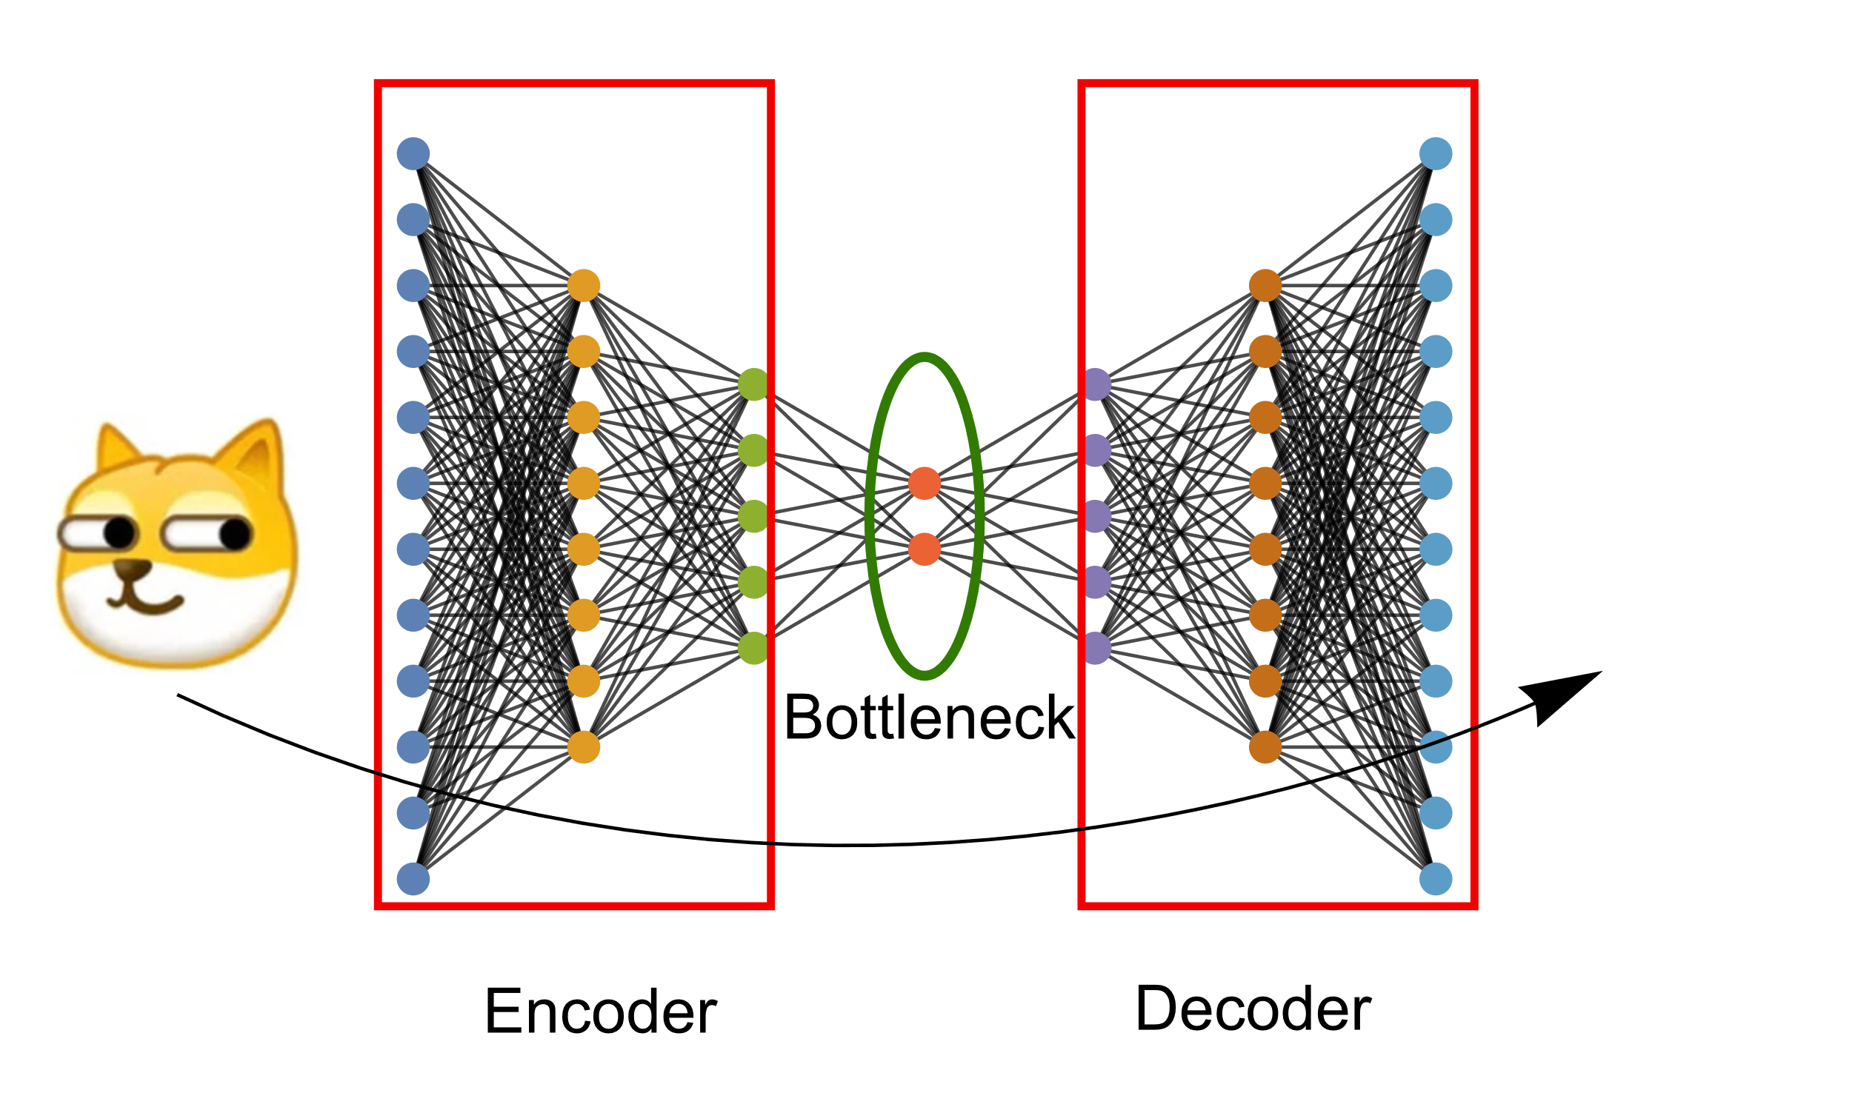
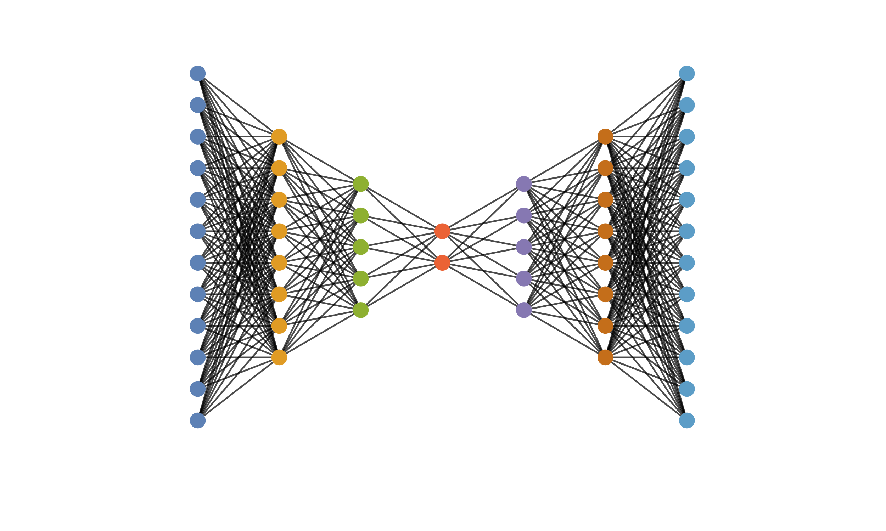
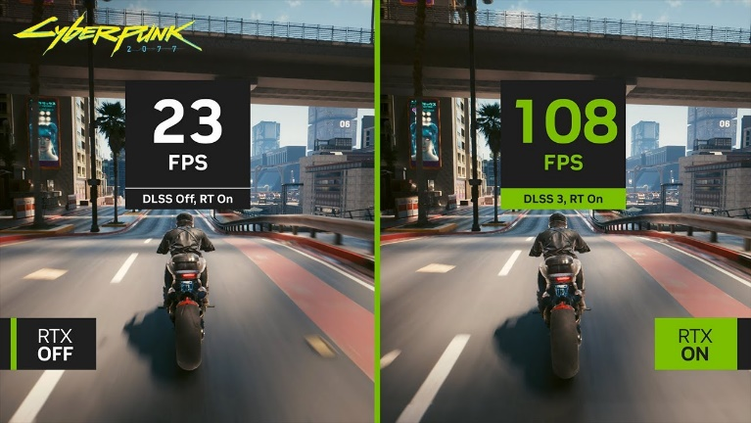
AutoEncoder(自动编码器)
Dimension Reduction
Mask Trick
Denoising, Inpainting
Super Resolution (naïve DLSS)
Not Magic, Merge Info in Other Samples to handle ill-definedness
arxiv:1611.09969

Slide 16
Encoder-Decoder Examples
Encoder
Recommendation System
Encoder
Big-Data
Discrimination

Slide 17
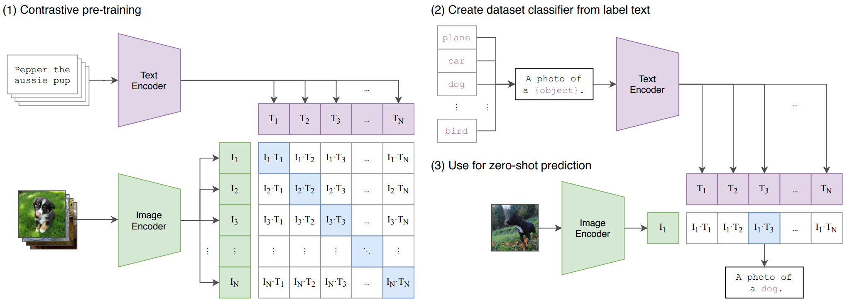
Encoder Decoder Examples
[CLIP by OpenAI, arXiv:2103.00020]
Encoder
Decoder
Good representation is a Treasure
Decoder
Language
Q&A, Programming,
Translation, Literature, …
“I am going to reveal the identity of the criminal,
and that person's name is …” by Sutskever
Statistical Inference $≈$ logic?
Predict the next word
Large Language Models (LLMs)
ChatGPT
“All models are wrong, but some are useful”
-- aphorism in statistics.

Slide 18
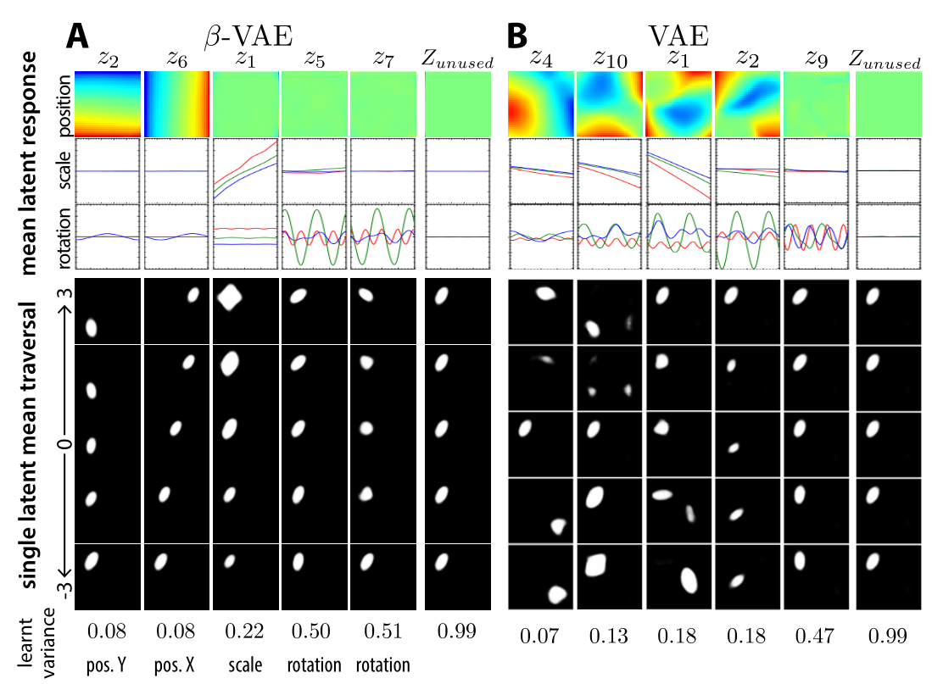
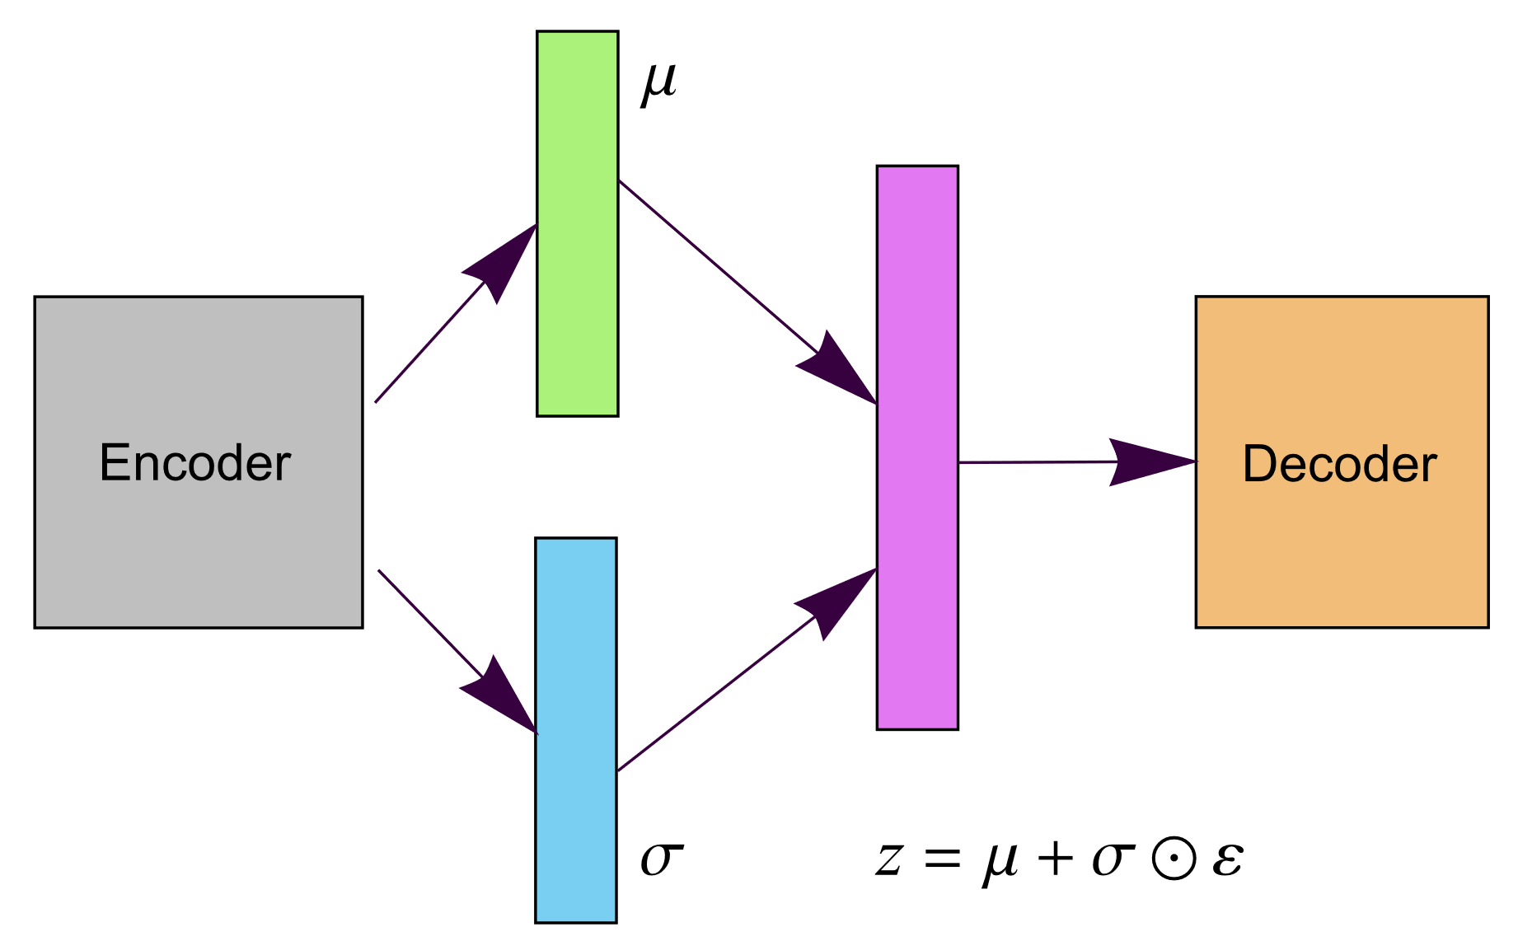
(β)Variational Auto-Encoder(βVAE变分自动编码器)
Latent Feature Interpretation
Disentangle latent factors
Realized by Statistical Independence
Statistical
Independence
Encoder
Decoder
Non-Linear
Linear
Non-linear
Independence
Higgins et.al https://openreview.net/forum?id=Sy2fzU9gl
$$\operatorname{argmax}{E_{q_{φ}\left(z | x\right)}\left[\log{p_{θ}\left(x | z\right)}\right]−βD_{KL}\left( q_{φ}\left(z | x\right)||p\left(z\right)\right)}$$

Slide 19
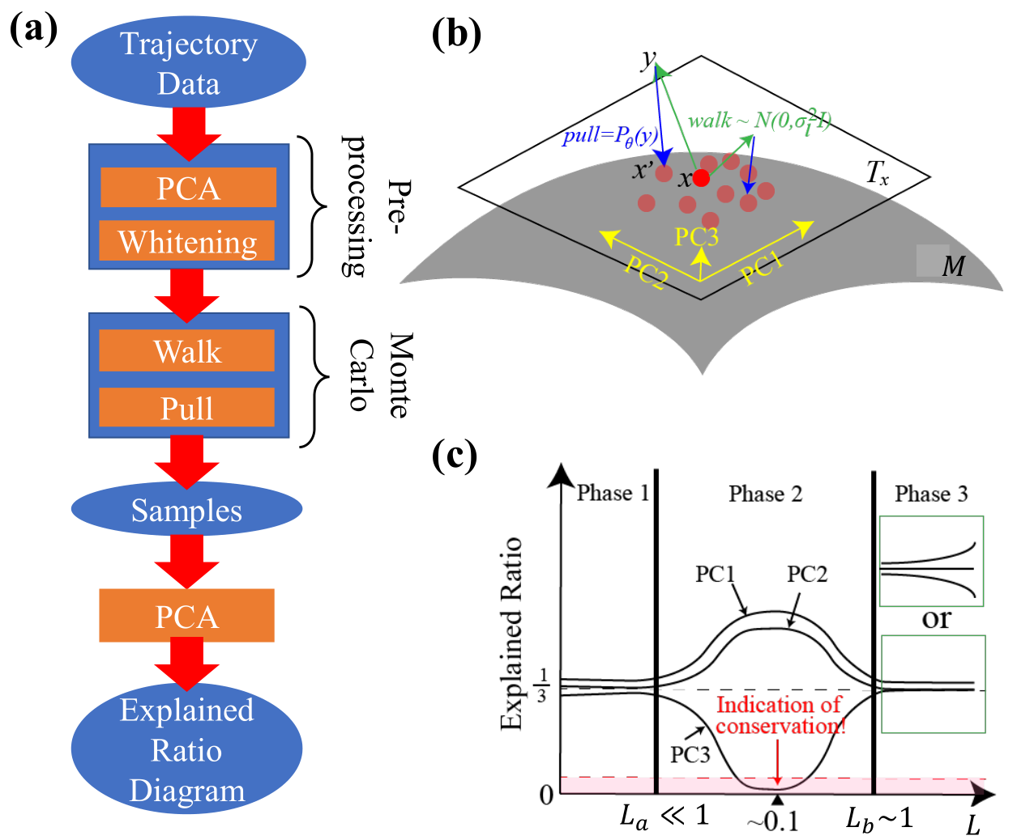
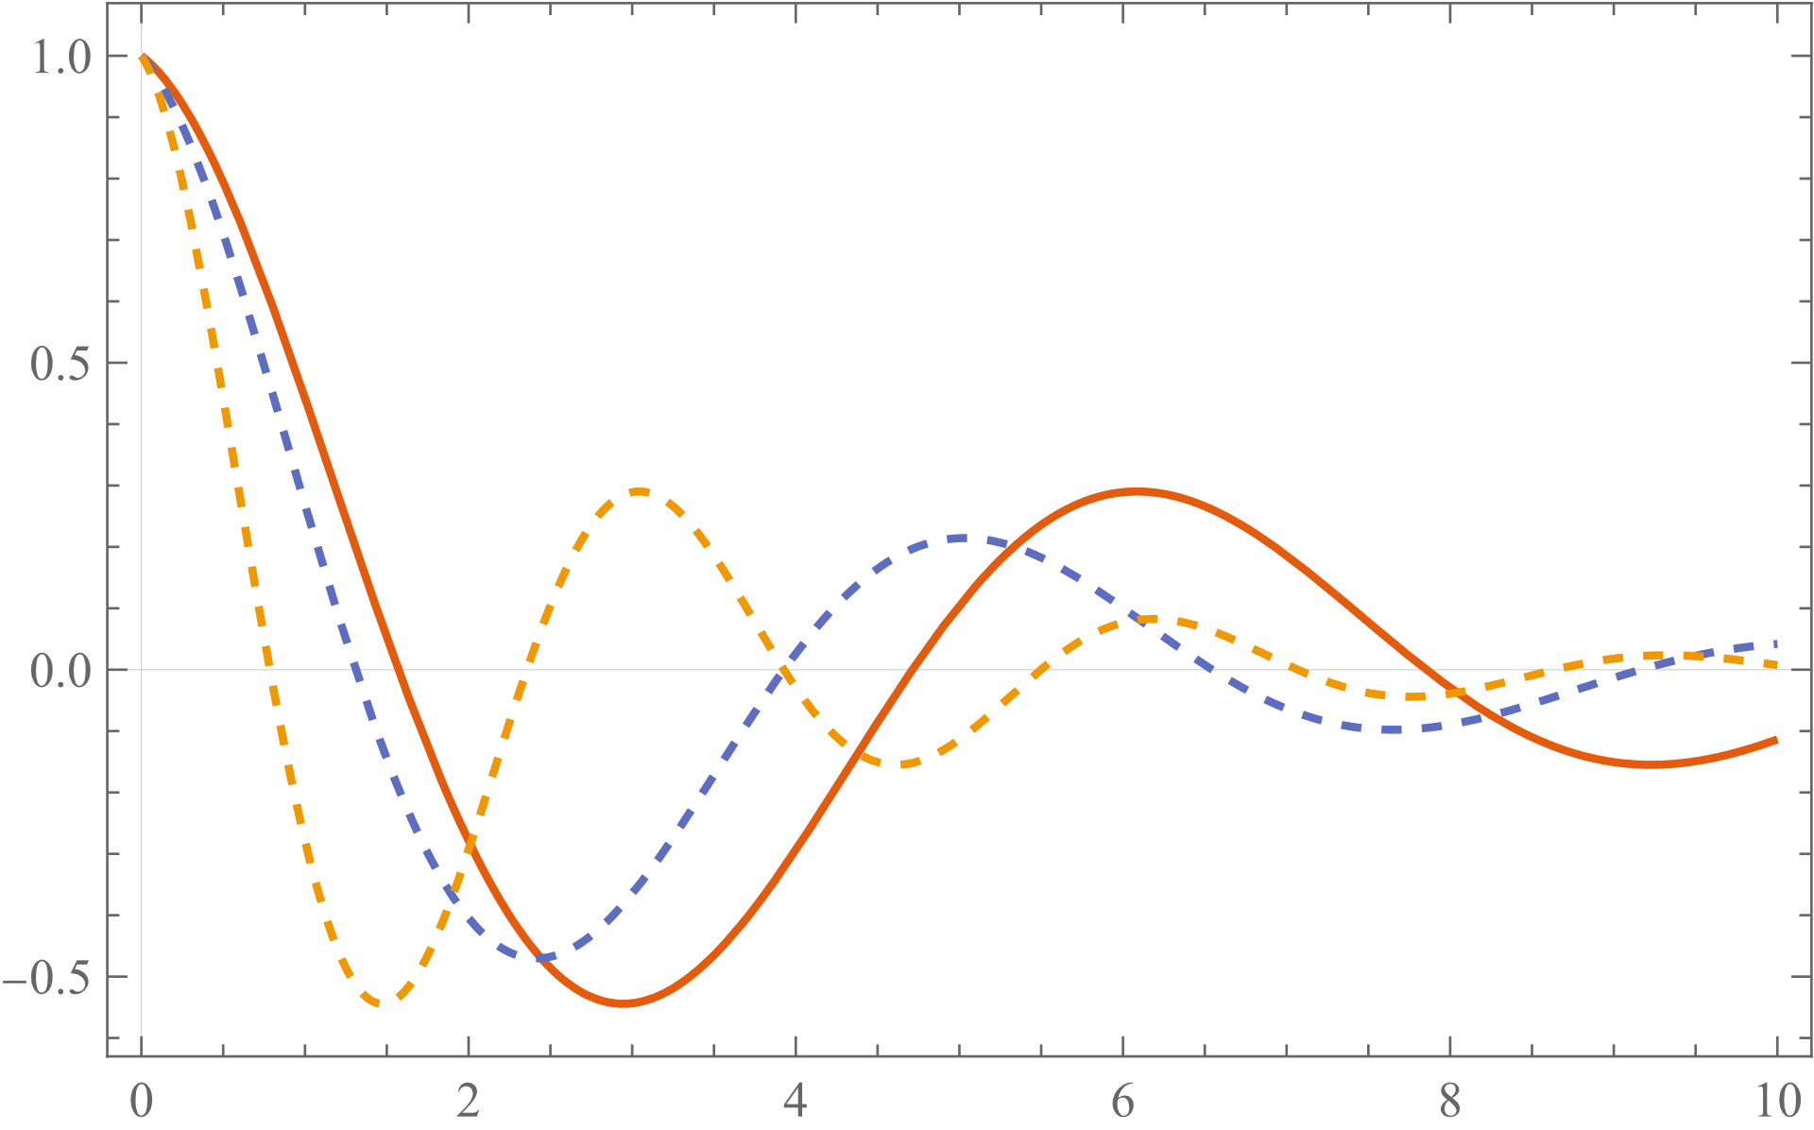
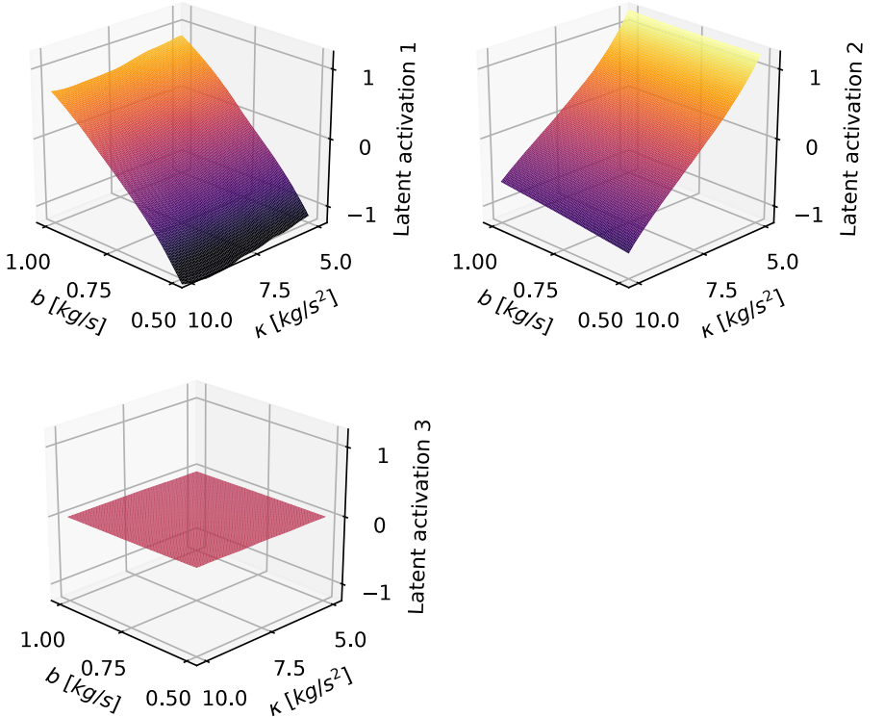
βVAE in Physics
PhysRevLett.124.010508
Statistical
Independence
$$x^{′′}\left(t\right)+bx^{′}\left(t\right)+kx\left(t\right)=0$$
Encoder
Decoder
Non-Linear
Linear
Non-linear
Independence
Philosophically Similar:
AI Poincare [PhysRevLett.126.180604]
Only Two are effective D.O.F!

Slide 20
“Perfection is achieved,
not when there is nothing more to add,
but when there is nothing left to take away.”
Antoine de Saint-Exupéry
安东尼·德·圣-埃克苏佩里

Slide 21
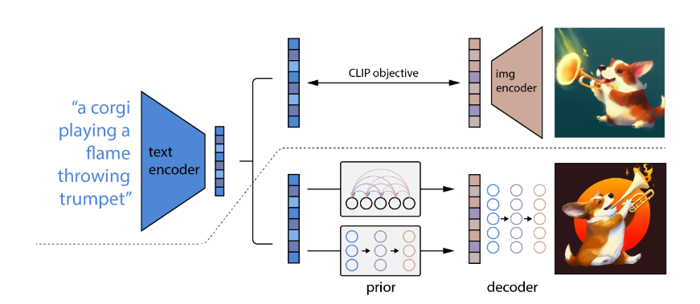
Parameter Number is Huge
Modern NN is wide & deep
1998: LeNet-5, $6×{10}^{4}$
2022: DALL-E 2, $3.5×{10}^{9}$

Slide 22
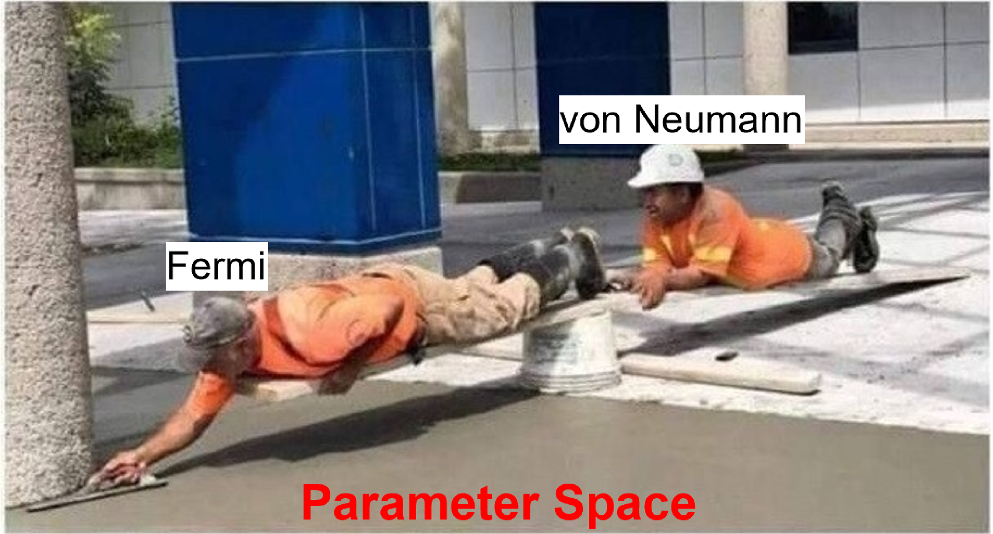
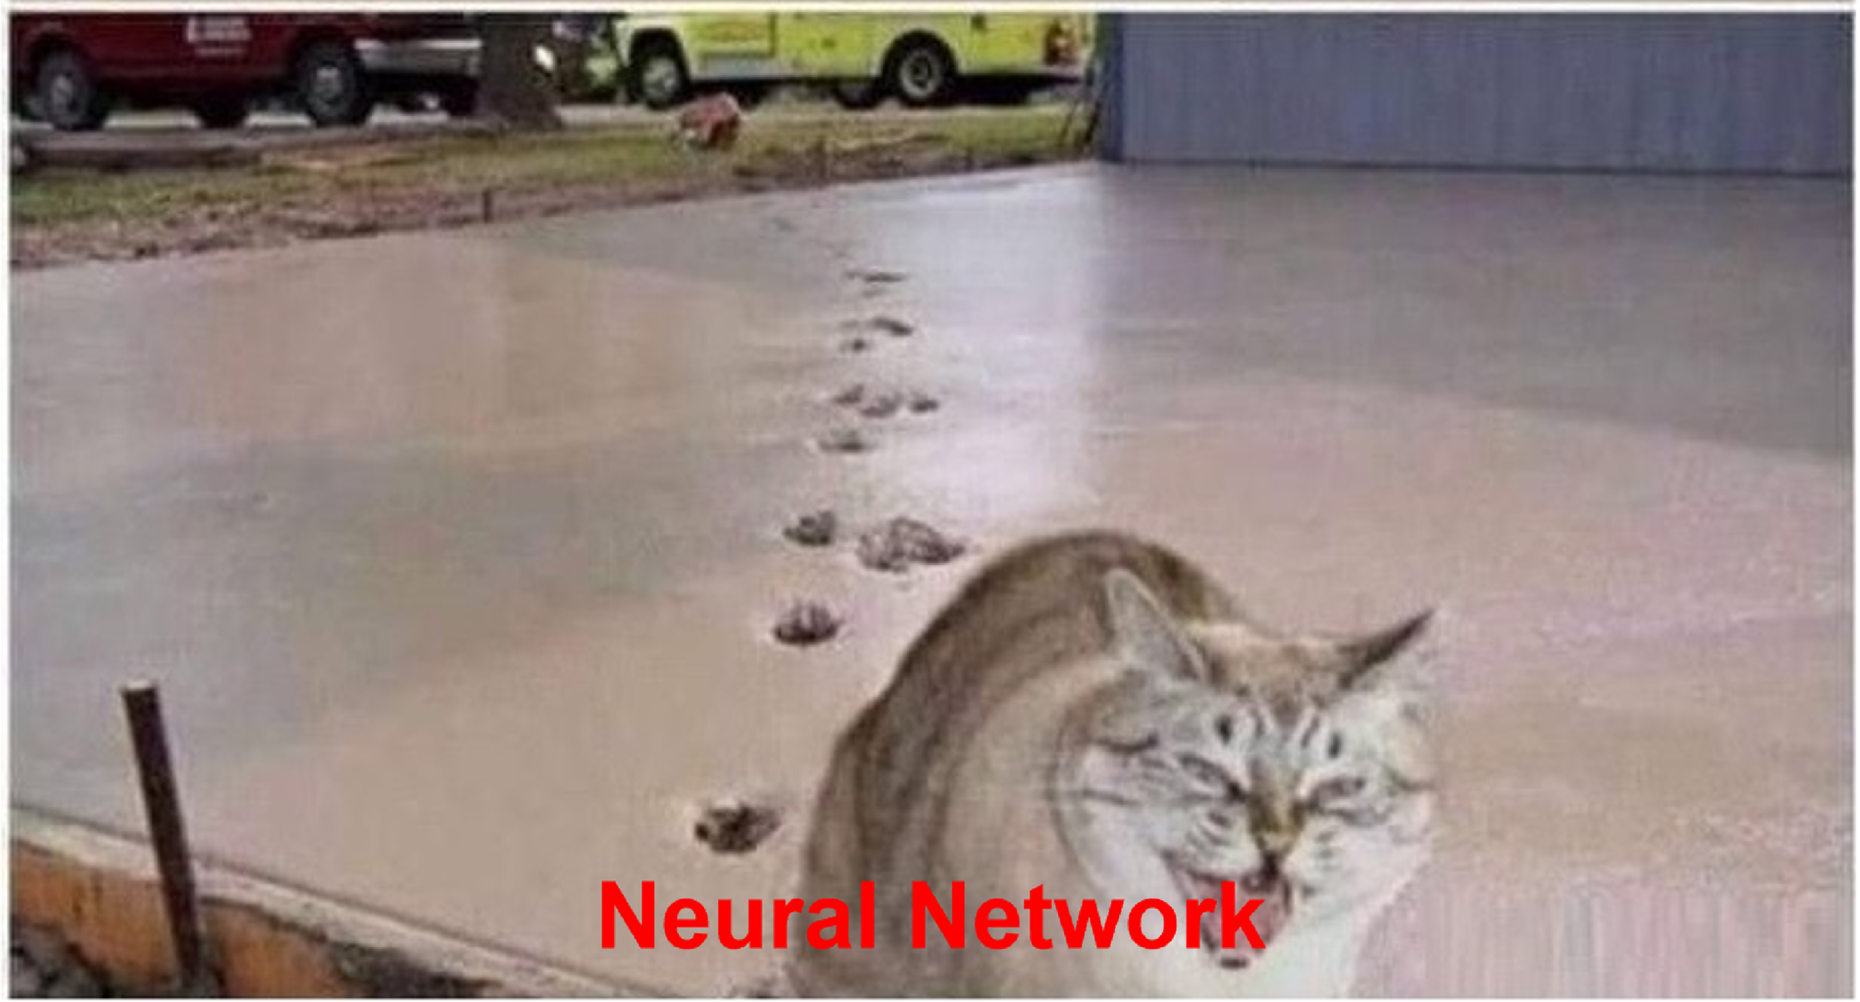
Possible Questions from Physicists
${10}^{n}$parameters?! That’s Toooooo Many!
Explainability/Interpretability, can be partially explained.
Personal comment at the end of this talk.

Slide 23
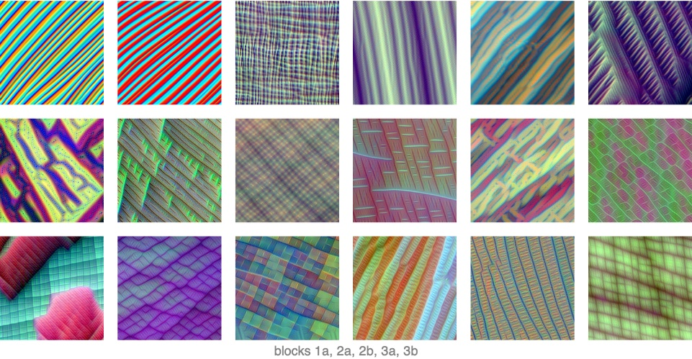
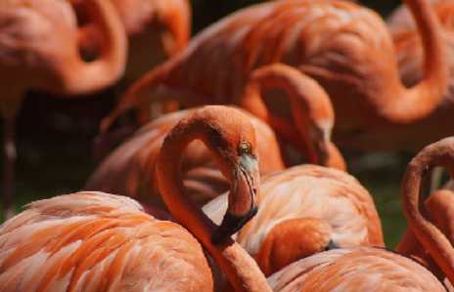
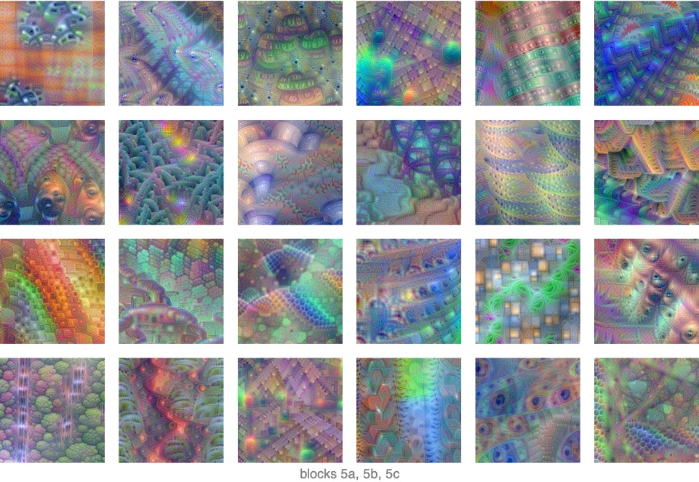
Possible Questions from Physicists
${10}^{n}$parameters?! That’s Toooooo Many!
Explainability/Interpretability, can be partially explained.
Personal comment at the end of this talk.
Difference between NN and fitting?
Fundamentally the same but somehow not that trivial
EfficientNet
flamingo
EfficientNet, arXiv:1905.11946

Slide 24
Possible Questions from Physicists
${10}^{n}$parameters?! That’s Toooooo Many!
Explainability/Interpretability, can be partially explained.
Personal comment at the end of this talk.
Difference between NN and fitting?
Fundamentally the same but somehow not that trivial
Why bother?
Vague idea becomes solid
In the spirit of Duck Test -> NN$≈$Underline Function
Cat/Dog
Function
Cat
Dog

Slide 25
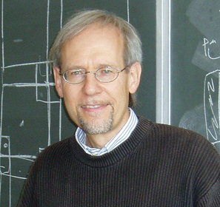
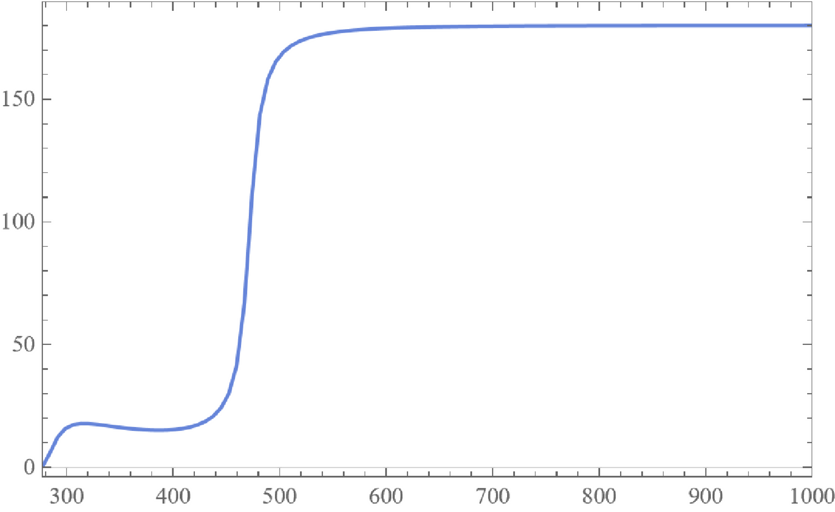
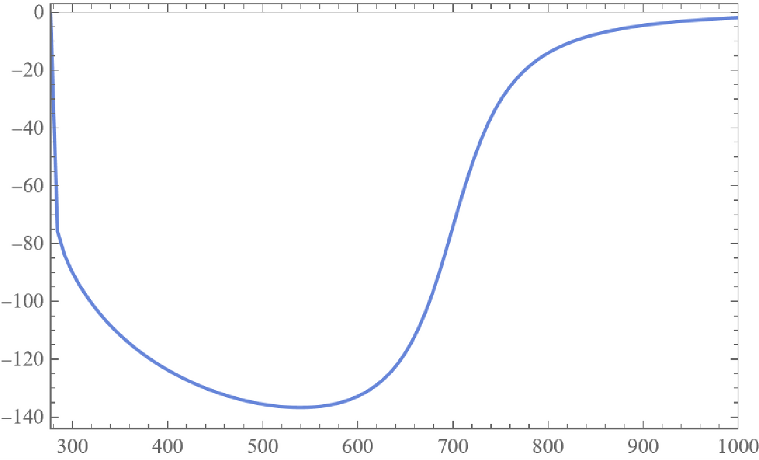
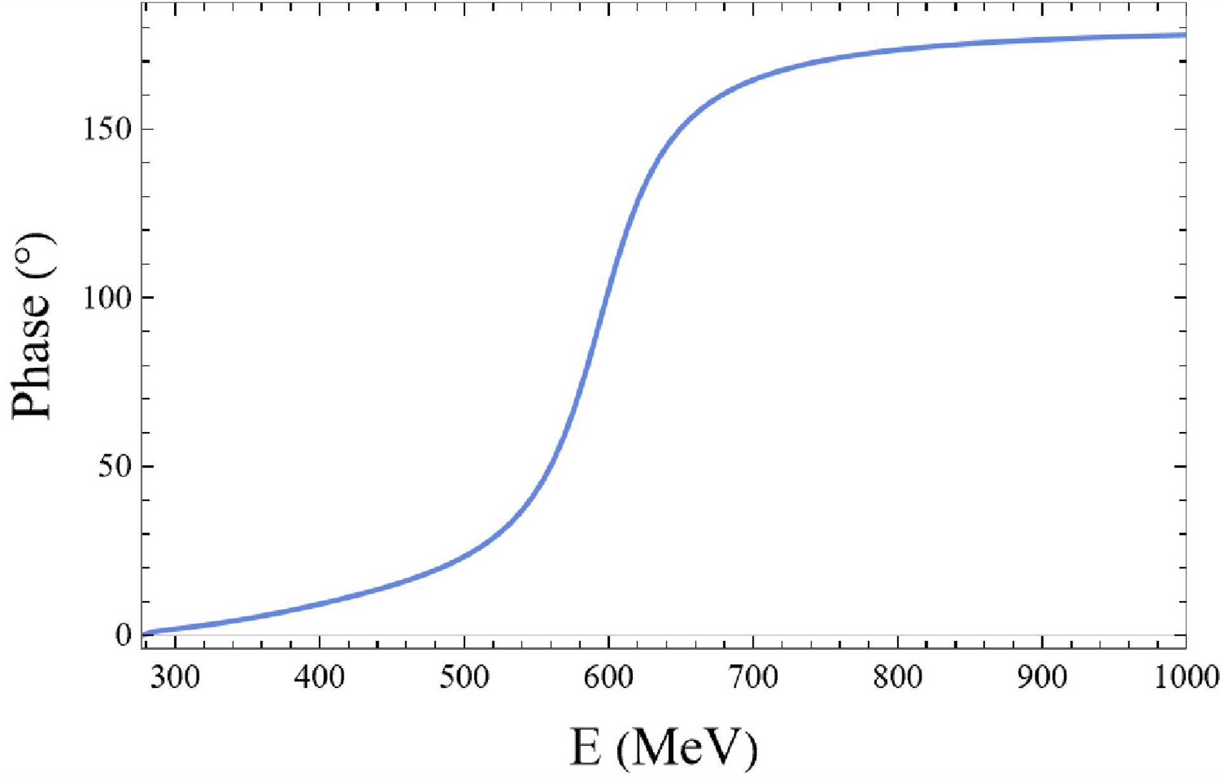
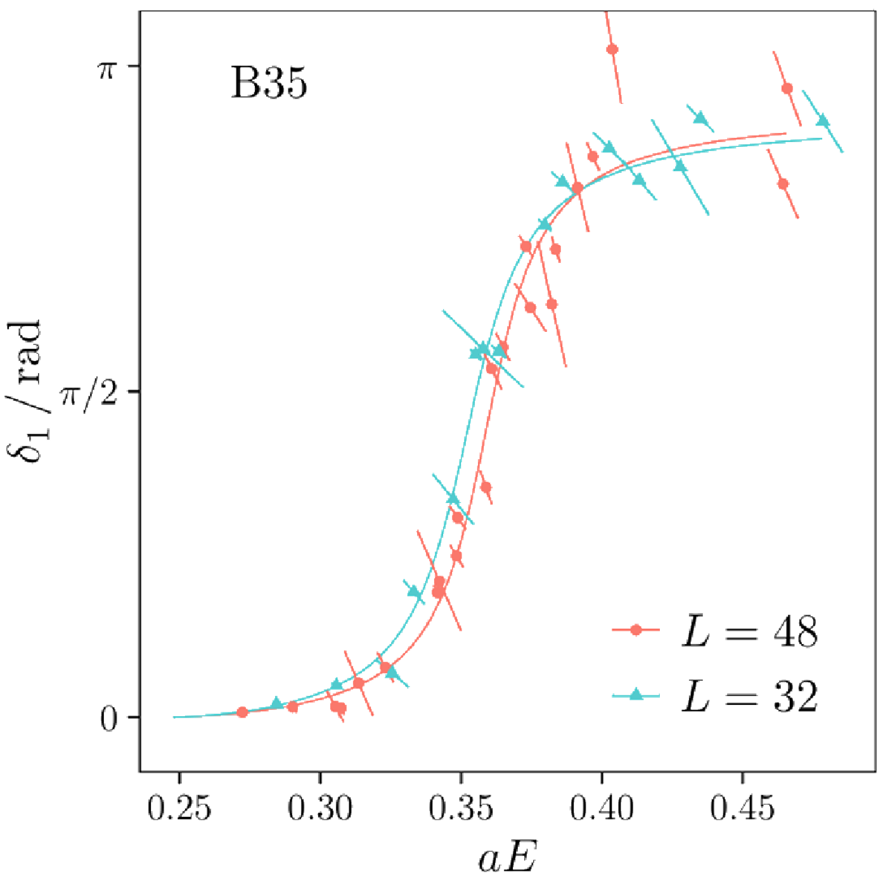
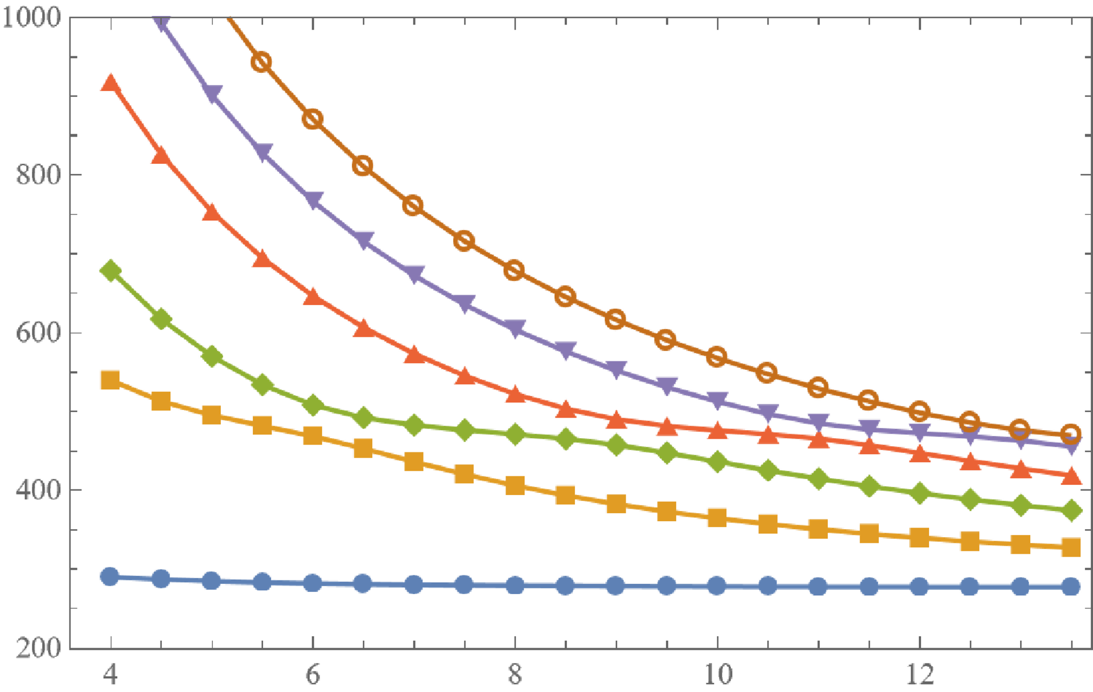
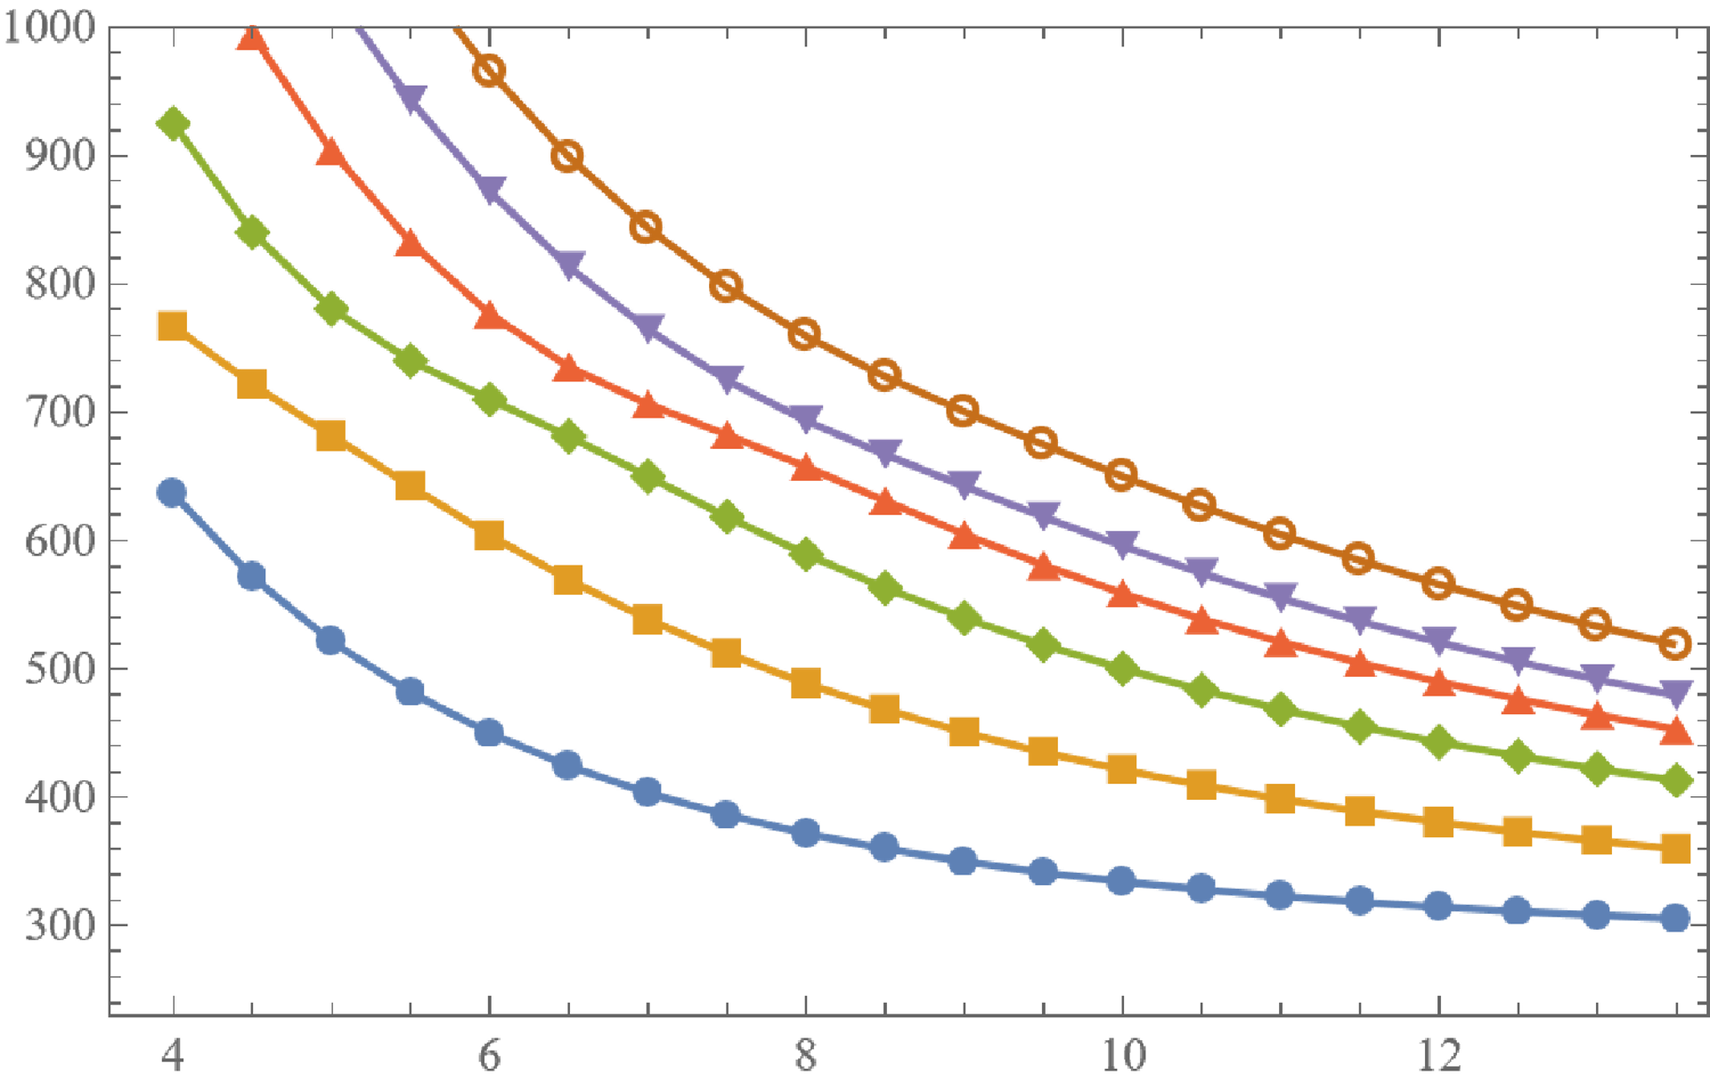
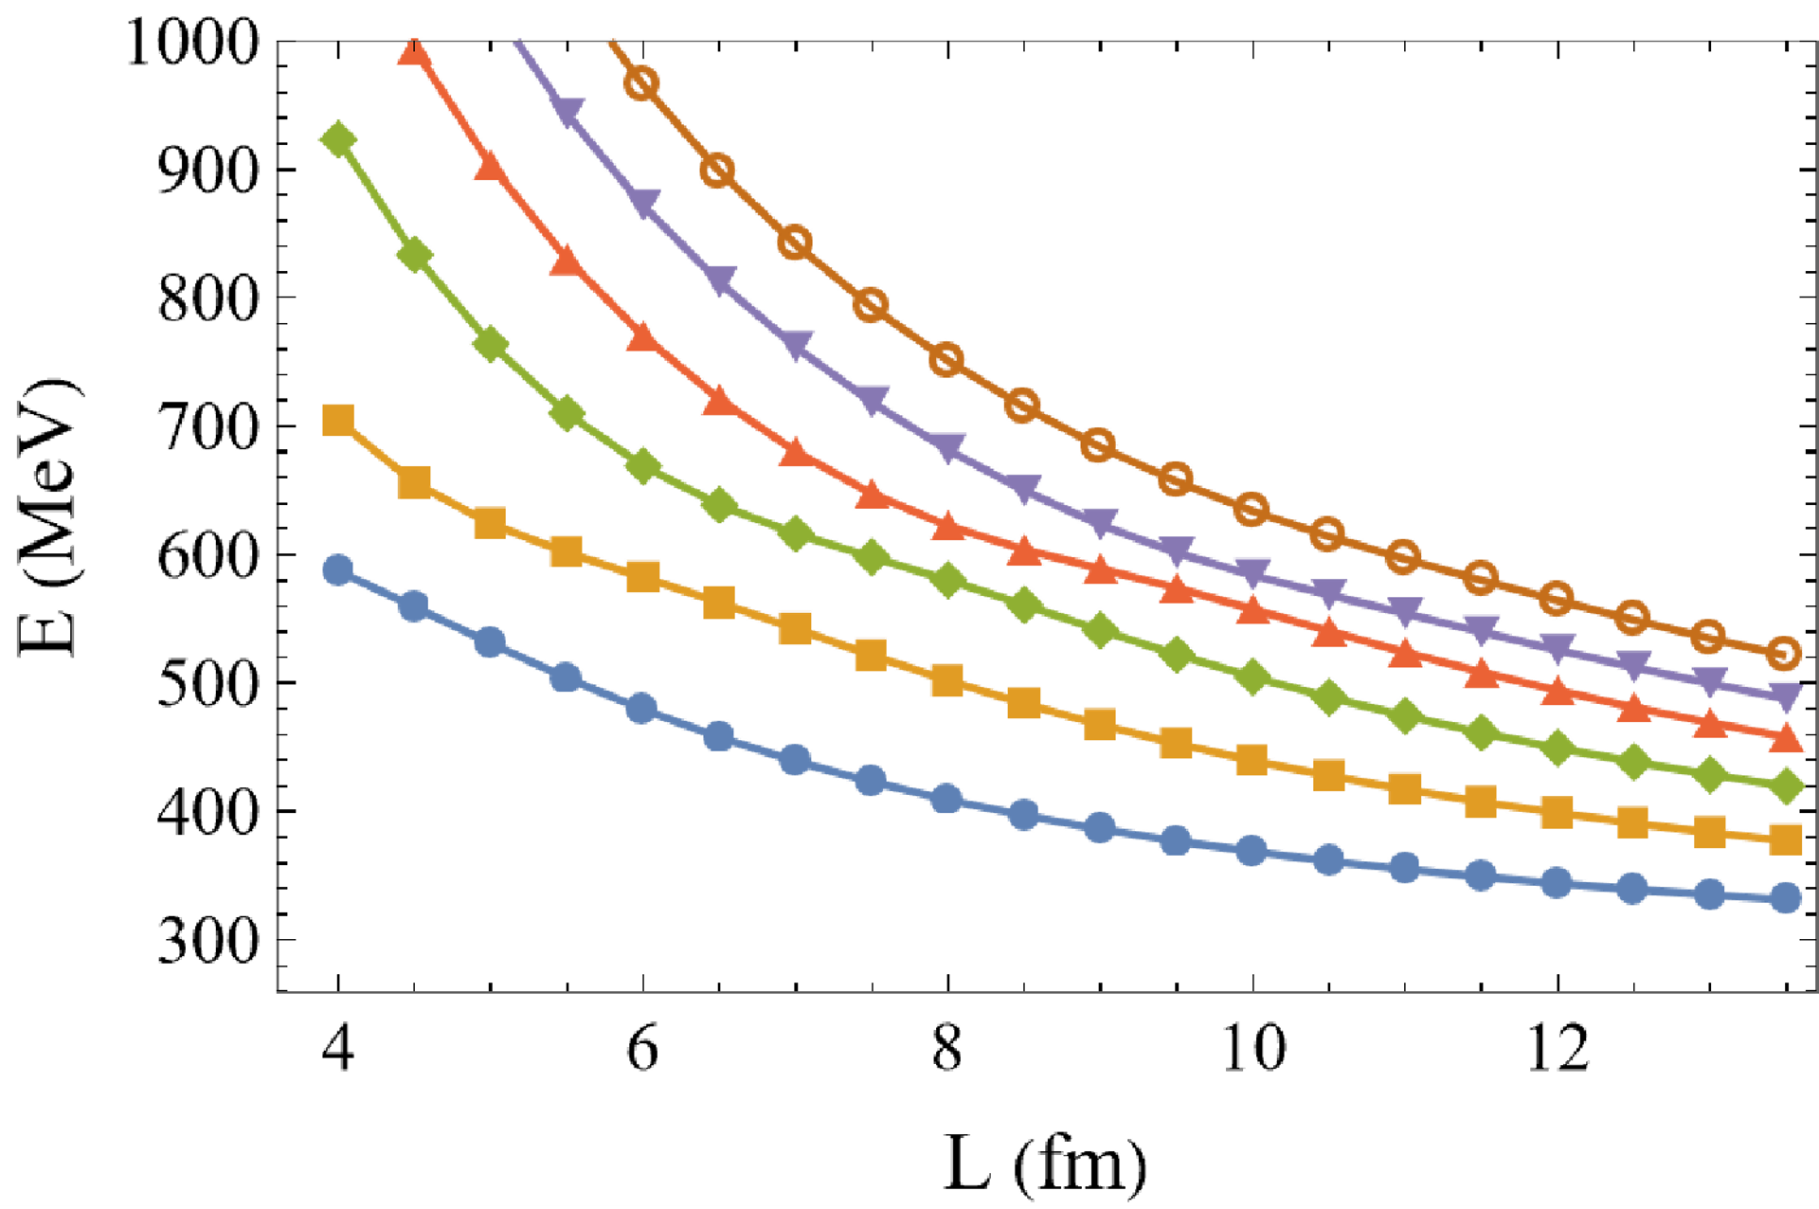
Motivation of Our Work
QCD is hard
Phenomenological models/ ChiPT etc.
LQCD
Is there a model-independent link between model-dependent quantities?
Hard/Impossible? Martin Lüscher did it in 1986
One Workflow in LQCD
$\left\langle {\hat{O}}_{i}{\hat{O}}_{j}\right\rangle →E\left(L\right)→δ\left(E\right)$
Commun. Math. Phys. 104, 177,
Commun. Math. Phys. 105, 153,
Nucl. Phys. B 354, 531
?
QCD
$$δ\left(E\right)=\arctan\left(q\frac{π^{3/2}}{\left.ℒ_{00}(1;q^{2}\right)}\right)$$
$$ℒ_{00}\left(1;q^{2}\right)\sim \frac{1}{\sqrt{4π}}\sum_{ \vec{n}}{{\left({\vec{n}}^{2}−q^{2}\right)}^{−1}}$$
Fig. from Eur. Phys. J. A 56, 61

Slide 26
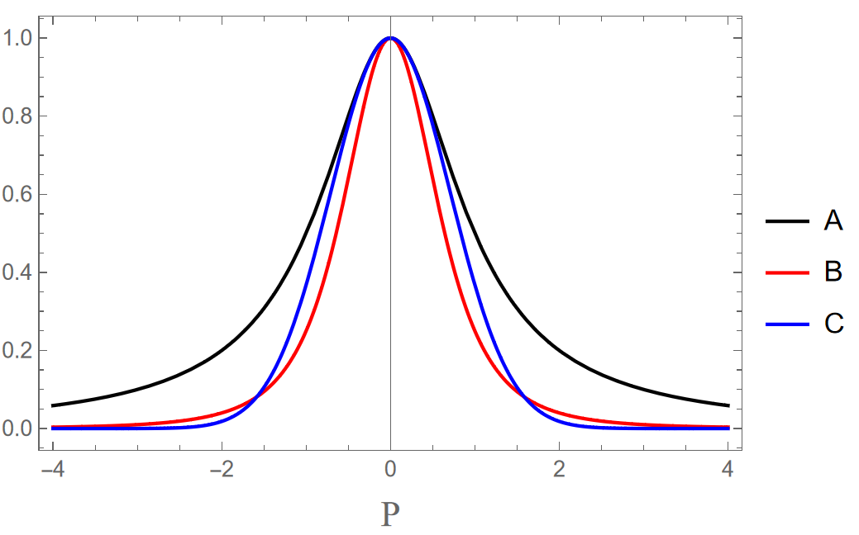
Hamiltonian Effective Field Theory(HEFT) & Data Generation
J.J. Wu et al. Phys.Rev.C.90.055206
$ππ→ππ$, s wave elastic scattering
$$H=H_{0}+H_{I}$$
$$H_{0}=\left|σ\right\rangle m_{σ}\left\langle σ\right|+\int{dk\left(\left|k\right\rangle \sqrt{m_{π}^{2}+k^{2}}\left\langle k\right|\right)}$$
$$H_{I}=\int{dk\left(\left|k\right\rangle g\left(k\right)\left\langle σ\right|+h.c.\right)}+\int{dkdk^{′}\left|k\right\rangle v\left(k,k′\right)\left\langle k′\right|}$$
$g\left(k\right)∝f\left(k\right), v\left(k,k^{′}\right)∝f^{2}(a,k)f^{2}(a,k′)$
Lippmann-Schwinger equation $→T→δ\left(E\right)$
$$f\left(a,k\right)=$$
$$A:{\left(1+{\left(ak\right)}^{2}\right)}^{−1}$$
$$B:{\left(1+{\left(ak\right)}^{2}\right)}^{−2},$$
$$C: e^{−{\left(ak\right)}^{2}}$$
$$π$$
$$π$$
$$π$$
Discretization, Eigenfunction:
$H\left(L\right)\left|ψ\right\rangle =E\left(L\right)\left|ψ\right\rangle$
$$g\left(k\right)$$
$$σ$$
$$v\left(k,k′\right)$$
$$π$$
$$π$$
$$π$$

Slide 27
Hamiltonian Effective Field Theory(HEFT) & Data Generation
J.J. Wu et al. Phys.Rev.C.90.055206
Model
(HEFT)
$δ\left(E\right)$ contains the full information
SoftPlus Not ReLU
Lowest 10 Energy levels
LossFunction: mean square error
2500 $δ\left(E\right)$ for each model, batch size 10^4, 4*10^4 epoch

Slide 28
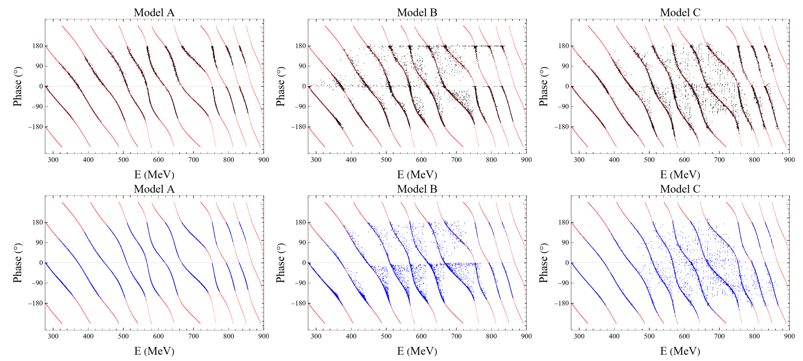
Model-dependent
Check $δ(E_{L})$ against LF
Model B: NN tries to drag the points towards LF
NN captures model-independent link (to some degree)
$$LF+o\left(e^{−mL}\right)=E\left(L\right)$$
LF NN Model
Model-independent
Stronger Evidence?

Slide 29
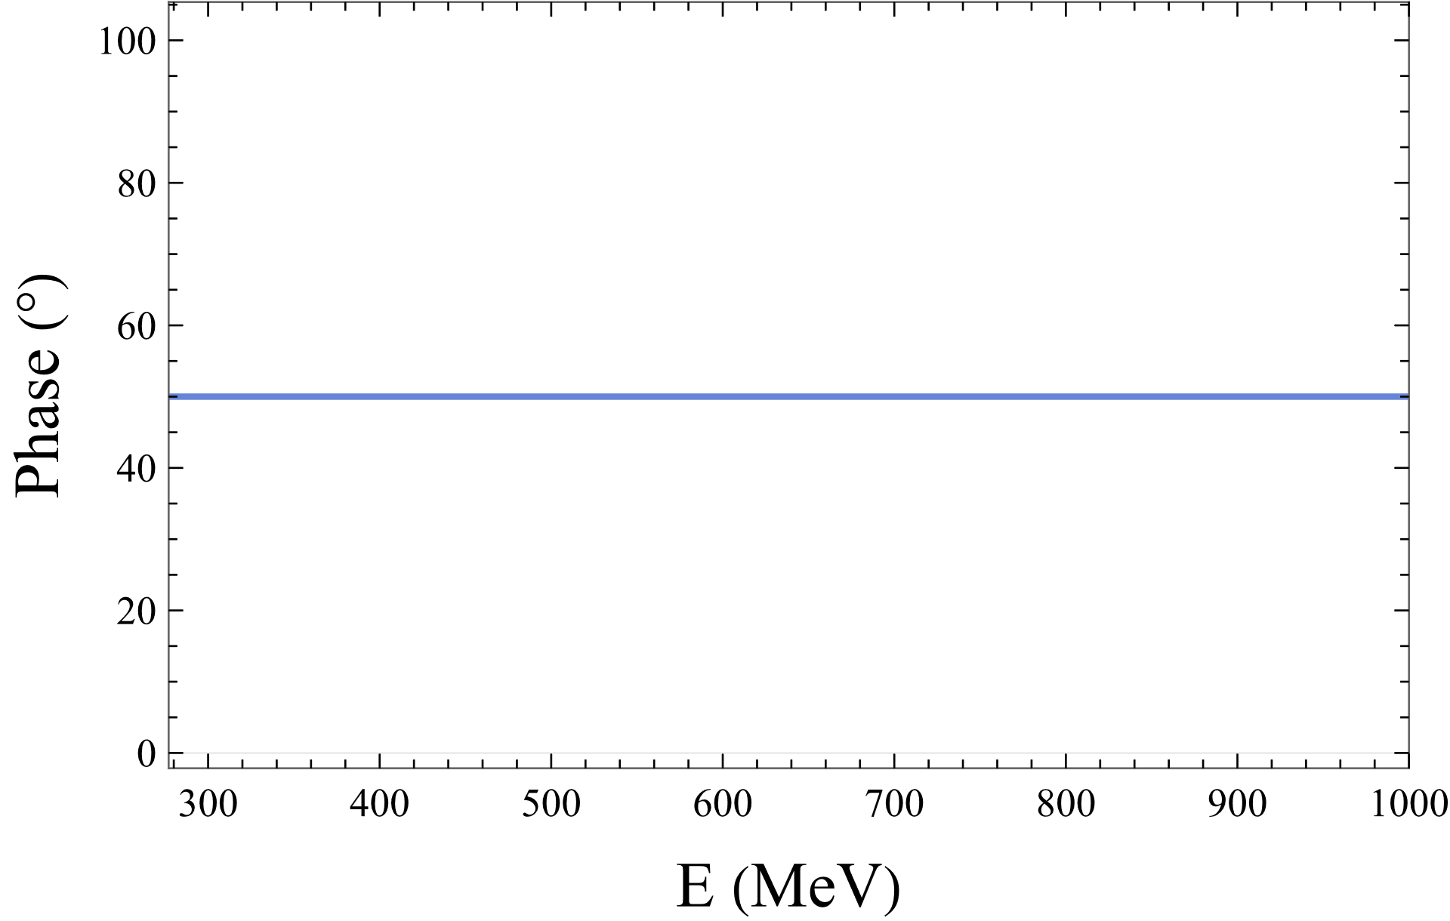
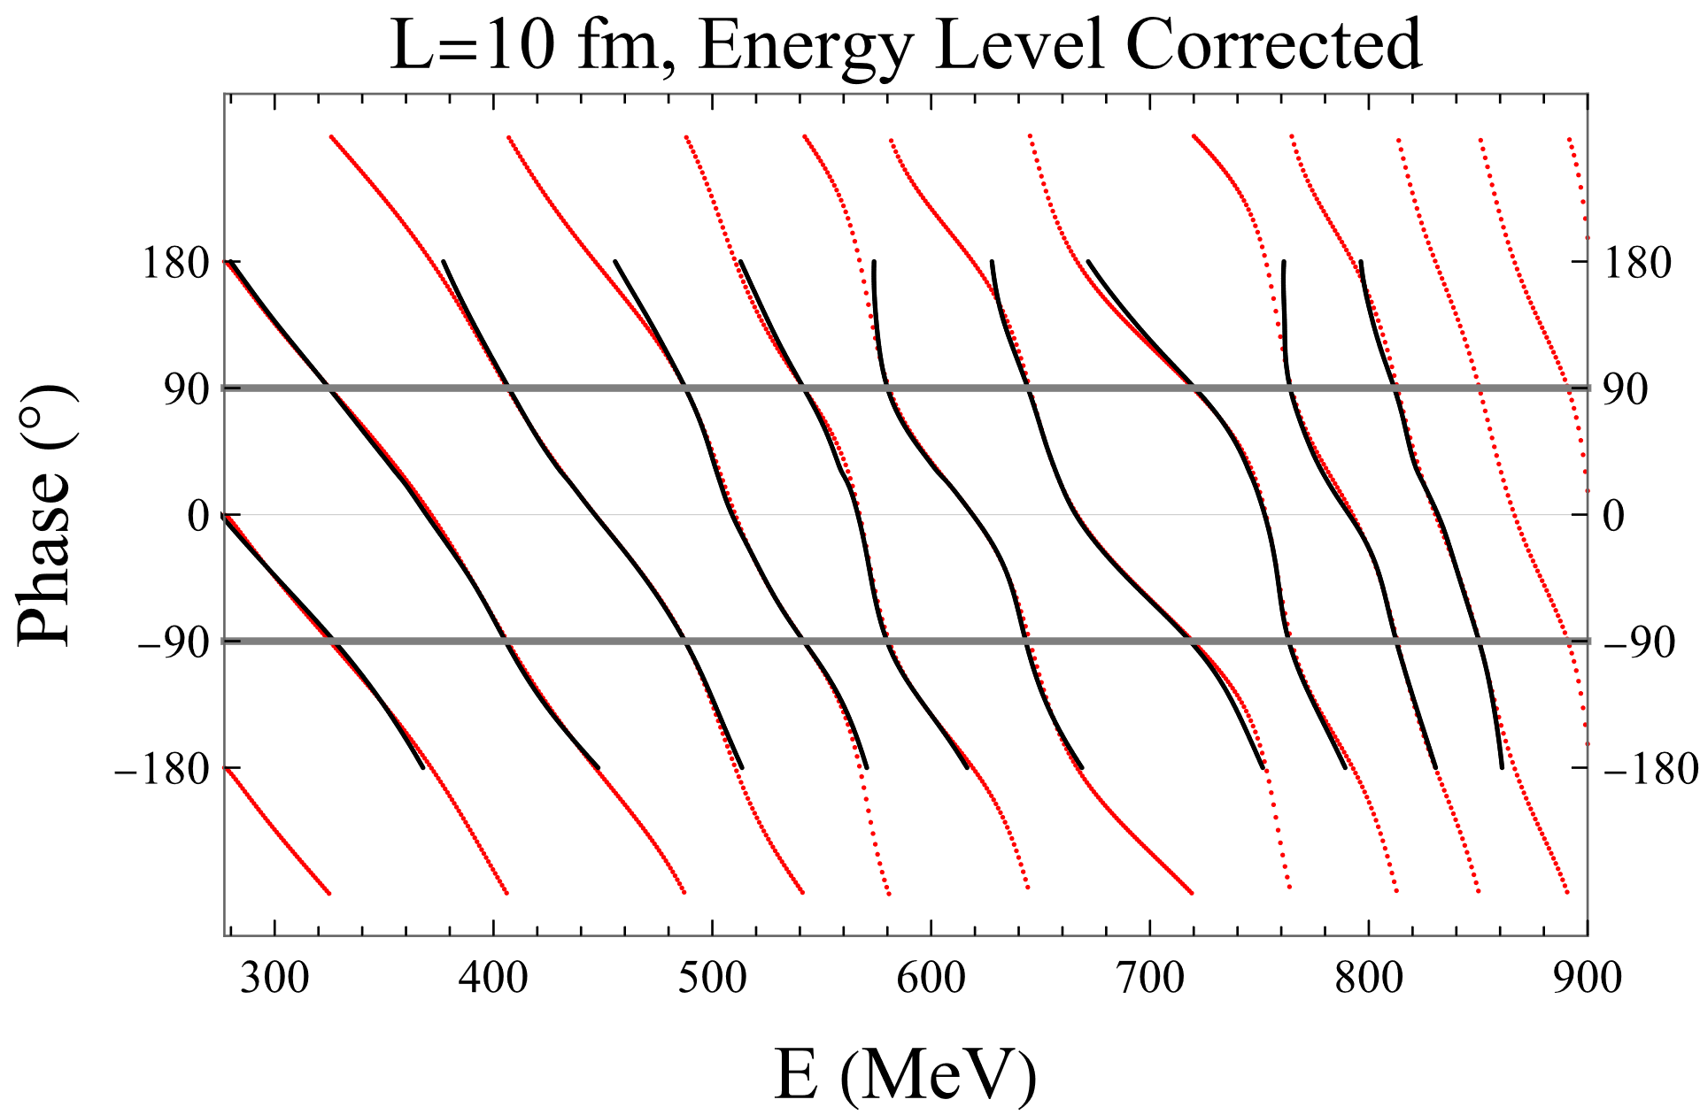
Go Far beyond training set & challenge the NN with constant $δ\left(E\right)$
LF is Numerically Reproduced

Slide 30
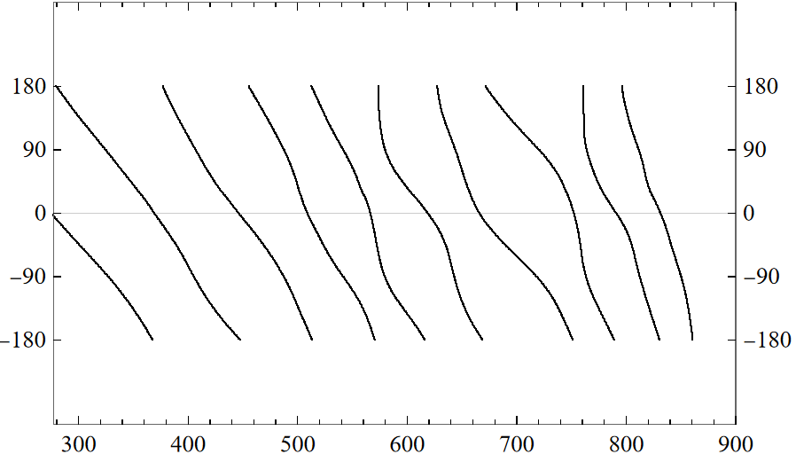
What We Learned
Even $δ\left(E\right), E\left(L\right)$are both model-dependent, NN can extract model-independent link (LF)
Model-dependent
$$LF+o\left(e^{−mL}\right)→E\left(L\right)$$
Model-independent
LF
Where there is a link,
there is a NN :)

Slide 31
Personal Remarks
Essentially Optimization Challenges
ML is a game changer It peeks the correct answer!
Orthodox Way
Yes | But
Beautiful Equation/Theory (SM, Einstein Equation) | Difficult to Solve
Perturbation Theory (ChiPT) | Limited Usage
Beyond Perturbation (LQCD) | Various Artifacts
… | …
AlphaFold2 [Nature 596, 583]
Huge Searching Space
Plenty Protein Data

Slide 32
Outlook
Sensible mathematics involves neglecting a quantity when it is small,
not neglecting it just because it is infinitely great and you do not want it!
★Renormalization
Schwinger, Feynman, Tomonaga; Wilson, ‘t Hooft, …
With four parameters I can fit an elephant,
and with five I can make him wiggle his trunk
More is different?
P.W. Anderson, J. Hinton & You audience

Slide 33
Thank you

Slide 34
Cheese Paradox
Bigger Cheese
Bigger Holes
Smaller Cheese

Slide 35
All models are wrong, but some are useful
Huge Searching Space
Plenty Protein Data
Orthodox Way
Yes | But
Beautiful Equation/Theory (SM, Einstein Equation) | Difficult to Solve
Perturbation Theory (ChiPT) | Limited Usage
Beyond Perturbation (LQCD) | Various Artifacts
… | …
ML Way
Yes | But
Simple Idea (Relatively) | Many GPU time To Train Resource Hungry
It Works! (mostly) | Black Box + Adversarial Examples
Plenty of Data | Data Cleaning
… | …

Slide 36
Result Analysis
$$ΔE≔E_{model}−E_{NN}$$
Decently trained on model A, C
$ΔE\left(L\right)<1$MeV, $E\left(L\right)∼300−900$ MeV
For model B,
as a test set, slightly worse
$ΔE$ has heavier-tail on the right
Signifies the existence of link
Under the hood, LF is in charge
-> Check against LF
?

Slide 37
BackUp
Results after level correction
$δ\left(E\right)$ is evenly sampled by 100 points in $\left[2m_{π},1GeV\right]$
$m_{σ}∈\left[350,700\right]$, $a→c,d∈\left[0.5,2\right]$

Slide 38
$$δ\left(E\right)=\arctan\left(q\frac{π^{3/2}}{\left.ℒ_{00}(1;q^{2}\right)}\right)+n⁢π$$
$$ℒ_{00}\left(1;q^{2}\right)=\frac{1}{√4π}\sum_{ \vec{n}}{{\left({\vec{n}}^{2}−q^{2}\right)}^{−1}}$$

