Slide 1
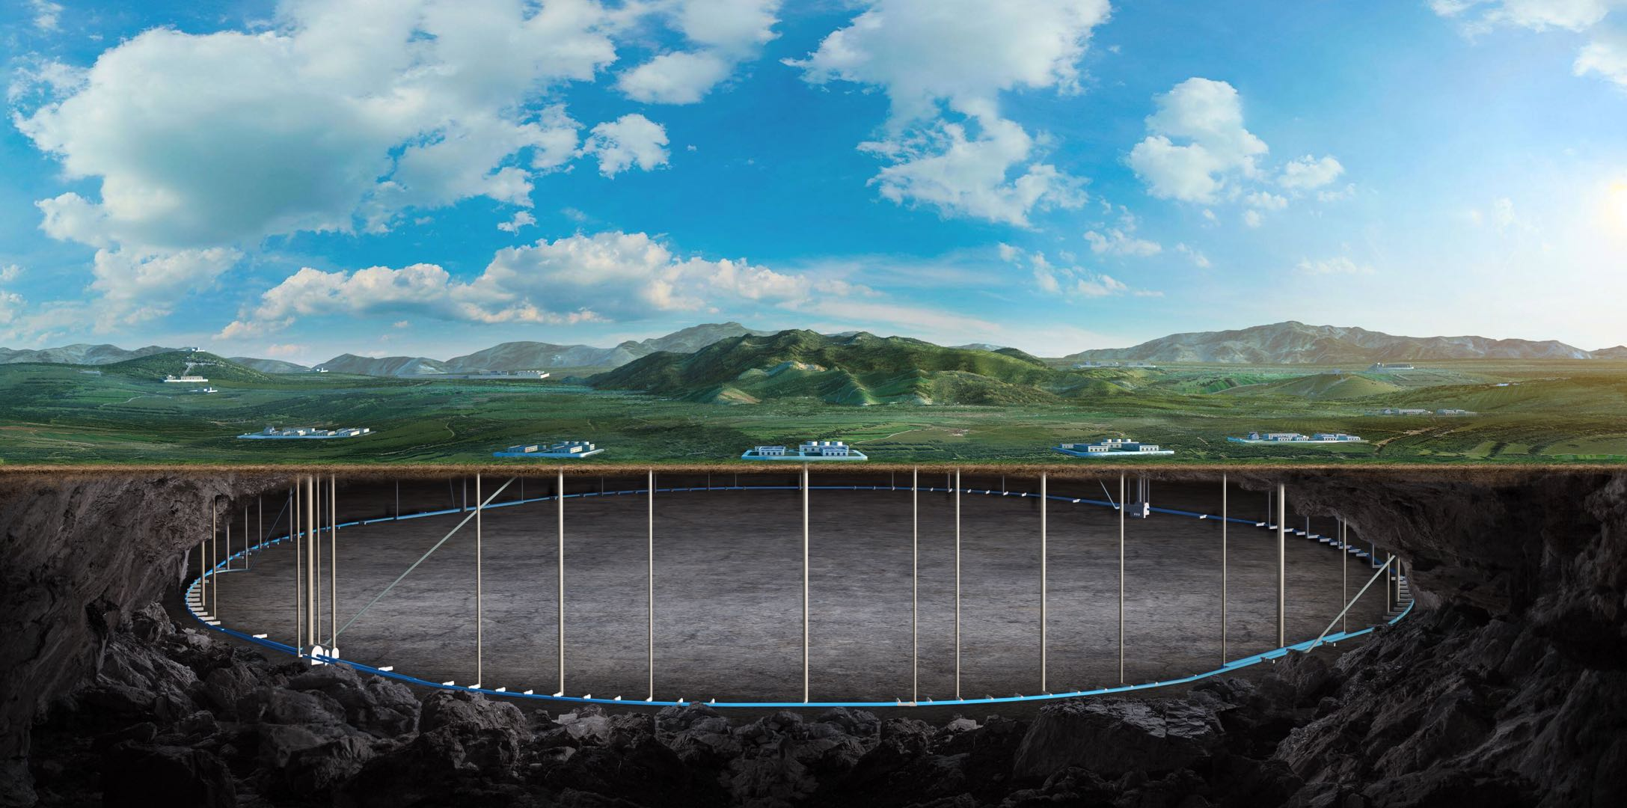
Feedback and optimization of Detector Magnet
Feipeng Ning
On behalf of Detector magnet team
Oct. 21-23, 2024, CEPC IDRC Meeting

Slide 2
Findings
A detector magnet design based on low-temperature superconducting (LTS) technology has been selected as the baseline to be further integrated and the technology to be demonstrated prior to the EDR.
Al-stabilized superconductor development, as a key technology for the detector magnet, has progressed much in cooperation with the Chinese industry.
The general magnet design is found to be adequately optimized, with an important, fundamental scaling parameter represented by stored energy / cold mass (E//M) ratio to be ~ 8.5 kJ/kg for ensuring safe operation and redundancy.
On the other hand, superconductor design optimization was not sufficiently reported (because of time limit?). It might be a concern that the Al-stabilized superconductor strength seems to reach the edge of the ordinal safety limit against ⅔ of yield strength.
No R&D plan for the coil winding was presented, and it should be included in the R&D plan towards the EDR.

Slide 3
Comments
We have been impressed with the progress in the Al-stabilized superconductor development successfully achieving the applicable level to a large magnet system. The committee (we) congratulates the progress in resuming this technology in China.
Based on this excellent progress, the Al-stabilized superconductor and magnet design may be optimized to accomplish mechanical reliability and quench safety and protection. Further R&D for mechanical reinforcement possibly by using the “cold work” process may be a good approach if it has not been done. It may contribute to sufficiently improving the mechanical safety margin of the magnet by satisfying an ordinal safety guideline of the use of the conductor at < ⅔ of 0.2% yield strength.
Concerning the cooling design, LHe-pipe cooling path with many parallel cooling paths may be simplified by using a serpentine cooling path concept for minimize the number of Al-cooling pipe welding, concerned by the team, and for minimizing risks for welding difficulty of Al. It may provide further advantages to adapt both thermosyphon cooling and forced flow cooling.
Magnetic field design may be further optimized to optimize the field quality and the peak field to be suppressed.
The superconductor conductor stability and safety are very important and the quench safety and protection design shall proceed.

Slide 4
Recommendations
1. Extend Al-stabilized superconductor R&D mile-stone particularly for improving mechanical strength while keeping electrical stability with the residual resistance ratio (RRR) for necessary magnet operational stability, and for demonstrating the full conductor fabrication capability in a timely manner.
2. Confirm the quench safety with the current NbTi superconducting cable and Al-stabilizer parameter while providing sufficient stability with the temperature margin at the coil operational current and field.
3. Optimize the conduction cooling design with 2-phase helium cooling channel, by further optimizing the cooling paths, simplifying the cooling path in the fabrication and enabling flexibility of the operational modes.
4. Confirm the field quality / uniformity enabling to satisfy necessary field quality required for the TPC region under the current iron yoke (HCAL) and the final focusing magnet including the compensation solenoid.
5. As a critical and longer term R&D program, a full-size (in radius) coil winding R&D to demonstrate the coil fabrication including mechanical, electrical, and thermal characteristics to meet the design requirement. It shall be realized prior to the EDR.

Slide 5
Feedback 1
Superconductor design optimization was not sufficiently reported (because of time limit?). It might be a concern that the Al-stabilized superconductor strength seems to reach the edge of the ordinal safety limit against ⅔ of yield strength.
Based on this excellent progress, the Al-stabilized superconductor and magnet design may be optimized to accomplish mechanical reliability and quench safety and protection. Further R&D for mechanical reinforcement possibly by using the “cold work” process may be a good approach if it has not been done. It may contribute to sufficiently improving the mechanical safety margin of the magnet by satisfying an ordinal safety guideline of the use of the conductor at < ⅔ of 0.2% yield strength.
The maximum von mise stress on the aluminum stabilizer (96MPa) is close to the yield strength of the material (105MPa). The safety margin is less than 1/3 of 0.2% yield strength.
Because of the time limit, we didn’t report the optimization of the superconductor, we will detailed list the optimization process in Ref-TDR.
The maximum stress on the aluminum stabilizer is only in a very small local area, with the majority of the region having stress levels below 1/3 of 0.2% yield strength, indicating that the coil can operate safely.
We will continue to do the R&D of aluminum stabilizers, aiming to achieve higher strength by combining the required RRR values for quench simulations. In fact, we have used the cold work process to reinforce the mechanical strength.

Slide 6
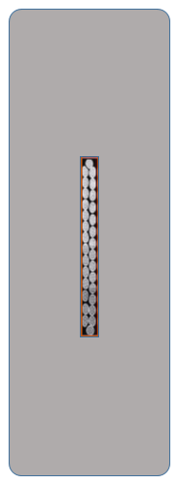
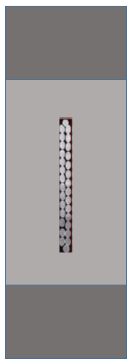
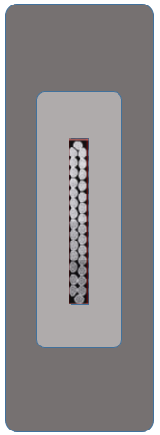
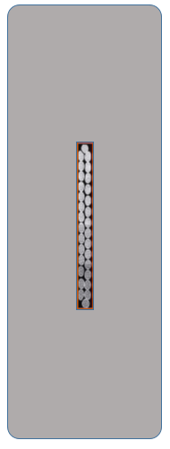
Superconductor design optimization
Stress analysis：
 | High strength Al stabilizer | NbTi | 5083 Al alloy
Yield stress@4.2K | 105 MPa | 800 MPa | 500 MPa
Cable parameter | 56*22 | 56*22 CMS-Like | 56*22 box | 68*22 | 80*22 | 56*28
Coil at 4.2 K
NbTi | 172-242 | 181-256 | 188-246 | 174-243 | 174-243 | 174-245
Al Stabilizer | 5.5-88.3 | 1.2-92.5 | 12.8-96.5 | 4.4-86.1 | 3.9-86.3 | 4.3-89.5
Support | 5.65-36.3 | 1.8-70.2 | - | 4.6-36.2 | 3.9-35.8 | 4.2-36
Al Reinforce | - | 1-81 | 30.2-57.1 | - | - | -
Coil at 4.2 K, energized
NbTi | 20.9-208 | 61-221 | 80-223 | 54.9-221 | 73.1-214 | 31.3-211
Al Stabilizer | 47-103 | 38.5-99.7 | 46.7-105 | 41.5-95.9 | 36.5-92.6 | 44.7-102
Support | 49.5-115 | 33.8-112 | - | 43.2-87.4 | 37.5-74 | 46.9-104
Al Reinforce | - | 37.8-124 | 52.5-102 | - | - | -

Slide 7
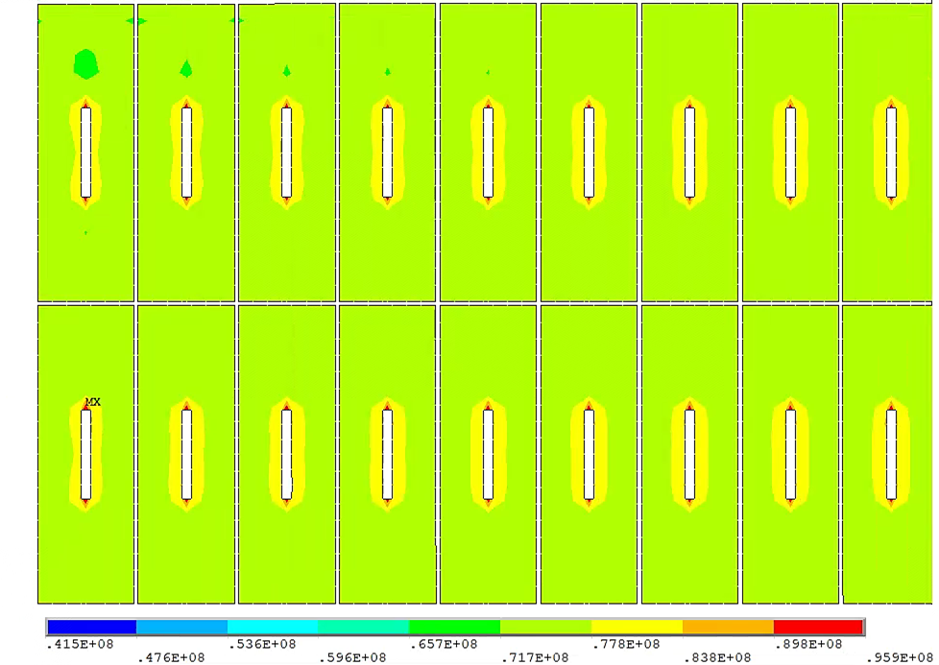
Superconductor design optimization
Max Von stress distribution on Aluminum stabilizer：
The maximum stress on the aluminum stabilizer is only in a very small local area, with the majority of the region having stress levels below 1/3 of 0.2% yield strength, indicating that the coil can operate safely.

Slide 8
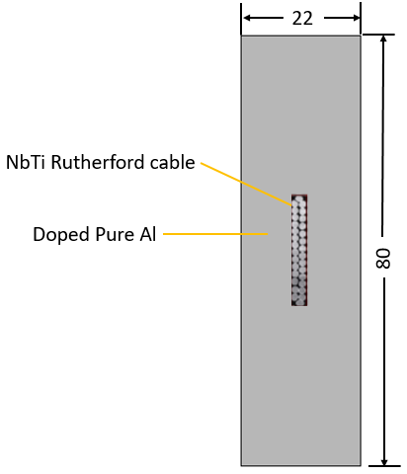
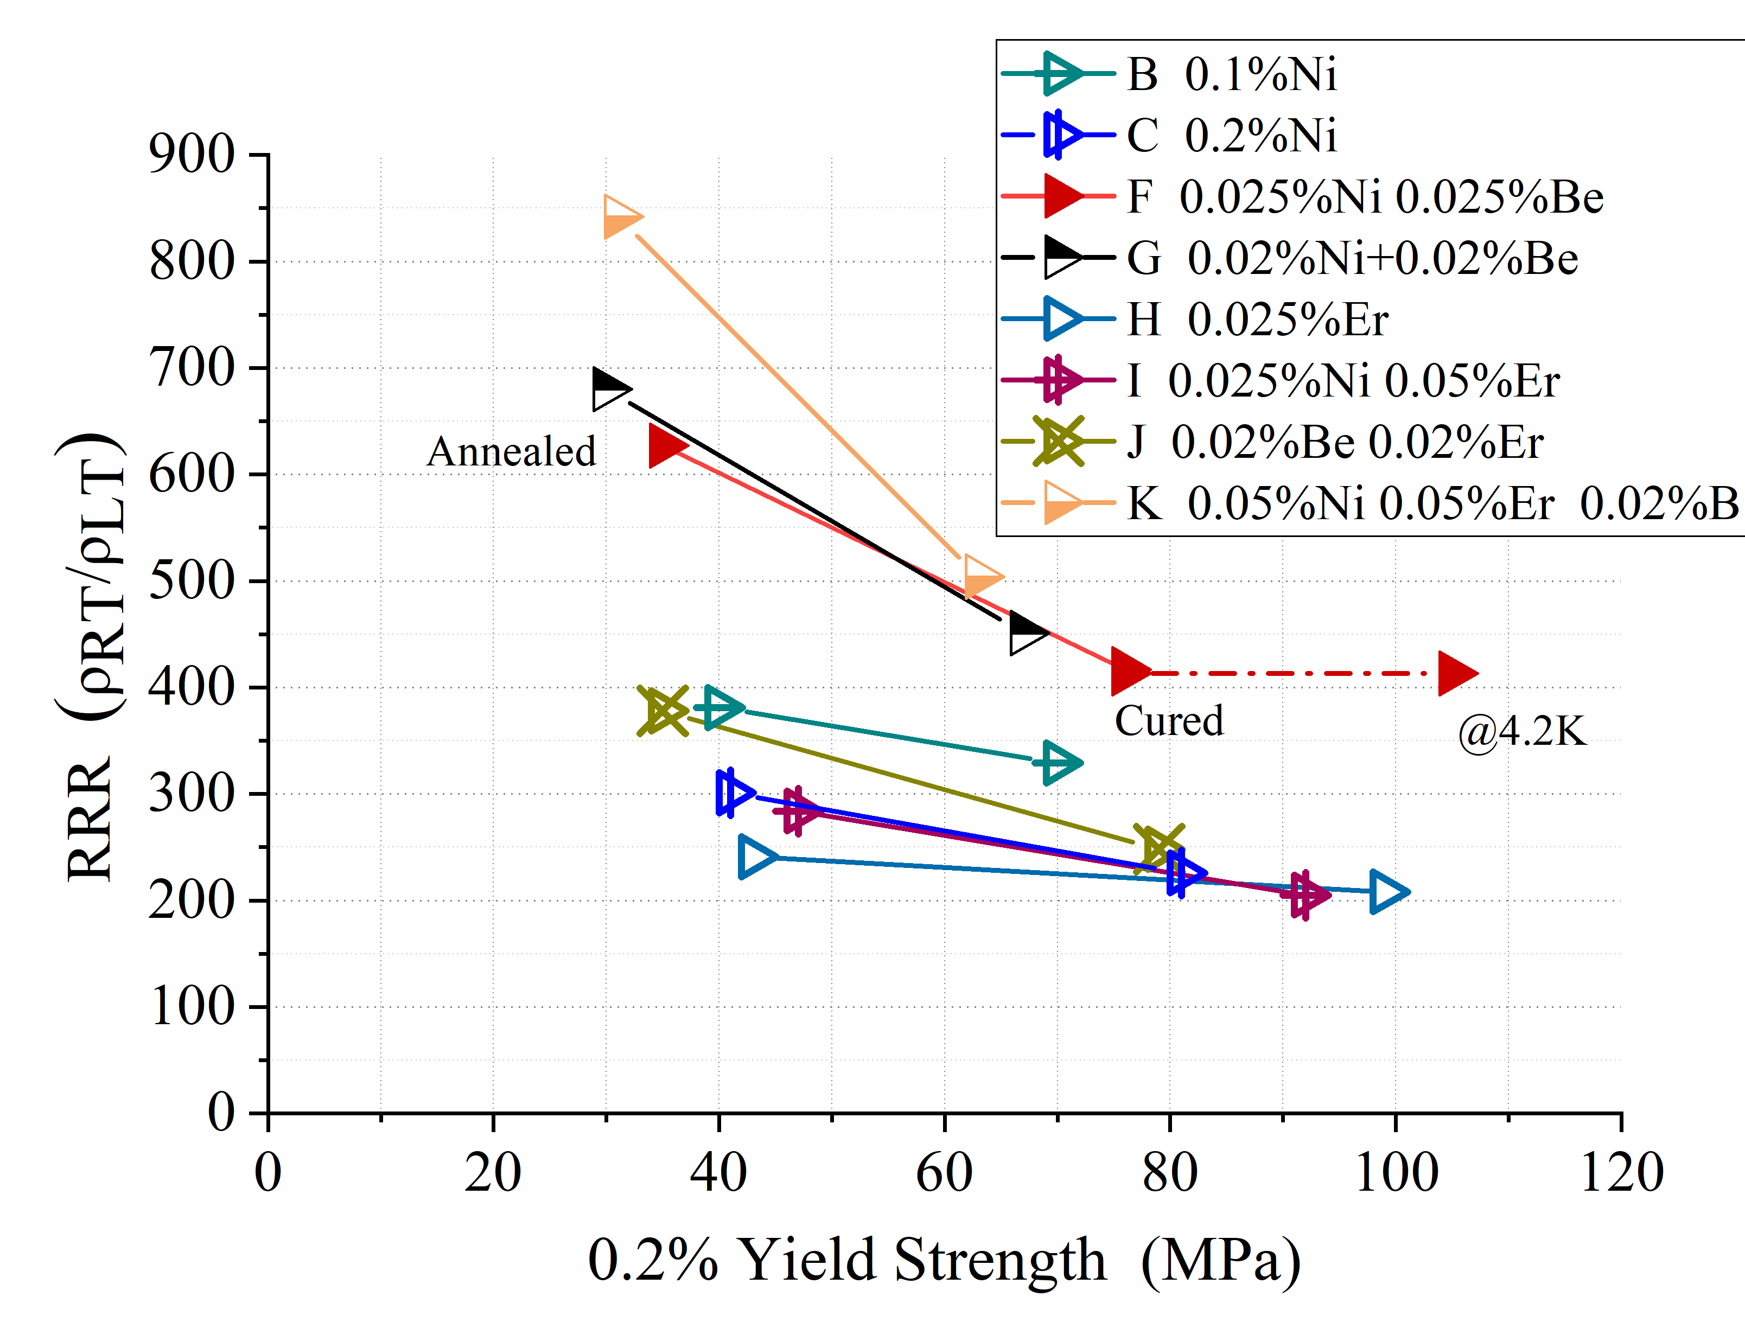
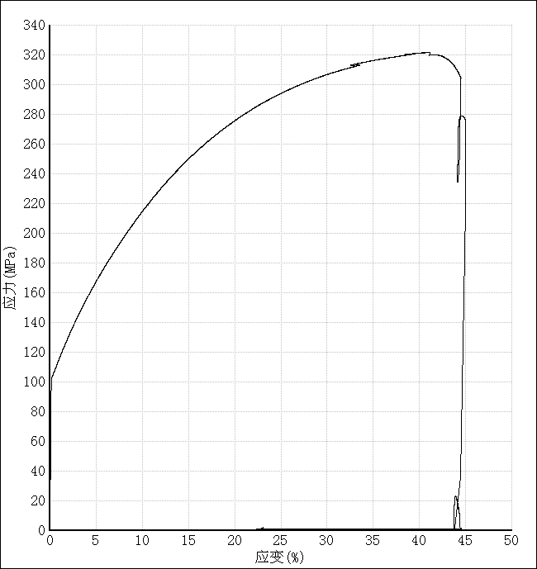
R&D efforts and results
We will continue to do the R&D of aluminum stabilizers, aiming to achieve higher strength by combining the required RRR values for quench simulations. In fact, we have used the cold work process to reinforce the mechanical strength.
High strength and High RRR aluminum stabilizer
Yield strength > 100 MPa@4.2K, 74 MPa at room temperature, RRR value > 400
By doping Ni-0.025% Be-0.025.
The Al-0.025%Ni-0.025%Be alloy prepared from 4N8-aluminum achieved high 0.2% yield strength of 75MPa (R.T.) with RRR of 417 after cold working of 21% and annealing at 130℃ for 15hours.
Poisson’s ratio | 0.33/0.34
Young modulus | See the curve
Thermal expansivity | 14.23×10⁻⁶ K⁻¹
4.2KRp_{0.25} | 105MPa
8

Slide 9
Feedback 2
No R&D plan for the coil winding was presented, and it should be included in the R&D plan towards the EDR.
As a critical and longer term R&D program, a full-size (in radius) coil winding R&D to demonstrate the coil fabrication including mechanical, electrical, and thermal characteristics to meet the design requirement. It shall be realized prior to the EDR.
We built a large superconducting coil winding platform with company, and developed a full-size dummy coil. This can only demonstrate the winding process of the coil, but cannot demonstrate the mechanical, electrical, and thermal performance.
We are currently working on TDR, and plan to develop the full-size aluminum stabilized NbTi Rutherford cable, but we do not plan to develop a full-size superconducting coil.

Slide 10
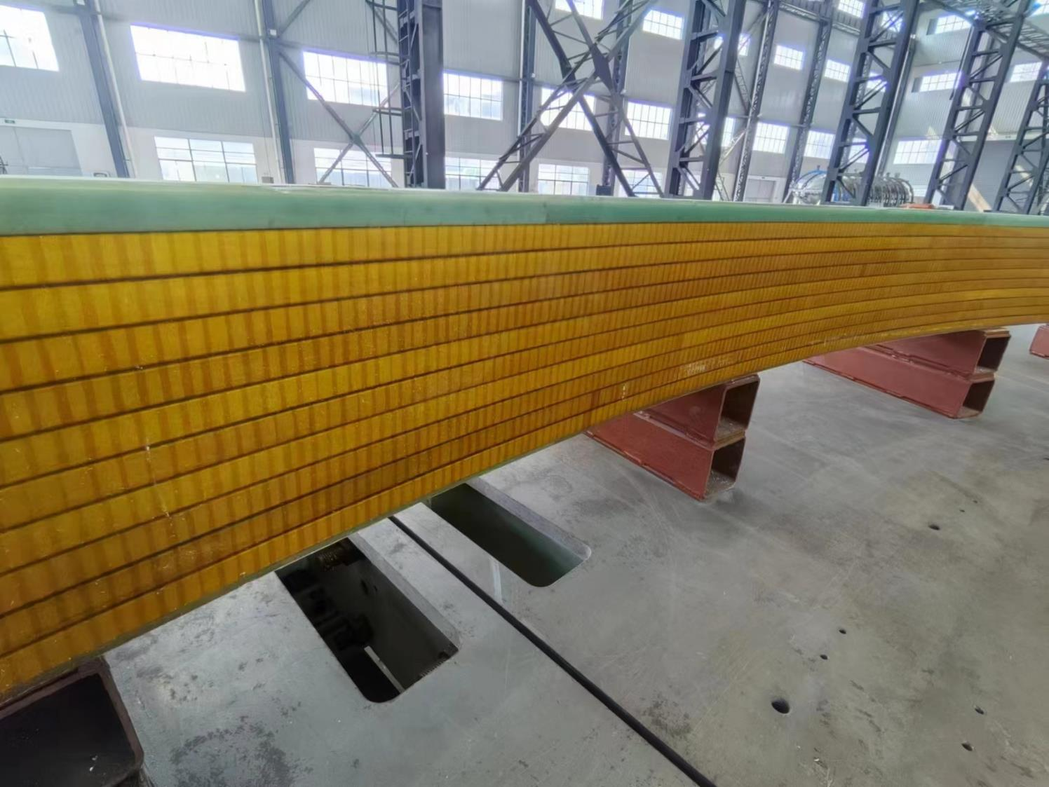
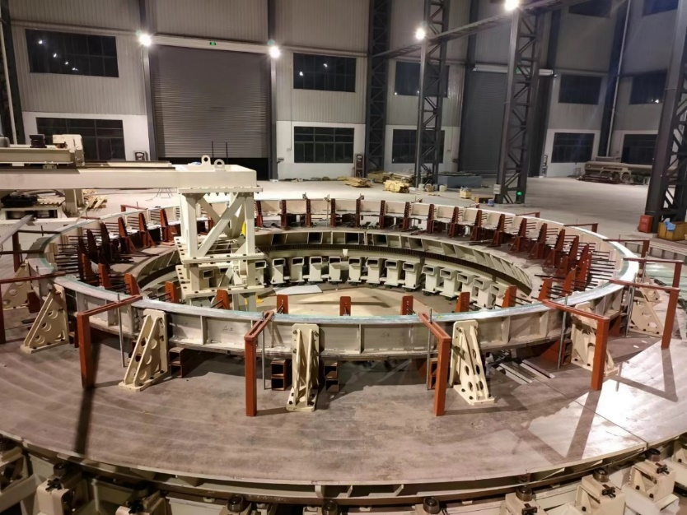
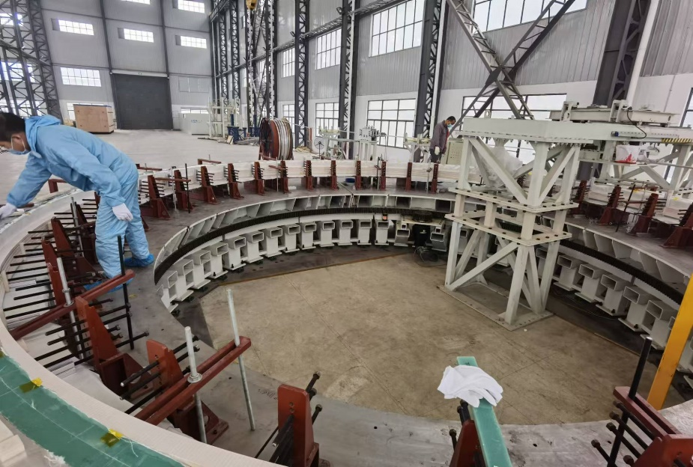
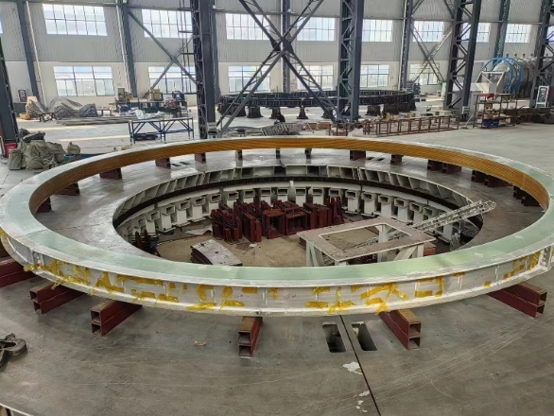
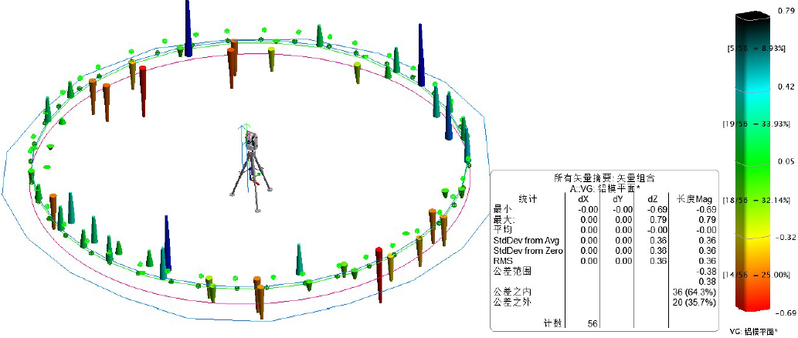
R&D efforts and results
Dummy coil development
Coil winding, vacuum leak detection, epoxy impregnation curing.
4 layers*10 turns
φ7.2m dummy coil
Large scale superconducting coil winding platform
Coil winding
The manufacturing accuracy is controlled within ± 1mm
Dummy coil
10

Slide 11
Feedback 3
The superconductor conductor stability and safety are very important and the quench safety and protection design shall proceed.
Confirm the quench safety with the current NbTi superconducting cable and Al-stabilizer parameter while providing sufficient stability with the temperature margin at the coil operational current and field.
The report did not display any content on quench protection, but we have conducted simulations of magnet quench protection.

Slide 12
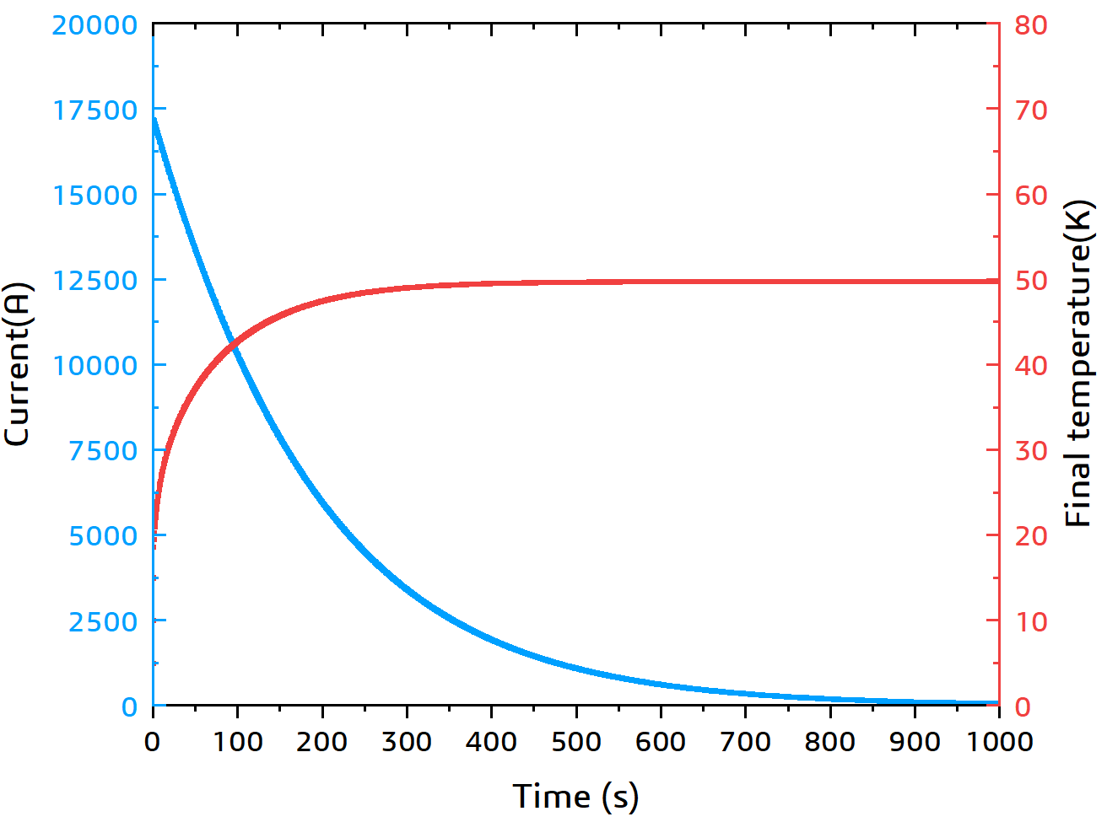
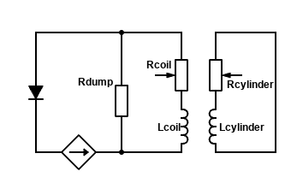
Quench Protection
The coil protection system is based on a dump resistor.
Fast dump discharge
The Al alloy support cylinder is also used for quench back.
Protection
resistor
Winding
Quench back
cylinder
Delay time | 0.03 s
Dump resistance | 50 mΩ
Terminal voltage | 951.7 V
Coil internal voltage | 92.13 V
Final temperature | 49.84 K
Extracted energy ratio | 86.39%
Decay time* | 823 s
The quench analysis considering the protection resistance and quench back is in progress
*time when the current is I = I0 /100= 170 A.
Notes:
Here is the decay curve for the coil current and temperature change based on 50 mΩ resistance and an RRR value of 300. The table outlines some quench parameters, with a delay time to activate quench protection set at 30 ms.
Role of the Supporting Cylinders: Additionally, the aluminum alloy support cylinder will play a vital role during the quench process, serving as feedback. Besides providing a protective circuit through the resistor, the support cylinder will also utilize the mutual inductance with the coils to generate eddy currents, thereby heating up and returning heat to the coils, which further accelerates the decay of the coil current. Consideration for practical feedback and detailed quench simulations is currently ongoing.

Slide 13
Feedback 4
Concerning the cooling design, LHe-pipe cooling path with many parallel cooling paths may be simplified by using a serpentine cooling path concept for minimize the number of Al-cooling pipe welding, concerned by the team, and for minimizing risks for welding difficulty of Al. It may provide further advantages to adapt both thermosyphon cooling and forced flow cooling.
Optimize the conduction cooling design with 2-phase helium cooling channel, by further optimizing the cooling paths, simplifying the cooling path in the fabrication and enabling flexibility of the operational modes.
After detailed calculations and simulations, we have ultimately chosen the thermosyphon cooling method. So we have to use the parallel cooling paths. At the same time, we are seeking support from companies to reduce the risks for aluminum welding.
 | Thermosyphon | Force flow
Difference | Need more space to install the phase separator | A liquid helium circulating pump is required
heat exchange capability | 1200 W/(K·m²) | 412.1 W/(K·m²)
Coil maximum temperature | 4.982 K | 5.383 K
Coil average temperature | 4.591 K | 4.972 K
Inner diameter of Liquid helium pipes | Φ15 mm | Φ 20 mm

Slide 14
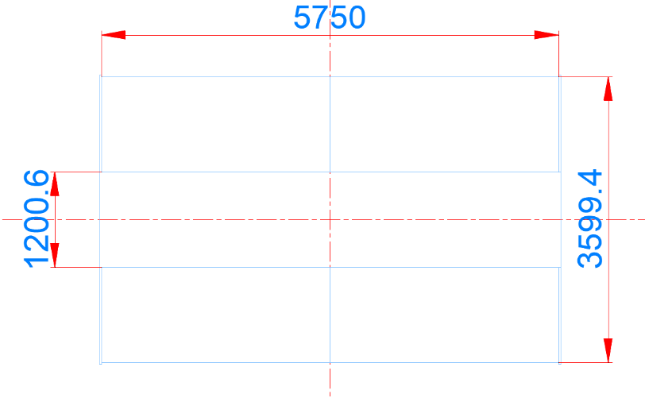
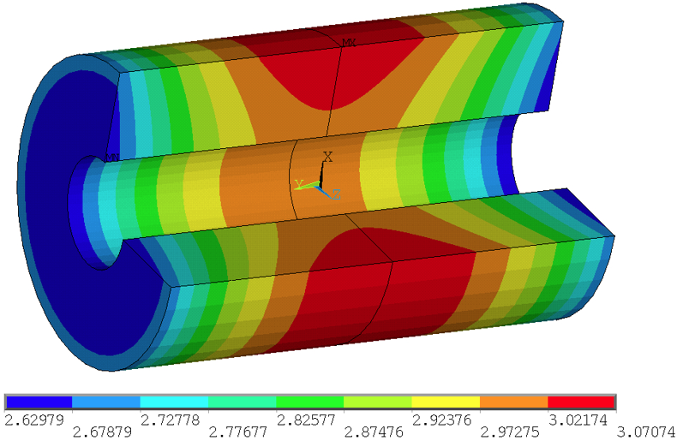
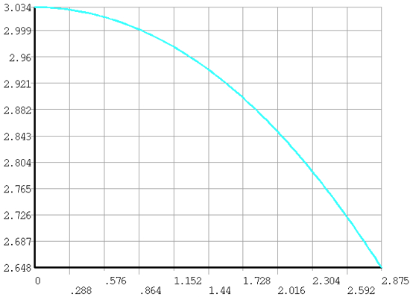
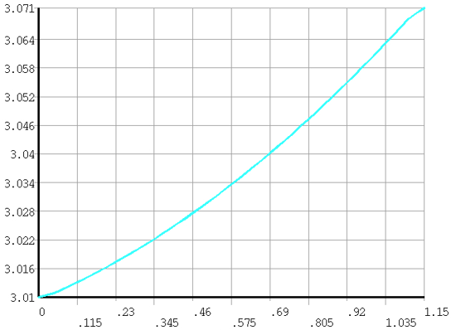
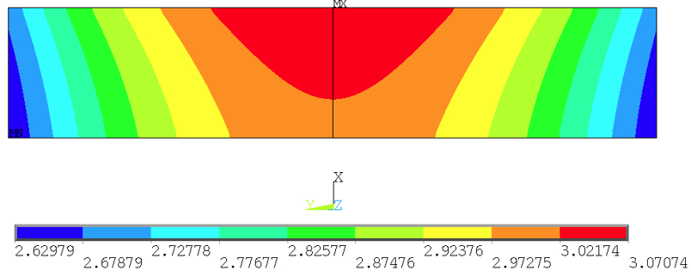
Feedback 5
Magnetic field design may be further optimized to optimize the field quality and the peak field to be suppressed.
Confirm the field quality / uniformity enabling to satisfy necessary field quality required for the TPC region under the current iron yoke (HCAL) and the final focusing magnet including the compensation solenoid.
1
2
TPC
TPC
The magnetic field distribution without compensation solenoid has been provided to TPC software. The magnetic field distribution with anti-solenoid and focusing magnet is being simulated.
The key is not the uniformity of the magnetic field, but rather the gradient of the magnetic field, the accuracy and magnetic field mapping density.
1
2
△B=0.386 T
△B=0.061 T
The TPC magnetic field distribution without compensation solenoid
Magnetic field distribution on path 1 and 2

Slide 15
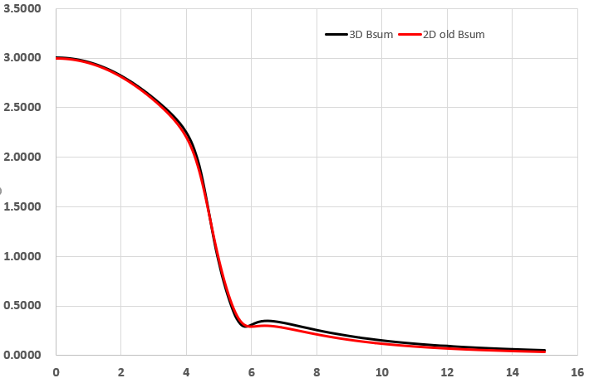
Plan
Joint design with anti-solenoid Magnet. The magnetic field distribution of the superconducting detector magnet or the detector has been provided.
Magnetic field uniformity of the TPC region including the anti-solenoid magnet.
The optimization of Al-stabilized superconductor design to achieve mechanical reliability. Development of aluminum stabilizers with higher strength.
Full-size aluminum stabilized superconductor development.

Slide 16
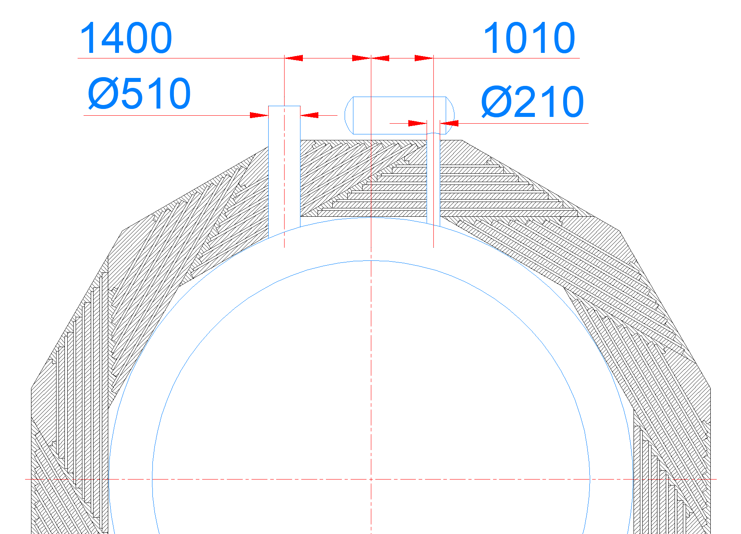
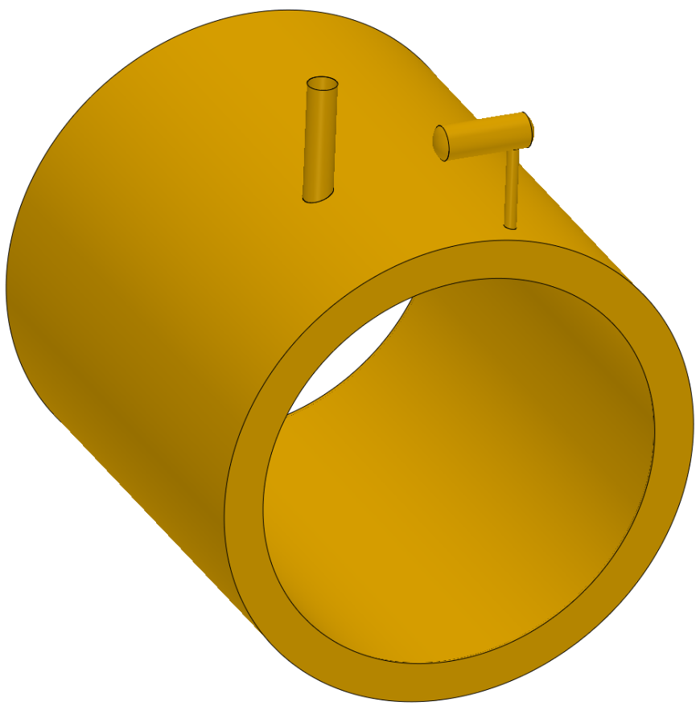
Optimization
The diameter of Valve box chimney
Changes from 210mm to 360mm
Valve box
Current leads and Vacuum pump chimney
Chimney

Slide 17
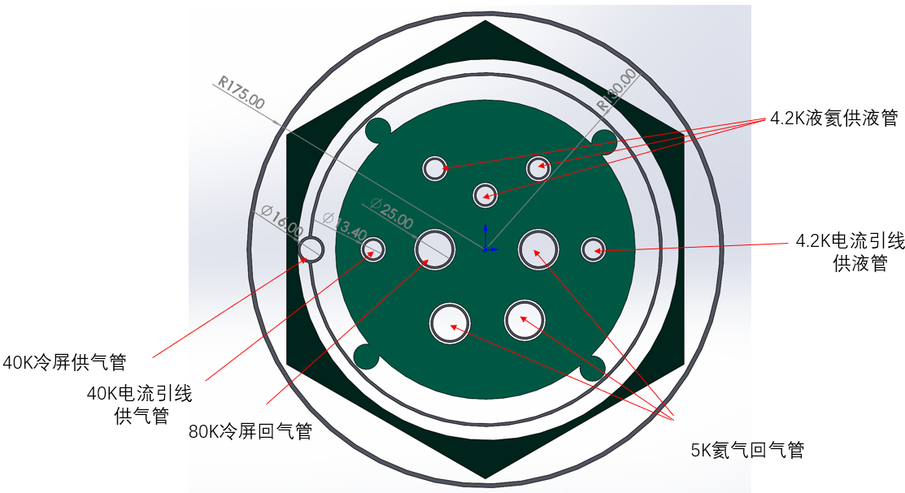
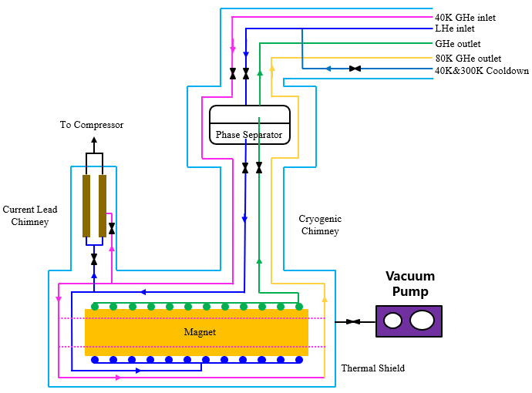
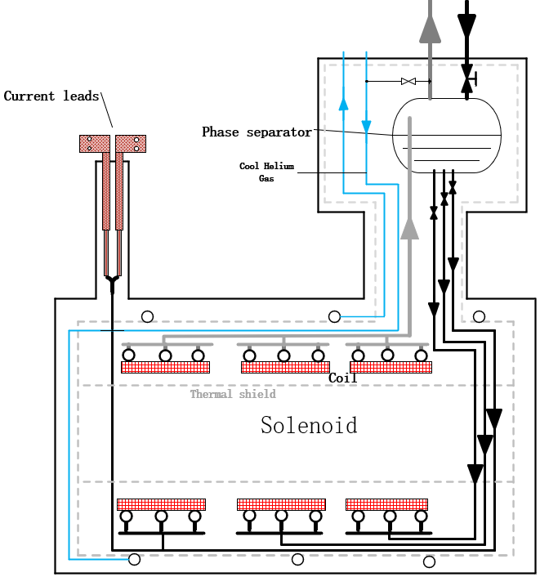
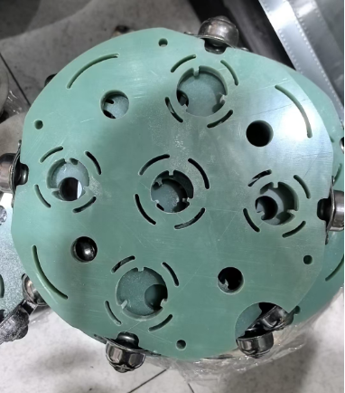
Optimization
The diameter of Valve box chimney
From 210mm to 360mm

