Slide 1
Design of electromagnetic components at MACE and Muon beamline MuST
Guihao Lu, on behalf of MACE working group and MuST group
International Workshop on Muon Physics at the Intensity and Precision Frontiers
MIP2025
11 May 2025

Slide 2
Contents
The capture front-end design in MuST
I. Beamline introduction
II. Radiation-resistant capture solenoid (RCS) design
III. Electromagnetic, irradiation, and cooling research
The MACE positron transport system (PTS)
I. Motivations
II. Solenoid system and Electrostatic acceleration module
III. Performance
Summary

Slide 3
Contents
The capture front-end design in MuST
I. Beamline introduction
II. Radiation-resistant capture solenoid (RCS) design
III. Electromagnetic, irradiation, and cooling research
The MACE positron transport system (PTS)
I. Motivations
II. Solenoid system and Electrostatic acceleration module
III. Performance
Summary

Slide 4
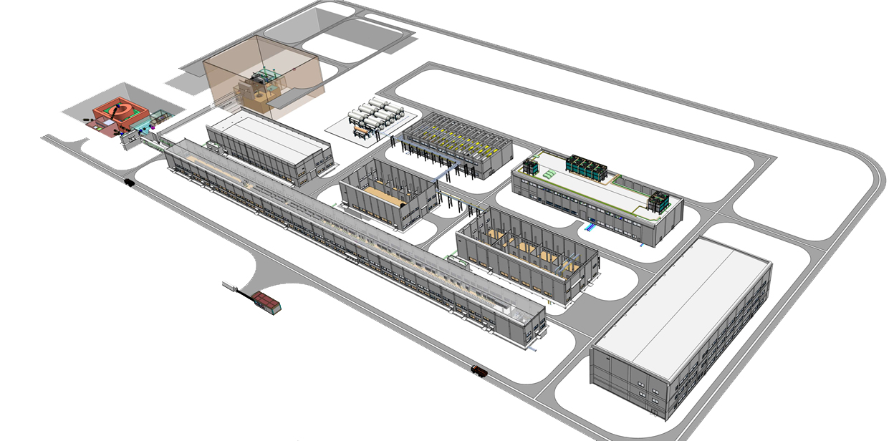
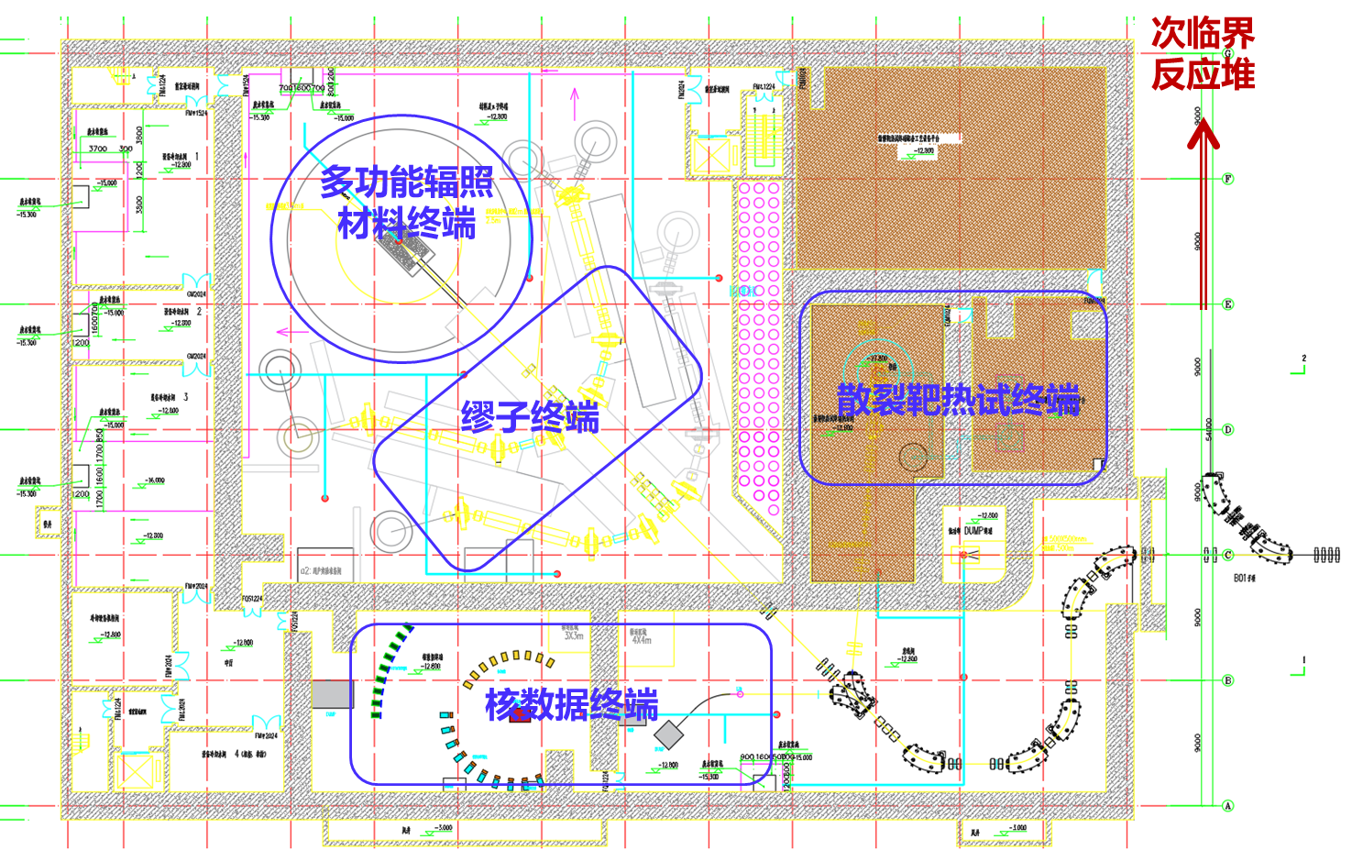
MuST in CiADS
Beam Supply Mode
Reactor：~3 months independently
B05 Experimental Hall：8–9 months
Multi-terminal Mode：
1. ISOL vs B05
2. HiTa vs NDET vs MuST+MIRS
Phase I ;
Accelerators and Facilities;
2022~2023
Phase I ;
Reactors and Experimental Halls;
2025~2026
B05 Experimental Hall
Reported by: Rong Wang
MIRS
HiTa
Power on Target | Target | Configuration | Surface Muon $μ^{+}$/s |  | Polarization | Background
 |  |  | Full-scale | $Φ$30mm
300 kW | Graphite Rotary Target | Solenoid | ＞5E8 | ~1E8 | ~94% | ＜0.1%
 |  | Hybrid Focusing | ＞5E7 | ~1E7 | ＞99%
3 MW | Liquid lithium | Solenoid | ＞1E10 | ~2E9 | ~94%
 |  | Hybrid Focusing | ＞1E9 | ~2E8 | ＞99%
MuST
Proton
NDET

Slide 5
Contents
The capture front-end design in MuST
I. Beamline introduction
II. Capture front-end design
III. Electromagnetic, irradiation, and cooling research
The MACE positron transport system (PTS)
I. Motivations
II. Solenoid system and Electrostatic acceleration module
III. Performance
Summary

Slide 6
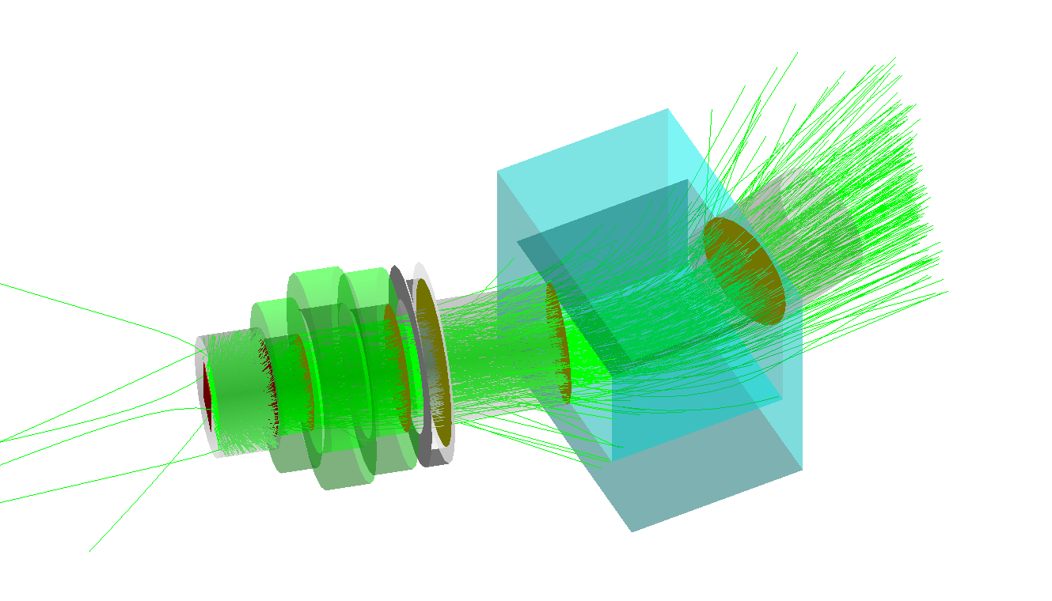
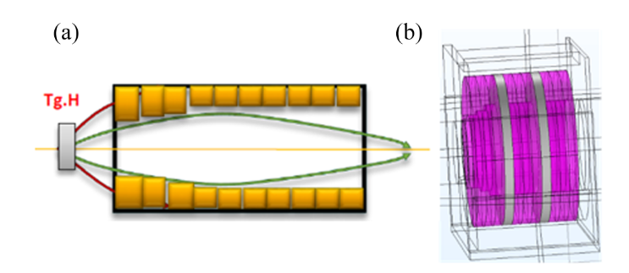
Capture front-end
The capture front-end design in MuST
Radiation-resistant Capture Solenoid (RCS)
Radiation-resistant Dipole
$$μ^{+}$$
J-PARC H-line
RCS components
One capture coil
Two focusing coils
PSI HIMB

Slide 7
RCS optimization
RCS contains 3 coils
Each coil contributes 3 parameters: inner diameter, length, current density
At least 10-D Optimization Model
$$μ^{+}$$
Passing parameters
Invoke Shell
Invoke G4BL
Invoke ROOT
Return results to Python
Add regularization and construct multiple optimization objectives
Update parameter monitoring
Define parameters and boundaries
Define optimization function
Iteration parameters
Process pool
Record operation data
Output the current generation optimal
CMA-ES algorithm

Slide 8
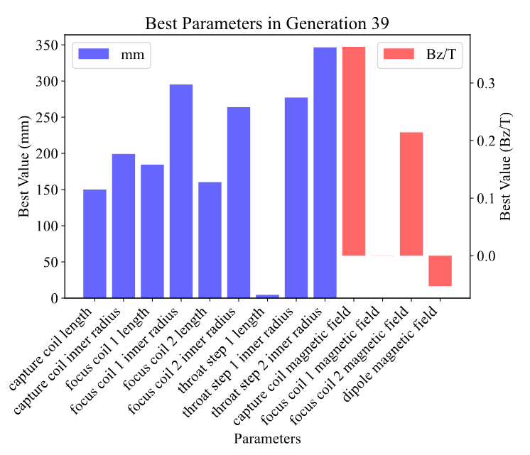
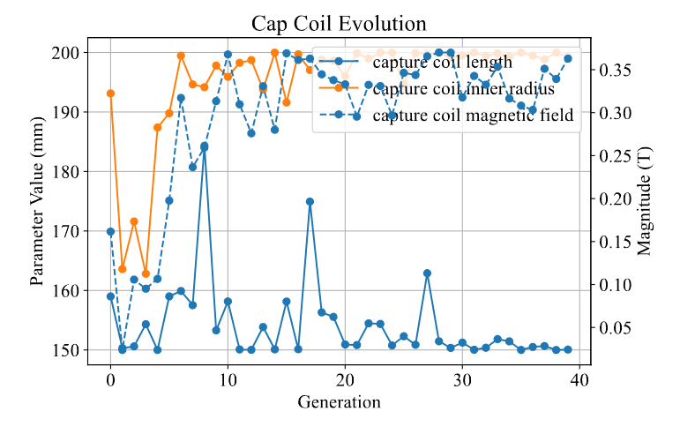
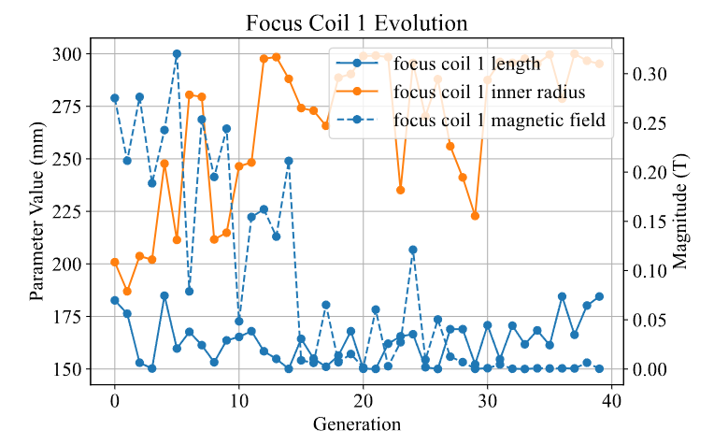
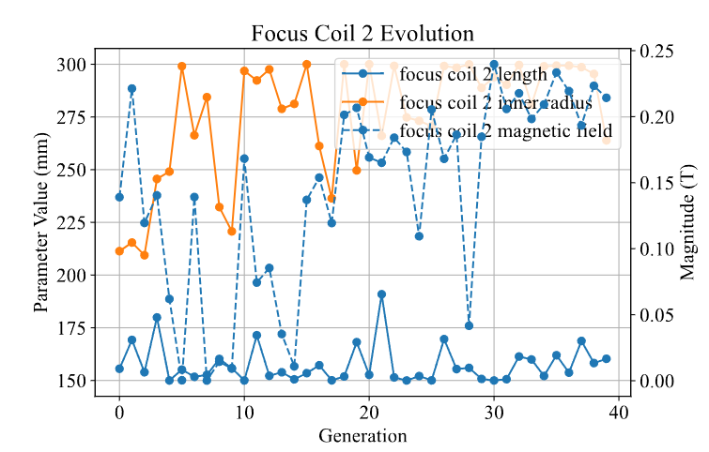
Capture front-end optimization
Although some parameters are unilaterally constraints in theory, they are follow engineering limitations.
The optimization goal is mainly transmission efficiency, but beam spot size and other factors are also taken into consideration.
The length of the capture coil tends to be the shortest.
The magnetic field of the first focusing coil is close to 0

Slide 9
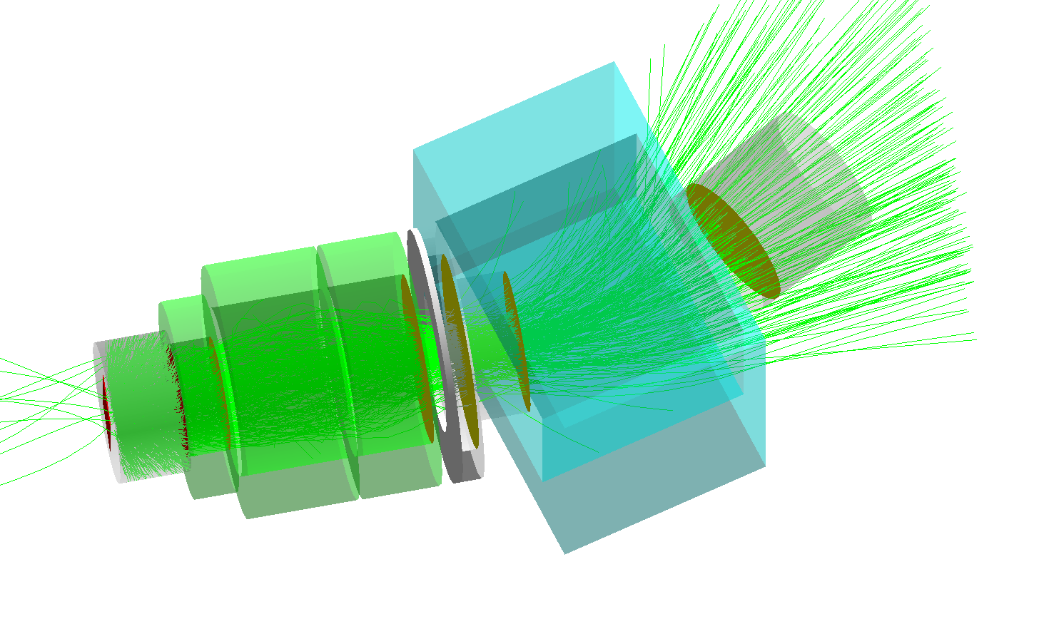
Current design
By controlling the total length of the RCS, we can obtain designs with different budgets.
Longer solenoids have advantages in same acceptance
$$Ω$$
Acceptance (mSr) | Efficiency | RMS
663 mSr | 20.0% | 94.8 mm
Aperture (mm) | Length (mm) | Polarization
400/600/600 | 150/405/252 | 89%
Acceptance (mSr) | Efficiency | RMS
663 mSr | 16.0% | 106.1 mm
Aperture (mm) | Length (mm) | Polarization
400/564/563 | 150/198/150 | 84%

Slide 10
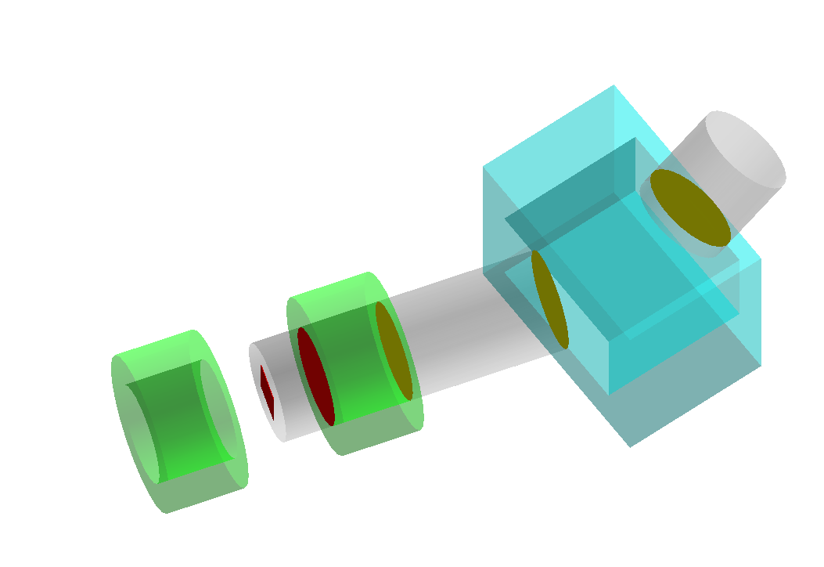
Contrast
Model | Length (mm) | Aperture (mm) | magnetic field (T) | Acceptance (mSr) | Efficiency
Current | 450 | 400 | 0.4 (max) | 633 | 16.0%
Longer | 800 | 400 | 0.4 (max) | 633 | 20.0%
Old | 500 | 500 | 0.37 | 633 | 14.1%
Tracewin | 500 | 500 | 0.37 | 633 | 16.2%
Himb old | 500 | 400 | 0.37 | 790 | 14.6%
$$Ω$$
$$Ω$$
Current model
Longer model
Old model

Slide 11
Contents
The capture front-end design in MuST
I. Beamline introduction
II. Radiation-resistant capture solenoid (RCS) design
III. Electromagnetic, irradiation, and cooling research
The MACE positron transport system (PTS)
I. Motivations
II. Solenoid system and Electrostatic acceleration module
III. Performance
Summary

Slide 12
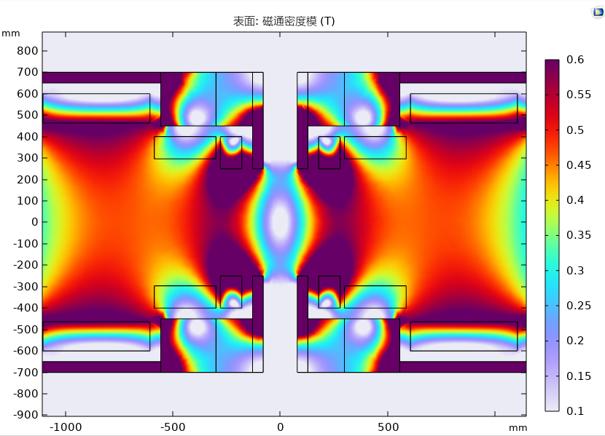
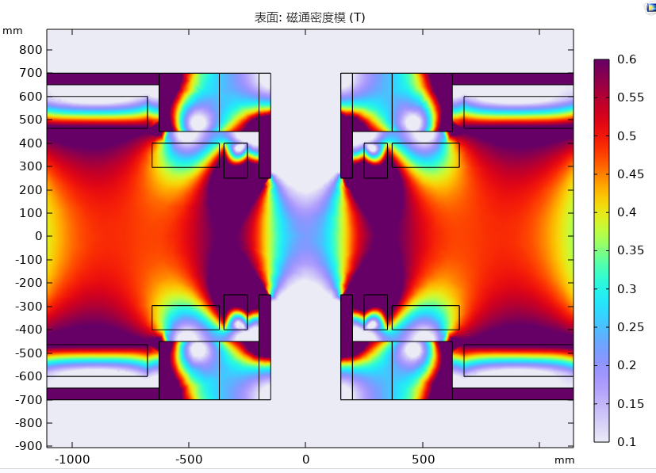
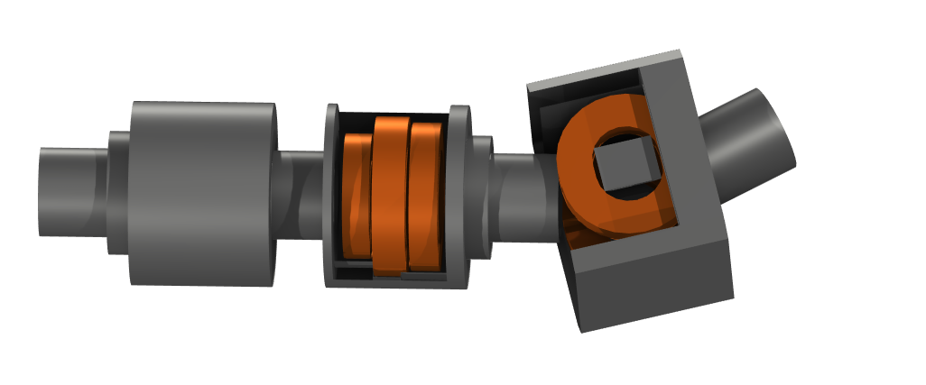
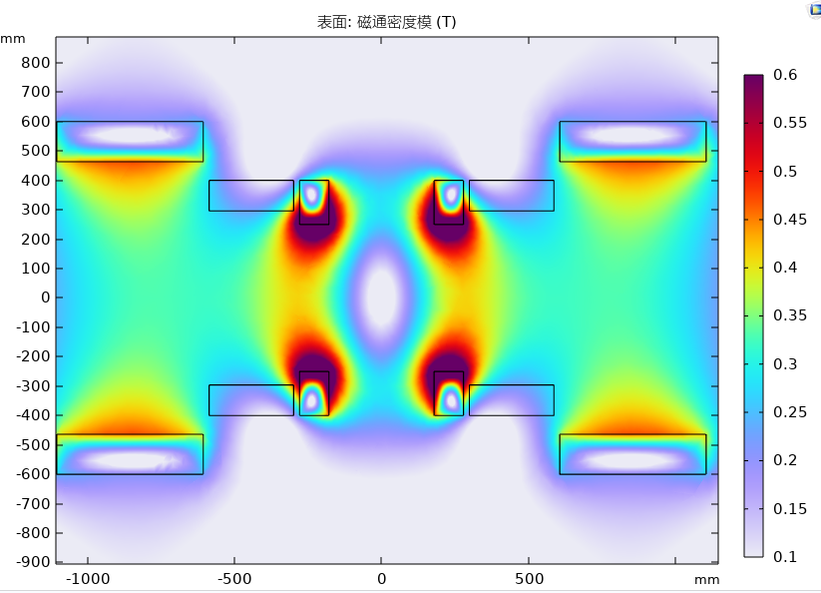
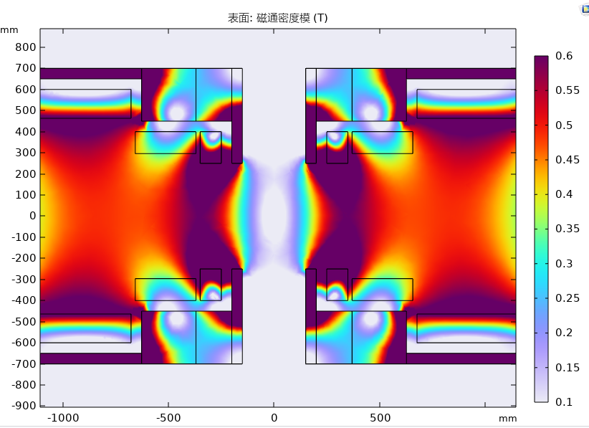
Electromagnetic field
The simulation result comes from COMSOL.
The fringe effect can not be ignored, when the interval is small. and even if yoke existed, there is a stronger integral field.
+/- has a stronger shielding performance than +/+
The distance between the target and the capture solenoid is set to 250 mm to reduce the difficulty of yoke design.
+/- with 400 mm gap
+/+ with 500 mm gap
+/- with 500 mm gap
+/- with 500 mm gap

Slide 13
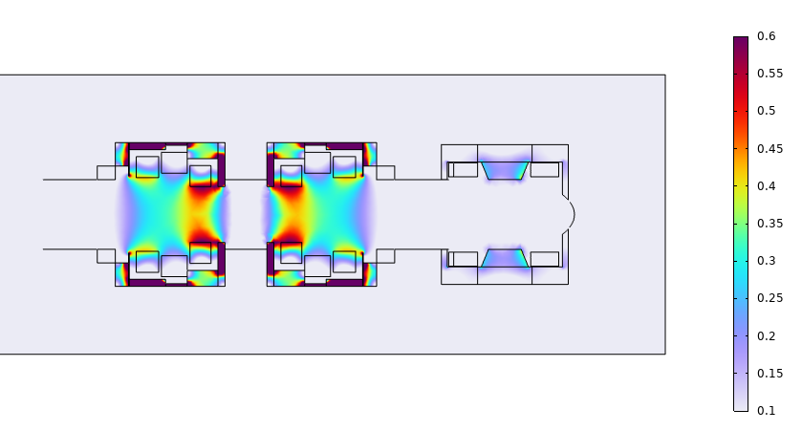
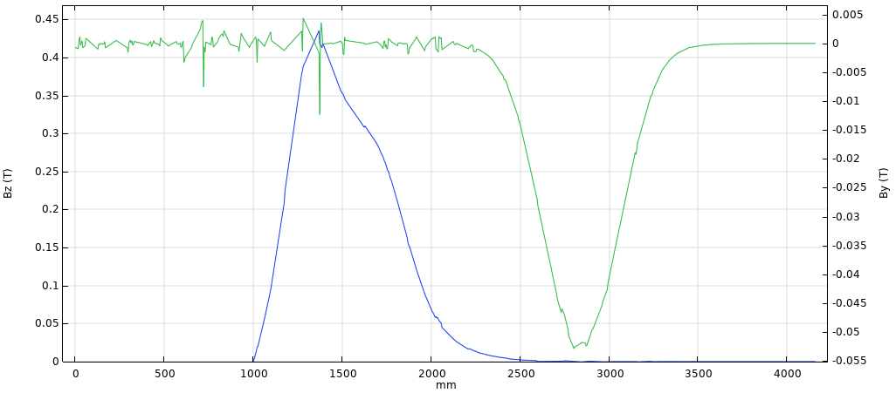
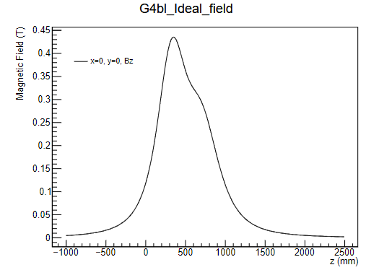
Electromagnetic field
We optimize the magnetic field in COMSOL by treating the fields in G4BL as ideal fields.
The blue line in the figure below represents the axial magnetic field, while the green line represents the magnetic field in the $y$ direction.
The field on the right is the field in G4BL, which behaves almost identically to the COMSOL field when there is no yoke.

Slide 14
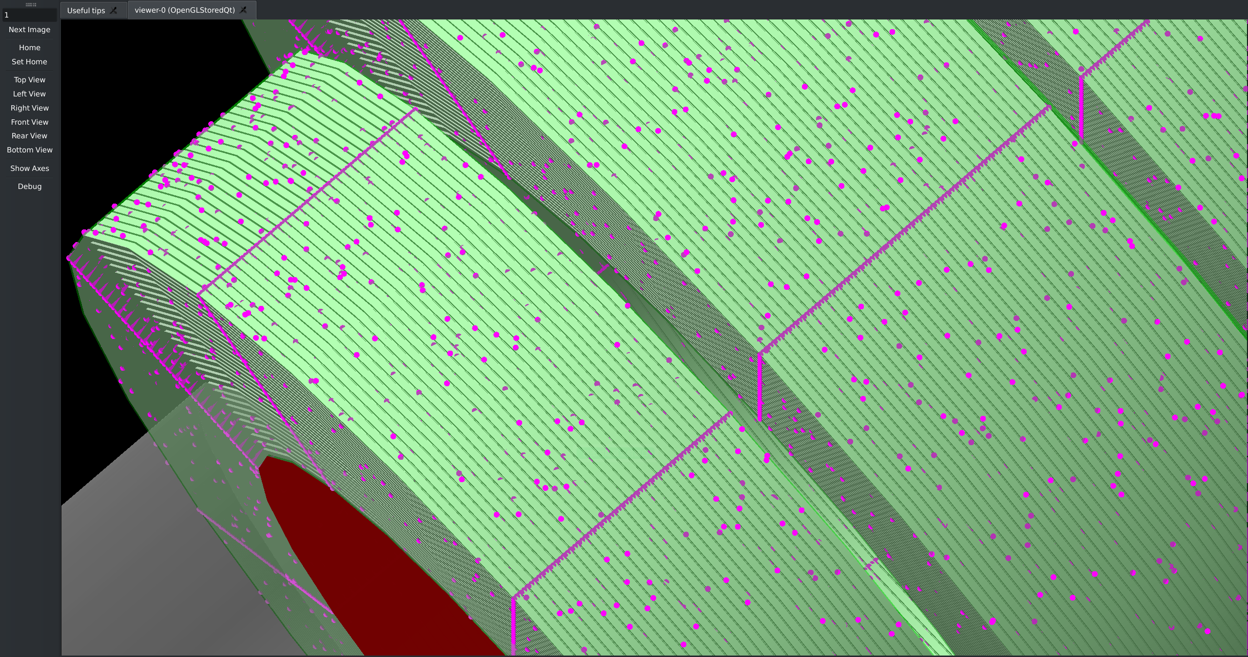
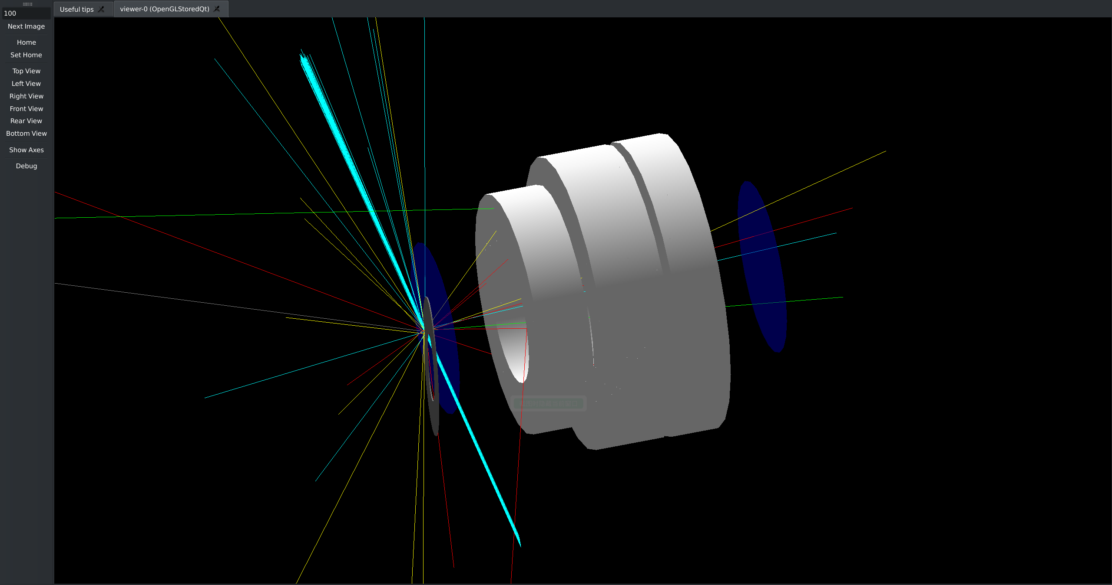
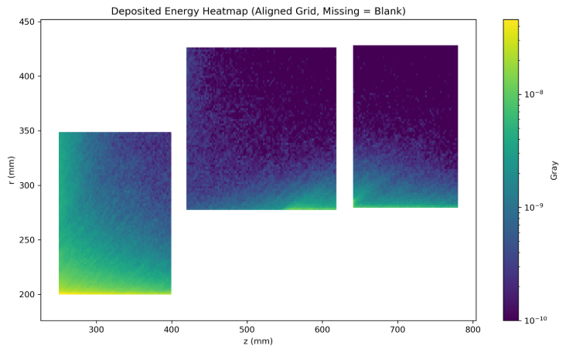
Irradiation, and cooling research
G4BL has no geometric energy deposition distribution. Voxelization methods can subdivide the total energy deposition of a geometry into voxels deposited energy.
The energy deposition of the solenoid can be obtained by simulating proton targeting in G4BL using voxelized solenoid modeling.
The results show that the irradiation level is highest on the inner surface of the RCS capture coil (yoke is not shown in the figure), up to 143 Gy/s (5 mA, 3 MW).
Solenoids with magnesium oxide, epoxy coated solenoids.

Slide 15
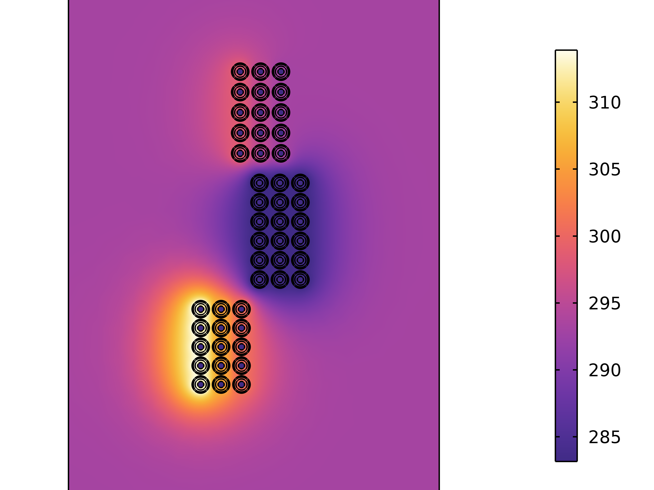
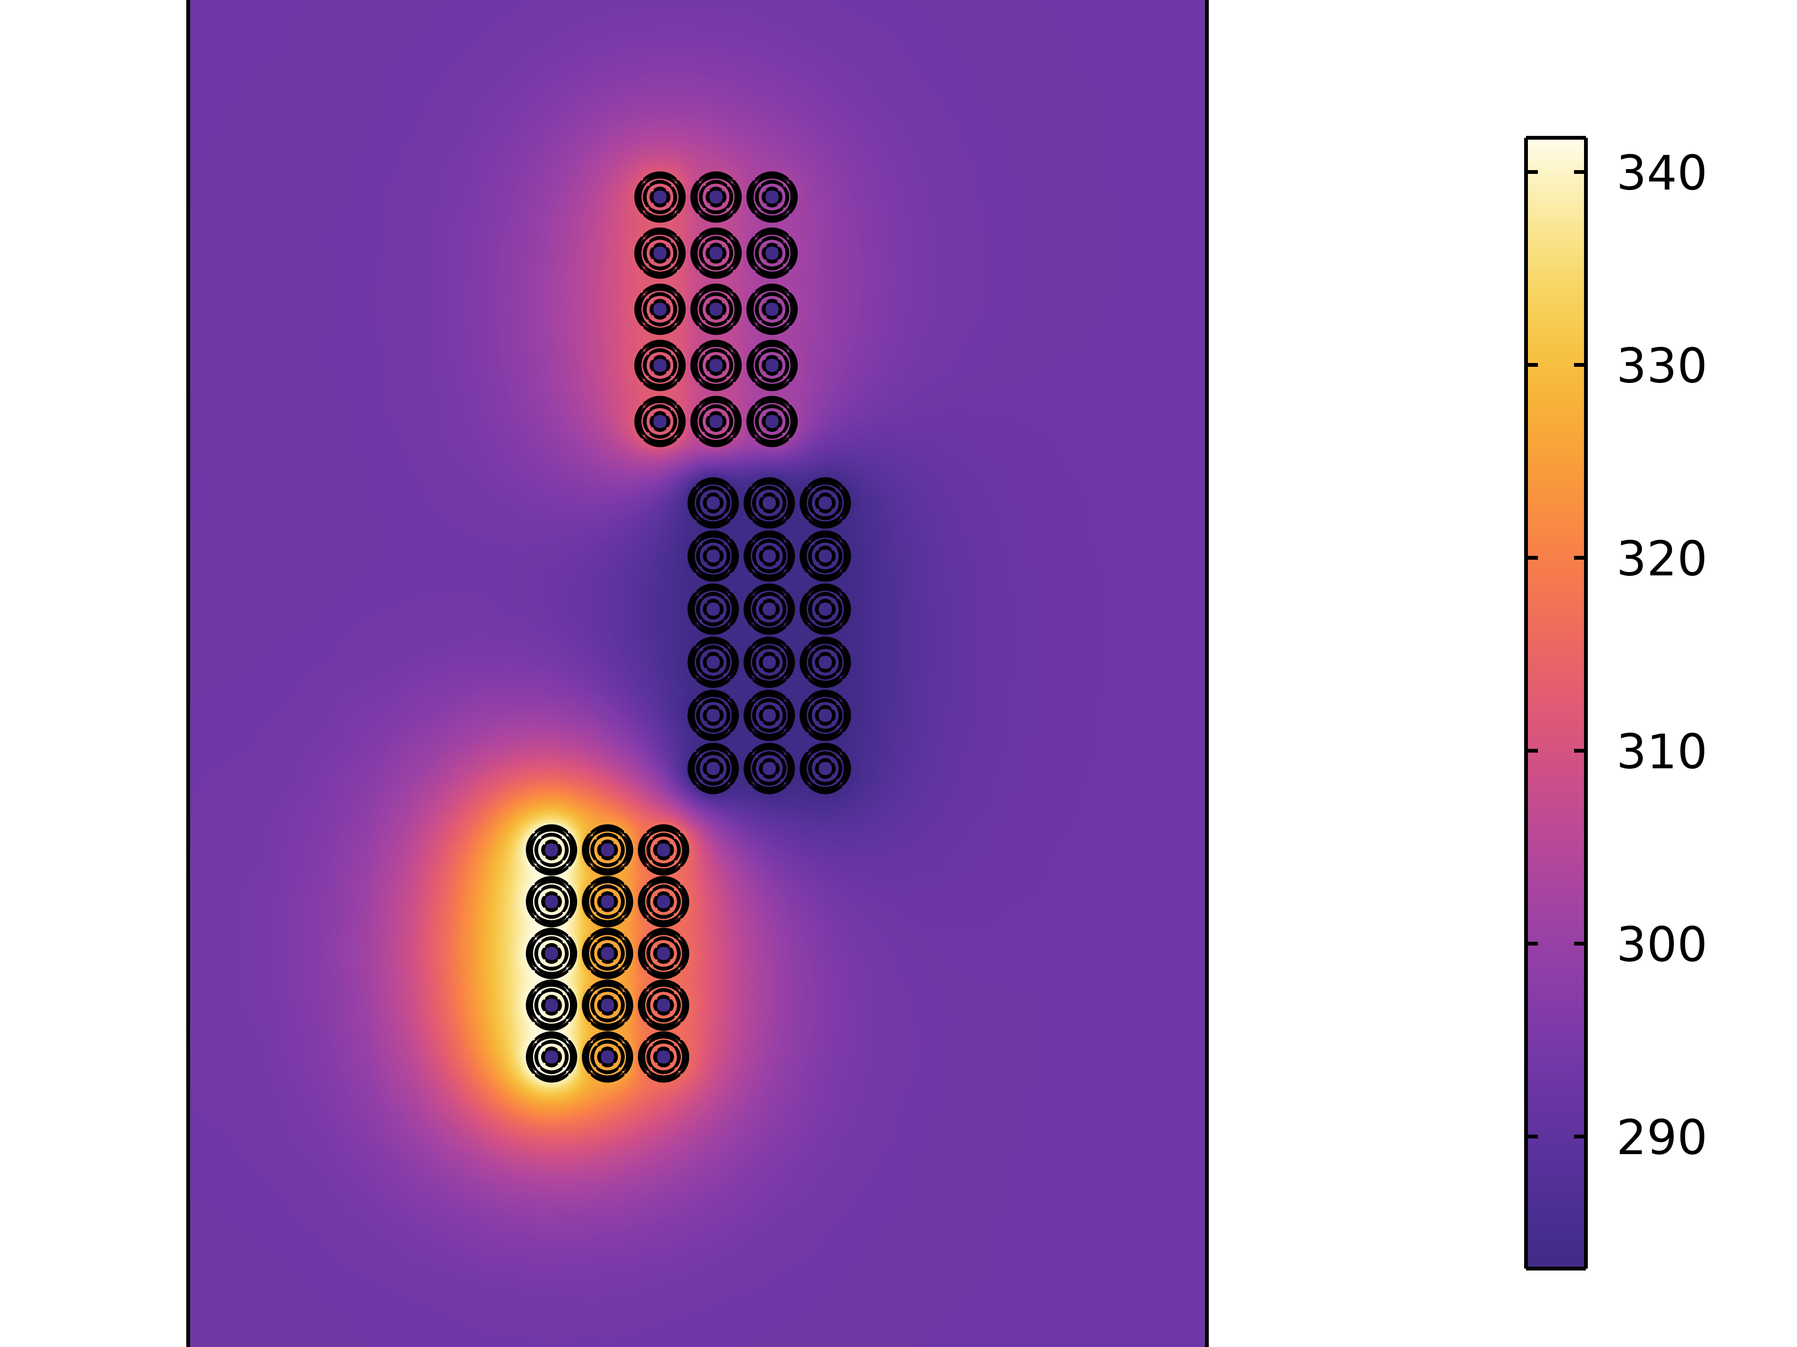
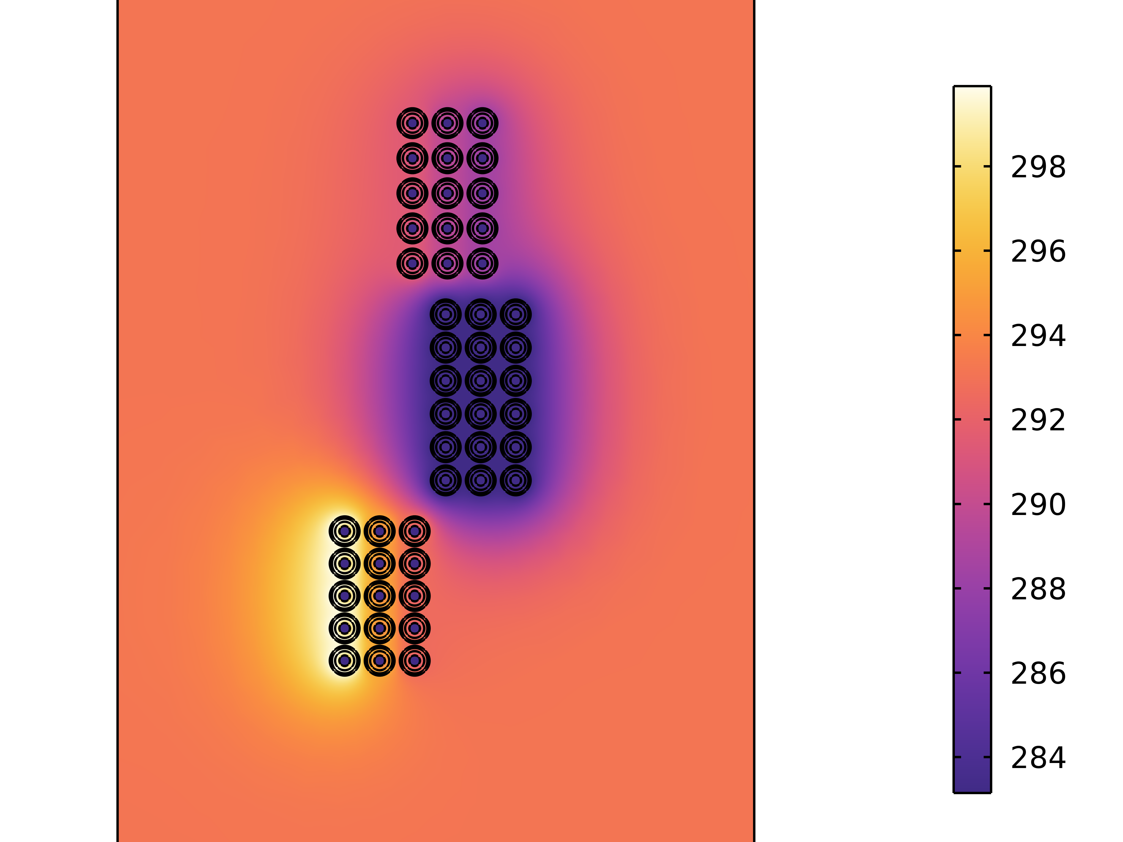
Irradiation, and cooling research
Armor
MgO
The currents carried by the coils are 12.5 kA, 131.42 A, 9.2 kA, corresponding to the current solenoid design.
The heat transfer coefficient is used for cooling simulation, and the simulation of the heat transfer coefficient is still in progress.
The thermal equilibrium time is within 1 minute. When the number of solenoid winding layers cannot be increased, the heat transfer coefficient may reach about 40,000 W/($m^{2}$⋅K).
We have little experience in this heat transfer coefficient of water-cooling solenoid, so any guidance would be greatly appreciated.
Copper
Water
20000 W/($m^{2}⋅K$), hot point~315 K
10000 W/($m^{2}⋅K$), hot point~340 K
40000 W/($m^{2}⋅K$), hot point~300 K

Slide 16
Contents
The capture front-end design in MuST
I. Beamline introduction
II. Radiation-resistant capture solenoid (RCS) design
III. Electromagnetic, irradiation, and cooling research
The MACE positron transport system (PTS)
I. MACE and Motivations
II. Solenoid system and Electrostatic acceleration module
III. Performance
Summary

Slide 17
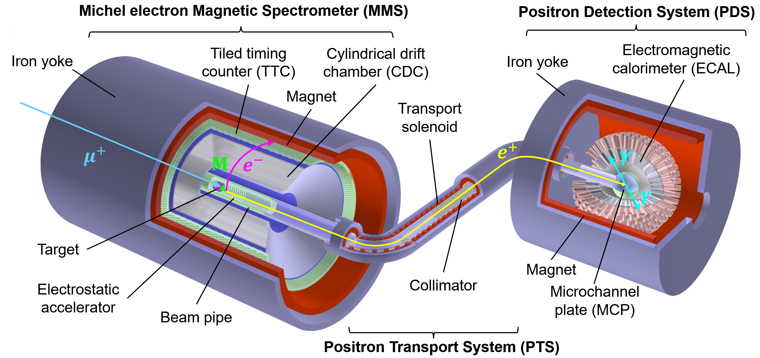
MACE introduction
Muonium-to-Antimuonium Conversion Experiment (MACE) aims to search for charged lepton flavor violation (cLFV)
Currently, MACE has established extensive collaboration with MuST. By fully utilizing high-intensity muon beam of MuST, MACE is expected to reduce the current conversion limit by two orders of magnitude.
MACE REPORTS:
Positron Transport System: Gui-Hao Lu
CDR: Shi-Han Zhao (Sunday Morning)
Cosmic Ray Veto: Zhichao Wang (Monday)
MACE Phase-I: Yin-Yuan Huang (Monday)
Tiled Timing Counter: Hao Jiang (Monday)

Slide 18
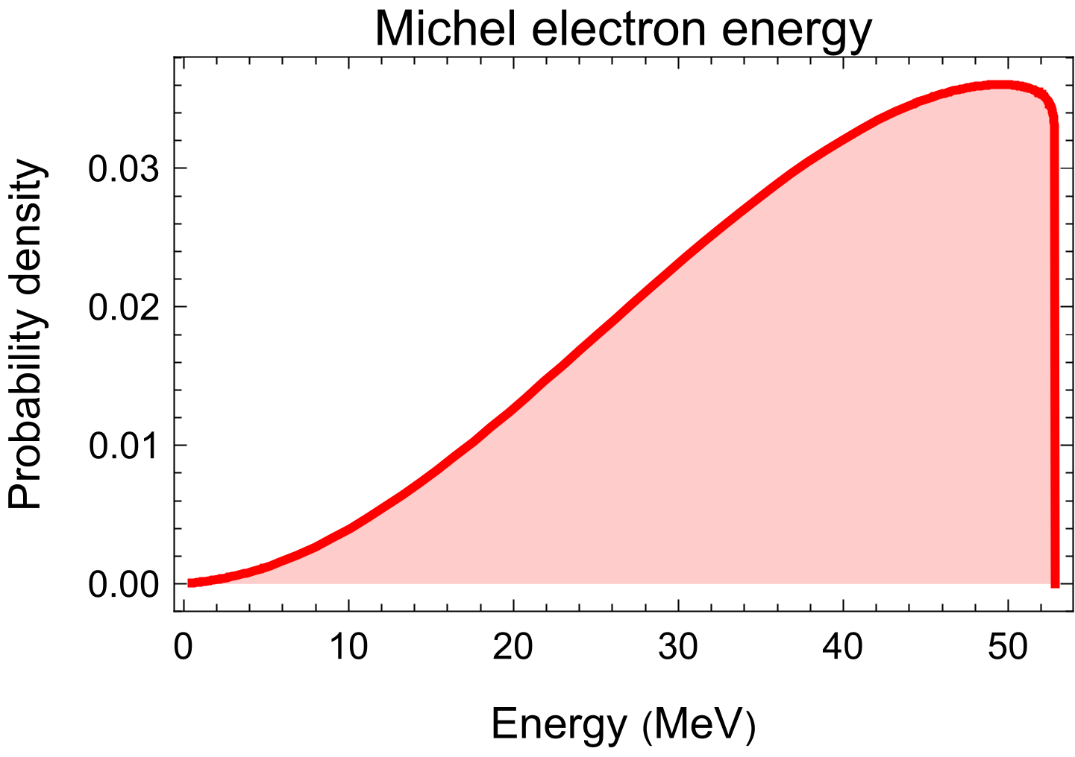
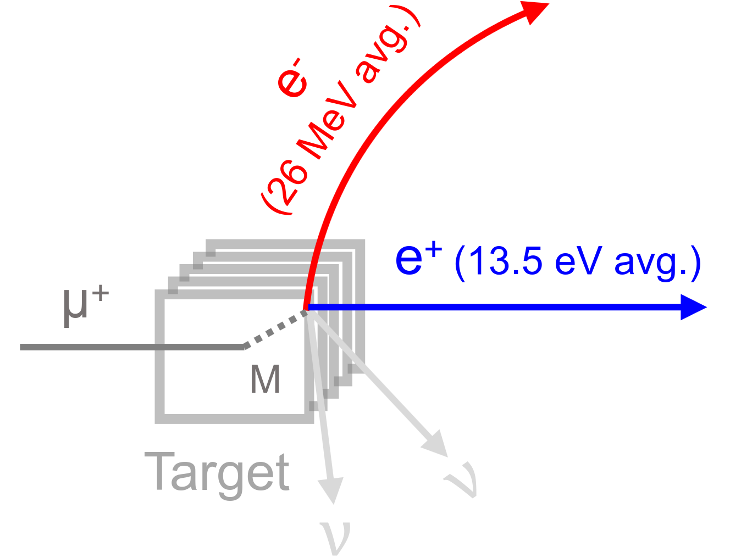
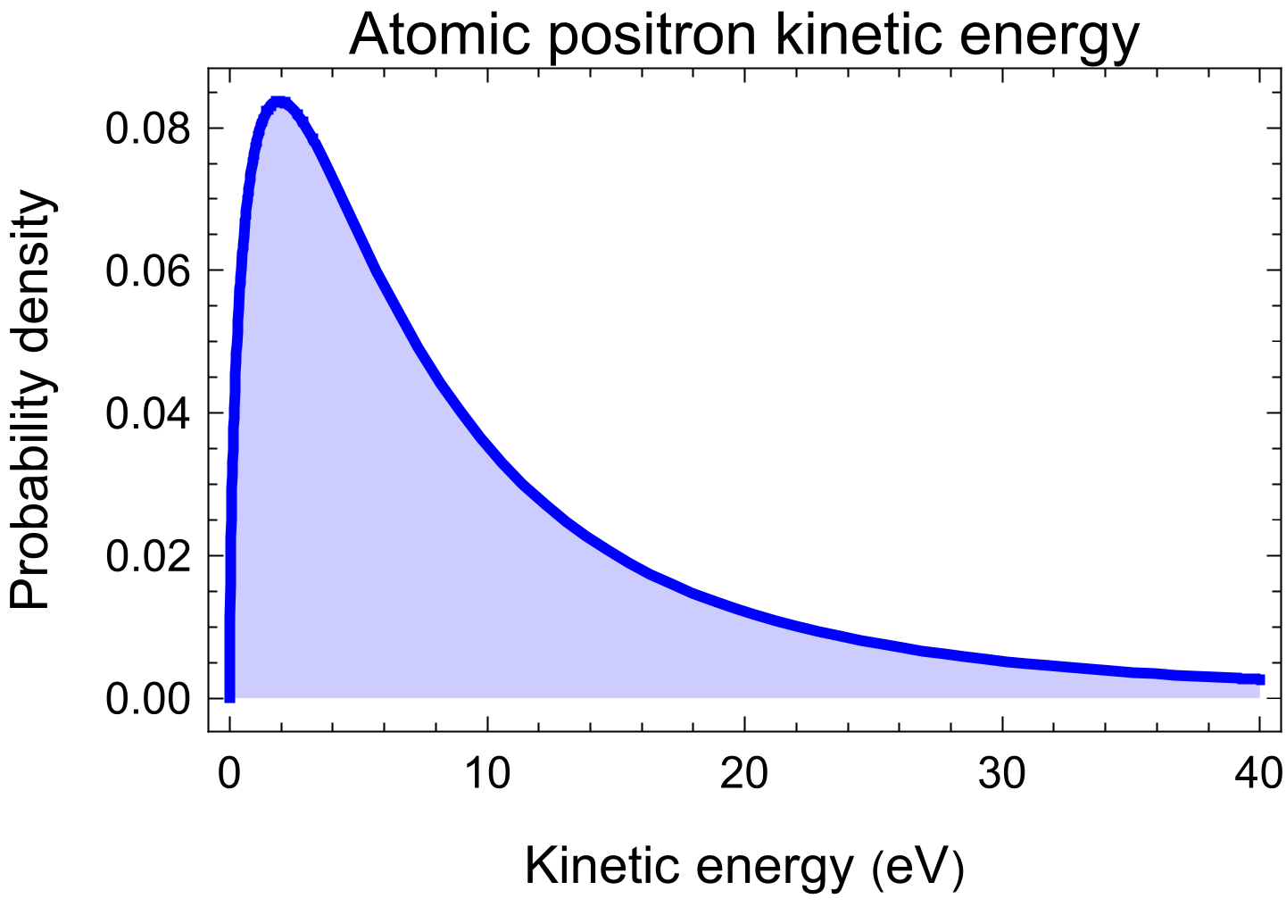
Design goals of PTS
Transmitting signal from cLFV Process
$$\overline{M} \underset{→}{ } e^{+}e^{−}ν_{μ}{\overline{ν}}_{e}$$
fast $e^{−}$ + slow $e^{+}$
Momenta for Atomic positron (PTS)
I. Isotropic
II. Mean kinetic energy of 13.5 eV
Electrostatic accelerator with ~500 eV
Transmitting signals

Slide 19
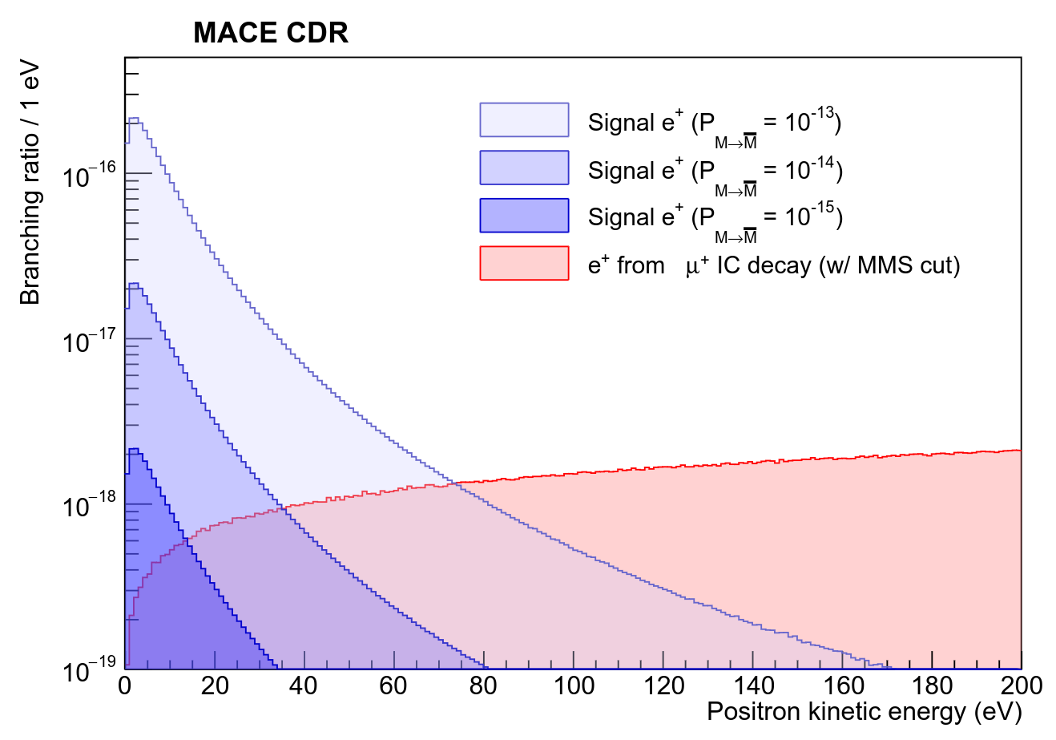
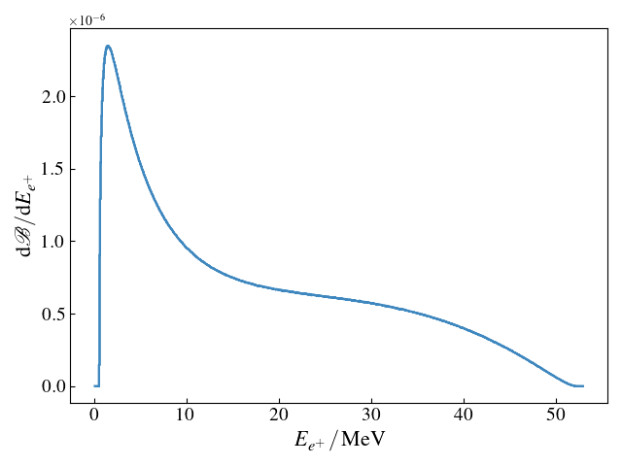
Design goals of PTS
Reduce background from IC decay
$$μ^{+}→e^{+}e^{−}e^{+}{\overline{ν}}_{μ}ν_{e}$$
A positron momentum selector design
TOF coincidence
Collimator
Reduce backgrounds
$$BR(μ→eeeνν)= 3.4×{10}^{−5}$$
$e^{+}$ energy spectrum of
$μ^{+}→e^{+}e^{−}e^{+}{\overline{ν}}_{μ}ν_{e}$
$$BR(μ→eeeνν | E_{k}^{1e^{+}}<100 eV)= 3×{10}^{−12}\text{ (}\text{LO} \text{prediction}\text{)}$$

Slide 20
Contents
The capture front-end design in MuST
I. Beamline introduction
II. Radiation-resistant capture solenoid (RCS) design
III. Electromagnetic, irradiation, and cooling research
The MACE positron transport system (PTS)
I. Motivations
II. Solenoid system and Electrostatic acceleration module
III. Performance
Summary

Slide 21
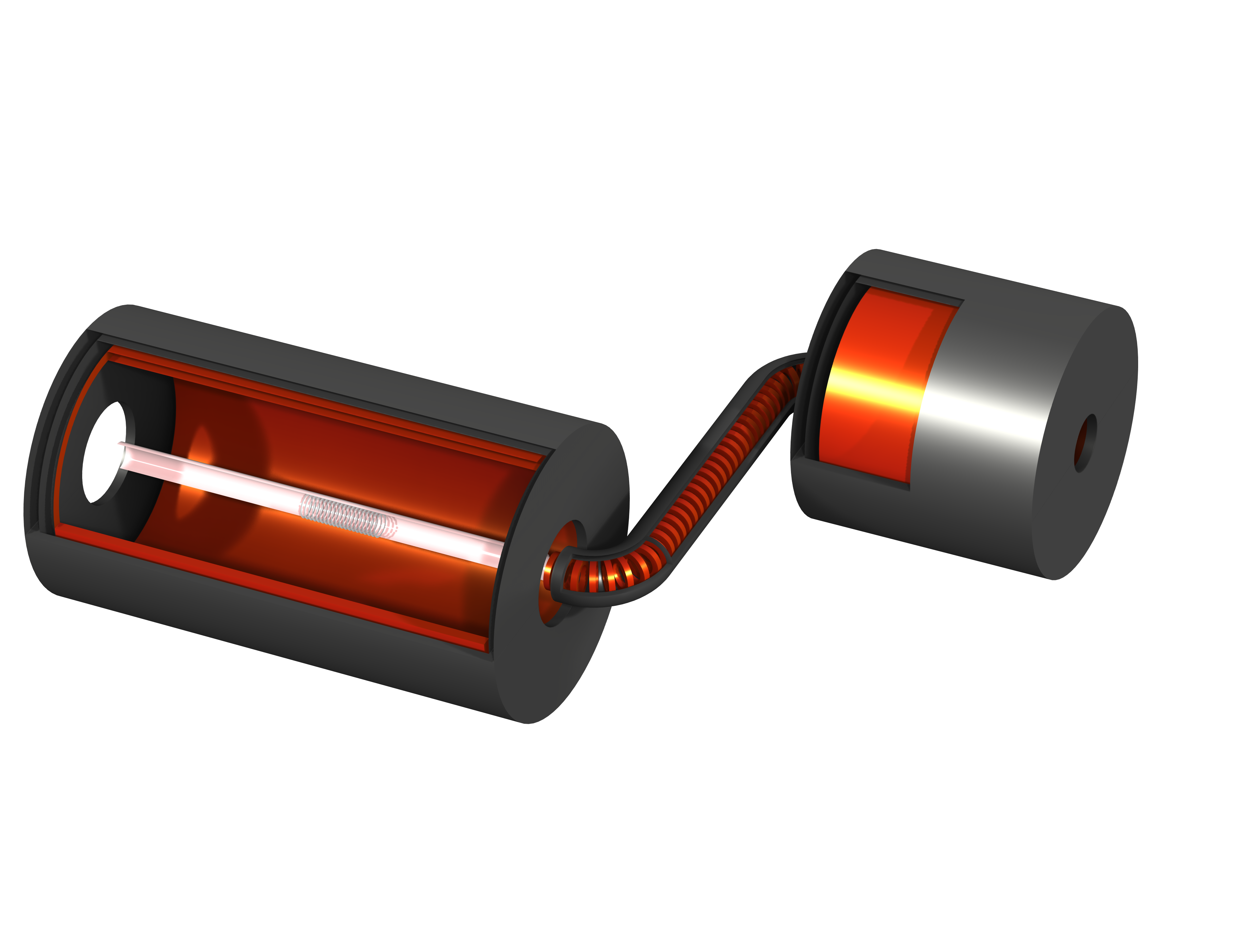
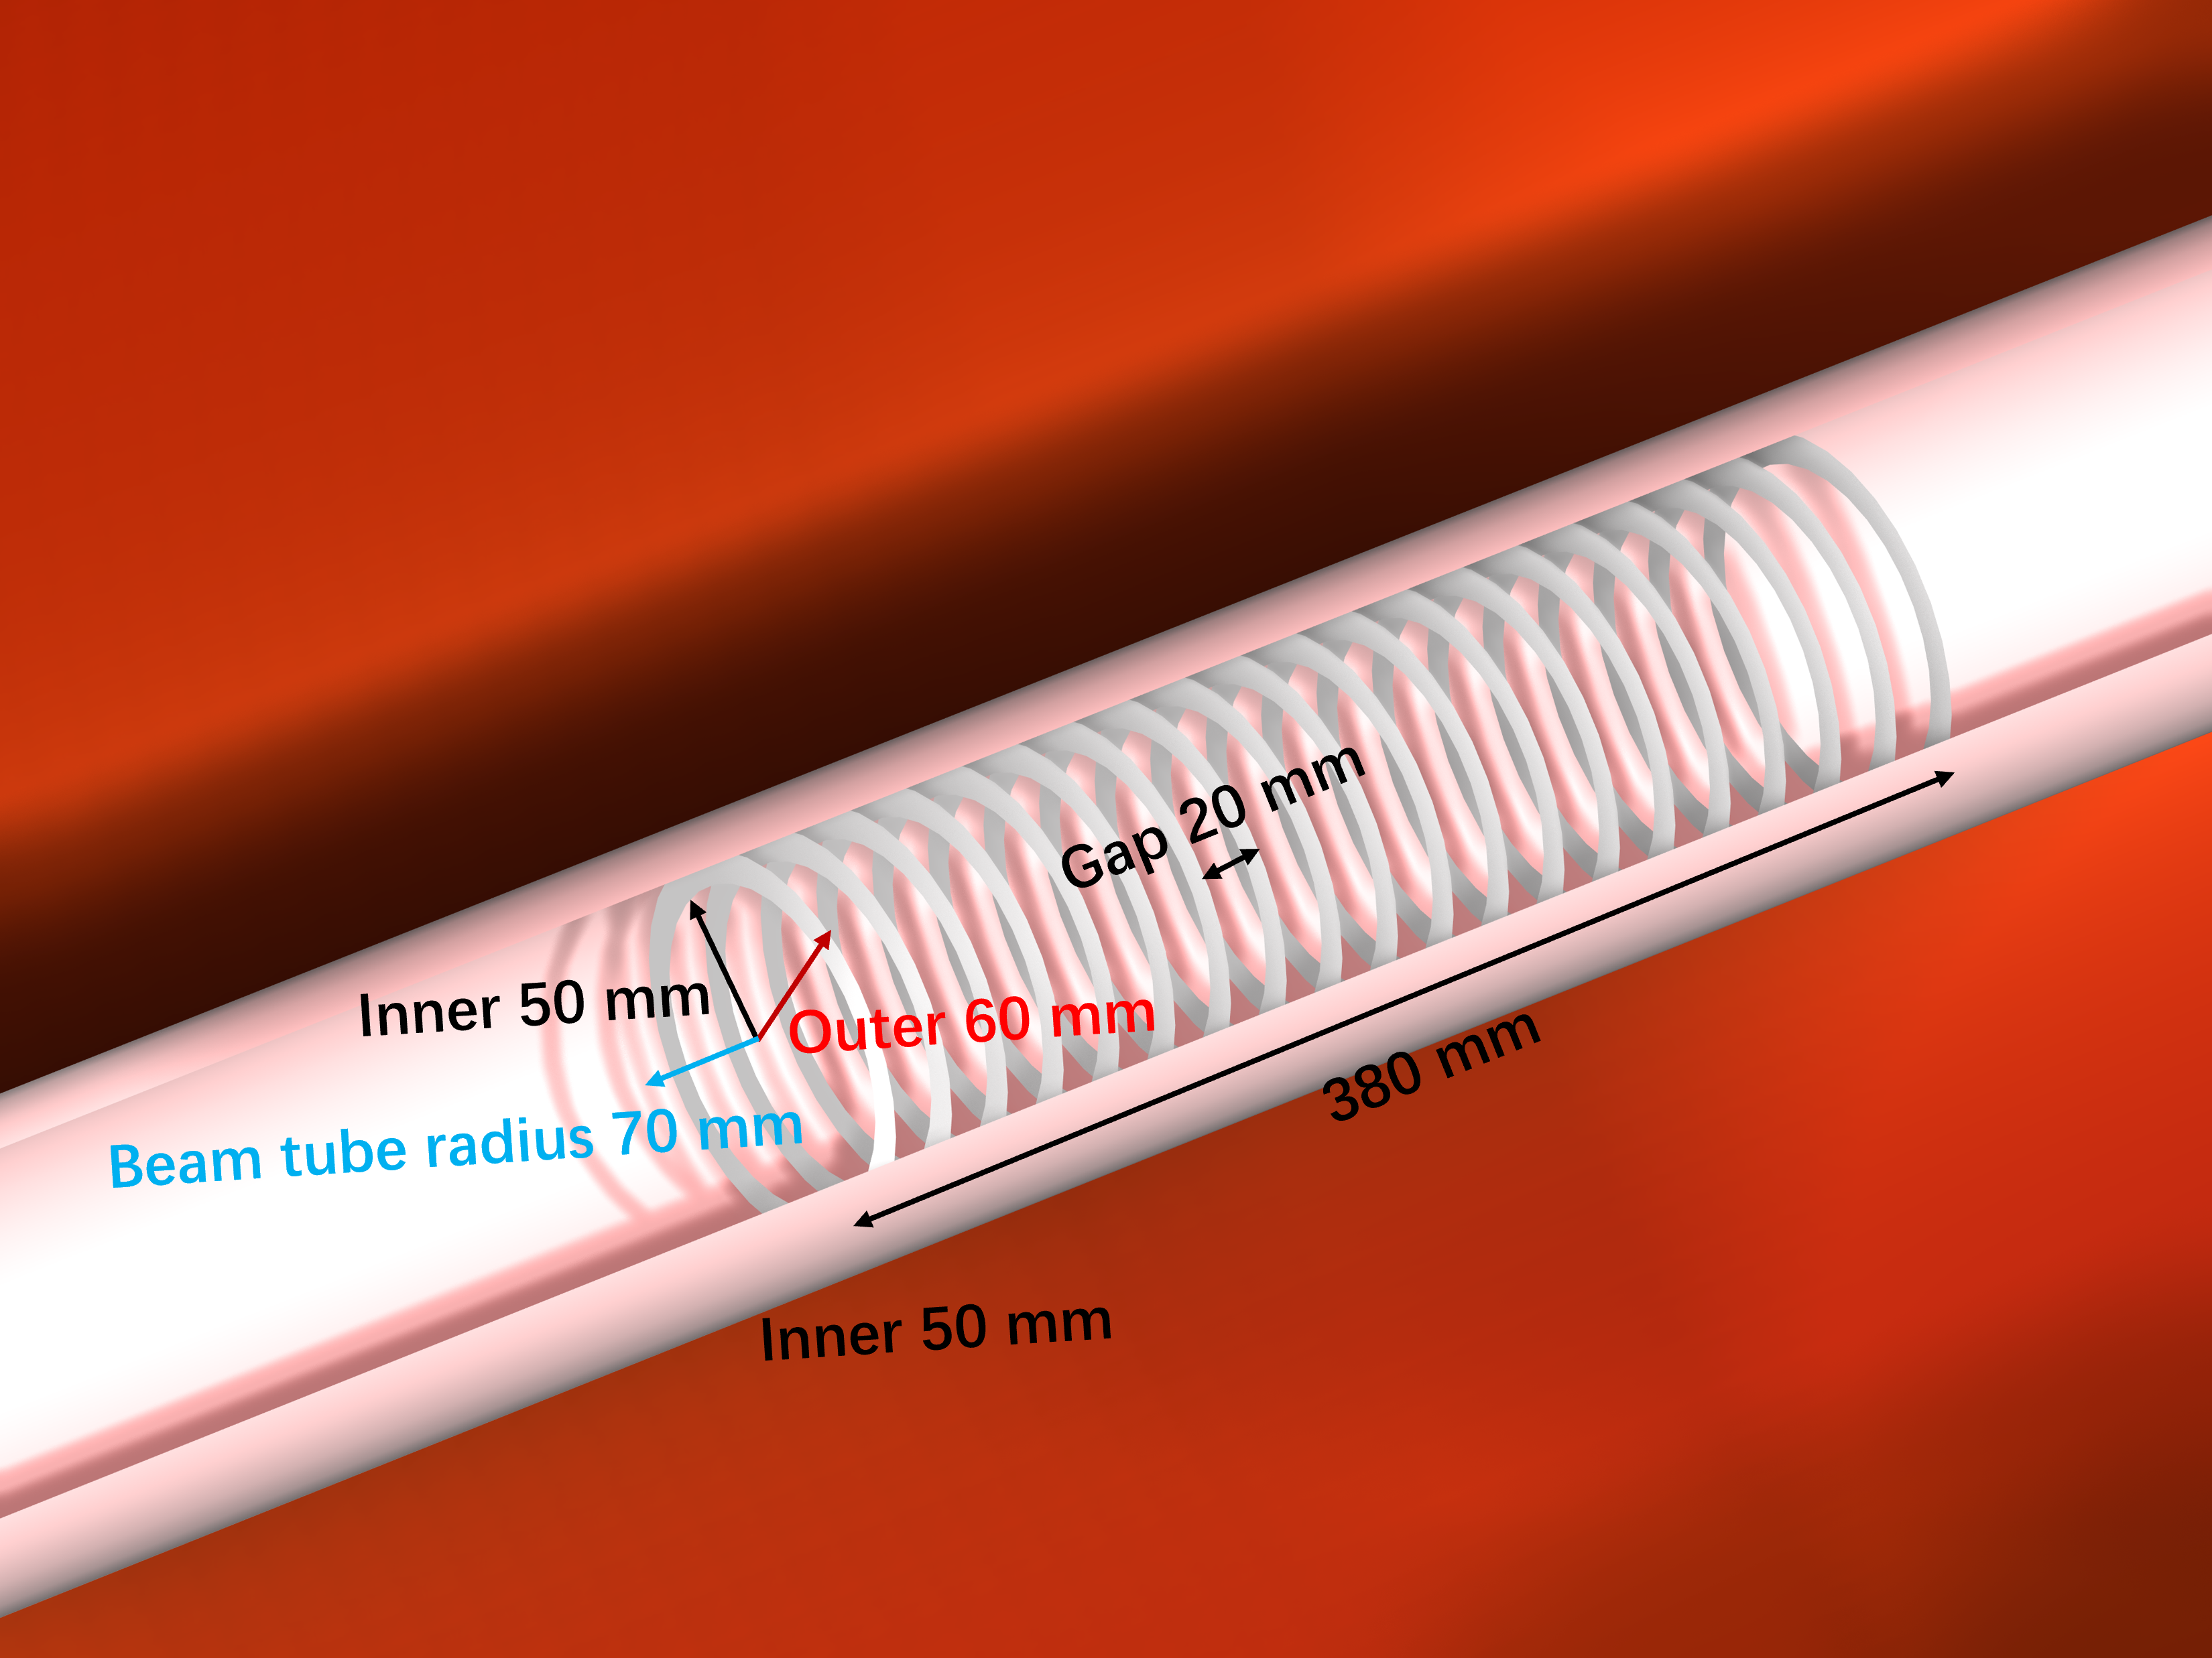
Design of PTS for MACE
The design of the MACE positron transport system (PTS)
I. Electrostatic accelerator
The equally spaced electrodes create a uniform field
II. Solenoid system
1. MMS solenoid
2. TS solenoid
Straight line segments: T1, T2, T3
Bend segments B1, B2
3. PDS solenoid
Beam Pipe
Yoke Iron
T3
T2
Accelerator
ECal
1.4 m
3.16 m
MMS
B2
B1
T1
4.20 m

Slide 22
Schematic of PTS geometry
Beam Pipe
Yoke Iron
T3
T2
Values for solenoid system
Accelerator
ECal
Main | Component | Length/ Radius (mm) | Inner Radius (mm) | Thickness (mm) | Quantity
MMS Solenoid | Solenoid | 2200 | 550 | 50 | 1
 | Yoke | 2400 | 650 | 50 | 1
 | Windows | 250 |  | 250 | 2
TS Solenoid | TS coils | 30 | 60 | 30 | 37
 | T1/T3 | 150 | 60 | 30 | 2
 | B1/B2 | 250 | 60 | 30 | 2
 | T2 | 1314.6 | 60 | 30 | 1
 | Yoke | 3185.35 | 100 | 130 | 1
ECal Solenoid | Solenoid | 1000 | 500 | 50 | 1
 | Yoke | 1200 | 600 | 50 | 1
 | Windows | 130 |  | 130 | 2
3.16 m
MMS
1.4 m
B2
B1
T1
4.20 m

Slide 23
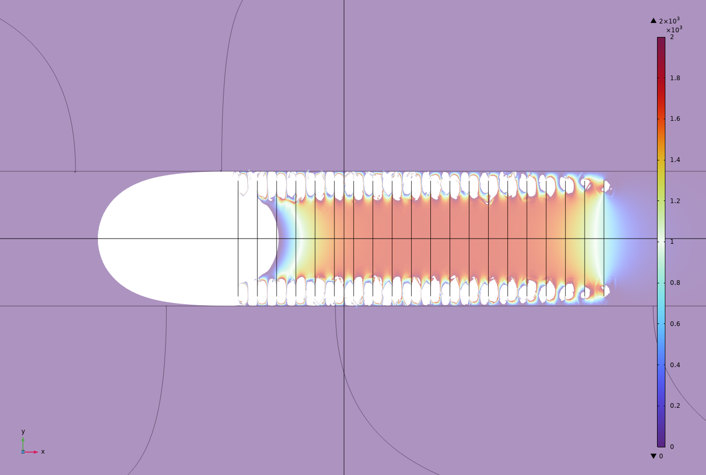
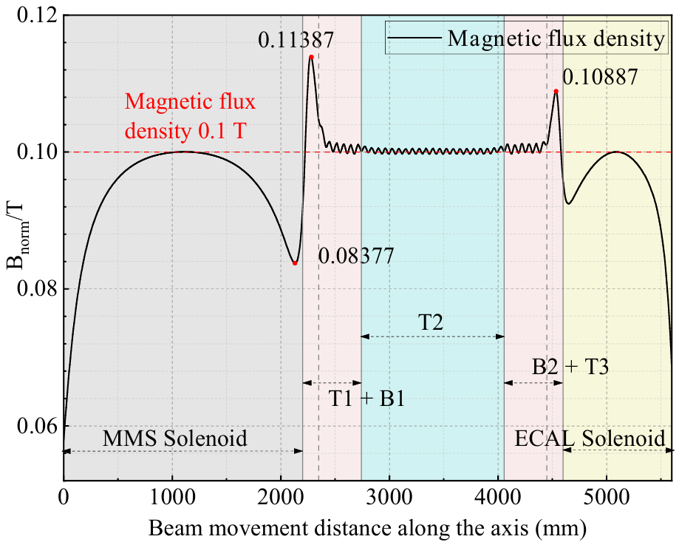
Electromagnetic field characteristics
Electromagnetic field simulation was performed using COMSOL
Target region
Schematic diagram of the electric field distribution
The blank is the region where the electric field is reversed
Provides signal energy of ~500 eV
Considering the MMS performance and sensitivity, the magnetic field of the MMS solenoid should be 0.1 T
Due to the low kinetic energy of antimuonium, the positron production region is the target region.

Slide 24
Contents
The capture front-end design in MuST
I. Beamline introduction
II. Radiation-resistant capture solenoid (RCS) design
III. Electromagnetic, irradiation, and cooling research
The MACE positron transport system (PTS)
I. Motivations
II. Solenoid system and Electrostatic acceleration module
III. Performance
Summary

Slide 25
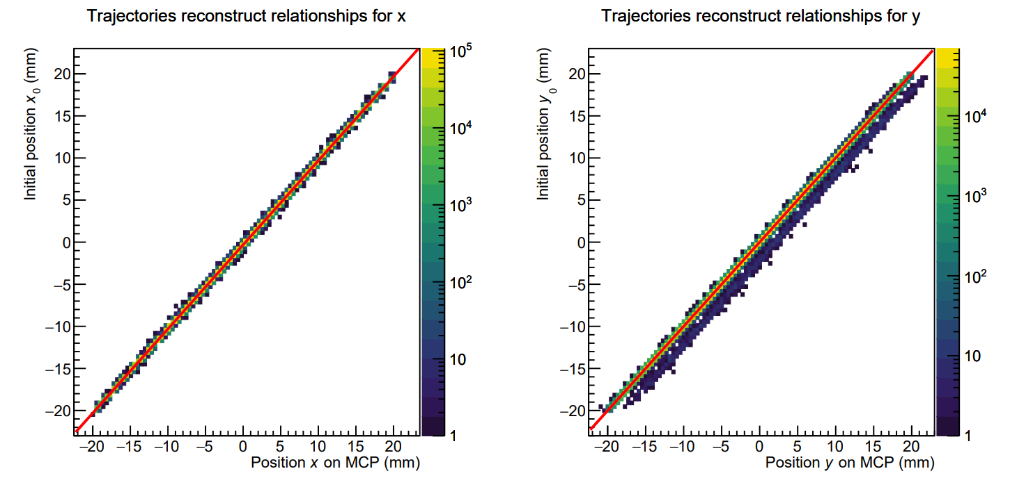
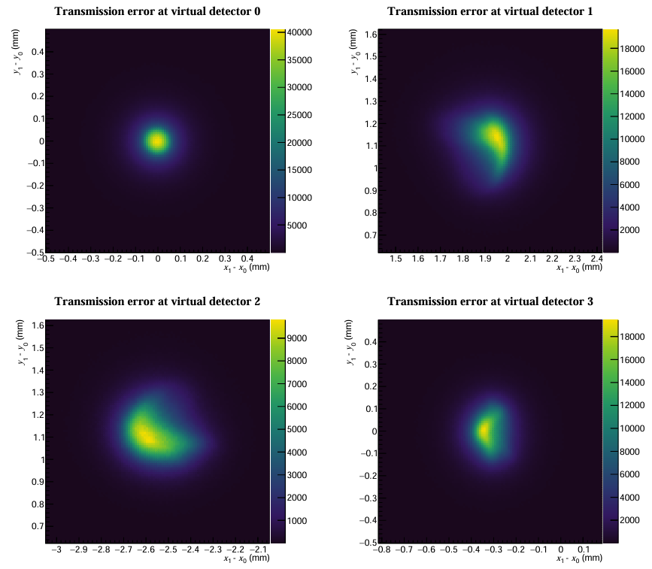
PTS Performance for signal transmission
Signal transmission efficiency: 65.8%
Transport efficiency is defined as the proportion of signal transported to MCP from the decay vertex.
Spatial resolution: 0.088(1) mm × 0.102(1) mm
This value is equivalent to std dev and represents the error during transmission.
Transmission offset: 0.315(1) mm × 0.003(1) mm
Represents the displacement of the average position during the transmission.
Flight time and FWHM: 322.4 ns & 6.9 ns
Represents the time from MCP to the decay vertex, where FWHM can be used as TOF information to reduce background
Notes:
coordinates

Slide 26
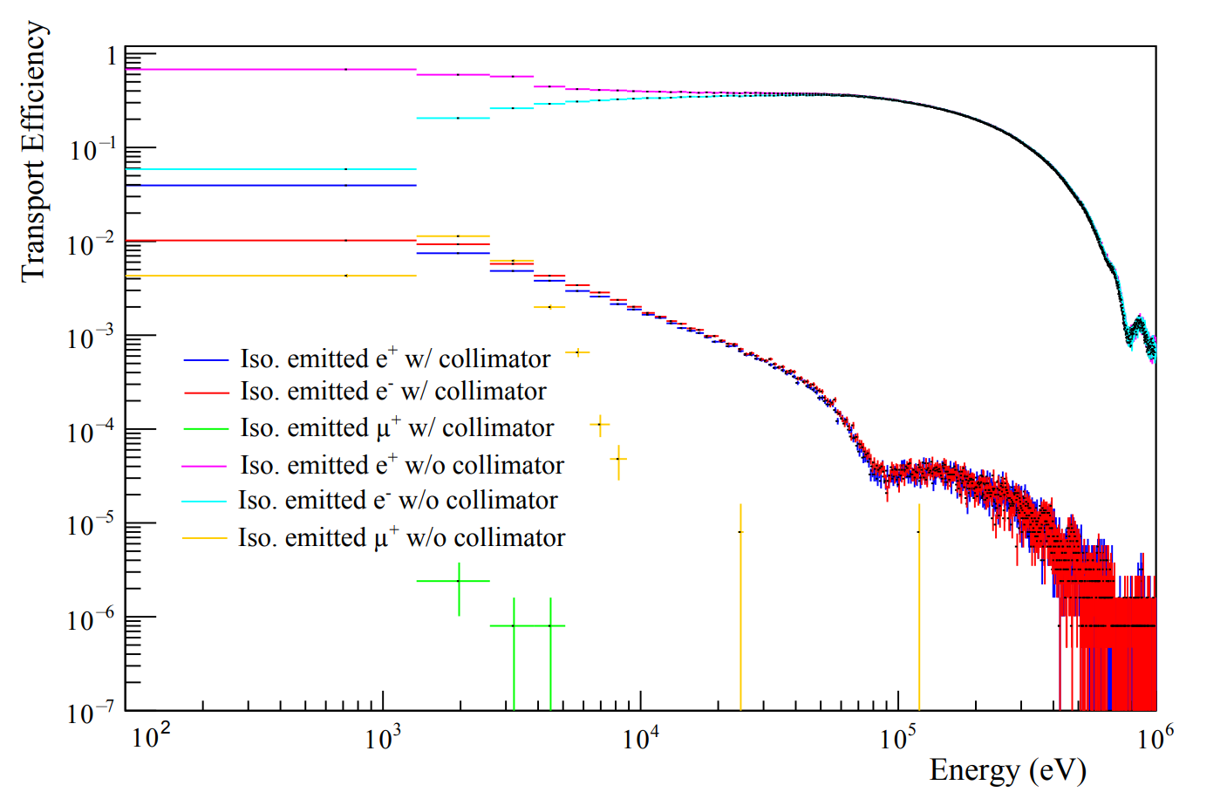
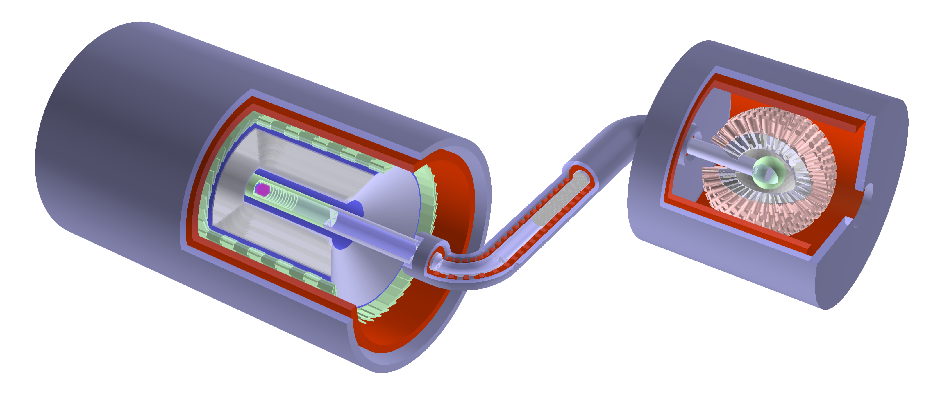
PTS Performance for background suppression
Collimate has a strong filter ability
Optimal pitch: 1.15 mm → $p_{xy}^{max}⁡$=14 keV/𝑐
Collimator
0.2 mm
1.15 mm
1
2
3
4
5
Calculating IC decay supression levels: $\overline{ε}=Σ_{i=0}ε_{i}{P(E}_{i})$
Set different regions: 1, 2, 3, 4, 5
$$1.05×{10}^{−7}+3.58×{10}^{−7}+6.61×{10}^{−7}+4.25×{10}^{−7}+3.52×{10}^{−7}=1.90×{10}^{−6}$$
With the TOF window of (301.4 ns, 343.4 ns), the different regions TOF suppression: 0.594, 0.0230, 0.0152, $6.93×{10}^{−4}$, < $6.93×{10}^{−4}$. Finally can give a $O({10}^{−8})$ suppression to IC decay.

Slide 27
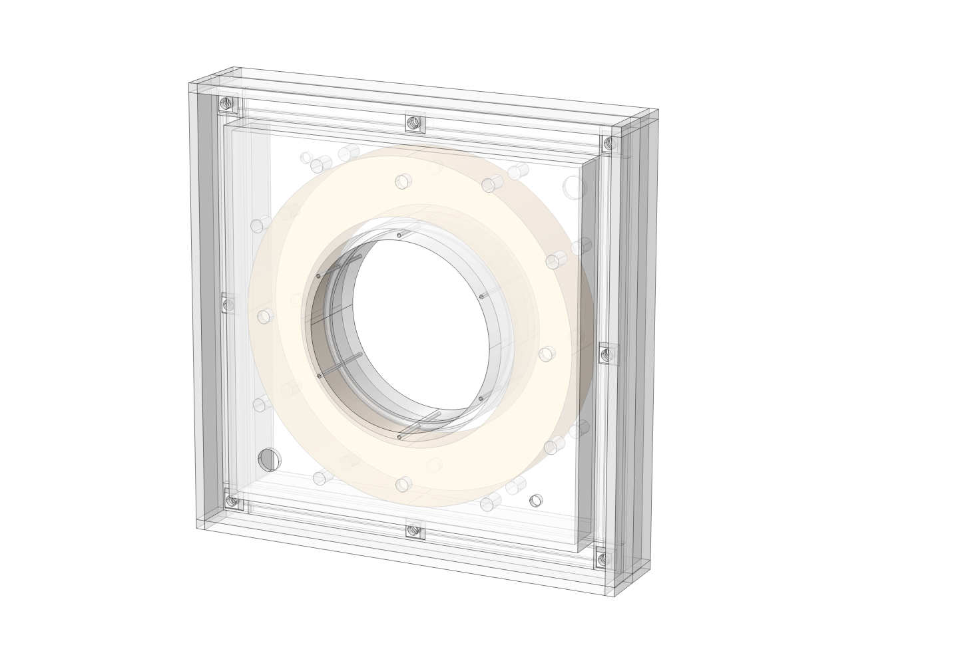
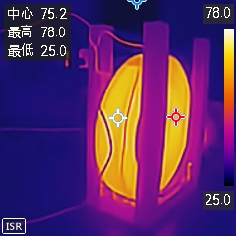
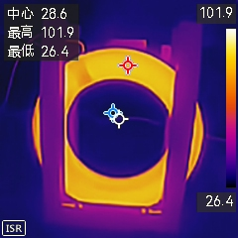
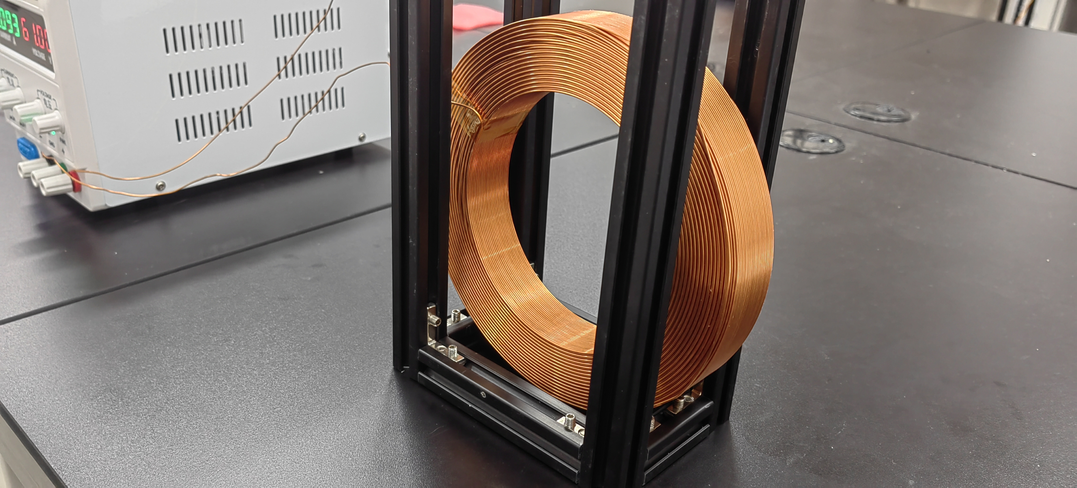
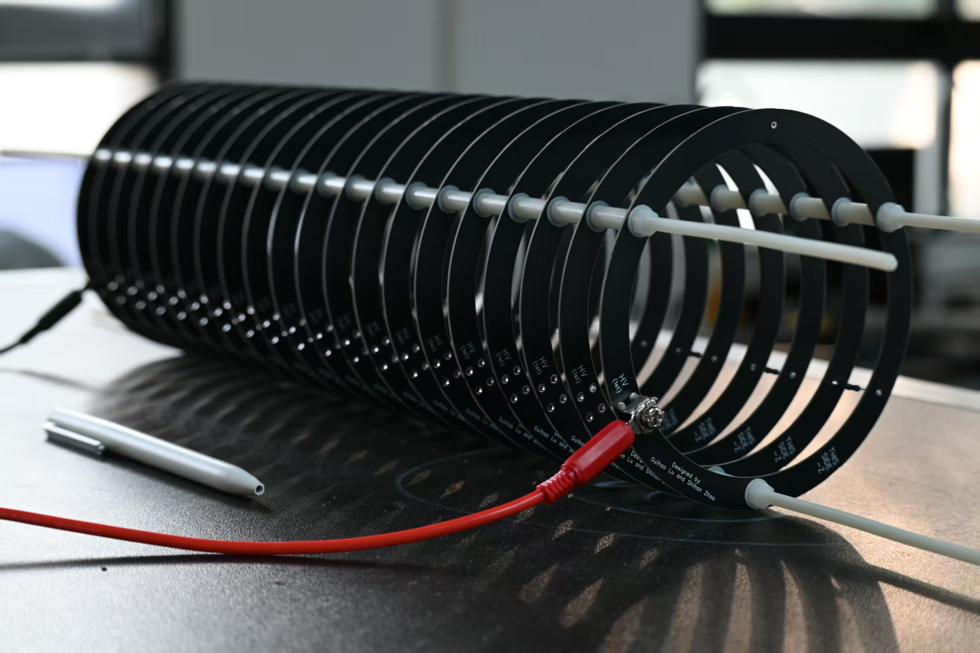
PTS in the next
PTS validation
Testing with TS solenoids and accelerator module
Coil feasibility validation
Water cooling coil test
Detector Chamber
Ionization Vacuum Gauge
Venting Valve
Validation system
Particle Source
Roughing Valve
Accelerator module prototype
Multi-layer PCB
High voltage > 2 kV
Thermocouple Vacuum Gauge
High Vacuum Gate Valve
Foreline Valve
Dry Mechanical Pump
Molecular Pump

Slide 28
Summary
We used an optimization program to complete the design of capture front-end. This method can be widely used in accelerator design.
Compared with other previous models, the segmented RCS model can bring considerable efficiency and economic advantages.
At present, the electromagnetic, irradiation, and cooling research has been preliminarily completed. The next step will be to conduct more detailed simulation and experimental testing of front-end capture.
The design of PTS in MACE fulfills two essential requirements:
High-precision signal transmission: 0.088(1) mm × 0.102(1) mm
Strong background suppression: $O({10}^{−8})$for IC decay
In the next, PTS will focus on the engineering implementation of accelerator modules and solenoid systems, finishing TDR design.
Our future validation system will provide an ultra-high vacuum environment for PTS testing and other MACE component testing, and may be equipped with a positron particle source.
Capture front-end
PTS

Slide 29
Thanks

Slide 30
当前传输结果对比
模型 | 参数[mm]/[T] | 发射度[mSr] | 传输效率
CiADS Old | 250 *500 0.37(D) | 663 | 14.6%
 | 250 *500 0.37(S) | 663 | 14.1%
 | 250 *500 0.40(D) | 663 | 13.3%
CiADS new | 200*150+478*292 +171*296 0.37*0.00*0.25 | 663 | 20.00%
 | 200*150+226*260 +119*257 0.36*0.00*0.20 | 663 | 16.33%
模型 | 参数[mm]/[T] | 发射度[mSr] | 传输效率
Himb old | 250 *400 0.37(D) | 790 | 14.6%
CiADS old(Tracewin) | 250 *500 0.4(D) | 663 | 16.2%
Himb old

Slide 31
PTS Performance for charged particles
The previous simulation is performed on the signal of antimuonium, and the main parameters obtained are:
Transmission efficiency: 65.8%
Spacial resolution: 0.088(1) mm × 0.102(1) mm
Transmission offset: 0.315(1) mm × 0.003(1) mm
In order to measure the ability of the PTS system to filtered the high-energy background, a variety of charged particles with flat energy spectra are simulated
$$e^{+}, e^{−}, π^{+}, π^{−}, μ^{+}, μ^{−}$$

Slide 32
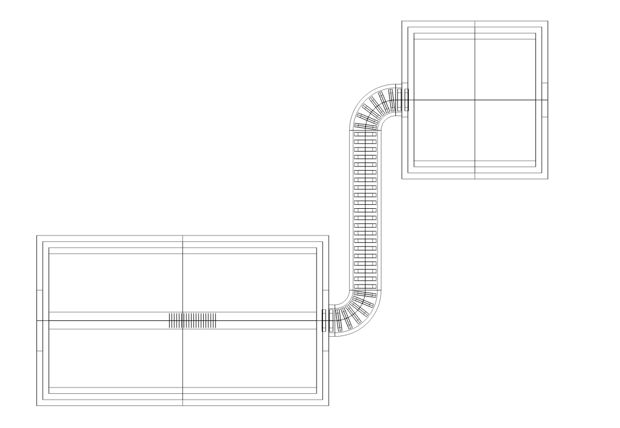
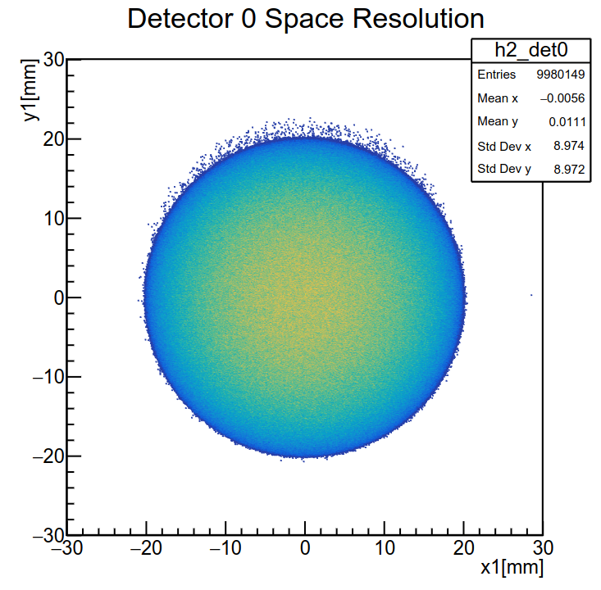
PTS Performance for signal
Import the field file into Geant4 for simulation
A program for PTS simulation developed based on the existing MACE offline software framework
Parameter
Simulate particle distribution: Ellipsoid
Radius of distribution: 30 mm × 20 mm × 20 mm
Signal Initial Particle: Antimuonium
The total number of simulated events: 10⁷
Virtual detector 3
Virtual detector 2
Virtual detector 1
Virtual detector 0
Virtual detector 0: After the electrostatic accelerator accelerates
Virtual detector 1: After B1
Virtual detector 2: After collimator(Inside S2)
Virtual detector 3: At the middle of ECal solenoid(Location of the MCP)
The shape of the beam spot after passing through the electrostatic accelerator

Slide 33
R&D route
I.
I. Experimental design
Verify design feasibility.
II. Electromagnetic field calculations
Debugging, analysis, electromagnetic fields in close proximity to reality and use simulation results to verify with previous experiments
III. Export the field file for calculations
Import the field file into the beam simulation software for calculation
IV. Final simulation of the physical design
Integrate the MACE framework to perform calculations using field files
G4beamline
II.
Verify design
Geometry
COMSOL
Verify field file
III.
Field file
G4beamline
Field file
IV.
Geant4-MACE
Verify
Output

Slide 34
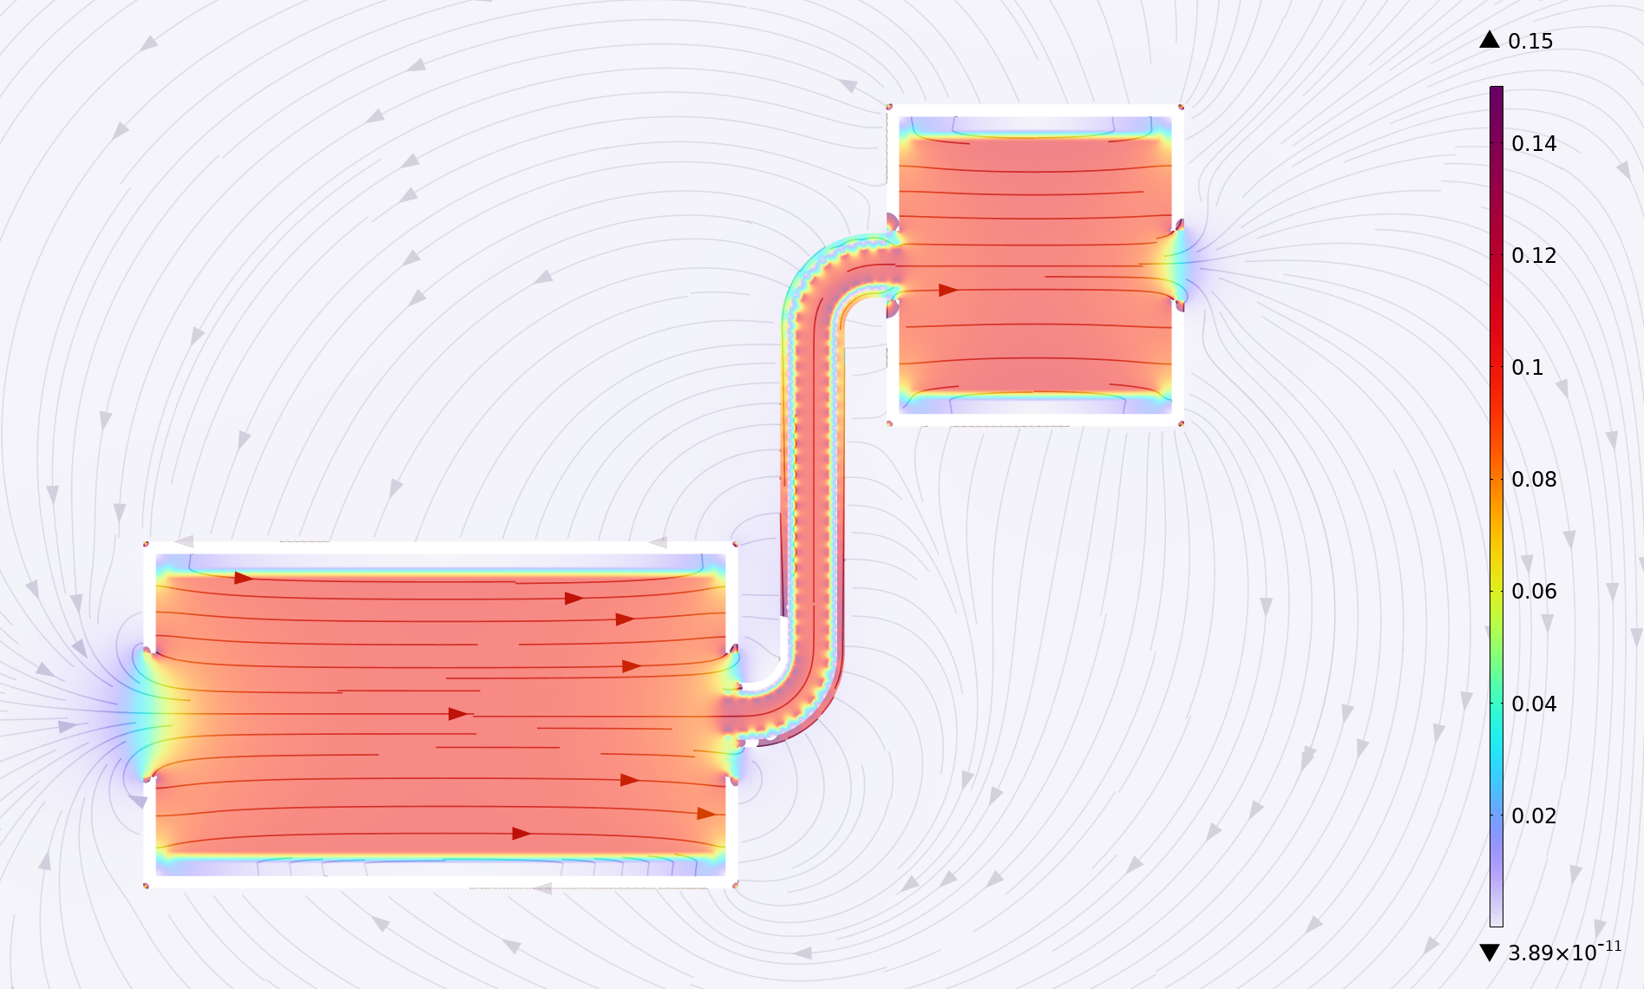
Electromagnetic field characteristics -II
Distribution of the overall magnetic field across the cross-section of the PTS simulation, with magnetic field lines also depicted.
B2+T3
MMS solenoid
ECal solenoid
T2
T1+B1
PTS is the bridge between MMS and PDS
PTS is capable of trajectory reconstruction, linking PDS and MMS
Considering the MMS performance and sensitivity, the magnetic field of the MMS solenoid should be 0.1 T
Due to the low kinetic energy of antimuonium, the positron production region is the target region.

Slide 35
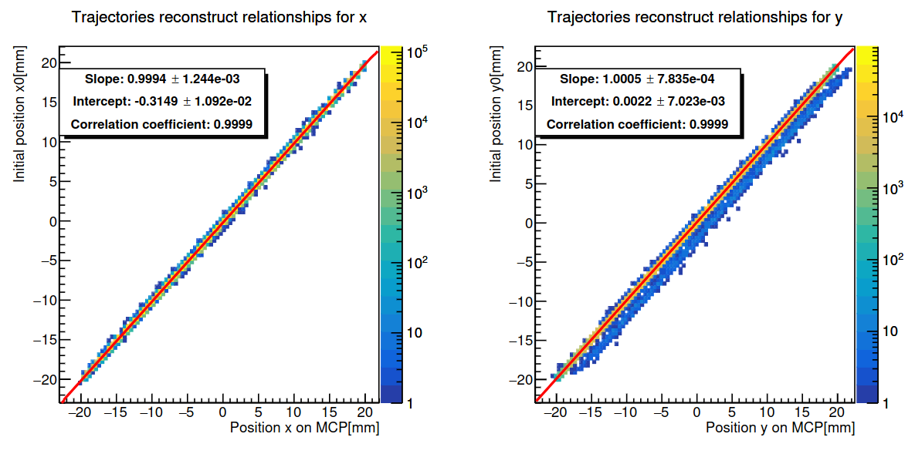
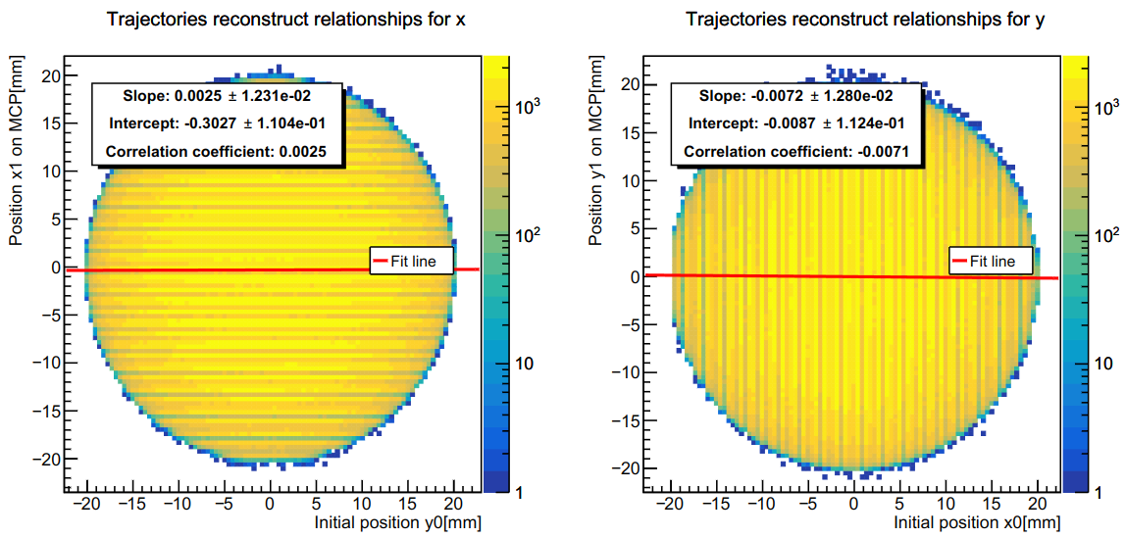
PTS Performance for signal
Data from the last virtual detector at PDS
The diagram represents the relationship between positron coordinates after a complete transmission
The slope of the fit for the corresponding coordinates is approximately 1
During spot transport, only translational transformations occur and there is almost no stretching.
Offset in the vertical beam direction: 0.31(2) mm × 0.002(8) mm
This result is related to the bins, and the subsequent calculation of the signal will give more reasonable results
The correlation between non-corresponding coordinates is poor
Trajectory reconstruction only needs to take into account the offset of the corresponding coordinates

Slide 36
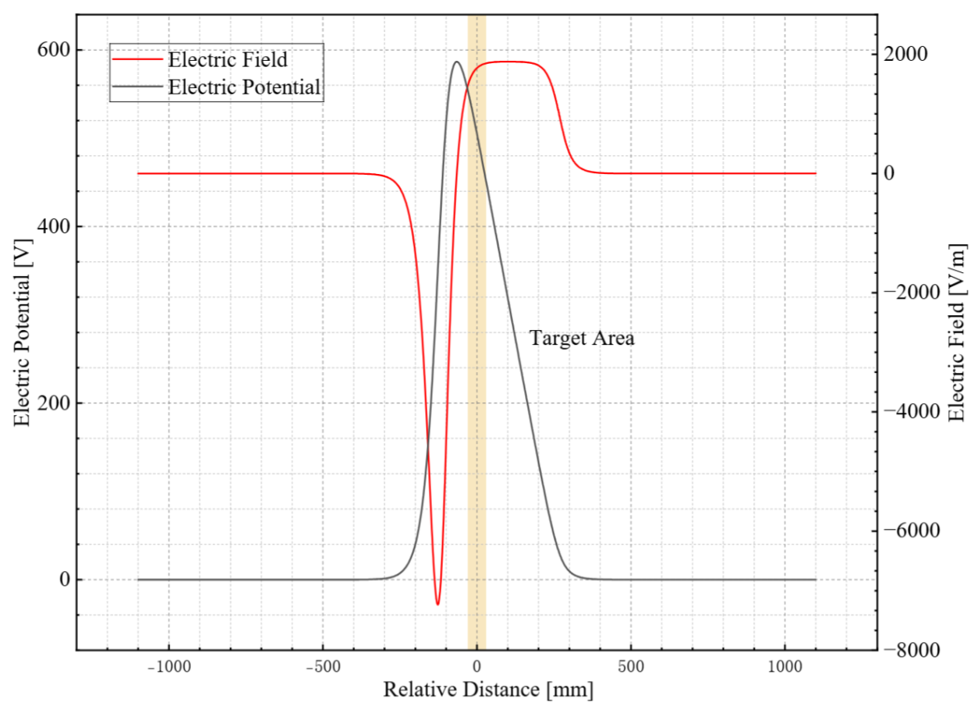
Electromagnetic field characteristics -I
Schematic diagram of the electric field distribution
the blank is the region where the electric
field is reversed
Target region
The electrostatic accelerator needs to cover the entire target region.
Due to the low kinetic energy of antimuonium, the positron production region is the target region.
Electromagnetic field parameters in the region.
Target region: 60 mm × 50 mm × 50 mm
Electric field: 1473 ~1850 V/m
Potential: 450 ~554 V
The electric potential field distribution in the
axial beam direction.

Slide 37
Engineering achievability
Since the magnetic field strength is 0.1 T, the current required is small, there is no need to use a superconducting coil.
Main | Component | Copper wire $φ$ (mm) | Current (A) | Power (kW) | Current Density (A/mm²) | Voltage (V)
MMS Solenoid |  | 15 | 894.5 | 68.7 | 5.1 | 40
TS Solenoid | T1/T3 | 1.8 | 64.8 (16.2 × 4) | 0.96 (0.24 × 4) | 6.4 | 14.8
 | B1/B2 | 1.8 | 224.8 (20.4 × 12) | 4.58 (0.38 × 12) | 8.0 | 18.7
 | T2 | 1.8 | 401.1(19.1 × 21) | 7.01 (0.33 × 21) | 7.5 | 17.5
ECal Solenoid |  | 10 | 77.7 | 6.32 | 1.0 | 81.3

