Slide 1
RPC-Scintillator Hybrid Detection System for
Muon Scattering Experiments at HIAF-HIRIBL
Jinning Li on behalf of collaborators
2025/5/17

Slide 2
Outline
Muon Scattering Experiment on Beamline
Detector Design
-First Stage: ToF-dE PID of Beam Particles
-Multilayer PID System in Higher-momentum Case
Experimental Progress
Summary & Outlook

Slide 3
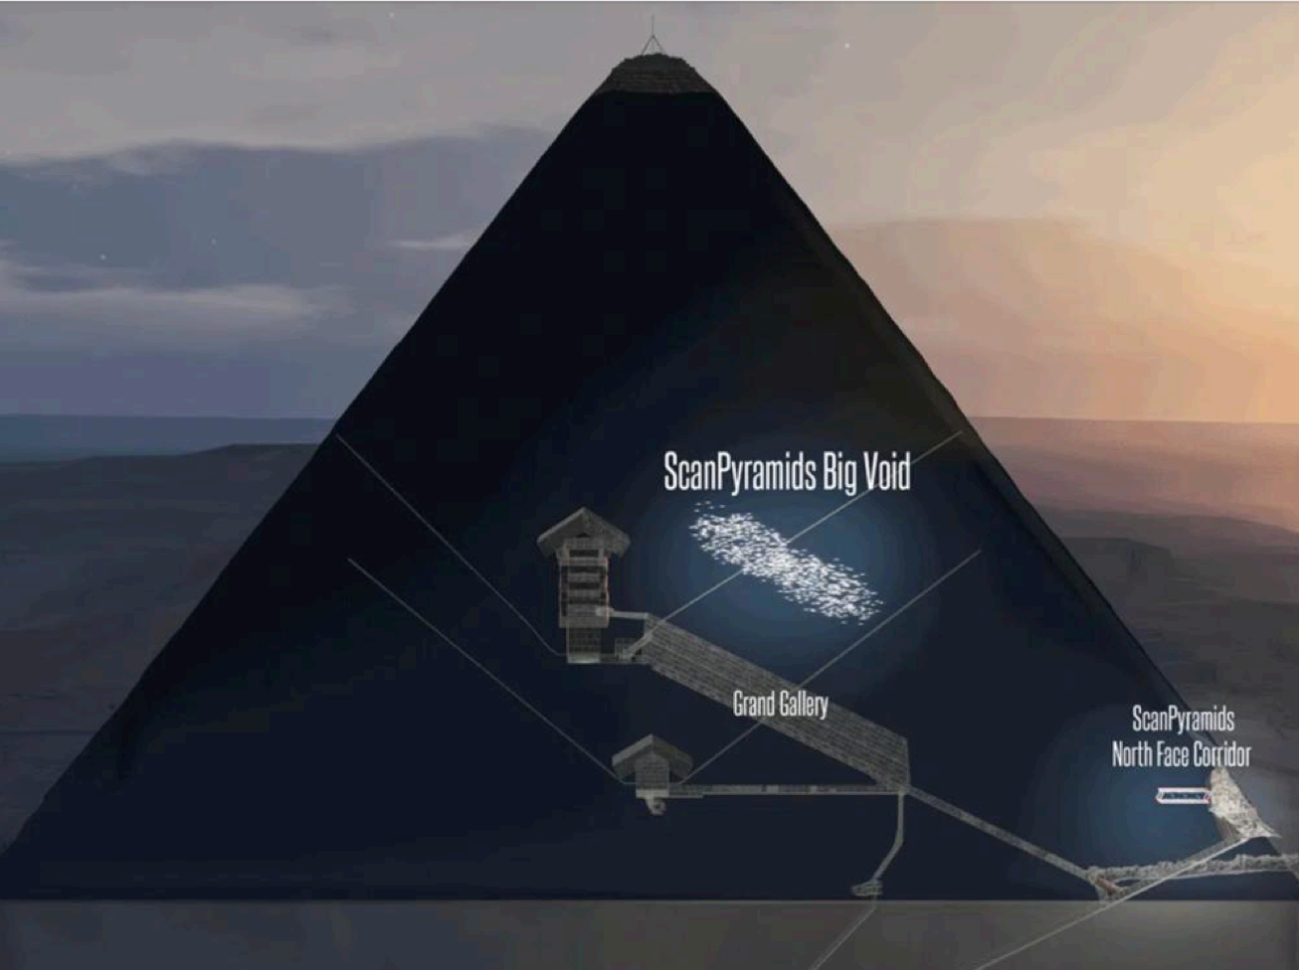
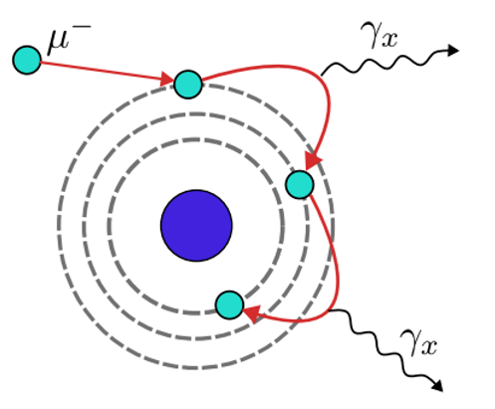
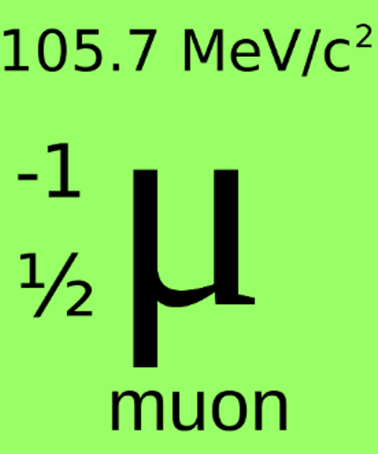
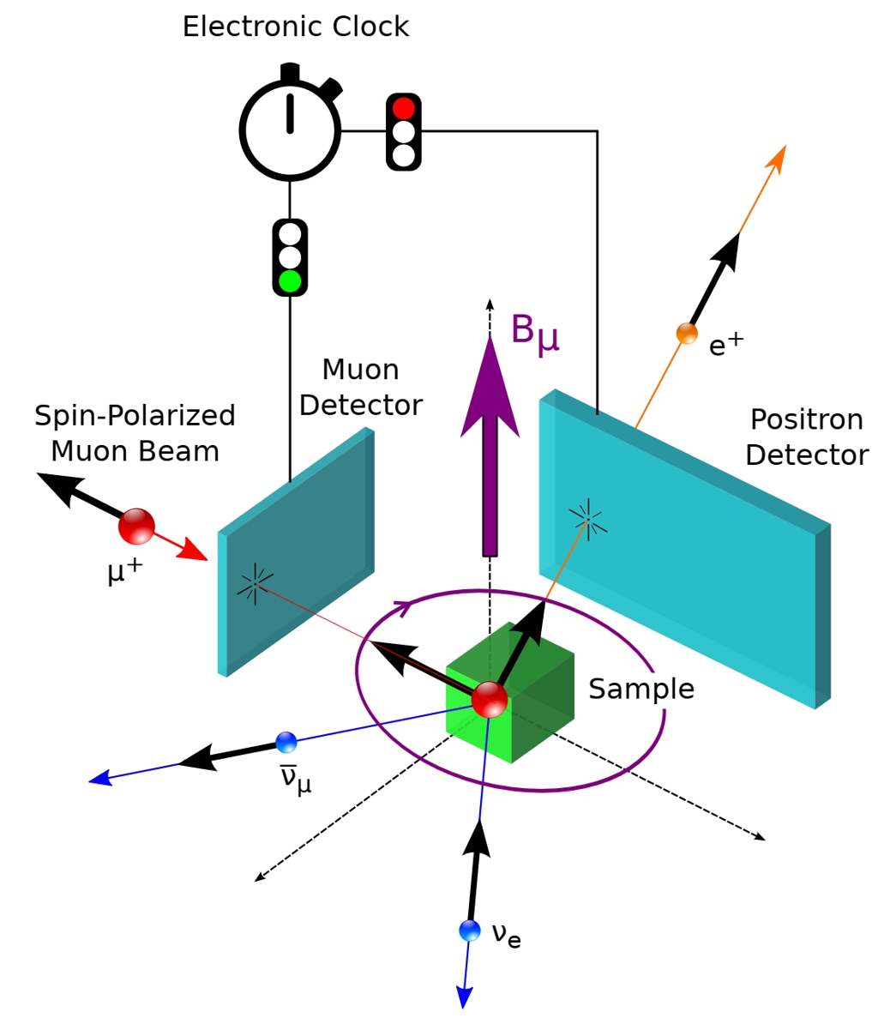
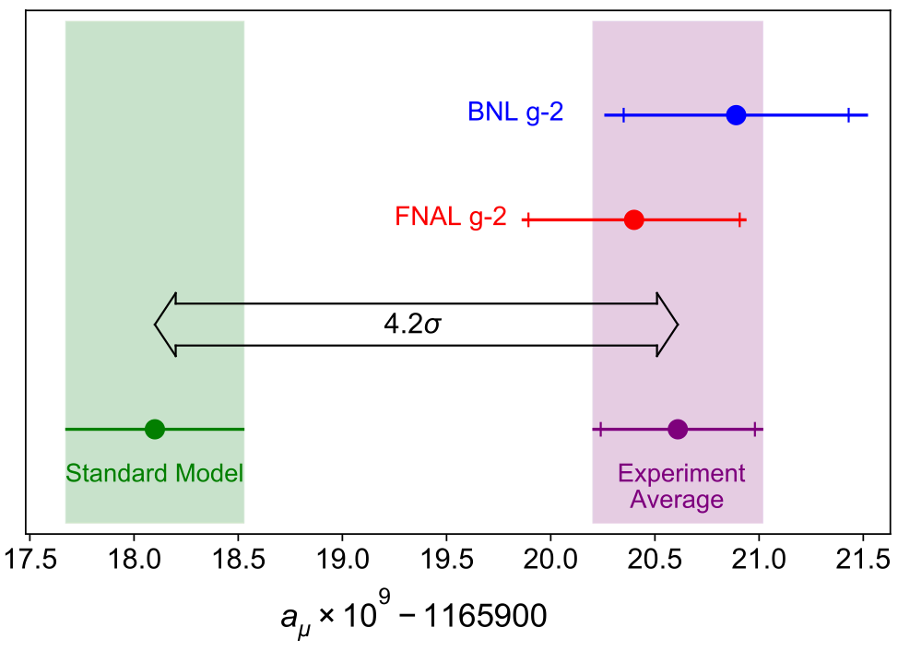
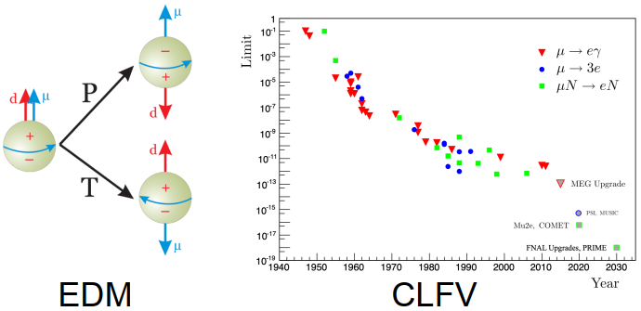
Muon Scattering Experiment on Beamline
Muons play a vital role in both fundamental physics and applied research:
Muongraphy:
-Archaeology
-Geology
-Nuclear safety
Muonic X-ray:
-Elemental analysis
-Tomography
Fundamental particle physics:
-Muon g-2
-Muon EDM
-Muon CLFV
-…
muSR:
-Heavy fermion
-Superconductivity
-Quantum spin liquid
Muon g-2
Experiments on muon scattering for new physics are relatively rare internationally.
(NA64mu, MuonE, PKMu…)

Slide 4
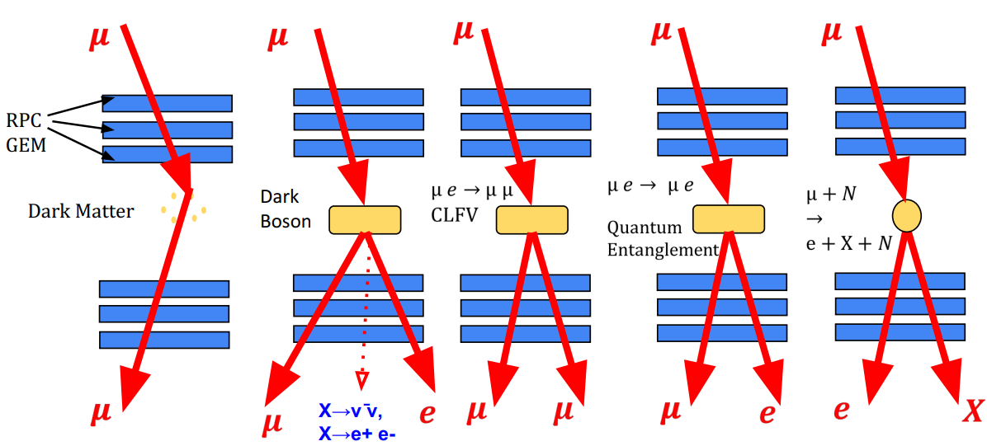
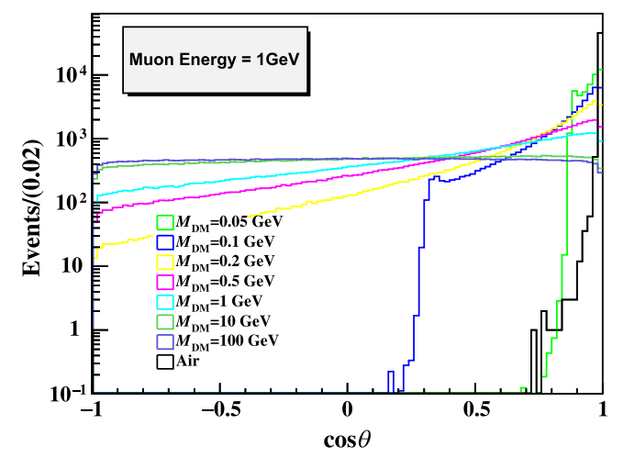
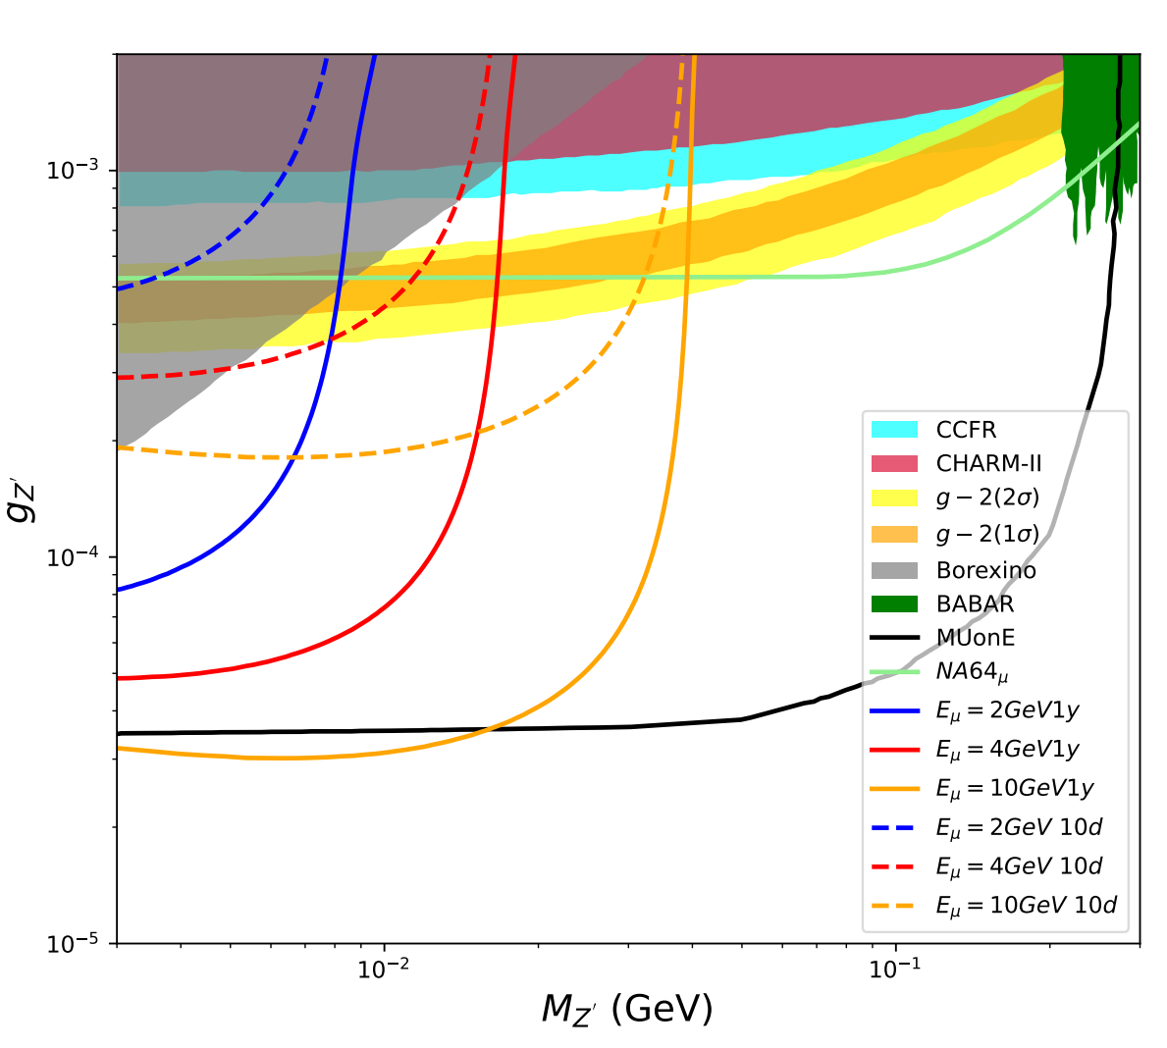
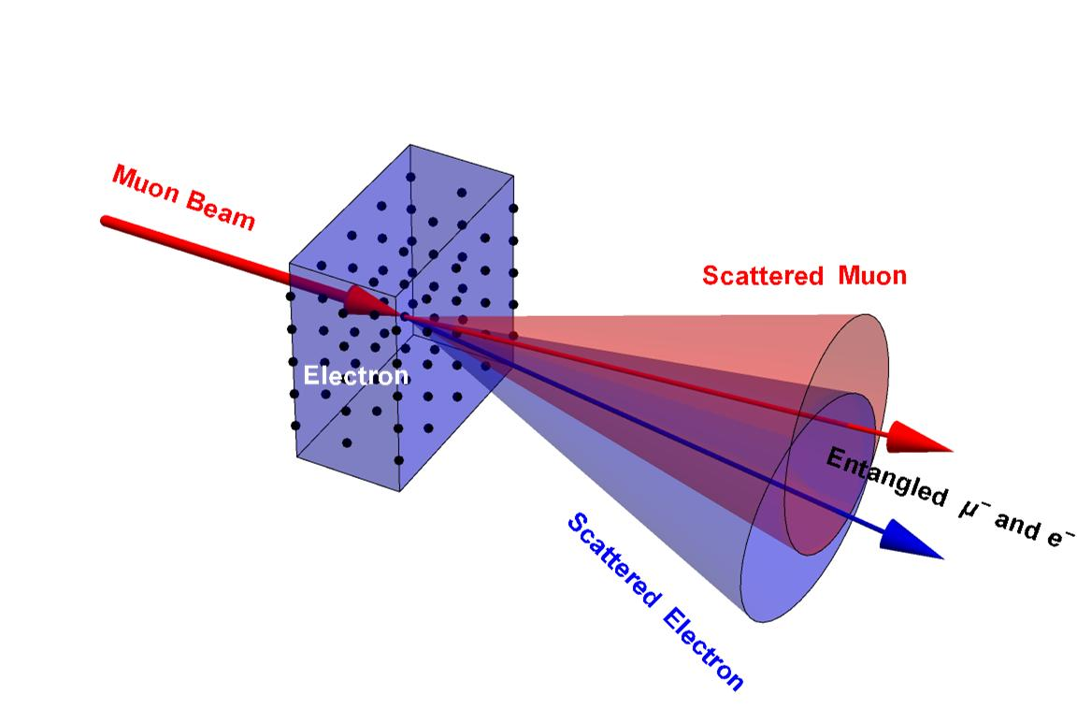
Muon Scattering Experiment on Beamline
PKMu--Probing and Knocking with Muons
Multi-purpose platform detecting muon scattering on target for cosmic muon or muon beam:
Dark matter
Dark boson
CLFV
Quantum entanglement
Muon-nuclear interaction
Muongraphy
[1] Phys. Rev. D 110, 016017
[2] arXiv: 2410.20323
[3] arXiv: 2411.12518
[4] arXiv: 2502.20915
[5] arXiv: 2503.22956
Preliminary simulation researches for muon beam experiments:
Free lepton quantum
entanglement:
μ e -> μ e
Angle and momentum
μ dark matter:
μ DM -> μ DM
Angle distribution
Dark boson:
μ e -> μ e Z’
E loss caused by Z’
Scattering angle distribution of 1GeV muons on dark matter
Sensitivity to dark bosons

Slide 5
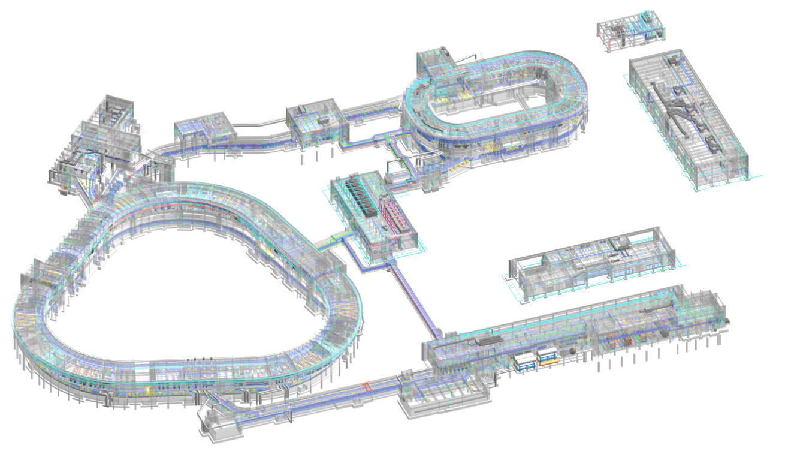
Muon Scattering Experiment on Beamline
Refers to The Feasibility Study of the GeV-Energy Muon Source Based on HIAF, Yu Xu (IMP)
HIAF-HIRIBL is one of the world's earliest high-energy muon beams.
It separates muon\pion generated by projectile-nucleus reaction via magnetic rigidity:
Momentum: 500MeV/c~7.5GeV/c
Flux: 10⁶~10⁷ mu/s
Beam spot size: 10cm*10cm
High-energy muon source with higher momentum purity and brightness.

Slide 6
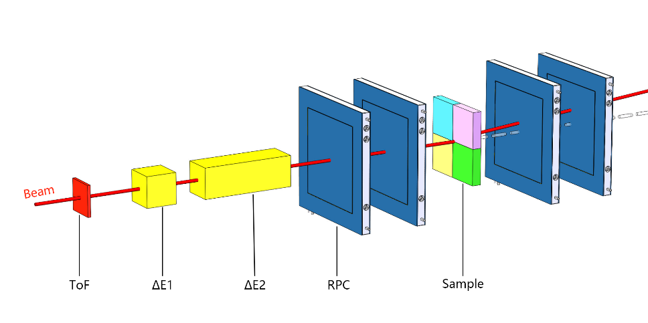
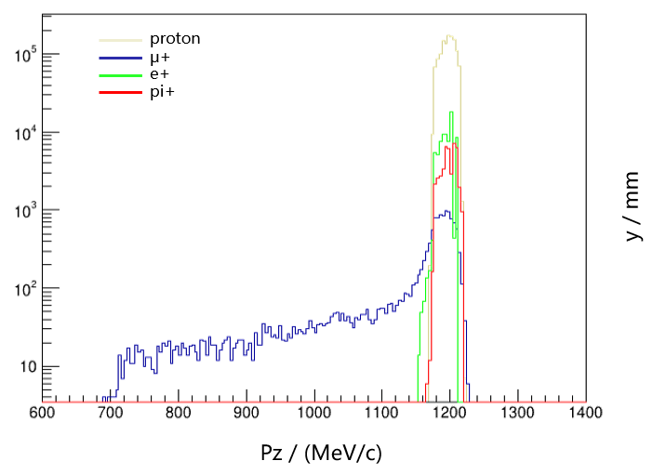
First Stage: ToF-dE PID of Beam Particles
By the end of 2025：
A prototype detection system will be implemented on HIRIBL for muon beam condition monitoring, detector testing, and preliminary experiments (scattering on samples, tomography)
Measurement objective
- Beam profile and divergence
- Beam particle identification
Decay; magnetic rigidity selection:
Muon\pion\electron\proton at the same momentum (GeV/c)…
PID basis:
-> Mass difference: ToF, dE
-> Different physical processes: dE

Slide 7
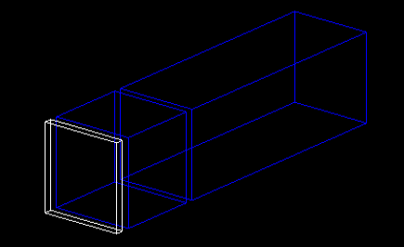
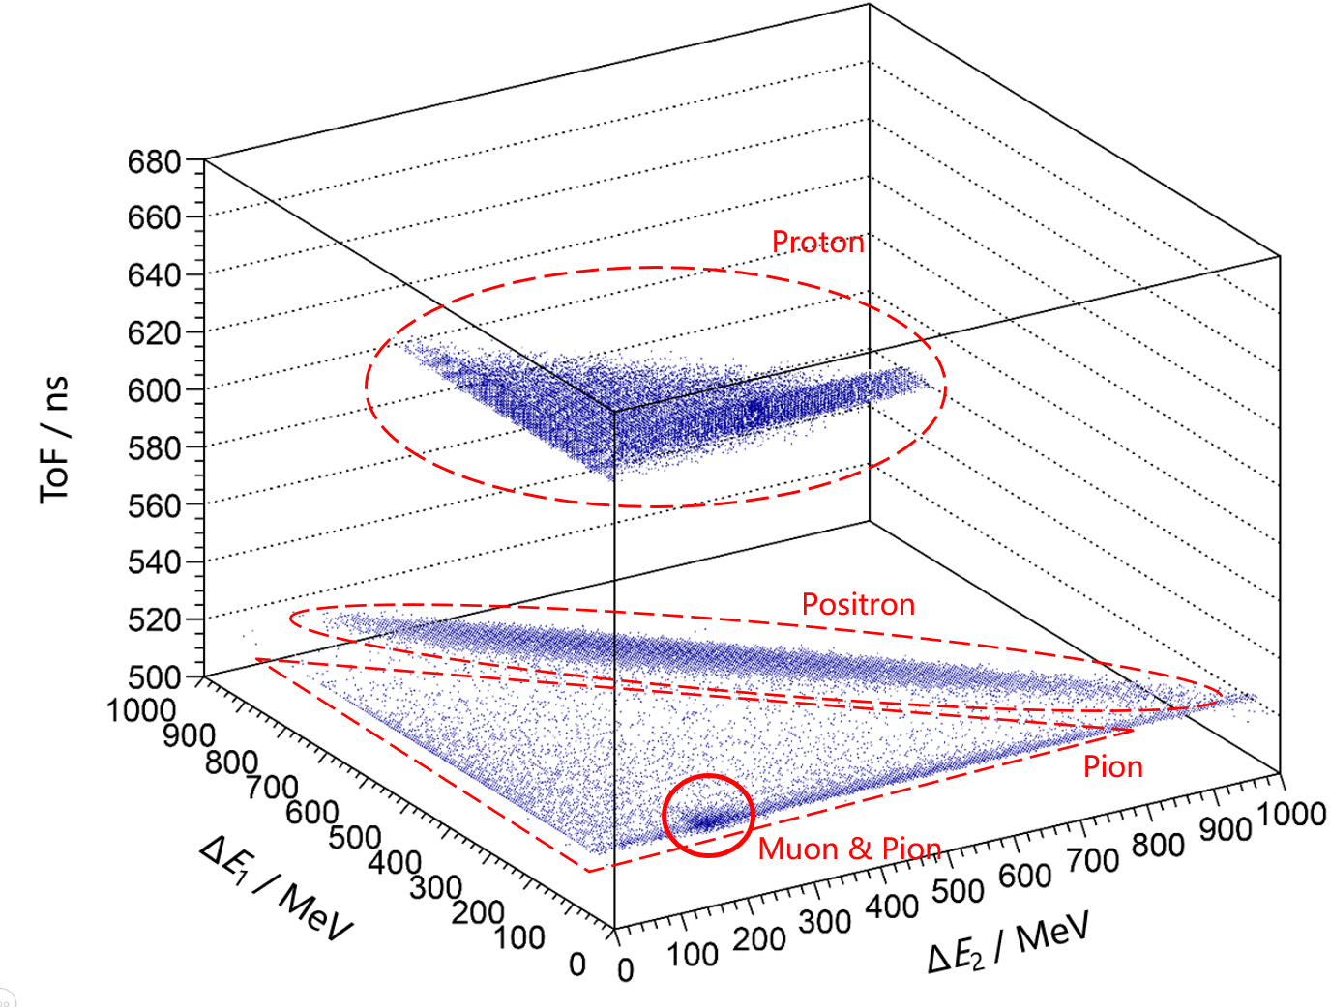
First Stage: ToF-dE PID of Beam Particles
Simulation:
ToF start detector is a thin plastic scintillator in G4BL beamline simulator.
ToF stop detector (~155m to the start counter) and two E_{dep} detectors are simulated in Geant4.
1cm Plastic Scintillator
+
10cm CsI Scintillator
+
30cm CsI Scintillator
For 1.2GeV/c μ⁺ beam, 0.2ns time resolution, 2% E_{dep} resolution:
Electron(positron)--dE、ToF
Proton—ToF、dE
Muons and pions have similar masses;
Muons decay from pions.
Muons and a major part of pions distribute closely on the spectrum.

Slide 8
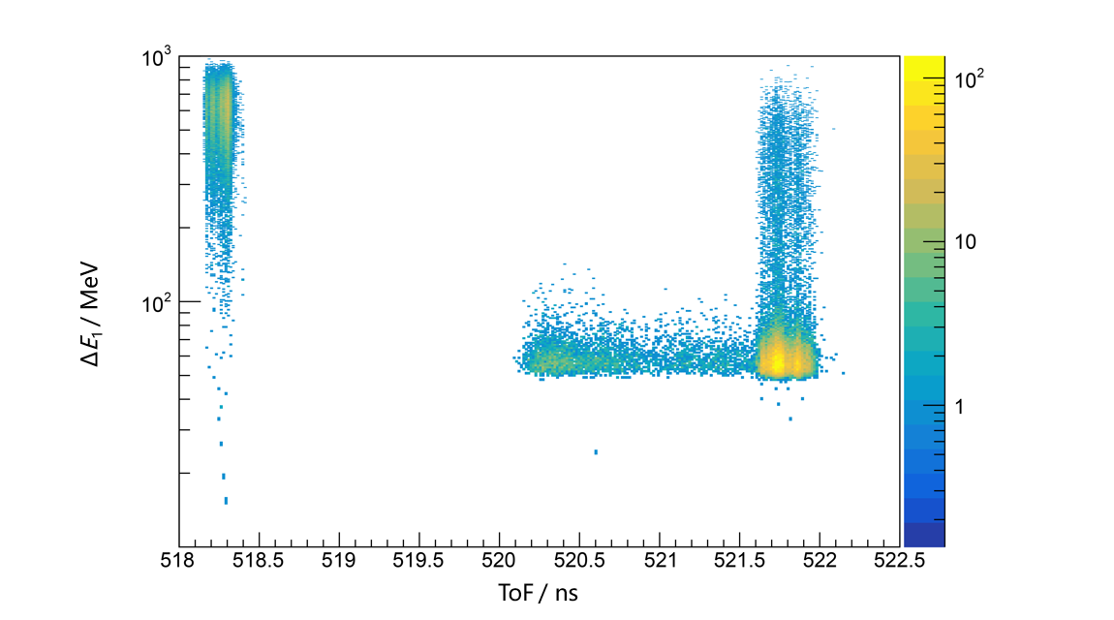
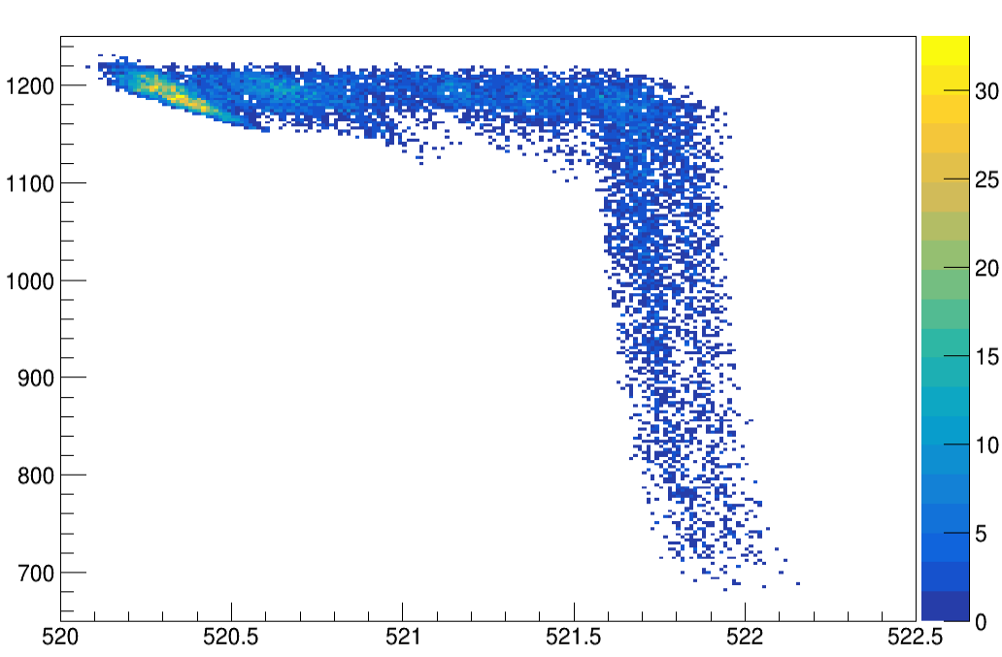
First Stage: ToF-dE PID of Beam Particles
Pion
Positron
P_{z} / (MeV/c)
Muon
ToF / ns
ToF-dE: Muons' tail of ToF mixes with pions.
Detailed identification of L-shaped P_{z}-ToF spectrum of muons:
- Muons decay from pions midway, which might causes ToF of muons distributes in a wide range.
- The momentum tail of muons generated late can be excluded together with pions via ToF cut.
Effective exclusion of pi, p, e, and the momentum tail of muons in relatively low-momentum beam via ToF-dE.

Slide 9
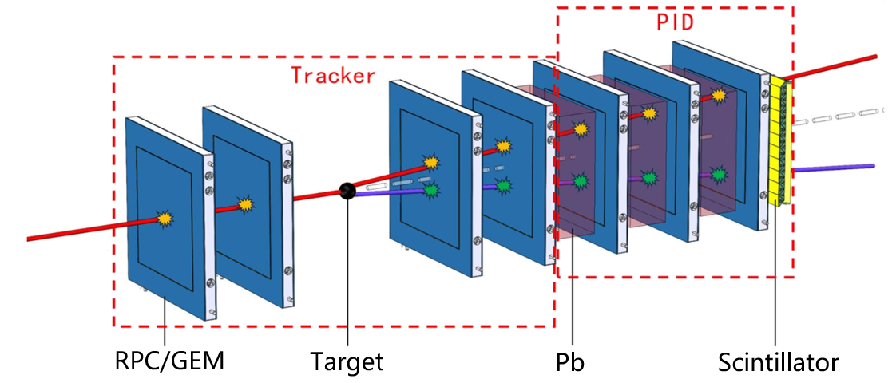
Multilayer PID System in Higher-momentum Case
ToF-based PID is less effective (ineffective) for higher energy muon\pion or secondary particles.
Differences in energy deposition and scattering in heavy matters (scattering angle\track residual...) will be more significant.
Muon\pion:
ToF difference for 155m length is less than 10ps at 3GeV/c;
Ionization energy losses are very close; Pions can interact via strong force.
Secondaries:
Generated inside the detection system;
Complex composition;
Electrons, gamma, and ions readily deposit energy.
PID system attached to the tracker:
Multilayer Pb and position detectors: Scattering behavior
End scintillator: Energy deposition
ToF detectors before tracker are remained
9

Slide 10
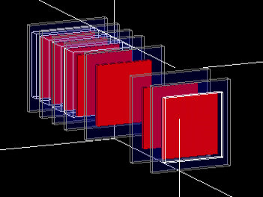
Multilayer PID System in Higher-momentum Case
Simulation study of higher-momentum muon\pion identification:
Plastic scintillators
10cm-thick Pb
RPC: 2mm gas gap as sensitive detector; hit positions averaged (weighted by ionization energy loss)
ToF / energy deposition / square residual of linear track:
3 GeV/c muons and pions (simplified simulation: 4% momentum spread; equal numbers of muons and pions):
10

Slide 11
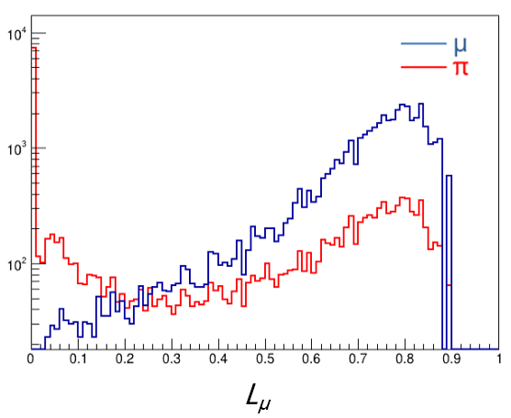
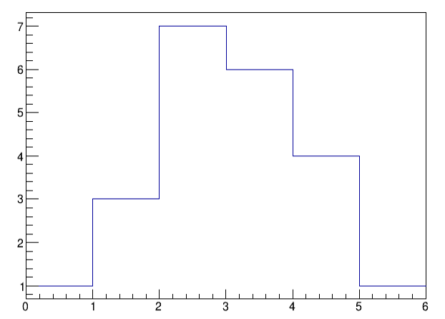
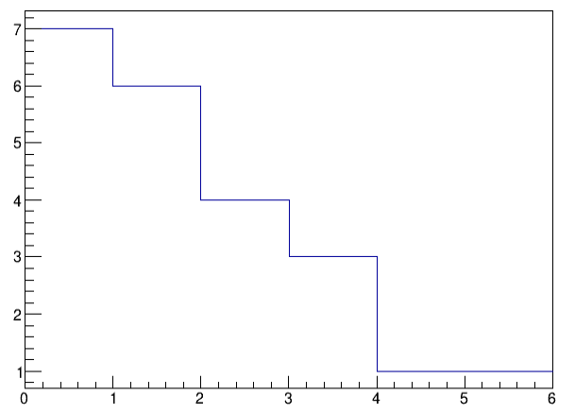
Multilayer PID System in Higher-momentum Case
PID based on the product of likelihoods of 3 variables:
(ToF / energy deposition / square residual of linear track)
α
Accumulate spectrums of measurable variable X by simulation as P(X|α) & P(X|β) distributions;
For a certain event with measured value X₀, the likelihood values of different initial particles are L(α|X₀)=P(X₀|α) & L(β|X₀)=P(X₀|β).
β
Likelihood analysis + Pb scatters and absorbs more pions;
Over 70% muon\pion efficiency at 3 GeV/c in this preliminary version.
Upgrade: detailed simulation, delicate detectors (ECal/RICH…)
Study on secondary particle identification is ongoing…
L_{μ}>0.7
\ | True Muon | True Pion
Identified Muon | 30756 | 4815
Identified Muon | 12778 | 13321

Slide 12
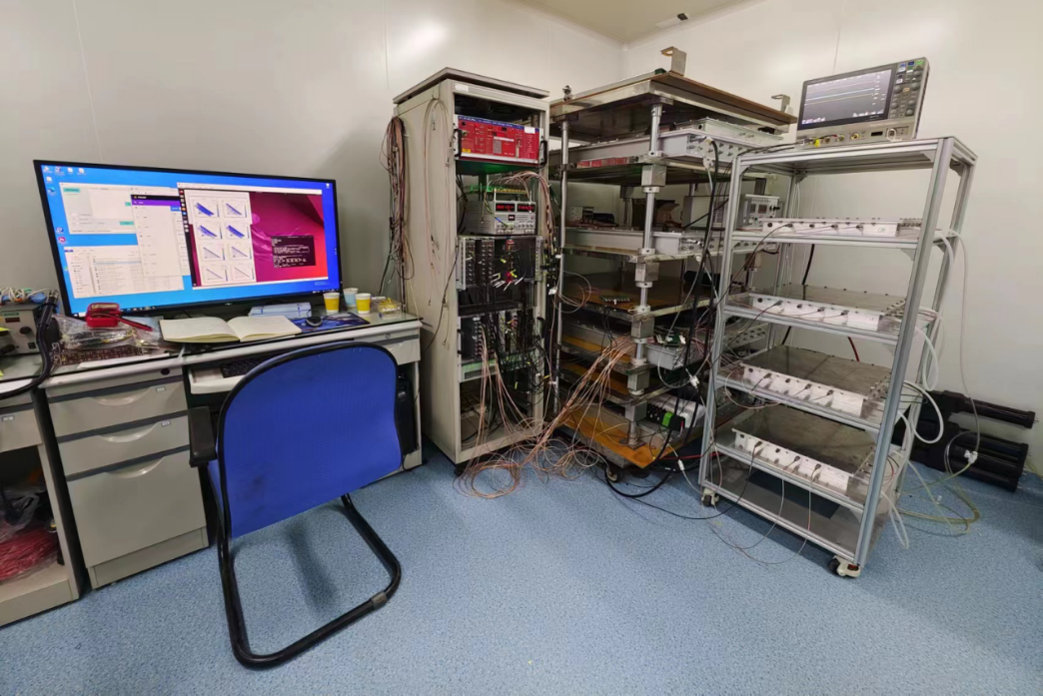
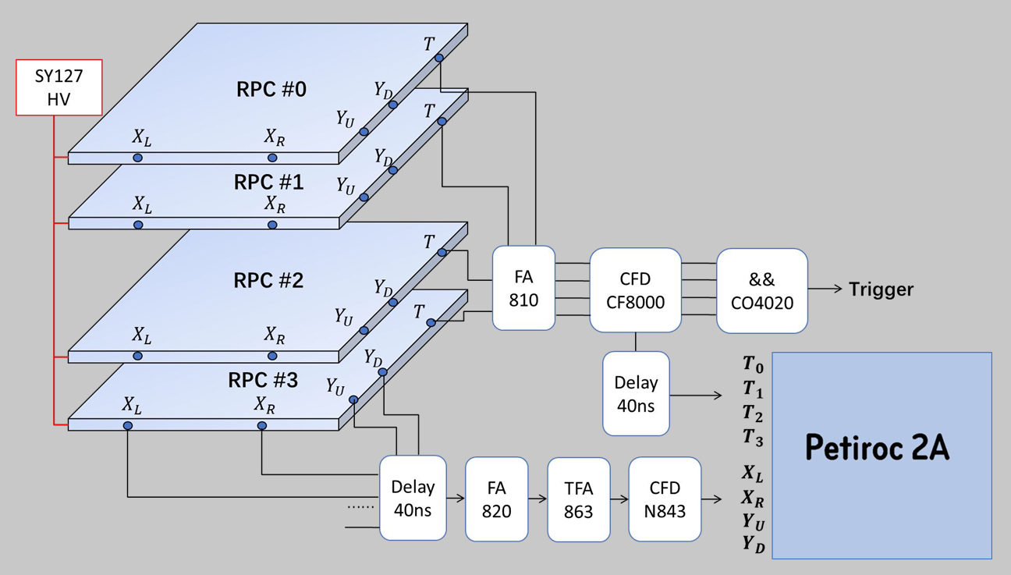
PKMu Experimental Progress
4-RPC detection system:
Timing and X-Y position with delay-line readout method.
Accumulating cosmic-ray data for composition analysis and muon-DM scattering searching…
Tracker prototype for further experiments.
Monday 19/05:

Slide 13
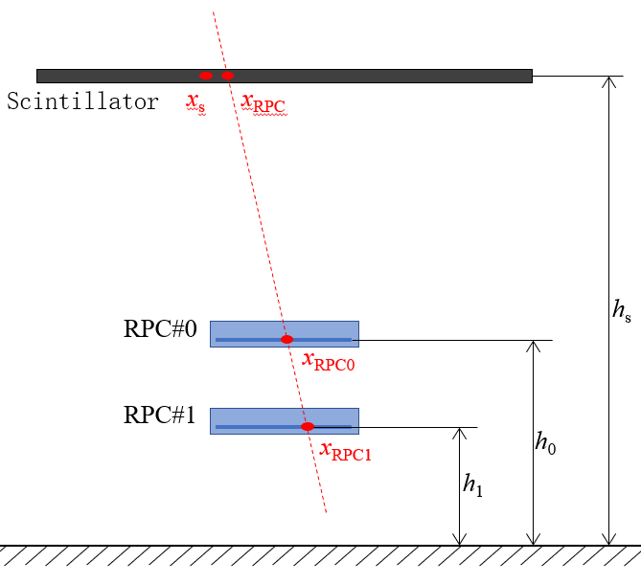
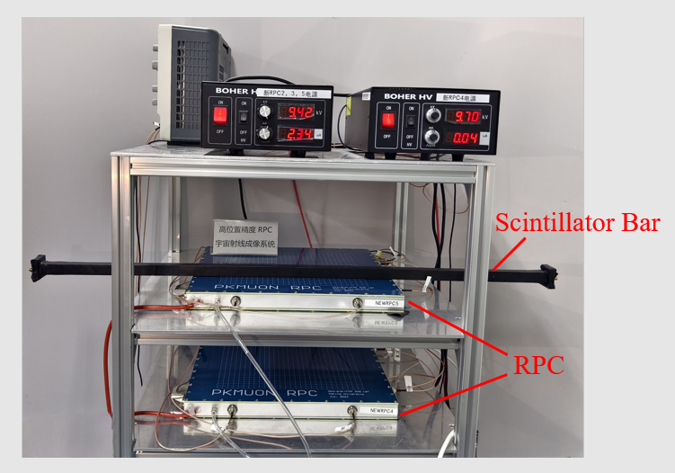
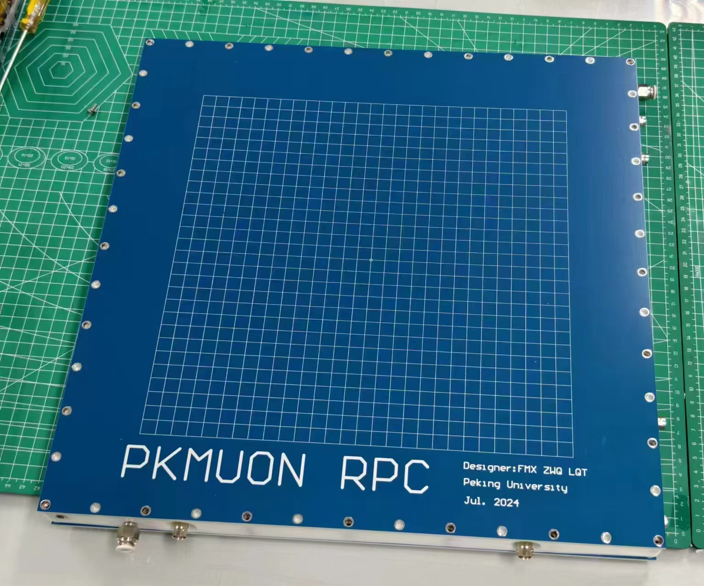
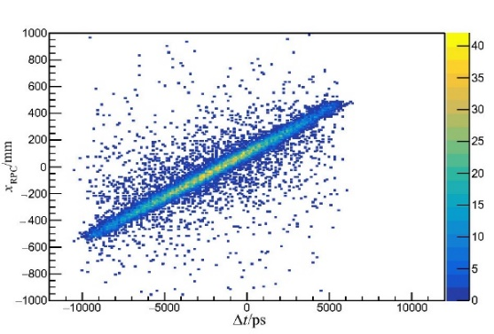
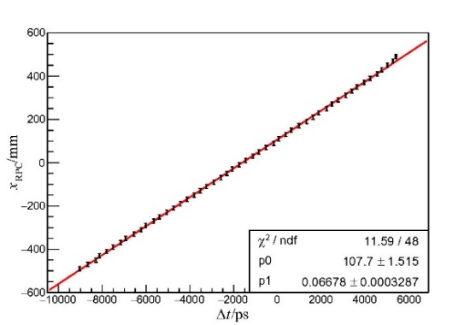
Experimental Progress
Detector commission with Scintillators: Cosmic-ray test of plastic scintillator bar based on new RPC
New RPC:
Less matter over sensitive area;
2-D strip read-out on a single PCB.
Correlation between hit positions measured by RPCs and scintillator

Slide 14
Summary & Outlook
Muon scattering experiments on HIAF-HIRIBL beamline proposed by PKMu
- DM search, dark boson, quantum entanglement…
The scintillator-RPC hybrid detector for first-stage experiments on HIRIBL
- 1cm plastic+10cm CsI+30cm CsI ToF-dE detection
- Exclude p\e\pi and the tail of muon momentum in reletively low energy beam
Multilayer system for higher momentum beam\secondaries identification
- Multiple Pb-RPCs and the end scintillator layer
- Identification based on likelihood (energy deposition, square residual, ToF…)
- To be upgraded: efficiency optimization and secondary particle identification
Development of the new RPC and detector commission with scintillators are ongoing…

