Slide 1
Preliminary Design of a Cosmic Ray Veto (CRV) Detector System for the Muonium-to-Antimuonium Conversion Experiment (MACE)
MIP2025,
Hunan University
2025-5-19
Zhichao Wang（王志超）
wangzhch29@mail2.sysu.edu.cn

Slide 2
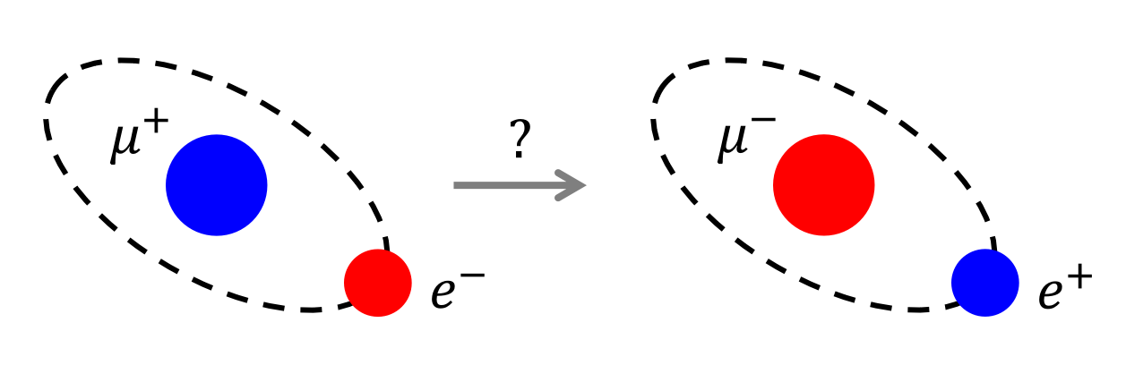
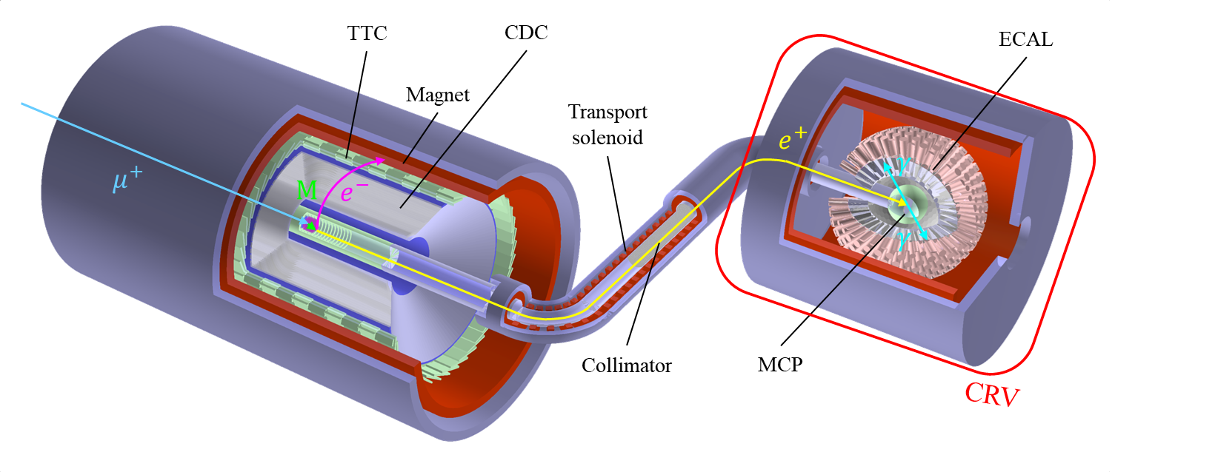
Introduction: MACE background
The Muonium-to-Antimuonium-Conversion-Experiment (MACE) aims at searching for CLFV process $\overline{M}→e^{+}e^{−}ν_{μ}{\overline{ν}}_{e}$.
$e^{−}$
$${\overline{ν}}_{e}$$
$e^{+}$
Muonium
Antimuonium
$$ν_{μ}$$
The detector system is designed to identify the final state with a high precision.
$e^{−}$ : Tiled timing counter (TTC) & Cylindrical drift chamber (CDC)
$e^{+}$ : Microchannel plate (MCP) & Electromagnetic calorimeter (ECAL)
Ref: Shihan Zhao’s talk
More info: Hao Jiang, Yinyuan Huang
Challenge:
Unavoidable background—accidental coincidence of cosmic ray muon hit through PDS.
Solution:
A cosmic ray counter “box” surrounding PDS as a veto detector.

Slide 3
Requirements
MACE CDR summary of currently investigated background
Reducing signal-like cosmic ray muon backgrounds to < 0.1 (over the course of run).
Not introducing too much dead time.
Not using too much DAQ bandwidth.
Strict background selection criteria.

Slide 4
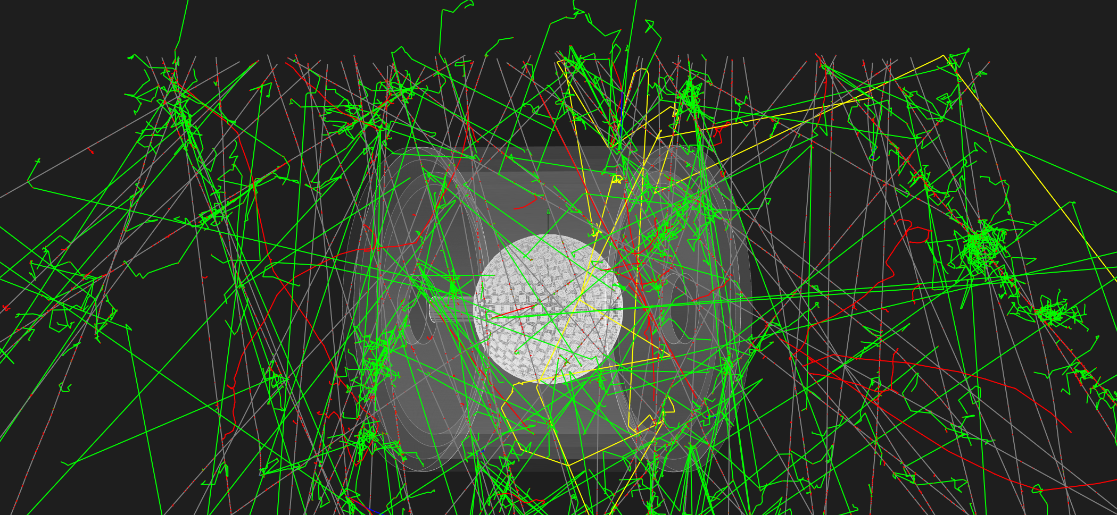
Goals: efficiency and dead time
During data-taking period—about 1yr
Rejection efficiency > 99% → background < 0.1
Veto time 1 μs:
muon rate ~ 125 Hz/m² × 20 m² = 2500Hz
→ 0.025 dead time per sec.
→ DAQ closed for about 1 day
Goals:
Rejection efficiency better than 99%
System resolution time less than 1μs
Simulation visualization in Geant4

Slide 5
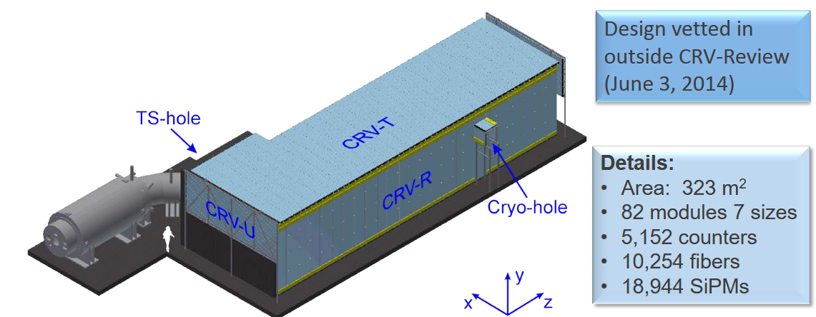
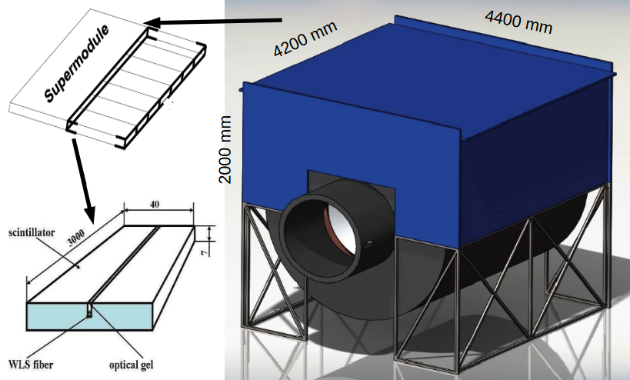
Cosmic ray veto counter in Mu2e and COMET
Experiments similar in detector and detection requirements: Mu2e, COMET
(E. Craig Dukes, 2014, Mu2e CD-2/3b DOE Review)
(Oleg Markin, ICPPA-2015)
Detection object: plastic scintillator(PS) [cost, simple & robust, tunable]
Basic unit: PS strip of several meters, embedded with wavelength shifting(WLS) fiber
Unit assembly: PS strips modules Veto detector
multiple layers
put together

Slide 6
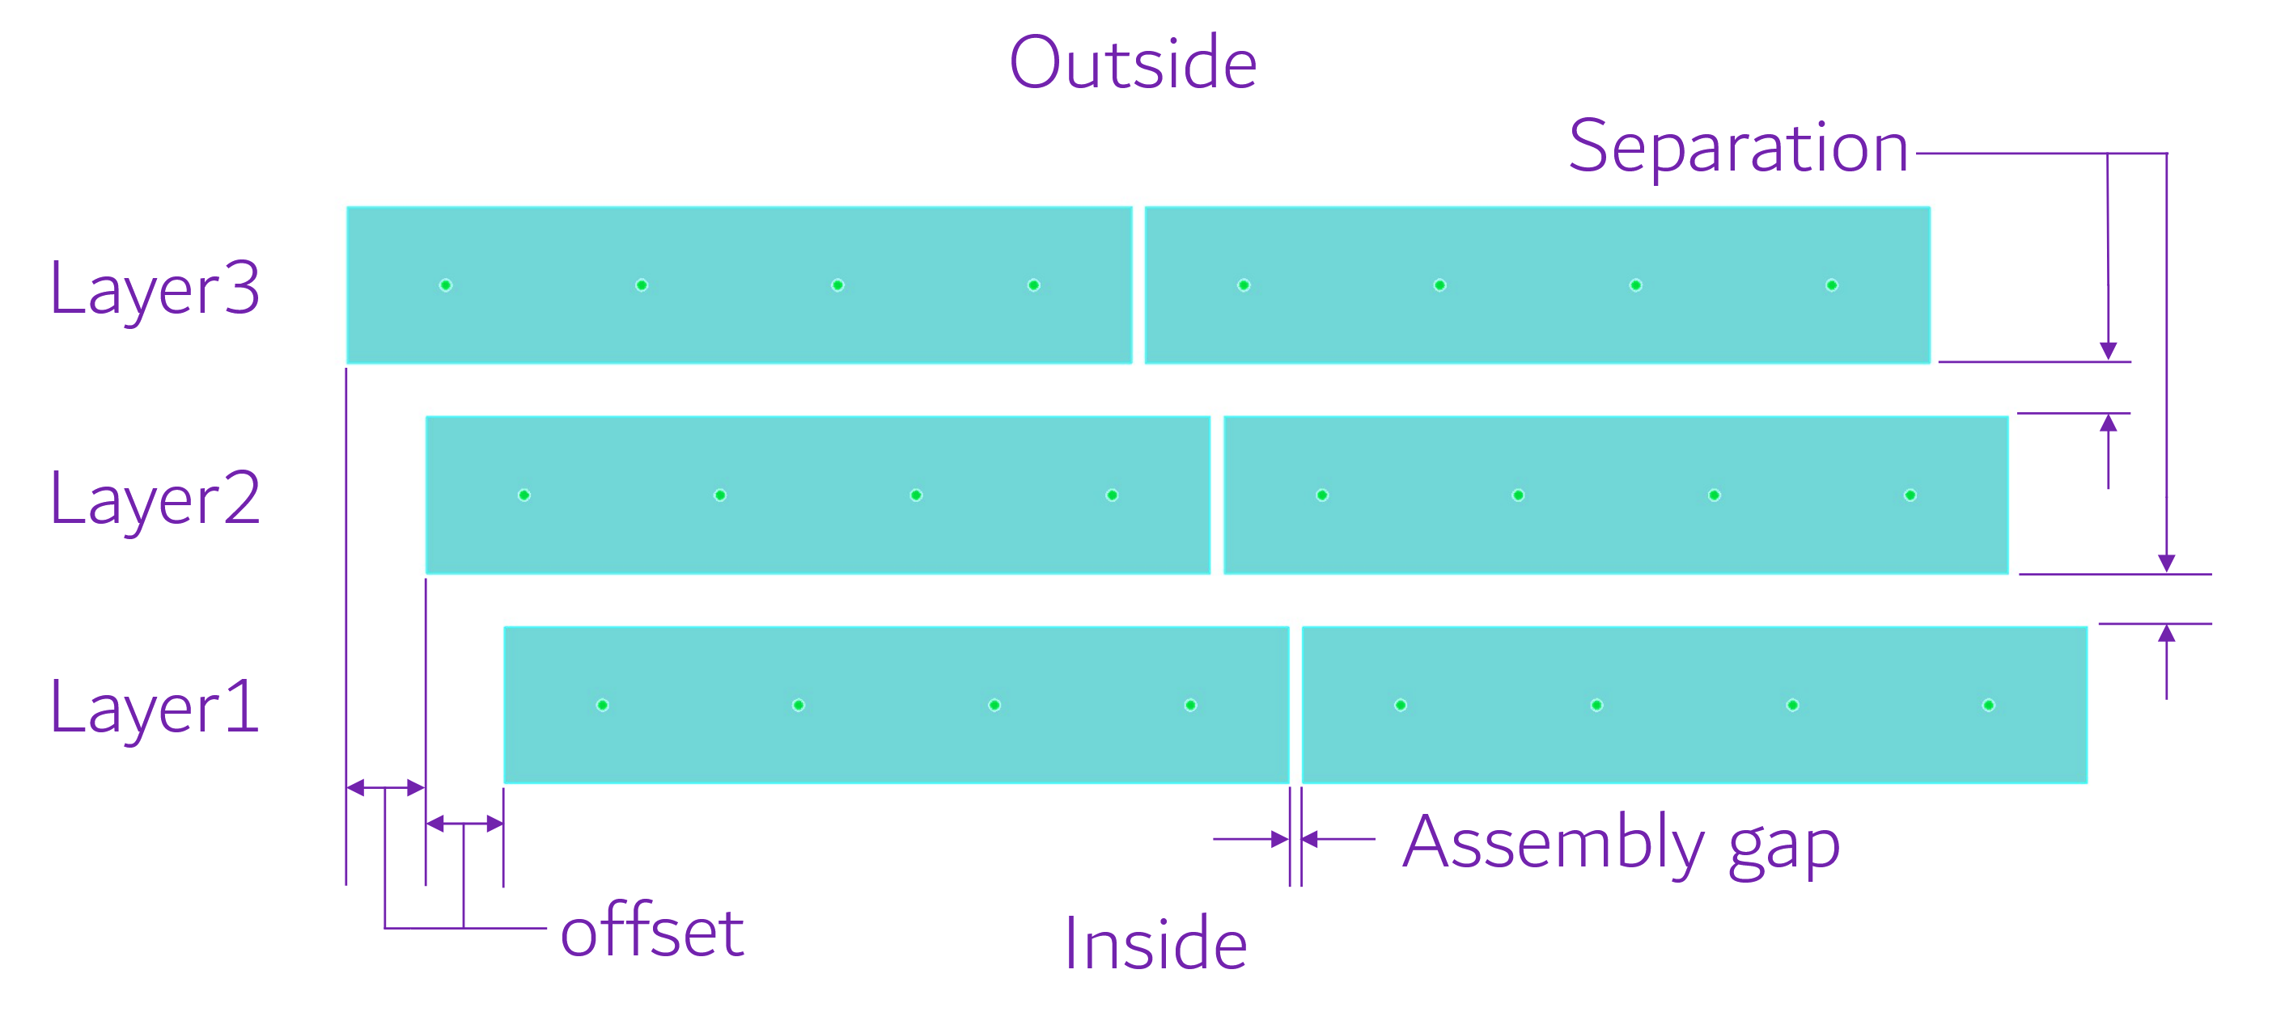
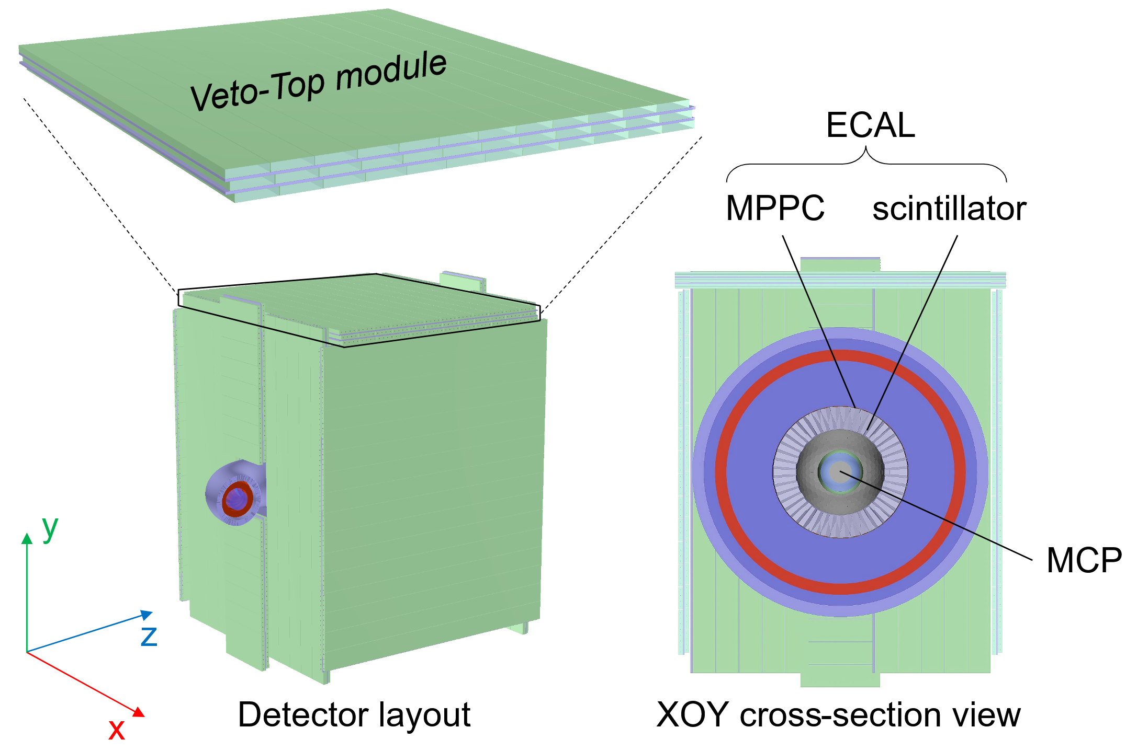
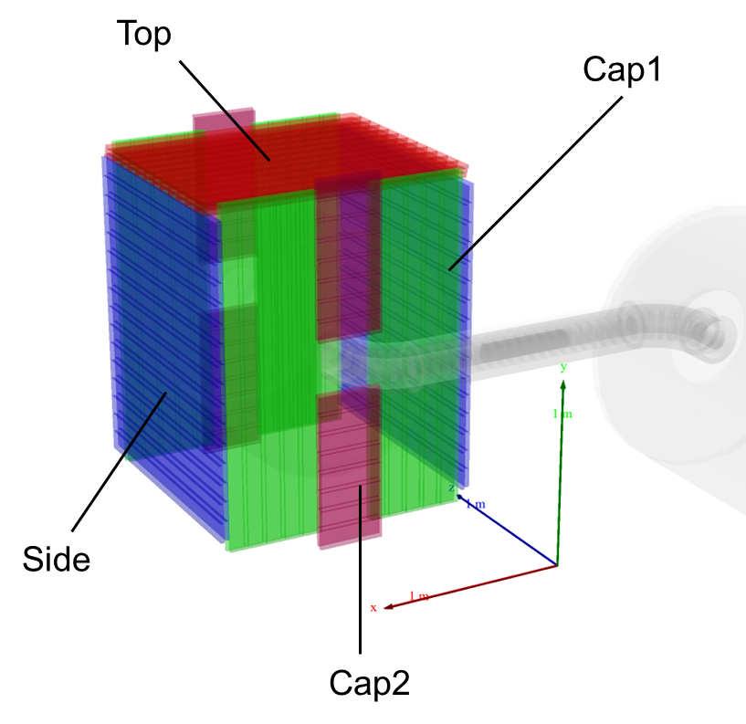
Conceptual design: strip assembly
Inter-layer features:
Separation—space for Al absorbers
Mechanical support
Shielding (low-penetration particles)
Offset—Staggered gaps to minimize dead zones
Scintillator parameters are set below:
Category | length(cm) | layers | quantity
Top | 145.0 | 3 | 1
Side | 140.0 | 2 | 2
Cap1 | 180.0 | 2 | 4
Cap2 | 35.0 | 2 | 4

Slide 7
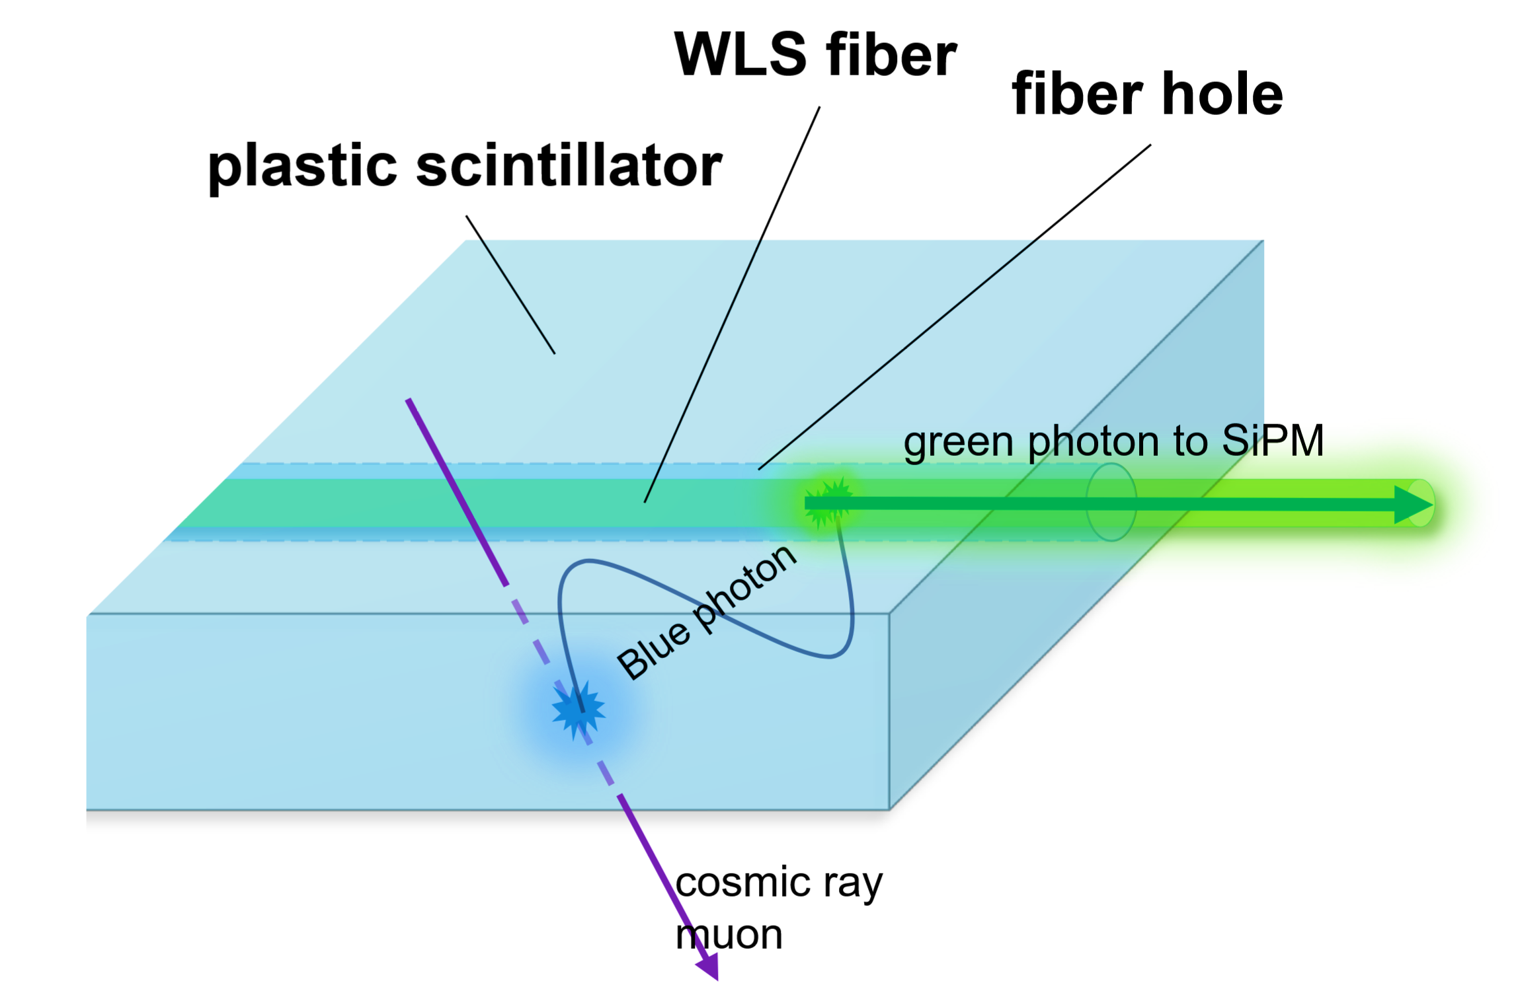
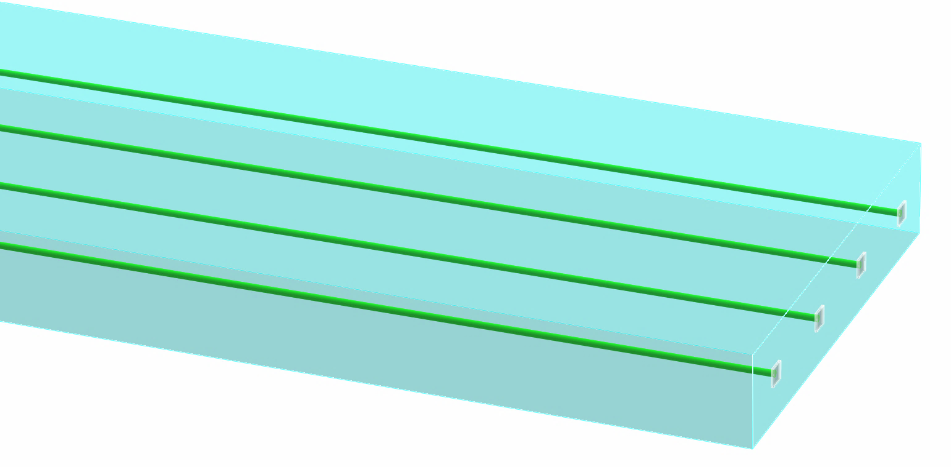
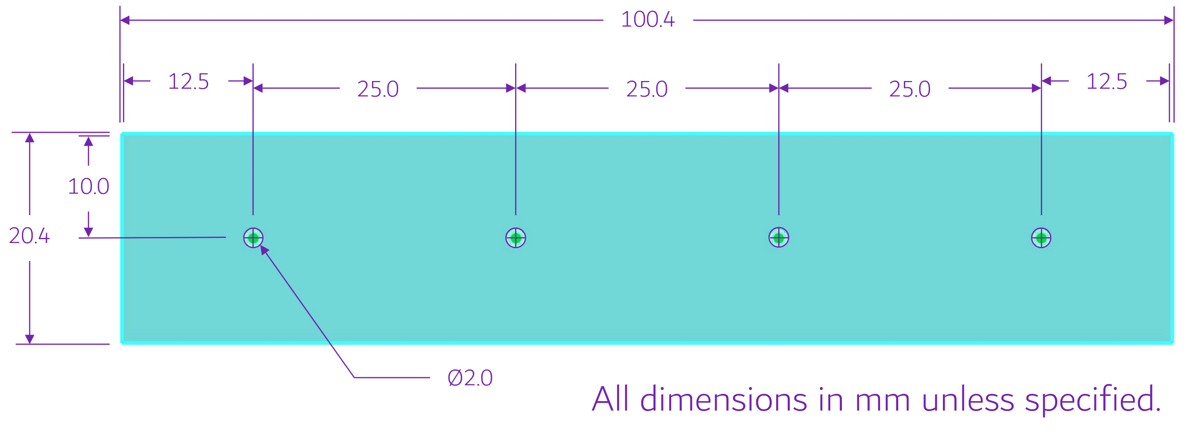
Conceptual design: plastic scintillator strip
1 strip with 4 fibers inserted inside
Why WLS fiber?
Improves transmission efficiency and light output uniformity.

Slide 8
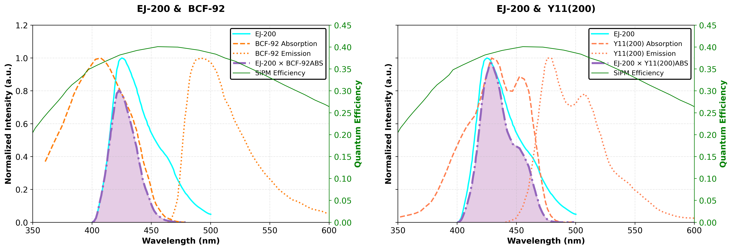
Simulation parameter: material selection
Plastic scintillator: EJ-200
Fast timing
Long optical attenuation length
WLS Fiber: Saint-Gobain BCF-92 or Kuraray Y11(M200) ?
Decay times meet requirement: [LHCb-2000-039]
Y11 (8.8±1.5 ns) ; BCF (2.4±0.4 ns)
Y11 matches better with EJ-200 than BCF-92.

Slide 9
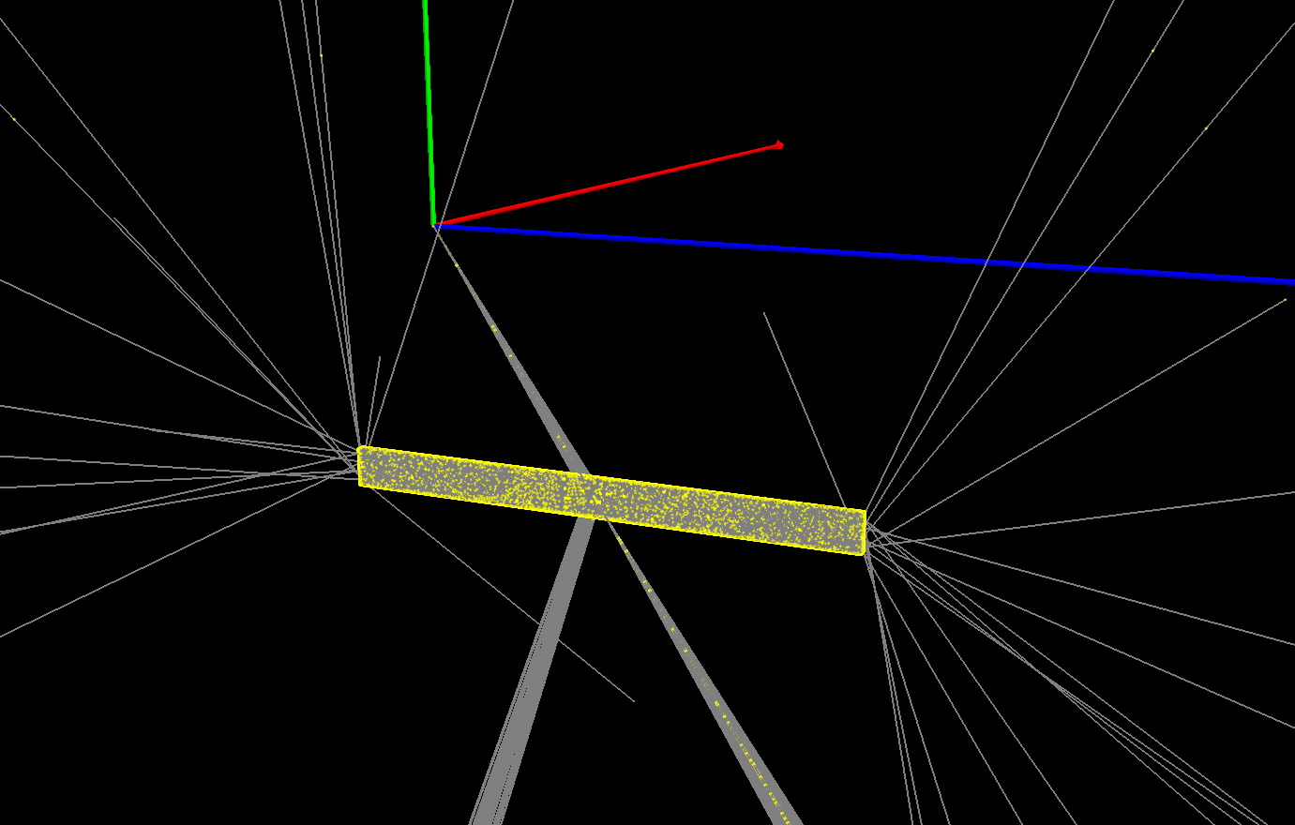
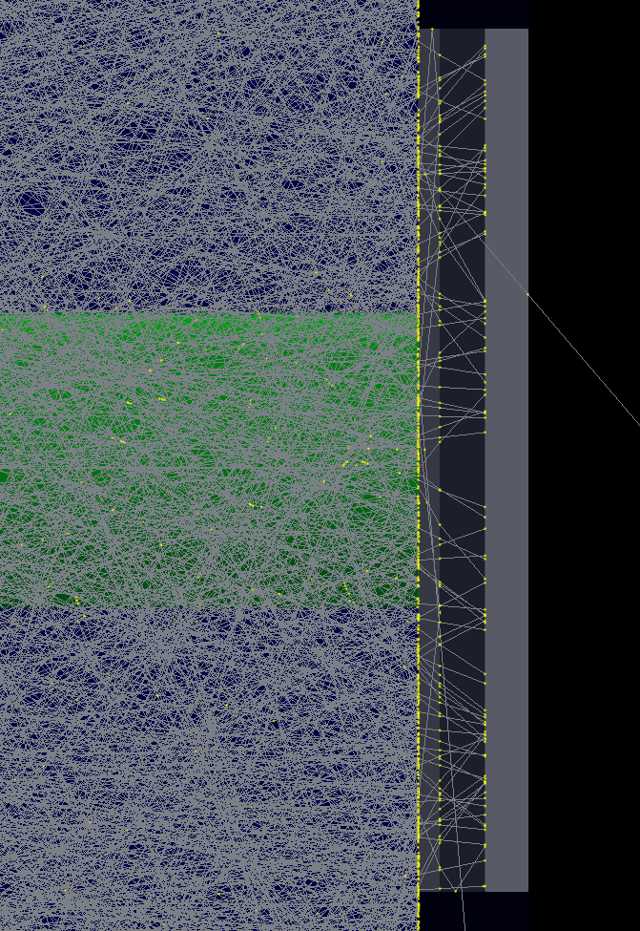
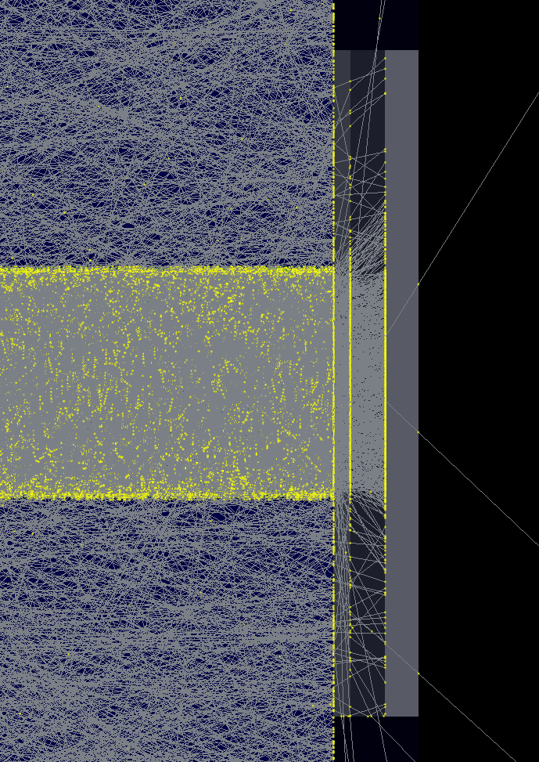
Optical simulation
Result:
z
BCF-92
Y11(M200)
x
y
a 10GeV μ
a Veto-Side strip
Both coupled with EJ-200
Hit by 10GeV muon, same direction and position

Slide 10
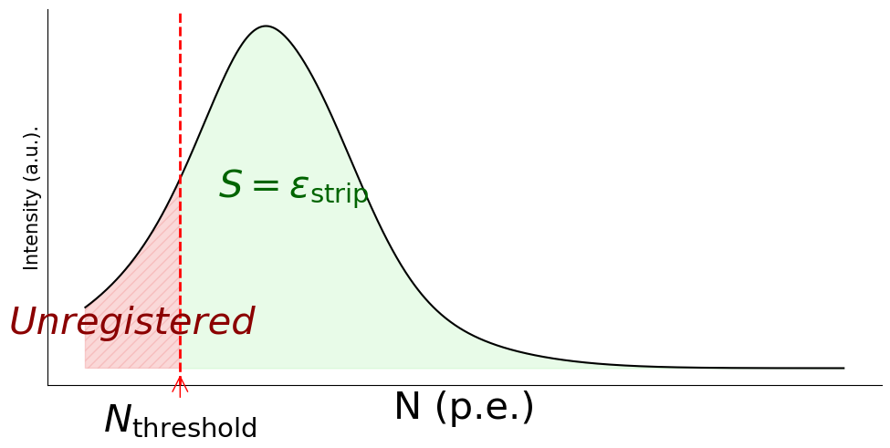
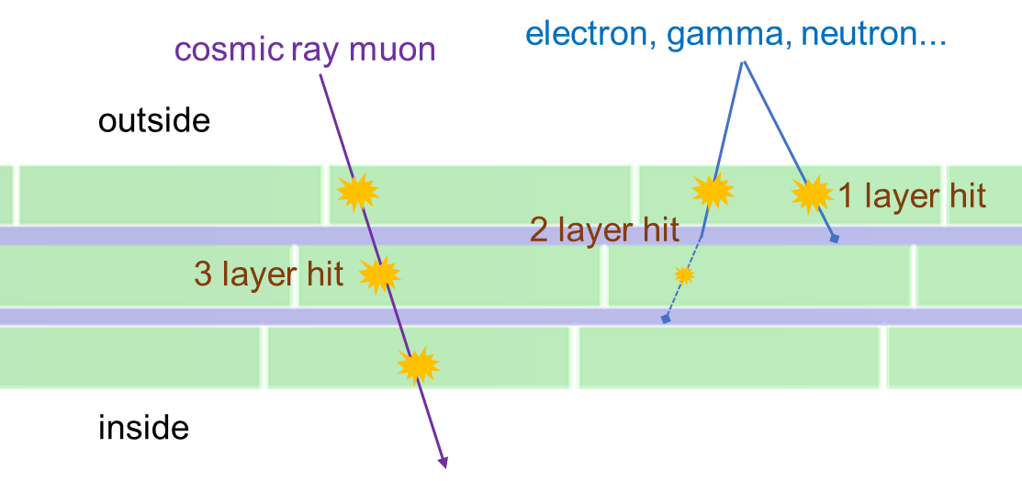
Performance simulation: registration efficiency ϵ
$$ε_{strip}=1−\int_{0}^{N_{threshold}}{f\left(N\right) dN}$$
where $f\left(N\right)$ is the P.D.F. of the photoelectron on SiPM;
Basic assumption on background cosmic ray:
hits PS strip independently
penetrates layer = module’s layer
→$n_{coinc}=n_{L}$
Schematic showing ε. Not actual data.
$$ε_{module}=\sum_{k=n_{coinc}}^{n_{L}}{C_{n_{L}}^{k}}ε_{strip}^{k}{\left(1−ε_{strip}\right)}^{n_{L}−k}$$
where $n_{coinc}$ indicates the coincidence rule of CRV;
$$ε_{system}=\sum{P_{module}ε_{module}}$$
where $P_{module}$ is the hit probability of each module.
Example: Veto-Top module hit diagram

Slide 11
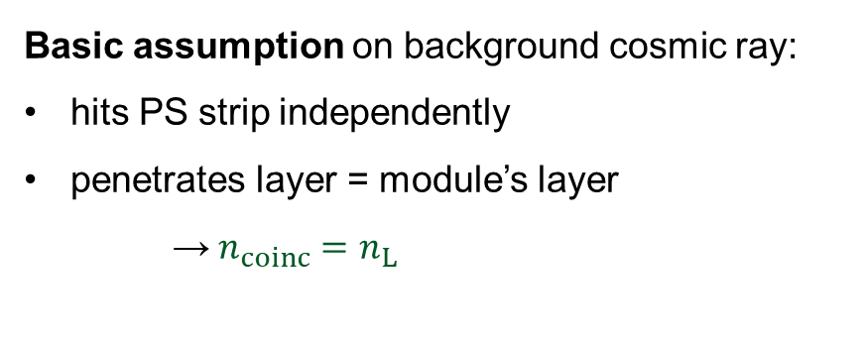
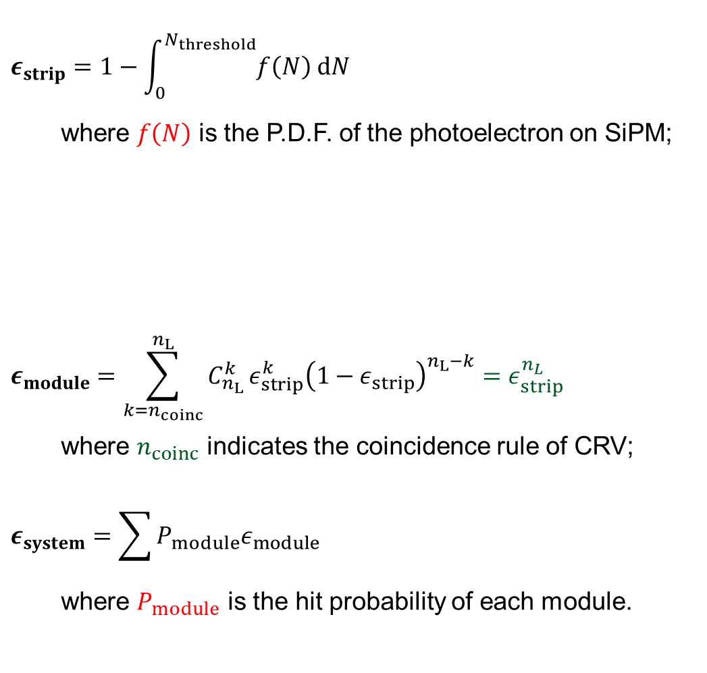
Performance simulation: registration efficiency ϵ
$$ε_{strip}=1−\int_{0}^{N_{threshold}}{f\left(N\right) dN}$$
where $f\left(N\right)$ is the P.D.F. of the photoelectron on SiPM;
$$ε_{module}=\sum_{k=n_{coinc}}^{n_{L}}{C_{n_{L}}^{k}}ε_{strip}^{k}{\left(1−ε_{strip}\right)}^{n_{L}−k}=ε_{strip}^{n_{L}}$$
where $n_{coinc}$ indicates the coincidence rule of CRV;
$$ε_{system}=\sum{P_{module}ε_{module}}$$
where $P_{module}$ is the hit probability of each module.
Basic assumption on background cosmic ray:
hits PS strip independently
penetrates layer = module’s layer
→$n_{coinc}=n_{L}$
Simulation
Schematic showing ε. Not actual data.
✓
Example: Veto-Top module hit diagram

Slide 12
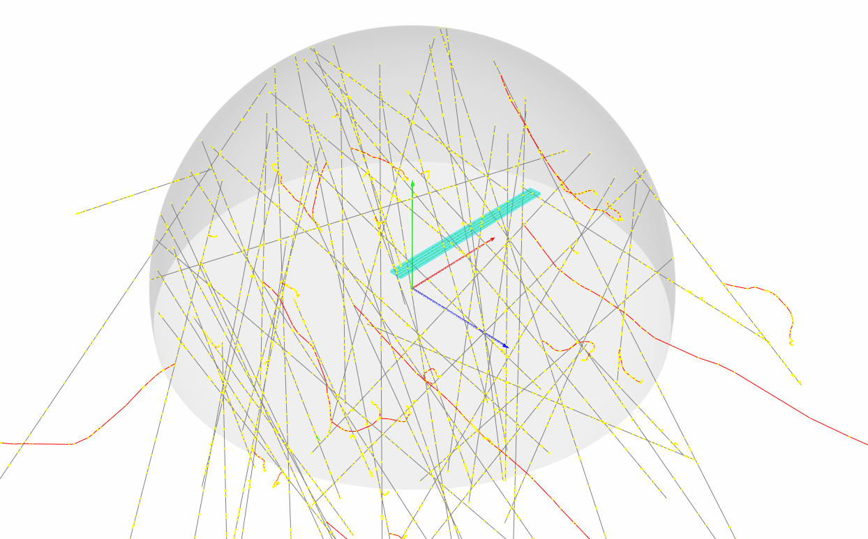
Simulation #1: strip efficiency
Settings:
Geometry—1 strip
Generator—a hemisphere inner surface (R=2m)
Workflow:
Count the hit of optical photons on SiPMs (each event)
Count the event with optical photons less than threshold: $n$
$efficiency=1−\frac{n}{N}$, where $N$ is the total event number.
Generated events: ≥ 1×10⁶
Hit events: > 59,000
Cosmic ray muon generator: EcoMug
Pagano, D., et al. (2021). EcoMug: An Efficient COsmic MUon Generator for cosmic-ray muon applications. Nuclear Instruments and Methods in Physics Research A, 1014, 165732.

Slide 13
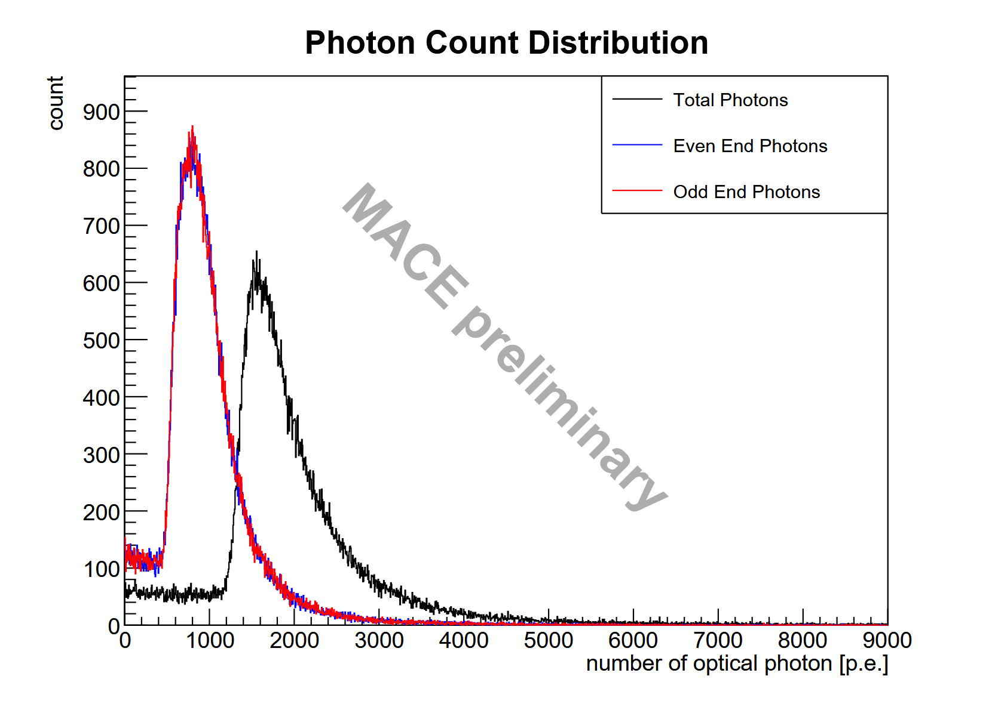
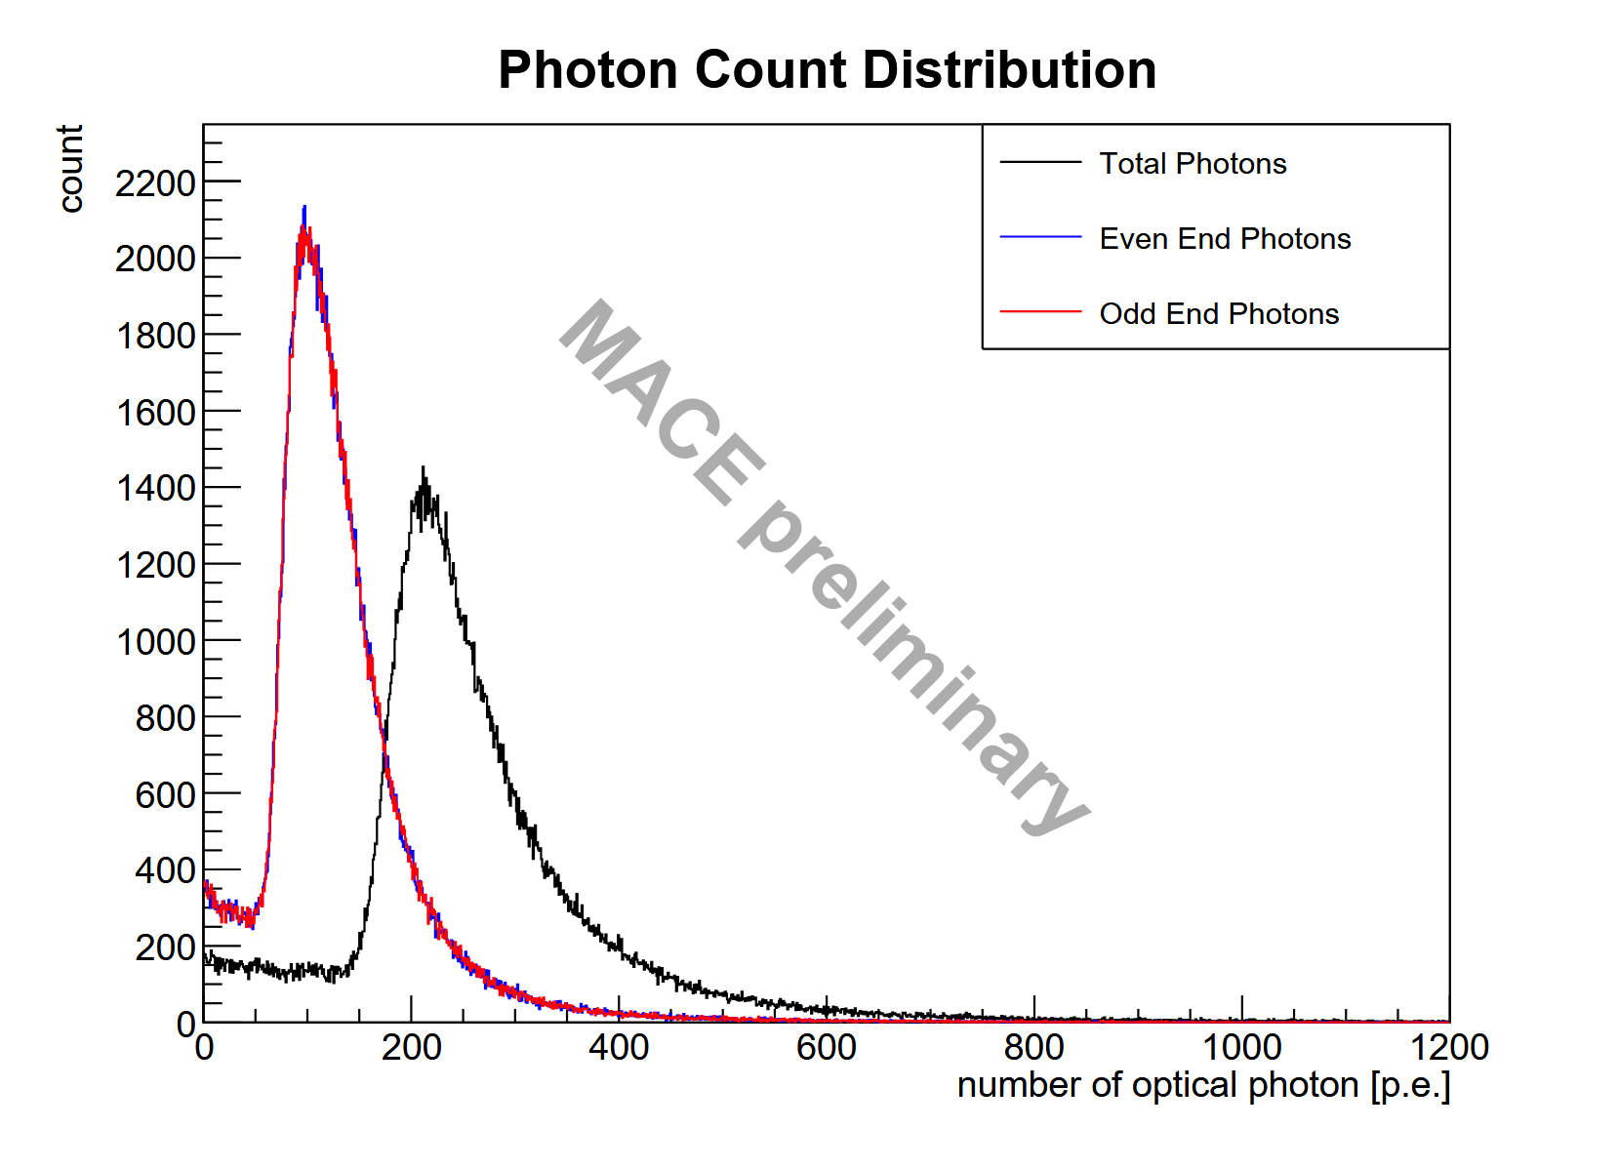
Simulation #1: strip efficiency result
Illustration: result data of different fiber materials (both on Veto-Top module)
threshold
Y11
threshold
BCF-92
Strip efficiency:
Coincidence rule: 2-End(≥ 12 p.e. ) AND mode
Result:
category | Top | Side | Cap1 | Cap2
ϵ_{strip}(%)Y11 | 99.70 ± 0.02 | 99.55 ± 0.03 | 99.70 ± 0.02 | 99.69 ± 0.02
ϵ_{strip}(%)BCF-92 | 97.71 ± 0.03 | 96.64 ± 0.07 | 97.20 ± 0.06 | 98.96 ± 0.08
✓
✗

Slide 14
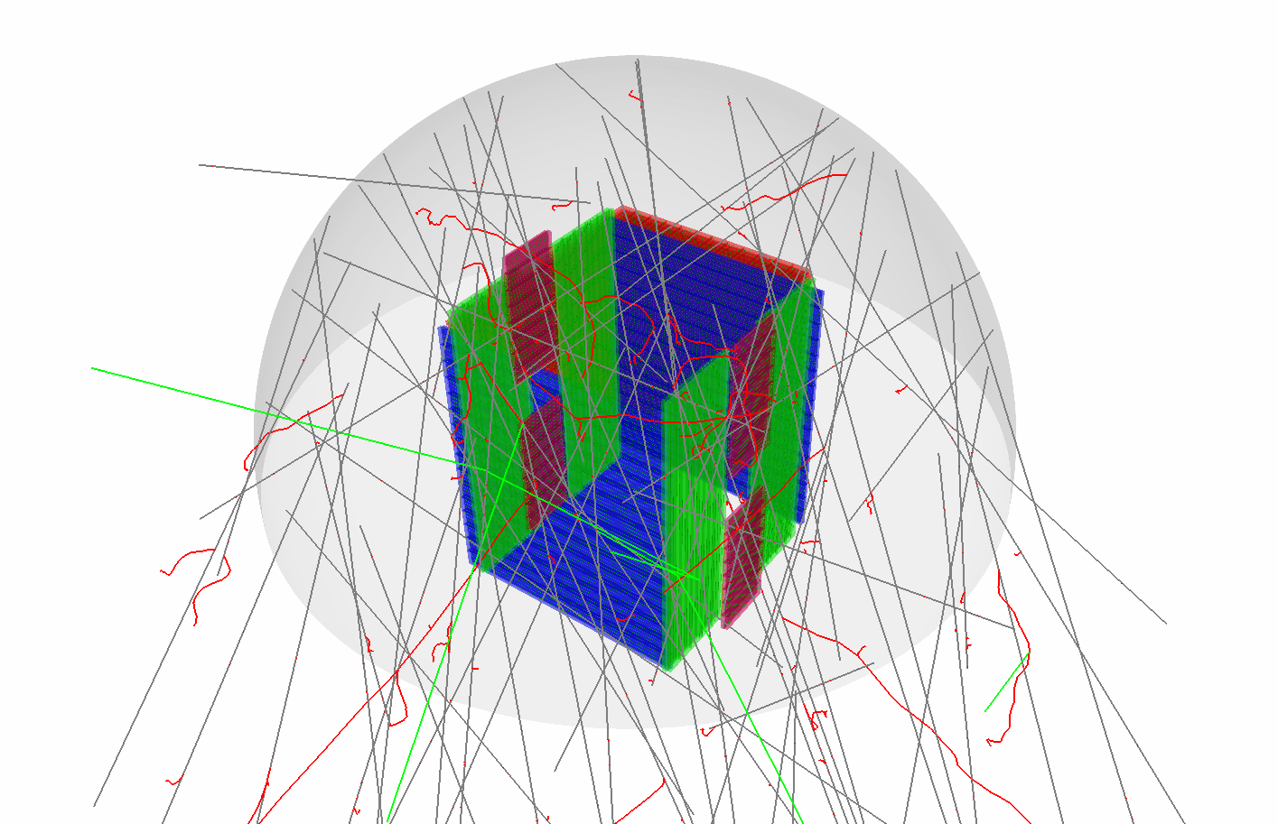
Simulation #2: modules’ hit probability
Settings:
Geometry—total detector system
Generator—a hemisphere inner surface (R=2m)
Workflow:
Record the module category of each hit.
Count the partial of hits for each category.
Ran events: 1×10⁷
Hit events: > 2.5×10⁶

Slide 15
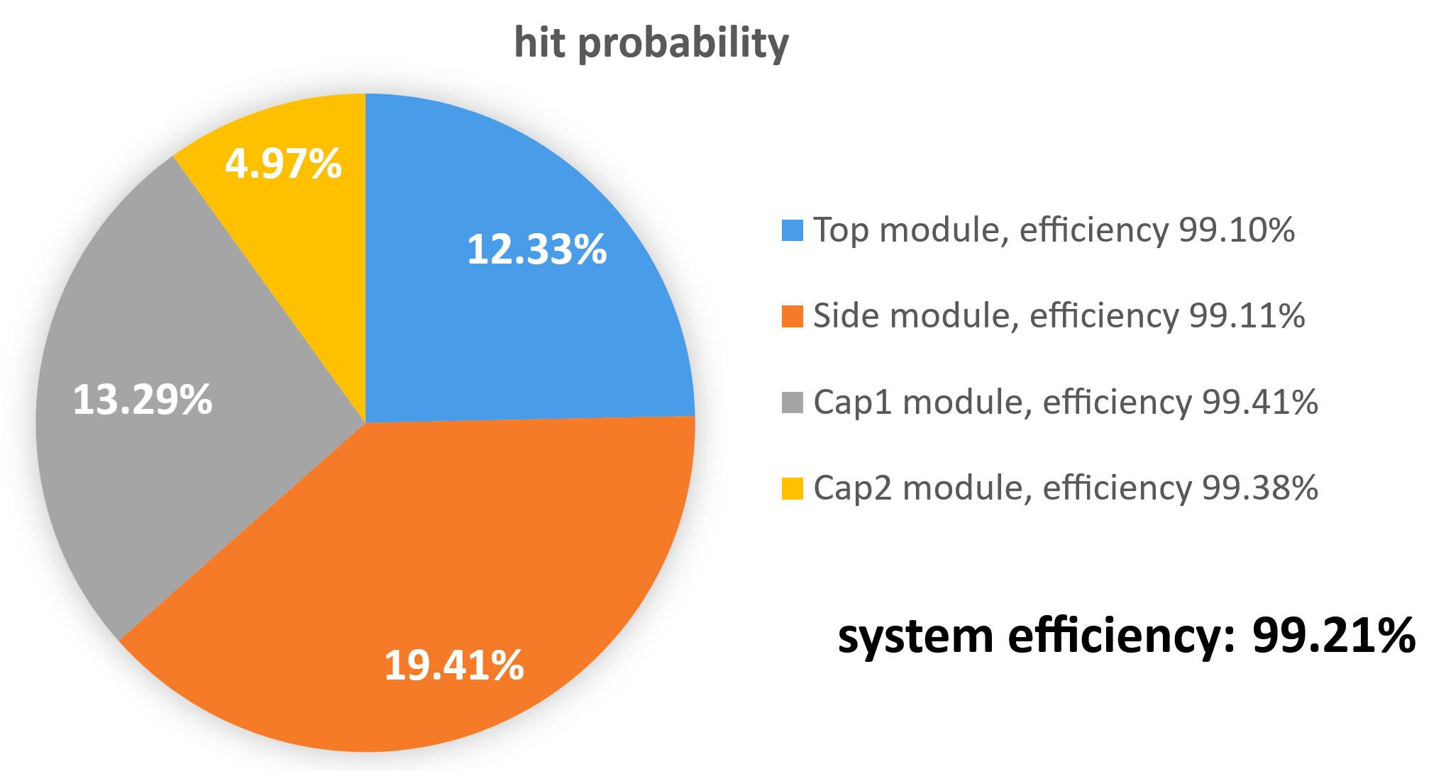
Performance test: simulation result
category | ϵ_{strip}(%)Y11 | # total layer | # coincidence layer | ϵ_{module}(%)
Top | 99.70 ± 0.02 | 3 | 3 | 99.10±0.05
Side | 99.55 ± 0.03 | 2 | 2 | 99.11±0.05
Cap1 | 99.70 ± 0.02 | 2 | 2 | 99.41±0.04
Cap2 | 99.69 ± 0.02 | 2 | 2 | 99.38±0.03

Slide 16
Performance estimate: dead time
Conservative assume: veto time window = 1μs
Simulation:
total time of 1 × 10⁷ simulated cosmic ray muon events = 5390 s
→ total time of 2559198 registered events = 1380 sec.
→ event rate ~ 1855 Hz
Dead time
veto time window × event rate = 0.001 s per sec.
→ about 9 hour dead time during data-taking period
(nearly a half of that in the requirement)

Slide 17
Summary and outlook
A cosmic ray counter—CRV, can veto accidental background for MACE.
The CRV detector consists of multiple plastic scintillator strips embedded with WSL fibers.
The simple probabilistic model is applied to calculate the registration efficiency of cosmic ray muon.
According to the simulation result, WSL fiber is Y11(M200) a suitable choice, which makes the CRV registration efficiency up to 99.21%.
Future efforts would focus on prototype test & background analysis of CRV.
Thanks!
Acknowledgement:
Shihan Zhao (SYSU),
Jian Tang (SYSU),
Changlin Chen (HNU).
:-)

Slide 18
Backups

Slide 19
Geant4 simulation: physics list & optical properties
Physics list:
,
Optical properties:
Material properties
Scintillator: reflection index, absorption length, photon energy spectrum, scintillation yield, σ_{N-photon}
WLS Fiber (3 Layers): absorption length of first WLS process, emission spectrum of first WLS process, reflection index
Coupler: reflection index
Boundary process
Reflective film
Transparent boundary
QBBC
G4EmStandardPhysics_option4

