Slide 1
Research on Cosmic Ray Muon Imaging Algorithms
Qun-Gang Wen
AnHui University
MIP 2025 Hunan Changsha May 16-19, 2025

Slide 2
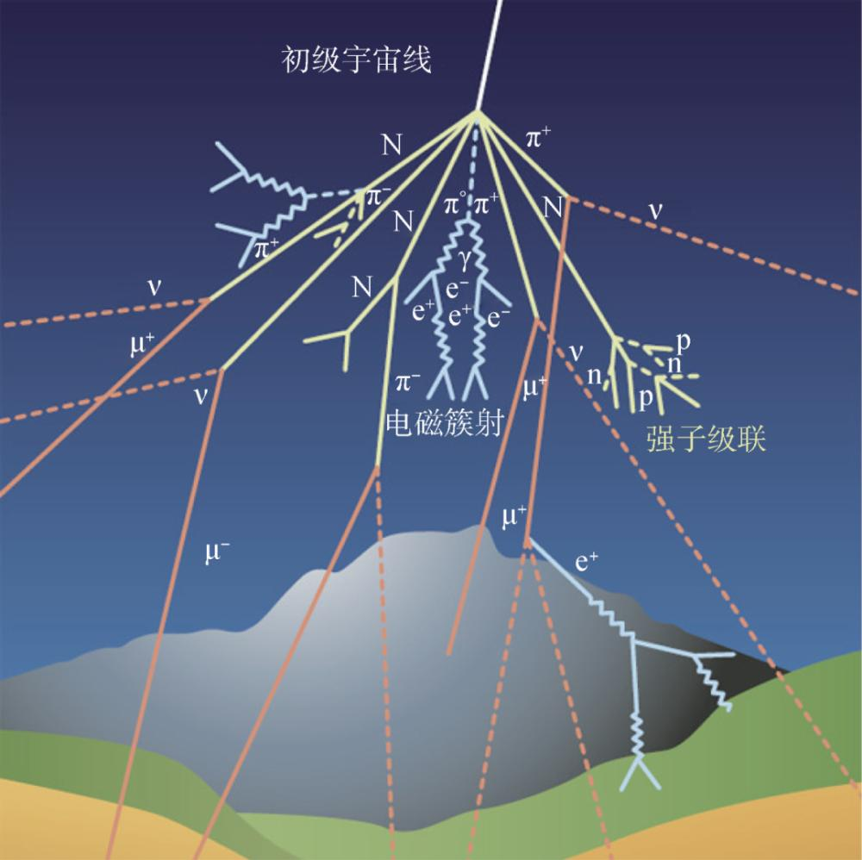
Cosmic Ray Muon Imaging
The universe is full of cosmic rays, including cosmic muons, which are high-energy particles that constantly bombard the Earth’s atmosphere. Muons are similar to electrons, but they are significantly heavier. This reduces their Bremsstrahlung and allows them to penetrate much deeper into matter. About 10⁴ muons reach the Earth’s suface per square meter per minute, with an average energy of 3 to 4 GeV. Muons are particularly penetrating, capable of passing through 2 meters of lead, and even higher energy muons can penetrate several kilometers deep undeground. These particles with strong penetrating power are a fantastic natural resource and are worth developing and utilizing.

Slide 3
Cosmic Ray Muon Imaging
Transmission Imaging
Scattering Imaging

Slide 4
Theoretical Basis of Muon Scattering Imaging
When a muon penetrates an object, it will undergo multiple small-angle Coulomb scattering with the atomic nucleus of the object, resulting in an accumulated scattering angle, and the distribution of this scattering angle is approximately satisfied Gaussian distribution with a mean of zero.
The standard error of the angular distribution is

Slide 5
Theoretical Basis of Muon Scattering Imaging
For cosmic ray muons, the magnitude of the momentum is not a single value but a certain distribution, which can be obtained as
Where p’ is called the equivalent momentum

Slide 6
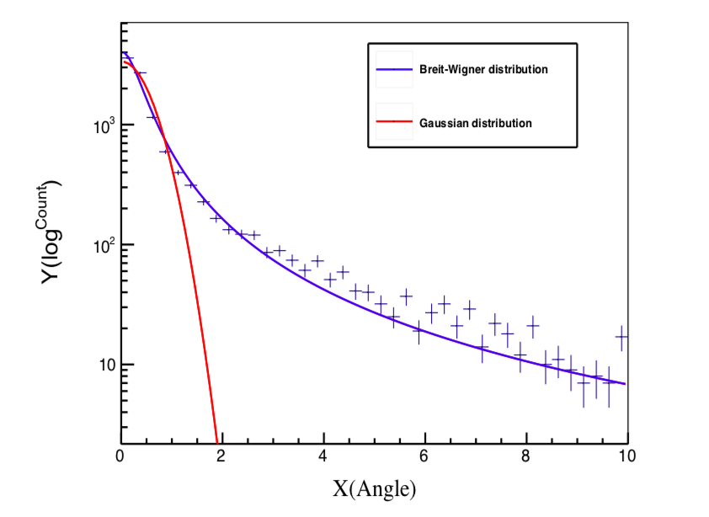
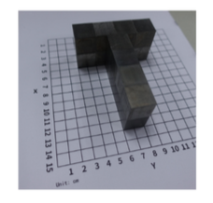
Imaging results with Breit-Wigner hypothesis
Collaborators: Yadi Wang, Yuhan Fan, North China Electric Power University

Slide 7
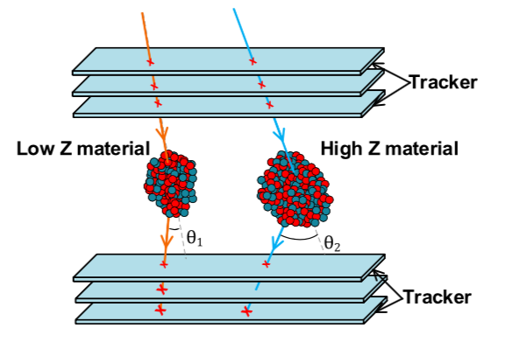
Ratio Algorithm Idea
The probability of the muon passing through the high Z matter to produce a large angle event is higher.
The probability of the muon passing through the high Z matter to produce a small angle enent is smaller.
Quantitative probability of small angle —— Ratio Algorithm

Slide 8
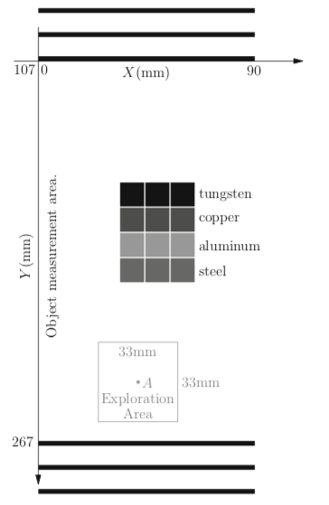
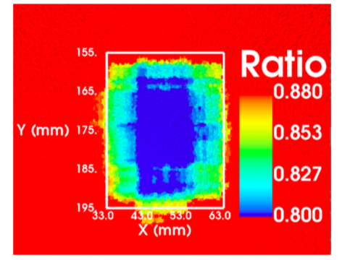
Ratio Algorithm
Radiat Detect Technol Methods 4, 263-268 (2020)

Slide 9
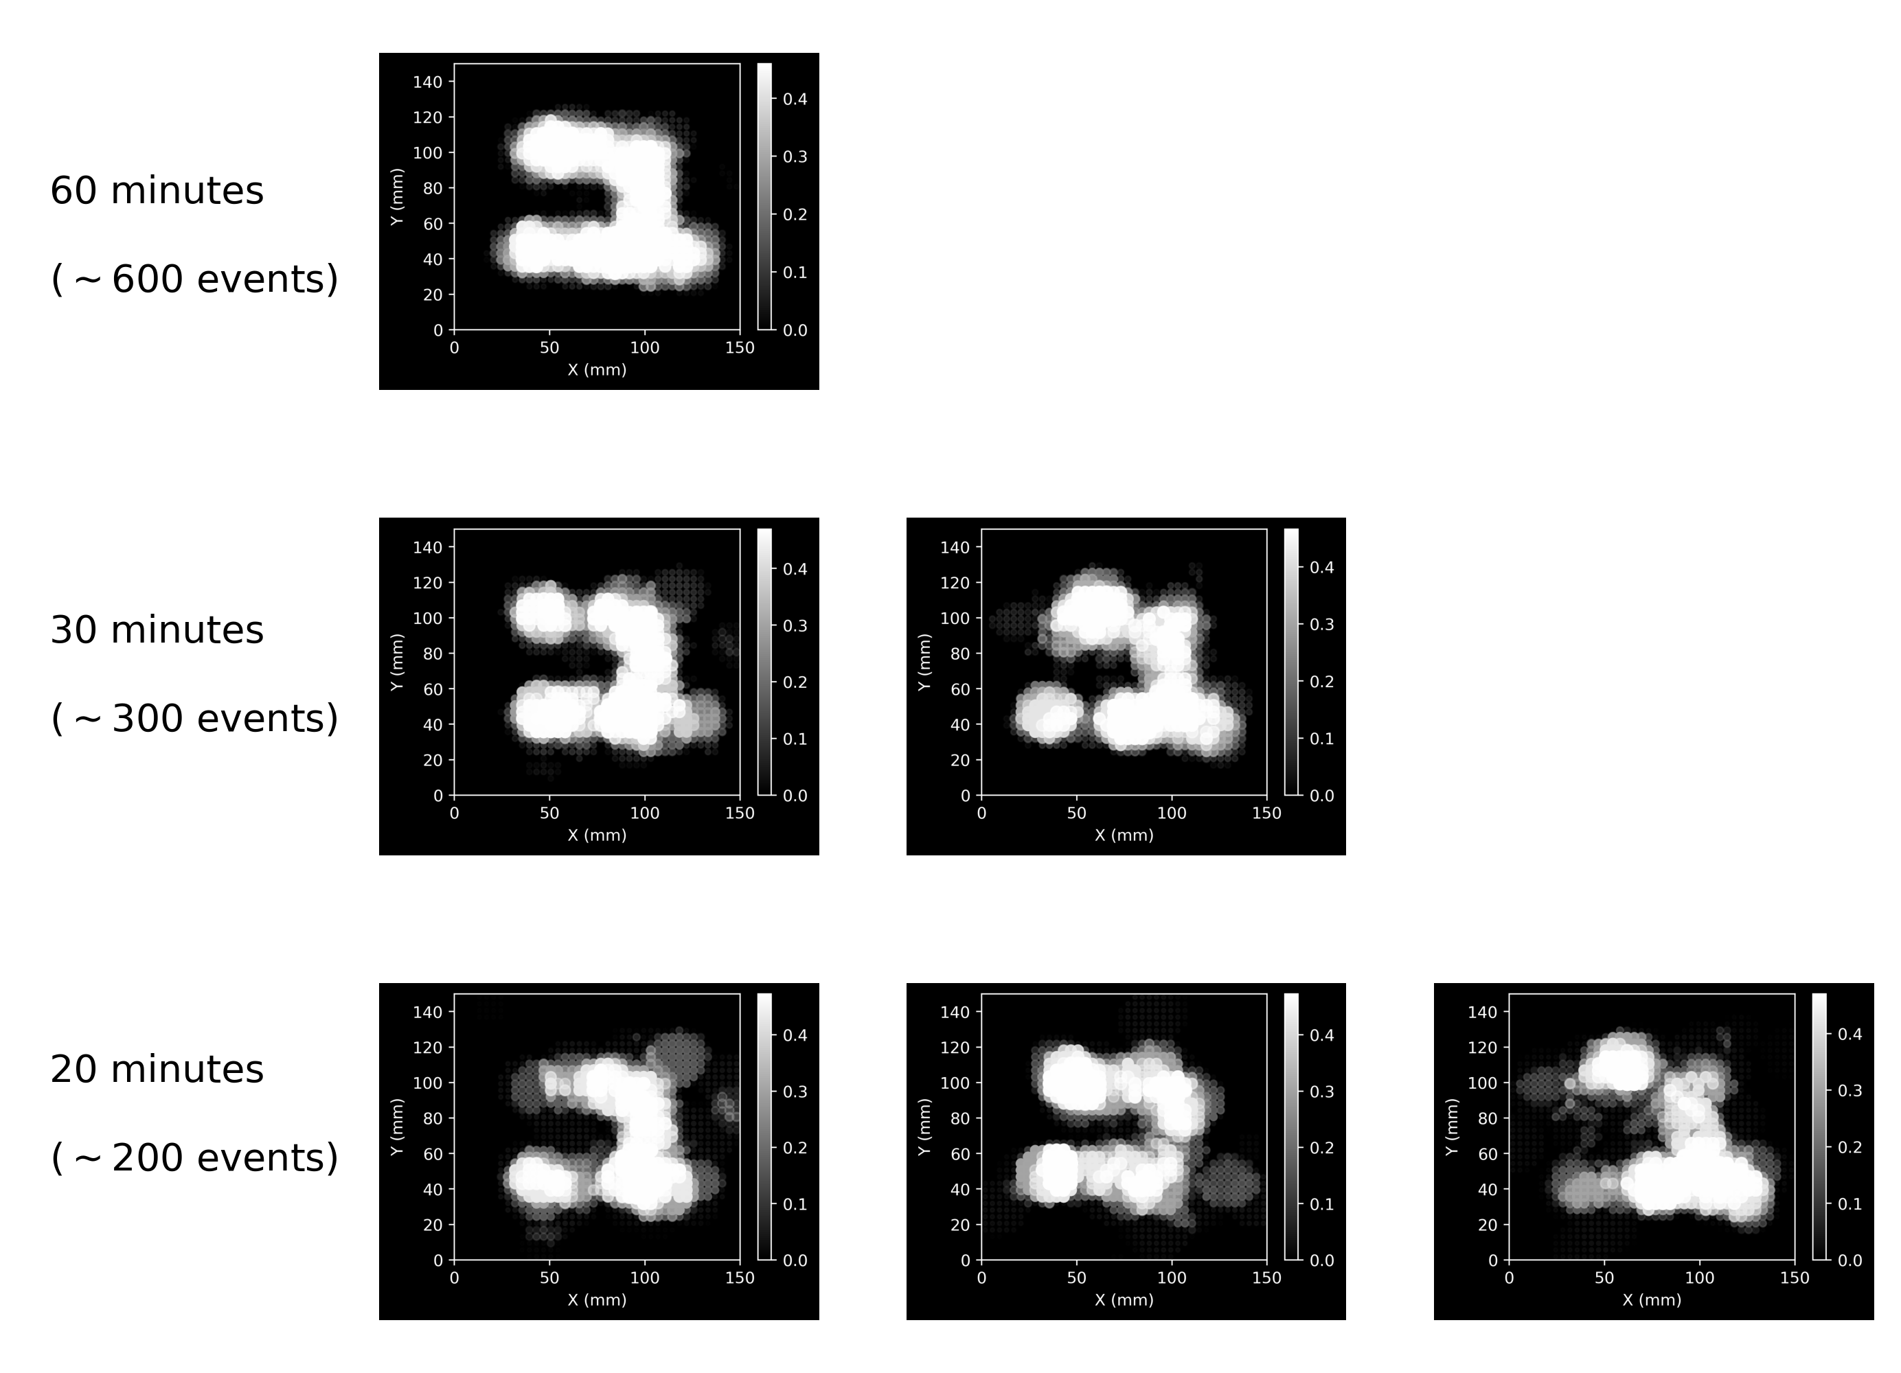
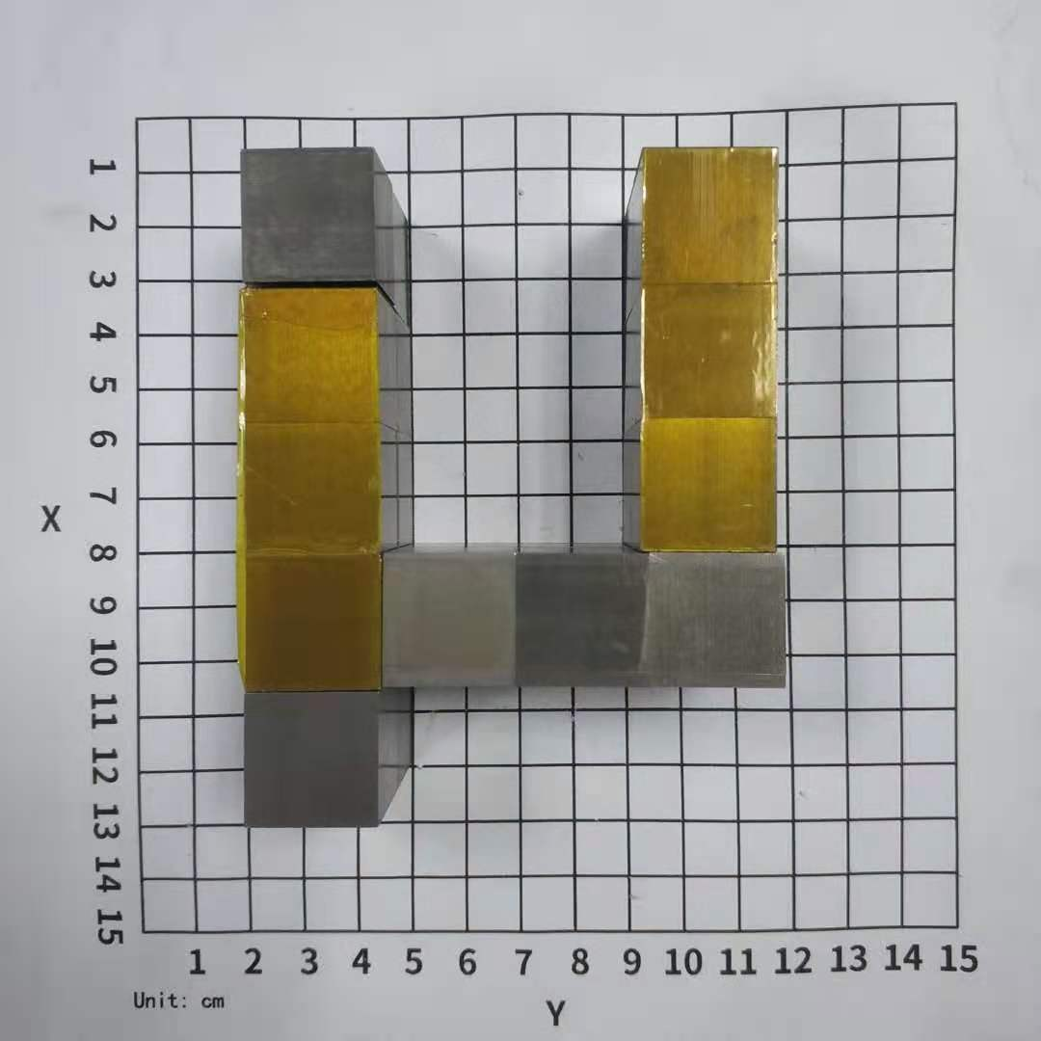
Without Voxel Imaging
Scientific Reports 13, 19718 (2023)
https://doi.org/10.1038/s41598-023-47023-w

Slide 10
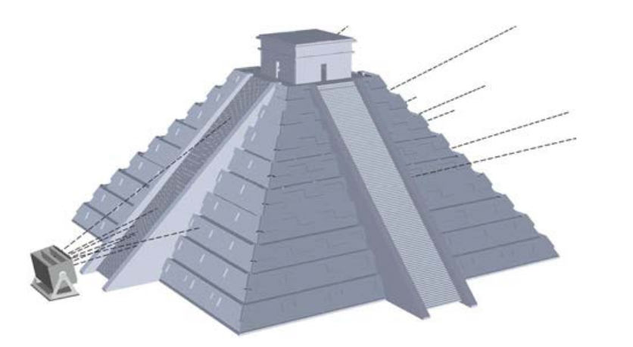
Transmission Imaging
The muon lines used for imaging to pass through the virtual point.

Slide 11
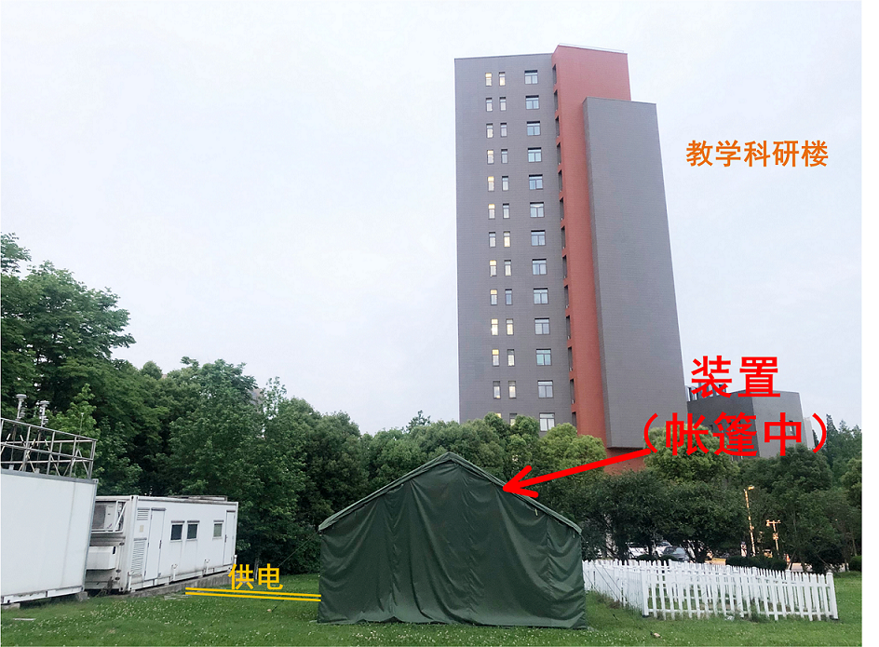
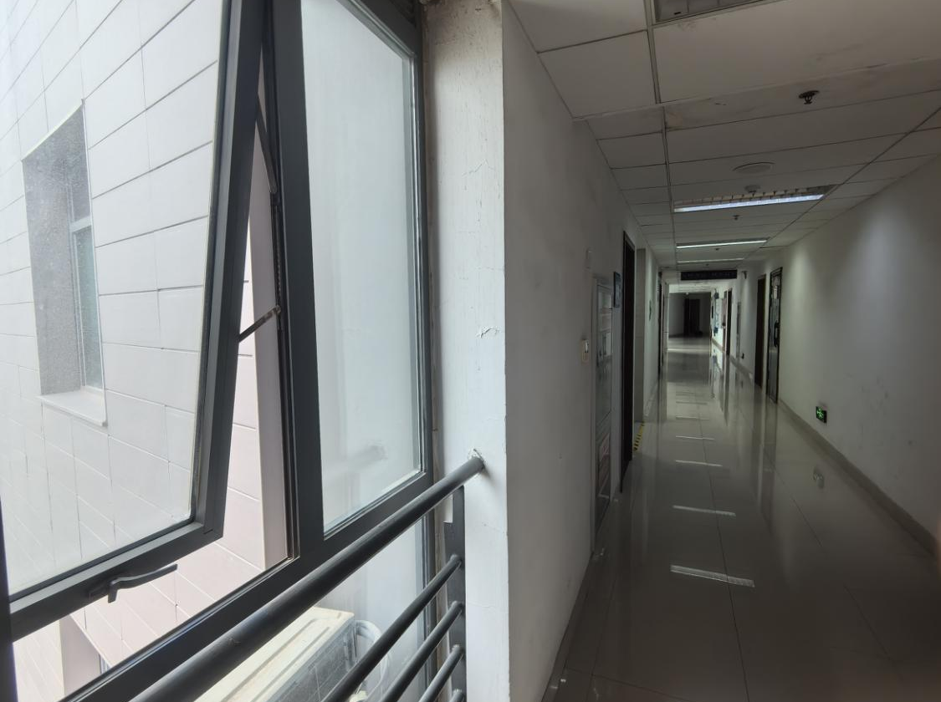
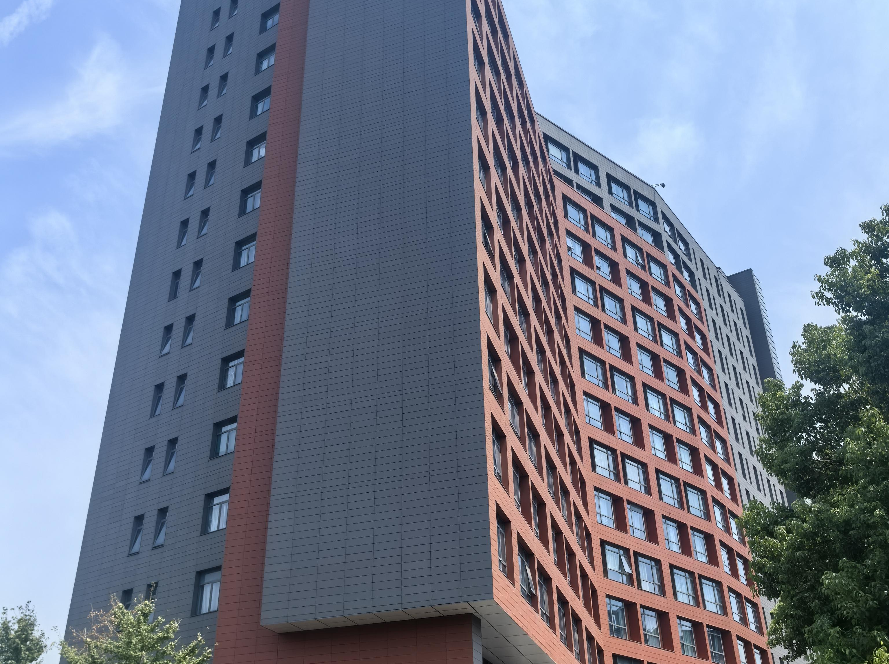
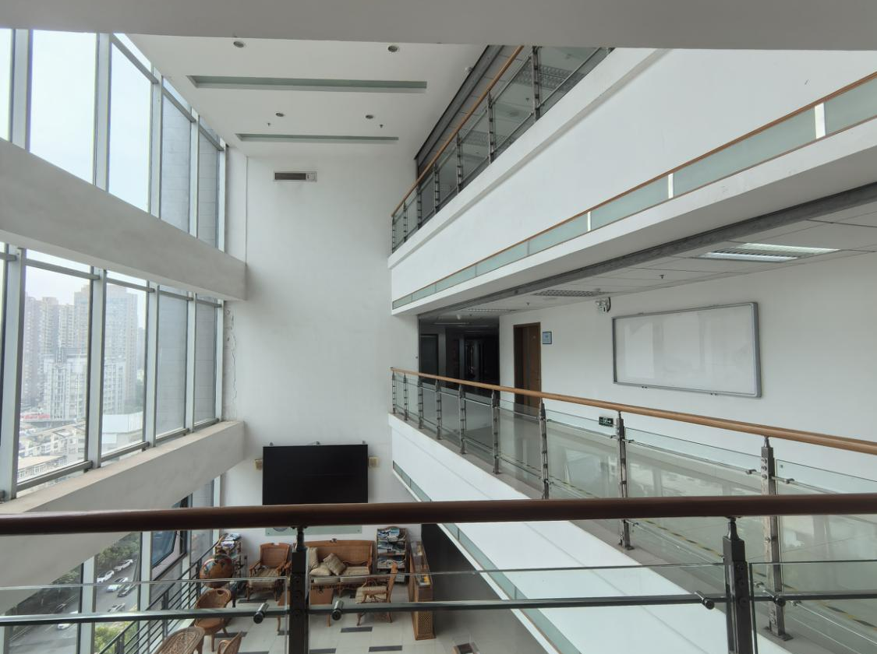
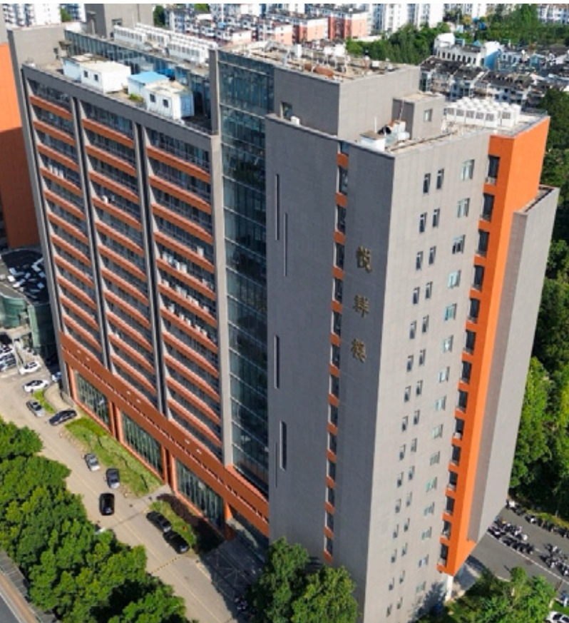
Transmission Imaging

Slide 12
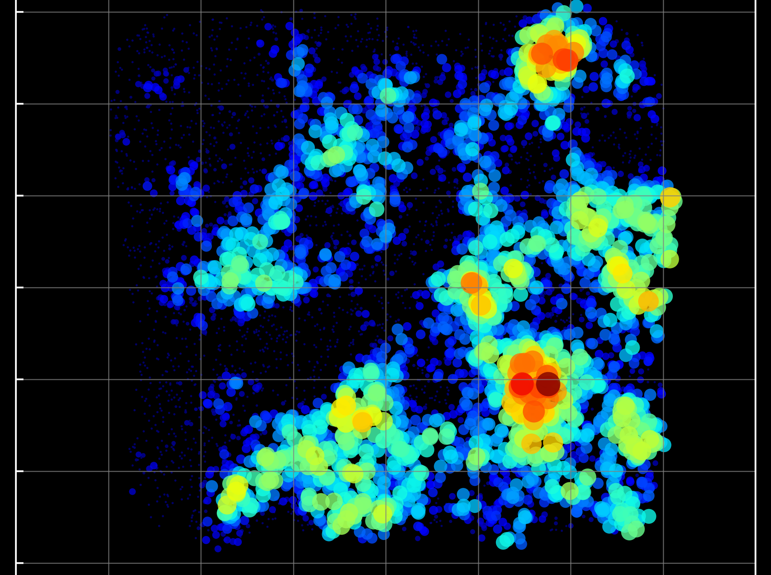
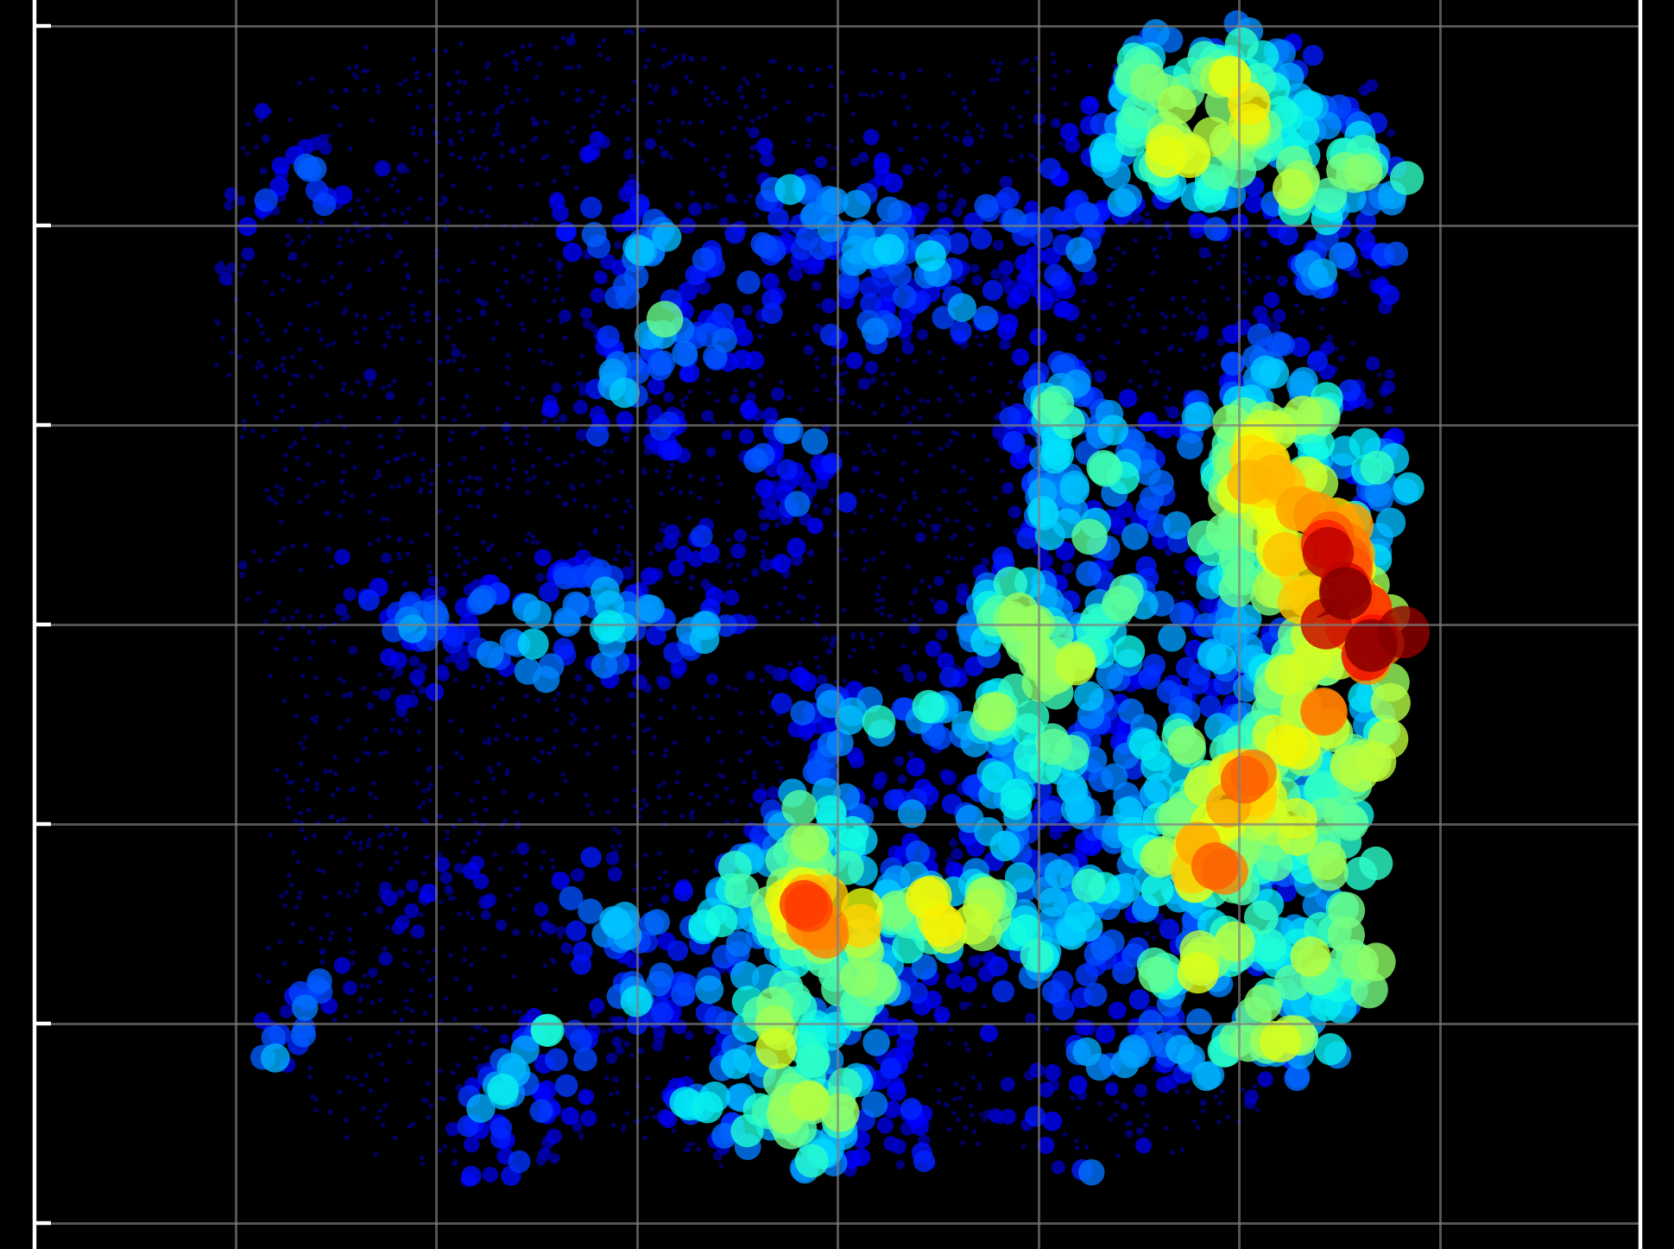
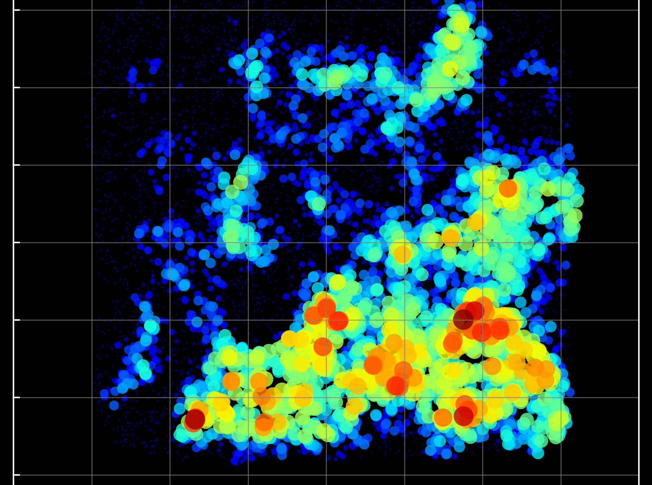
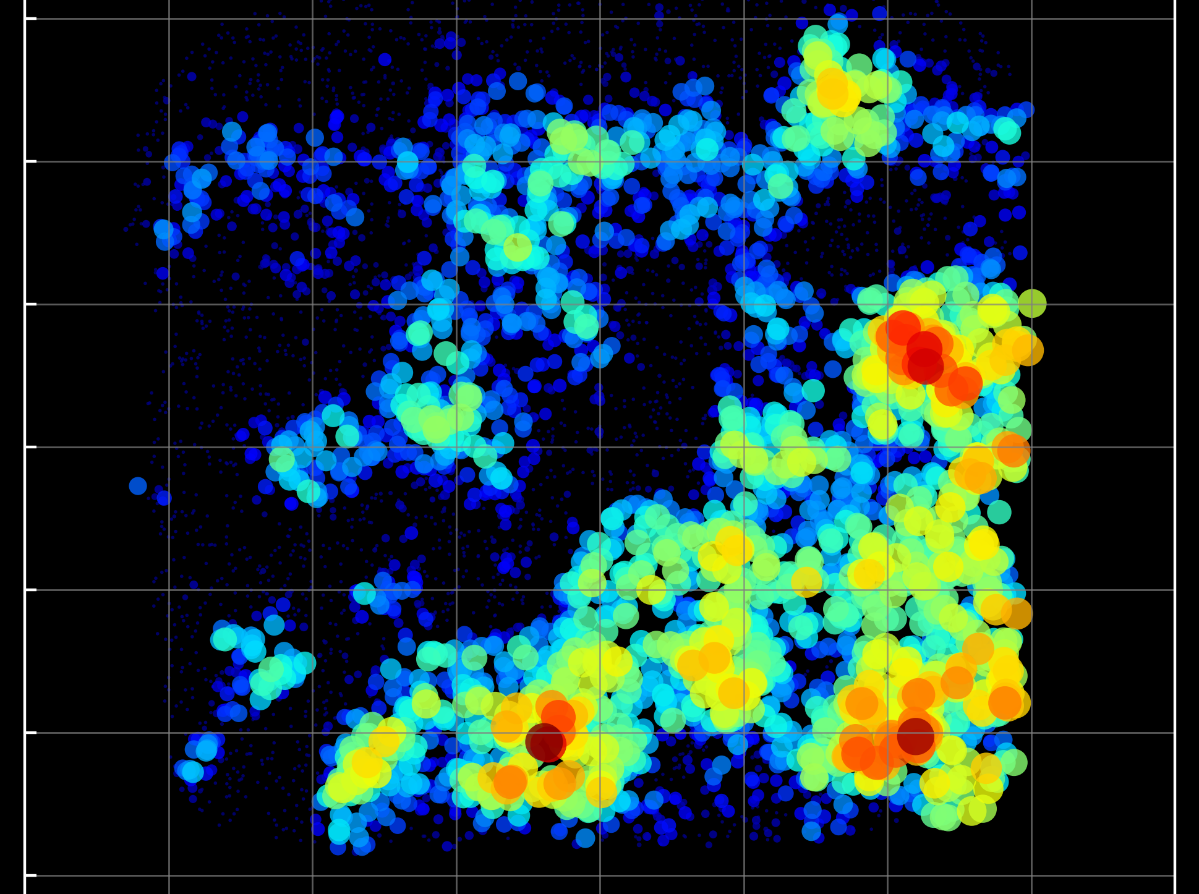
Transmission Imaging

Slide 13
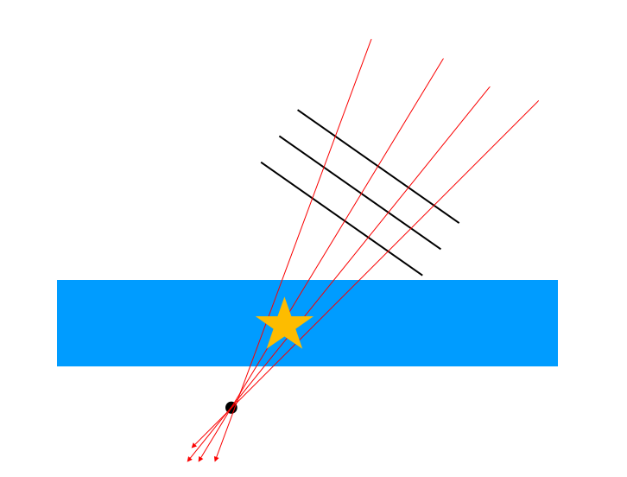
一个有趣的想法（Presentation in Chinese）

Slide 14
Notes
The experimental data used in the report was provided freely by the muon Scattering and Transmission imaging facility (μSTC) of the USTC.
Due to my limitations in English listening and speaking, I will answer questions in Chinese. Regarding questions asked in English, I will provide answers during the subsequent personal communication segment.

Slide 15
THANK YOU

