Slide 1


AI-Enhanced Magnetic Field Measurements
Bingzhi Li, Zejia Lu, Haohan Yu

Slide 2
1
Outline
Motivations
Machine Learning Method Principle to Measure the Magnetic Field: PINN
Simulation Data Generation and Validation
Experimental Data: Helmholtz Coils and Sliding Table System
Preliminary Data Analysis
Summary and Outlook

Slide 3
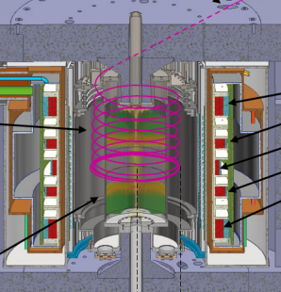
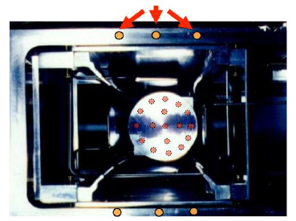
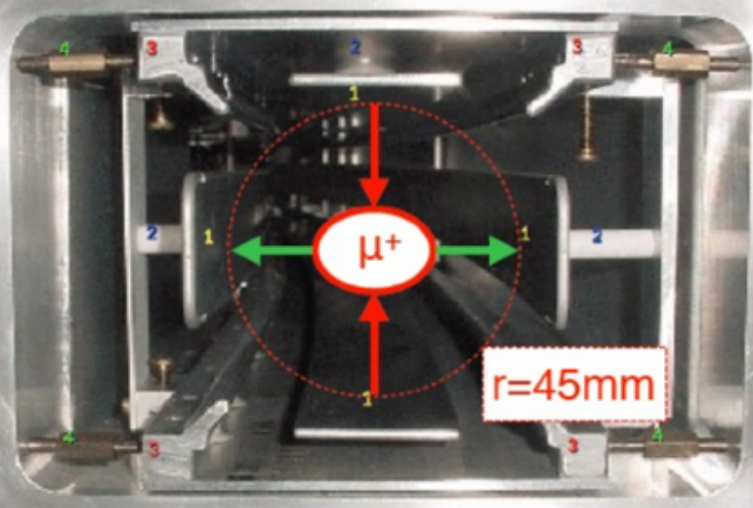
2
Motivation
Muon g-2 experiment: magnetic field within experimentally inaccessible region is hard to determine
  Muon production / storage region when the beam is on
Need to use magnetic probes and do the interpolation
Limited number of probes effect the precision of the measurements
Inaccessible region when the muons are storage
Fixed Probe
Trolley
Fermilab muon g-2 storage region
J-PARC muon g-2 storage region

Slide 4
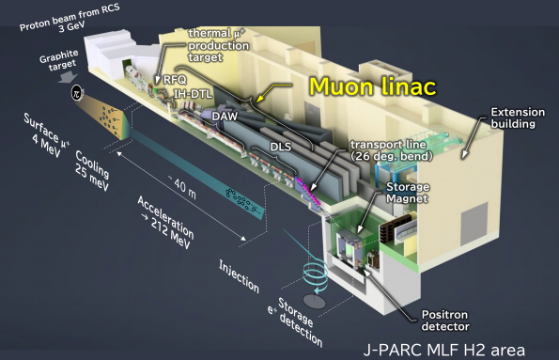
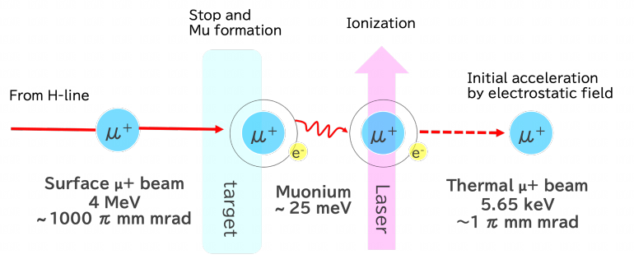
3
Motivation
Magnetic field need also to be precisely controlled in the muon production region (J-PARC)
Muonium’s spin direction is easily disturbed by the surrounding magnetic field (e.g., geomagnetic ∼60 μT)
The ambient magnetic field must be controlled below ±1 μT to preserve the Mu spins
Minimize beam shift due to the ambient magnetic field by controlling the magnetic field

Slide 5
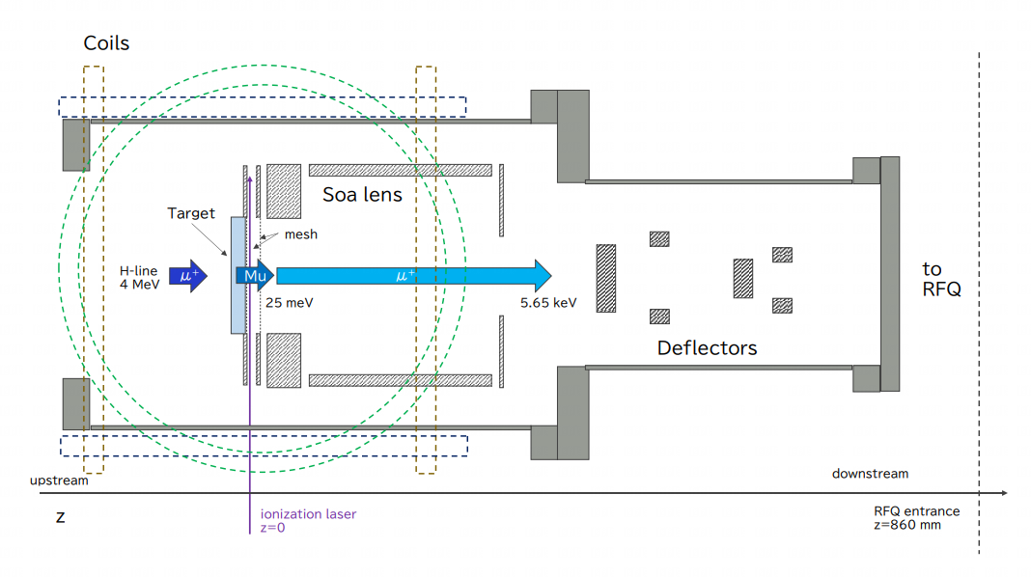
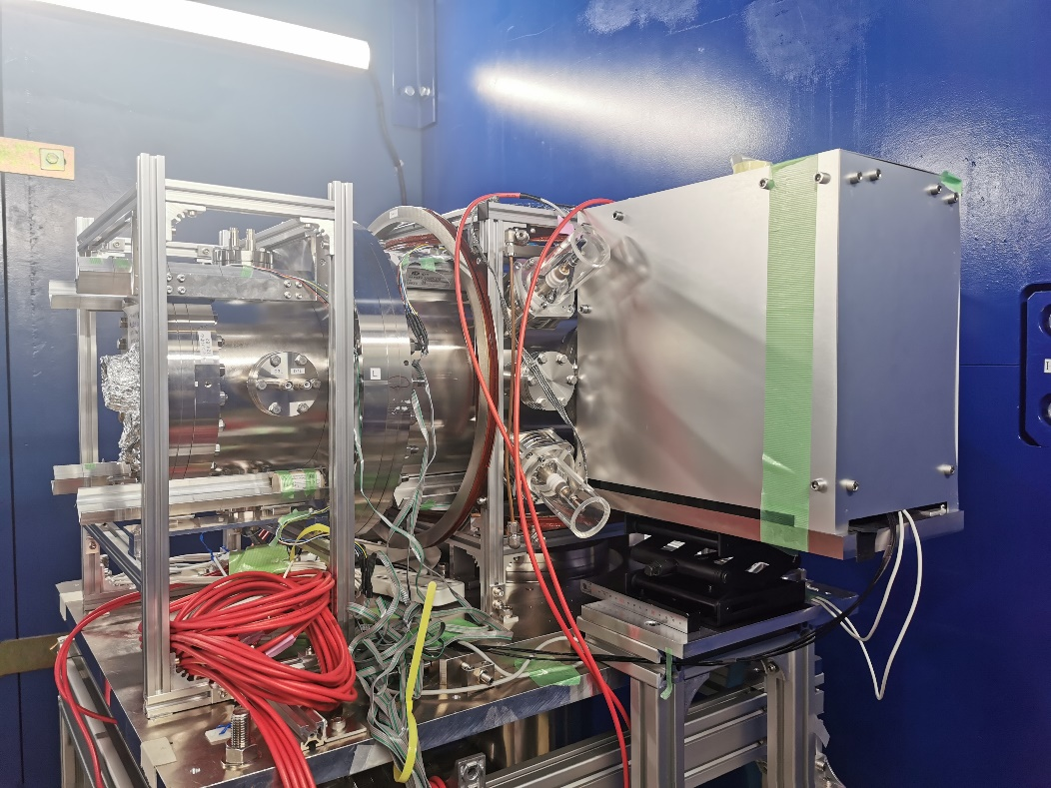
4
Motivation
3 Helmholtz coils are designed to cancel the surrounding magnetic field
  geomagnetic
  magnet from nearby experiments
Develop an AI-Enhanced magnetic field measurement to help the monitoring

Slide 6


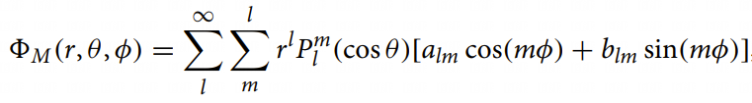

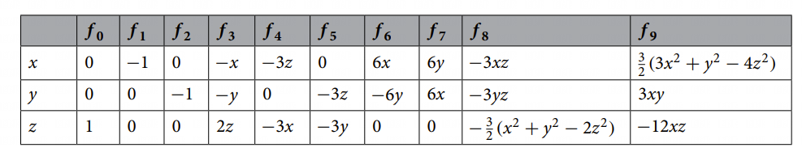

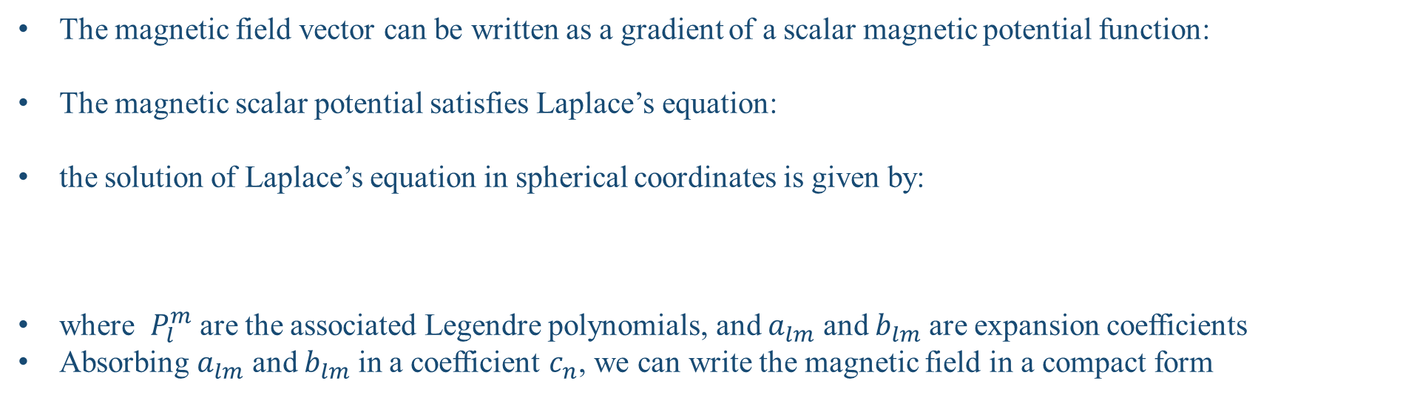

5
Multipole expansion method.
The magnetic field vector can be written as a gradient of a scalar magnetic potential function:
The magnetic scalar potential satisfies Laplace’s equation:
the solution of Laplace’s equation in spherical coordinates is given by:
where $P_{l}^{m}$ are the associated Legendre polynomials, and $a_{lm}$ and $b_{lm}$ are expansion coefficients
Absorbing $a_{lm}$ and $b_{lm}$ in a coefficient $c_{n}$, we can write the magnetic field in a compact form
B field multipole expansion in the Fermilab muon g-2 experiment
the first 10 $f_{n}$ basis vector functions

Slide 7
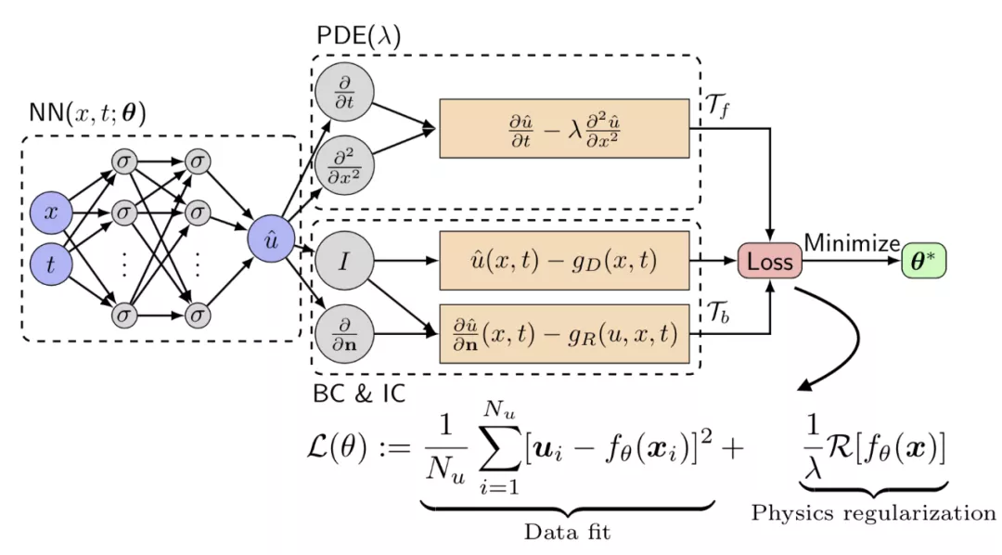
6
AI-Enhanced Method: PINN
PINN: Physics Informed Neural Network
A popular method for recent years in fluid mechanics area
Aim to solve a set of PDE (partial differential equations)

Slide 8


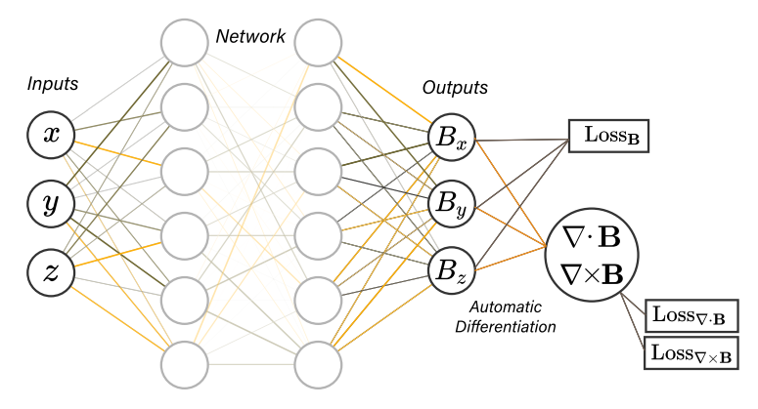

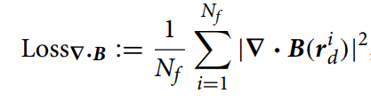
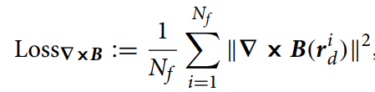
7
AI-Enhanced Method: PINN
Maxwell equation is also PDE
Assuming there are no free currents (J=0) and no magnetization M=0, the Maxwell equation is:
Input: position (x,y,z)
Output: field in (x,y,z)
Not only satisfy the data constraint but also satisfy the physical constraint

Slide 9
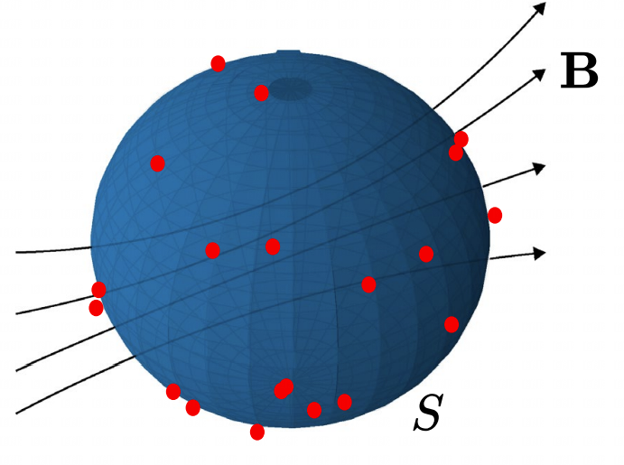

8
AI-Enhanced Method: PINN
Select a enclosed surface S and choose some locations on it
Using the measurements in these locations to predict the inner field
With enough data points $→$ successfully obtain the true solution (within uncertainty)
Input: position (x, y, z)
Output: field in (x, y, z)
Not only satisfy the data constraint but also satisfy the physical constraint

Slide 10
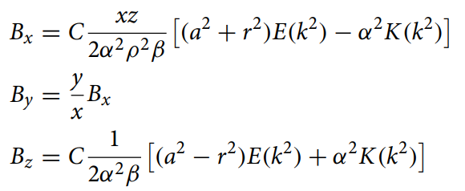
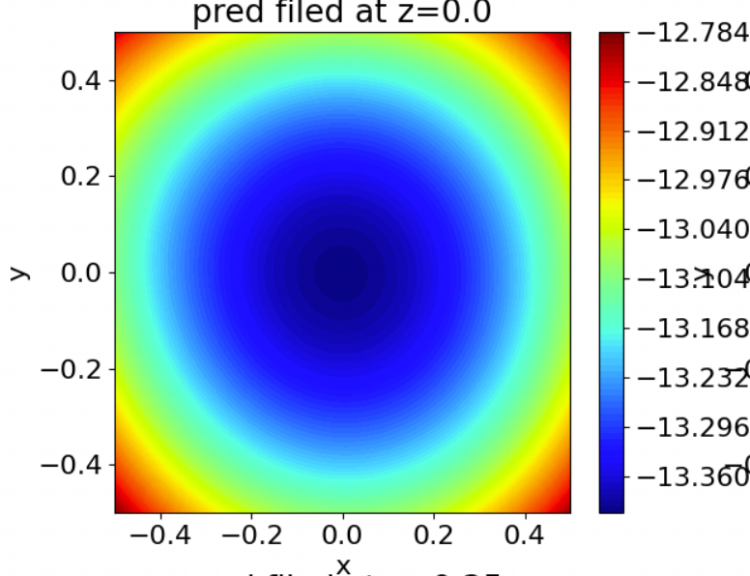
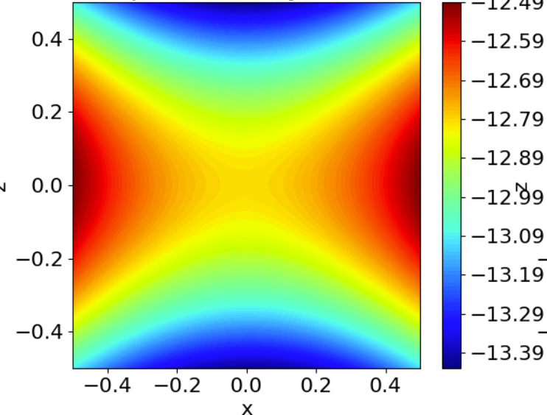
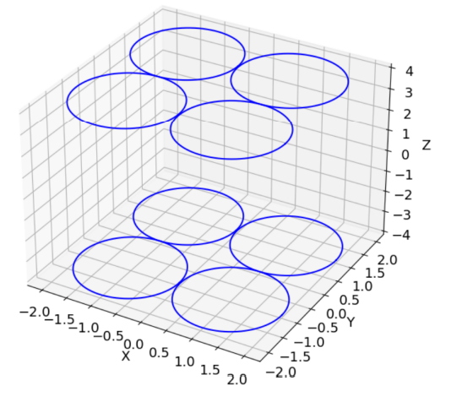
9
Simulate the Field: Case 1 (Coils along 1 axes)
Simulate the magnetic field generated by several current-carrying coils Based on the Biot–Savart law in arbitrary units
Vertical Field Bz at z=0
Vertical Field Bz at y=0
Vertical Field Bz at z=0
Vertical Field Bz at y=0

Slide 11
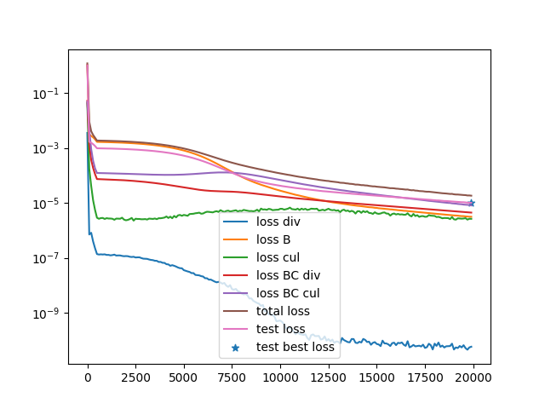
10
Train the PINN
Select a box region with side length L=1 in arbitrary units
Predict the field inside the box using the field data on the surface
Randomly select 18 points on the surface

Slide 12
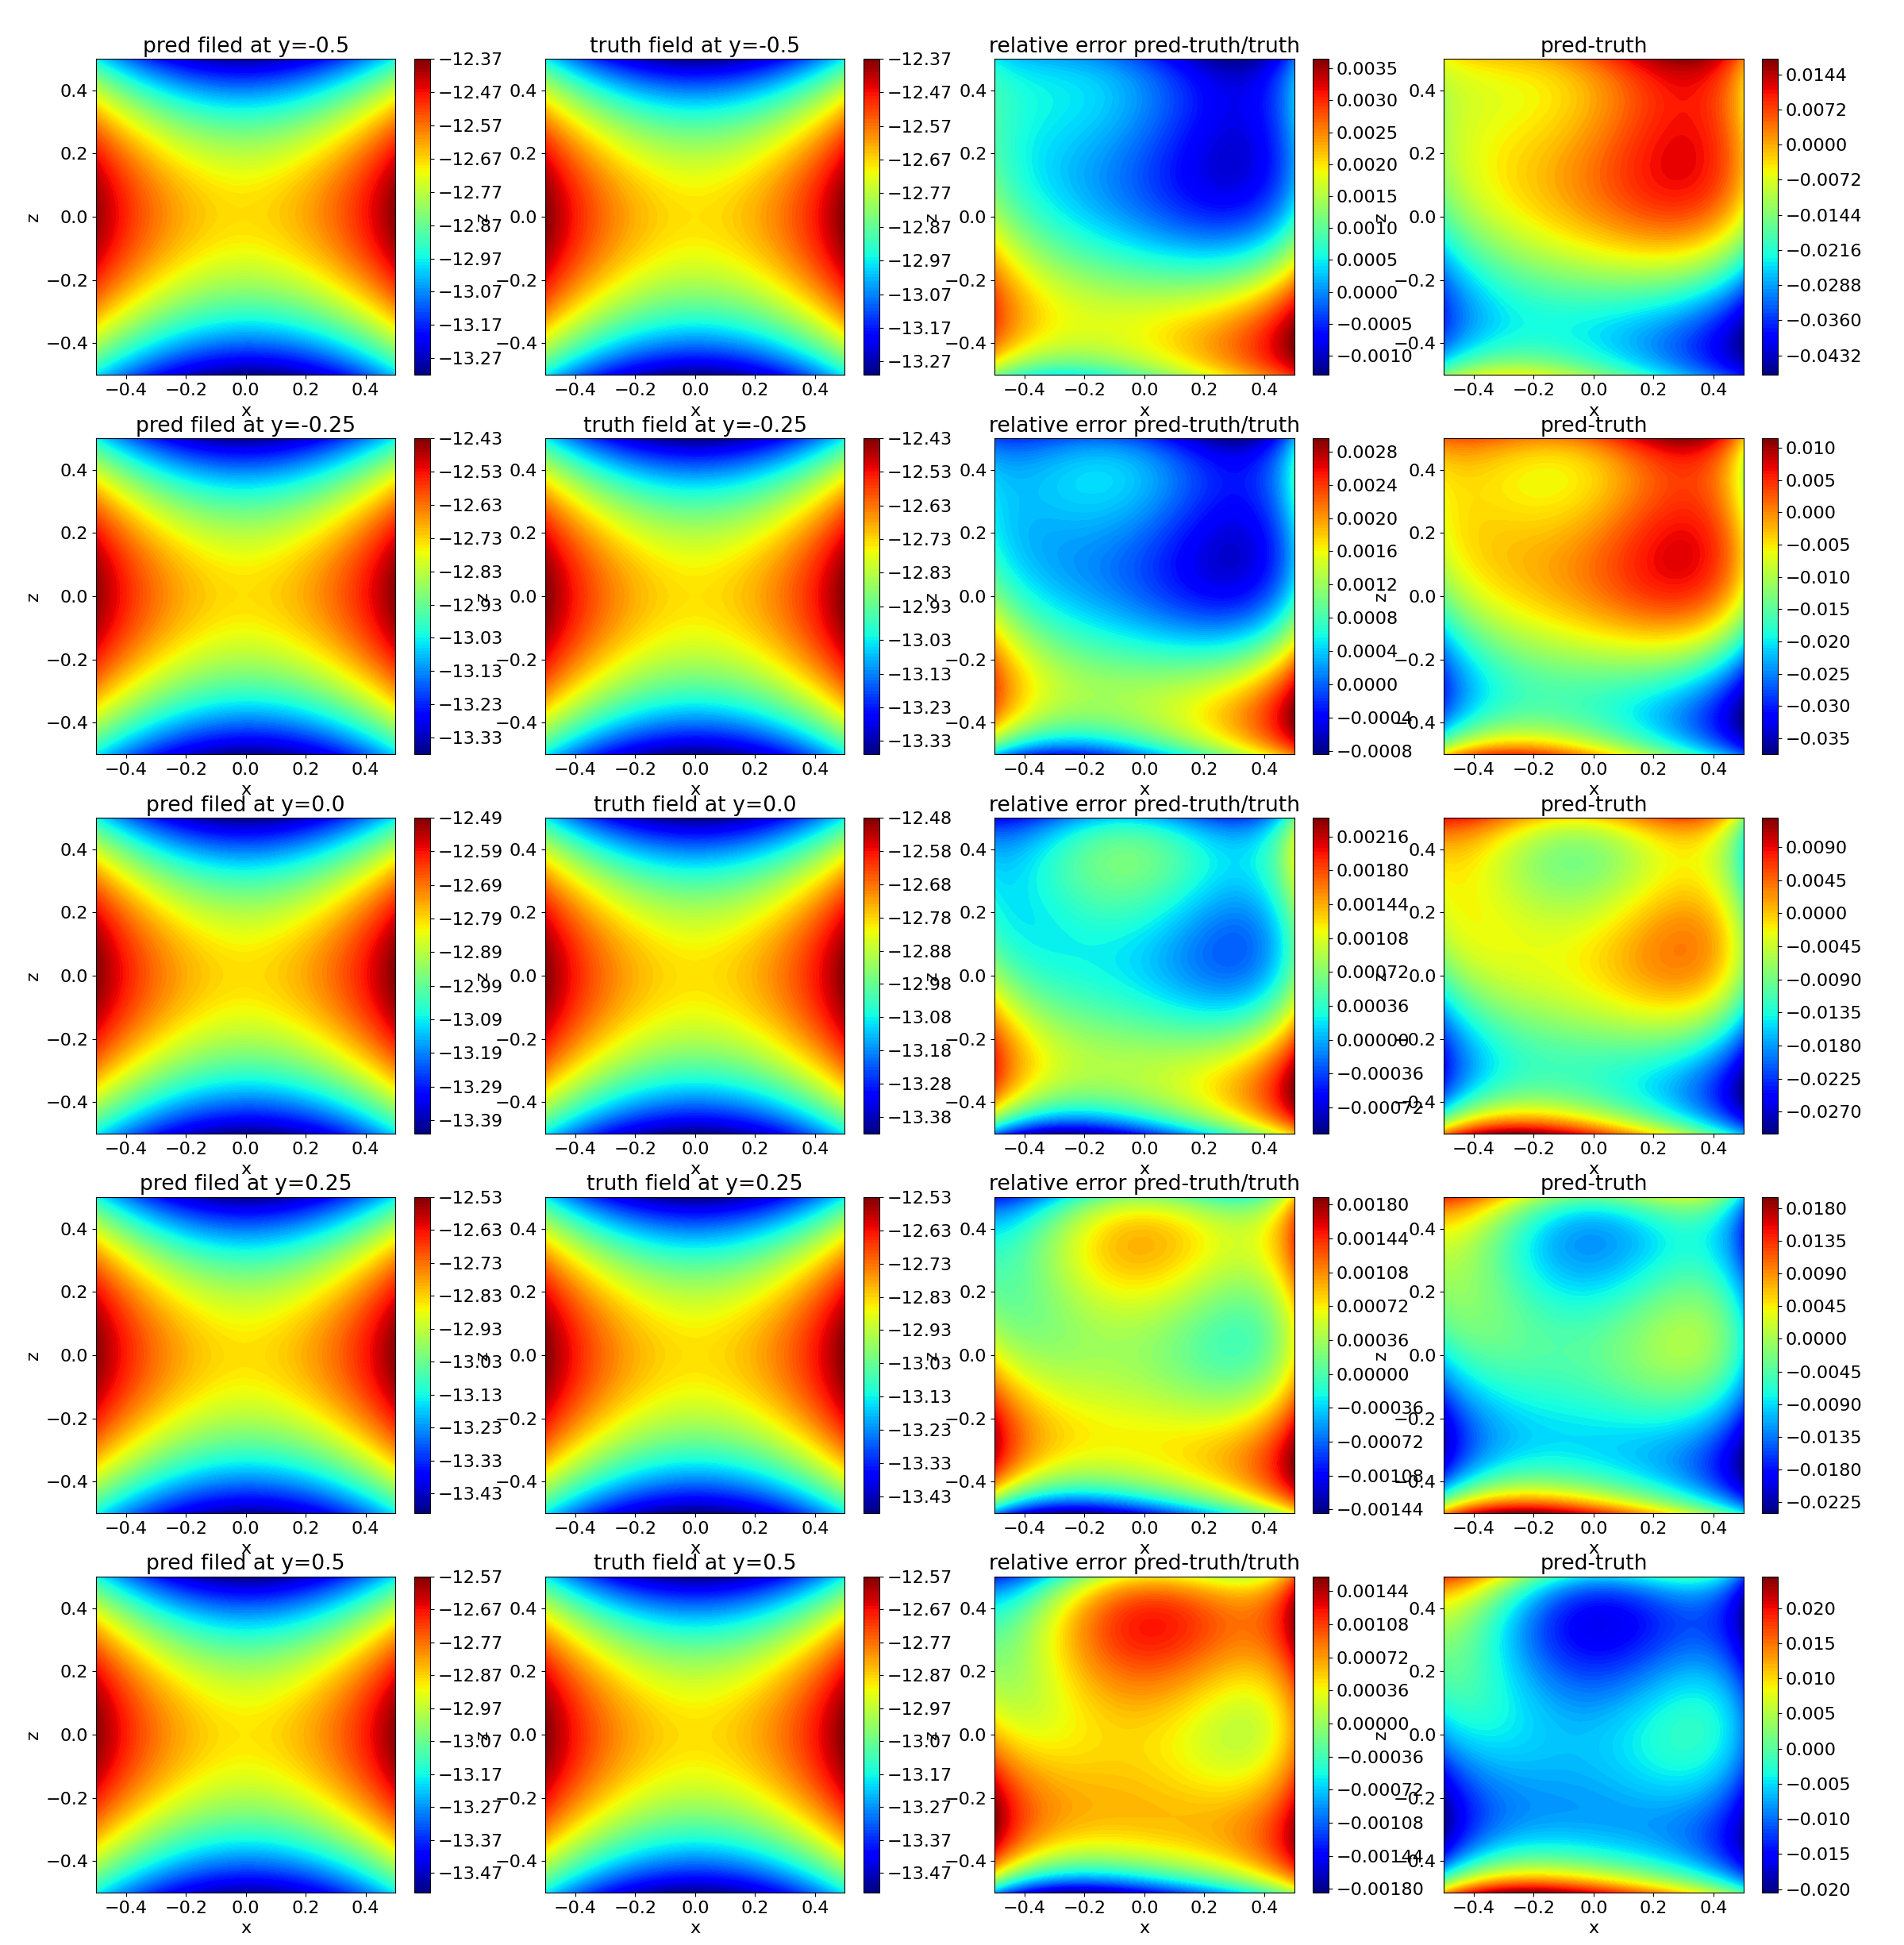
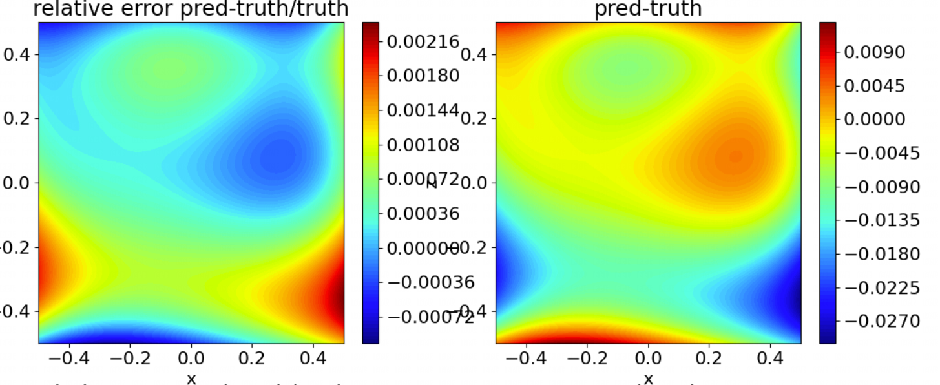
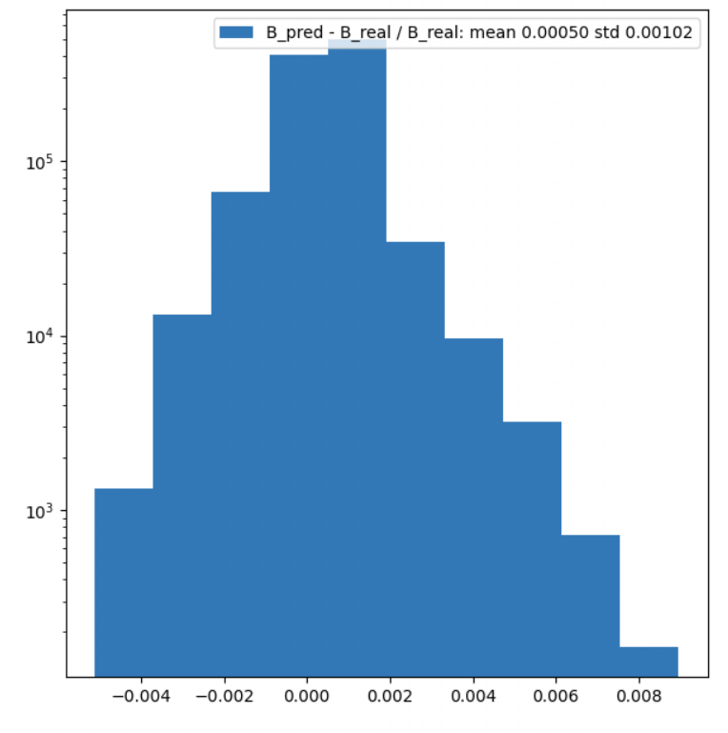
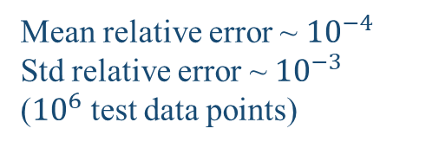
11
Prediction Result
Mean relative error ~ ${10}^{−4}$
Std relative error ~ ${10}^{−3}$
(${10}^{6}$ test data points)
prediction
truth
(pred-truth)/truth
pred-truth

Slide 13
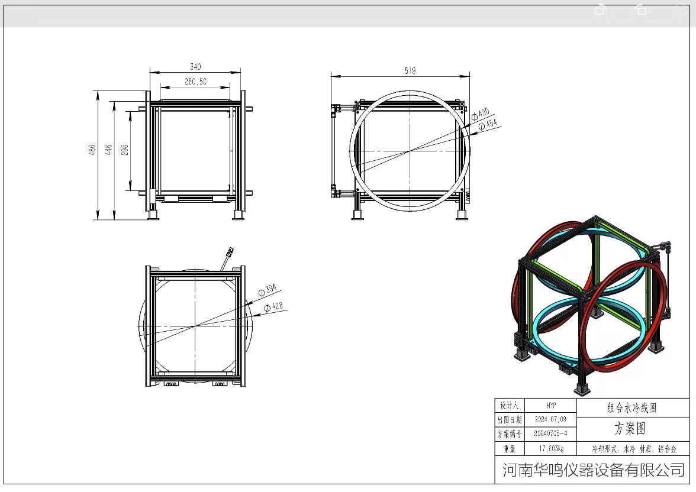
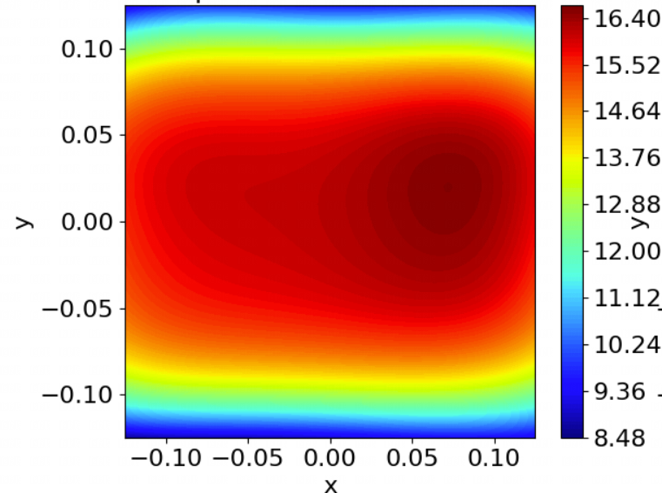
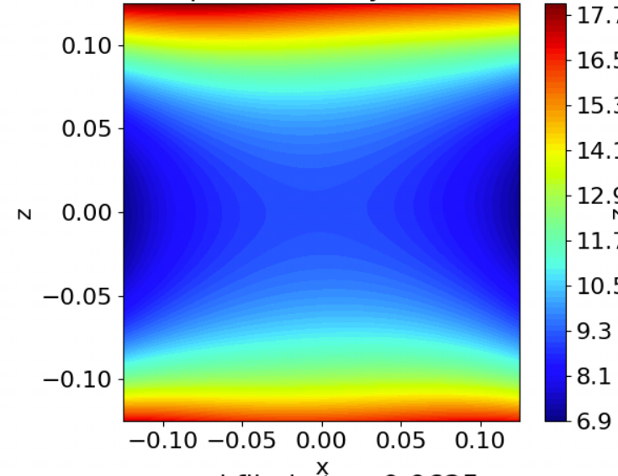
12
Simulate the Field: Case 2 (Helmholtz Coil)
2 circular coils and 1 square coil
dx | dy | dz | r1 | r1 | a | b
0.316 | 0.358 | 0.358 | 0.22 | 0.207 | 0.378 | 0.272
Ix | Iy | Iz
1 | 1 | 5
arbitrary units
arbitrary units
Vertical Field Bz at z=0
Vertical Field Bz at y=0

Slide 14
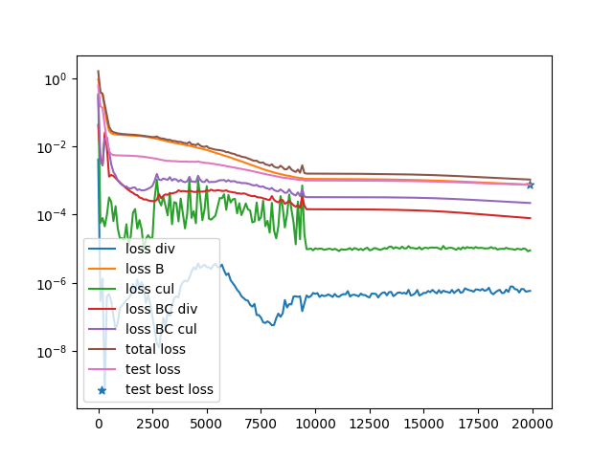
13
Train the PINN
Select a box region with side length L=0.25 in arbitrary units
Predict the field inside the box using the field data on the surface
Randomly select 96 points on the surface

Slide 15
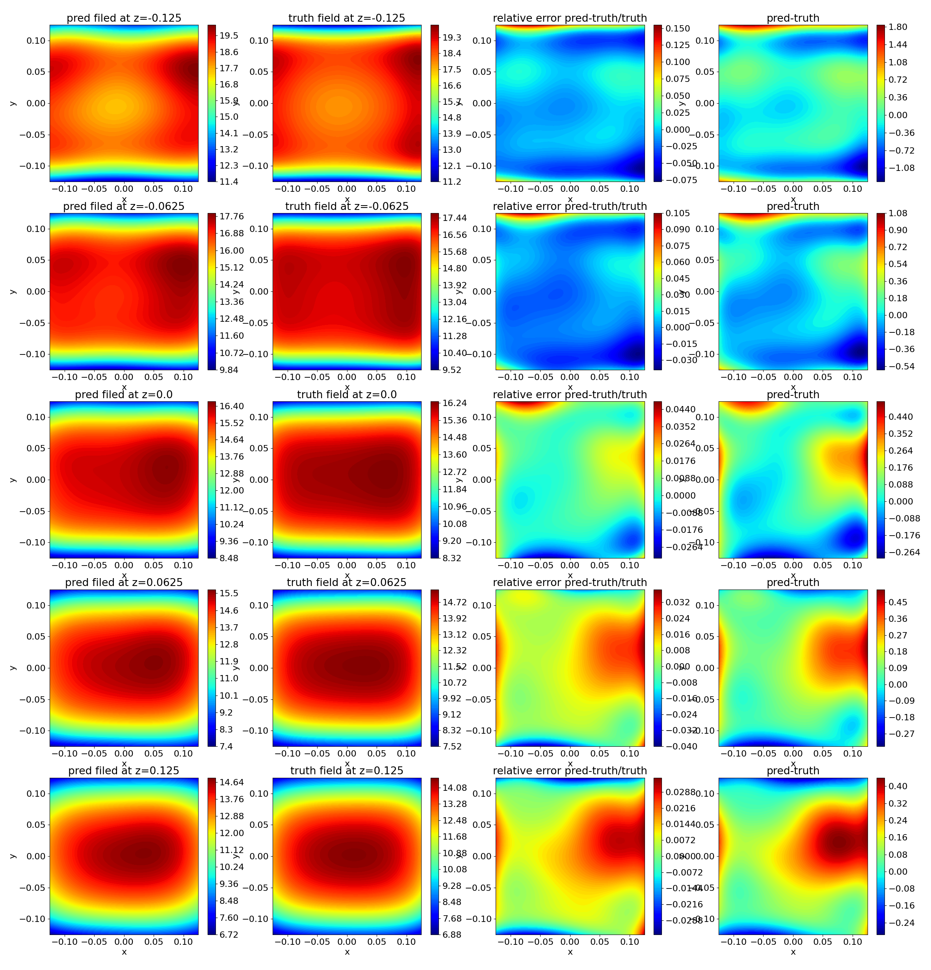
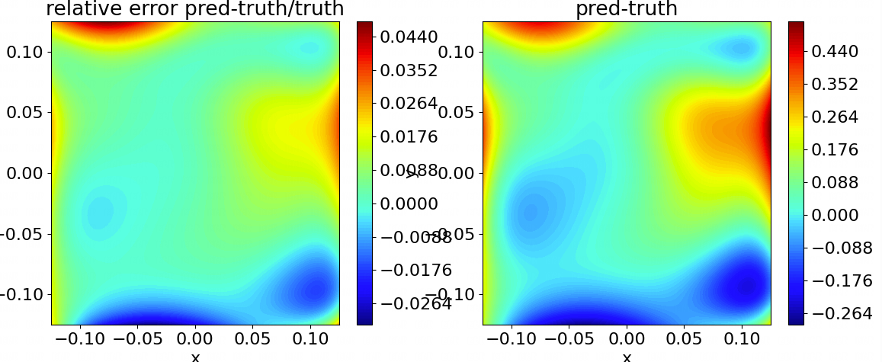
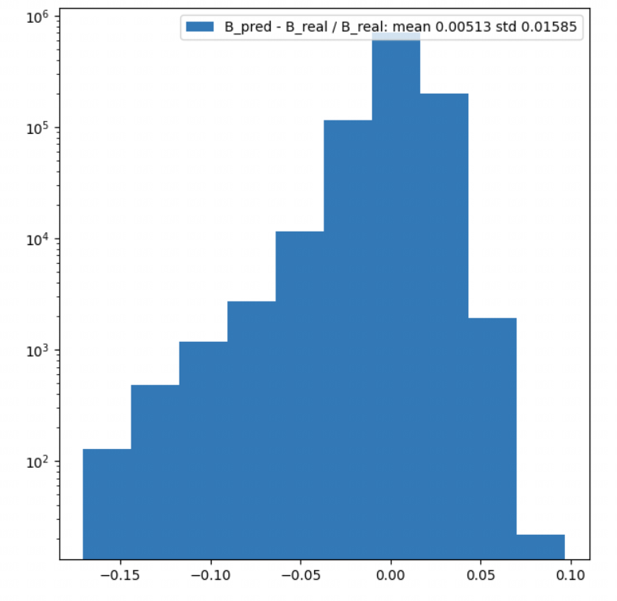
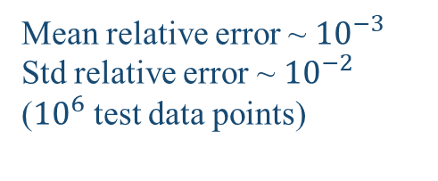
14
Prediction Result
Mean relative error ~ ${10}^{−3}$
Std relative error ~ ${10}^{−2}$
(${10}^{6}$ test data points)
prediction
truth
(pred-truth)/truth
pred-truth

Slide 16
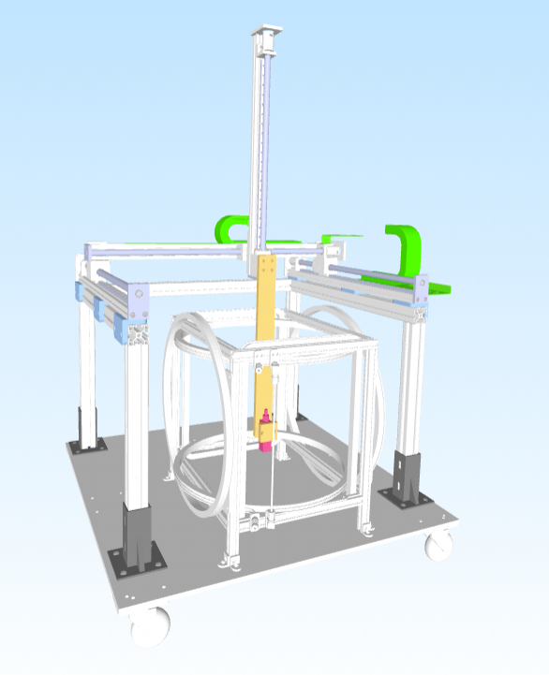
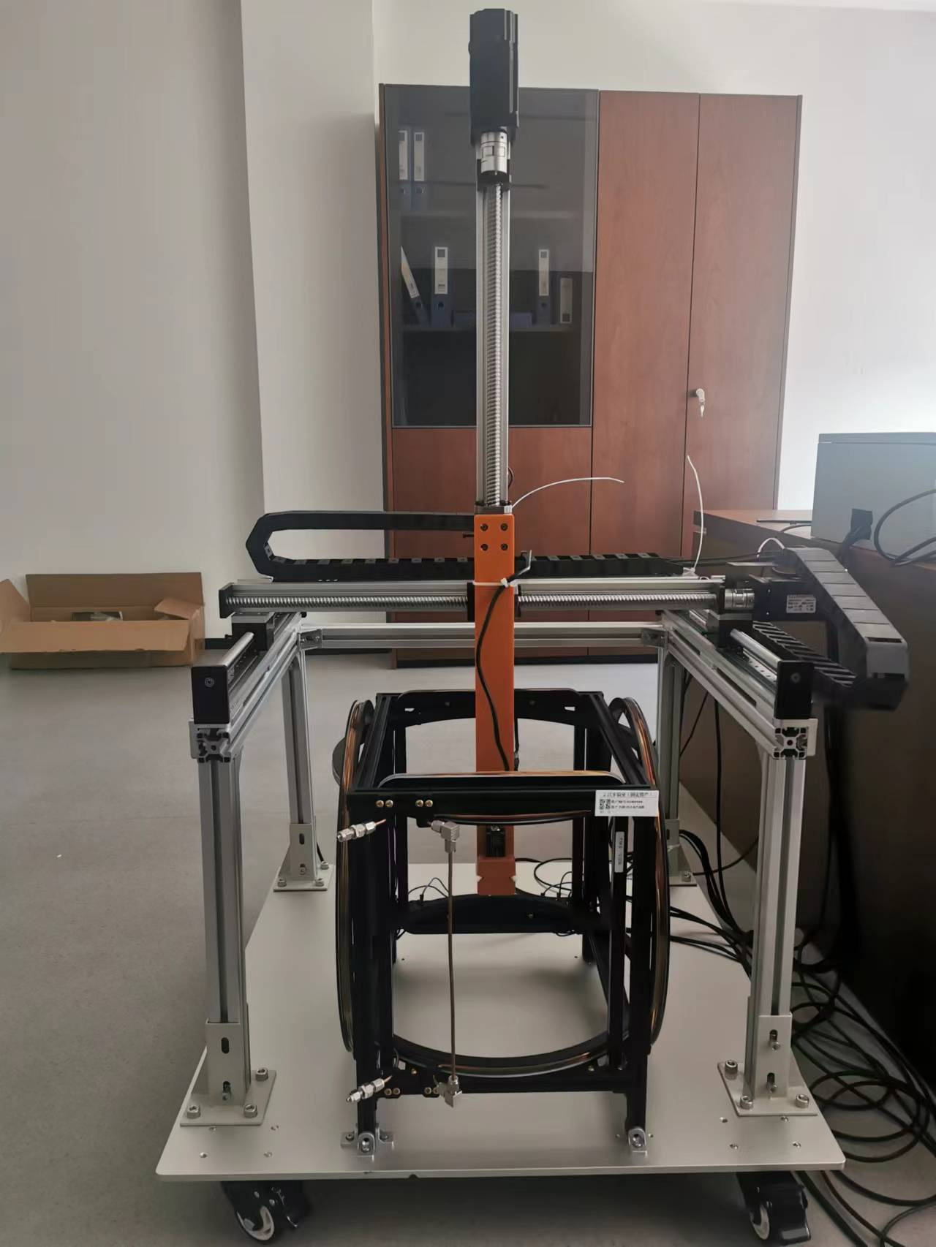
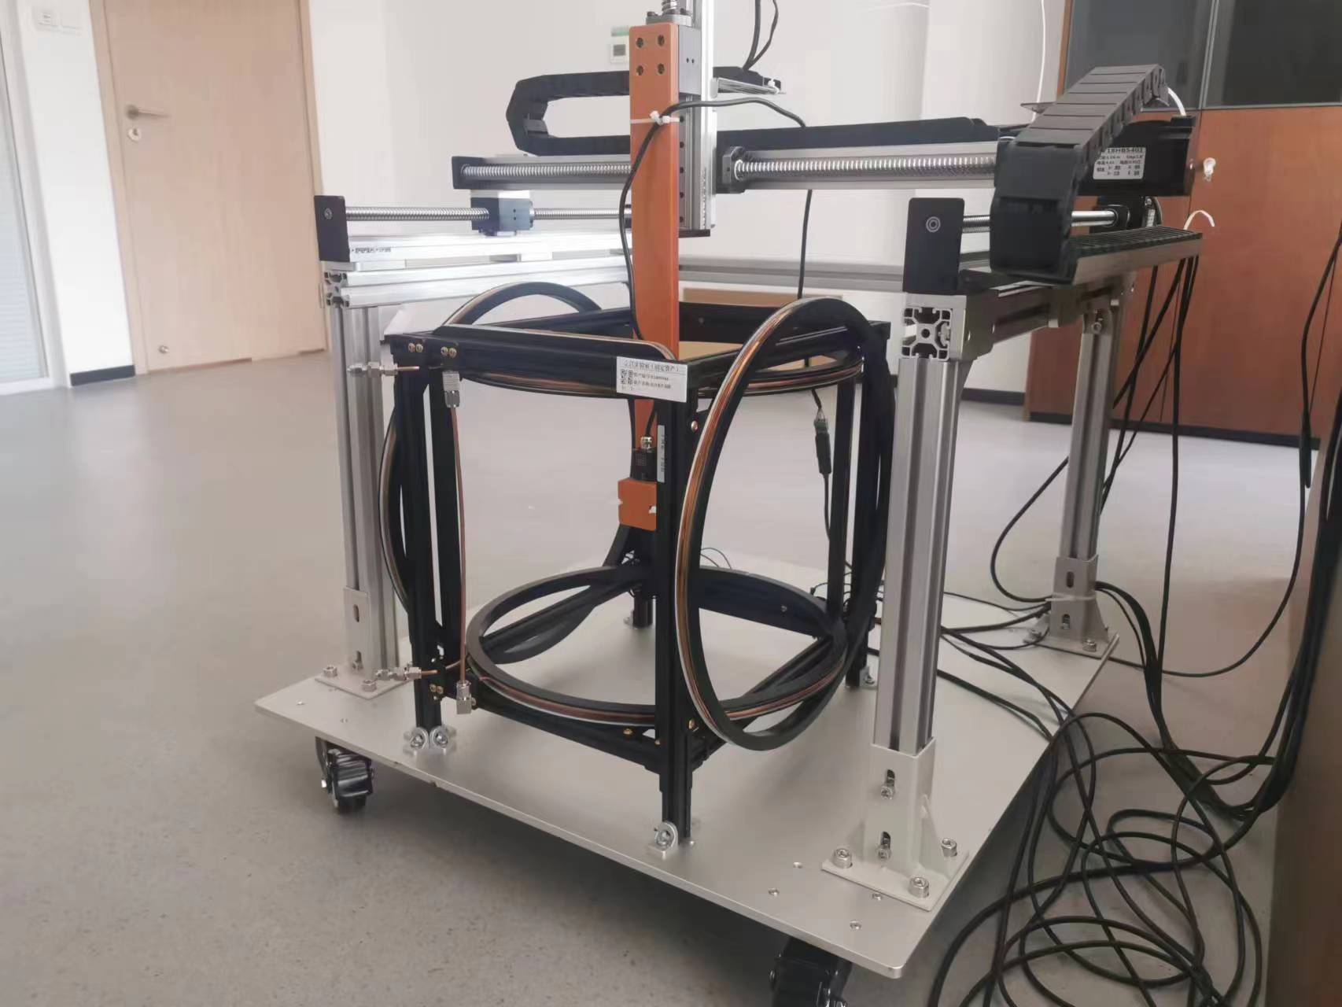
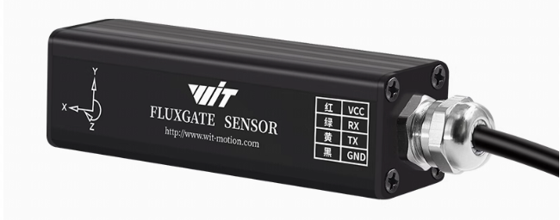
15
Experimental Data
Helmholtz Coils and Sliding Table System (position resolution ~0.5mm)

Slide 17
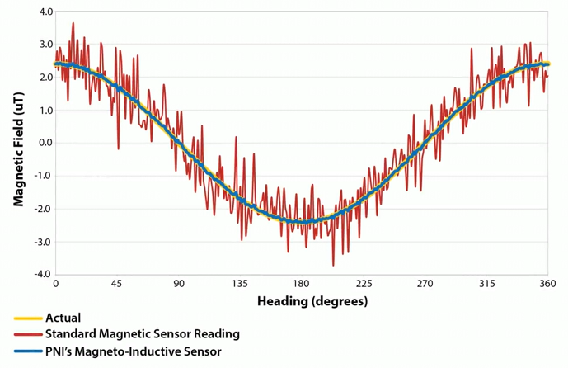
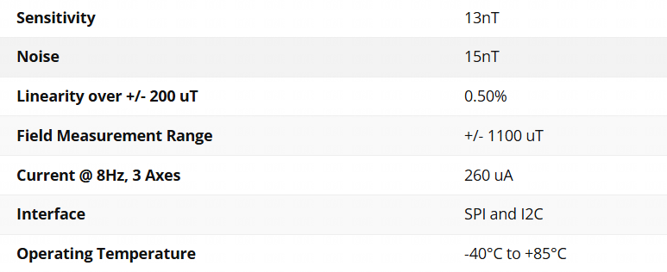
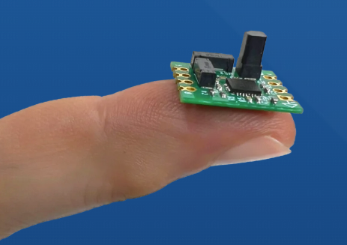

16
Sensor: RM3100 magneto-inductive sensor
23 times better resolution and 33 times less noise compared to traditional Hall-effect sensors
Core sensors have very small size
Sensitivity 13nT / Noise 15nT

Slide 18
17
Data Collection
Adjust the currents of the coils to cancel the geomagnetic at the center point (field ~0 μT)
The zero-field point is set as the origin point
Scan a cube region in range [-80mm to 80mm] for each axis with 40mm interval
At each point, stay 10s to get stable measurements (std ~ 15 nT)
In total collect 125 (5×5×5) points for one loop
The surface points are used as train data (98 points)
The inner points are used as test data (27 points)
We also adjust the currents of the coils to scale the field to 10 μT / 100 μT / 400 μT
Build 4 datasets (0 μT, 10 μT, 100 μT, 400 μT)

Slide 19
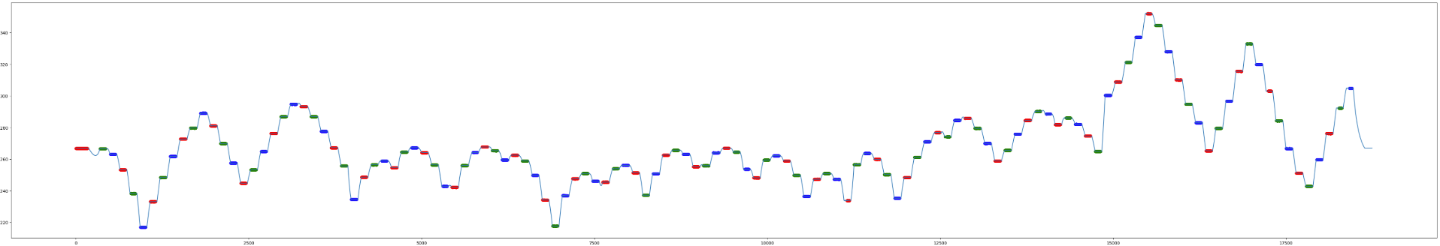
18
Measurement Data Overview
Scan loop #1
Scan loop #2
Repeatable measurement -> stable field condition
125 scanning data points for Bx (400 μT dataset)
The colored data are selected by setting a STD threshold

Slide 20
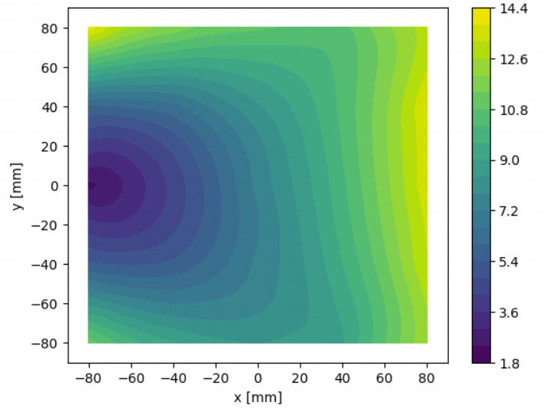
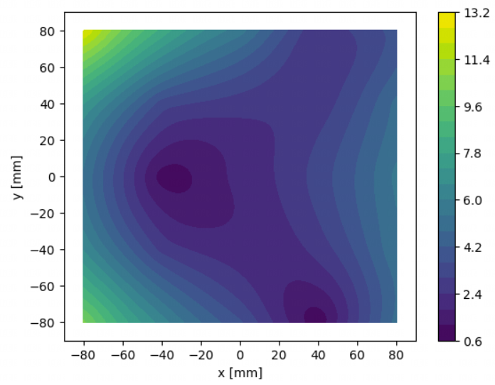
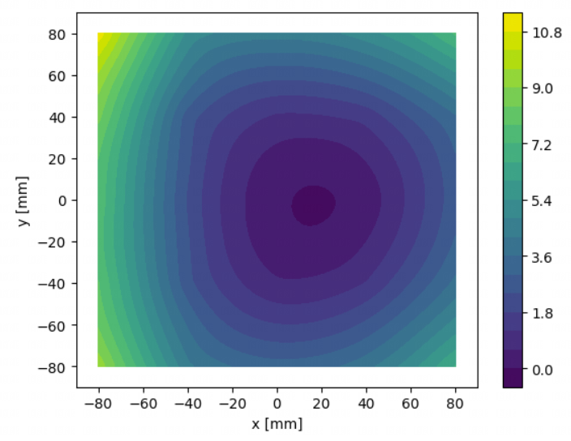
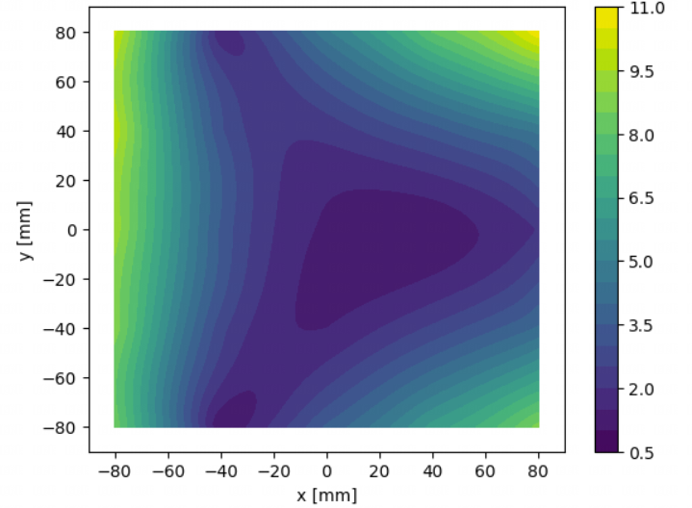
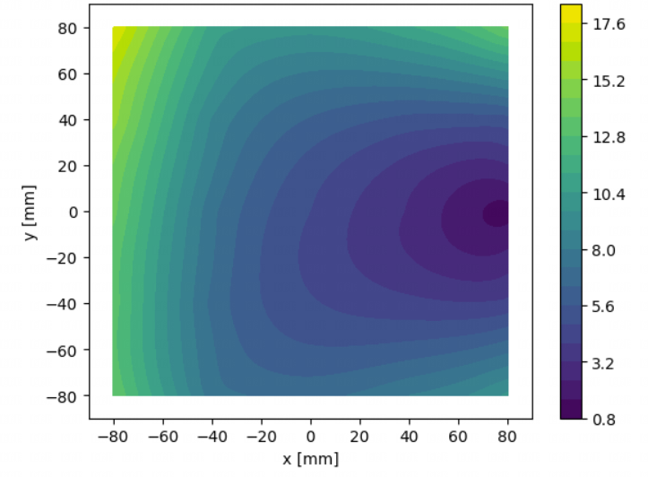
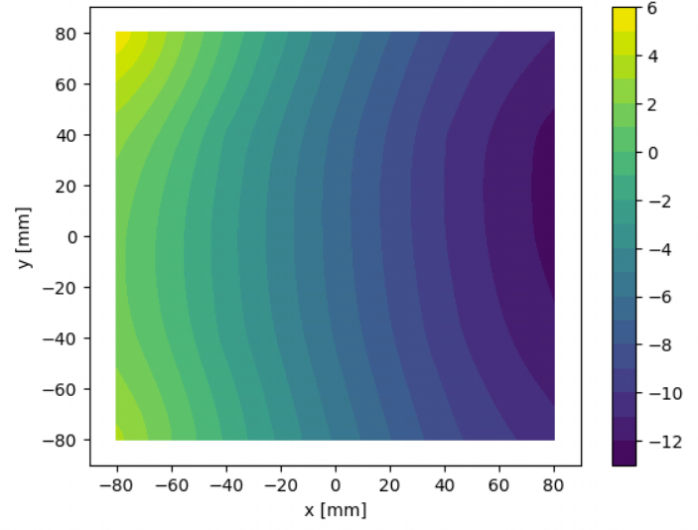
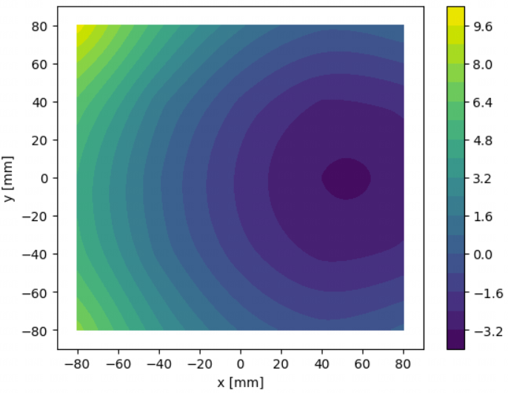
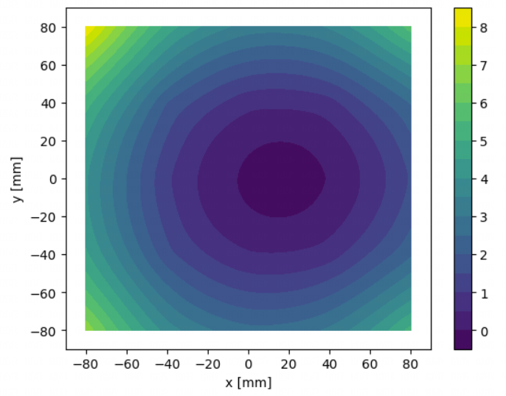
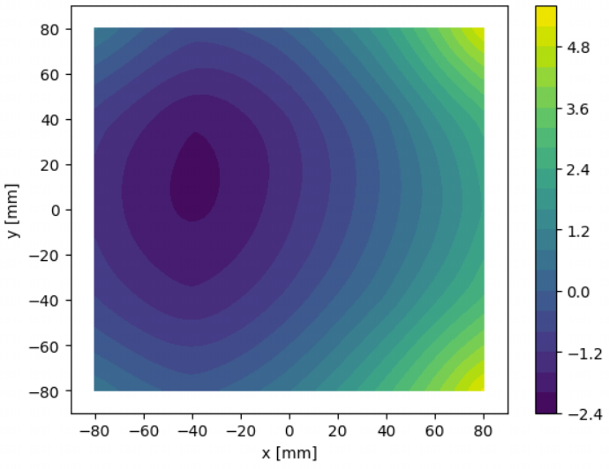
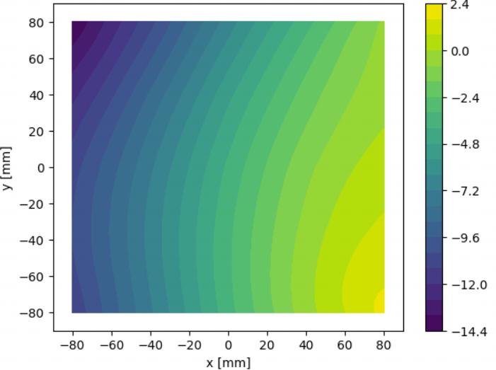
19
Field shape (0 μT dataset)
|B| at z=-80
|B| at z=-40
|B| at z=0
|B| at z=40
|B| at z=-80
Bz at z=-80
Bz at z=-40
Bz at z=0
Bz at z=40
Bz at z=-80

Slide 21

20
Preliminary Data Analysis
Training Steps：
Using the points at the surface as the input training dataset (in total 98 points)
The inner 27 points are treated as test dataset
To minimize the impact of randomness, we trained each dataset 30 times and averaged the results to validate the performance of PINN
[μT]
Training result on 27 test data points [0 uT dataset]

Slide 22
21
Preliminary Result
As the field strength increases, the relative error decreases rapidly
The reason is that the absolute field error between the predictions and measurements are at a similar level ~ sub-micro Tesla
The model demonstrates effective field monitoring at 0.37 μT precision for zero-field conditions
Satisfy the magnetic field requirement at the muon production region (±1 μT)
With absolute field errors maintained at sub-micro Tesla levels across increasing field strengths, the PINN method achieves proportionally higher prediction accuracy at stronger fields
Dataset | Mean relative error % | Std relative error % | Mean absolute error μT | Std absolute error μT
0 μT | 16 | 50 | -0.1 | 0.37
10 μT | 2.4 | 2.6 | 0.25 | 0.26
100 μT | 0.07 | 0.26 | 0.07 | 0.25
400 μT | 0.14 | 0.13 | -0.47 | 0.53

Slide 23
22
Summary
Precision magnetic filed measurement is an important part of the muon g-2 experiment
We develop a AI-Enhanced magnetic field measurements method
The PINN can both optimize the neural network from the data and the physics constrains
We built a coil and sliding table system to collect the real magnetic field data
A suitable fluxgate sensor which can monitor the tiny field in high precisions
The PINN method in experimental data shows promising result
Outlook
ML for PDE remain a laboratory product, performing better in simulated data but facing many challenges with real-world data
The PINN can be further improved by applying advanced optimization and better data taking/preprocessing
We plan to try more physical informed AI method like DeepONet / FNO
Questions or comments are very welcome!

