Slide 1
Search for Dark Photons via Visible Decays at Fixed-Target Experiments
Zejia Lu, Liang Li
^{Shanghai Jiao Tong University}
May 18th , 2025
International Workshop on Muon Physics at the Intensity and Precision Frontiers (MIP 2025)

Slide 2
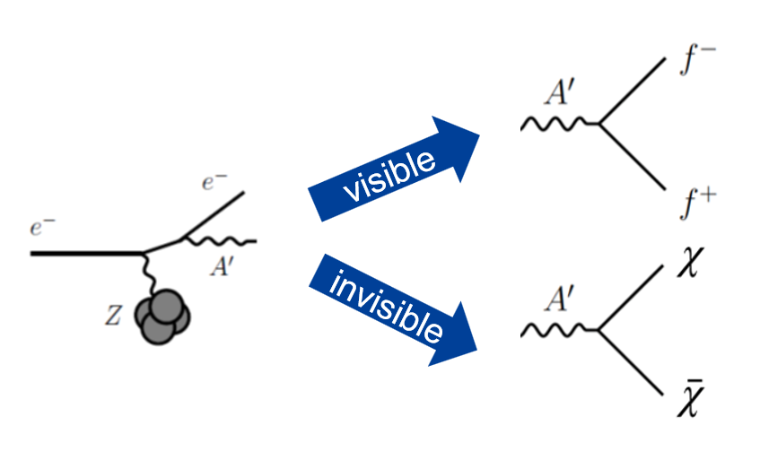
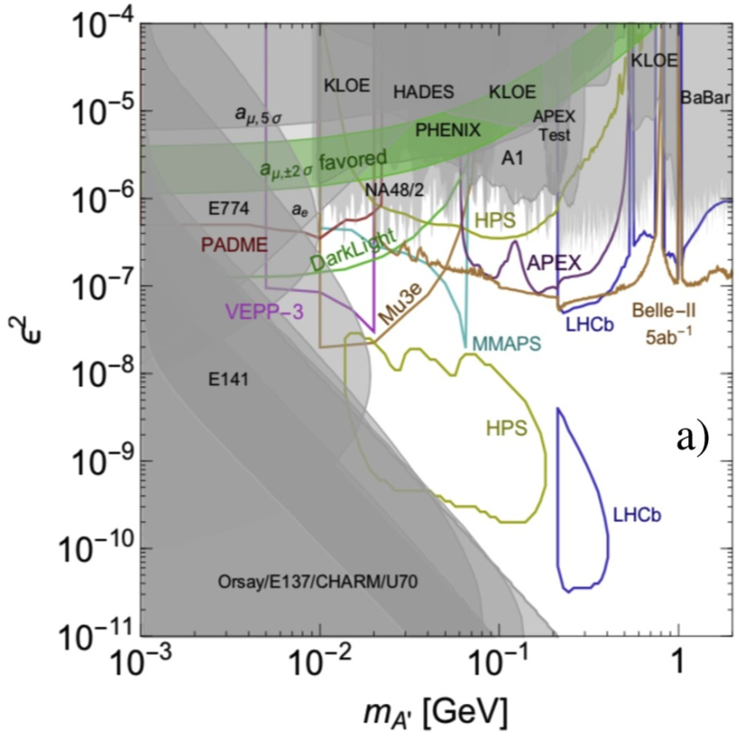
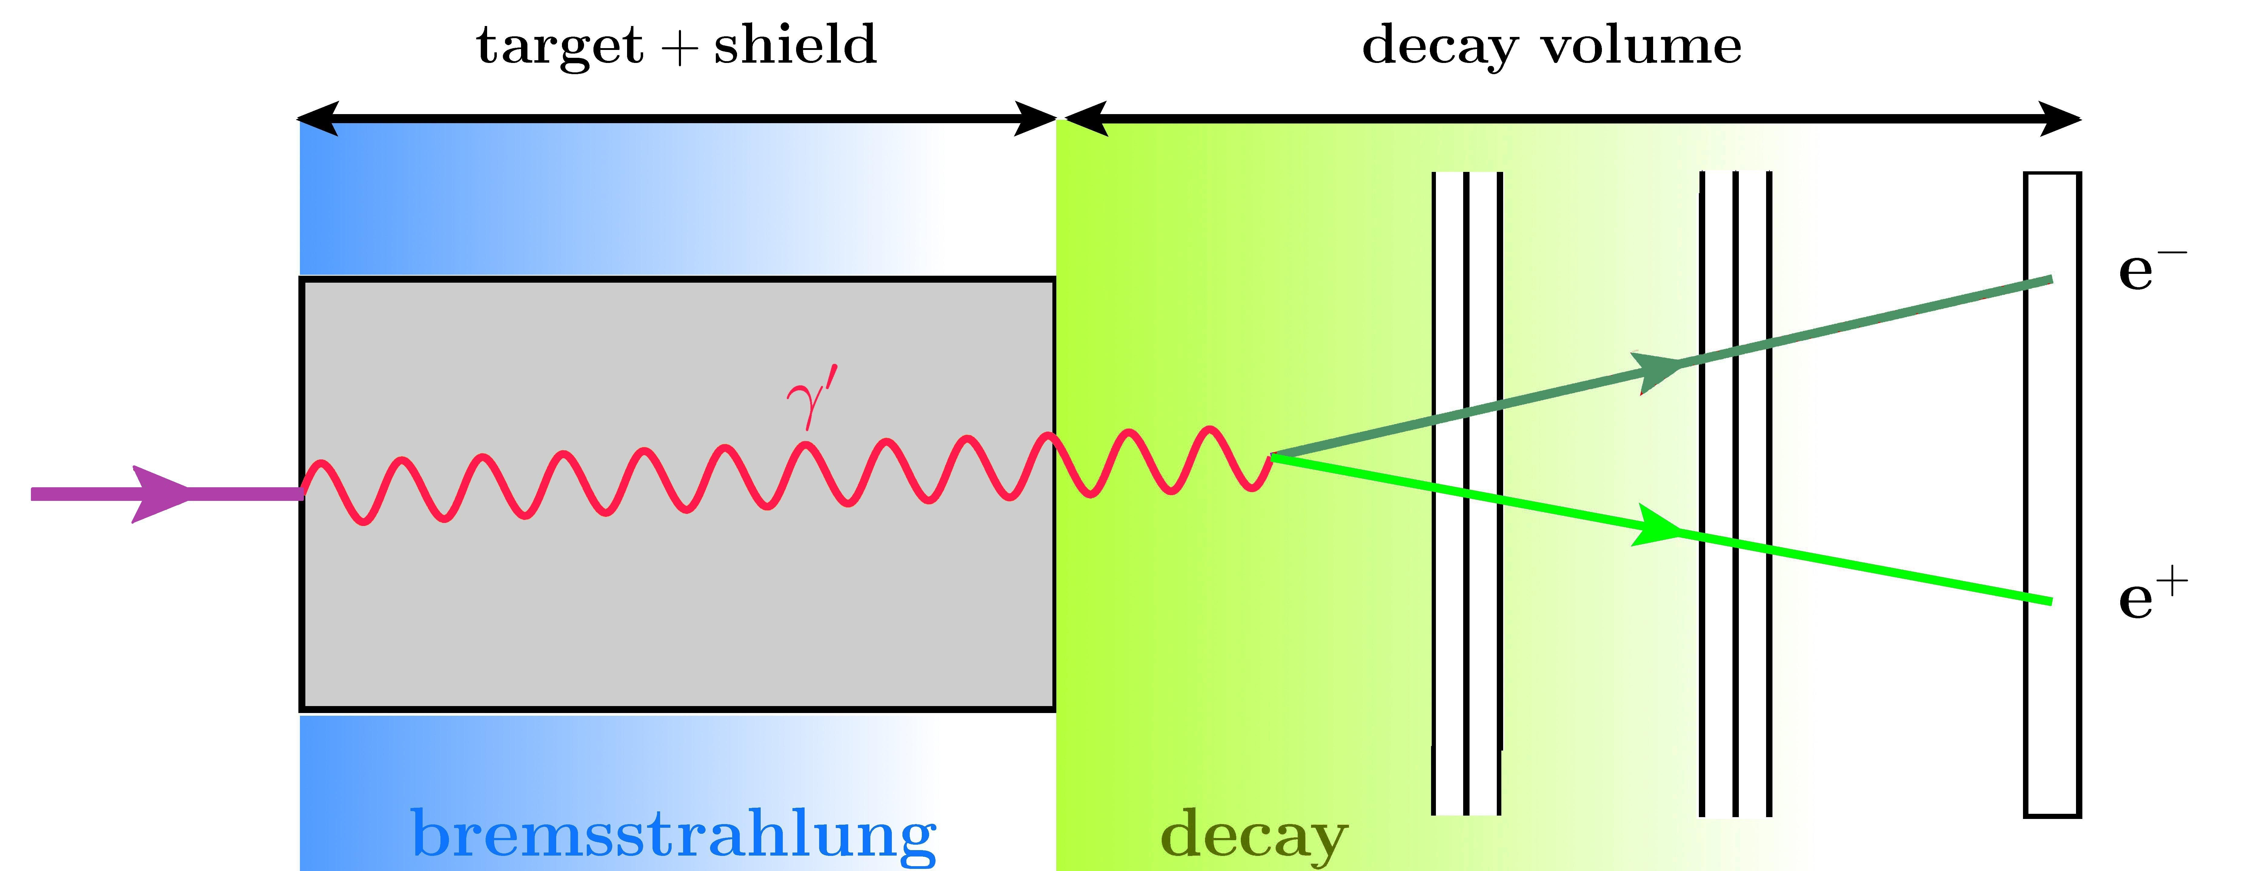
Introduction
Two model parameters:
Coupling constant $ε$
Dark photon mass $m_{A^{′}}$
We will focus on visible decay
Light dark matter search: dark photon
According to the decay channel of dark photon, we have invisible and visible decay.
$$ℒ=ℒ_{SM}+\frac{1}{2}\frac{ε}{\cos{θ_{W}}} F^{Y,μν}F_{μν}^{′}+\frac{1}{4}F^{′,μν}F_{μν}^{′}+m_{A^{′}}^{2}{A^{′}}^{2}$$
Bump hunting : High production rate
Challenging region :
Signal rate too low for bump hunting
Lifetime too short for beam-dump experiment
-> Displaced vertex reconstruction needed!
Beam-dump experiment : Long decay length
arixv:2006.04640

Slide 3
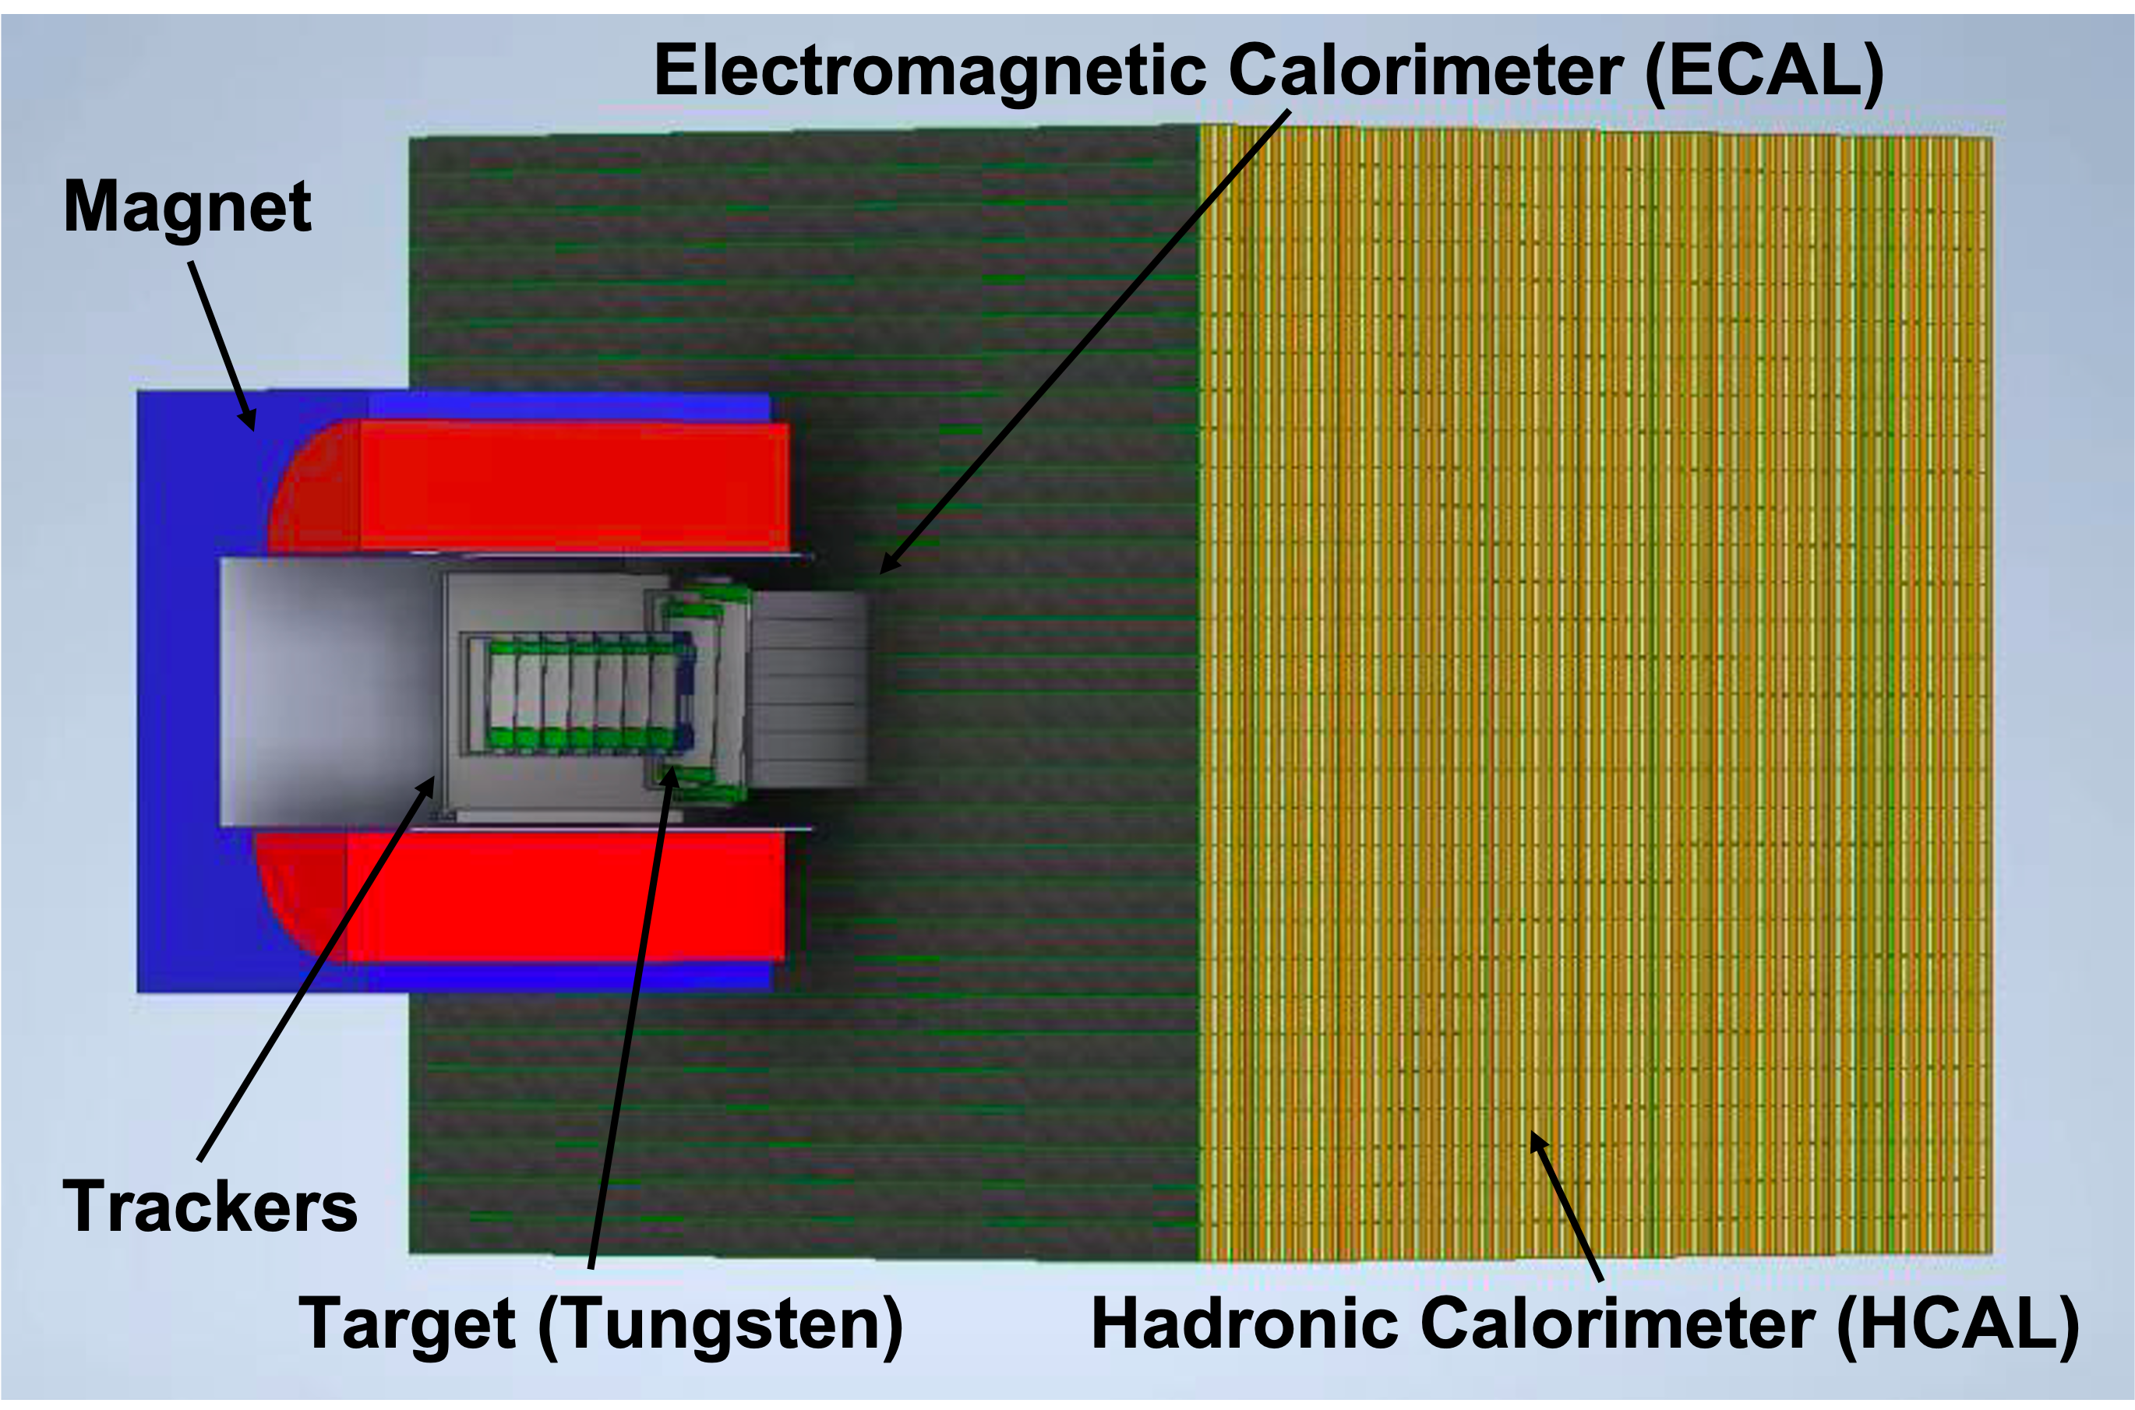
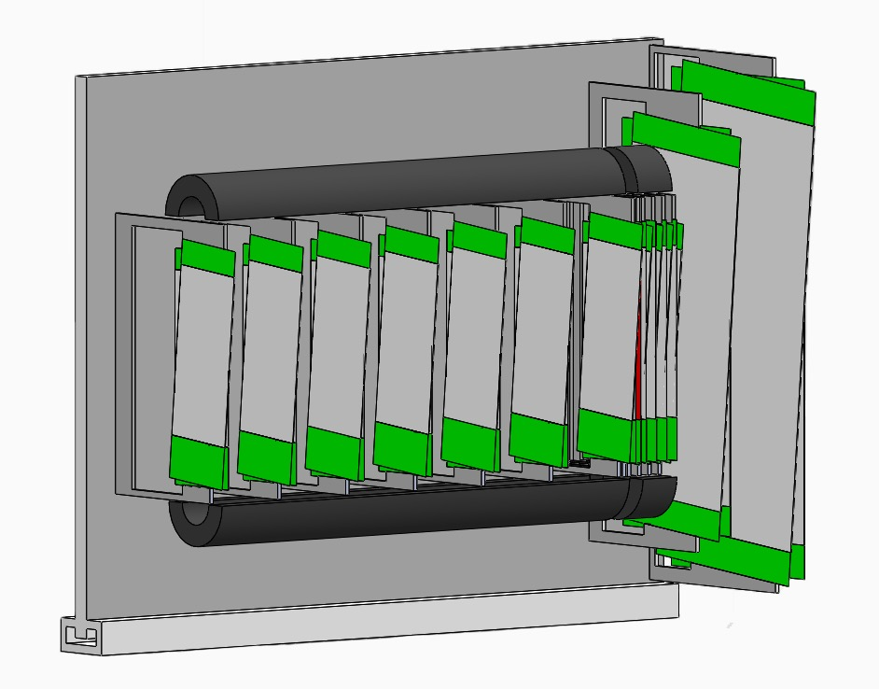
DarkSHINE Experiment at SHINE Facility
8 GeV $e^{−}$ beam
from Shanghai High Repetition-Rate XFEL and Extreme Light Facility (SHINE)
Stagger strip trackers
6 layers recoil trackers
$$e^{−}$$
$$e^{−}$$
$$e^{+}$$
 | Z location (mm) | Strip width (µm)
Tag tracker | [-630, -530, -430, -330, -230, -130, -30] | 30
Recoil tracker | [30, 60, 90, 120, 150, 180]
7 layers tagging trackers

Slide 4
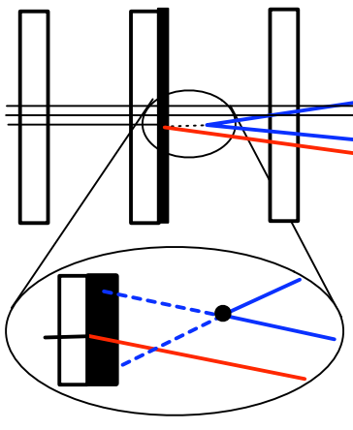
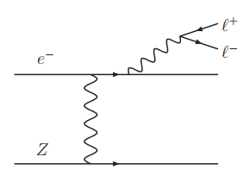
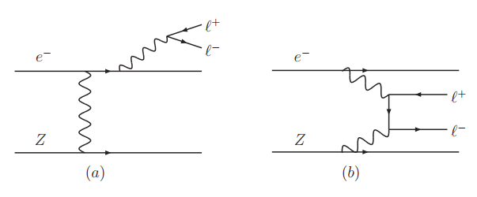
Signal and Background
arixv:0906.0580
Main background
(both virtual $γ→e^{+}e^{−}$)
Displaced vertex
Signal
$$A′$$
$$γ^{∗}$$
$A^{′}$ production and decay
$γ^{∗}$ trident reaction
Bethe-Heitler trident reaction
The main signature to differentiate signal from background is the displaced vertex.

Slide 5
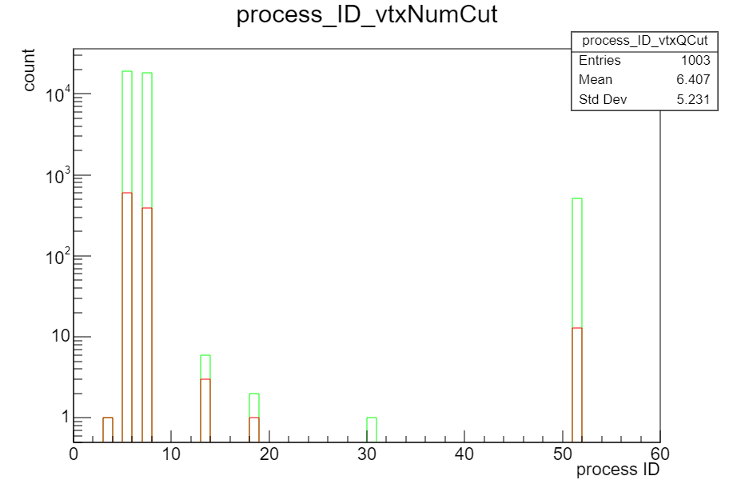
Signal and Background Separation
Through full simulation, two major background types can be identified:
Bremsstrahlung + gamma conversion and electron pair production.
The kinematics distributions of these two processes are similar.
To effectively exclude backgrounds, high-resolution vertex reconstruction is necessary.
0.1 $X_{0}$ W target
$3×{10}^{14}$ Electron-On-Target
conv
eBrem
ePairProd
Event type | eBrem + conv | ePairProd
Production rate | 2.5% | 0.06%
photonNuclear
compt
* For each ${10}^{4}$ EOT, there will be ~250 eBrem + conv events and ~6 ePairProd events, the background rate is pretty high!
electronNuclear
phot

Slide 6
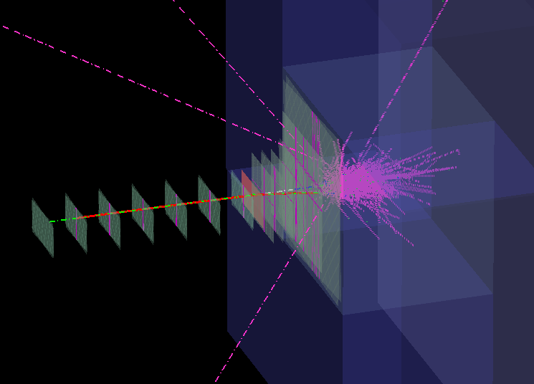
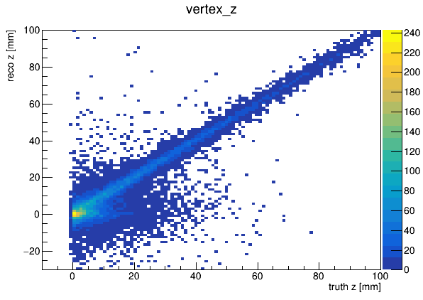
Simulation
Full simulation study: tracking and vertex reconstruction are needed to accurately estimate the vertexing resolution and background level in visible decay searching.
We conduct full Geant4 simulation, CalcHEP generator for signal production.
We apply full chain reconstruction from hits to tracks and to vertexes. We adopt Kalman Filter algorithm for both tracking (GenFit) and vertexing (Rave).
Track finding
Hit reconstruction
Vertex reconstruction
Track fitting
*In this study, we use truth track finding result.

Slide 7
Vertexing
We develop several methods to increase the vertexing resolution:
Use primary beam to reconstruct primary vertex on target, remove recoil electron track by its proximity to the primary vertex.
$$e^{−}$$
$$e^{−}$$
$$e^{+}$$

Slide 8
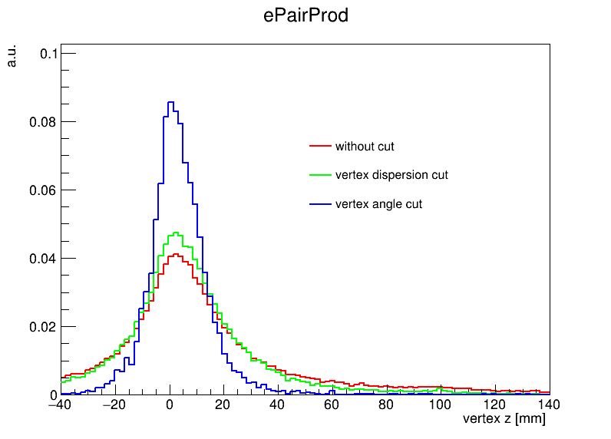
Vertexing
We develop several methods to increase the vertexing resolution:
Use primary beam to reconstruct primary vertex on target, remove recoil electron track by its proximity to the primary vertex.
Define variables for vertex quality:
Vertex dispersion: tracks distance at the vertex z plane
Vertex theta: the angle between two tracks
Shared hit num: number of shared hits in the tracks
Electron pair production background. Truth vertex at target.
By adding vertex quality cut, the long tail of reconstructed vertex distribution is reduced.

Slide 9
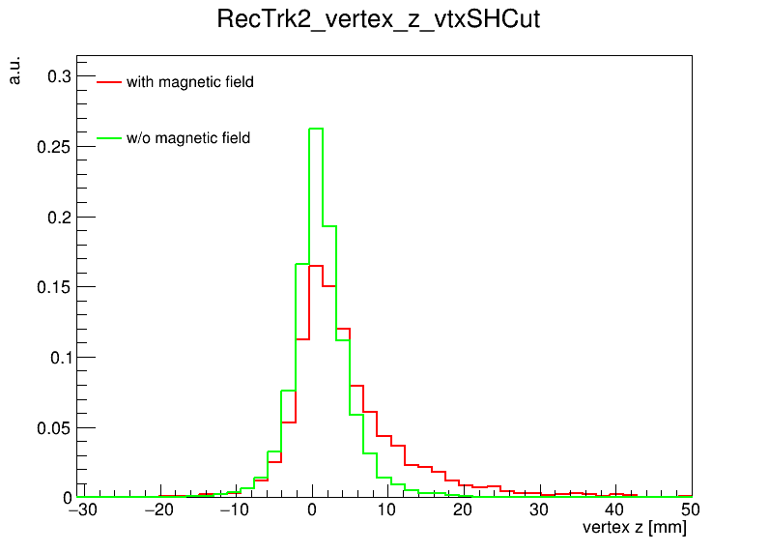
Vertexing
We develop several methods to increase the vertexing resolution:
Use primary beam to reconstruct primary vertex on target, remove recoil electron track by its proximity to the primary vertex.
Define variables for vertex quality:
Vertex dispersion: tracks distance at the vertex z plane
Vertex theta: the angle between two tracks
Shared hit num: number of shared hits in the tracks
To reduce the long tail at vertex z:
Turning off the magnetic field, vertex resolution is
improved by a factor of 2 (from 8 mm to 4 mm).
By turning off the magnetic field, the vertex resolution is improved by a factor of 2 (from 8 mm to 4 mm), and the tail is reduced.

Slide 10
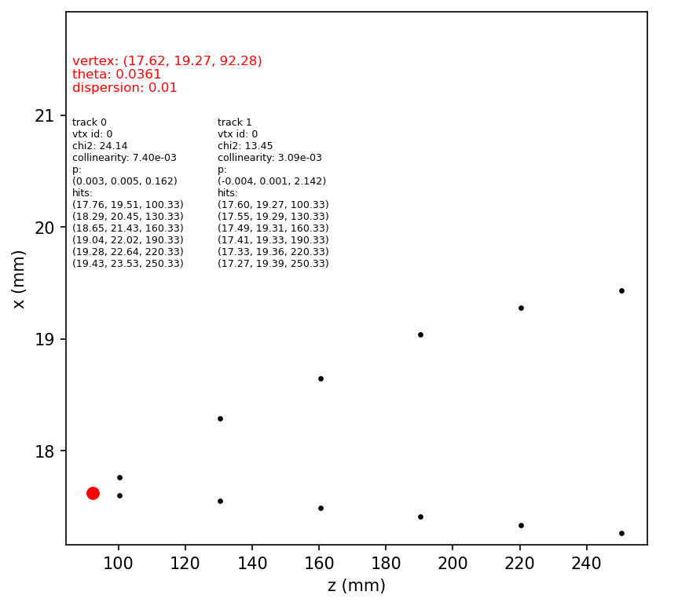
Vertexing
We develop several methods to increase the vertexing resolution:
Use primary beam to reconstruct primary vertex on target, remove recoil electron track by its proximity to the primary vertex.
Define variables for vertex quality:
Vertex dispersion: tracks distance at the vertex z plane
Vertex theta: the angle between two tracks
Shared hit num: number of shared hits in the tracks
To reduce the long tail at vertex z:
Turning off the magnetic field, vertex resolution is
improved by a factor of 2 (from 8 mm to 4 mm).
Many large reconstructed vertex z is due to scattering
at tracker, we add collinearity cut on track to exclude such cases.
(vertex resolution improved from 4 mm to 3 mm).

Slide 11
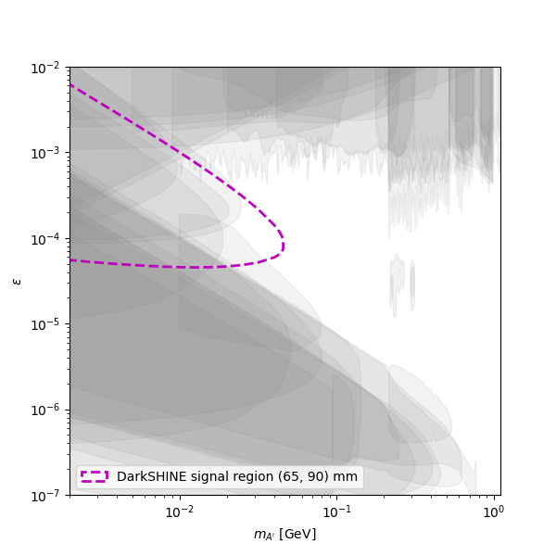
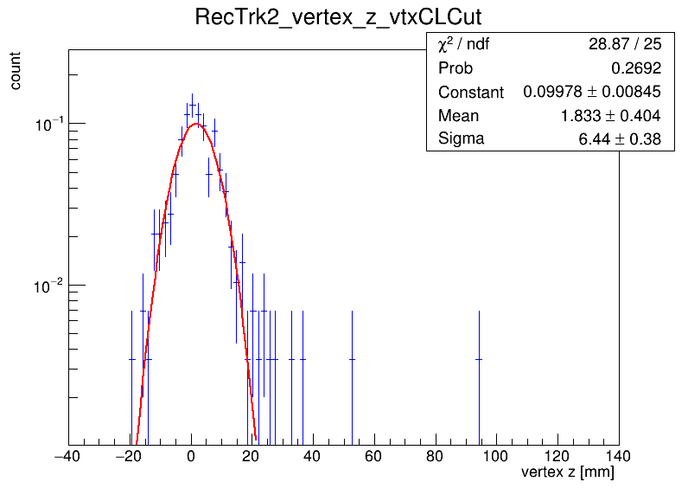
Signal Region Definition
To define a low background region, we need to increase the distance between target and tracker, even though this will reduce the vertex resolution.
The distance between target and first tracker changes from 30 mm to 100 mm.
After several cuts, the vertex resolution can reach around 6.5 mm. Assuming gaussian distribution, take $10σ$ region as low background region, we take (65, 90) mm.
By selecting a displaced vertex to achieve a low background region
Background: 100 out of 3E14 EOT
90% C.L. signal limit can be defined

Slide 12
Possible Improvement
Add an extra layer of close tracker:
It can improve the vertex resolution in background case since it is closer to the vertex.
It can also be used for background veto, we can select events with single hit at close tracker.
Signal region is defined at between the close tracker and far trackers
 | Background (ePairProd)
total | 1000000
Single hit at close tracker | 7200
Vertex angle < 0.02 rad | 10
signal region
After single hit cut and vertex angle cut, the ePairProd at target background can be greatly suppressed.
The main background becomes electron pair production at the close tracker. Consider change the close tracker to drift chamber to reduce multiple scattering.
Further study is ongoing.
Target
close tracker
far trackers

Slide 13
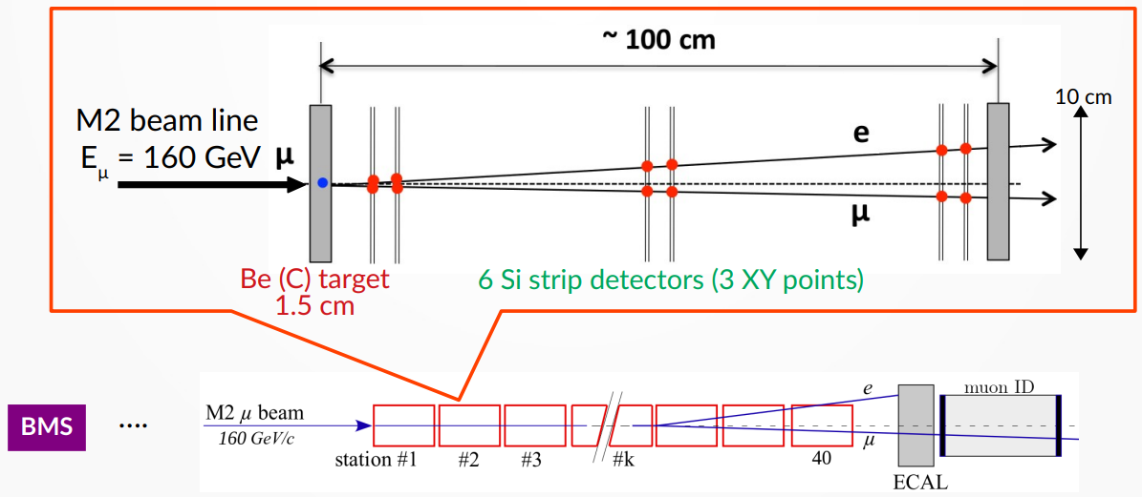
MUonE Experiment
MUonE experiment is designed to measure the differential cross section of the elastic scattering process $μ^{±}e^{−}→μ^{±}e^{−}$. Given the high angular resolution of tracking system, it is also suitable for searching the dark photon at visible decay channel.
*Plot taken from 1st Europe-China-Japan Workshop on Muon Physics

Slide 14
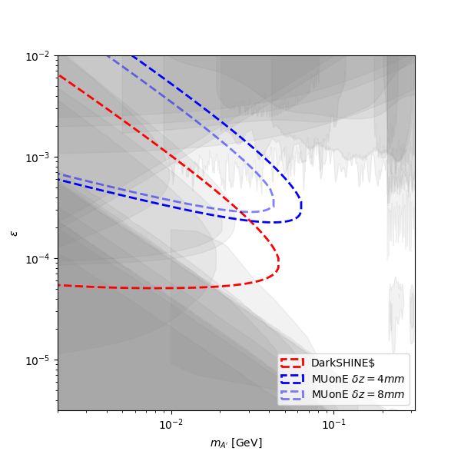
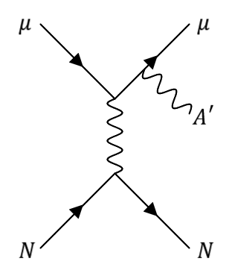
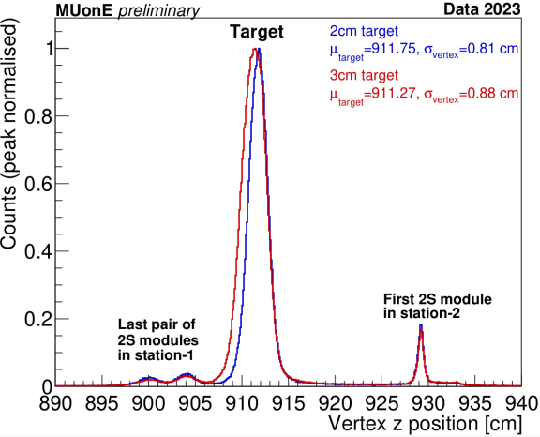
Comparison of DarkSHINE and MUonE
Dark photon production via muon bremsstrahlung in $μN$ scattering process:
DarkSHINE uses tungsten target and MUonE uses beryllium target, DarkSHINE has a higher production rate.
MUonE has 20 times higher beam energy than DarkSHINE, more sensitive to short lifetime signals.
Complementarity between DarkSHINE and MUonE.
Requiring > $10σ$ (vertex resolution) to achieve low background region
Assuming signal efficiency ~ 60%
Sensitivity increases if vertex resolution improves from 8 mm to 4 mm
 | Target | EOT(MOT)
DarkSHINE | W, $0.1X_{0}$ | $$3×{10}^{14}$$
MUonE | Be, $5×0.08X_{0}$ | $$1.3×{10}^{15}$$

Slide 15
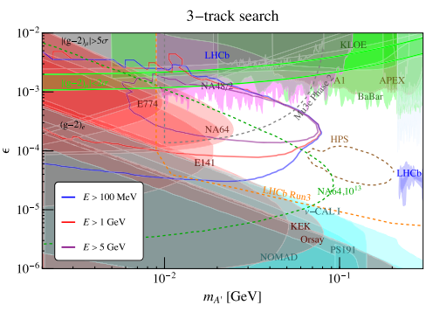
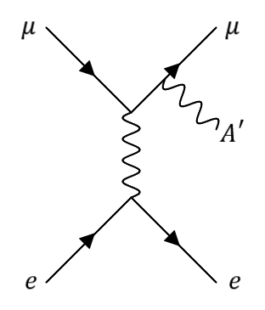
Visible Decay Search at MUonE
MUonE can also search for dark photon production in $μe$ scattering process.
There has been a phenomenology study of visible decay search at MUonE in 2023.
However, the analysis is somewhat simplified using fast simulation with strong assumptions.
E.g. vertexing resolution has been assumed to be 1mm.
More realistic checks with full reconstruction of displaced vertex is needed.
What can we do at MUonE?
Full analysis of visible decay search based on full simulation and data.
Improve vertexing resolution based on the experience at DarkSHINE.
MUonE has the potential for search for other muon-philic BSM particles.
PHYS. REV. D 107, 095003 (2023)

Slide 16
Summary
Fixed-target experiments such as DarkSHINE and MUonE have the potential for search of the dark photon visible decay.
In the preliminary study at DarkSHINE, full simulation based on Geant4 and vertex reconstruction algorithm based on Rave have been established.
Several methods to improve vertex resolution have been explored.
A low-background region is achieved, and the signal sensitivity reaches unexplored parameter space at $m_{A′}=40 MeV$, $ε={10}^{−4}$.
New detector setup to further extend signal region is under evaluation.
The methodology of visible decay search can be easily applied to MUonE.
Optimizing vertexing algorithm based on the geometry and beam of MUonE.
Ability to search for muon-philic BSM physics.

Slide 17
Thank You

