Slide 1

Search for a muon EDM
Using the frozen-spin technique
Dr. Philipp Schmidt-Wellenburg
International Workshop on Muon Physics
at the Intensity and Precision Frontiers | Changsa | 17.05.2025

Slide 2


















CP violation & edm
$$\vec{μ}=μ\vec{s}$$
$$\vec{d}=d\vec{s}$$
A non-zero particle EDM
violates P, T and,
assuming CPT conservation, also CP.
$$|\left.↑\right\rangle$$
$$|\left.↑\right\rangle$$
$$U=− \vec{μ}⋅\vec{B}$$
$$U=− \vec{d}⋅\vec{E}$$
$$ΔU=ℏω_{e}$$
$$|\left.↓\right\rangle$$
$$|\left.↓\right\rangle$$
$$B$$
$$E$$
`
T
T
$$|\left.↑\right\rangle$$
$$U=−\vec{μ}⋅\vec{B}$$
Baryon asymmetry
of the Universe
$$U=\vec{d}⋅\vec{E}$$
$$|\left.↑\right\rangle$$
$$B$$
$$E$$
Arises “naturally” in
beyond SM theories
EDM
CPV
Strong CP violation
($θ$-term)
Notes:
Symmetries and the breaking of symmetries are an important concept of all modern physics theories.
To better understand the violation of discrete symmetries by an EDM I have made this sketch of the energie levels of a spin-1/2 particle in a magnetic and electric field.
The left side every body is familiar with. It corresponds to the classical zeeman splitting in atoms. Depending on the spin of the particle the magnetic moment will lead to an increase or decrease in energy.
Similar on the right side, the electric dipole moment leads to a similar level splitting in the electric field.
Lets concentrate on the spin up state. [click]
Now we apply a Ti

Slide 3
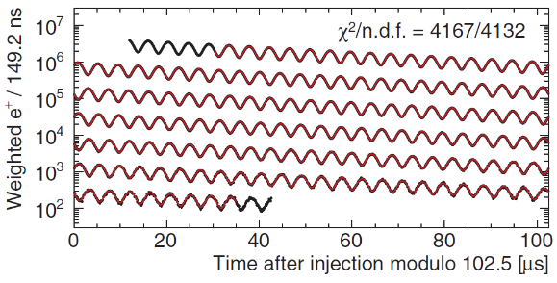
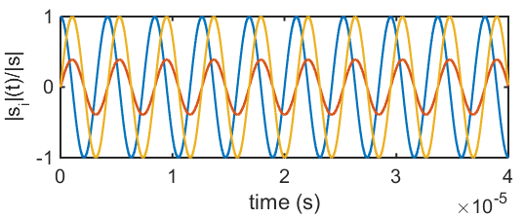


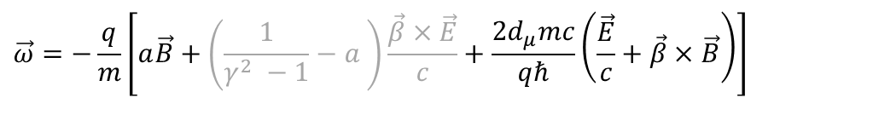


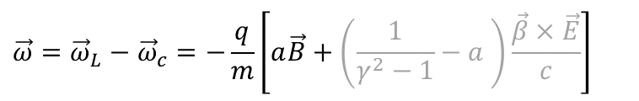






Muon dipole moments and frequencies
$$\vec{ω}=−\frac{q}{m}\left[a\vec{B}+\left(\frac{1}{γ^{2} −1}−a \right)\frac{\vec{β}×\vec{E}}{c}+\frac{2d_{μ}mc}{qℏ}\left(\frac{\vec{E}}{c}+\vec{β}×\vec{B}\right)\right]$$
$$\vec{ω}={\vec{ω}}_{L}−{\vec{ω}}_{c}=−\frac{q}{m}\left[a\vec{B}+\left(\frac{1}{γ^{2}−1}−a \right)\frac{\vec{β}×\vec{E}}{c}\right]$$
g-2 term $ω_{a}$
EDM term $ω_{e}$
B
$${\vec{ω}}_{a}$$
$$\sqrt{{\vec{ω}}_{a}^{2}+{\vec{ω}}_{e}^{2}}$$
$$ζ$$
$$R=7.114 m$$
$$ζ=\operatorname{atan}\left(\frac{2d_{μ}βcm}{a}\right)$$
$$\vec{s}$$
FNAL* & JPARC**:
$$σ\left(d_{μ}\right)≈{10}^{−21}ecm$$
$${\vec{ω}}_{e}$$
[Abi et al., PRL126 141801(2021)]
[*Chislett et al., EPJConf.118 01005(2016), Abi et al., PRL126 141801(2021), **Abe et al., PTEP053C02 (2019)]
Notes:
Many of you probably know about the g-2 measurement of the muon at Fermilab.
The principle physics are described in the equation. The difference between the Larmor frequency of the muon, essentially the precision due to the magnetic moment, and the cyclotron frequency of the muon moving in a magnetic and electric field.
The muon moves along its reference orbit perpendicular to the main magnetic field. Due to the small anomalous magnetic moment the difference is not exactly zero and one can observe the famous wiggle plot by measuring in the number of decay positrons per time.
The electric field is required for steering the muon inside the storage ring. By selecting the correct momentum the electric term can be set to zero and the observed oscillation frequency directly relates to the anomalous magnetic moment.
Now in the presence of a electric dipole moment the plane of oscillation tilts and one could observe a tiny vertical observation of the positron intensity, and the measured frequency would be a little bit larger.
The prospected sensitivity is about 10E-21 ecm for the EDM at Fermilab and JPARC.

Slide 4
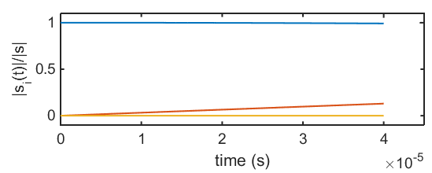


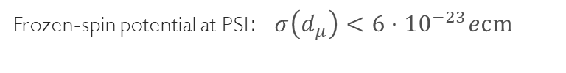



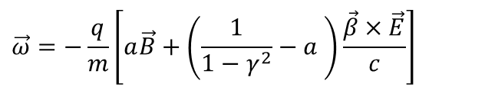


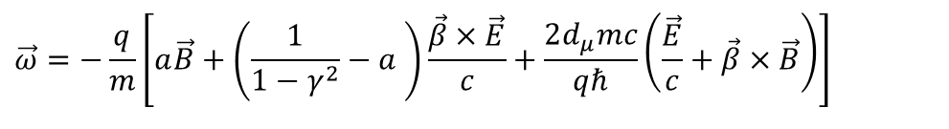


Muon dipole moments –freezing the spin at PSI
$$\vec{ω}=−\frac{q}{m}\left[a\vec{B}+\left(\frac{1}{1−γ^{2}}−a \right)\frac{\vec{β}×\vec{E}}{c}+\frac{2d_{μ}mc}{qℏ}\left(\frac{\vec{E}}{c}+\vec{β}×\vec{B}\right)\right]$$
$$\vec{ω}=−\frac{q}{m}\left[a\vec{B}+\left(\frac{1}{1−γ^{2}}−a \right)\frac{\vec{β}×\vec{E}}{c}\right]$$
g-2 term $ω_{a}$
EDM term $ω_{e}$
$$s_{z}$$
Frozen-spin potential at PSI:$σ\left(d_{μ}\right)<{6⋅10}^{−23}ecm$
B
$$s_{y}$$
$$R=31 mm$$
$${\vec{ω}}_{e}$$
E
$$s_{x}$$
set $E ≅aBcβγ^{2}$
Phase I: $σ\left(d_{μ}\right)<{3⋅10}^{−21}ecm$
[*Farley et al,, PRL93 042001 (2004) ] ,
Notes:
To further increase the sensitivity to a muon EDM we propose to use the frozen-spin technique to measure the electric dipole moment.
By applying a well tuned electric field this entire term can be canceled and the spin exactly follows the momentum, essentially it is frozen to the momentum.
The only term present is the one of the electric dipole moment which leads to a precession of the spin around the radial axis like a bicycle going in a circle.
This in turn leads to a build up of a asymmetry of positron decays along and against the direction of the magnetic field, the signal we are searching for.

Slide 5
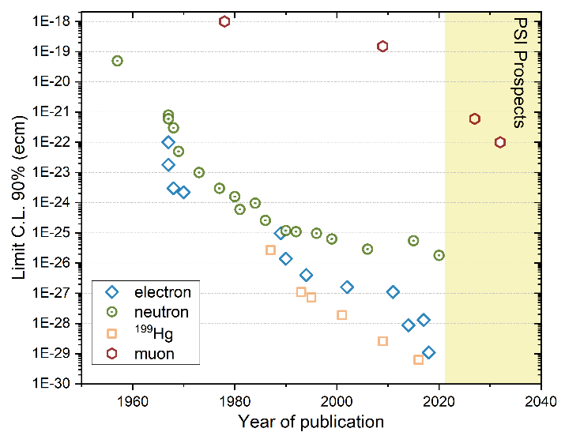
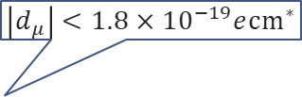
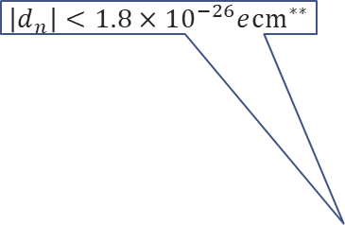

A not so brief history of EDM searches
$$\left|d_{μ}\right|<1.8×{10}^{−19}e{cm}^{∗}$$
Neutron
Electron
Muon
log(d) /ecm
log(d) /ecm
log(d) /ecm
$$\left|d_{n}\right|<1.8×{10}^{−26}e{cm}^{∗∗}$$
-18
-20
-22
-24
-26
-28
-30
-32
-34
-36
-38
-18
-20
-22
-24
-26
-28
-30
-32
-34
-36
-38
-18
-20
-22
-24
-26
-28
-30
-32
-34
-36
-38
$$\frac{m_{μ}}{m_{e}}$$
10¹⁸
10⁶
*Bennett et al.,PRD80(2009)052008
** Abel et al., PRL124(2020)081803
10⁸
Notes:
Searches for electric dipole moments started a long time ago in the 1950 when Ramsey and Purcell were first searching an EDM using a beam of neutrons.
Since then, the race to the bottom started.
Here on this graph I depicted for you the 90% limits versus the year of publication. In green the neutron, the blue diamonds are measurements on atoms and molecules extracting the EDM off the electron.
In yellow squares the impressive story of the mercury EDM. Lagging far behind is the muon, the only sizable search for an EDM of a particle in the second generation.
On the right side you see the expectation range for standard model EDM from the small imaginary phase of the CKM matrix in relation to the current limit.
The neutron still has another 6 orders of magnitude until they will hit the SM background. The electron another 9 order of magnitude, while the muon is today where Ramsey started 70 years ago and has another 18 orders of magnitude of legroom.

Slide 6
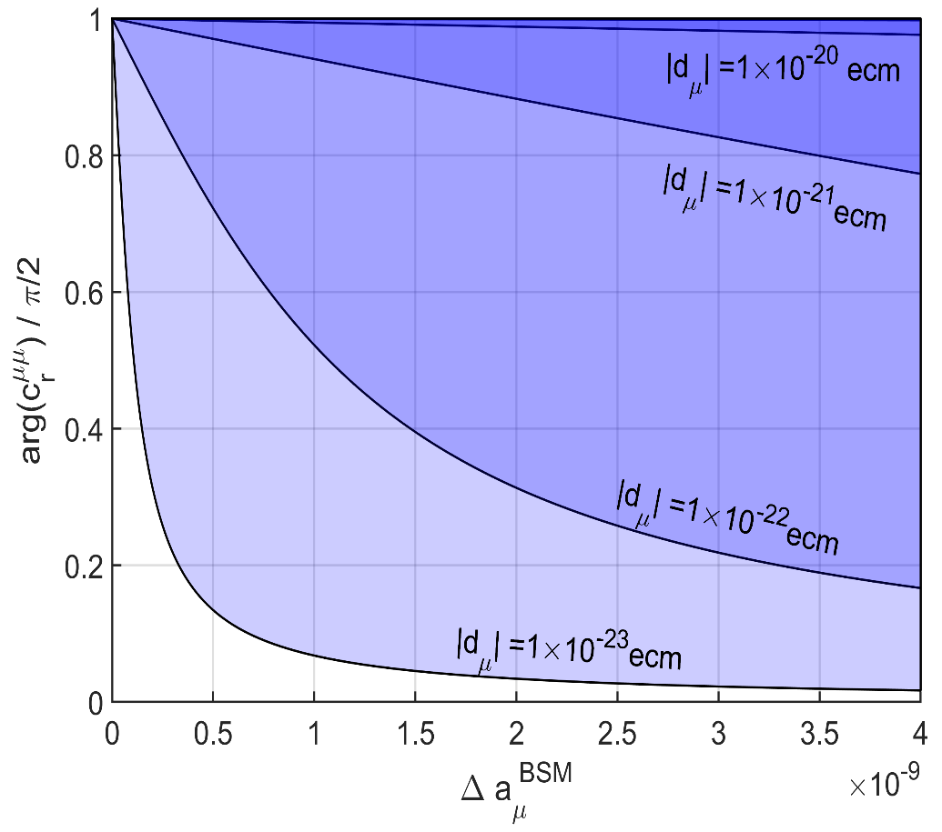
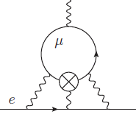

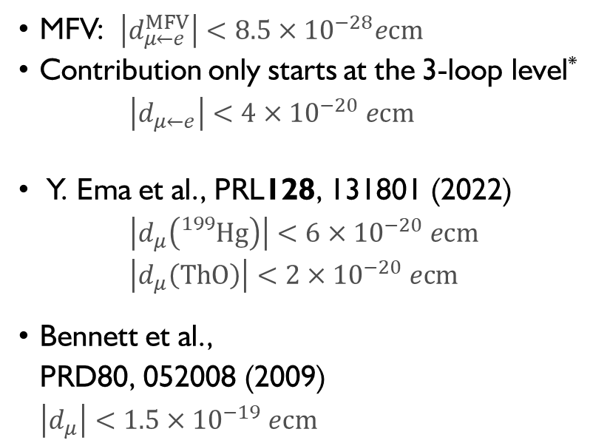
General limits on $μ$EDM
MFV: $\left|d_{μ←e}^{MFV}\right|<8.5×{10}^{−28}ecm$
Contribution only starts at the 3-loop level* $\left|d_{μ←e}\right|<4×{10}^{−20} ecm$
Y. Ema et al., PRL128, 131801 (2022)
$\left|d_{μ}\left({}_{}^{199}{Hg}\right)\right|<6×{10}^{−20} ecm$
$\left|d_{μ}\left(ThO\right)\right|<2×{10}^{−20} ecm$
Bennett et al.,
PRD80, 052008 (2009)
$\left|d_{μ}\right|<1.5×{10}^{−19} ecm$
Fermilab/J-PARC
BMW $±2σ$
PSI (frozen spin)
*A.Crivellin, M. Hoferichter, PSW PRD 98, 113002 (2018)

Slide 7
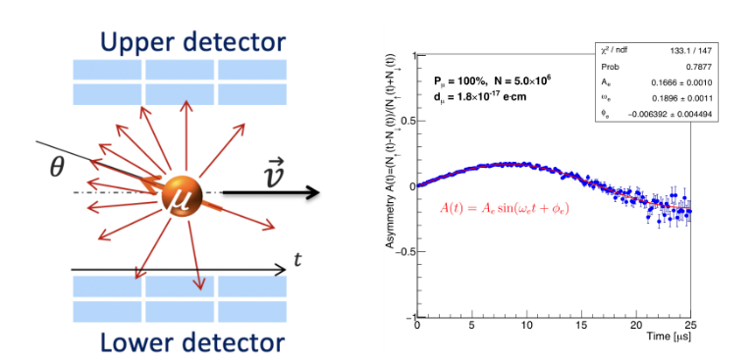


The general experimental idea
B
If the EDM ≠ 0, then there will be a vertical precession out of the plane of the orbit
  An asymmetry increasing with time will be observed recording decay positrons
If the EDM = 0, then the spin should always be parallel to the momentum
asymmetry should be zero
Some asymmetry could still be
observed due to systematic effects
$$R=31 mm$$
$${\vec{ω}}_{e}$$
E

Slide 8
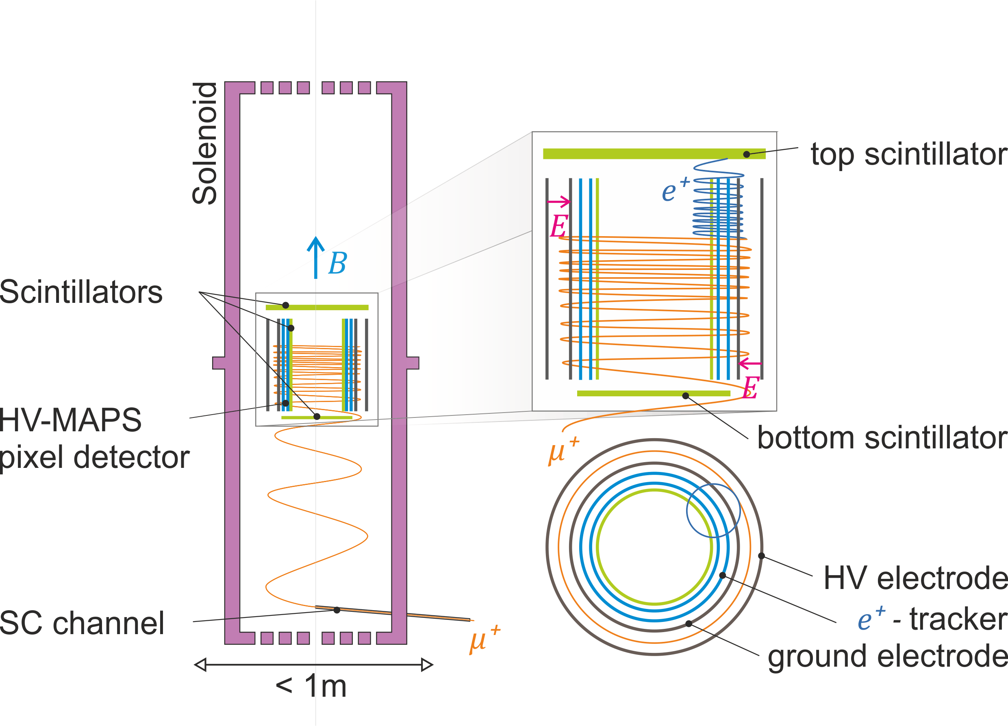
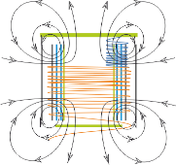




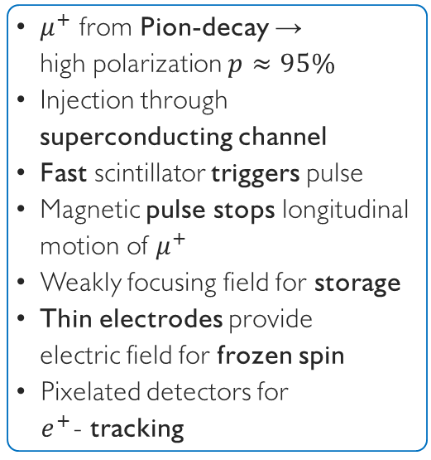




Search for a muon EDM using the frozen-spin technique with longitudinal injection
$μ^{+}$ from Pion-decay →
high polarization $p≈95\%$
Injection through superconducting channel
Fast scintillator triggers pulse
Magnetic pulse stops longitudinal motion of $μ^{+}$
Weakly focusing field for storage
Thin electrodes provide
electric field for frozen spin
Pixelated detectors for
$e^{+}$- tracking
$$B=3T$$
$$R=0.14 m$$
$$\vec{s}$$
$$\vec{s}$$
$$π$$
$${\overline{ν}}_{μ}$$
$$μ^{+}$$
$μ^{+} @ 125MeV/c$ or $28MeV/c$
Notes:
Here is a conceptional sketch of the proposed instrument to search for an electric dipole moment of the muon using the frozen spin technique.
The plan is to use a dedicated highly uniform solenoid, with a weakly focusing field in the center.
We will use positive muons from backwards decaying pions with a very high polarization.
[click]
The are injected through a superconducting channel into the high field region of a very homogeneous solenoid.
Scintillators inside the collimation channel trigger a magnetic pulse.
[click]
While the muon spirals into the central region, a magnetic pulse is prepared to stop the longitudinal motion, such that the muon finally is stored on a stable orbit in the weakly focusing field in the center of the magnet.
[click]
Two cylindrical and very thin electrodes provide the electric field for the frozen spin condition.
[click]
Once the muon decays into a positron, the positron can be observe by a cylindrical tracker within the ground electrode.

Slide 9
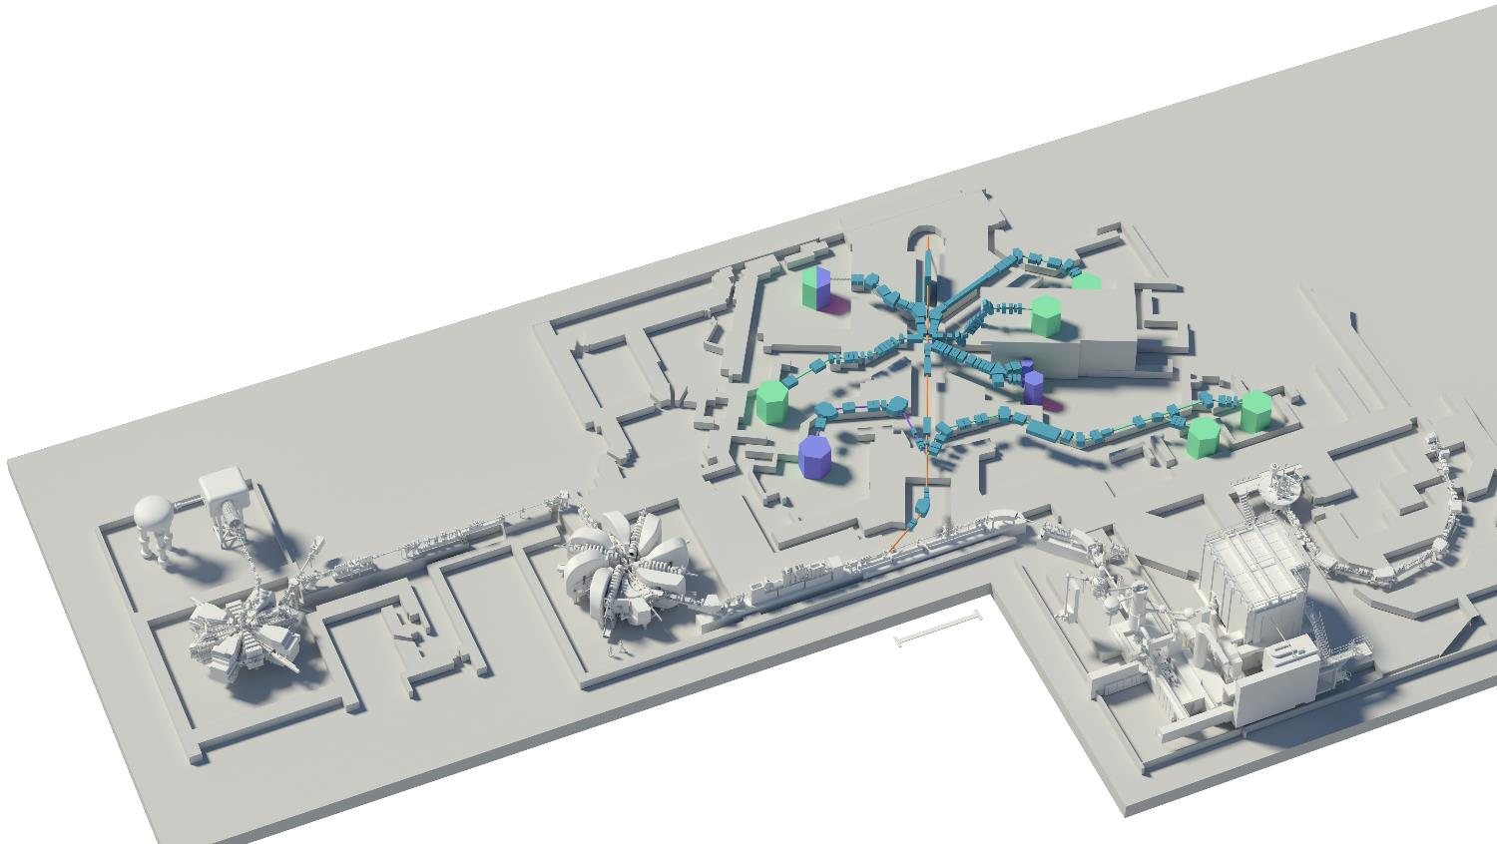
HIPA – high intensity proton accelerator
Pion and Muon
research
Main cyclotron
590 MeV
I_{p} = 2.4 mA
P=1.4 MW
Cockcroft-Walton
860 keV
nEDM
Injector cyclotron
72MeV
UCN area

Slide 10
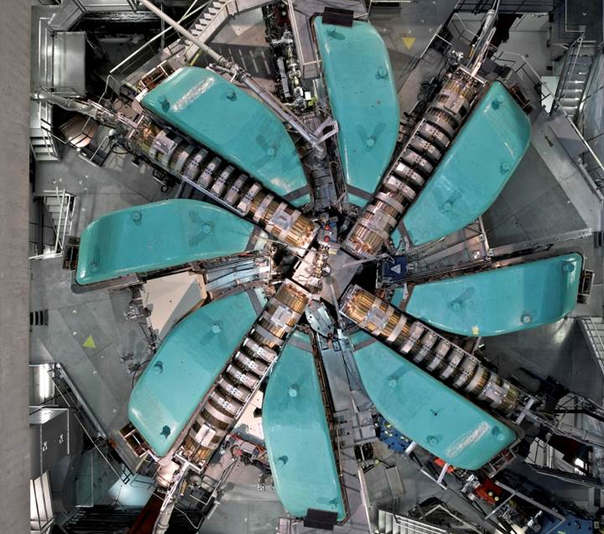
590 MeV
2.4 mA
1.4MW
50.6 MHz

Slide 11
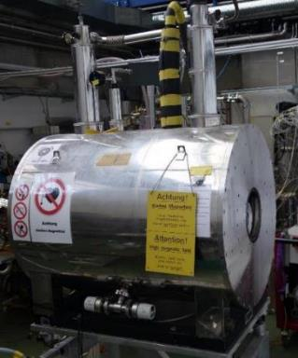
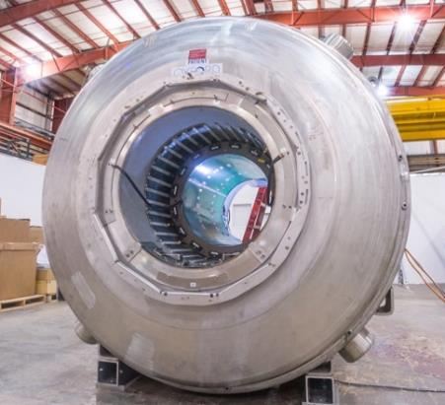
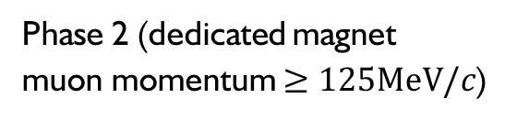
A phased approached
Phase I (small solenoid, surface muons)
Phase 2 (dedicated magnet
muon momentum $≥125MeV/c$)
Argonne 4T solenoid
Existing solenoids at PSI (max 4T and 5T)
Bore diameters (300mm and 200mm)
Field was measured in 2022
(found suitable for injection)
Large bore (up to 900 mm diameter)
High Temporal field stability (10ppb/h)
Excellent spatial field uniformity
  (<1 ppb/mm)

Slide 12
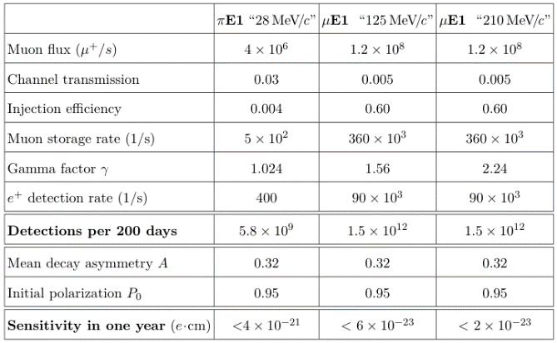
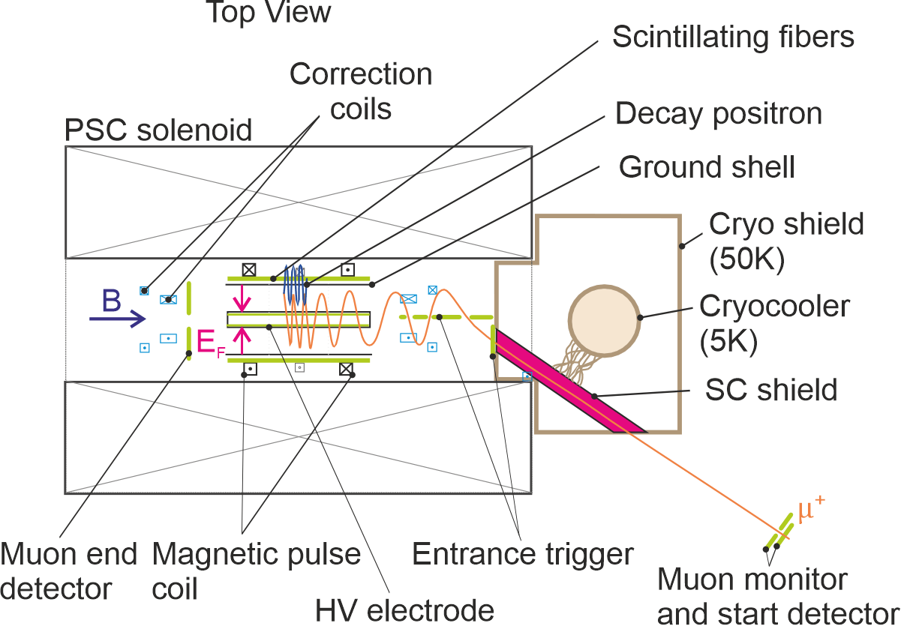

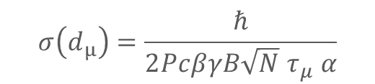
Injection and statistical sensitivity
Large phase space at exit of beam,
collimated by passage through SC -shield
Due to adiabatic magnetic collimation large part of transmitted $μ^{+}$ are reflected.
Simulations show, only about $0.4×{10}^{−3}$ muons can be stored
$$σ\left(d_{μ}\right)=\frac{ℏ}{2PcβγB{\sqrt{N} τ}_{μ} α}$$
Page 12
Notes:
At PSI we will profit from the highest muon fluxes in the world.
The two possible beamlines provide very different energies and phase spaces.
For the precursor experiment we will use low energy muons and profit from a high transmission through the collimation channel
As the solenoid is not optimized only a small fraction will be stored.
Already this precursor experiment will have a sensitivity better than 3E-23 ecm.
In the long run with a dedicated magnet, using higher energetic muons we expect a sensitivity better than 10E-23ecm.

Slide 13
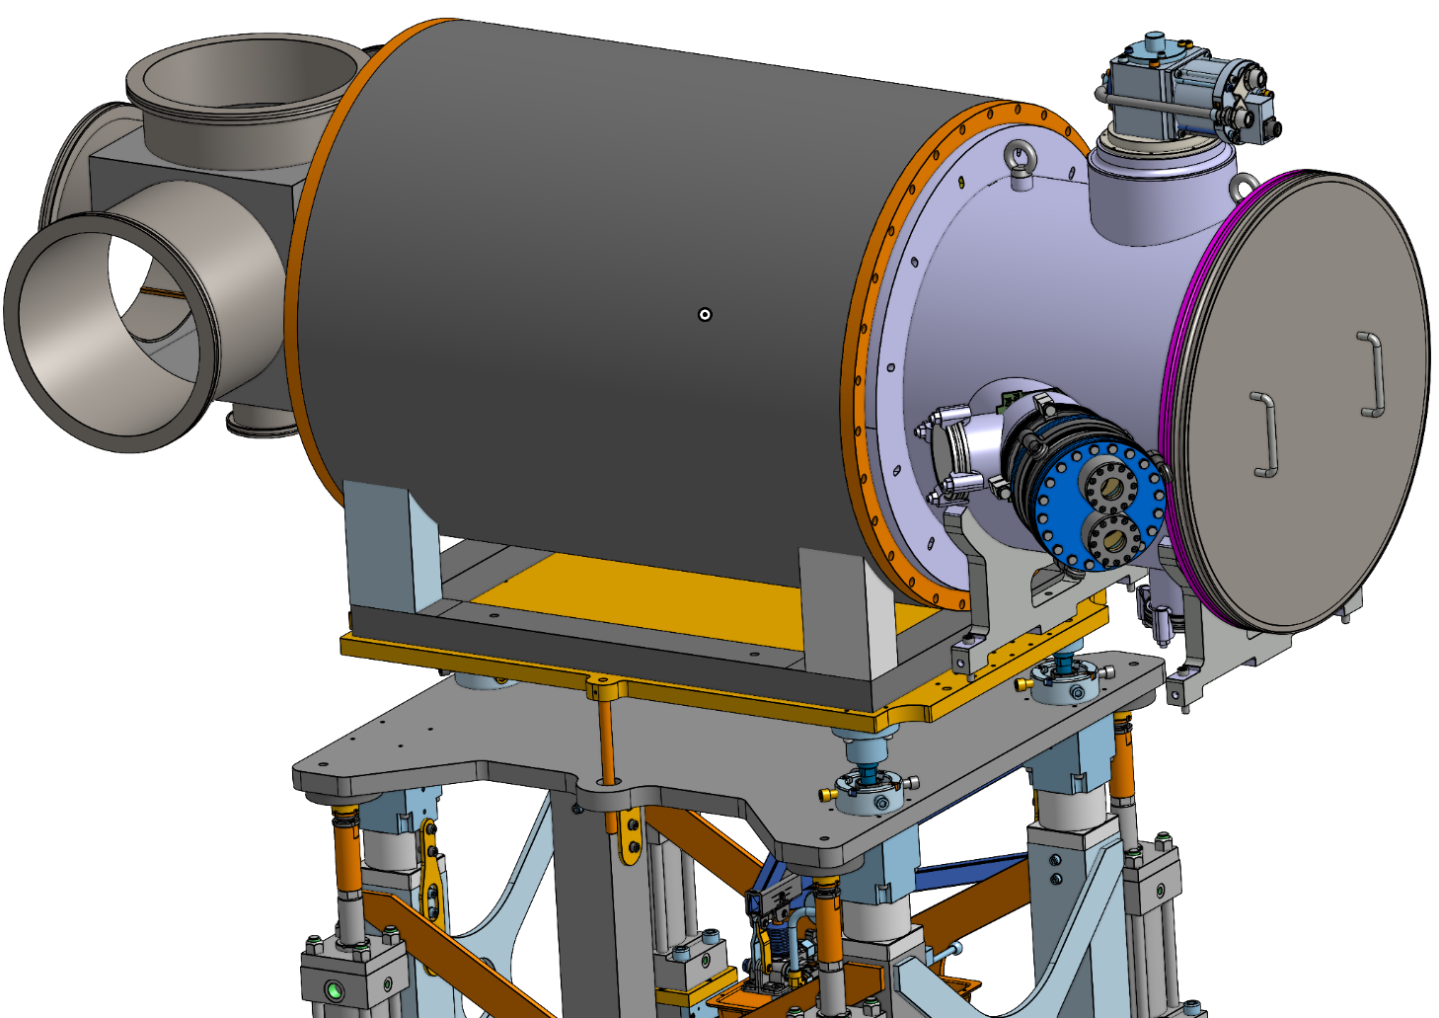
The Experiment - Technical overview
4K cryo head
Cryostat in vacuum
Vacuum cross for services
SC storage magnet
Off-axis Injection tubes
Magnet lifter

Slide 14
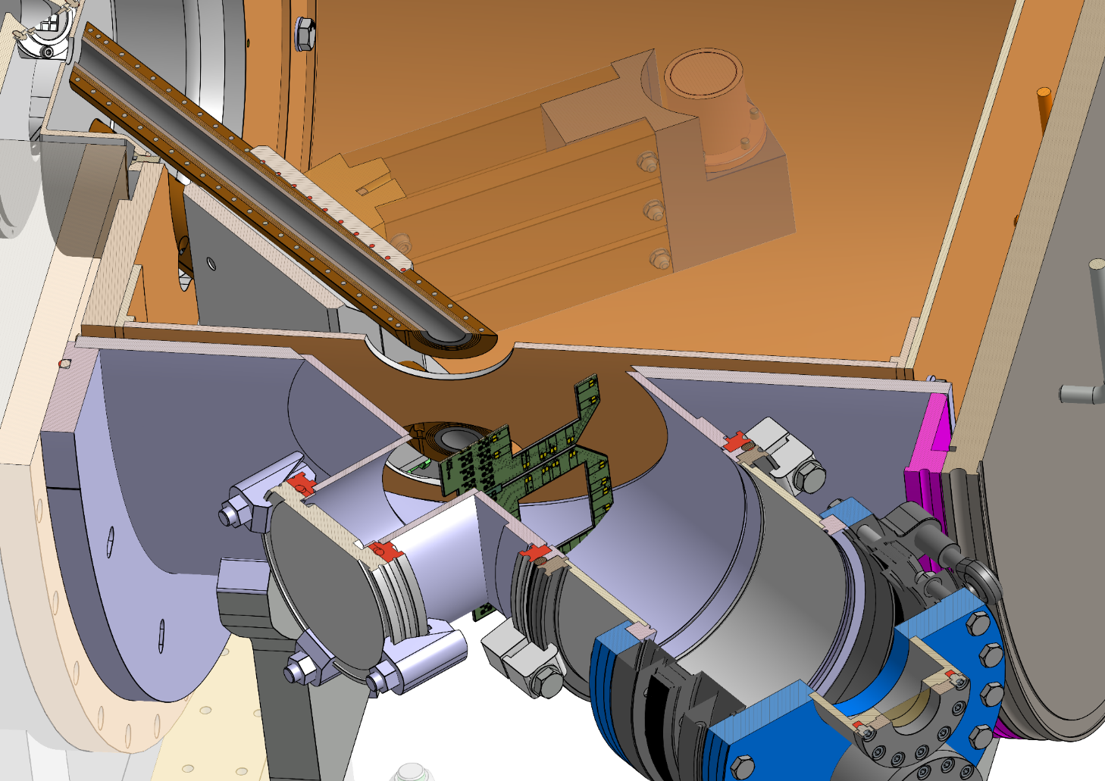
The Experiment - Technical overview
Cryo shield
Superconducting Injection tube
Bendable vacuum tube
Vacuum Chamber
μ⁺
Beam entrance
Flange for beam monitors feed-throughs

Slide 15
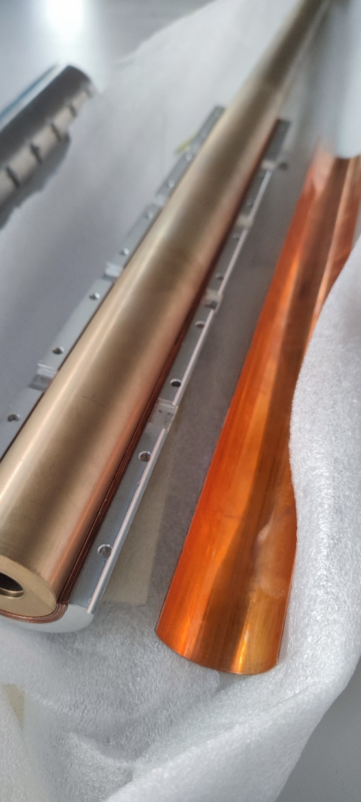
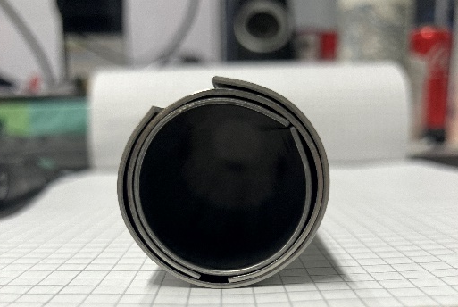
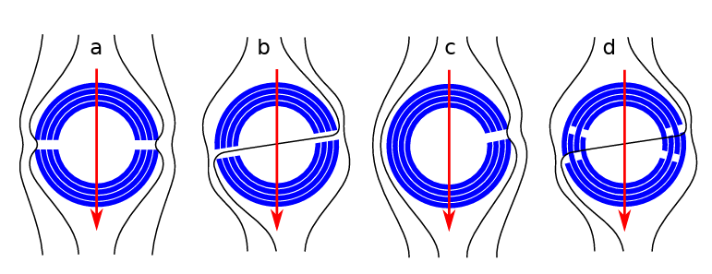
Bending the NbTi/Nb/Cu sheets
✅ Sheets @PSI
✅ Initial tests with steel sheets
✅ Tested to shield up to ~3.1T @CERN
  NbTi/Nb/Cu multilayer shield for the superconducting shield (SuShi) septum
  D. Barna et al.
https://arxiv.org/abs/1809.04330
✅ /❌ Holder design
❌ Formed sheets

Slide 16
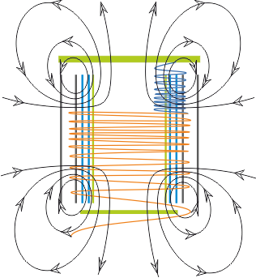
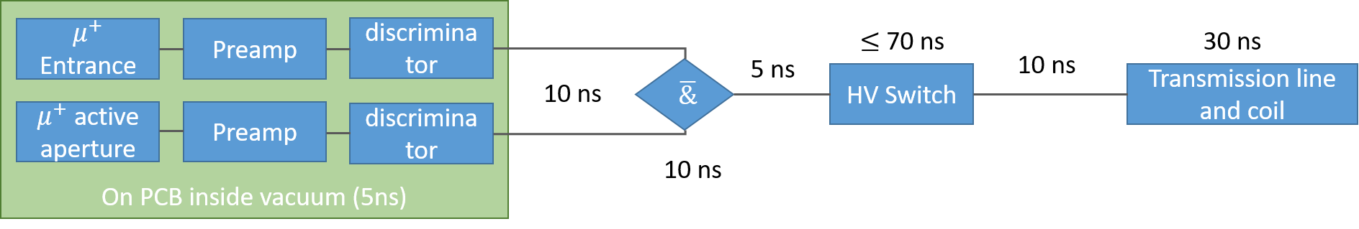
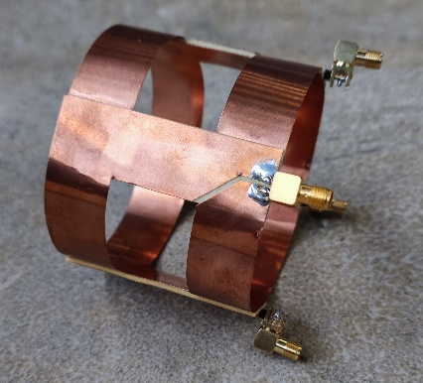
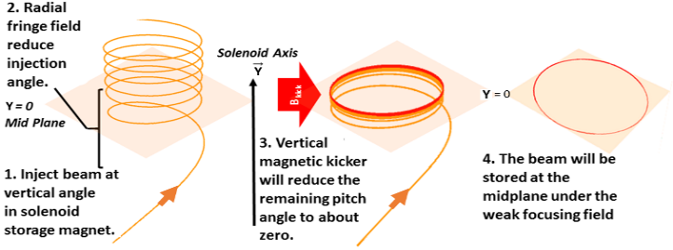
Radial magnetic field pulse to kick muons
Pulse generator
courtesy A.M. Rehman
Page 16

Slide 17
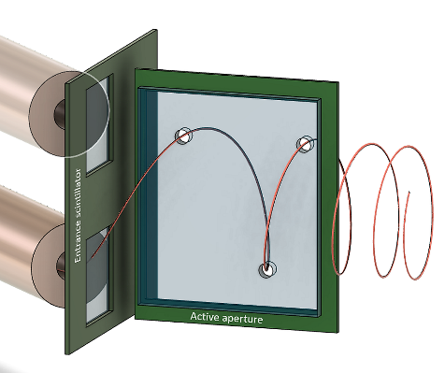
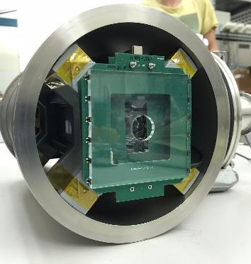
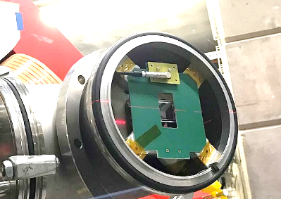
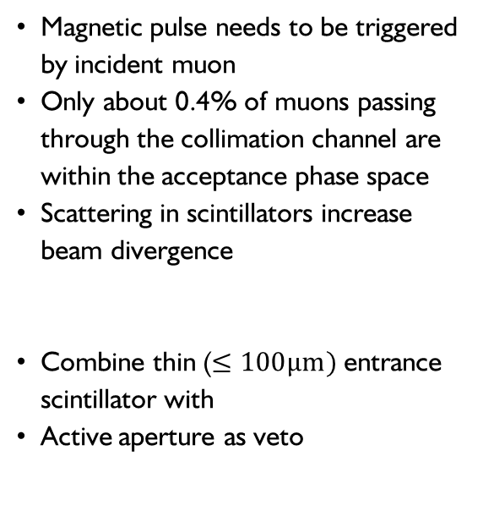
Muon entrance trigger
Entrance
Magnetic pulse needs to be triggered by incident muon
Only about 0.4% of muons passing through the collimation channel are within the acceptance phase space
Scattering in scintillators increase beam divergence
Combine thin ($≤100μm)$entrance scintillator with
Active aperture as veto
Veto
Entrance
Veto

Slide 18
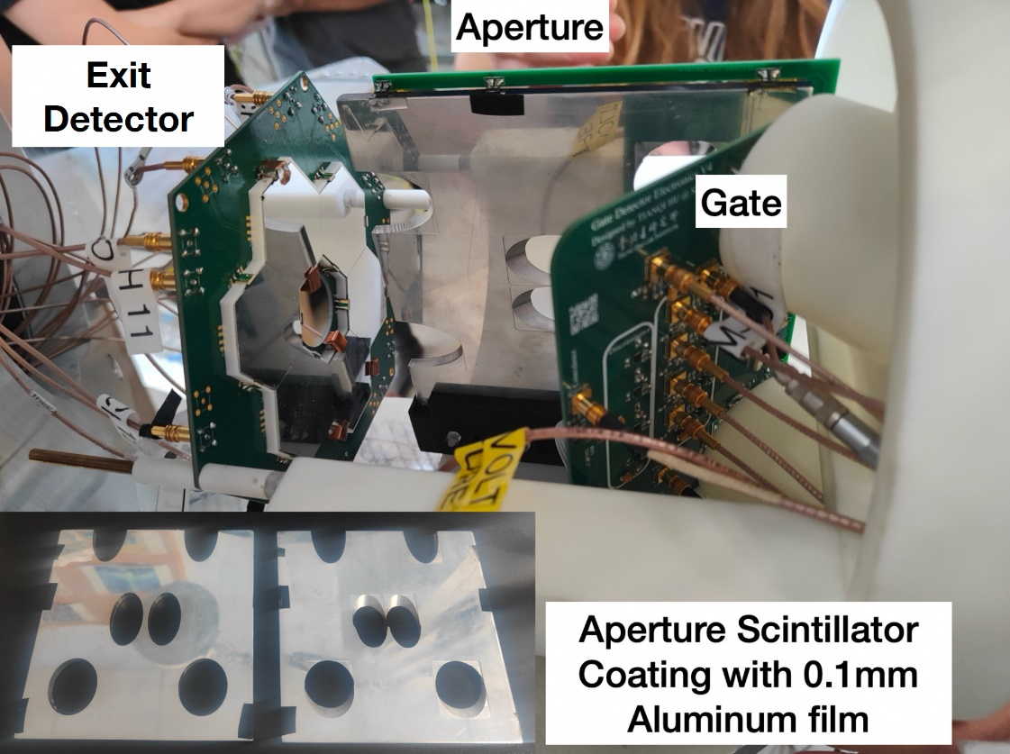

Trigger detector
Detector requirements $≤10 ns$ propagation delay ✅
Maximise acceptance rate and rejection rate
Optimise design for best compromise
Storable muons
Non-storable muons

Slide 19
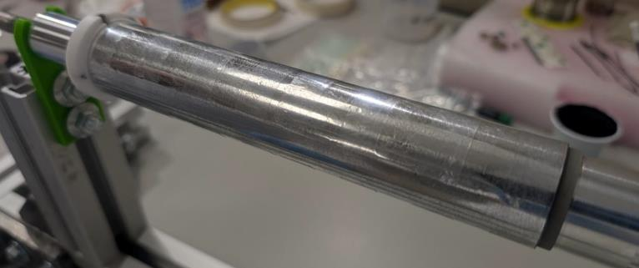
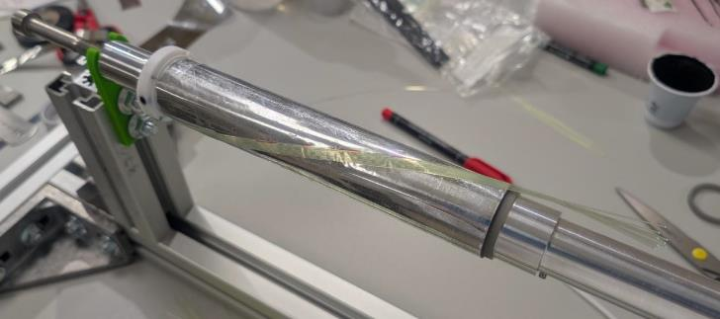








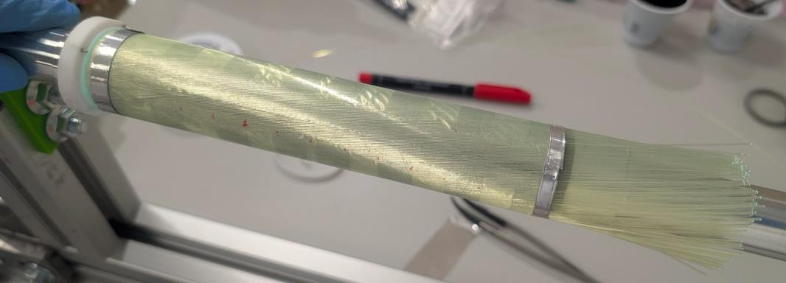
C1 demonstrator prototype: construction
PTFE
hard stop
US
US
10 cm-long fiber excess
DS
Positioning of the first stereo fiber layer
Pen helical line sign to
guide the first fibers
Aluminized 20 um-thick Mylar foil wrapped on the cylindrical mounting body
Arrows highlight the 50 um-thick bi-tape
stripes
Inner ring
DS
First stereo fiber layer completed
200 fibers
LESSON LEARNED
Good fiber positioning
Good filling factor
Reinforcement in the Mylar foil wrap closing point (single longitudinal bi-tape stripe now)
Helix pattern printed on the Mylar foil would help in minimizing the fiber stack drift error
Mandatory to not force the start fiber
end against the US hard stop ➔ accumulating azimuthal fiber stack drift error ➔ recovered by hand
Maybe even too much…
No real control on the total number of fibers per layer
US
DS

Slide 20
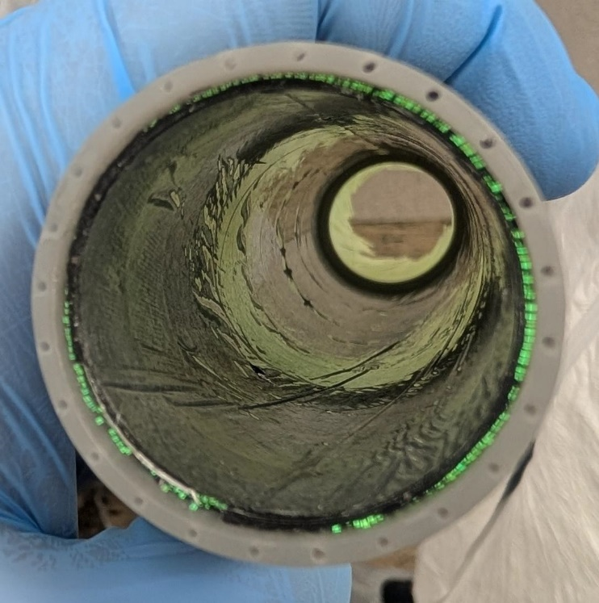
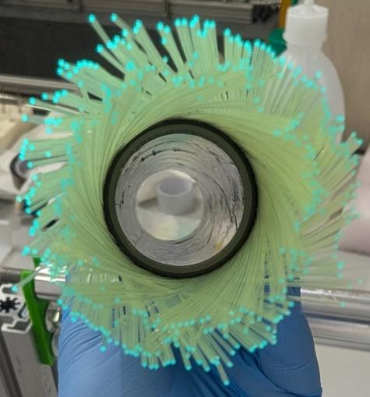
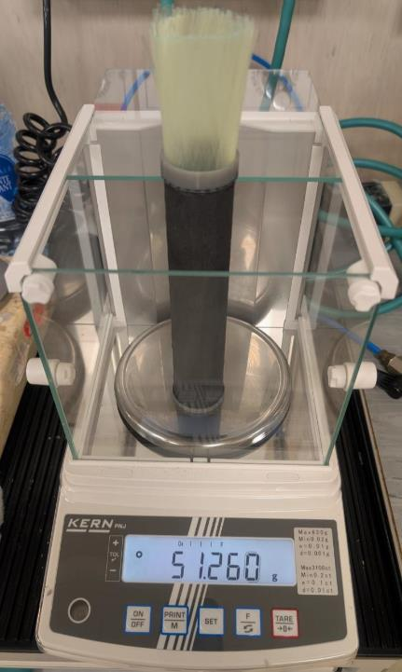
C1 demonstrator prototype: final details
US
DS
Total weight of the demonstrator prototype is 51.3 g
  27.5 g given by the 420 fibers (PS)

Slide 21


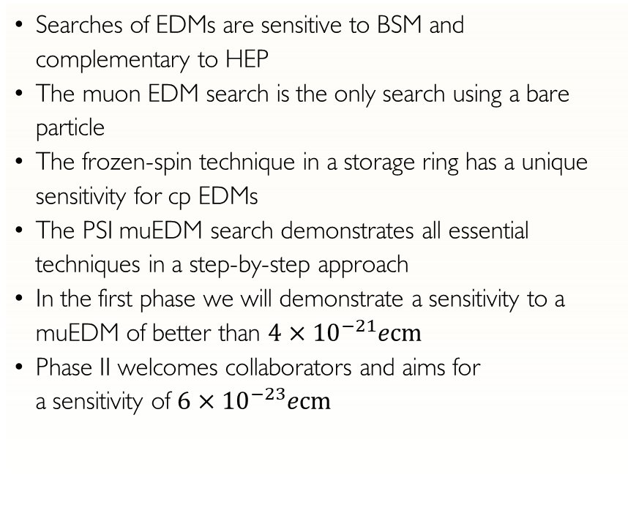
Conclusion and outlook
Searches of EDMs are sensitive to BSM and complementary to HEP
The muon EDM search is the only search using a bare particle
The frozen-spin technique in a storage ring has a unique sensitivity for cp EDMs
The PSI muEDM search demonstrates all essential techniques in a step-by-step approach
In the first phase we will demonstrate a sensitivity to a muEDM of better than $4×{10}^{−21}ecm$
Phase II welcomes collaborators and aims for
a sensitivity of $6×{10}^{−23}ecm$

Slide 22




















The collaboration open for participation
PSI proposal R-21-02.1

Slide 23
Backup

Slide 24








Geometric phases, and non-uniformities
Magnetic field
Electric field
$$ω_{a}$$
$$ω_{c}$$
$$ω_{a}$$
$$ω_{c}$$
$$ω_{b}$$
Cavoto G., Chakraborty R., Doinaki A., et al., EJPC 84(2024)262

Slide 25


Detection efficiency asymmetry
The EDM will be deduced from the accumulation of asymmetry between the upstream and downstream detectors that increases with time
Static differences in the detection efficiency of one detector compared to the other is not a problem
Change of the detection efficiency with time is a problem as it will introduce time dependent asymmetry
Positron detectors
y
$$n_{L}=κ_{L}N$$
py
-py
$$n_{R}=κ_{R}N$$

Slide 26



Constraints on the total detection efficiency
Assumption: Change of detection efficiency triggered by pulse,
exponential decay
Detection efficiency of up and downstream detectors:
Change in measured asymmetry with time:

Slide 27

Systematic study - overview

Slide 28

Finding New Physics with Flavor
At colliders one produces many (up to 10¹⁴) heavy quarks or leptons and measures their decays into light flavors
Experiment
SM
b→sµµ
PIONEER
New Physics
Mu3e
MEG
LHC
Flavor observables are sensitive to higher energy scales than collider searches
Courtesy Andreas Crivellin

Slide 29

Fine-Tuning?
Bigaran, Volkas, 2110.03707
No signifcant tuning necessary
8
Courtesy Andreas Crivellin

