Slide 1
τ-data based evaluation of a_{μ}^{HVP,LO}
Pablo Roig Cinvestav (Mexico City) & IFIC (Valencia)
Work in collaboration with Álex Miranda '20 & Pere Masjuan & Álex Miranda '23 &
Gabriel López Castro & Álex Miranda '24 (See also Davier-Malaescu-Zhang'23 & '25)
International Workshop on Muon Physics at the Intensity and Precision Frontiers (MIP 2025) Changsha, China, 16-20 May, 2025 School of Physics & Electronics Hunan University

Slide 2
a_{μ}
DISCLAIMER: WP2 WILL APPEAR SOON. INFO STILL NOT PUBLIC.

Slide 3
SM numbers still from WP1, to be updated publicly soon.
Precision of the measurement (combination of BNL&FNL): 22x10⁻¹¹
Pablo Roig (Cinvestav, Mexico City)

Slide 4
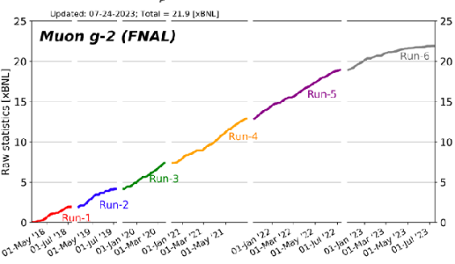
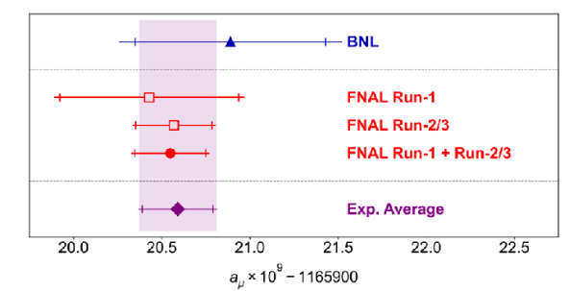
Precision of the measurement (combination of BNL&FNL): 22x10⁻¹¹
Pablo Roig (Cinvestav, Mexico City)

Slide 5
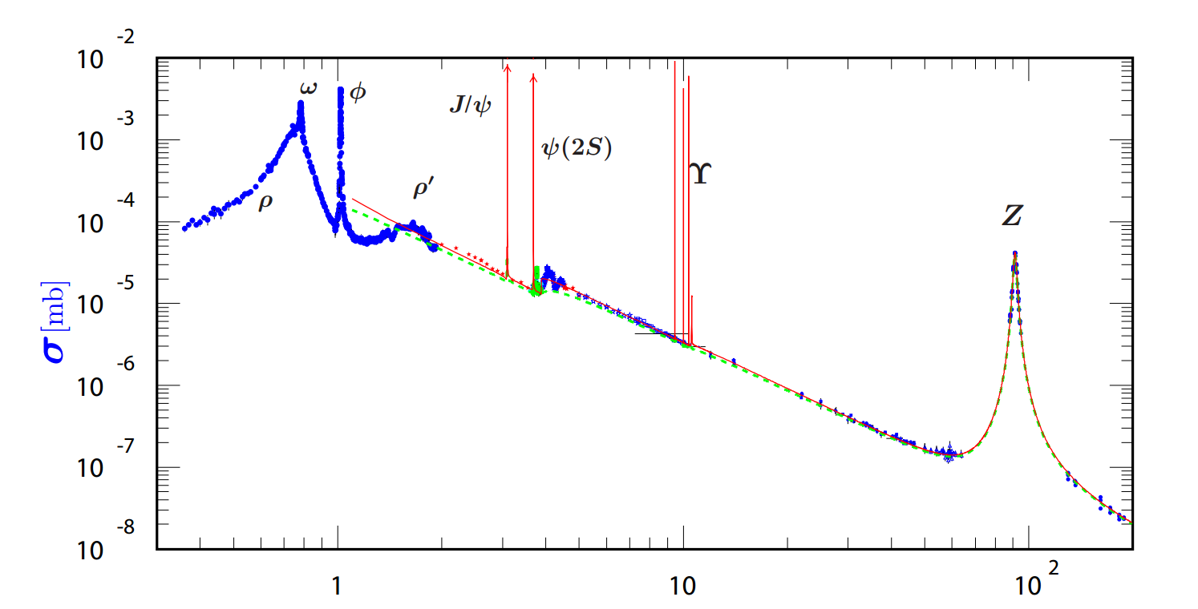
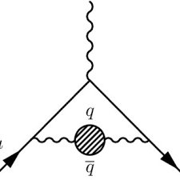
a_{μ}^{HVP} in the SM: e⁺e⁻ data-driven
White Paper'20, Snowmass document and refs. therein
Both K & σ go as 1/s enhancing low-E contributions
E[GeV]
Pablo Roig (Cinvestav, Mexico City)

Slide 6
Davier-Höcker-Malaescu-Zhang'19 & Keshavarzi-Nomura-Teubner'19 drive the White Paper'20 combination
Pablo Roig (Cinvestav, Mexico City)

Slide 7
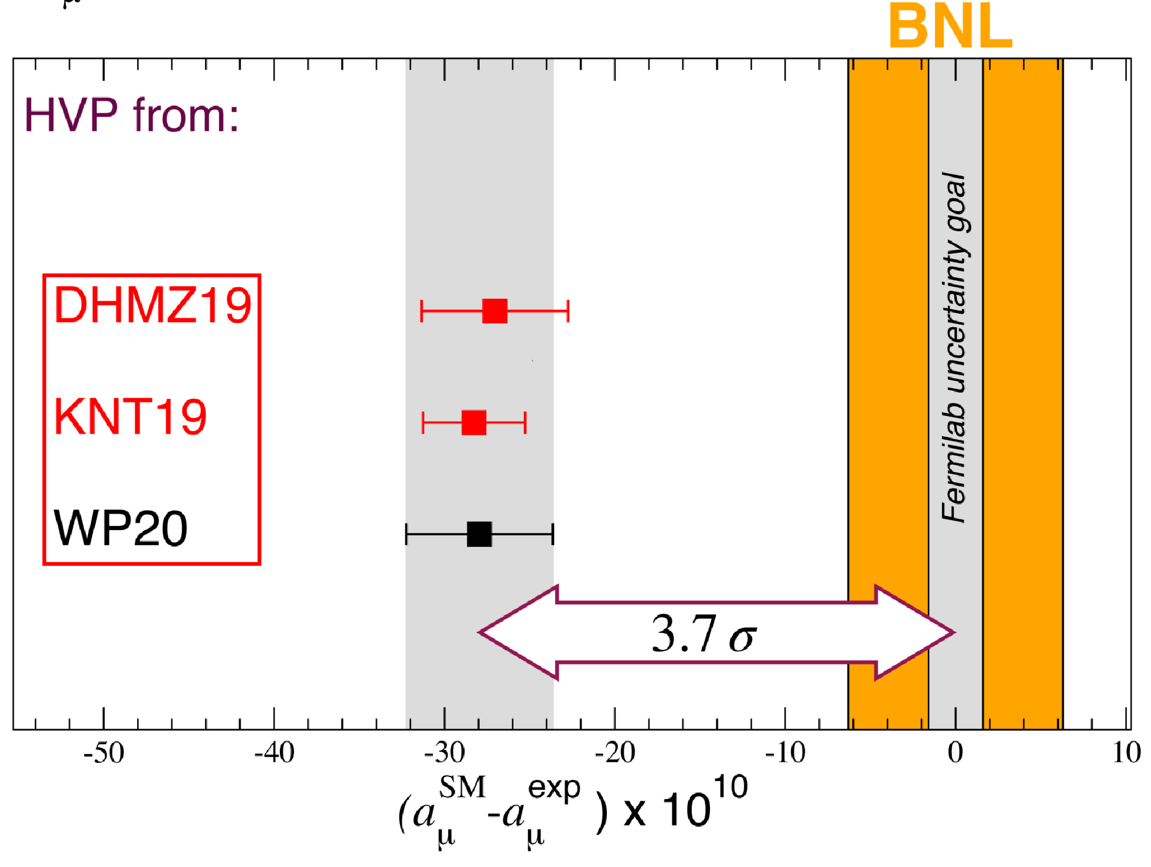
a_{μ} in the SM using e⁺e⁻ data-driven for HVP
Davier-Höcker-Malaescu-Zhang'19 & Keshavarzi-Nomura-Teubner'19 drive the White Paper'20 combination
Pablo Roig (Cinvestav, Mexico City)

Slide 8
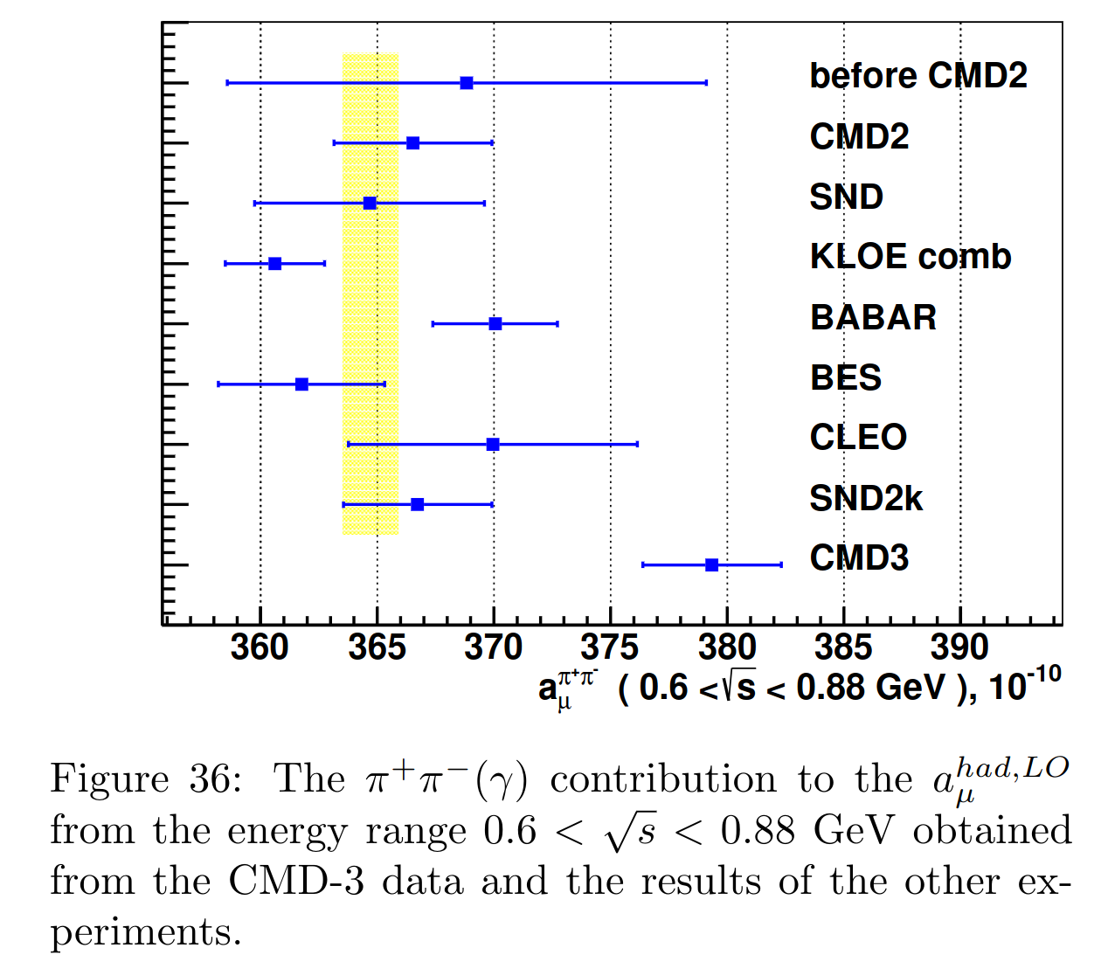
a_{μ} in the SM using e⁺e⁻ data-driven for HVP
Davier-Höcker-Malaescu-Zhang'19 & Keshavarzi-Nomura-Teubner'19 drive the White Paper'20 combination
Pablo Roig (Cinvestav, Mexico City)

Slide 9
a_{μ} in the SM using e⁺e⁻ data-driven for HVP
Davier-Höcker-Malaescu-Zhang'19 & Keshavarzi-Nomura-Teubner'19 drive the White Paper'20 combination
Pablo Roig (Cinvestav, Mexico City)

Slide 10
a_{μ}^{HVP} in the SM: Our τ-data based prediction
Miranda-Roig'20
Both K & σ go as 1/s enhancing low-E contributions
Pablo Roig (Cinvestav, Mexico City)

Slide 11
a_{μ}^{HVP} in the SM: Our τ-data based prediction
Miranda-Roig'20
Both K & σ go as 1/s enhancing low-E contributions
(Alemany, Davier, Höcker '97)
Alternative evaluation possible using semileptonic tau decay data, specifically 2π (4π) channel. Requires isospin breaking (IB).
Pablo Roig (Cinvestav, Mexico City)

Slide 12
a_{μ}^{HVP} in the SM: Our τ-data based prediction
Miranda-Roig'20
Both K & σ go as 1/s enhancing low-E contributions
(Alemany, Davier, Höcker '97)
Alternative evaluation possible using semileptonic tau decay data, specifically 2π (4π) channel. Requires isospin breaking (IB).
Kinematics & global cts.
Measurement
Short-distance EW RadCor
Pablo Roig (Cinvestav, Mexico City)

Slide 13
a_{μ}^{HVP} in the SM: Our τ-data based prediction
Miranda-Roig'20
Both K & σ go as 1/s enhancing low-E contributions
(Alemany, Davier, Höcker '97)
Alternative evaluation possible using semileptonic tau decay data, specifically 2π (4π) channel. Requires isospin breaking (IB).
Kinematics & global cts.
Measurement
Short-distance EW RadCor
Pablo Roig (Cinvestav, Mexico City)

Slide 14
a_{μ}^{HVP} in the SM: Our τ-data based prediction
Miranda-Roig'20
Both K & σ go as 1/s enhancing low-E contributions
(Alemany, Davier, Höcker '97)
Alternative evaluation possible using semileptonic tau decay data, specifically 2π (4π) channel. Requires isospin breaking (IB).
Final-state Rad
Kinematics & global cts.
Measurement
Short-distance EW RadCor
Kinematics
Pablo Roig (Cinvestav, Mexico City)

Slide 15
a_{μ}^{HVP} in the SM: Our τ-data based prediction
Miranda-Roig'20
Both K & σ go as 1/s enhancing low-E contributions
(Alemany, Davier, Höcker '97)
Alternative evaluation possible using semileptonic tau decay data, specifically 2π (4π) channel. Requires isospin breaking (IB).
Final-state Rad
Kinematics & global cts.
Measurement
Short-distance EW RadCor
Kinematics
(Cirigliano-Ecker-Neufeld '01)
The ratio of neutral to charged current di-pion form factors (F_{V}/f₊) and the long-distance em RadCor (G_{EM}) are challenging.
Pablo Roig (Cinvestav, Mexico City)

Slide 16
a_{μ}^{HVP} in the SM: Our τ-data based prediction
Miranda-Roig'20, updated
Final-state Rad
Kinematics & global cts.
Measurement
Short-distance EW RadCor
Kinematics
The ratio of neutral to charged current di-pion form factors (F_{V}/f₊) and the long-distance em RadCor (G_{EM}) are challenging.
-119.6
1.0233
3
[62] Cirigliano-Ecker-Neufeld'02 [67] Davier-…-López Castro-…-Toledo et al.'09
-74.7
+45.6(4.5)
Vincenzo Cirigliano identified an additional uncertainty in S_{EW} that will be included in WP2.
Pablo Roig (Cinvestav, Mexico City)

Slide 17
a_{μ}^{HVP} in the SM: Our τ-data based prediction
Miranda-Roig'20, updated
Final-state Rad
Kinematics & global cts.
Measurement
Short-distance EW RadCor
Kinematics
The ratio of neutral to charged current di-pion form factors (F_{V}/f₊) and the long-distance em RadCor (G_{EM}) are challenging.
(Our average)
[62] Cirigliano-Ecker-Neufeld'02 [67] Davier-…-López Castro-…-Toledo et al.'09
+71.3(23.0)
We have revisited this correction in López Castro-Miranda-Roig '24. See also Davier-Malaescu-Zhang'25
Pablo Roig (Cinvestav, Mexico City)

Slide 18
a_{μ}^{HVP} in the SM: Our τ-data based prediction
Miranda-Roig'20, updated
Final-state Rad
Kinematics & global cts.
Measurement
Short-distance EW RadCor
Kinematics
The ratio of neutral to charged current di-pion form factors (F_{V}/f₊) and the long-distance em RadCor (G_{EM}) are challenging.
[62] Cirigliano-Ecker-Neufeld'02 [67] Davier-…-López Castro-…-Toledo et al.'09
(ω->π⁰ γ contribution was subtracted from [65]'s)
[65] Florez Baez- Flores Tlalpa-López Castro-Toledo '06 Consistent results found in Esparza-Arellano—Rojas—Toledo'23
We have revisited this correction in López Castro-Miranda-Roig '24
Pablo Roig (Cinvestav, Mexico City)

Slide 19
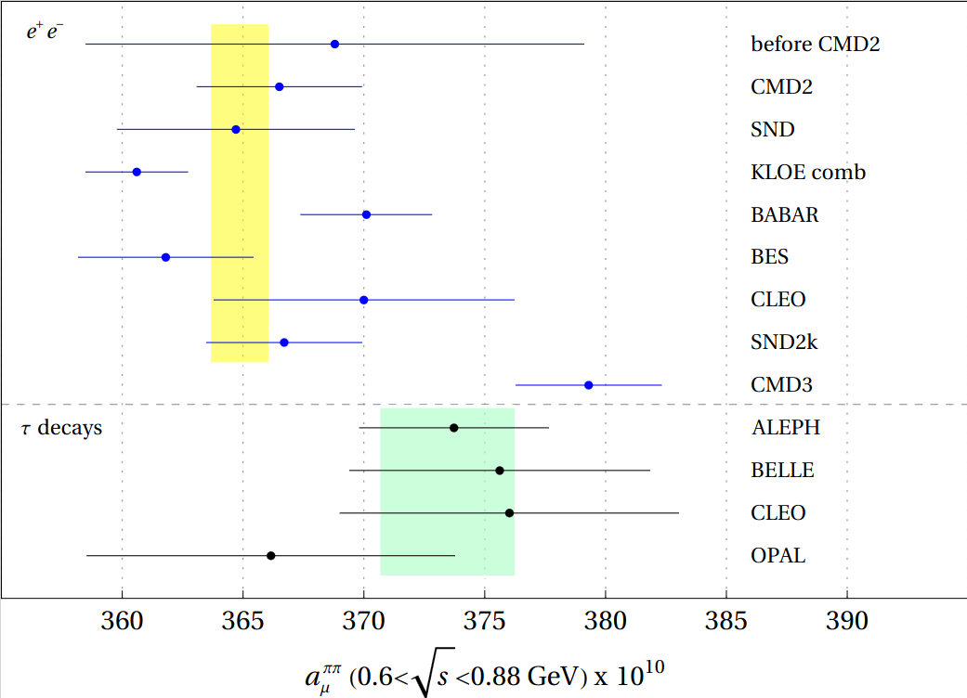
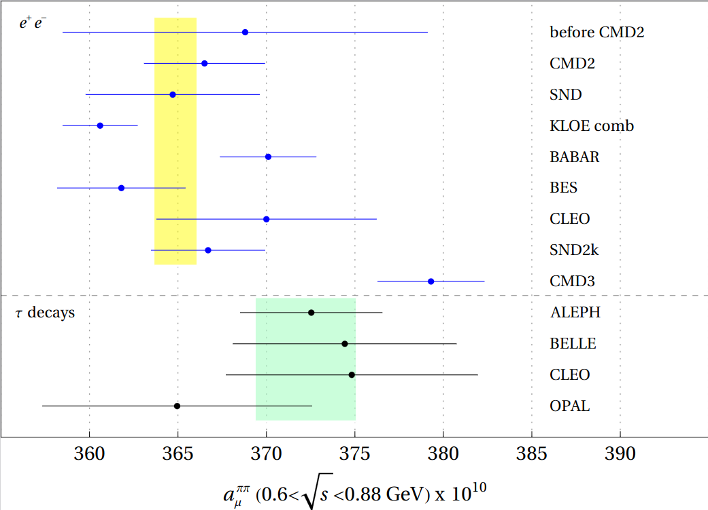
a_{μ}^{HVP} in the SM: Our τ-data based prediction
This illustrates that the uncertainty on G_{EM} is not dominant.
O(p⁶)
Miranda-Roig'20, updated
O(p⁴)
Pablo Roig (Cinvestav, Mexico City)

Slide 20
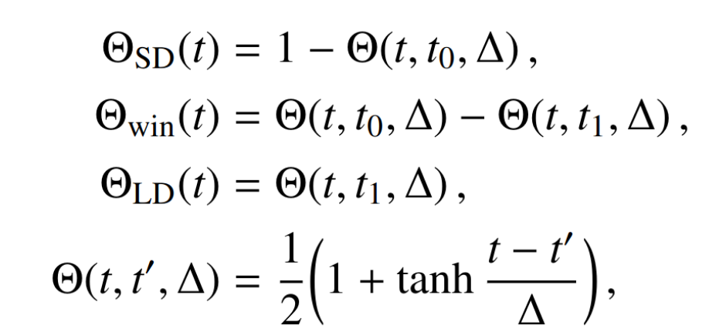
a_{μ}^{HVP} in the SM: Window quantities
Blum, Boyle, Gülpers, Izubuchi, Jin, Jung, Jüttner, Lehner, Portelli, Tsang (RBC, UKQCD),'18
Pablo Roig (Cinvestav, Mexico City)

Slide 21
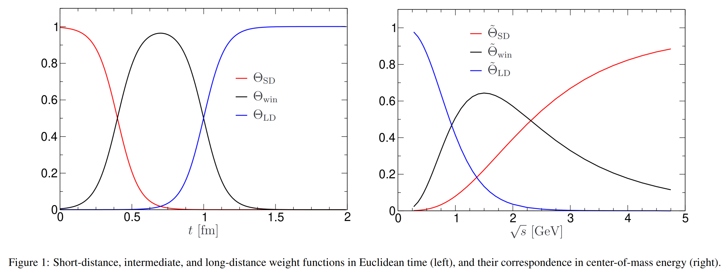
a_{μ}^{HVP} in the SM: Window quantities
Colangelo, El-Khadra, Hoferichter, Keshavarzi, Lehner, Stoffer, Teubner'22
Pablo Roig (Cinvestav, Mexico City)

Slide 22
a_{μ}^{HVP} in the SM: Our τ-data based prediction
Masjuan-Miranda-Roig'23
Window quantities @O(p⁴) below 1 GeV. Blue band is τ-data average. e⁺e⁻ number taken from Colangelo et al.'22 (pre-CMD3)
Pablo Roig (Cinvestav, Mexico City)

Slide 23
a_{μ}^{HVP} in the SM: Our τ-data based prediction
Masjuan-Miranda-Roig'23
We have revisited these comparisons in López Castro-Miranda-Roig '24
Pablo Roig (Cinvestav, Mexico City)

Slide 24
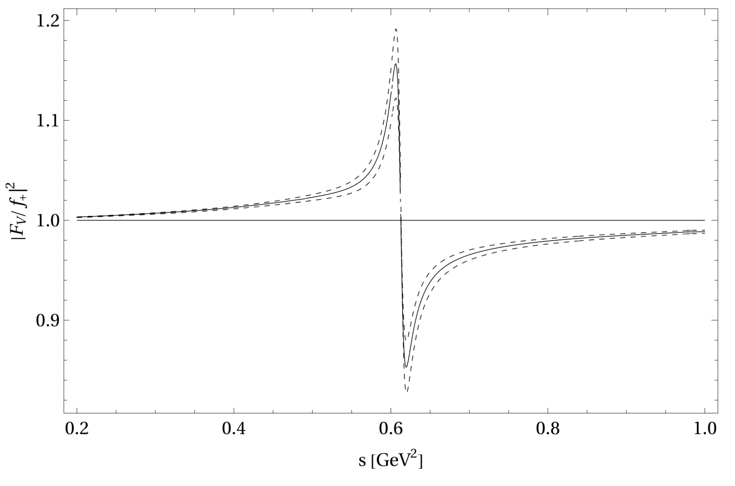
a_{μ}^{HVP} in the SM: Our τ-data based prediction
Masjuan-Miranda-Roig'23
Comparison with CMD-3 data seems to be dominated by the FFs ratio!!
We have revisited these comparisons in López Castro-Miranda-Roig '24
Pablo Roig (Cinvestav, Mexico City)

Slide 25
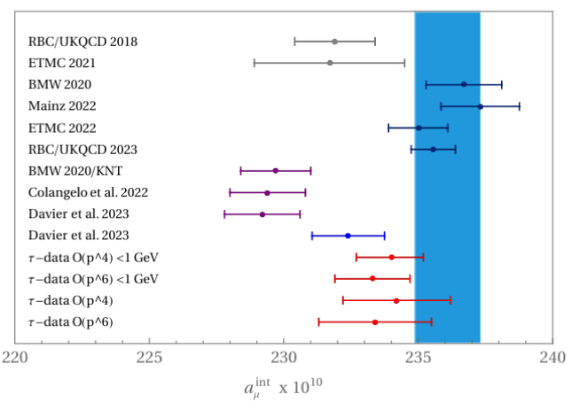
a_{μ}^{HVP} in the SM: Our τ-data based prediction
Masjuan-Miranda-Roig'23
Comparison of the total intermediate window contribution to a_{μ}^{HVP,LO}. Blue band corresponds to lattice average excluding first two results (currently superseded).
Lattice QCD
e⁺e⁻ data (+Lattice)
τ data
Pablo Roig (Cinvestav, Mexico City)

Slide 26
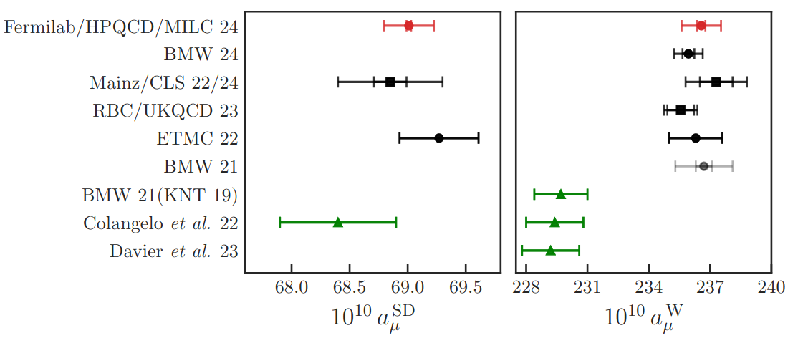
Update on the windows from lattice vs. e⁺e⁻
Masjuan-Miranda-Roig'23
Comparison of the total intermediate window contribution to a_{μ}^{HVP,LO}. Blue band corresponds to lattice average excluding first two results (currently superseded).
Lattice QCD
e⁺e⁻ data (+Lattice)
τ data
Pablo Roig (Cinvestav, Mexico City)

Slide 27
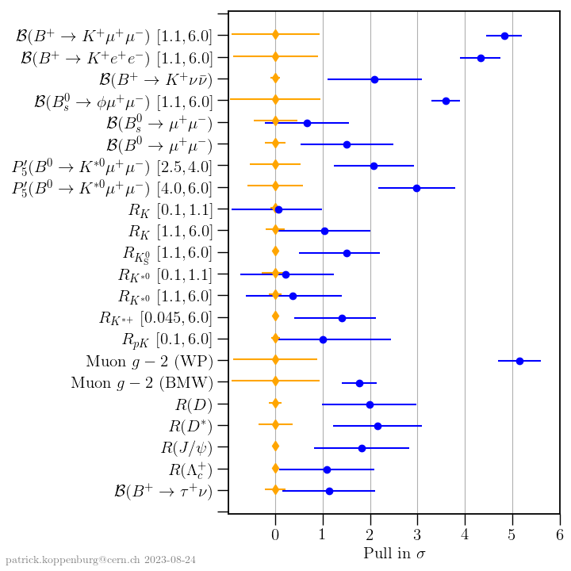
ANOMALIES & THEIR PULL
Pablo Roig (Cinvestav, Mexico City)

Slide 28
ANOMALIES & THEIR PULL
To be updated publicly soon, in WP2!
Pablo Roig (Cinvestav, Mexico City)

Slide 29
Outlook
(Largely from Theory Initiatitive web, to be updated in WP2, not yet publicly available)
See VI plenary workshop of the Muon g-2 Theory Initiative in Bern, http://muong-2.itp.unibe.ch/ (4-8 Sept. '23).
A new analysis of the cross section based on the full statistics collected by the BABAR experiment is underway.
The SND 2020 analysis of was based on 10% of the available statistics. An update using the full data set is in preparation.
Improved BES III data between 2&5 GeV will be published.
The largest KLOE data set ('04-'05) will be analyzed. Its statistics is 7 times larger than their published results together.
Radiative corrections and Monte Carlo generators, in particular for the crucial di-pion channel, are being scrutinized. This includes the calculation and implementation of higher-order and structure-dependent corrections.
New lattice-QCD results for the total HVP contribution and the long-distance window observable with a precision comparable to BMW and the data-driven approach will be available by 2025.
Other window quantities and related observables will be analyzed.
Belle-II has just released their 3pi analysis & by 2025 will publish the ππ one.
The MUonE experiment at CERN will provide an independent and competitive method to compute the HVP contribution to the muon g-2, based on the high-precision measurement of the shape of the differential cross section of muon-electron elastic scattering as a function of the space-like squared momentum transfer. It would take data from 2026 on.
Lattice QCD will make substantial progress in the evaluation of the IB corrections needed to use tau data for the HVP contribution.
Belle-II shall improve the measurement of di-pion tau decays.
...
Pablo Roig (Cinvestav, Mexico City)

Slide 30
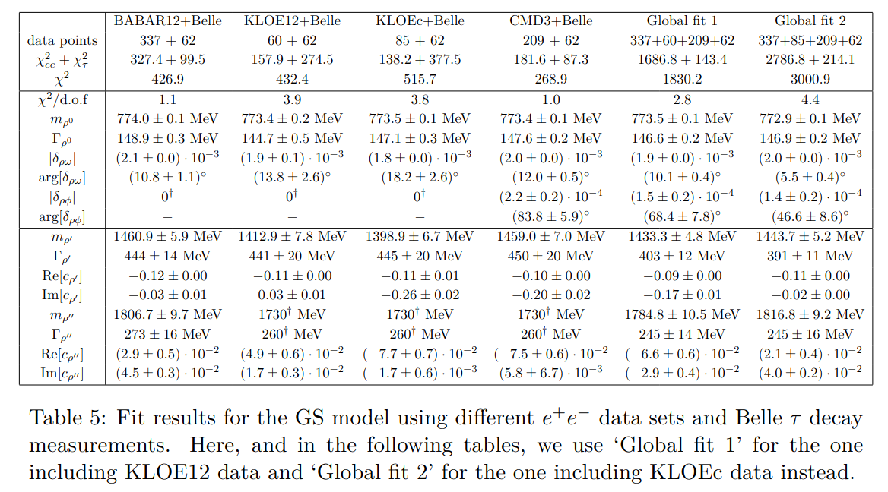
Very similar results with the other parametrizations. Nice consistency between either BaBar or CMD3 with Belle.
López Castro-Miranda-Roig'24

Slide 31
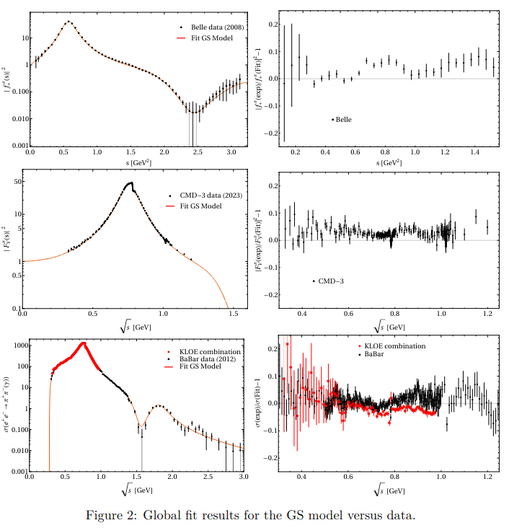
López Castro-Miranda-Roig'24

Slide 32
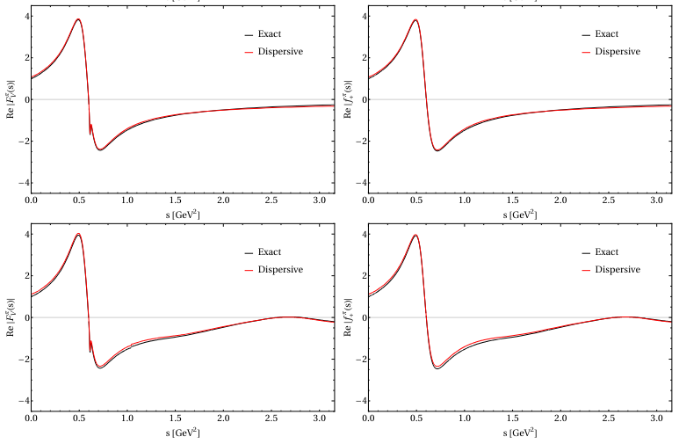
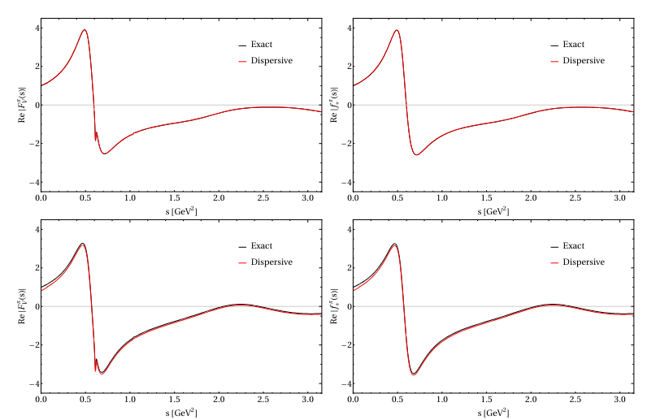
Analyticity tests favor the GS (and, obviously, even more, the dispersive) FF
GP
GS
KS
Seed
López Castro-Miranda-Roig'24

Slide 33
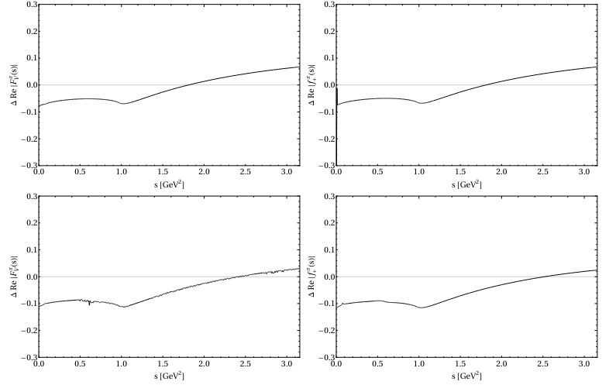
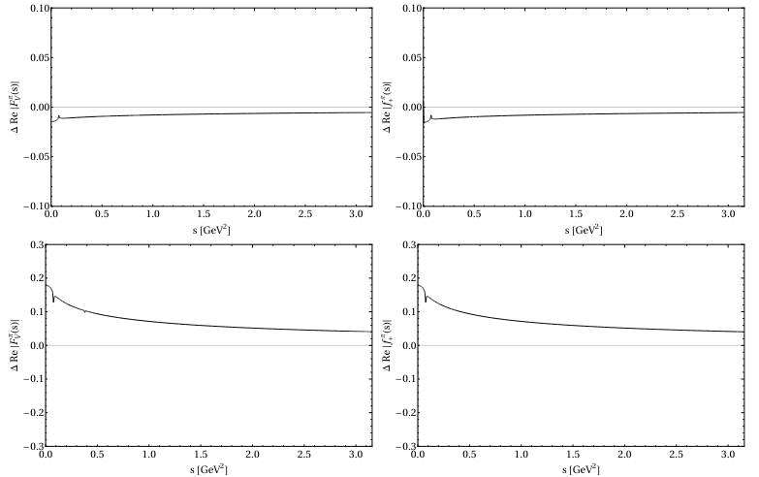
Analyticity tests favor the GS (and, obviously, even more, the dispersive) FF
GP
GS
Seed
KS
López Castro-Miranda-Roig'24

Slide 34
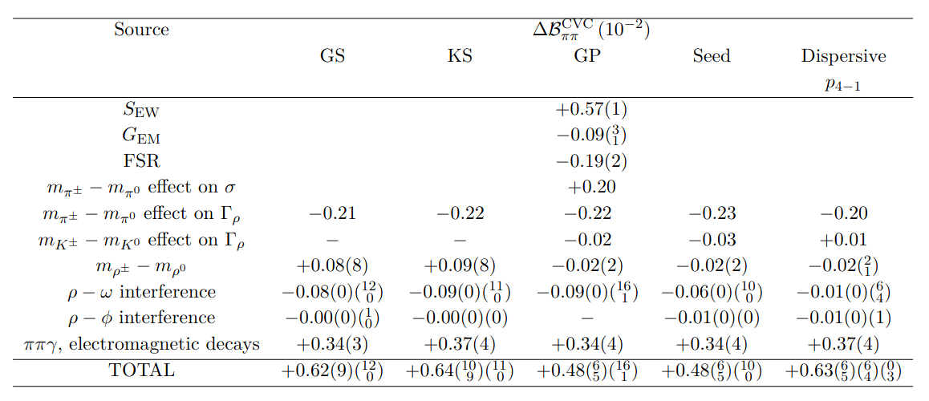
López Castro-Miranda-Roig'24
We improve a bit w.r.t. to Orsay's group (ρ region):

Slide 35
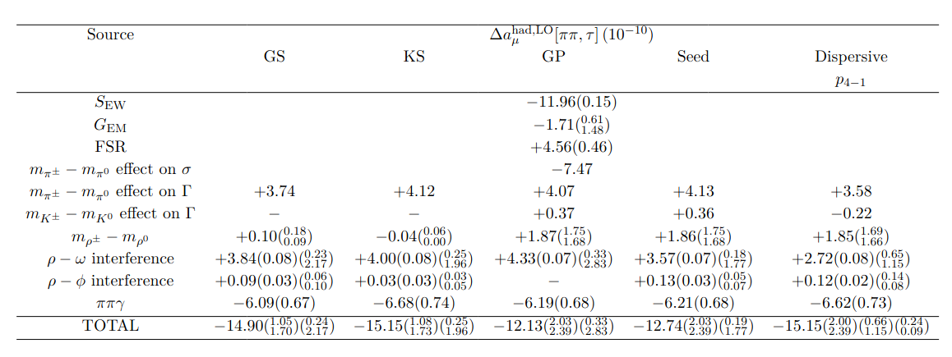
López Castro-Miranda-Roig'24
We are a bit worse than the Orsay group (G_{EM} uncertainty at low energies):

Slide 36
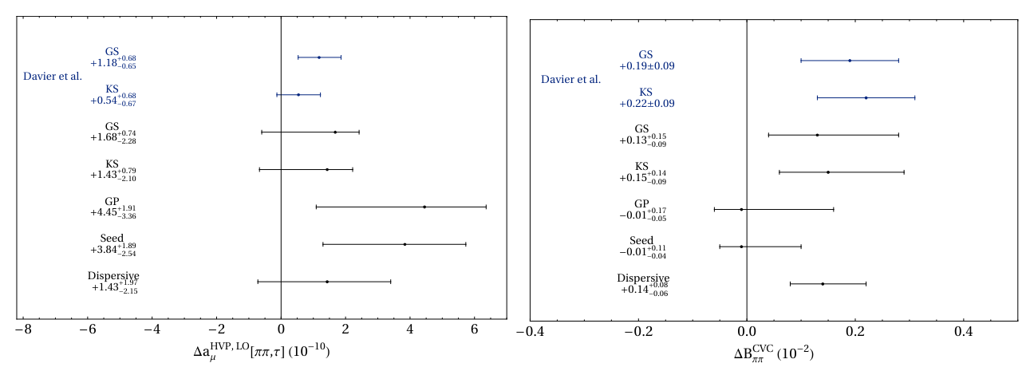
López Castro-Miranda-Roig'24

Slide 37
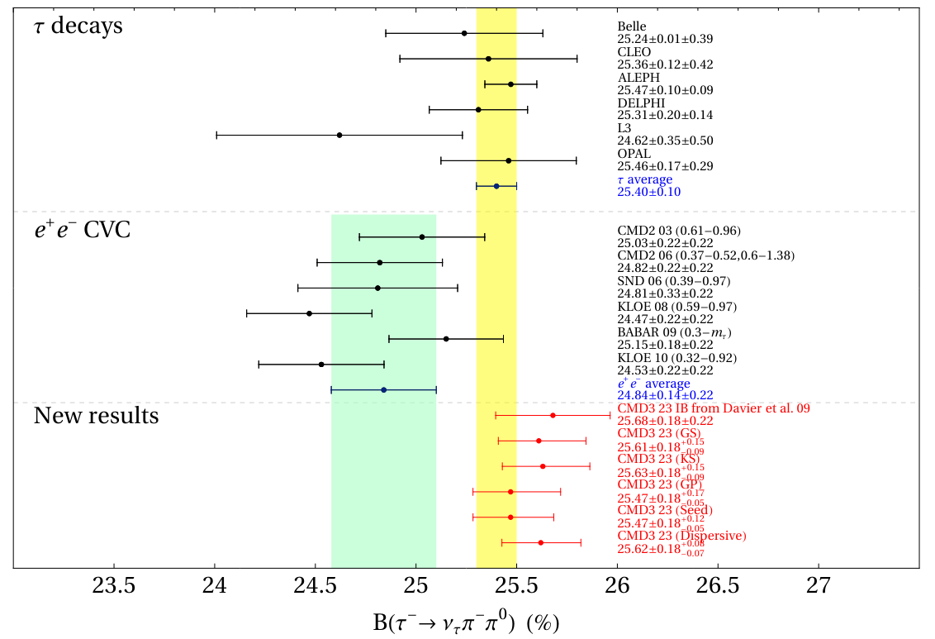
López Castro-Miranda-Roig'24

Slide 38
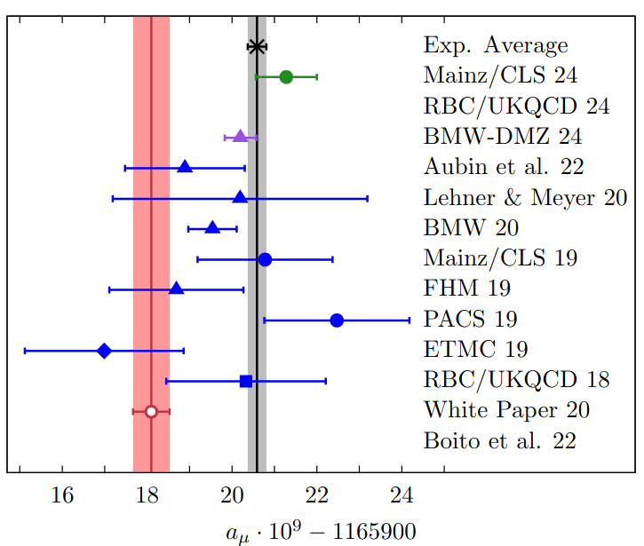
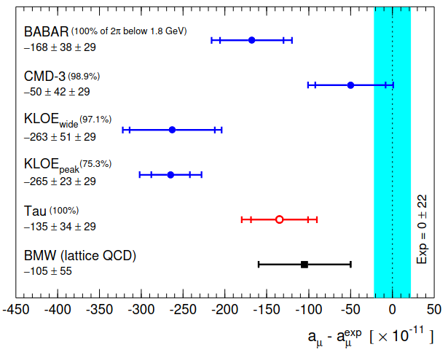
From DMZ'23
Our τ-based result (2.7σ) Castro-Miranda-Roig'24:

Slide 40
Davier-Malaescu-Zhang'25 (see back up)
A crucial aspect of this paper is allowing the normalization to float. This, beyond CVC warranting F(0)=1, should absorb normalization uncertainties in the data, independently of the ρ−ω physics. BR basically depends on ρ, while a_{μ} also on the low-E region, given the integration kernel.
Data may not be precise enough yet to achieve this purpose. Dispersive fits seem to be slightly unstable (see also LMR24) which prevents wider tests of model-independence. With GS&KS, the biggest (smallest) correction for the normalization is found for CMD-3 (KLOE) while agreement with τ (and lattice) a_{μ} result exhibits the opposite pattern. Also ρ−ω mixing angle departs a bit more than expected from the dispersive determination (see PDG) in BaBar's case.
A close look to normalization (luminosities) uncertainties should clarify whether the corrections to F(0)=1 found in the fits accord with the published experimental info. Additional shape changes could be revealed and perhaps be related to missing radiative corrections (MC Gens).
In any case, this paper opens a new path for accessing IB corrs. needed for τ-based a_{μ} analysis, of fundamental importance for the problem at hand, given the current situation with e⁺e⁻ data. DMZ'25 appeared too late to be used in WP2.

Slide 41
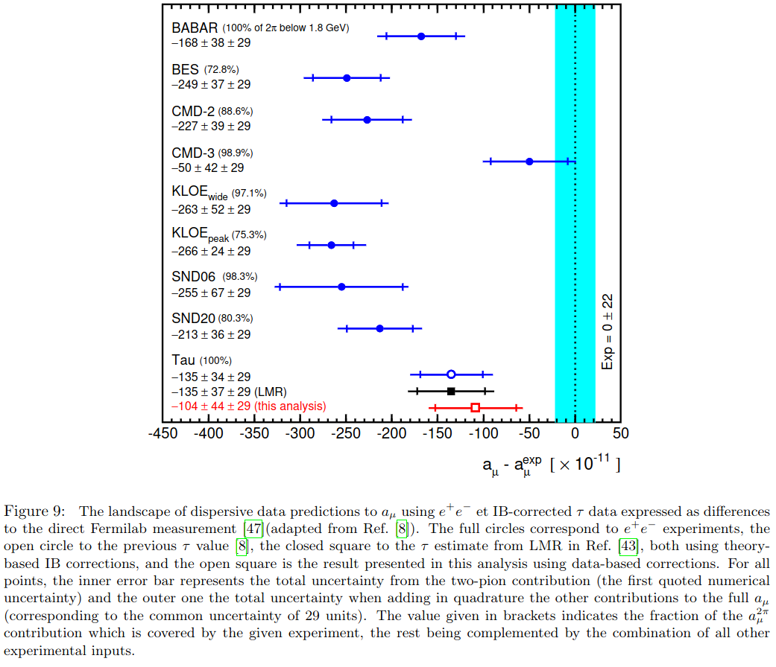
DMZ23 & LMR24 have been combined into the WP25 number for the τ-based determination (but cannot be shown yet). To me, this is a useful result now.
Agreement between CMD-3 and lattice (BMW20,RBC/UKQCD24,Mainz24 & BMW-DMZ24, etc.) is extremely good. See WP2 (very soon).
Overall, the SM result looks much more solid than in the 1st WP, but time will tell.
Soon after WP2 appears we will have the final result from FNAL, stay tuned!
Recent results for τ-based determinations of a_{μ}^{HVP}
Pablo Roig (Cinvestav & IFIC)
From DMZ'25
(DMZ'23)

Slide 42
BACK UP

Slide 43
Gounaris-Sakurai & Kühn-Santamaría

Slide 44
Guerrero-Pich

Slide 45
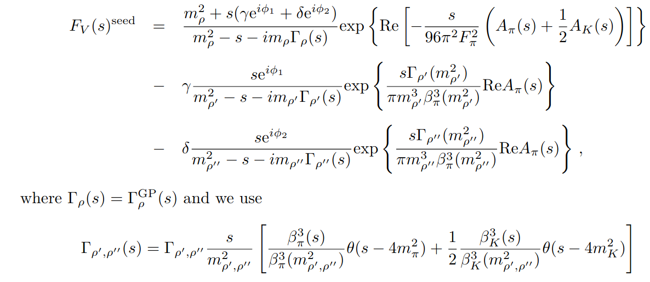
'Seed'

Slide 46
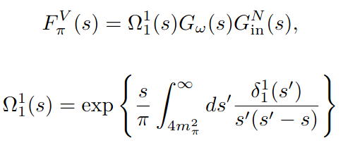
Dispersive

Slide 49
Material from Davier-Malaescu-Zhang'25

Slide 50
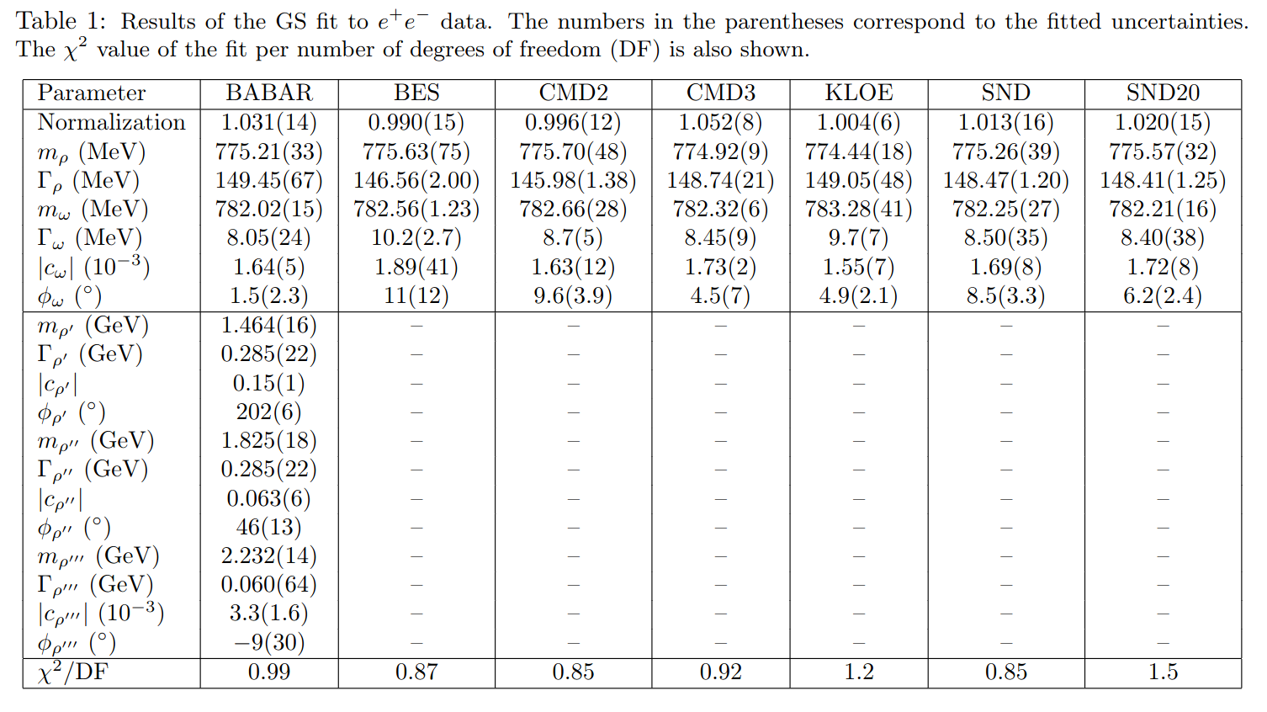

Slide 51
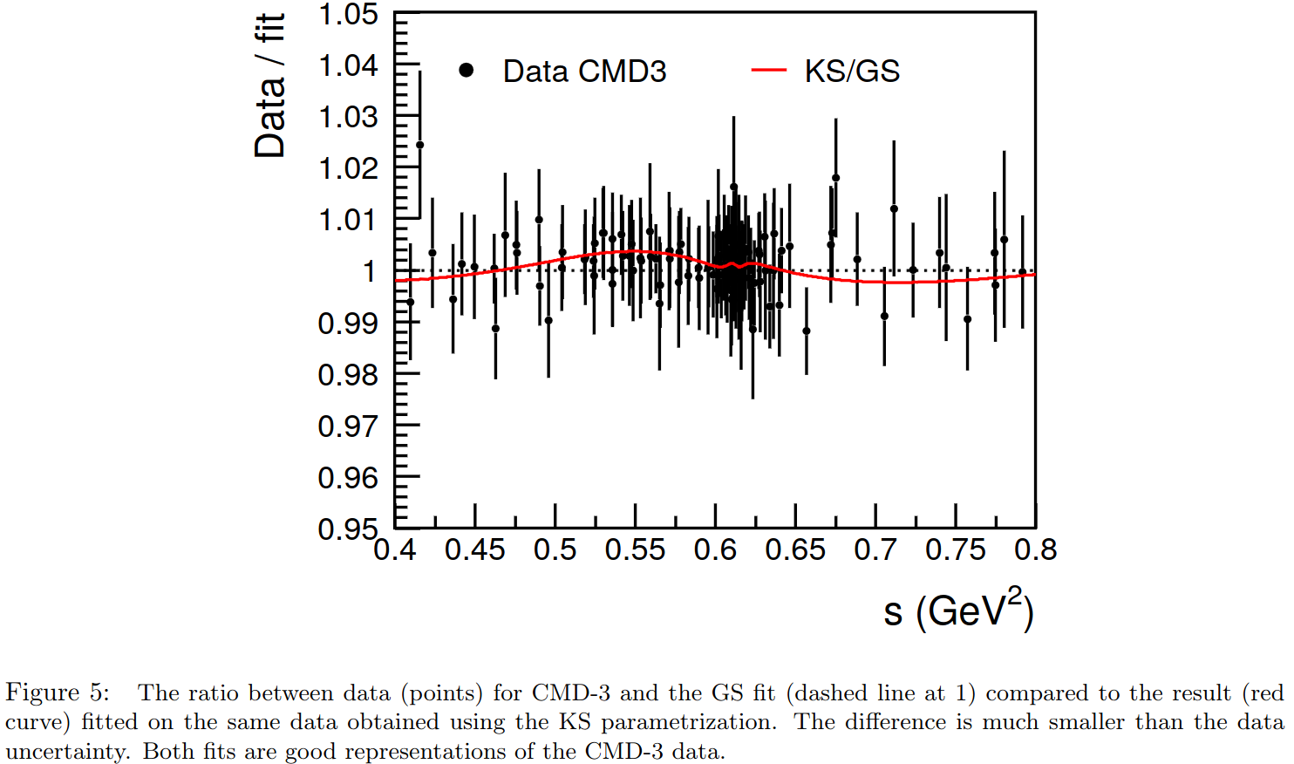

Slide 52
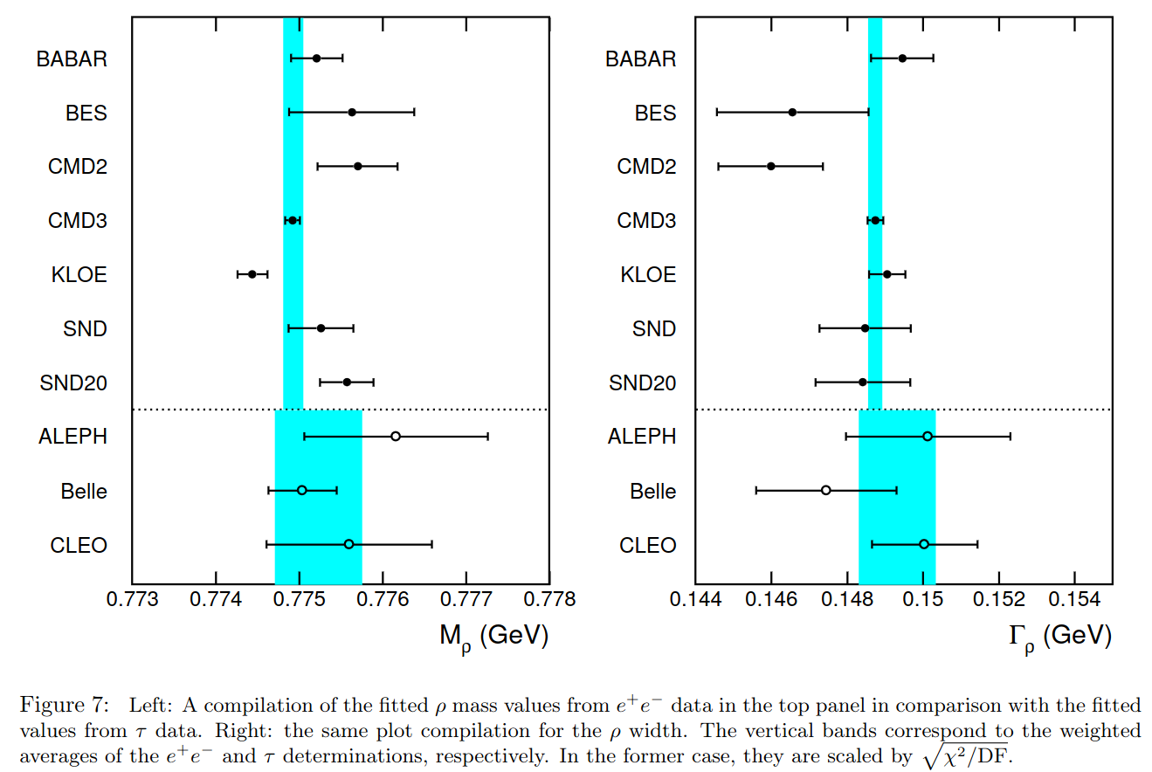

Slide 53
