Slide 1
arXiv:hep-ph/0001284v1 27 Jan 2000

Slide 3
Expanded
Vanish
Background

Slide 4
Energy conservation

Slide 5
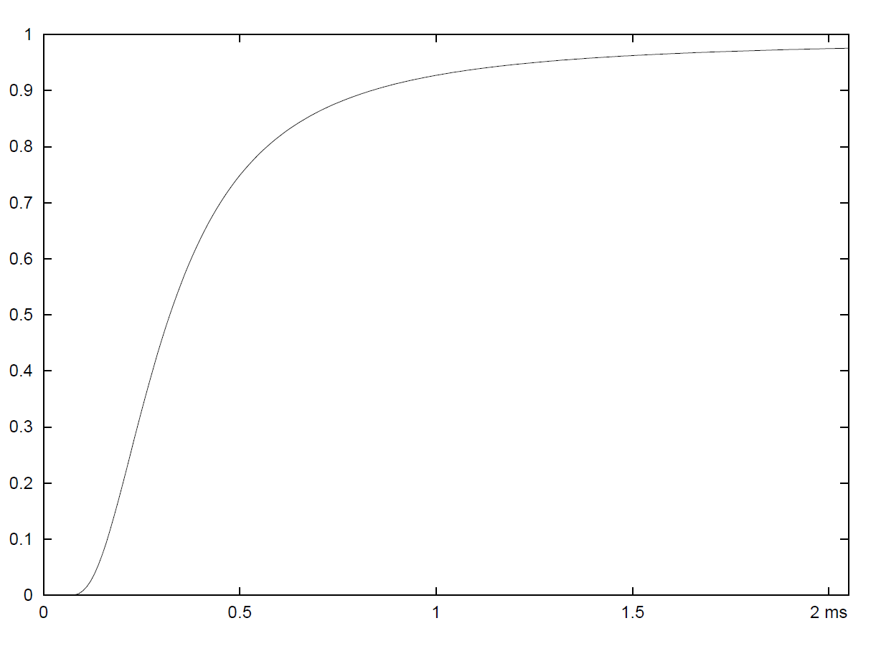
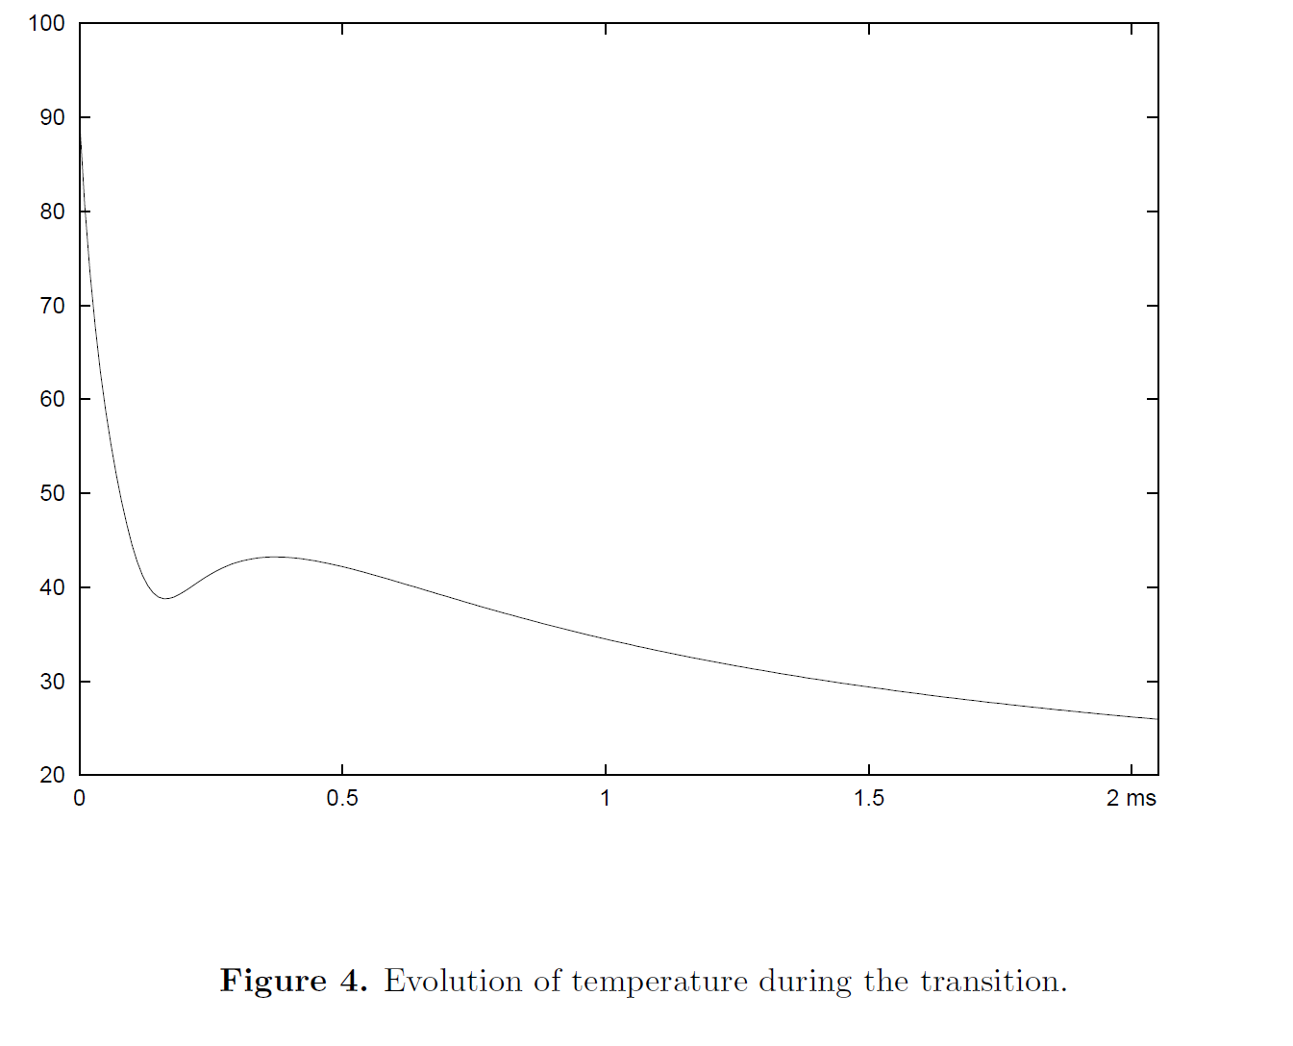
x

Slide 6
N(tf ) the corresponding
number density of nucleation sites
$$0.3M_{☀}$$
$B=(120MeV)^{4}$, $λ=17.77$, $m_{s}=100MeV$
$T_{c}=90.1MeV$, $T_{f}=17.7MeV$, $R_{f}=7000R_{c}$, $𝒩_{q}={10}^{57}$
Peisi Huang and Kepan Xie, 10.1103/PhysRevD.105.115033

Slide 7
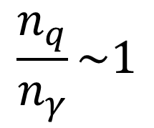
Calculation with chemical potential is similar
$$\frac{n_{q}}{n_{γ}}\sim 1$$
Entropy not conserved
$$\frac{n_{q}}{n_{γ}}\sim {10}^{−9}$$
Affleck-Dine mechanism or so

