Slide 1
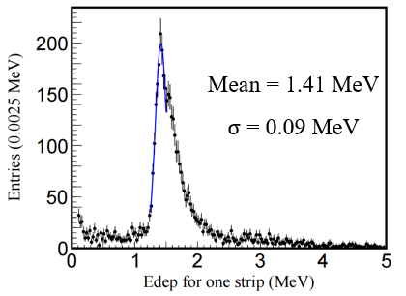
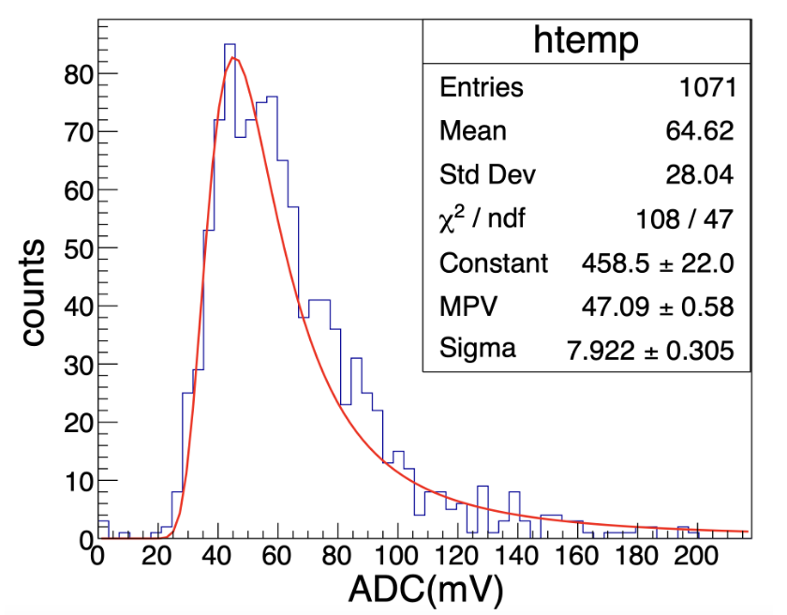
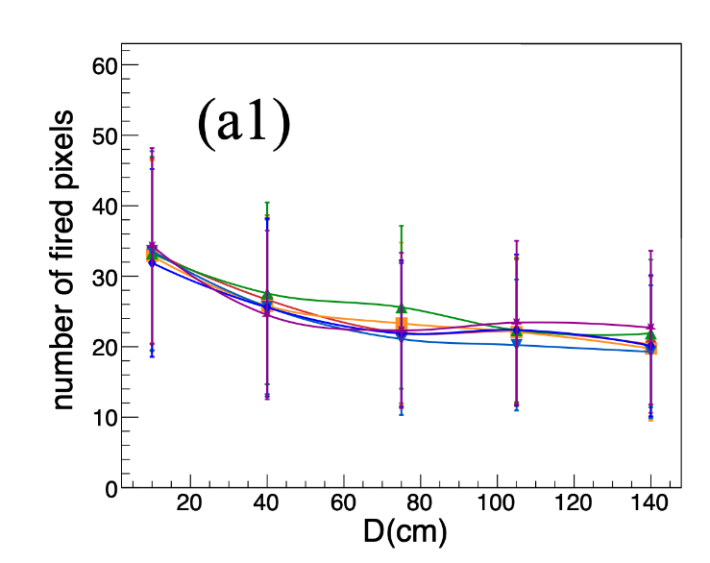
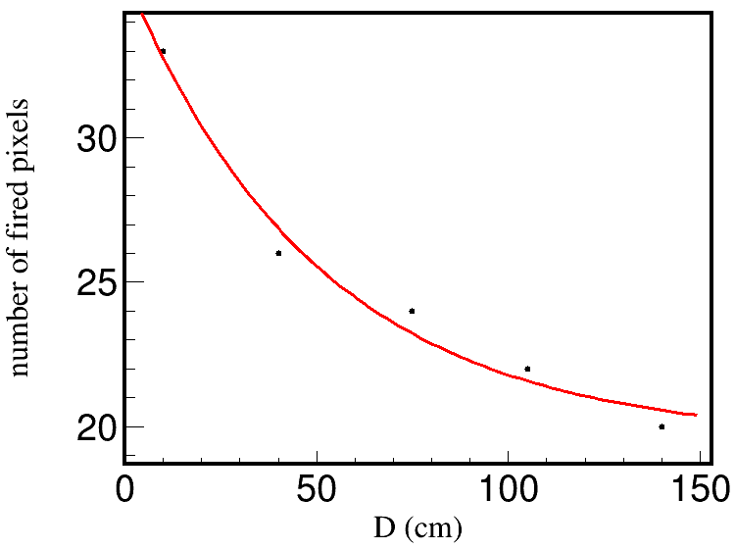
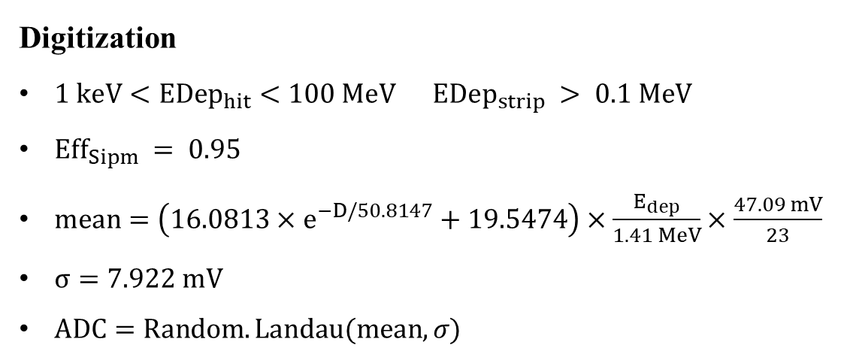
Digitization
$1 keV<EDep_{hit}<100 MeV EDep_{strip} > 0.1 MeV$
$Eff_{Sipm} = 0.95$
$mean=\left(16.0813×e^{−D/50.8147}+19.5474\right)×\frac{E_{dep}}{1.41 MeV}×\frac{47.09 mV}{23}$
$σ=7.922 mV$
$ADC=Random.Landau(mean,σ)$
$$mip=1.41 MeV$$
$$1 mip→ADC=47.09$$
$$p. e.=23 σ=7.922$$
Zhang H, Wang X, Ma W, et al. Journal of Instrumentation, 2024, 19(06): P06020.
$$N=16.0813×e^{−x/50.8147}+19.5474$$

Slide 2
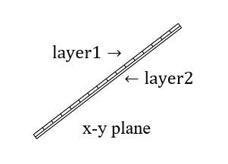
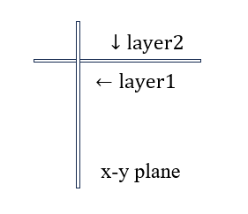
Reconstruction
Find the point with the smallest $x^{2}+y^{2}$ in each section as the starting point, then search for the point closest to the previous point layer by layer.
Use polynomial fitting to fit the track of these points with first, second, and third-degree polynomials, and select the one with the smallest $χ^{2}$.
In a superlayer of Barrel, layer1 gives pos.x and pos.y, layer2 gives pos.z.
In a superlayer of Endcap, layer1 gives pos.y, layer2 gives pos.x, both can give pos.z.

Slide 3
$$Eff_{Sipm} =1$$
 | 5 GeV Barrel | 5 GeV Endcap | 10 GeV Barrel | 10 GeV Endcap | $$h→μ^{+}μ^{−}$$
$$N_{events}$$ | 1k | 1k | 1k | 1k | 1k
$$N_{muonid}$$ | 967 | 963 | 965 | 977 | 927
$$N_{muonrec}$$ | 957 | 952 | 957 | 970 | 902
$Eff_{Sipm} =$ 0.95
 | 5 GeV Barrel | 5 GeV Endcap | 10 GeV Barrel | 10 GeV Endcap | $$h→μ^{+}μ^{−}$$
$$N_{events}$$ | 1k | 1k | 1k | 1k | 1k
$$N_{muonid}$$ | 964 | 961 | 965 | 976 | 926
$$N_{muonrec}$$ | 908 | 923 | 924 | 948 | 859

