Slide 1
Study of $γγ→γψ(2S)$ at BelleII
2024.11.08

Slide 2
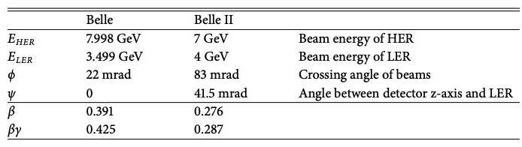
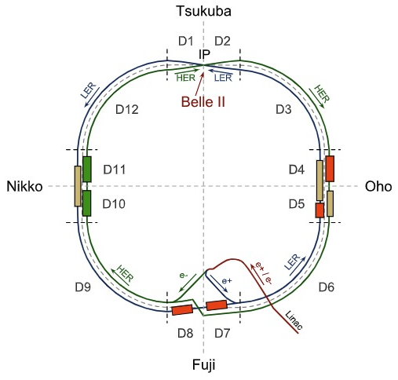
Beam parameters of super KEKB
HER 7 GeV, LER 4 GeV, HER angle:+41.5 mrad, LER angle:-41.5 mrad.
Lorentz-invariant Mandelstam variables $s$:
$s=m_{1}^{2}+m_{2}^{2}+2E_{1}E_{2}−2\vec{p_{1}}∙\vec{p_{2}}$
$\sqrt{s}≈2\sqrt{7∗4}≈10.583 GeV$
Boost vector in (x,0,z)
let $ψ=41.5 mrad$
Beam momenta:
HER (7sin$ψ$,0,7cos $ψ$), LER (4sin$ψ$,0,-4cos $ψ$)
boost vector(11sin$ψ$,0,3cos $ψ$)
$$\sqrt{s}=10.57389325786920331041GeV$$
boost vector: (0.45636897,0,2,9974701)
$θ=0.0057692395934144867 rad$ (动量与z轴夹角)

Slide 3
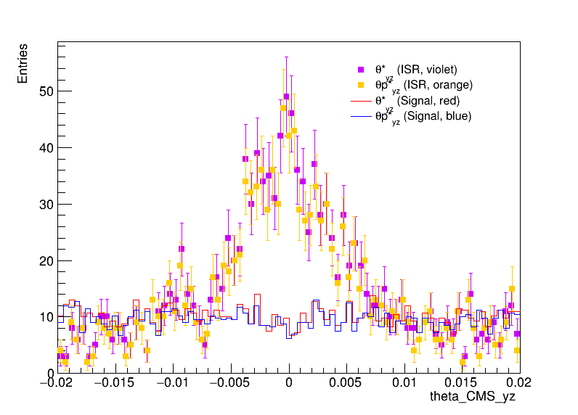
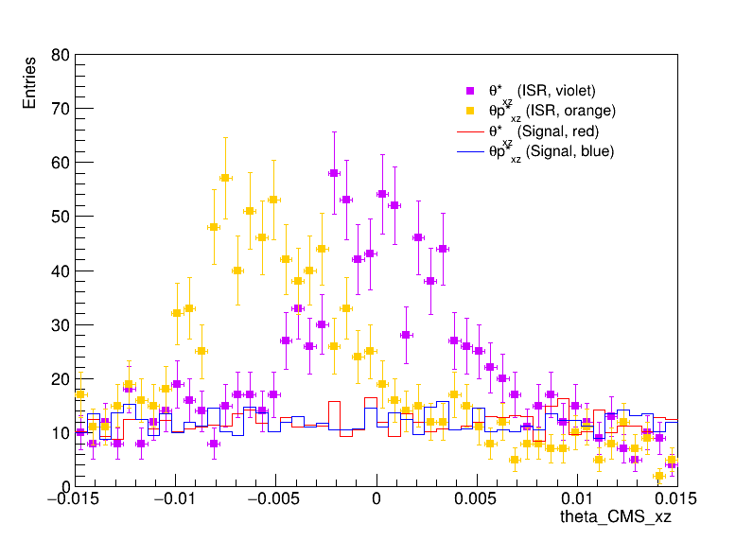
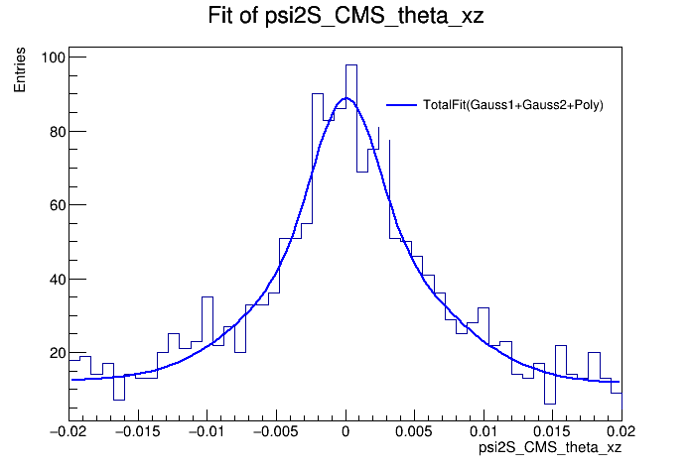
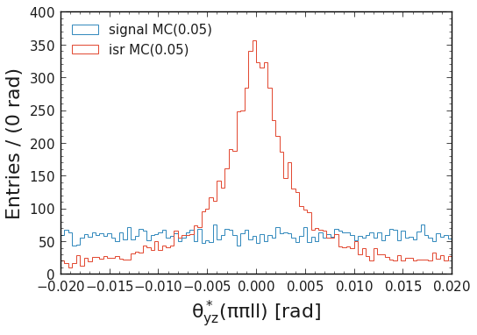
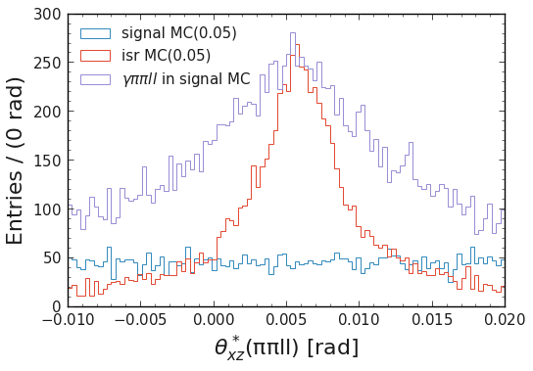
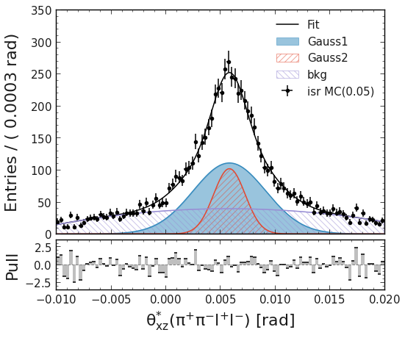
From Qingyuan Liu’s ipynb

Slide 4
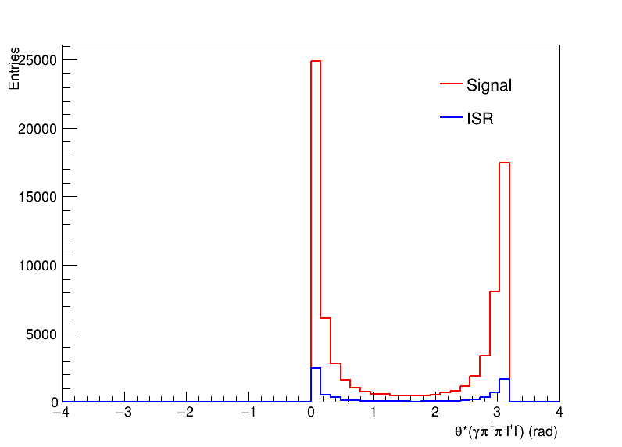
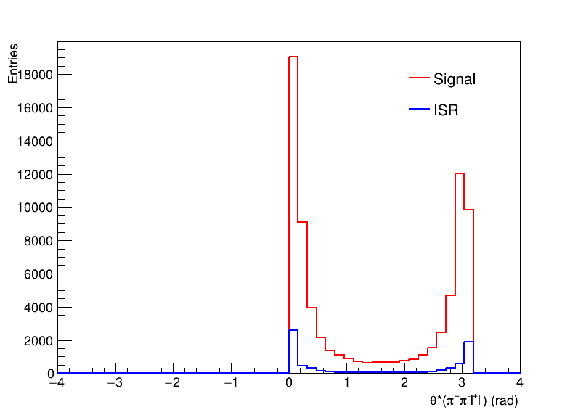
Angle check (before rotation)
* means in the c.m.s
$$θ^{∗}=arctan2(p_{t}^{∗},p_{z}^{∗})$$
$$θ of γψ(2S)$$
$$θ of ψ(2S)$$

Slide 5
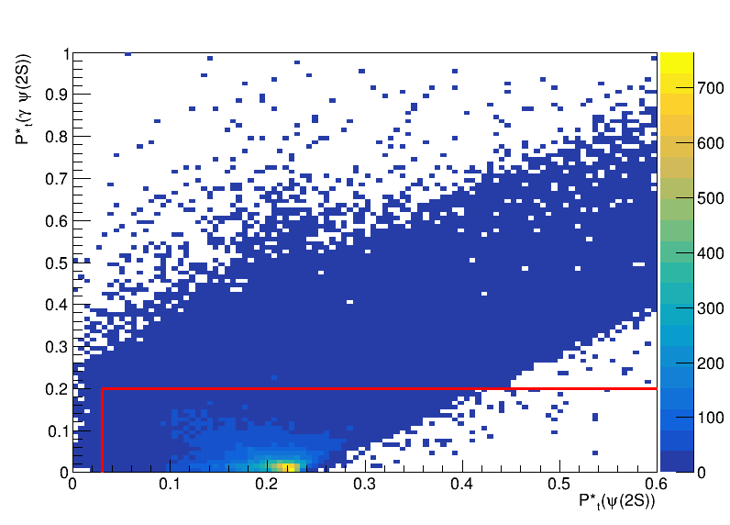
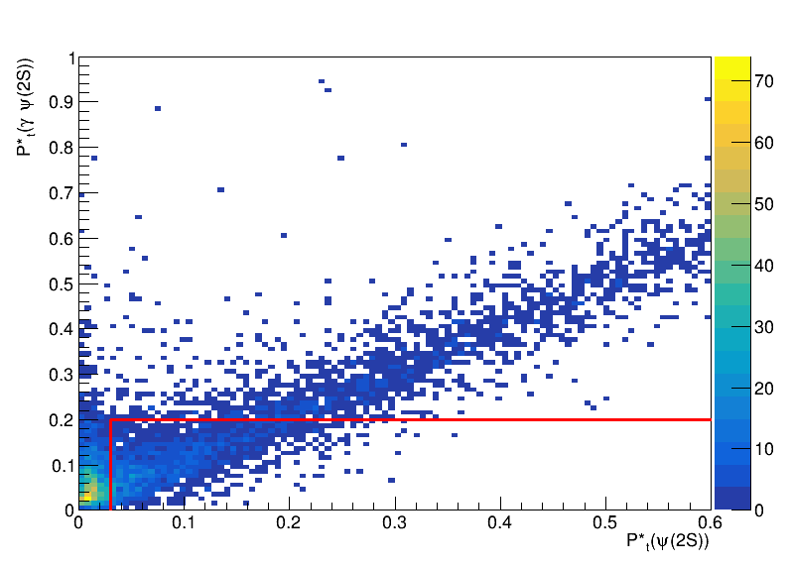
* means in the c.m.s
Transverse momenta of $P_{t}^{∗}$(before rotation)
Signal(ee+mm)
ISR background(ee+mm)
The scatter plot is $P_{t}^{∗}(ψ(2S))$ vs $P_{t}^{∗}(γψ(2S))$.
The region enclosed by the red line is the transverse momenta selection criteria in Belle analysis work.

Slide 6
Angle check (after rotation)
* means in the c.m.s
’ means after rotation
$$θ^{∗}=arctan2(p_{t}^{∗},p_{z}^{∗})$$
$$p_{x}^{∗′}=p_{x}^{∗}∙\sin\left(\frac{π}{2}−θ^{∗}\right)−p_{z}^{∗}∙\sin{θ^{∗}}$$
$$p_{z}^{∗′}=p_{x}^{∗}\cos\left(\frac{π}{2}−θ^{∗}\right)+p_{z}^{∗}∙\cos{θ^{∗}}$$
$$θ_{xz/yz}^{∗′}=arctan2(p_{x/y}^{∗′},p_{z}^{∗′})$$
$$θ^{∗′}=arctan2\left(p_{t}^{∗′},p_{z}^{∗′}\right)$$
If $θ$ from theoretical cal.
$$θ of γψ(2S)$$
$$θ of ψ(2S)$$

Slide 7
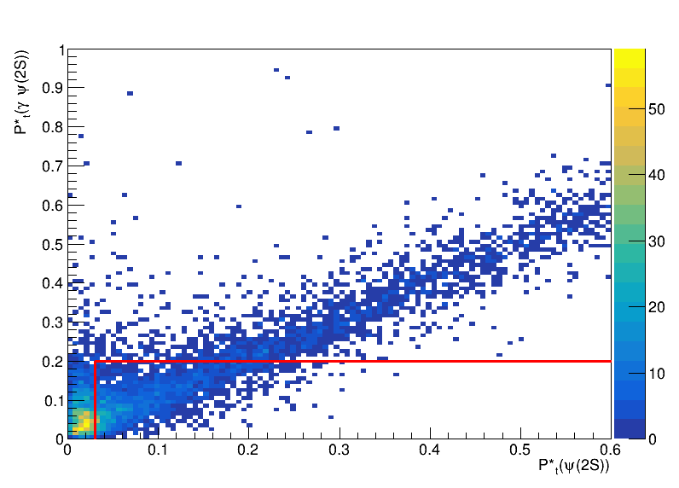
* means in the c.m.s
Transverse momenta of $P_{t}^{∗}$(after rotation)
’ means after rotation
Signal(ee+mm)
ISR background(ee+mm)
The scatter plot is $P_{t}^{∗′}(ψ(2S))$ vs $P_{t}^{∗′}(γψ(2S))$.
The region enclosed by the red line is the transverse momenta selection criteria in Belle analysis work.

Slide 8
Signal mm-mode rec. eff.
Cut flow
nCleanedTracks < 5, Efficiency: 0.278484
(psi2S_Jpsi_mu_0_muID_noSVD > 0.1 || psi2S_Jpsi_mu_1_muID_noSVD > 0.1), Efficiency: 0.277232
psi2S_pi_0_kaonID_binary < 0.4, Efficiency: 0.269302
psi2S_pi_1_kaonID_binary < 0.4, Efficiency: 0.262804
abs(psi2S_pi_0_dr) < 0.5, Efficiency: 0.262804
abs(psi2S_pi_1_dr) < 0.5, Efficiency: 0.262804
abs(psi2S_Jpsi_mu_0_dr) < 0.5, Efficiency: 0.262804
abs(psi2S_Jpsi_mu_1_dr) < 0.5, Efficiency: 0.262804
abs(psi2S_pi_0_dz) < 2, Efficiency: 0.262804
abs(psi2S_pi_1_dz) < 2, Efficiency: 0.262804
abs(psi2S_Jpsi_mu_0_dz) < 2, Efficiency: 0.262804
abs(psi2S_Jpsi_mu_1_dz) < 2, Efficiency: 0.262804
psi2S_pi_0_eID_noSVD_noTOP < 0.9, Efficiency: 0.245988
psi2S_pi_1_eID_noSVD_noTOP < 0.9, Efficiency: 0.225636
M < 5.5, Efficiency: 0.225480
abs(psi2S_Jpsi_M-3.097) < 0.044, Efficiency: 0.167954
abs(pipiJpsi_M-3.686) < 0.006, Efficiency: 0.145236
m2Recoil > 10, Efficiency: 0.140284
gamma_E > 0.100, Efficiency: 0.127394
CMS_pt < 0.2, Efficiency: 0.080340
psi2S_CMS_pt > 0.03, Efficiency: 0.079860
The rec. eff. is too low! The selection conditions should be optimized!!

Slide 9
Signal ee-mode rec. eff.
Cut flow
nCleanedTracks < 5, Efficiency: 0.209352
(psi2S_Jpsi_e_0_eID_noSVD_noTOP > 0.1 && psi2S_Jpsi_e_1_eID_noSVD_noTOP > 0.1), Efficiency: 0.196970
psi2S_pi_0_kaonID_binary < 0.4, Efficiency: 0.194322
psi2S_pi_1_kaonID_binary < 0.4, Efficiency: 0.190688
abs(psi2S_pi_0_dr) < 0.5, Efficiency: 0.190688
abs(psi2S_pi_1_dr) < 0.5, Efficiency: 0.190688
abs(psi2S_Jpsi_e_0_dr) < 0.5, Efficiency: 0.190688
abs(psi2S_Jpsi_e_1_dr) < 0.5, Efficiency: 0.190688
abs(psi2S_pi_0_dz) < 2, Efficiency: 0.190688
abs(psi2S_pi_1_dz) < 2, Efficiency: 0.190688
abs(psi2S_Jpsi_e_0_dz) < 2, Efficiency: 0.190688
abs(psi2S_Jpsi_e_1_dz) < 2, Efficiency: 0.190688
psi2S_pi_0_eID_noSVD_noTOP < 0.9, Efficiency: 0.177322
psi2S_pi_1_eID_noSVD_noTOP < 0.9, Efficiency: 0.161444
M < 5.5, Efficiency: 0.138170
abs(psi2S_Jpsi_M-3.097) < 0.044, Efficiency: 0.079716
abs(pipiJpsi_M-3.686) < 0.006, Efficiency: 0.068690
m2Recoil > 10, Efficiency: 0.066532
gamma_E > 0.100, Efficiency: 0.060682
CMS_pt < 0.2, Efficiency: 0.037896
psi2S_CMS_pt > 0.03, Efficiency: 0.037700
The rec. eff. is too low! The selection conditions should be optimized!!

Slide 10
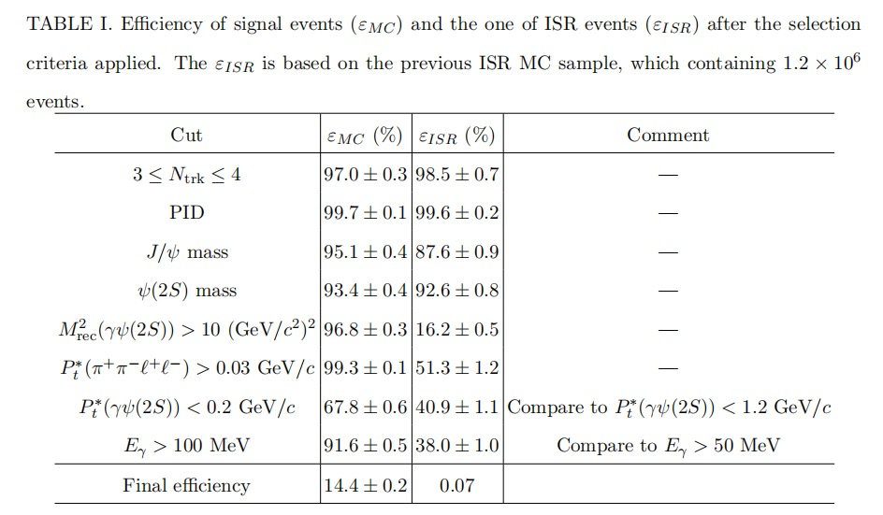
Cut flow
Efficiency from belle note
My final efficiency
11.756%
0.096%

Slide 11
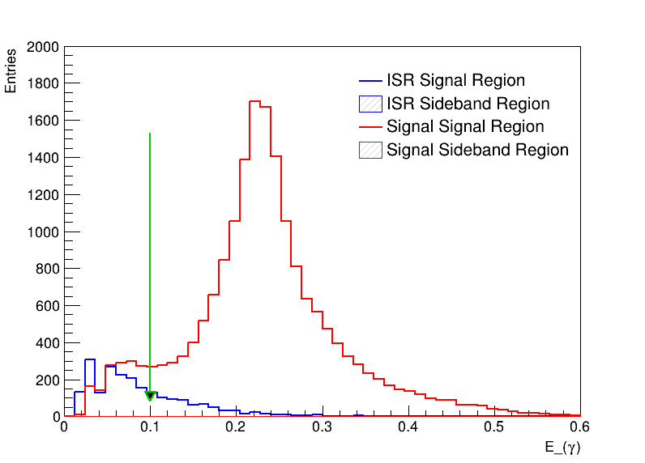
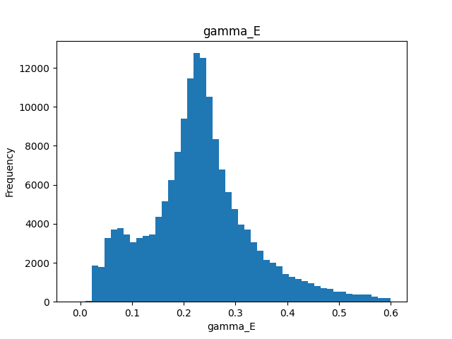
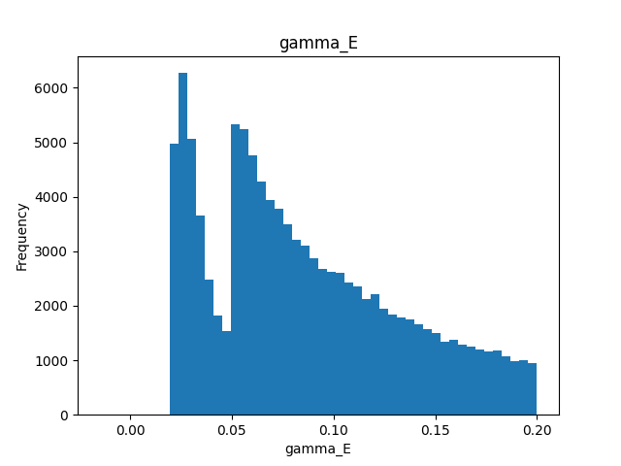
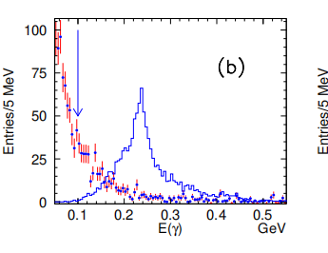
Energy of $γ$
signal
ISR
From Xu Dong’s slide
signal
signal
ISR

Slide 12
Evaluation of ISR events
$$The cross section of the ISR production of ψ\left(2S\right):$$
$σ\left(ψ\left(2S\right)\right)=\left(15.42±0.12±0.89\right)pb$
$The Branch ratio of ψ\left(2S\right)→π^{+}π^{−}J/ψ:$(PDG2022)
$Br(ψ\left(2S\right)→π^{+}π^{−}J/ψ)=\left(35.68±0.30\right)\%$
$The Branch ratio of J/ψ→e^{+}e^{−}/μ^{+}μ^{−}:$(PDG2022)
$Br(J/ψ→μ^{+}μ^{−})=\left(5.971±0.032\right)\%$
$Br(J/ψ→e^{+}e^{−})=\left(5.961±0.033\right)\%$
$$N_{events}=σ×ℒ×Br(ψ\left(2S\right)→π^{+}π^{−}J/ψ)×Br(J/ψ→l^{+}l^{−})≈239616$$
$$scale factor=\frac{239616}{{10}^{6}}=0.2396$$

Slide 13
Data sample and MC simulation
MC simulation:
Signal MC
using TREPS, M=3.922GeV/$c^{2}$,$J^{PC}=2^{++}.$
Decay chain: $χ_{c_{2}}\left(3930\right)→γψ\left(2S\right),$ $ψ\left(2S\right)→π^{−}π^{+}J/ψ$, $J/ψ→π^{−}π^{+}$or $μ^{−}μ^{+}$.
Number: $5×{10}^{5}$.
ISR event
officially produced. (it is main background.)
Decay chain: $e^{−}e^{+}→nγ_{ISR}+ψ\left(2S\right)$.
Number: $1×{10}^{6}$.
Low-multiplicity($e^{+}e^{−}μ^{+}μ^{−},e^{+}e^{−}e^{+}e^{−},llXX,hhISR$)
officially produced.
Luminosity:361/fb

Slide 14
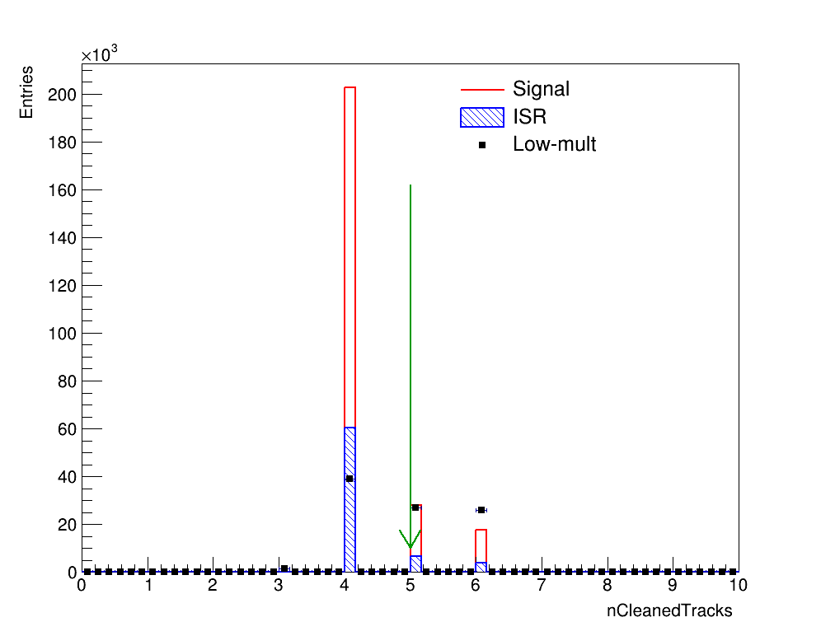
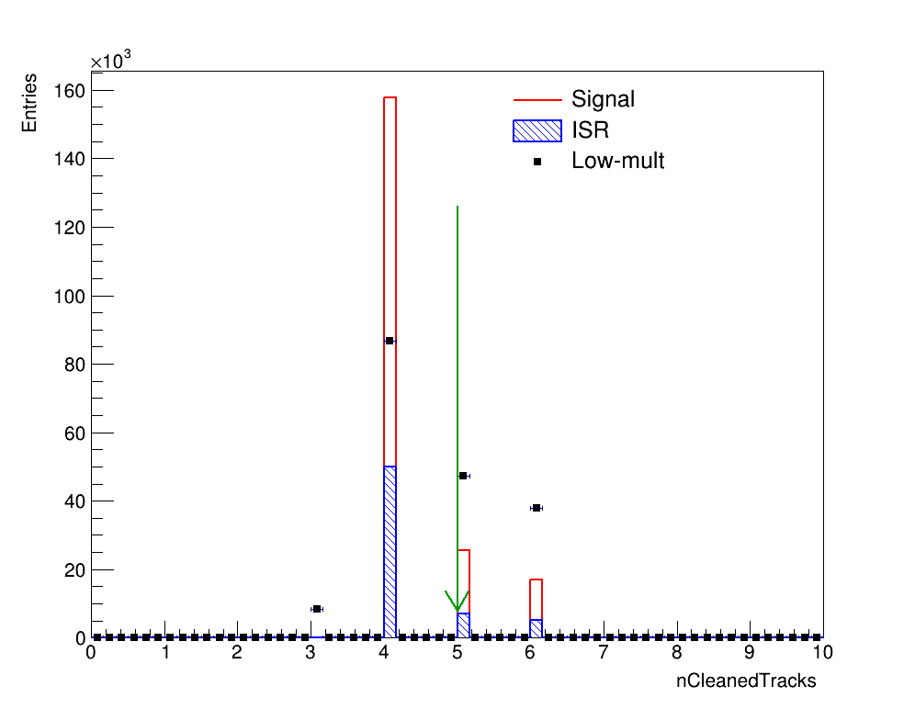
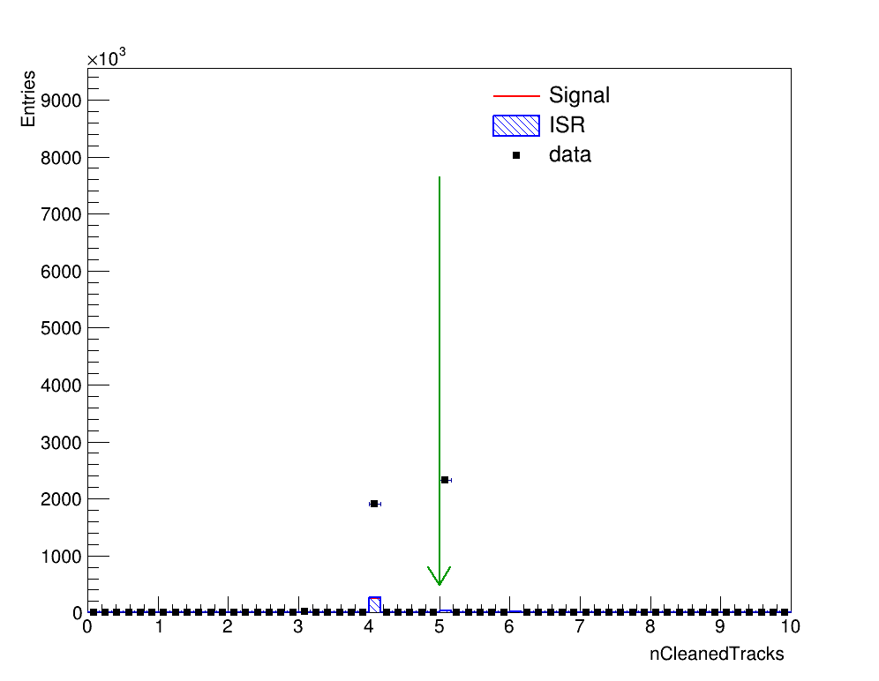
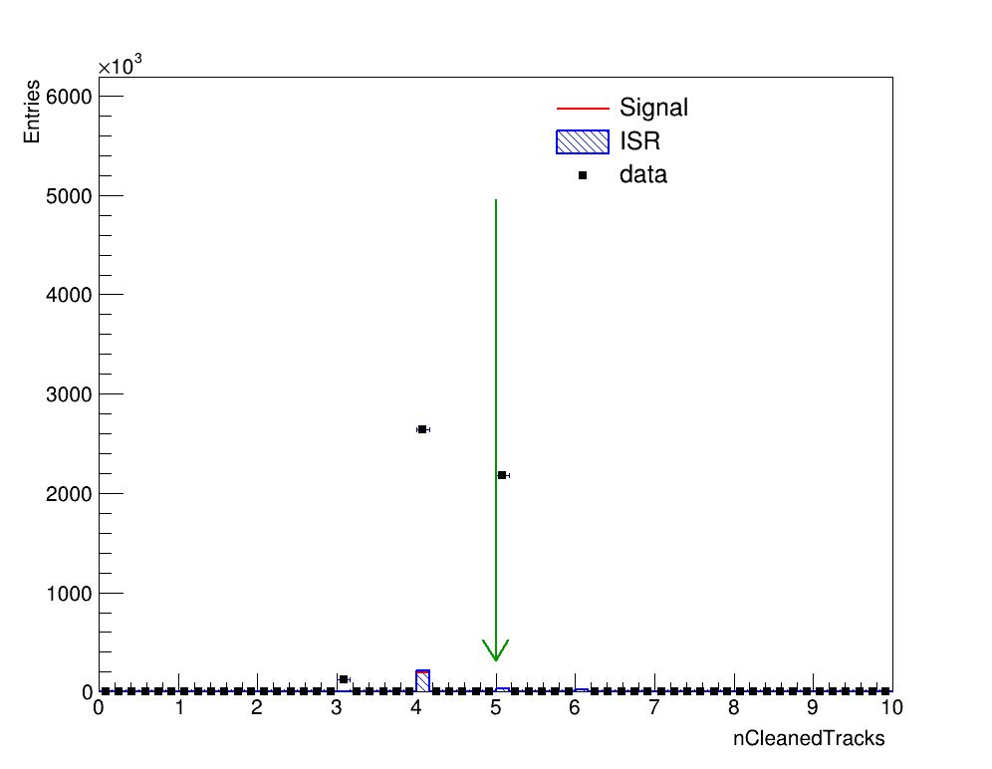
Number of charged tracks
mm mode
Low-mult
ee mode
Low-mult
mm mode
data
ee mode
data
$N_{track}<5$ is required.

Slide 15
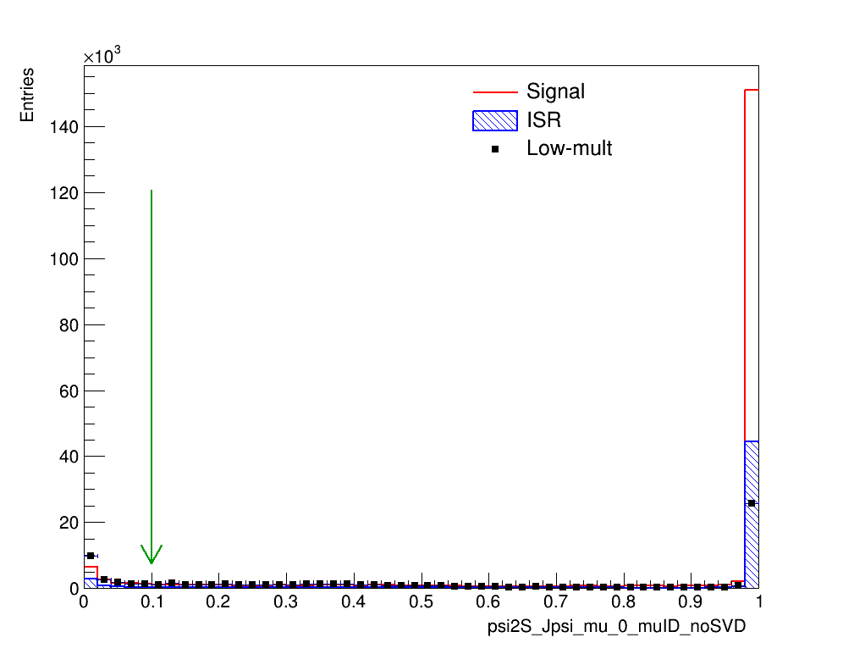
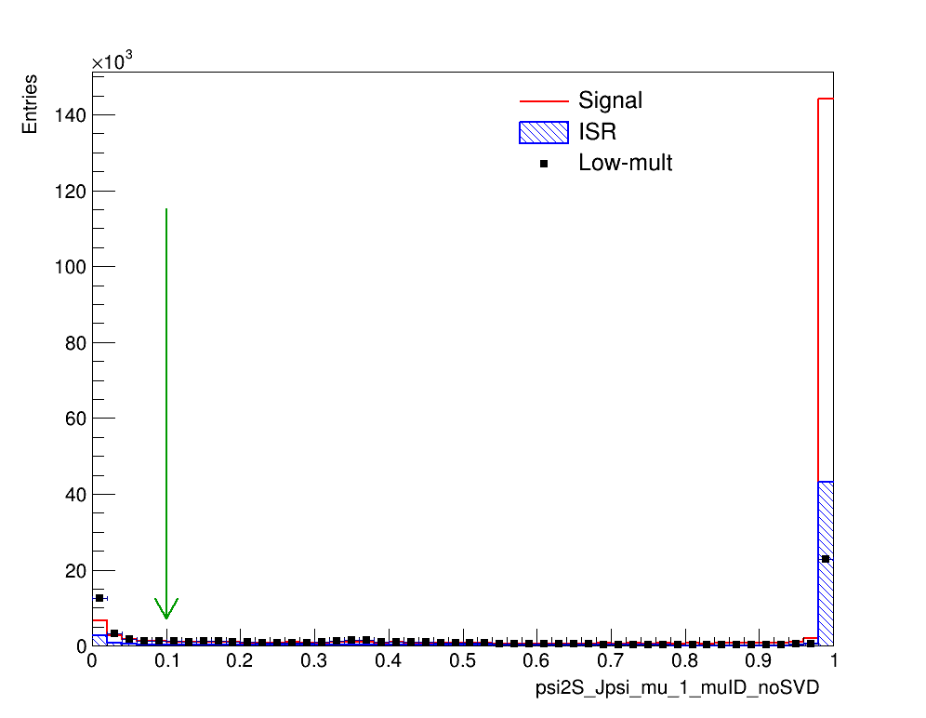
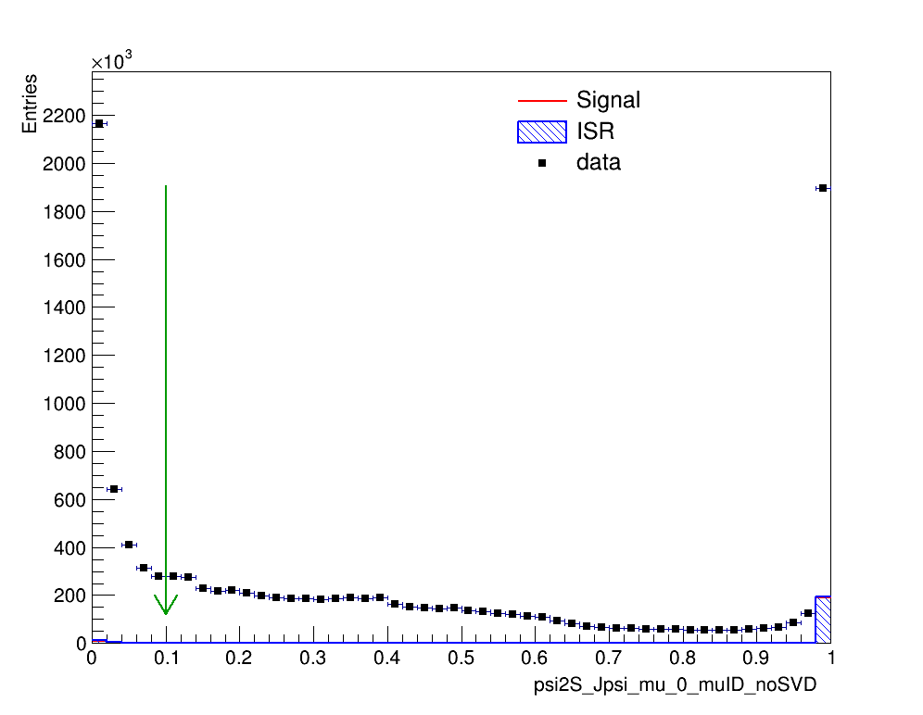
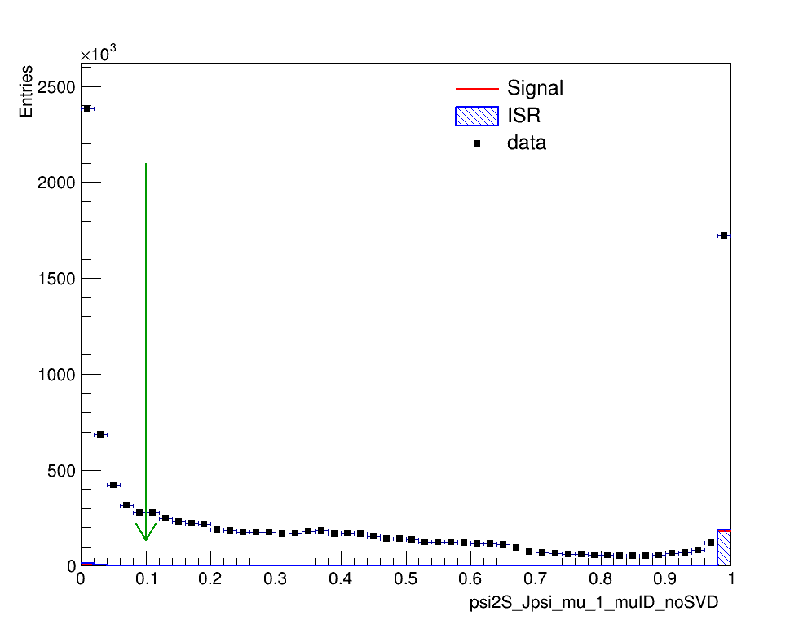
Particle Identification-muonID
Muon could have $L\left(μ\right)=0$.
One of muon candidate should have $L\left(μ\right)>0.1$.
$${μ^{±}}_{1}$$
Low-mult
$${μ^{±}}_{2}$$
Low-mult
$${μ^{±}}_{1}$$
data
$${μ^{±}}_{2}$$
data

Slide 16
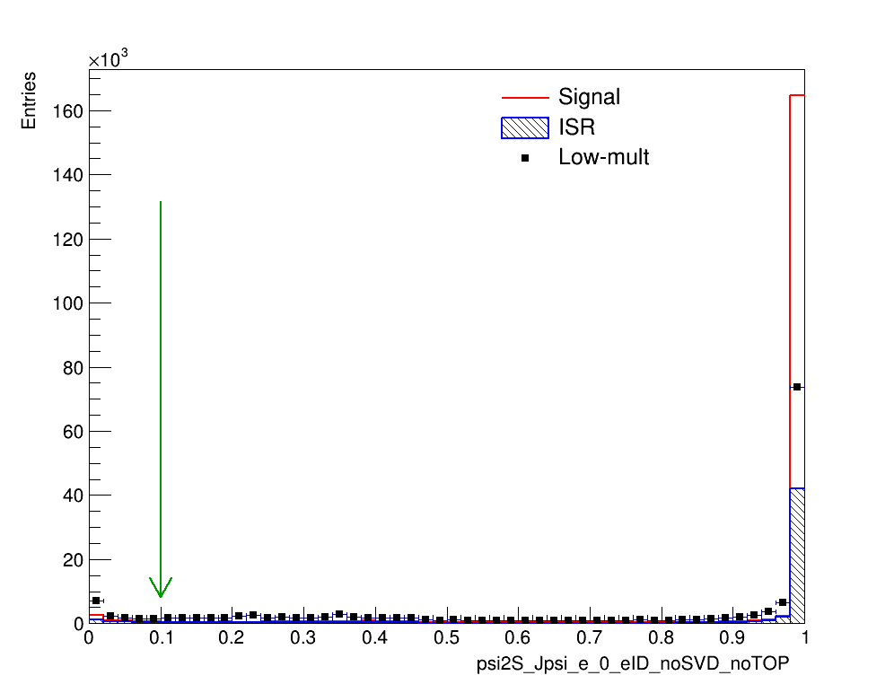
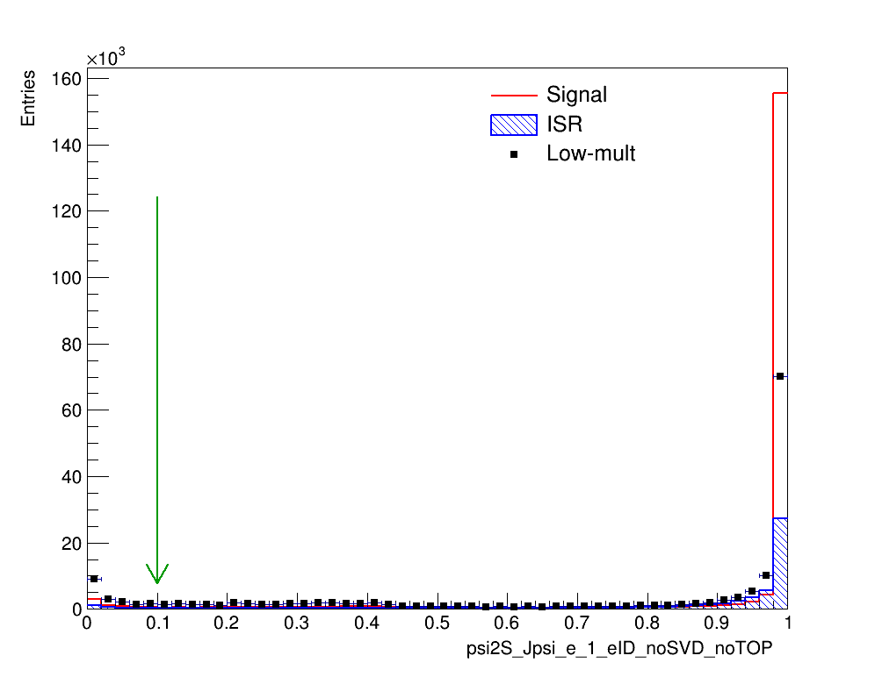
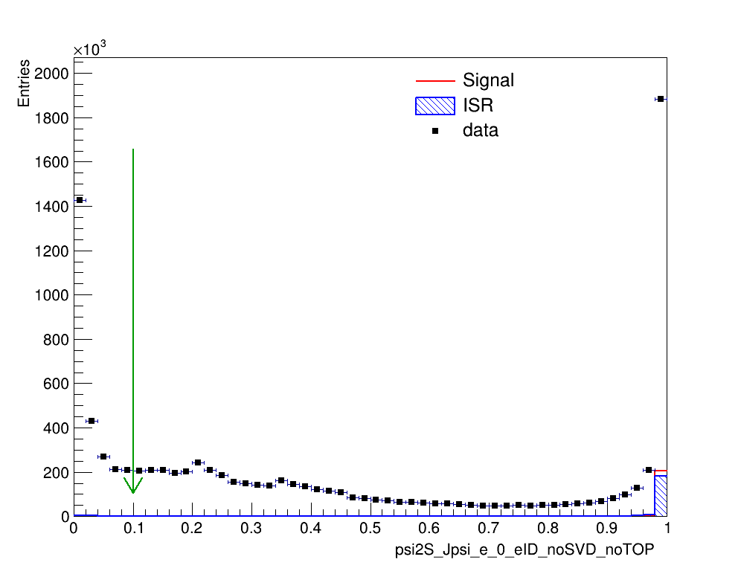
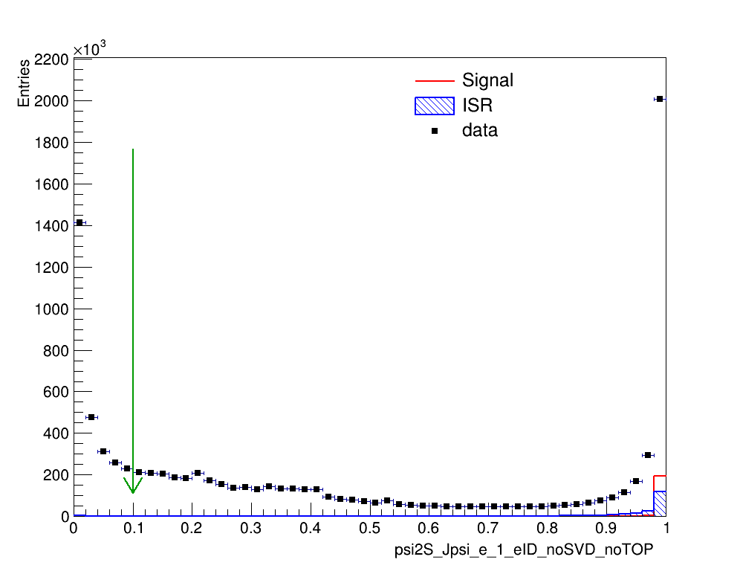
Particle Identification-electronID
Both electron candidates are required to have eID_noSVD_noTOP > 0.1.
$${e^{±}}_{1}$$
Low-mult
$${e^{±}}_{2}$$
Low-mult
$${e^{±}}_{1}$$
data
$${e^{±}}_{2}$$
data

Slide 17
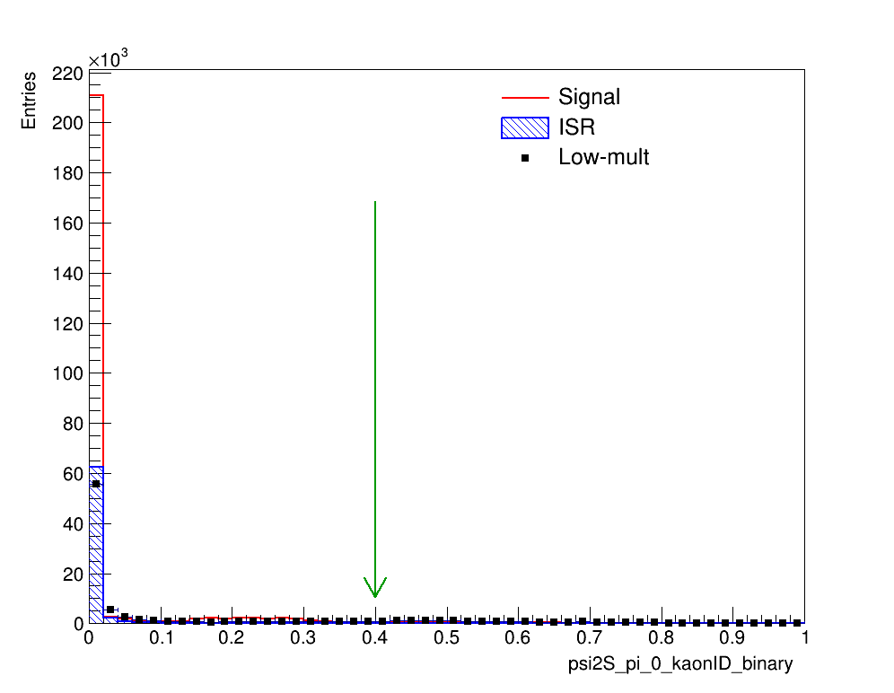
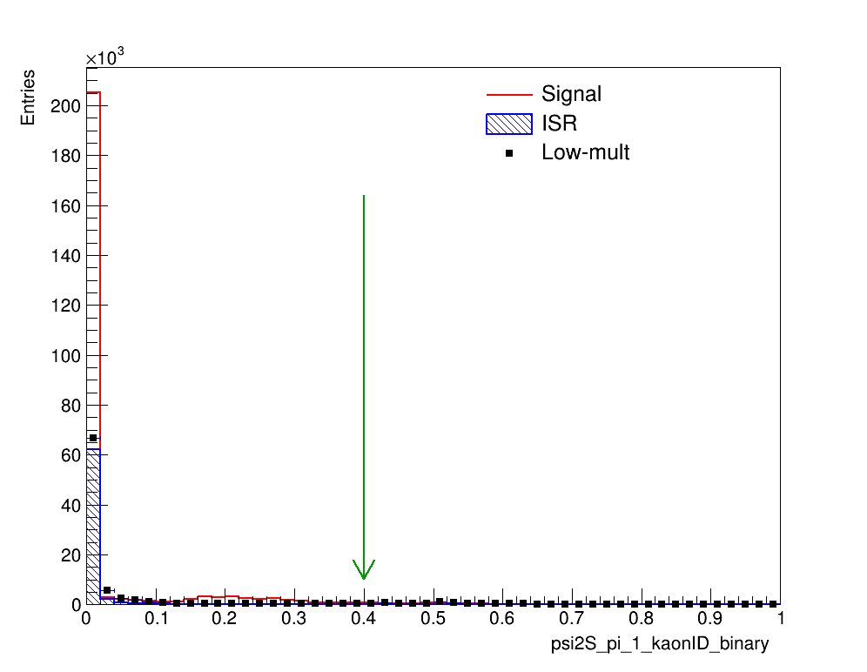
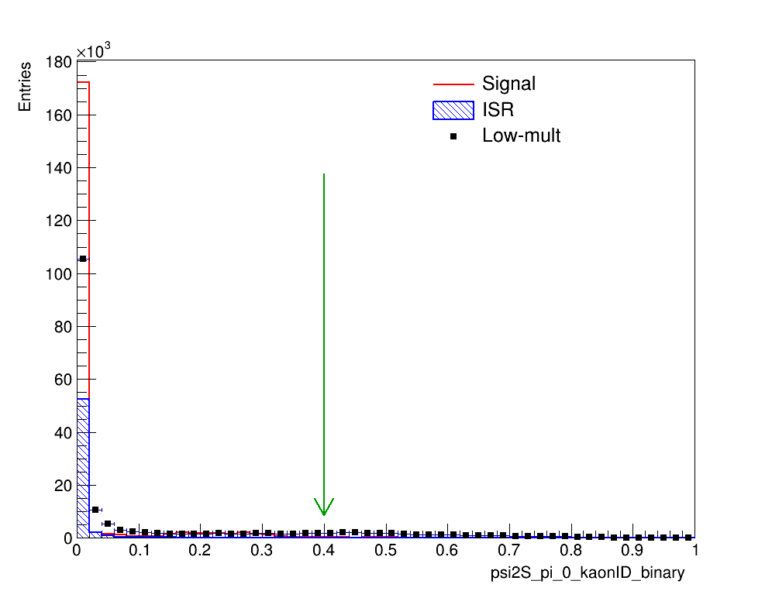
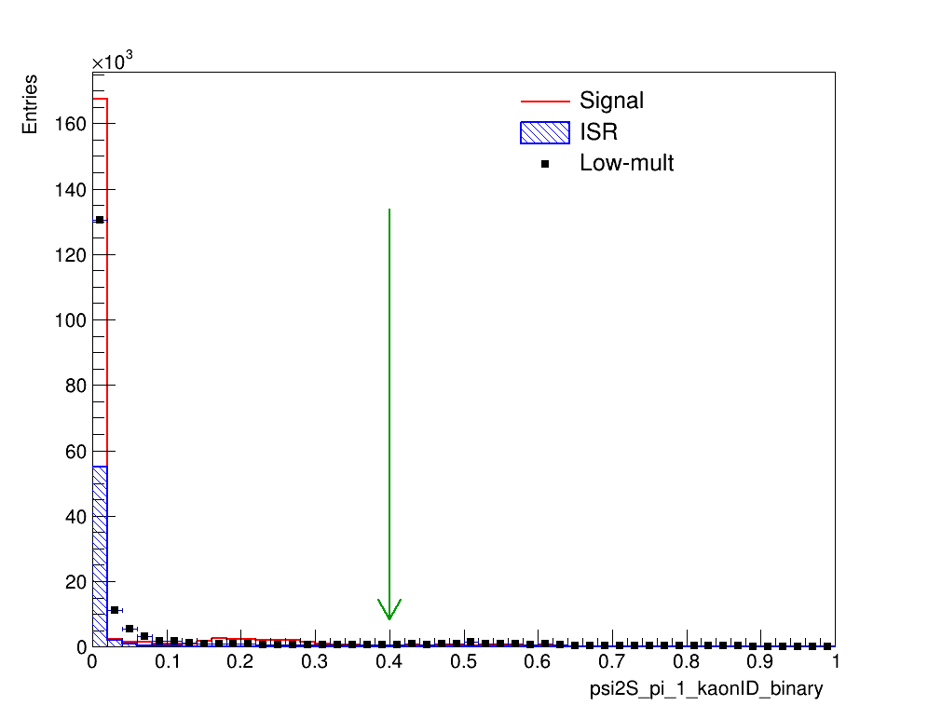
Particle Identification-kaonID
${π^{0}}_{1}$ from mm mode
Low-mult
${π^{0}}_{2}$ from mm mode
Low-mult
${π^{0}}_{1}$ from ee mode
Low-mult
${π^{0}}_{2}$ from ee mode
Low-mult
$KaonID_{binary}<0.4$ is required.

Slide 18
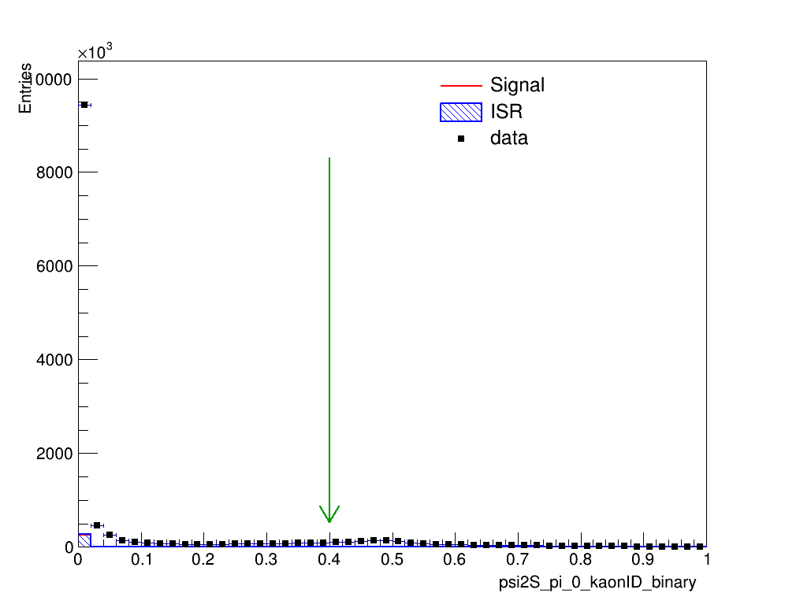
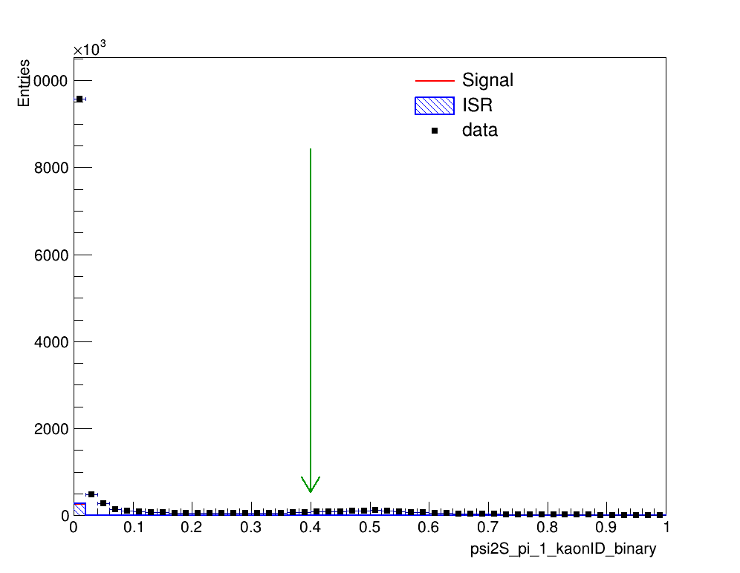
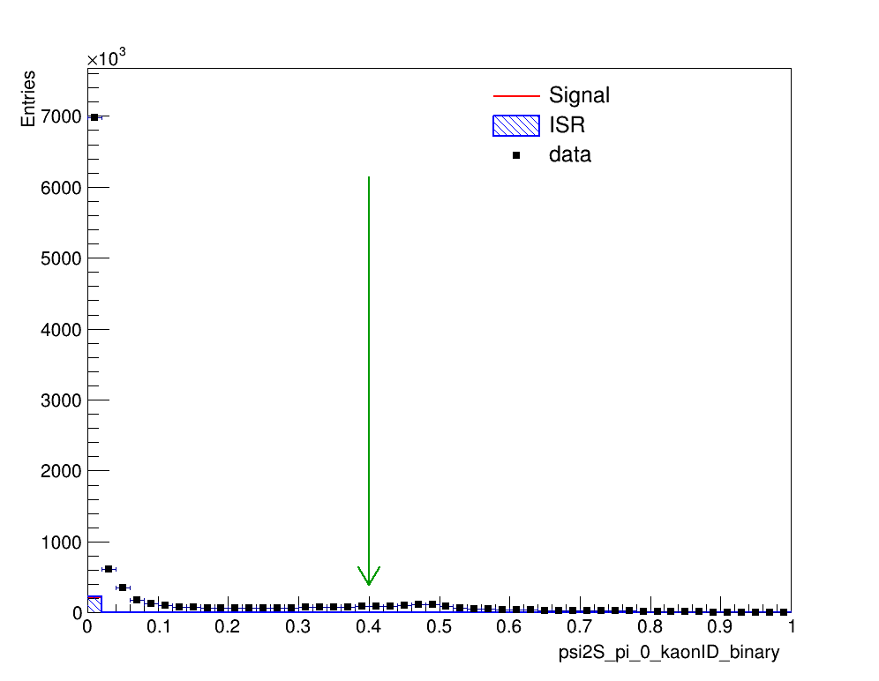
Particle Identification-kaonID
${π^{0}}_{1}$ from mm mode
data
${π^{0}}_{2}$ from mm mode
data
${π^{0}}_{1}$ from ee mode
data
${π^{0}}_{2}$ from ee mode
data
$KaonID_{binary}<0.4$ is required.

Slide 19
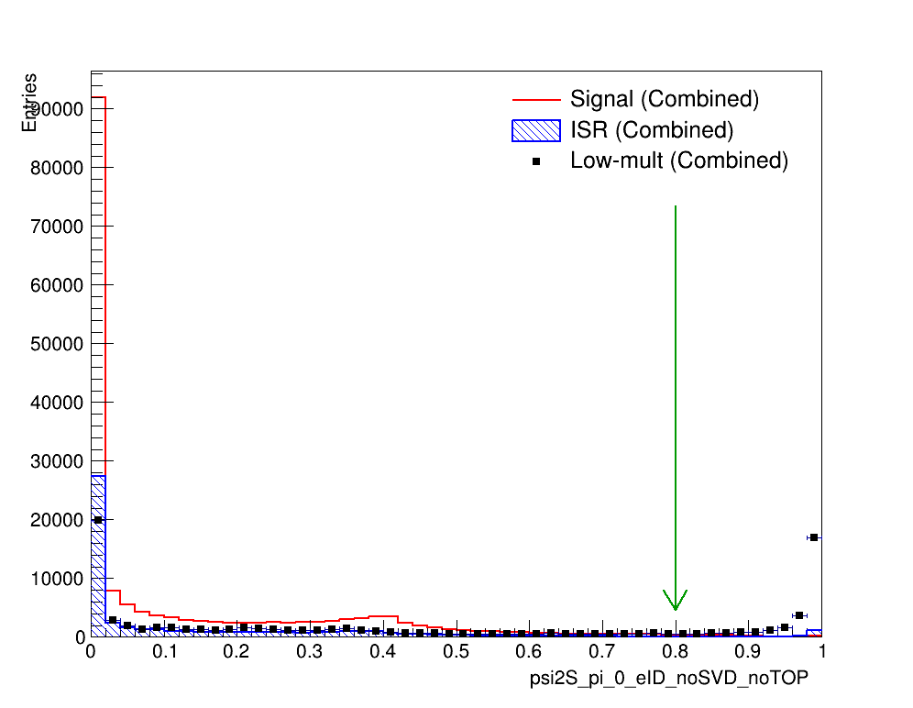
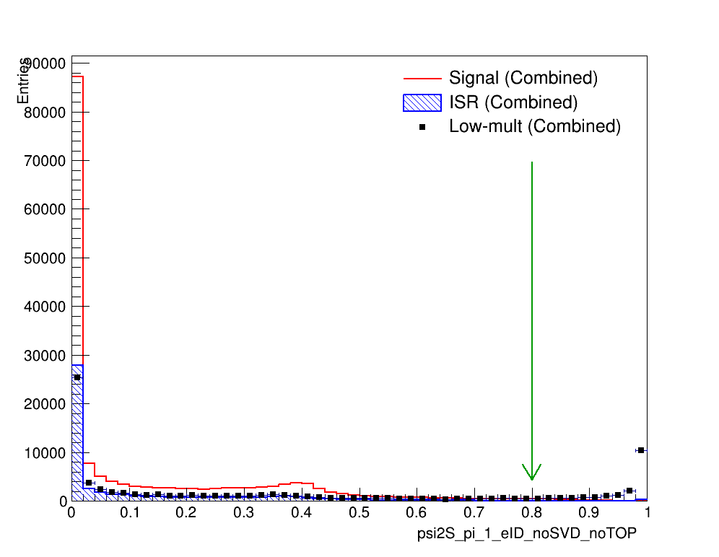
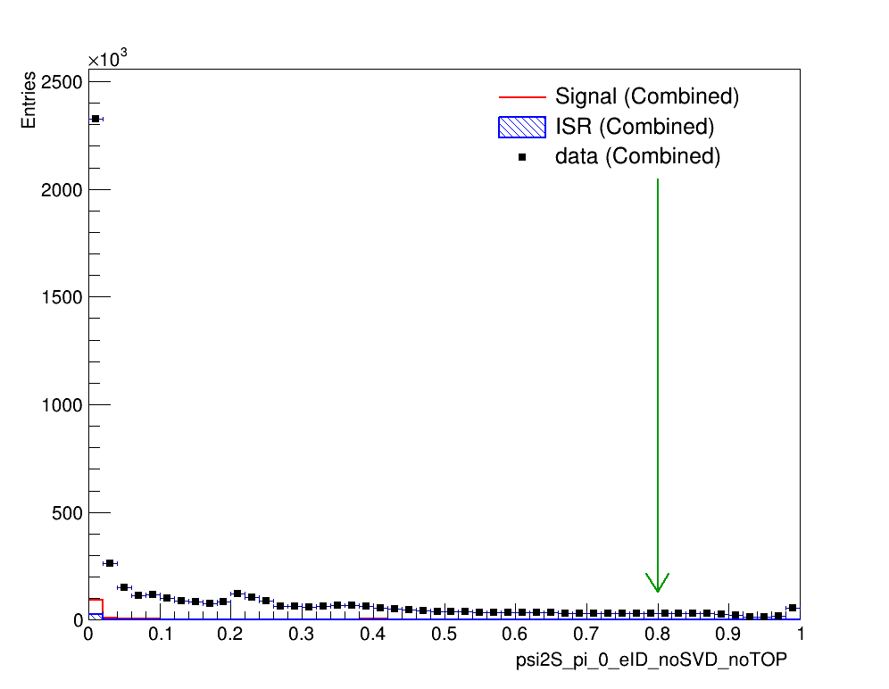
Particle Identification-electronID
$${π^{0}}_{1}$$
Low-mult
$${π^{0}}_{2}$$
Low-mult
$${π^{0}}_{1}$$
data
$${π^{0}}_{2}$$
data
$L(e)<0.8$ to remove $γ$-conversion background.

Slide 20
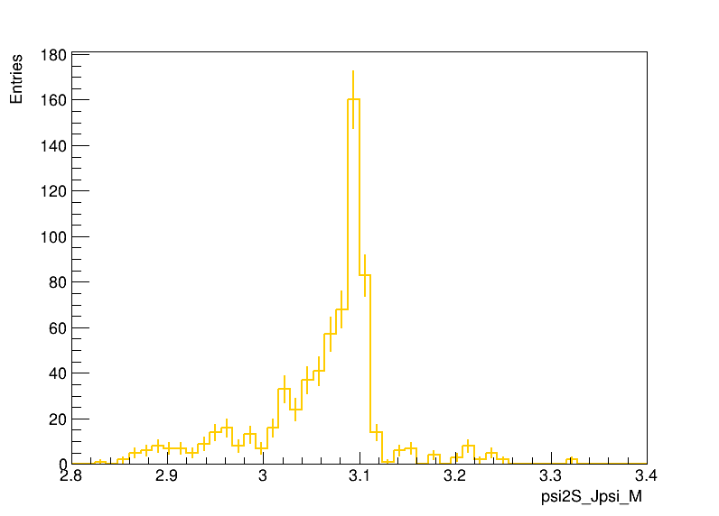
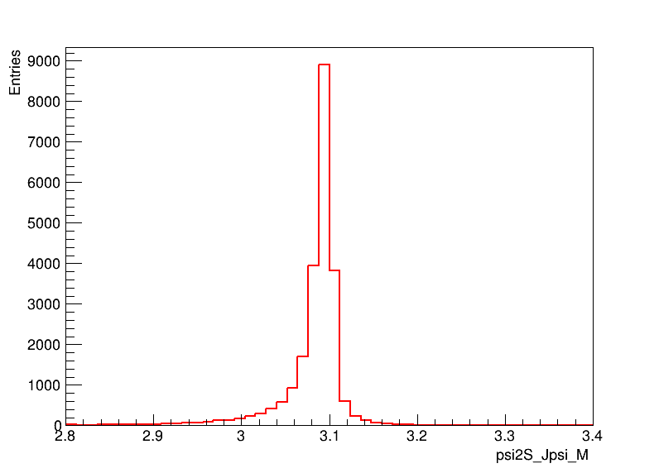
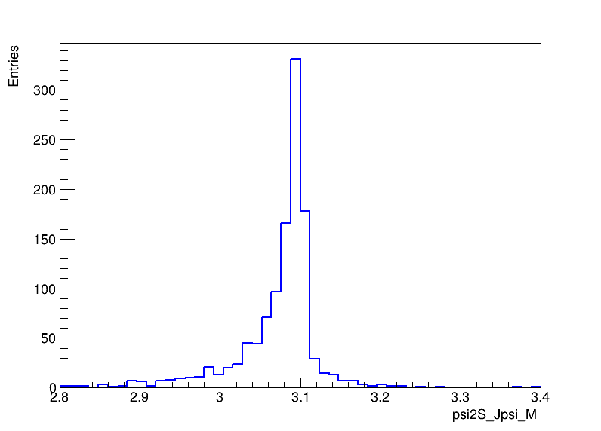
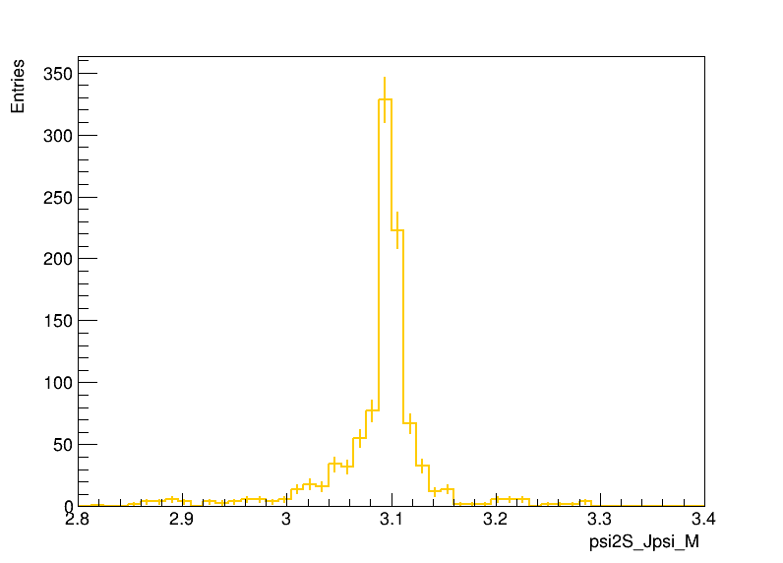
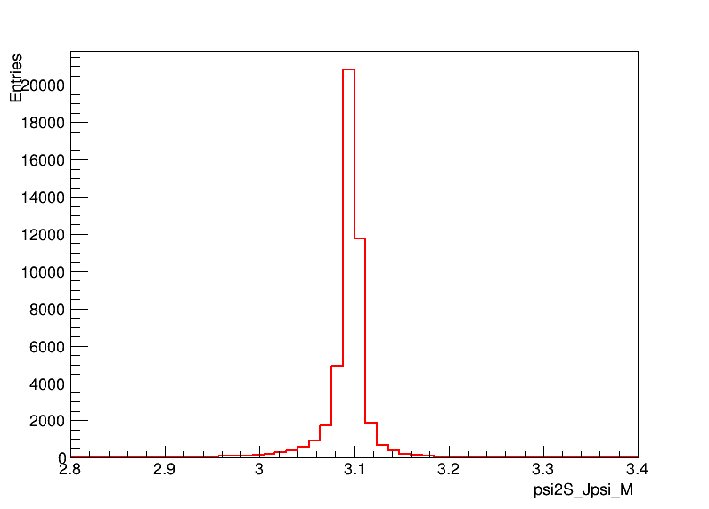
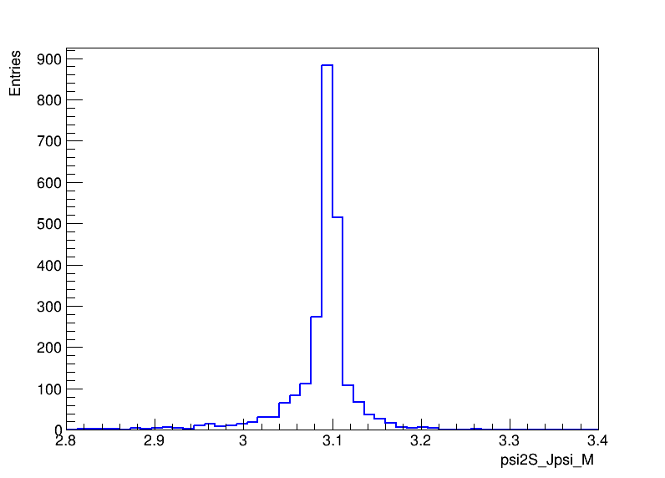
$J/ψ$ $signals$
data
ee_mode
Signal
ee_mode
ISR background
ee_mode
data
mm_mode
Signal
mm_mode
ISR background
mm_mode
In low-mult MC sample there is not event.

Slide 21
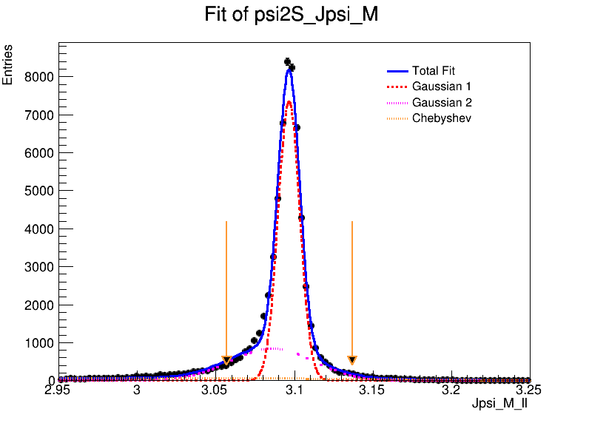
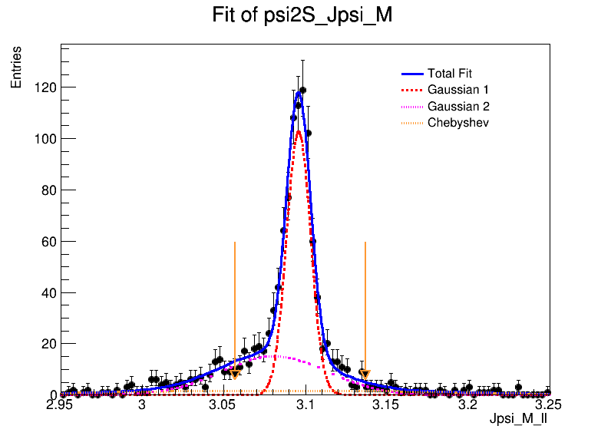
$$Fit to J/ψ signals$$
Floating Parameter FinalValue +/- Error
-------------------- --------------------------
chebYield 7.0823e+03 +/- 1.69e+02
gauss1Yield 4.5758e+04 +/- 3.66e+02
gauss2Yield 2.0392e+04 +/- 2.99e+02
mean1 3.0965e+00 +/- 4.29e-05
mean2 3.0862e+00 +/- 3.02e-04
p0 -7.8819e-01 +/- 1.53e-02
p1 -1.6505e-01 +/- 1.90e-02
sigma1 6.8061e-03 +/- 4.96e-05
sigma2 2.5537e-02 +/- 3.78e-04
Floating Parameter FinalValue +/- Error
-------------------- --------------------------
chebYield 1.9498e+02 +/- 4.08e+01
gauss1Yield 7.4772e+02 +/- 4.14e+01
gauss2Yield 4.6035e+02 +/- 4.80e+01
mean1 3.0958e+00 +/- 3.74e-04
mean2 3.0795e+00 +/- 2.70e-03
p0 -2.2495e-01 +/- 1.32e-01
p1 -6.1409e-01 +/- 1.74e-01
sigma1 7.5989e-03 +/- 4.09e-04
sigma2 3.4160e-02 +/- 3.13e-03

Slide 22
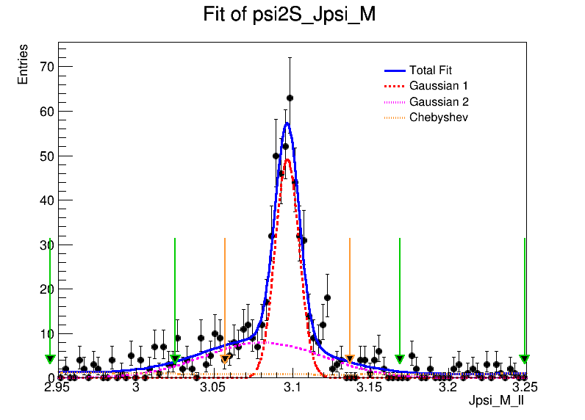
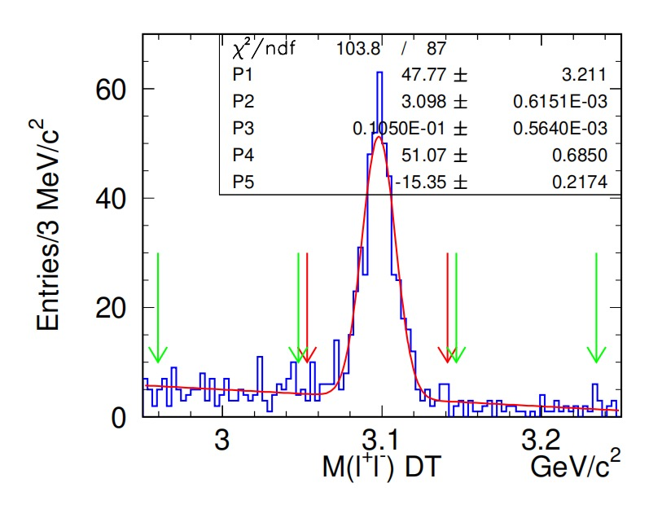
$$Fit to J/ψ signals$$
Floating Parameter FinalValue +/- Error
-------------------- --------------------------
chebYield 9.2281e+01 +/- 5.08e+01
gauss1Yield 3.1555e+02 +/- 2.65e+01
gauss2Yield 2.5619e+02 +/- 5.21e+01
mean1 3.0966e+00 +/- 5.78e-04
mean2 3.0813e+00 +/- 4.08e-03
p0 -1.4310e-01 +/- 2.70e-01
p1 1.8265e-01 +/- 5.80e-01
sigma1 7.6838e-03 +/- 6.48e-04
sigma2 3.8644e-02 +/- 5.60e-03
Signal region: $\left|M_{l^{+}l^{−}}−m_{J/ψ}\right|<5σ,σ=8MeV$
Sideband region: $\left|M_{l^{+}l^{−}}±14σ−m_{J/ψ}\right|<5σ$
Belle result: $σ_{DT}=11MeV/c^{2}$
$\left|M_{l^{+}l^{−}}−m_{J/ψ}\right|<4σ$

Slide 23
$ψ(2S)$ $signals$
data
ee_mode
Signal
ee_mode
ISR background
ee_mode
data
mm_mode
Signal
mm_mode
ISR background
mm_mode
$M_{π^{+}π^{−}J/ψ}$ is defined as $M_{π^{+}π^{−}J/ψ}=M_{π^{+}π^{−}l^{+}l^{−}}−M_{l^{+}l^{−}}+m_{J/ψ}$

Slide 24
$$Fit to ψ(2S) signals$$
data(ee+mm)
$$σ≈8 MeV$$
signal(ee+mm)
$$σ≈3 MeV$$
signal(ee+mm)
$$σ≈4 MeV$$
$M_{π^{+}π^{−}J/ψ}$ is defined as $M_{π^{+}π^{−}J/ψ}=M_{π^{+}π^{−}l^{+}l^{−}}−M_{l^{+}l^{−}}+m_{J/ψ}$.
Signal region: $\left|M_{π^{+}π^{−}J/ψ}−m_{ψ\left(2S\right)}\right|<3σ$,here we take $σ$= 3 MeV.
Sideband region: $\left|M_{π^{+}π^{−}J/ψ}−m_{ψ\left(2S\right)}±12σ\right|<4.5σ$.

