Slide 1
Progress and Plan
Mingyi Dong
2024.11.11

Slide 2
Progress last week
 | Planned tasks last week | Time needed (day) | person in charge | Status
1 | Check and fix the preamplifier boards of W13-12, and W19-16 | 2 | Mingyi Dong， Yunhua Sun | done
2 | MDC HV test and Cosmic-ray test | 2 | Mingyi Dong | done
3 | Preinstall shielding plates for CGEM | 2 | Italy team, Jinyu Fu | Move to next week

Slide 3
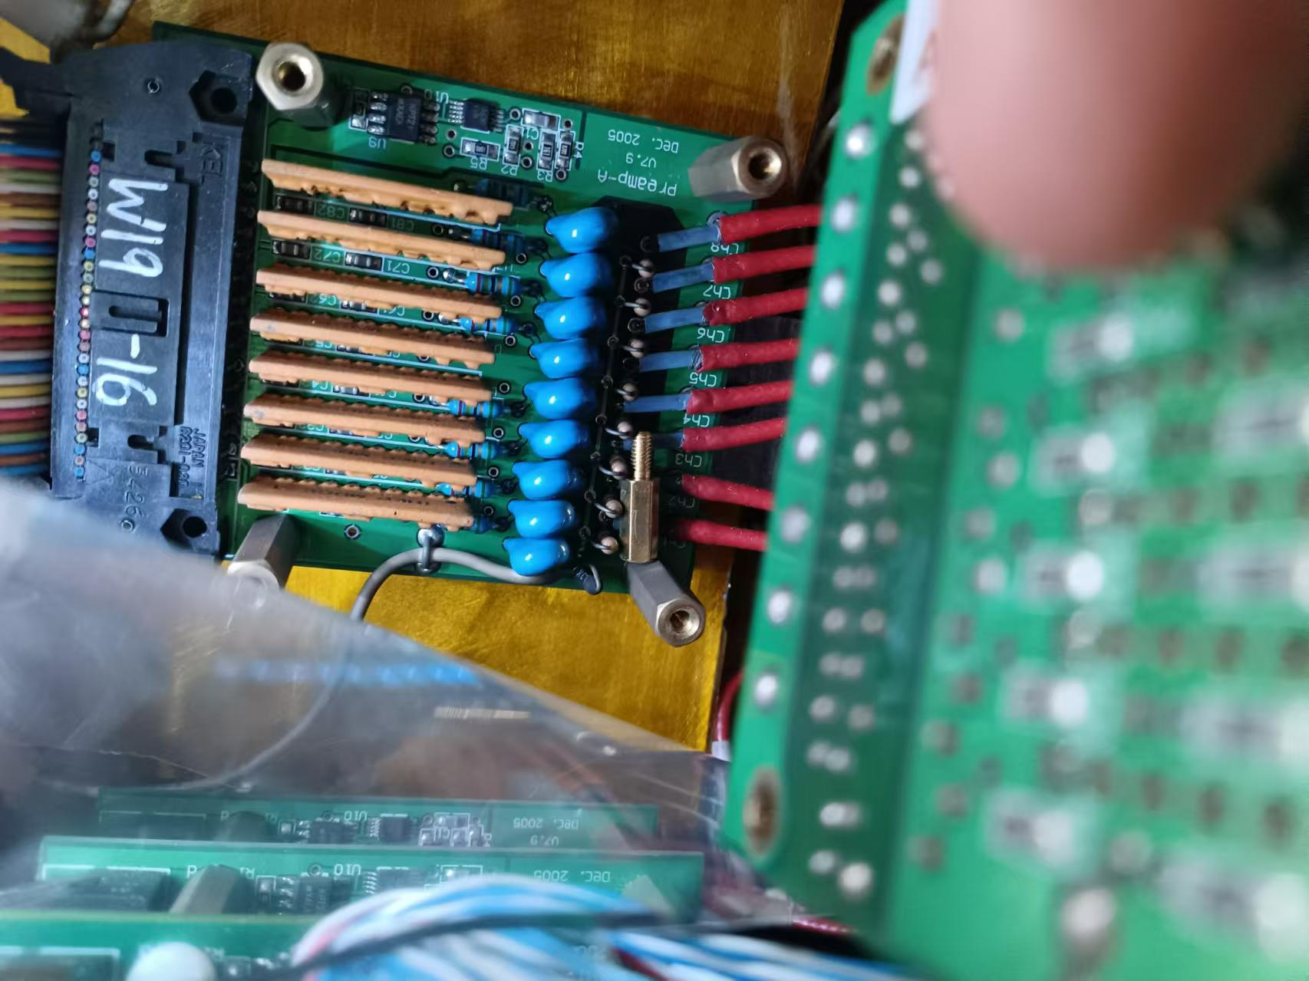
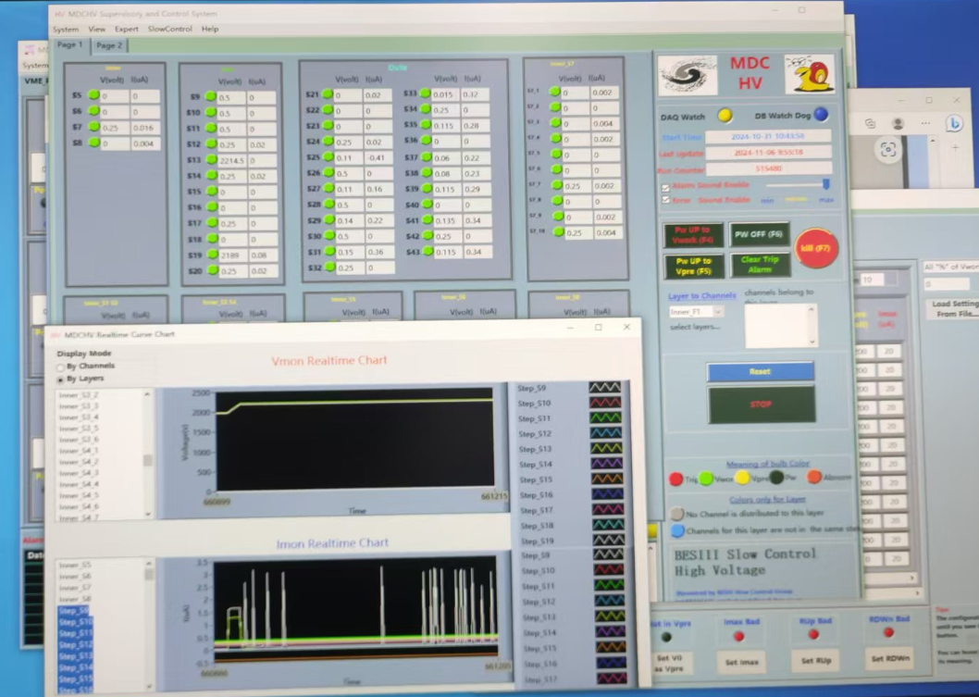
Check and fix MDC preamplifier boards
Nov. 5-6
W13-12 : Removed CGEM boards, disconnected channel 8. this preamplifier board worked well with nominal voltage. And then connected the channel 8. it also worked well with HV
W19-16 : Removed CGEM boards. Found a CGEM screw on this board, which almost touched the resister for HV circuit. Removed this screw, and this board worked well with nominal voltage.
W19-13: Discharge was found during the test. Disconnected channel 6, and this board worked well with nominal voltage

Slide 4
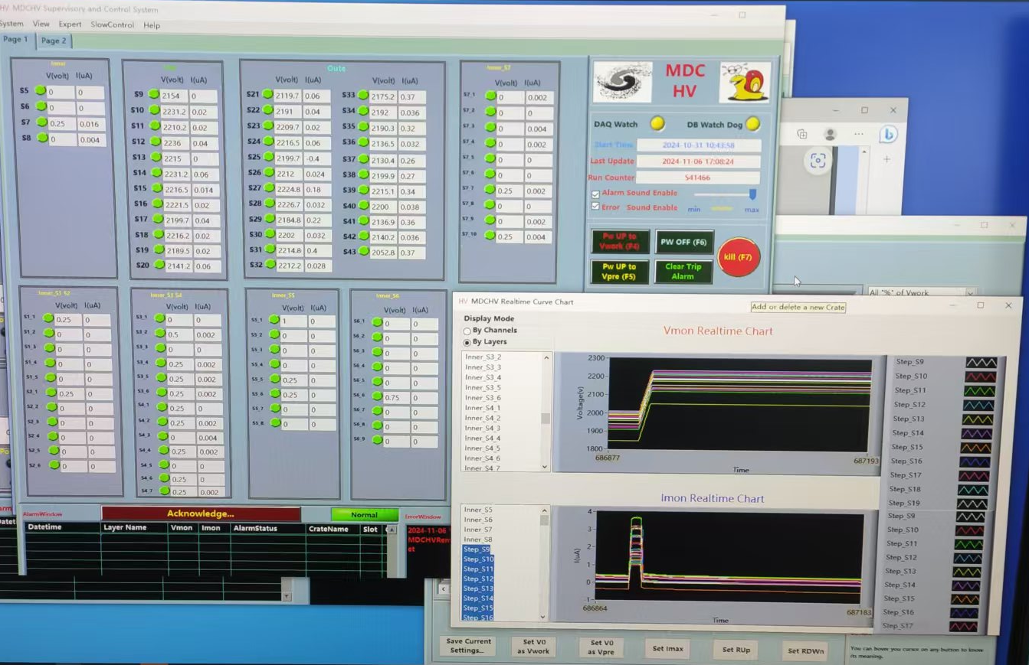
Check and fix MDC preamplifier boards
All layers work stable with operating HV

Slide 5
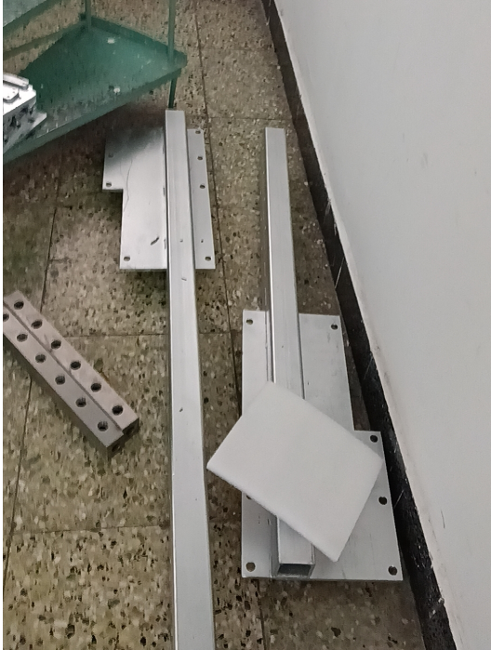
Shielding plates and HV support structure for CGEM
All shielding plates arrived
All components of HV support structure arrived

Slide 6
Plan for next week
 | Tasks | Time needed (day) | person in charge
1 | MDC HV test and cosmic-ray test | 1/2 | Mingyi Dong
2 | CGEM cosmic-ray test | 1/2 | Italy team,
3 | Joint testing of CGEM and MDC | 1/2 | Mingyi Dong, Italy team
4 | Installation of shielding plates for CGEM | 2 | Italy team, Jinyu Fu
5 | Preparation for pushing EEMC to its original position | 1 | Facilities Operation group(Jing Xiaoping)

Slide 7
Backup

Slide 8
Schedule (may be updated each week)
No. | tasks | Duration（day） | Start time and stop time | Sub-system involved | Status
1 | Removal of equipment of machine |  | July 1- Aug. 6 | Utility, Small angle lum. Detector and ZDD, Beam pipe, slow control | done
2 | Pull-out of EEMC |  |  | Utility, EMC, TOF, MDC | done
3 | Removal of inner chamber（Operate simultaneously on both sides ） | 51 | Aug. 7- Sep.7 Sep.8- Sep. 28 | MDC, MDC electronics, Gas, Mechanics, Laser measurement group, Trigger, DAQ, Slow control | done
4 | Installation of CGEM | 44 | Sep.29- Nov. 13 | CGEM group, MDC, MDC electronics, Gas, Mechanics, Laser measurement group, Trigger, DAQ, Slow control | On Schedule
5 | Recover EEMC |  | Nov. 14-Dec.30 | Utility, EMC, TOF, MDC | Change the start date from Nov. 12 to Nov. 14
6 | Recover equipment of machine |  |  | Utility, Small angle lum. Detector, ZDD, Beam pipe, slow control
total |  | 180 days | July 1- Dec.30

