Slide 1
Operation mode vs Higgs, LowLumi Z & HighLumi Z from Electronics
Vertex
Higgs & Low LumiZ
Data rate: ~2Gbps per RSU/chip innermost @triggerless
Given the power limit of 40mW/cm²，the chip capability is reaching the limit
Long distance transmission on stitching, or Flex Cable material, are challenging, however there are possible solutions
High LumiZ
Data rate: ~4Gbps per chip innermost @CDR MDI @25μm pixel @triggerless
Even higher in current TDR MDI calculation, needs further optimization from MDI design
Even higher with 16μm pixel (x 2.5times)
Estimated power ~110mW/cm², by using TJ65
Even higher with 16μm pixel (x 2.5times)
Not possible with current Stitching Technology for power distribution, only possible by normal Ladder
Major issue for cooling of conventional CMOS Ladder for innermost
Not achievable for the compatible design at current technology
TID
~2.1Mrad/y, with 10year operation reaching the limit of a MAPS, a replacement is necessary
Strategy:
A replaceable design for Vertex
First 10 years of Higgs + LowLumi Z @triggerless
A critical upgrade expected (~15years from now), new technology for HighZ@triggerless, or HighZ@Fast trigger

Slide 2
Operation mode vs Higgs, LowLumi Z & HighLumi Z from Electronics
ITK
No general issue for Higgs & Low LumiZ
Waiting for MDI Bkgrd rate for High LumiZ, total data rate on module may need MTX fiber channels
However compatible with current design
Pixel TPC
Higgs & Low LumiZ @ 2T
To prove the compatibility @ High LumiZ with 3T from the detector side
OTK
No general issue for Higgs, Low LumiZ & High LumiZ
However, OTK is fully fixed on TPC
Strategy:
If Pixel TPC should be replaced or changed to Drift Chamber, the full Tracker also seems to be upgraded
Otherwise can be stood in HighZ

Slide 3
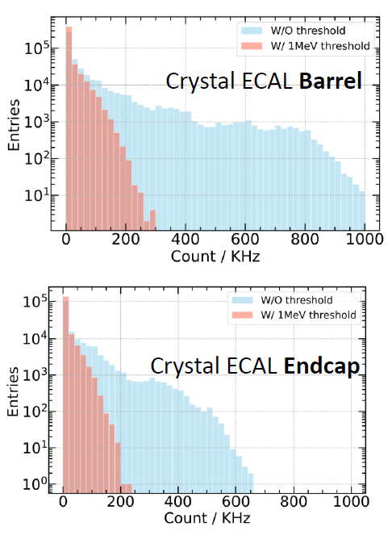
Operation mode vs Higgs, LowLumi Z & HighLumi Z from Electronics
ECAL & HCAL & Muon cannot be replaceable due to the total cost
Main issue related to Higgs, Low Z & High Z comes from ECAL Bkgrd rate
Maximum rate 1 (230 kHz) vs. mean rate 2 (13 kHz) for barrel @Higgs
The count rate w/ 1Mev threshold is do-able for electronics
If higher rate, a continues ADC should be considered, results in large power
Higher rate also impacts a lot on detector’s energy resolution
But the Bkgrd rate w/o threshold had a big impact on crystal’s rad damage
Rate too high from current HighZ estimation, needs MDI optimization
Similar as the vertex for HighZ
Strategy:
Electronics currently has enough headroom for the readout on module
The optimization of MDI Bkgrd rate is a must for High Lumi Z
Matters for crystal radiation damage
Matters for detector energy resolution
Matters on electronics FEE scheme (low power FEE or continuous ADC)

