Slide 1
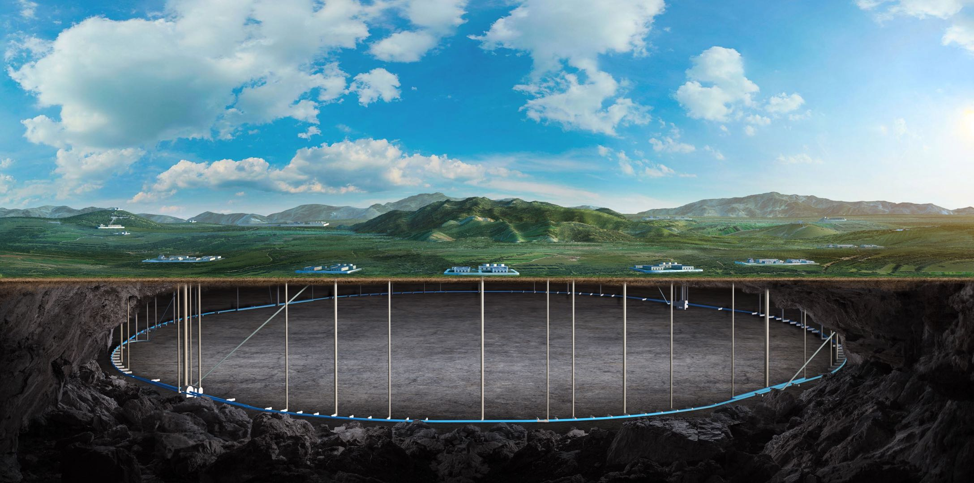
Magnetic field distribution of TPC
Feipeng Ning
On behalf of Detector magnet team
Oct. 21-23, 2024, CEPC IDRC Meeting

Slide 2
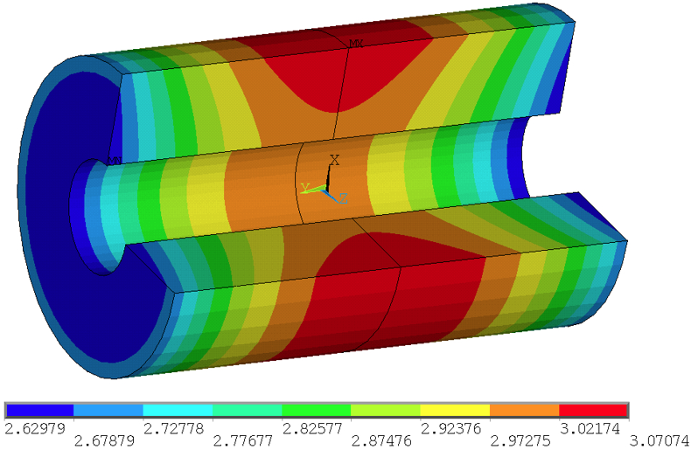
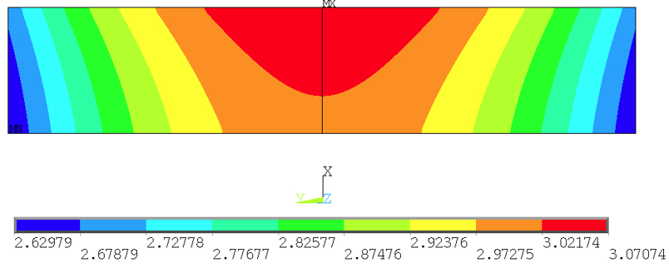
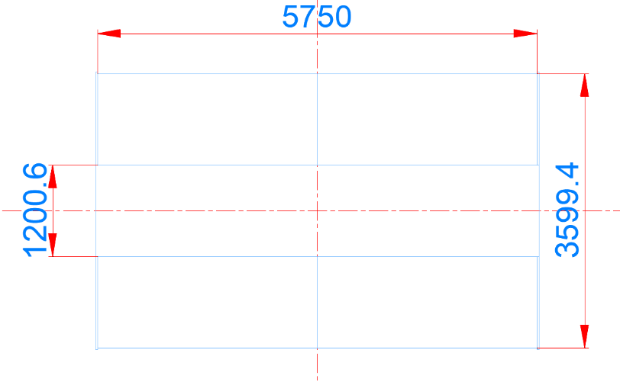
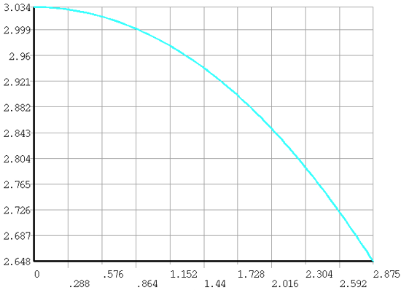
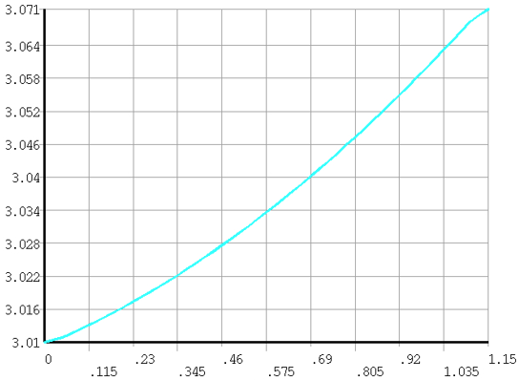
Feedback 5
Magnetic field design may be further optimized to optimize the field quality and the peak field to be suppressed.
Confirm the field quality / uniformity enabling to satisfy necessary field quality required for the TPC region under the current iron yoke (HCAL) and the final focusing magnet including the compensation solenoid.
The TPC magnetic field distribution without anti-solenoid
1
2
TPC
TPC
1
2
△B=0.386 T
△B=0.061 T
Magnetic field distribution on path 1 and 2

Slide 3
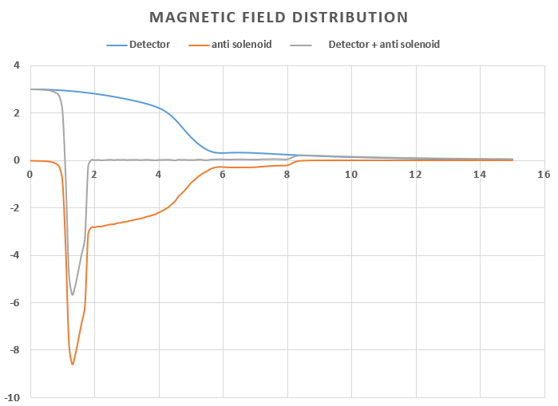
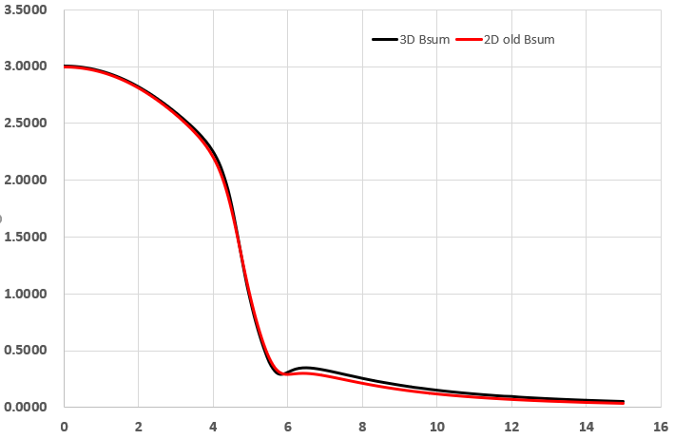
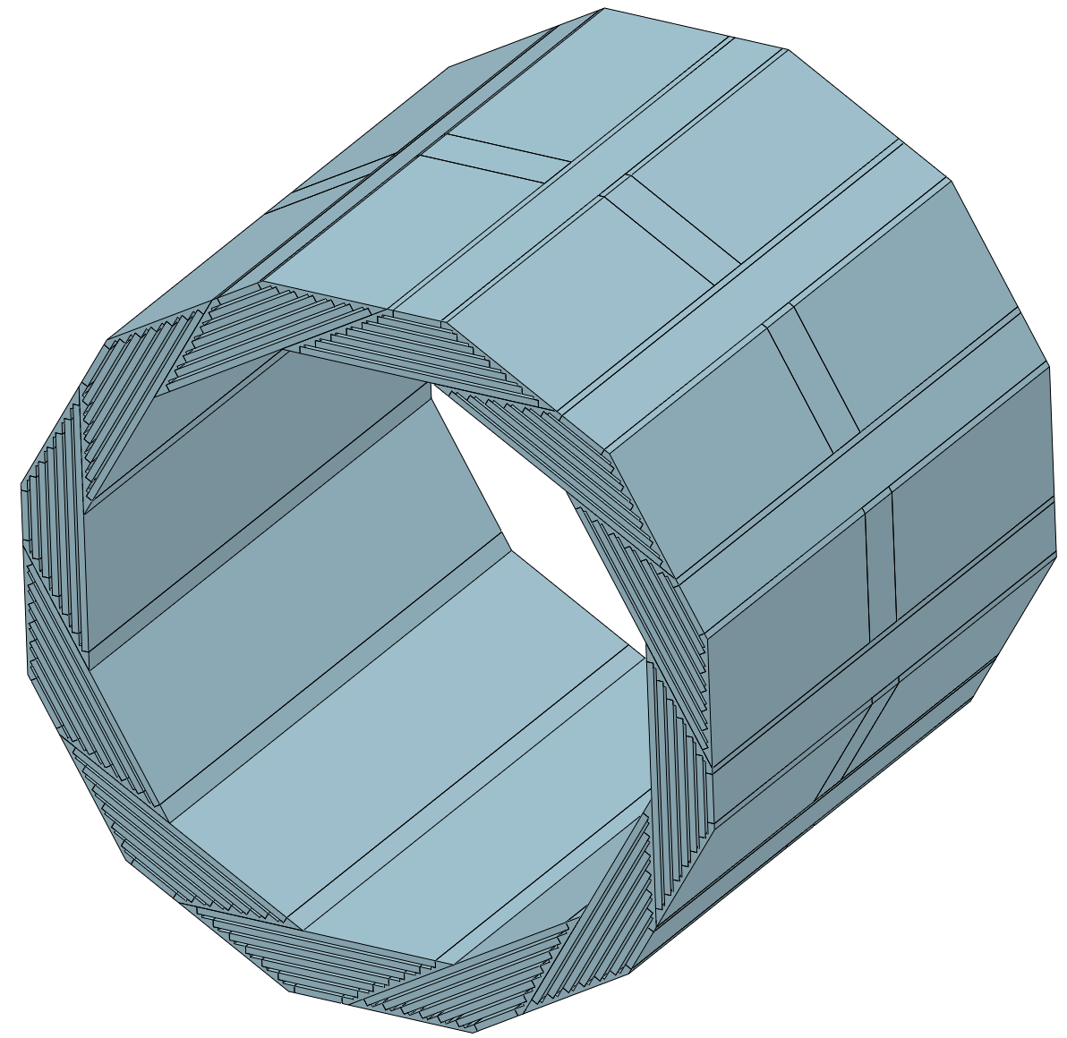
TPC magnetic field
Joint design with anti-solenoid Magnet.
 | Old | New
Barrel yoke (ton) |  | 1560
Each end yoke (ton) |  | 700
Total (ton) |  | 2960

Slide 4
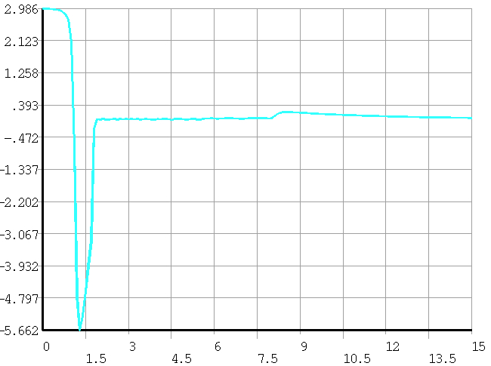
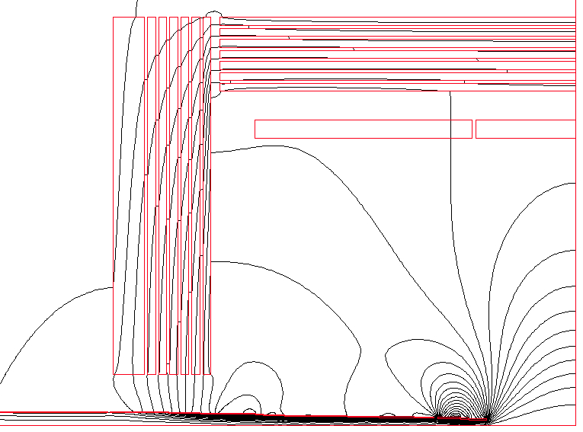
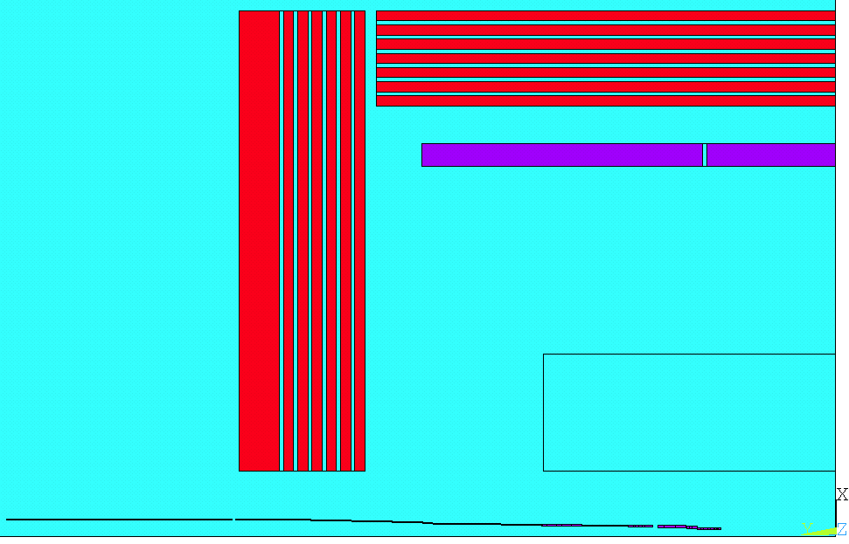
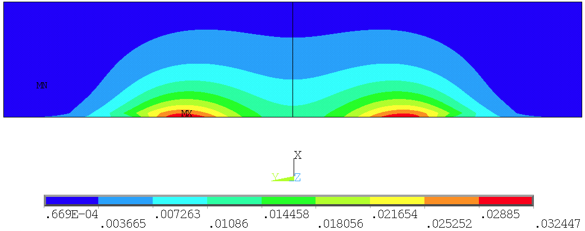
TPC magnetic field
Joint design with anti-solenoid Magnet.

Slide 5
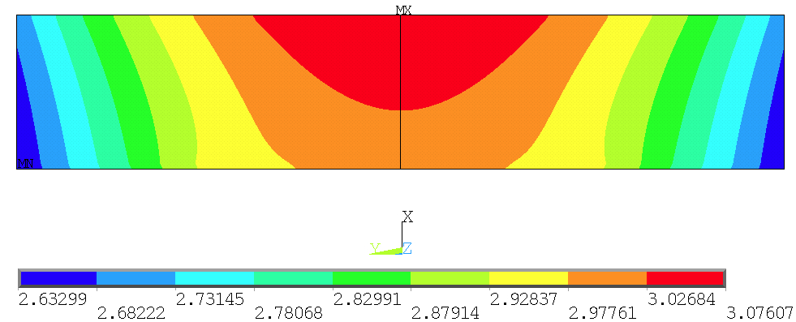
TPC magnetic field
Joint design with anti-solenoid Magnet.

Slide 6
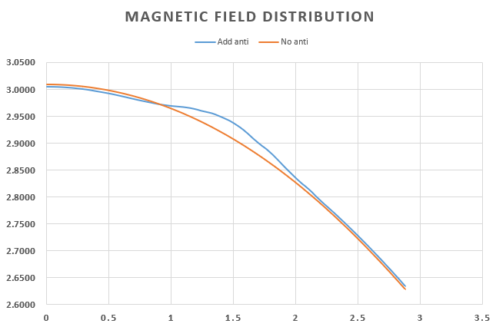
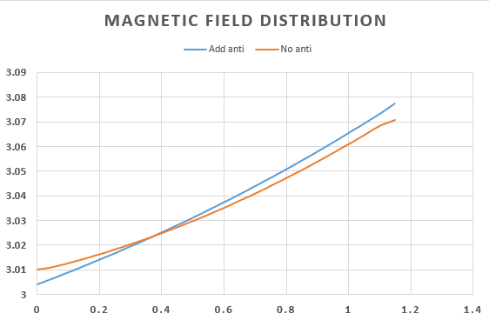
TPC magnetic field
Joint design with anti-solenoid Magnet.
Path 2
Path 1
Path 1
Path 2

